Slide 1
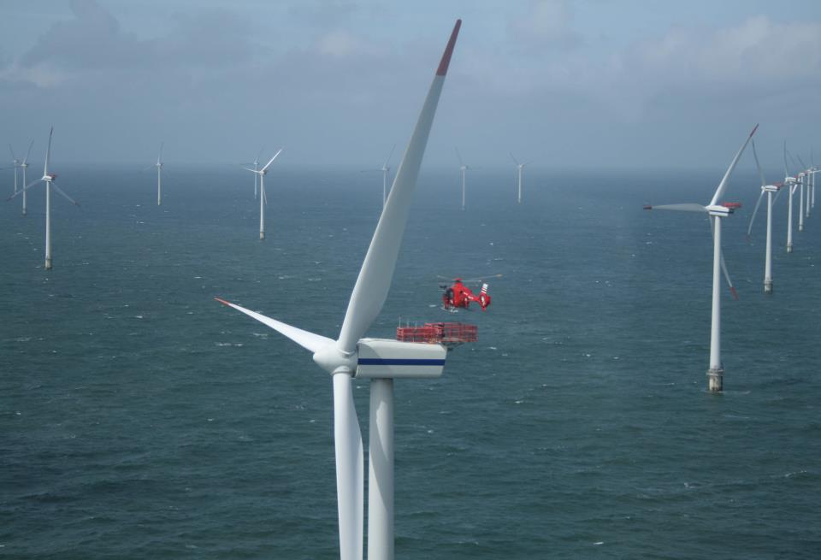






Sea Breeze, Coastal Upwelling Modeling to Support Offshore Wind Energy Planning and Operations
Greg Seroka¹, Erick Fredj², Travis Miles¹, Rich Dunk¹,
Josh Kohut¹, Scott Glenn¹
¹
October 28, 2015
MABPOM 2015
²

Slide 2
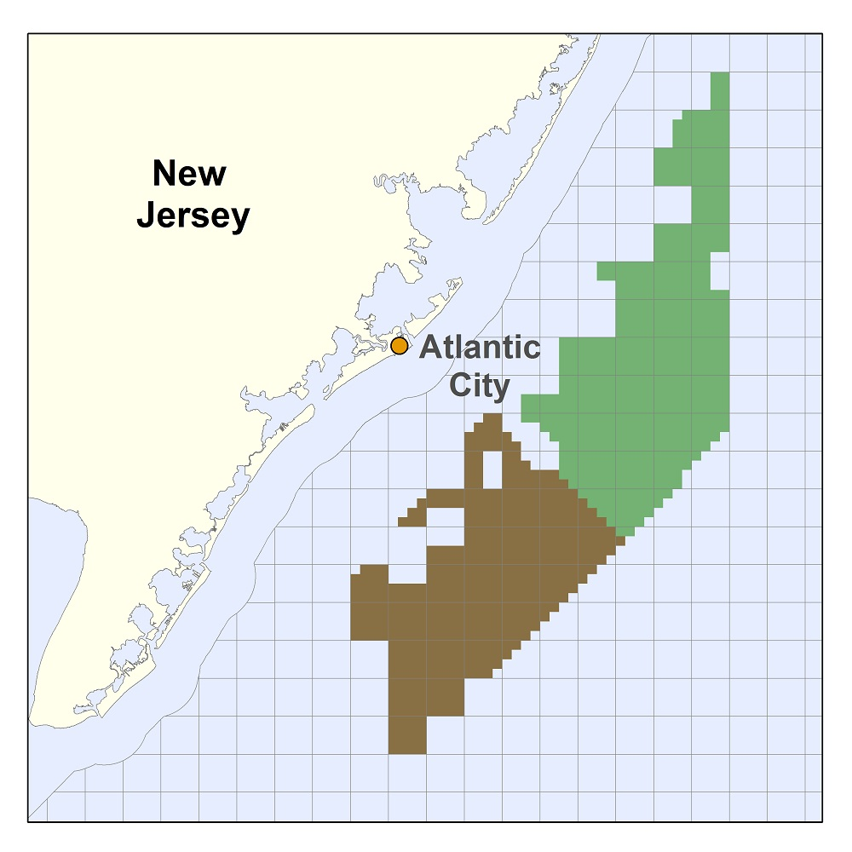
Introduction
On November 9, 2015, BOEM commercial lease auction for NJ will take place
  Nearly 344,000 acres for leasing offshore wind (OSW)
  5th competitive lease auction for OSW in U.S.
OSW developer(s) who win a lease zone will submit application to develop to NJ Board of Public Utilities (NJ BPU)
  Must include wind resource assessment & economic analysis

Slide 3
Introduction
NJ BPU Offshore Wind Rules state:
  “Applications shall account for…the coincidence between time of generation for the project and
  peak electricity demand.”
NJ sea breeze and coastal upwelling coincident with peak electricity demand
Relative Load
Frequency
Notes:
-Sea breeze time of day (afternoon/evening) is also coincident with peak demand time of day (5-7 pm)

Slide 4
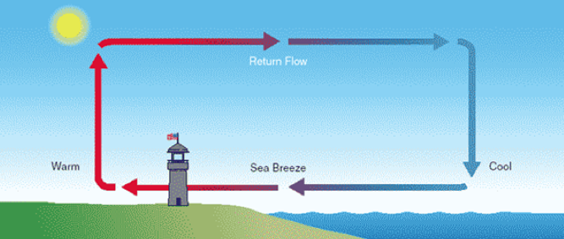
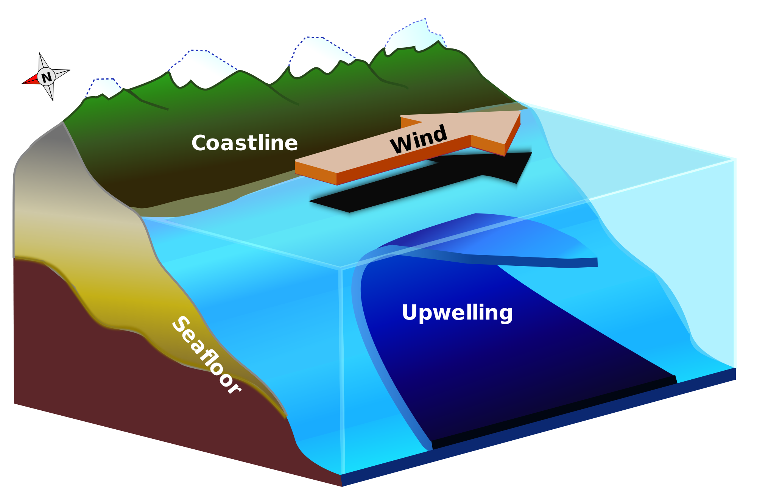
Introduction
Sea breeze
Coastal upwelling
Notes:
Cut-out speed of OSW turbines of 4 m/s (calm zone?)

Slide 5
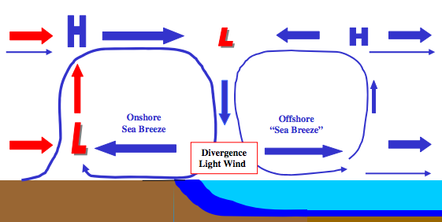
Introduction
Coastal upwelling + Sea breeze Hypothesis
Cold upwelling
Does this occur? With or without upwelling?

Slide 6
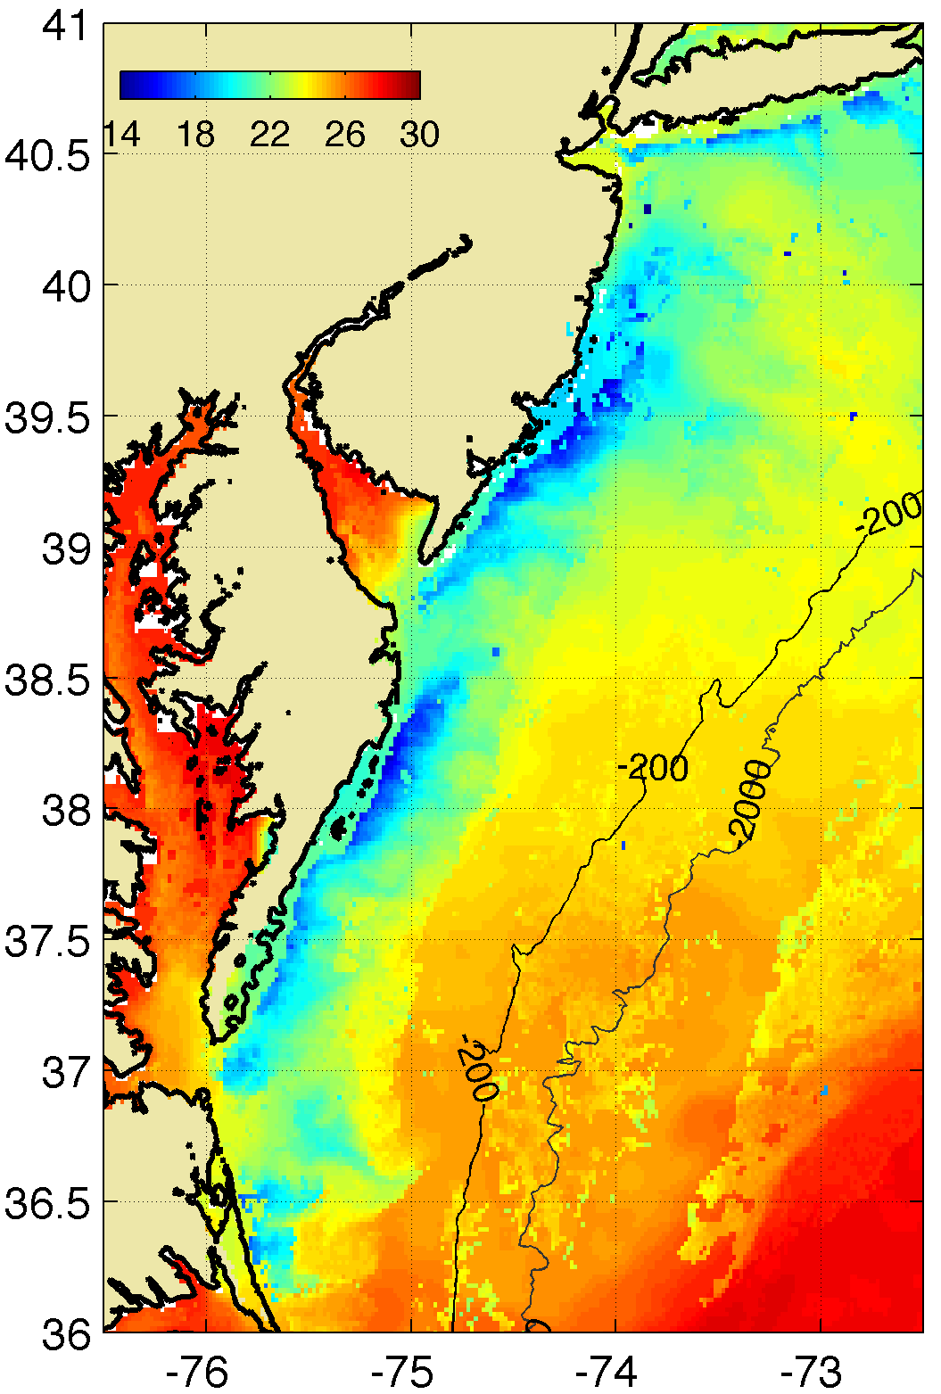
Introduction
Key Questions:
What effect does cold coastally-upwelled water have on the coastal/offshore wind resource?
What does the offshore component of the sea breeze look like? Secondary circulation (size, structure)? Offshore divergence?
Coastal upwelling
?

Slide 7


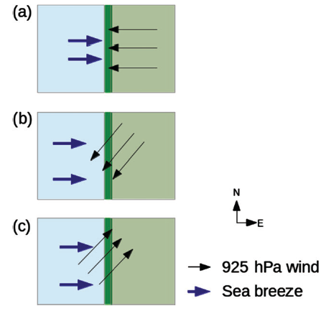

Materials and Methods
Satellite: state-of-the-science declouding and compositing technique designed by Rutgers to determine SST and resolve coastal upwelling
Model: 3km, 600m WRF-ARW 3.6.1; YSU PBL; MM5 Monin-Obukhov surface layer
Advantages (vs. offshore met tower): cost, spatial variability, prediction
Sea Breeze Cases:
July 7, 2013: corkscrew, strong upwelling
July 31, 2014: corkscrew, weak upwelling
April 27, 2013: pure, no upwelling
Coastal upwelling
  Backdoor
  Corkscrew
  Pure
Notes:
Satellite: High res in space and time
Previous satellite SST products low in spatial or temporal resolution and are often warmest pixel composites for declouding; cannot resolve coastal upwelling
SST product is IR/near IR (AVHRR); SPoRT is IR/near IR as well
Model: NAM12km for boundary conditions
Cases: largest and longest lasting upwelling in NJ 2012-2014
20140731 case has similar ambient (outside upwelling) water T to 20130707

Slide 8
Part 1: Coastal upwelling

Slide 9
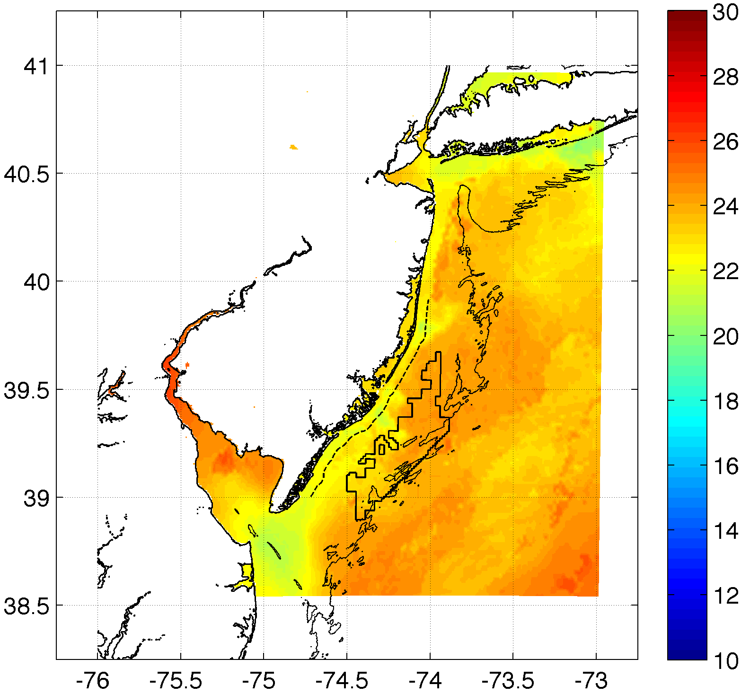
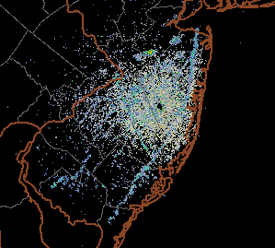
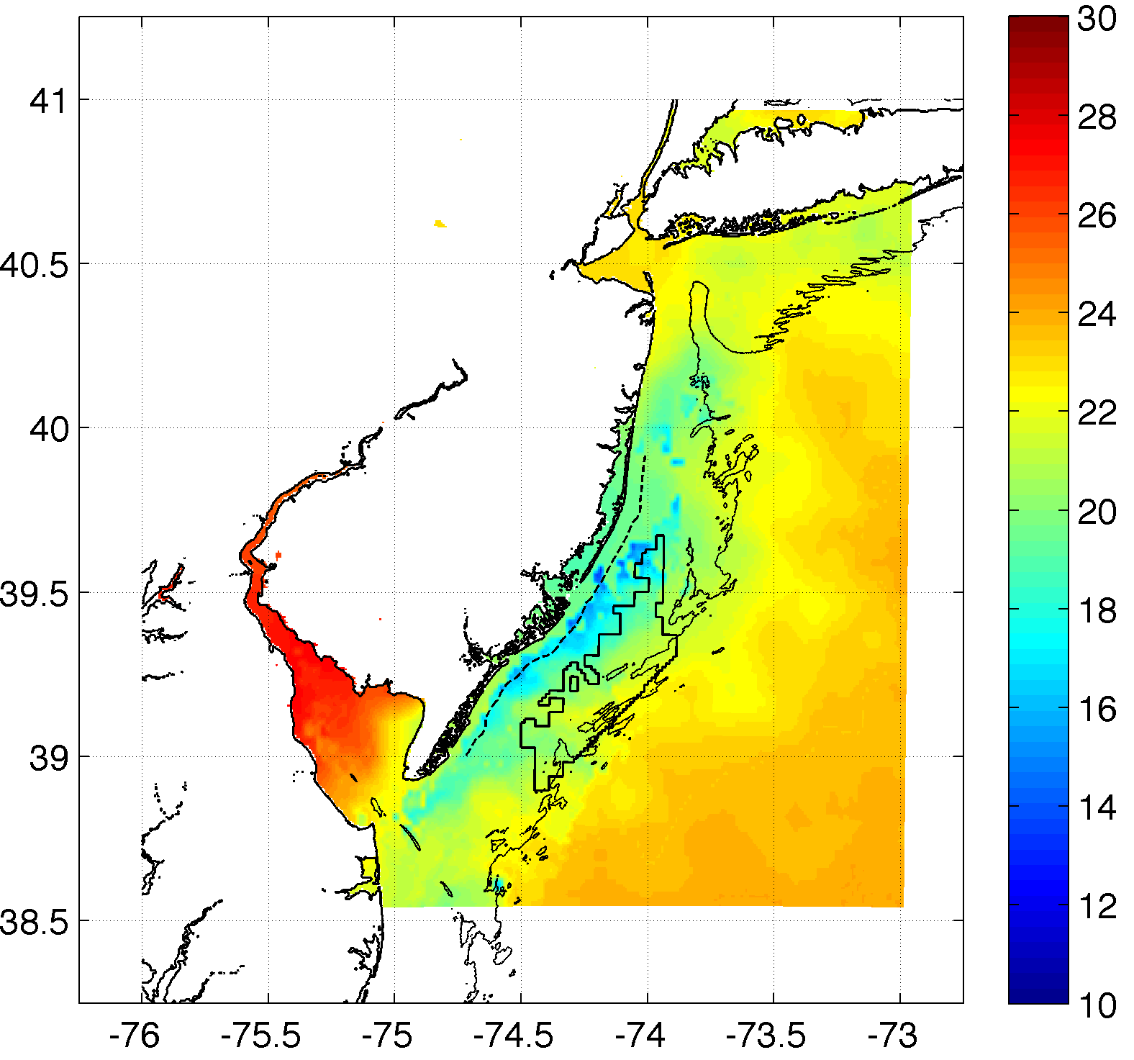
Methods
Weak upwelling
(Actual)
Case 2: July 31, 2014: corkscrew, weak upwelling
Strong upwelling

Slide 10
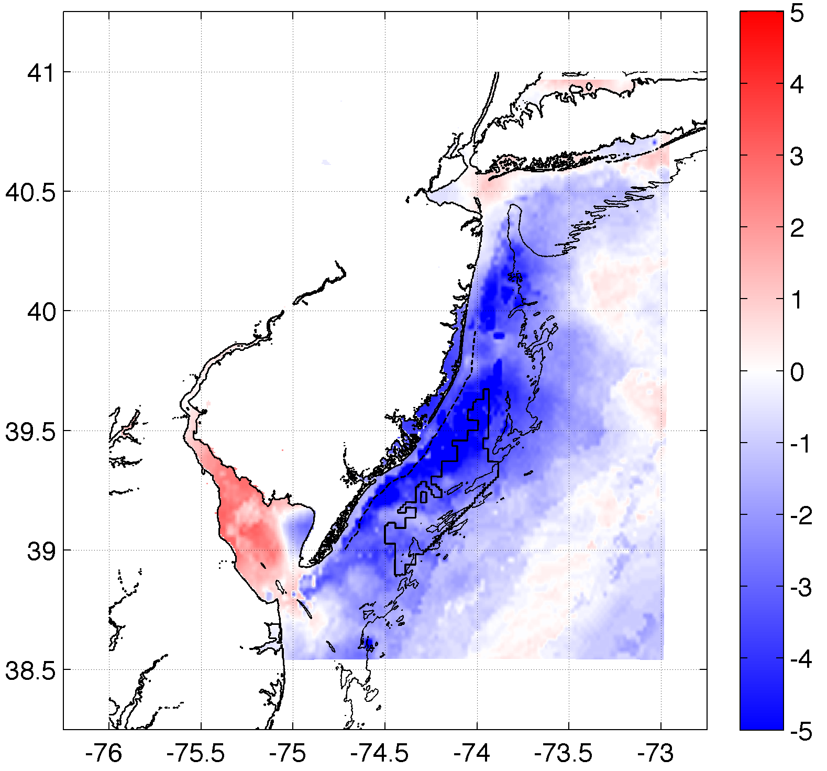
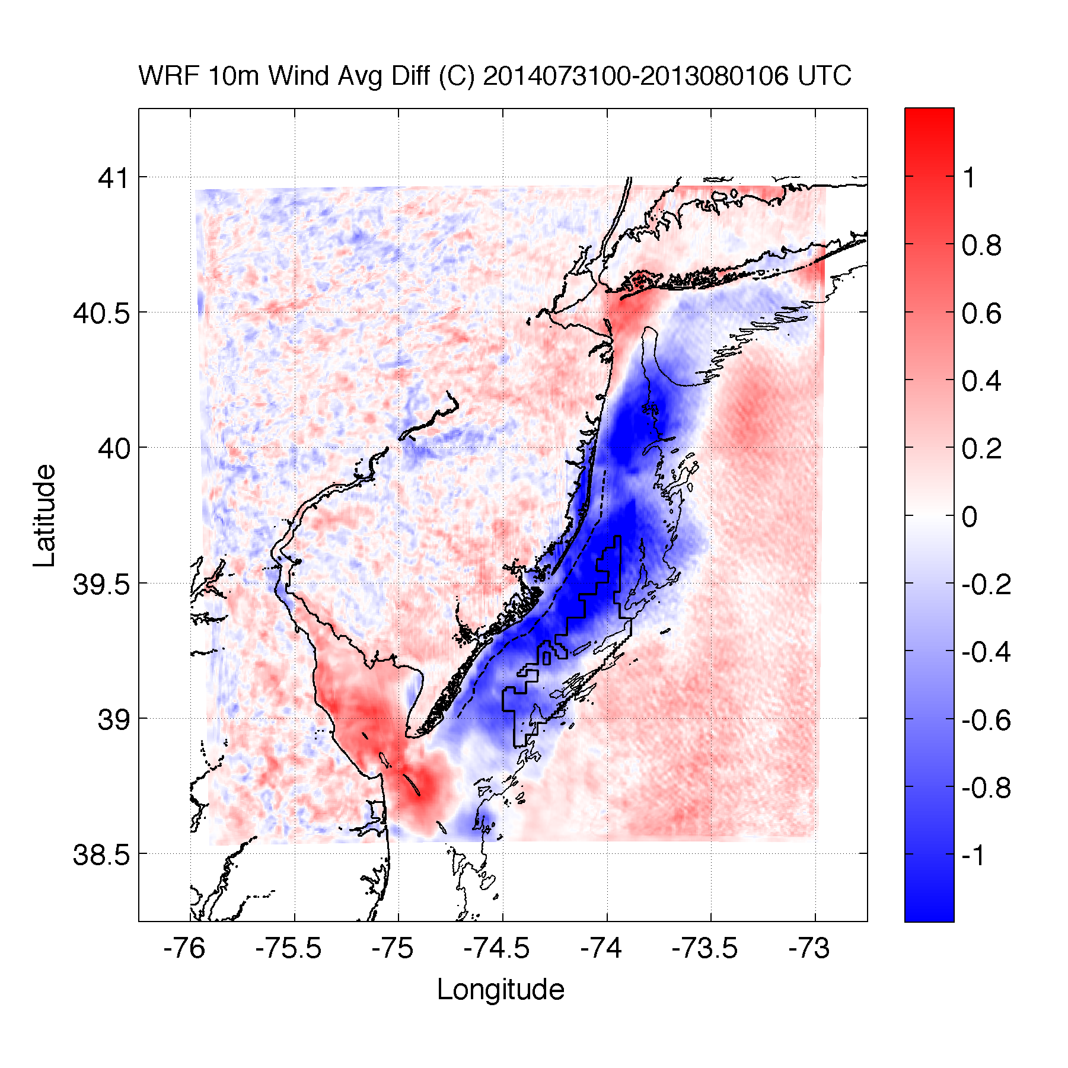
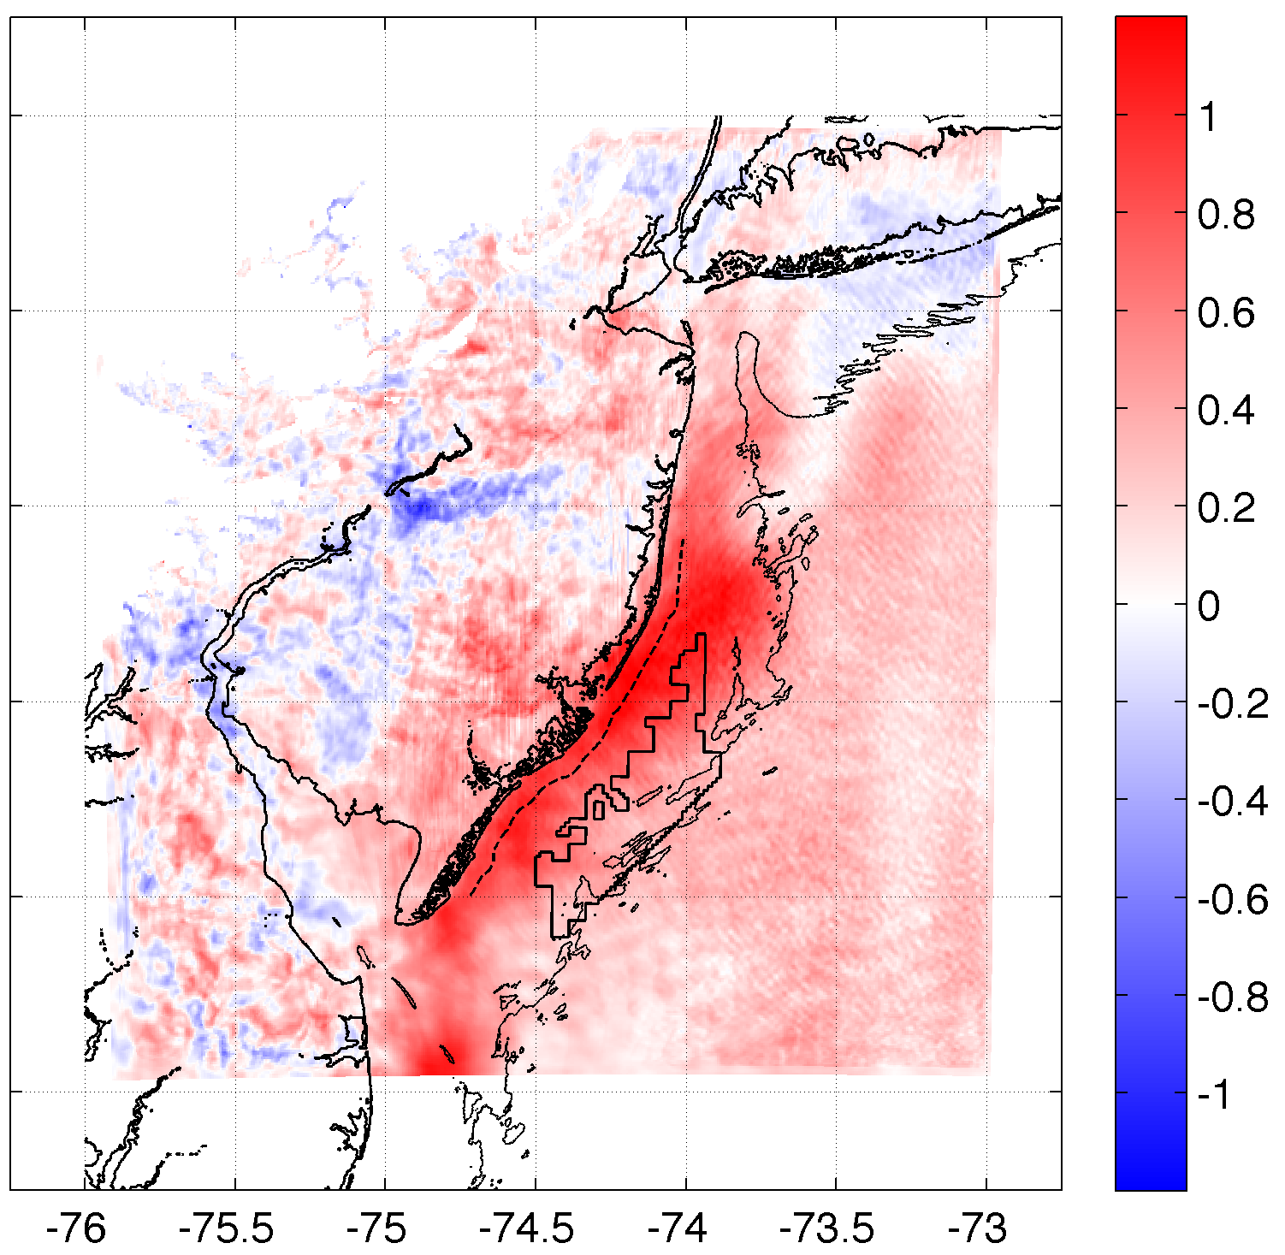
Results
Upwelling produces an inversion, decreasing 10m winds & increasing 100m hub height winds
SST Diff.
10m Wind Speed Diff.
100m Wind Speed Diff.
r²=0.61
r²=0.58
Case 2: 20140731

Slide 11
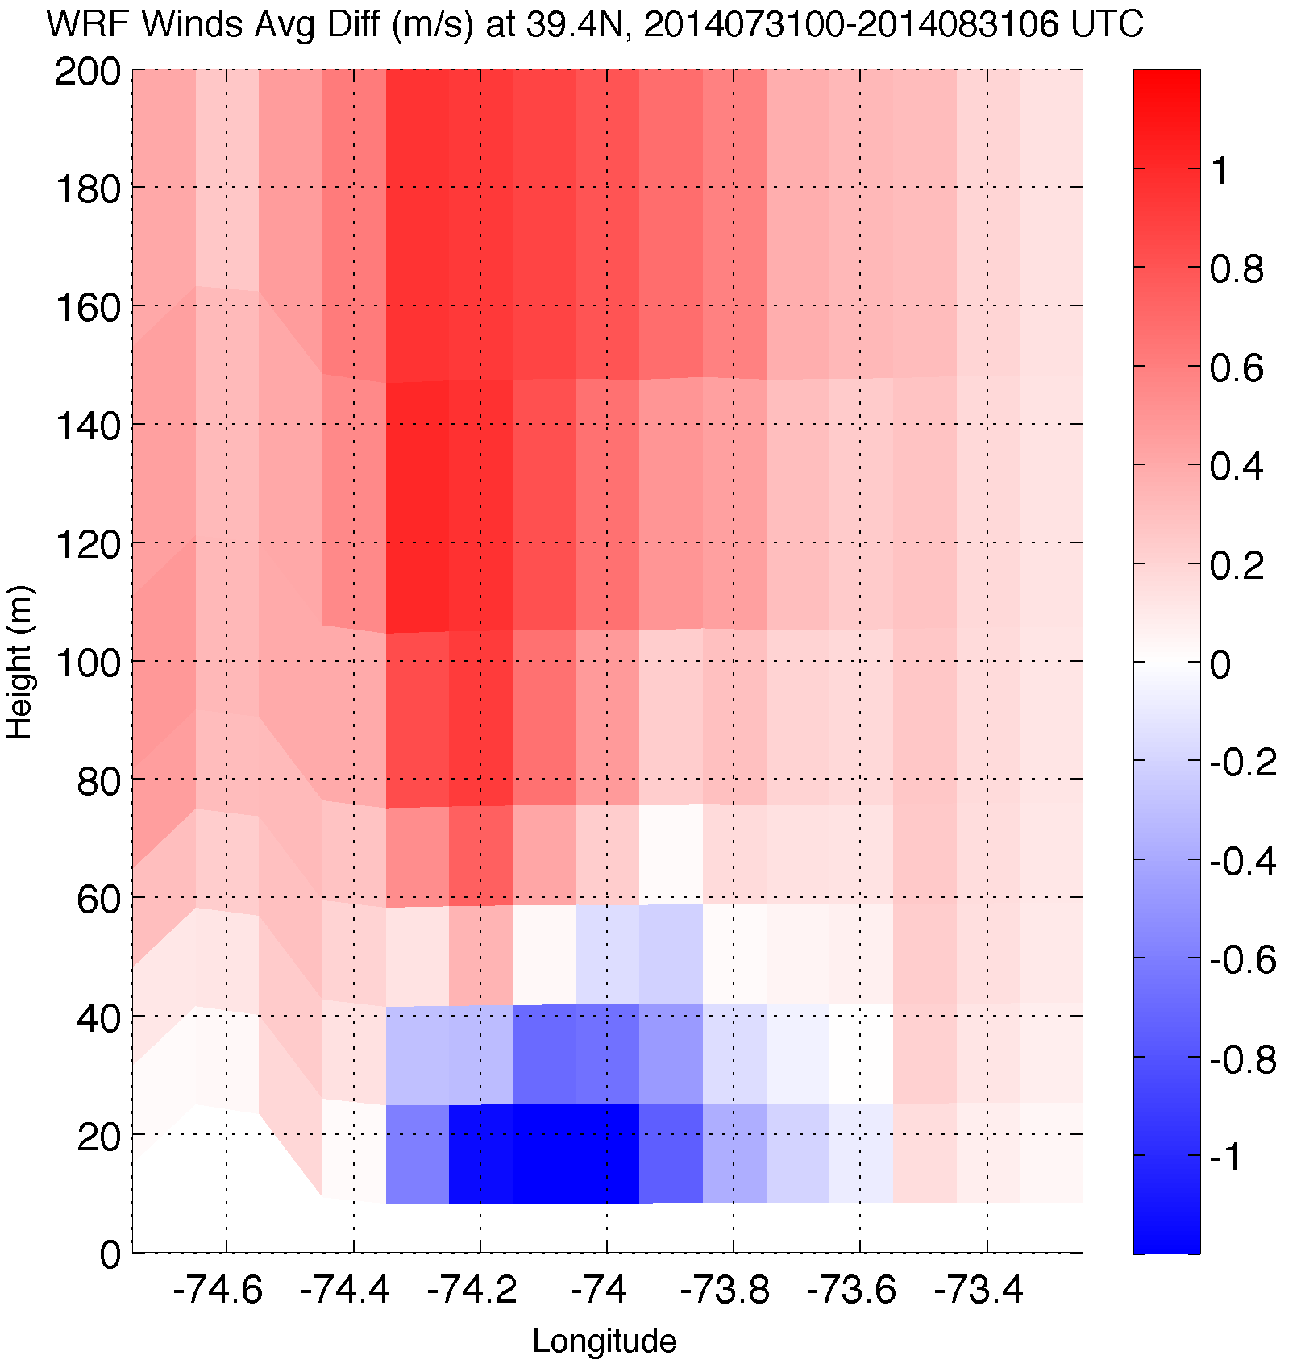

Upwelling produces an inversion, decreasing 10m winds & increasing 100m hub height winds
Results
Wind Speed Difference
10m Wind Speed Diff.
Case 2: 20140731

Slide 12
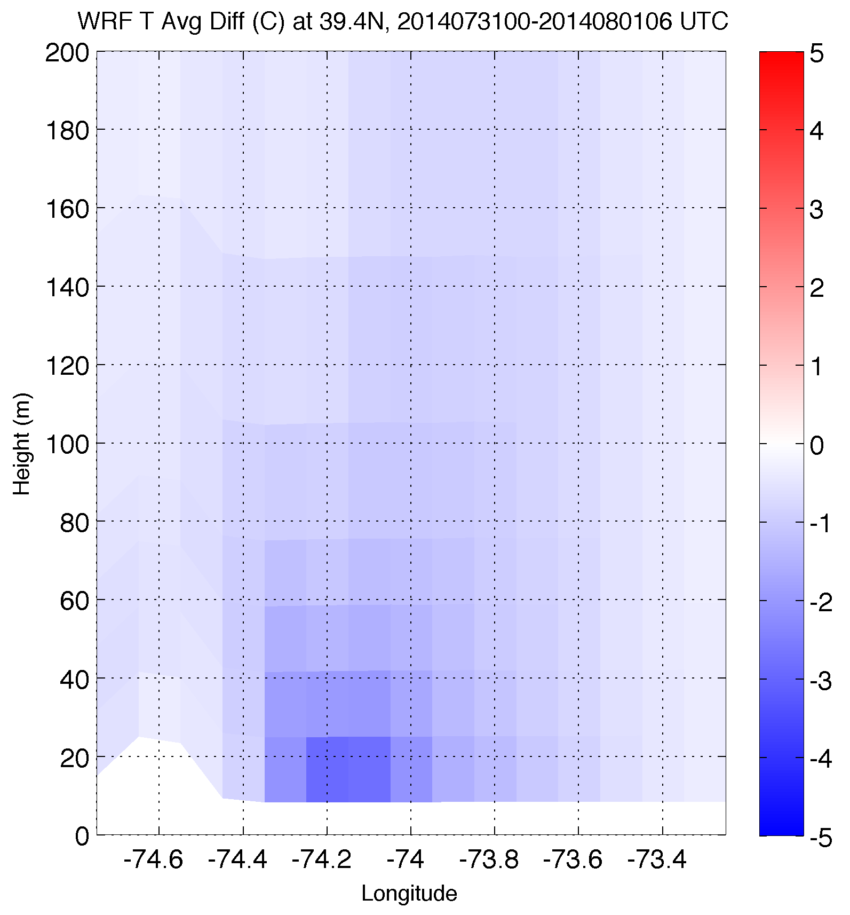
Upwelling produces an inversion, decreasing 10m winds & increasing 100m hub height winds
Results
Temperature Difference
10m Wind Speed Diff.
Case 2: 20140731

Slide 13
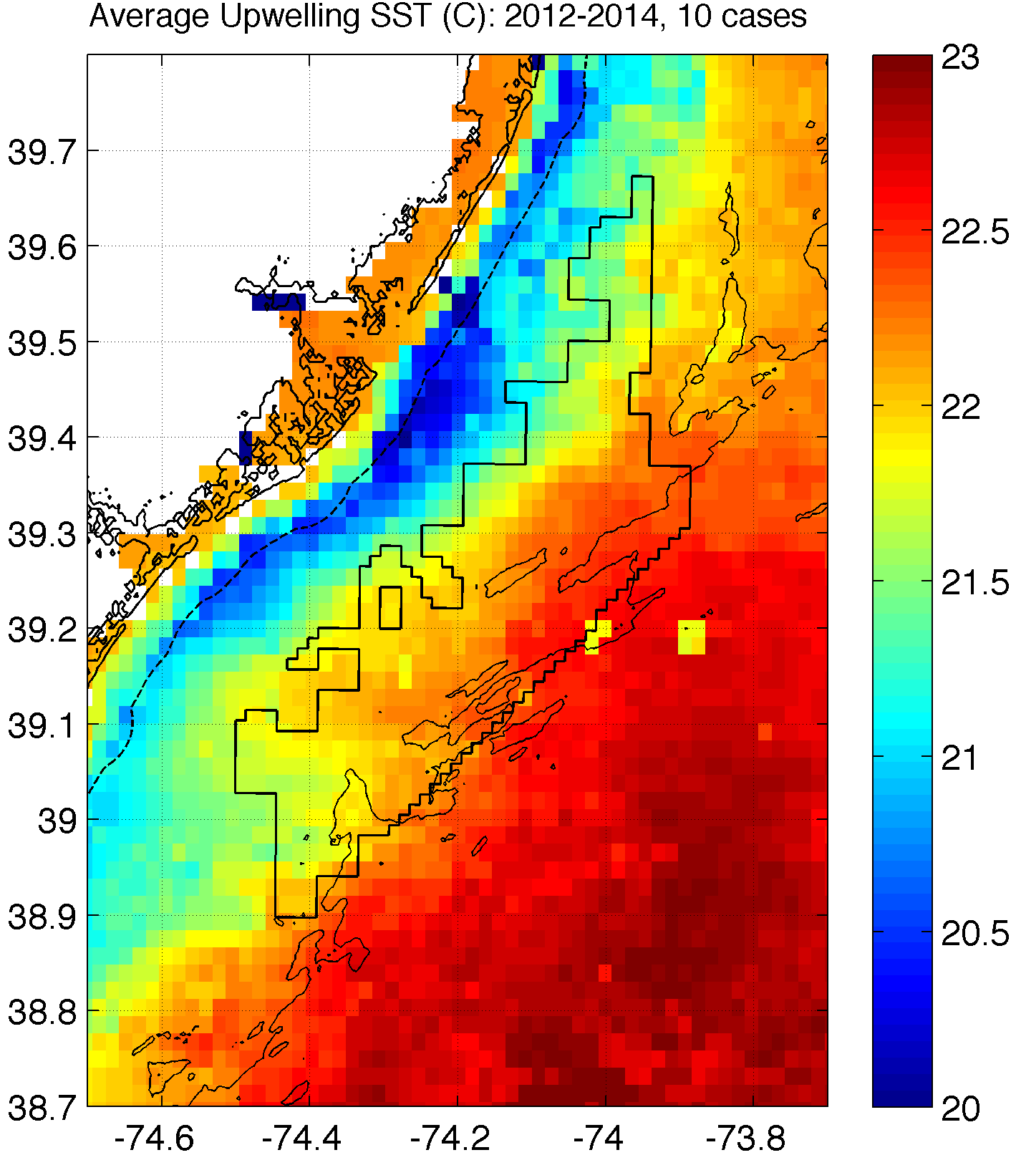
How will coastal upwelling affect the NJ WEA?
Notes:
Could expect similar inversions, impact on 100m winds over upwelling in this structure (affects NJ WEA!)
Need good ocean model to predict this correctly!

Slide 14
Part 2: Sea Breeze

Slide 15
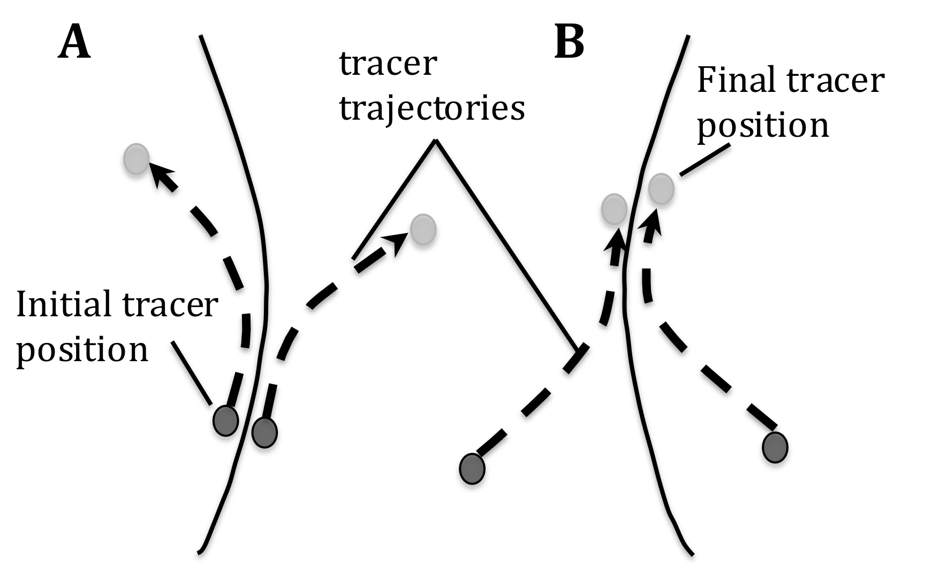
Methods
Case 3: April 27, 2013: pure, no upwelling
Lagrangian Coherent Structures (LCSs)
LCSs are boundaries in a fluid that distinguish regions of differing dynamics (e.g. eddies, jets, fronts)
Particles move away from and along a repelling LCS (A), aggregate and move along attracting LCSs (B)
LCS maps identify convergence and divergence in a fluid flow (e.g. sea breeze)

Slide 16
Methods
Benefits of LCS
The Lagrangian measures are advantageous as they are frame independent and robust with respect to localized noise in the data.
Additionally, LCS analysis reveals coherent structures in more detail and with better clarity than streamline plots generated from 2D wind retrieval (Chan and Shao 2007; Tang et al. 2011)

Slide 17
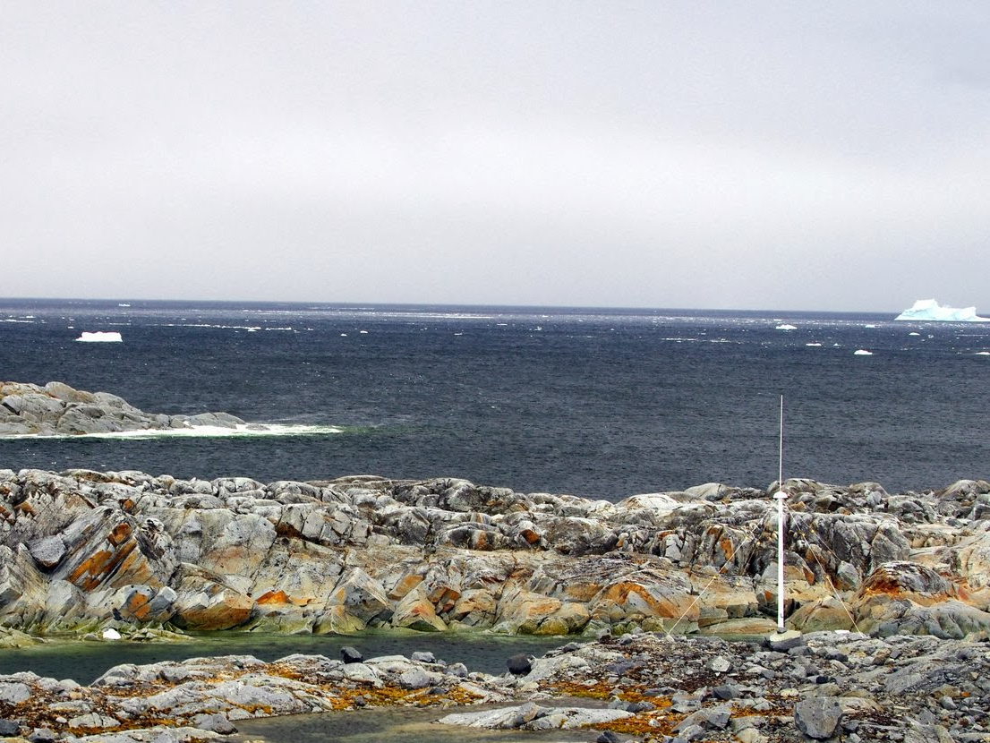

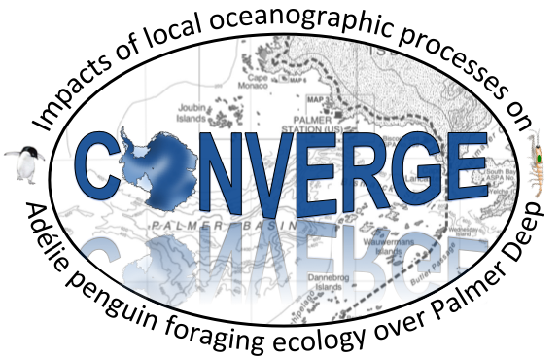
Collaborative research: Impacts of local oceanographic processes on Adélie penguin foraging ecology over Palmer Deep
Rutgers University
Oregon State University
Polar Oceans Research Group
University of Delaware
University of Alaska, Fairbanks
In Collaboration with PAL-LTER (Ducklow et. al.)

Slide 18
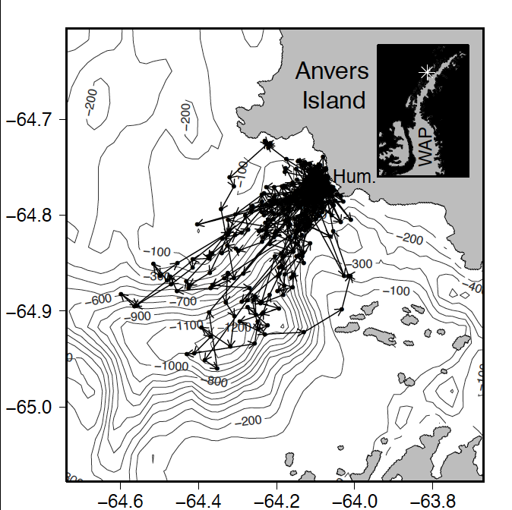
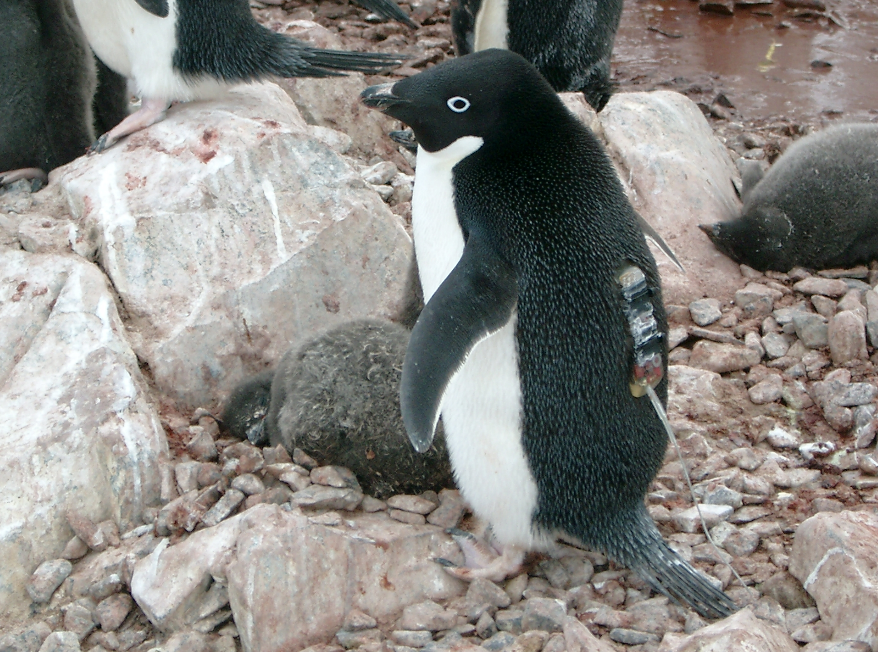

First Field Season Results
Tracking penguins from Humble Island
Where did the Adélie penguins go?

Slide 19
Science Objectives
From these initial observations we hypothesize that:
H1. Convergence zones in the surface waters within 50 km of the coast shift location between the diurnal and semi-diurnal tidal regime.
H2. These convergence zones concentrate phytoplankton and aggregate schools of krill and subsequently influence the behavior of top predator species between tidal regimes.
To do this we will sample the:
Physics
Primary Producers
Zooplankton
Top Predators
Over semi-diurnal and diurnal tidal regimes.
Diurnal
Semi-Diurnal

Slide 20
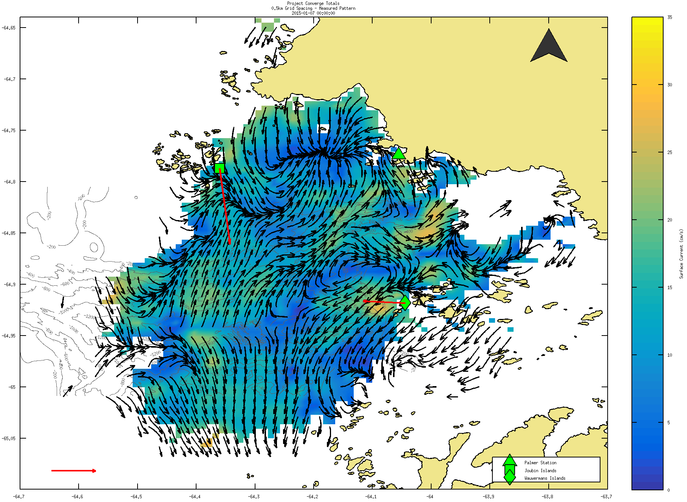

Slide 21
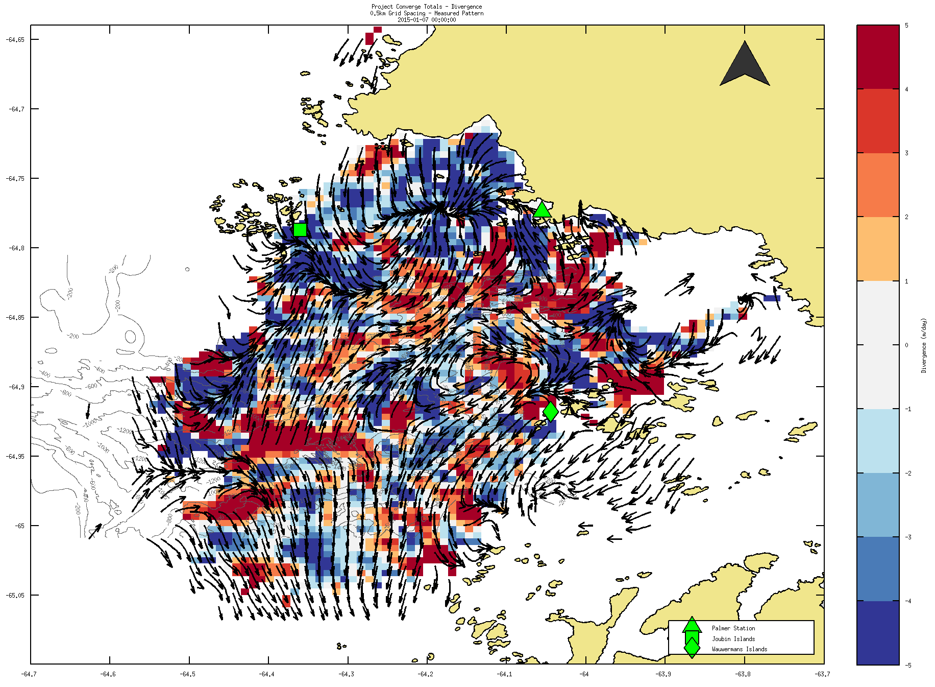

Slide 22
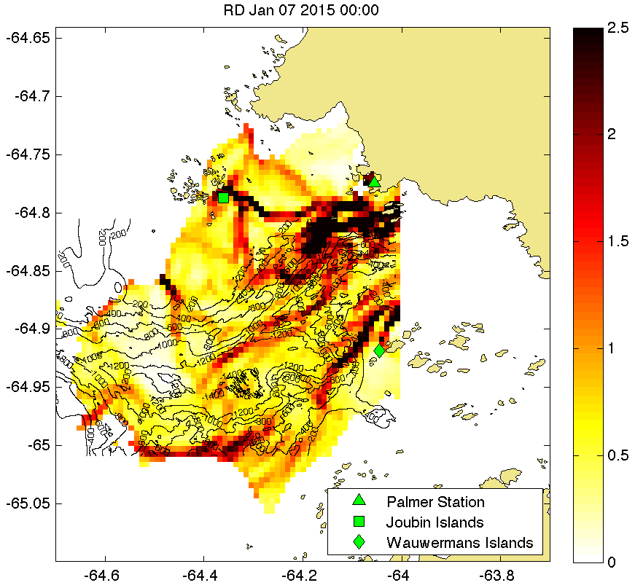

Slide 23
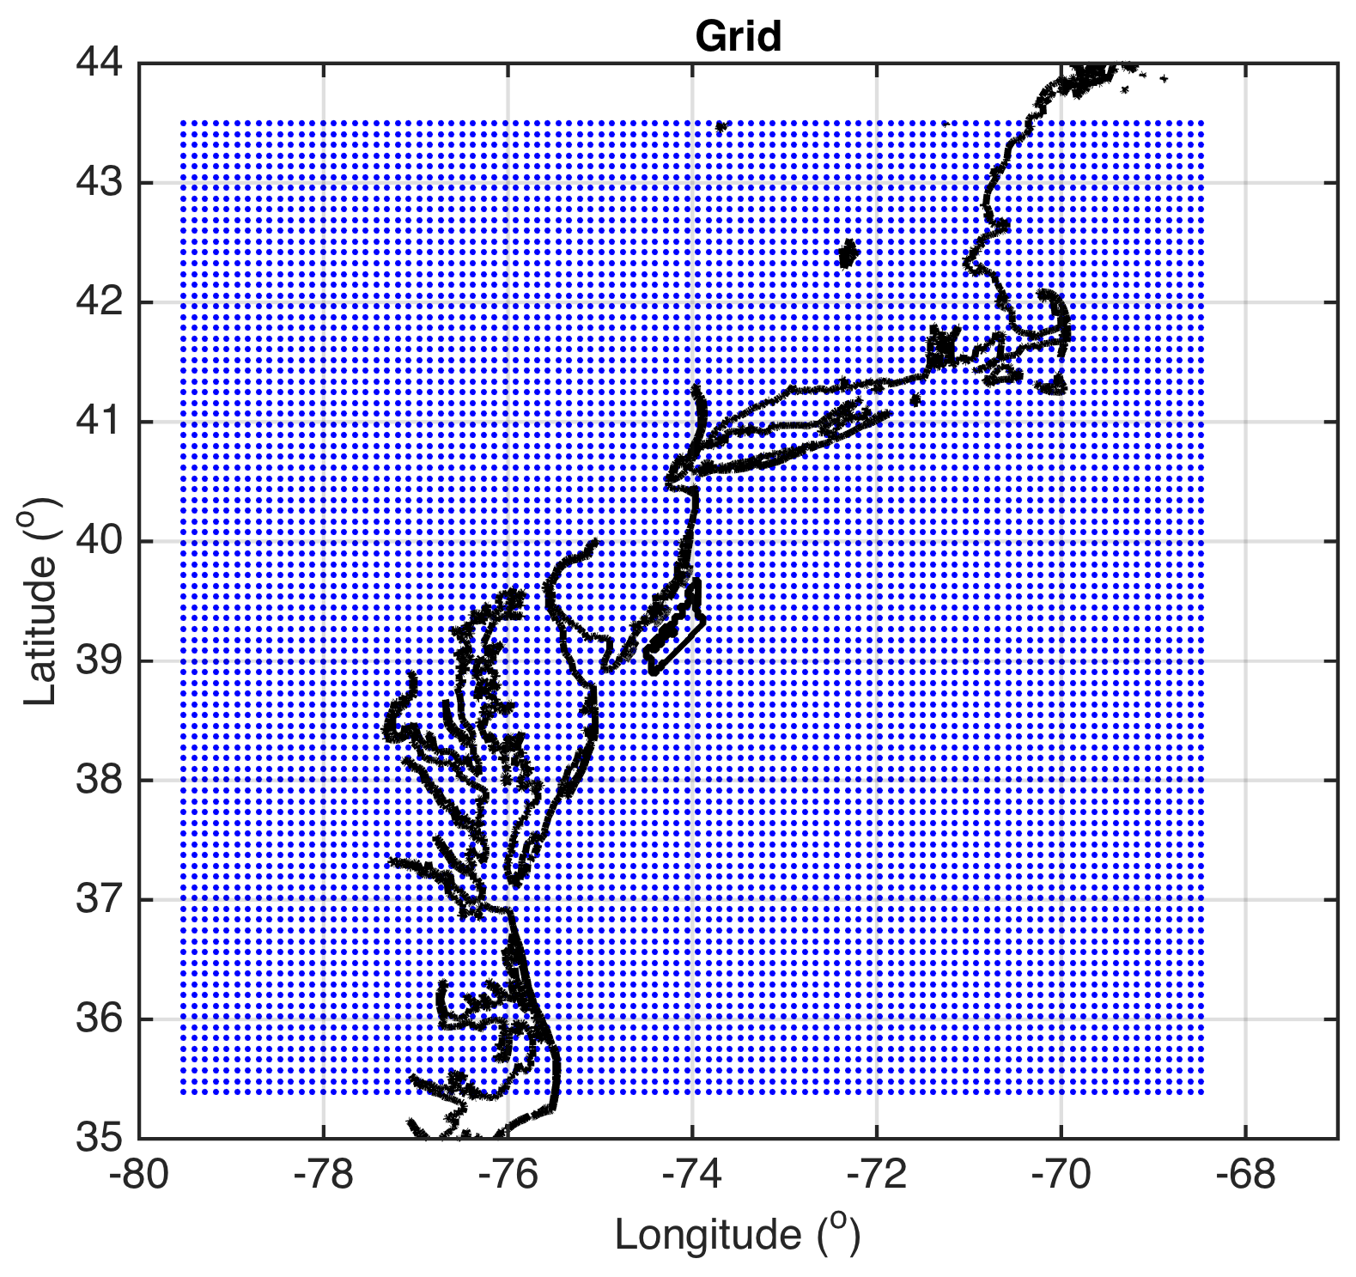
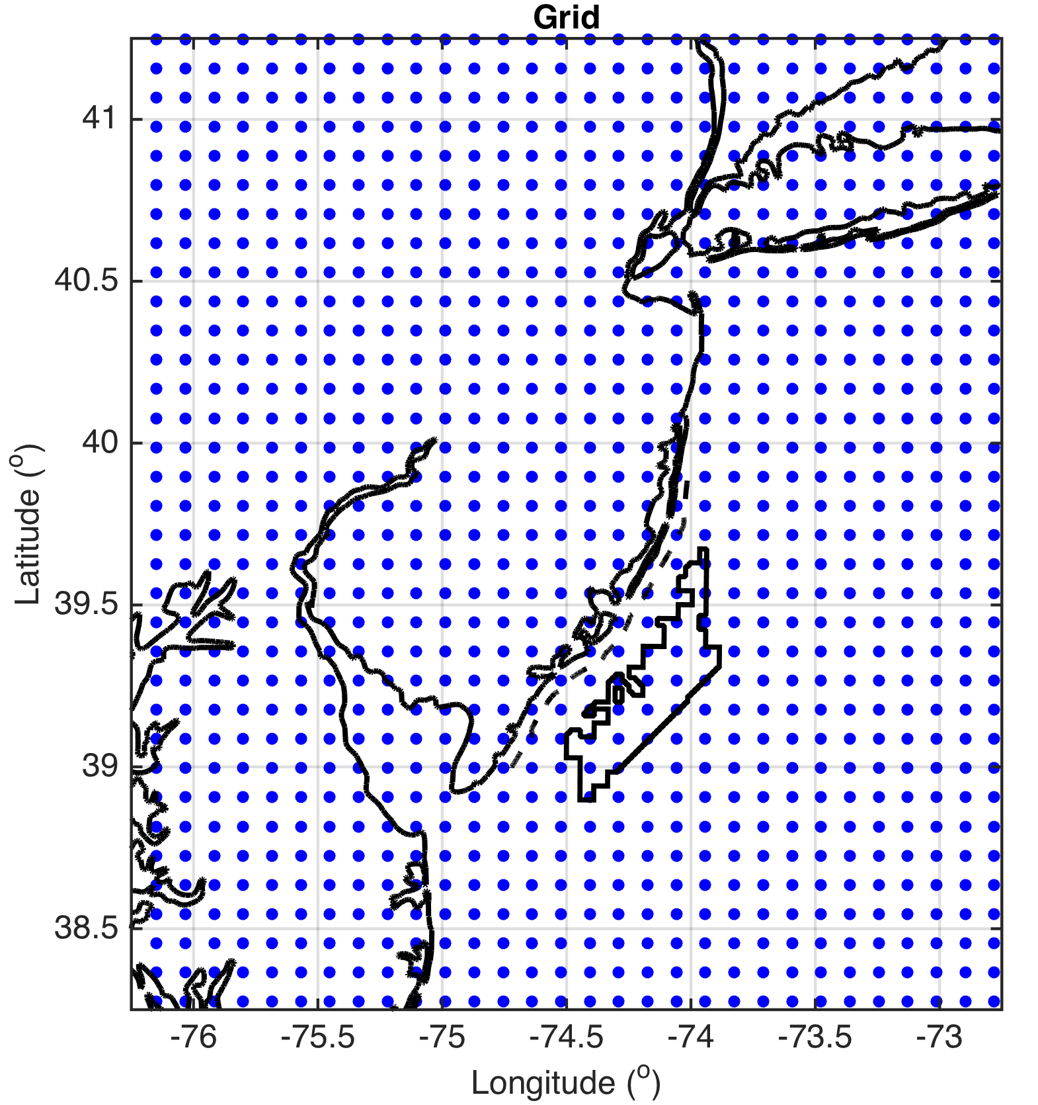
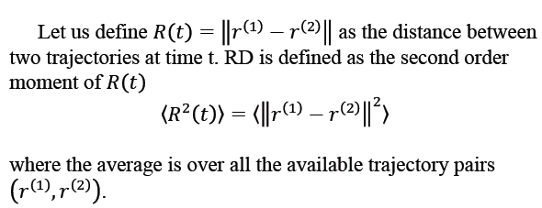
Methods
LCS Set-up
On 3km WRF winds
1800 UTC to 2300 UTC (peak sea breeze time)
10km grid spacing for tracer trajectories
Perform at these levels in WRF:
  10, 50, 150, 500, 600, 700, 800, 900, 1000, 1500, 2000, 2500m (through marine boundary layer)
Use relative dispersion (RD) to identify LCSs

Slide 24
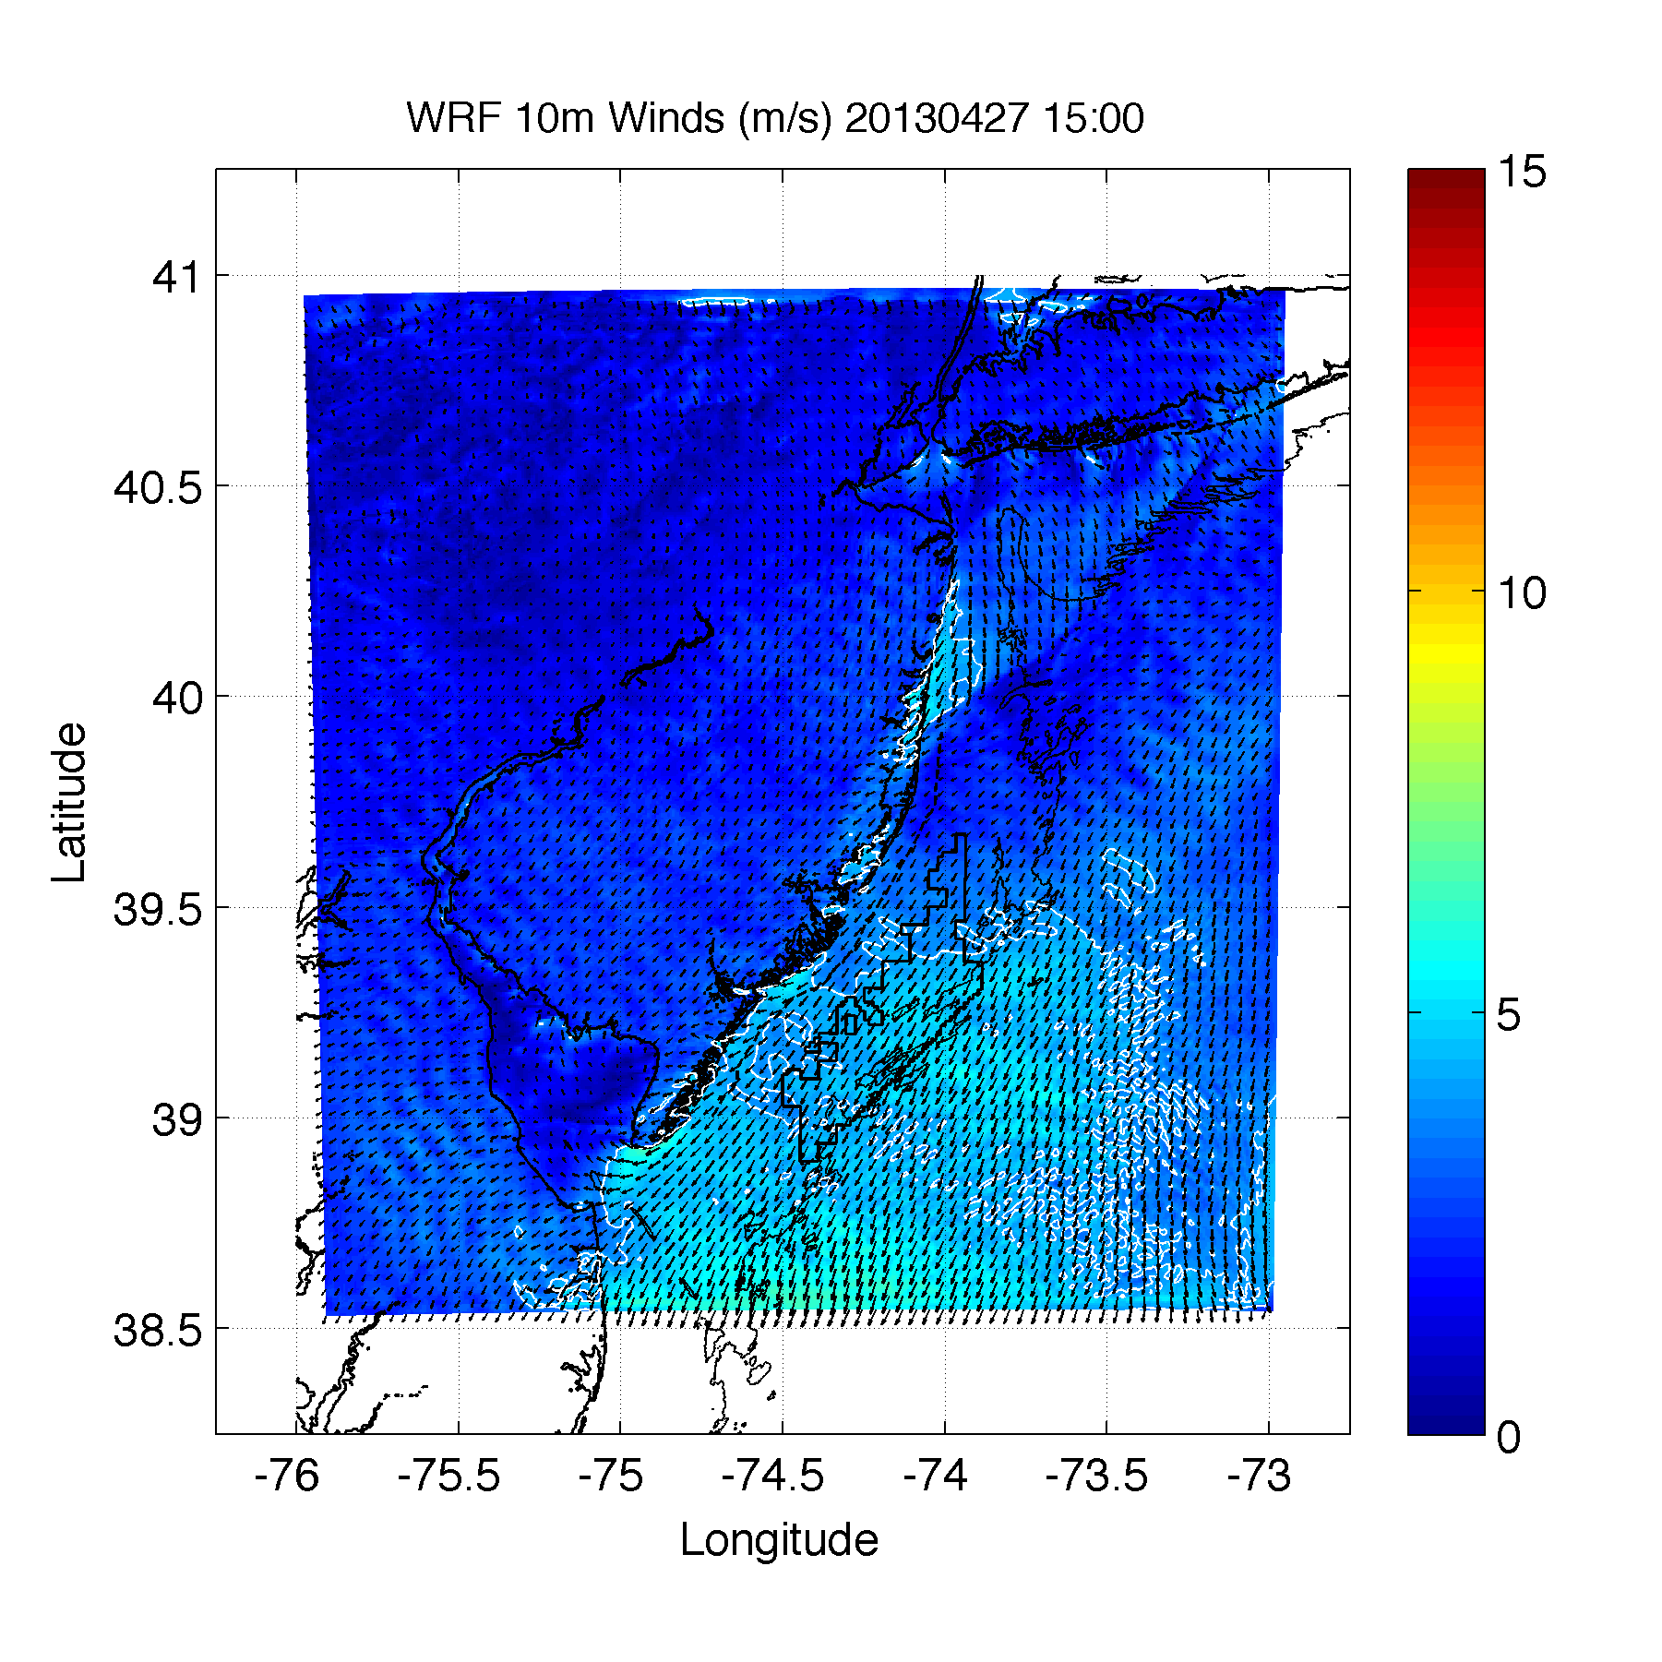
1500 UTC
1 km WRF simulation

Slide 25
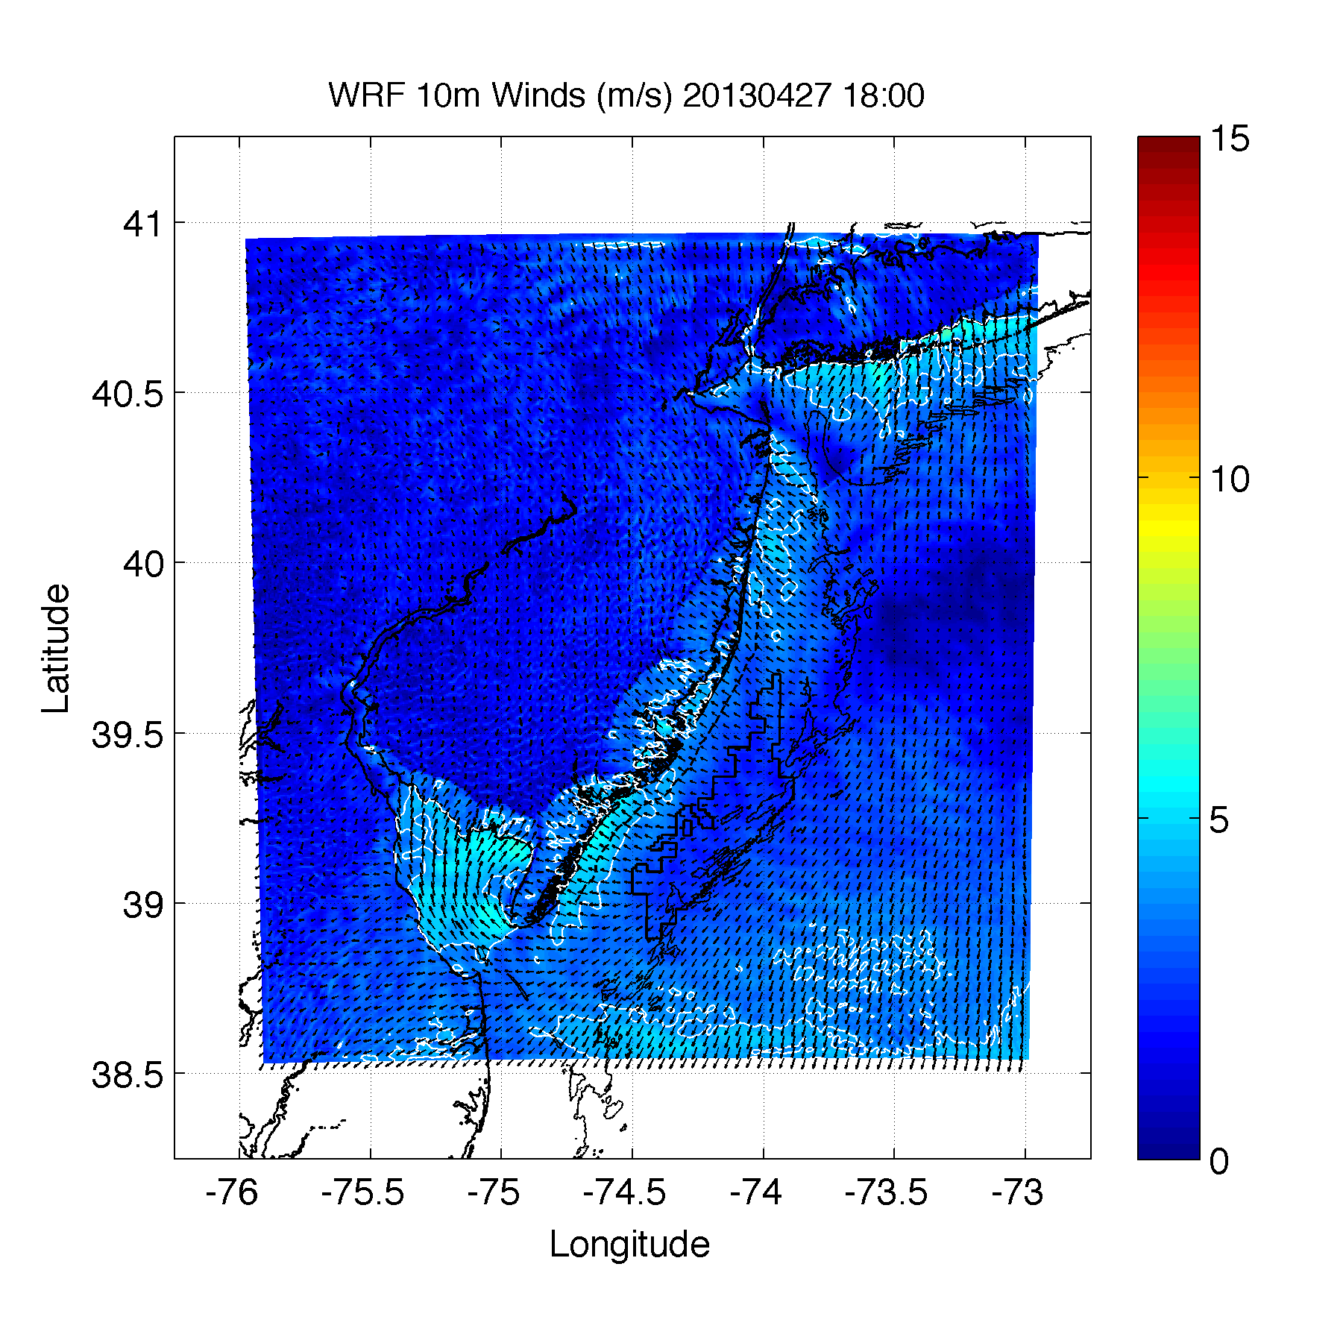
1800 UTC
1 km WRF simulation

Slide 26
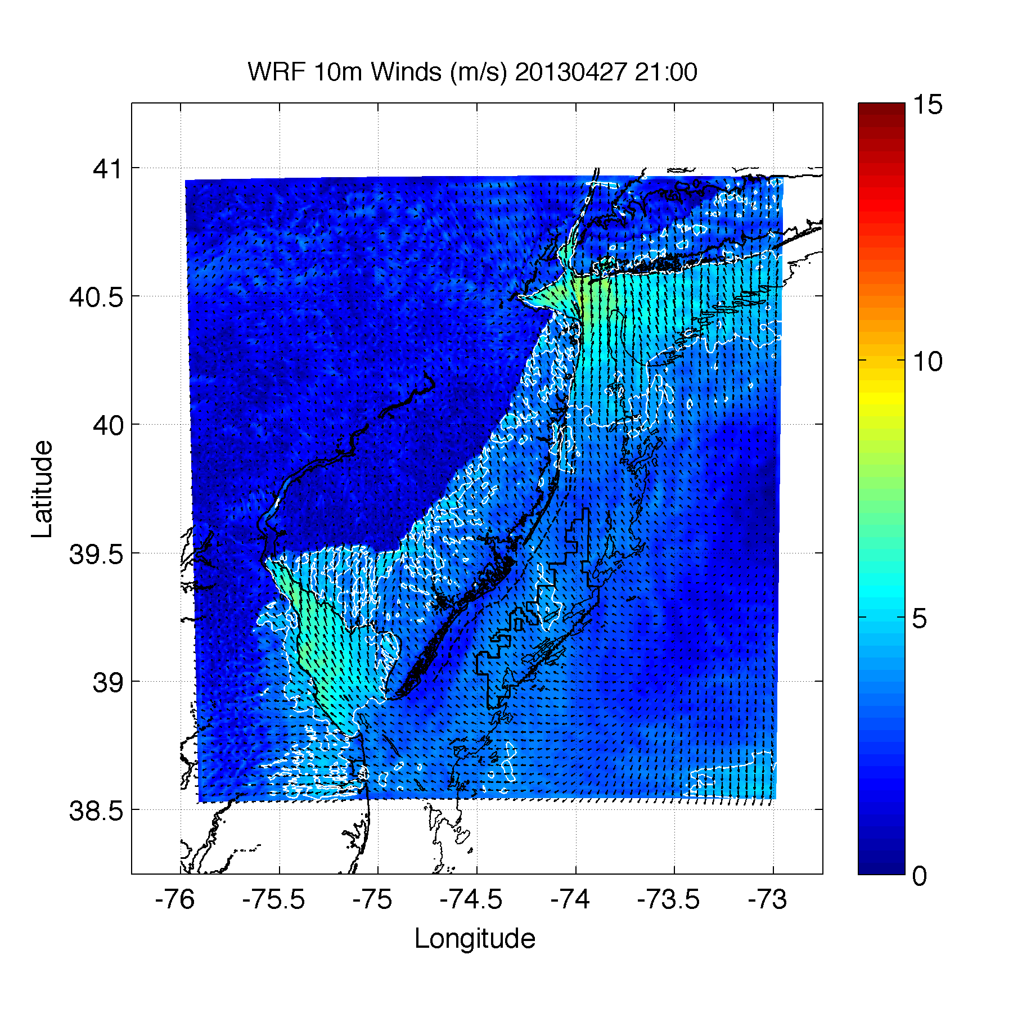
2100 UTC
1 km WRF simulation

Slide 27
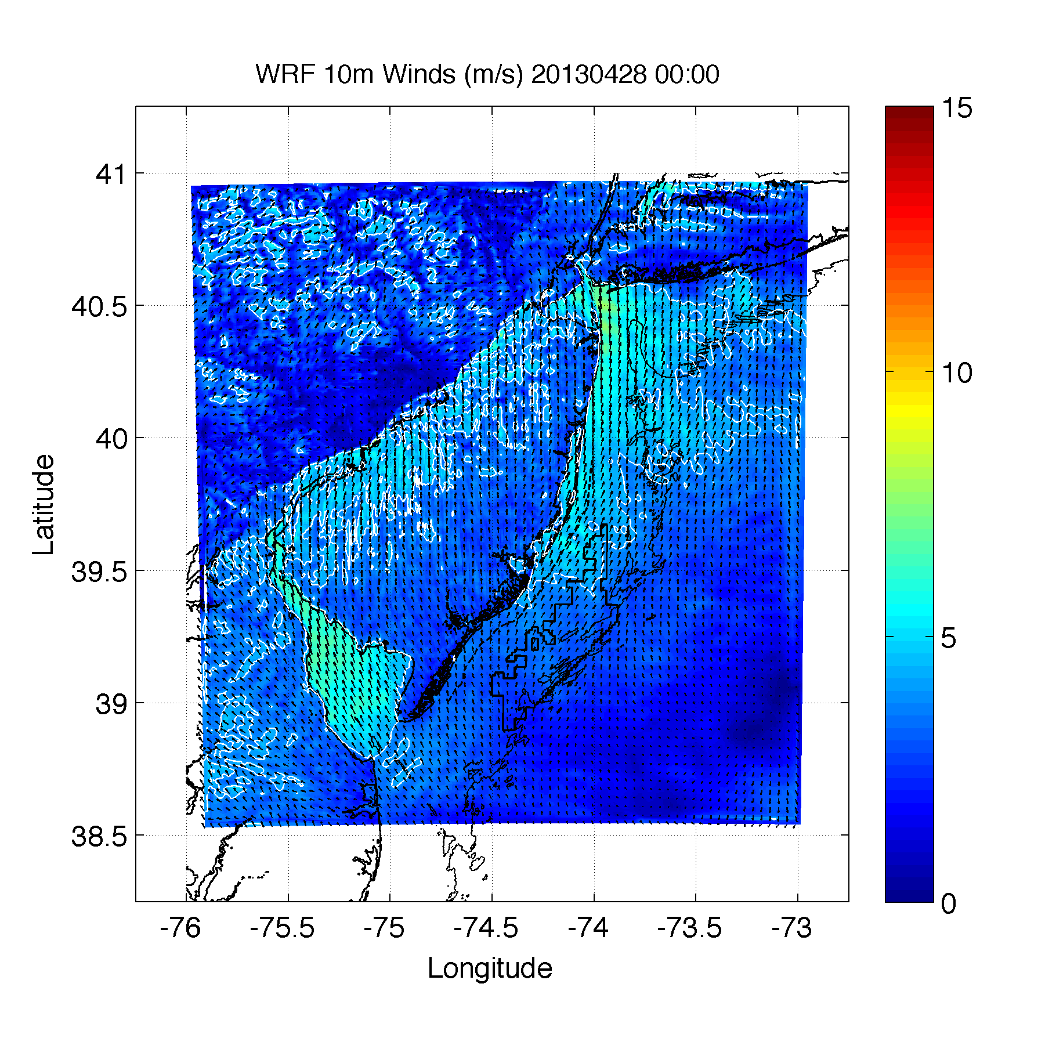
0000 UTC
1 km WRF simulation

Slide 28
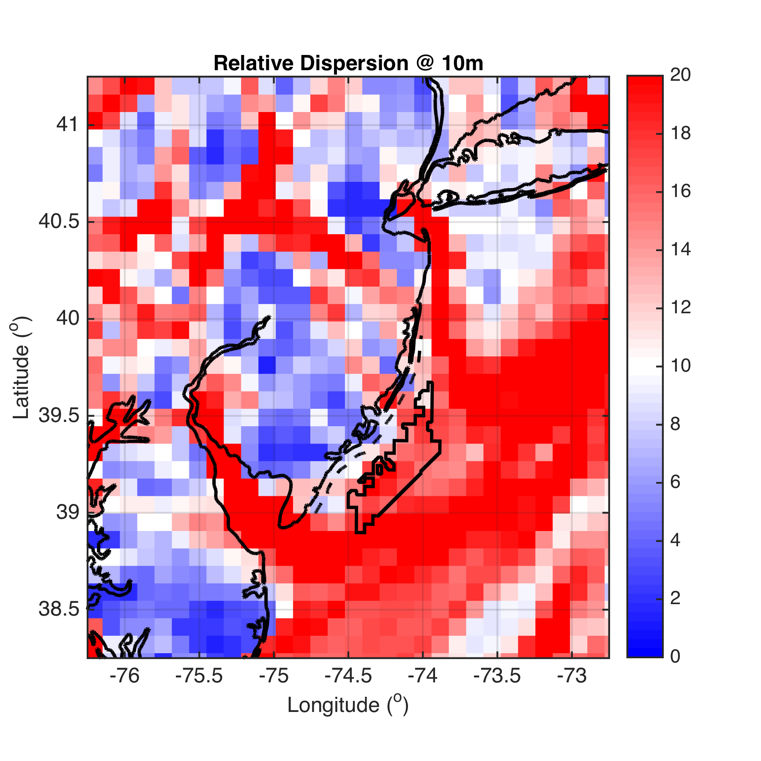
Results
10m

Slide 29
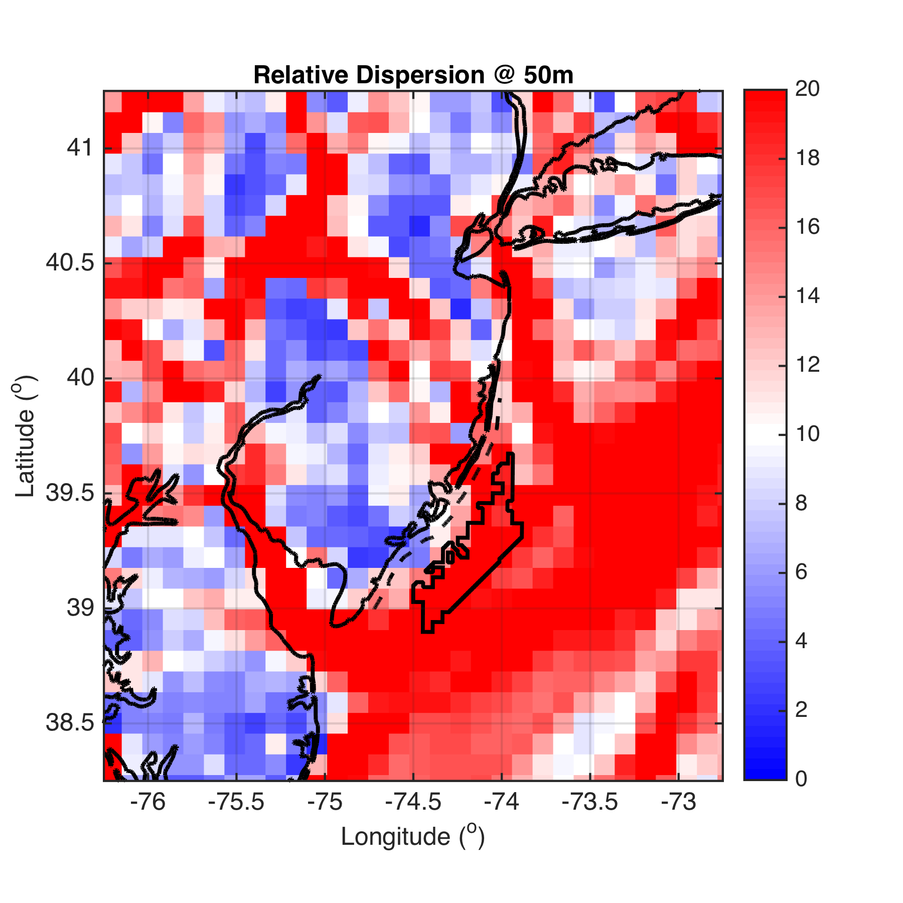
50m
Notes:
Blue red colorbar at +/- 10

Slide 30
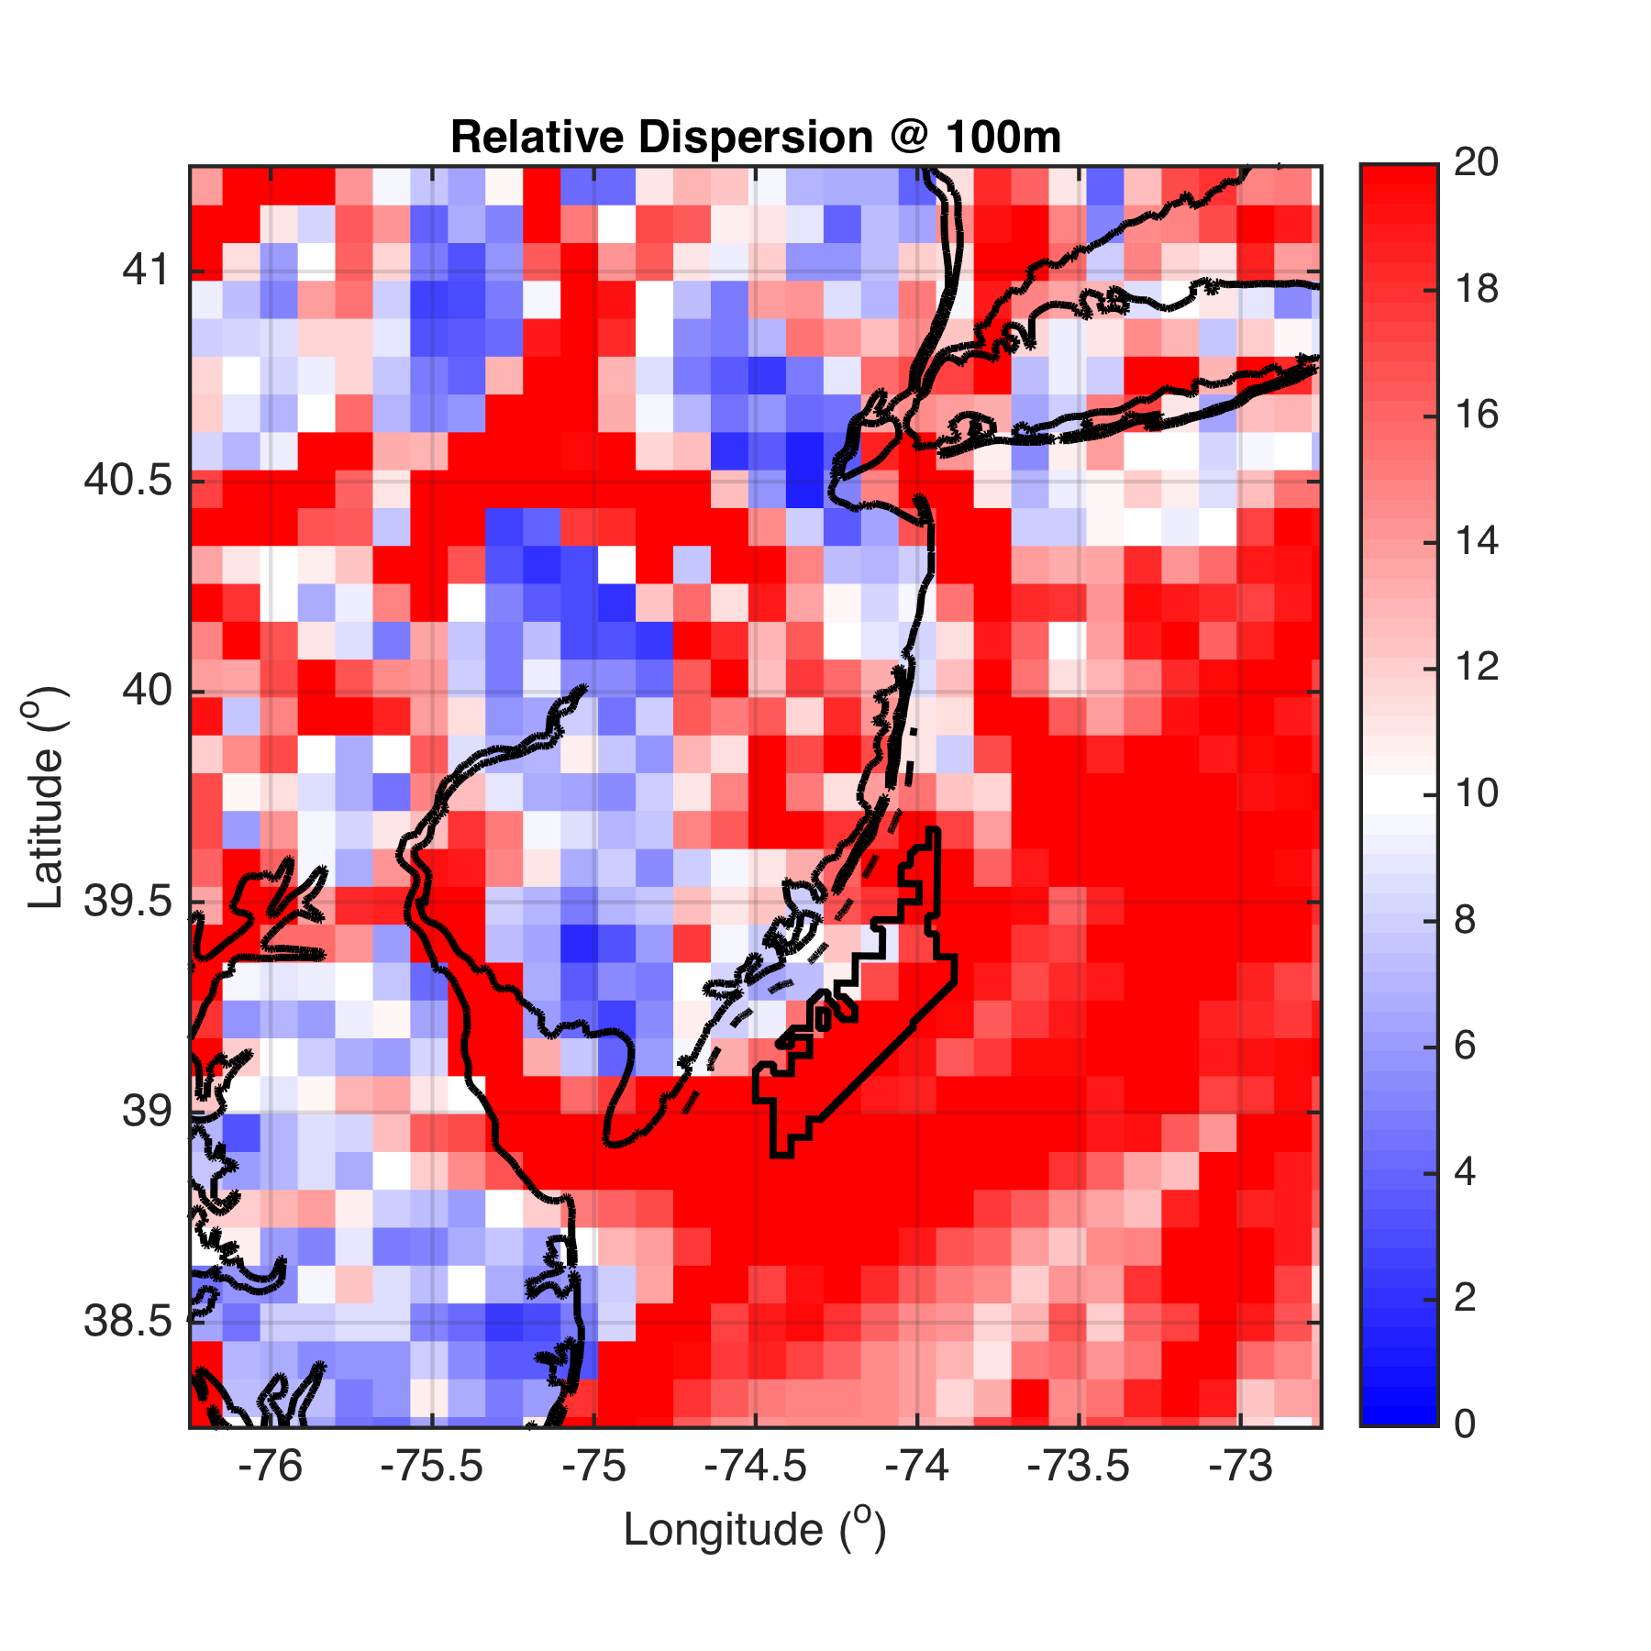
100m

Slide 31
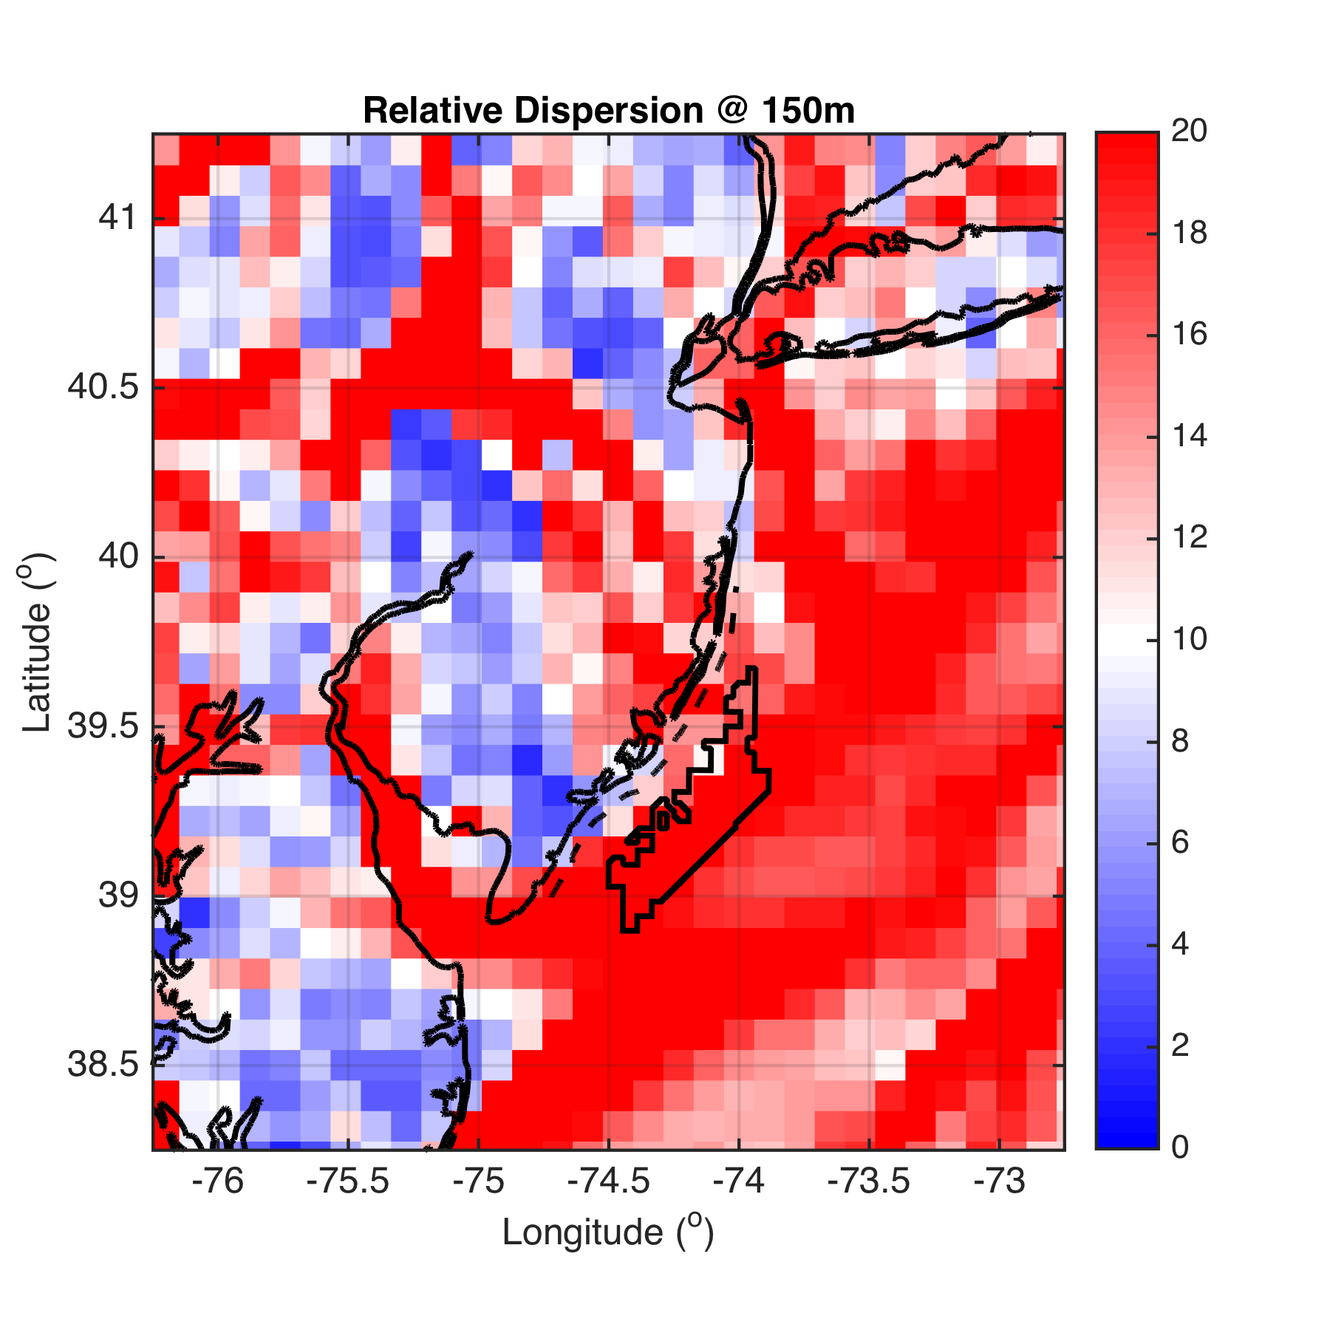
150m

Slide 32
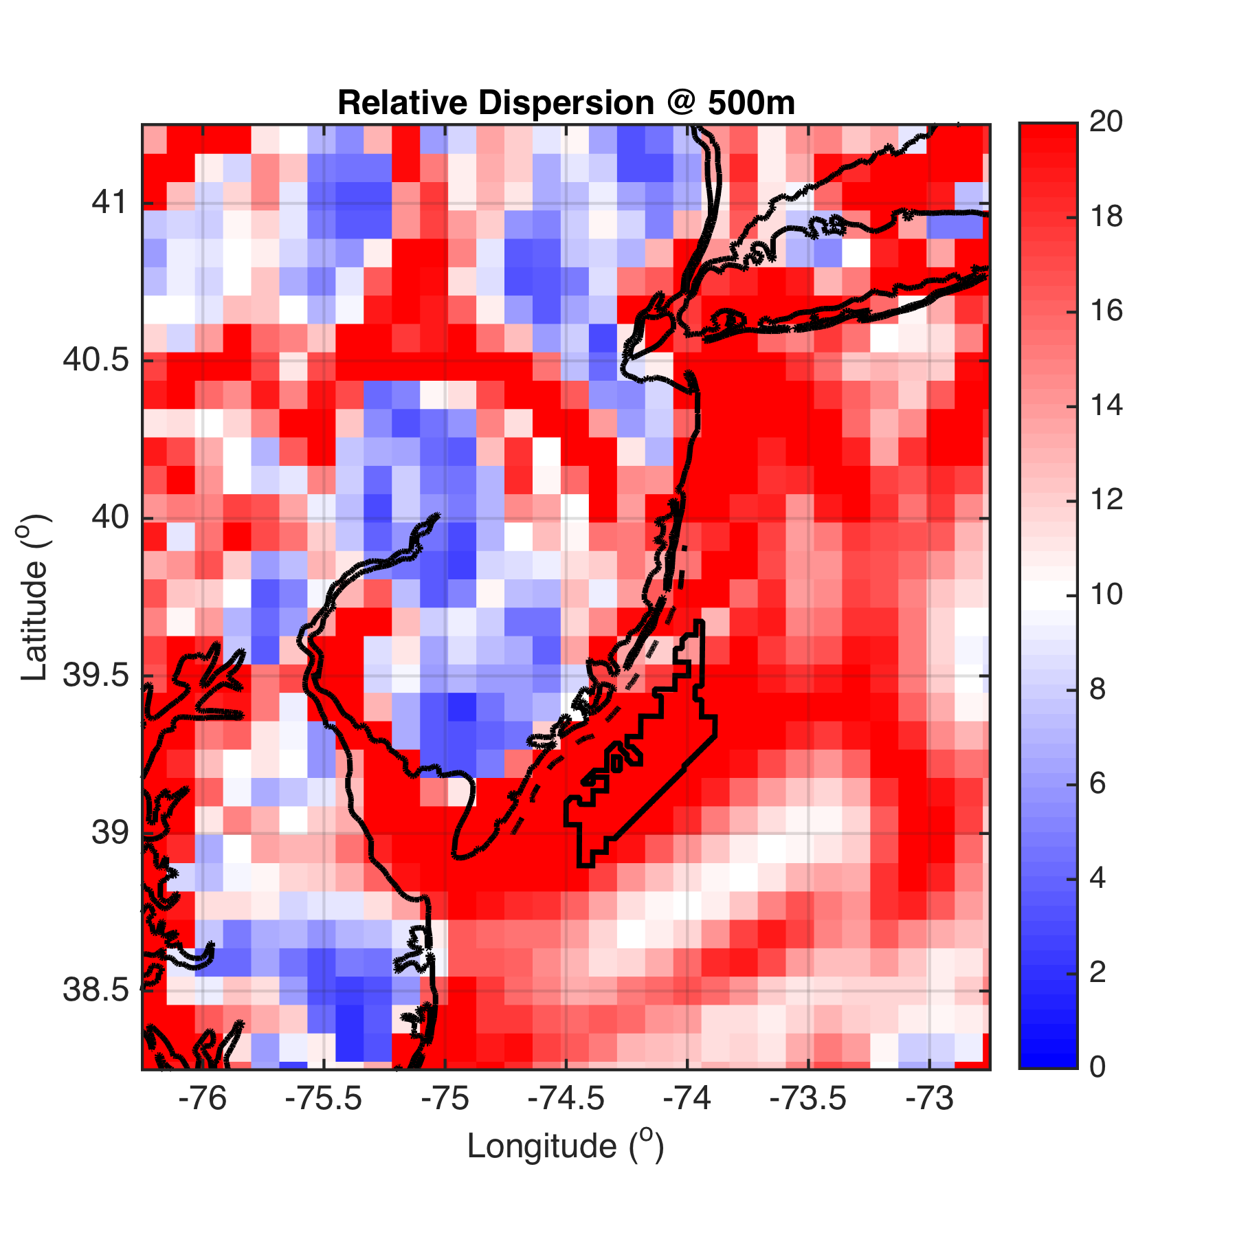
500m

Slide 33
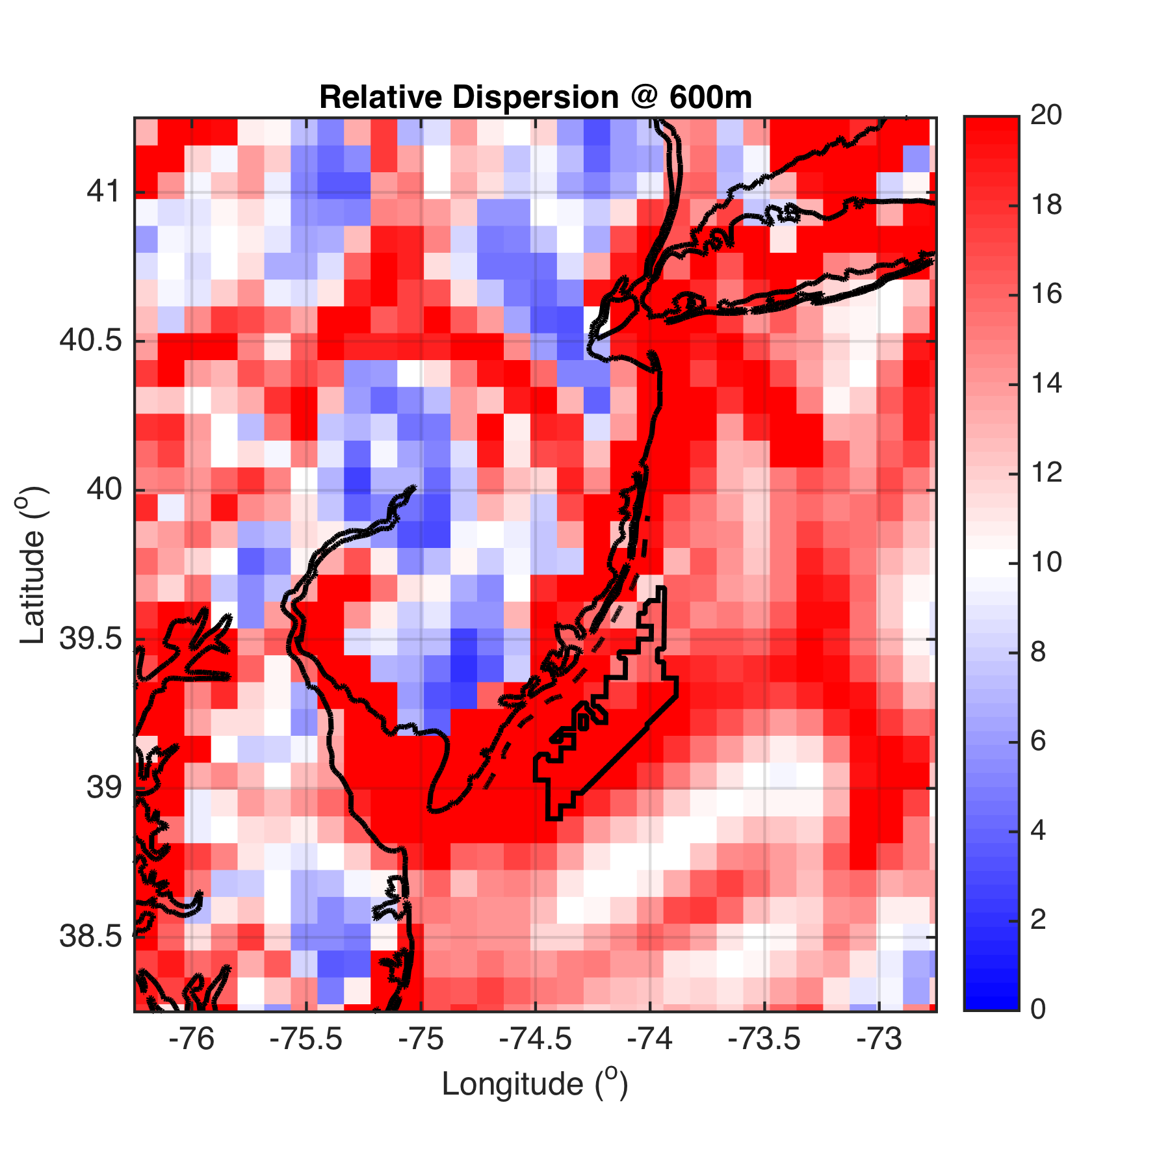
600m

Slide 34
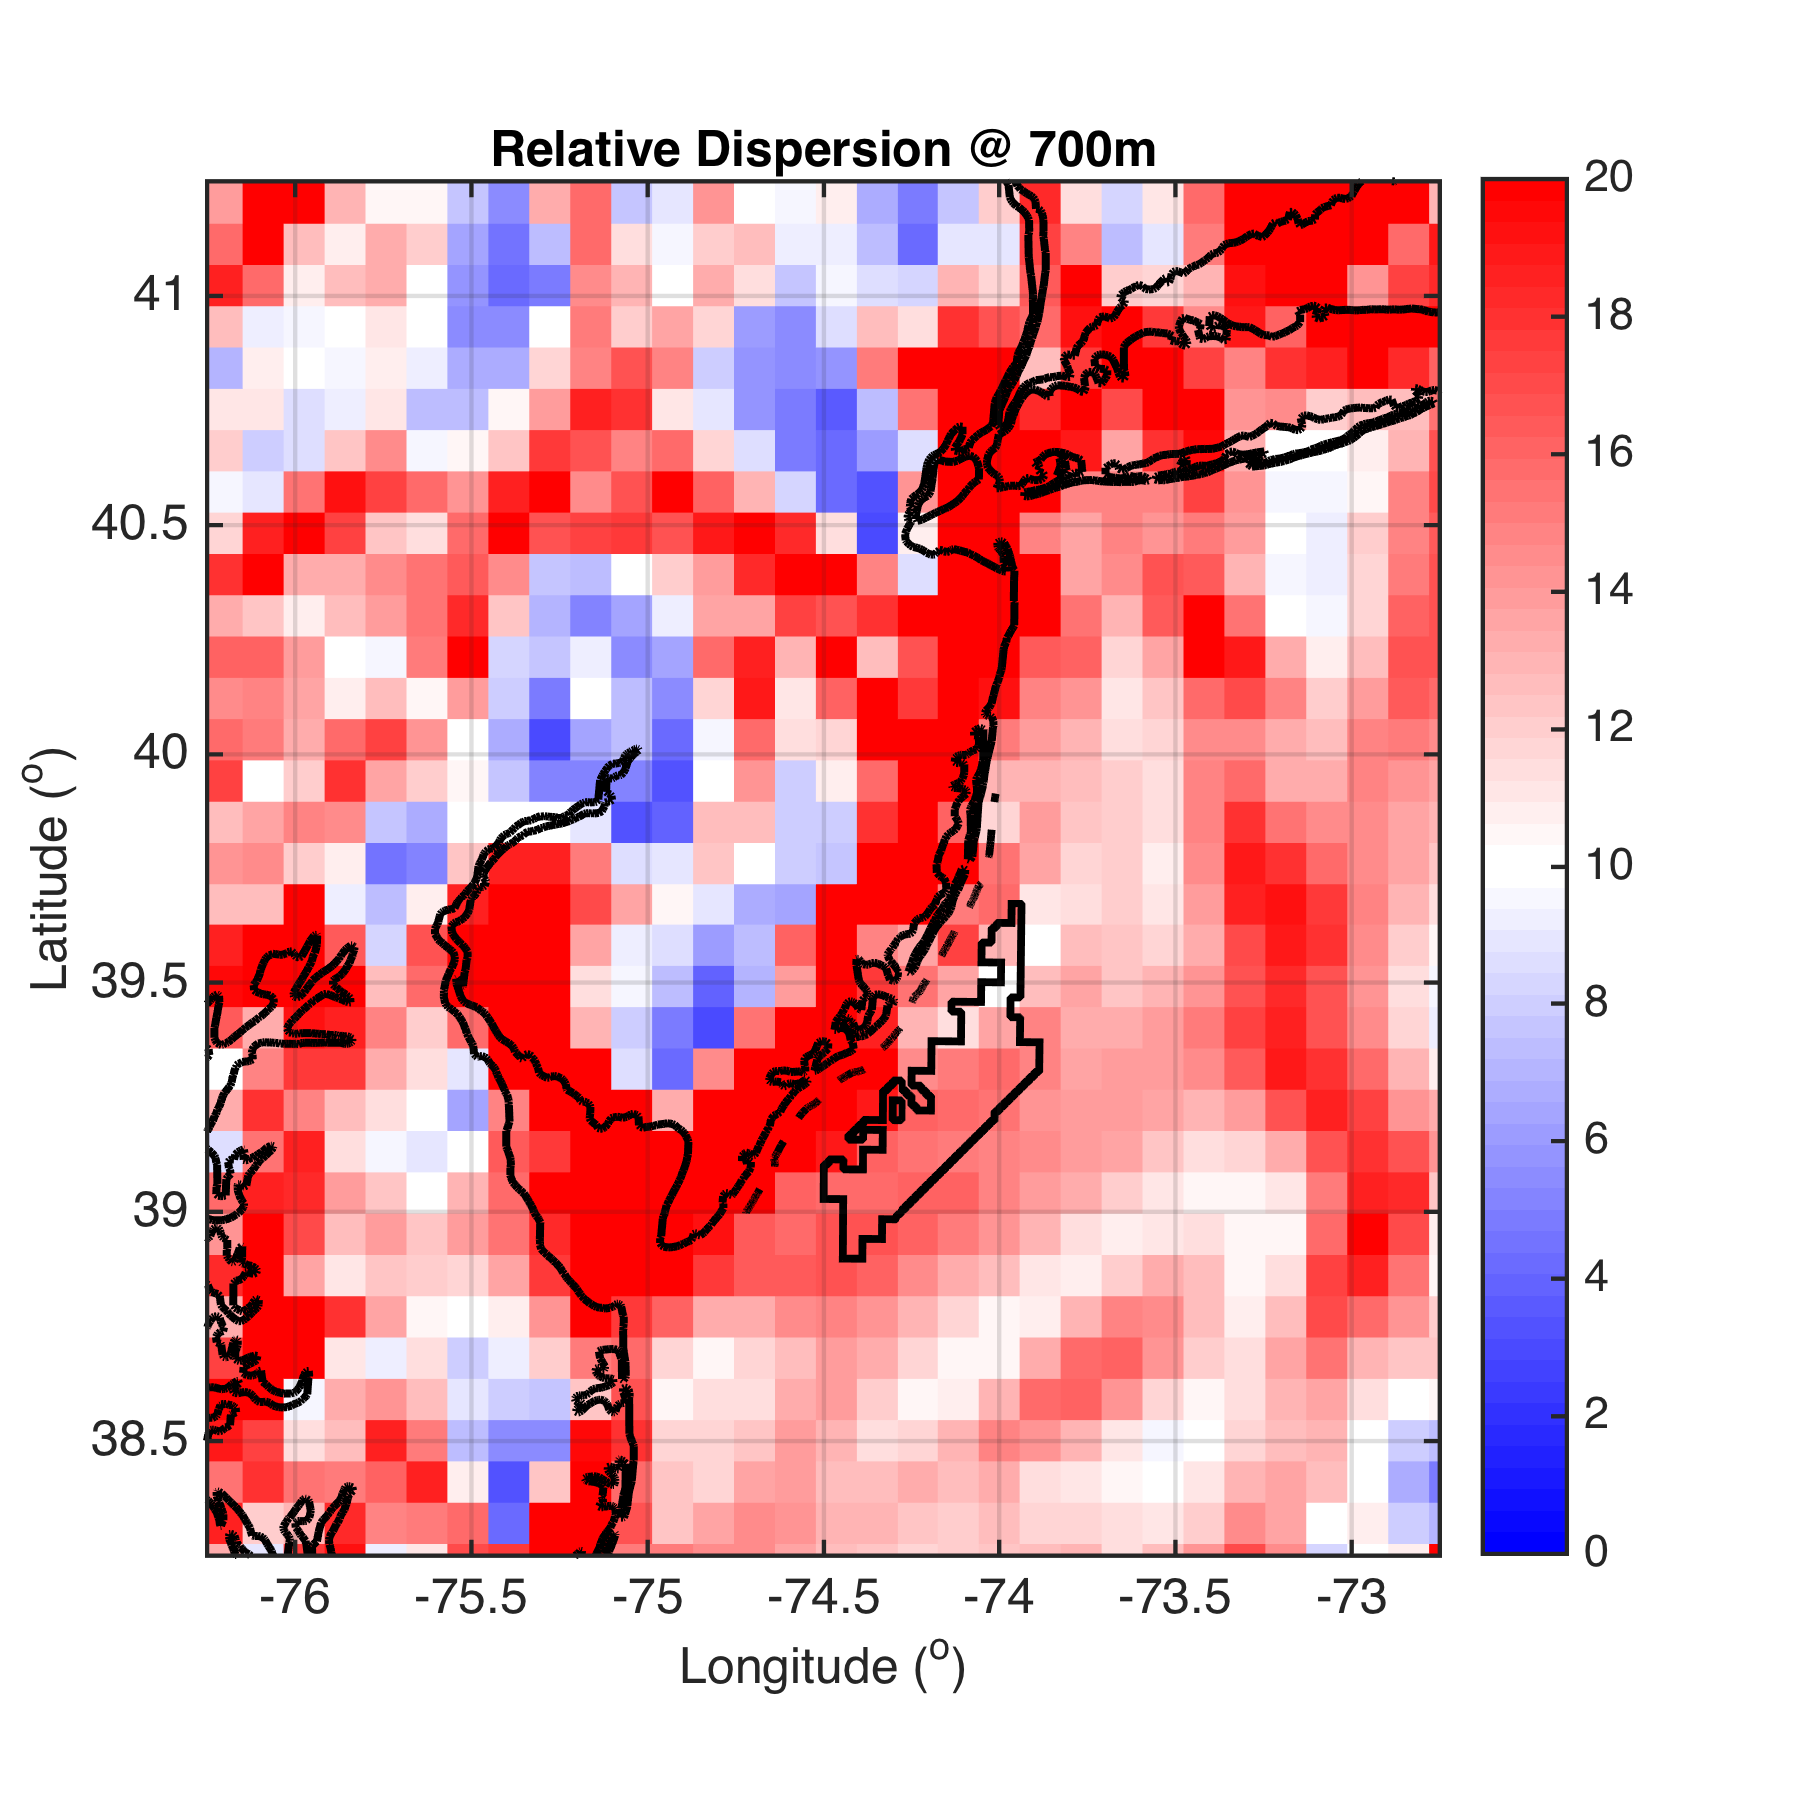
700m

Slide 35
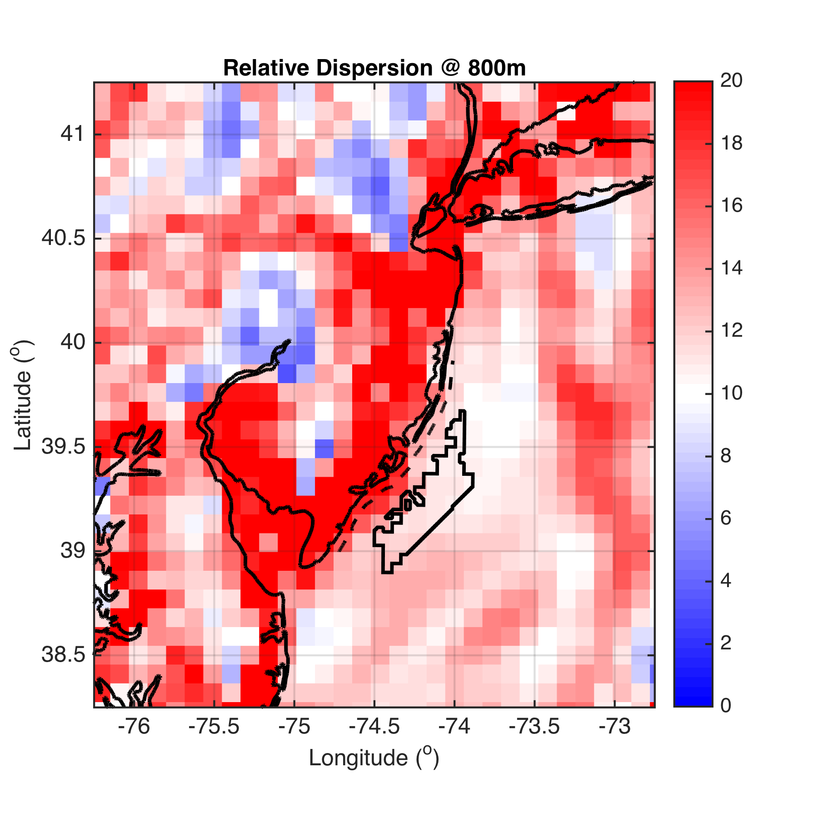
800m

Slide 36
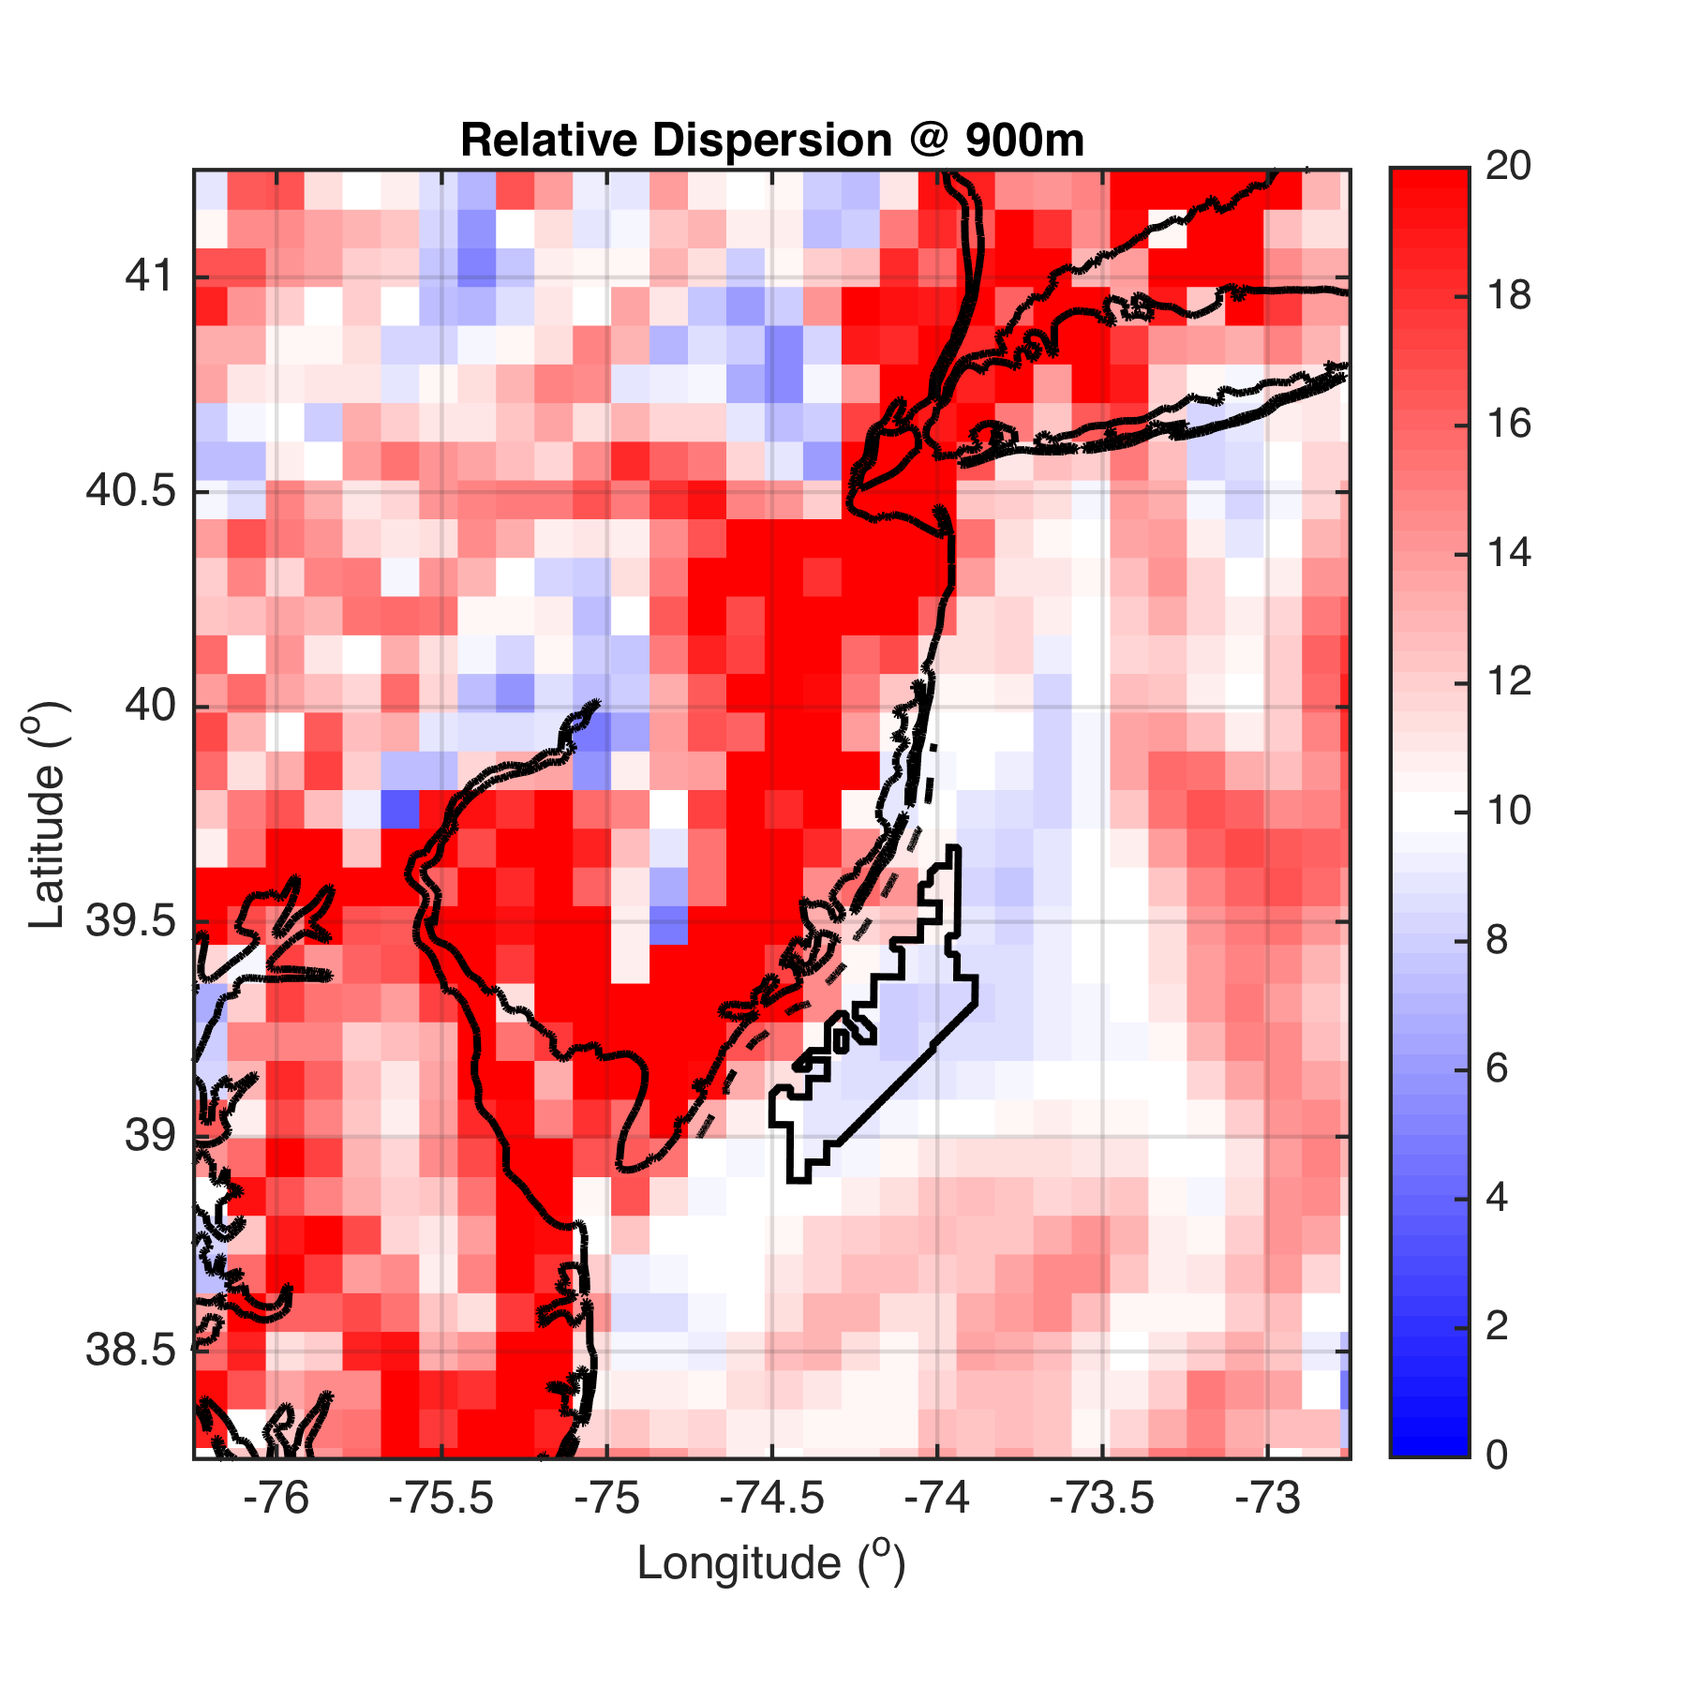
900m

Slide 37
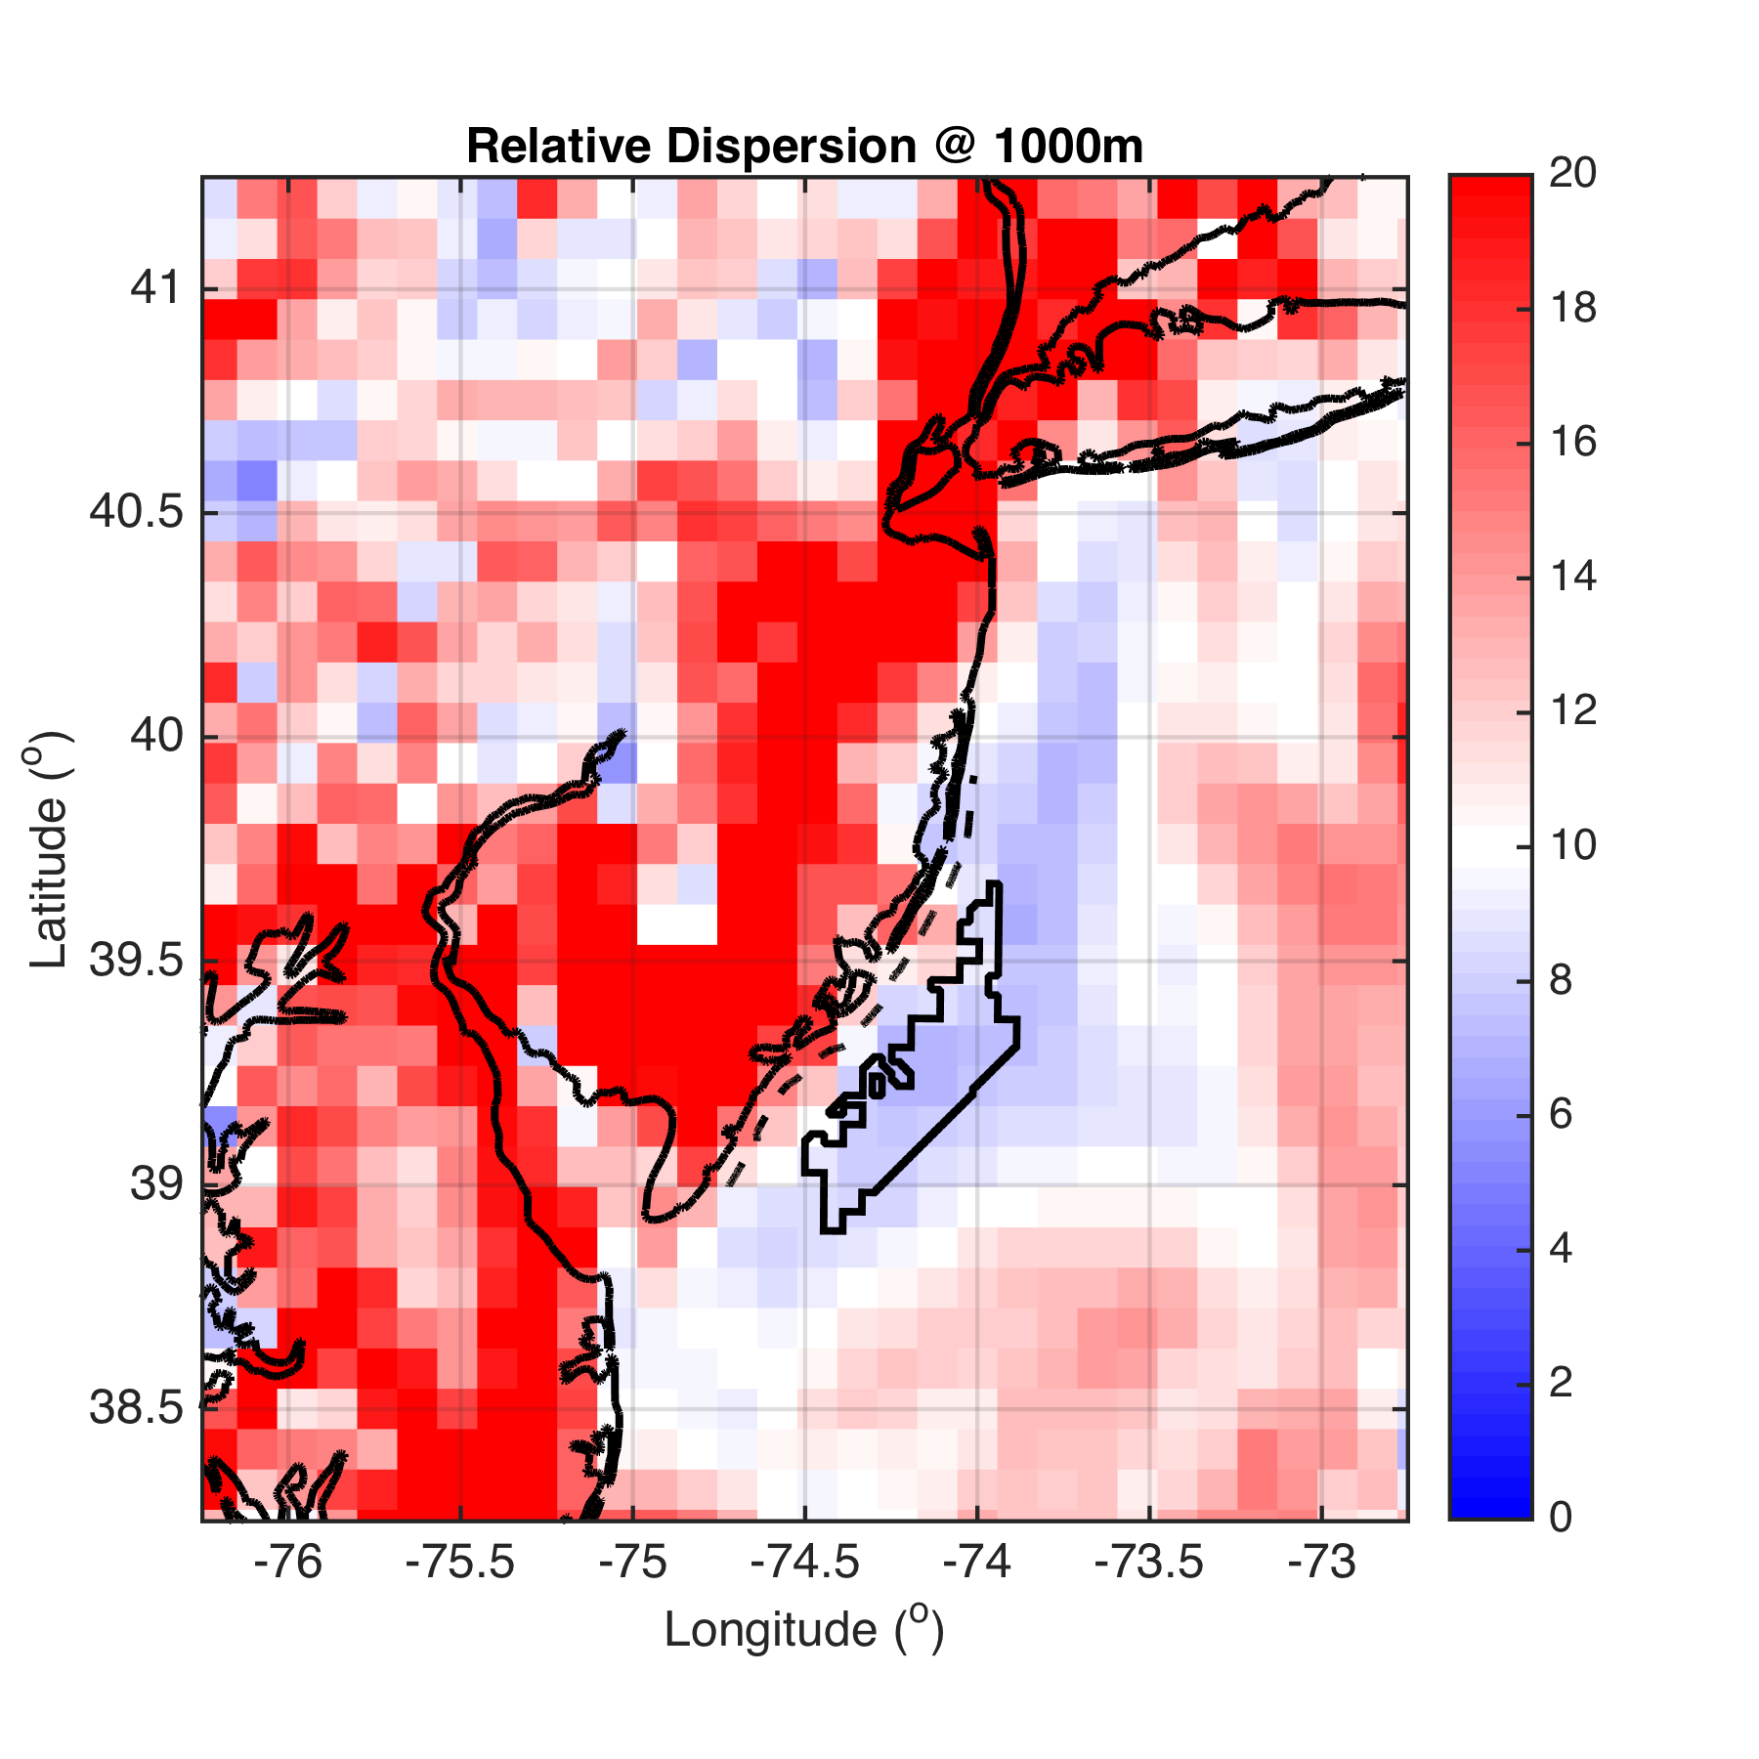
1000m

Slide 38
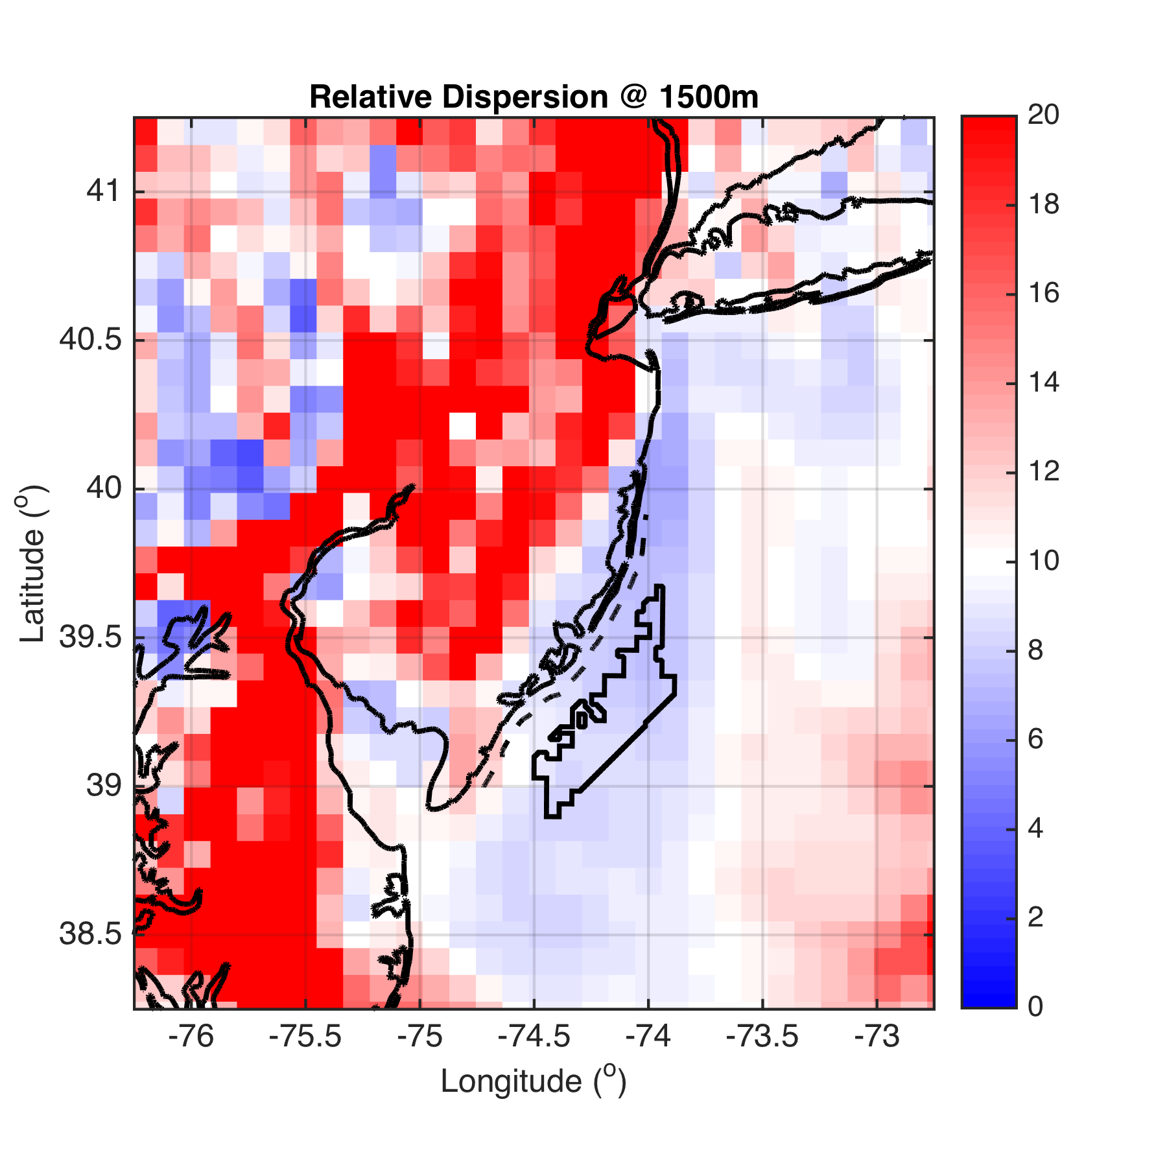
1500m

Slide 39
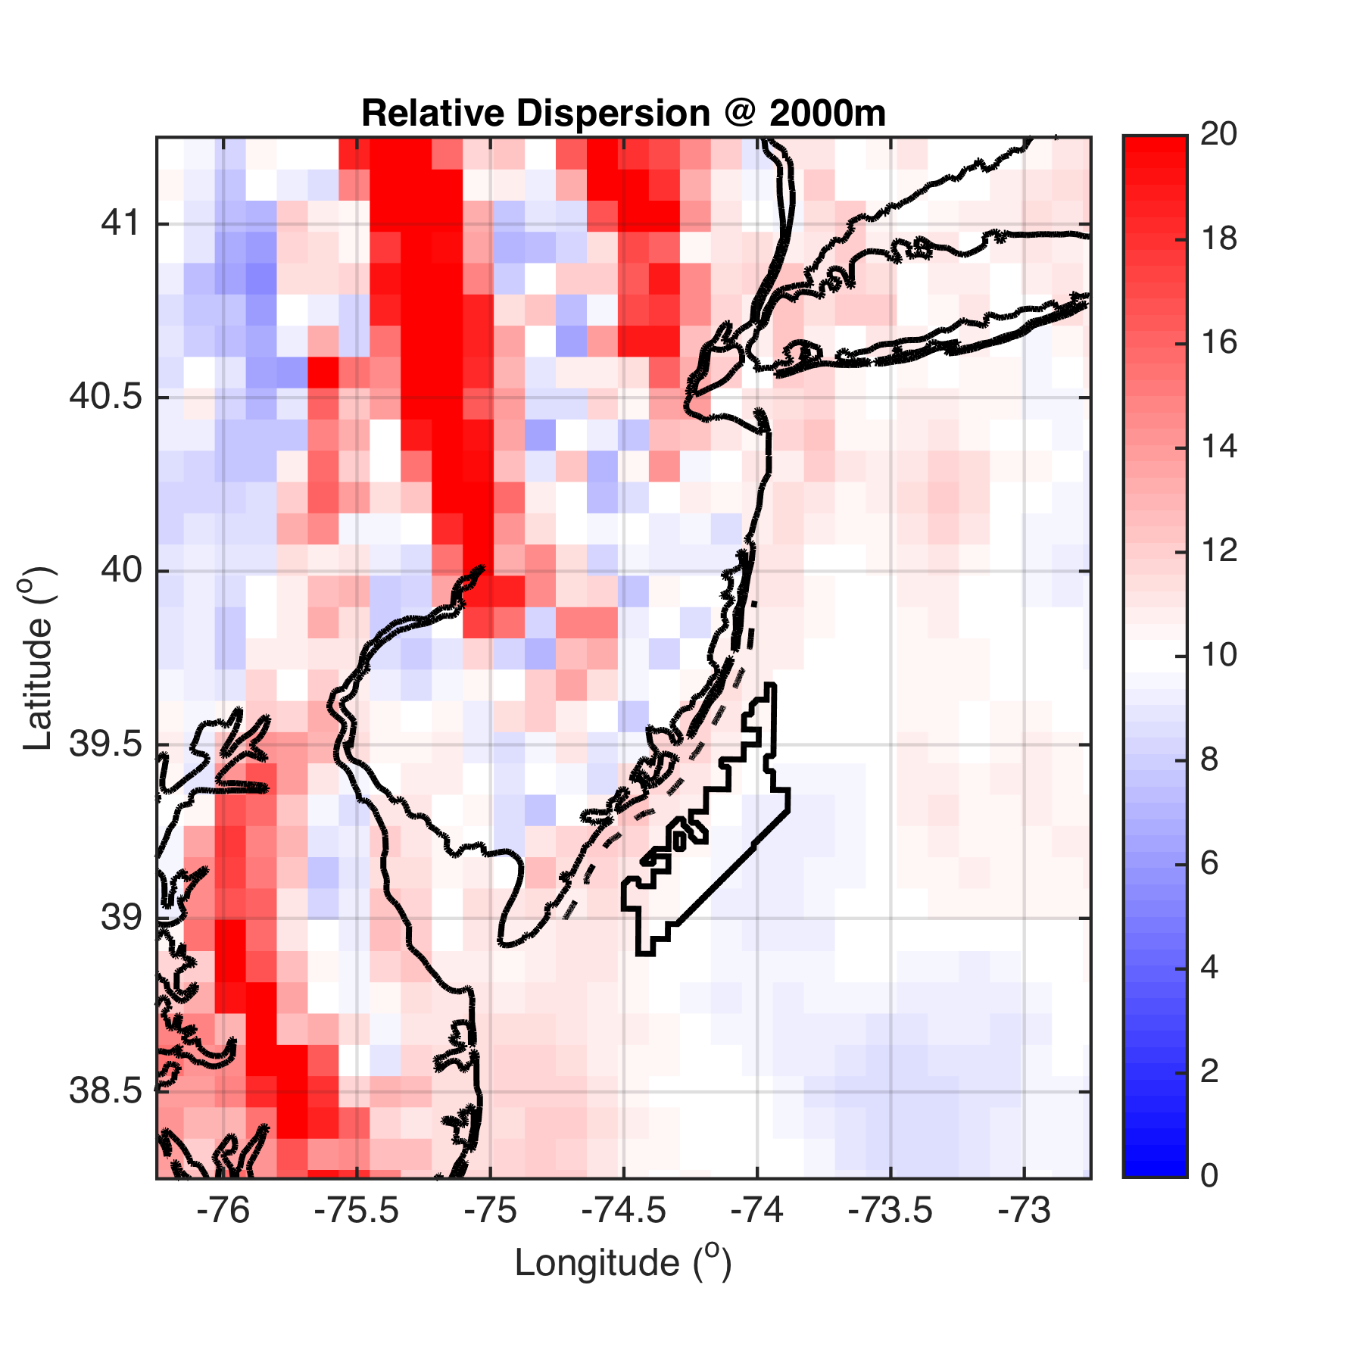
2000m

Slide 40
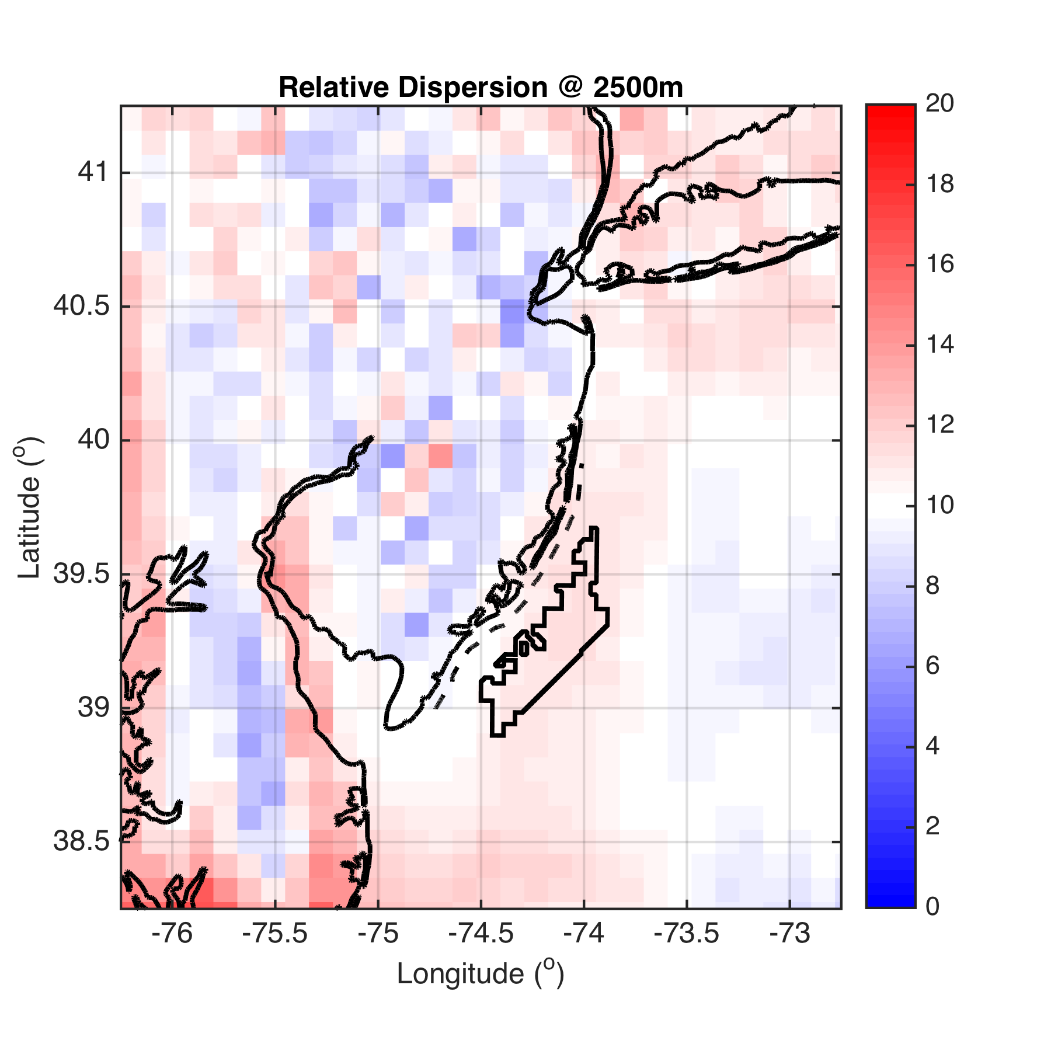
2500m

Slide 41
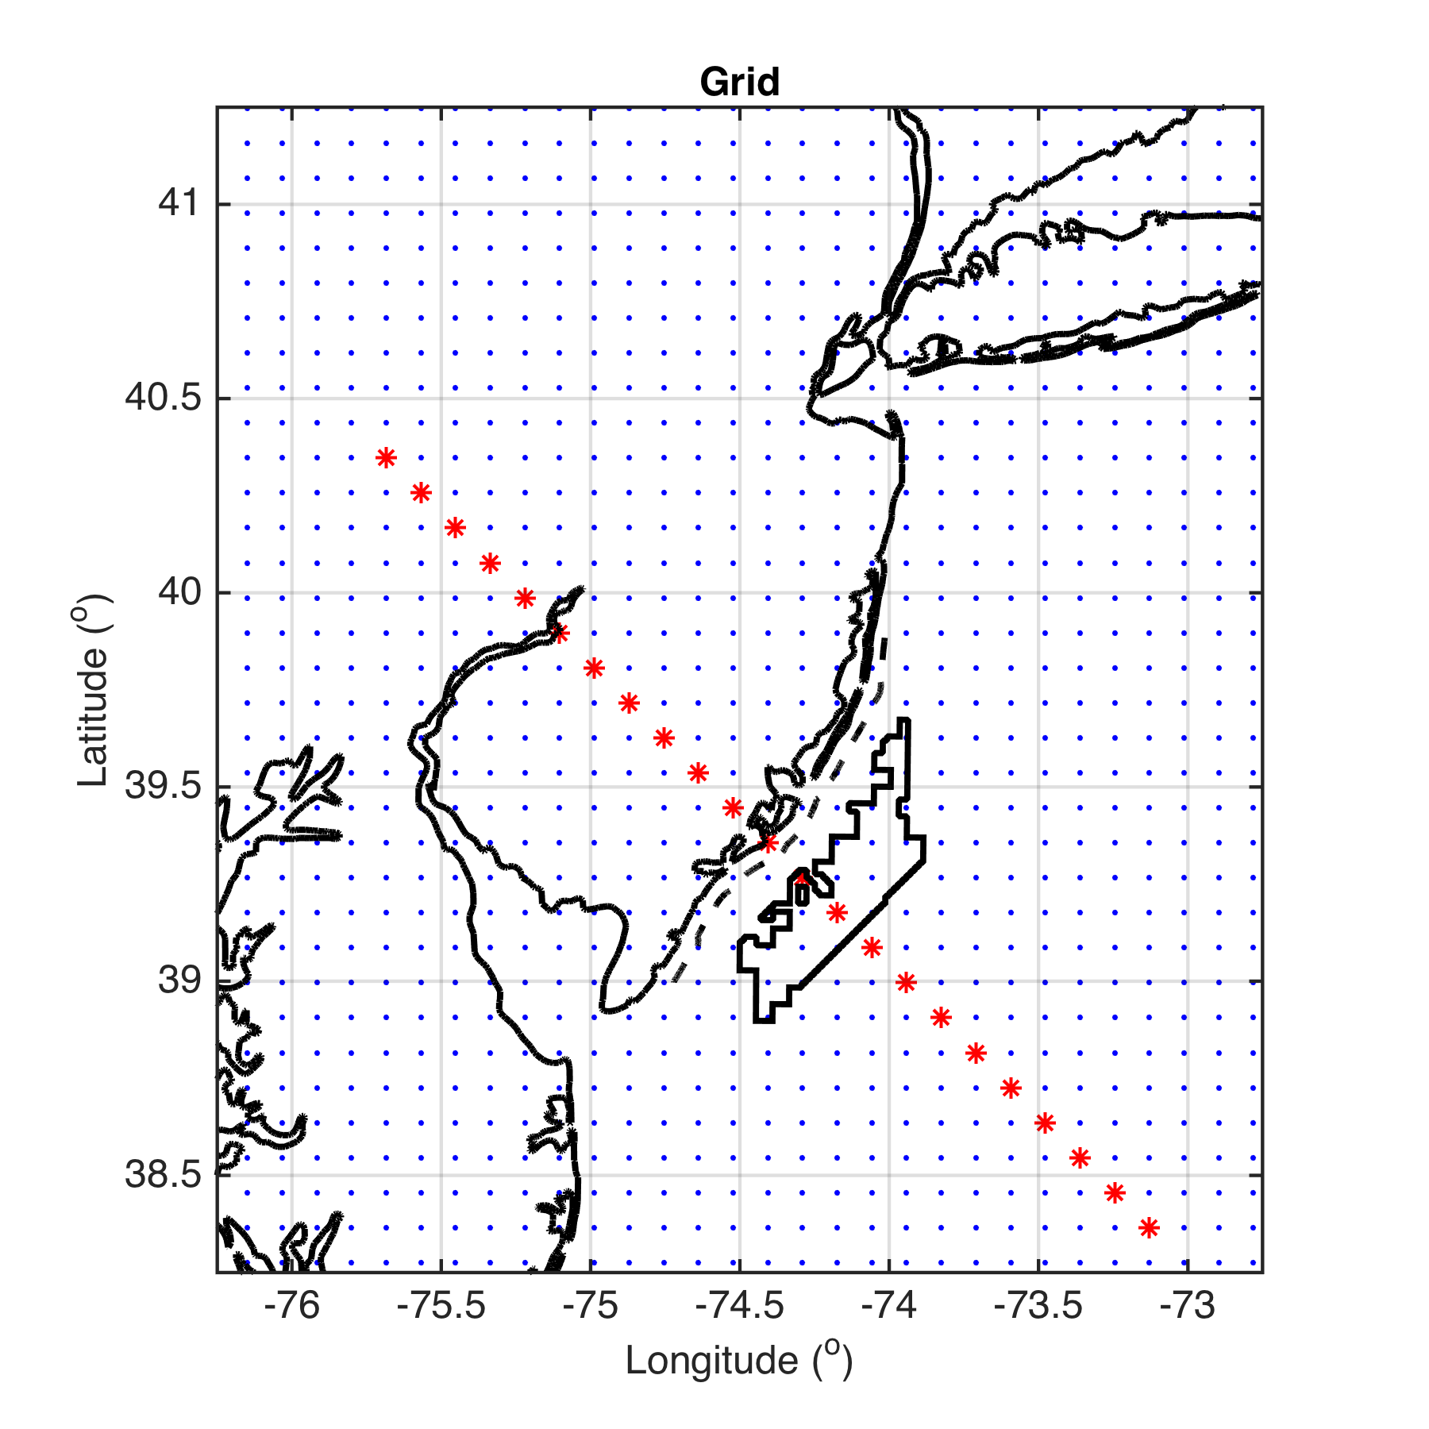
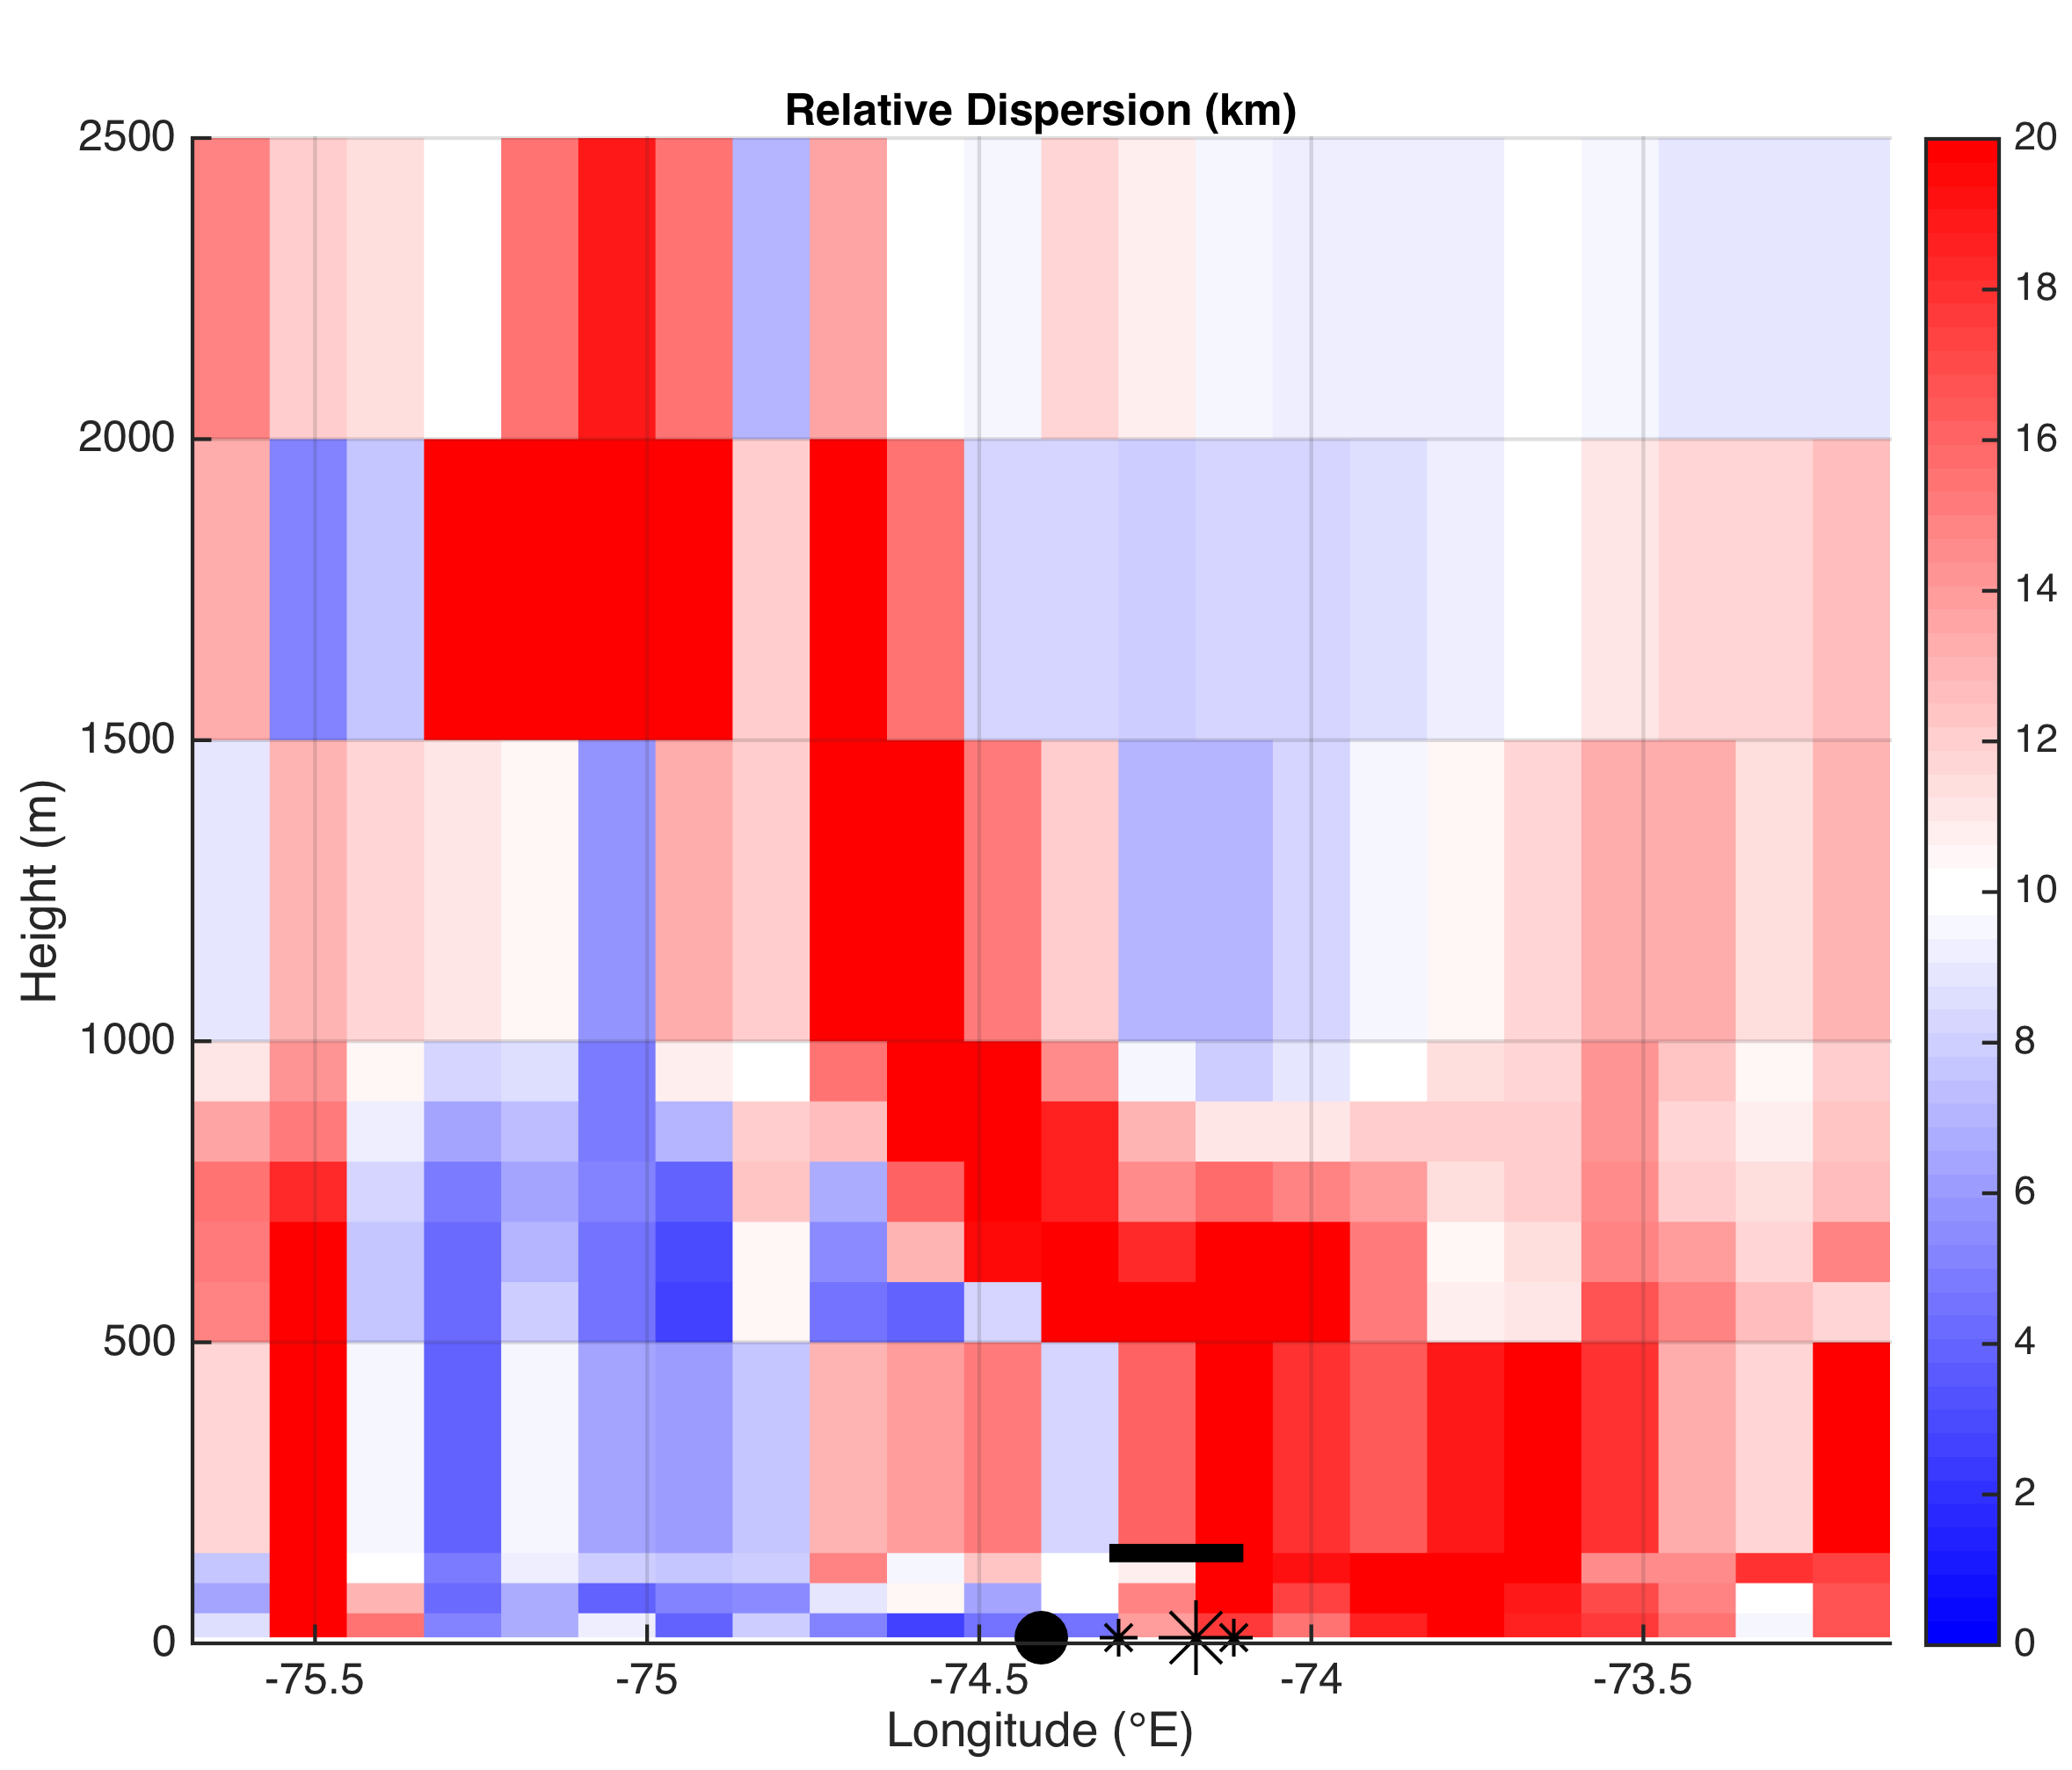
Vertical Cross Section
Top of wind turbine
Coastline
Wind Energy Area
Bounds

Slide 42
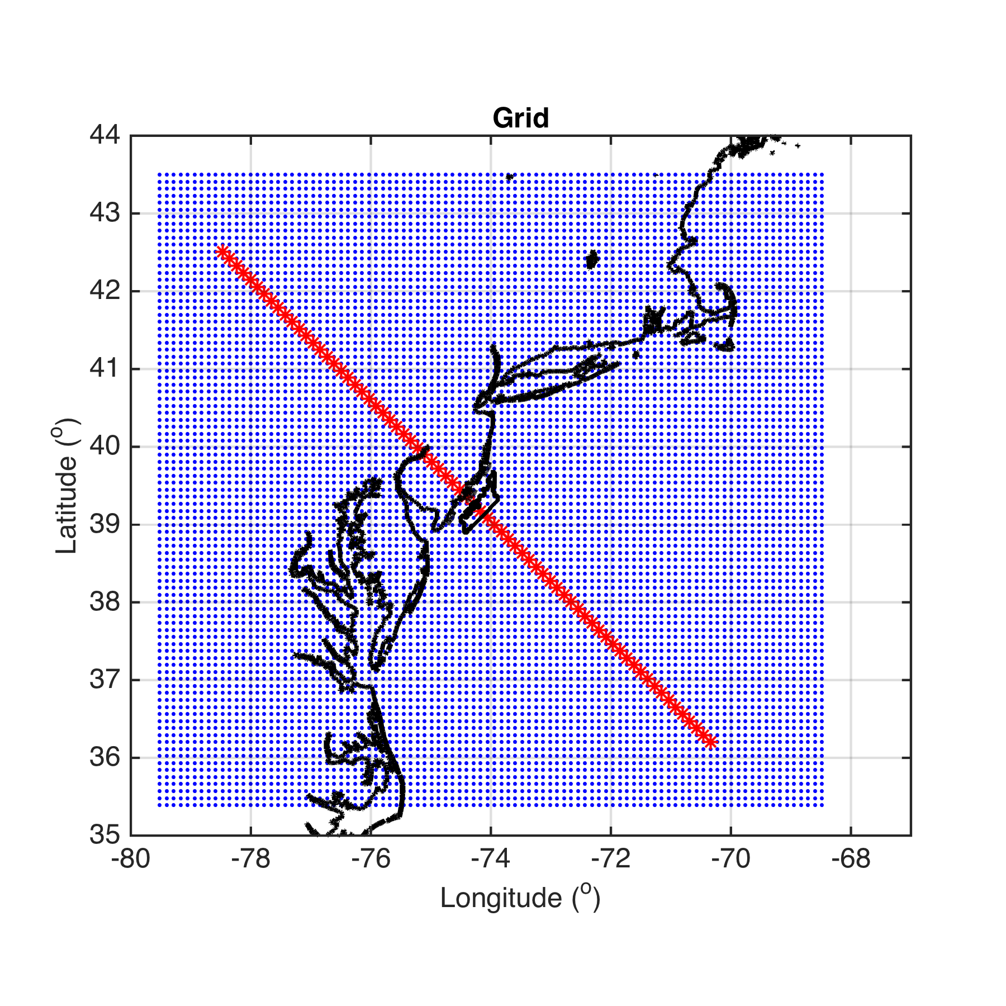
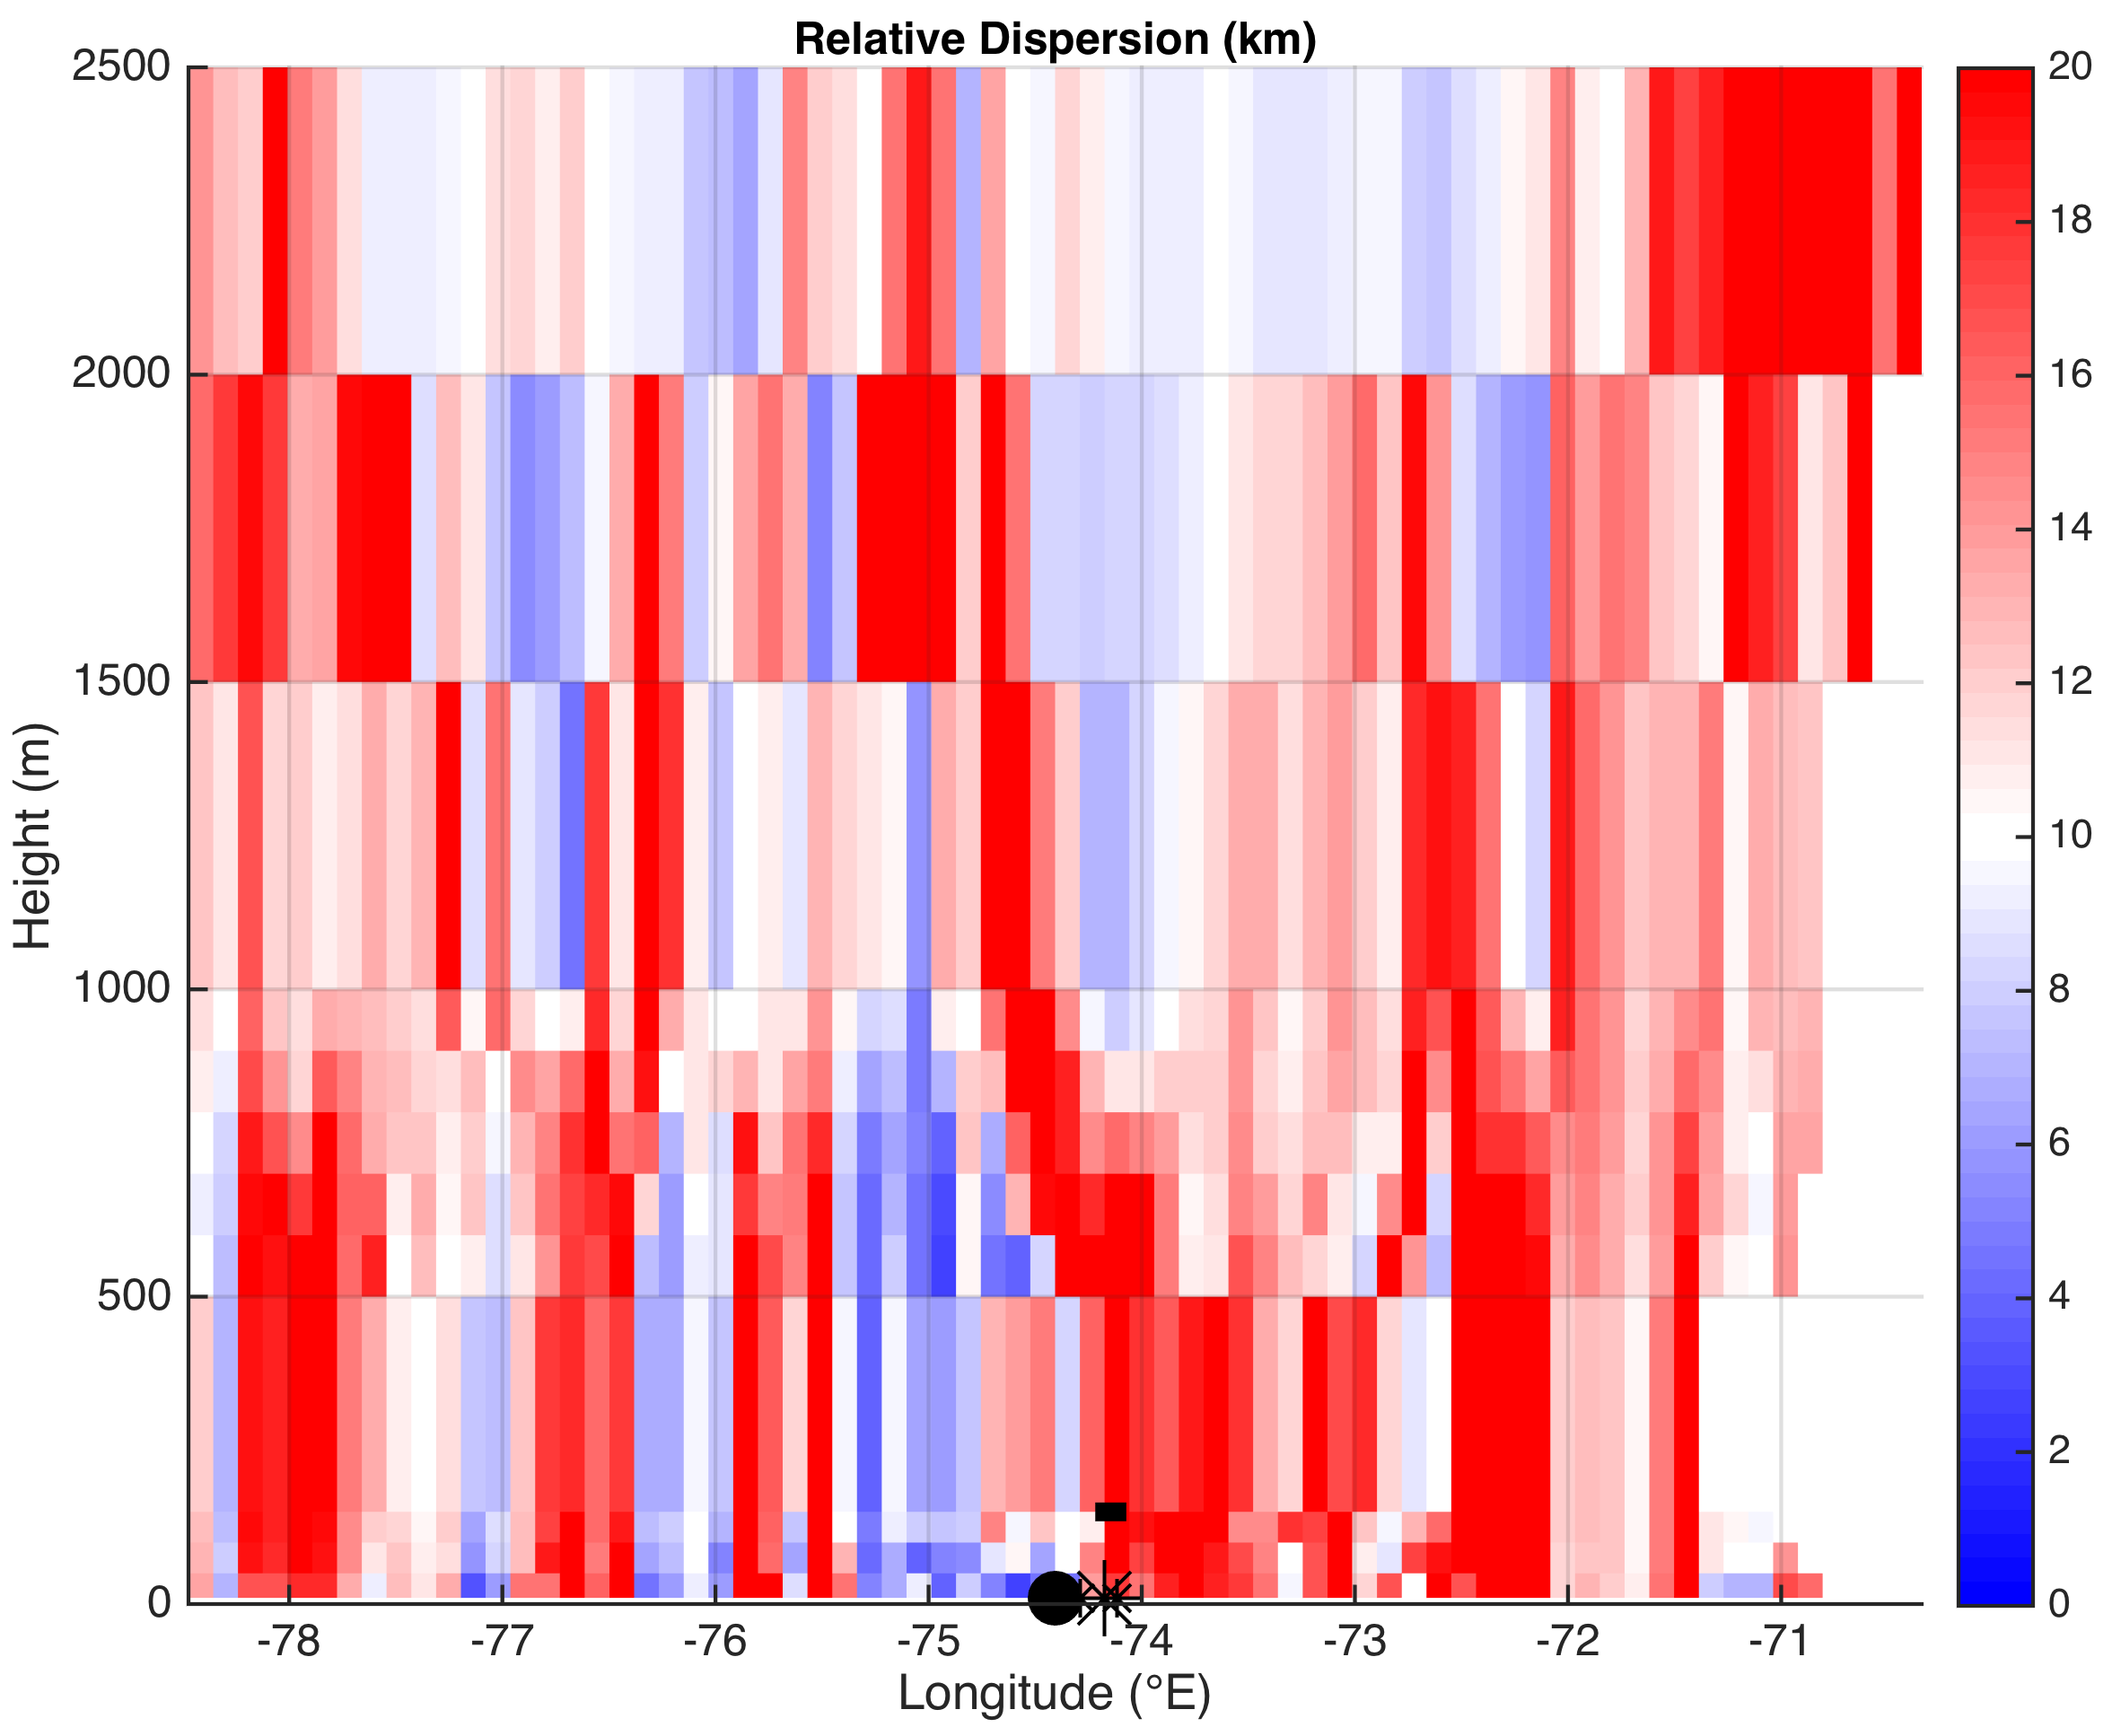
Vertical Cross Section
Top of wind turbine
Coastline
Wind Energy Area
Bounds

Slide 43
Summary of Part 2 Results
Divergence is slanted with height, from surface offshore to aloft onshore (agrees with theory)
Reversal in divergence/convergence, and thus approximate height size of sea breeze cell, similar onshore and offshore
  Offshore:
    Divergence: 10 to ~700m
    Convergence: ~700 to 2000m
  Onshore:
    Convergence: 10 to ~600m
    Divergence: ~600 to 1500m

Slide 44
Future Work
Hourly LCS RD maps
  Divergence aligned with inland frontal progression?
LCS predictive sea breeze index
  e.g. offshore surface divergence, onshore surface convergence→ high enough value to get sea breeze? (quick, efficient forecasting method)
3D LCS
  To account for vertical velocities
  For vertical shear analysis (important for wind turbine engineering)

Slide 45
Thank you!

Slide 46
Extra Slides

Slide 47
Key Questions
Can we use LCS to more clearly identify and characterize (horizontal & vertical extent, duration, timing, etc.) key structures within the sea breeze (areas of divergence and convergence, fronts, return flow, over water subsidence, calm zones, circulation cells)?
More importantly for offshore wind, can we use LCS to detect areas of higher turbulence and wind shear within the sea breeze, especially offshore?

Slide 48
Sea Breeze Cases
Case 01: July 7-8, 2013
  Corkscrew, strong upwelling
Case 02: July 31-August 1, 2014
  Corkscrew, weak upwelling
Case 03: April 27-28, 2013
  Pure, no upwelling
  Pure
  Corkscrew
  Backdoor
  Check 925 mb wind direction for sea breeze type

Slide 49
Sea Breeze Cases
Case 01 and Case 02:
  Results coming soon
Case 03: April 27-28, 2013
  Pure, no upwelling
  Results presented here
  Pure
  Corkscrew
  Backdoor
  Check 925 mb wind direction for sea breeze type

Slide 50
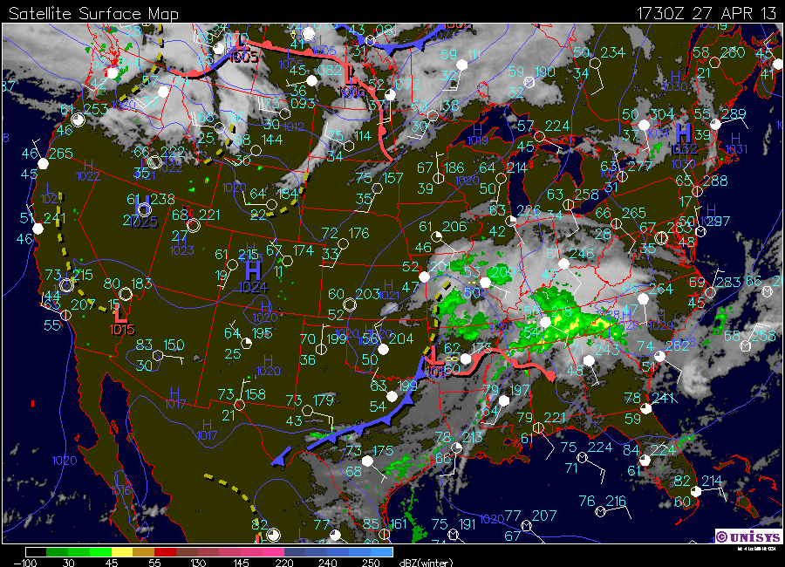
Case 03: April 27-28, 2013

Slide 51
WRF Setup
WRF-ARW 3.6.1
3km outer nest, 600m inner nest
North American Mesoscale (NAM) initial and boundary conditions
YSU PBL
  Best PBL scheme for offshore 2m T in UK, no difference for offshore winds (Steele et al 2013)
MM5 Monin-Obukhov surface layer

Slide 52
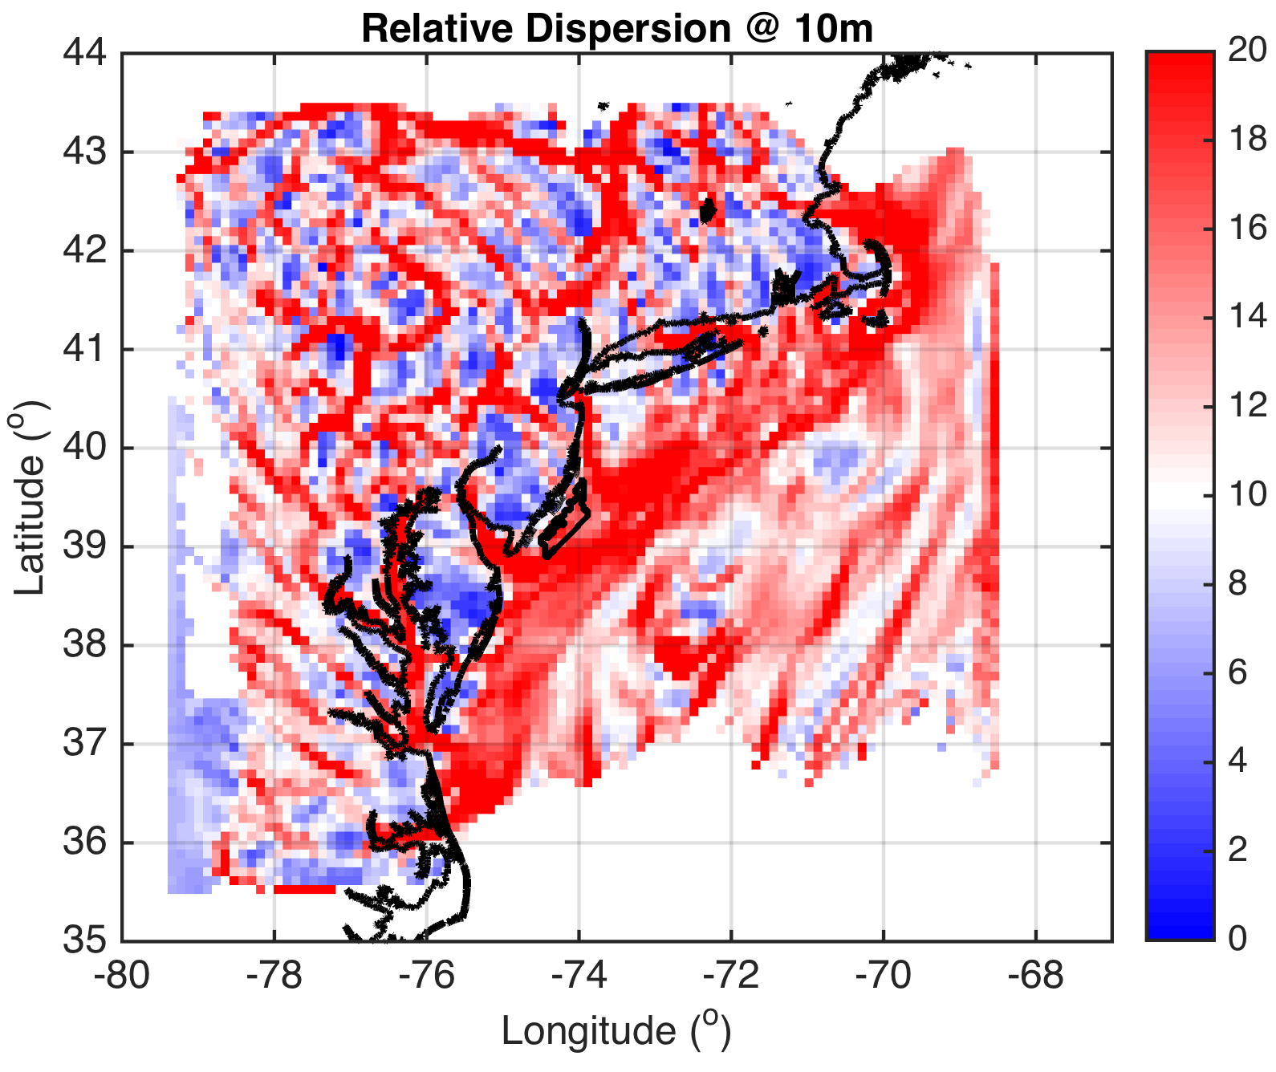


Why is RD heterogenous onshore and homogeneous offshore?

Slide 53
Therefore, speed of sea breeze front is nearly constant between 1900 and 2200 UTC
LCS linear interpolation assumption is valid→will gather hourly LCS output to determine temporal evolution of LCS

Slide 54
More Future Work
Offshore sea breeze extent (i.e. calm zone propagation offshore) sensitivity to PBL scheme?
  YSU 21km, MYNN 0km offshore for one pure sea breeze case (Steele et al 2013)
Apply LCS to scanning LIDAR winds
  Combine with WRF to get back (LIDAR) and forward (WRF) trajectories for real-time structure detection and automated turbulence and wind shear warning system for offshore wind

