Slide 1
Sea Breeze and Lagrangian Coherent Structures (LCS)
Greg Seroka
Erick Fredj
9/10/2015

Slide 2
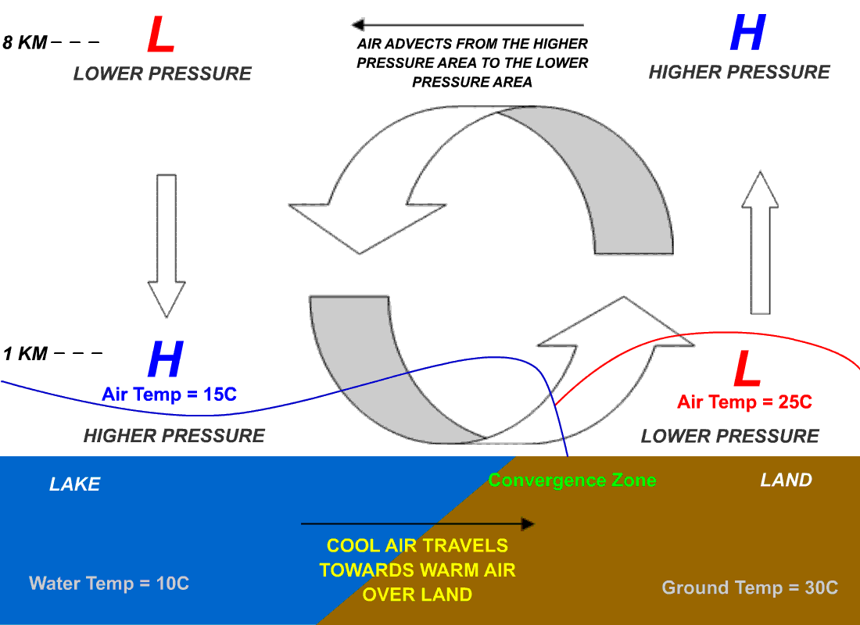
Causes and Circulation
Or Ocean
Notes:
The sea has greater heat capacity than land, so surface of sea warms up more slowly than land’s surface. As temperature of the surface of the land rises, the land heats the air above it by convection. The warm air is less dense so it expands, decreasing the pressure over the land near the coast. The air above the sea has a relatively higher pressure, causing air near the coast to flow towards the lower pressure over land.
If strong offshore wind is present, that is, a wind greater than 8 knots, and opposing the direction of a possible sea breeze, the sea breeze is not likely to develop.

Slide 3
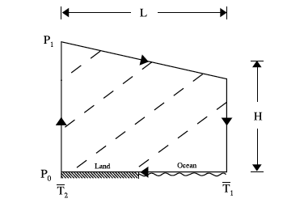
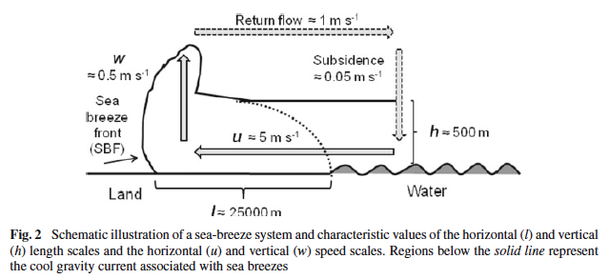
Causes and Circulation
Or Ocean
Notes:
The sea has greater heat capacity than land, so surface of sea warms up more slowly than land’s surface. As temperature of the surface of the land rises, the land heats the air above it by convection. The warm air is less dense so it expands, decreasing the pressure over the land near the coast. The air above the sea has a relatively higher pressure, causing air near the coast to flow towards the lower pressure over land.
If strong offshore wind is present, that is, a wind greater than 8 knots, and opposing the direction of a possible sea breeze, the sea breeze is not likely to develop.

Slide 4
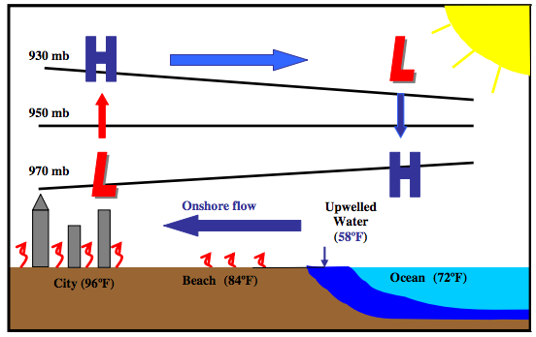
Modifications
Coastal upwelling
Prolonged winds from southwesterly sector off NJ leads to upwelling
Spatial extent of sea breeze may not be as large

Slide 5
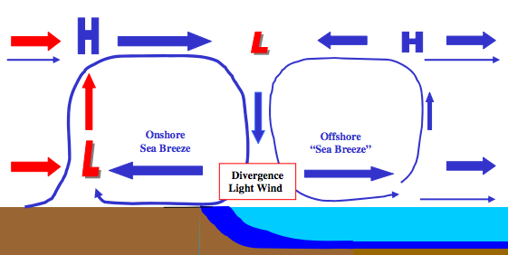
Modifications
Coastal upwelling + Sea breeze Hypothesis
Cold upwelling
Does this occur? With or without upwelling?

Slide 6
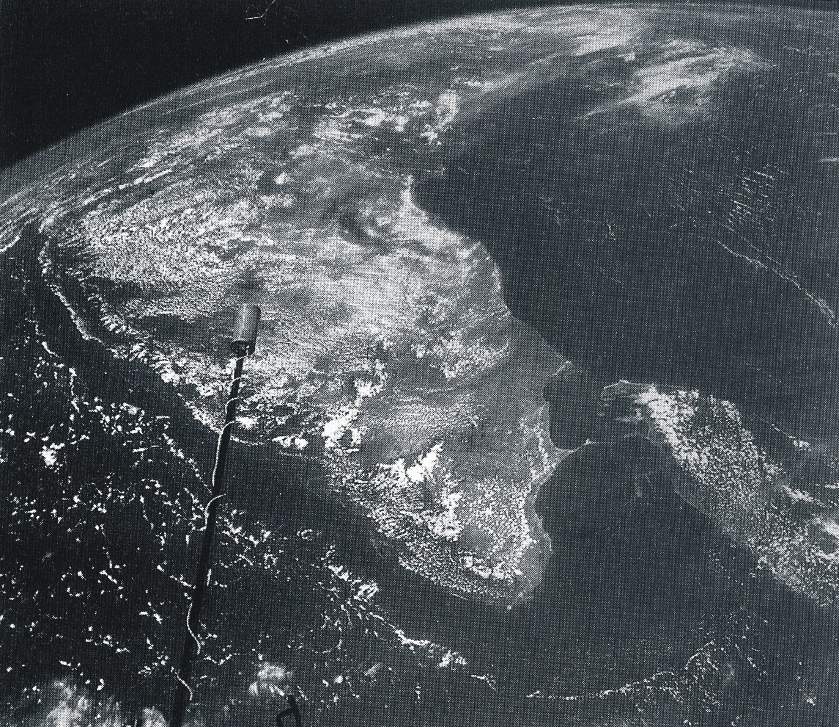
Offshore Extent of the Sea Breeze
Picture of India taken by Gemini XI in 1966
Cloudless area offshore has stable, sinking
air due to the
sea breeze circulation
Offshore extent of the sea breeze is 2-3 times the inland penetration of the sea breeze front
(Simpson, 1994; and many others)

Slide 7
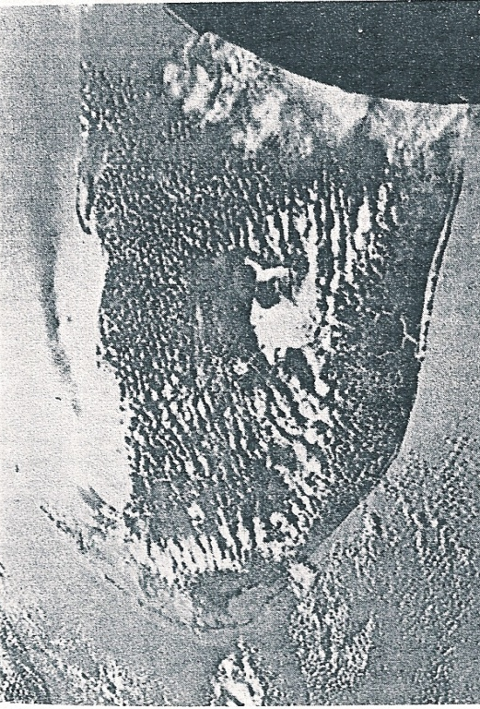
Offshore Extent of the Sea Breeze
Picture of Florida taken by Gemini XII in 1966
Sea breezes are occurring along both the east and west Florida coast
Lack of sunglint off of the calm ocean surface is seen in a dark strip off the west coast as the smooth ocean surface scatters less reflected light
The smooth surface is indicative of calm winds and divergent winds with little wave activity at the offshore edge of the sea breeze
(Fett and Tag, 1984)

Slide 8
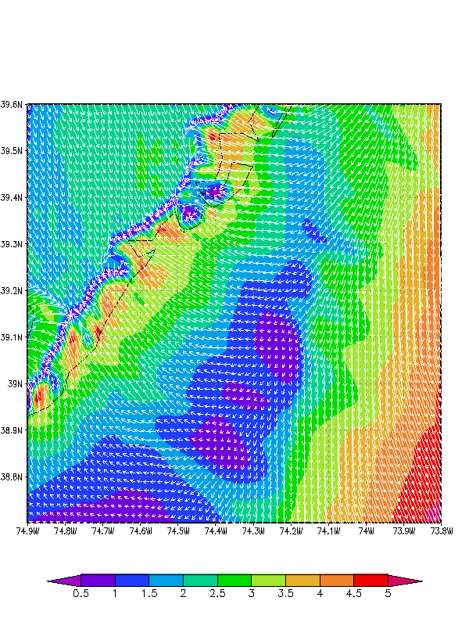
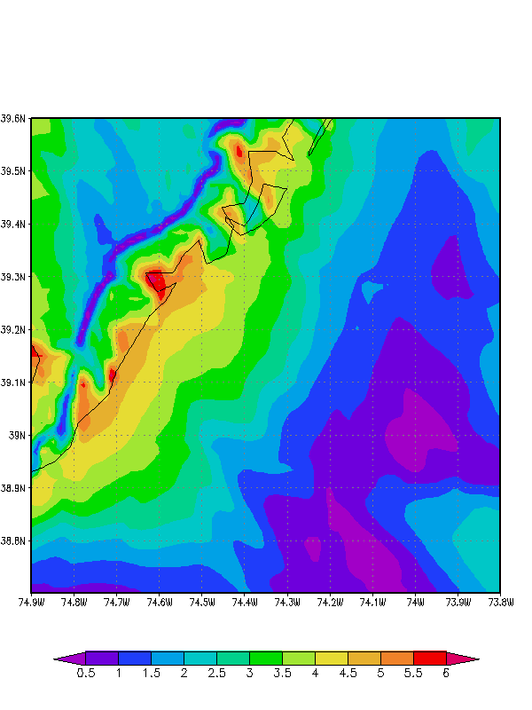
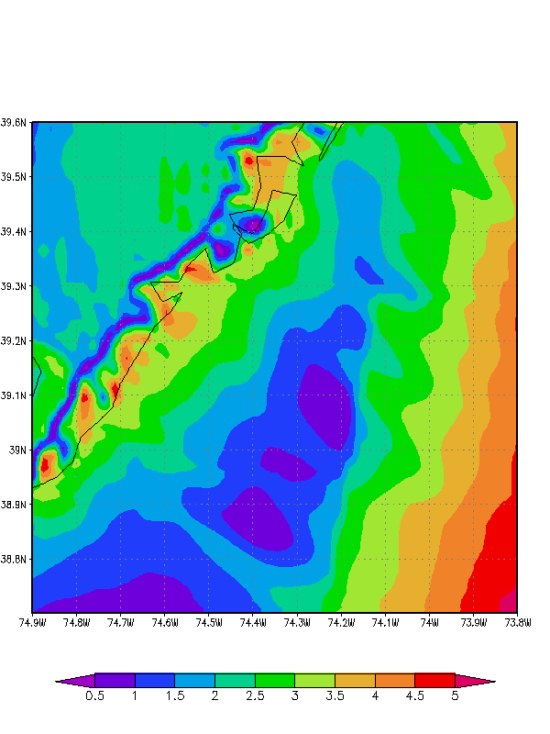
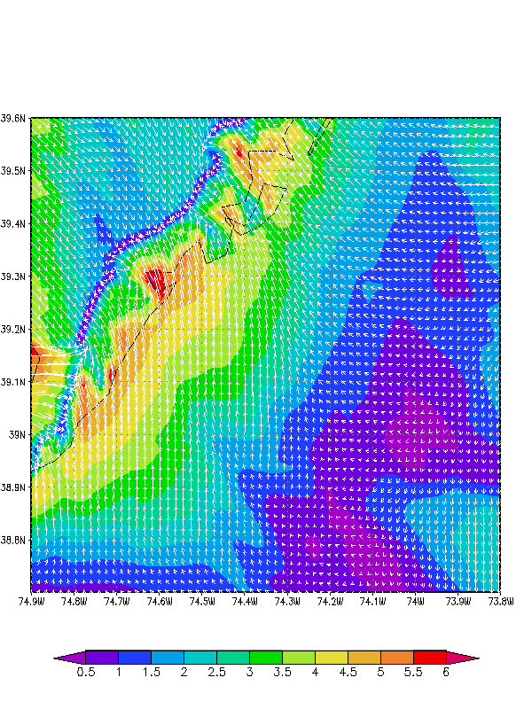
Offshore Extent of the Sea Breeze
Offshore Divergence Zone WRF Case: April 16, 2004 Winds (m/s, shaded)
April 16, 2004 1800 GMT
April 16, 2004 2000 GMT
Moved east

Slide 9
Benefits of LCS Notes from “Lagrangian Coherent Structure Analysis of Terminal Winds Detected by Lidar, Parts I and II”
The Lagrangian measures are advantageous as they are frame independent and robust with respect to localized noise in the data.
Additionally, LCS analysis reveals coherent structures in more detail and with better clarity than streamline plots generated from the two-dimensional wind retrieval (Chan and Shao 2007; Tang et al. 2011).

Slide 10
Key Questions
Can we use LCS to more clearly identify and characterize (horizontal & vertical extent, duration, timing, etc.) key structures within the sea breeze (areas of divergence and convergence, fronts, return flow, over water subsidence, calm zones, circulation cells)?
More importantly for offshore wind, can we use LCS to detect areas of higher turbulence and wind shear within the sea breeze, especially offshore?

Slide 11
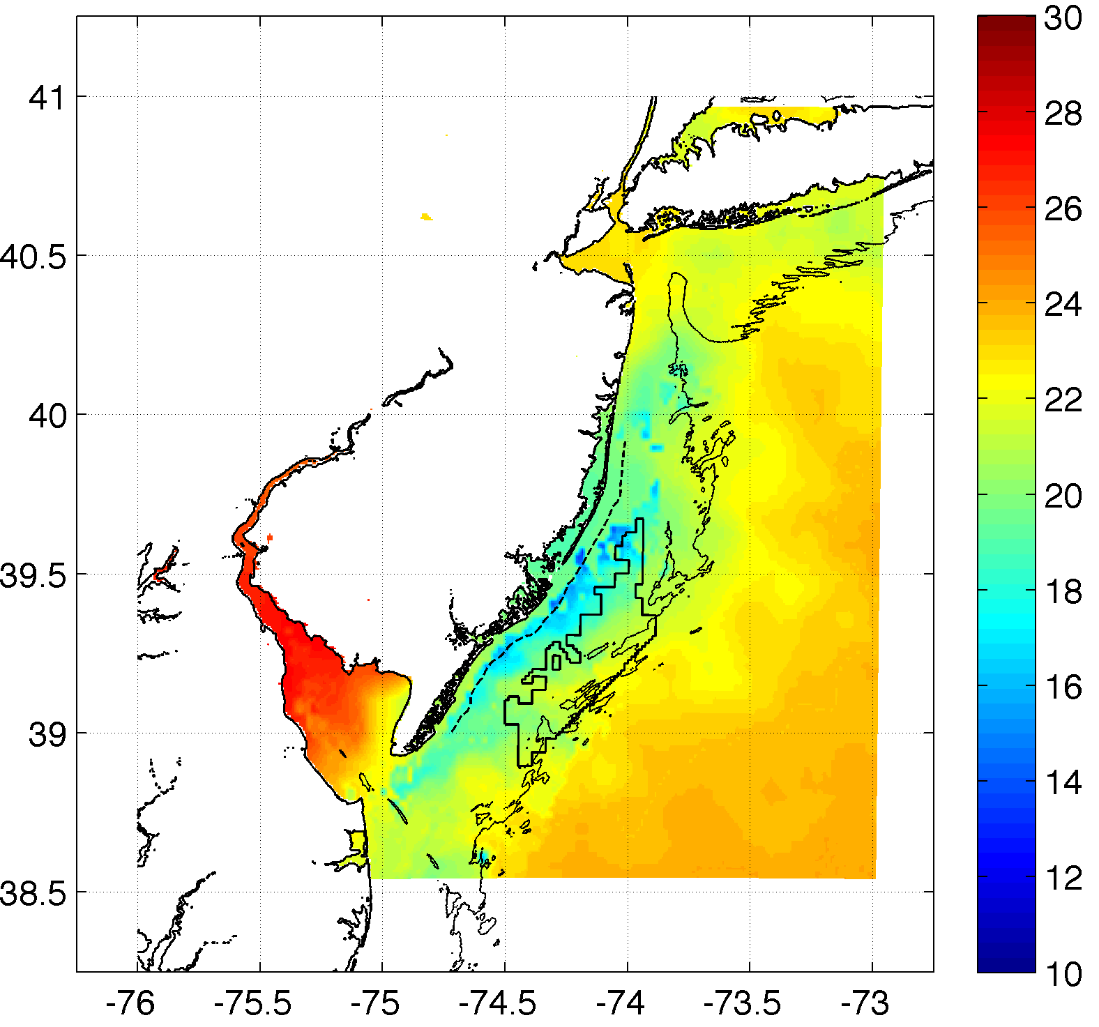
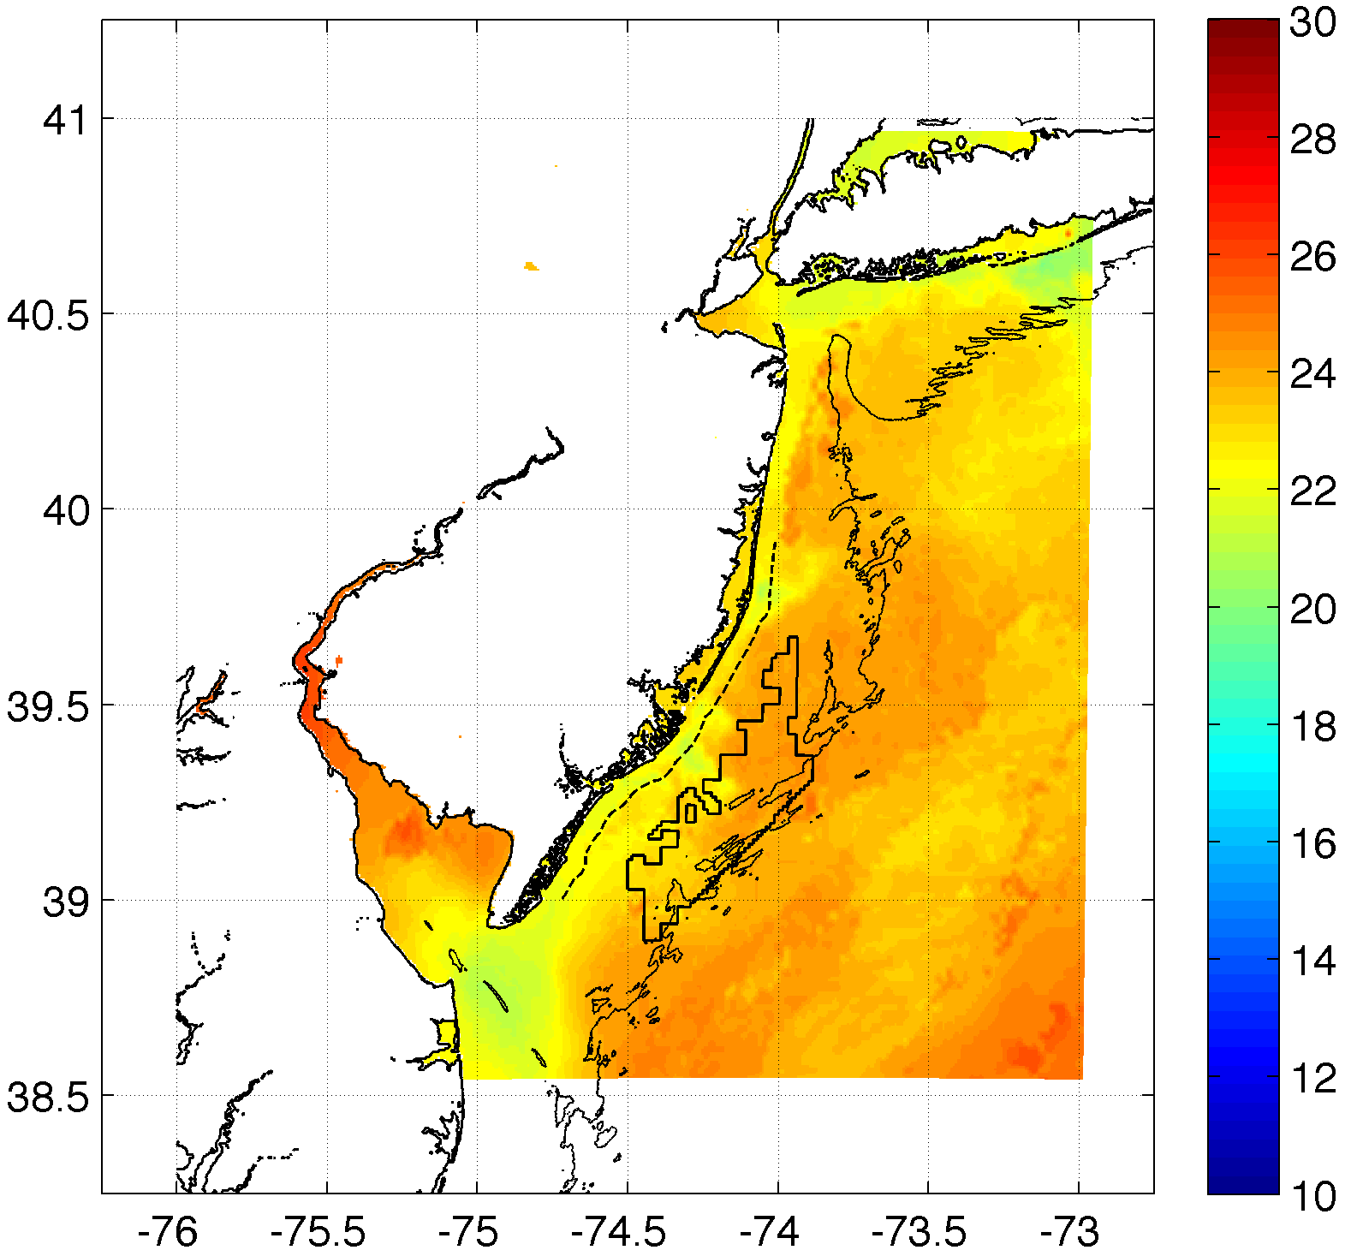
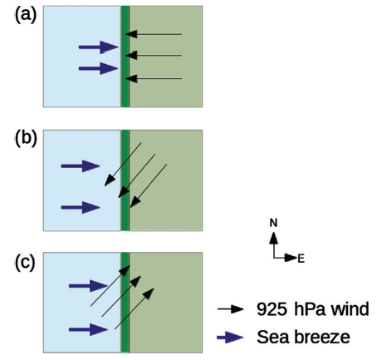
Sea Breeze Cases
Case 01: July 7-8, 2013
Corkscrew, strong upwelling
Case 02: July 31-August 1, 2014
Corkscrew, weak upwelling
Case 03: April 27-28, 2013
Pure, no upwelling
Pure
Corkscrew
Backdoor
Check 925 mb wind direction for sea breeze type

Slide 12
Sea Breeze Cases
Case 01 and Case 02:
Results coming soon
Case 03: April 27-28, 2013
Pure, no upwelling
Results presented here
Pure
Corkscrew
Backdoor
Check 925 mb wind direction for sea breeze type

Slide 13
Sea Breeze Cases
Case 01 and Case 01:
Results coming soon
Case 03: April 27-28, 2013
Pure, no upwelling
Results presented here
Pure
Corkscrew
Backdoor
Check 925 mb wind direction for sea breeze type

Slide 14
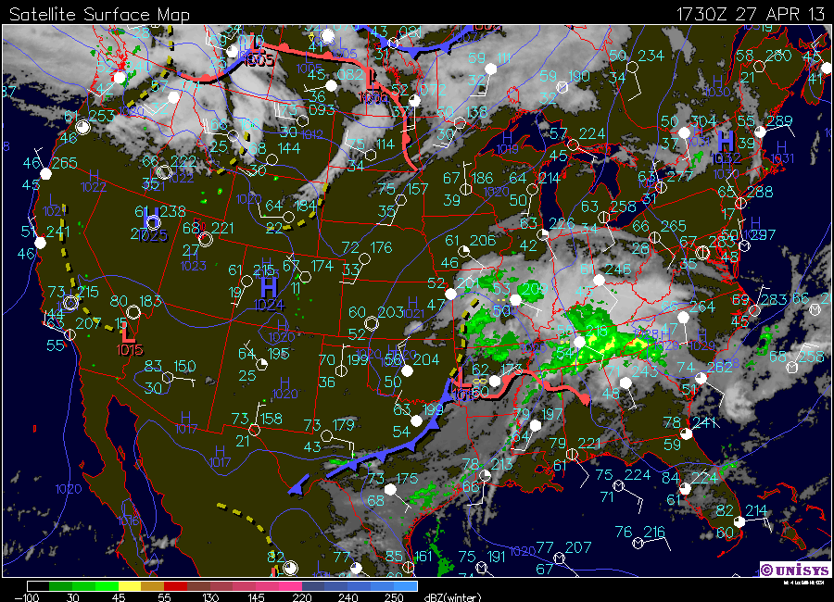
Case 03: April 27-28, 2013

Slide 15
WRF Setup
WRF-ARW 3.6.1
3km outer nest, 600m inner nest
North American Mesoscale (NAM) initial and boundary conditions
YSU PBL
Best PBL scheme for offshore 2m T in UK, no difference for offshore winds (Steele et al 2013)
MM5 Monin-Obukhov surface layer

Slide 16
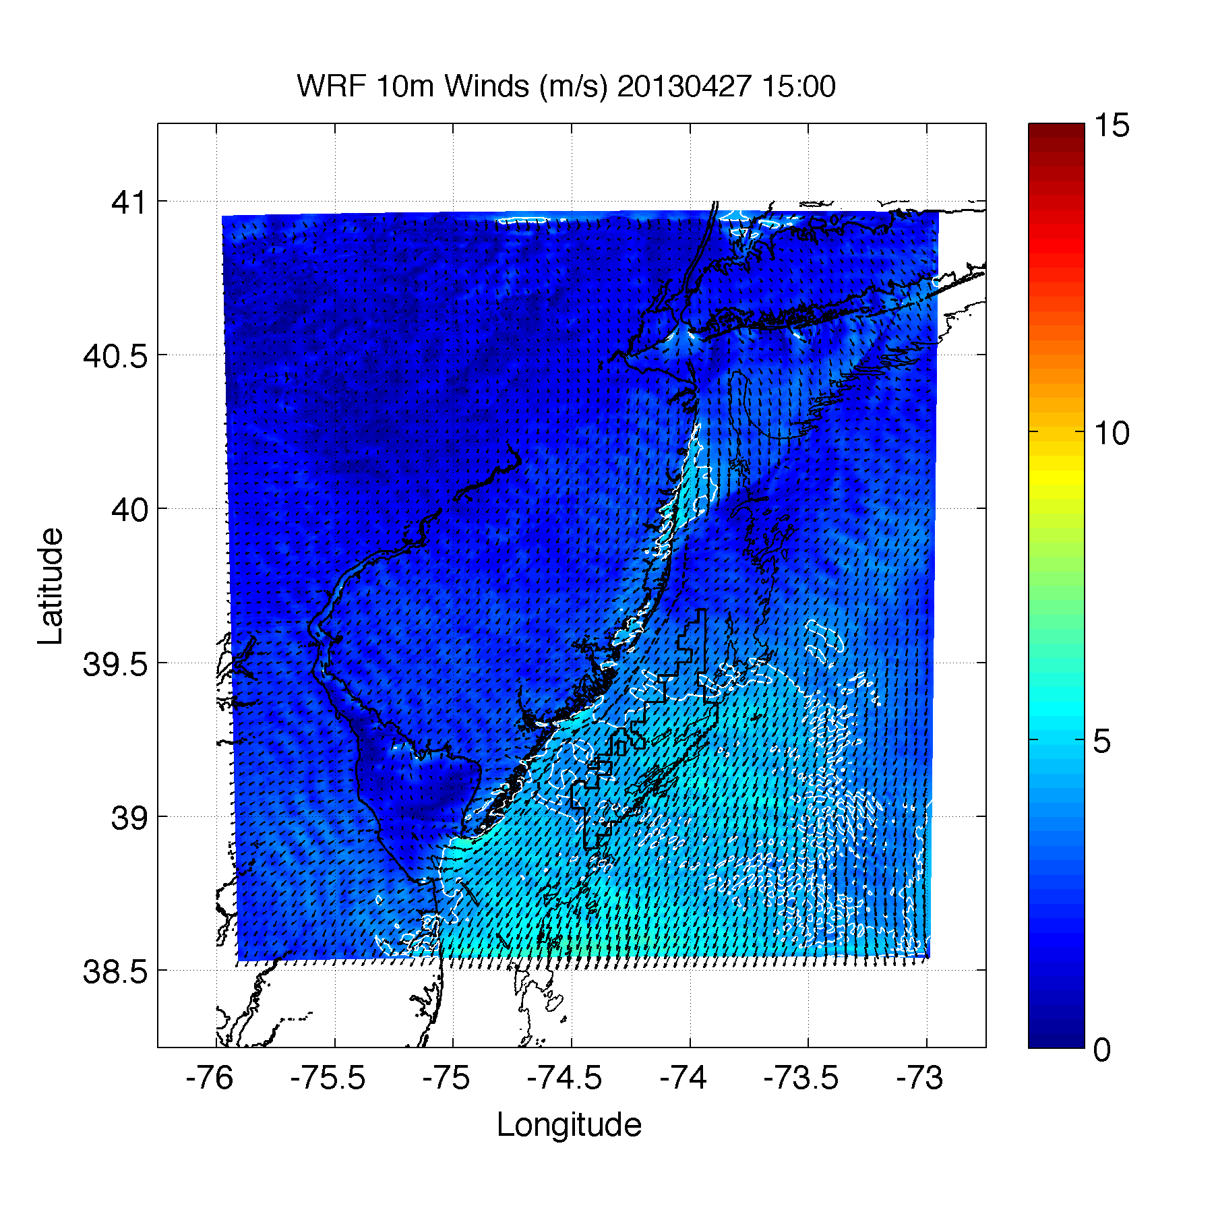

Slide 17
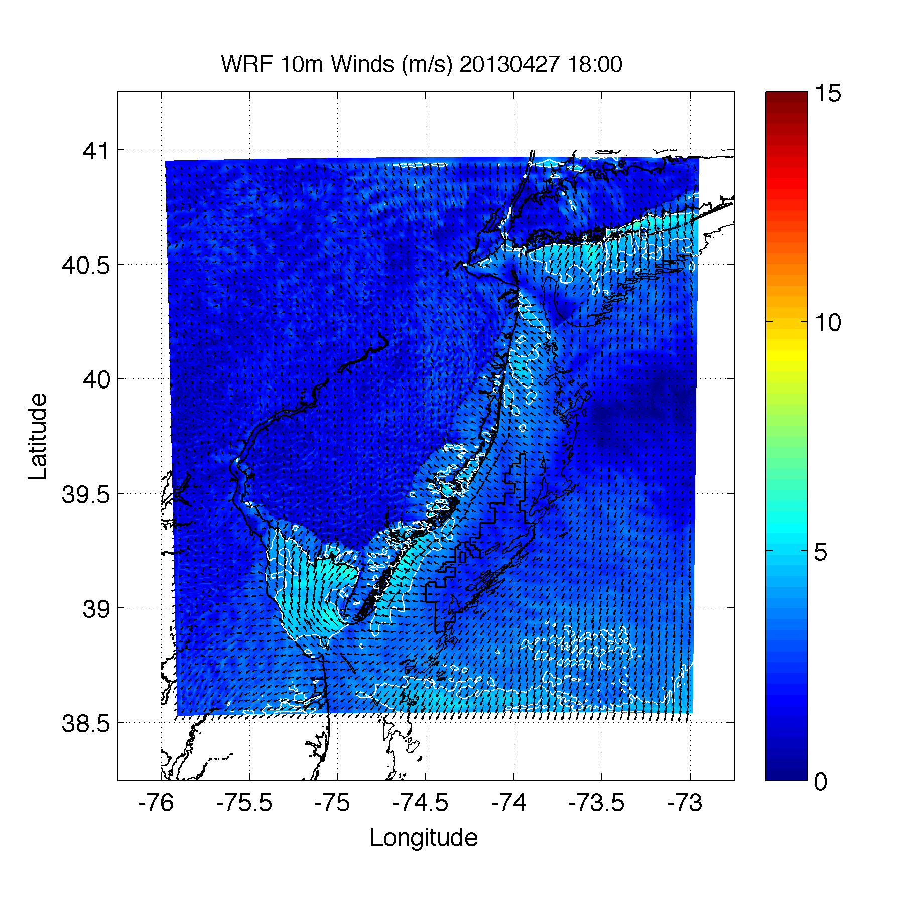

Slide 18
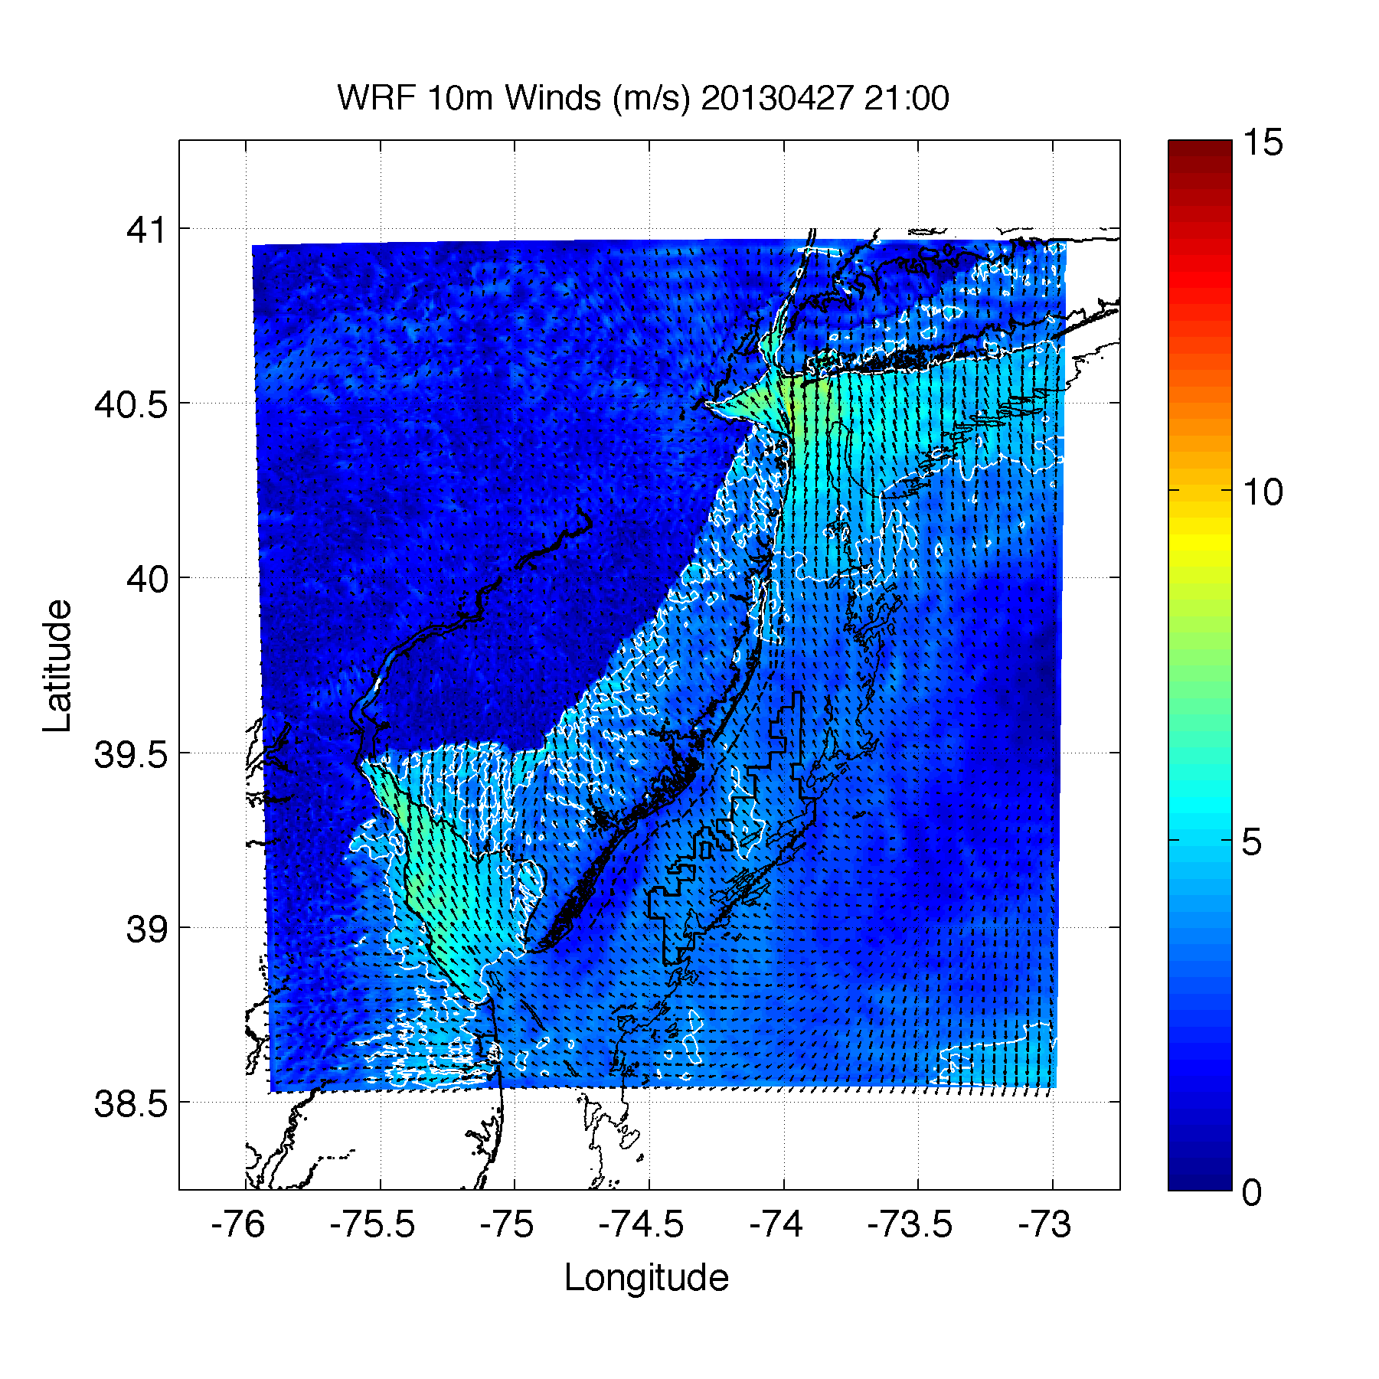

Slide 19
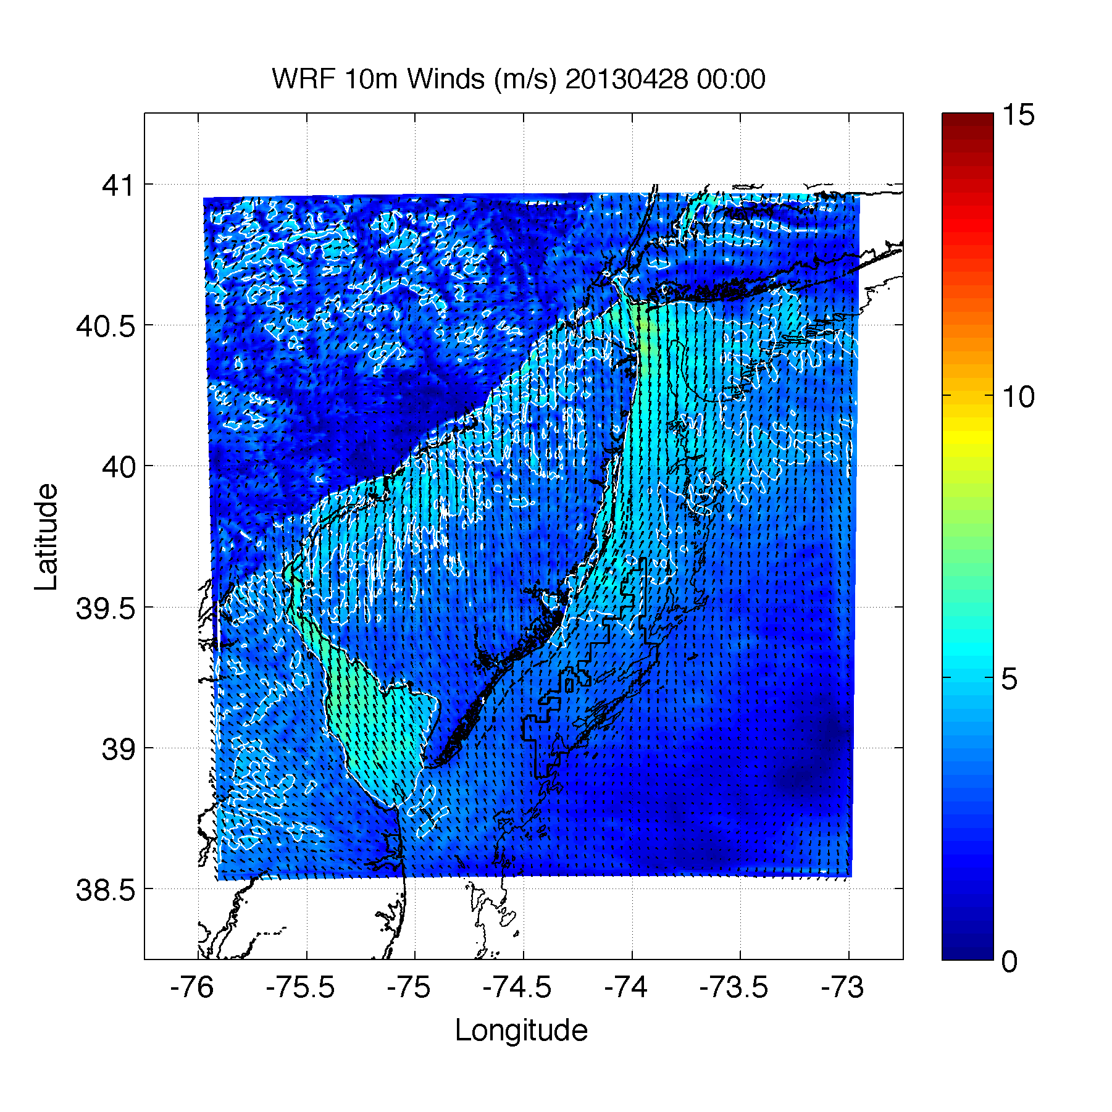

Slide 20
LCS Setup
On 3km WRF winds
1800 UTC to 2300 UTC (sea breeze time)
10km grid spacing for tracers
Perform at these levels in WRF:
10, 50, 150, 500, 600, 700, 800, 900, 1000, 1500, 2000, 2500m

Slide 21
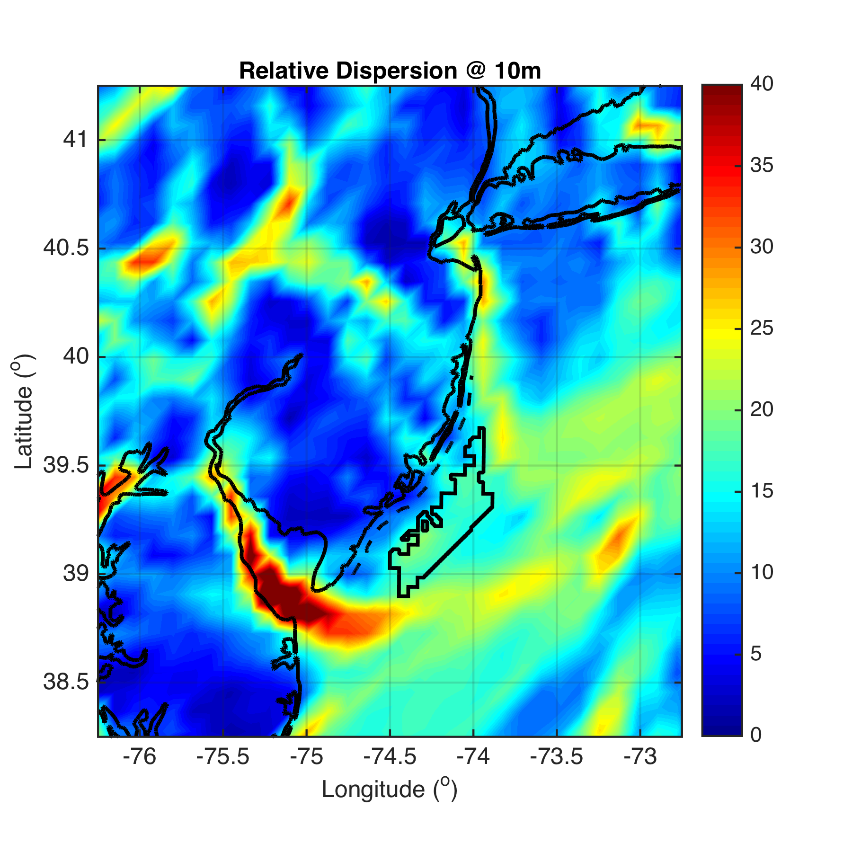

Slide 22
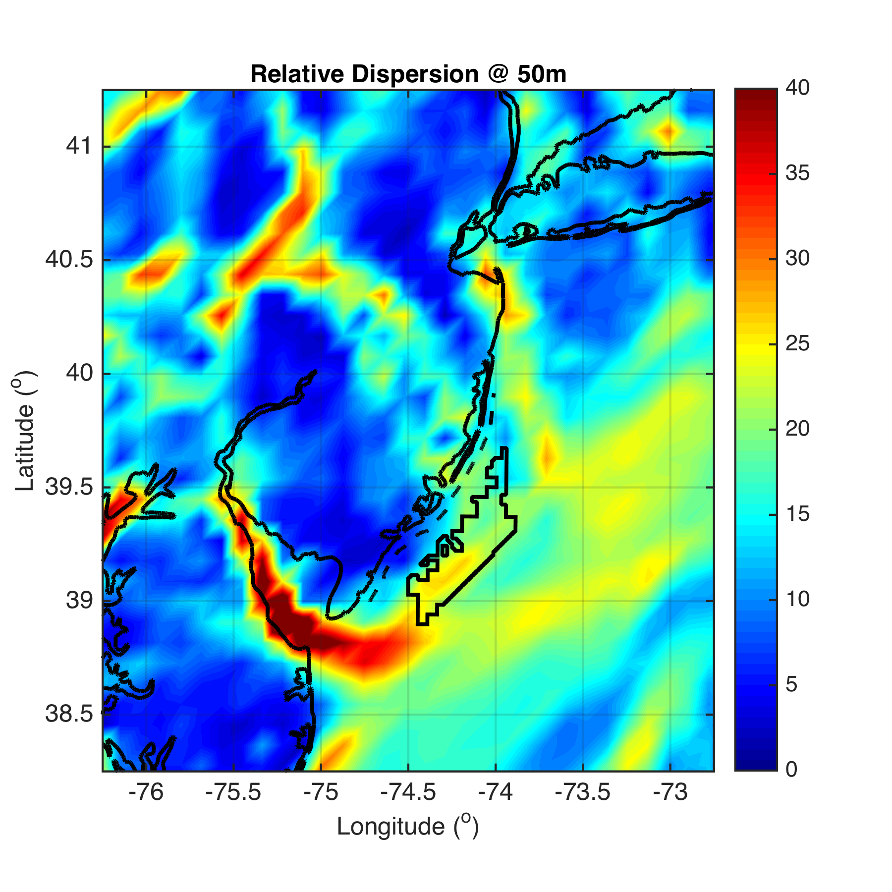
Notes:
Blue red colorbar at +/- 10

Slide 23
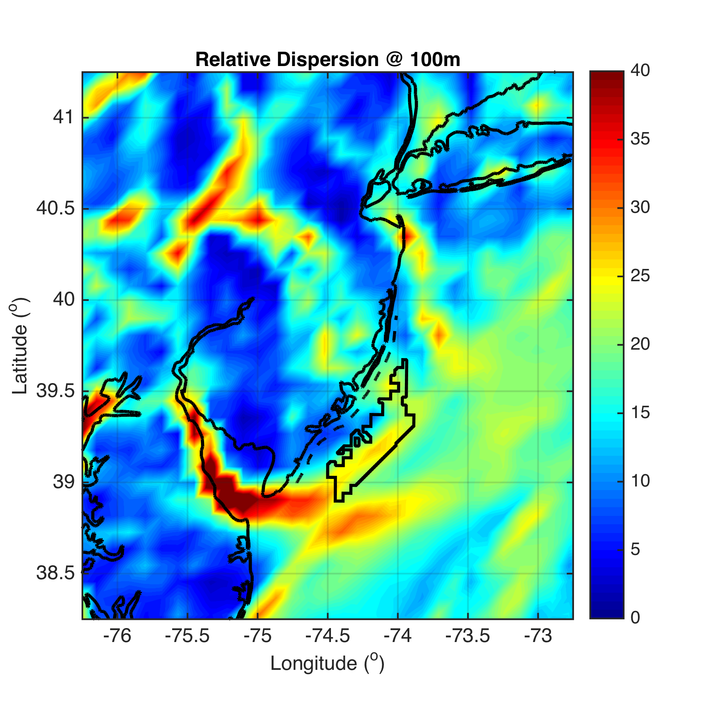

Slide 24
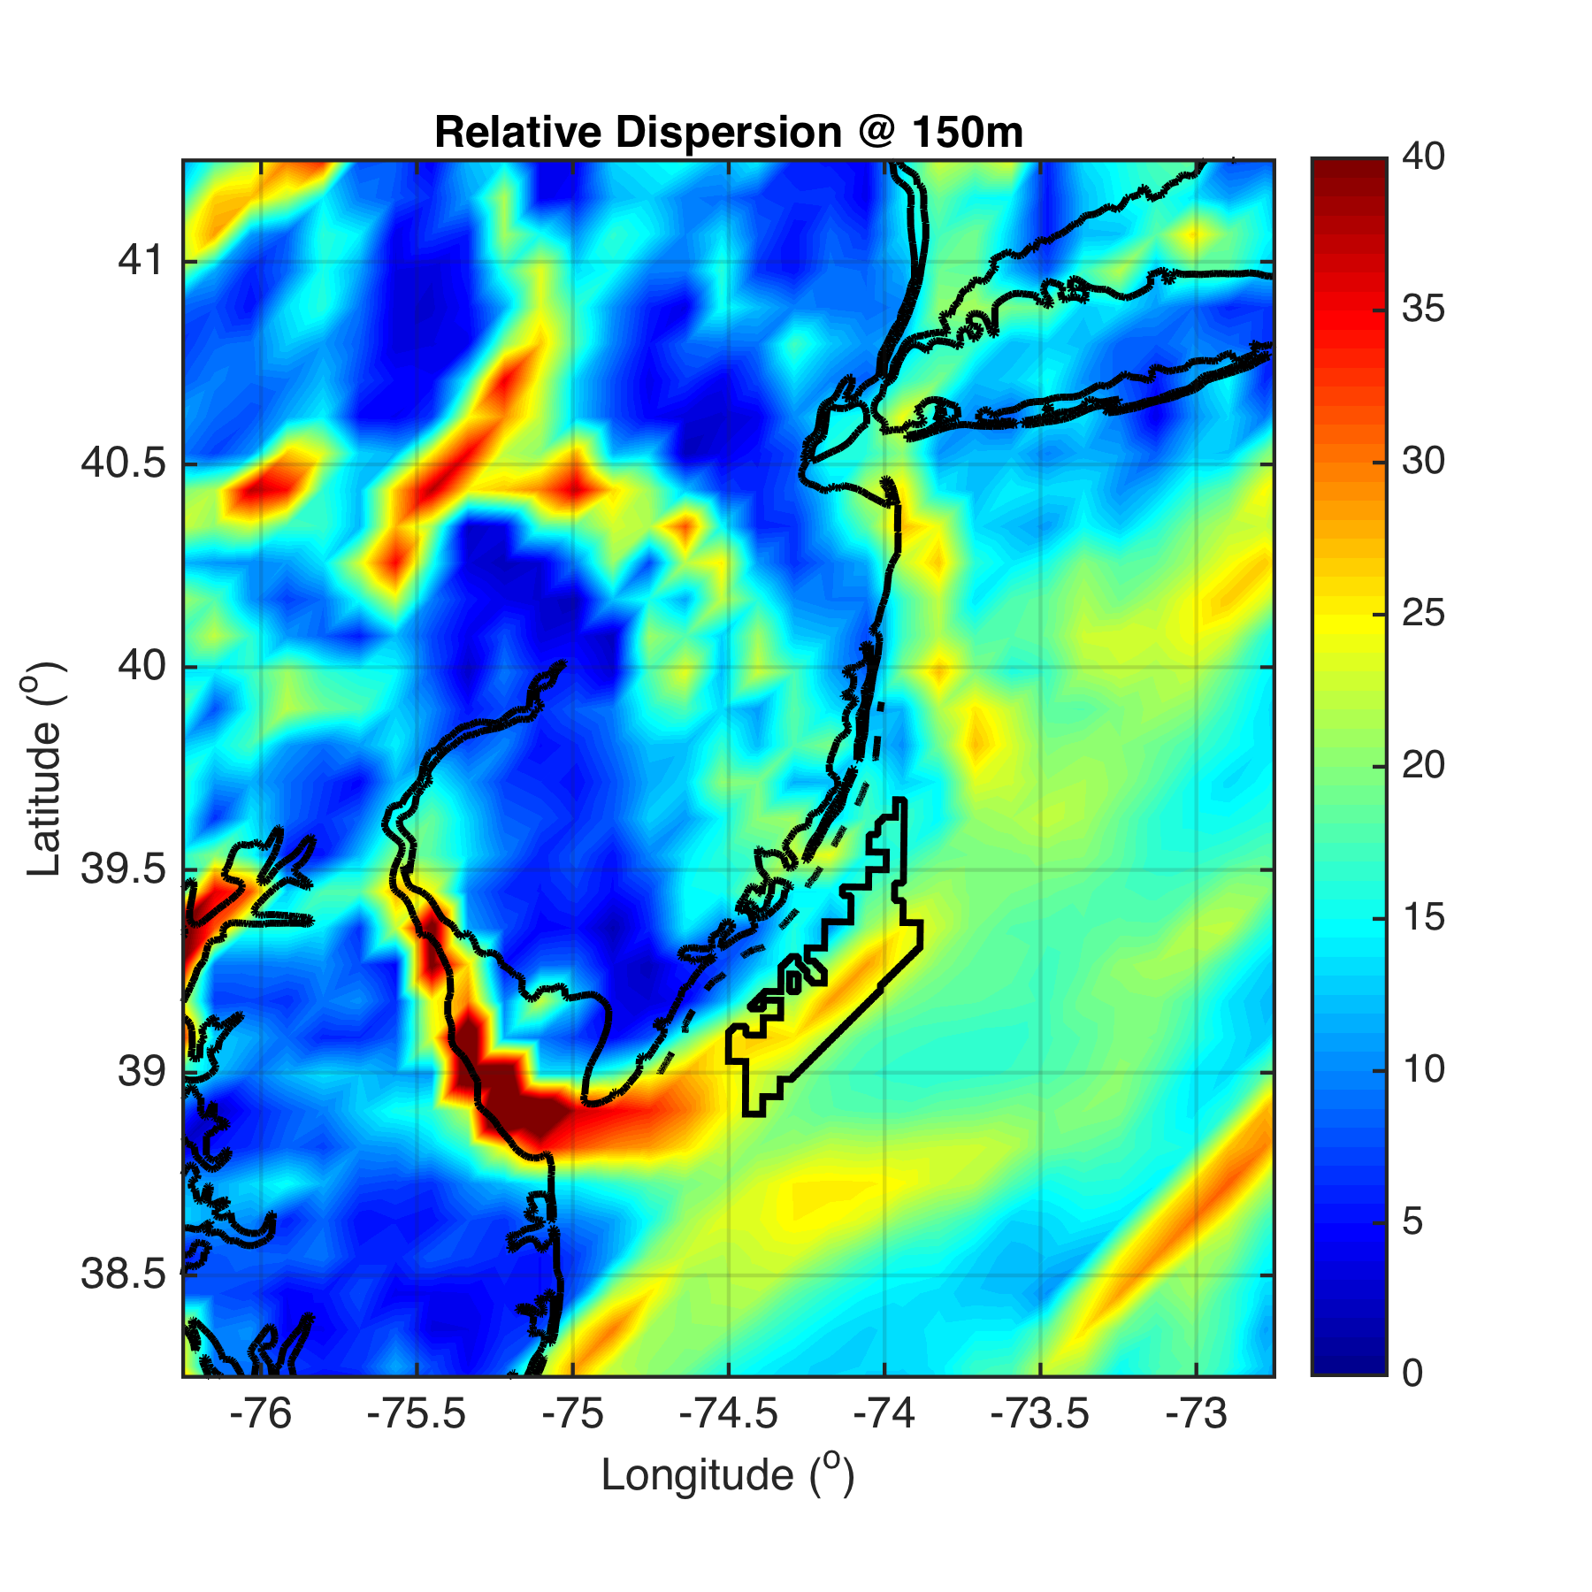

Slide 25
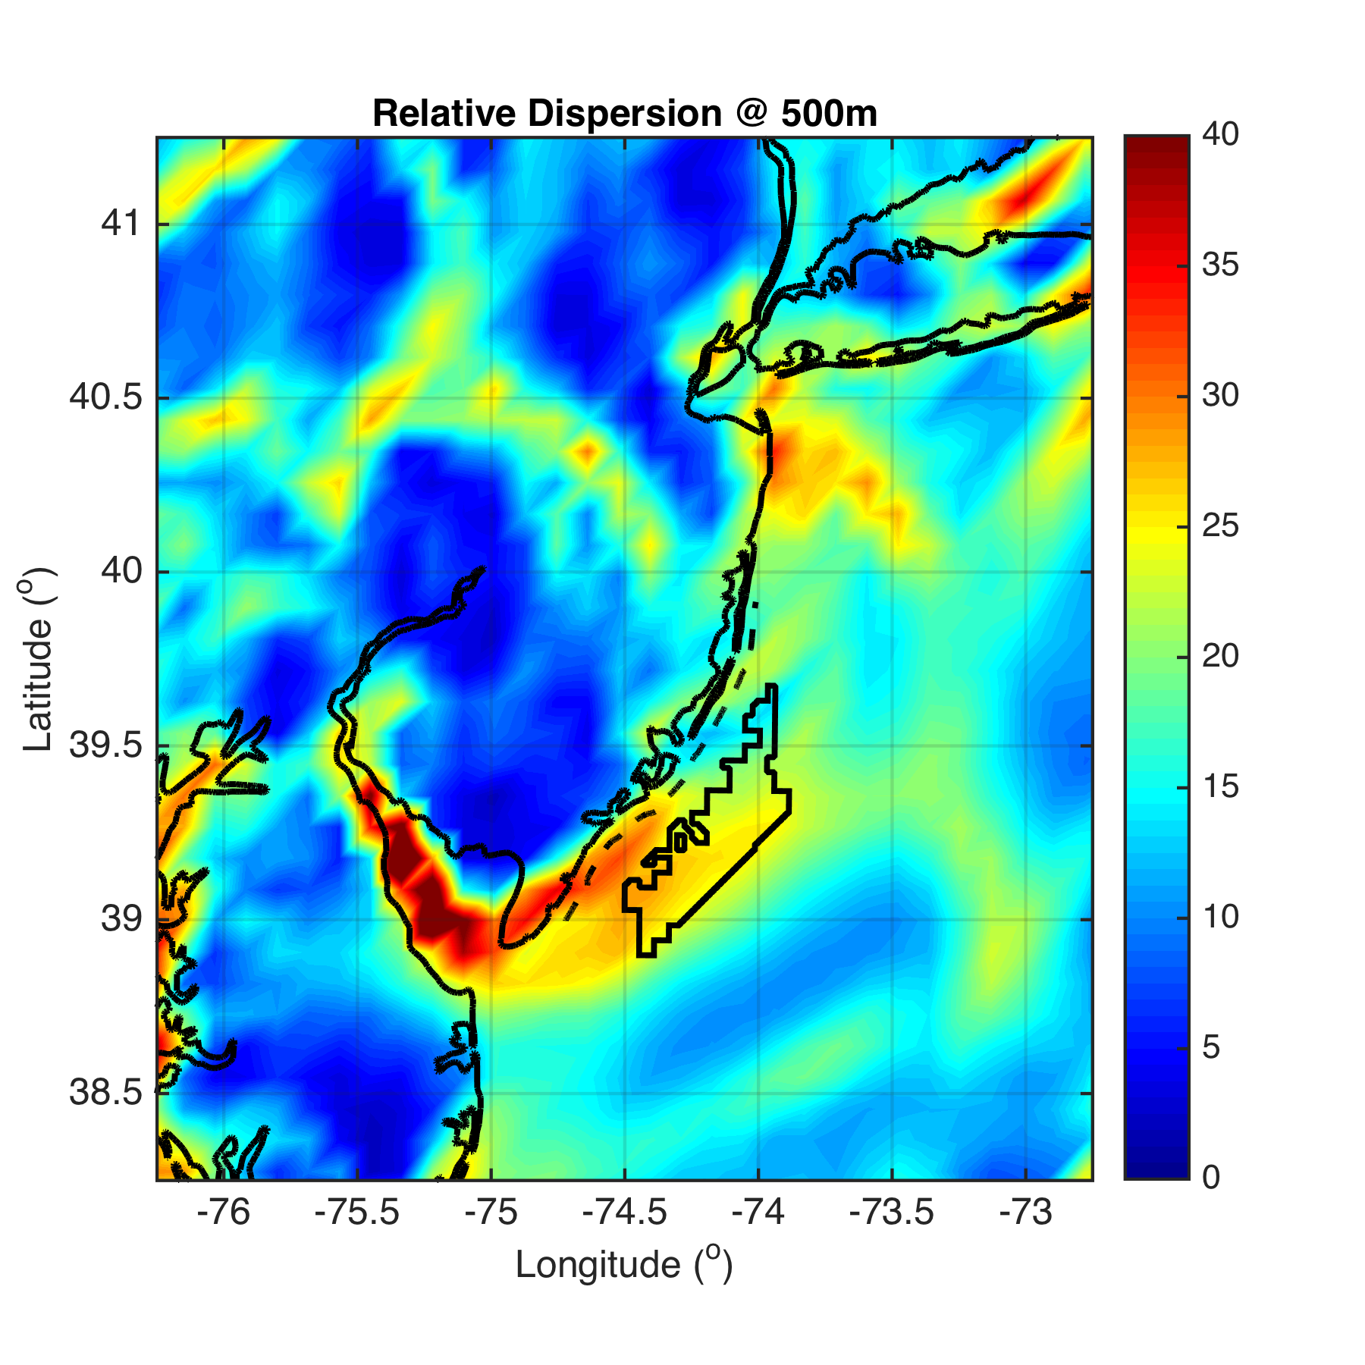

Slide 26
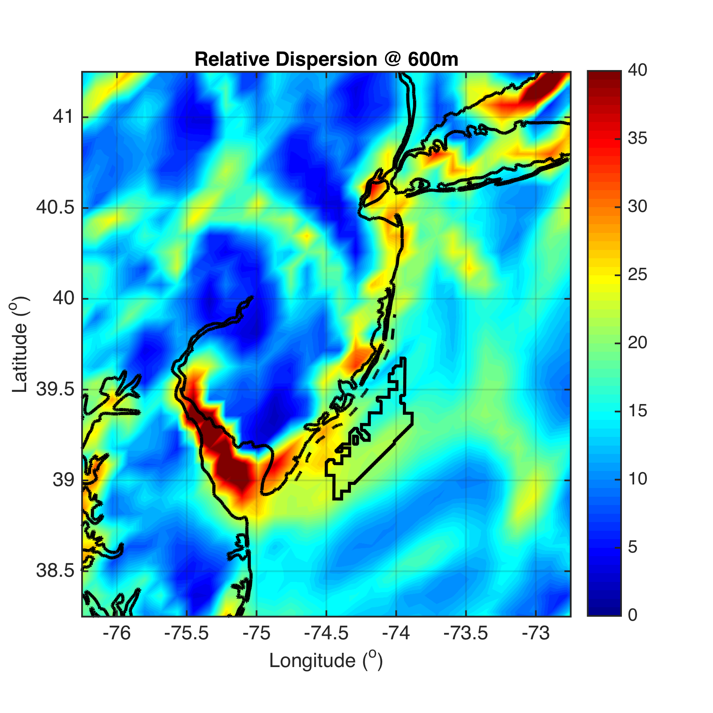

Slide 27
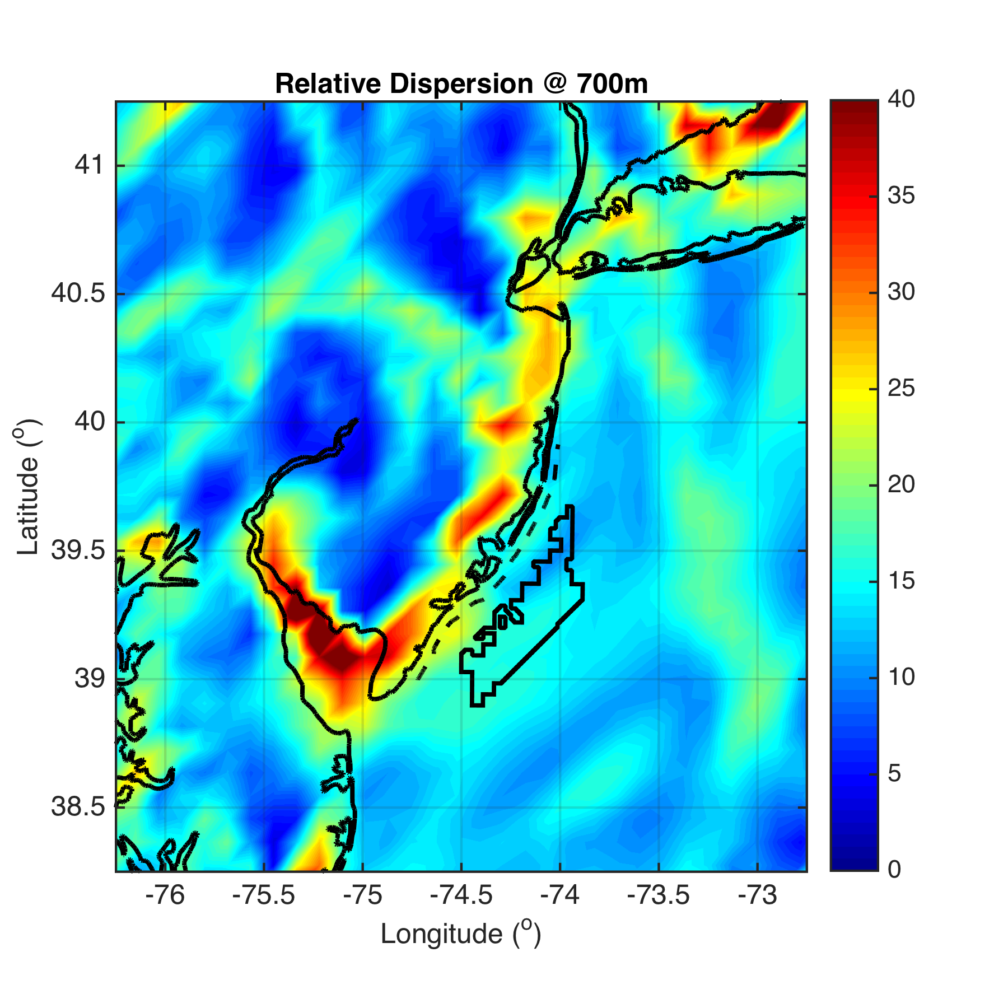

Slide 28
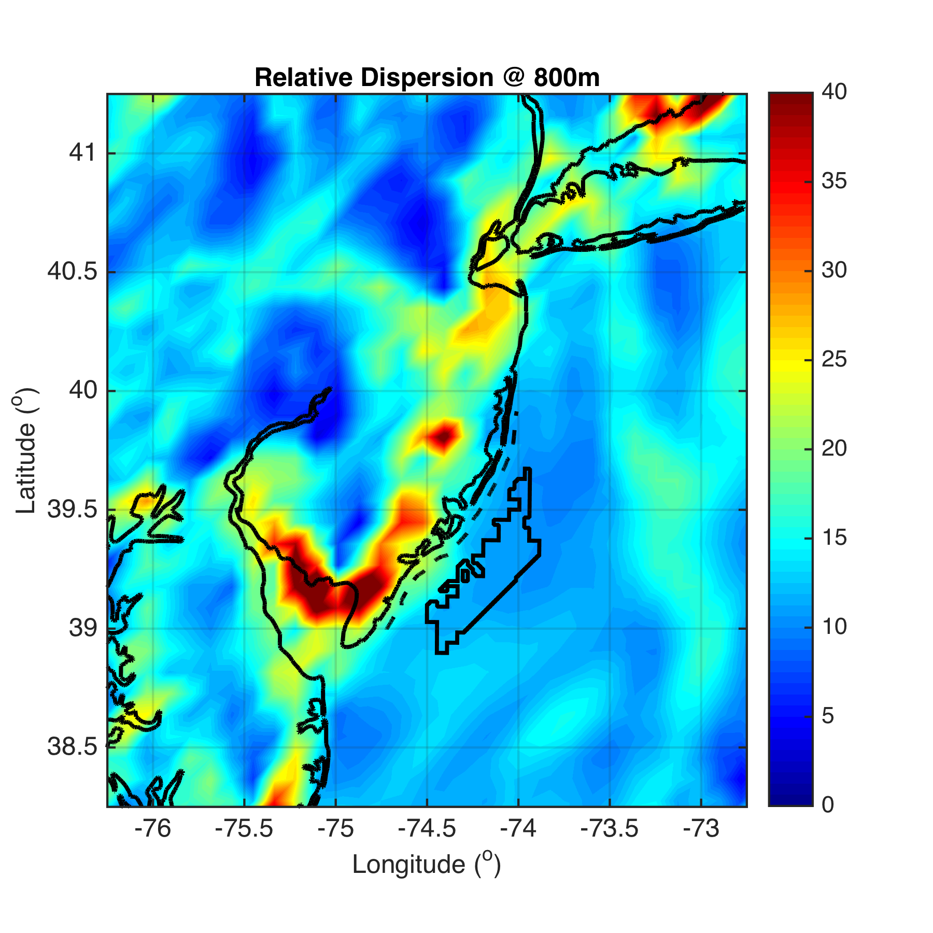

Slide 29
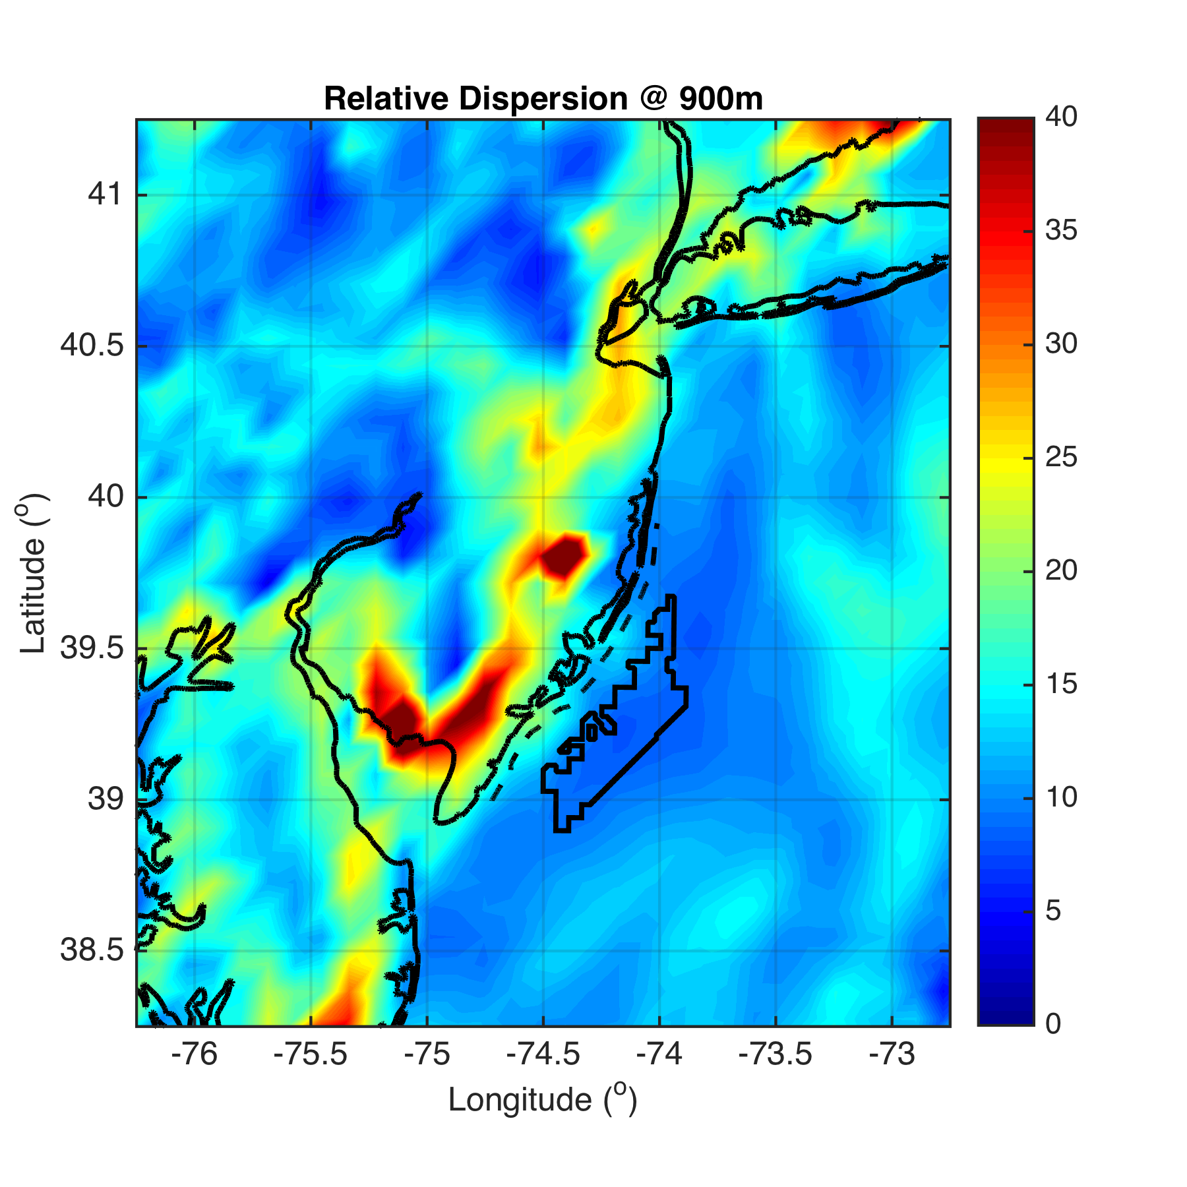

Slide 30
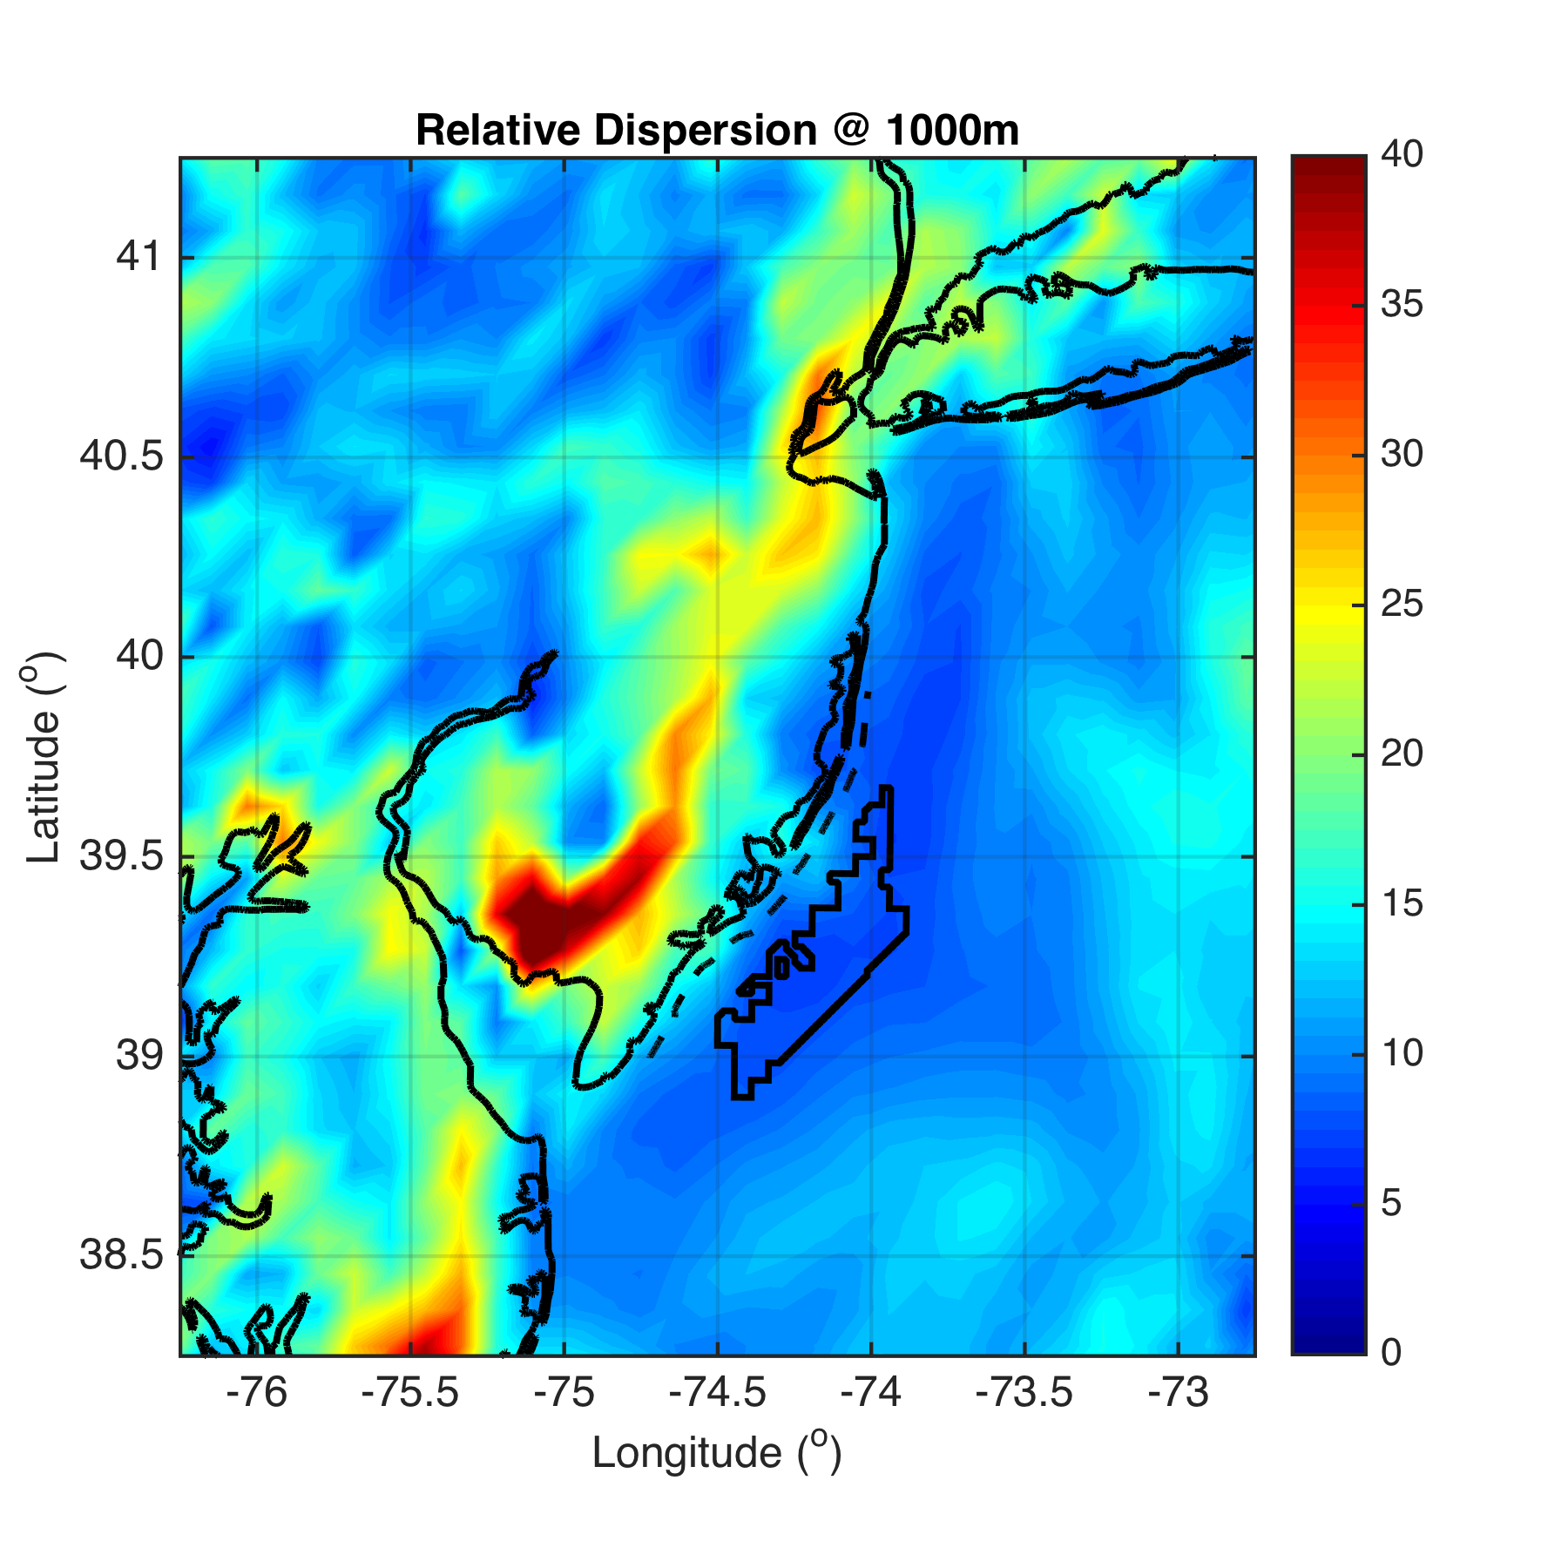

Slide 31
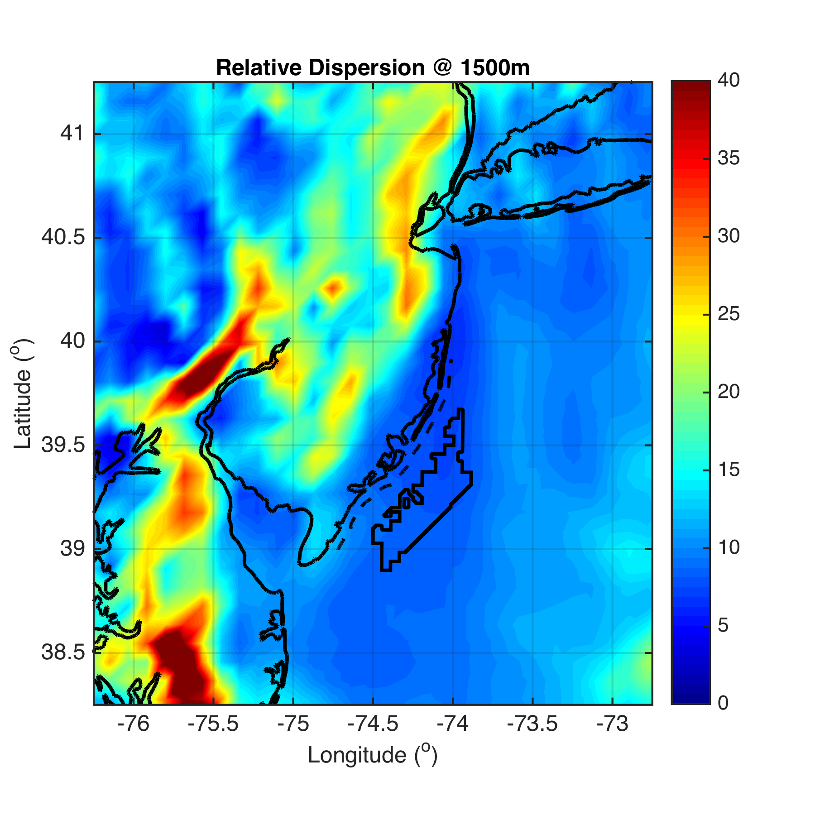

Slide 32
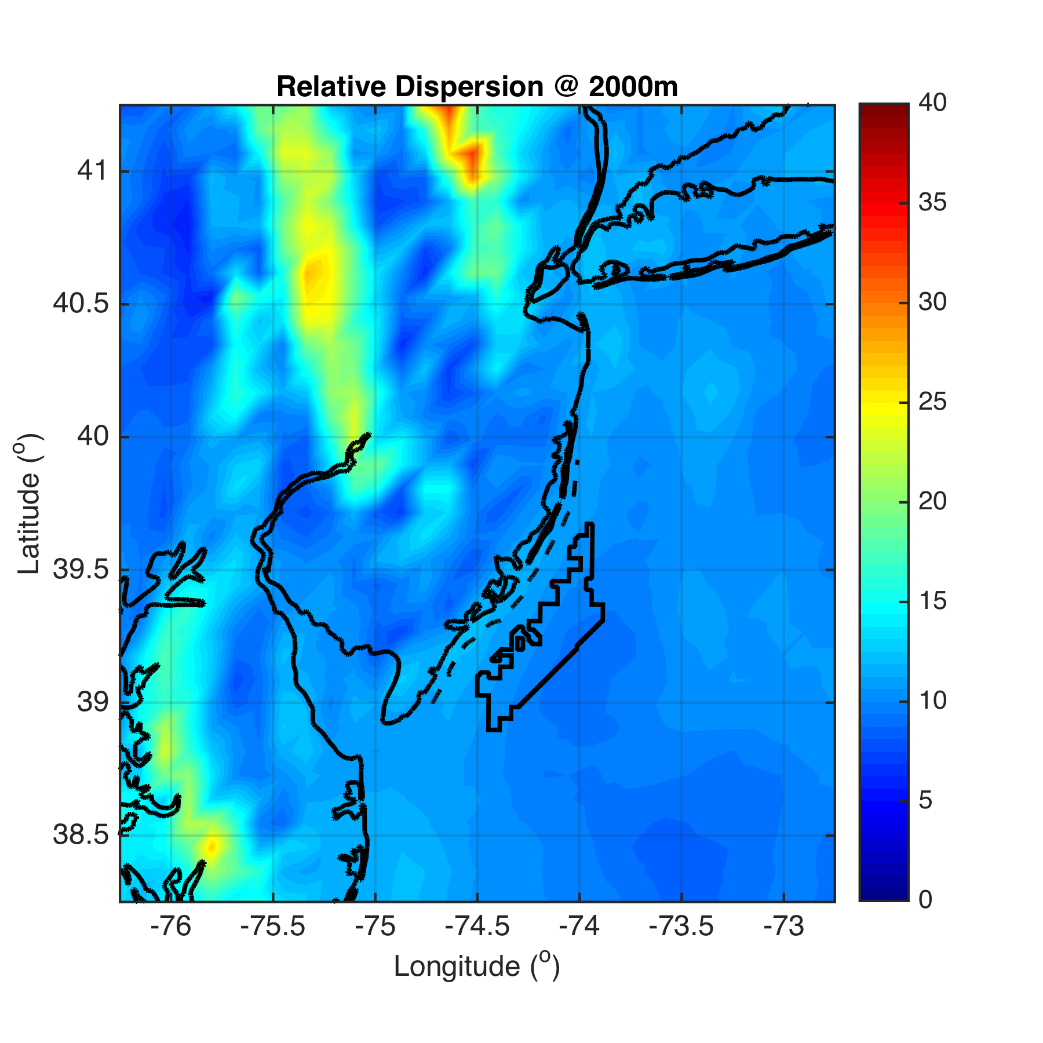

Slide 33
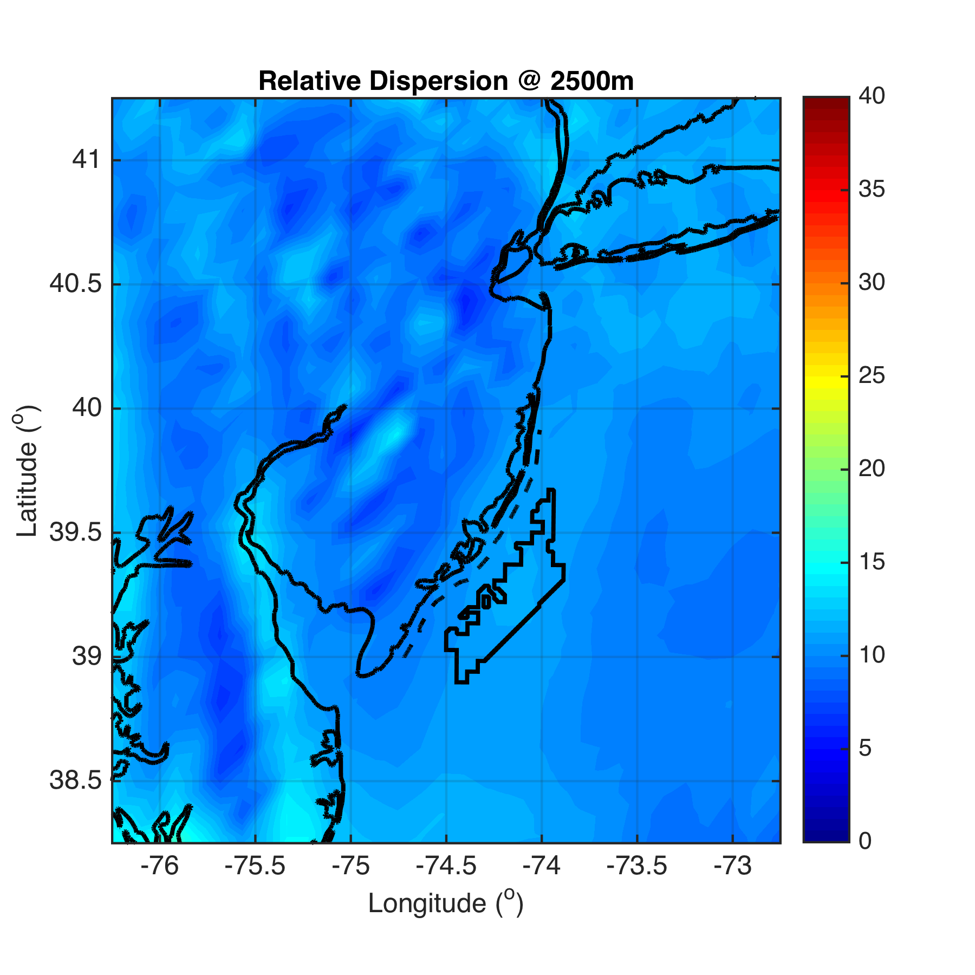

Slide 34
Preliminary Conclusions
Offshore:
Divergence: 10 to ~700m
Convergence: ~700 to 2000m
Onshore:
Convergence: 10 to ~600m
Divergence: ~600 to 1500m
Reversal in divergence/convergence, and thus approximate height size of sea breeze cell, similar onshore and offshore
Divergence is slanted with height, from surface offshore to aloft onshore

Slide 35
Next Steps
Vertical slice through LCS to show divergence slant with height
Change colorbar of LCS RD figures to blue/red +/- 10 km
because resolution of LCS is 10km (parcels dropped every 10km for trajectories), any RD values less than 10km will be convergent, and any RD values greater than 10km will be divergent
WRF 10min winds→hourly LCS RD maps
then track progression of front as it moves inland

Slide 36
Future Work
Offshore sea breeze extent (i.e. calm zone propagation offshore) sensitivity to PBL scheme?
YSU 21km, MYNN 0km offshore for one pure sea breeze case (Steele et al 2013)
Use (3D) LCS to look at vertical shear?
Apply LCS to scanning LIDAR winds
Combine with WRF to get back (LIDAR) and forward (WRF) trajectories for real-time structure detection and automated turbulence and wind shear warning system for offshore wind

