Slide 1
Committee Meeting
4/27/2016
Greg Seroka

Slide 2
Outline
Introduction
  Commonalities among chapters
Chapter 1
  Hurricane Irene Sensitivity to Stratified Coastal Ocean Cooling
  TC coastal atmospheric investigation
  Revision #1 resubmitted to Monthly Weather Review
Chapter 2
  Spatiotemporal variability of stratified coastal ocean cooling processes in MAB hurricanes
  TC coastal oceanic investigation
  Outline of ideas, methods
Chapter 3
  Examination of Sea Breeze for Offshore Wind Energy using WRF and Lagrangian Coherent Structures
  Sea breeze coastal atmospheric investigation
  Figures

Slide 3
Introduction
Commonalities/common threads among chapters:
Highly stratified ocean over wide, shallow continental shelves
Downwelling, upwelling circulation; how they influence weather and vice versa; how they interact
Both timely: TC intensity prediction problem [even more important for landfalling storms (impacts)], offshore wind resource and variability (sea breeze) assessment for burgeoning industry
Track of storms predicted well, intensity prediction lags (Rogers et al. 2006, Cangialosi and Franklin 2013); inshore side of sea breeze well-observed + understood, offshore side not (Steele et al. 2014)
New techniques to better understand coastal processes
  Integration of atmospheric/ocean modeling (WRF, ROMS) and monitoring [gliders (w/ ADCP), HF radar, buoys, satellites) for TCs
  Integration of atmospheric modeling (WRF), monitoring (weather radar, satellites), and LCS techniques for sea breeze/upwelling

Slide 4
Chapter 1
Hurricane Irene Sensitivity to Stratified Coastal Ocean Cooling

Slide 5
Chapter 1
Hurricane Irene Sensitivity to Stratified Coastal Ocean Cooling
Submitted to Monthly Weather Review Dec 12
First round of reviews came back Mar 9 (one week after last meeting)
  Editor: Major Revision:
  Reviewers: 2 minor, 1 major revisions
Resubmitted Apr 25 (due May 8)

Slide 6
Chapter 1
Hurricane Irene Sensitivity to Stratified Coastal Ocean Cooling
Reviewer #1: Major
  Additional simulation to test sensitivity to aerosols (mp_physics=30), Hebrew Univ. Jerusalem, spectral bin microphysics
    Aerosol-induced convection near TC center→ intensification
    Continental aerosol-induced convection at TC periphery→ weakening
    →SST sensitivity still larger

Slide 7
Figure 4
Notes:
Include 1D ocean model results
Include WRF namelist options? – in a table/description

Slide 8
Chapter 1
Hurricane Irene Sensitivity to Stratified Coastal Ocean Cooling
Reviewer #1: Major
  Wind shear
    Issues with KBUF, 700km to NW
    “The outflow from Irene for stream calculations should be taken at distances off to the north and east as it was moving through the MAB as well (KOKX, KALB, KCHH)”
    KALB, KCHH, KWAL, 200-800km annulus for 850-200, 850-500 hPa shear time series

Slide 9
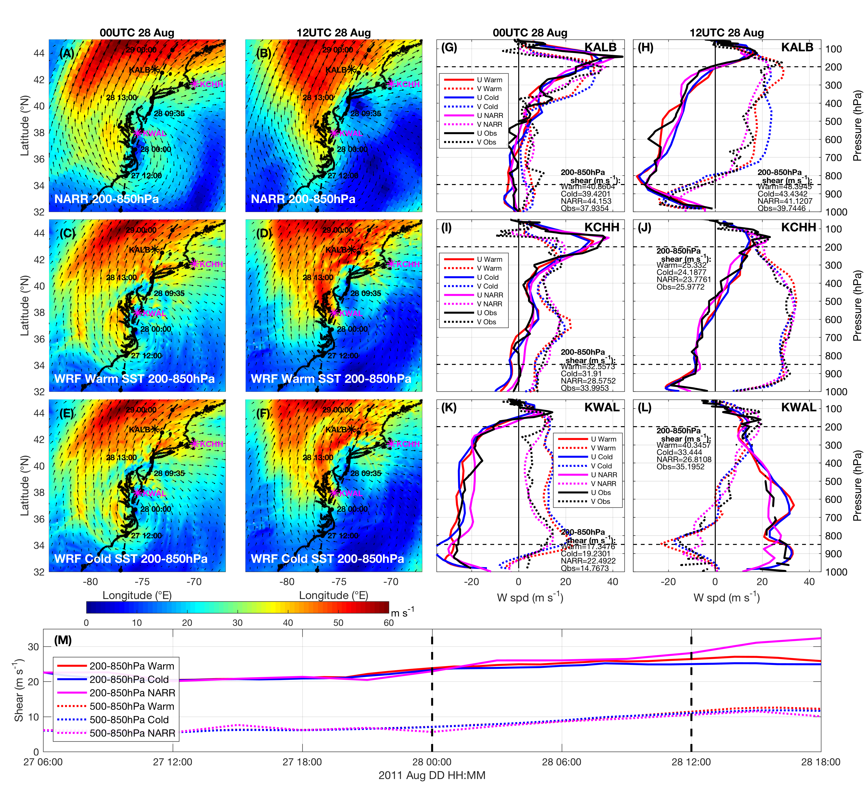
Figure 12
Notes:
250mb used because focused on midlatitudes where jet stream is lower in the atmosphere as compared to tropics
On the Calculation of Vertical Shear: An Operational Perspective: “a time lag between the onset of increased vertical shear and decreasing TC intensity has been shown to range from a nearly instantaneous response up to about 36 hours (Frank and Ritchie 2001). Further, some studies have shown that small amounts of vertical shear might actually be conducive in some cases for intensification”
KWAL
KBUF
KOKX
CYWA
KIAD
KMHX
KALB
KPIT

Slide 10
Chapter 1
Hurricane Irene Sensitivity to Stratified Coastal Ocean Cooling
Reviewer #1: Major
  Humidity/Dry air intrusion
    KWAL: southern half; added KALB for northern half
    Moved analysis from 300 to 200 hPa to highlight difference between KWAL & KALB

Slide 11
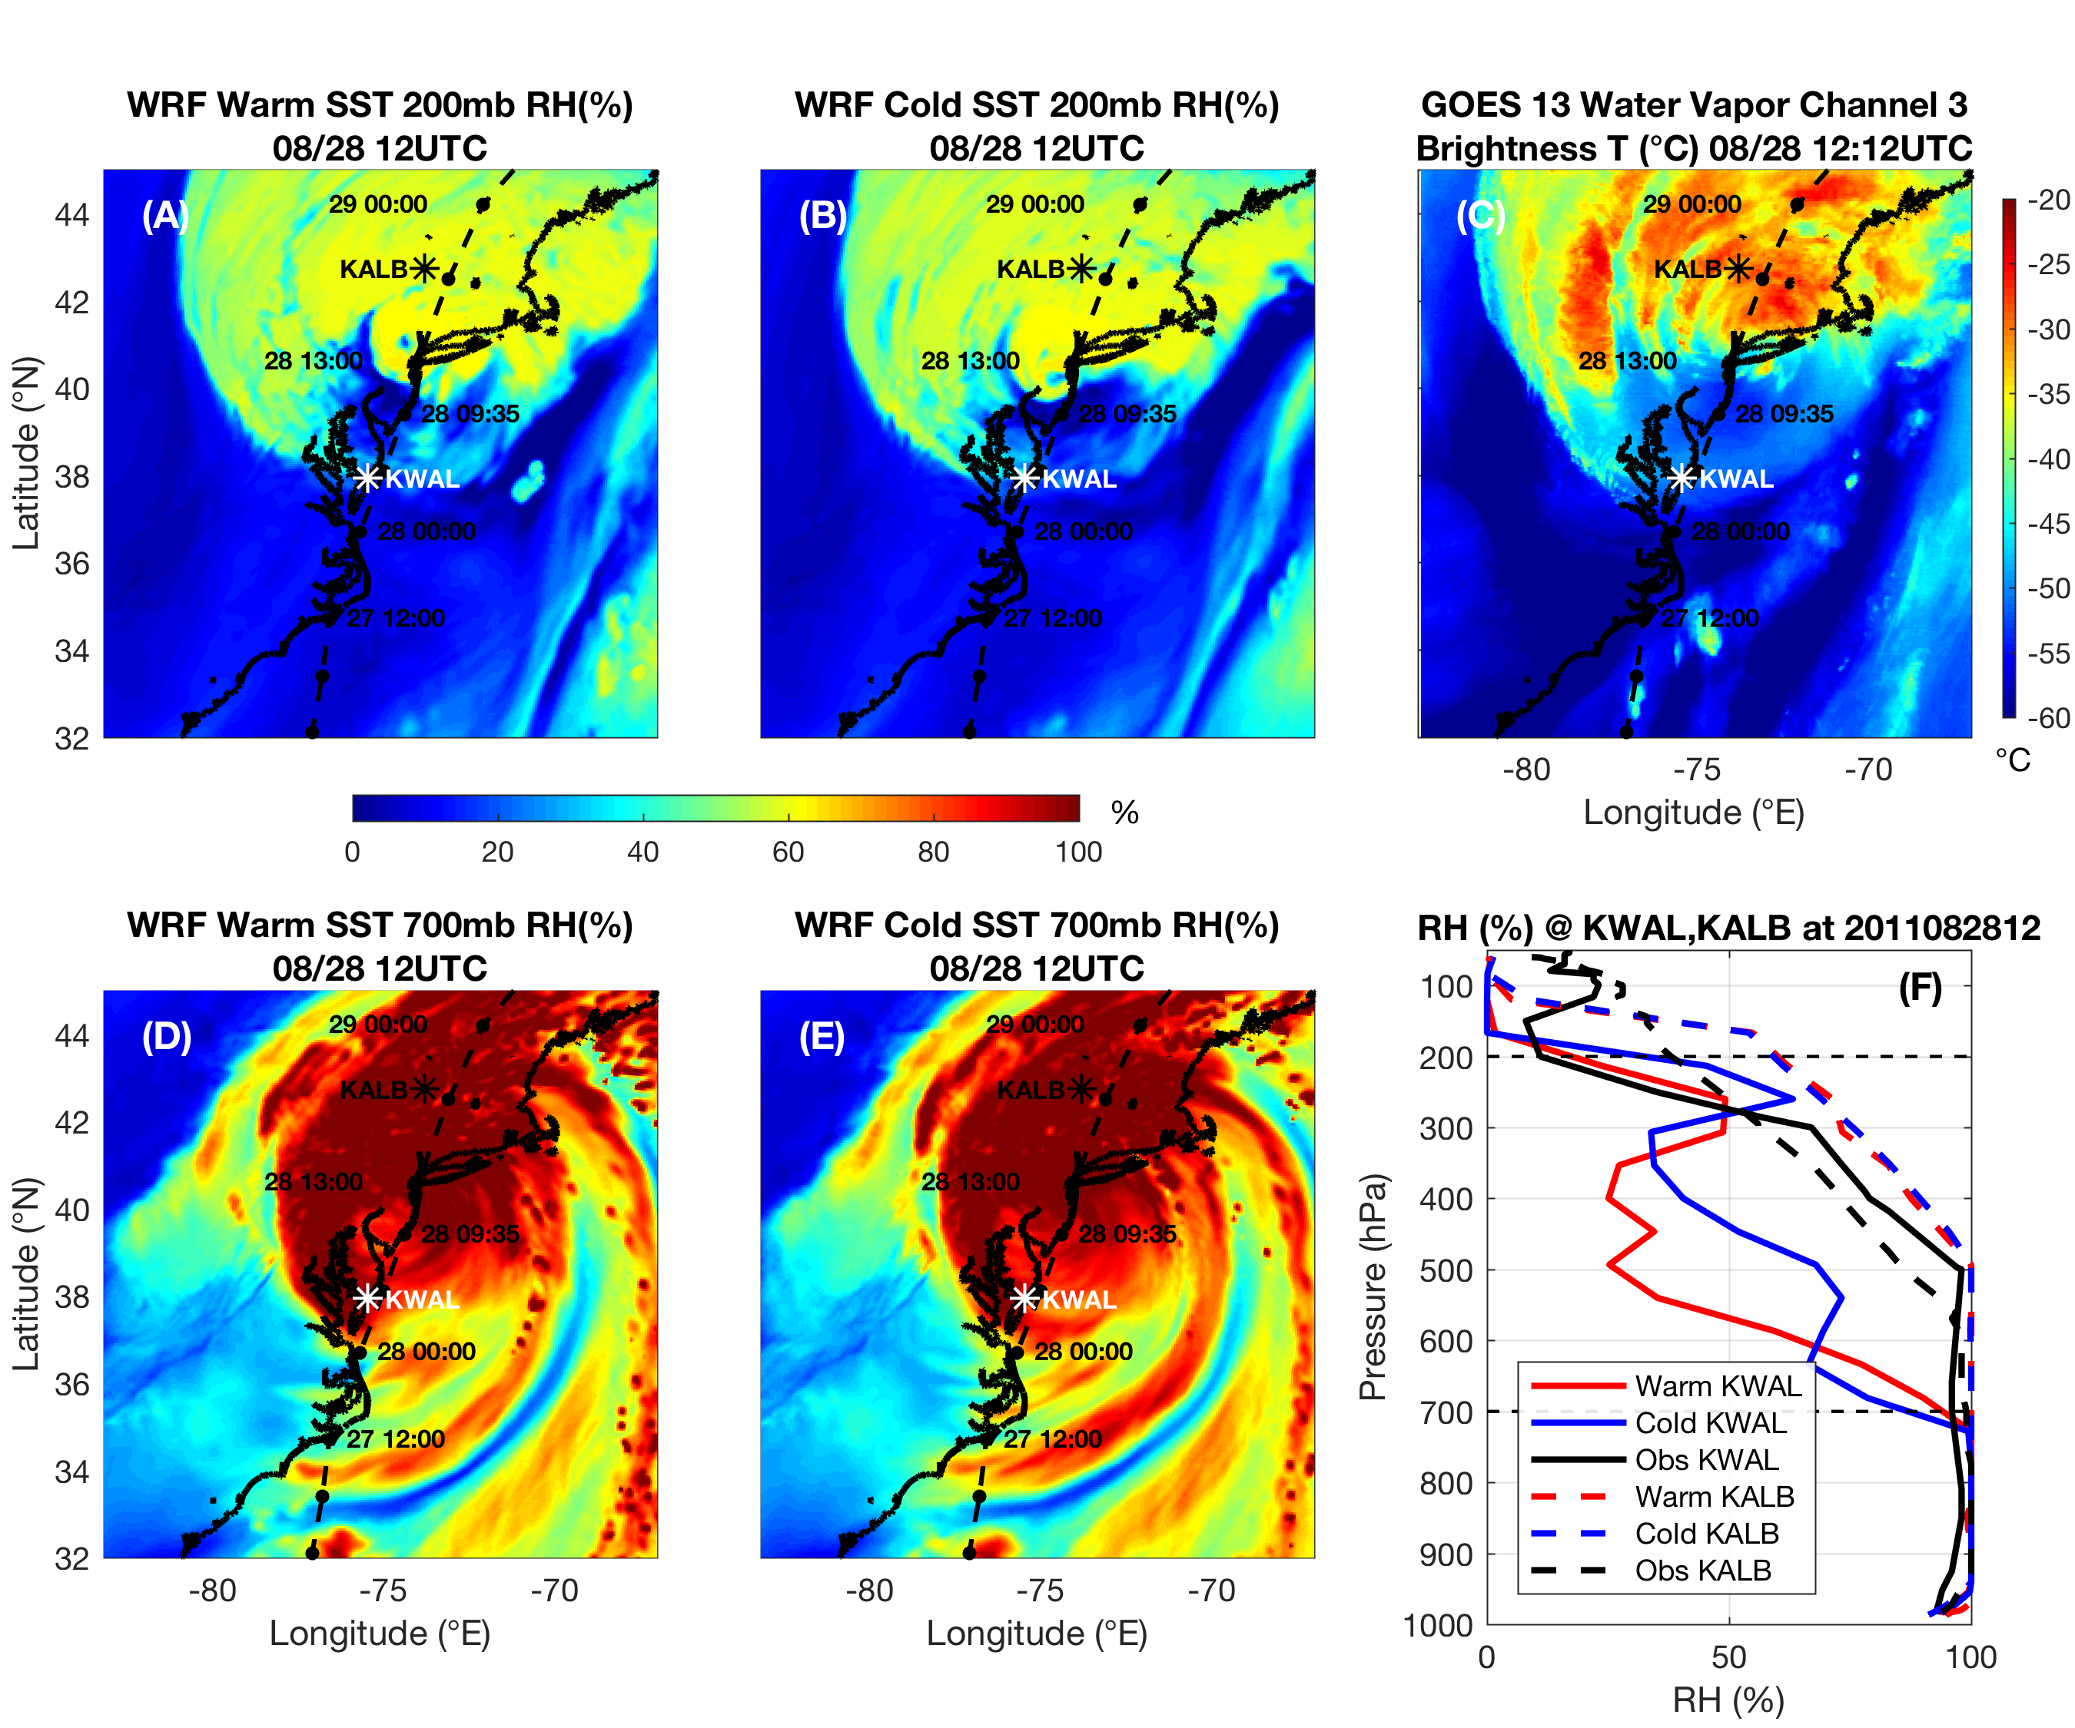
Figure 13

Slide 12
Chapter 1
Hurricane Irene Sensitivity to Stratified Coastal Ocean Cooling
Reviewer #2: Minor
  Most insightful results from “realistic ocean stratification and the 3D PWP mixing scheme”
    No coastlines, bathymetry, and no realistic 3D stratification
      “Observed glider stratification at 40m (26C surface, strong thermocline at 10m, 8C to the bottom, 12UTC 27 Aug on RR Fig. 7) could be applied uniformly across the entire domain and could be held constant from a depth of 40m to 400m”

Slide 13
Chapter 1
Hurricane Irene Sensitivity to Stratified Coastal Ocean Cooling
Reviewer #2: Minor
  3D PWP storm intensity fluctuations similar to cold SST; wanted us to include 3D PWP in wind shear, RH analyses; underscore importance of 3D PWP physics; present 3D PWP SST response
    “The 3D ocean PWP model resolves 3D open ocean, deepwater processes, including Ekman pumping/upwelling and mixing across the base of the mixed layer caused by shear instability when the surface layer flows over a relatively quiescent and deep bottom layer.”
    Glenn et al. (2016) coastal baroclinic mixing processes different
    Resulting cooling from 3D PWP different in magnitude and timing
    Accuracy of intensity prediction of 3D PWP decreased

Slide 14
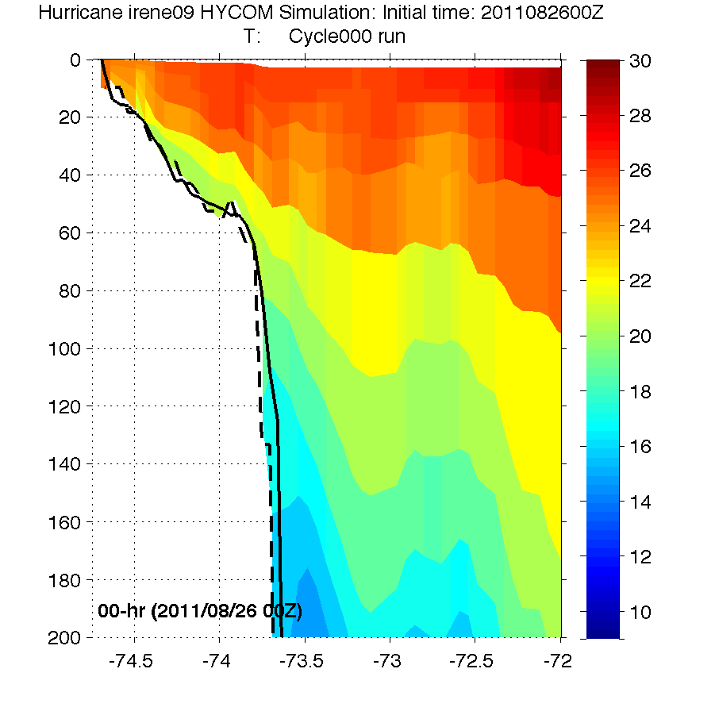
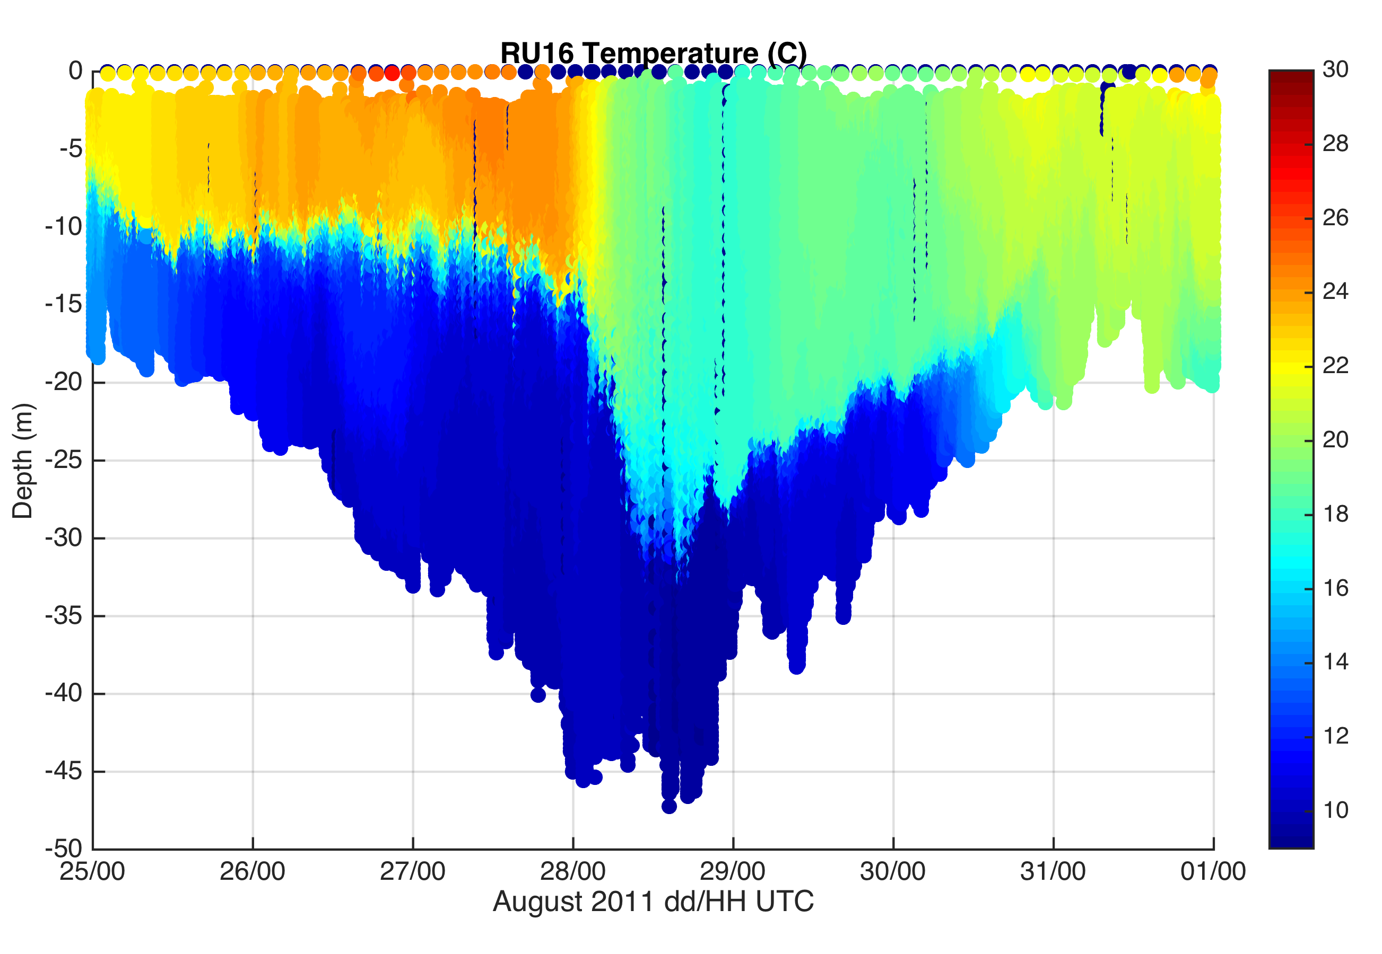
Chapter 1
Hurricane Irene Sensitivity to Stratified Coastal Ocean Cooling
Reviewer #2: Minor
    Suggested 3D PWP simulation init. w/ HWRF-HYCOM (400m)
      Useful to determine poor ocean initialization contribution to error
      Sensitivity equivalent to 1D deepwater, open ocean mixing
Before
HWRF-HYCOM
Before
RU16 Glider

Slide 15
Figure 4
Notes:
Include 1D ocean model results
Include WRF namelist options? – in a table/description

Slide 16
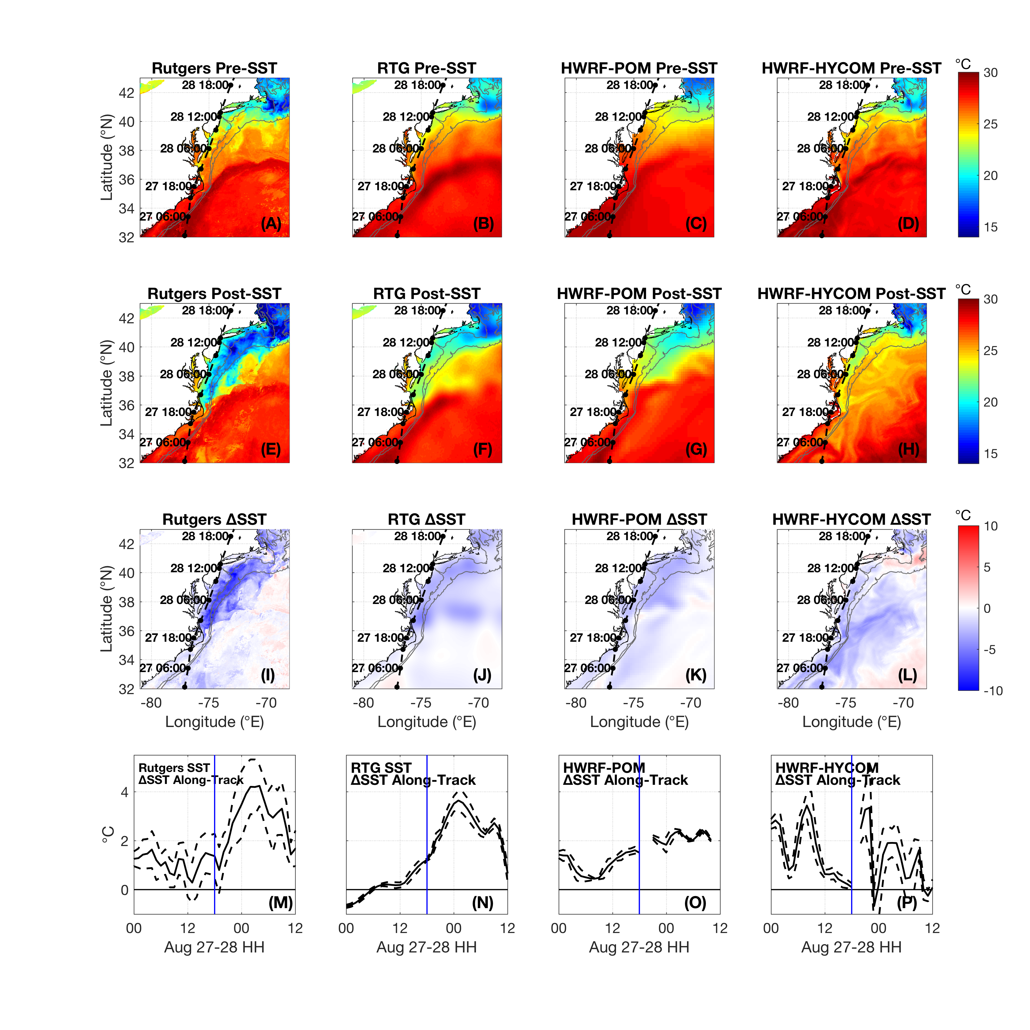
Figure 3
Reviewer #2: Minor
Add standard deviation
to Fig. 3 time series

Slide 17
Chapter 1
Hurricane Irene Sensitivity to Stratified Coastal Ocean Cooling
Reviewer #3: Minor
  Also had issues with KBUF for wind shear
  Asked for more details on flux parameterizations (roughness lengths, exchange coefficients, exchange coefficient ratios)
    “The reader is encouraged to refer to Green and Zhang (2013) for a detailed look at the impact of isftcflx=0, 1 and 2 on roughness lengths, exchange coefficients, and exchange coefficient ratios C_{H}/C_{D}, C_{Q}/C_{D}, and C_{K}/C_{D}, where C_{K}=C_{H}+C_{Q}. Some key points from their paper are that, at wind speeds of 33 m s⁻¹ or greater, isftcflx=1 has the largest C_{K}/C_{D} ratio and shares with isftcflx=2 the lowest C_{D}. As a result, they found that for Hurricane Katrina (2005), using isftcflx=1 produced the most intense storm in terms of minimum SLP and max winds.”
    “Consistent with the results found by Green and Zhang (2013), isftcflx=1 produced the most intense storm using both minimum SLP and max winds intensity metrics, for both the warm pre-storm SST and cold post-storm SST”

Slide 18
Chapter 1
Hurricane Irene Sensitivity to Stratified Coastal Ocean Cooling
Reviewer #3: Minor
  Need to show q>q_{sfc} for negative latent heat flux, not T>_{Tsfc}
    Added q, q_{sfc} to Fig. 11

Slide 19
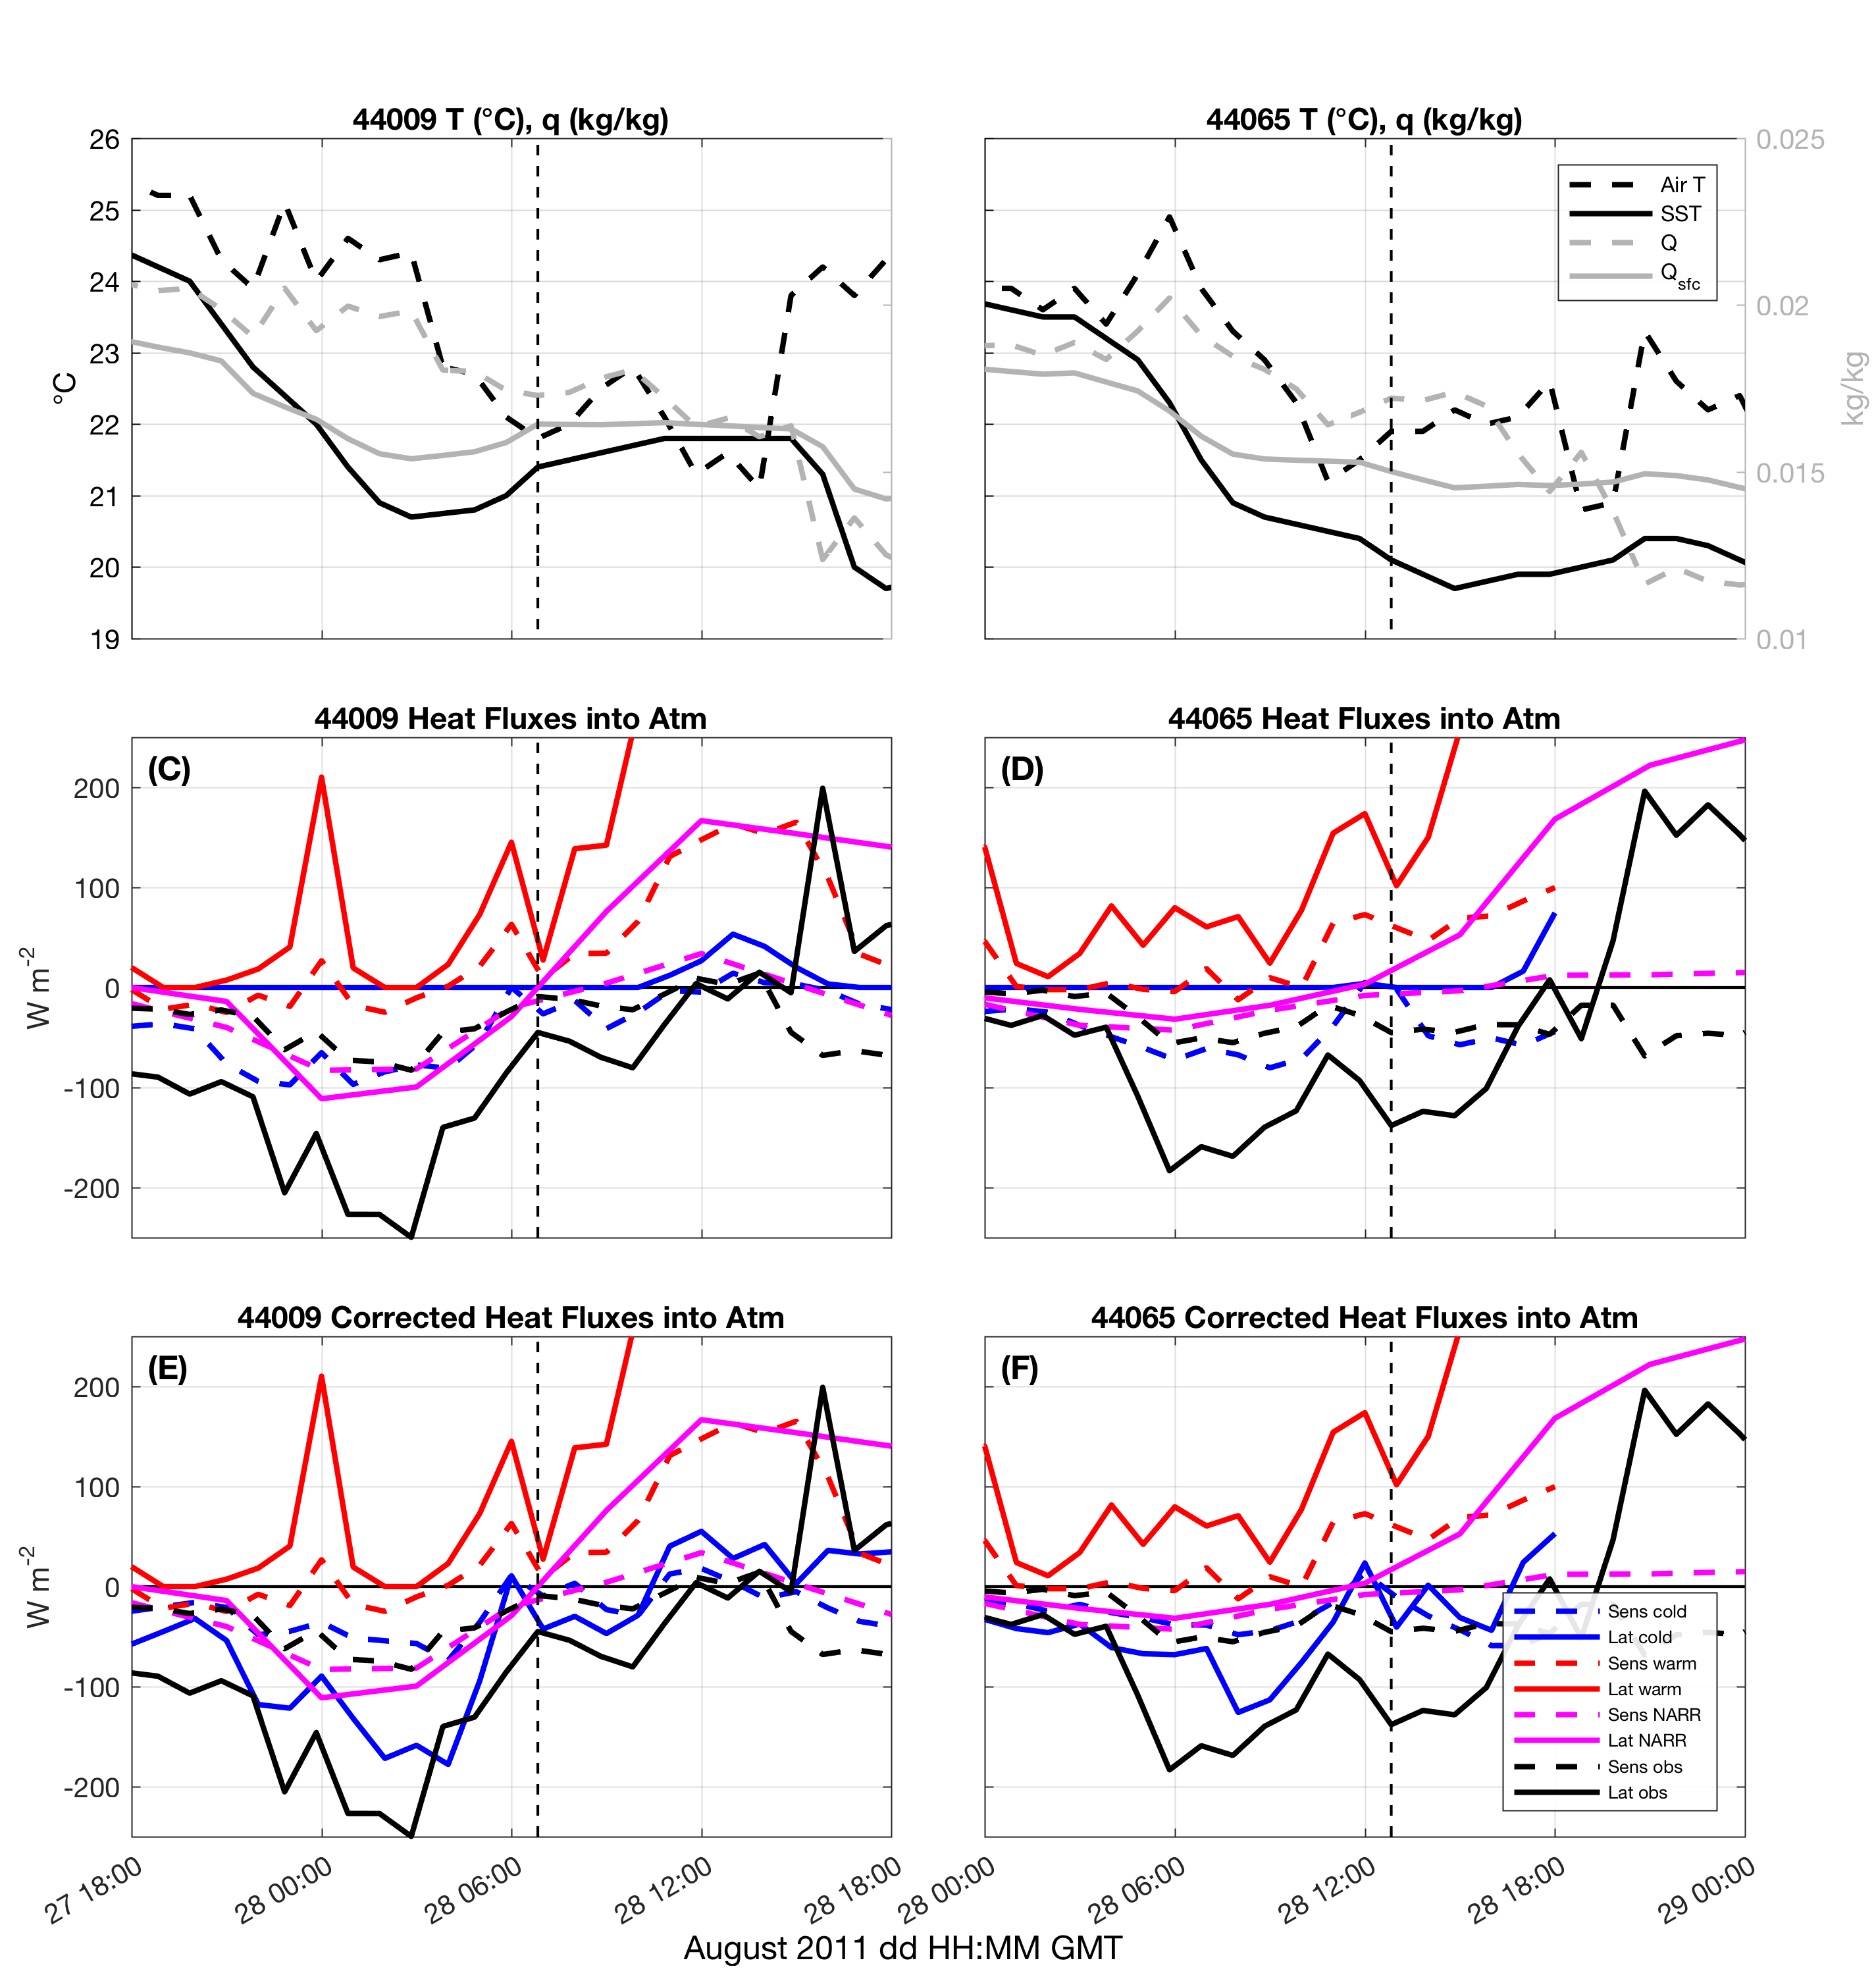
Figure 11
Notes:
In words: warm SST flux goes to ___ W m-2, sensitivity to air sea flux parameterizations for warm SST run did not change fluxes much, esp. latent
Negative latent heat flux not allowed in WRF V3.6.1…

Slide 20
Chapter 2
  Spatiotemporal variability of stratified coastal ocean cooling processes in MAB hurricanes

Slide 21
Chapter 2
Spatiotemporal variability of stratified coastal ocean cooling processes in MAB hurricanes
Baroclinic coastal ocean cooling processes identified in Irene (2011) (Glenn et al. 2016)
Ahead-of-eye-center cooling (AOEC) signal present in 11 MAB storms since 1985, Typhoon Muifa (2011) in Yellow Sea (Glenn et al. 2016)
Cooling had large impact on Irene’s intensity (Seroka et al. 2016, Chapter 1)
Remaining questions:
Did mixing dominate advection and was dominant force balance PGF vs. wind stress in other 10 MAB storms? Did these lead to the AOEC signal identified? (1)
Spatial variability of baroclinic coastal ocean processes, force balances, mixing/advection for Irene? For other 10 MAB storms? (1)
What was the impact of the AOEC on other 10 MAB storm intensities? (3) ← Another study…
Notes:
-Extrapolated cooling process from glider to across MAB cont. shelf (via satellite SST) to identify intensity impact

Slide 22
Chapter 2
Spatiotemporal variability of stratified coastal ocean cooling processes in MAB hurricanes
Full range of storm “personalities” in atm. & OCEAN
  Standard operational model performance metrics (e.g. HWRF) take mean across all storms simulated
Investigate spatiotemporal variability of stratified coastal ocean cooling response over MAB continental shelf for Barry (2007), Irene (2011), and Arthur (2014), for better understanding of TC baroclinic ocean response

Slide 23
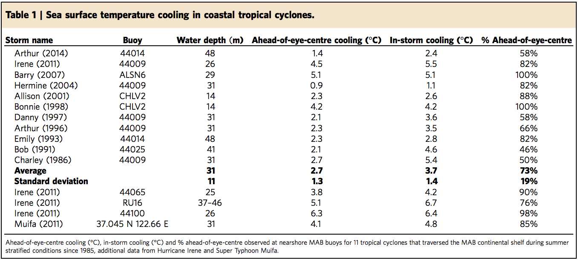
Glider w/ ADCP
Glider
Glider

Slide 24
Chapter 2
Spatiotemporal variability of stratified coastal ocean cooling processes in MAB hurricanes
Full range of storm “personalities” in atm. & OCEAN
  Standard operational model performance metrics (e.g. HWRF) take mean across all storms simulated
Investigate spatiotemporal variability of stratified coastal ocean cooling response over MAB continental shelf for Barry (2007), Irene (2011), and Arthur (2014)
  Dominant processes? Details?
    Vertical mixing or (horiz or vert) advection?
    Cross-shore and/or along-shore shear across thermocline?
    How far offshore, upshelf/downshelf does PGF=wind stress dominate?

Slide 25
Chapter 2
Spatiotemporal variability of stratified coastal ocean cooling processes in MAB hurricanes
Implications:
  Informs sampling strategies for future coastal ocean observatories for TCs
    Target extent of MAB Cold Pool?
    Target areas of greatest remaining uncertainty? Near Hudson Canyon?
  Improves modeling of full range of stratified coastal ocean TC response
    Target sampling not just for initial conditions (IC) but also for physical responses (forward integration)
    →Improved data assimilation (IC) + parameterizations/modeling of important processes (forward integration)

Slide 26
Chapter 2
Spatiotemporal variability of stratified coastal ocean cooling processes in MAB hurricanes
Methods:
Evaluate existing ROMS ESPreSSO
  Is pre-storm stratification adequate? (yes for Irene; TBD for Barry, Arthur)
Re-run ESPreSSO with diagnostics turned on (force balances, temp diagnostics)- can use Yi’s Irene run
  Use NAM winds first, then maybe WRF winds
Compare ESPreSSO runs to obs.
  T:
    Glider profile, buoy surface (Barry, Irene, Arthur)
  Currents:
    Glider depth-avg + CODAR surface for bottom currents (Barry, Irene, Arthur)
    Glider profile (Arthur only- ADCP)

Slide 27
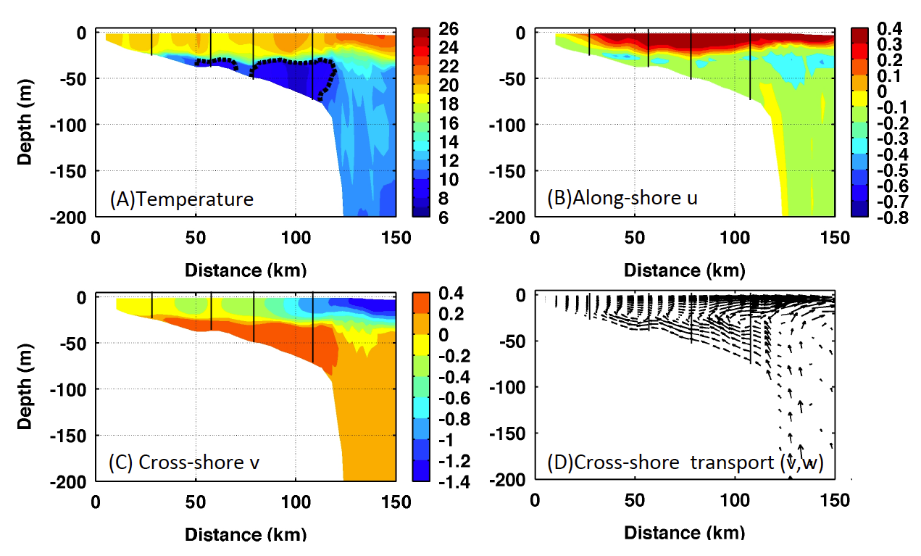
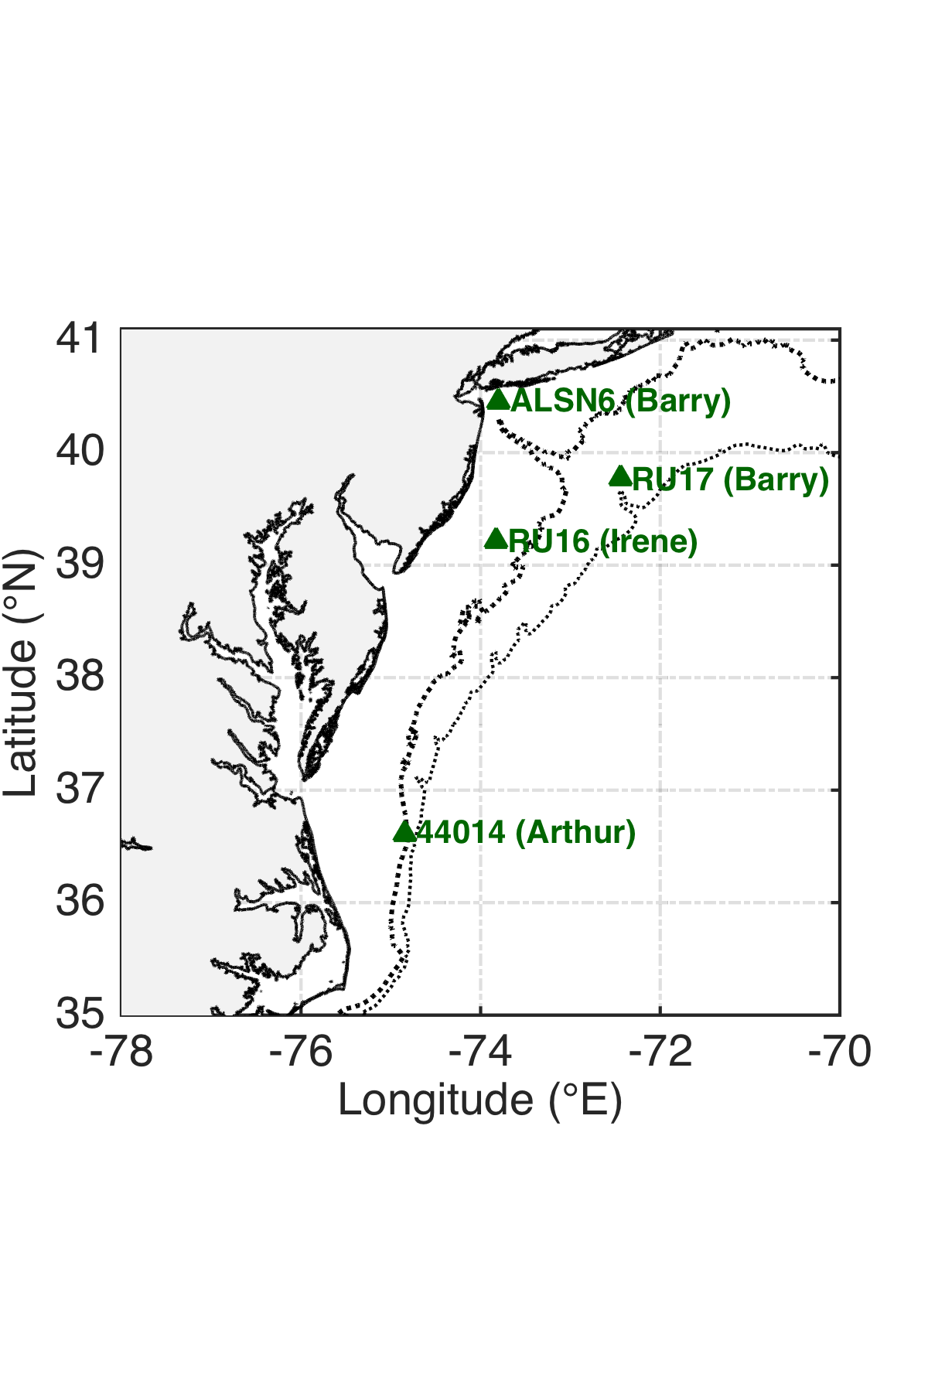
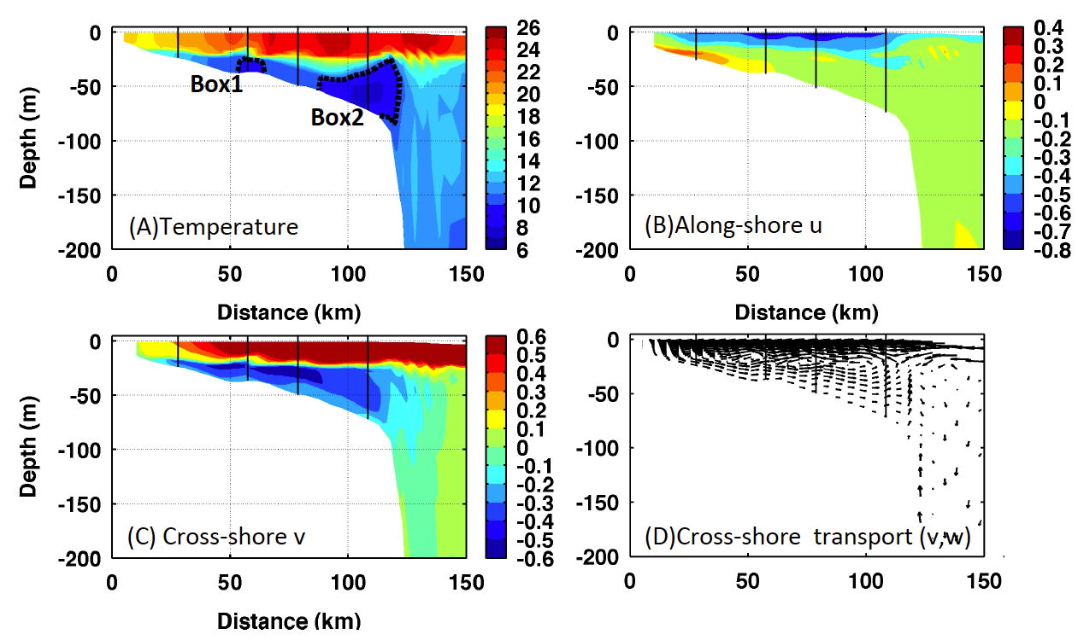
Chapter 2
Methods (cont’d):
Sample ESPreSSO at 3-4 MAB cross sections
  Temperature; u, v before/during/after storm
Irene example from Yi
Endurance line?

Slide 28
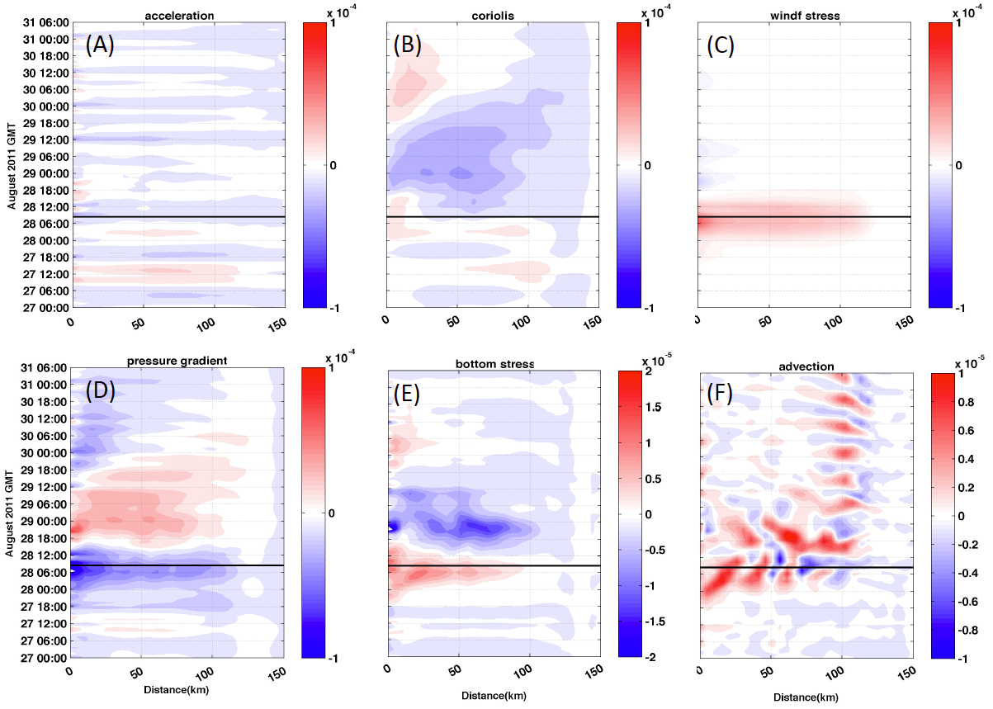
Chapter 2
Methods (cont’d):
Sample ESPreSSO at 3-4 MAB cross sections
  Hovmoeller of depth-avg forces: cross-, along-shelf
Irene example from Yi
Endurance line?

Slide 29
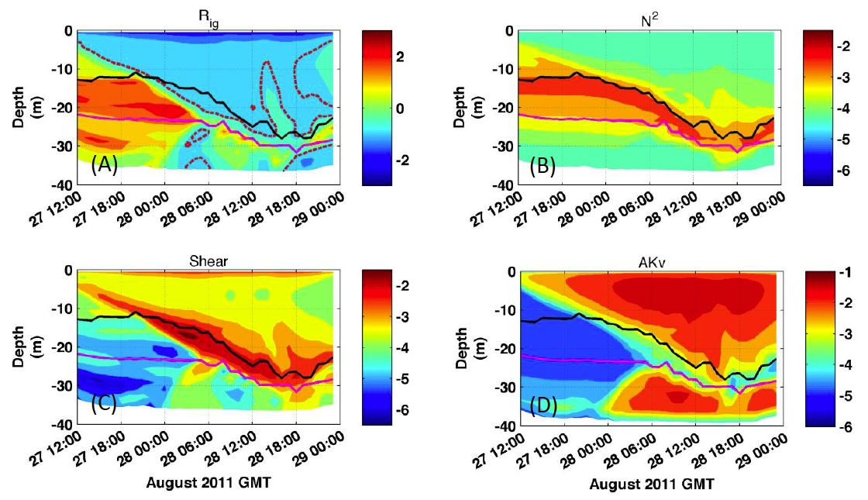
Chapter 2
Methods (cont’d):
Sample ESPreSSO at 3-4 MAB cross sections
    Hovmoeller of
    Ric# (tcline avg)
Endurance line?
Ric # (tcline)
VS
Physics: Mixing or
Total (u,v,w)
advection?

Slide 30
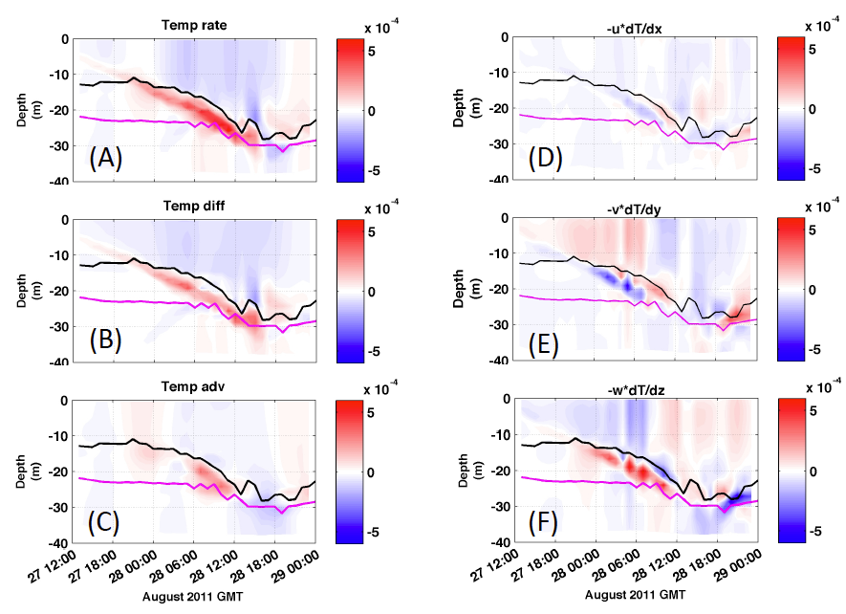
Chapter 2
Methods (cont’d):
3 pts: inshore, midshelf, shelf break
  Temperature diagnostic terms at each point:
Thermal response:
Due to vertical mixing or
advection?

Slide 31
Chapter 3
Examination of Sea Breeze for Offshore Wind Energy using WRF and Lagrangian Coherent Structures

Slide 32
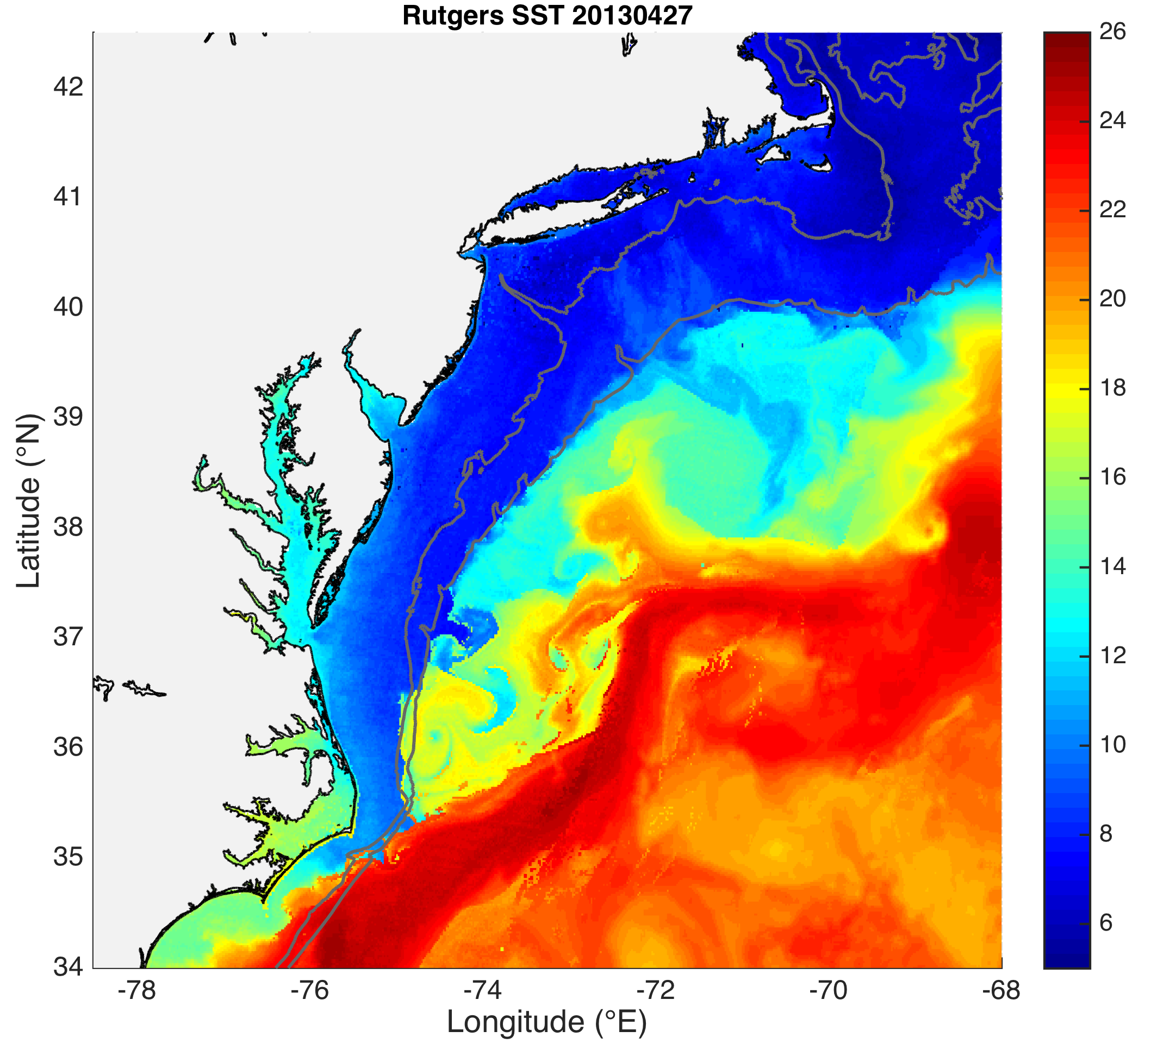
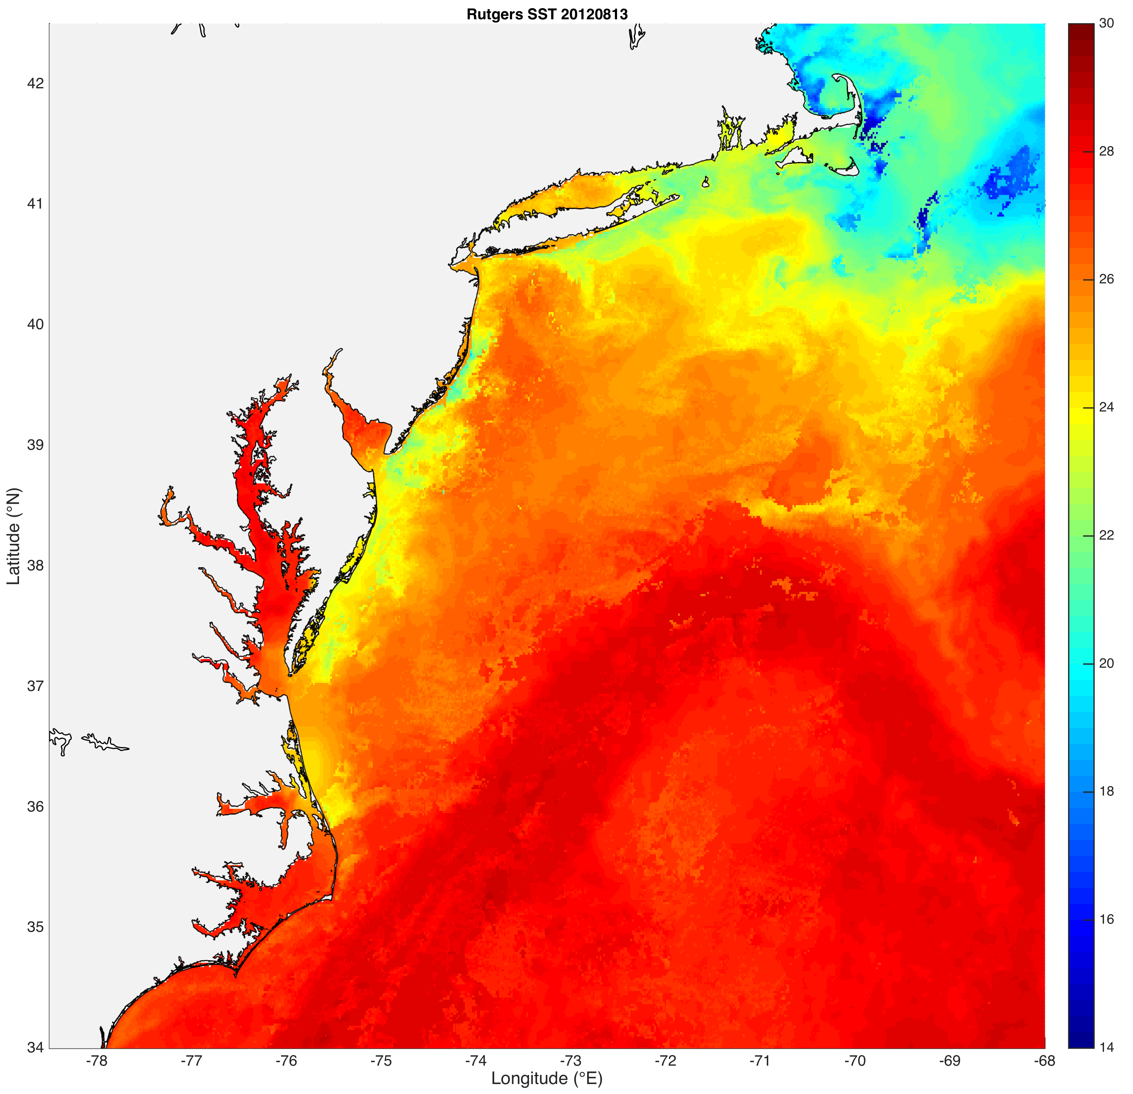
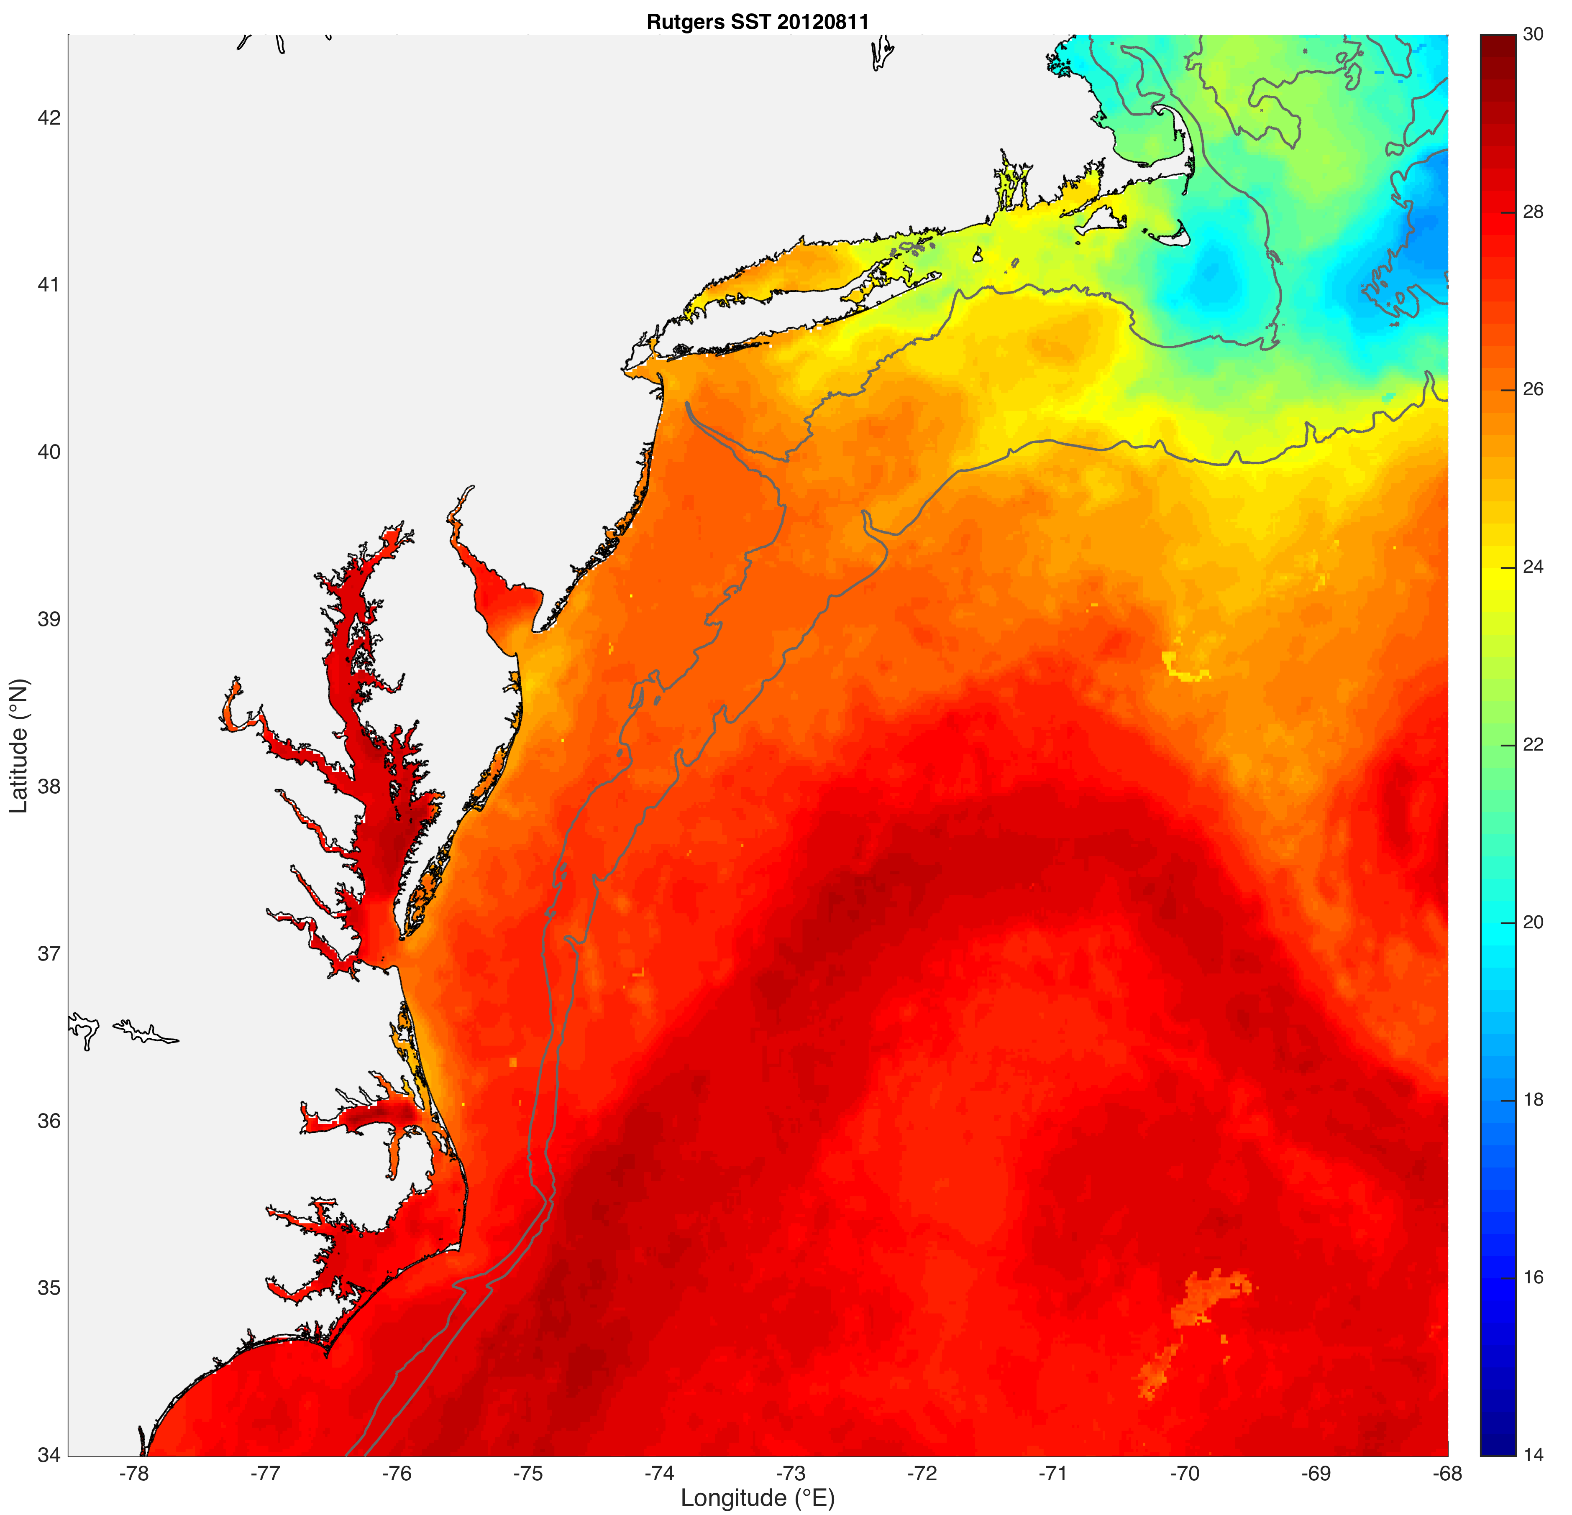
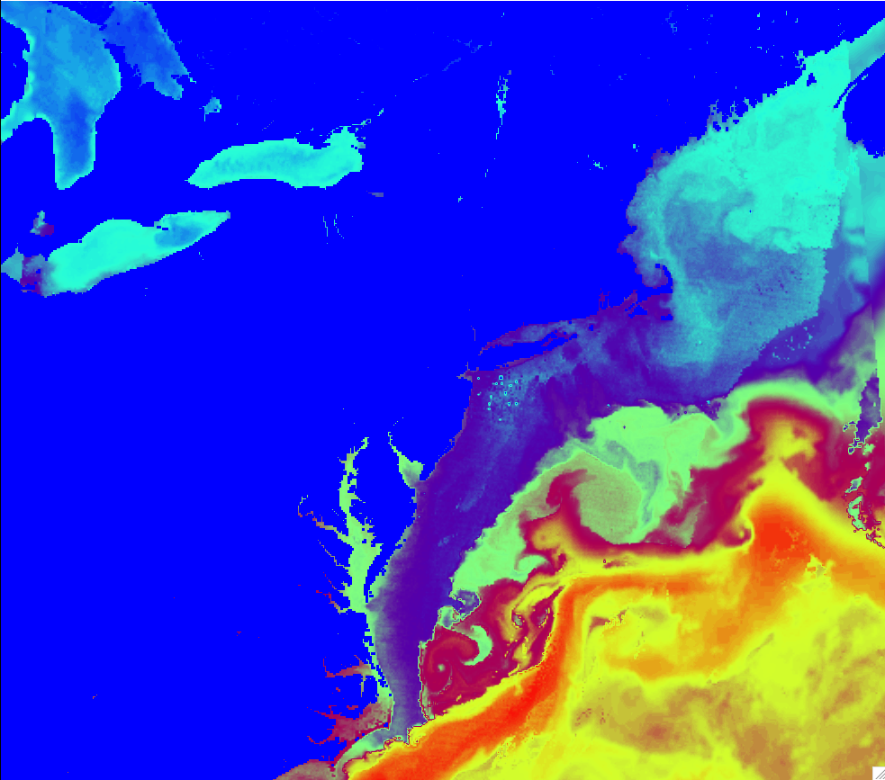
Fig 1
Case 1
Case 2
Case 3
As above but over full WRF domain
(to depict WRF domain)

Slide 33
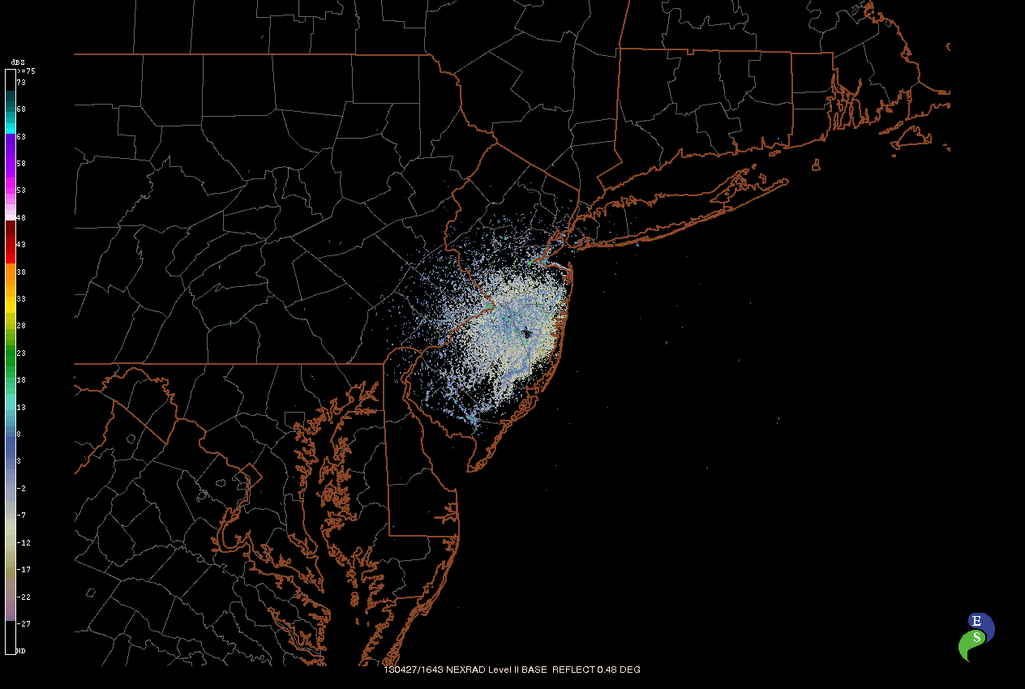
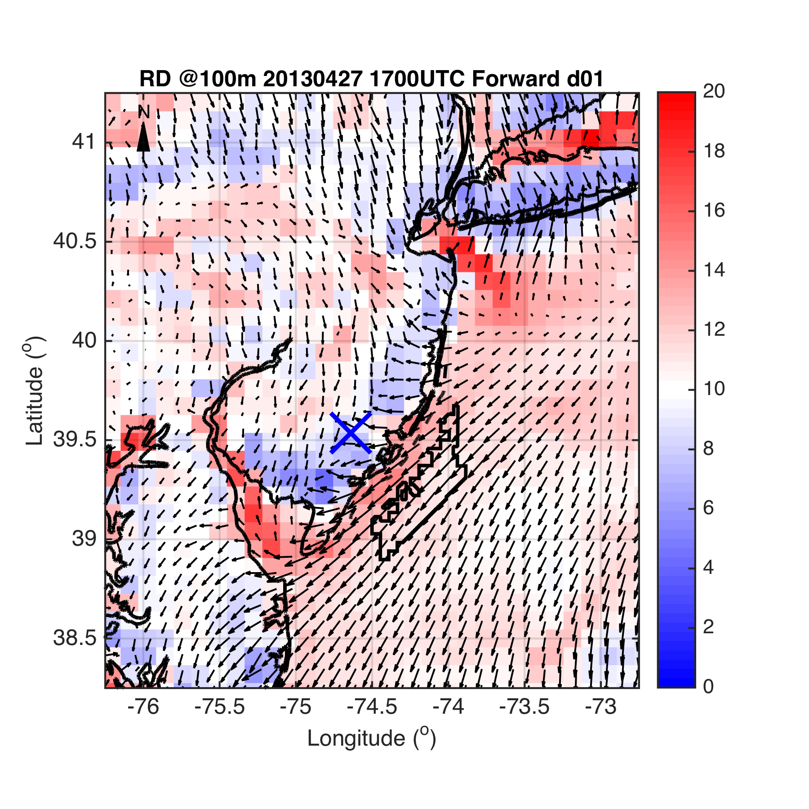
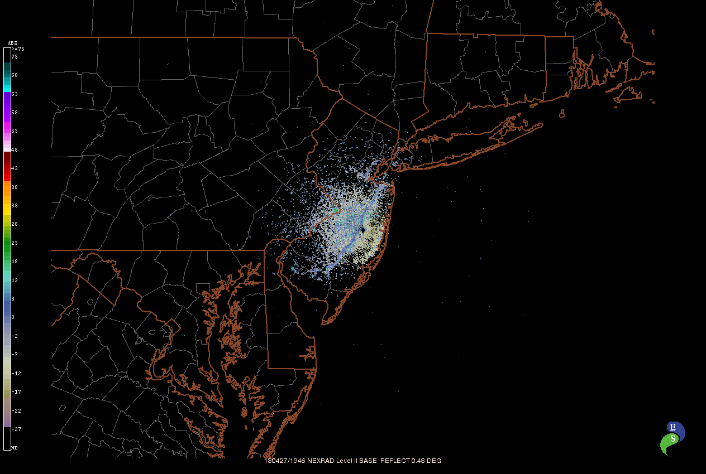
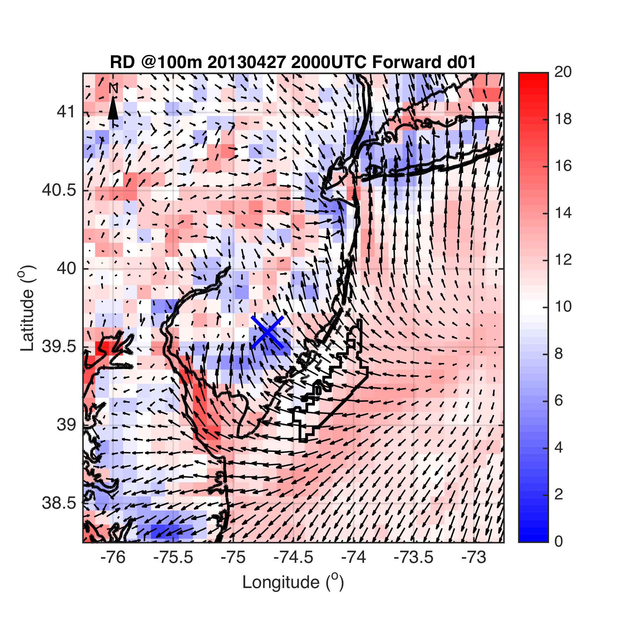
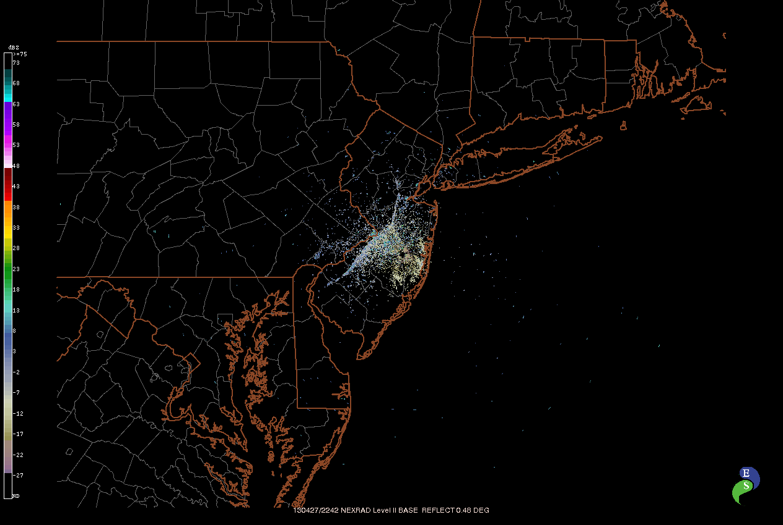
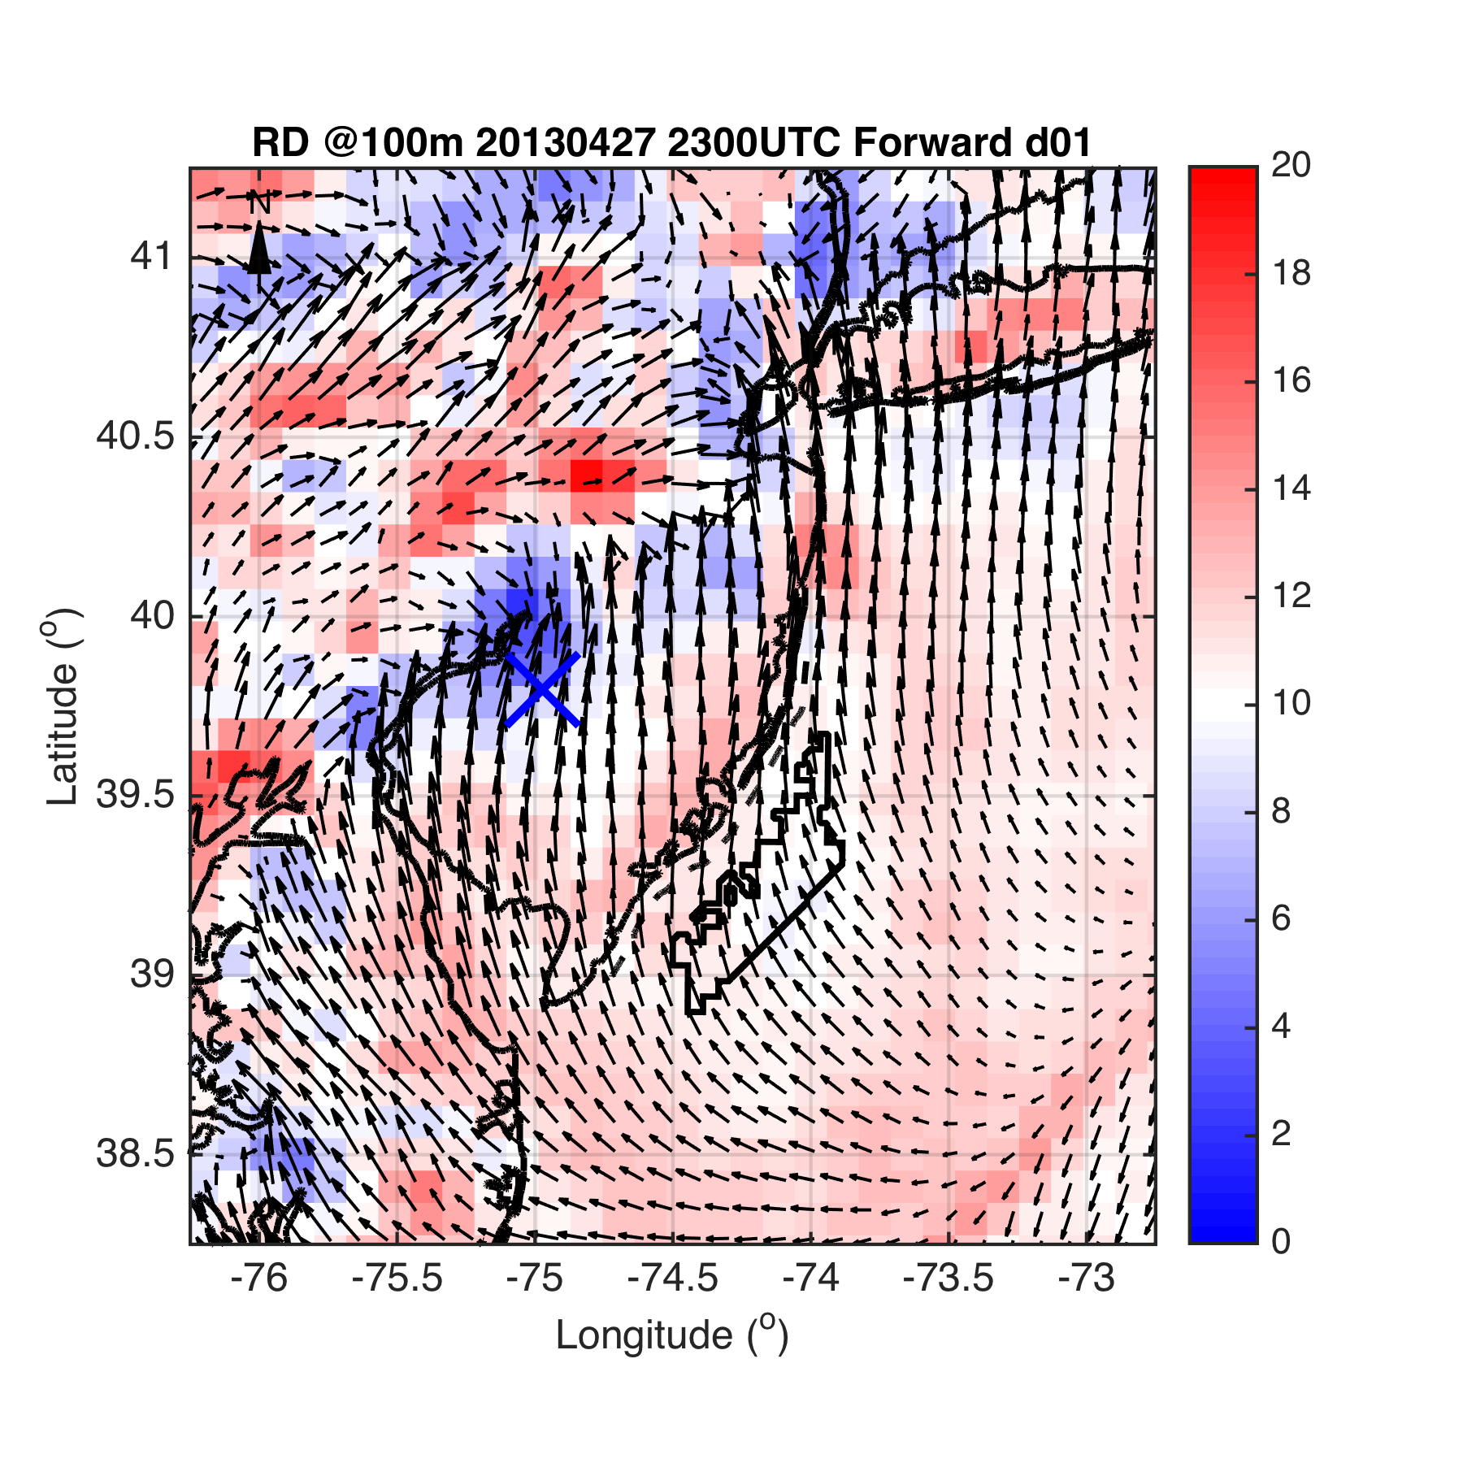
Case 1
Fig 2

Slide 34
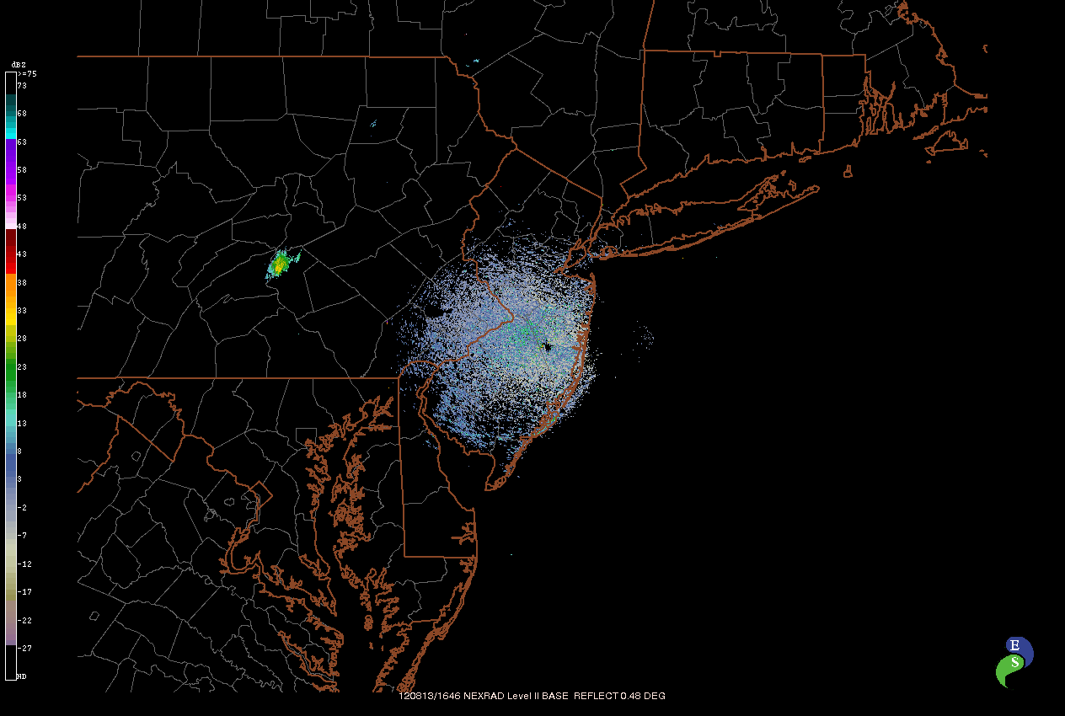
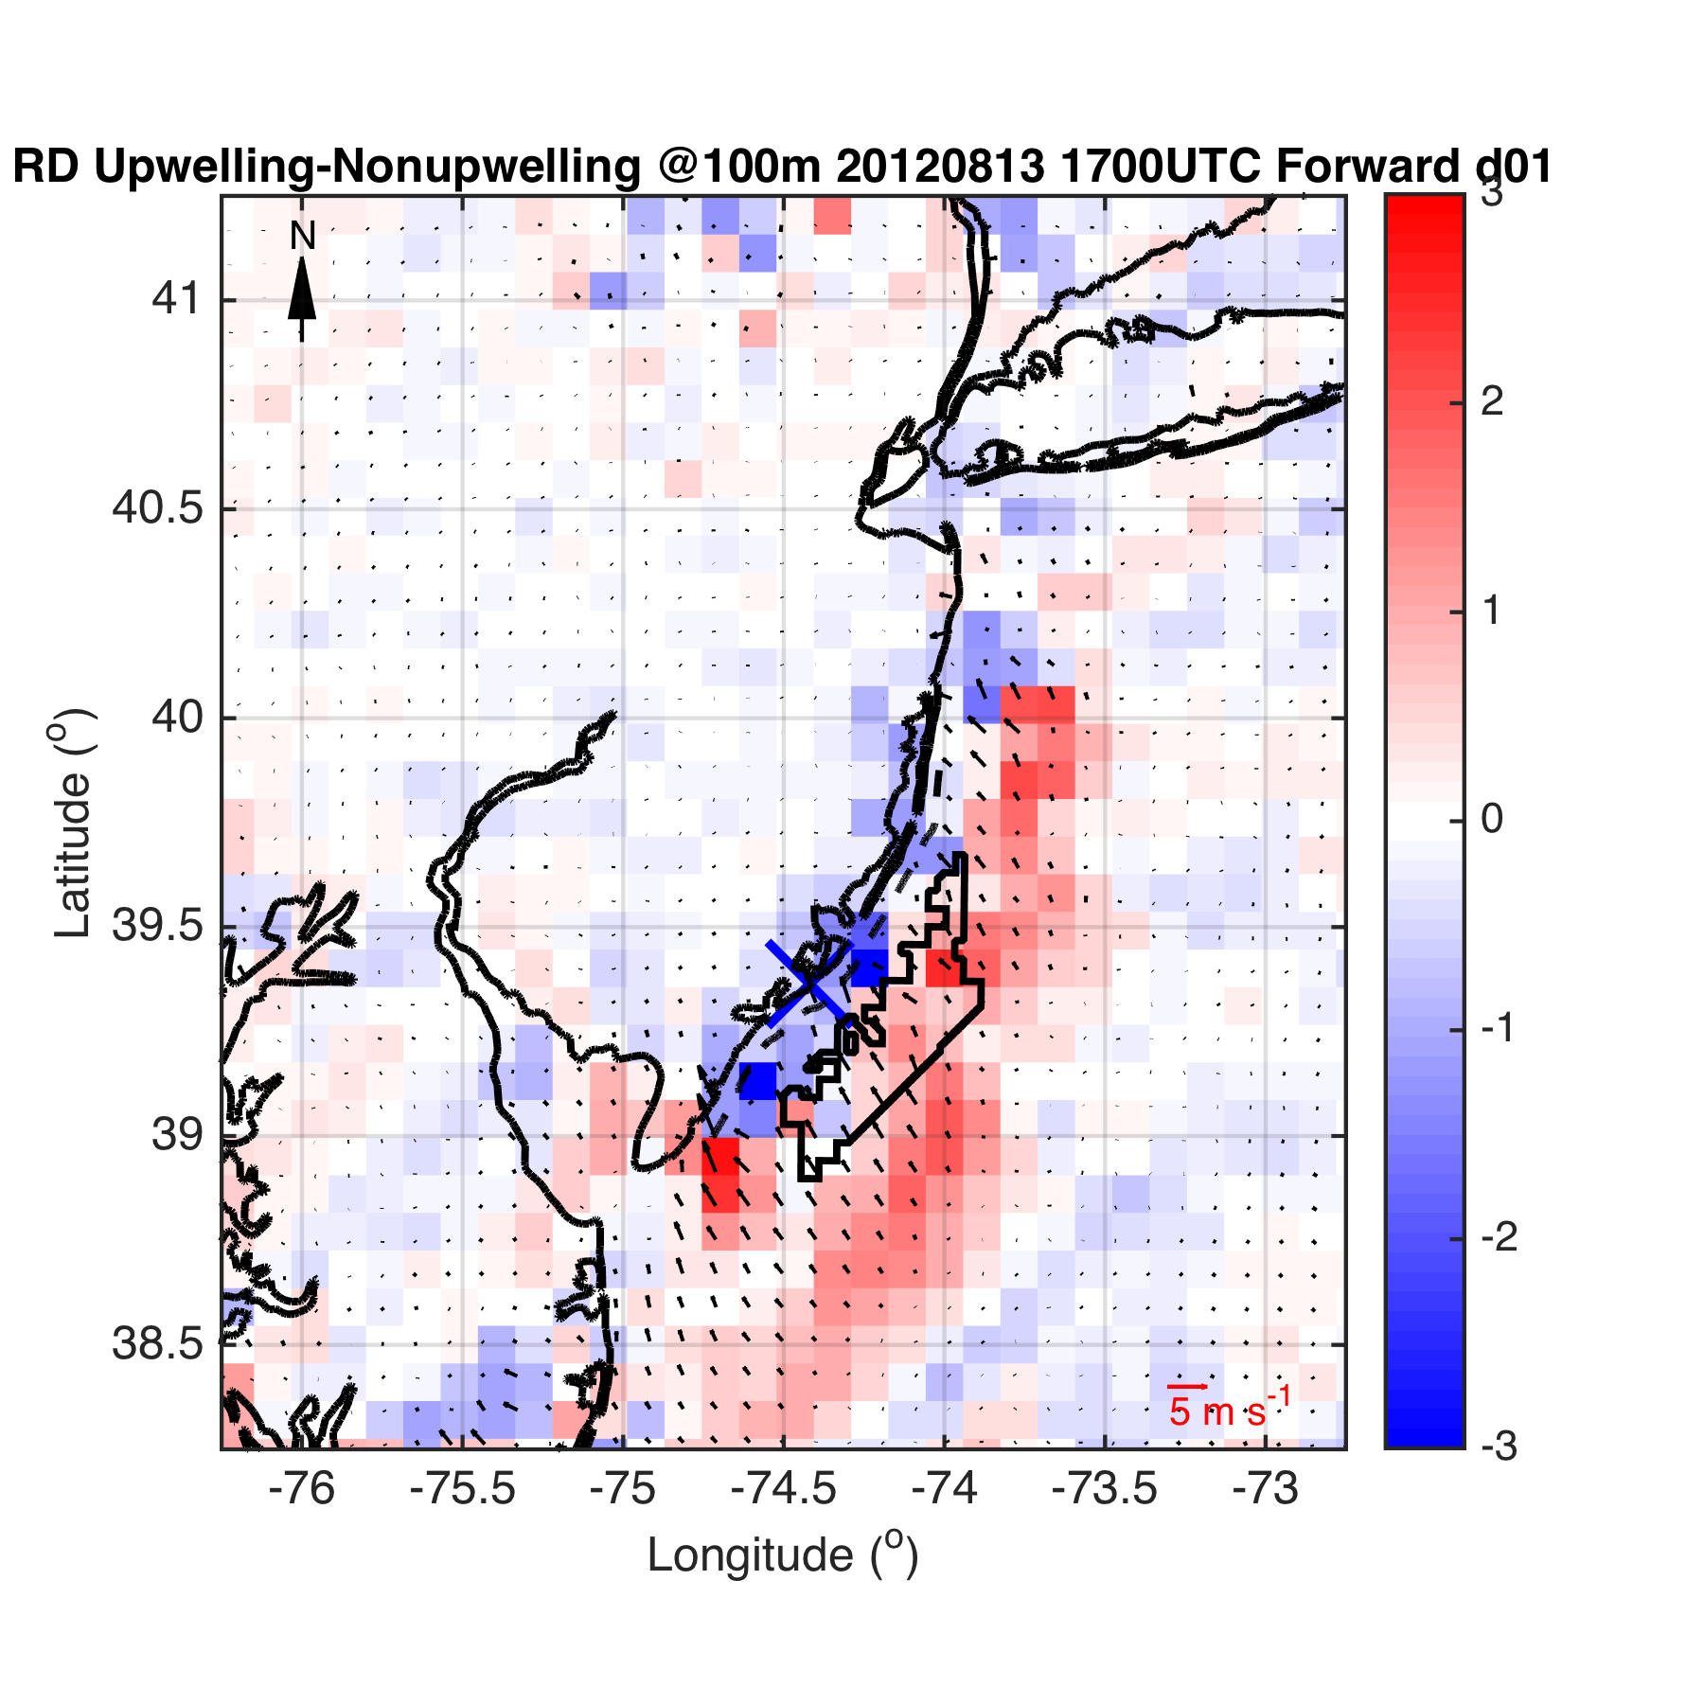
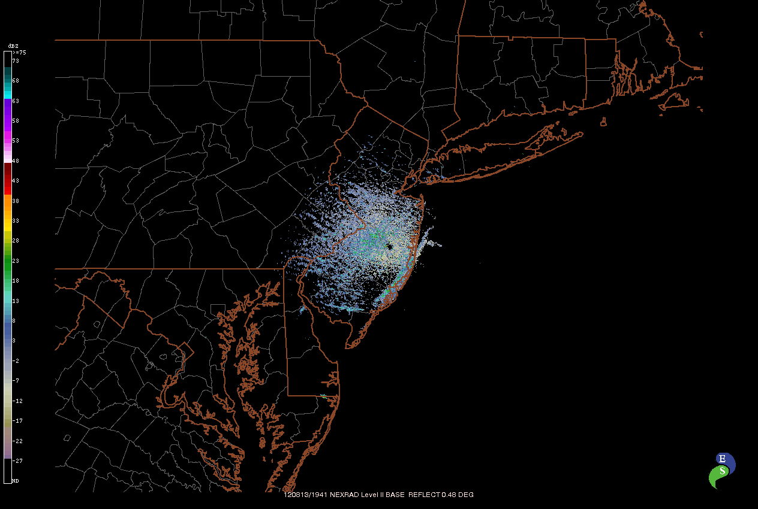
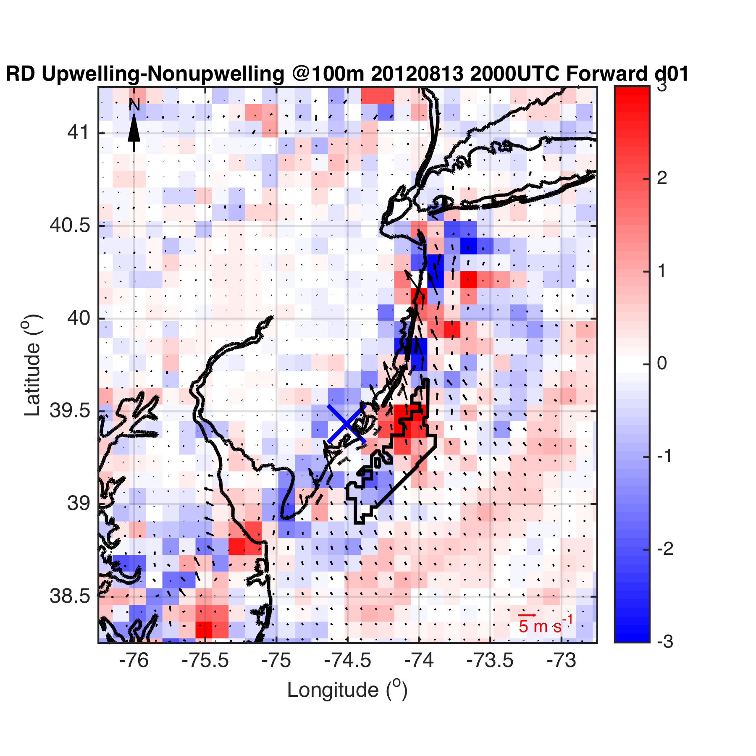
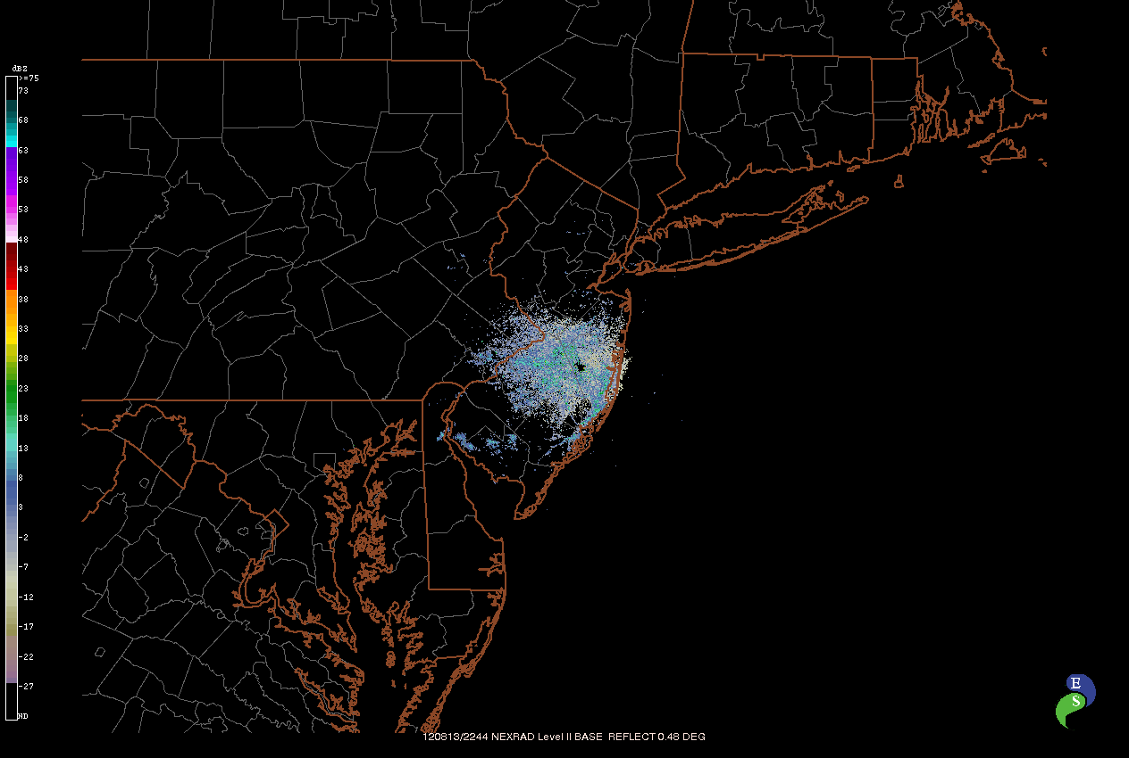
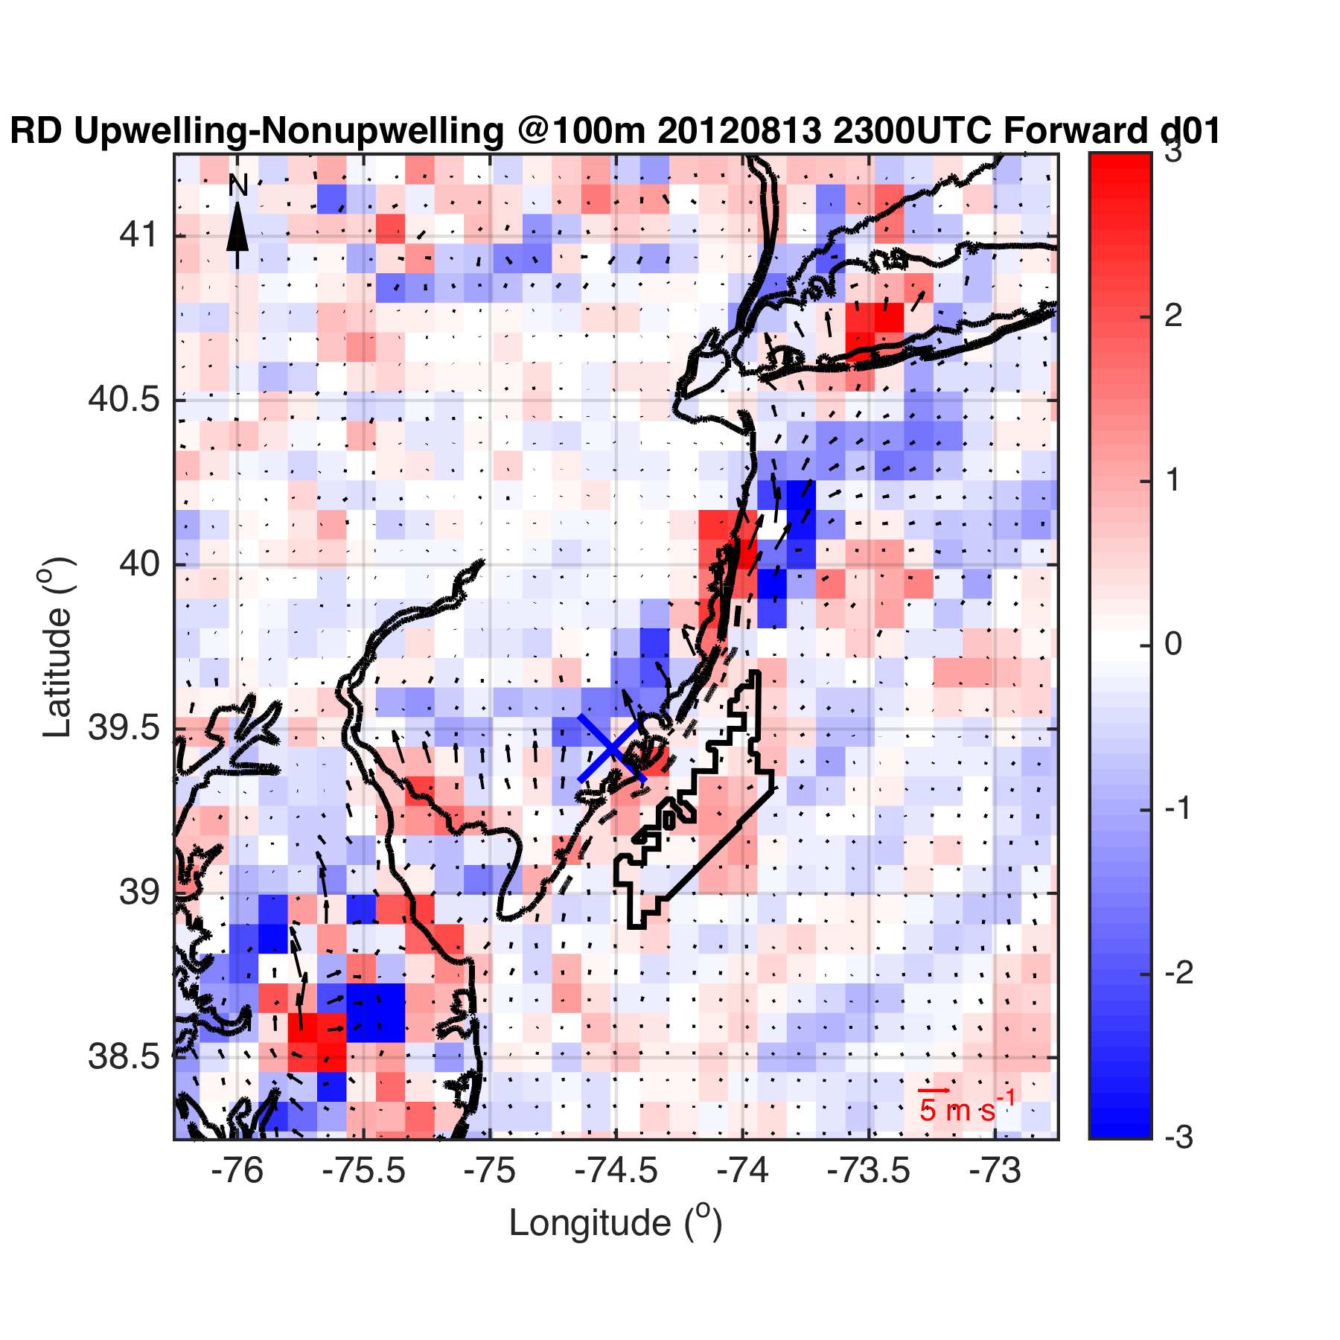
Case 2-
Case 3
Or
Case 2,
Case 3 separately?
Fig 3

Slide 35
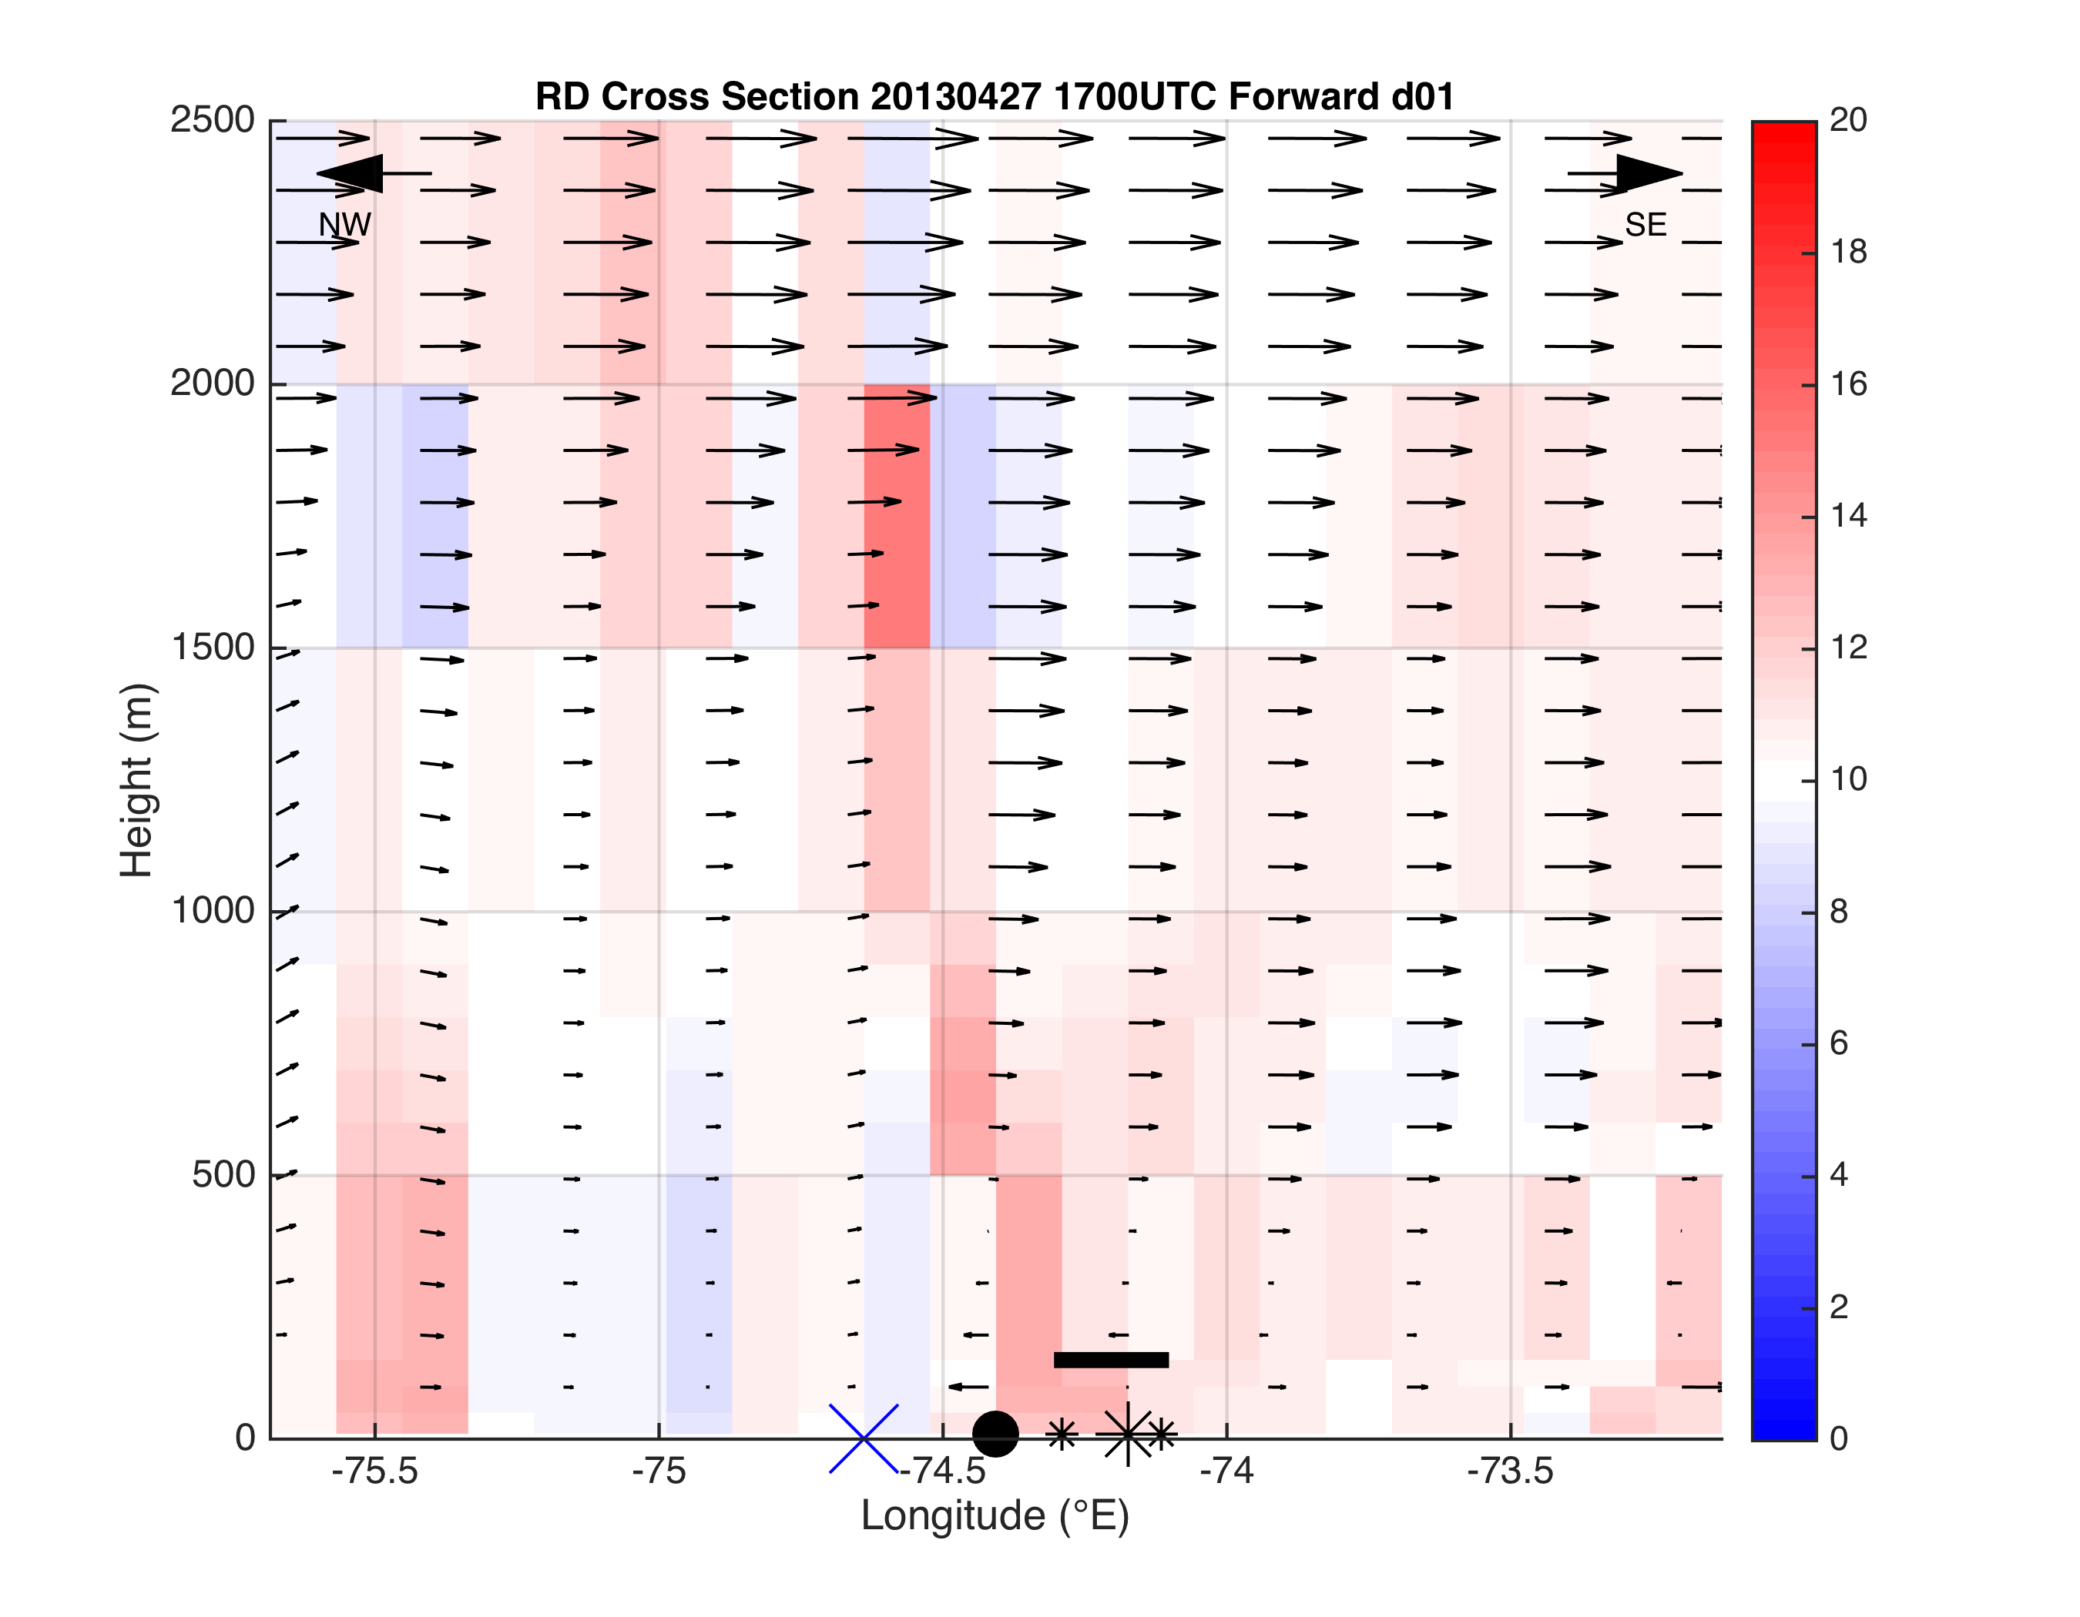
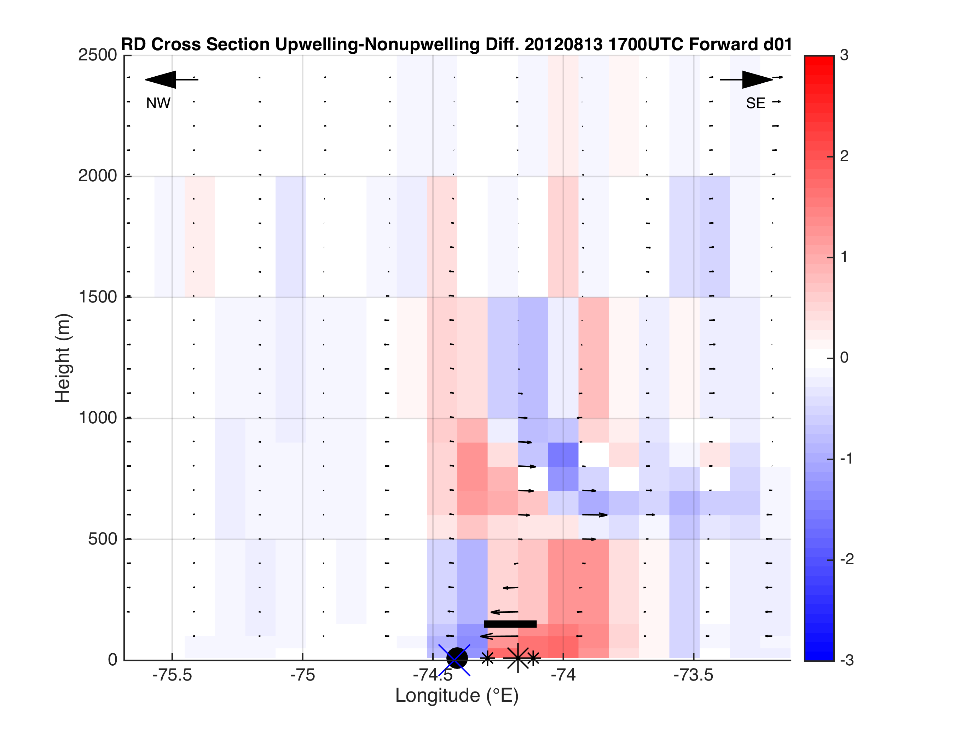
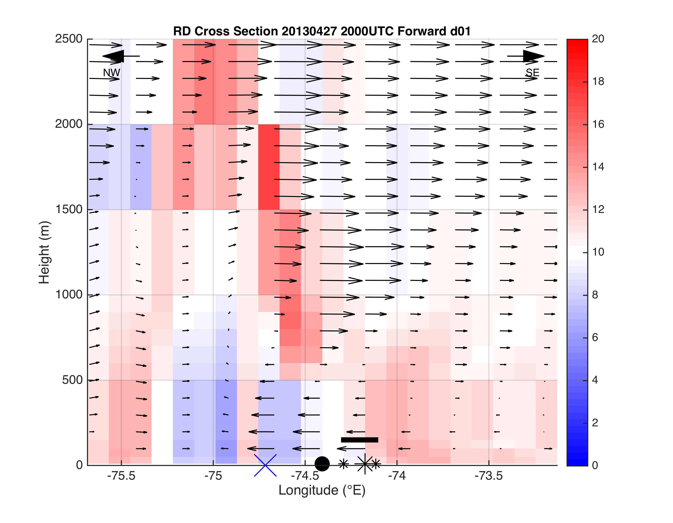
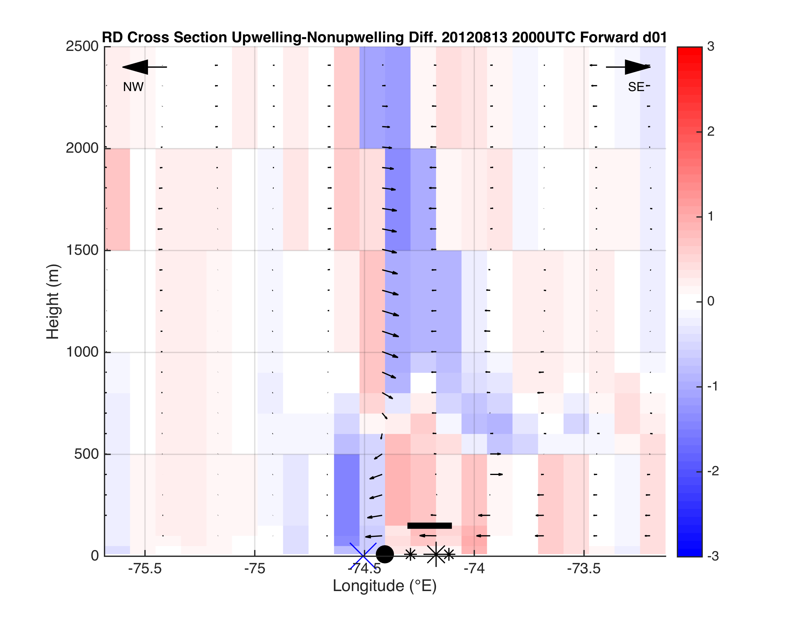
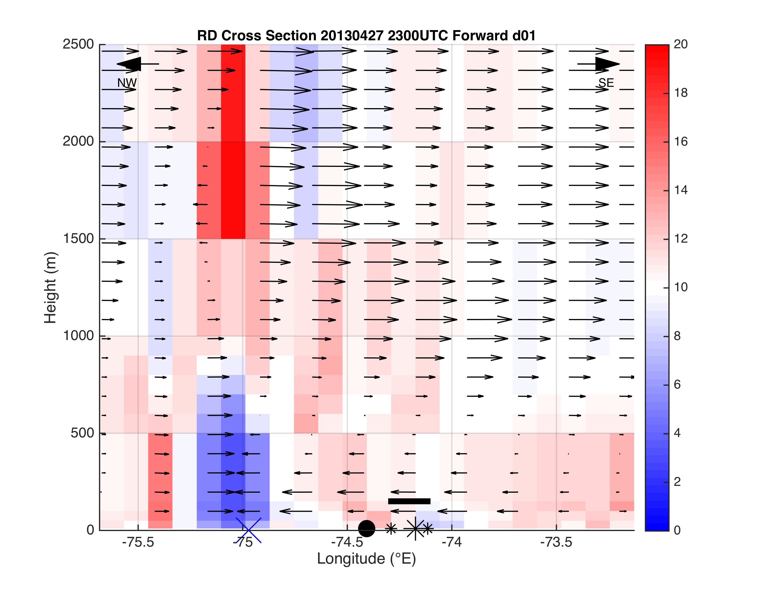
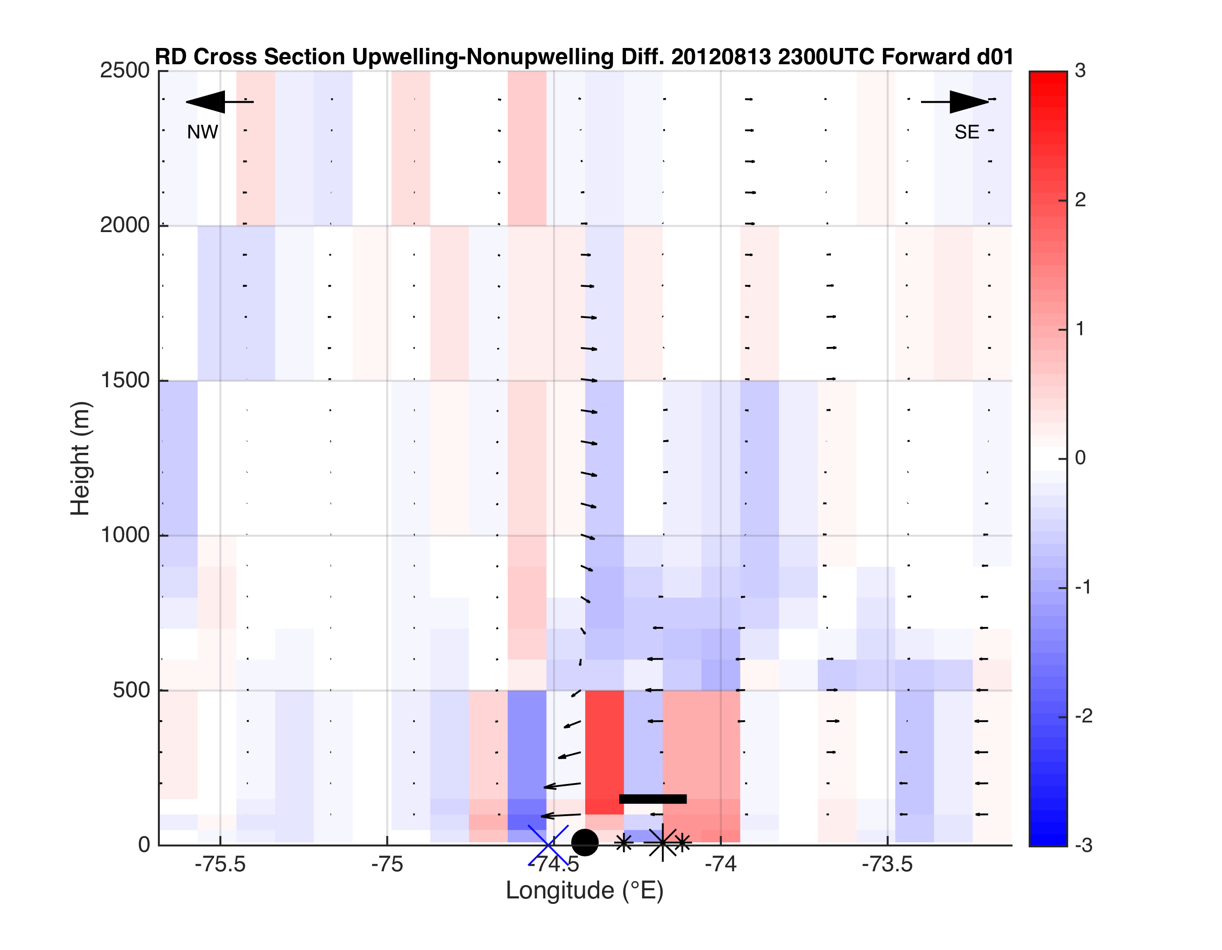
Case 1
Case 2-Case 3
Case 2-
Case 3
Or
Case 2,
Case 3 separately?
Fig 4

Slide 36
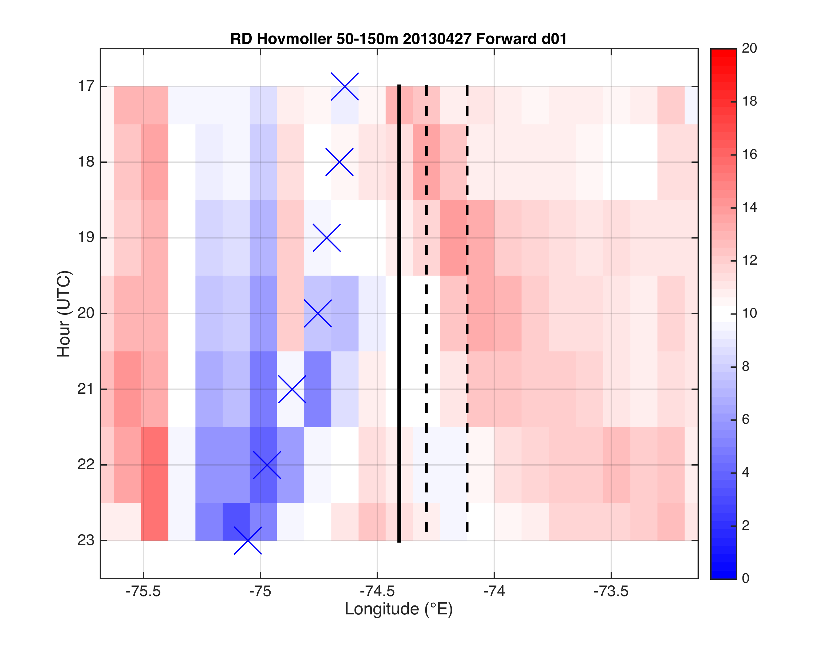
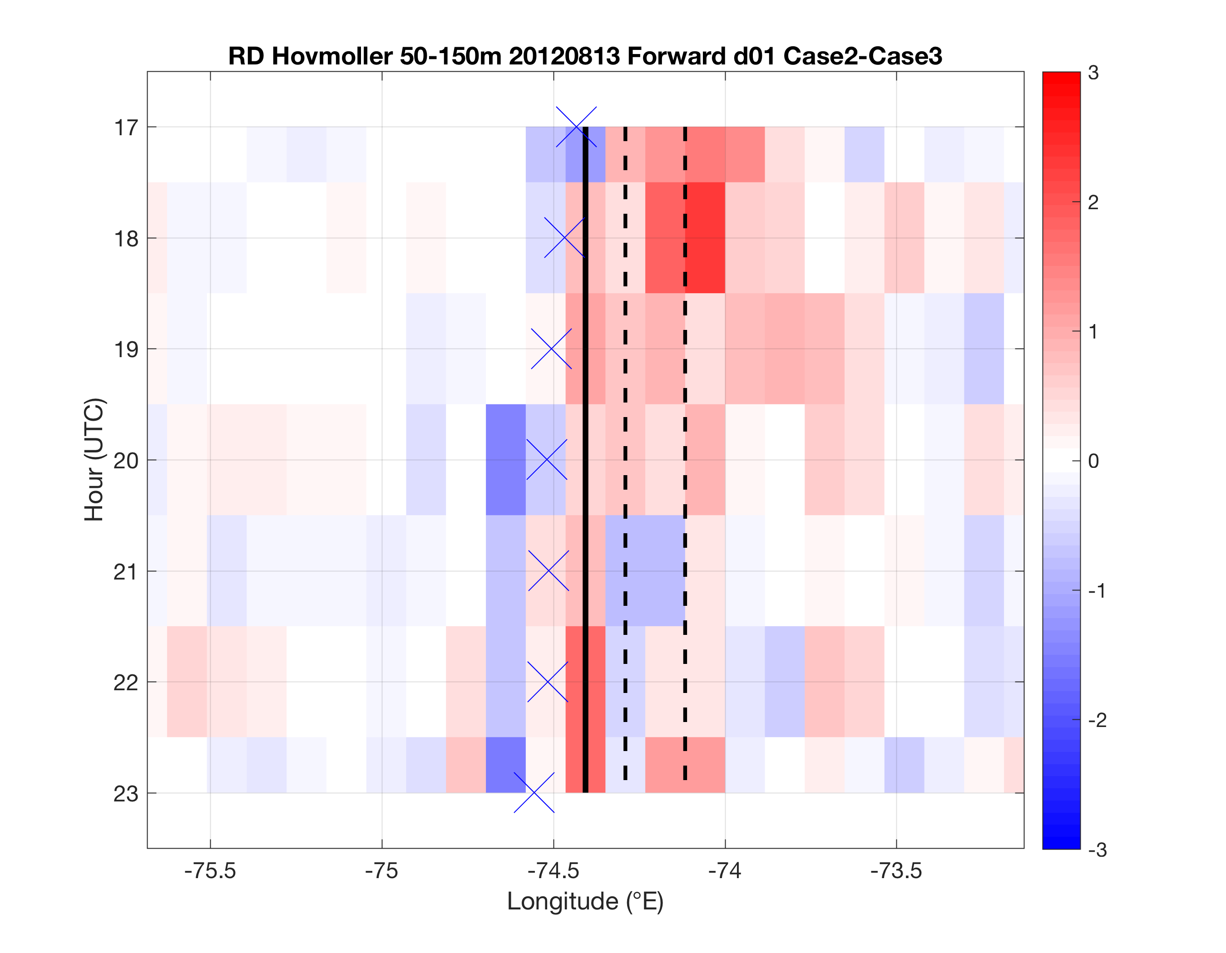
Case 2-
Case 3
Or
Case 2,
Case 3 separately?
Fig 5
Case 1
Case 2-Case 3

Slide 37
Final tasks
Hovmoller additions
  SST along cross section as bottom panel
  Distance on x-axis, 0 at coast, 0 at inland front
  Wind speed Hovmoller? (with vectors?)
  Correlation LCS vs. wind speed Hovmoller?
Time series of boxes
  LCS avg in 50-150m box over NJ WEA (Lagrangian) vs. wspd in box (Eulerian)- correlate wind speed and divergence?
  LCS avg in 50-150m box onshore same distance as offshore NJ WEA (Lagrangian) vs. wspd in box (Eulerian)- correlate wind speed and convergence?
Other time series
  Max convergence, divergence
  Width, height divergence
  Height of reversal from surface conv to aloft div
Sensitivity to MYNN vs. YSU PBL schemes
Increased vertical resolution of LCS between 150 and 1000m
LCS on CODAR for sea breeze
  Detided (method?) 10min shorts, gap filled with Fredj method

Slide 38
Work since 4/27 committee meeting
Look at along-shelf sensitivity to cross section location, add SST cross section to see its influence on relative dispersion

Slide 39
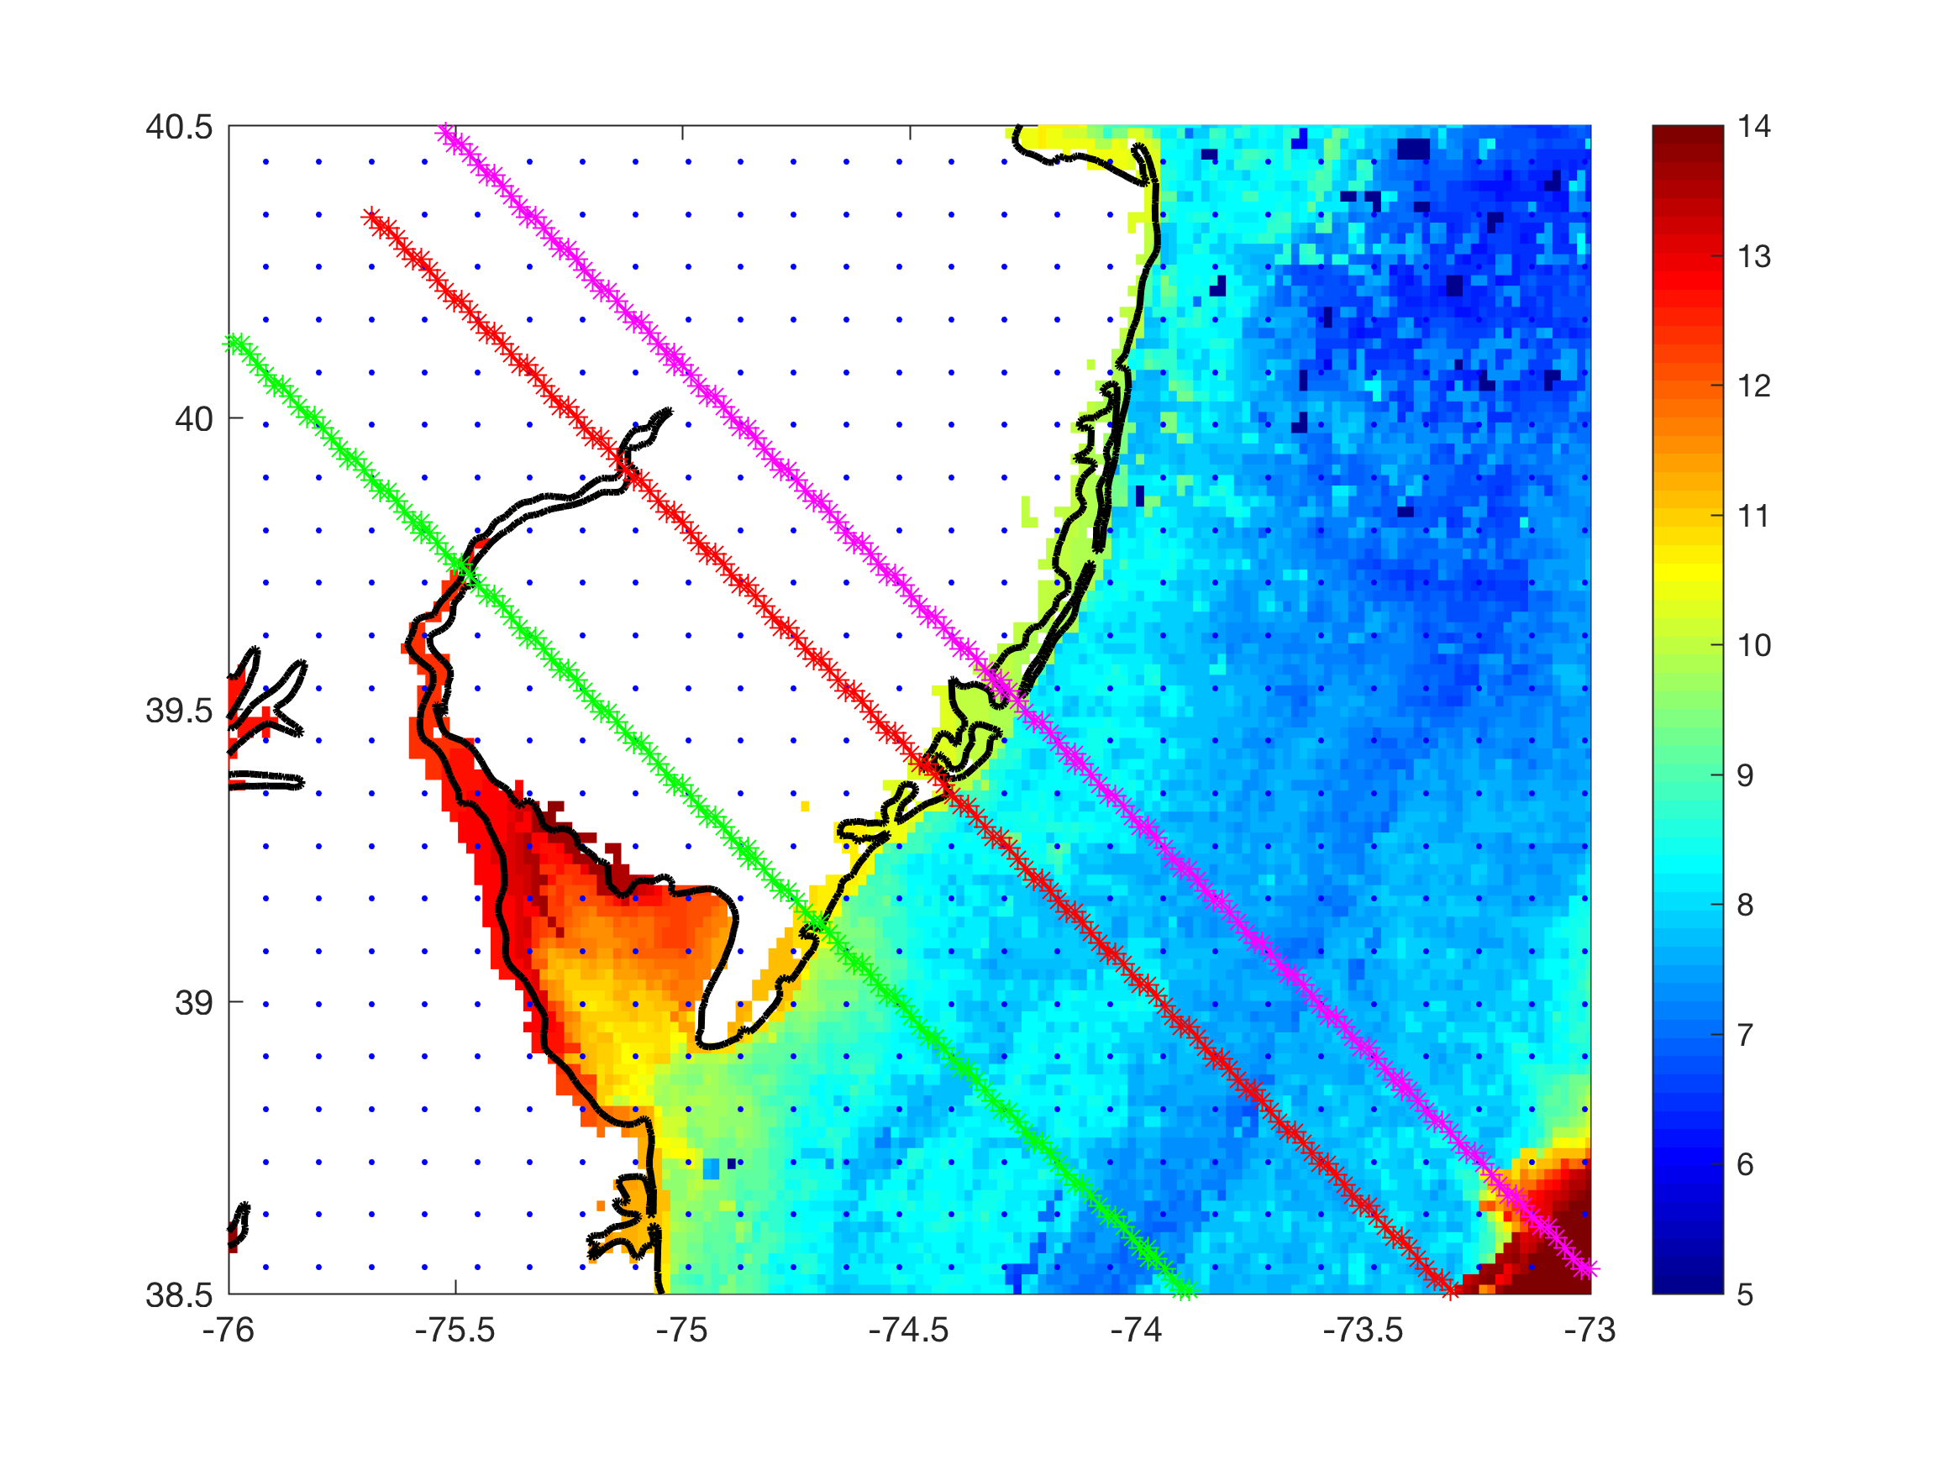
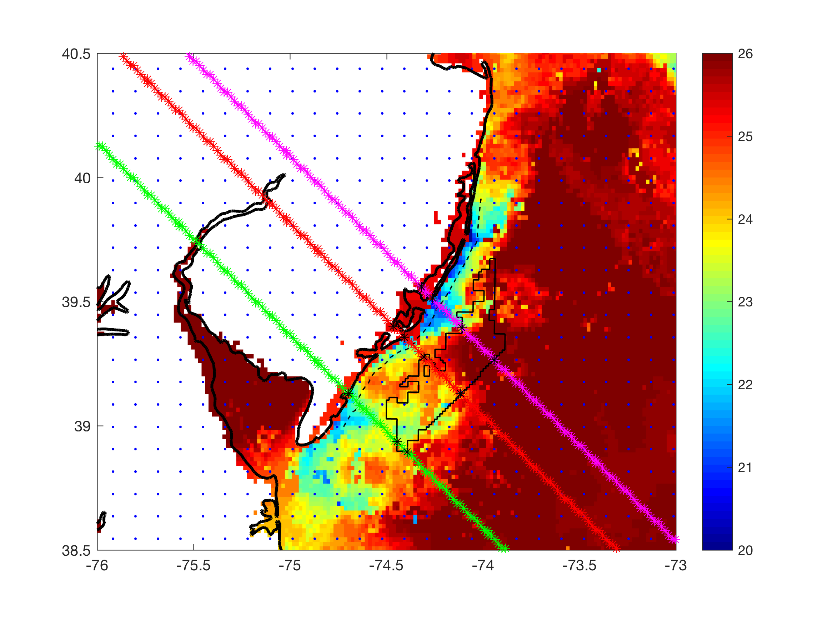
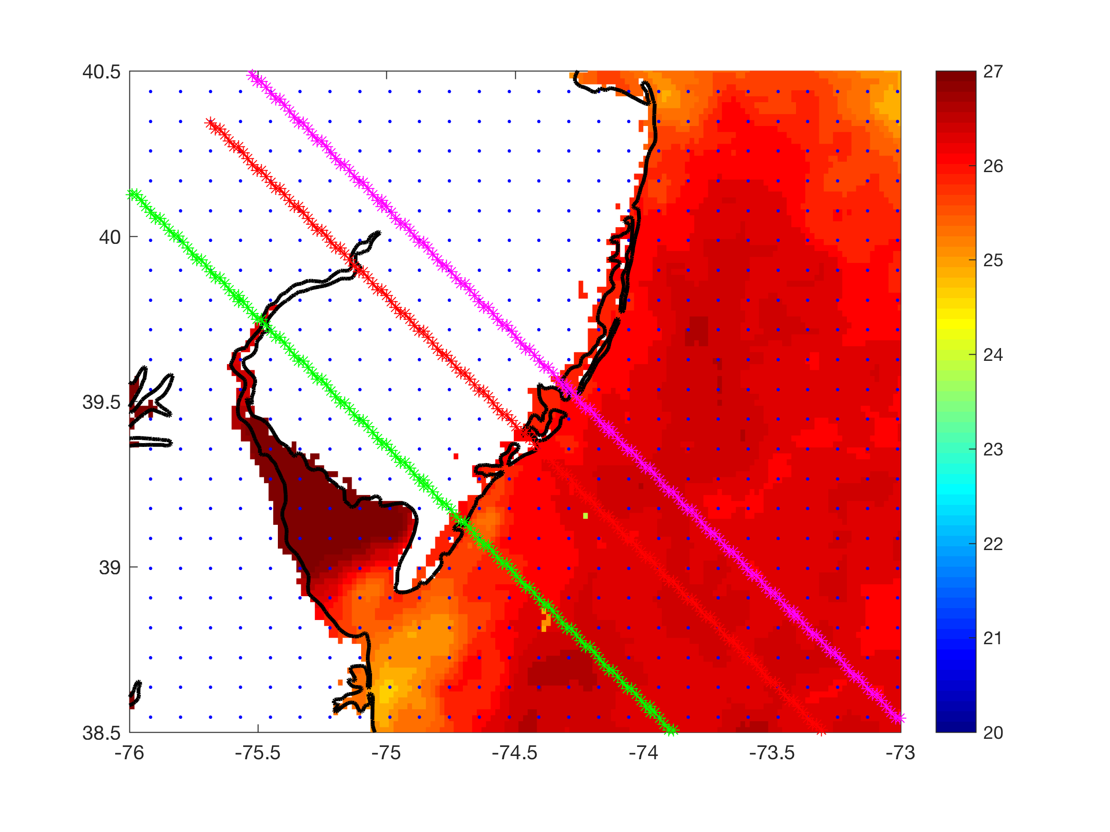
Cross section locations
Case 1
Case 3
Case 2

Slide 40
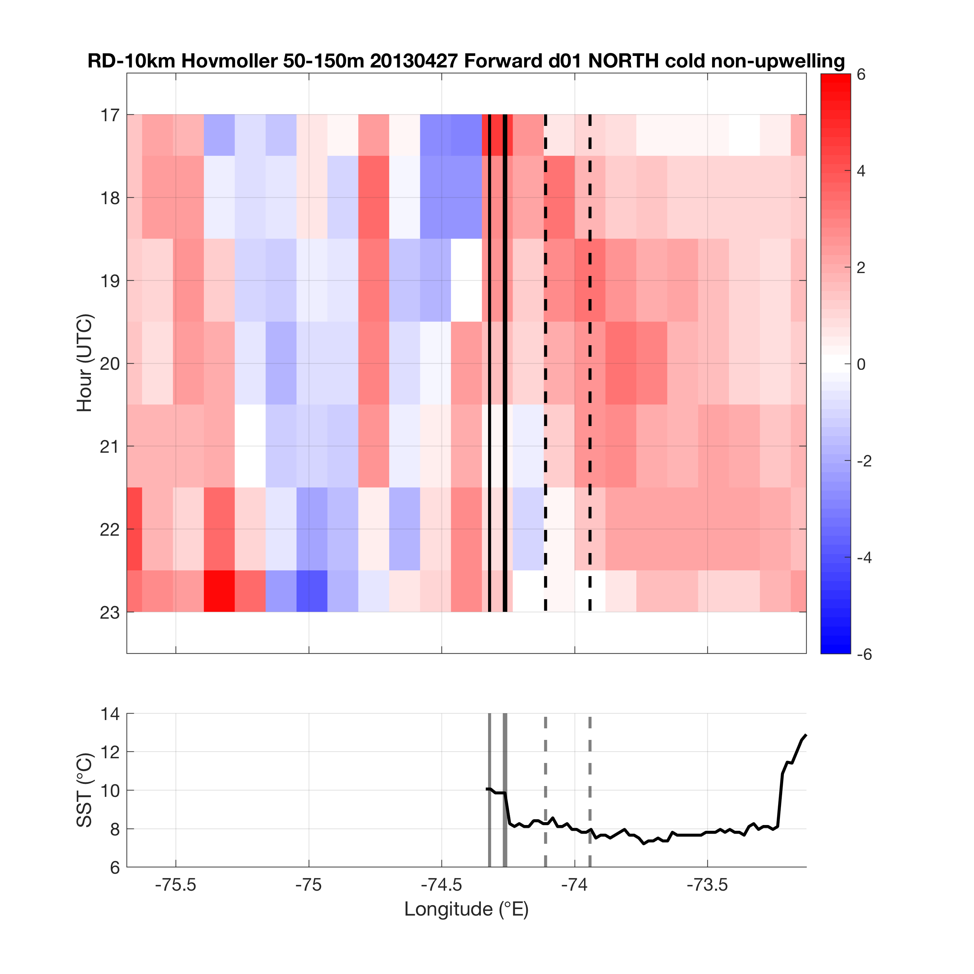
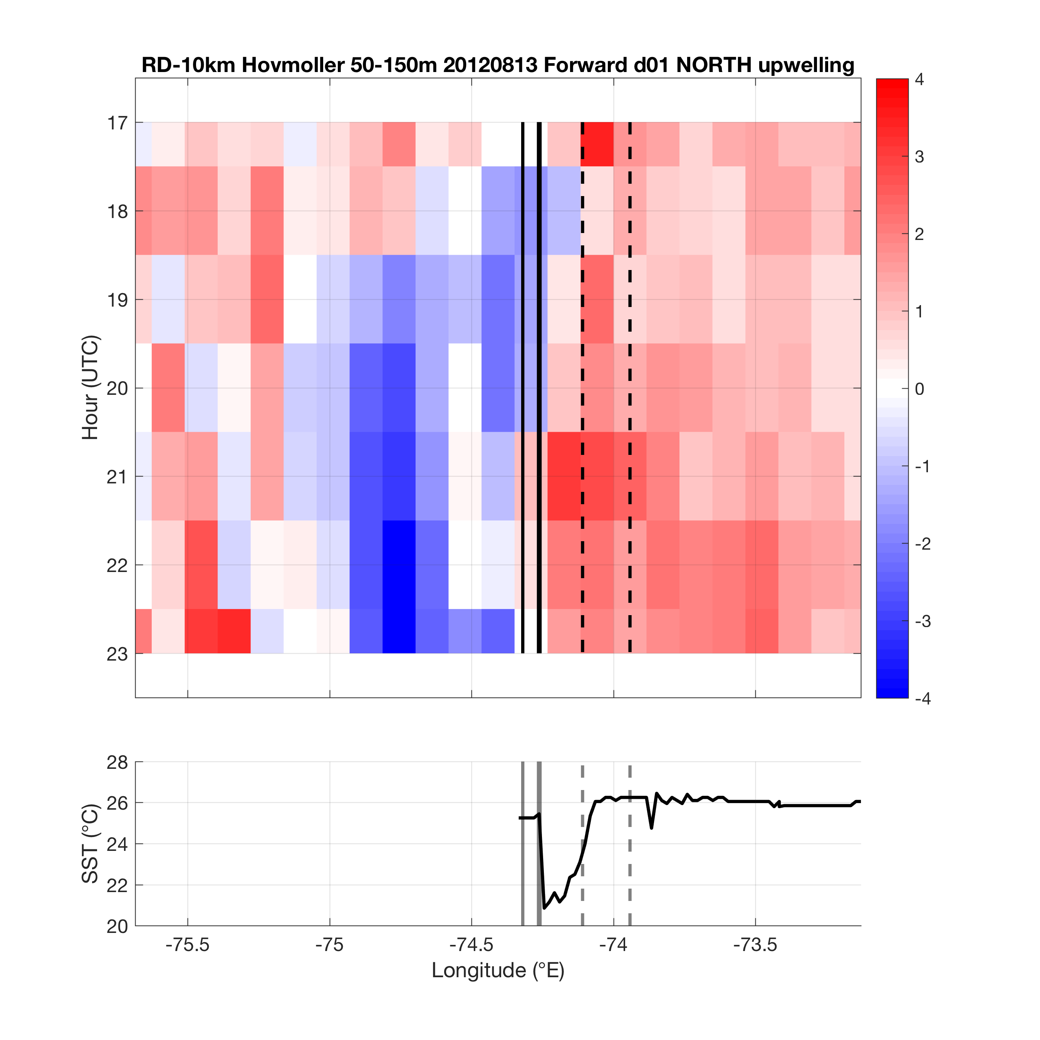
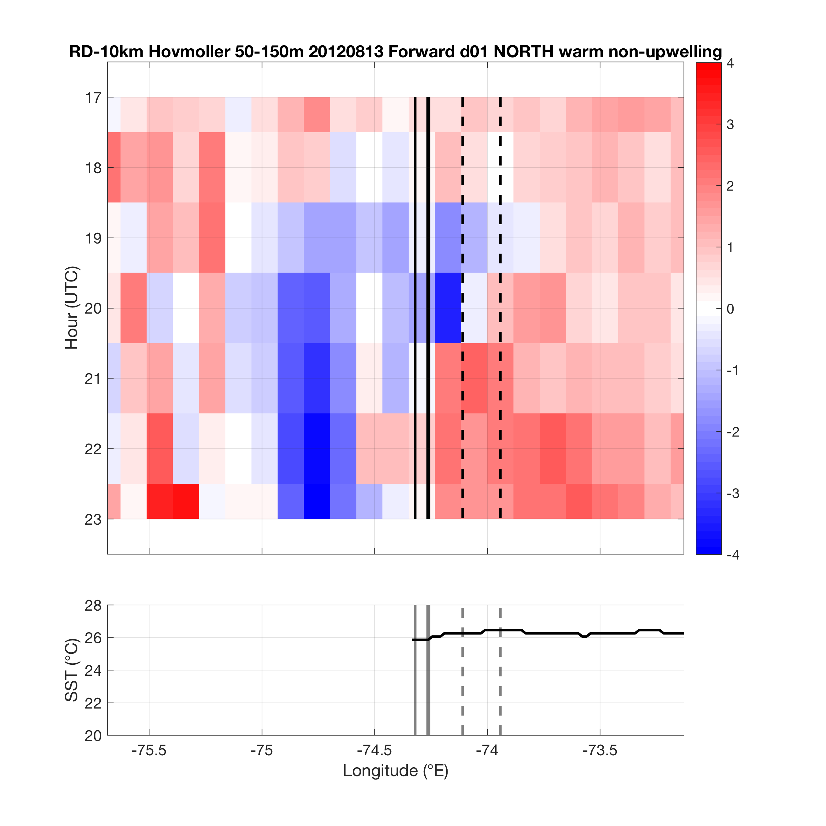
North (magenta)
Case 1
Case 2
Case 3

Slide 41
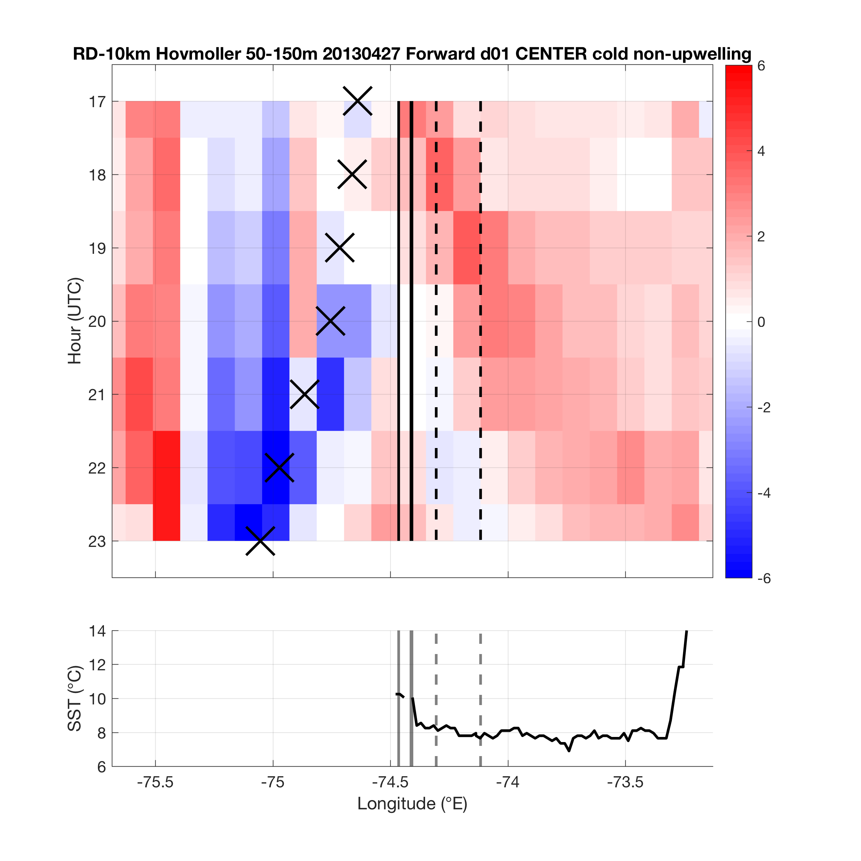
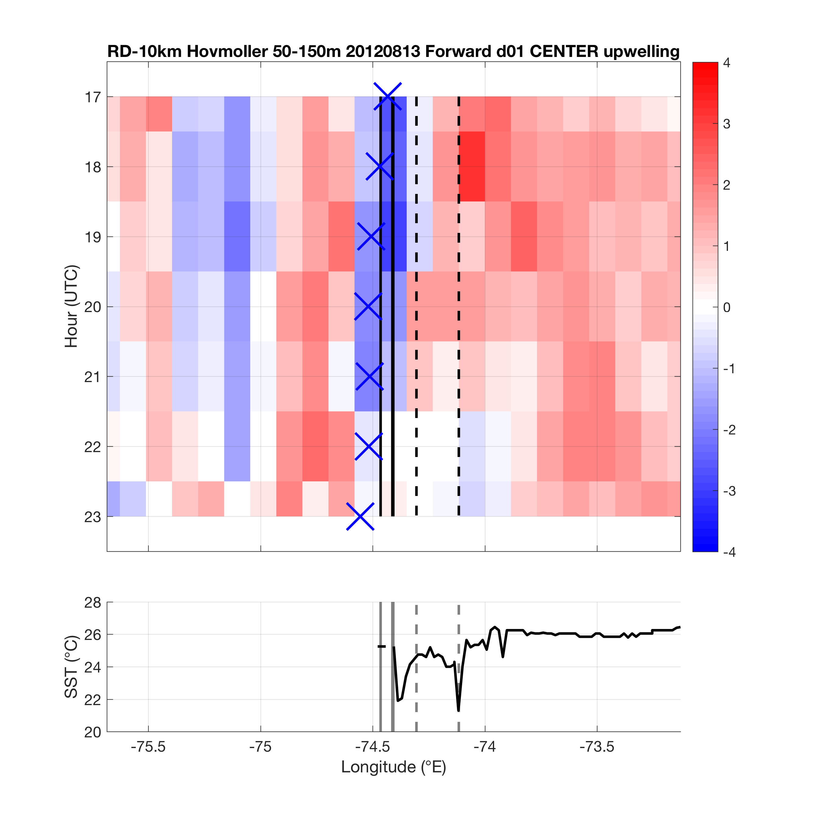
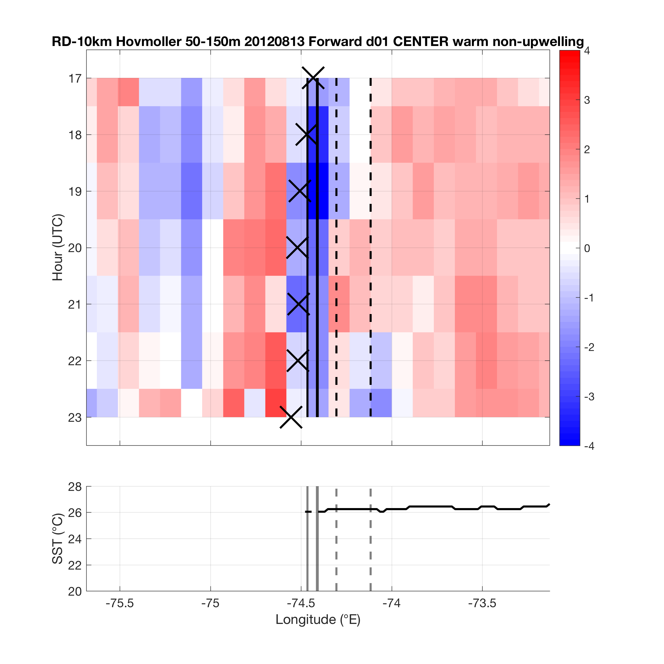
Center (red)
Case 1
Case 2
Case 3

Slide 42
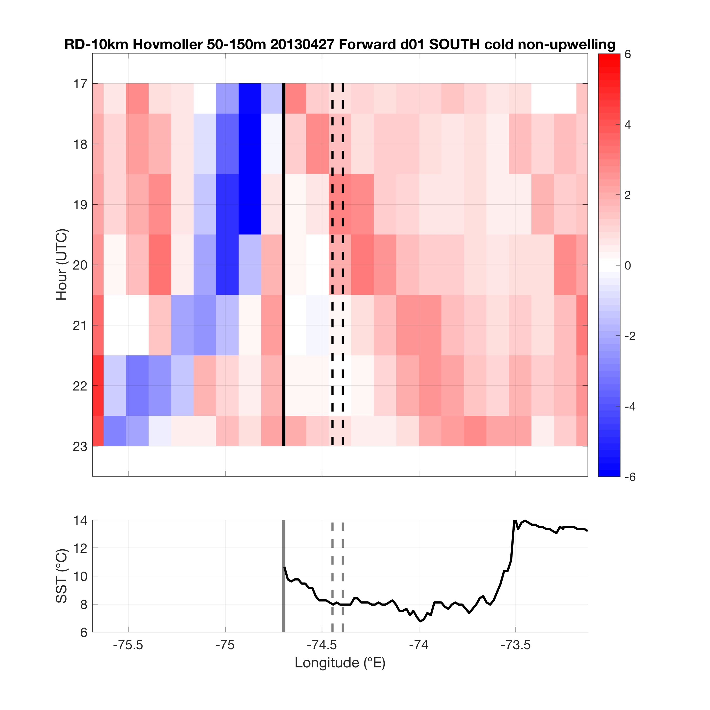
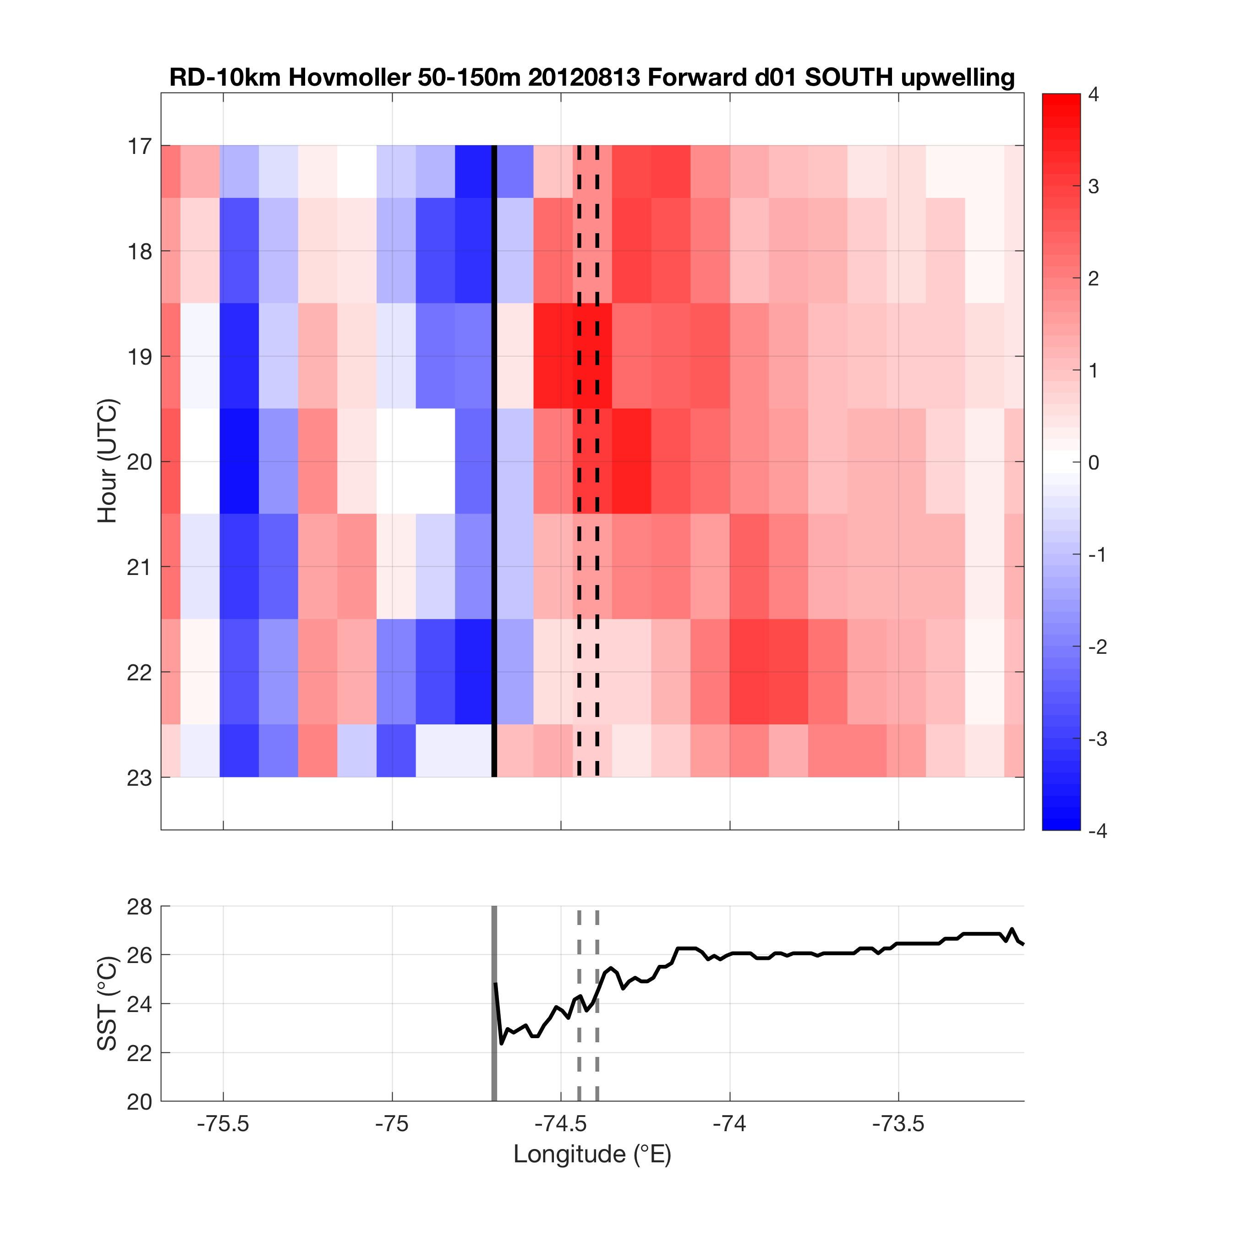

South (green)
Case 1
Case 2
Case 3

Slide 43
Extra slides

Slide 44
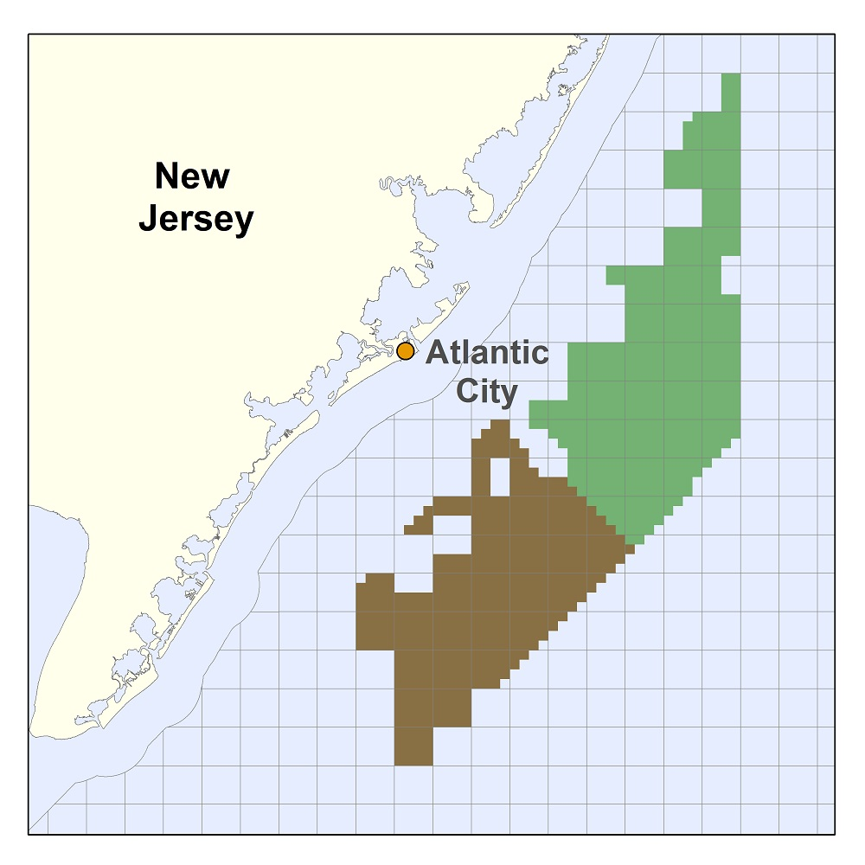
Introduction
On November 9, 2015, BOEM issued commercial lease auction for NJ
  Nearly 344,000 acres for leasing offshore wind (OSW)
  5th competitive lease auction for OSW in U.S.
RES Americas won North lease (sold lease to Dong Energy)
US Wind won South lease
Will submit application to develop to NJ BPU
  Must include wind resource assessment & economic analysis

Slide 45
Introduction
NJ BPU Offshore Wind Rules state:
  “Applications shall account for…the coincidence between time of generation for the project and
  peak electricity demand.”
NJ sea breeze and coastal upwelling coincident with peak electricity demand
Relative Load
Frequency
Notes:
-Sea breeze time of day (afternoon/evening) is also coincident with peak demand time of day (5-7 pm)

Slide 46
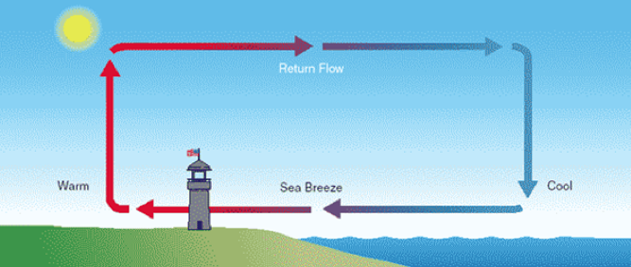

Introduction
Sea breeze
Coastal upwelling
Notes:
Cut-out speed of OSW turbines of 4 m/s (calm zone?)

Slide 47

Introduction
Little attention has been paid to sea breeze in offshore environment (Steele et al. 2014)
Limited to numerical simulations
  Paucity of offshore obs.
Spatial scales of offshore sea breeze more difficult to distinguish, unlike onshore sea breeze where frontal boundary well defined (Simpson, 1994)
Coastal upwelling

Slide 48

Introduction
Key Questions:
What does the offshore component of the sea breeze look like? Secondary circulation (size, structure)? Offshore divergence? Calm zone?
What effect does cold coastally-upwelled water have on the coastal/offshore wind resource?
Coastal upwelling
?

Slide 49
Introduction
Coastal upwelling + Sea breeze Hypothesis
Cold upwelling
Does this occur? With or without upwelling?

Slide 50




Materials and Methods
Satellite: state-of-the-science declouding and compositing technique designed by Rutgers to determine SST and resolve coastal upwelling
Model: 3km, 600m WRF-ARW 3.6.1; YSU PBL; MM5 Monin-Obukhov surface layer
Advantages (vs. offshore met tower): cost, spatial variability, prediction
Sea Breeze Cases:
April 27, 2013: pure, no upwelling
Aug 13, 2012: pure, upwelling
Aug 13, 2012: pure, remove upwelling
Coastal upwelling
  Backdoor
  Corkscrew
  Pure
Notes:
Satellite: High res in space and time
Previous satellite SST products low in spatial or temporal resolution and are often warmest pixel composites for declouding; cannot resolve coastal upwelling
SST product is IR/near IR (AVHRR); SPoRT is IR/near IR as well
Model: NAM12km for boundary conditions
Cases: largest and longest lasting upwelling in NJ 2012-2014
20140731 case has similar ambient (outside upwelling) water T to 20130707

Slide 51
Materials and Methods
Criteria for cases:
  June-August (peak load)
  Pure sea breeze
    largest gradient wind component perpendicular to the coast and in the offshore direction (257-345 degrees)
    12Z for synoptic 925mb (gradient) winds
  Backdoor
  Corkscrew
  Pure

Slide 52

Cases:
1. April 27, 2013: pure, no upwelling
925mb winds (m s⁻¹)
SST (°C)
Notes:
Pure: (257-345 degrees)

Slide 53

Cases:
1. April 27, 2013: pure, no upwelling
925mb winds (m s⁻¹)
SST (°C)
Notes:
Pure: (257-345 degrees)

Slide 54

Cases:
1. April 27, 2013: pure, no upwelling
925mb winds (m s⁻¹)
SST (°C)
Notes:
Pure: (257-345 degrees)

Slide 55
1. April 27, 2013: pure, no upwelling
NEXRAD radar

Slide 56
1. April 27, 2013: pure, no upwelling
NEXRAD radar

Slide 57
1. April 27, 2013: pure, no upwelling
NEXRAD radar

Slide 58

Cases:
2. August 13, 2012: pure, upwelling
925mb winds (m s⁻¹)
SST (°C)
Notes:
Pure: (257-345 degrees)

Slide 59

Cases:
2. August 13, 2012: pure, upwelling
925mb winds (m s⁻¹)
SST (°C)
Notes:
Pure: (257-345 degrees)

Slide 60

Cases:
2. August 13, 2012: pure, upwelling
925mb winds (m s⁻¹)
SST (°C)
Notes:
Pure: (257-345 degrees)

Slide 61
2. August 13, 2012: pure, upwelling
NEXRAD radar

Slide 62
2. August 13, 2012: pure, upwelling
NEXRAD radar

Slide 63
2. August 13, 2012: pure, upwelling
NEXRAD radar

Slide 64

Cases:
3. August 13, 2012: pure, remove upwelling
925mb winds (m s⁻¹)
SST (°C)
Notes:
Pure: (257-345 degrees)

Slide 65

Methods
Lagrangian Coherent Structures (LCSs)
LCSs are boundaries in a fluid that distinguish regions of differing dynamics (e.g. eddies, jets, fronts)
Particles move away from and along a repelling LCS (A), aggregate and move along attracting LCSs (B)
LCS maps identify convergence and divergence in a fluid flow (e.g. sea breeze)

Slide 66
Methods
Benefits of LCS
The Lagrangian measures are advantageous as they are frame independent and robust with respect to localized noise in the data.
Additionally, LCS analysis reveals coherent structures in more detail and with better clarity than streamline plots generated from 2D wind retrieval (Chan and Shao 2007; Tang et al. 2011)

Slide 67


Slide 68


Slide 69


Slide 70



Methods
LCS Set-up
On 3km WRF 10-min winds
Hourly, 1700 UTC to 2300 UTC (peak sea breeze time)
10km grid spacing for tracer trajectories (forward)
Perform at these levels in WRF:
  10, 50, 150, 500, 600, 700, 800, 900, 1000, 1500, 2000, 2500m (through marine boundary layer)
Use relative dispersion (RD) to identify LCSs

Slide 71
Results:
Case 1

Slide 72

1. April 27, 2013: pure, no upwelling
10m

Slide 73

1. April 27, 2013: pure, no upwelling
10m

Slide 74

1. April 27, 2013: pure, no upwelling
10m

Slide 75

1. April 27, 2013: pure, no upwelling
10m

Slide 76

1. April 27, 2013: pure, no upwelling
10m

Slide 77

1. April 27, 2013: pure, no upwelling
10m

Slide 78

1. April 27, 2013: pure, no upwelling
10m

Slide 79
1. April 27, 2013: pure, no upwelling
10m

Slide 80
1. April 27, 2013: pure, no upwelling
100m

Slide 81

1. April 27, 2013: pure, no upwelling
100m

Slide 82

1. April 27, 2013: pure, no upwelling
100m

Slide 83
1. April 27, 2013: pure, no upwelling
100m

Slide 84

1. April 27, 2013: pure, no upwelling
100m

Slide 85

1. April 27, 2013: pure, no upwelling
100m

Slide 86
1. April 27, 2013: pure, no upwelling
100m

Slide 87

1. April 27, 2013: pure, no upwelling

Slide 88
1. April 27, 2013: pure, no upwelling
xsection

Slide 89

1. April 27, 2013: pure, no upwelling
xsection

Slide 90

1. April 27, 2013: pure, no upwelling
xsection

Slide 91
1. April 27, 2013: pure, no upwelling
xsection

Slide 92

1. April 27, 2013: pure, no upwelling
xsection

Slide 93

1. April 27, 2013: pure, no upwelling
xsection

Slide 94
1. April 27, 2013: pure, no upwelling
xsection

Slide 95

1. April 27, 2013: pure, no upwelling
hovmoller

Slide 96
Results:
Case 2 minus 3

Slide 97

2-3. April 27, 2013: pure, upwelling minus non-upwelling
10m

Slide 98

2-3. April 27, 2013: pure, upwelling minus non-upwelling
10m

Slide 99

2-3. April 27, 2013: pure, upwelling minus non-upwelling
10m

Slide 100

2-3. April 27, 2013: pure, upwelling minus non-upwelling
10m

Slide 101

2-3. April 27, 2013: pure, upwelling minus non-upwelling
10m

Slide 102

2-3. April 27, 2013: pure, upwelling minus non-upwelling
10m

Slide 103

2-3. April 27, 2013: pure, upwelling minus non-upwelling
10m

Slide 104
2-3. April 27, 2013: pure, upwelling minus non-upwelling
100m

Slide 105

2-3. April 27, 2013: pure, upwelling minus non-upwelling
100m

Slide 106

2-3. April 27, 2013: pure, upwelling minus non-upwelling
100m

Slide 107
2-3. April 27, 2013: pure, upwelling minus non-upwelling
100m

Slide 108

2-3. April 27, 2013: pure, upwelling minus non-upwelling
100m

Slide 109

2-3. April 27, 2013: pure, upwelling minus non-upwelling
100m

Slide 110
2-3. April 27, 2013: pure, upwelling minus non-upwelling
100m

Slide 111
2-3. April 27, 2013: pure, upwelling minus non-upwelling

Slide 112
2-3. April 27, 2013: pure, upwelling minus non-upwelling
xsection

Slide 113

2-3. April 27, 2013: pure, upwelling minus non-upwelling
xsection

Slide 114

2-3. April 27, 2013: pure, upwelling minus non-upwelling
xsection

Slide 115
2-3. April 27, 2013: pure, upwelling minus non-upwelling
xsection

Slide 116

2-3. April 27, 2013: pure, upwelling minus non-upwelling
xsection

Slide 117

2-3. April 27, 2013: pure, upwelling minus non-upwelling
xsection

Slide 118
2-3. April 27, 2013: pure, upwelling minus non-upwelling
xsection

Slide 119
Ongoing work
Hovmoller for Case 2 and 3, difference
Sensitivity to MYNN vs. YSU PBL schemes
Sensitivity to NARR B.C. vs. NAM B.C.
Increased vertical resolution of LCS between 150 and 1000m
LCS on CODAR for sea breeze
  Detided data or not?

