Slide 1
From 2015 MTS Meeting 10/19/2015

Slide 2
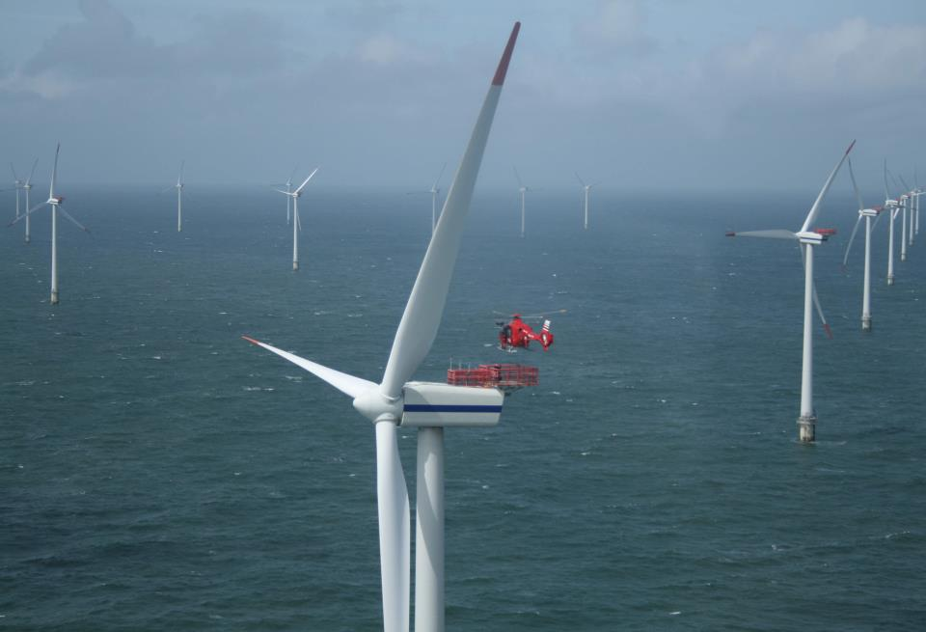
Sea Breeze, Coastal Upwelling Modeling to Support Offshore Wind Energy Planning and Operations
Greg Seroka¹, Erick Fredj², Travis Miles¹, Rich Dunk¹, Josh Kohut¹, Scott Glenn¹
¹
October 22, 2015 MTS/IEEE OCEANS ‘15
²

Slide 3
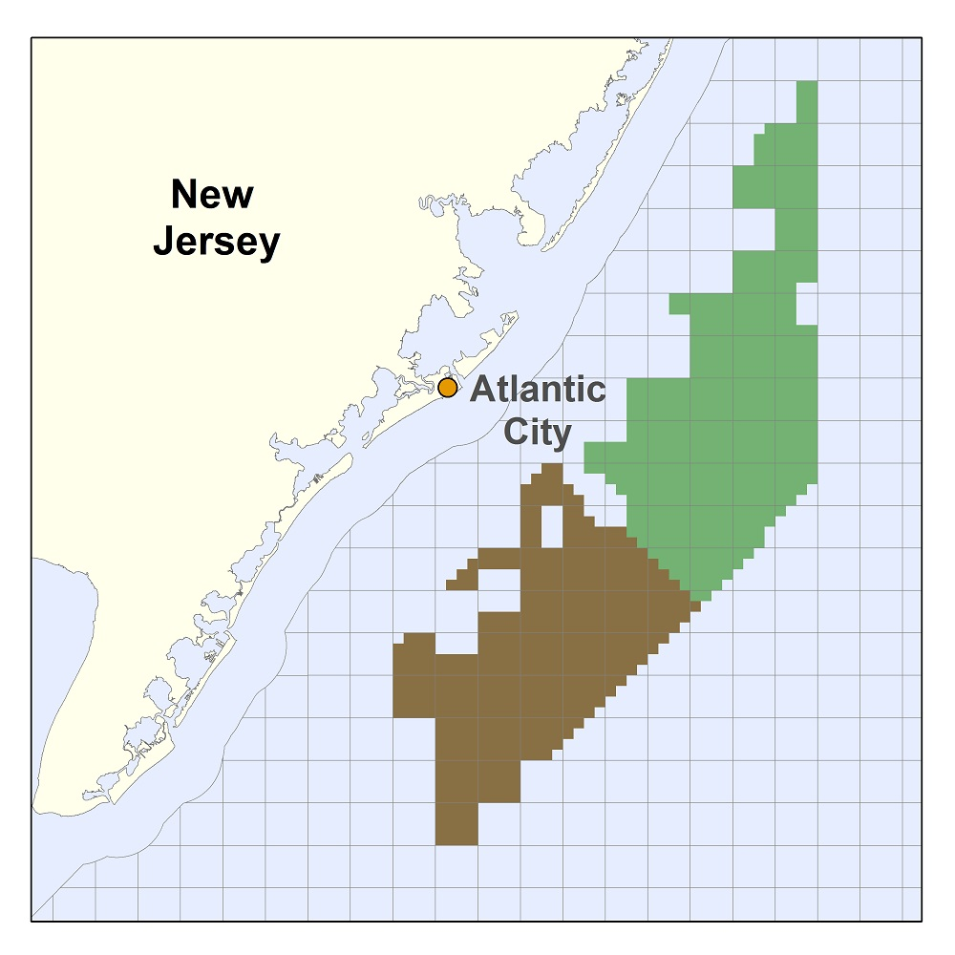
Introduction
On November 9, 2015, BOEM commercial lease auction for NJ will take place
Nearly 344,000 acres for leasing offshore wind (OSW)
5th competitive lease auction for OSW in U.S.
OSW developer(s) who win a lease zone will submit application to develop to NJ Board of Public Utilities (NJ BPU)
Must include wind resource assessment & economic analysis

Slide 4
Introduction
NJ BPU Offshore Wind Rules state:
“Applications shall account for…the coincidence between time of generation for the project and peak electricity demand.”
NJ sea breeze and coastal upwelling coincident with peak electricity demand
Relative Load
Frequency
Notes:
-Sea breeze time of day (afternoon/evening) is also coincident with peak demand time of day (5-7 pm)

Slide 5
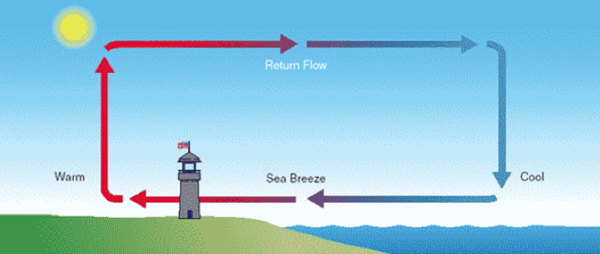
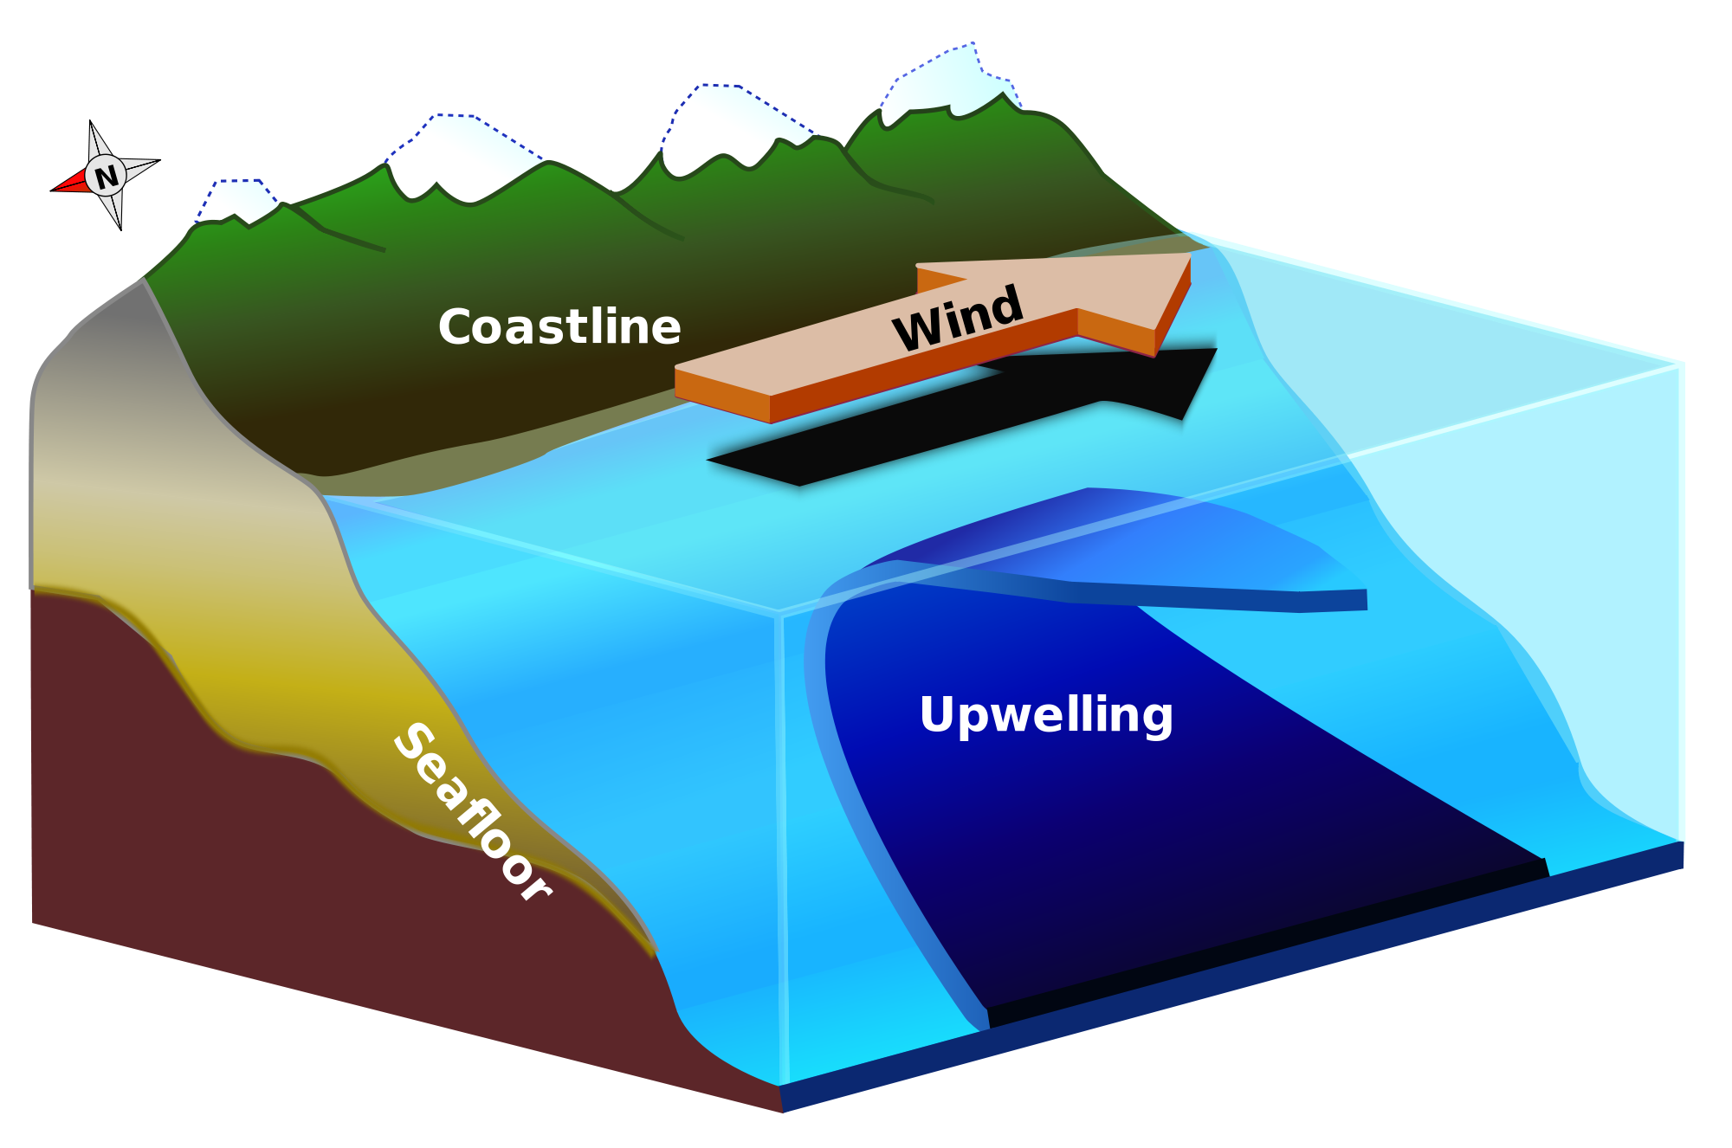
Introduction
Sea breeze
Coastal upwelling
Notes:
Cut-out speed of OSW turbines of 4 m/s (calm zone?)

Slide 6
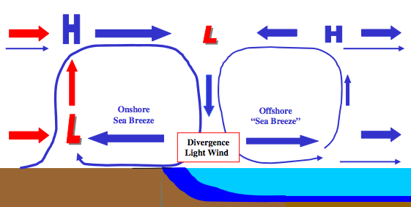
Introduction
Coastal upwelling + Sea breeze Hypothesis
Cold upwelling
Does this occur? With or without upwelling?

Slide 7
Introduction
Key Questions:
What effect does cold coastally-upwelled water have on the coastal/offshore wind resource?
What does the offshore component of the sea breeze look like? Secondary circulation (size, structure)? Offshore divergence?
Coastal upwelling
?

Slide 8
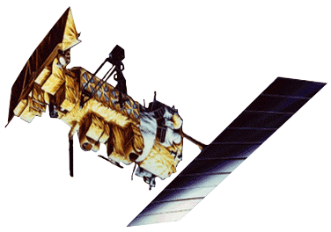
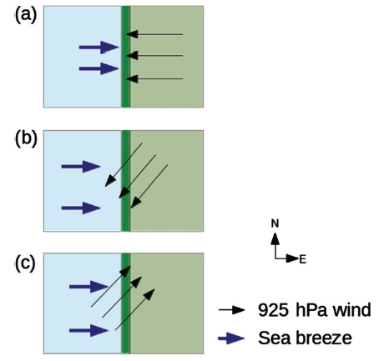
Materials and Methods
Satellite: state-of-the-science declouding and compositing technique designed by Rutgers to determine SST and resolve coastal upwelling
Model: 3km, 600m WRF-ARW 3.6.1; YSU PBL; MM5 Monin-Obukhov surface layer
Advantages (vs. offshore met tower): cost, spatial variability, prediction
Sea Breeze Cases:
July 7, 2013: corkscrew, strong upwelling
July 31, 2014: corkscrew, weak upwelling
April 27, 2013: pure, no upwelling
Coastal upwelling
Backdoor
Corkscrew
Pure
Notes:
Satellite: High res in space and time
Previous satellite SST products low in spatial or temporal resolution and are often warmest pixel composites for declouding; cannot resolve coastal upwelling
SST product is IR/near IR (AVHRR); SPoRT is IR/near IR as well
Model: NAM12km for boundary conditions
Cases: largest and longest lasting upwelling in NJ 2012-2014
20140731 case has similar ambient (outside upwelling) water T to 20130707

Slide 9
Part 1: Coastal upwelling

Slide 10
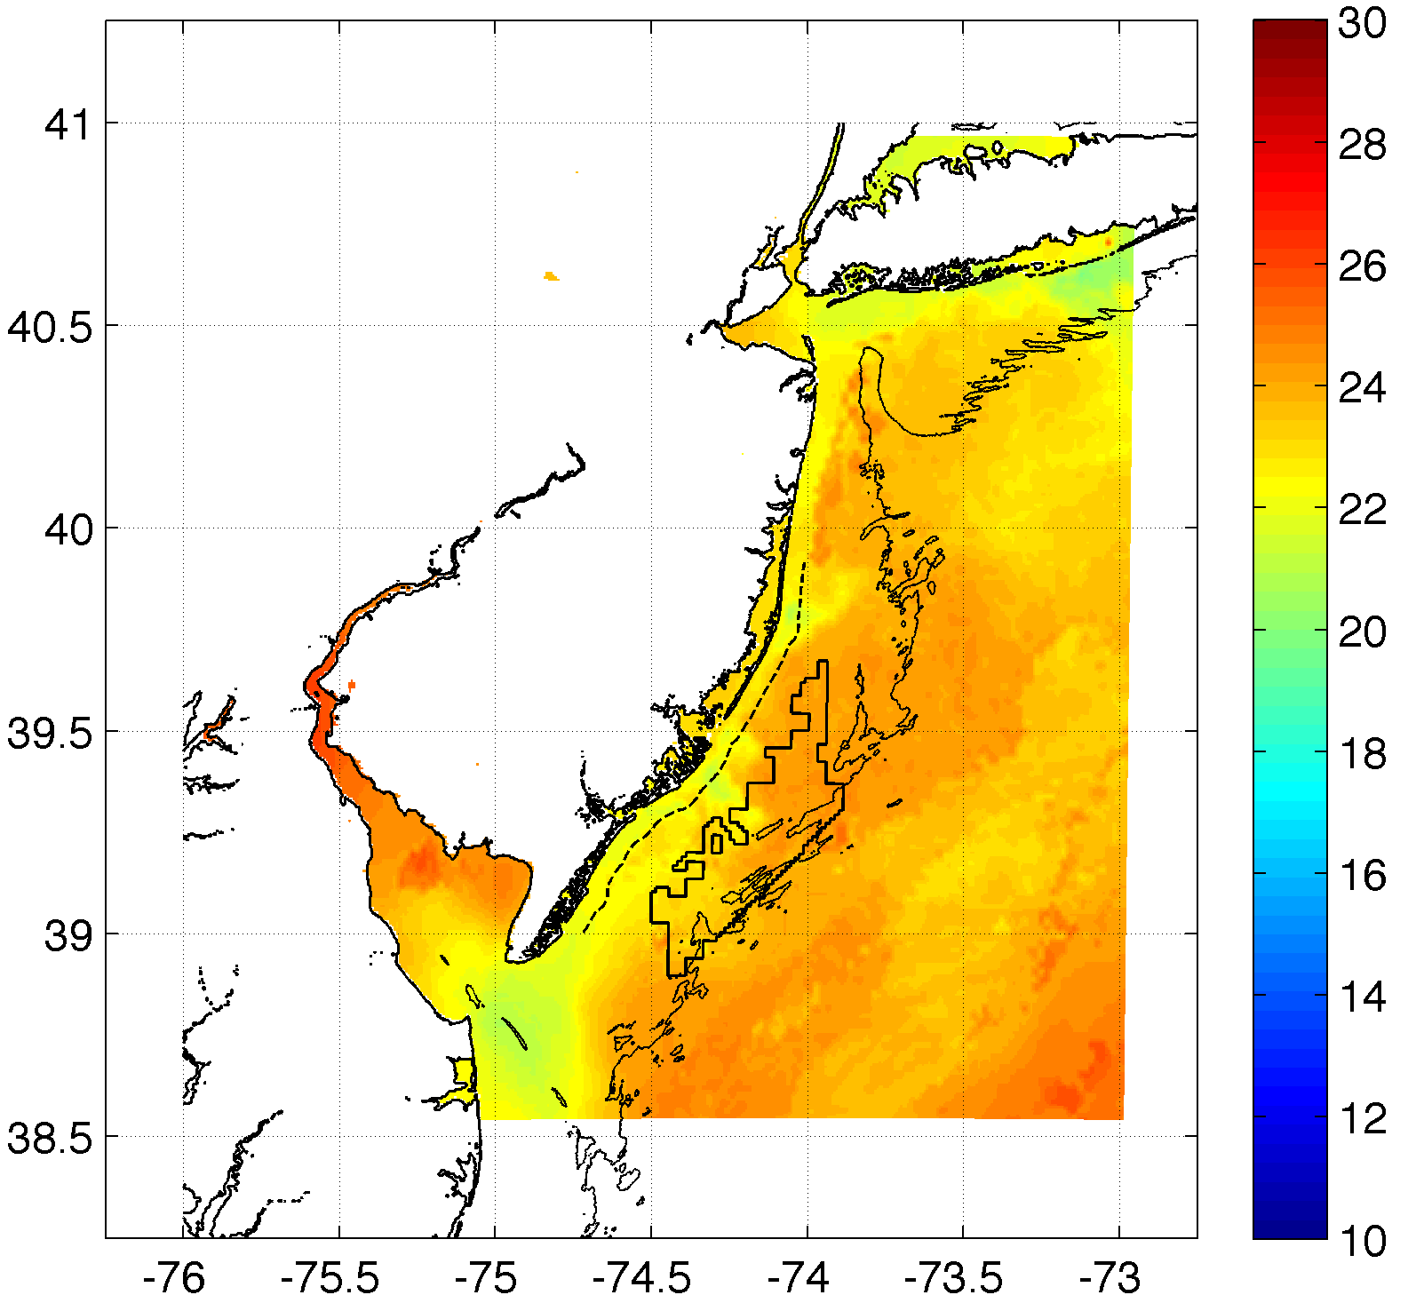
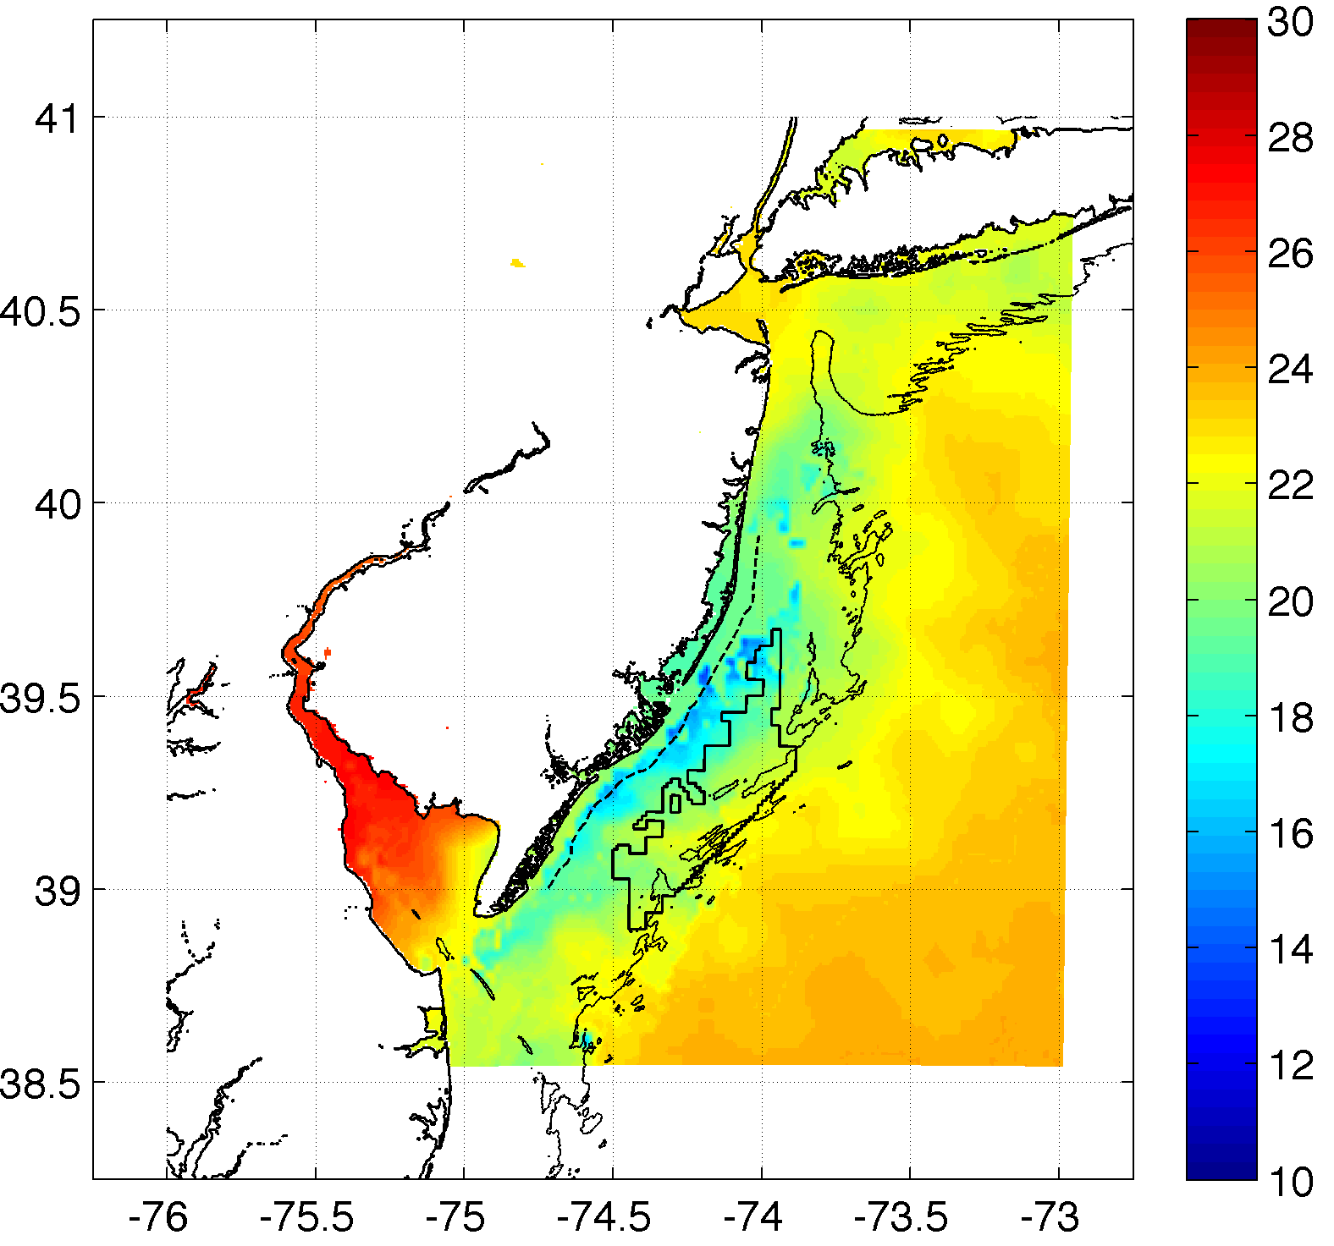
Methods
Weak upwelling (Actual)
Case 2: July 31, 2014: corkscrew, weak upwelling
Strong upwelling

Slide 11
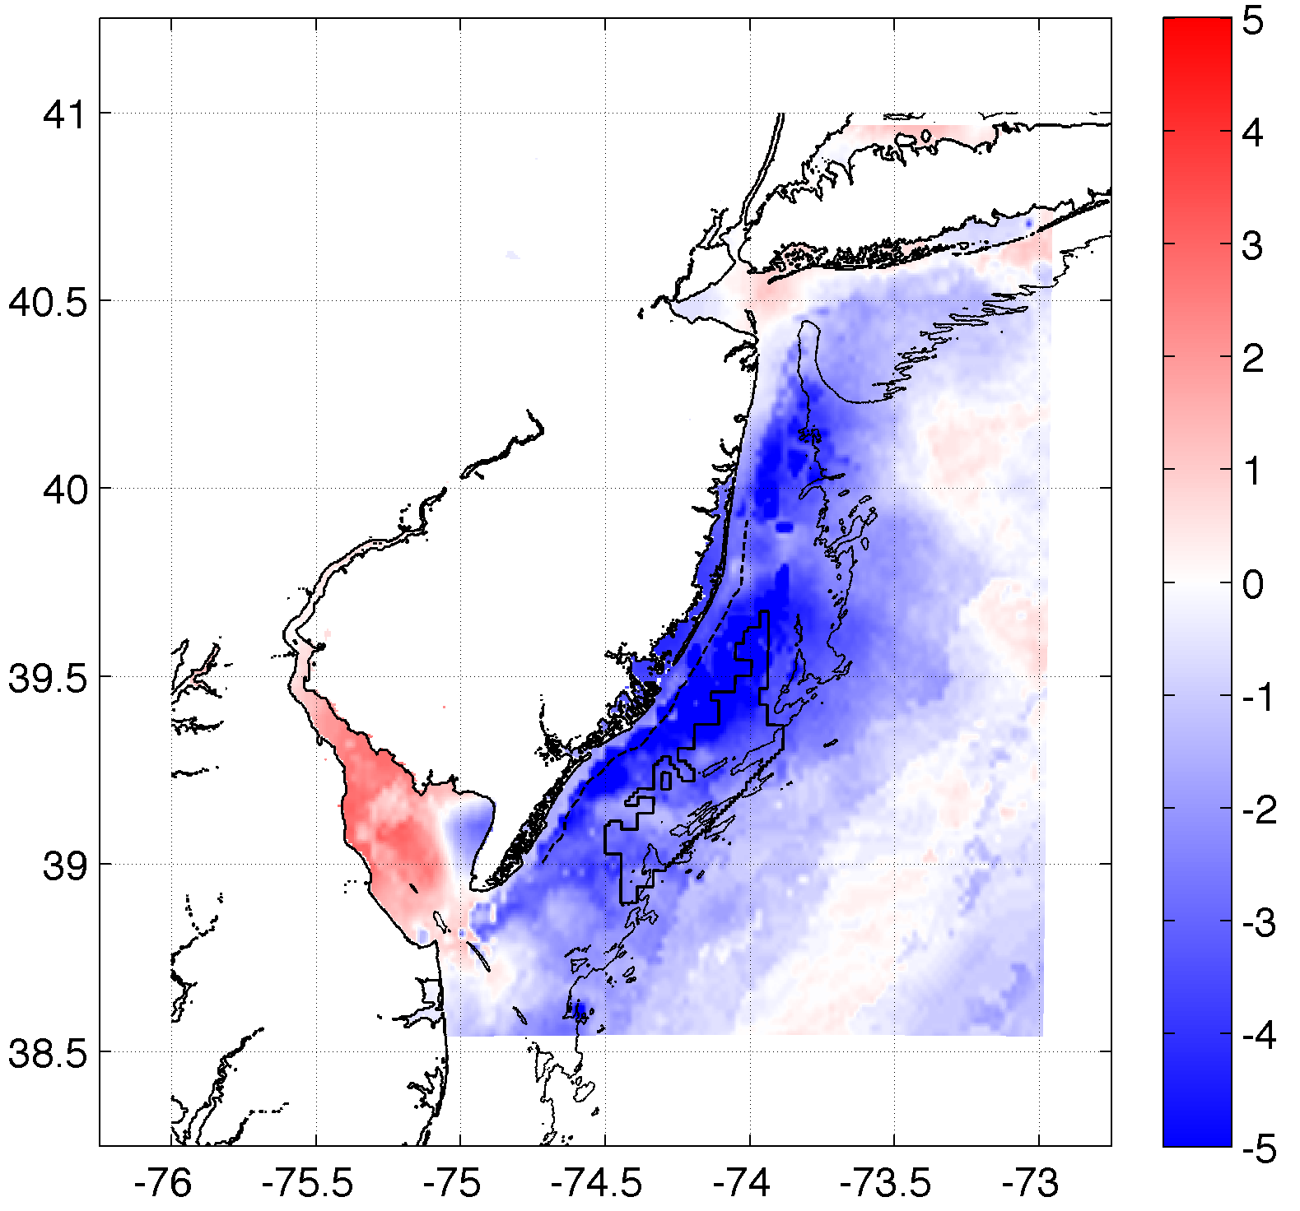
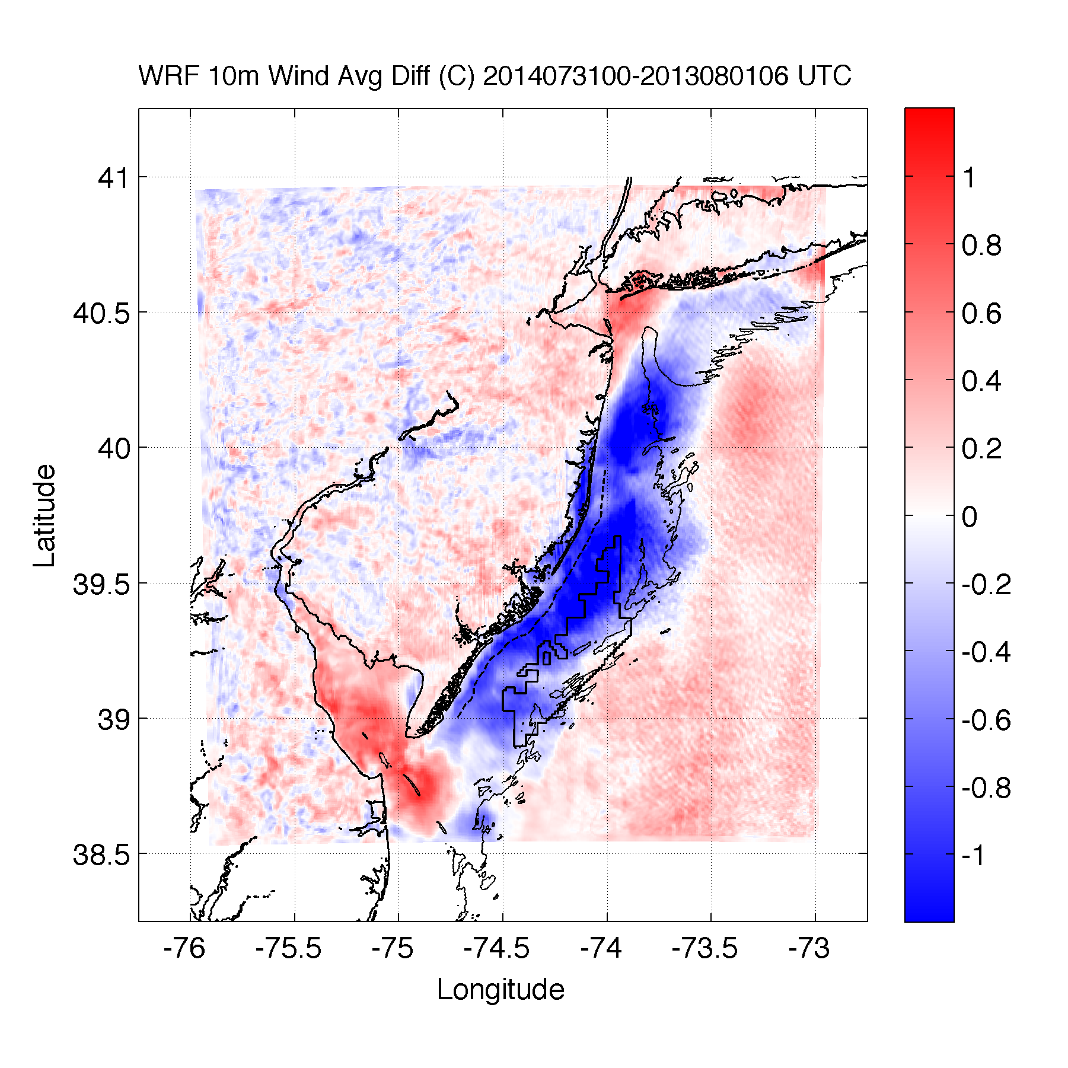
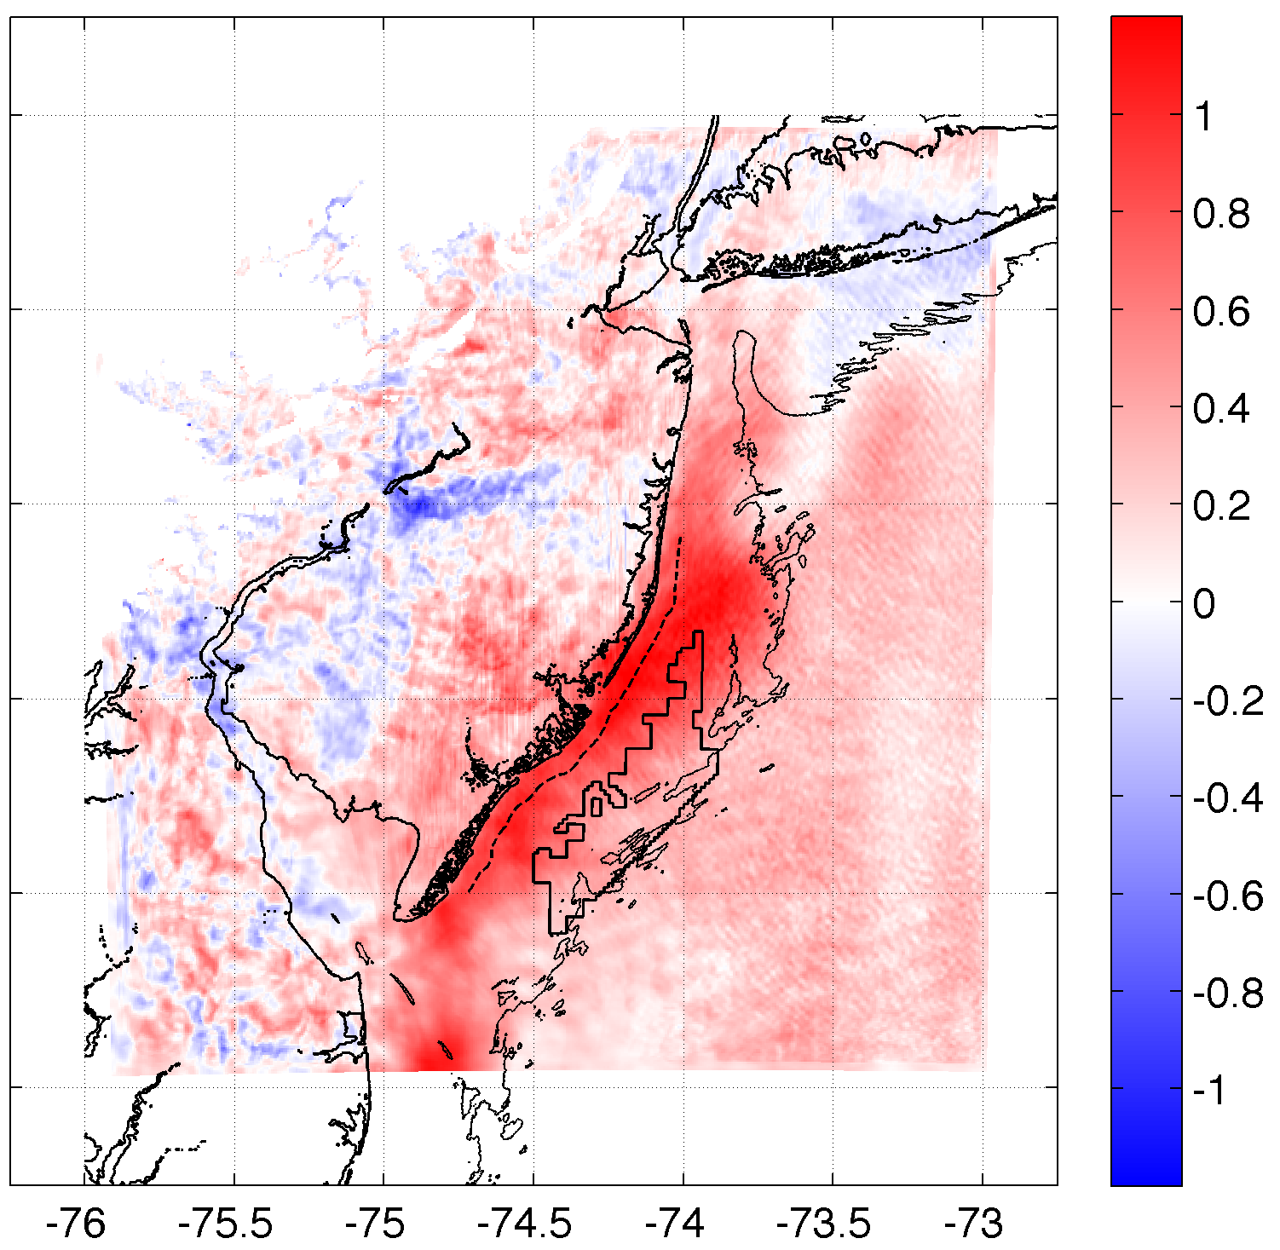
Results
Upwelling produces an inversion, decreasing 10m winds & increasing 100m hub height winds
SST Diff.
10m Wind Speed Diff.
100m Wind Speed Diff.
r²=0.61
r²=0.58
Case 2: 20140731

Slide 12
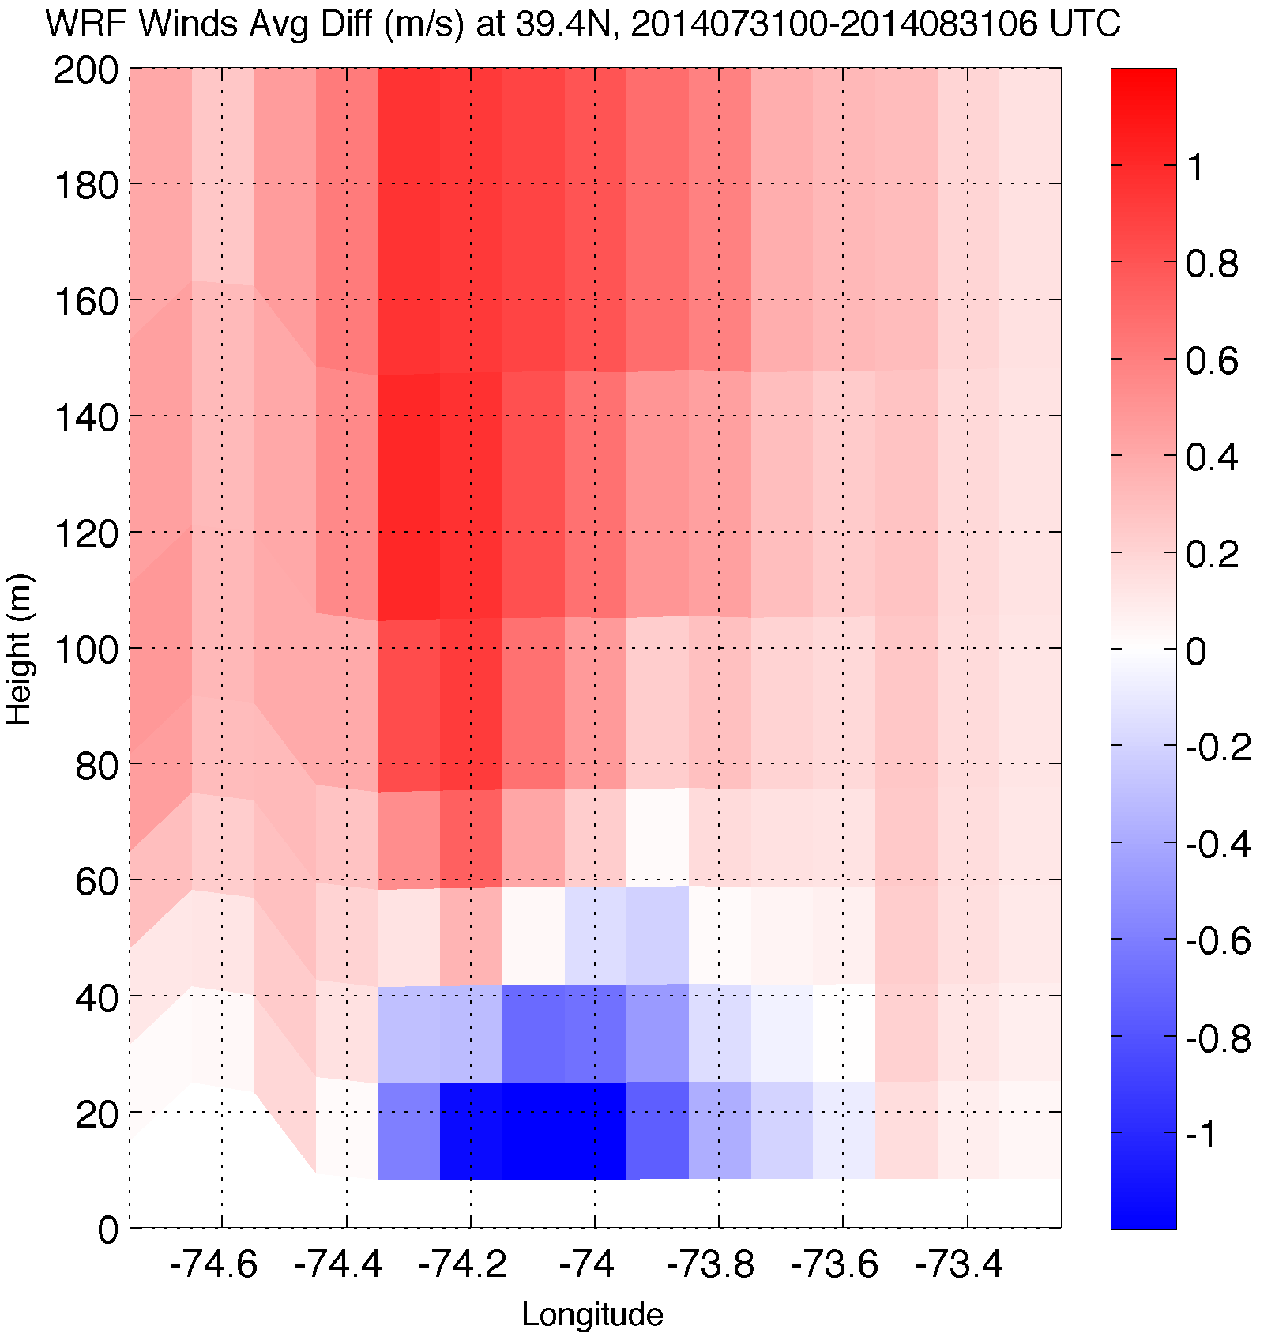
Upwelling produces an inversion, decreasing 10m winds & increasing 100m hub height winds
Results
Wind Speed Difference
10m Wind Speed Diff.
Case 2: 20140731

Slide 13
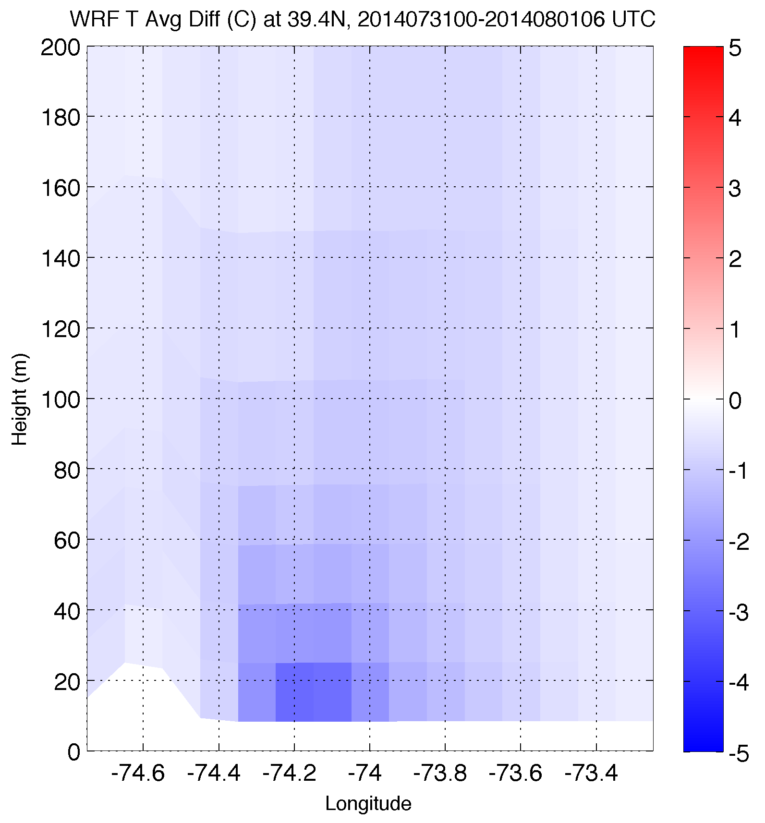
Upwelling produces an inversion, decreasing 10m winds & increasing 100m hub height winds
Results
Temperature Difference
10m Wind Speed Diff.
Case 2: 20140731

Slide 14
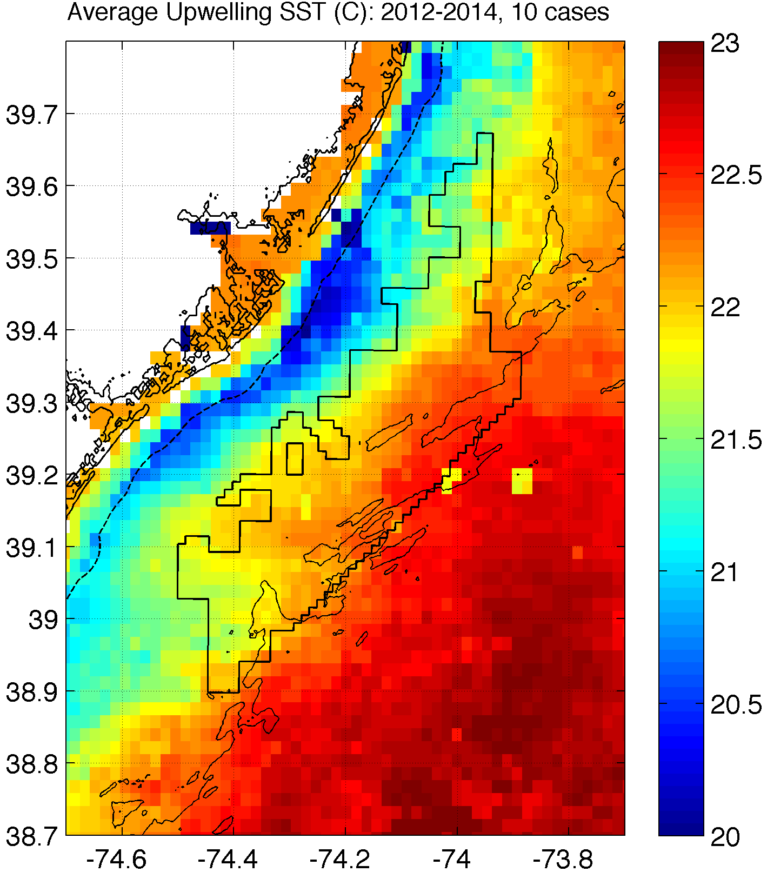
How will coastal upwelling affect the NJ WEA?
Notes:
Could expect similar inversions, impact on 100m winds over upwelling in this structure (affects NJ WEA!)
Need good ocean model to predict this correctly!

Slide 15
Chapter 3 from thesis meeting 4/27/2016
Examination of Sea Breeze for Offshore Wind Energy using WRF and Lagrangian Coherent Structures

Slide 16
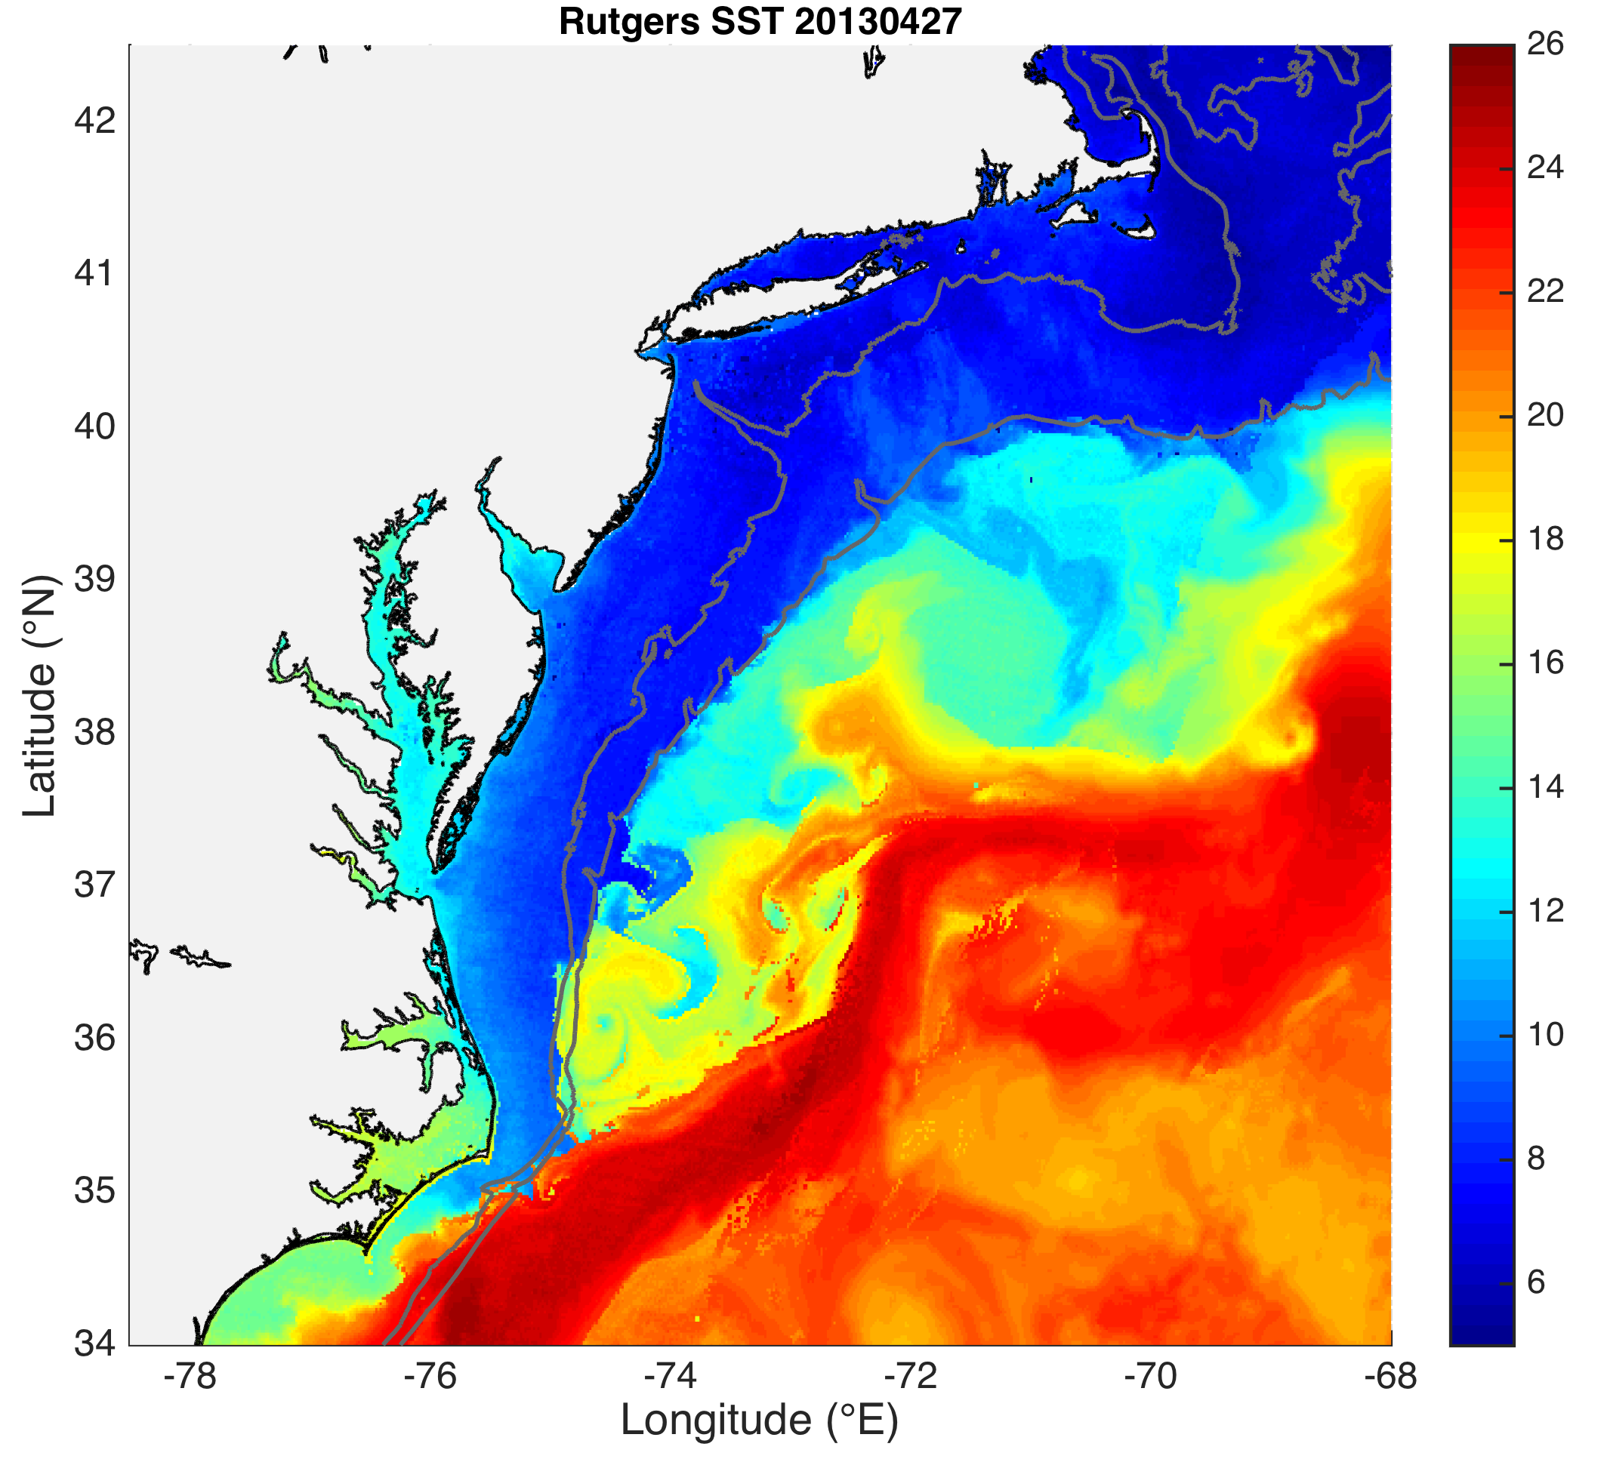
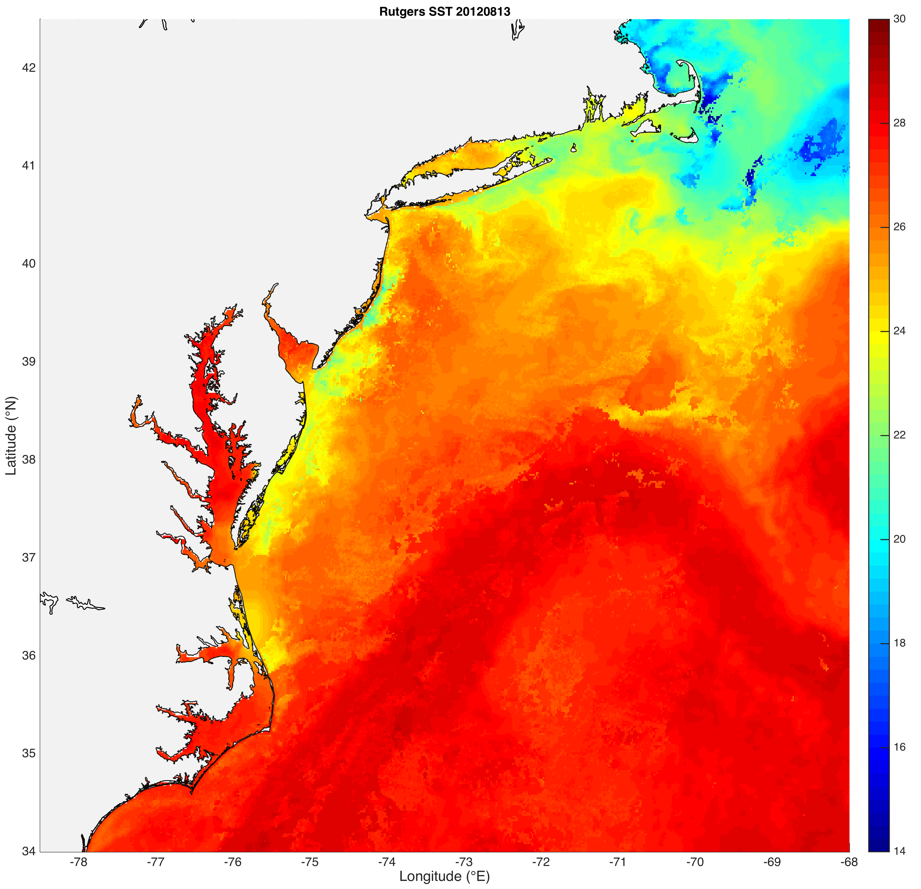
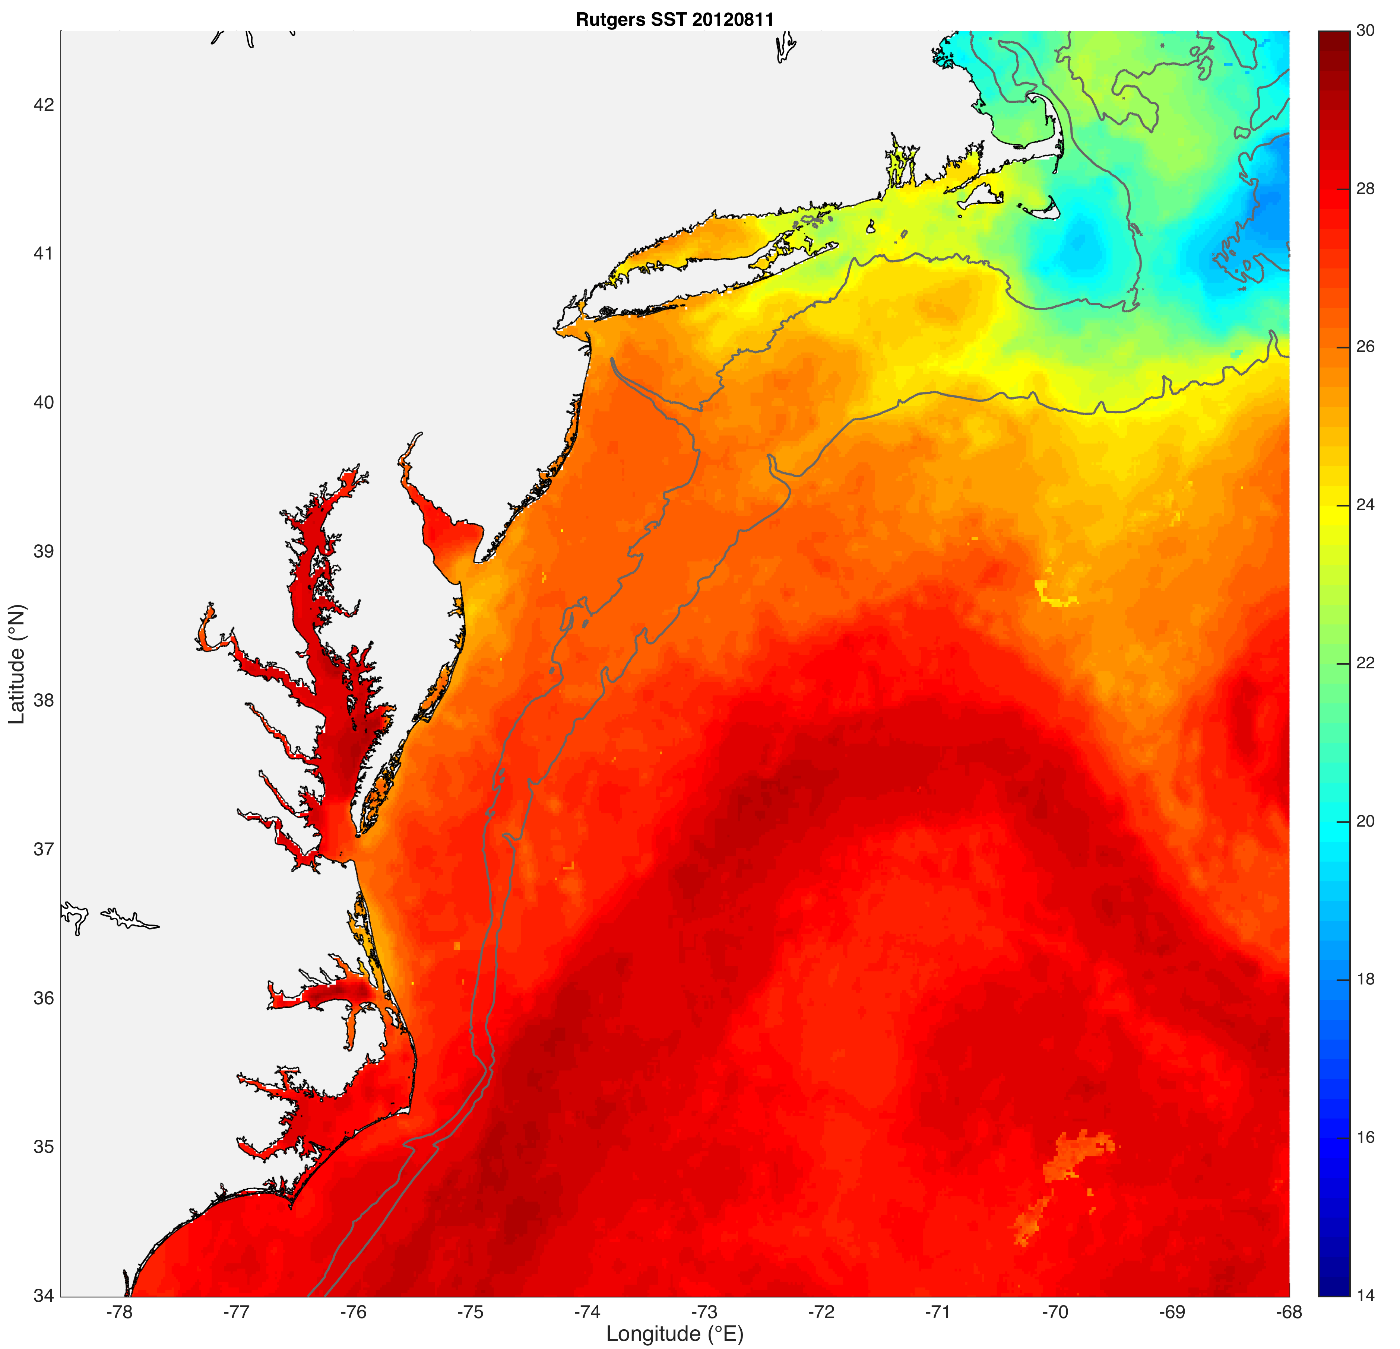
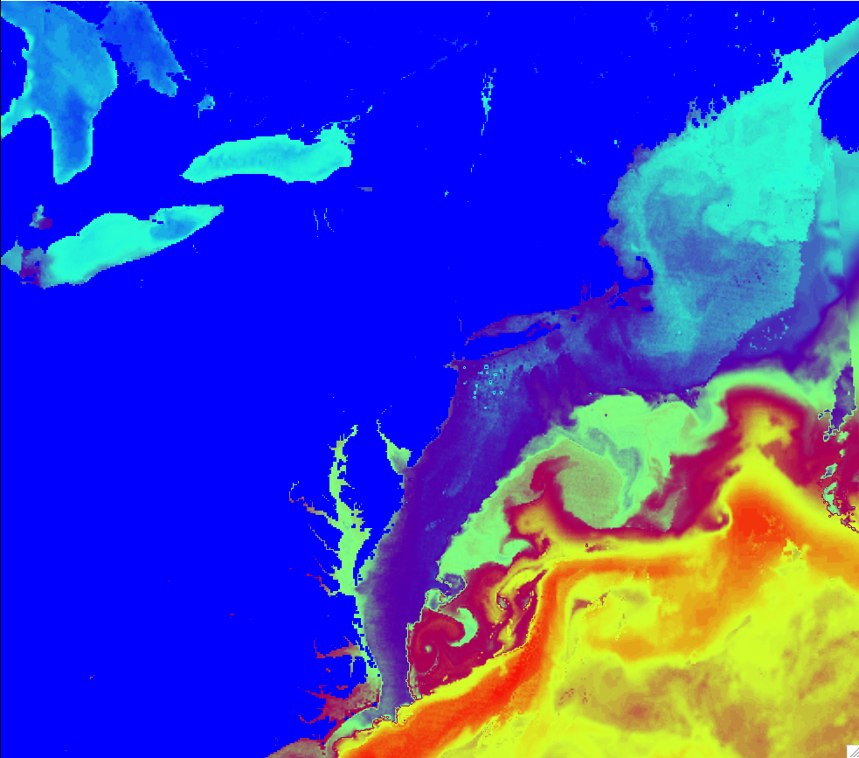
Fig 1
Case 1
Case 2
Case 3
As above but over full WRF domain (to depict WRF domain)

Slide 17
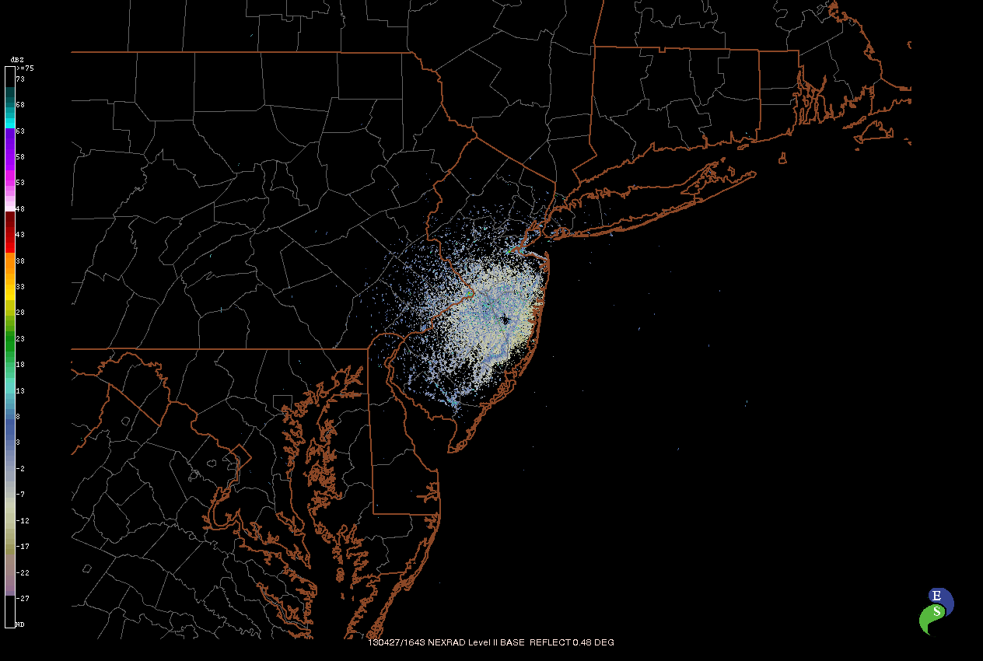
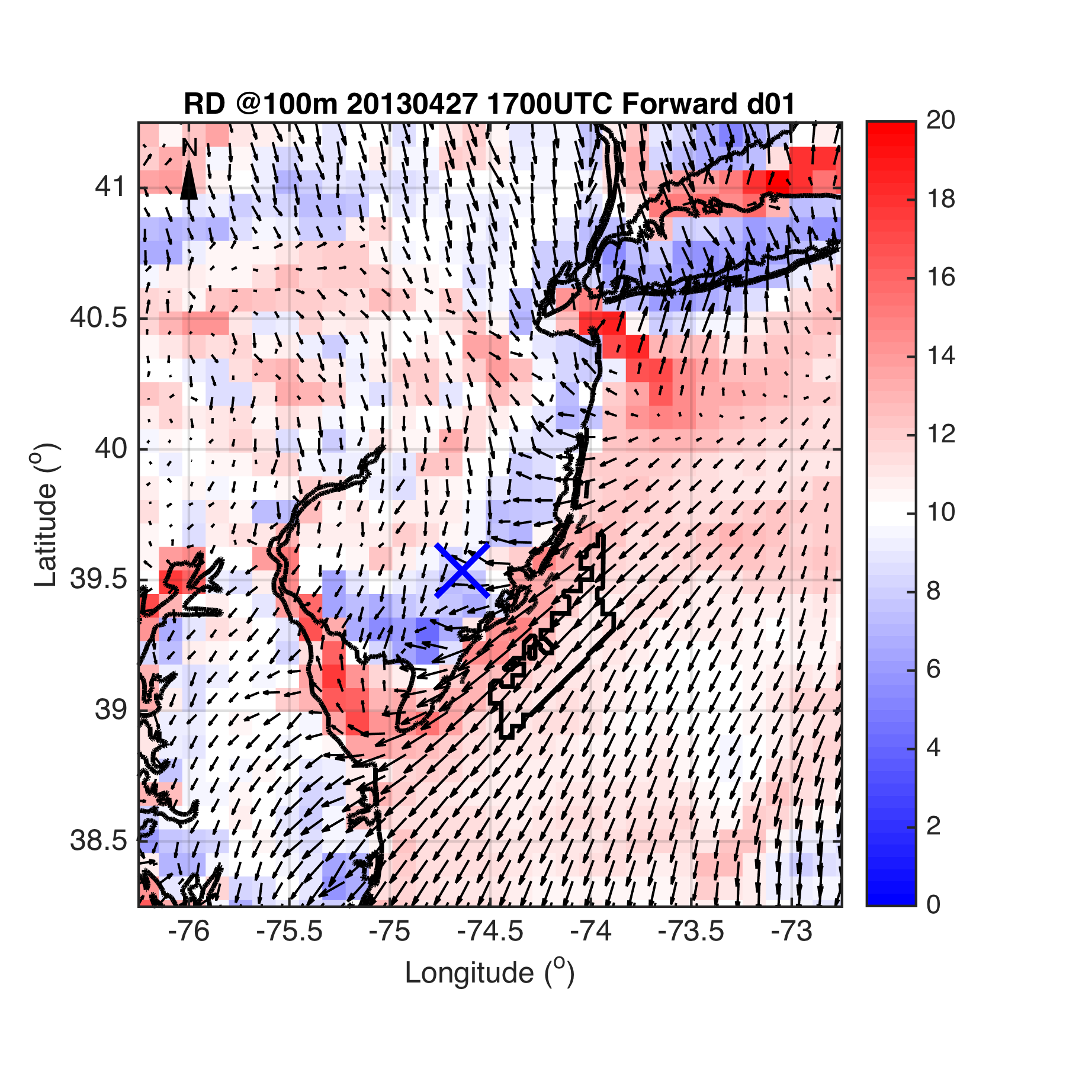
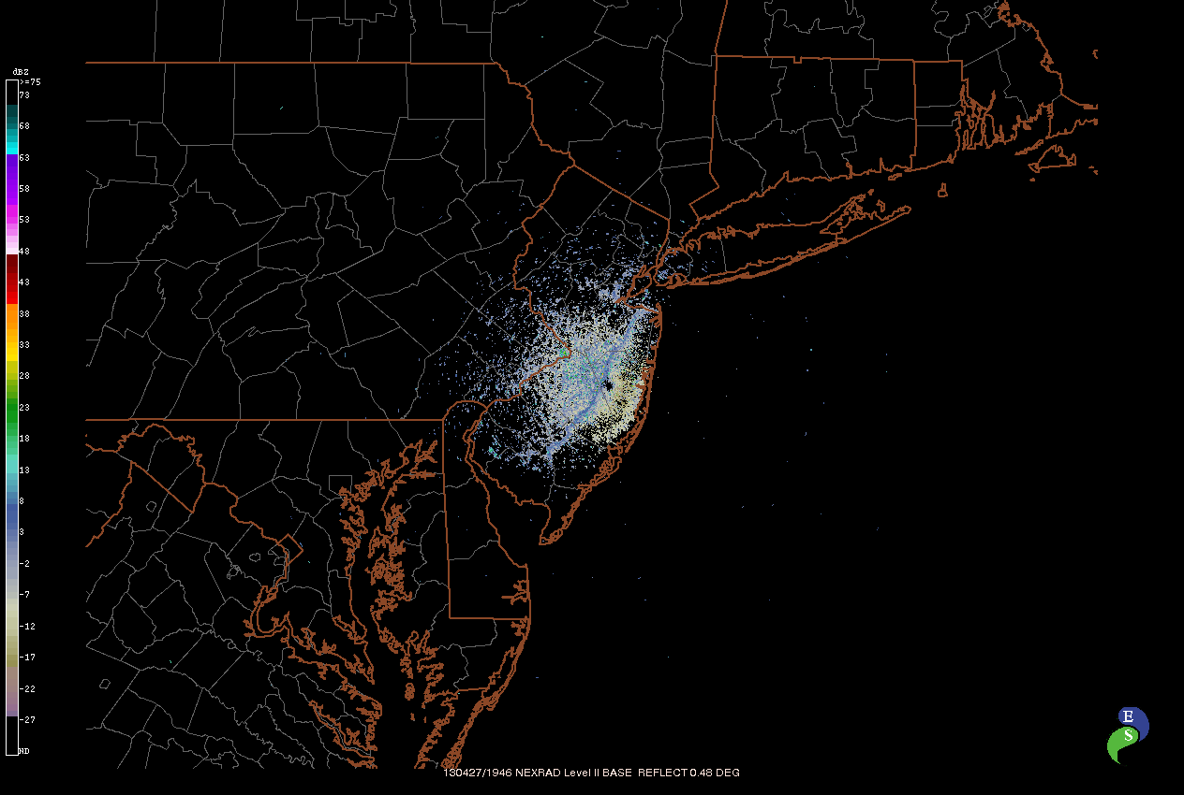
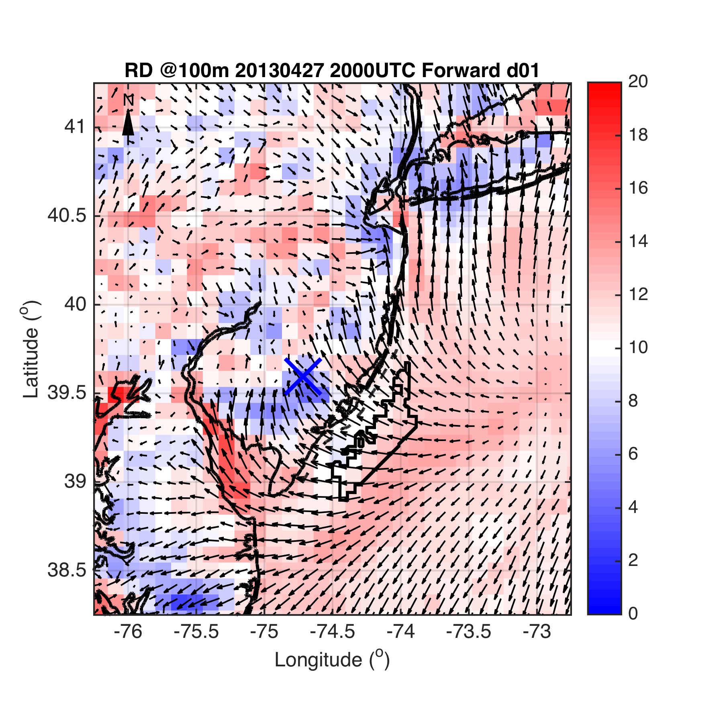
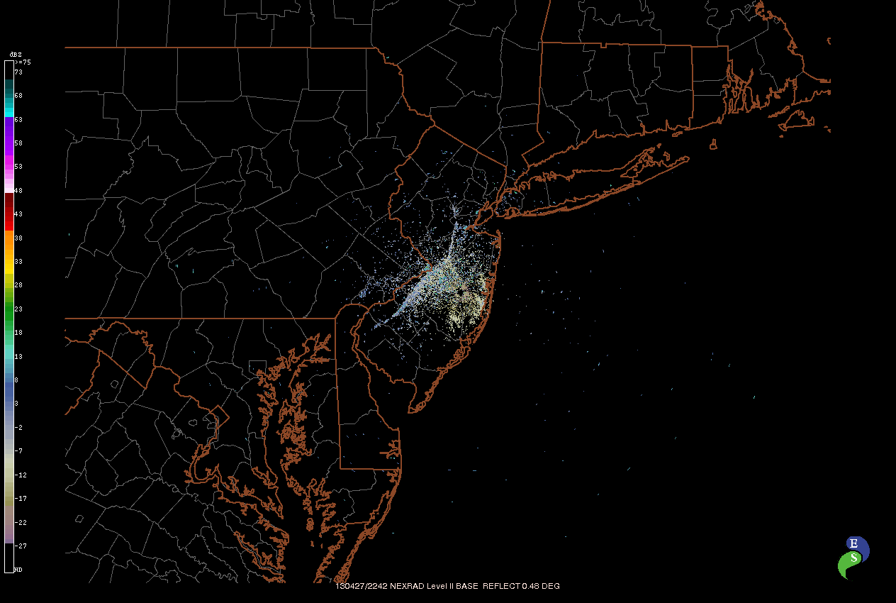
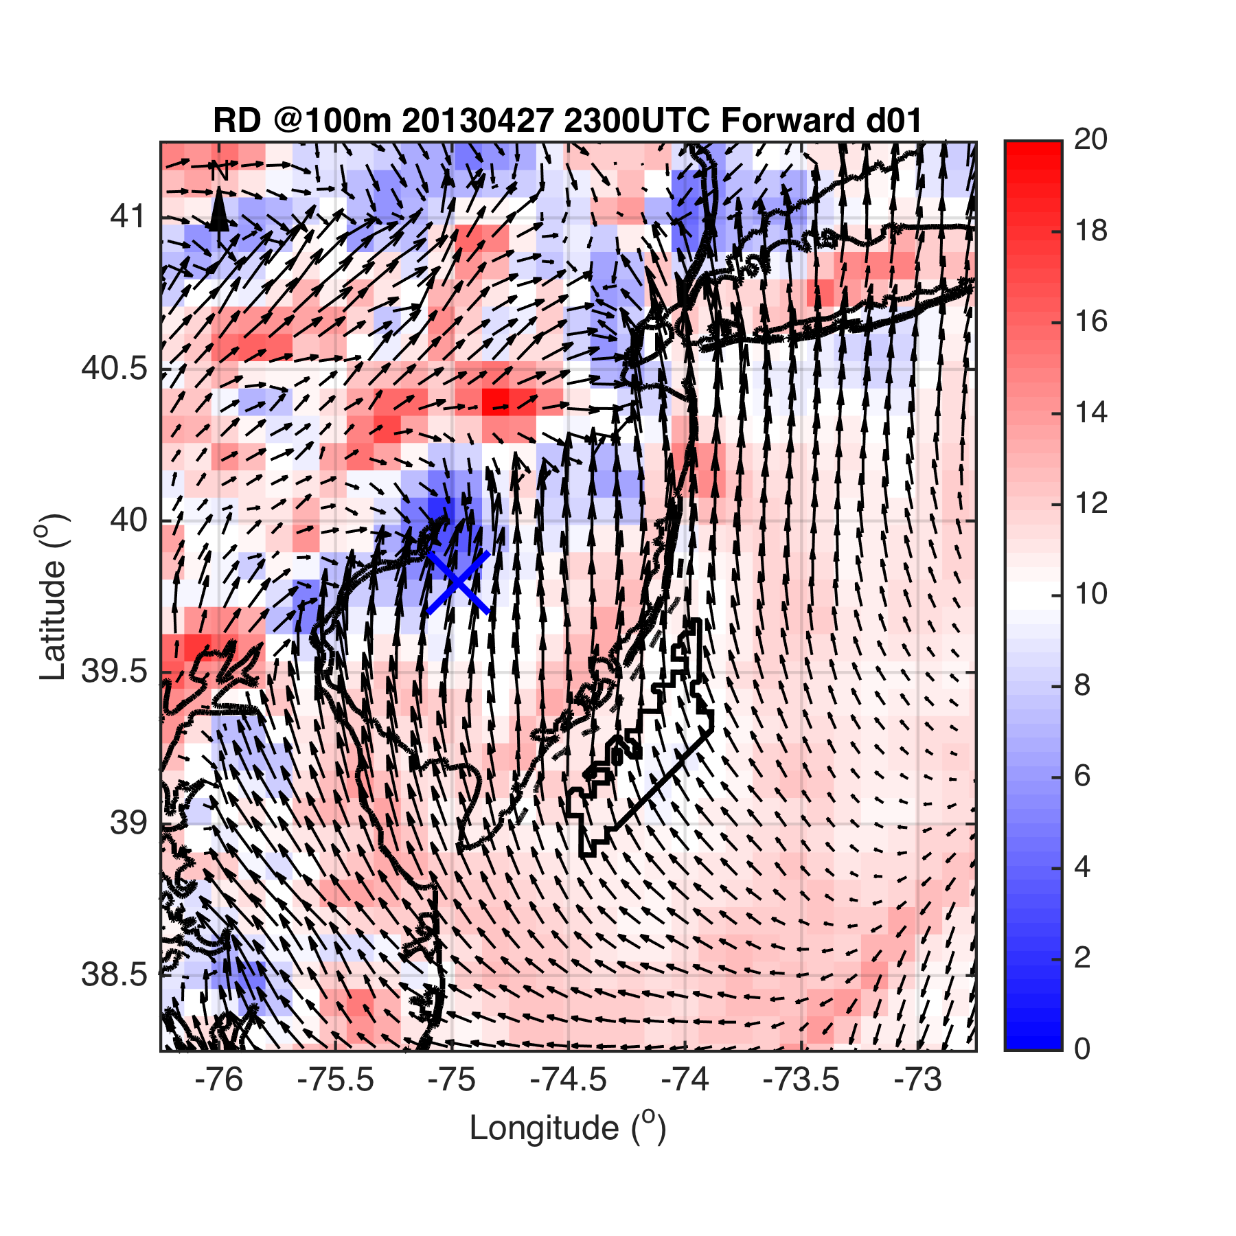
Case 1
Fig 2

Slide 18
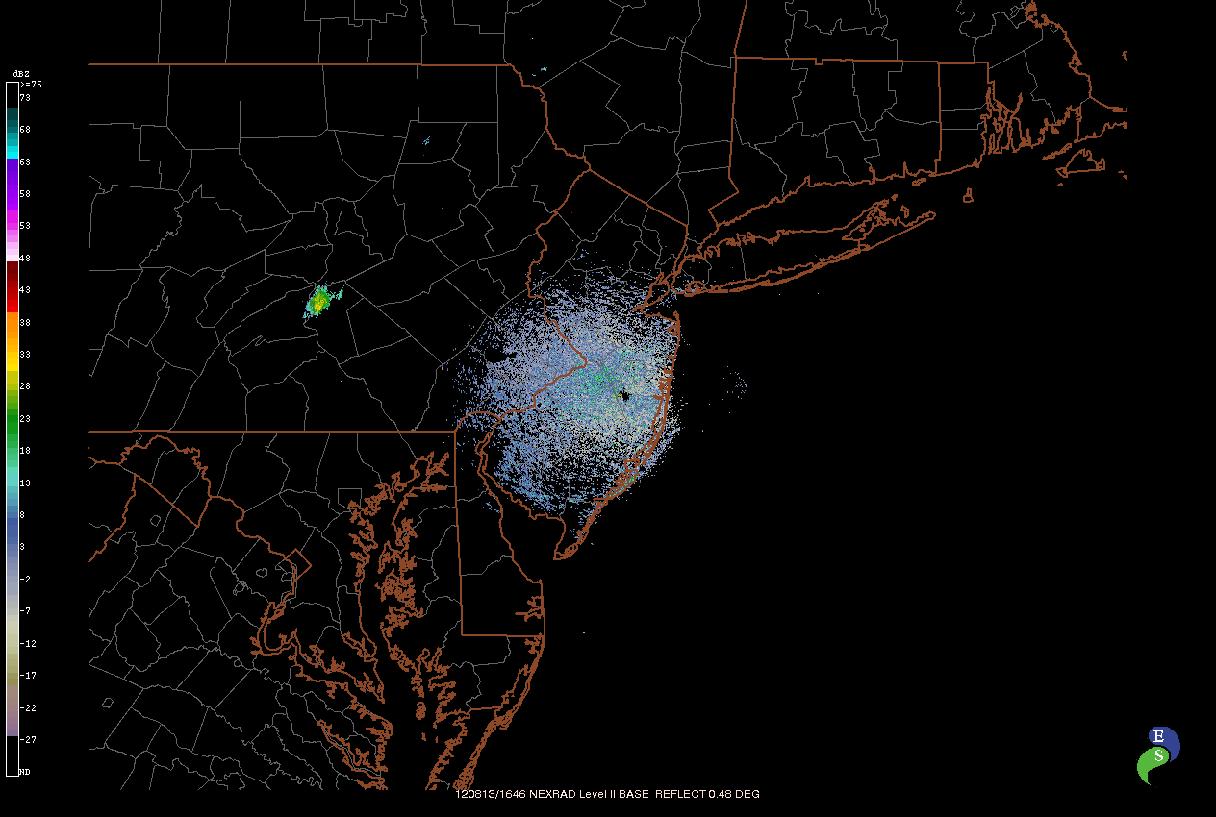
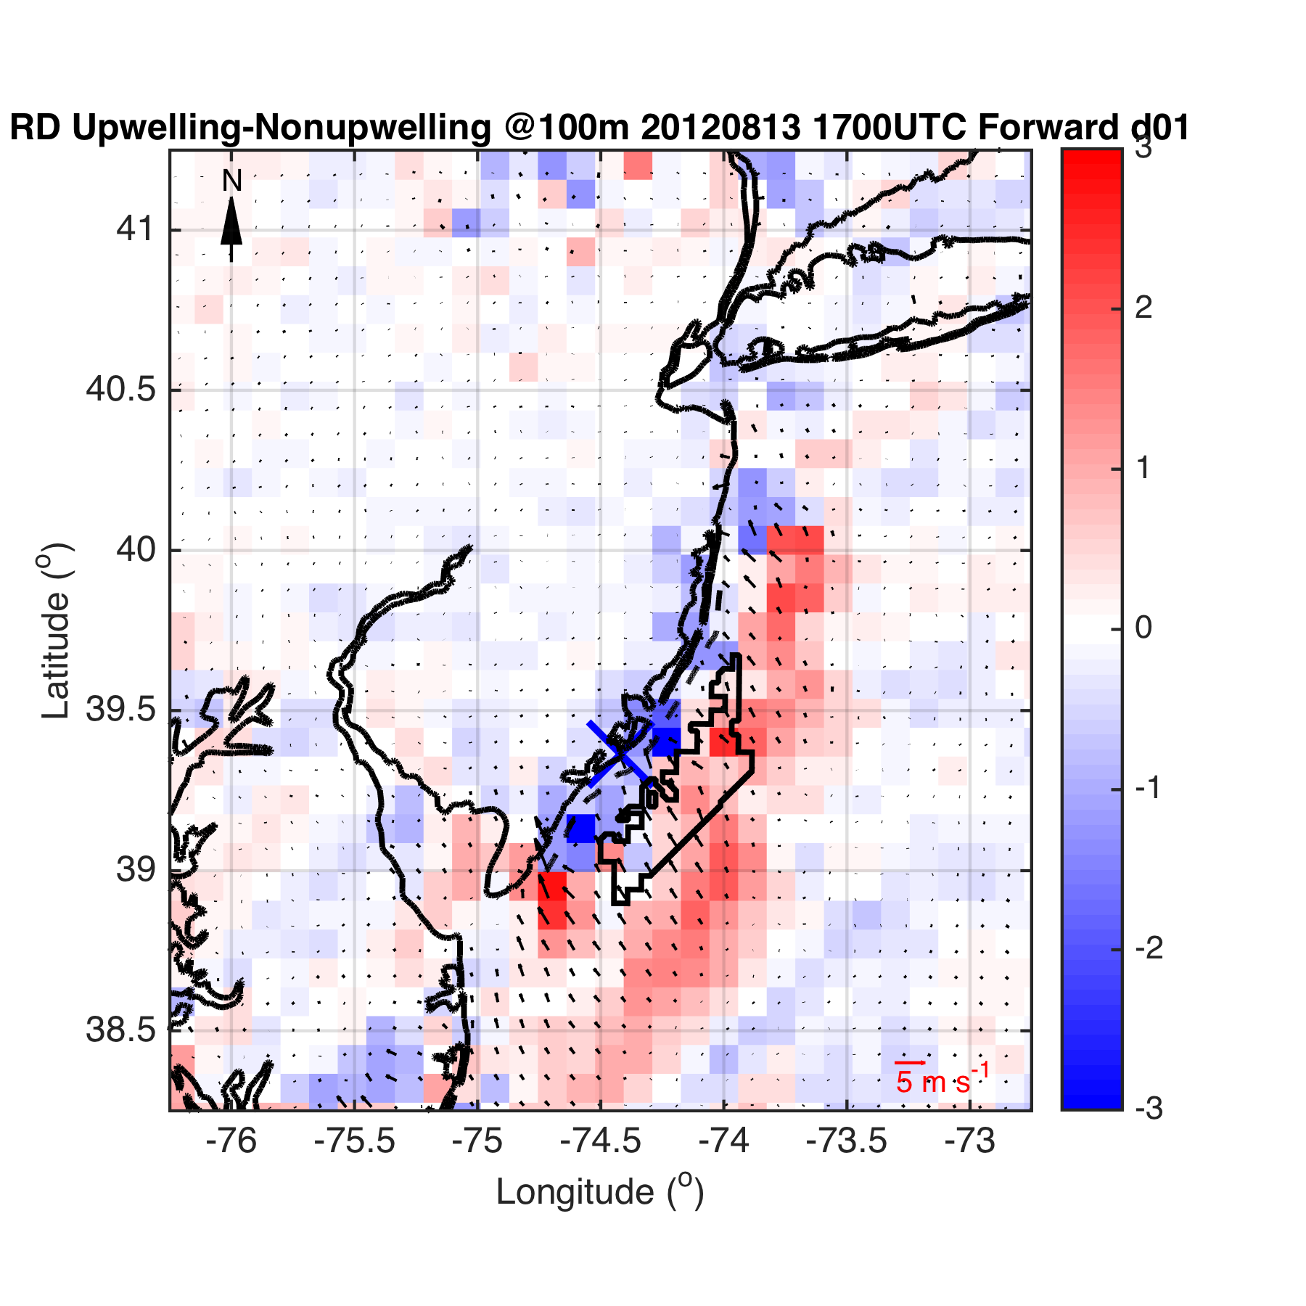
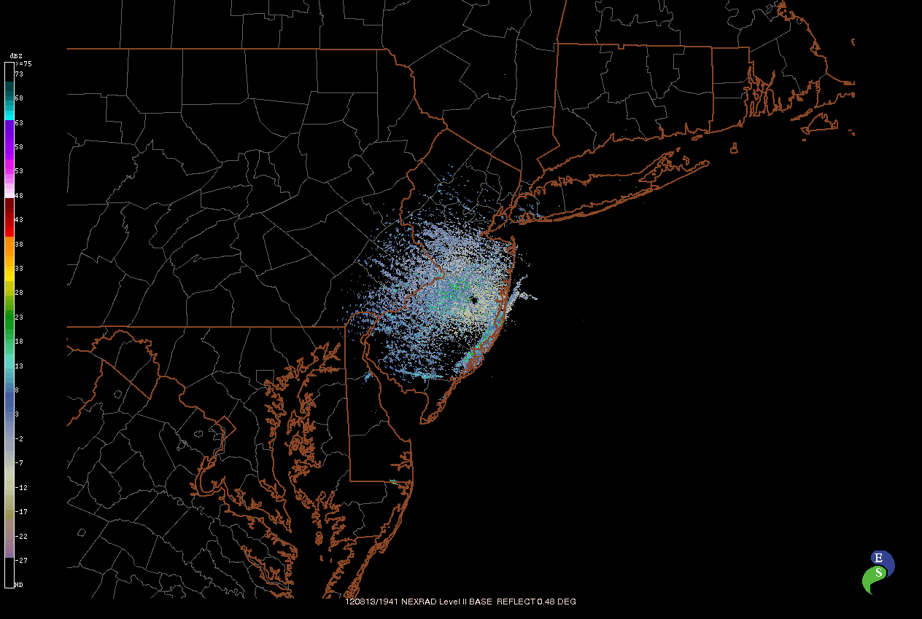
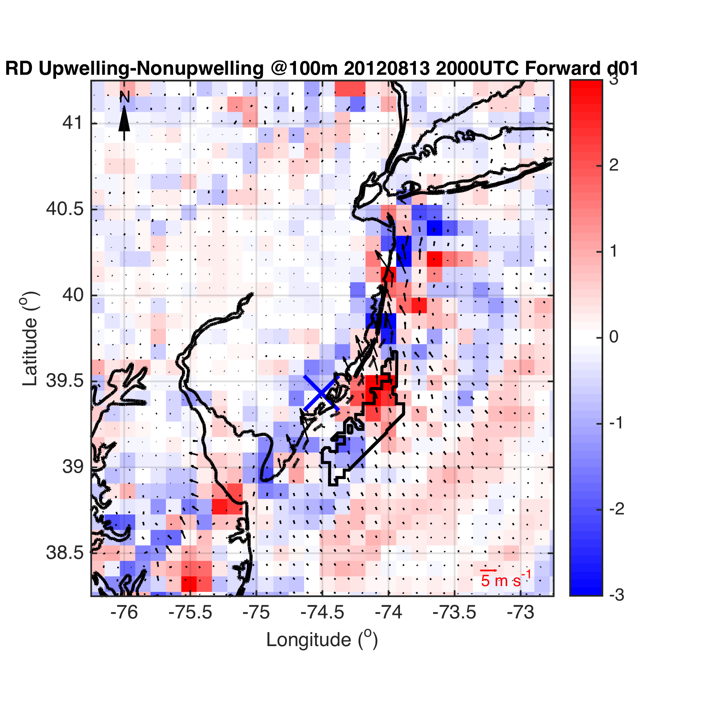
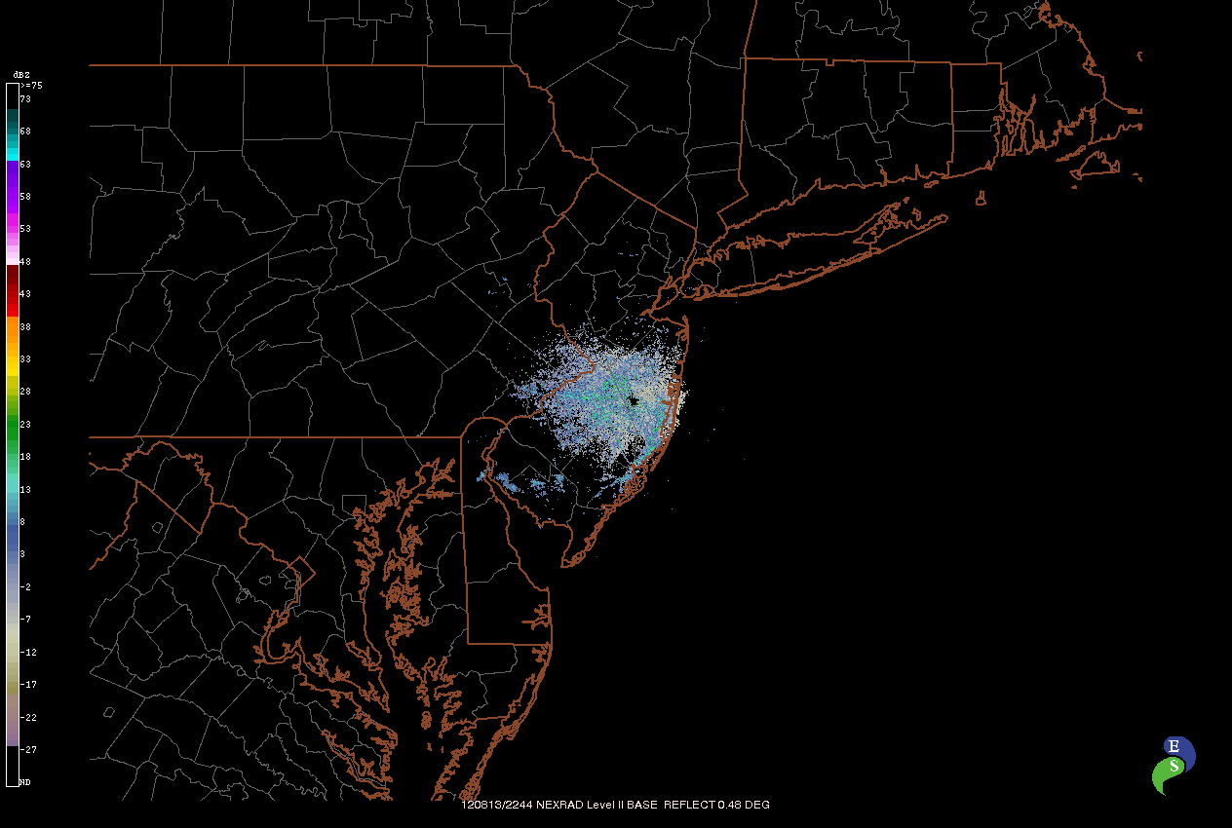
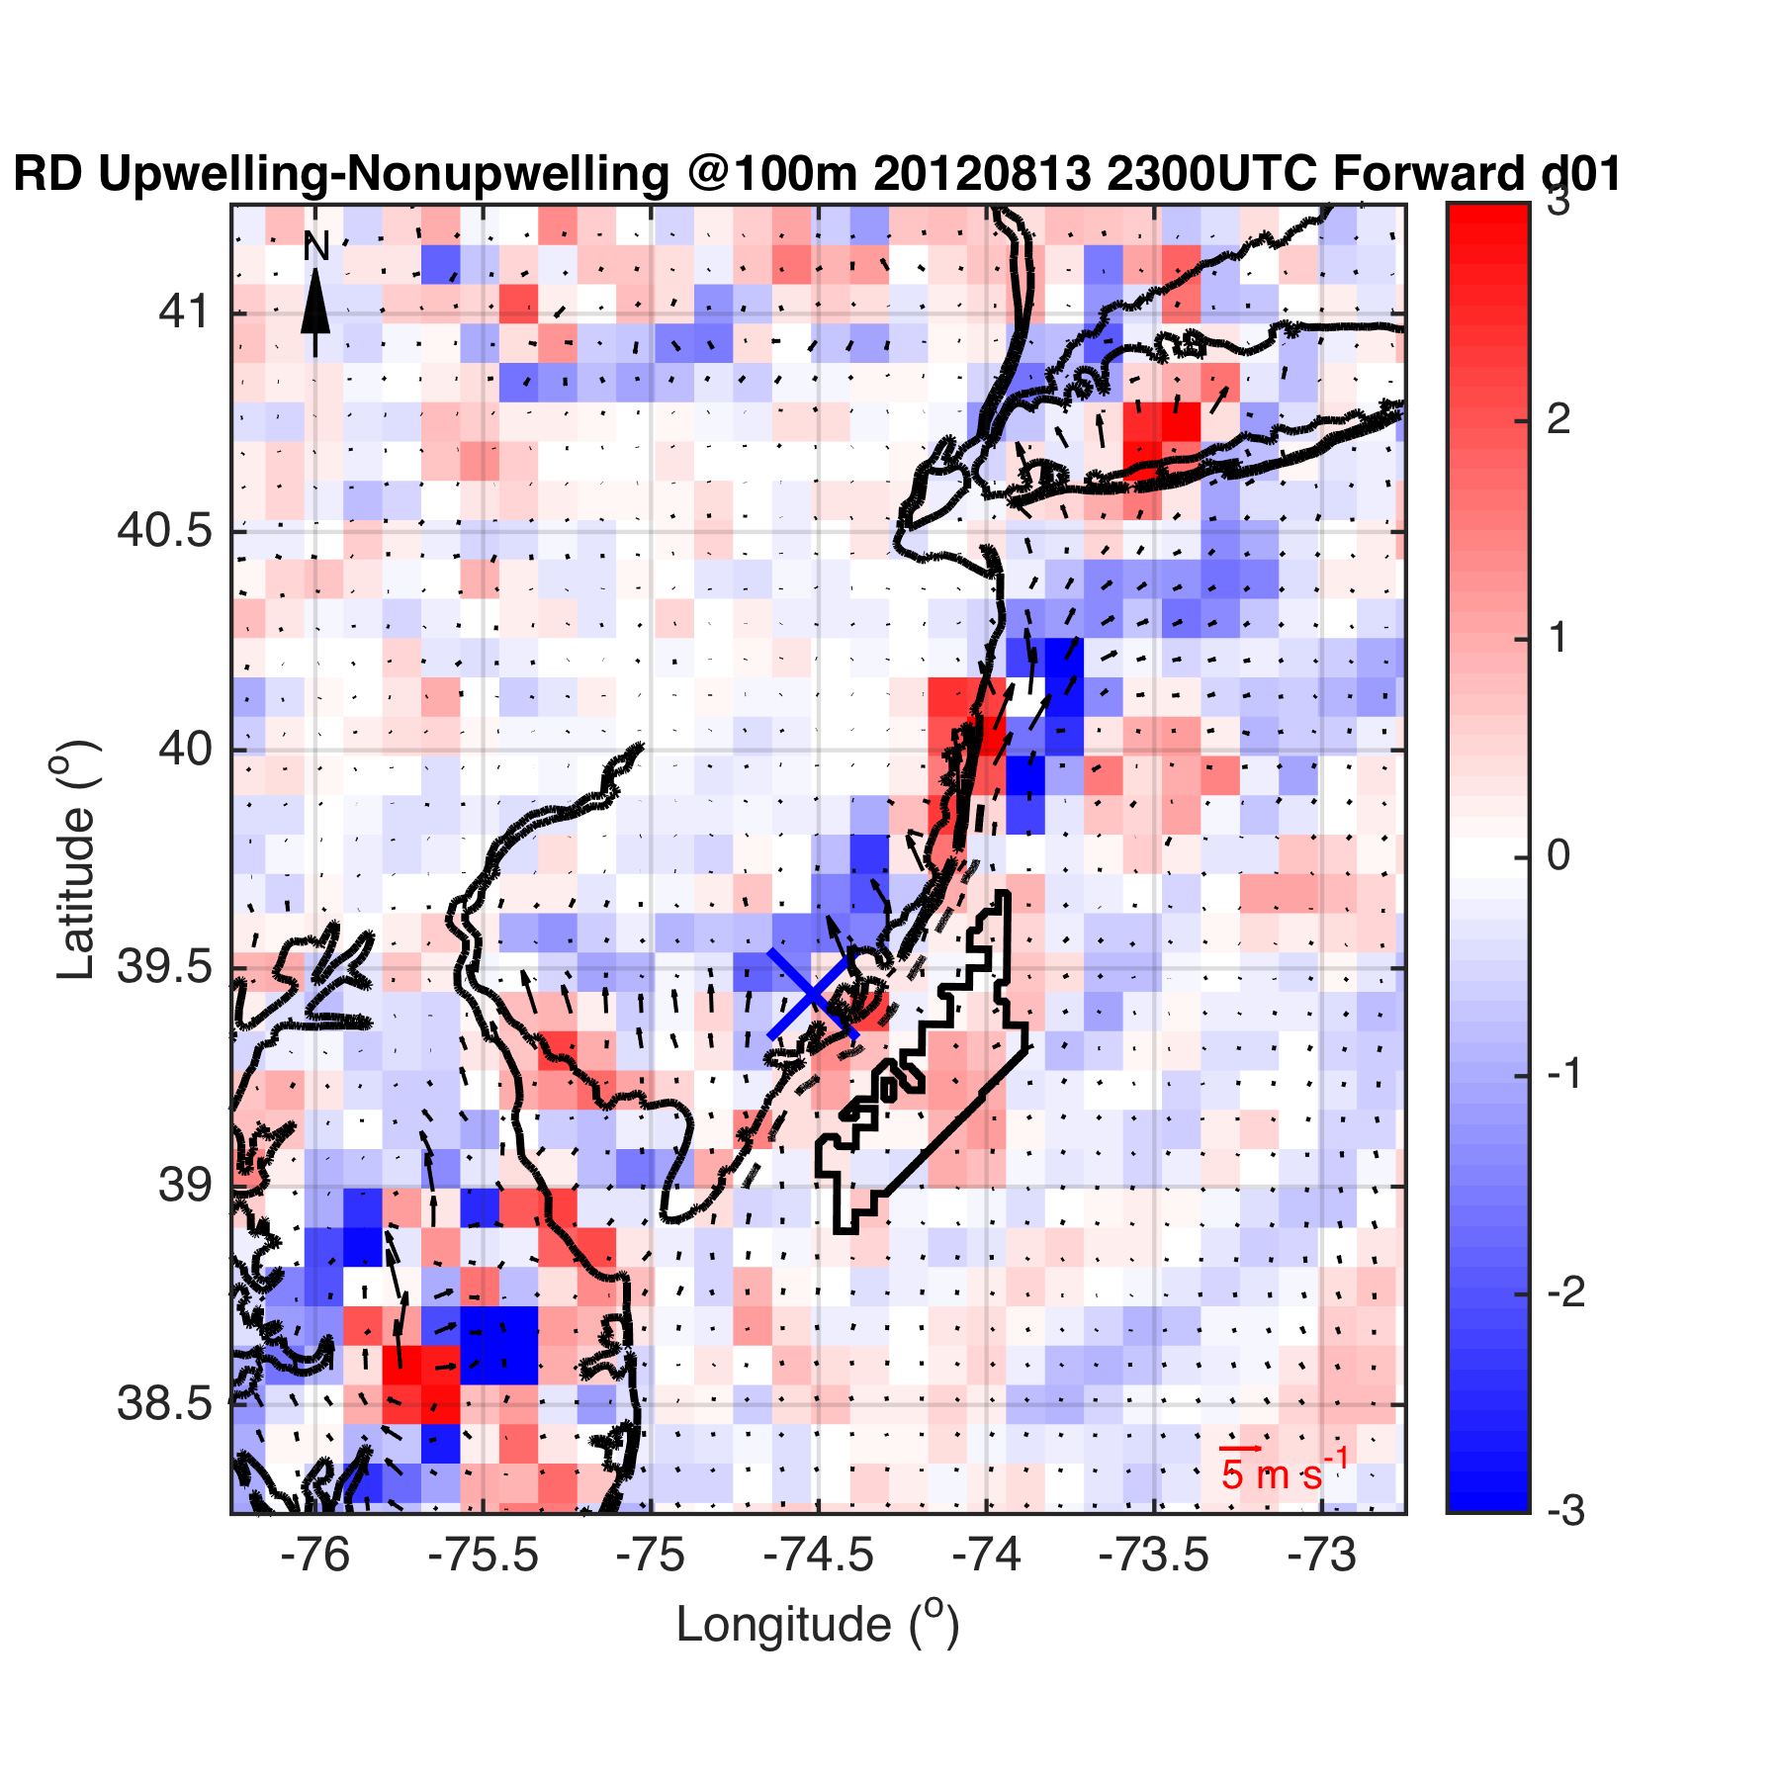
Case 2- Case 3
Or
Case 2,
Case 3 separately?
Fig 3

Slide 19
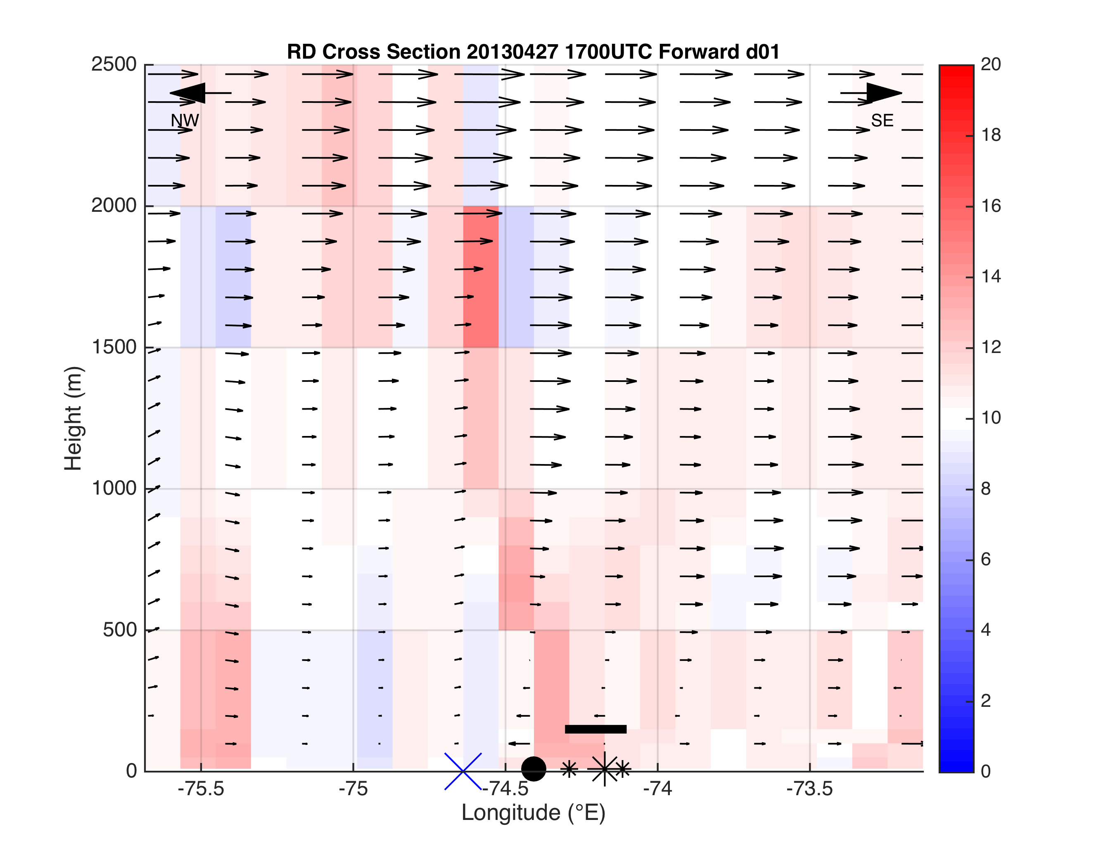
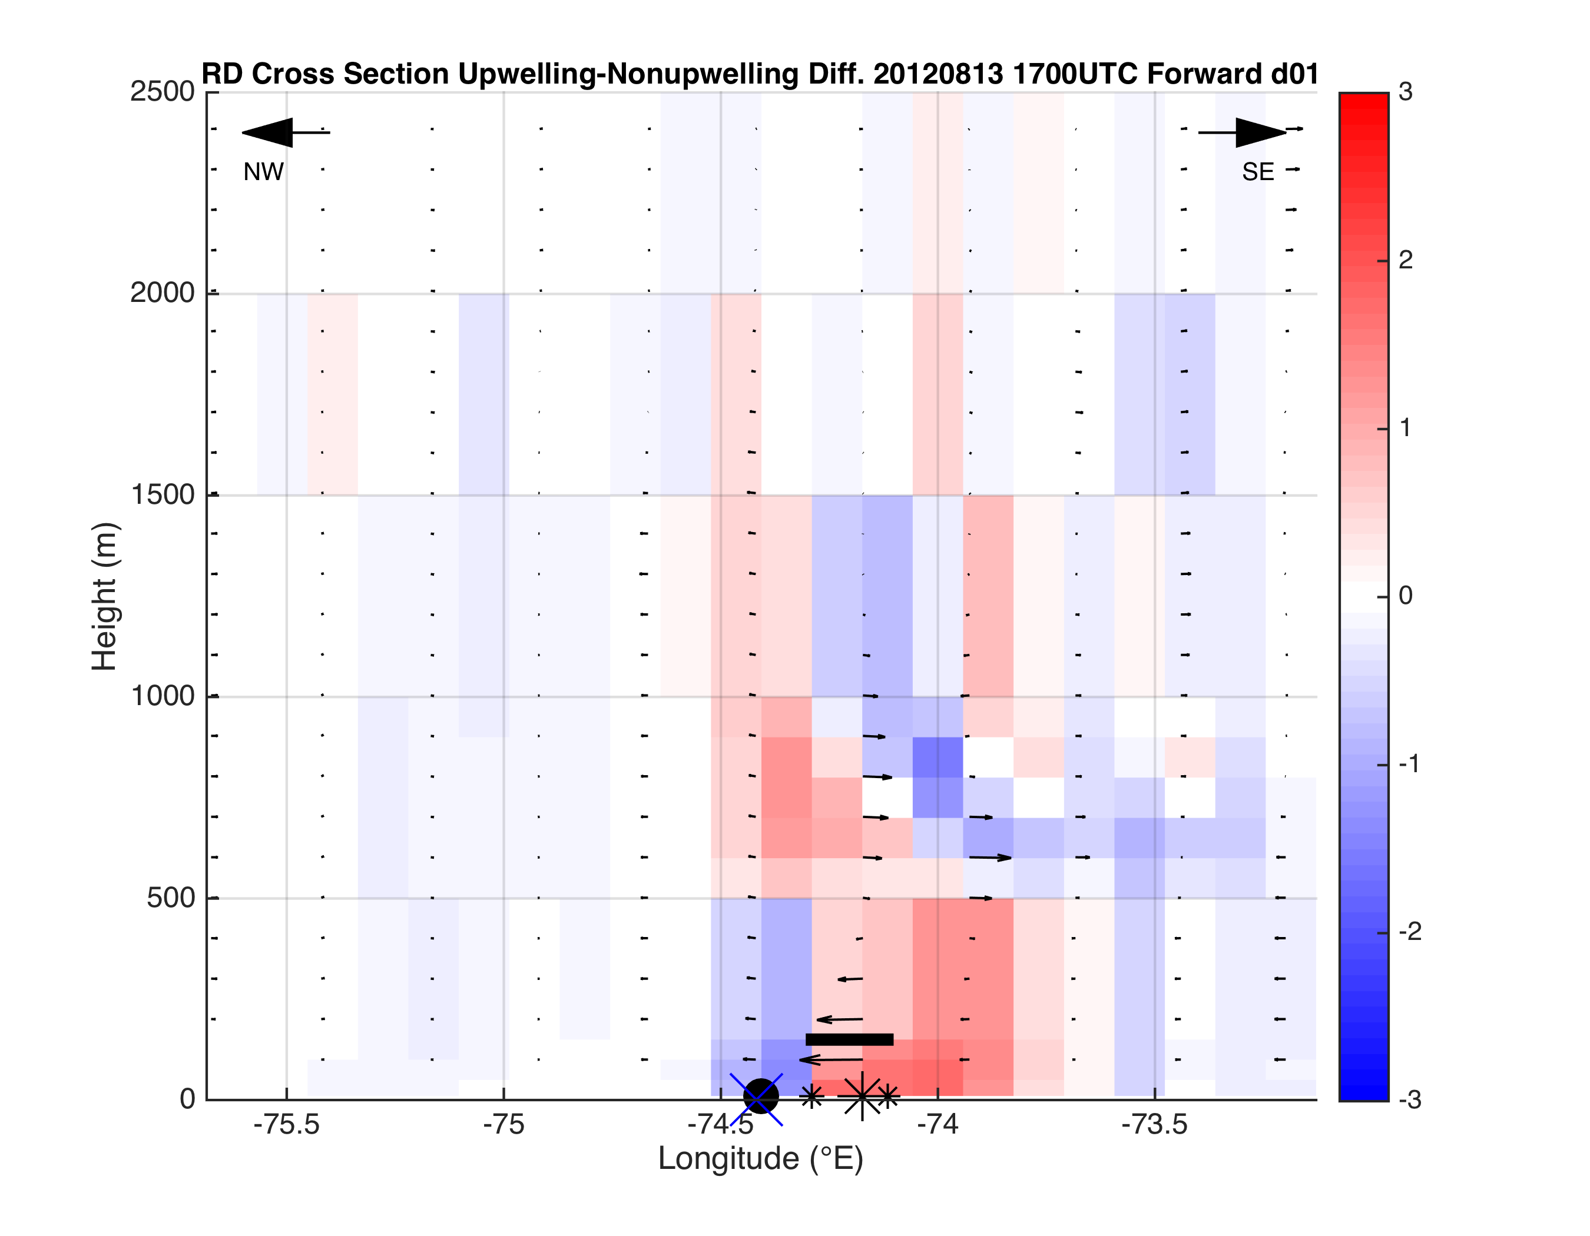
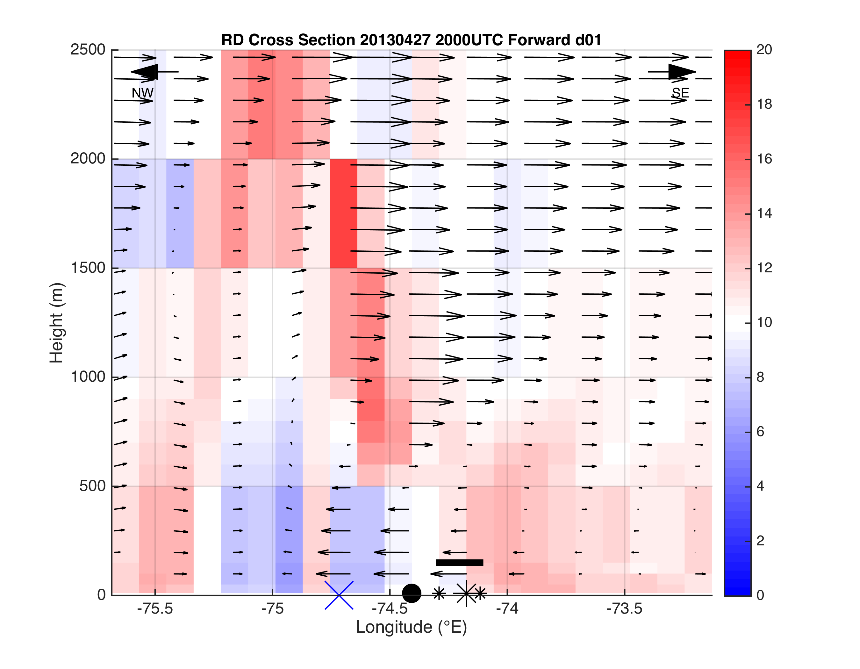
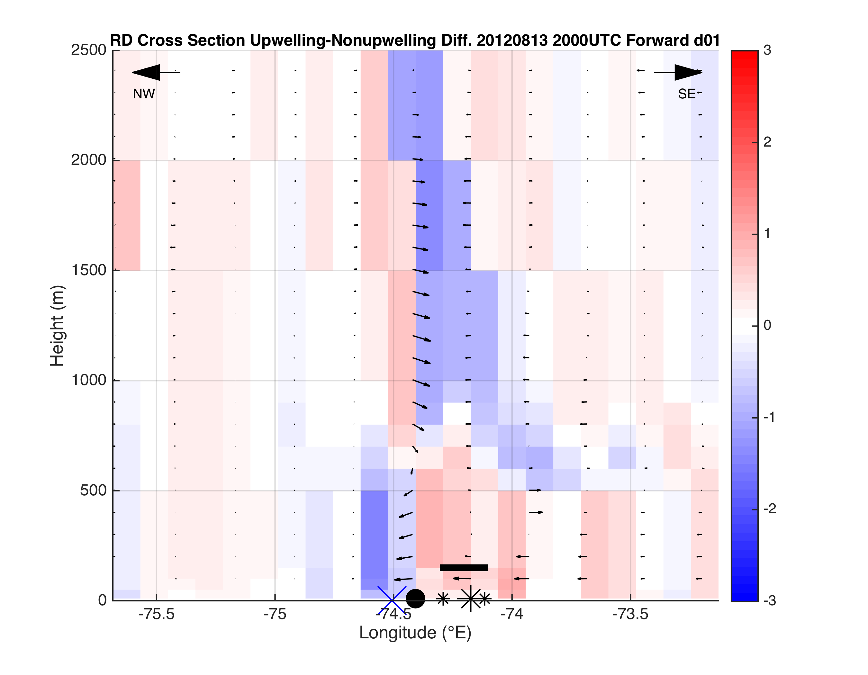
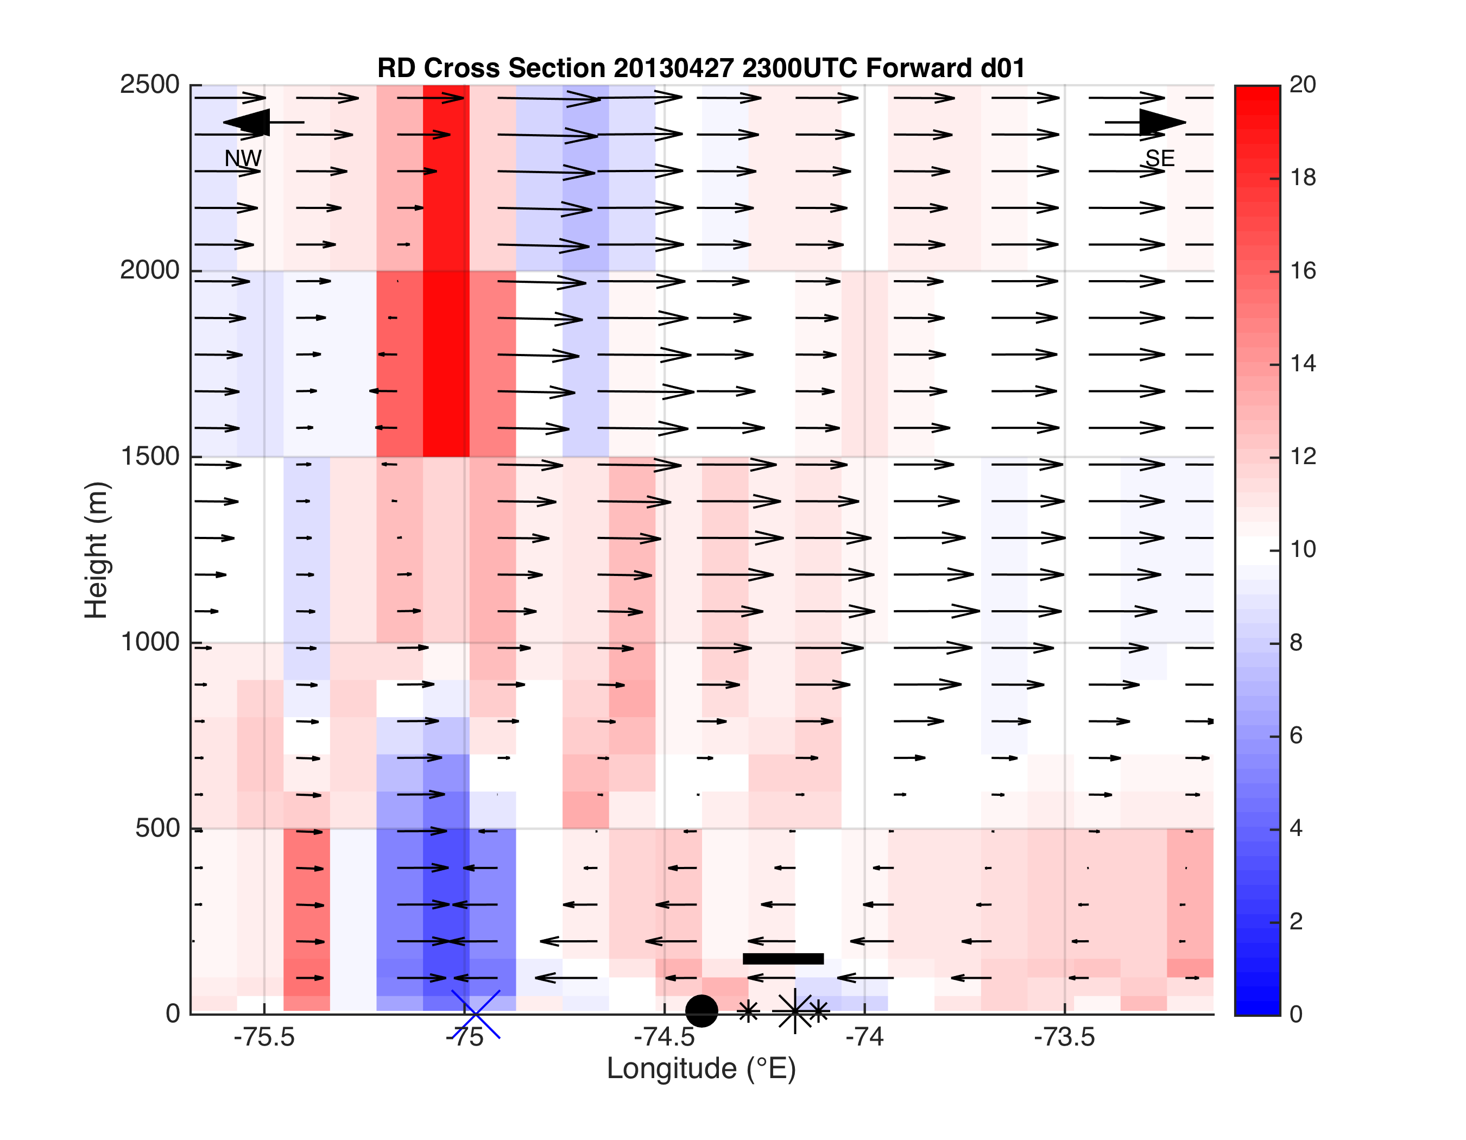
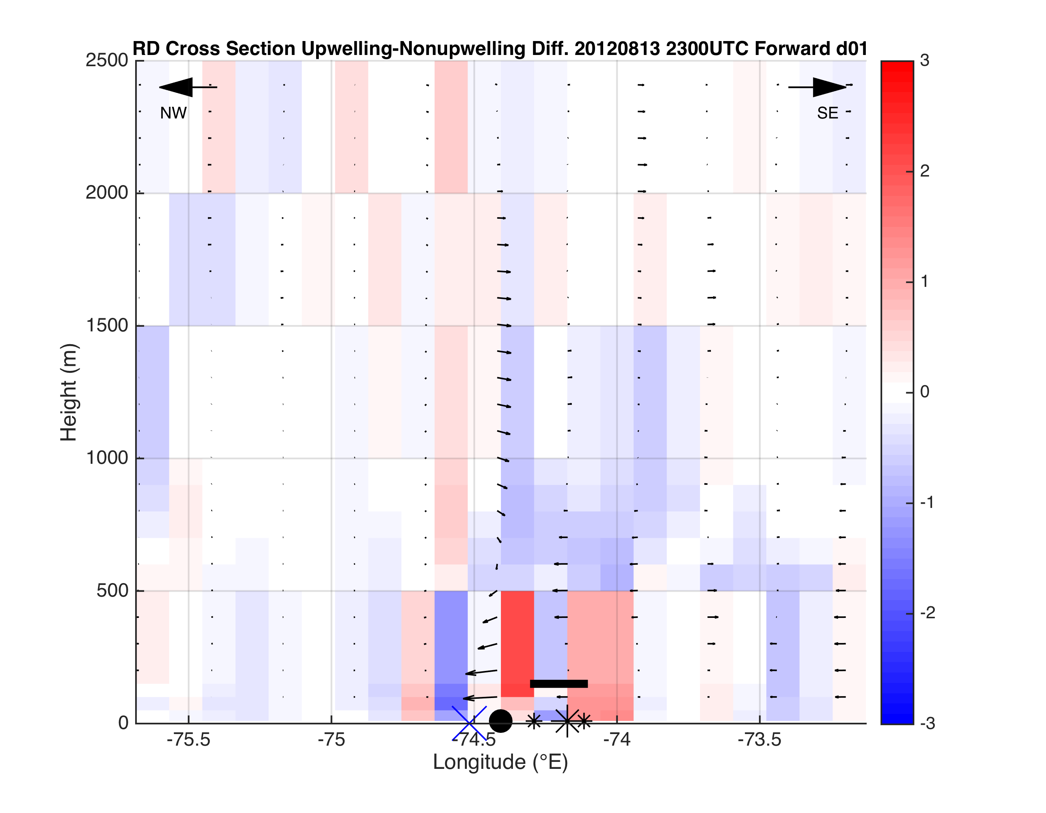
Case 1
Case 2-Case 3
Case 2- Case 3
Or
Case 2,
Case 3 separately?
Fig 4

Slide 20
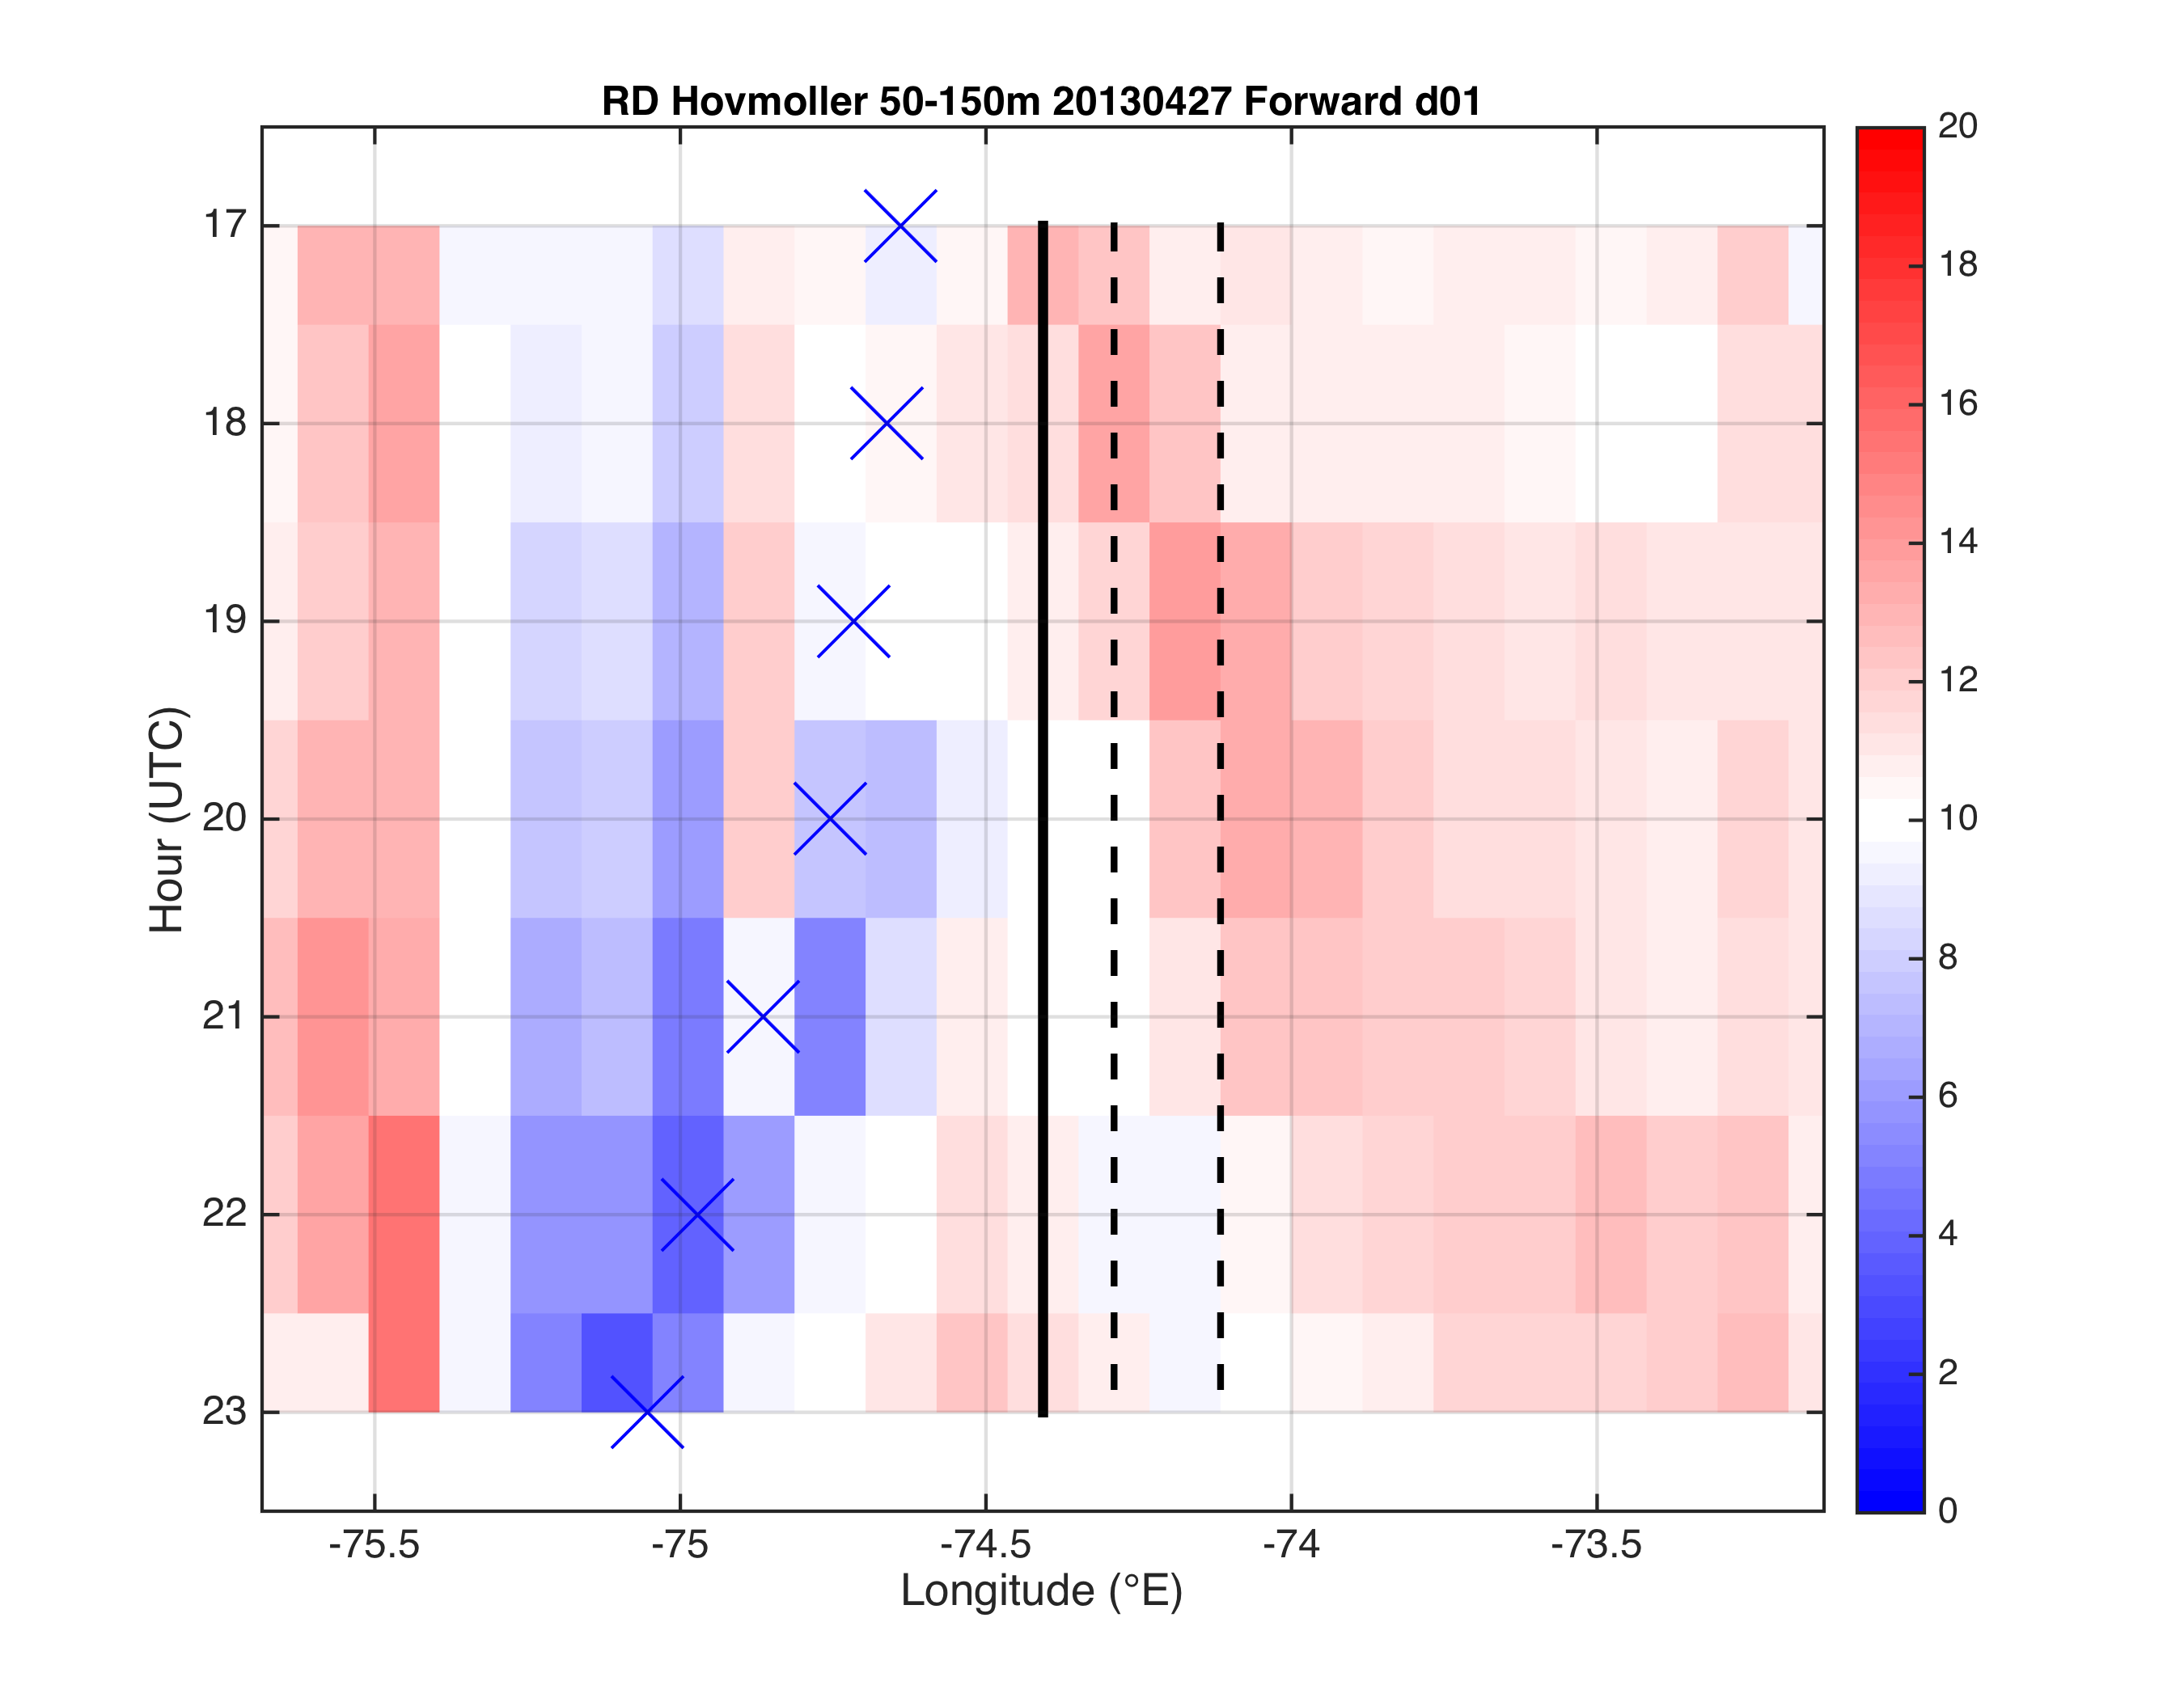
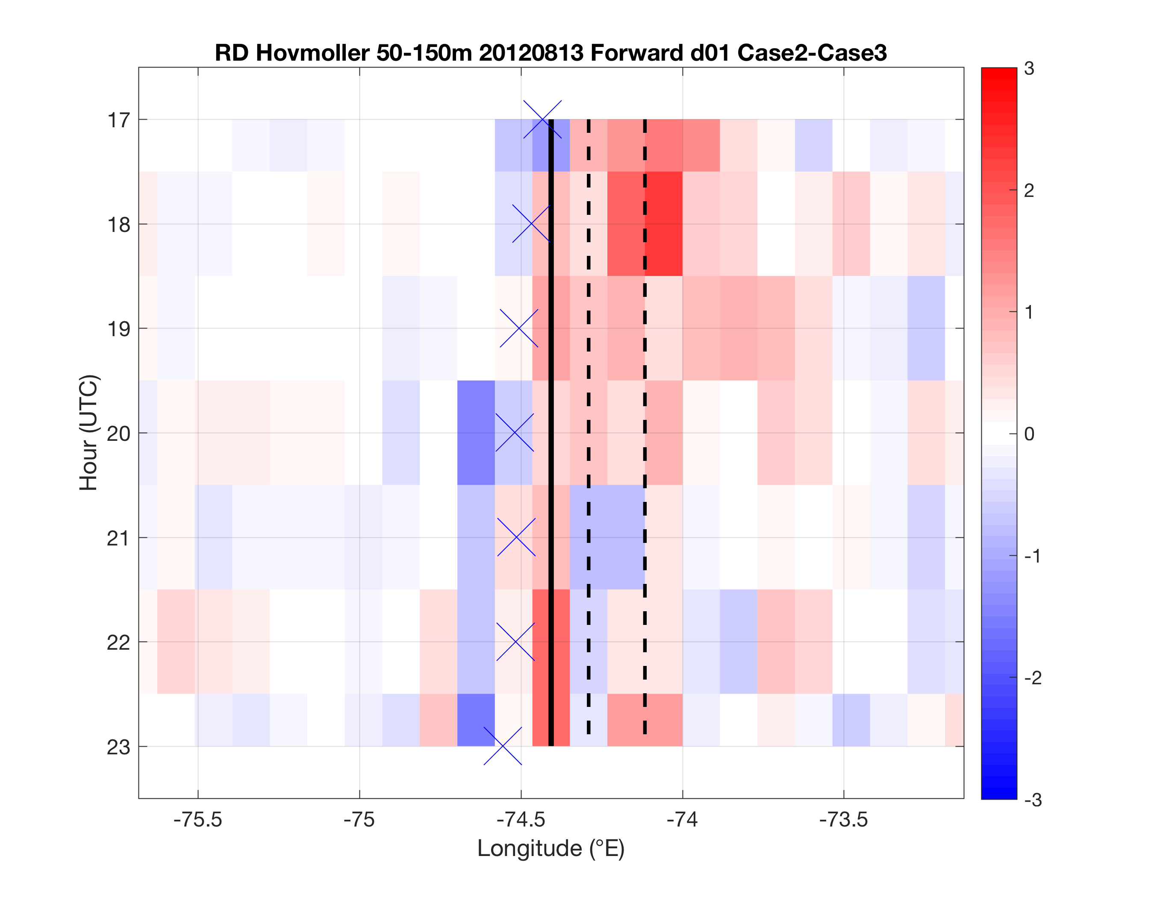
Case 2- Case 3
Or
Case 2,
Case 3 separately?
Fig 5
Case 1
Case 2-Case 3

Slide 21
Final tasks
Hovmoller additions
SST along cross section as bottom panel
Distance on x-axis, 0 at coast, 0 at inland front
Wind speed Hovmoller? (with vectors?)
Correlation LCS vs. wind speed Hovmoller?
Time series of boxes
LCS avg in 50-150m box over NJ WEA (Lagrangian) vs. wspd in box (Eulerian)- correlate wind speed and divergence?
LCS avg in 50-150m box onshore same distance as offshore NJ WEA (Lagrangian) vs. wspd in box (Eulerian)- correlate wind speed and convergence?
Other time series
Max convergence, divergence
Width, height divergence
Height of reversal from surface conv to aloft div
Sensitivity to MYNN vs. YSU PBL schemes
Increased vertical resolution of LCS between 150 and 1000m
LCS on CODAR for sea breeze
Detided (method?) 10min shorts, gap filled with Fredj method

Slide 22
Extra slides

Slide 23
Introduction
On November 9, 2015, BOEM issued commercial lease auction for NJ
Nearly 344,000 acres for leasing offshore wind (OSW)
5th competitive lease auction for OSW in U.S.
RES Americas won North lease (sold lease to Dong Energy)
US Wind won South lease
Will submit application to develop to NJ BPU
Must include wind resource assessment & economic analysis

Slide 24
Introduction
NJ BPU Offshore Wind Rules state:
“Applications shall account for…the coincidence between time of generation for the project and peak electricity demand.”
NJ sea breeze and coastal upwelling coincident with peak electricity demand
Relative Load
Frequency
Notes:
-Sea breeze time of day (afternoon/evening) is also coincident with peak demand time of day (5-7 pm)

Slide 25
Introduction
Sea breeze
Coastal upwelling
Notes:
Cut-out speed of OSW turbines of 4 m/s (calm zone?)

Slide 26
Introduction
Little attention has been paid to sea breeze in offshore environment (Steele et al. 2014)
Limited to numerical simulations
Paucity of offshore obs.
Spatial scales of offshore sea breeze more difficult to distinguish, unlike onshore sea breeze where frontal boundary well defined (Simpson, 1994)
Coastal upwelling

Slide 27
Introduction
Key Questions:
What does the offshore component of the sea breeze look like? Secondary circulation (size, structure)? Offshore divergence? Calm zone?
What effect does cold coastally-upwelled water have on the coastal/offshore wind resource?
Coastal upwelling
?

Slide 28
Introduction
Coastal upwelling + Sea breeze Hypothesis
Cold upwelling
Does this occur? With or without upwelling?

Slide 29
Materials and Methods
Satellite: state-of-the-science declouding and compositing technique designed by Rutgers to determine SST and resolve coastal upwelling
Model: 3km, 600m WRF-ARW 3.6.1; YSU PBL; MM5 Monin-Obukhov surface layer
Advantages (vs. offshore met tower): cost, spatial variability, prediction
Sea Breeze Cases:
April 27, 2013: pure, no upwelling
Aug 13, 2012: pure, upwelling
Aug 13, 2012: pure, remove upwelling
Coastal upwelling
Backdoor
Corkscrew
Pure
Notes:
Satellite: High res in space and time
Previous satellite SST products low in spatial or temporal resolution and are often warmest pixel composites for declouding; cannot resolve coastal upwelling
SST product is IR/near IR (AVHRR); SPoRT is IR/near IR as well
Model: NAM12km for boundary conditions
Cases: largest and longest lasting upwelling in NJ 2012-2014
20140731 case has similar ambient (outside upwelling) water T to 20130707

Slide 30
Materials and Methods
Criteria for cases:
June-August (peak load)
Pure sea breeze
largest gradient wind component perpendicular to the coast and in the offshore direction (257-345 degrees)
12Z for synoptic 925mb (gradient) winds
Backdoor
Corkscrew
Pure

Slide 31
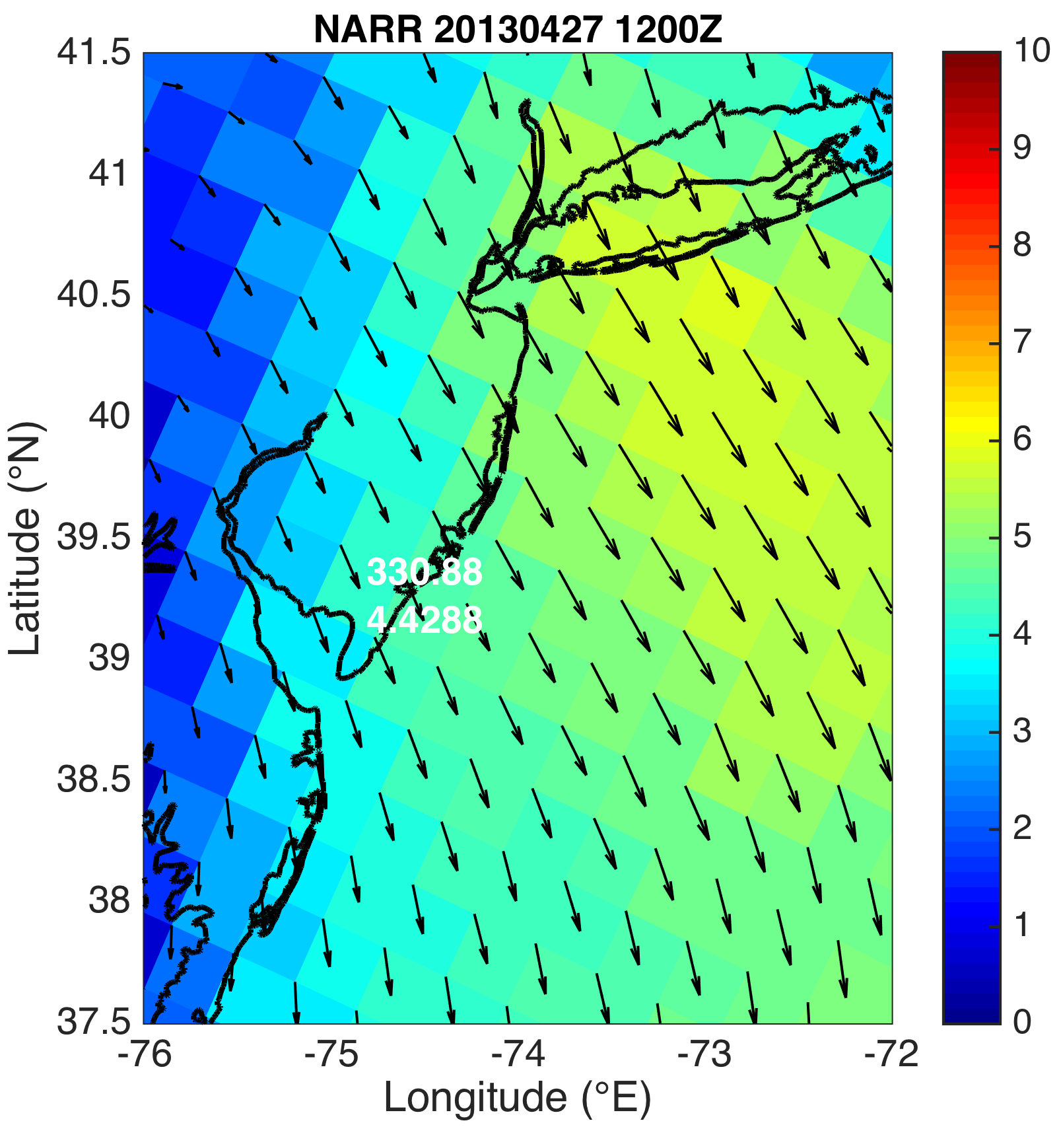
Cases: 1. April 27, 2013: pure, no upwelling
925mb winds (m s⁻¹)
SST (°C)
Notes:
Pure: (257-345 degrees)

Slide 32
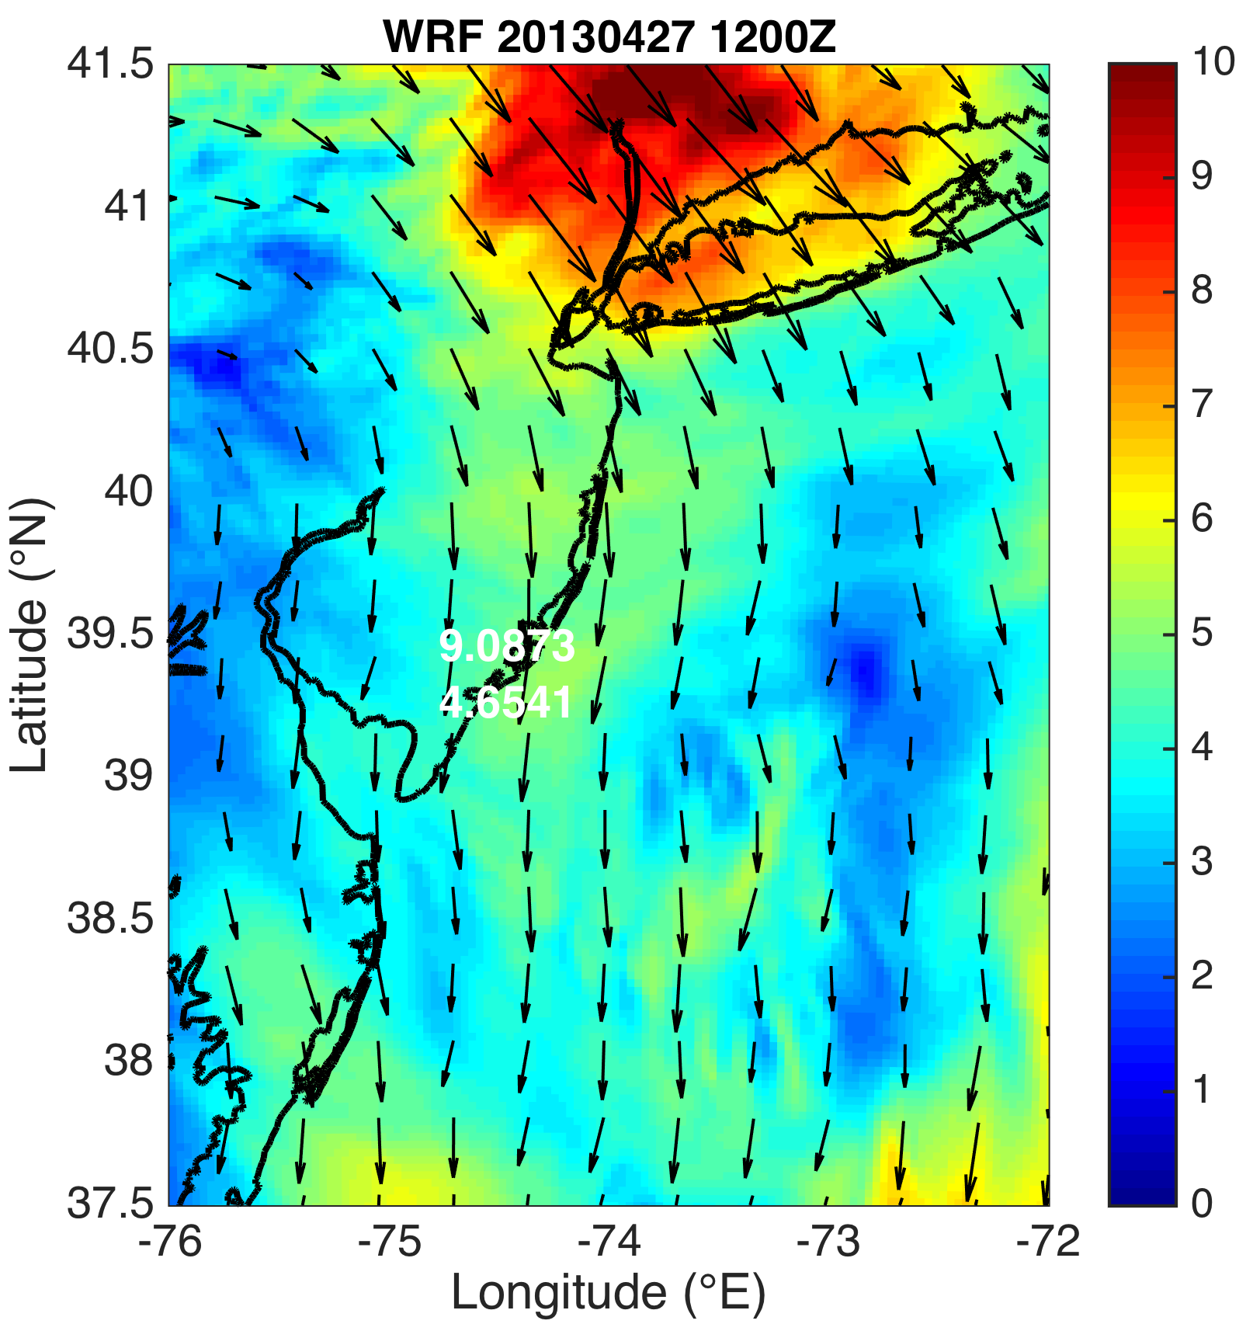
Cases: 1. April 27, 2013: pure, no upwelling
925mb winds (m s⁻¹)
SST (°C)
Notes:
Pure: (257-345 degrees)

Slide 33
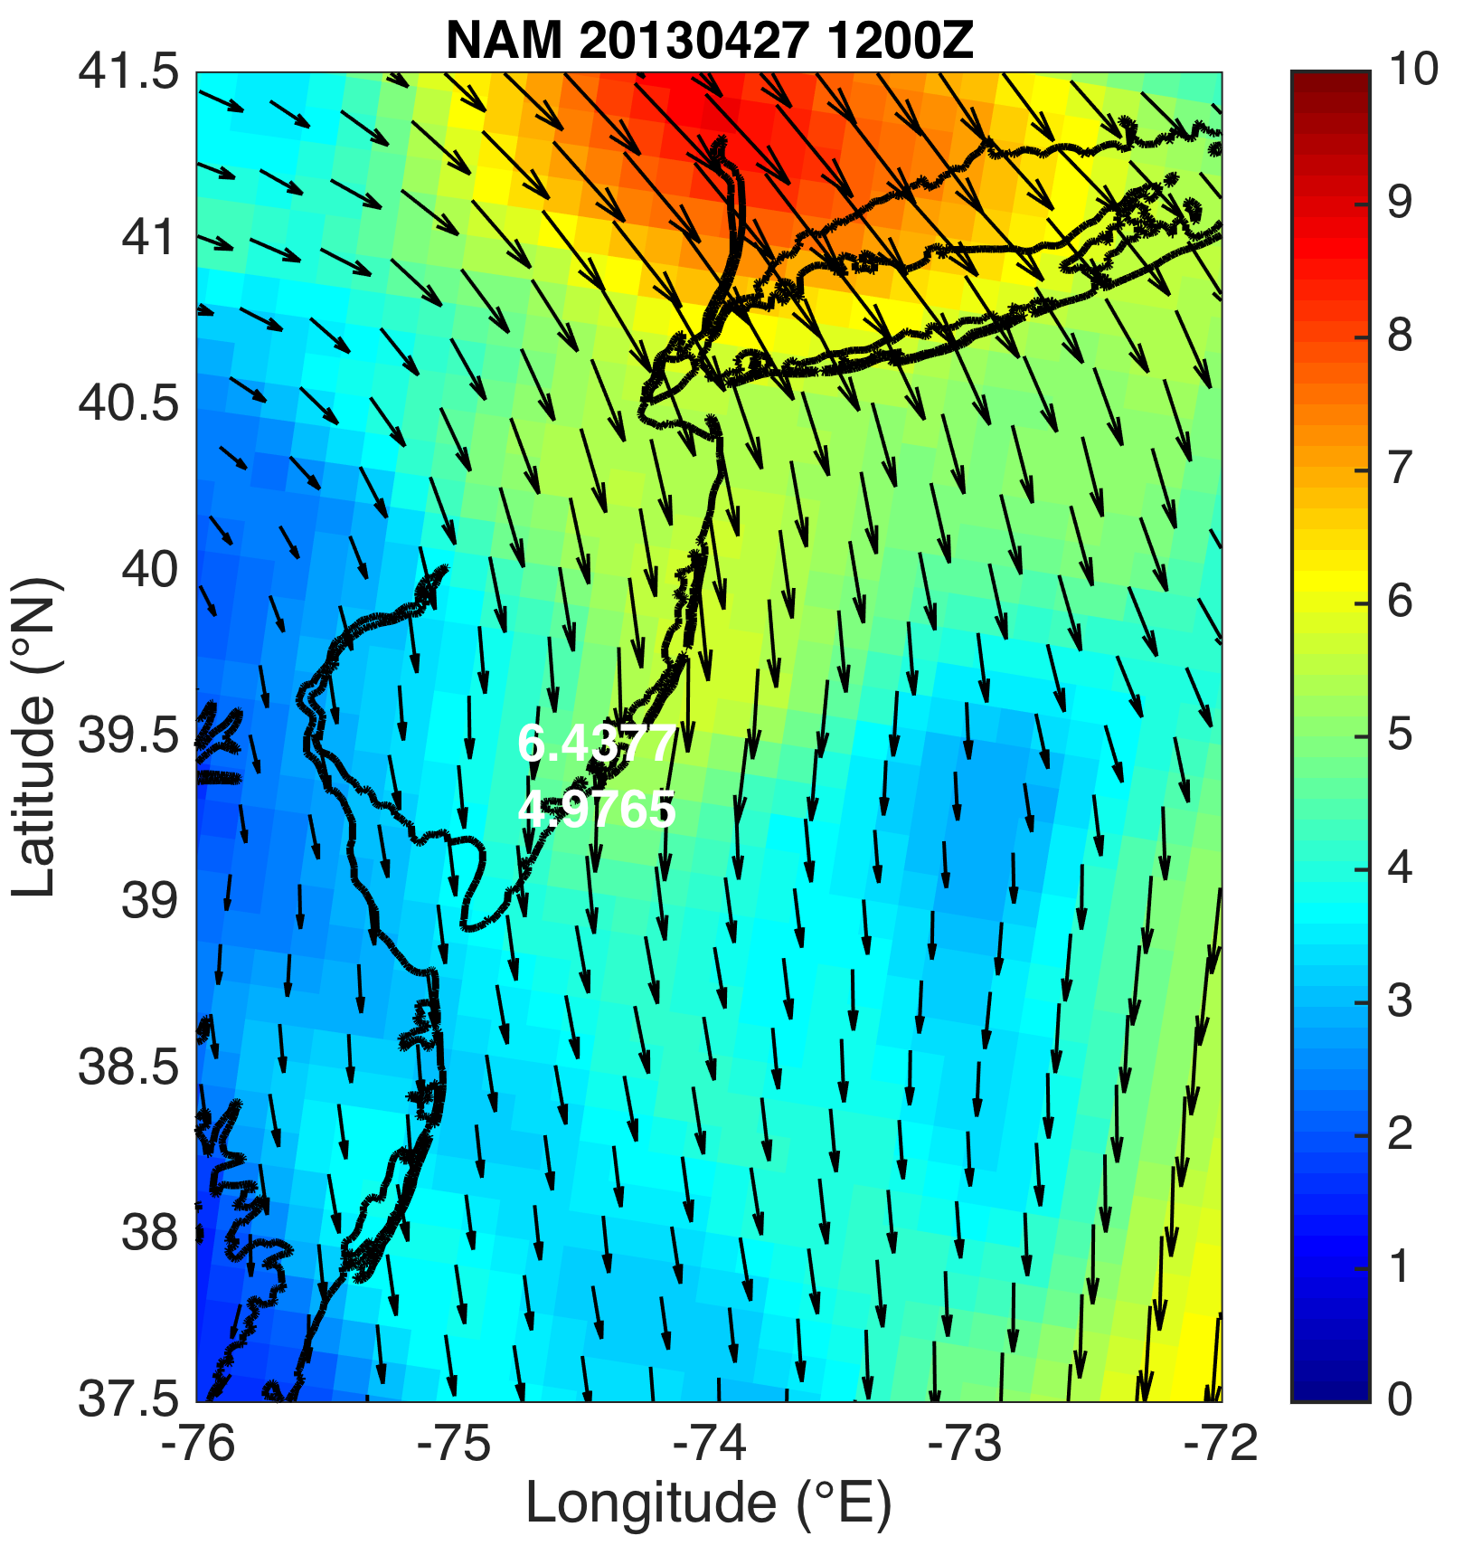
Cases: 1. April 27, 2013: pure, no upwelling
925mb winds (m s⁻¹)
SST (°C)
Notes:
Pure: (257-345 degrees)

Slide 34
1. April 27, 2013: pure, no upwelling
NEXRAD radar

Slide 35
1. April 27, 2013: pure, no upwelling
NEXRAD radar

Slide 36
1. April 27, 2013: pure, no upwelling
NEXRAD radar

Slide 37
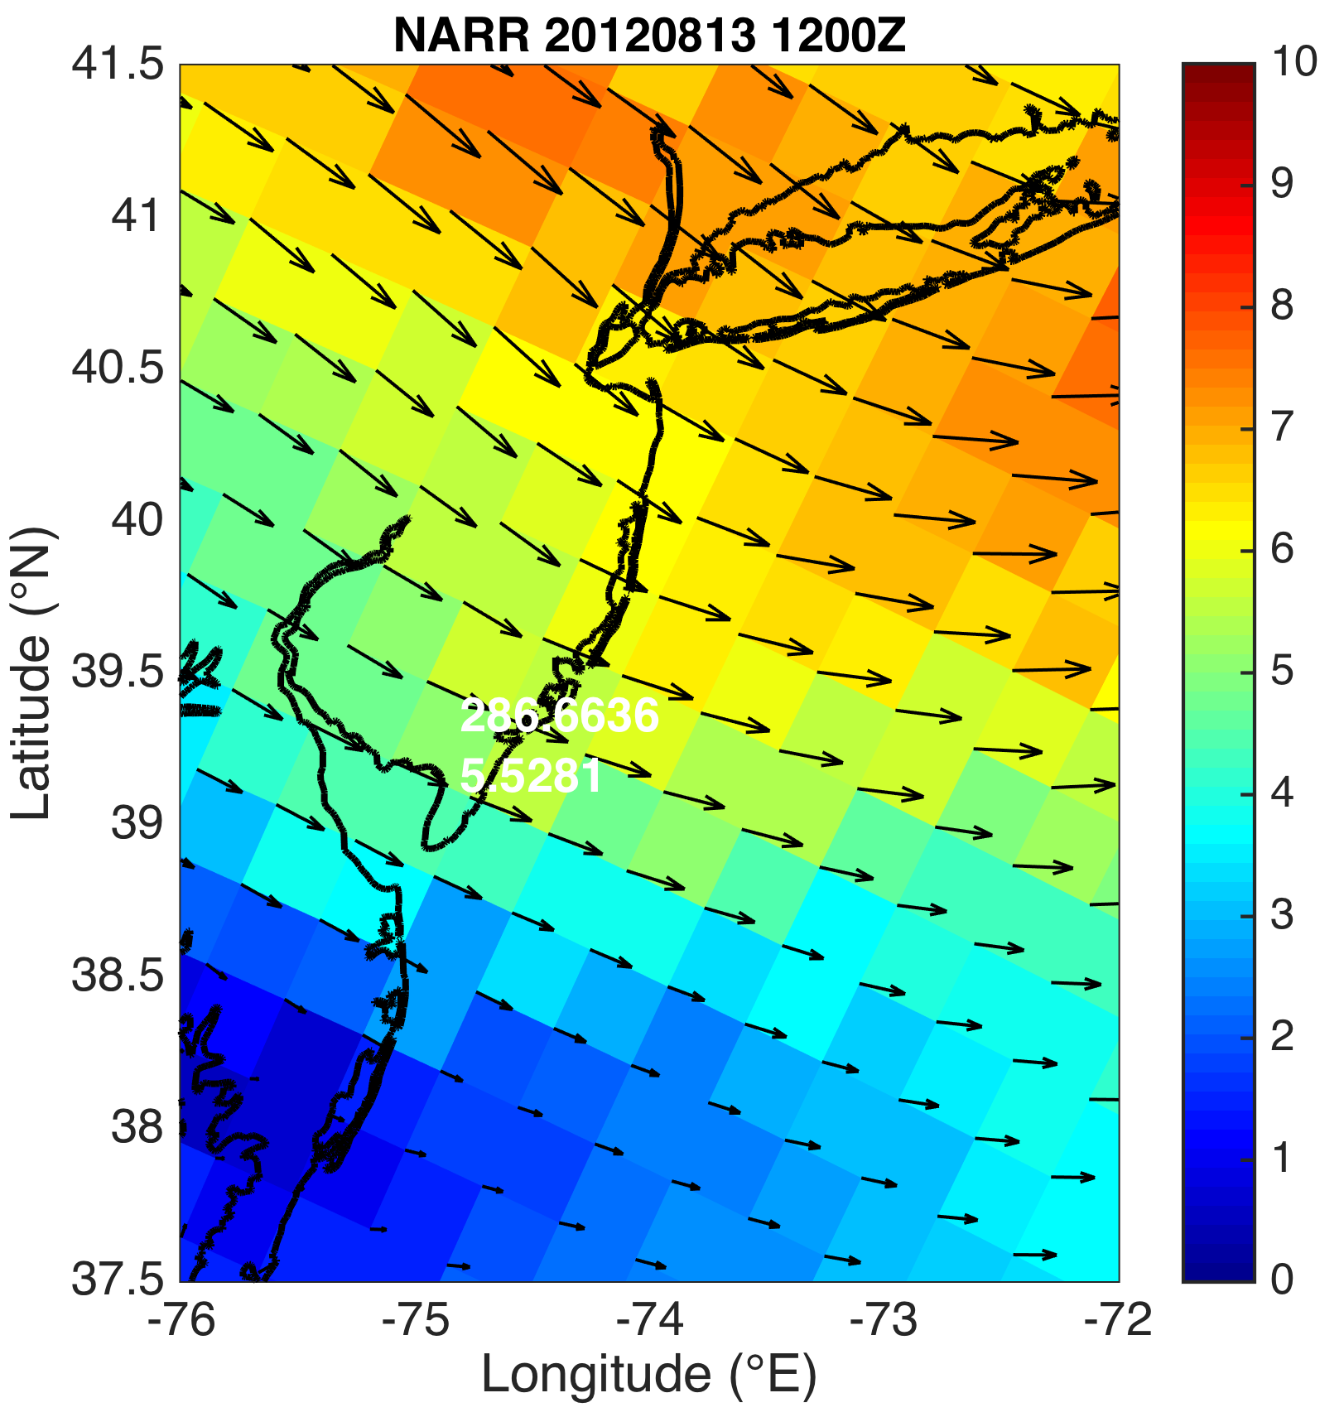
Cases: 2. August 13, 2012: pure, upwelling
925mb winds (m s⁻¹)
SST (°C)
Notes:
Pure: (257-345 degrees)

Slide 38
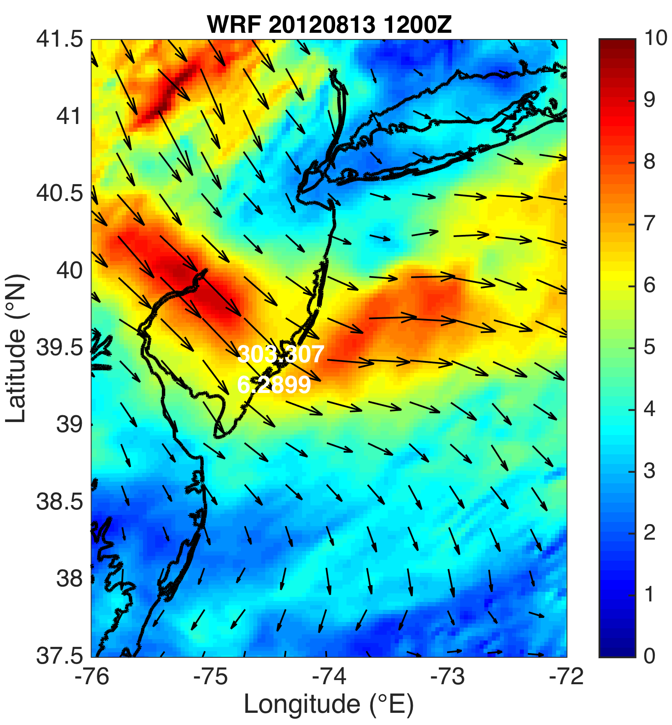
Cases: 2. August 13, 2012: pure, upwelling
925mb winds (m s⁻¹)
SST (°C)
Notes:
Pure: (257-345 degrees)

Slide 39
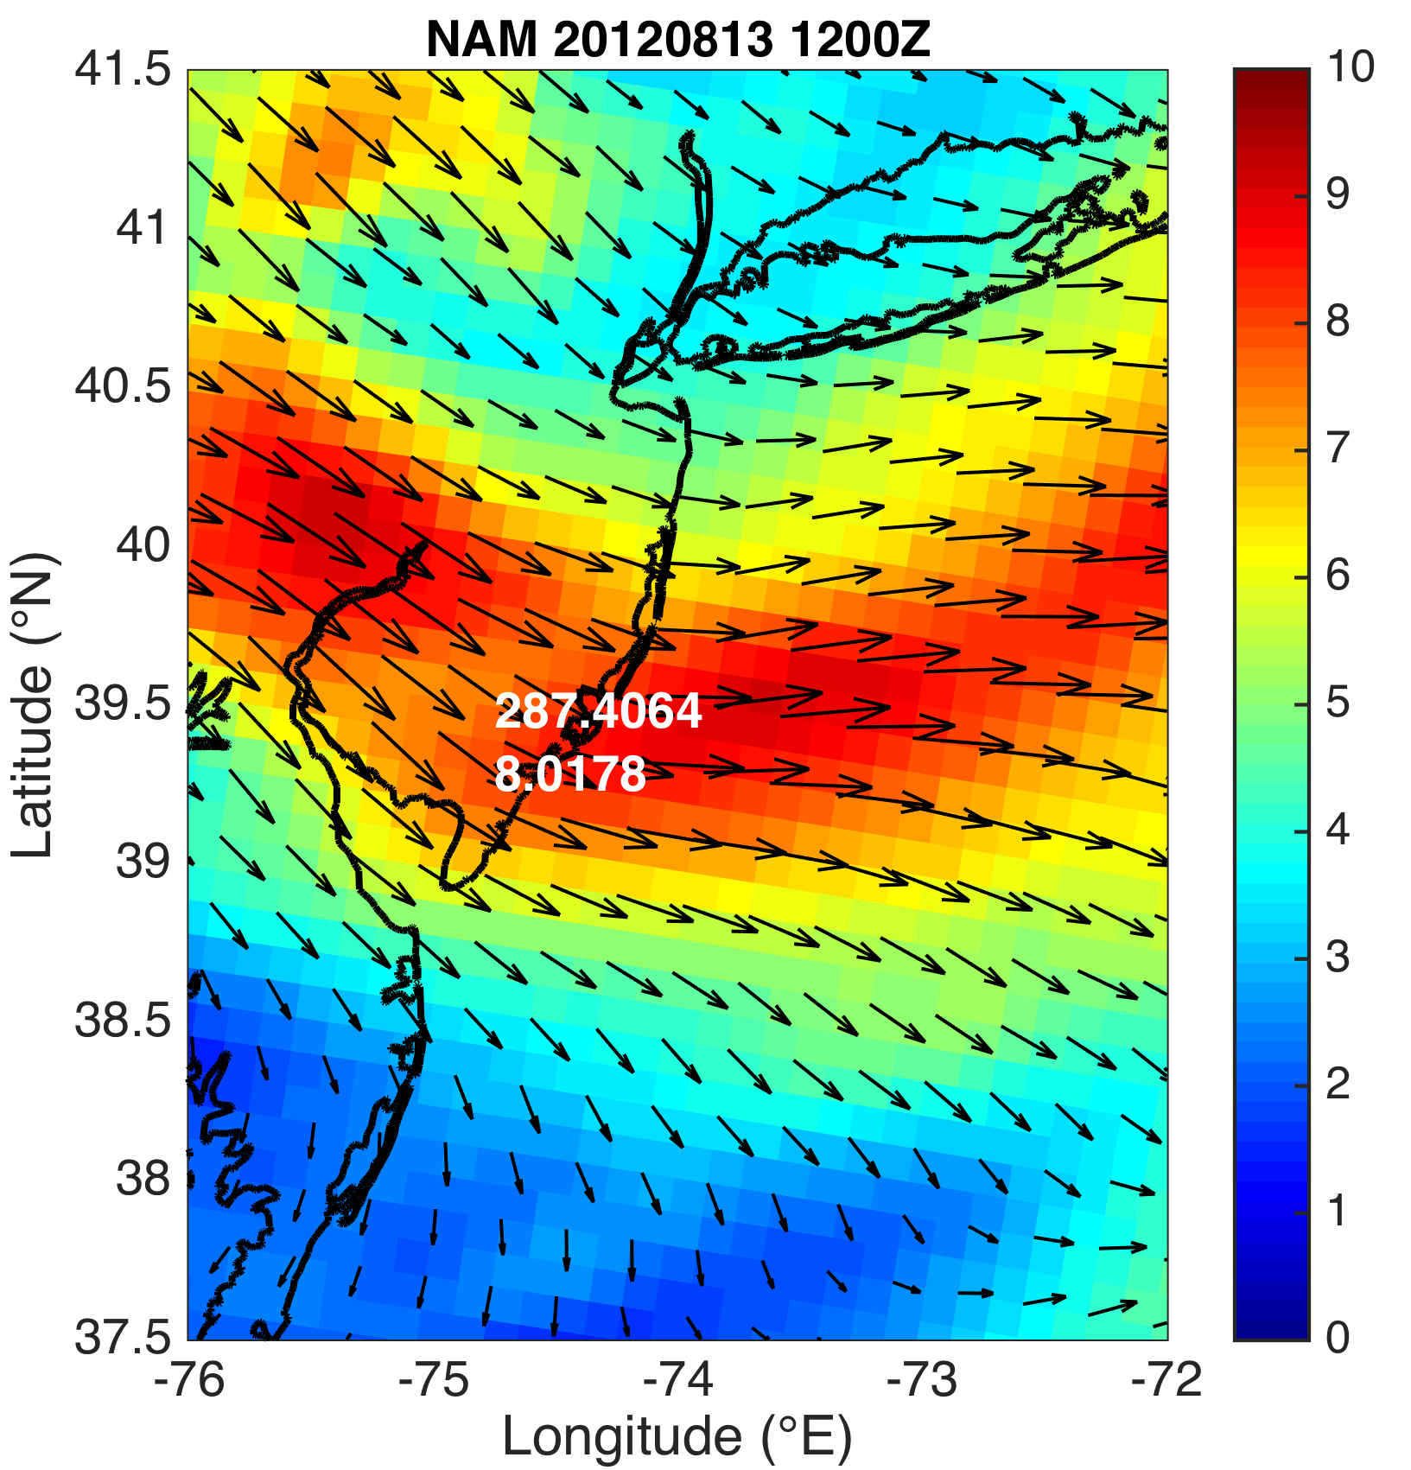
Cases: 2. August 13, 2012: pure, upwelling
925mb winds (m s⁻¹)
SST (°C)
Notes:
Pure: (257-345 degrees)

Slide 40
2. August 13, 2012: pure, upwelling
NEXRAD radar

Slide 41
2. August 13, 2012: pure, upwelling
NEXRAD radar

Slide 42
2. August 13, 2012: pure, upwelling
NEXRAD radar

Slide 43
Cases: 3. August 13, 2012: pure, remove upwelling
925mb winds (m s⁻¹)
SST (°C)
Notes:
Pure: (257-345 degrees)

Slide 44
Methods
Lagrangian Coherent Structures (LCSs)
LCSs are boundaries in a fluid that distinguish regions of differing dynamics (e.g. eddies, jets, fronts)
Particles move away from and along a repelling LCS (A), aggregate and move along attracting LCSs (B)
LCS maps identify convergence and divergence in a fluid flow (e.g. sea breeze)

Slide 45
Methods
Benefits of LCS
The Lagrangian measures are advantageous as they are frame independent and robust with respect to localized noise in the data.
Additionally, LCS analysis reveals coherent structures in more detail and with better clarity than streamline plots generated from 2D wind retrieval (Chan and Shao 2007; Tang et al. 2011)

Slide 46
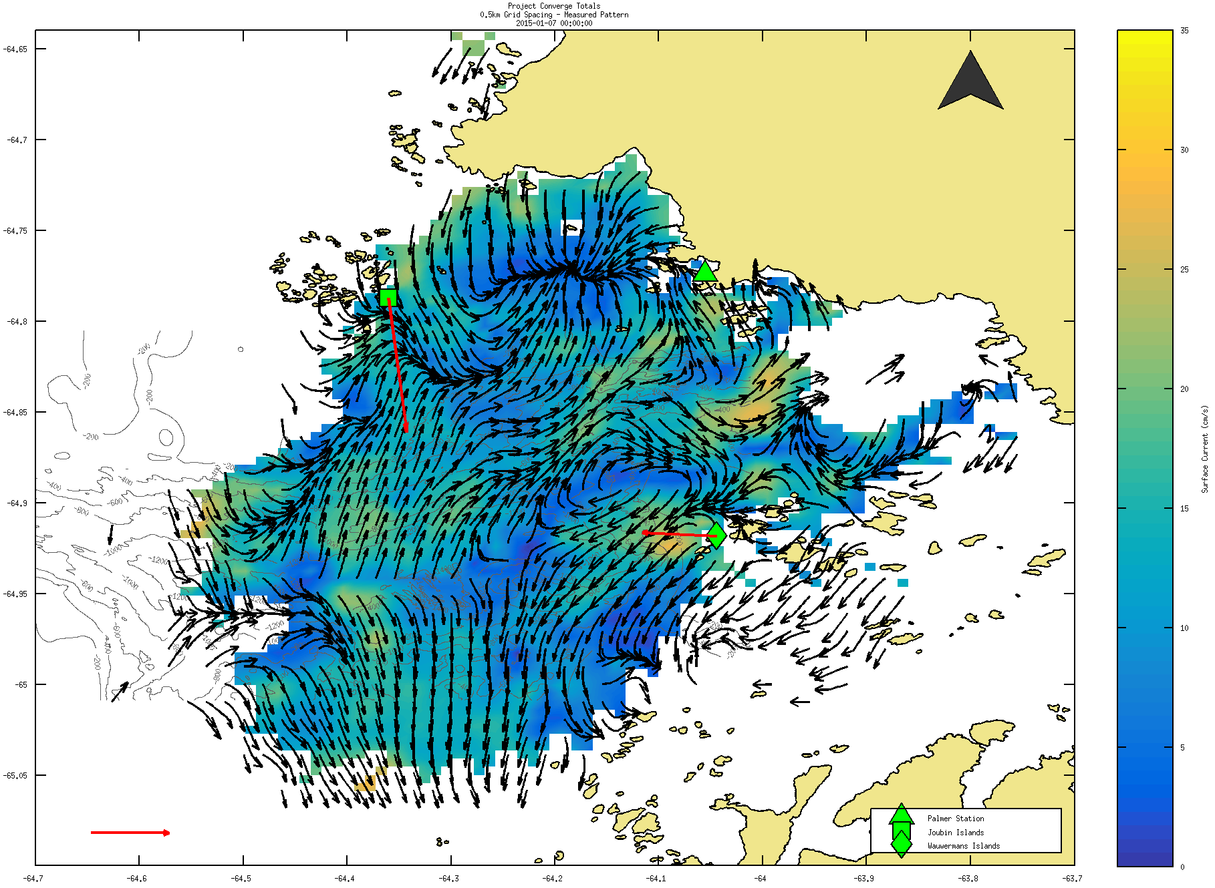

Slide 47
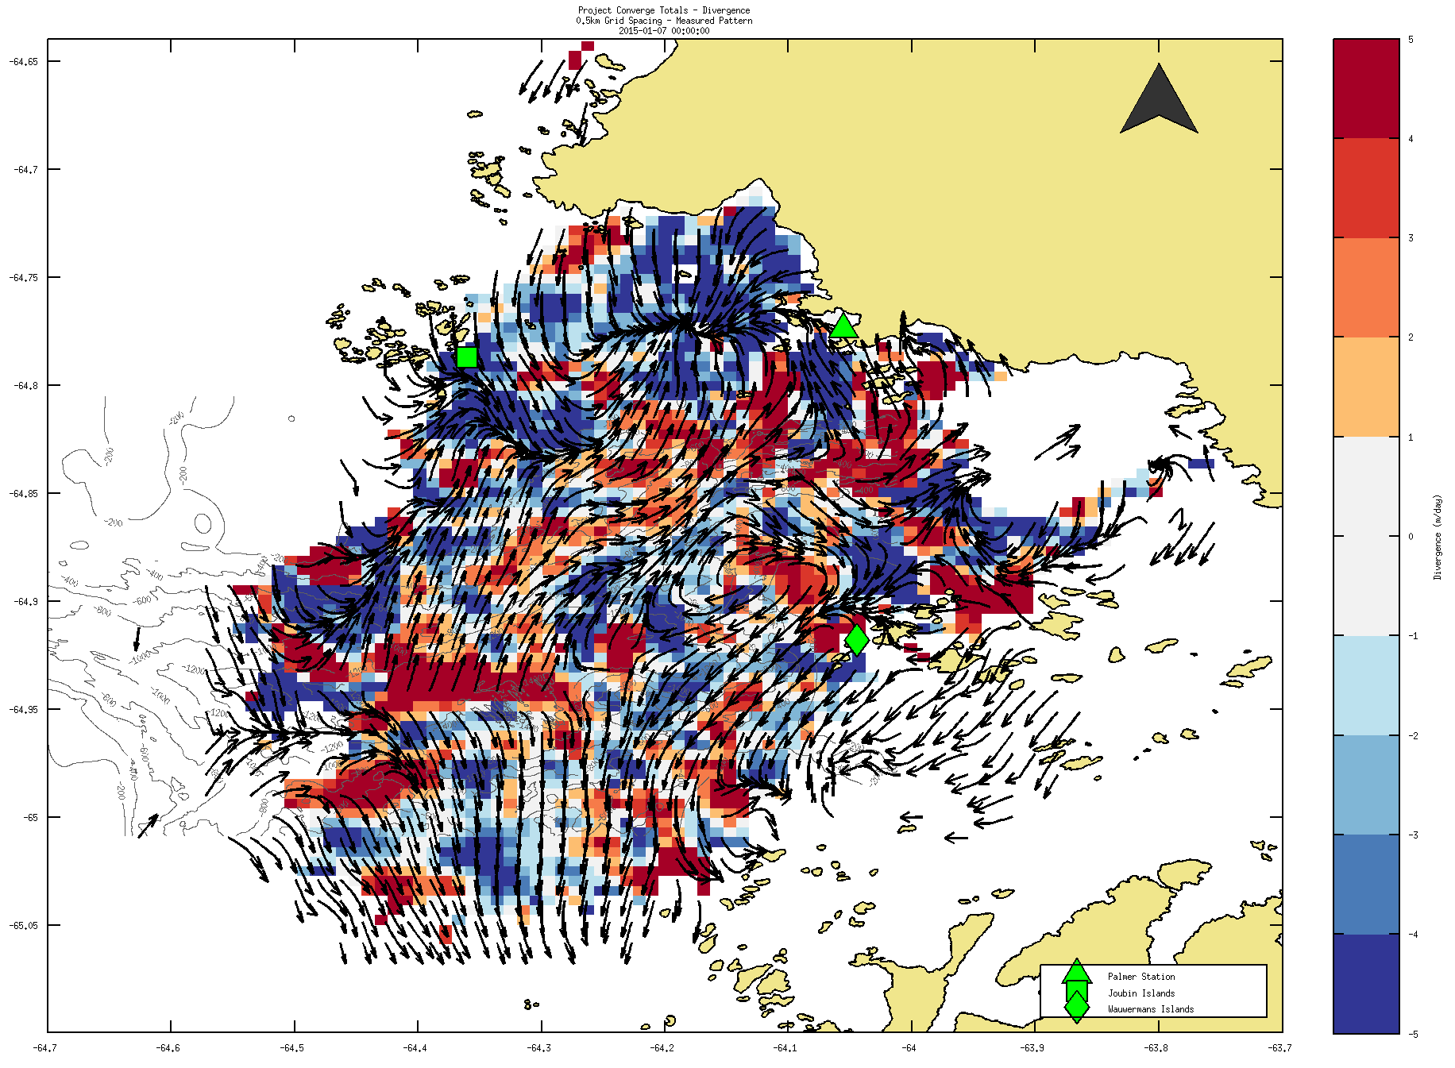

Slide 48
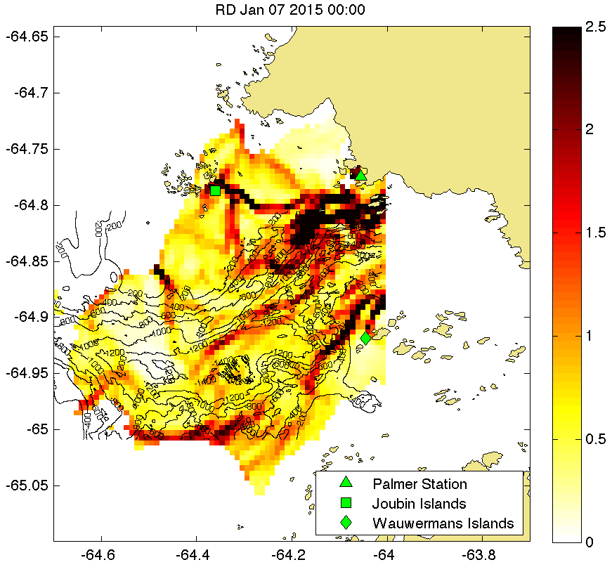

Slide 49
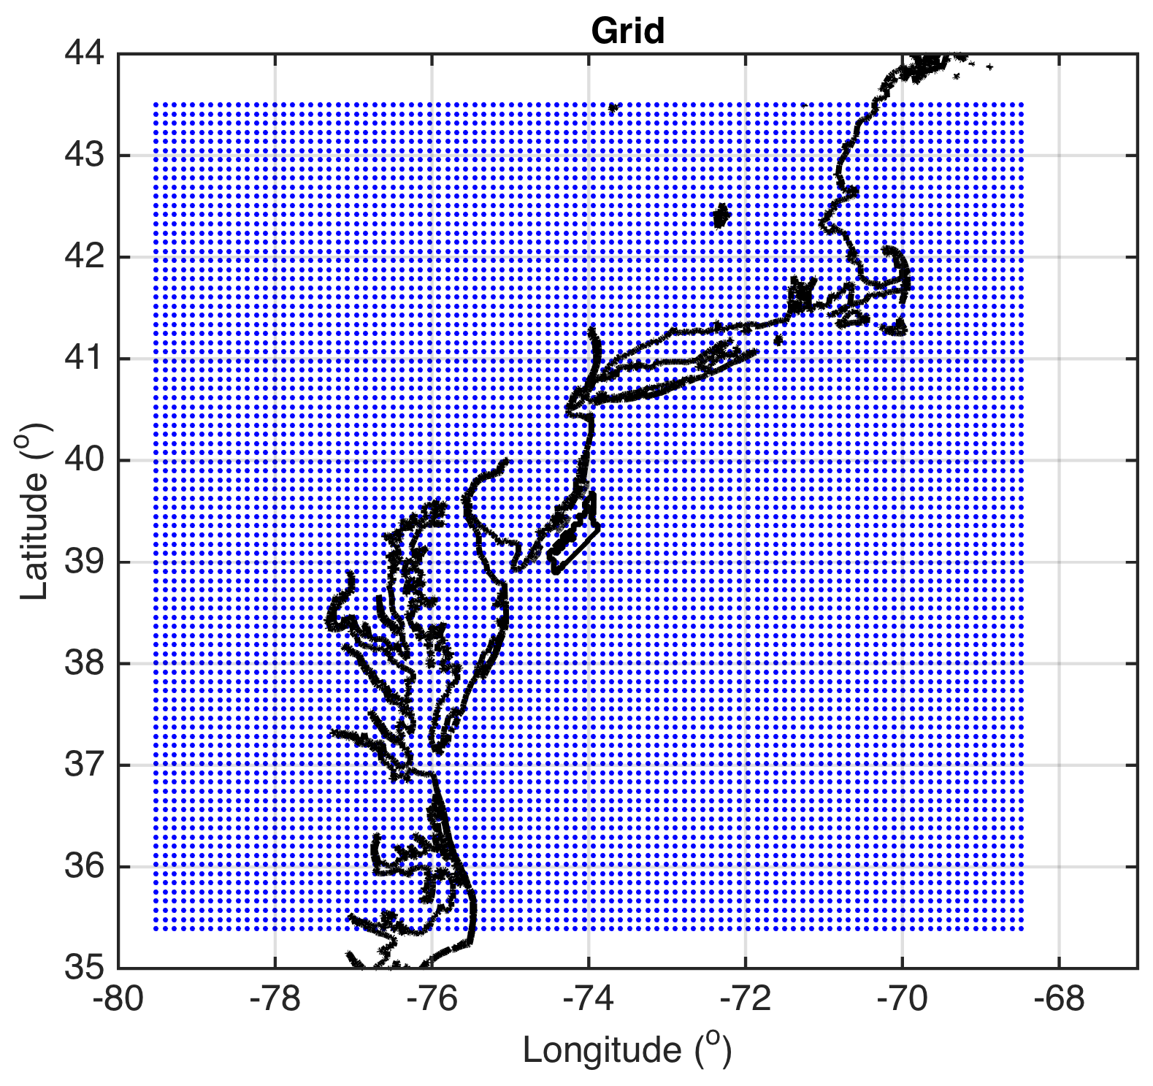
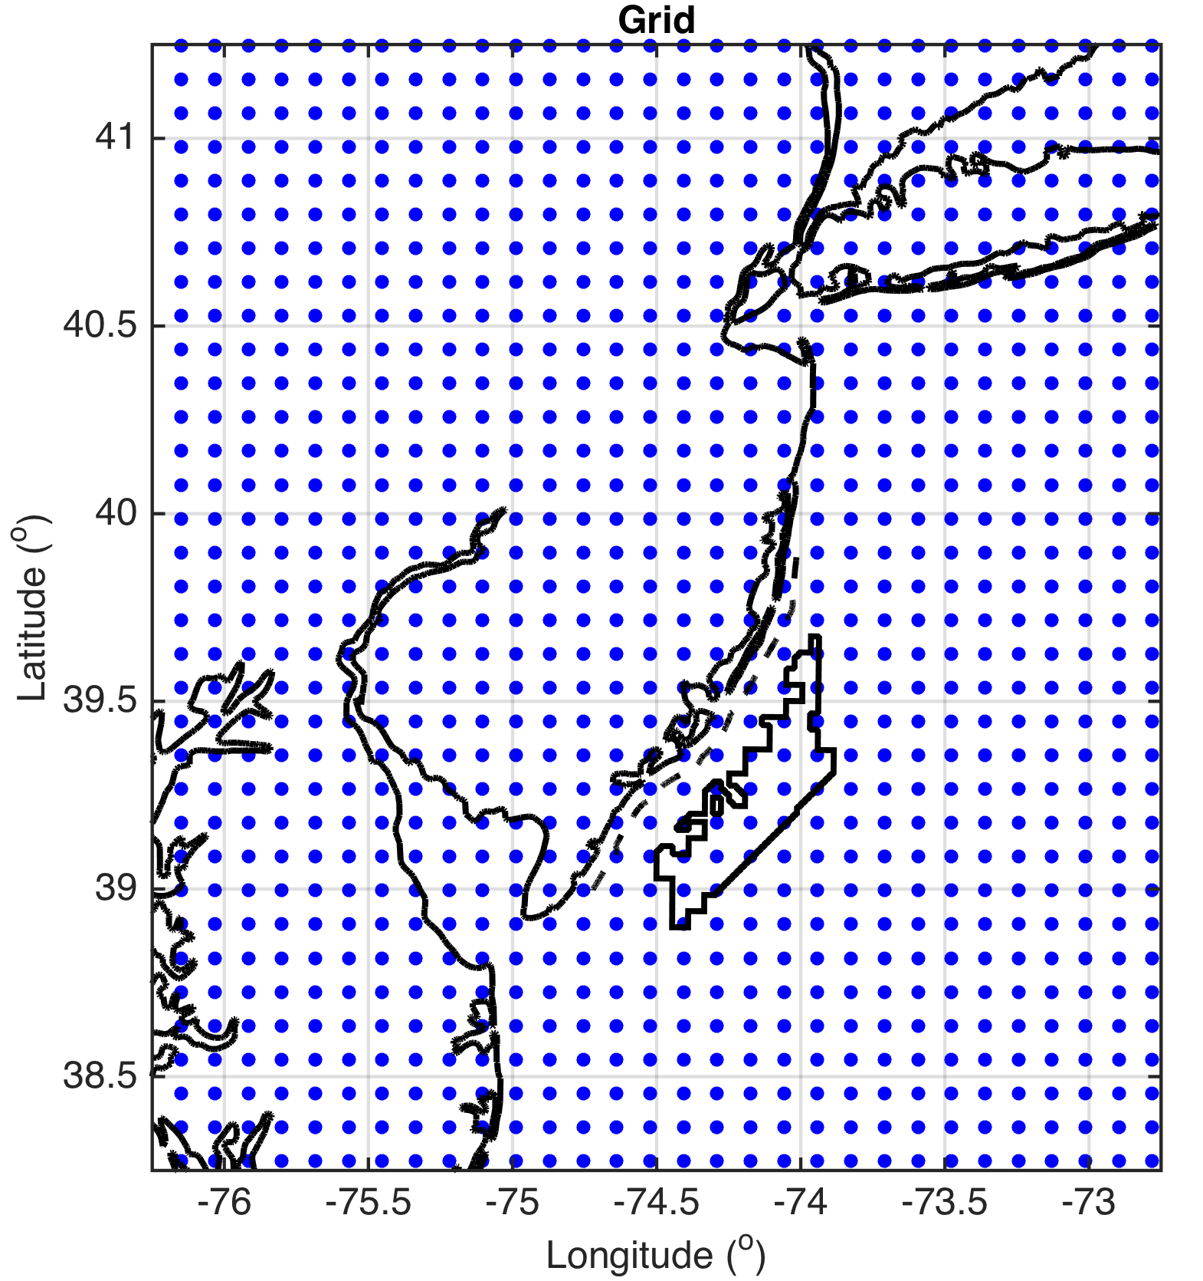
Methods
LCS Set-up
On 3km WRF 10-min winds
Hourly, 1700 UTC to 2300 UTC (peak sea breeze time)
10km grid spacing for tracer trajectories (forward)
Perform at these levels in WRF:
10, 50, 150, 500, 600, 700, 800, 900, 1000, 1500, 2000, 2500m (through marine boundary layer)
Use relative dispersion (RD) to identify LCSs

Slide 50
Results: Case 1

Slide 51
1. April 27, 2013: pure, no upwelling
10m

Slide 52
1. April 27, 2013: pure, no upwelling
10m

Slide 53
1. April 27, 2013: pure, no upwelling
10m

Slide 54
1. April 27, 2013: pure, no upwelling
10m

Slide 55
1. April 27, 2013: pure, no upwelling
10m

Slide 56
1. April 27, 2013: pure, no upwelling
10m

Slide 57
1. April 27, 2013: pure, no upwelling
10m

Slide 58
1. April 27, 2013: pure, no upwelling
10m

Slide 59
1. April 27, 2013: pure, no upwelling
100m

Slide 60
1. April 27, 2013: pure, no upwelling
100m

Slide 61
1. April 27, 2013: pure, no upwelling
100m

Slide 62
1. April 27, 2013: pure, no upwelling
100m

Slide 63
1. April 27, 2013: pure, no upwelling
100m

Slide 64
1. April 27, 2013: pure, no upwelling
100m

Slide 65
1. April 27, 2013: pure, no upwelling
100m

Slide 66
1. April 27, 2013: pure, no upwelling

Slide 67
1. April 27, 2013: pure, no upwelling
xsection

Slide 68
1. April 27, 2013: pure, no upwelling
xsection

Slide 69
1. April 27, 2013: pure, no upwelling
xsection

Slide 70
1. April 27, 2013: pure, no upwelling
xsection

Slide 71
1. April 27, 2013: pure, no upwelling
xsection

Slide 72
1. April 27, 2013: pure, no upwelling
xsection

Slide 73
1. April 27, 2013: pure, no upwelling
xsection

Slide 74
1. April 27, 2013: pure, no upwelling
hovmoller

Slide 75
Results: Case 2 minus 3

Slide 76
2-3. April 27, 2013: pure, upwelling minus non-upwelling
10m

Slide 77
2-3. April 27, 2013: pure, upwelling minus non-upwelling
10m

Slide 78
2-3. April 27, 2013: pure, upwelling minus non-upwelling
10m

Slide 79
2-3. April 27, 2013: pure, upwelling minus non-upwelling
10m

Slide 80
2-3. April 27, 2013: pure, upwelling minus non-upwelling
10m

Slide 81
2-3. April 27, 2013: pure, upwelling minus non-upwelling
10m

Slide 82
2-3. April 27, 2013: pure, upwelling minus non-upwelling
10m

Slide 83
2-3. April 27, 2013: pure, upwelling minus non-upwelling
100m

Slide 84
2-3. April 27, 2013: pure, upwelling minus non-upwelling
100m

Slide 85
2-3. April 27, 2013: pure, upwelling minus non-upwelling
100m

Slide 86
2-3. April 27, 2013: pure, upwelling minus non-upwelling
100m

Slide 87
2-3. April 27, 2013: pure, upwelling minus non-upwelling
100m

Slide 88
2-3. April 27, 2013: pure, upwelling minus non-upwelling
100m

Slide 89
2-3. April 27, 2013: pure, upwelling minus non-upwelling
100m

Slide 90
2-3. April 27, 2013: pure, upwelling minus non-upwelling

Slide 91
2-3. April 27, 2013: pure, upwelling minus non-upwelling
xsection

Slide 92
2-3. April 27, 2013: pure, upwelling minus non-upwelling
xsection

Slide 93
2-3. April 27, 2013: pure, upwelling minus non-upwelling
xsection

Slide 94
2-3. April 27, 2013: pure, upwelling minus non-upwelling
xsection

Slide 95
2-3. April 27, 2013: pure, upwelling minus non-upwelling
xsection

Slide 96
2-3. April 27, 2013: pure, upwelling minus non-upwelling
xsection

Slide 97
2-3. April 27, 2013: pure, upwelling minus non-upwelling
xsection

Slide 98
Ongoing work
Hovmoller for Case 2 and 3, difference
Sensitivity to MYNN vs. YSU PBL schemes
Sensitivity to NARR B.C. vs. NAM B.C.
Increased vertical resolution of LCS between 150 and 1000m
LCS on CODAR for sea breeze
Detided data or not?

