Slide 1
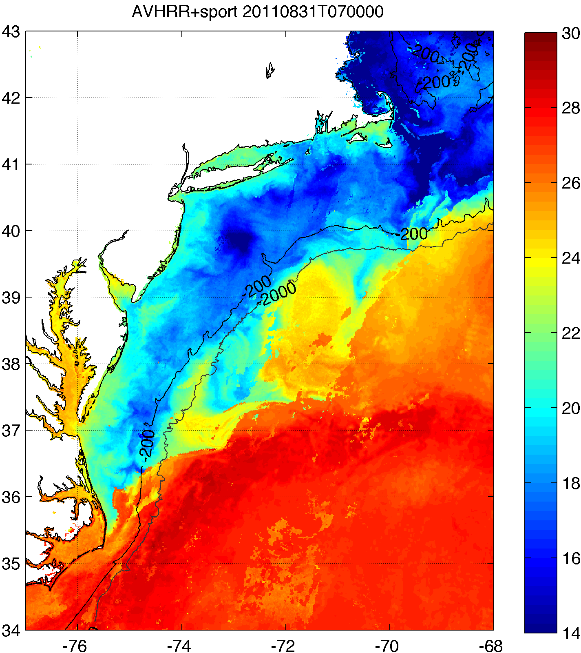
SST Products – coldest pixel composite
Coldest pixel SST composite used to retain coastal upwelling & storm mixing processes
Steps to creation:
Clean up AVHRR scans
Remove sun glint, data close to edge
Decloud (specific to MAB)
AVHRR Channel 2 (0.725-1 μm) tests:
Remove if near IR albedo > 2.3%
Remove if Δnear IR albedo > 0.15% within 3km x 3km box
AVHRR Channel 4 (10.3-11.3 μm) tests:
Remove if T < 5°C (summer), 3.5°C (winter)
Remove if ΔT > 1°C within ~3km x 3km box
3-day coldest pixel composite with NASA SPoRT 2km SST
Keep only coldest pixel between SPoRT SST and 12-21 UTC AVHRR scans
AVHRR Channel 2 needs daytime
Hurricane cooling
Coastal upwelling

Slide 2
SST Products – coldest pixel composite
RU-WRF continues to use coldest pixel SST composite for bottom boundary conditions
Web:http://rucool.marine.rutgers.edu/COOL-Data/ruwrf-model-output
THREDDS: http://tds.maracoos.org/thredds/rucool.html
Example: 8 July 2013 Upwelling
RTG SST
Coldest Pixel SST

Slide 3
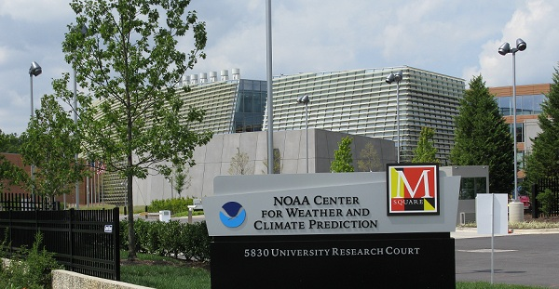
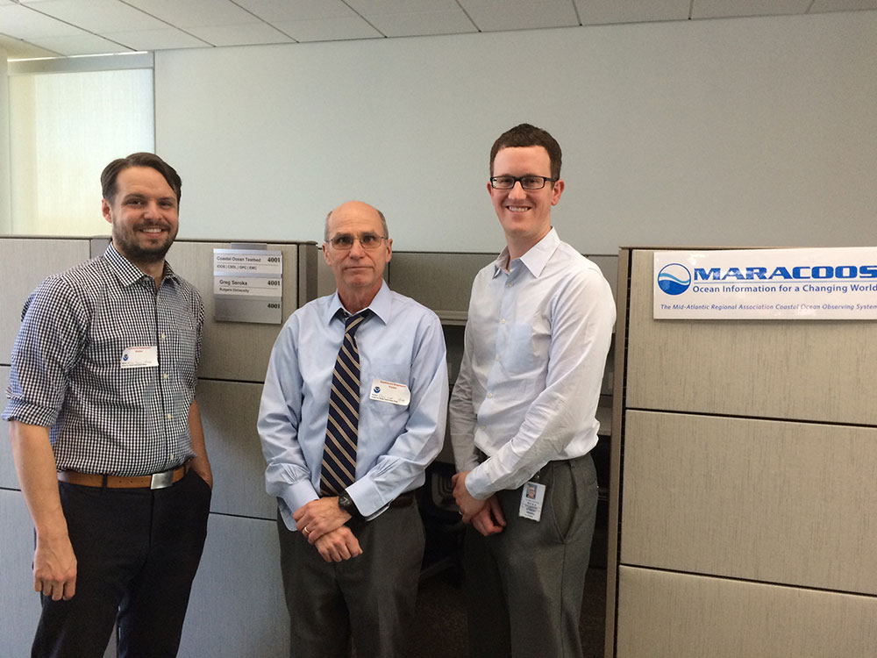
NCEP Visiting Student Desk – Greg Seroka
Greg Seroka’s Visiting Student/Scientist desk has been located on the Ocean Prediction Center’s operational forecast floor for the past 2 years
Ongoing tasks include (a) IOOS HF radar data into AWIPS for forecasters, (b) monitor glider dataflow and integrity from IOOS glider DAC to GTS and NCEP BUFR tanks, (c) evaluation of the ocean component of NCEP operational hurricane models including HWRF, (d) ocean data for AWIPS to AWIPS II transition
Pictured below is: NOAA Center for Weather Climate Prediction building where NCEP is located (left), Travis Miles, Scott Glenn, & Greg in front of Greg’s OPC desk (right)

