Slide 1
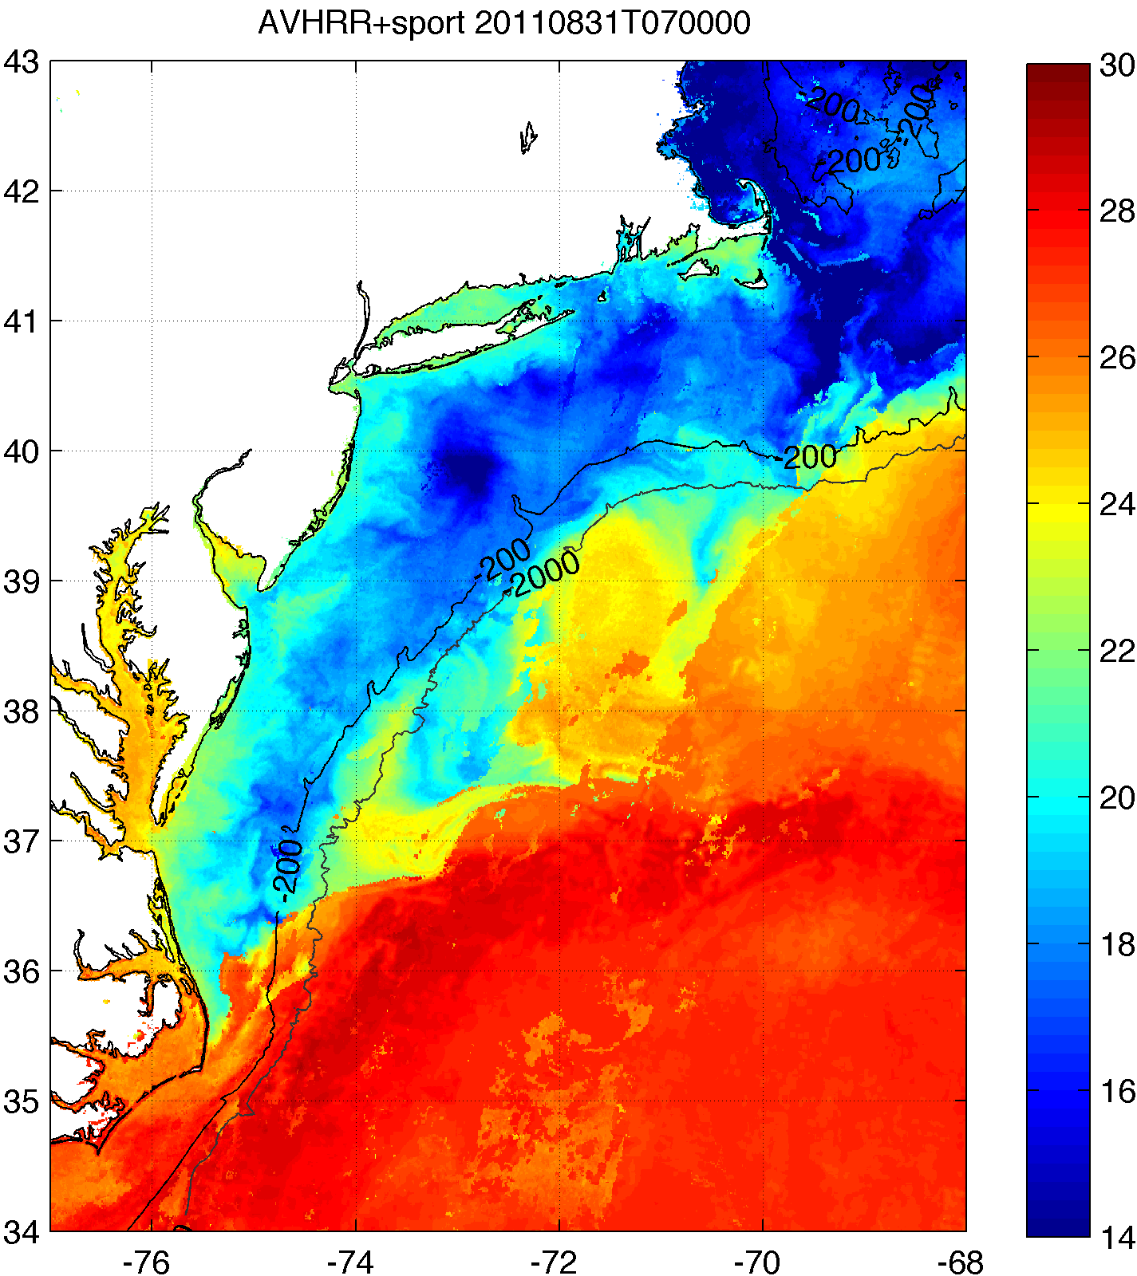
SST Products – coldest pixel composite
Coldest pixel SST composite used to retain coastal upwelling and storm mixing processes.
Steps to creation:
Clean up AVHRR scans
Remove sun glint, data close to edge
Decloud (specific to MAB)
AVHRR Channel 2 (0.725-1 μm) tests:
Remove if near IR albedo > 2.3%
Remove if Δnear IR albedo > 0.15% within 3km x 3km box
AVHRR Channel 4 (10.3-11.3 μm) tests:
Remove if T < 5°C (summer), 3.5°C (winter)
Remove if ΔT > 1°C within ~3km x 3km box
3-day coldest pixel composite with NASA SPoRT 2km SST
Keep only coldest pixel between SPoRT SST and 12-21 UTC AVHRR scans
AVHRR Channel 2 needs daytime
Coastal upwelling
Hurricane cooling

Slide 2
SST Products – coldest pixel composite
RU-WRF continues to use coldest pixel SST composite for bottom boundary conditions
Web:http://rucool.marine.rutgers.edu/COOL-Data/ruwrf-model-output
THREDDS:http://tds.maracoos.org/thredds/rucool.html
Example: 8 July 2013 Upwelling
RTG SST
Coldest Pixel SST

Slide 3
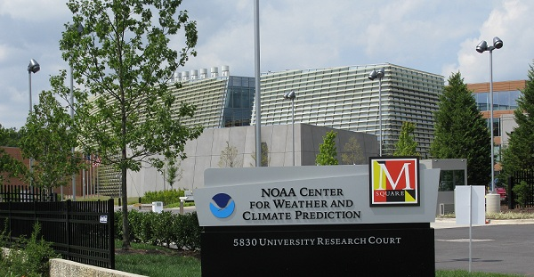
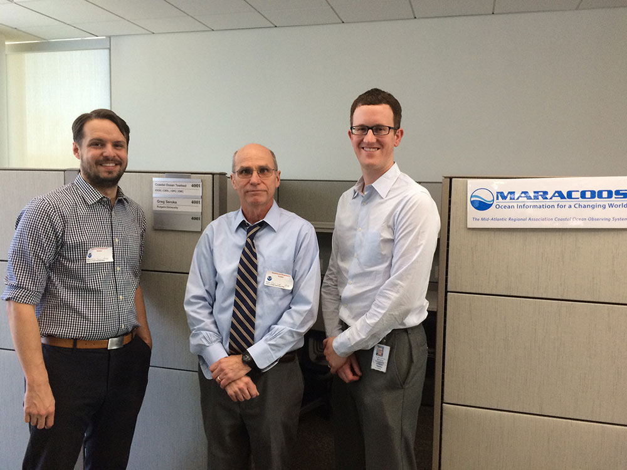
NCEP Visiting Student Desk – Greg Seroka
Greg Seroka’s Visiting Scientist/Student desk has been located on the Ocean Prediction Center’s operational forecast floor for the past 2 years
Pictured below is: the NOAA Center for Weather Climate Prediction building where NCEP is housed (left) and Travis Miles, Scott Glenn, and Greg in front of the OPC desk (right)

