Slide 1
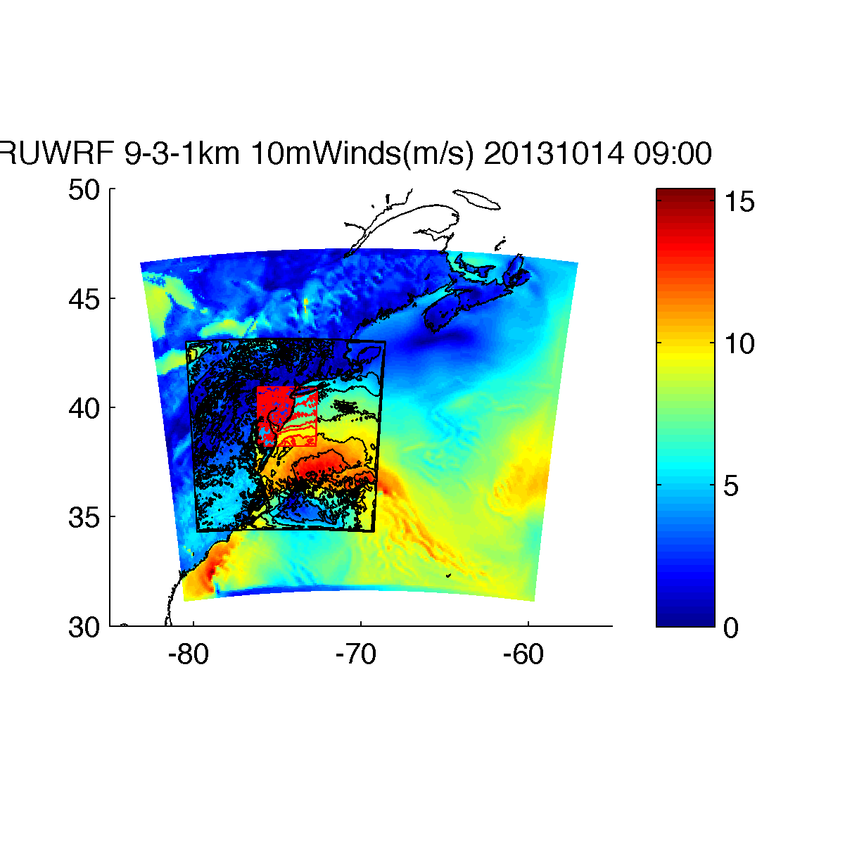
Atmospheric Modeling: Rutgers University
Weather Research and Forecasting (RU-WRF) Model
Triple nested: 9-3-1km
  9km: 0, 6, 12, 18Z cycles
  3km: 0, 12Z cycles
  1km: 12Z cycle
3-hourly forecast: out to 4 days (9km), 2 days (3km) and 1 day (1km)
Initial Conditions:
  9km: 0.25 degree GFS
  3km: 4km NAM
  1km: RU-WRF 3km
Boundary Conditions:
  9km: 0.25 degree GFS
  3km: RU-WRF 9km
  1km: RU-WRF 3km
Version: 3.7.1?
Physics options? (microphysics; PBL; cumulus parameterization; LW, SW radiation; surface layer; land surface)
Satellite SSTs: state-of-the-science declouded coldest pixel composite SST to resolve coastal upwelling and storm mixing

Slide 2
RU-WRF 3km Validation Results
Period of Validation: May 2012-May 2013
*Based on standard validation criteria for mesoscale atmospheric models (Pielke, 1984; Dvorak et al., 2012)

Slide 3
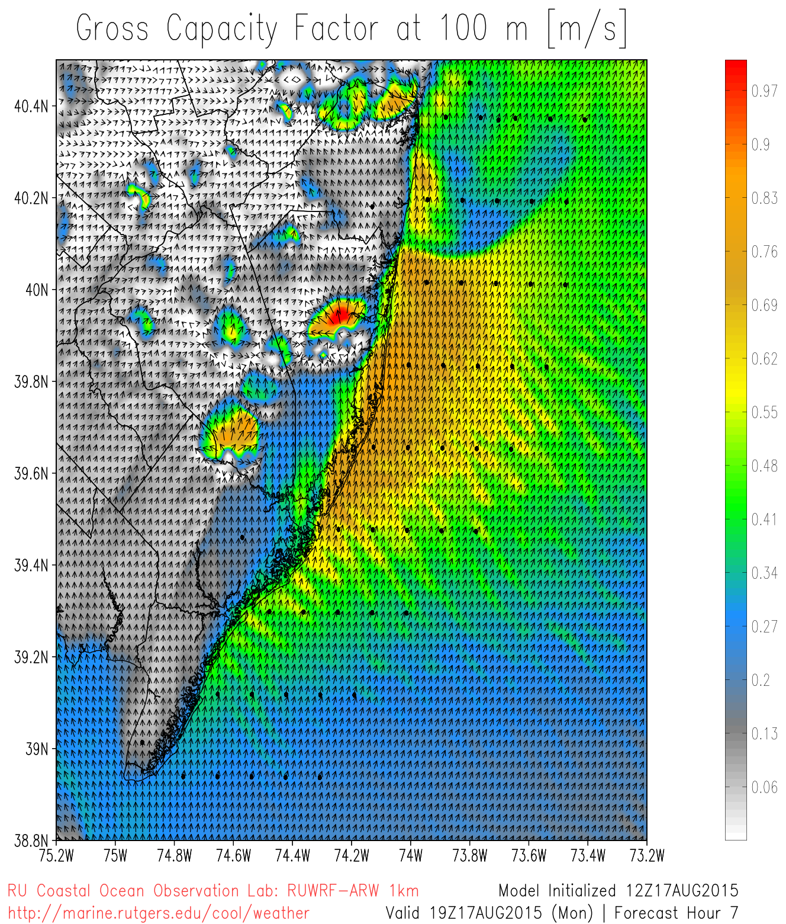
Atmospheric Modeling: RU-WRF and Offshore Wind
New RU-WRF wind energy tools, such as forecasts of capacity factor (figure to right)
Industry partners:
  NJ BPU
  Department of Energy
  PJM
  PSEG
  Offshore MW, LLC
  US Wind, LLC
  Deepwater Wind
  Garden State Offshore Energy
  And more
http://marine.rutgers.edu/cool/weather/RUWRF/animation/1km/gcf.html

Slide 4
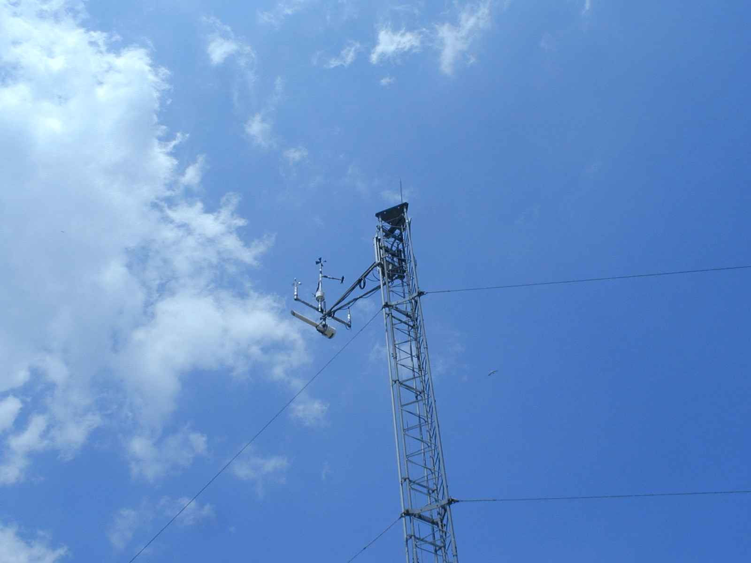
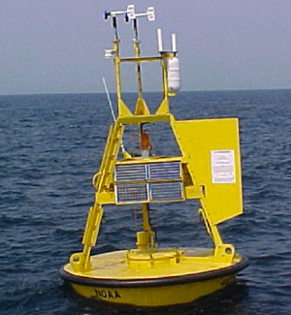
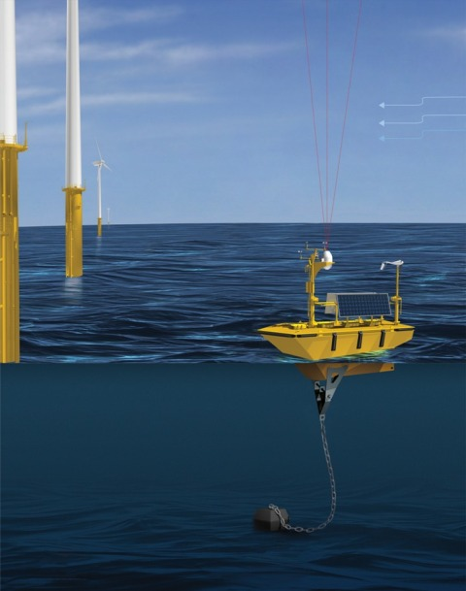
Coastal/Offshore Monitoring
Meteorological Tower
Meteorological Buoy
Offshore vertical LIDAR
Coastal/Offshore Scanning LIDAR
Infrared Satellite
Coastal Radar (CODAR)
Notes:
Fishermen: already deployed monitoring buoy, once done go to one 10 nm out
-purchased offshore vertical lidar, measure wind spd, dir, turbulence, deployed in June
-bought scanning lidar, deployed at end of summer
-bought wind tracer near Margate, see 10 nm offshore, in vertical
-2-3 60m met towers along coast, instrumented at 3 levels
Offshore Megawatt (German): no monitoring, rely on our study
Bluewater Wind: claim deploying monitoring sites at end of summer
Garden State Offshore Energy (part PSEG, part Deepwater Wind): vertical lidar on buoy, validate in Rhode Island, target this summer with LIDAR

Slide 5
Coastal/Offshore Monitoring
Offshore vertical LIDAR
Coastal/Offshore Scanning LIDAR
Notes:
Fishermen: already deployed monitoring buoy, once done go to one 10 nm out
-purchased offshore vertical lidar, measure wind spd, dir, turbulence, deployed in June
-bought scanning lidar, deployed at end of summer
-bought wind tracer near Margate, see 10 nm offshore, in vertical
-2-3 60m met towers along coast, instrumented at 3 levels
Offshore Megawatt (German): no monitoring, rely on our study
Bluewater Wind: claim deploying monitoring sites at end of summer
Garden State Offshore Energy (part PSEG, part Deepwater Wind): vertical lidar on buoy, validate in Rhode Island, target this summer with LIDAR

Slide 6
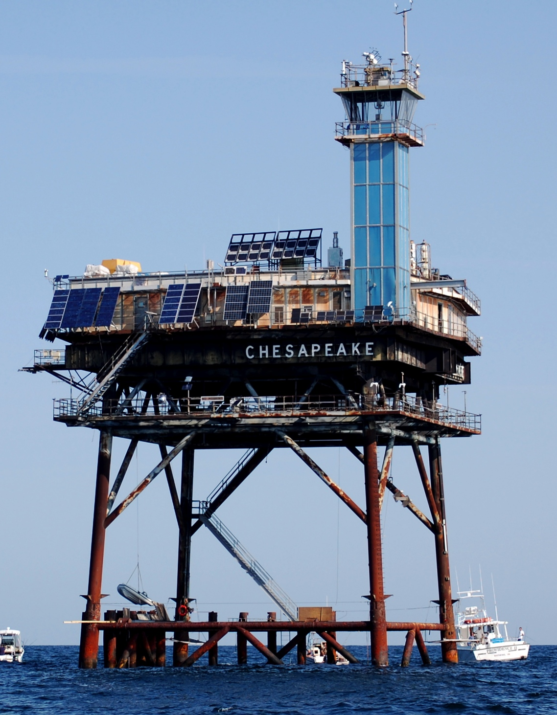
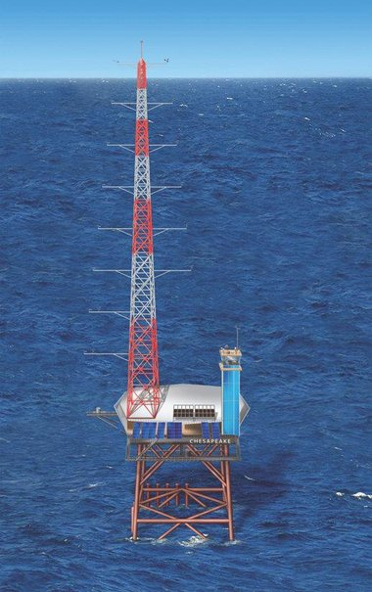
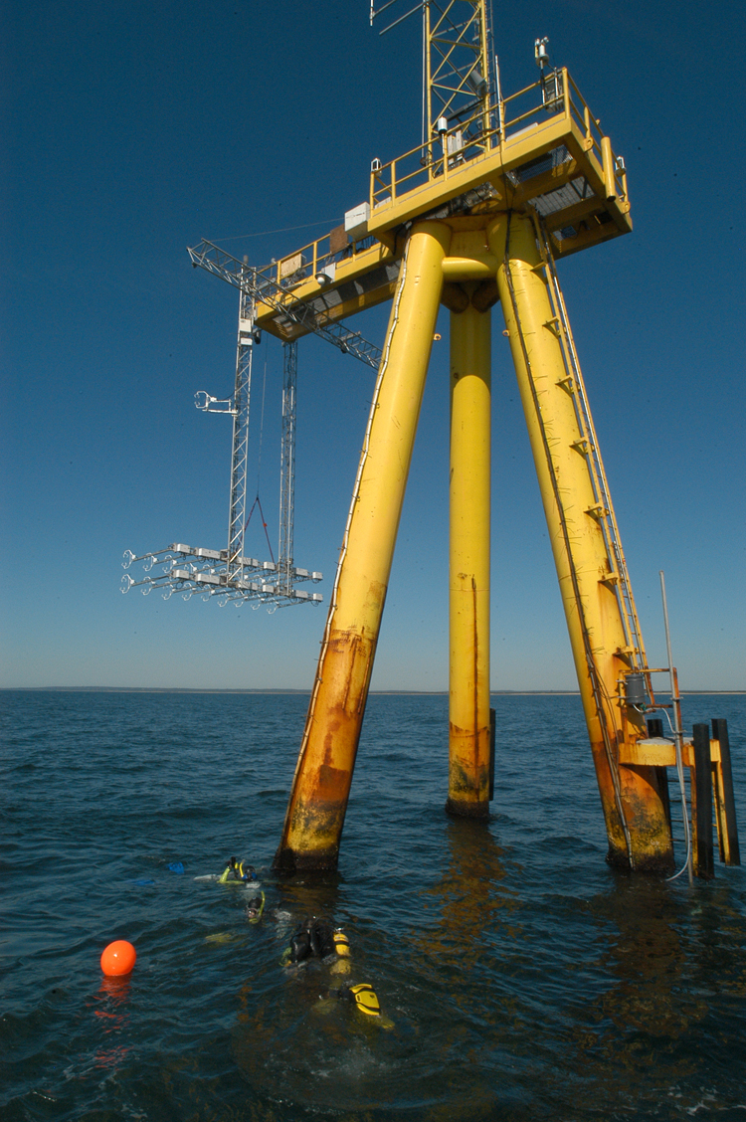
More Offshore Monitoring
Chesapeake Light Tower
Martha’s Vineyard ASIT
Current
Future

