Slide 1
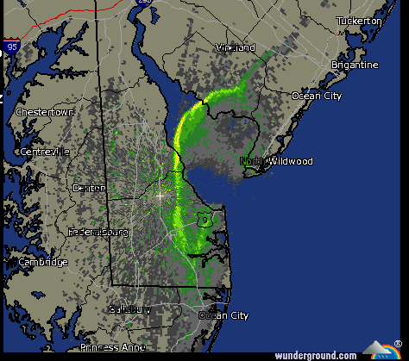
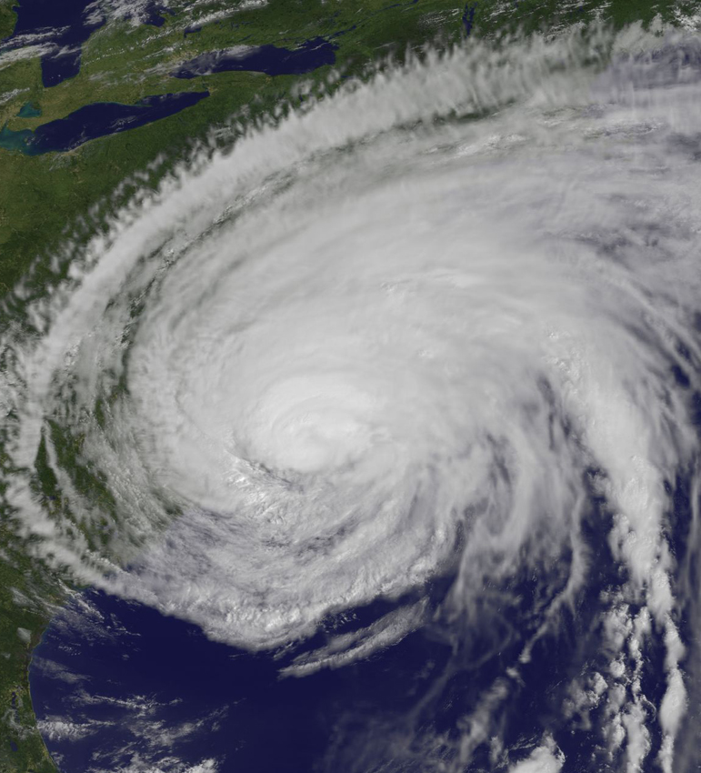
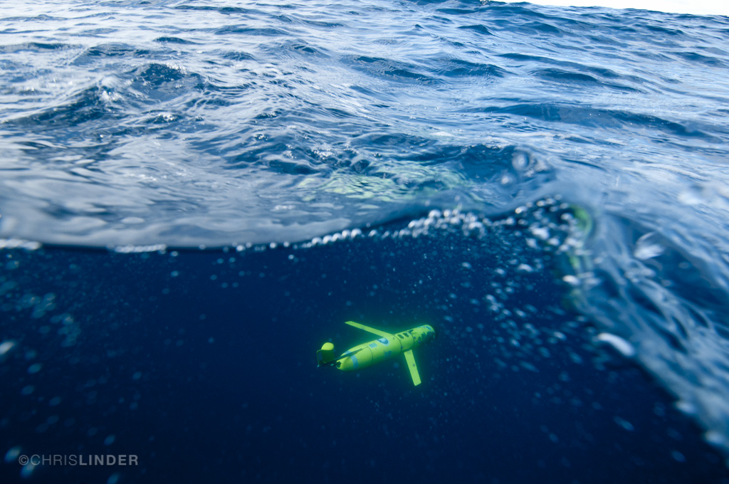
From the sea breeze to hurricanes: how the ocean affects the weather
Greg Seroka

Slide 2
Part I
Overview: The ocean impacts the weather

Slide 3
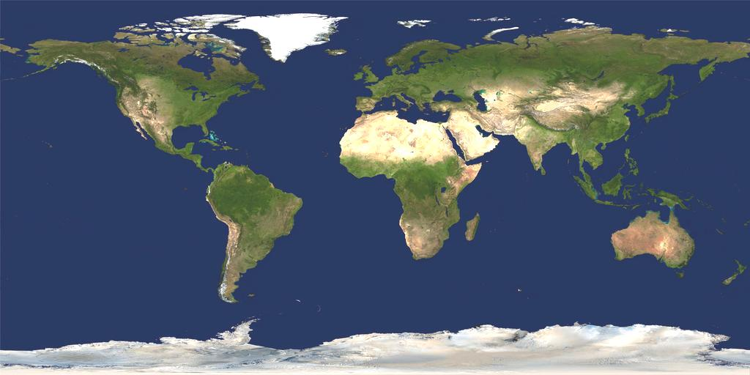
How Many Oceans Are There?

Slide 4
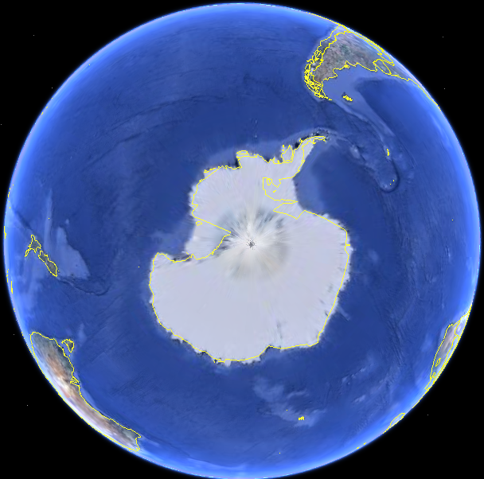
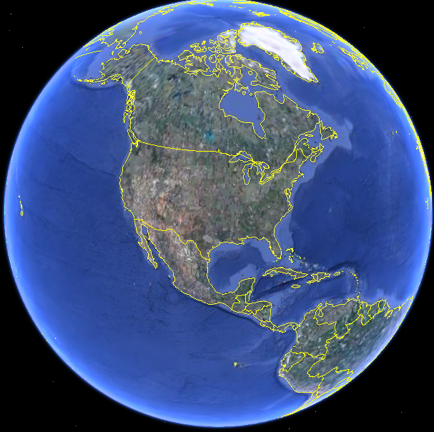
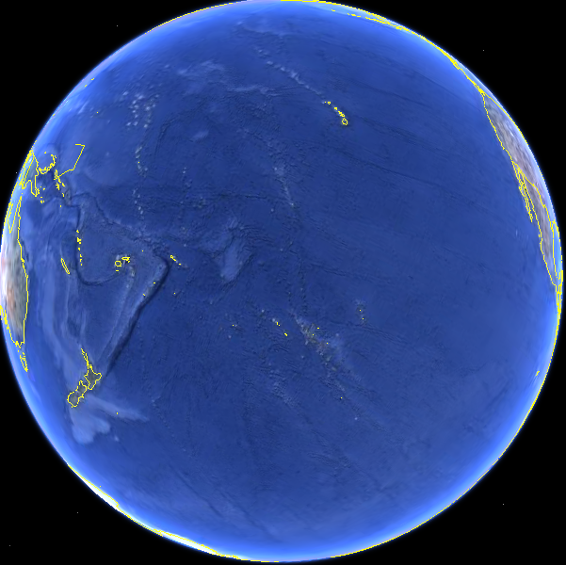
Our Global Ocean…
Covers 71% of the Earth's surface.
Contains 97% of the Earth's water.
Has an average depth of 12,430 feet.
Has had less than 10% explored by humans.
Supports a great diversity of life and ecosystems.
Is a major influence on weather and climate, making earth habitable.

Slide 5
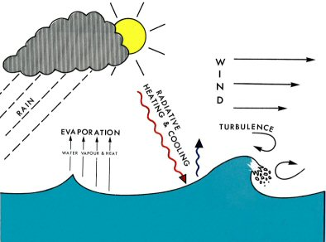
Air-Sea Interaction
Source: National Oceanography Centre (UK)

Slide 6
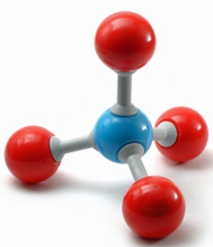
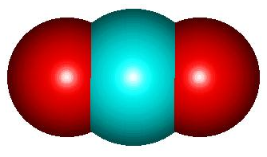
Air-sea fluxes
What’s exchanged
Diagram
Why it’s important
Storms & hurricanes, ocean circulation, general weather
Heat
Fresh water
Storms & hurricanes, clouds
Ocean acidification, climate change, photosynthesis
Gases
(CO2, methane, etc)
Momentum
Currents and waves, storms, hurricanes
Sea spray
Clouds, hurricanes
Source: National Oceanography Centre (UK)

Slide 7









Air-sea weather processes
Rainfall
Nor’easters
Lake Effect Snow
L
Sea Breeze
Hurricanes
El Nino
Waterspouts
H
Thunderstorms
& Lightning
High Pressure Systems
Sea Spray

Slide 8
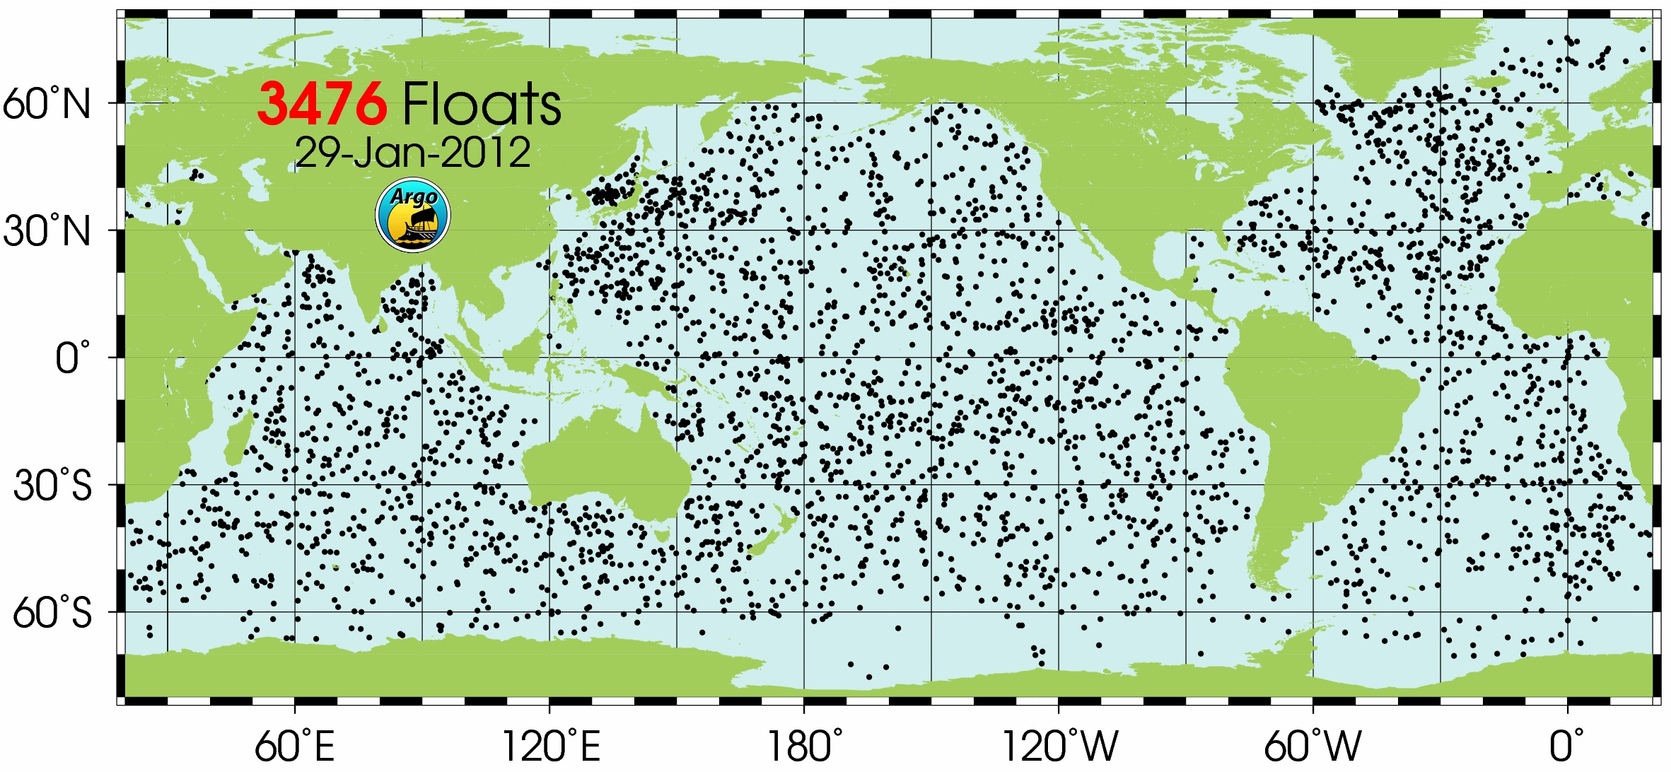
Surface observations
over ocean are plentiful
scarce!

Slide 9
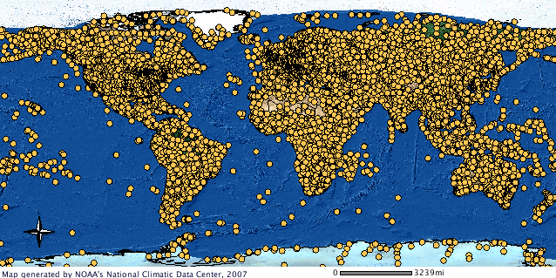
Surface observations
over ocean are plentiful
scarce!

Slide 10

Need models to fill in gaps
Bridge gap between obs.
Experiments
“What-if” scenarios
Sensitivities
Predictions
Notes:
Bridge gap between obs. (scattered in space & time) and real world
Experiments without harming system
Atmosphere, ocean too large to perform “lab” experiments
“What-if” scenarios
Sensitivities (control vs.
independent variable)
Predictions

Slide 11
Breakout activity:
models

Slide 12
Part II
Example 1: The Sea Breeze

Slide 13
Air-sea weather processes
Rainfall
Nor’easters
Lake Effect Snow
L
Sea Breeze
Hurricanes
El Nino
Waterspouts
H
Thunderstorms
& Lightning
High Pressure Systems
Sea Spray

Slide 14
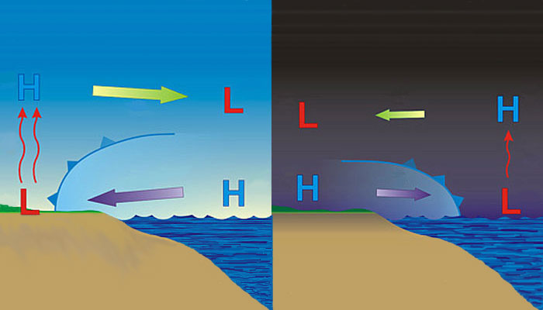
Sea breeze
Land breeze
Well known
Well known
Notes:
-day: warmer over land, cooler over water→ seabreeze
-night: cooler over land, relatively warmer over water→ landbreeze
-little known about offshore component of sea/land breeze due to dearth of observations/monitoring
-coastal upwelling changes dynamics

Slide 15
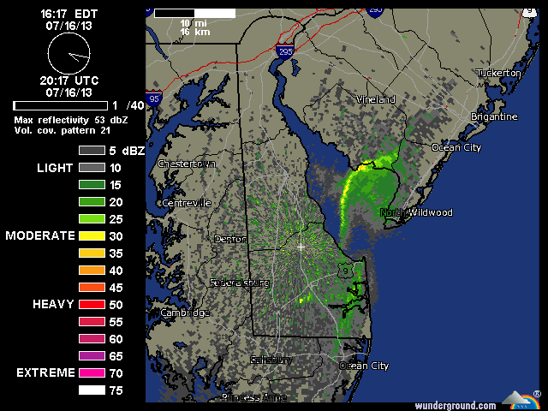
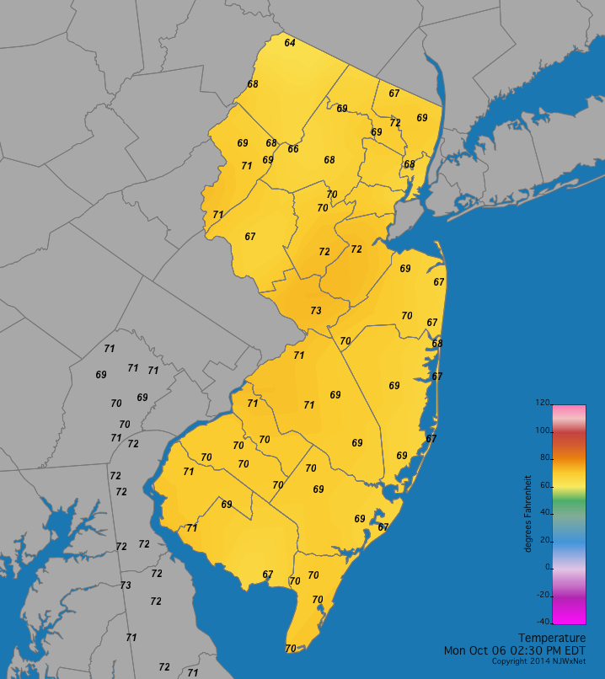
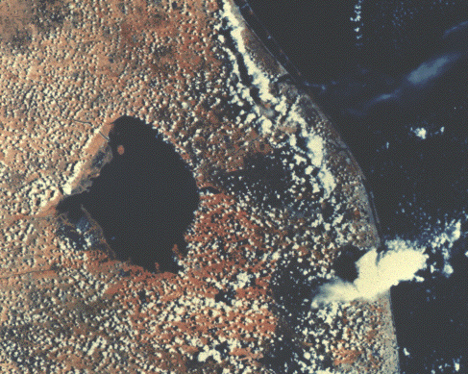
Weather radar
Land
observations
Satellites

Slide 16
Sea breeze
Land breeze
Cold upwelling
Little known
(fewer obs)
Little known
(fewer obs)
Notes:
-day: warmer over land, cooler over water→ seabreeze
-night: cooler over land, relatively warmer over water→ landbreeze
-little known about offshore component of sea/land breeze due to dearth of observations/monitoring
-coastal upwelling changes dynamics

Slide 17
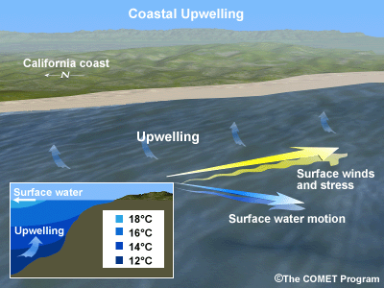
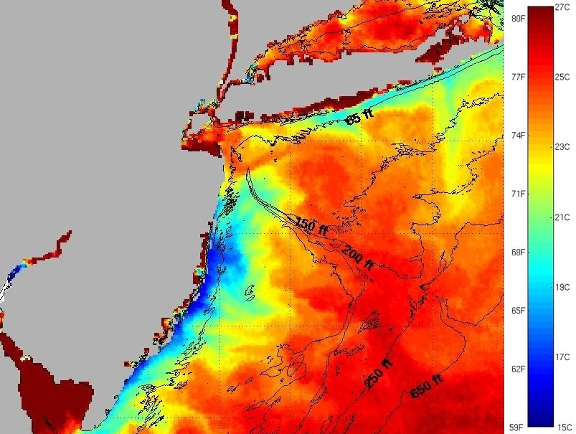
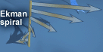
Coastal Upwelling
Schematic
Sea surface temperatures

Slide 18
Sea breeze
Land breeze
?
?
Cold upwelling
Little known
(fewer obs)
→ Models can be used to investigate little known offshore component
Notes:
-day: warmer over land, cooler over water→ seabreeze
-night: cooler over land, relatively warmer over water→ landbreeze
-little known about offshore component of sea/land breeze due to dearth of observations/monitoring
-coastal upwelling changes dynamics

Slide 19
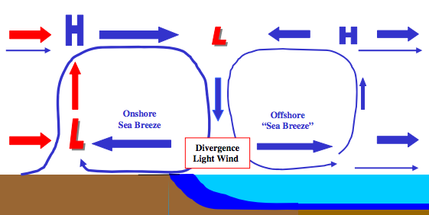
Sea breeze w/ offshore component:
a hypothesis
Cold upwelling
→ Models can be used to investigate scientific hypotheses

Slide 20

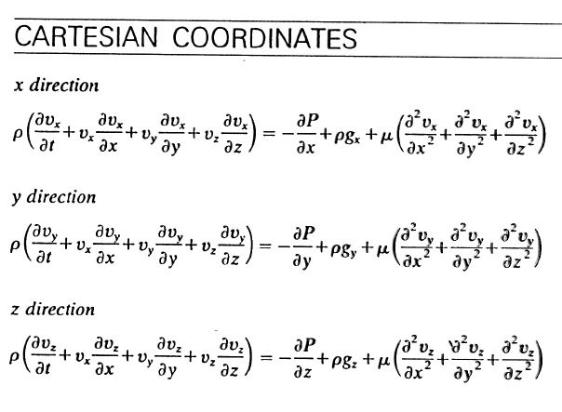
Model Setup
Weather Research and Forecasting (WRF) model, Advanced Research core (ARW) (Michalakes et al., 2001)
Bottom “boundary condition” (Sea Surface Temperature, SST): Independent Variable
Physics + math
Physics + math
Notes:
-NWP is cost-effective way to achieve accurate wind resource assessments and representative wind forecasts→ cost reductions
-minimize “risks” by determining variability in offshore wind resource
-mesoscale and local influences of sea breeze- one of primary microclimate circulations that affect offshore environment, during peak energy demand periods with ACs running on hot summer afternoons

Slide 21
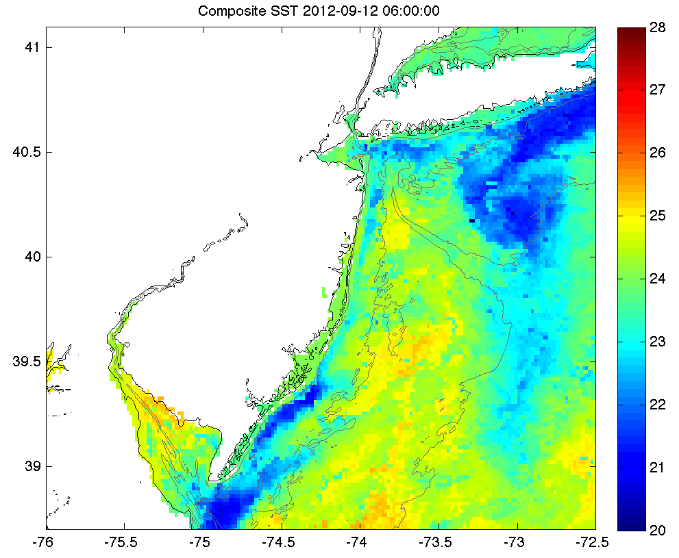
Case Study: Sept. 12, 2012: Upwelling
Sept. 4-8: persistent southerly winds→
NJ coastal upwelling

Slide 22
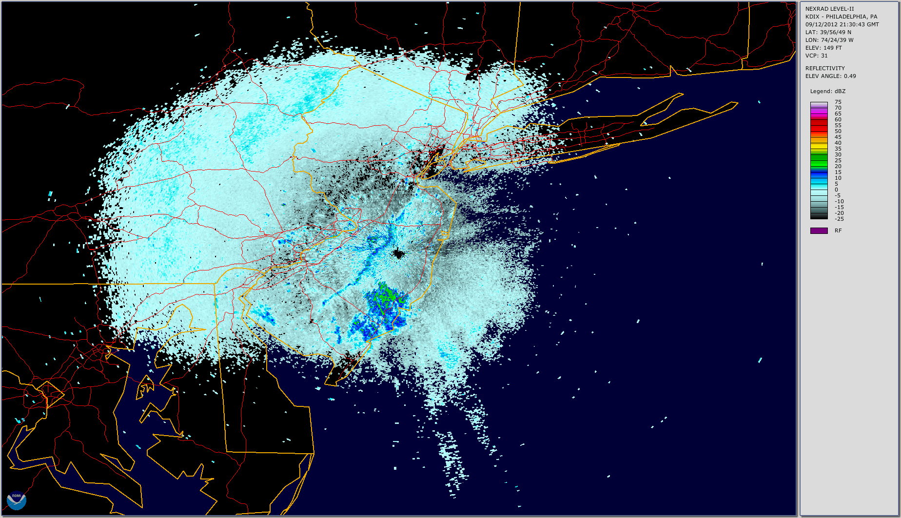
Case Study: Sept. 12, 2012: Sea breeze

Slide 23
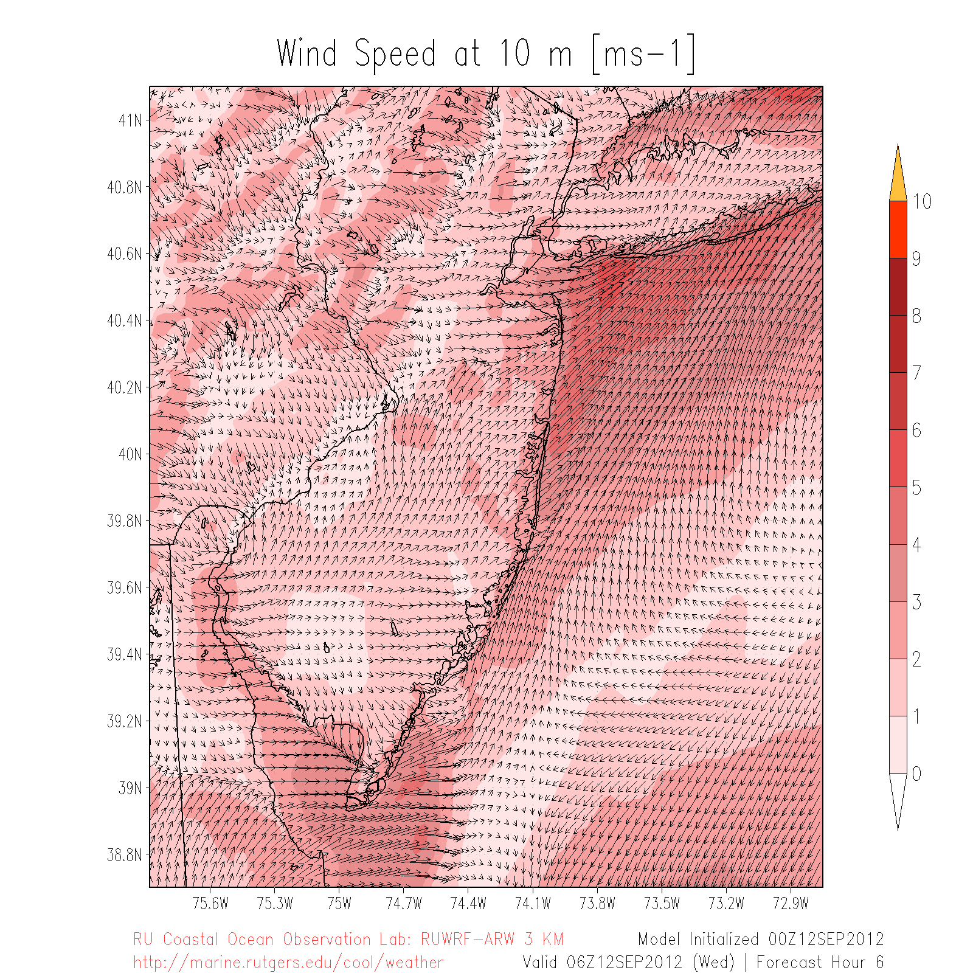
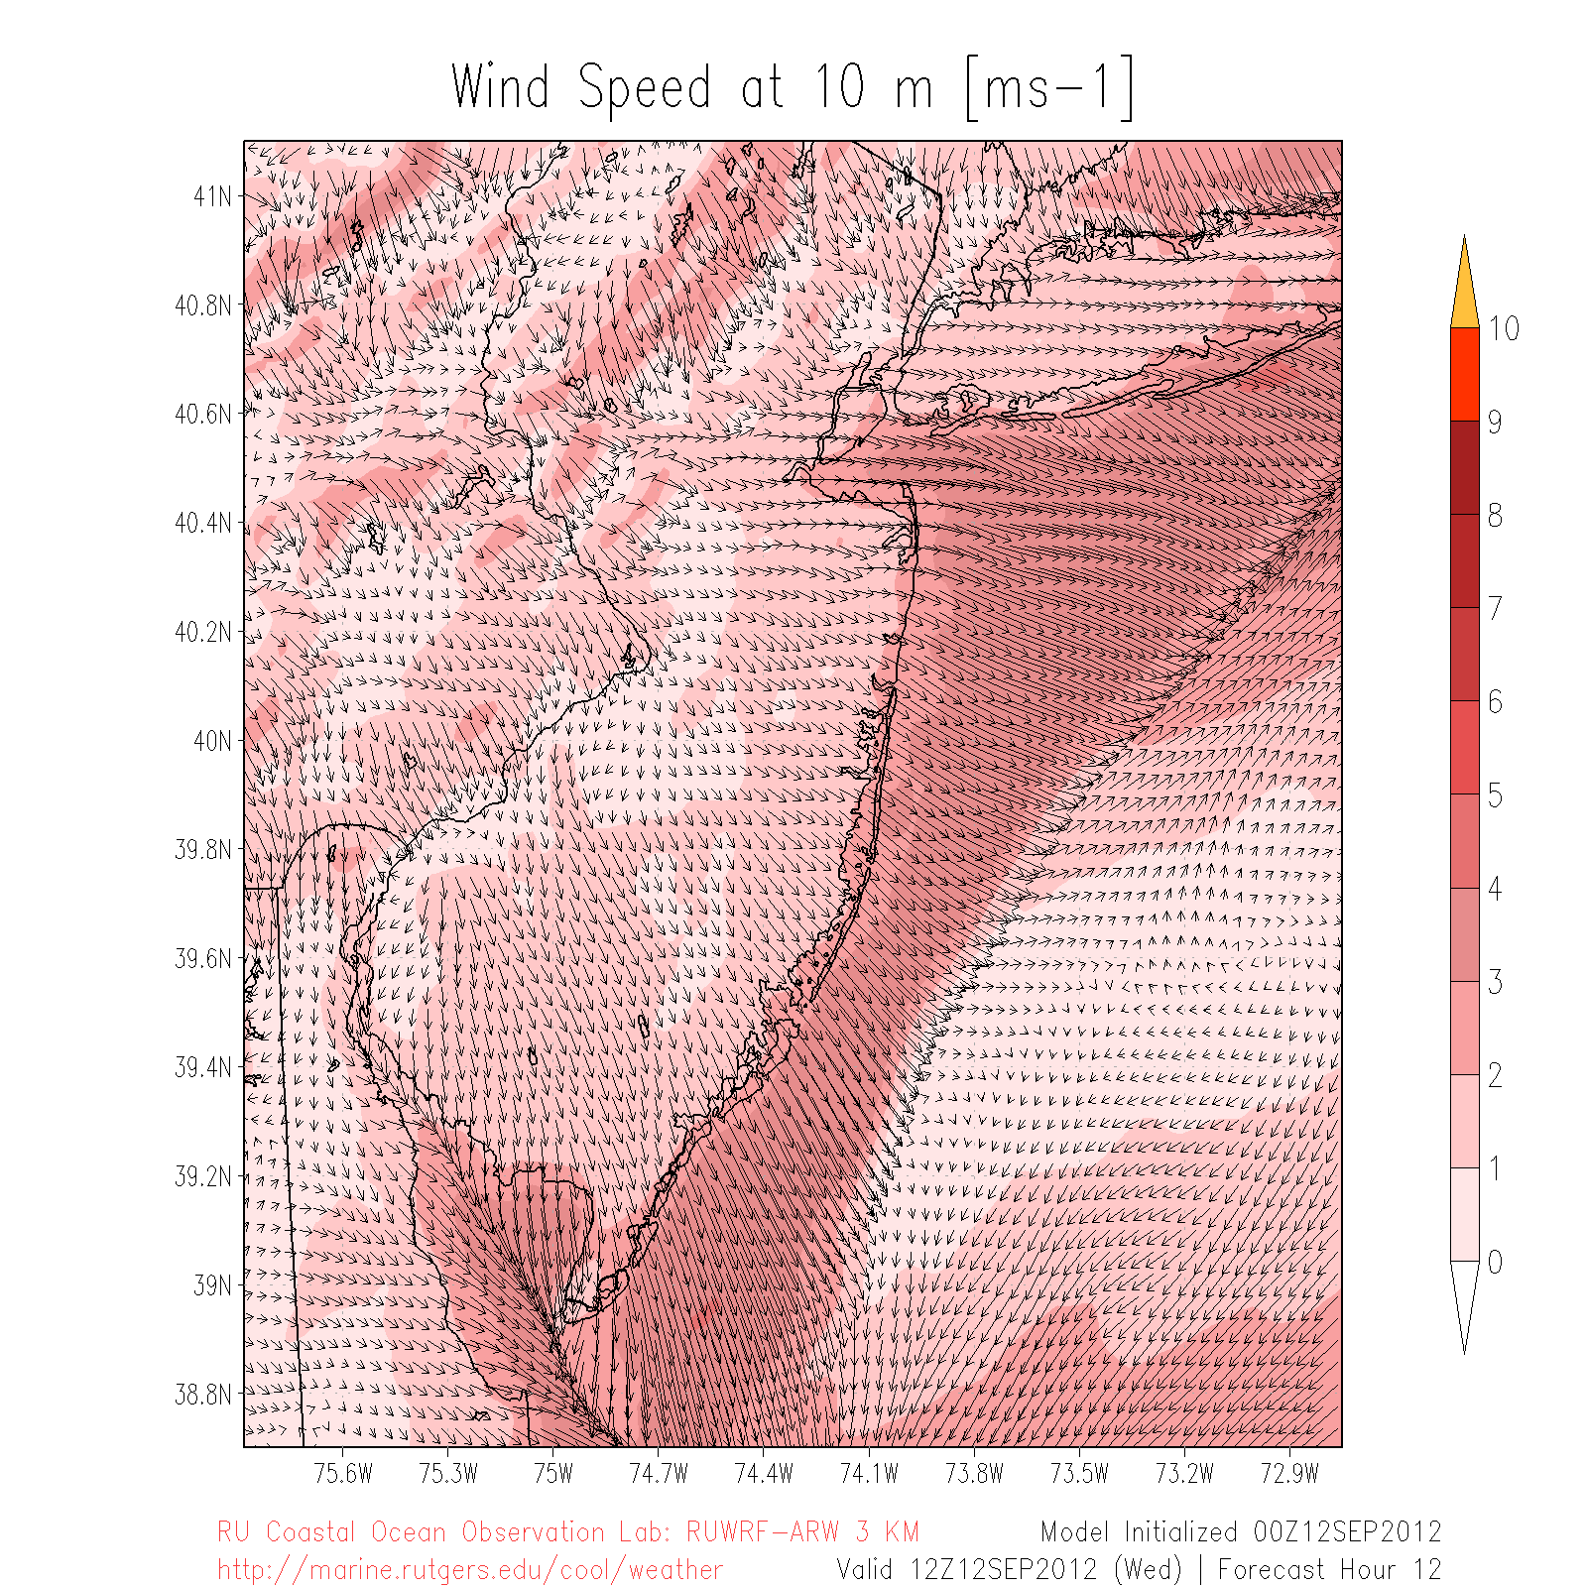
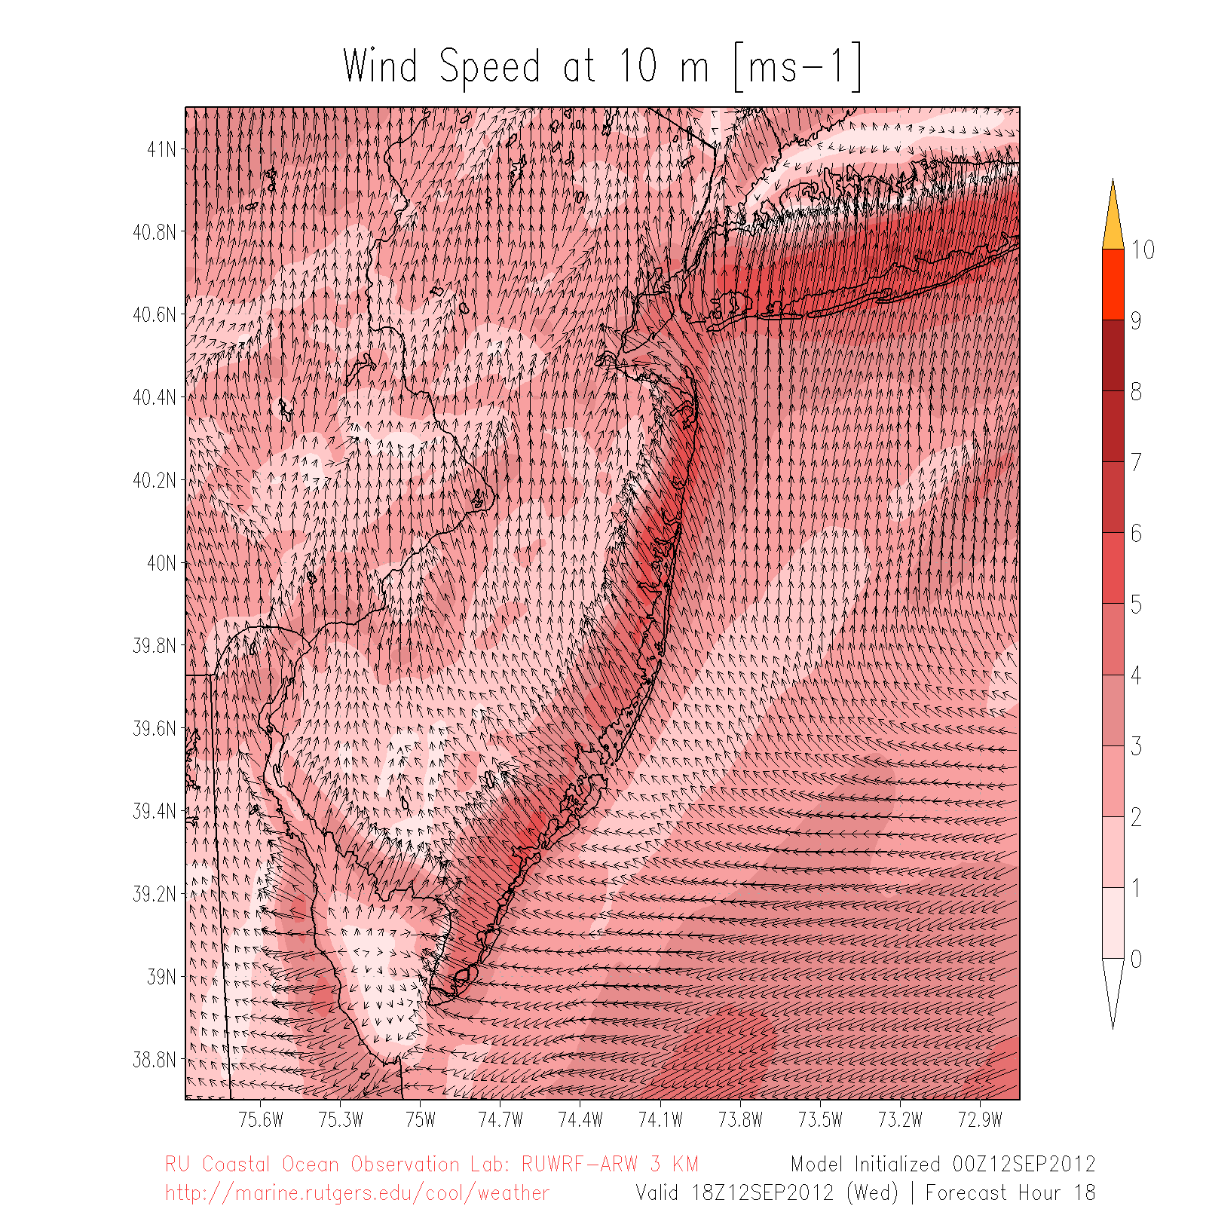
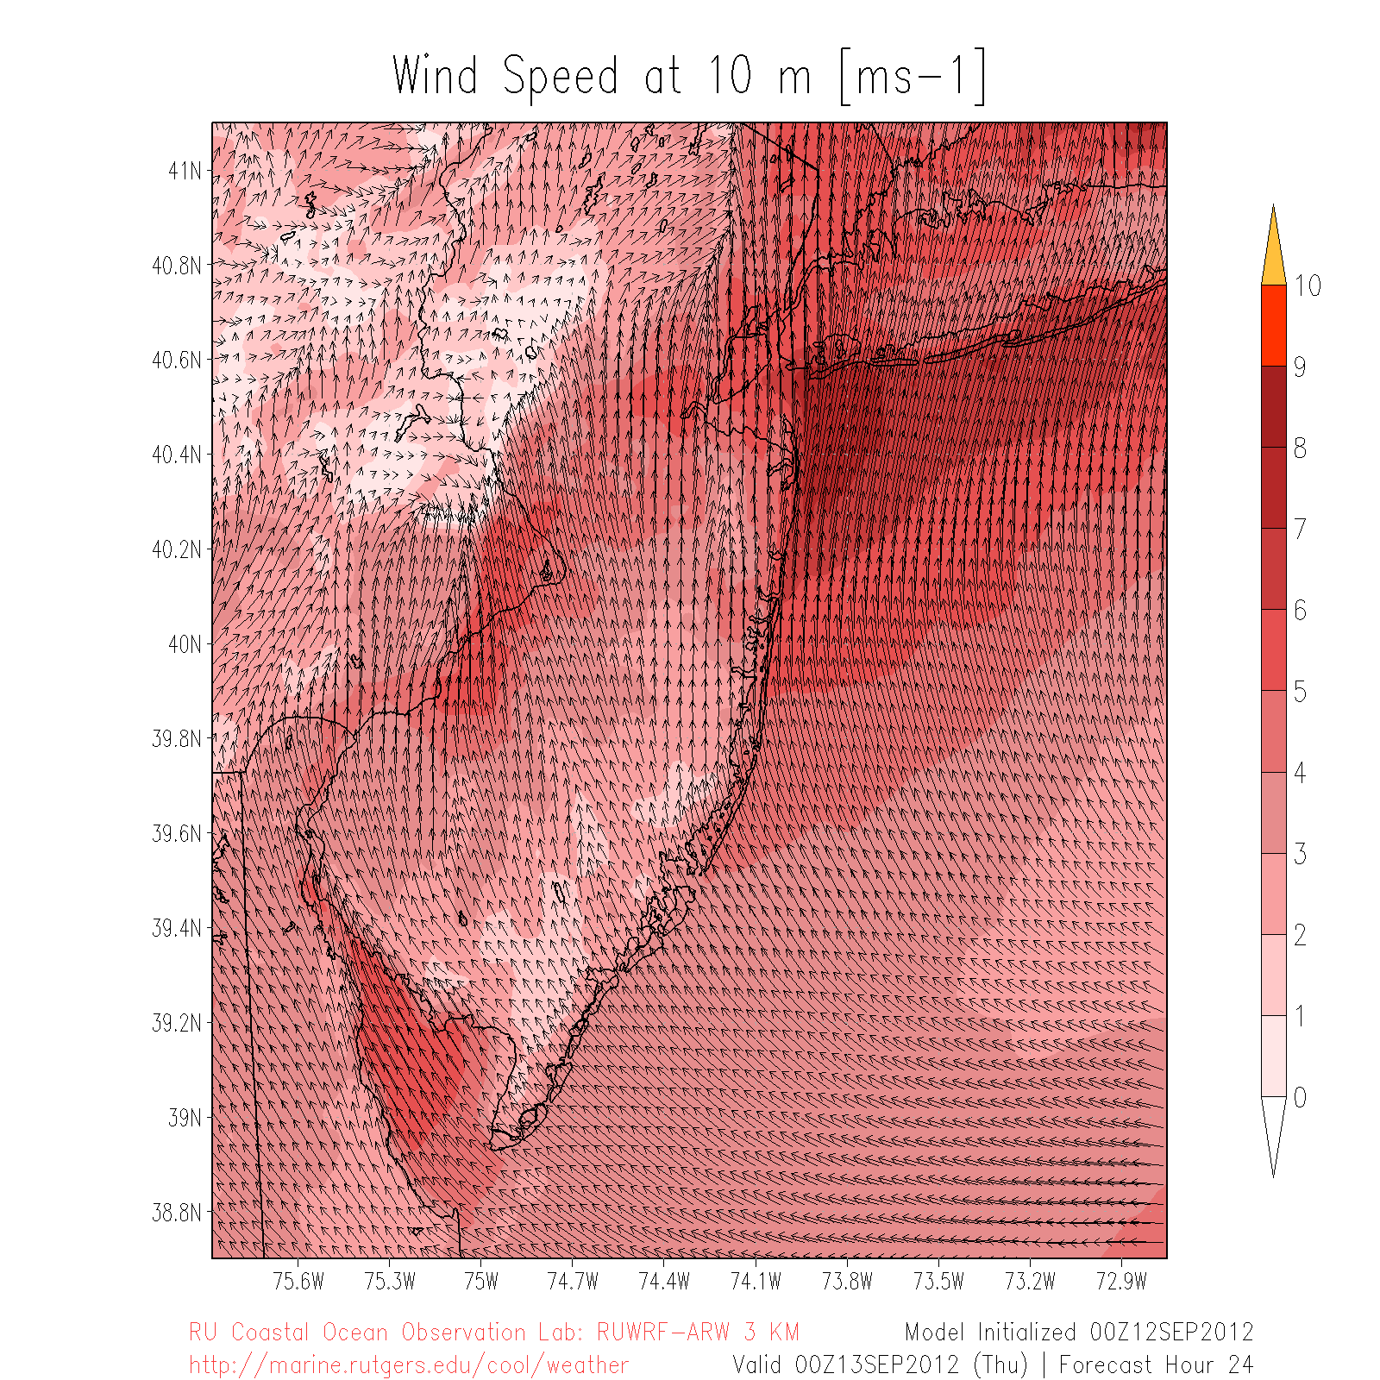
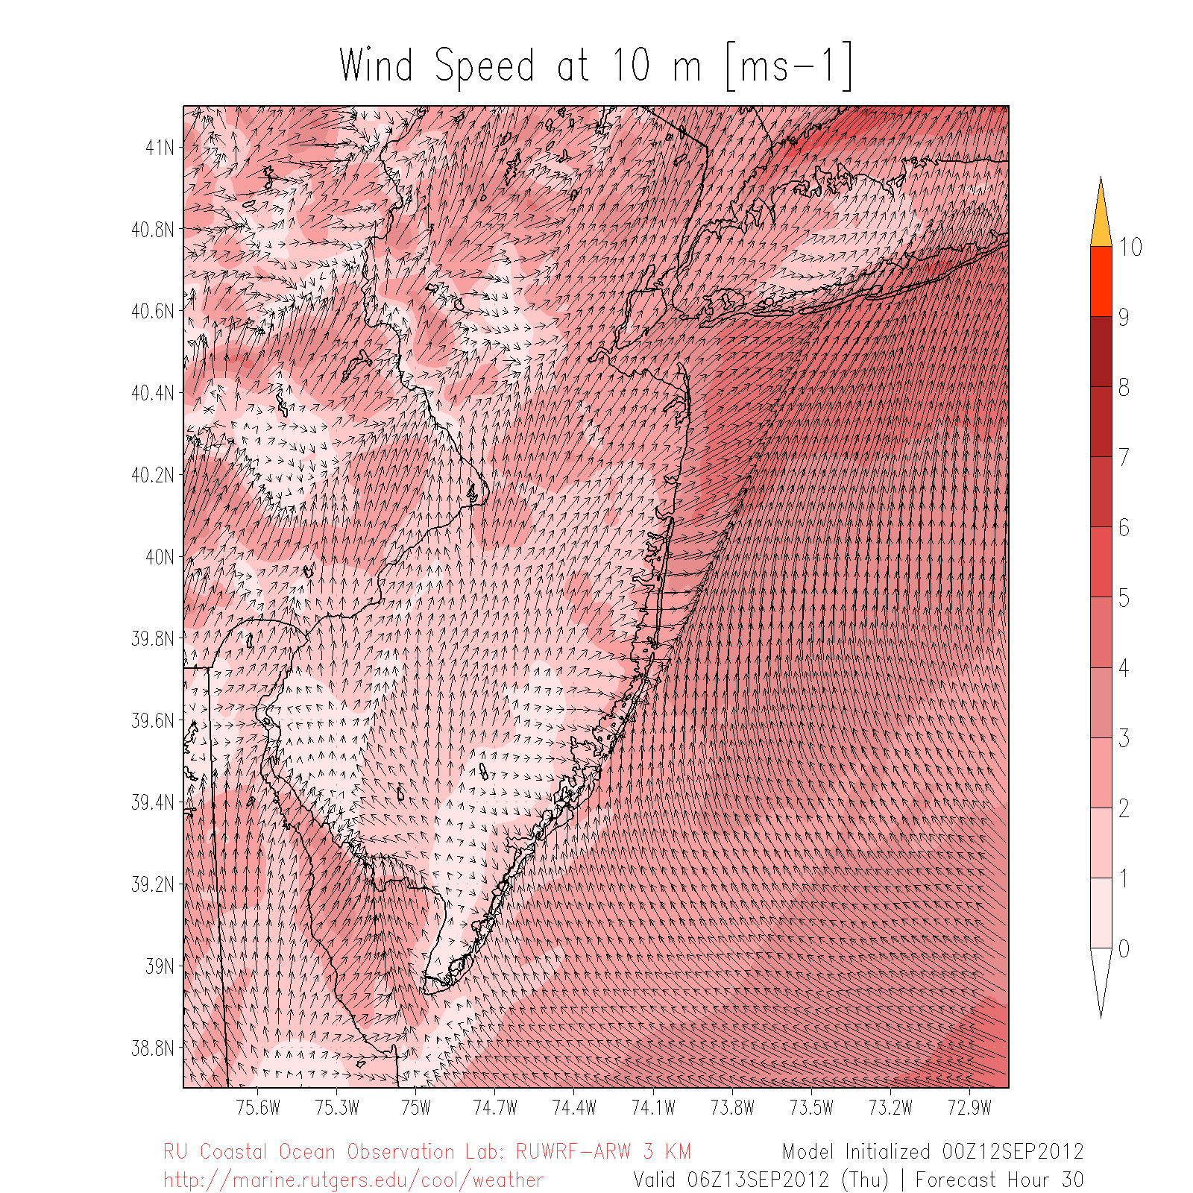
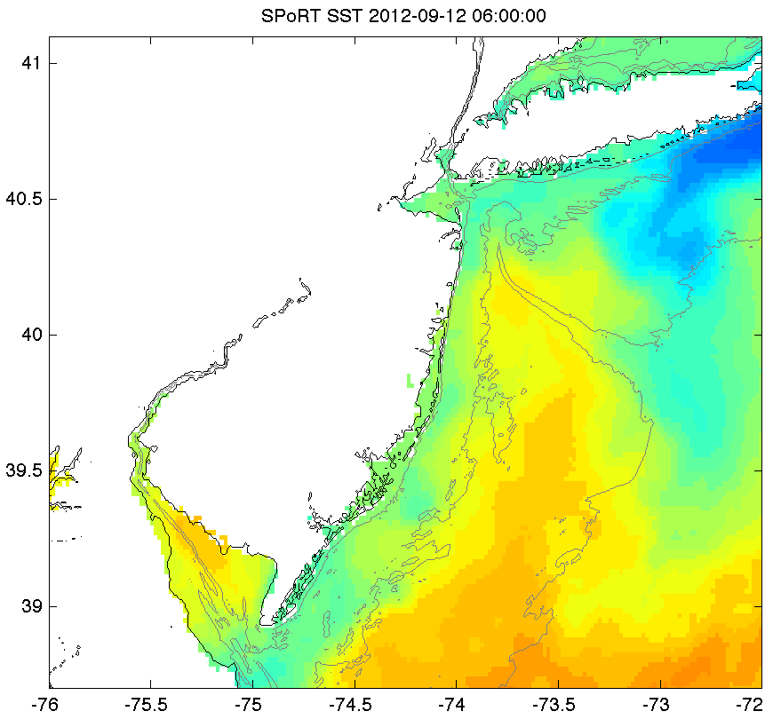
SST Sensitivity
Sept 12
06Z
New SST
Existing SST
12Z
Sept 13
18Z
00Z
06Z

Slide 24
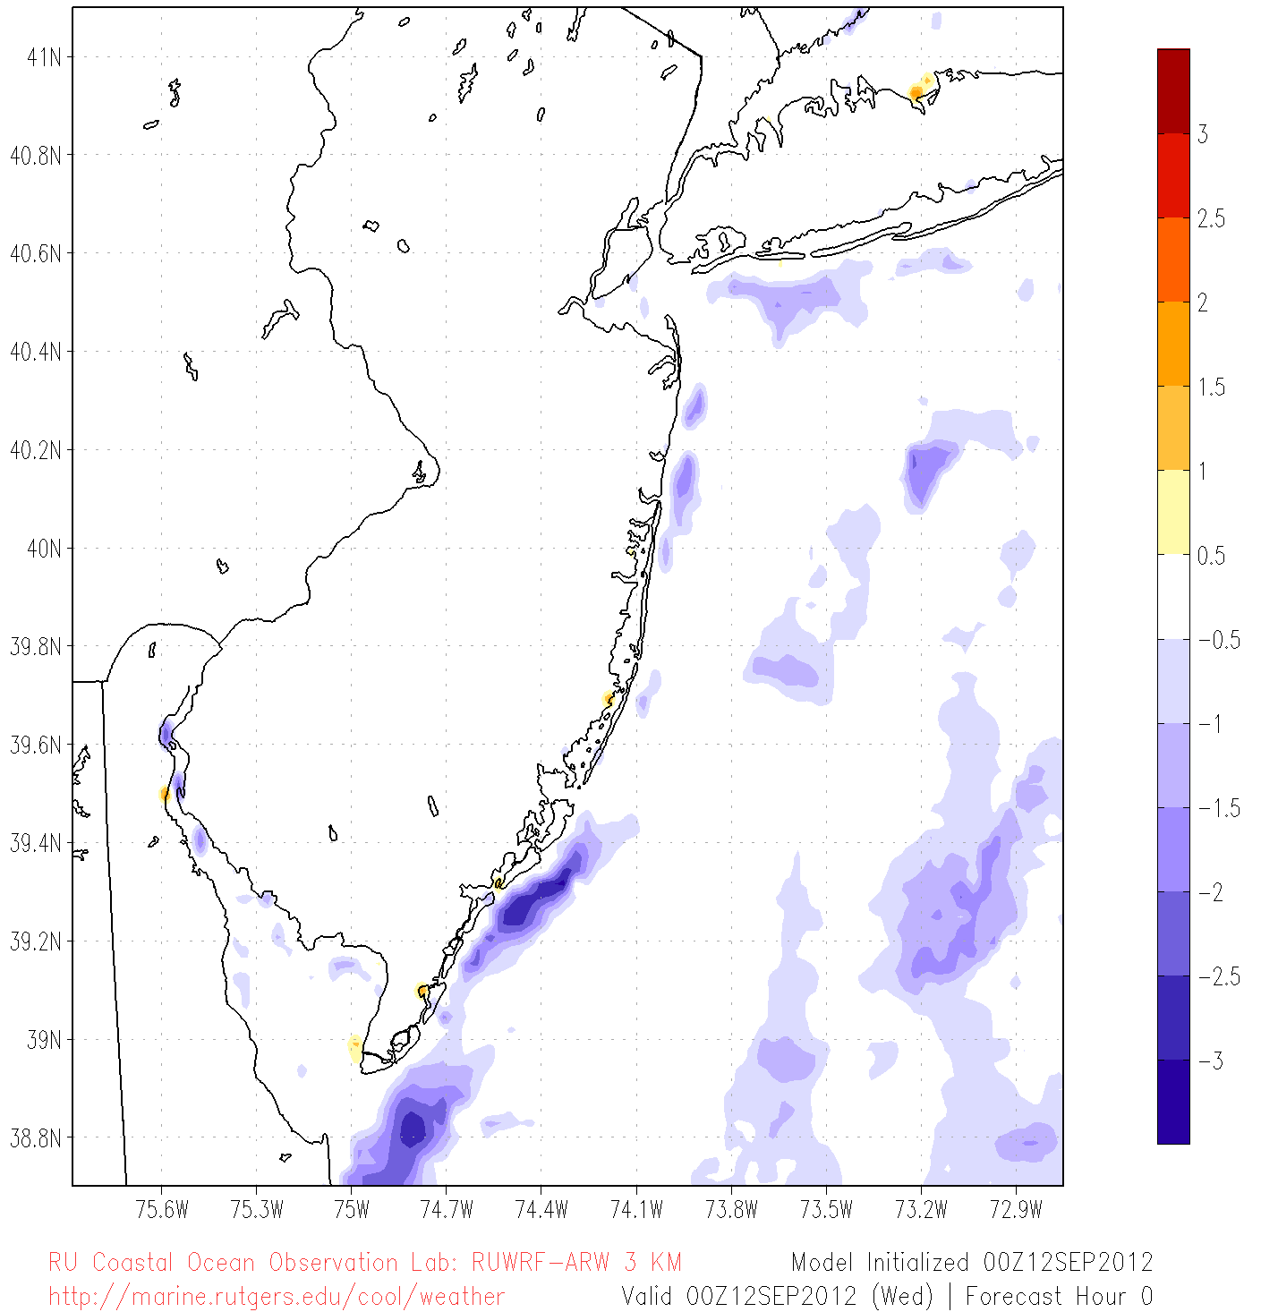
SST Diff(°C): New SST– Existing SST

Slide 25
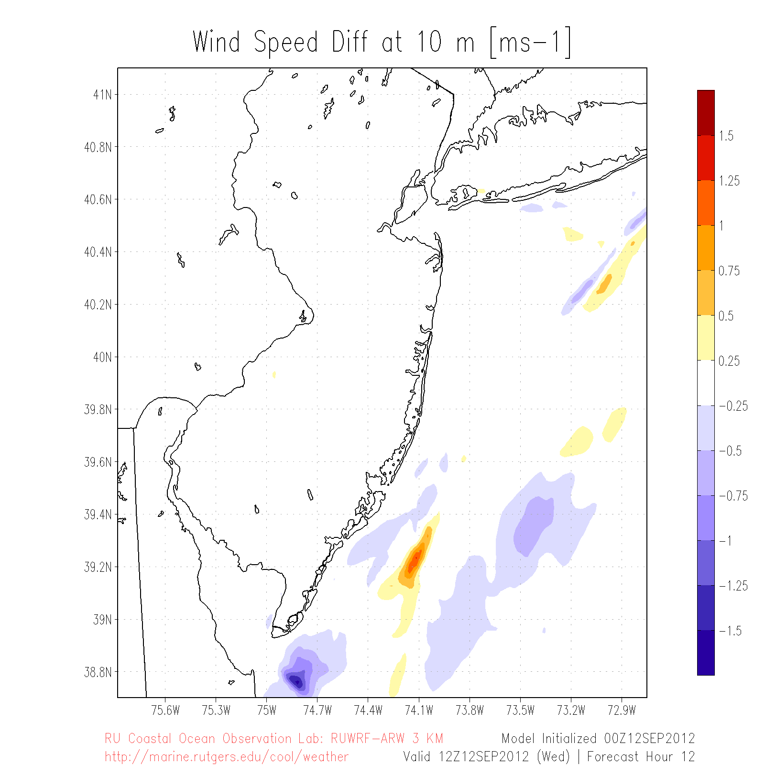
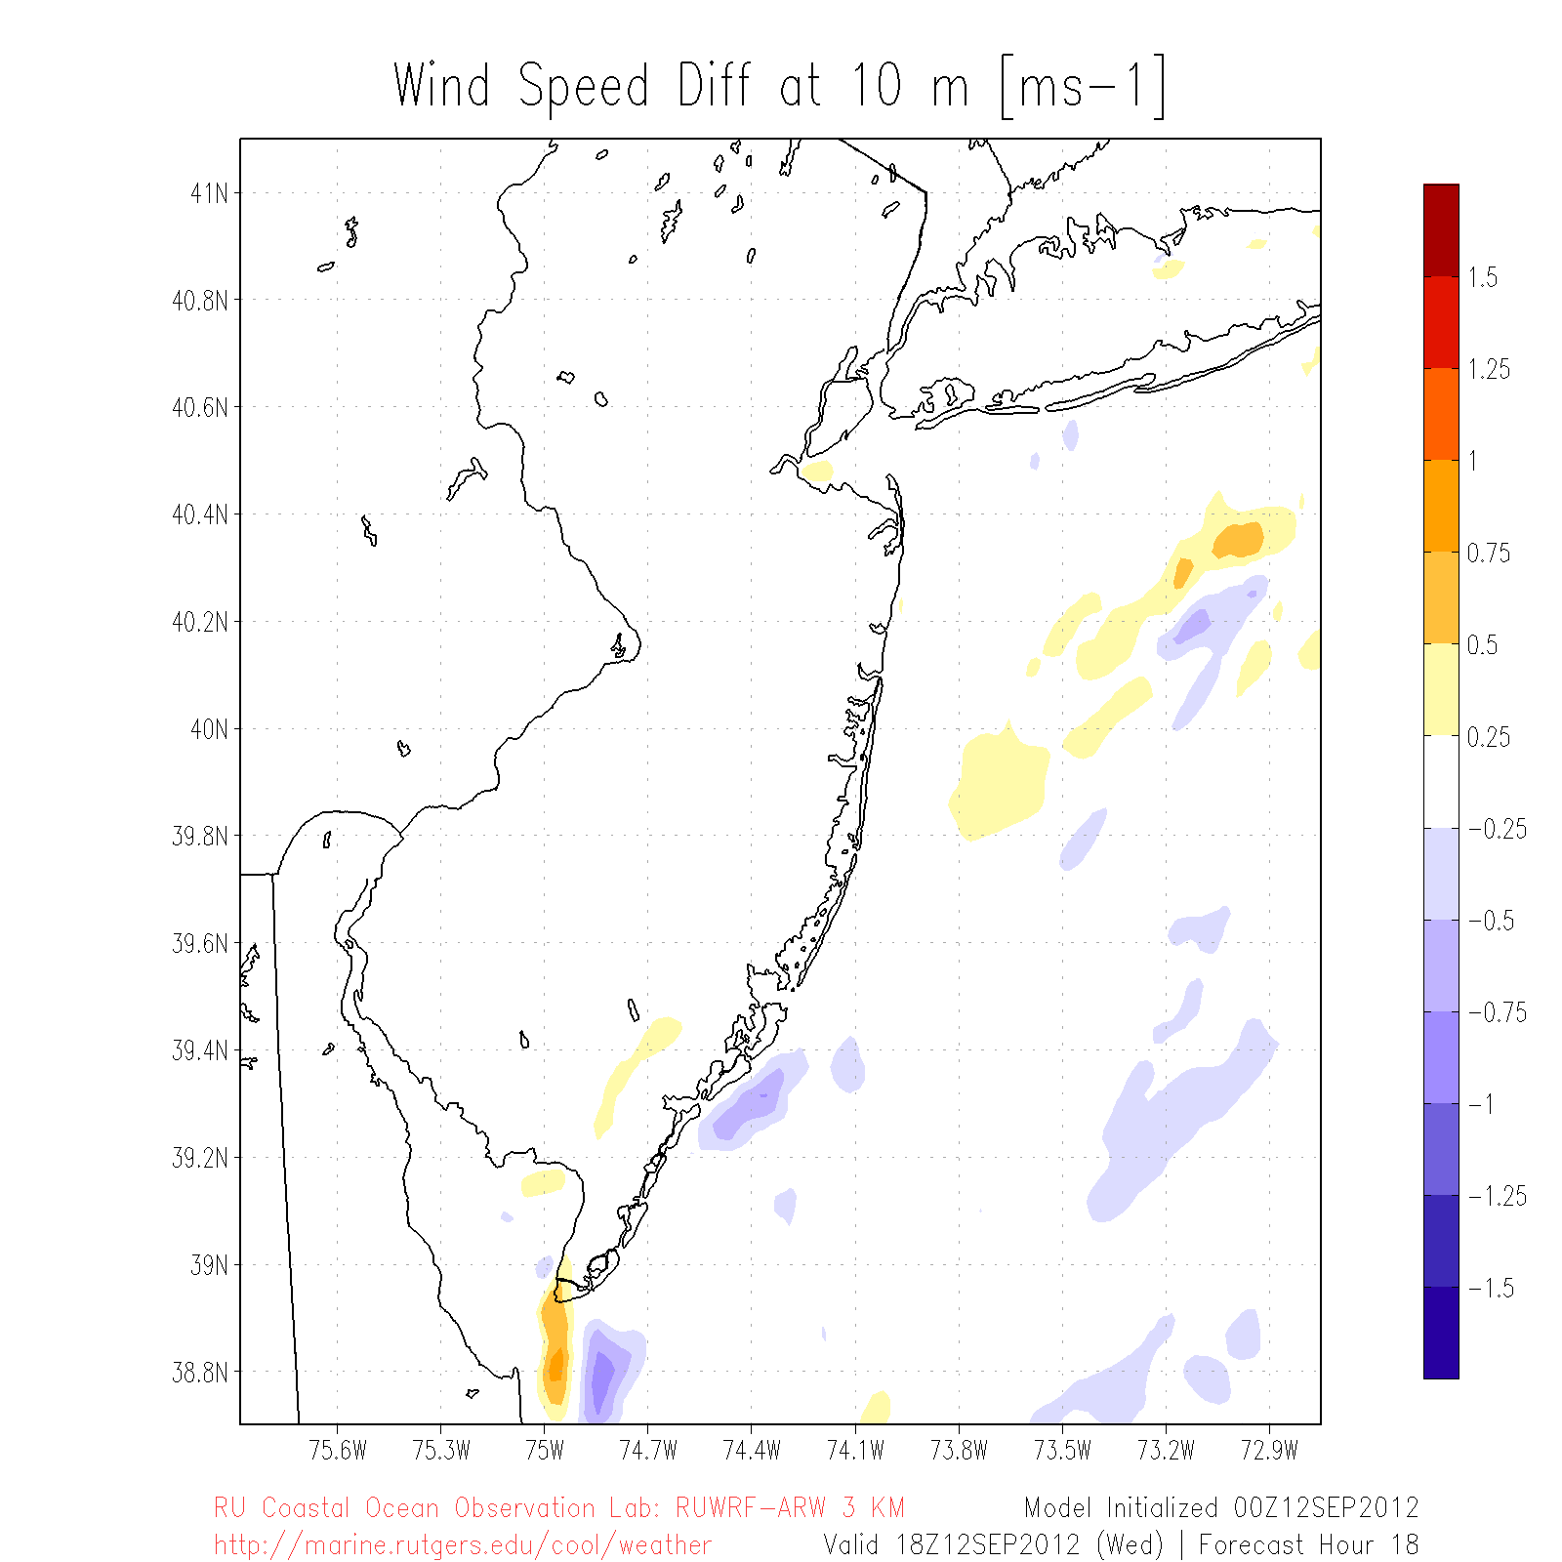
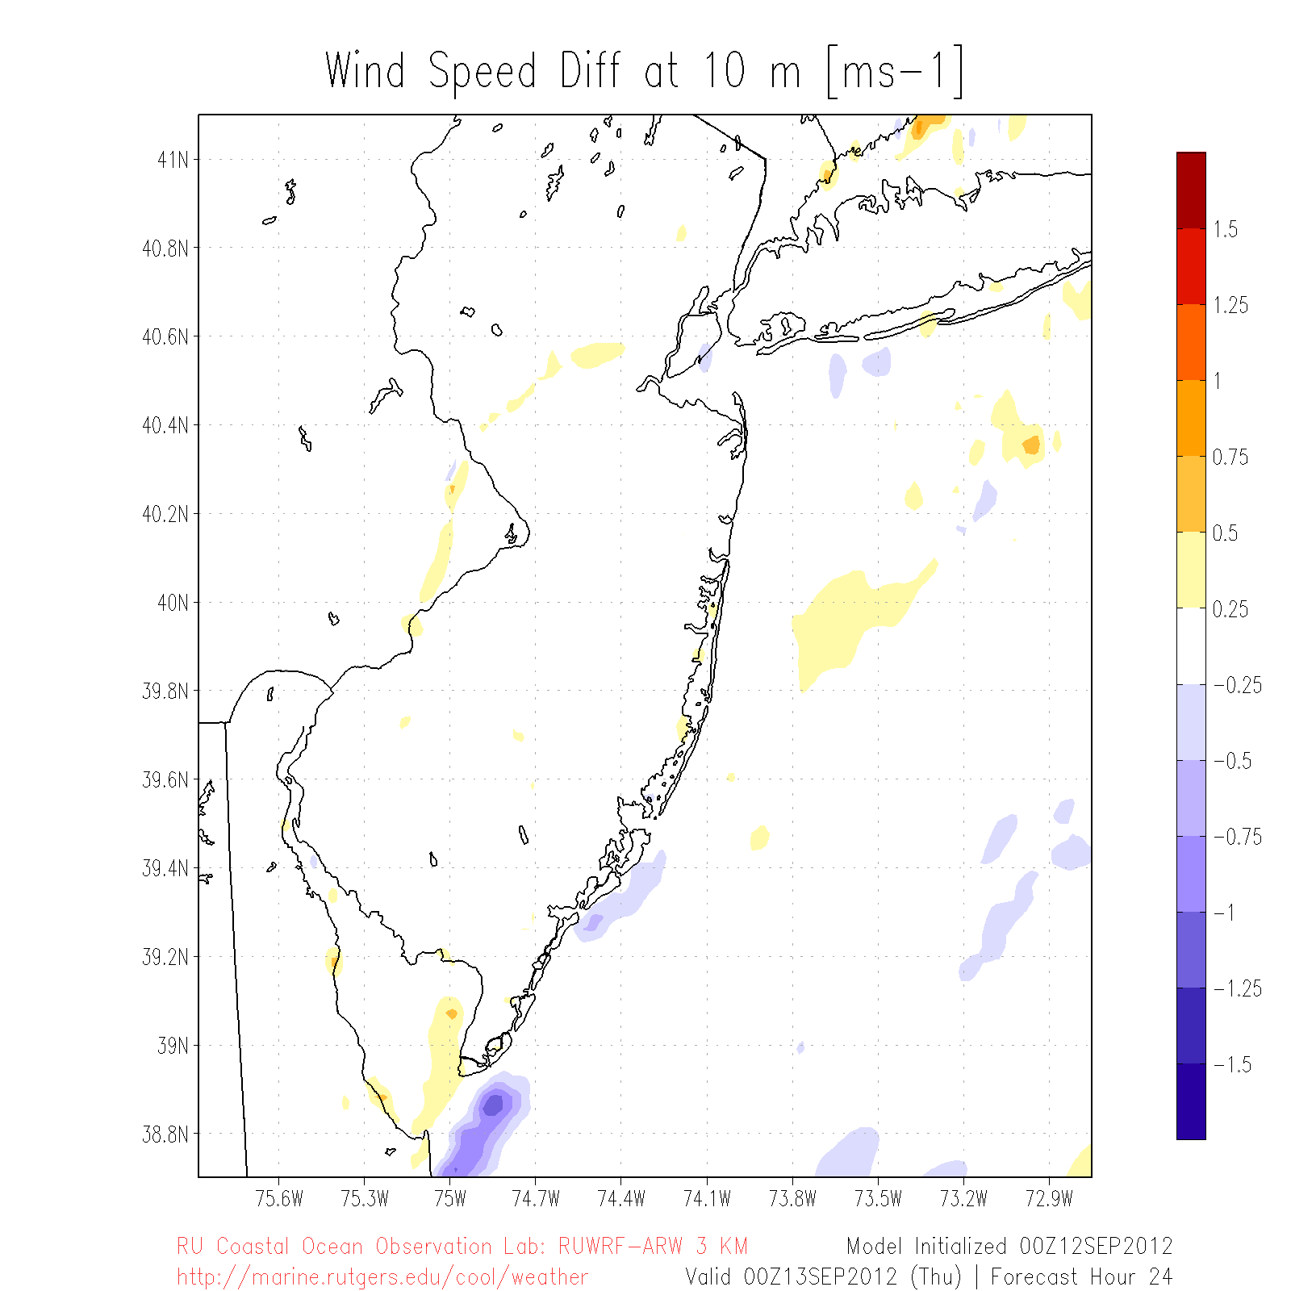
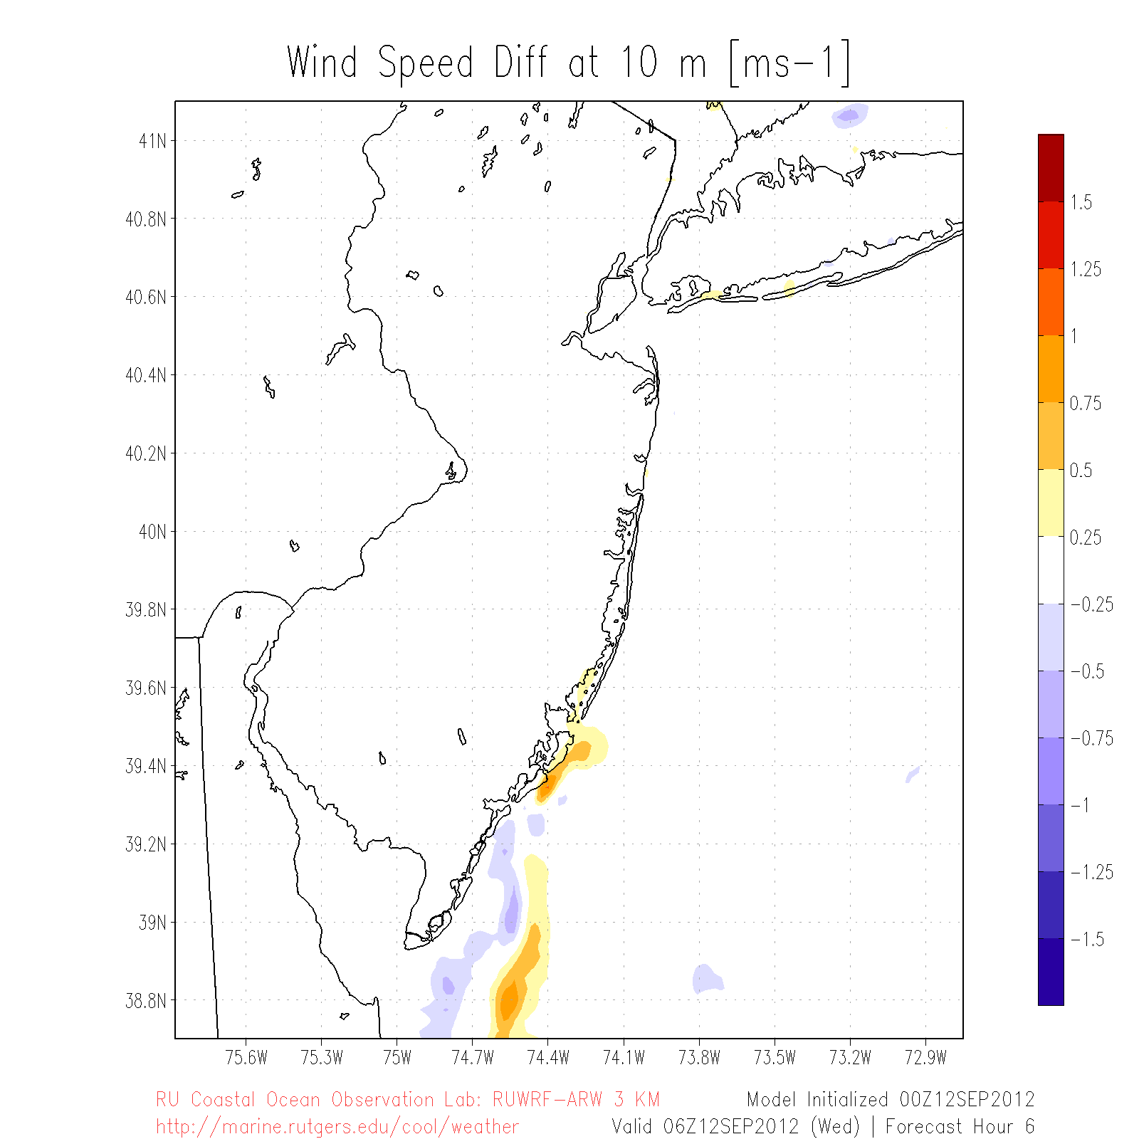
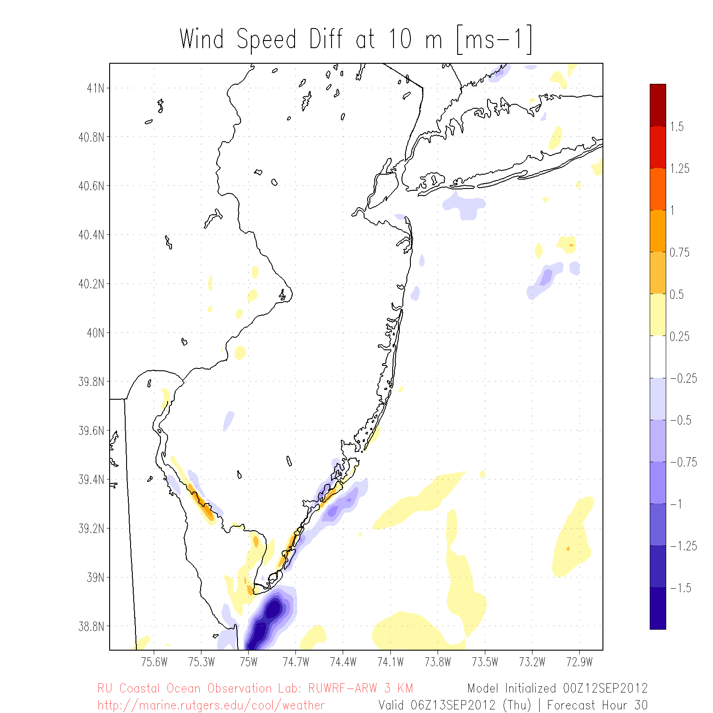
10m Wind Spd Diff (m/s): New SST run – Existing SST run
Sept 12
06Z
12Z
18Z
Sept 13
00Z
06Z
Cross section

Slide 26
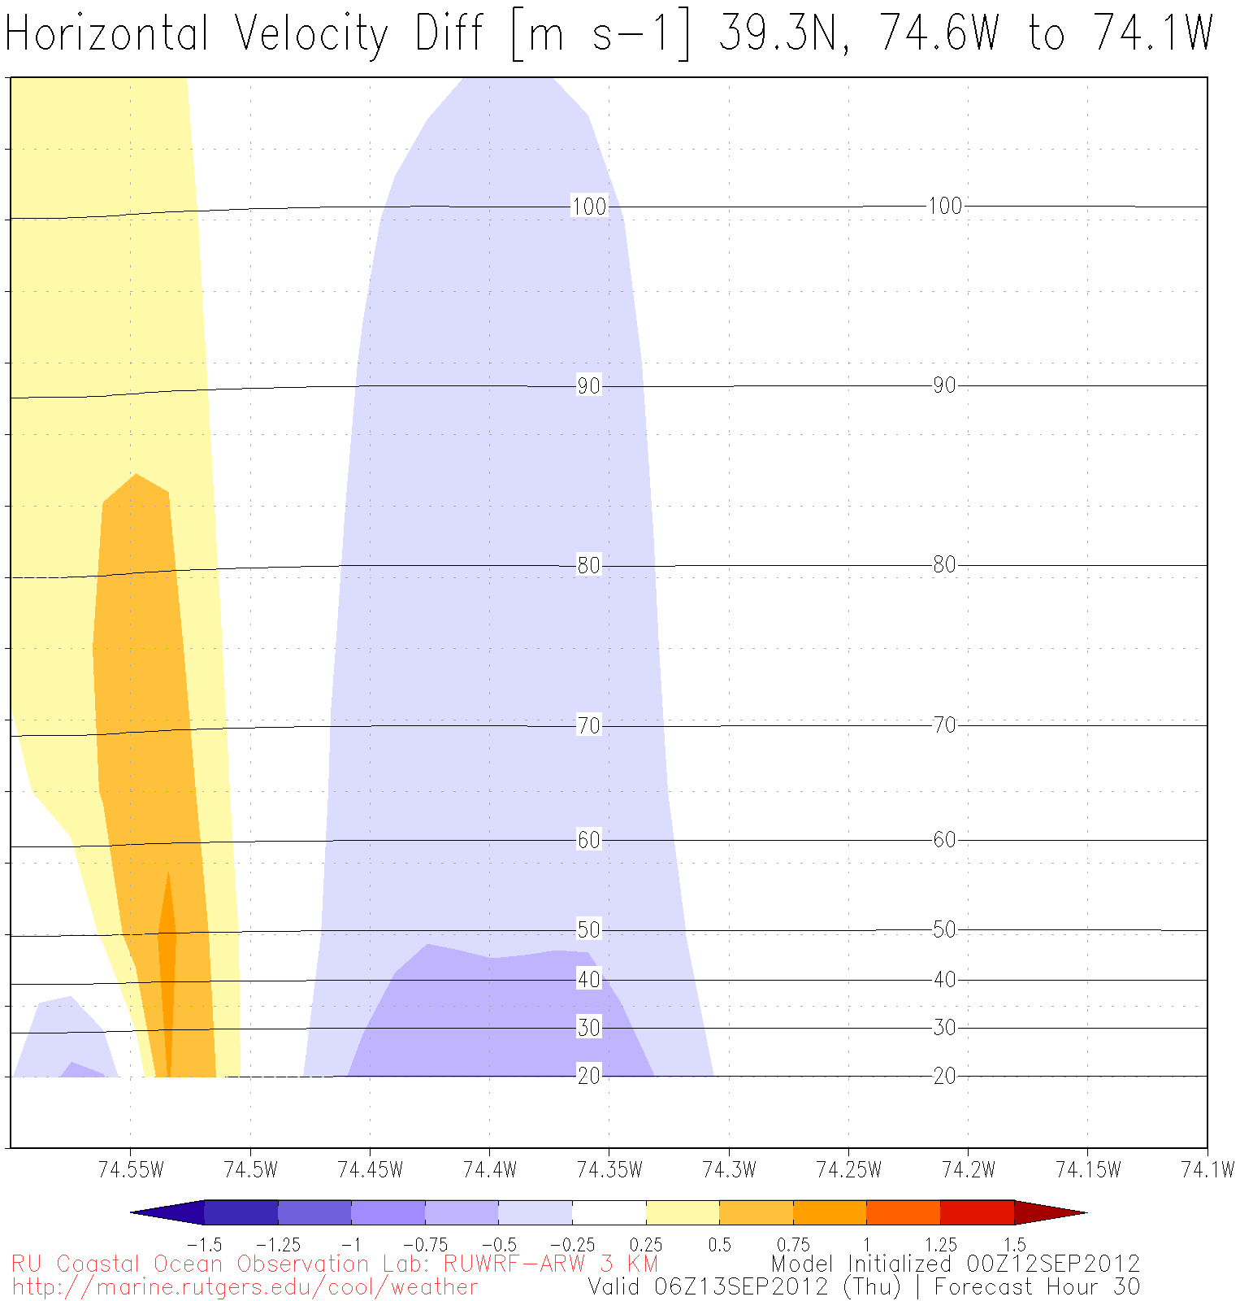

110+ m
40 m

Slide 27
Breakout activity:
upwelling?

Slide 28
Part III
Example 2: Hurricanes

Slide 29
Air-sea weather processes
Rainfall
Nor’easters
Lake Effect Snow
L
Sea Breeze
Hurricanes
El Nino
Waterspouts
H
Thunderstorms
& Lightning
High Pressure Systems
Sea Spray

Slide 30
Motivation
In August 2011, Hurricane Irene’s intensity was over-predicted by several hurricane models and over-forecast by the National Hurricane Center (NHC)
Notes:
Case study (Irene)

Slide 31



Governing factors of hurricane intensity
dry air intrusion
Question:
Did the upper ocean thermal structure and evolution contribute to Irene’s intensity over-prediction?
vertical wind shear
Hypothesis:
upper ocean thermal structure and evolution
Models handled well:
hurricane track
vertical wind shear
dry air intrusion
But not:
ocean
hurricane track
After Emanuel et al. (2004)

Slide 32
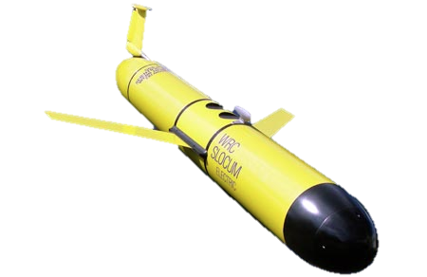
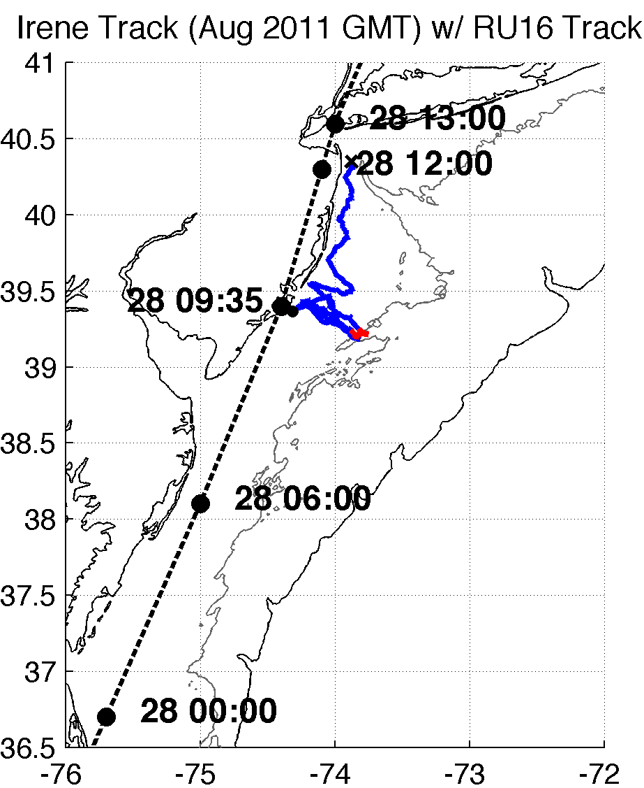
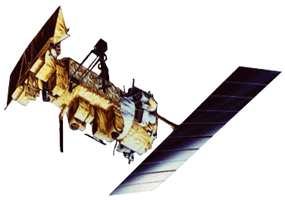

Methods – Observations and Model
32
RU16 Glider
Satellite (New sea surface temperature, SST)
Model: WRF
Full RU16 Glider Track
Irene RU16 Glider Track
40m isobath
200m isobath (shelf break)
Notes:
SST product is IR/near IR (AVHRR); SPoRT is IR/near IR as well
GFS 0.5 degree 08/27/11 06Z for boundary conditions
Modeling is semi-realistic/semi-idealized

Slide 33
Results
Glider data revealed surface cooling preceded passage of hurricane eye
Improved satellite SST product revealed that this surface ocean cooling was not captured by:
  Basic satellite products
  Ocean models used for forecasting hurricane intensity
Over 100 sensitivity tests showed that Hurricane Irene intensity is very sensitive to this “ahead-of-eye” SST cooling

Slide 34
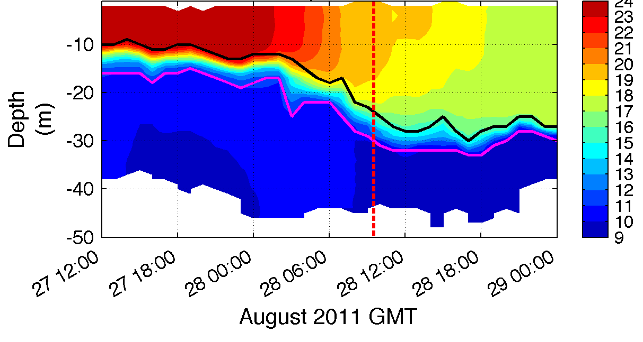
1. Glider revealed “ahead-of-eye” cooling
warm SSTs before storm
passage of eye
T (°C)
Notes:
**HF radar for surface currents onshore, glider depth-averaged currents near zero, infer offshore bottom currents
BUOYS CORROBORATED AHEAD OF EYE COOLING
Coastal downwelling circulation, which resulted in shear across thermocline, turbulence/entrainment, and finally surface cooling
Fire escape at bottom for less storm surge, fire extinguisher at top for weakening storm
Inertial response likely cooled remaining waters post-storm

Slide 35
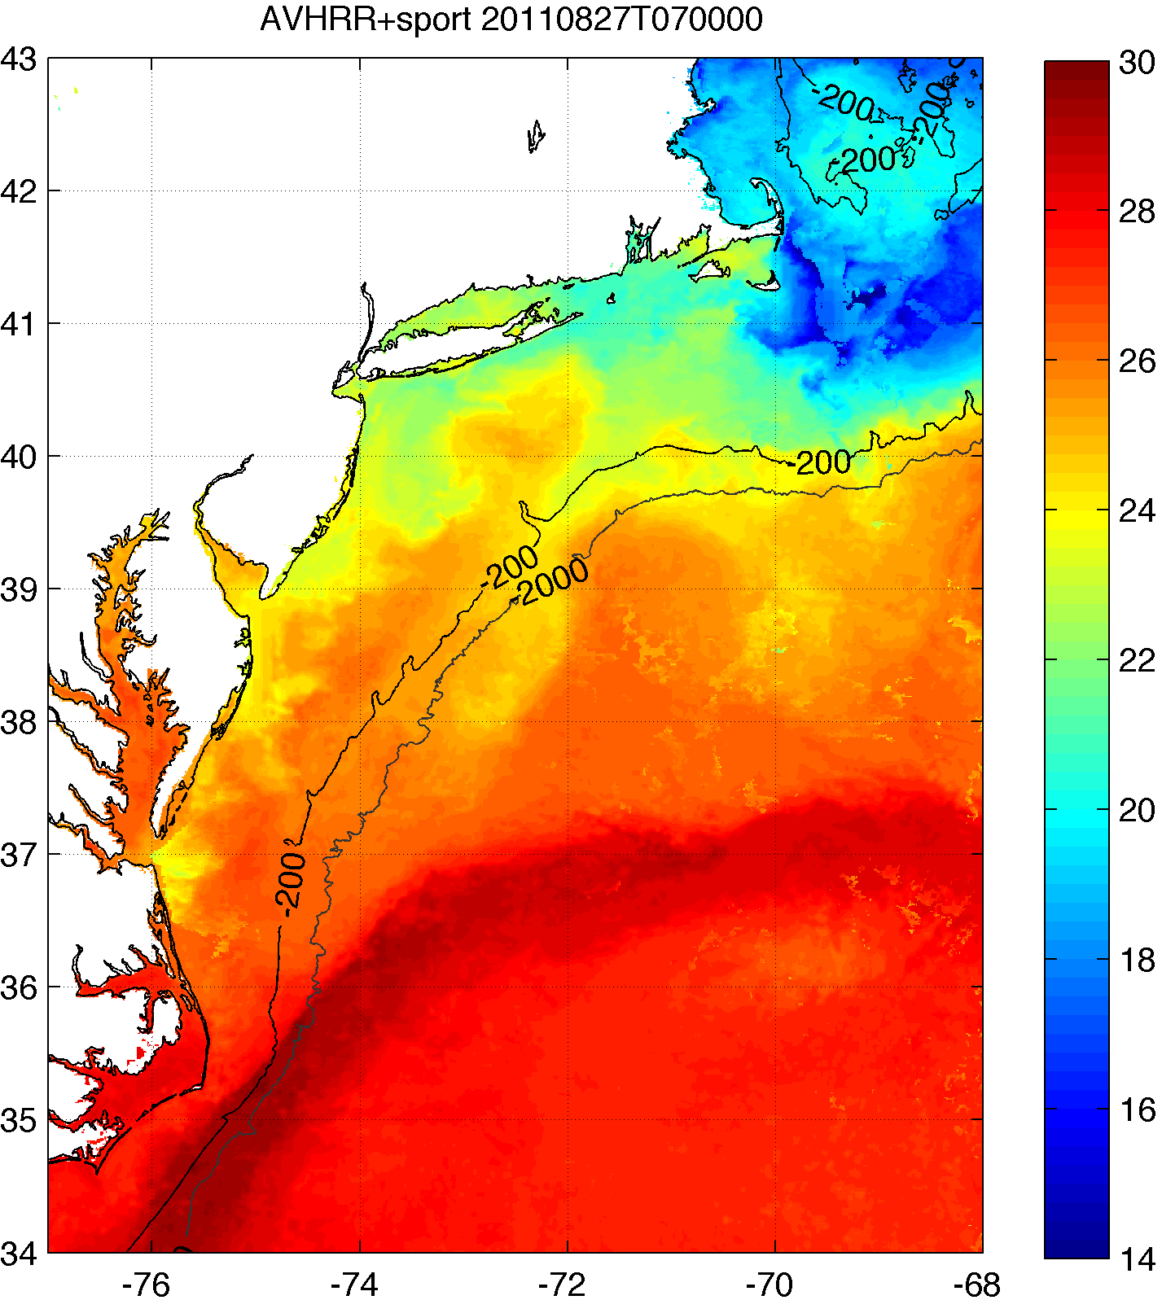
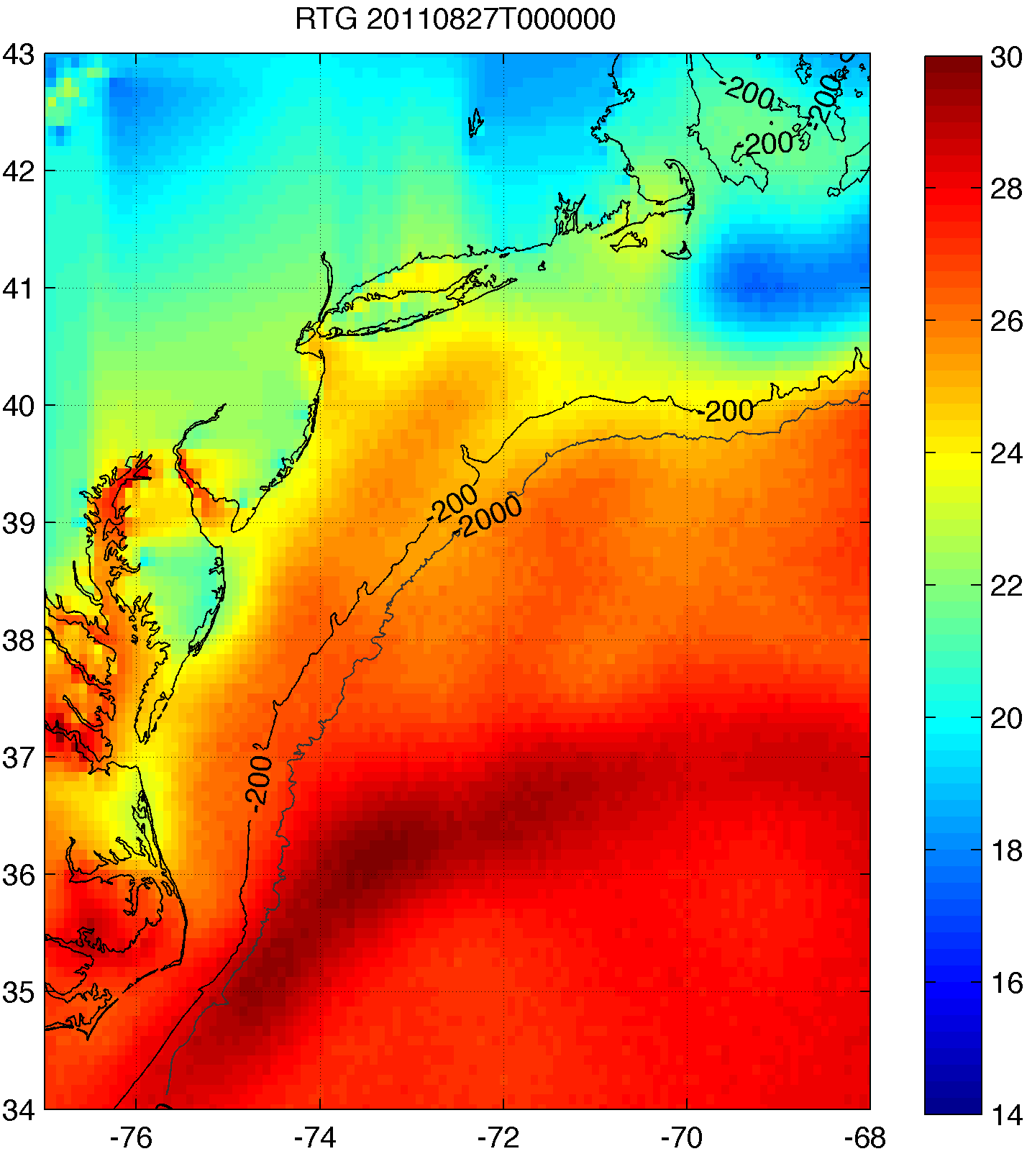
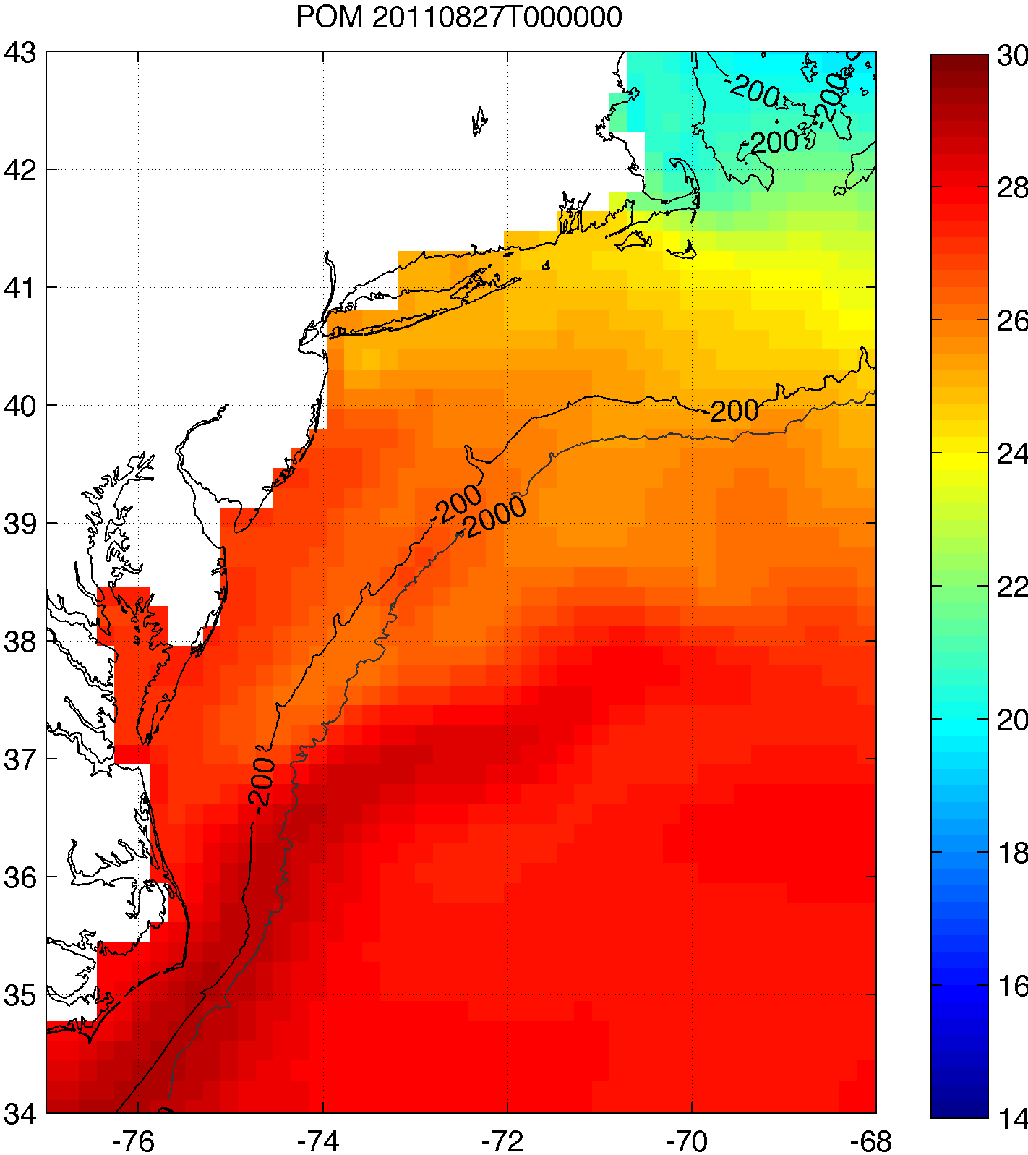
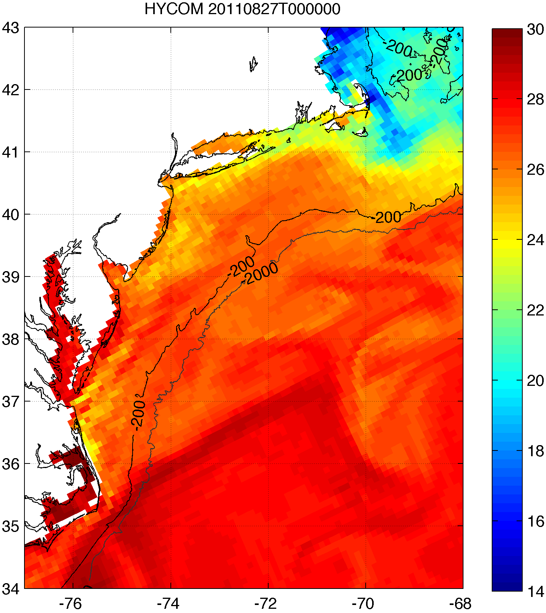
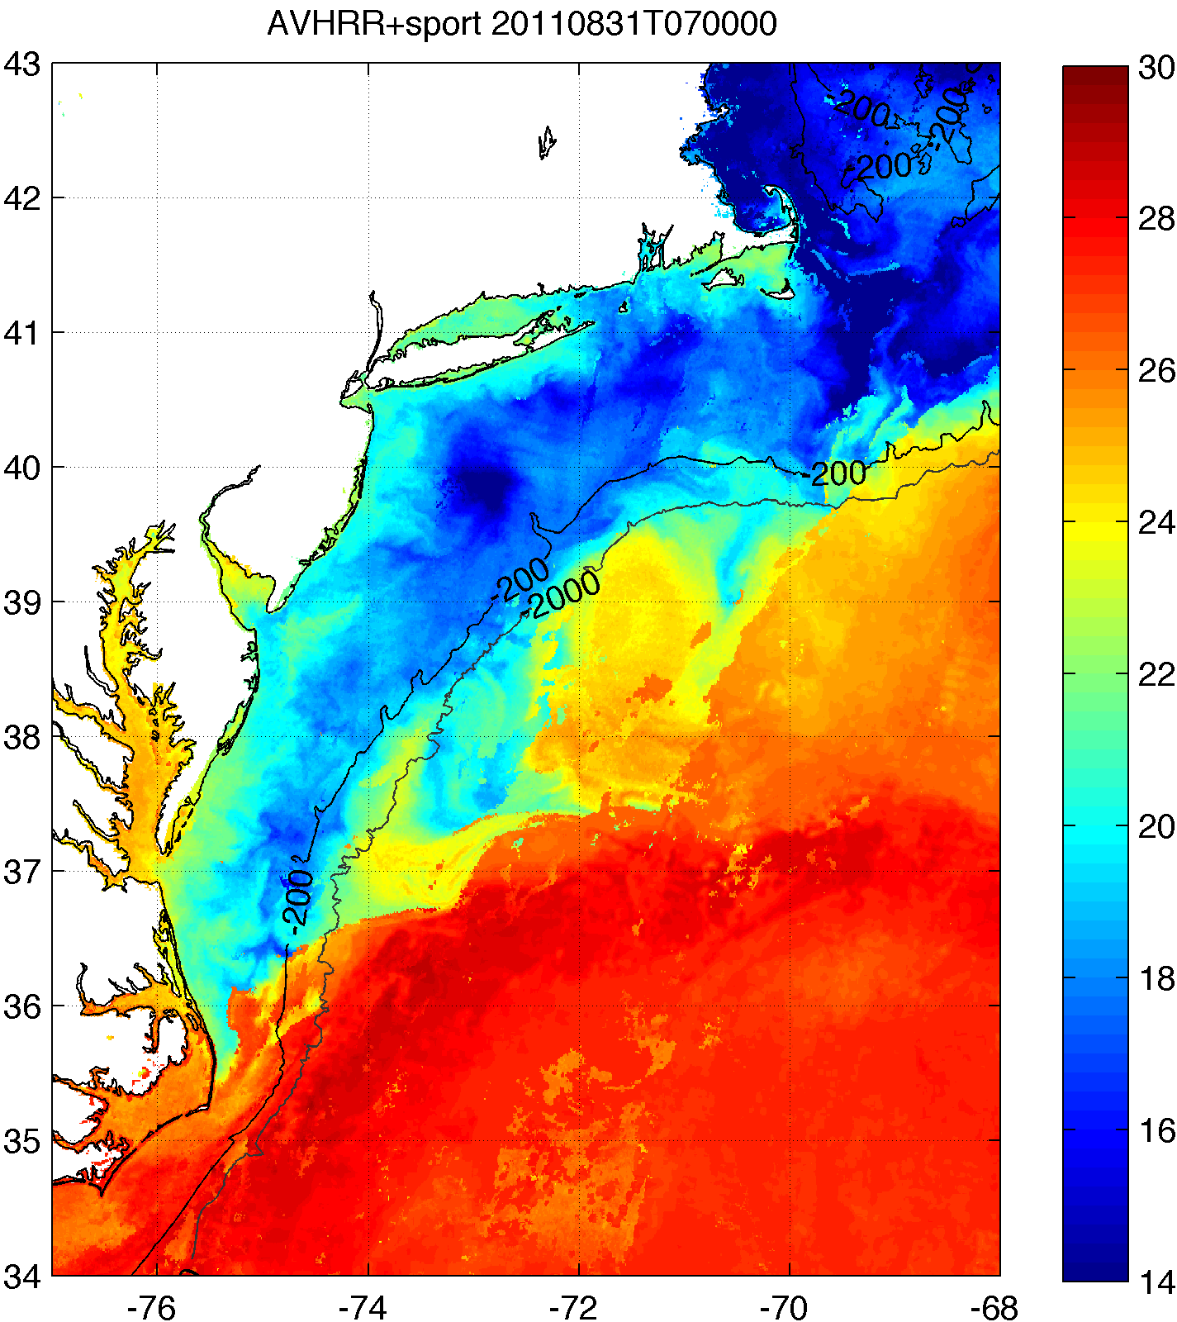
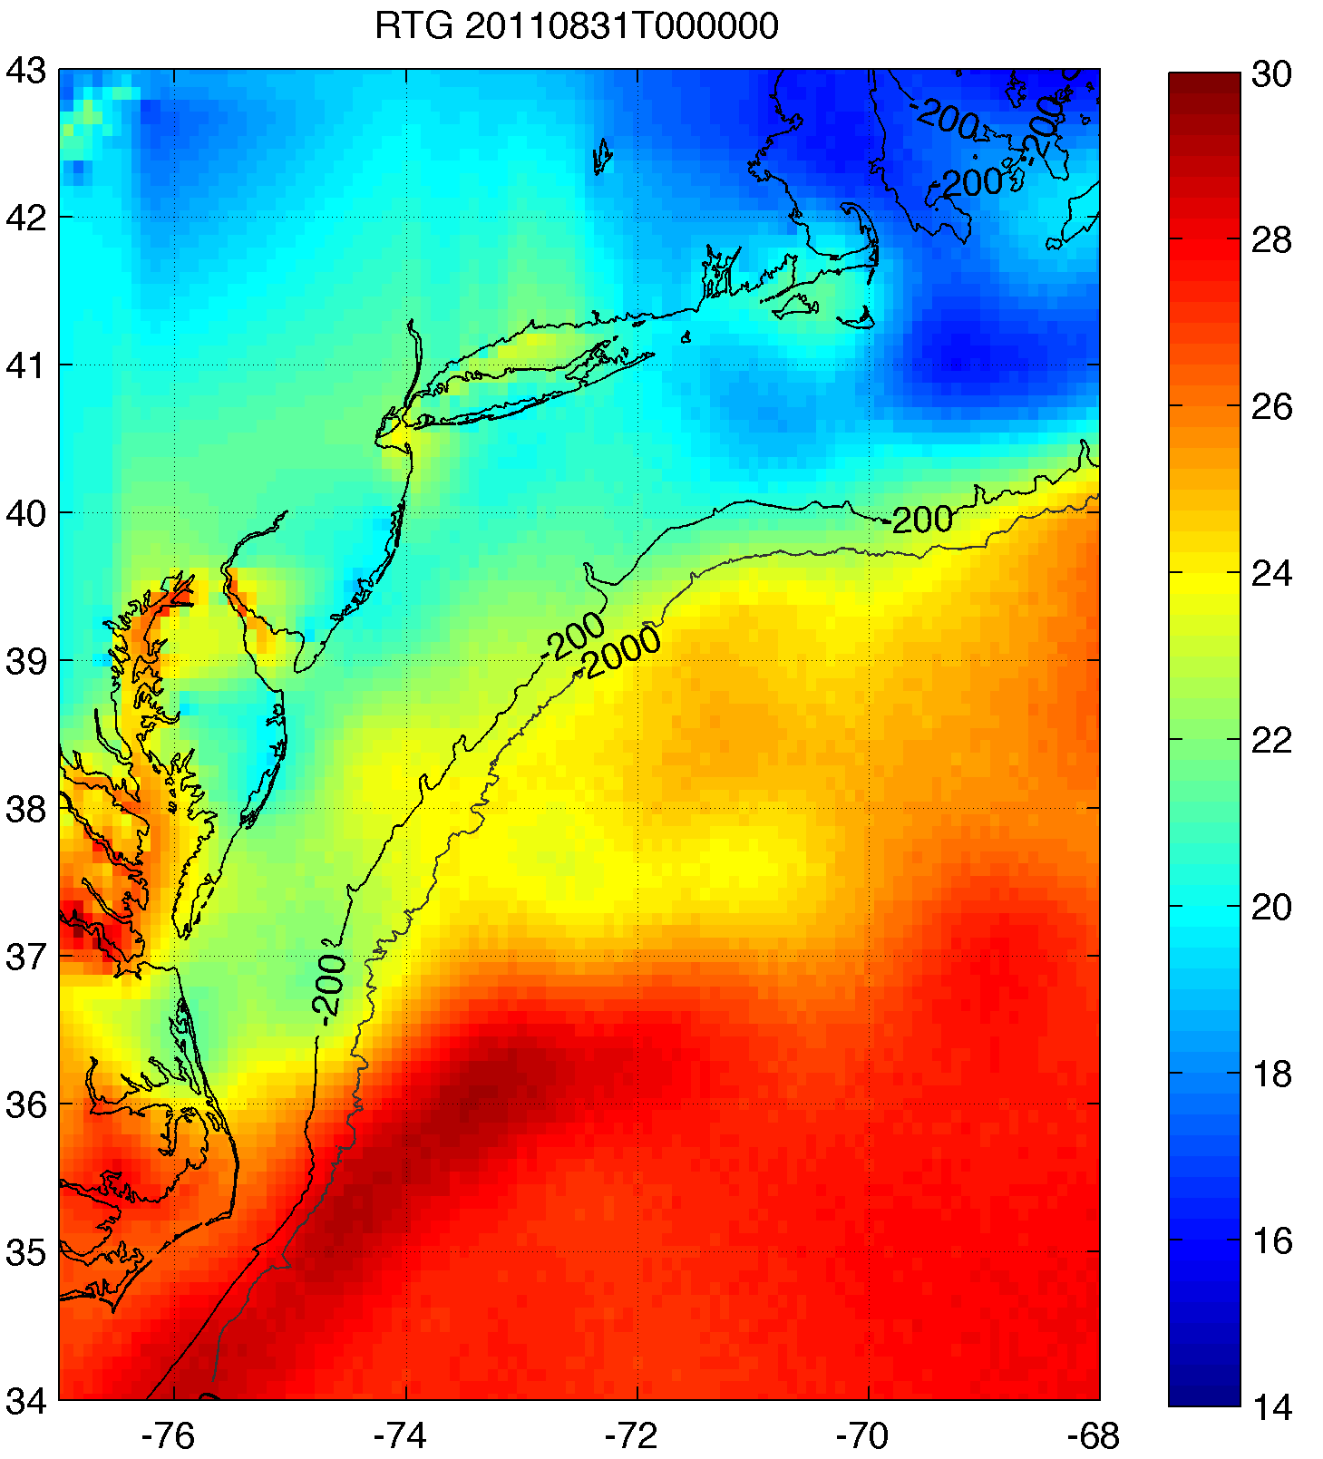
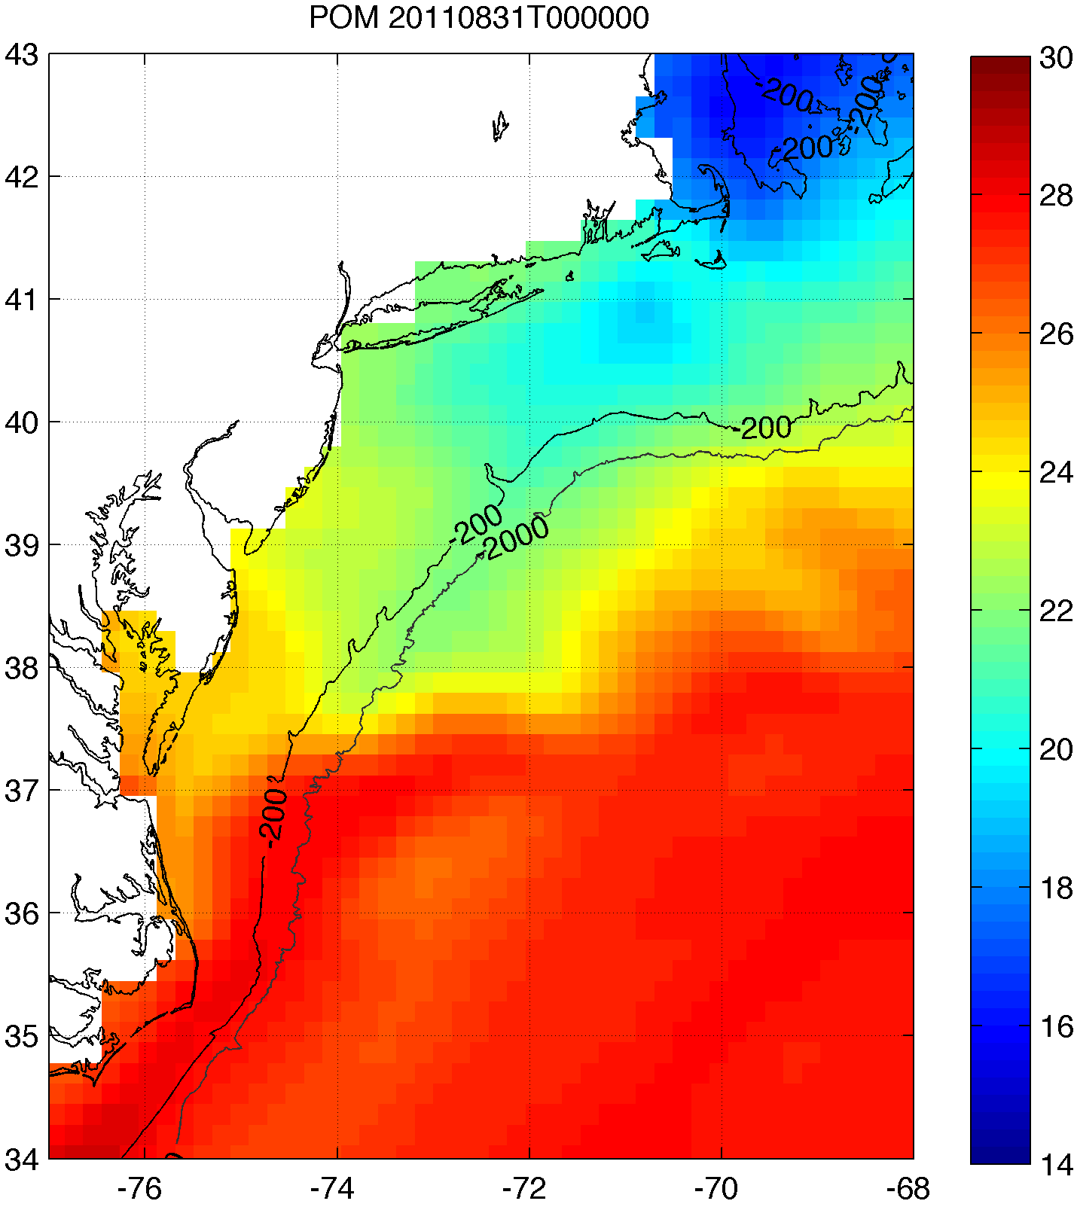
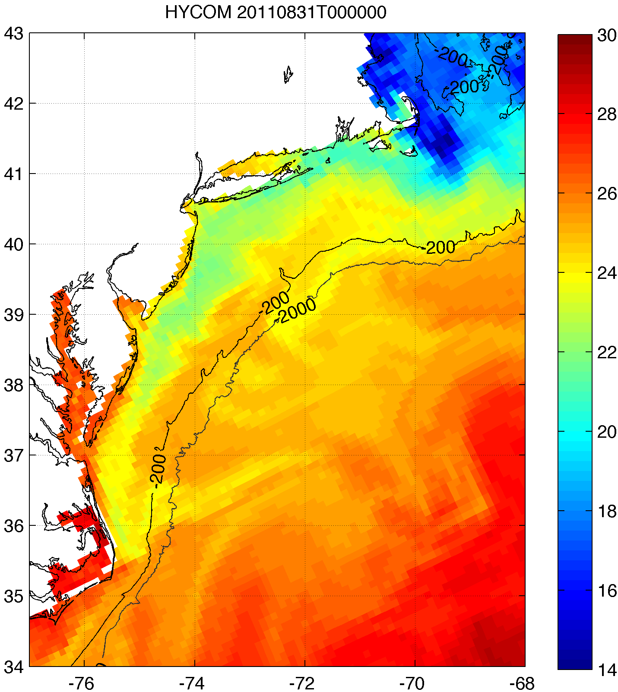
2. Improved satellite SST product revealed that this cooling was not captured by:
basic satellite product
ocean models used for forecasting hurricane intensity
Rutgers SST
RTG HR SST
NAM model
HWRF-POM
low res
HWRF-HYCOM
medium res
BEFORE IRENE
AFTER IRENE
Notes:
Caveats: different atmospheric forcing, etc.
Rutgers SST: 2km, RTG: 1/12 deg, ~9 km, HWRF-POM: 18km, HWRF-HYCOM: 1/12 deg, ~9km

Slide 36
3. >100 sensitivity tests showed Irene intensity very sensitive to this “ahead-of-eye” SST cooling
Minimum pressure

Slide 37
3. >100 sensitivity tests showed Irene intensity very sensitive to this “ahead-of-eye” SST cooling
Maximum wind
→ Ocean is critical factor for forecasting hurricanes!

Slide 38
End

Slide 39
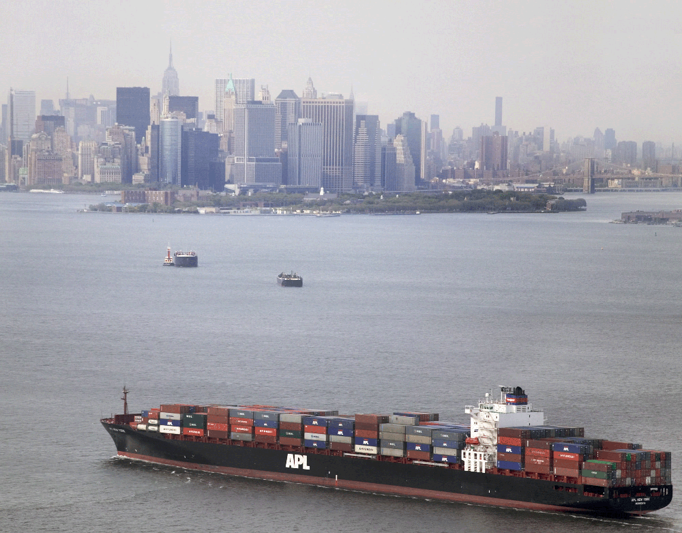
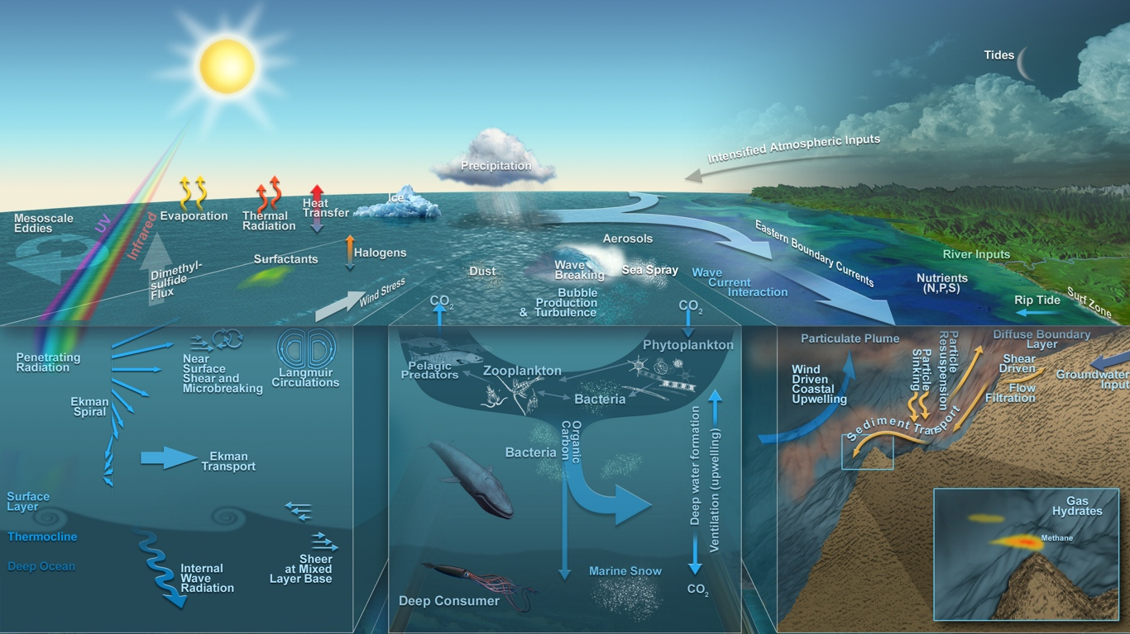




Marine systems are multi-use and complex
Thanks to the Neptune team

