Slide 1
What is a model?
What is it used for?

Slide 2
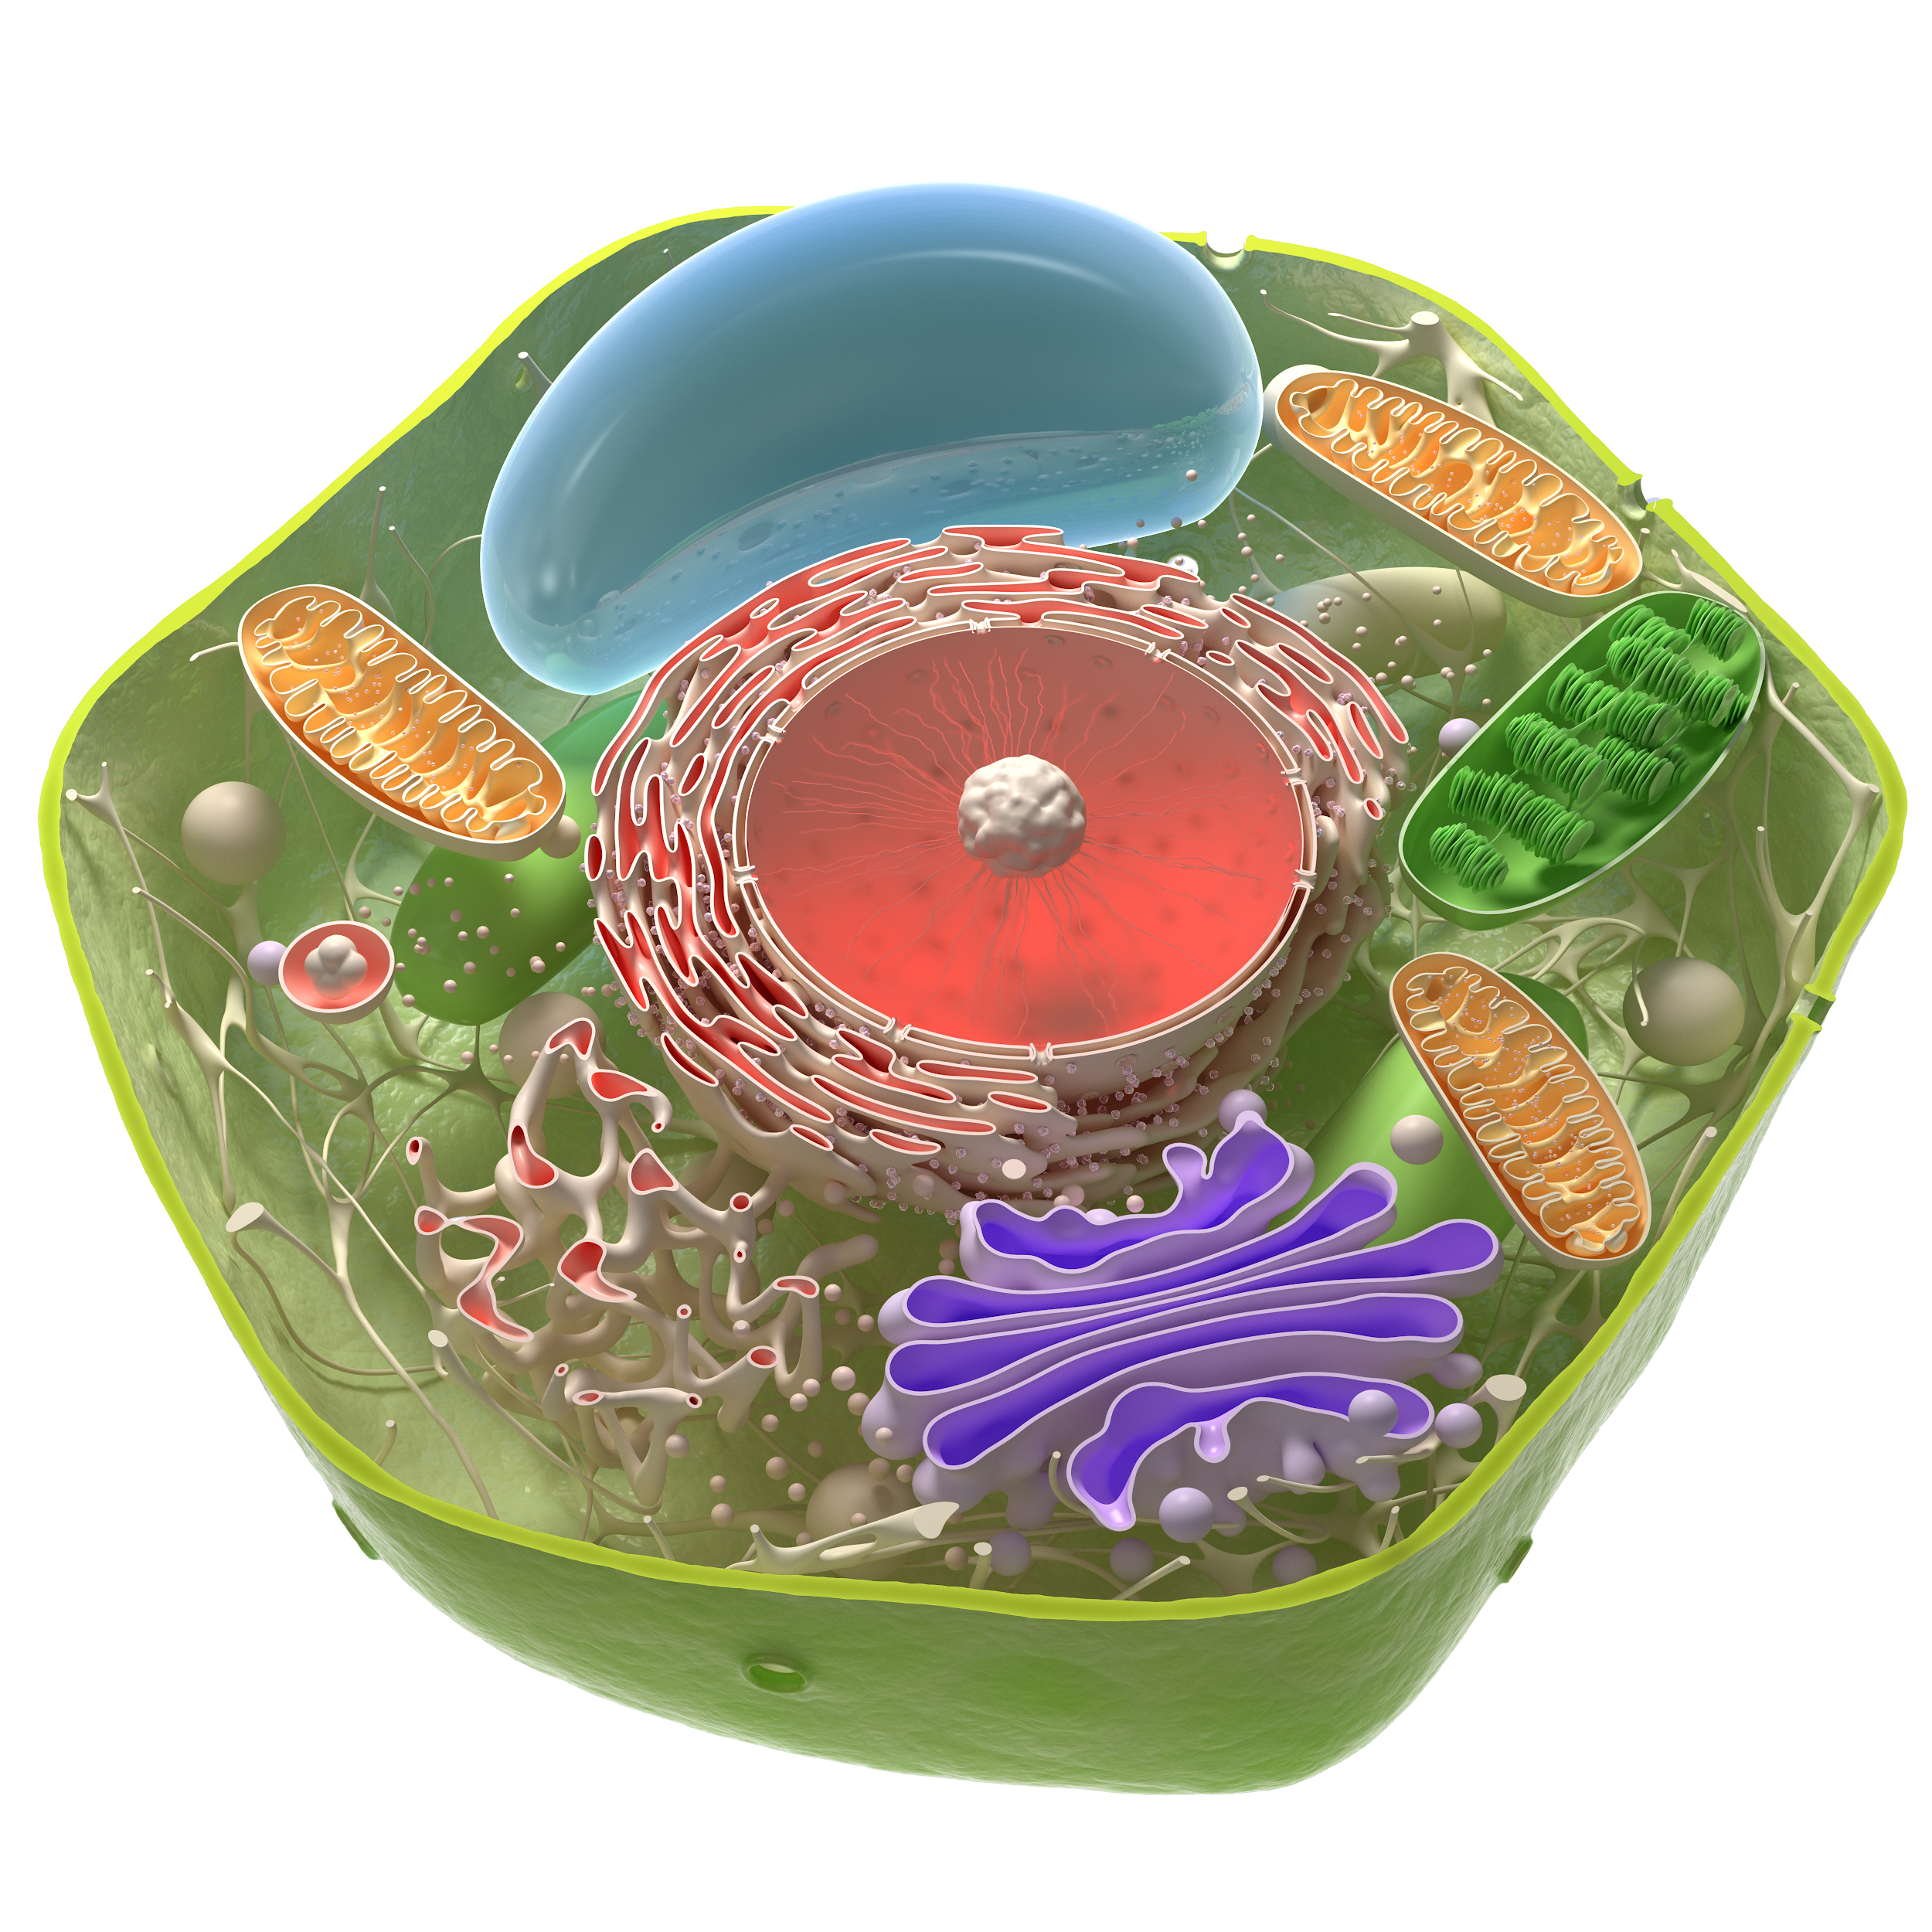
Is this a model?
Notes:
Teacher asks--What can you learn from this model?

Slide 3
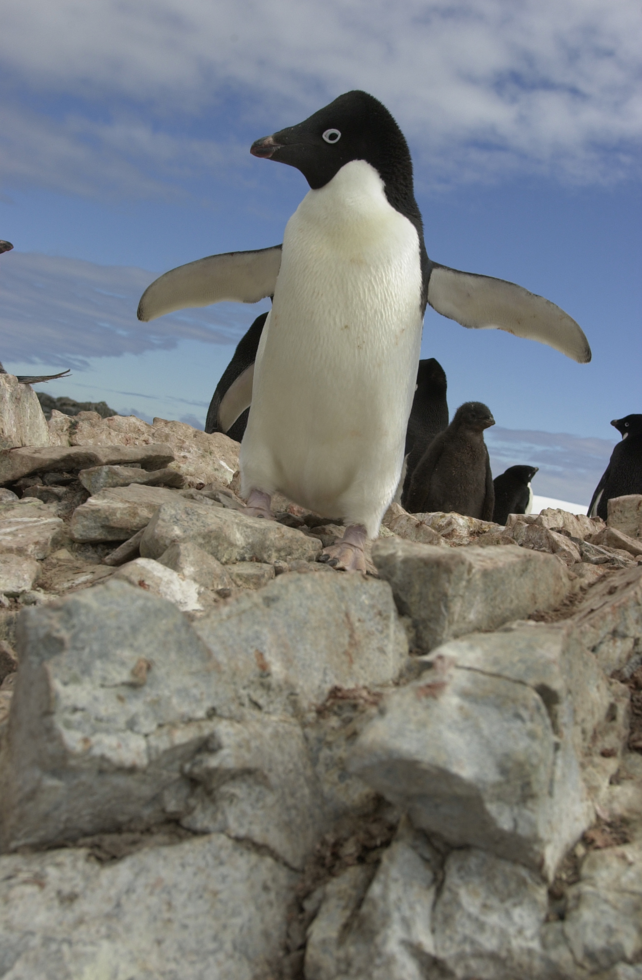
Is this a model?
Notes:
Teacher asks: What can you learn from this

Slide 4
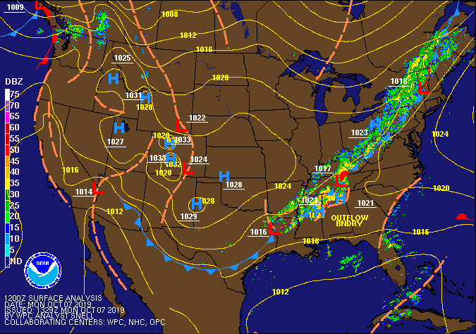
Is this a model?
Notes:
Teacher asks: What can you learn from this?

Slide 5
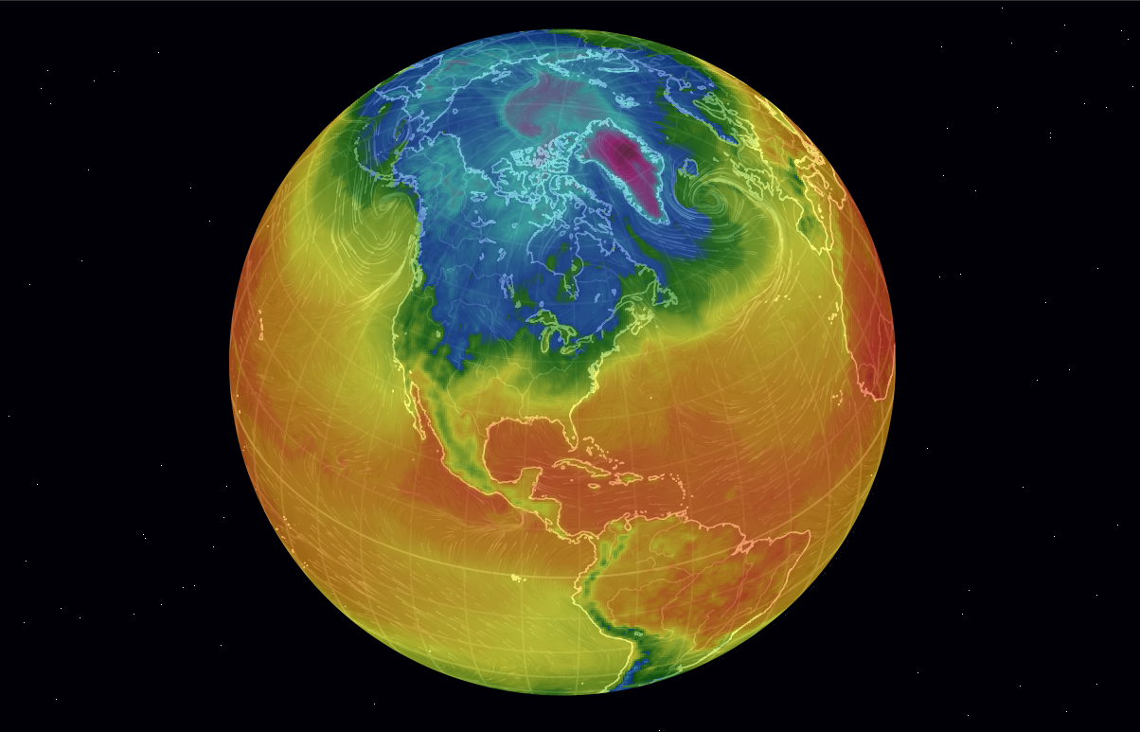
Is this a model?
Link to Fluid from Byrd
Notes:
Teacher asks: How does this compare to the previous models? Can you learn more or less?

Slide 6
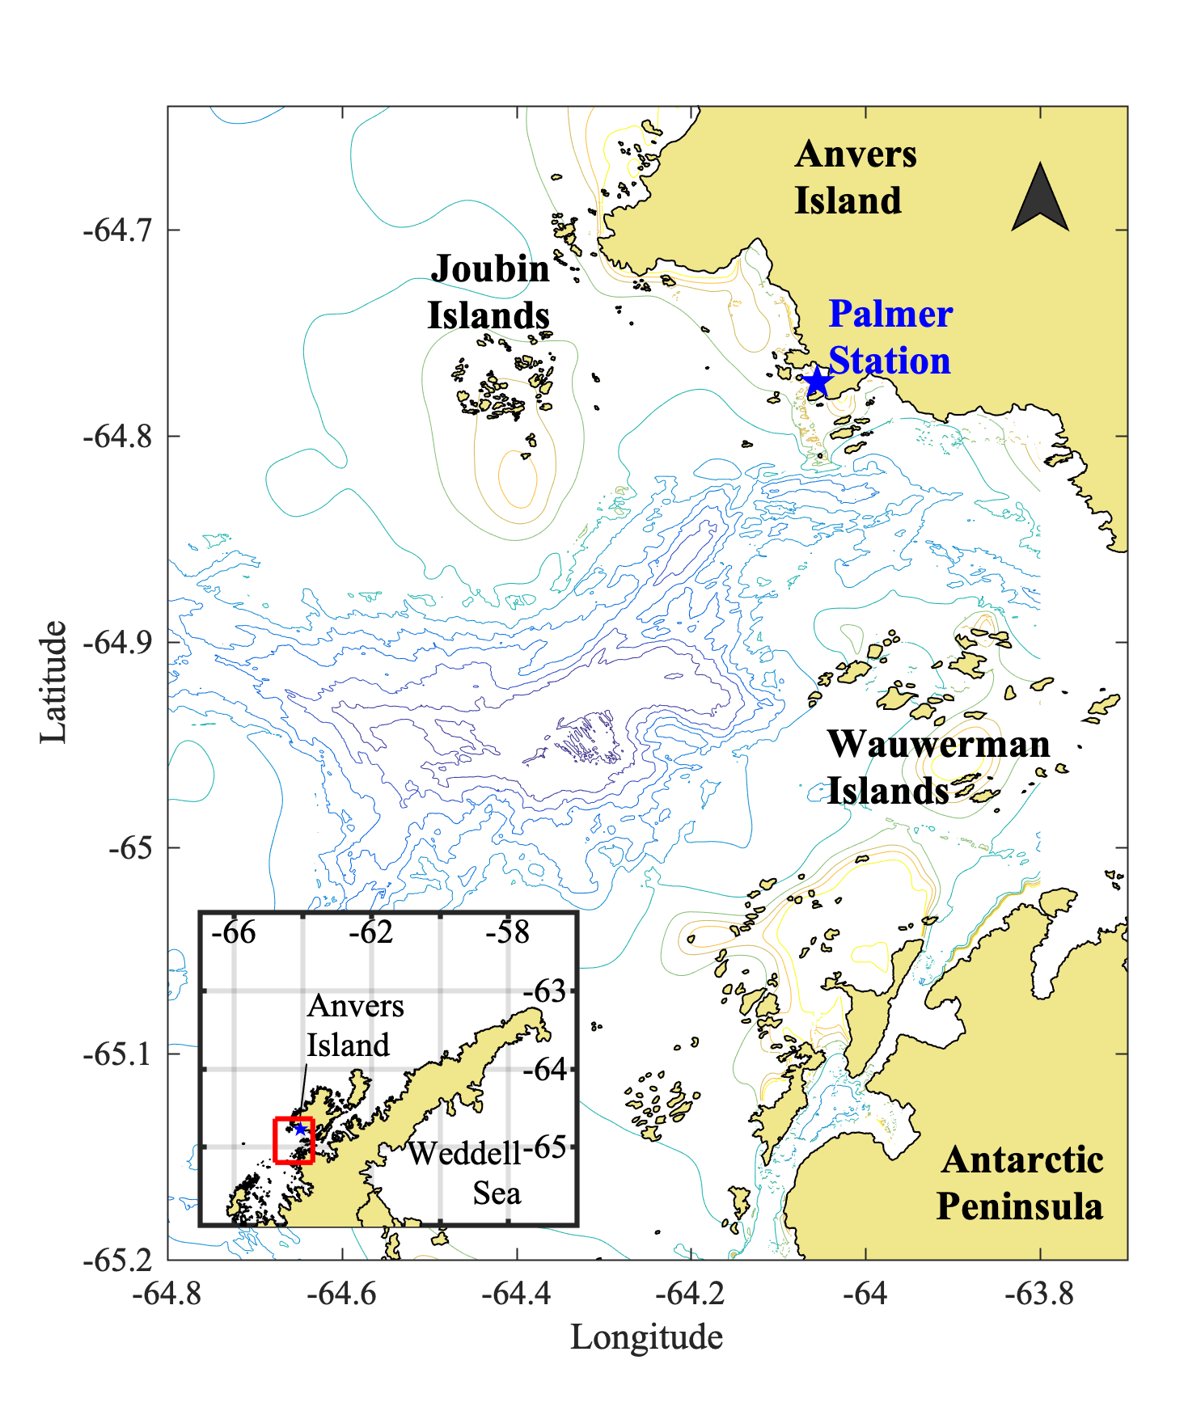
Student Task
Each group will look at a model that shows an abiotic factor of the Antarctic Ocean around Palmer Station
All group members will read the Primer for your model(s) to understand what is being displayed
Group will record their observations on “observation slide”
Group will share with the class
Notes:
Teacher may want to introduce the idea of a surface model and a cross section model (Can use the analogy of a cake--the surface is the frosting on the outside, while the cross section would require that you cut a piece of cake)

Slide 7
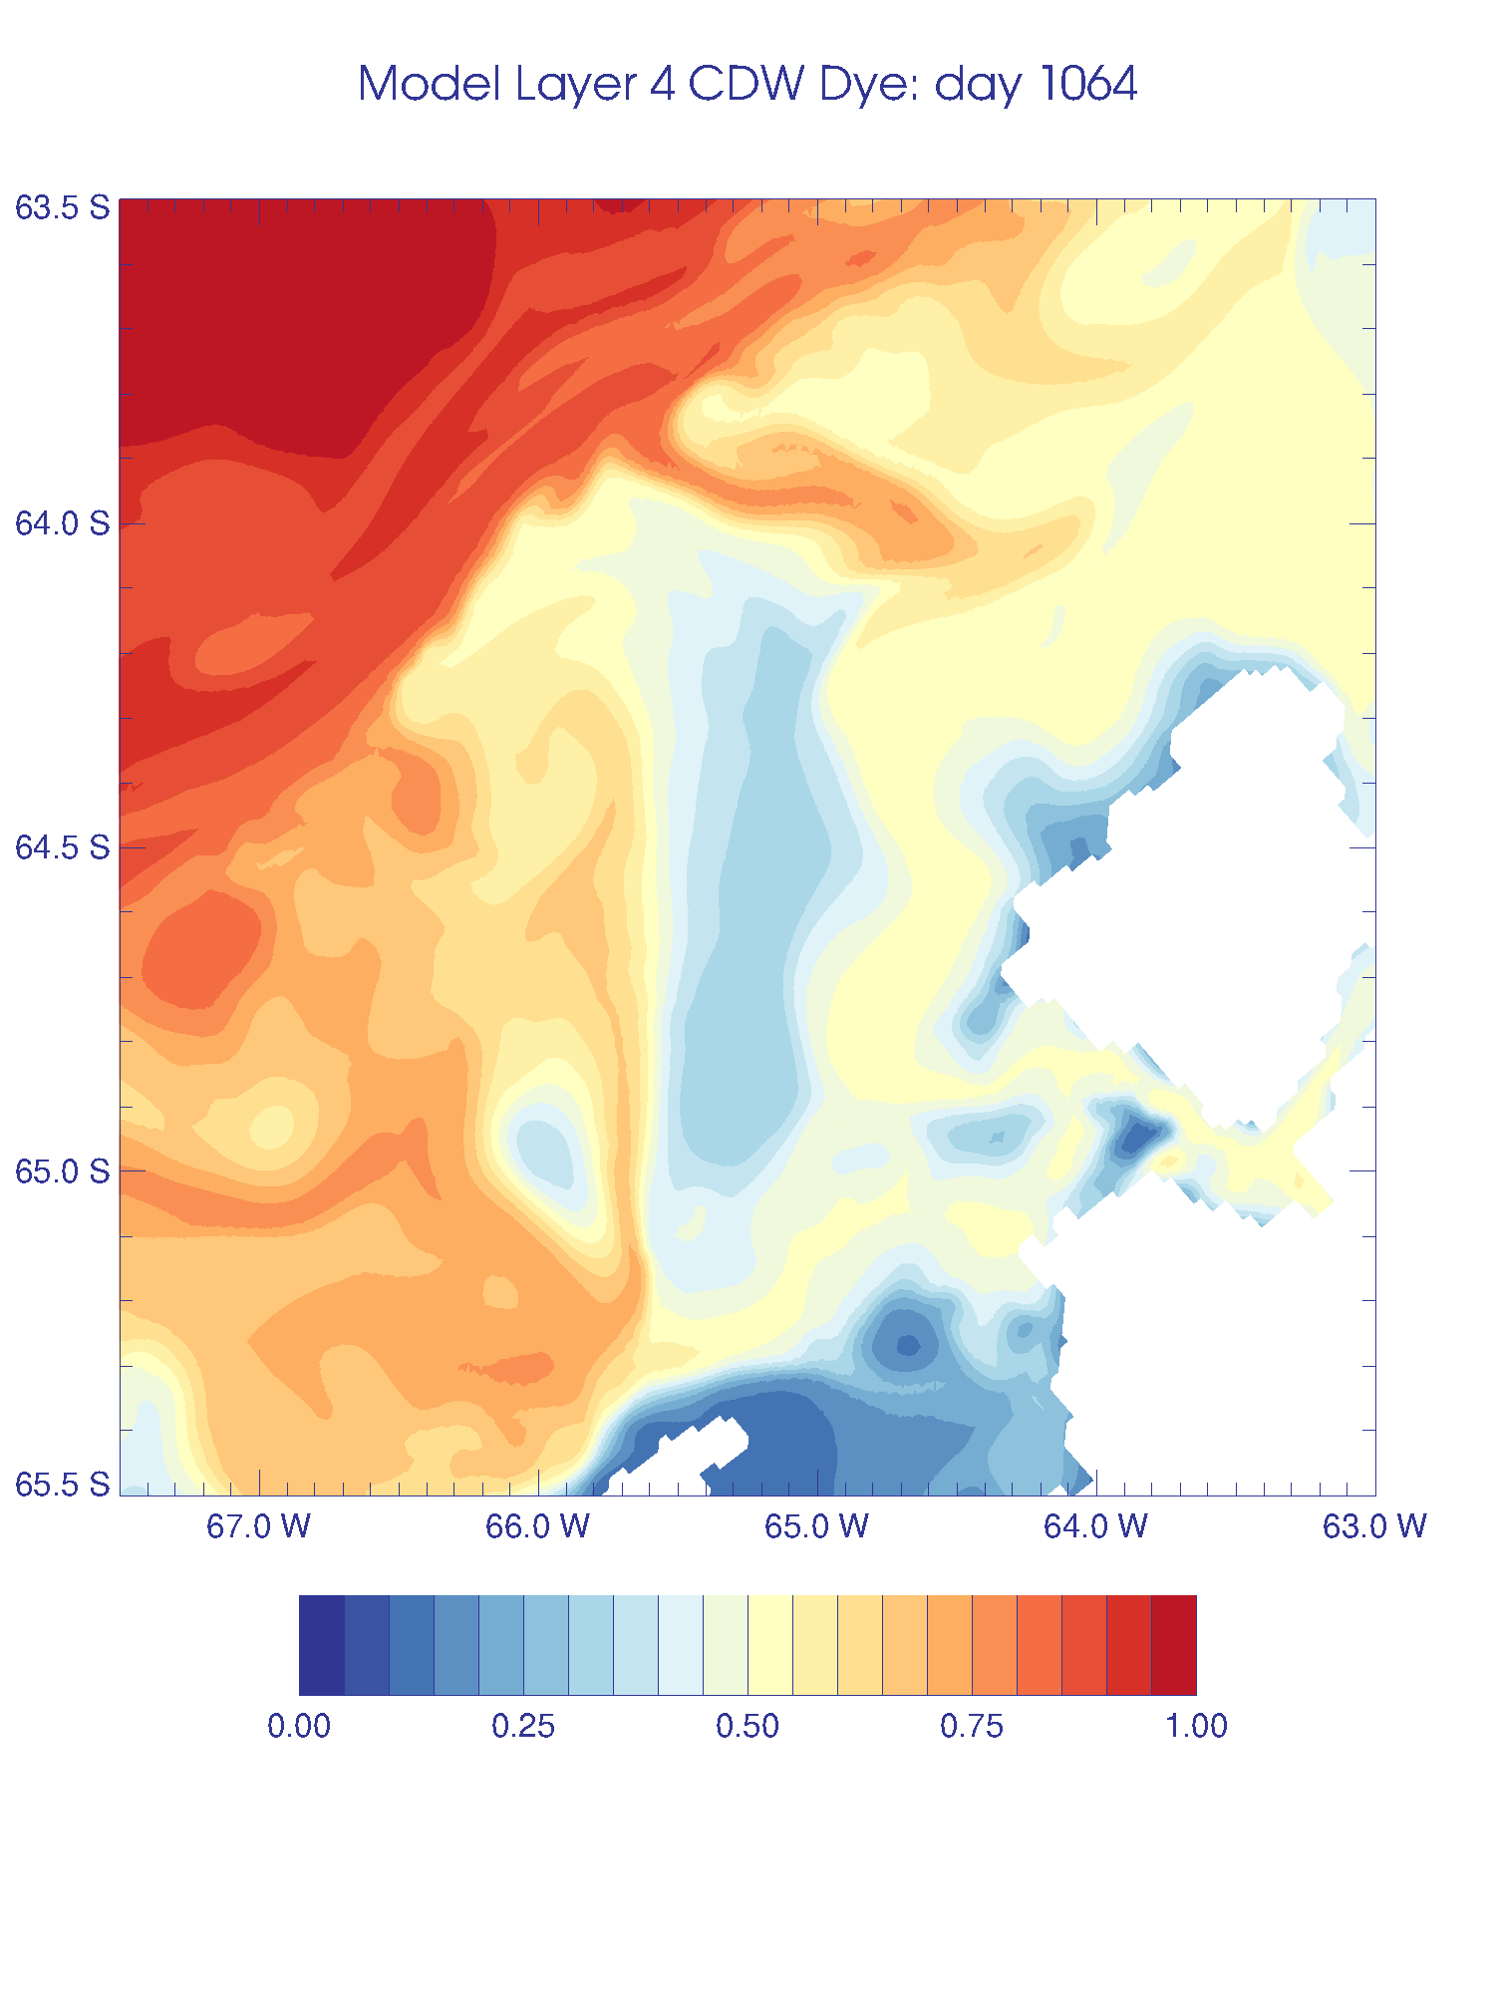
Modeled Upper Circumpolar Deep Water (UCDW) Concentration
Group 1
Anvers
Island
Palmer Station
Palmer Deep
Canyon
Less UCDW More UCDW

Slide 8
Group #1 Observations
https://docs.google.com/document/d/1tLlX0d8xJYQ_MmimBx4wV5wEUY8-BFgolK3gutXRIaU/edit
Jackie’s class notes

Slide 9
Group #2
Salinity Model Surface and Cross Section

Slide 10
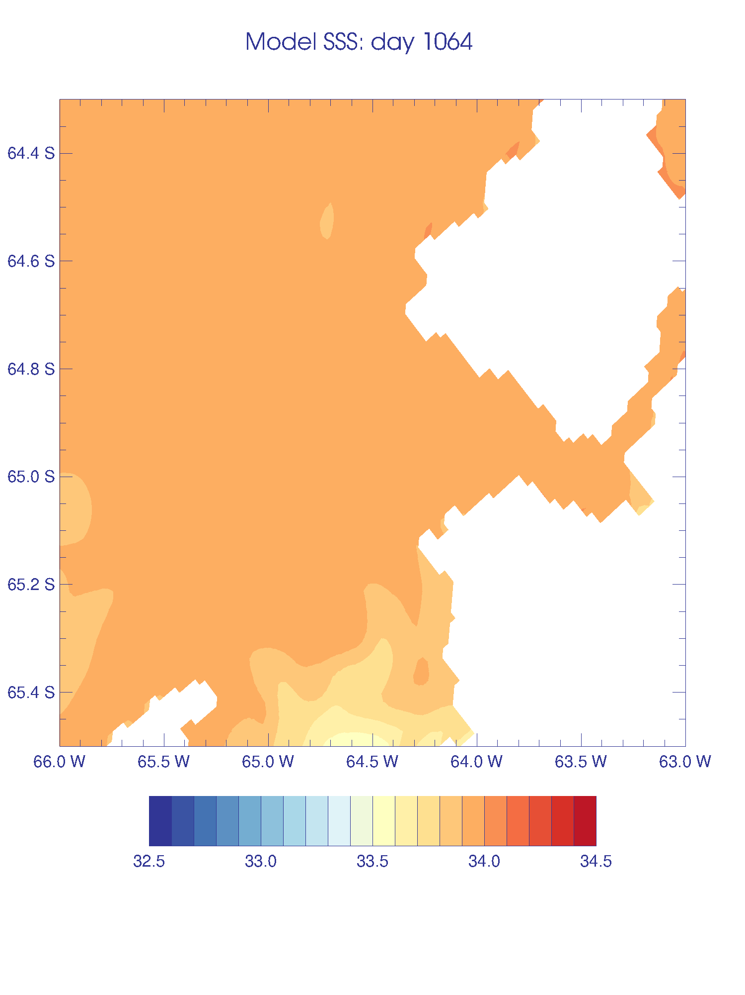
Surface Salinity (psu)
Anvers
Island
Palmer Station
Palmer Deep
Canyon
Salinity (psu)

Slide 11
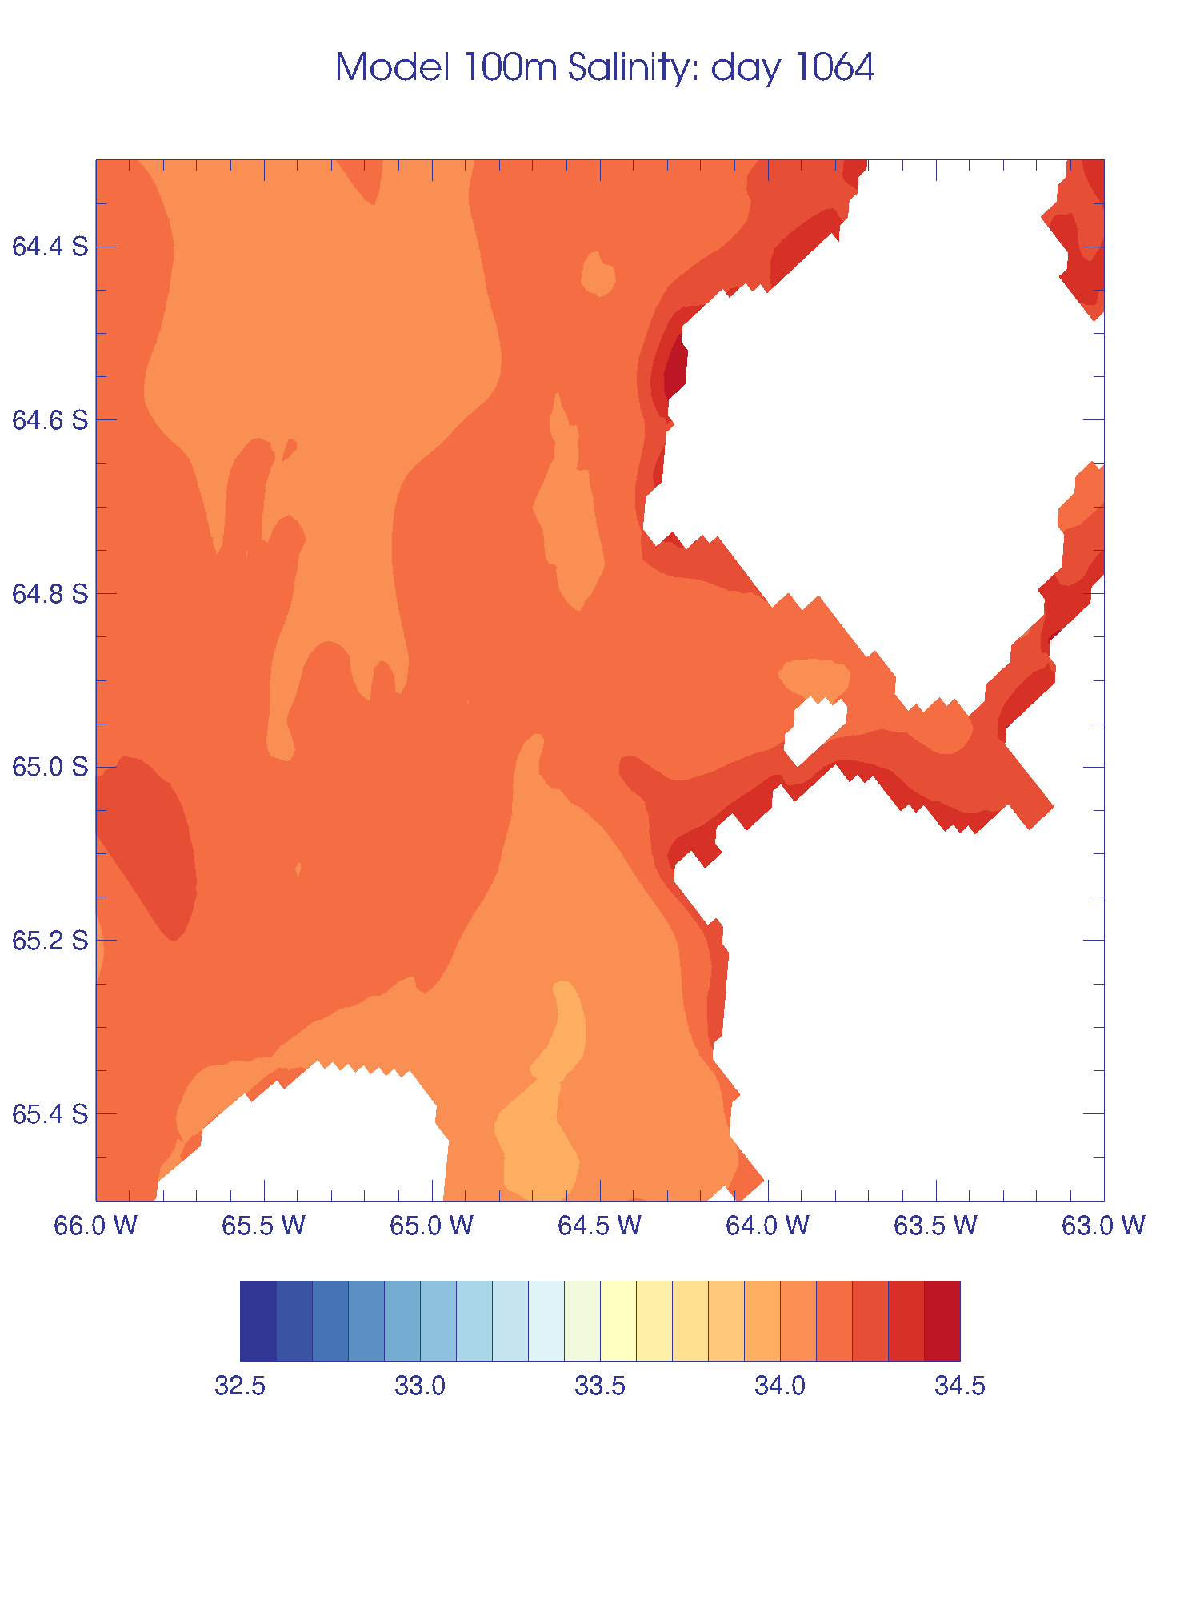
Salinity – 100m Deep (psu)
Anvers
Island
Palmer Station
Palmer Deep
Canyon
Salinity (psu)

Slide 12
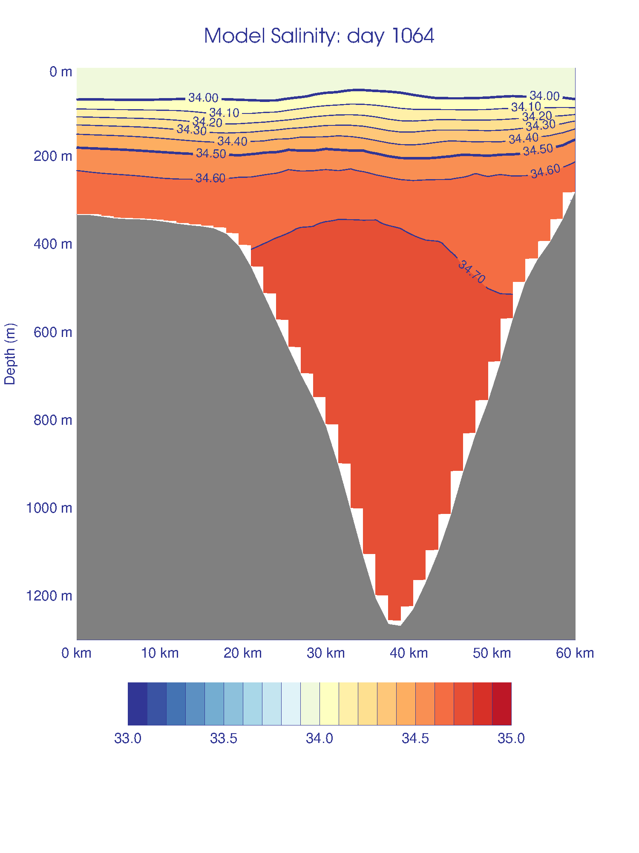
Salinity Cross Section (psu)
Ocean Surface
Palmer Deep
Canyon
Salinity (psu)

Slide 13
Group #2 Observations

Slide 14
Group #3
Temperature Model Surface and Cross Section

Slide 15
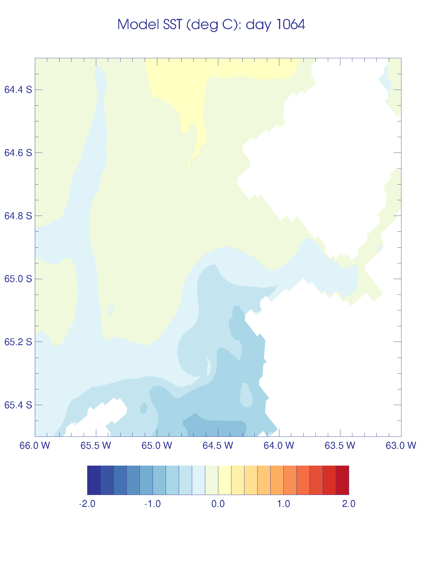
Surface Temperature (ºC)
Anvers
Island
Palmer Station
Palmer Deep
Canyon
Temperature (ºC)

Slide 16
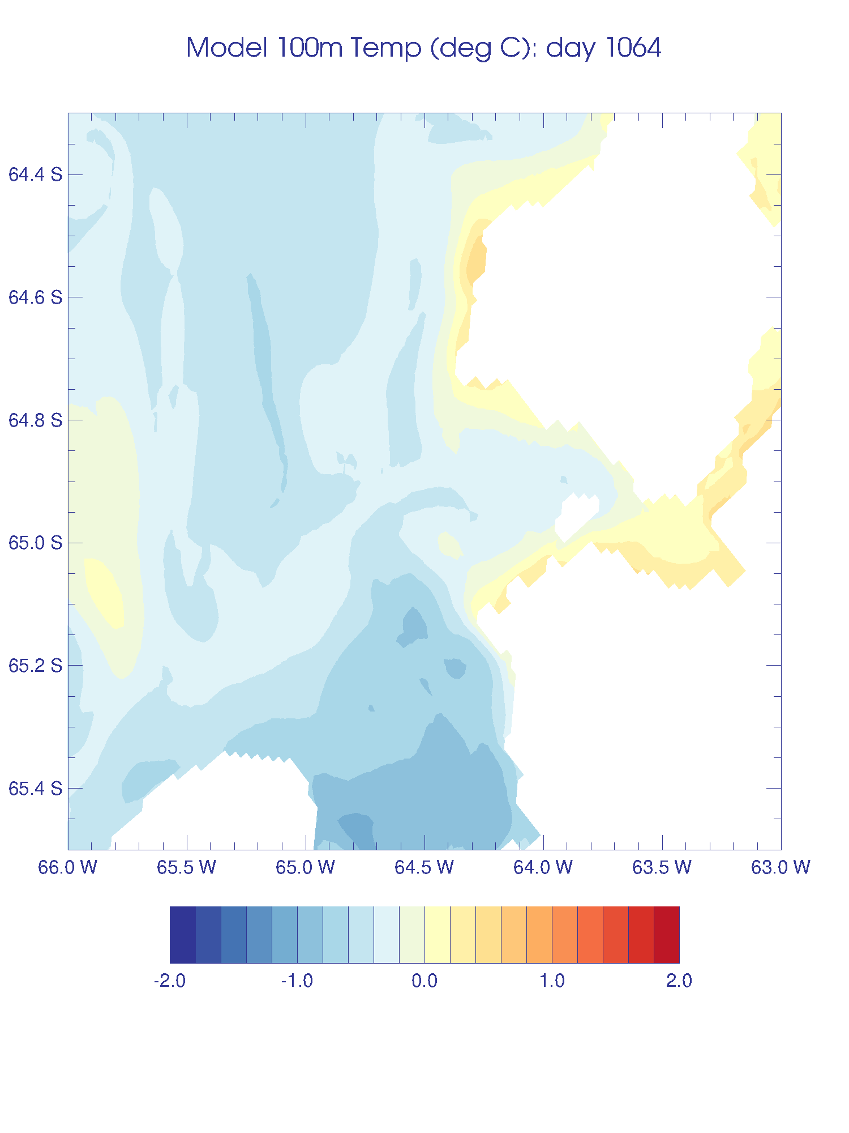
Temperature – 100m Deep (ºC)
Anvers
Island
Palmer Station
Palmer Deep
Canyon
Temperature (ºC)

Slide 17
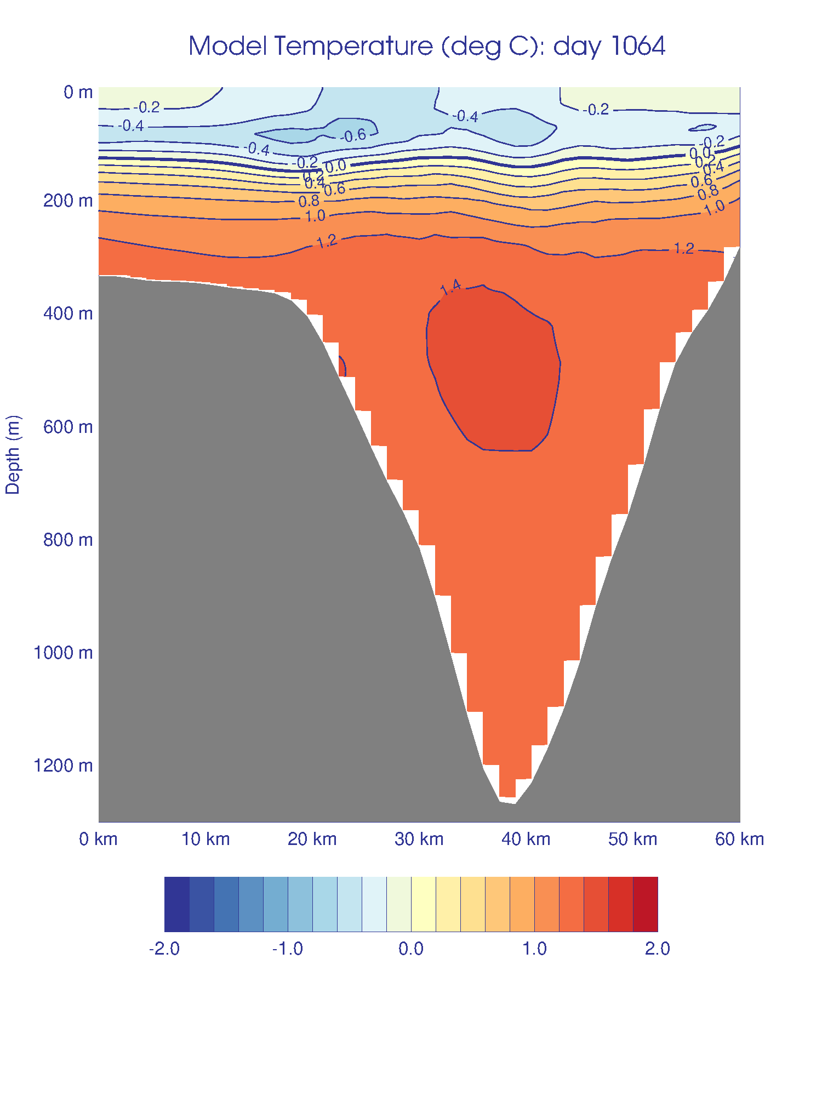
Temperature Cross Section (ºC)
Ocean Surface
Palmer Deep
Canyon
Temperature (ºC)

Slide 18
Group #3 Observations

Slide 19
Group #4
Vectors at 20 and 100m

Slide 20
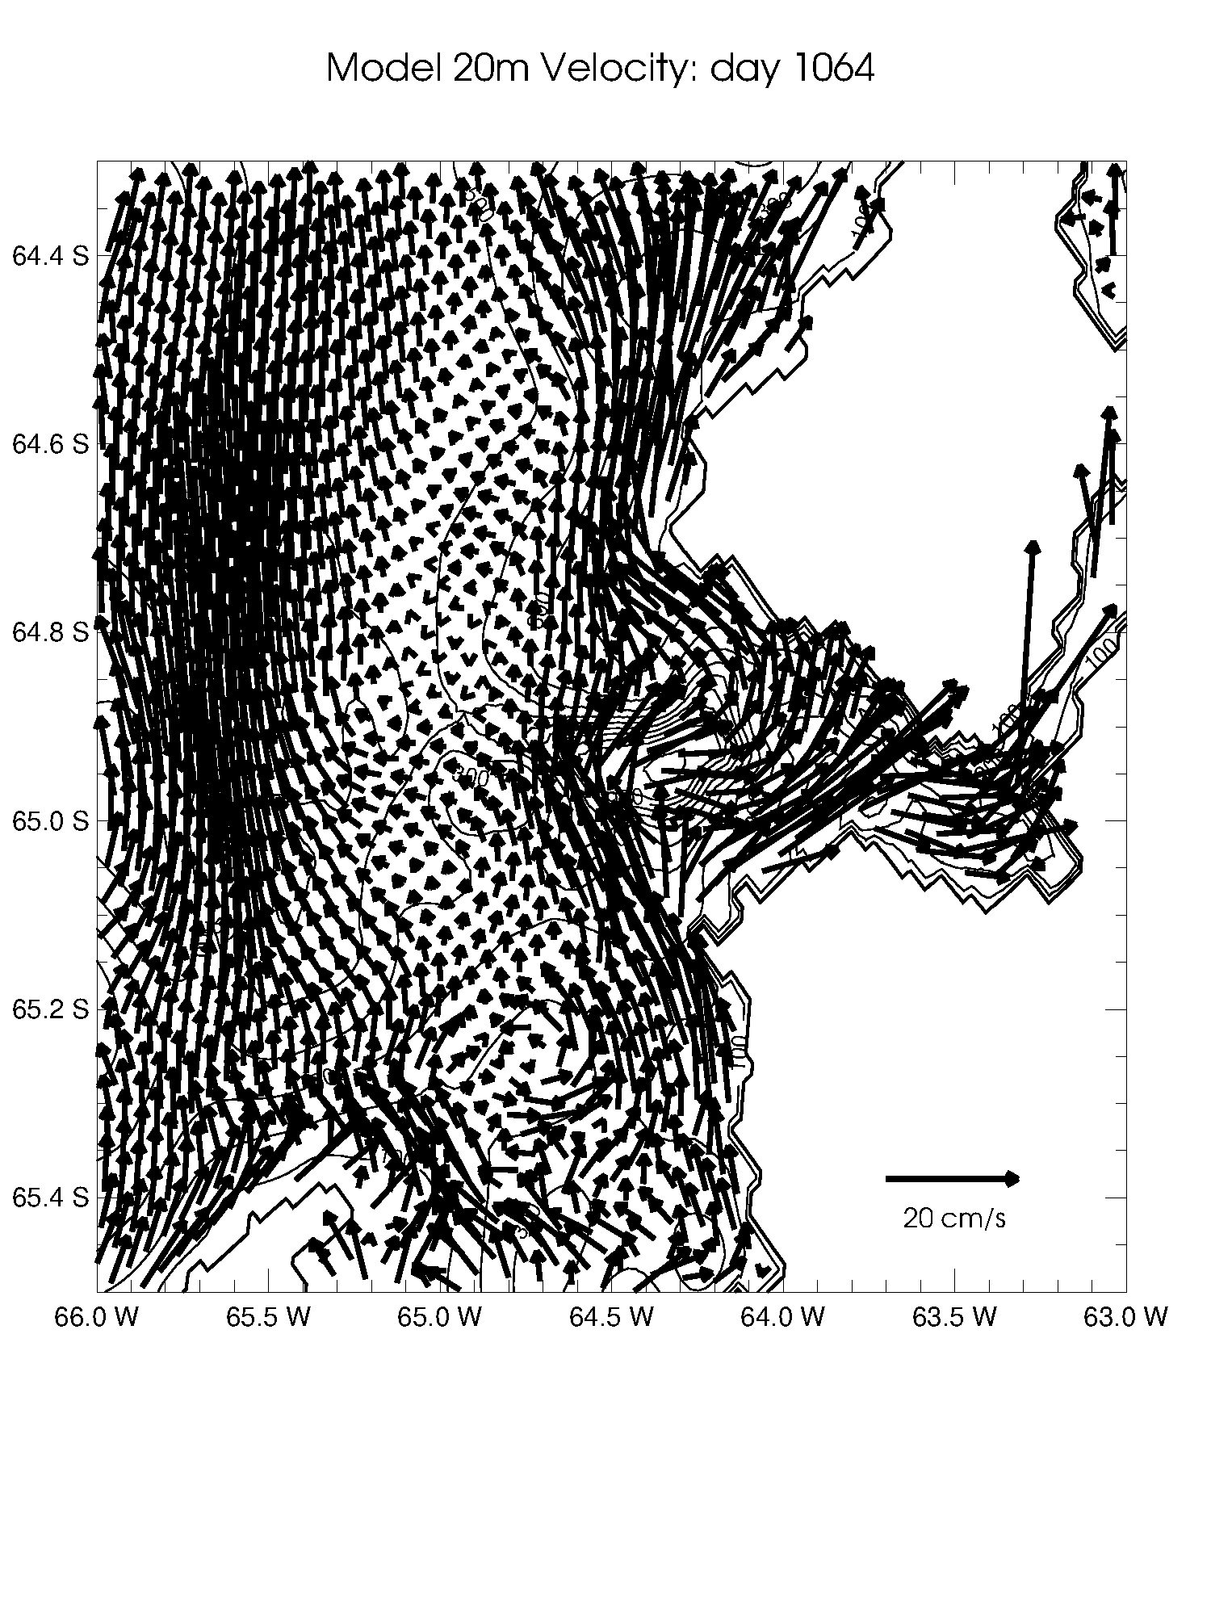
Velocity – 20 m deep (cm/s)
Anvers
Island
Palmer Station
Palmer Deep
Canyon
Velocity

Slide 21
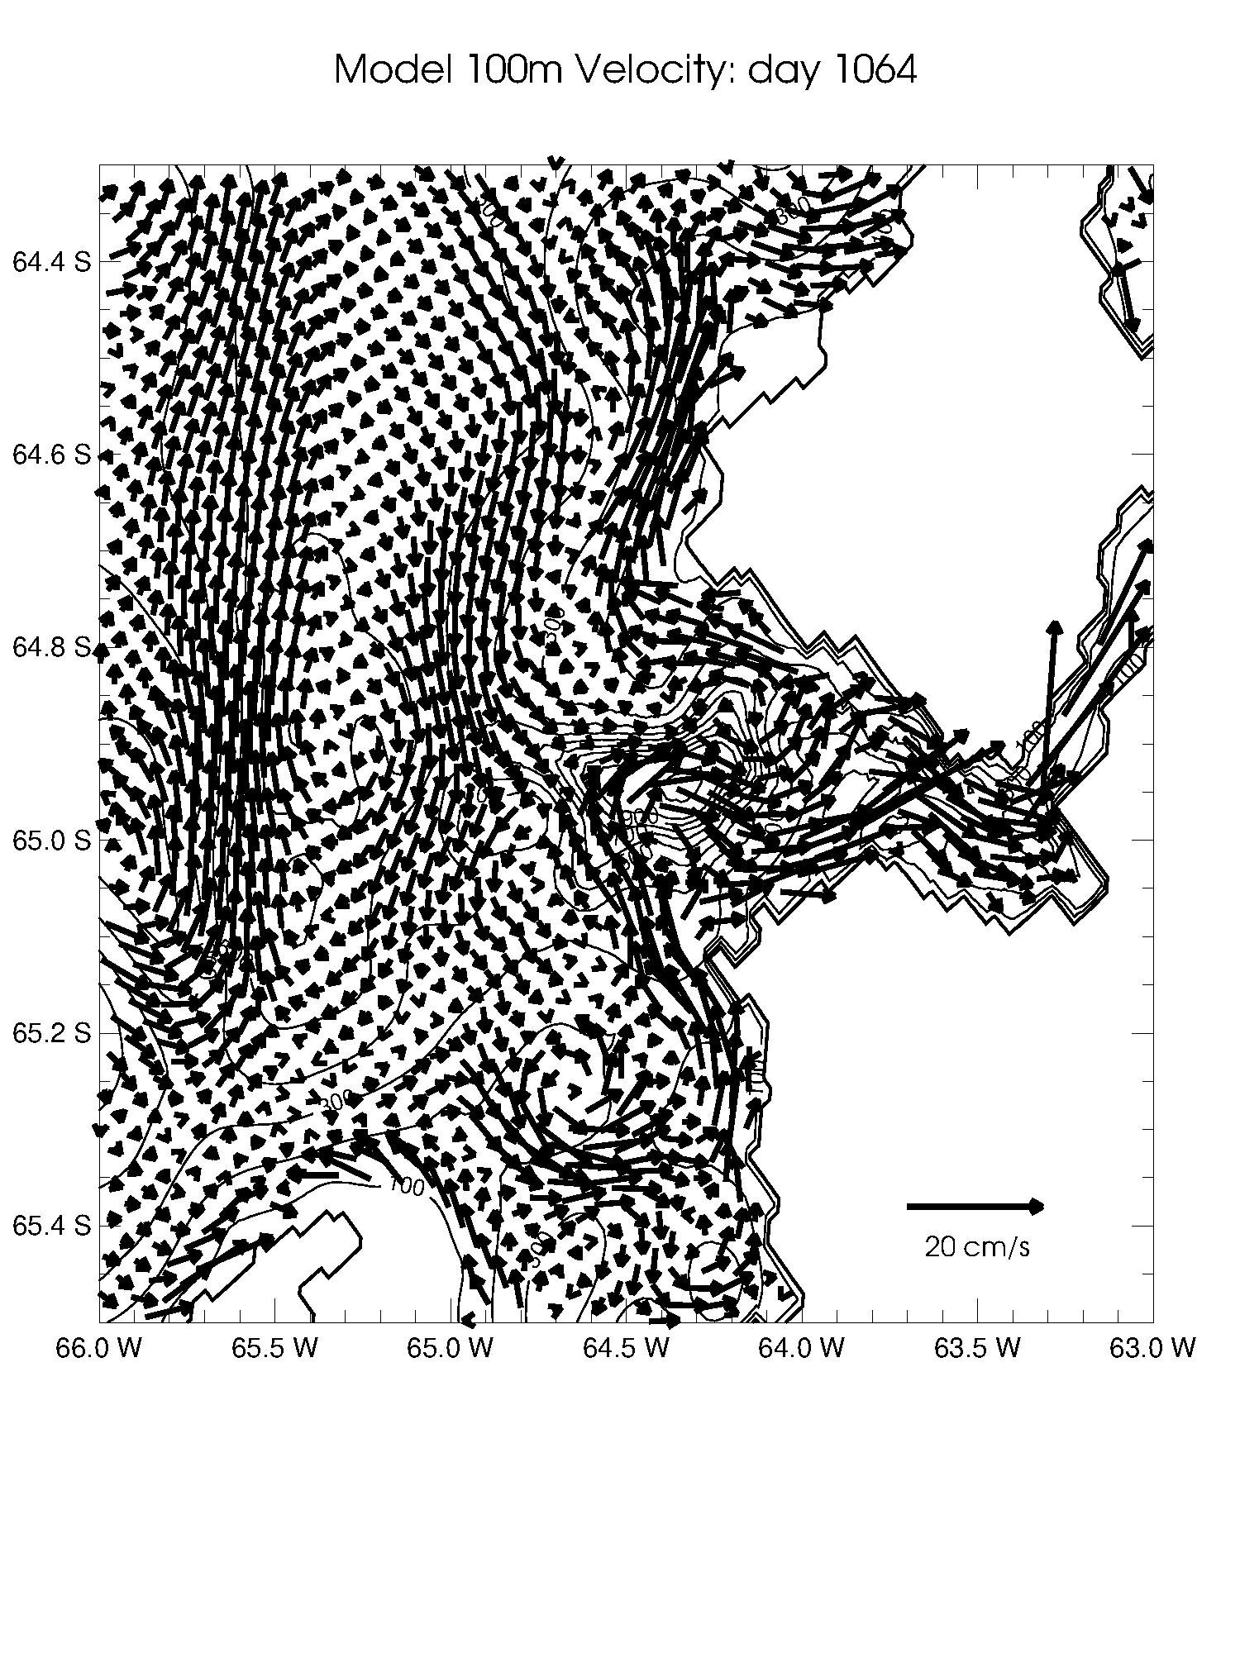
Velocity – 100 m deep (cm/s)
Anvers
Island
Palmer Station
Palmer Deep
Canyon
Velocity

Slide 22
Group #4 Observations

Slide 23
Group #5
Model of SSH

Slide 24
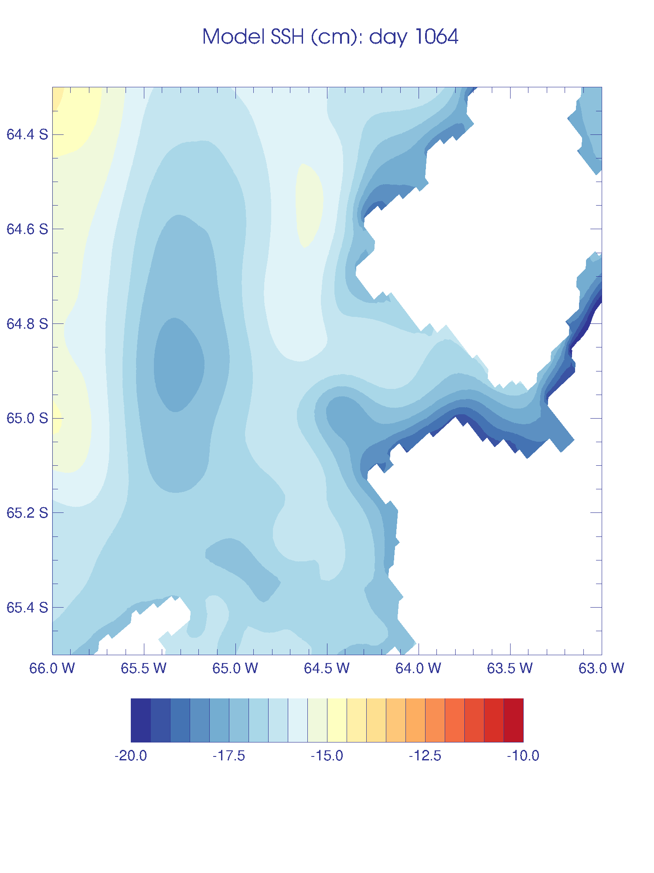
Sea Surface Height (cm)
Anvers
Island
Palmer Station
Palmer Deep
Canyon
Sea Surface Height (cm)

Slide 25
Group #5 Observations
Notes:
After sharing observations, discuss with the class what can be learned from a model and what makes a good model
What might be the value of a dynamic model rather than a static model?

Slide 26
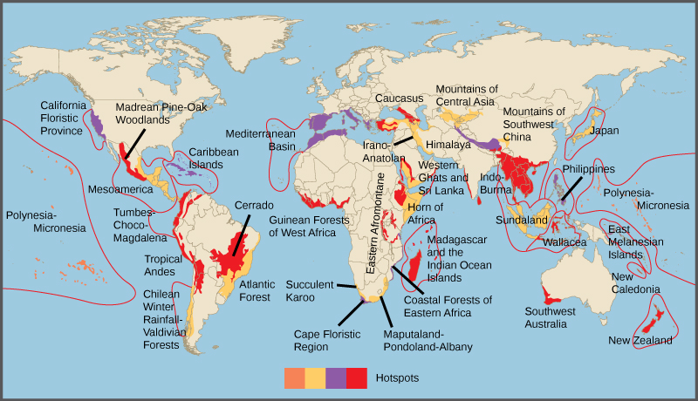
What is a biological hotspot ?
Notes:
After a discussion of what each group observed discuss biological hotspot
Teacher asks: Does seeing this map and breaking down the word help you to understand what a biological hotspot is?
Where in the models that you observed do you think there might be a biological hotspot? Pull back up map of Palmer station.
What factors might contribute to the maintenance of this biological hotspot? Why might the Antarctic scientists be interested in this particular location?

