Slide 1
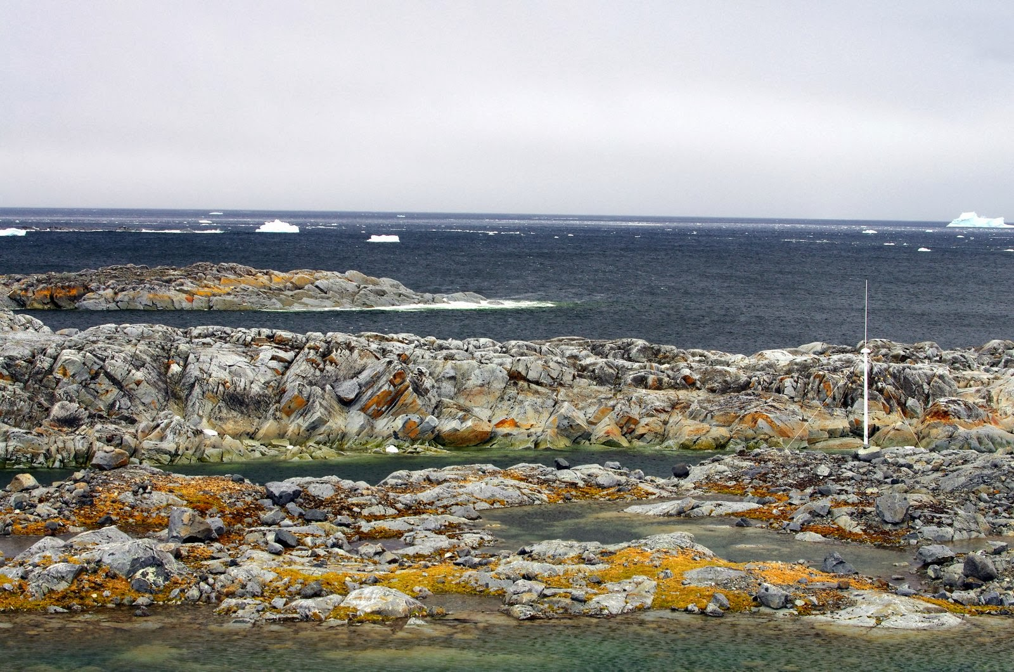

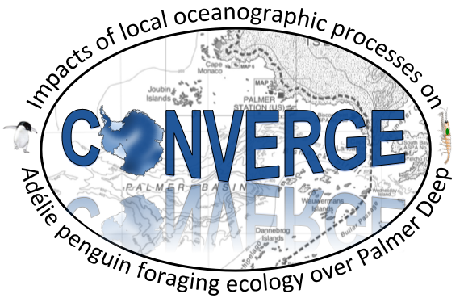
Project CONVERGE:
Impacts of local oceanographic processes on penguin foraging ecology
Josh Kohut, Laura Nazzaro, and Travis Miles
Rutgers University
Kim Bernard
Oregon State University
Bill Fraser and Donna Patterson-Fraser
Polar Oceans Research Group
Matt Oliver
University of Delaware
Megan Cimino
Scripps Institution of Oceanography
Peter Winsor and Hank Statscewich
University of Alaska, Fairbanks
Erick Fredj
Jerusalem College of Technology
In Collaboration with PAL-LTER

Slide 2
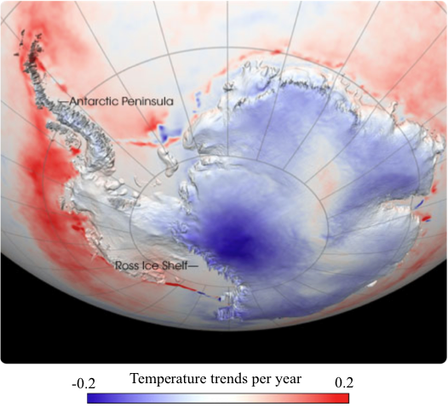
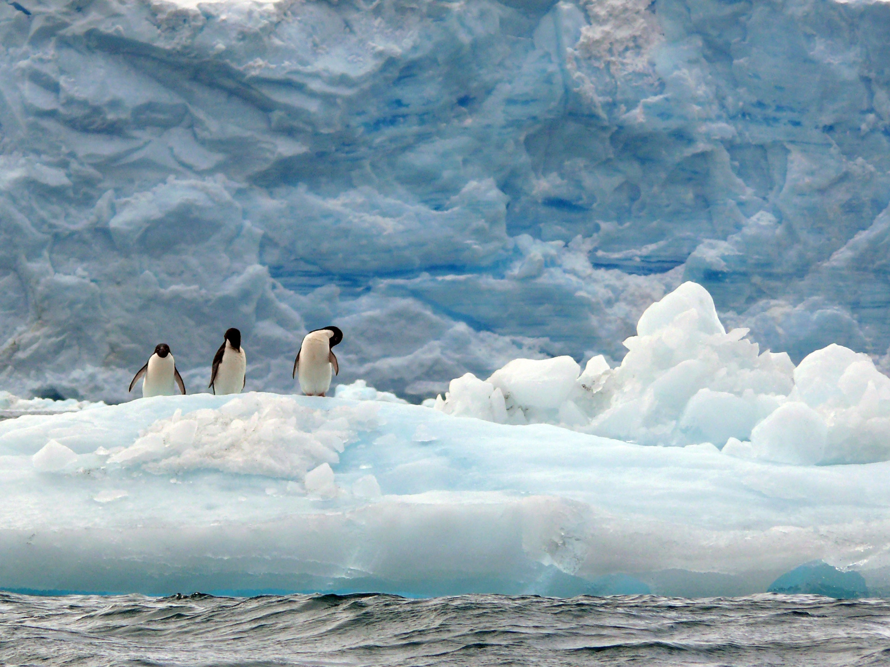
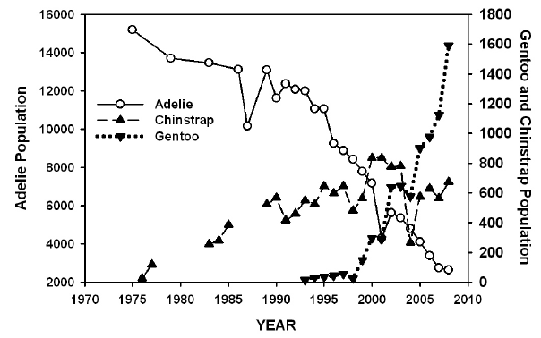
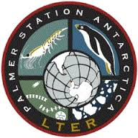

Slide 3
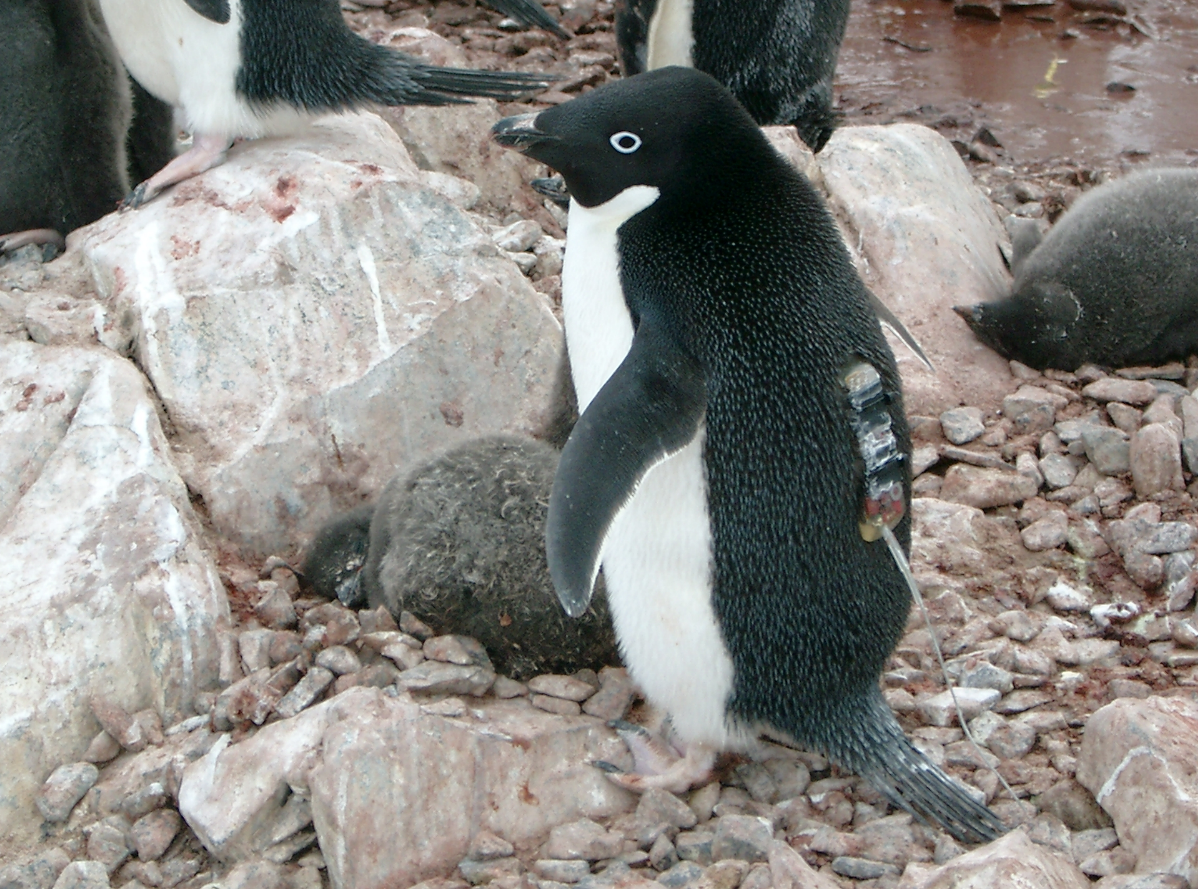
Objectives
H1. Convergence zones in the surface waters within 50 km of the coast shift location between the diurnal and semi-diurnal tidal regime.
H2. These convergence zones concentrate phytoplankton and aggregate schools of krill and subsequently influence the behavior of top predator species between tidal regimes.
To do this we sampled the:
Physics
Primary Producers
Zooplankton
Top Predators
Over semi-diurnal and diurnal tidal regimes.
Diurnal
Semi-Diurnal

Slide 4
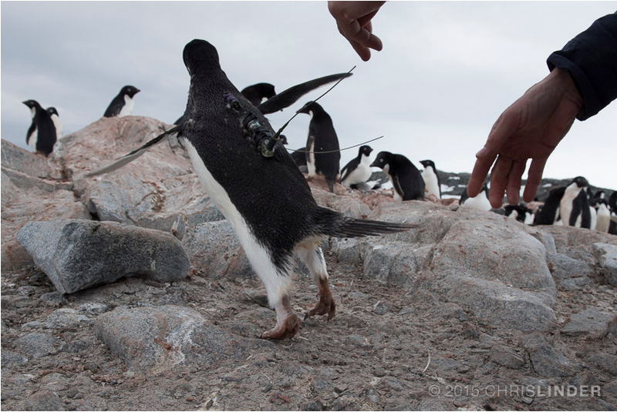
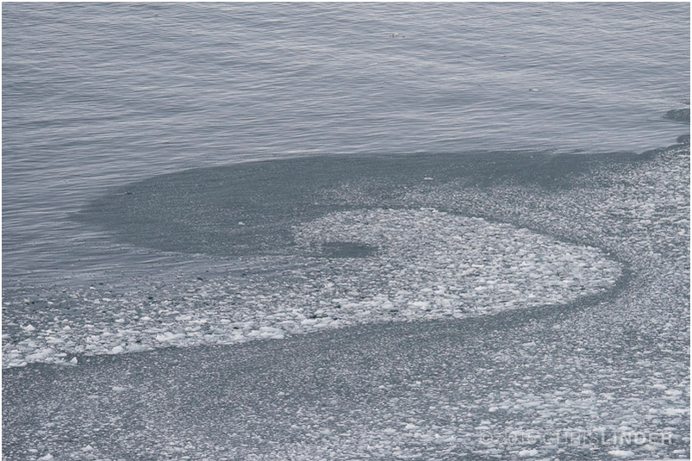
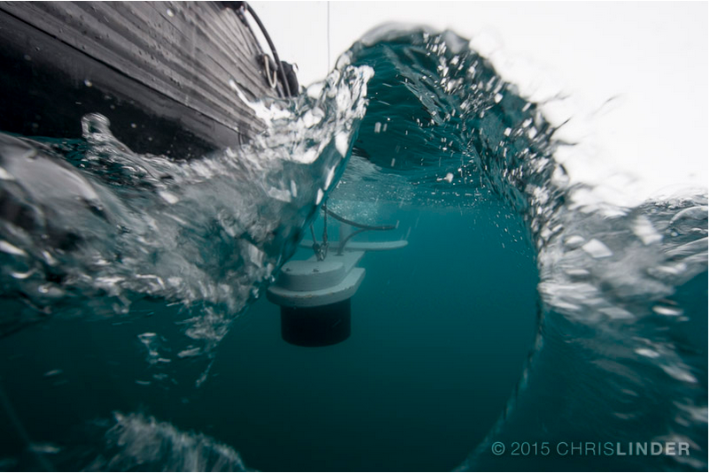
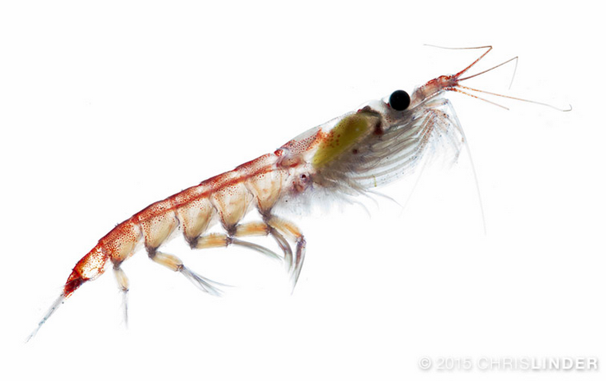
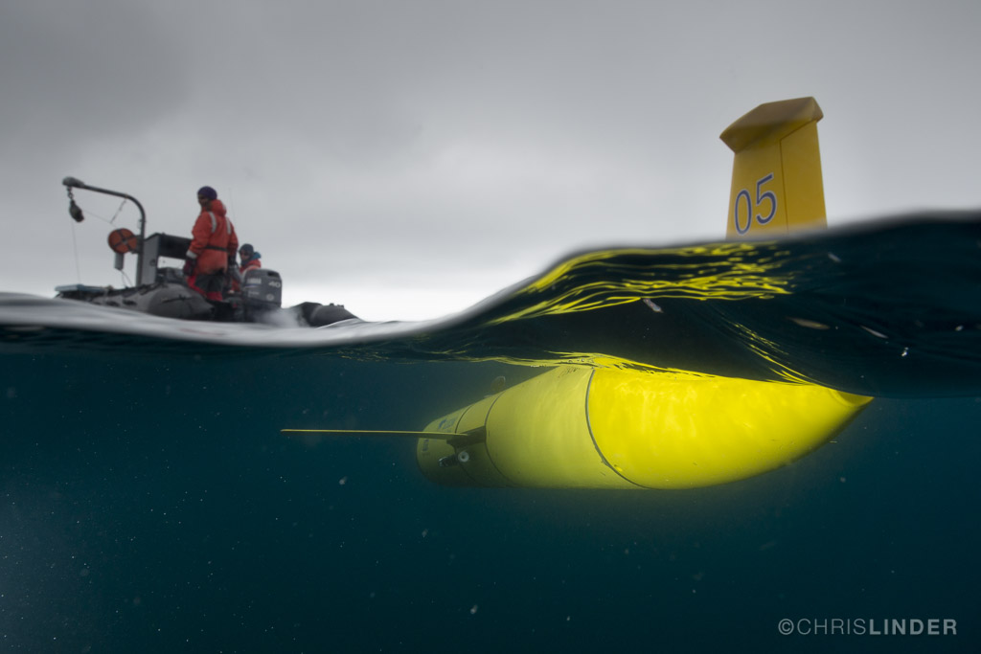
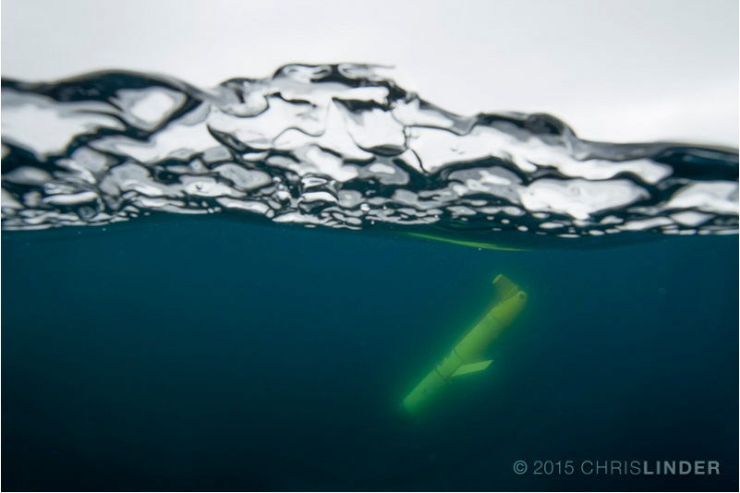
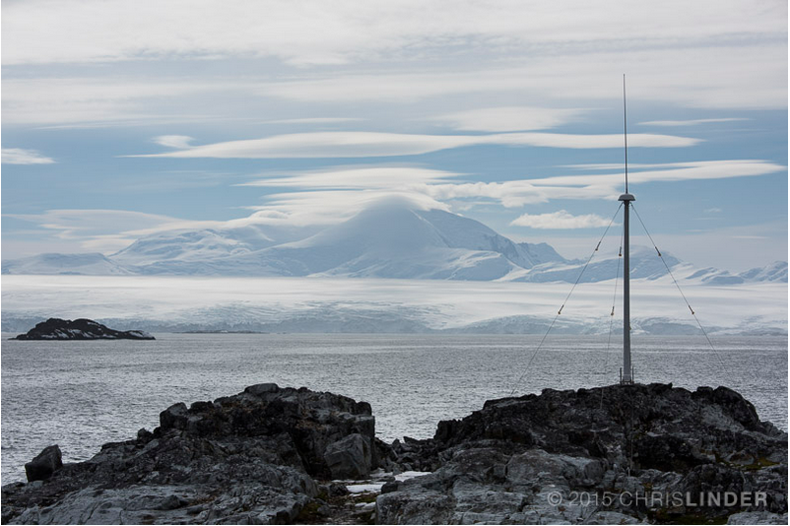
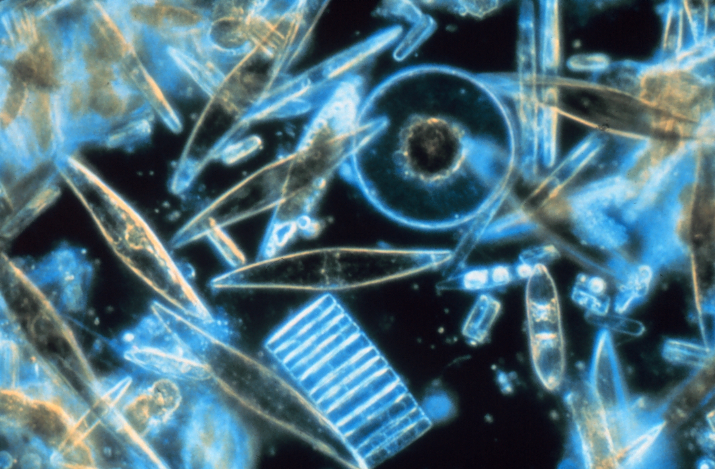
An Integrated Polar Observatory:
Our adaptive Approach

Slide 5
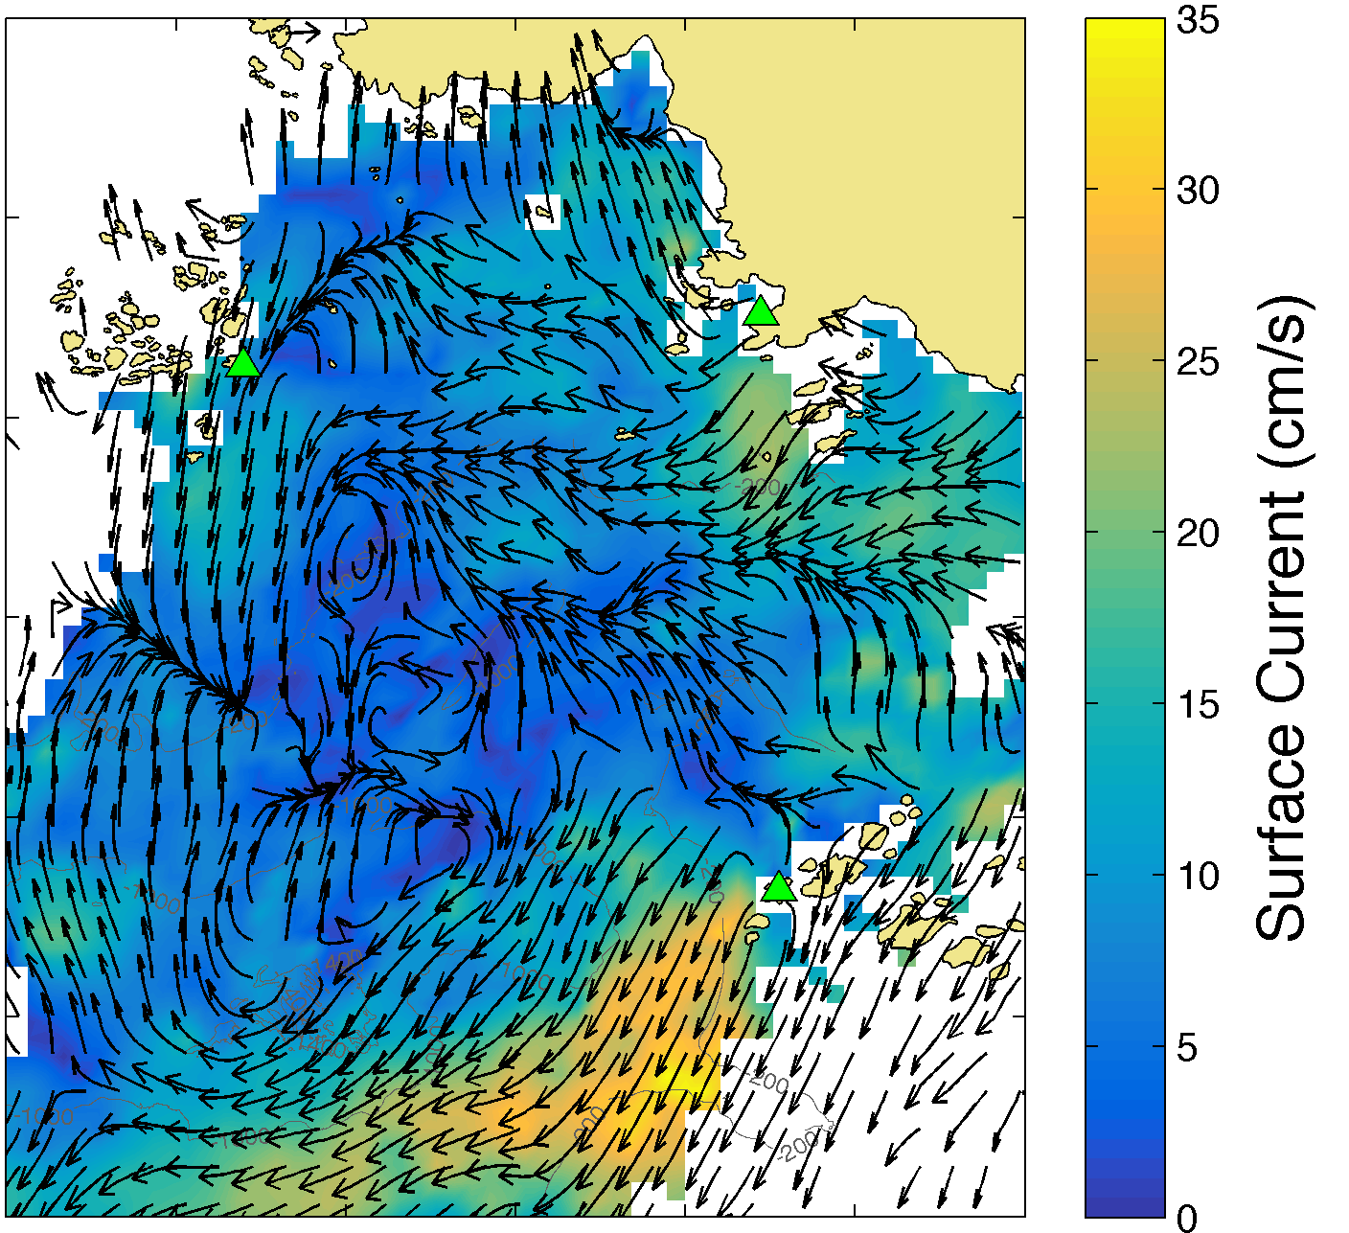
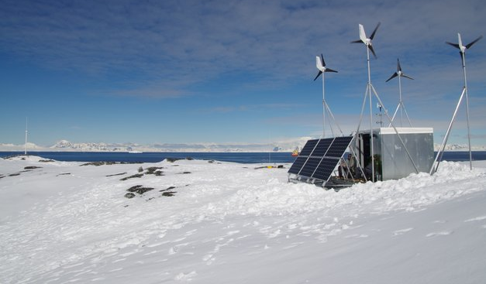
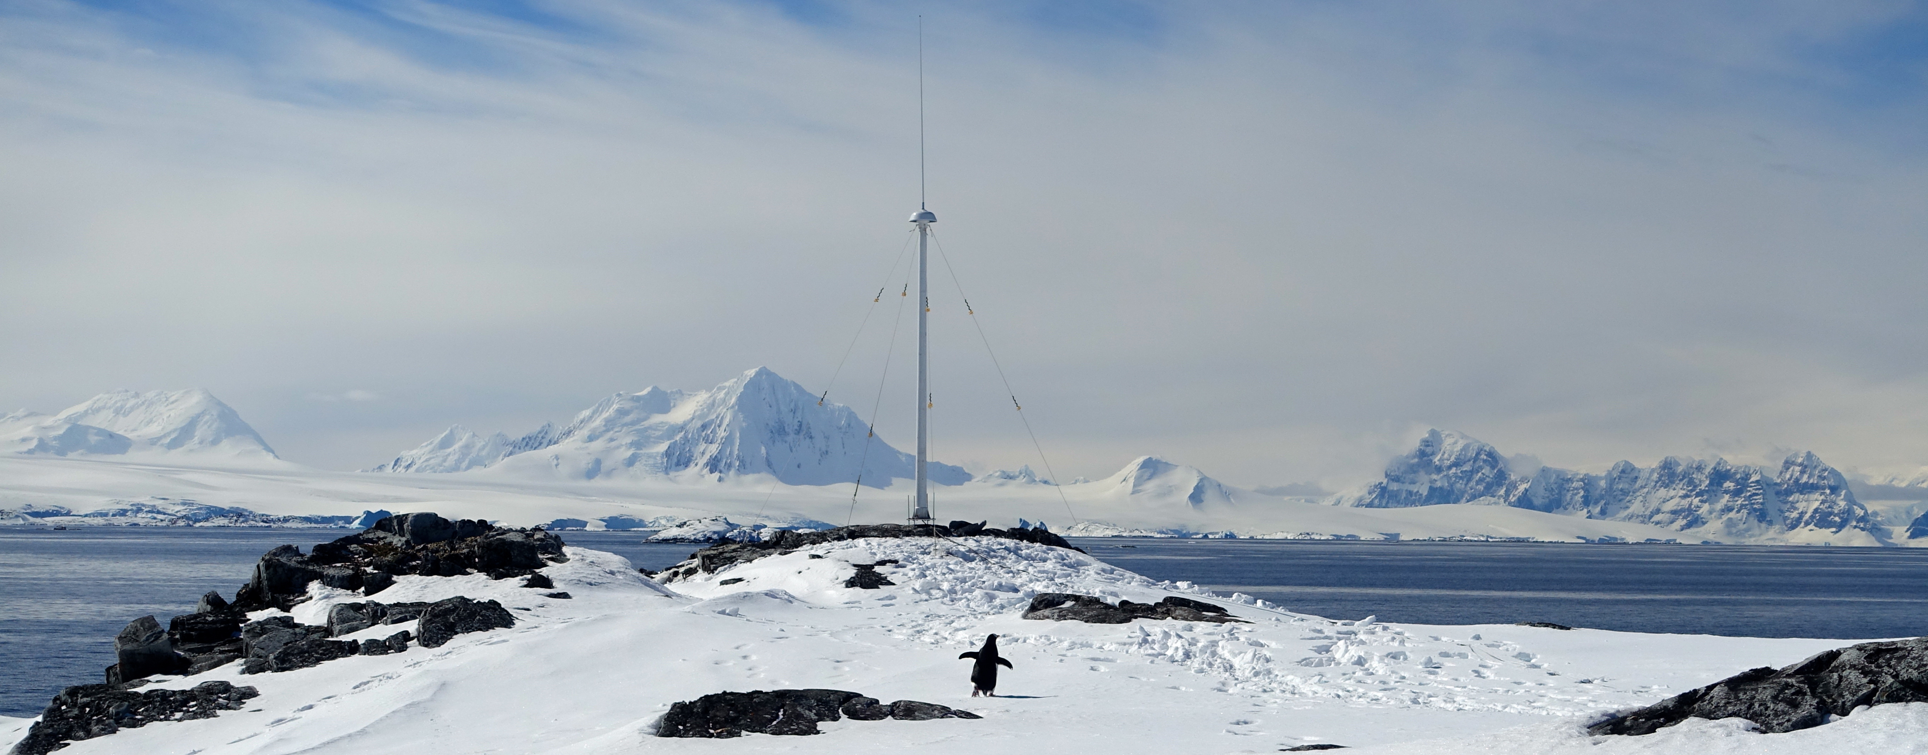
Hourly Surface Current Maps
500 m resolution
3 Site HF Radar Network

Slide 6
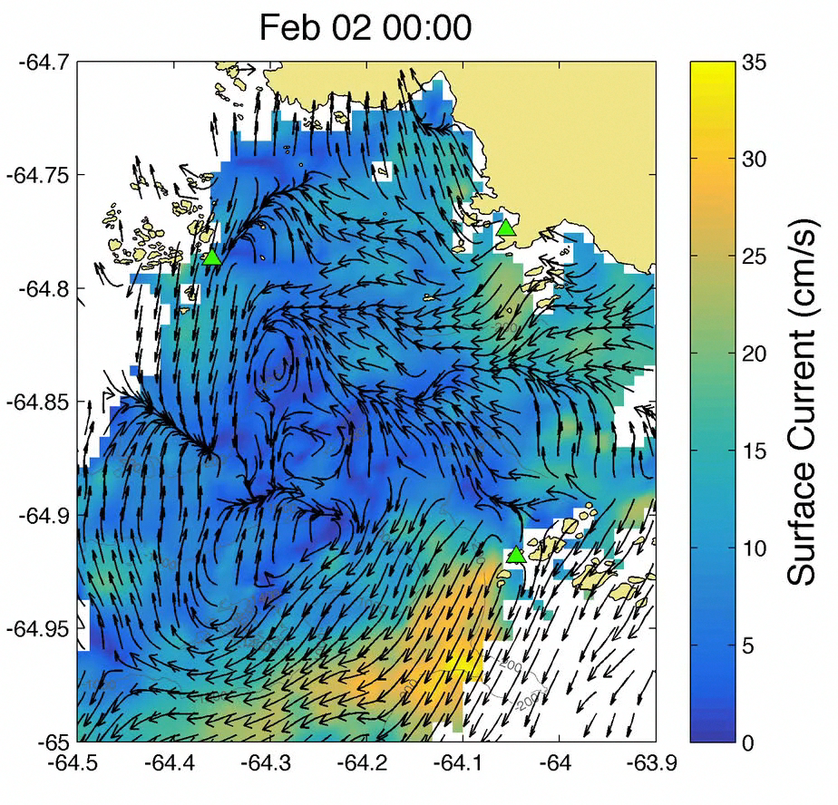
Hourly Surface Current Maps
500 m resolution

Slide 7
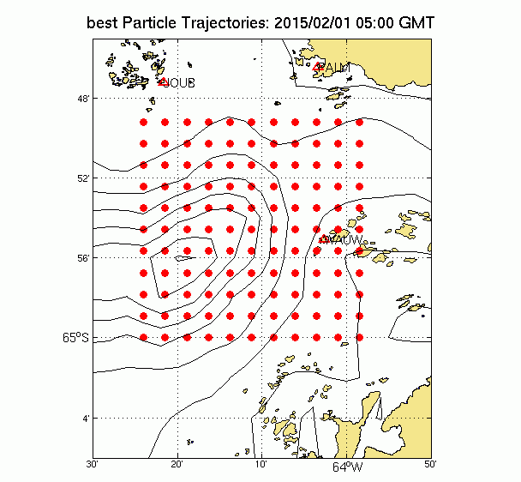

Slide 8
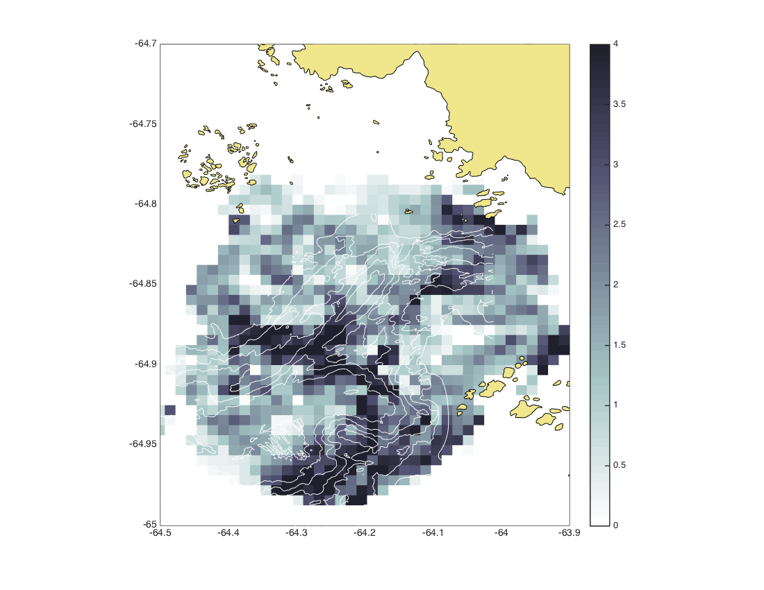
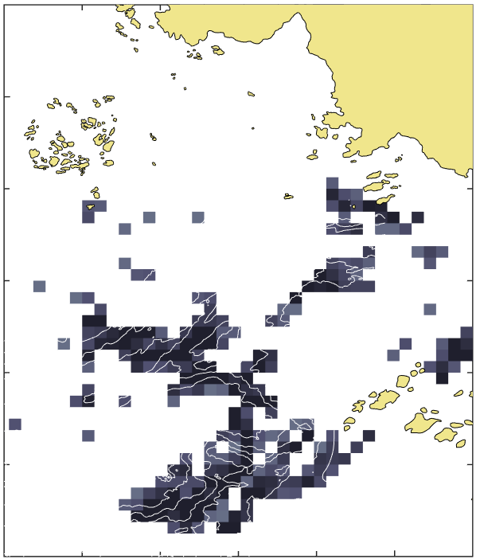
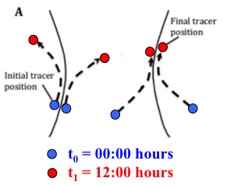
Lagrangian Coherent Structures
4.0
3.5
3.0
2.5
2.0
1.5
1.0
0.5
0
Finite Time Lyapunov Exponent (FTLE)
The FTLE field measures maximal linear attraction between initially neighboring particles over a pre-determined finite time interval.
We then calculated daily FTLE fields for January and February 2015.
January 27, 2015
FTLE (day⁻¹)

Slide 9
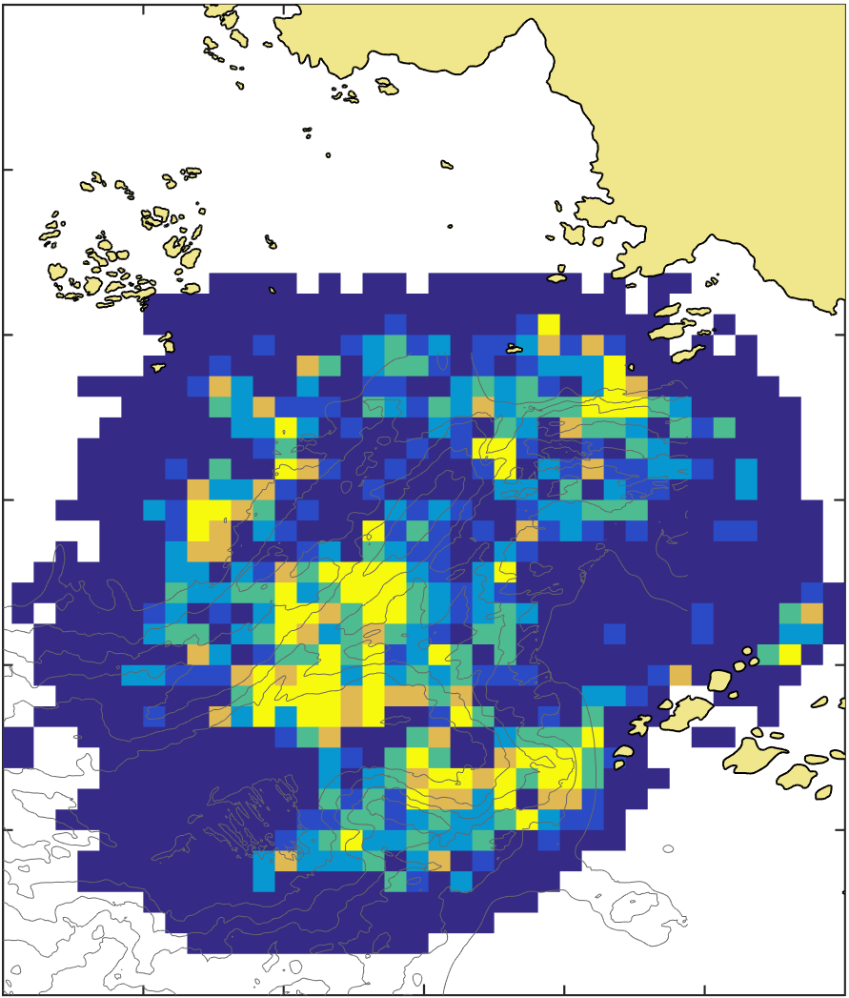
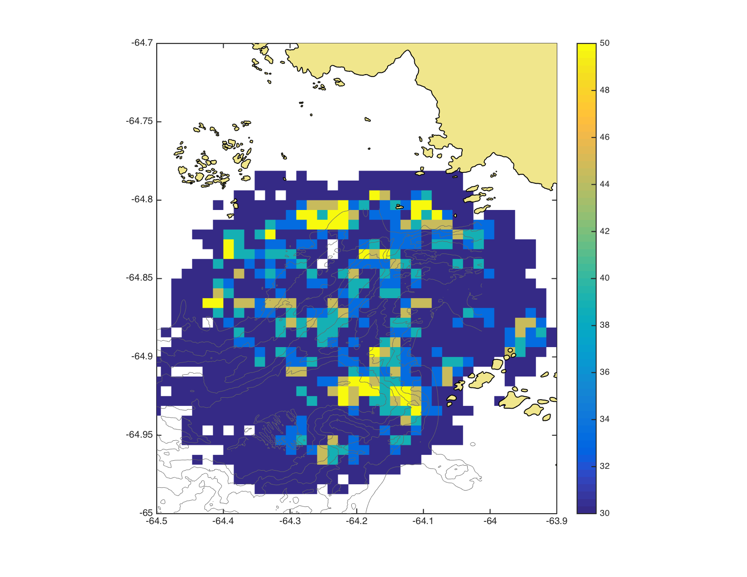
Strong Convergent Fronts
January – February, 2015
50
45
40
35
<30
Semi-Diurnal
Diurnal
Percent Occurrence

Slide 10
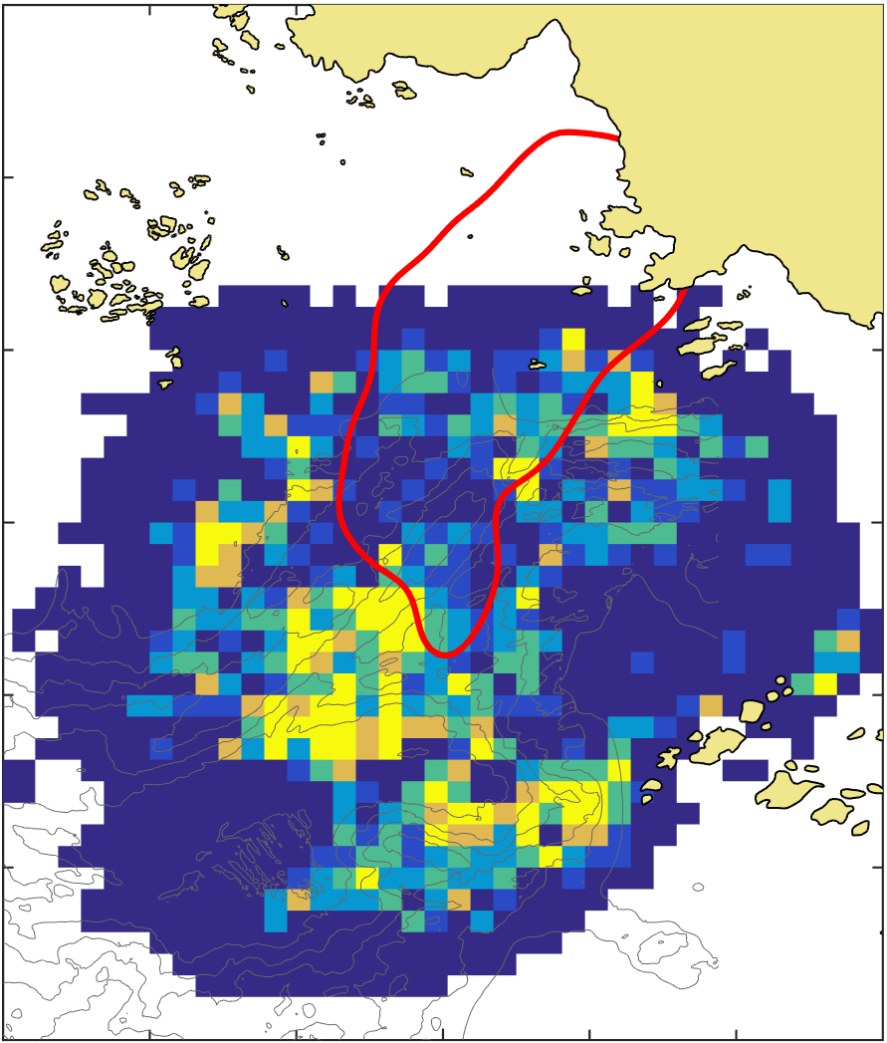

Strong Convergent Fronts
January – February, 2015
50
45
40
35
<30
Semi-Diurnal
Diurnal
Percent Occurrence

Slide 11
Selectivity of
Convergent Features
Adélie
Gentoo

Slide 13
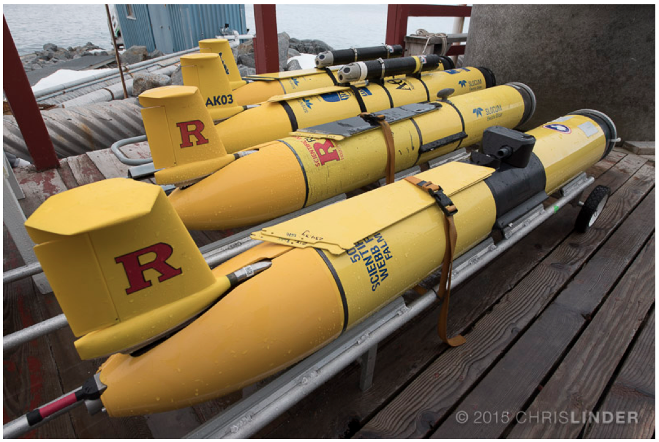



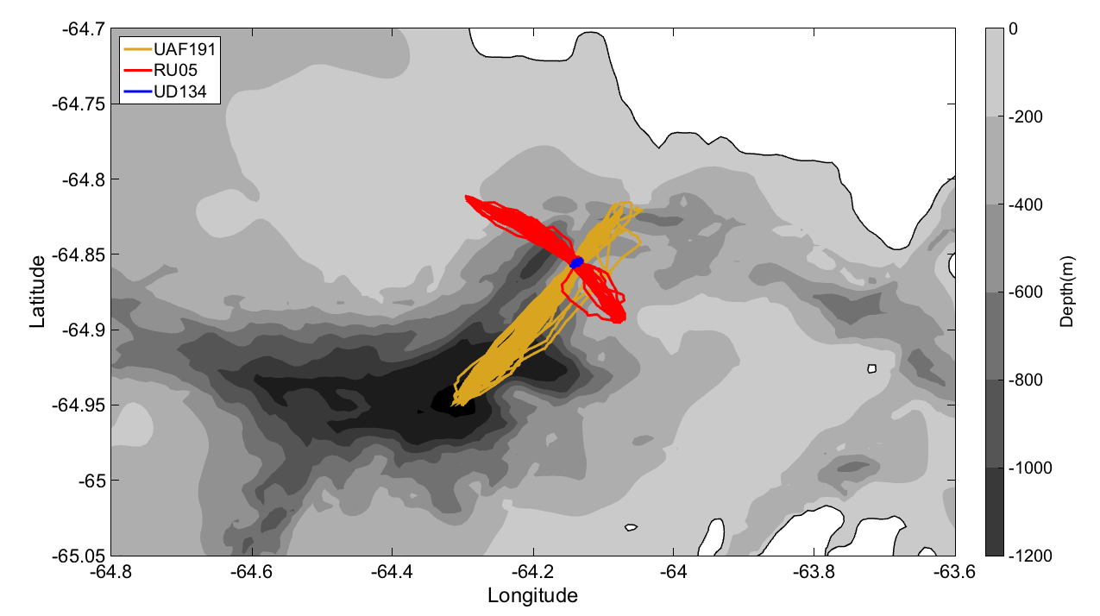
A coordinated fleet of gliders
Anvers Island
Along Canyon
Cross Canyon
Stationary

Slide 14
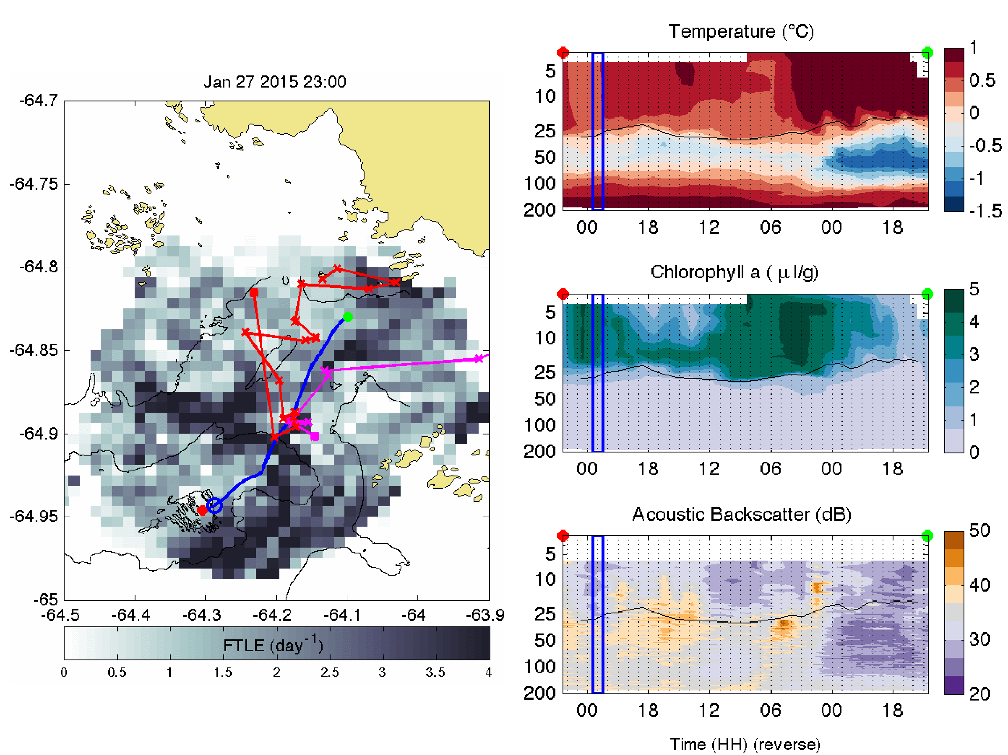
Offshore Onshore
Anatomy of a Front
Glider - 04:00 GMT
Adelie – 10:00 to 13:00 GMT
Gentoo – 21:30 to 22:30 GMT
23:00 GMT

Slide 15
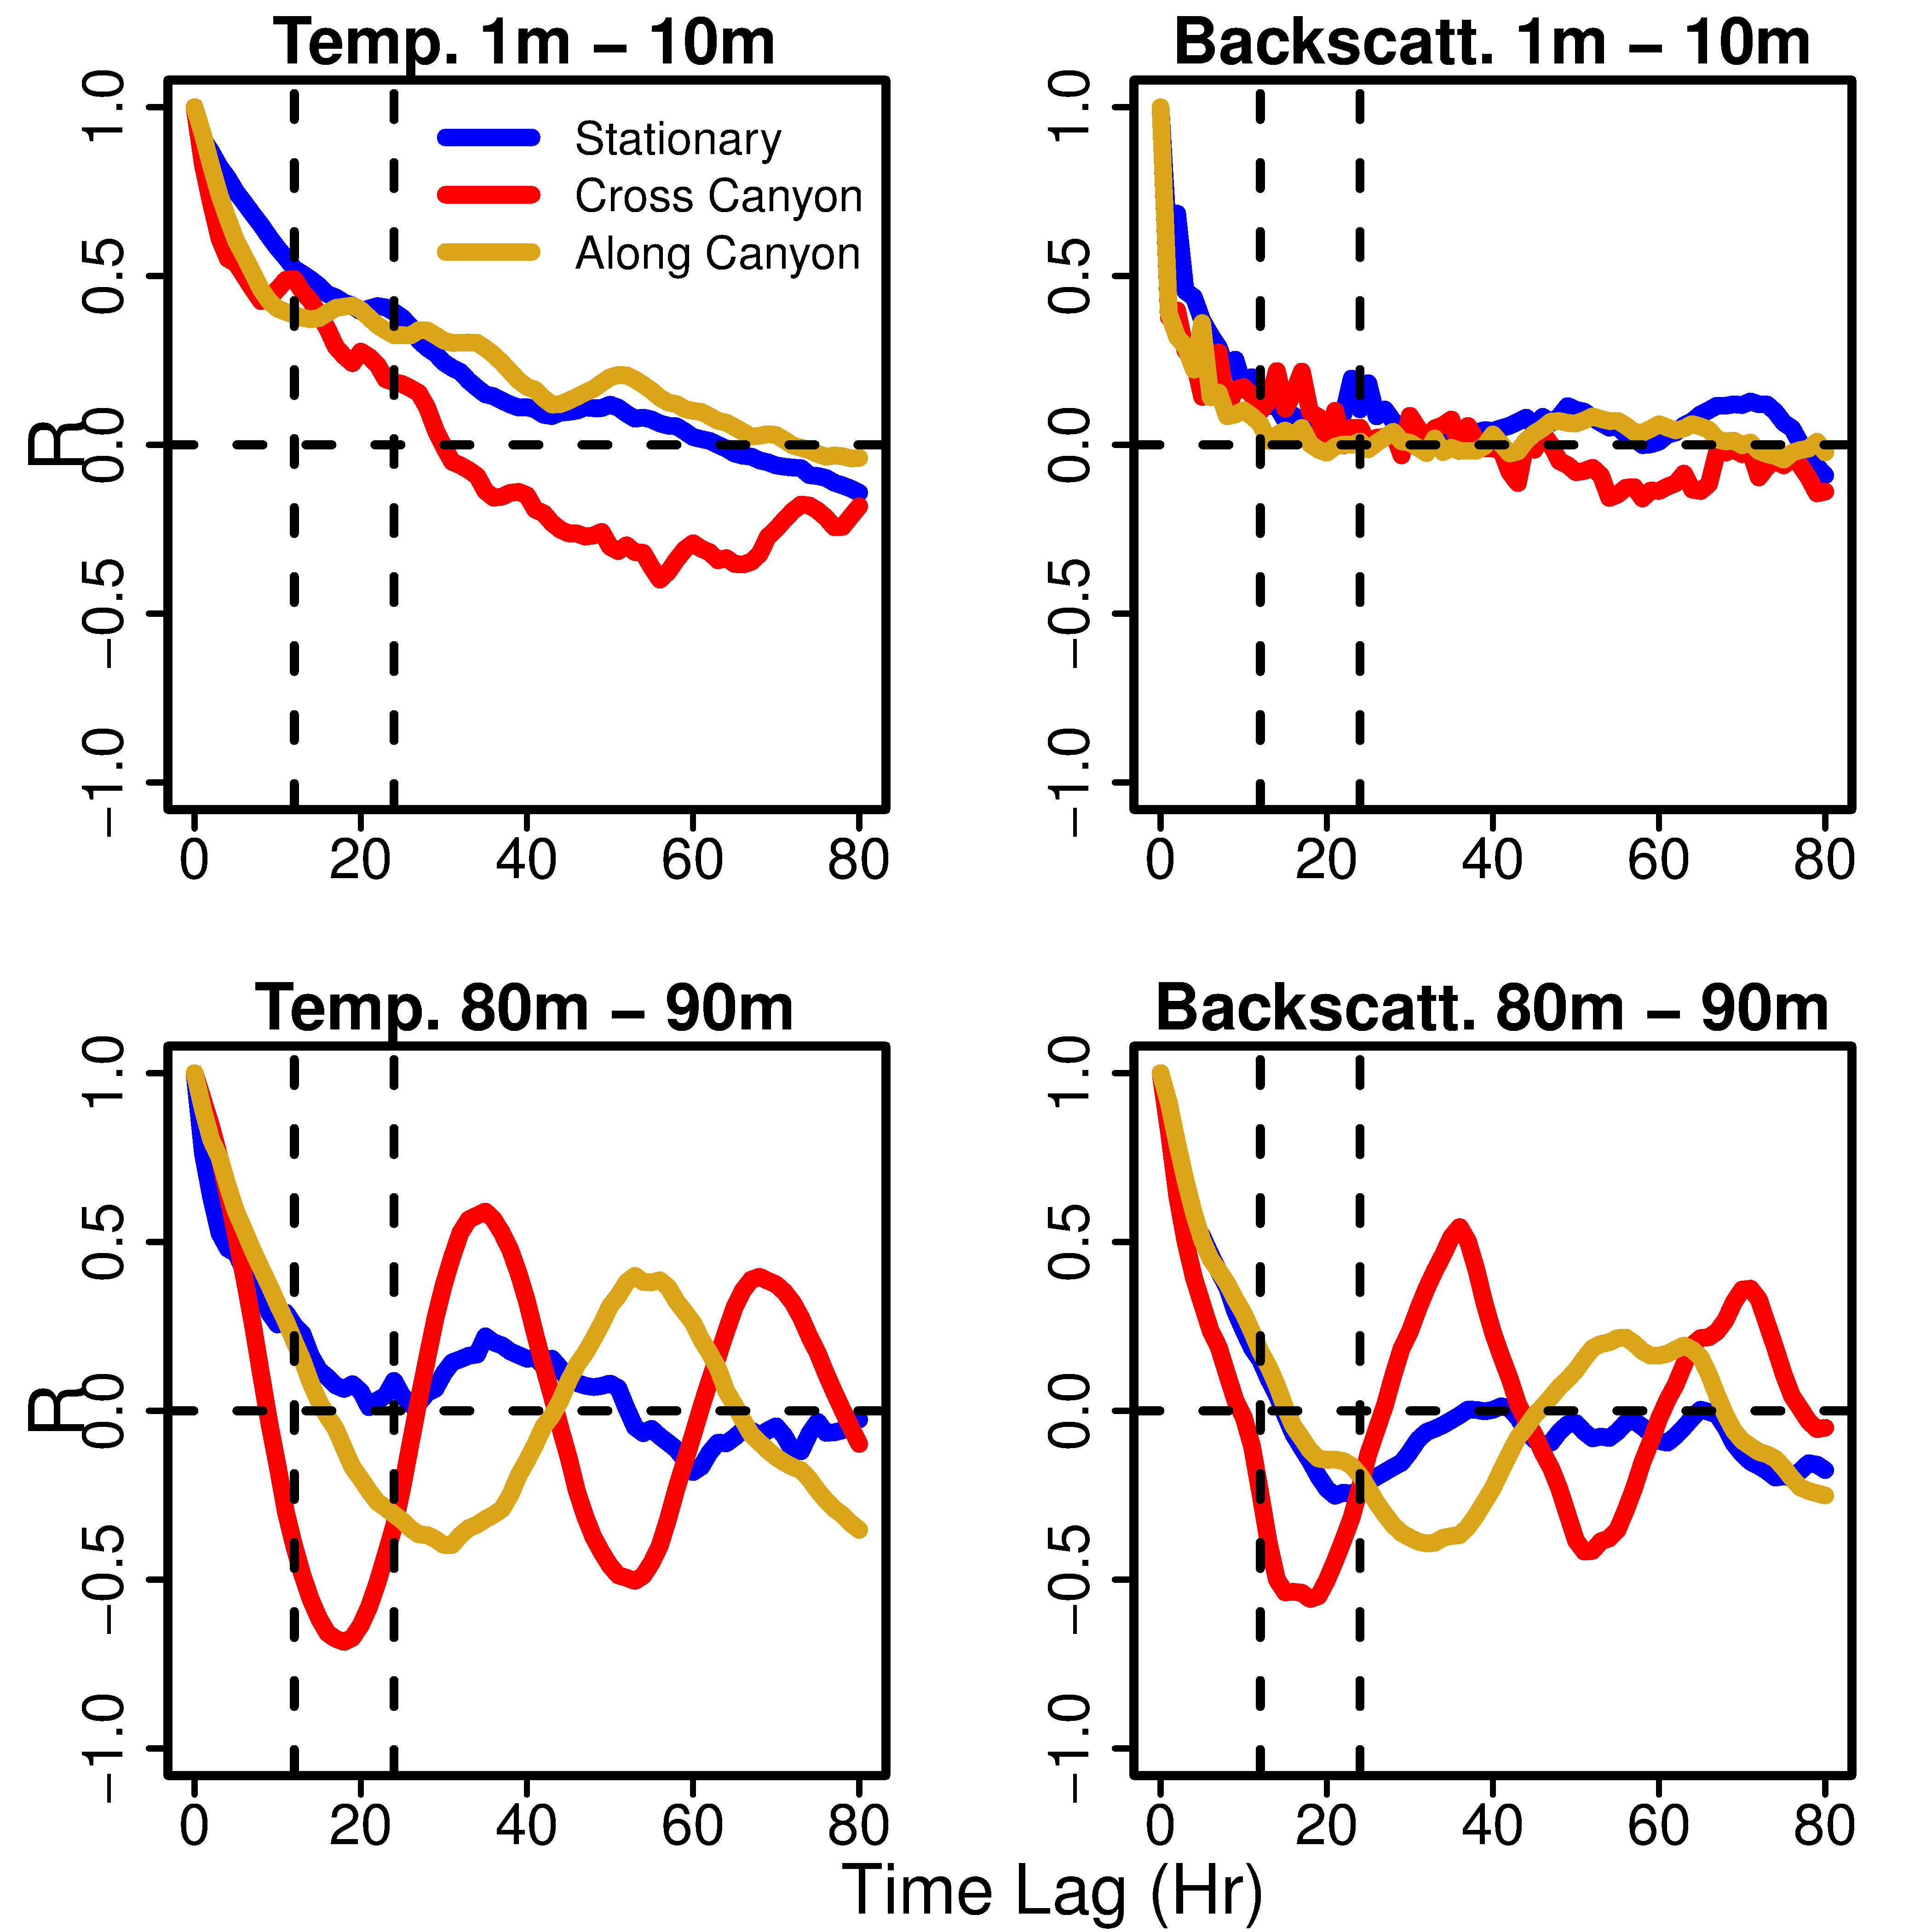
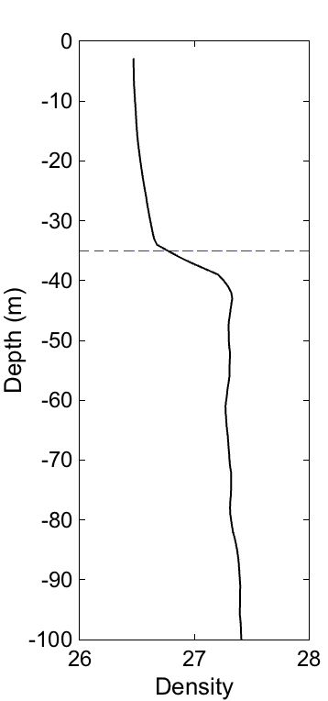
Teasing out temporal and spatial variability
Temperature Backscatter
Correlation (R)
Time Lag (Hours)

Slide 16
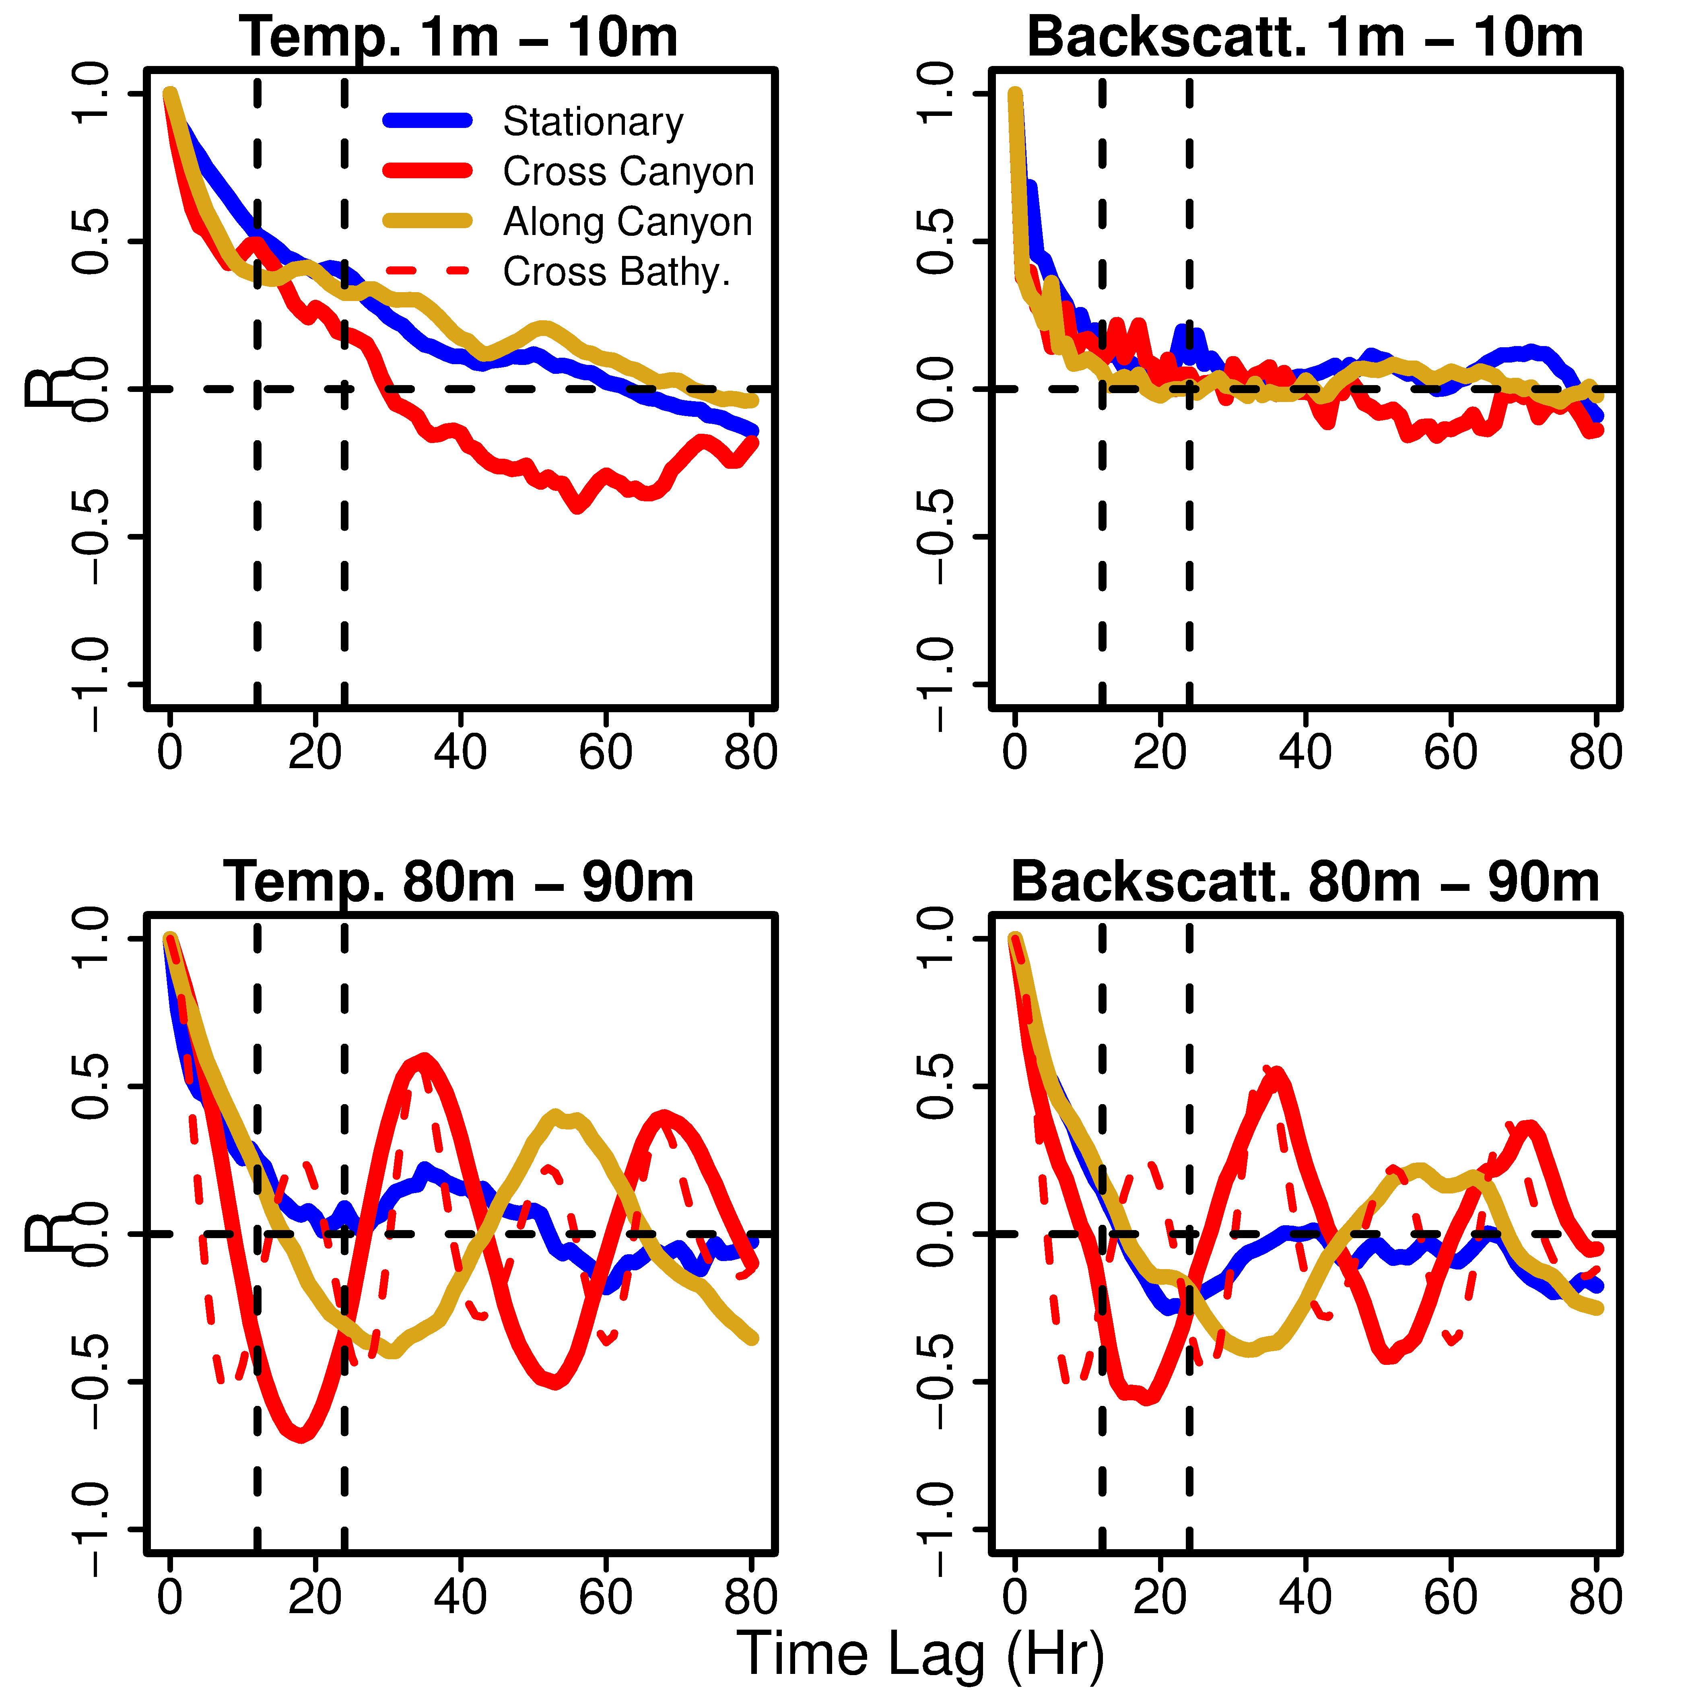
Teasing out temporal and spatial variability
Temperature Backscatter
Correlation (R)
Time Lag (Hours)

Slide 17
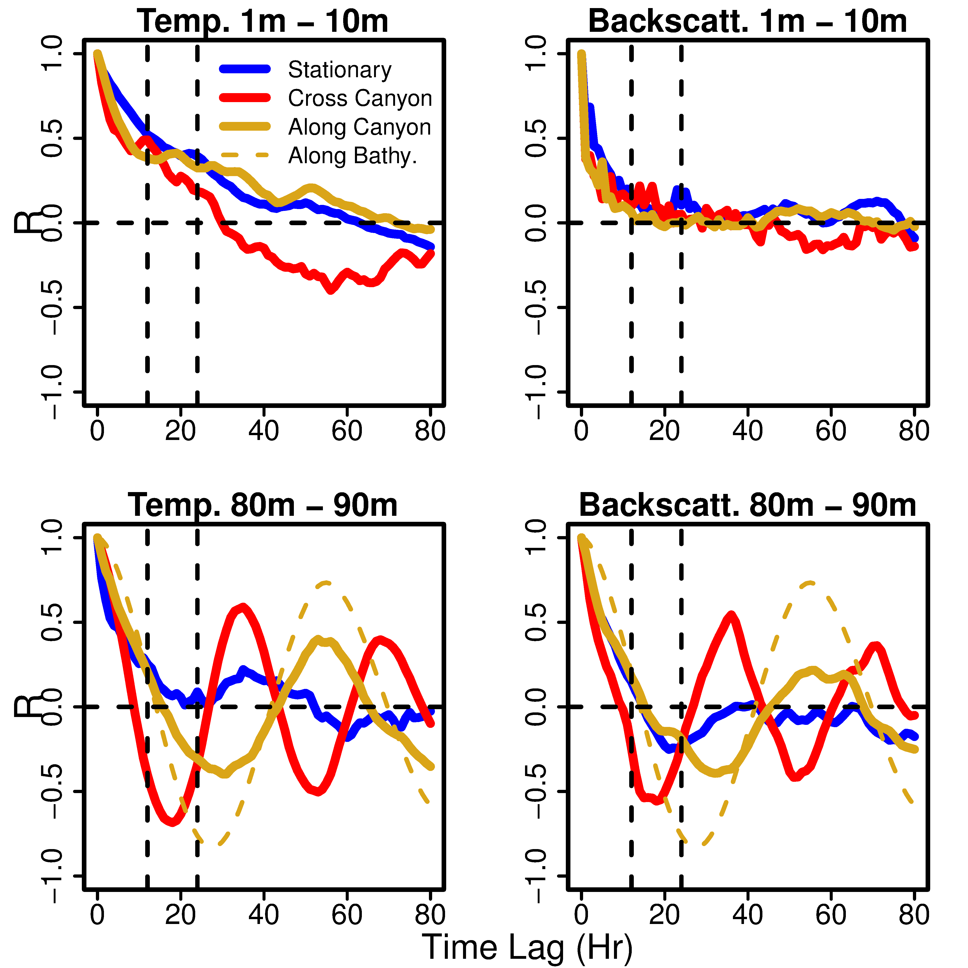
Teasing out temporal and spatial variability
Temperature Backscatter
Correlation (R)
Time Lag (Hours)

Slide 18
An Integrated Polar Observatory:
Summary
Our integrated approach enabled new understanding at the scale of the ecosystem
(H1) Patterns of convergence shifted position between diurnal and semi-diurnal tidal regimes in 2015, consistent with historic penguin foraging behavior.
(H2) There is evidence that these convergent zones identify regions of higher concentrations of food web components.
Raises new questions on the mechanics of biological hotspots along the WAP in the context of longer term climate variability, specifically related to the mechanisms that link different penguin foraging strategies to the local environment.

