Slide 1
Can we improve fisheries stock assessments by using dynamic habitat models informed by the Integrated Ocean Observing System (IOOS)?
OpenOcean
OpenOcean Study Group
John Manderson
NOAA/NMFS/NEFSC
Josh Kohut
Rutgers University
Matthew Oliver and Matthew Breece
University of Delaware
Dewayne Fox
Delaware State University

Slide 2
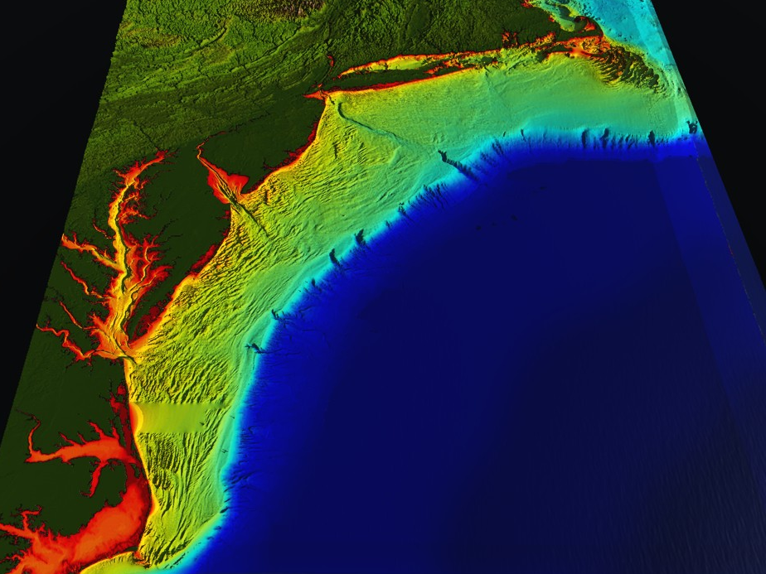
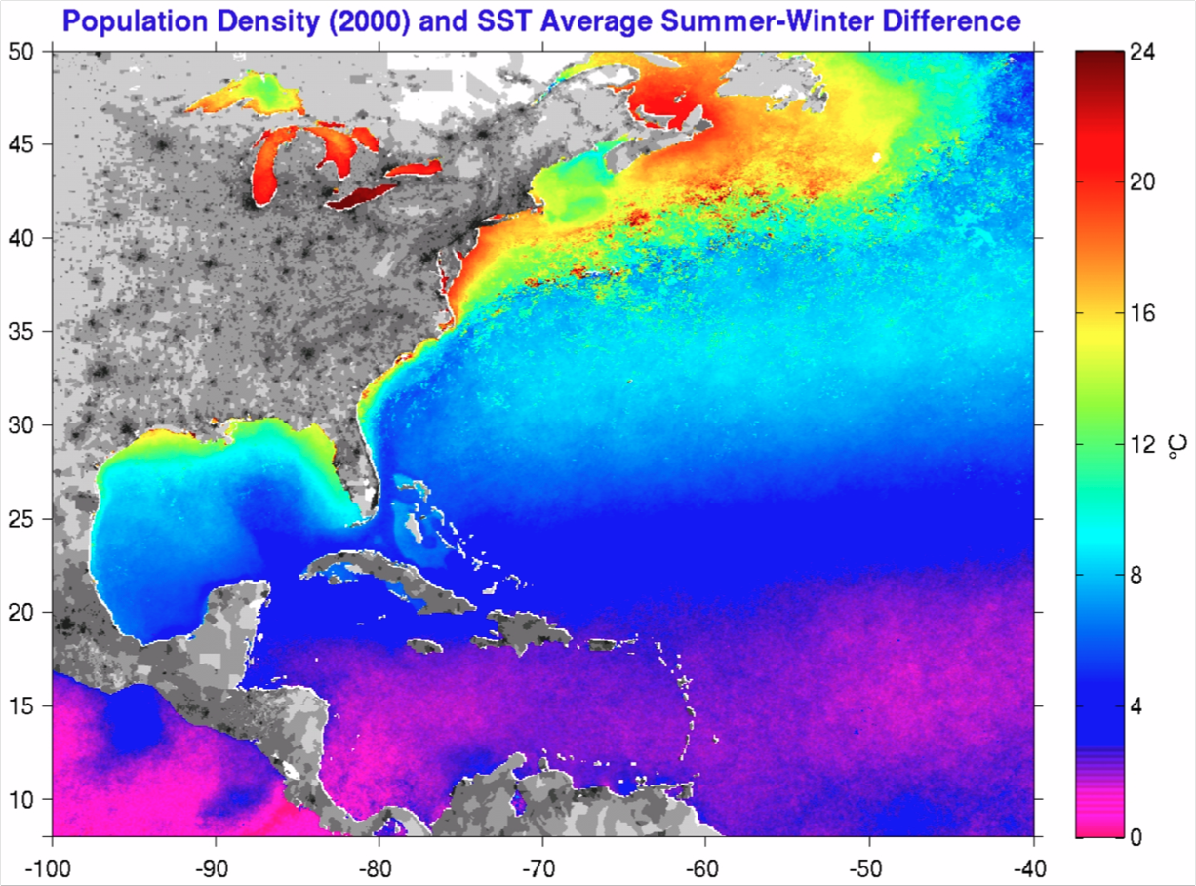
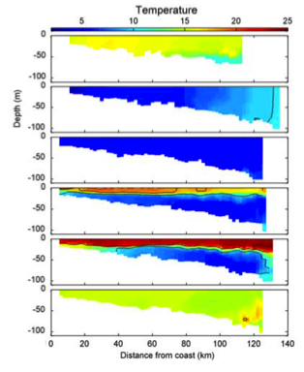
Middle Atlantic
Regional Association
Coastal
Ocean Observing System
1000 km
Cape to Cape
CT
RI
Cape
Cod
MA
NY
PA
NJ
20 Institutions
(Government, Industry, Academia)
MD
DE
October
VA
January
March
June
NC
August
Cape
Hatteras
November

Slide 3
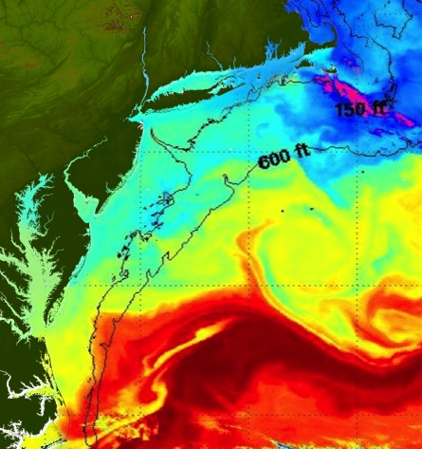
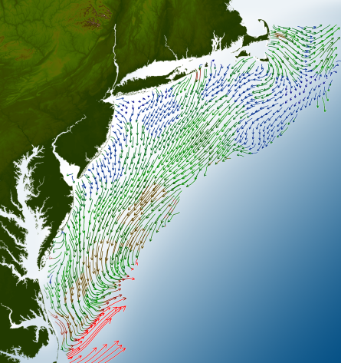
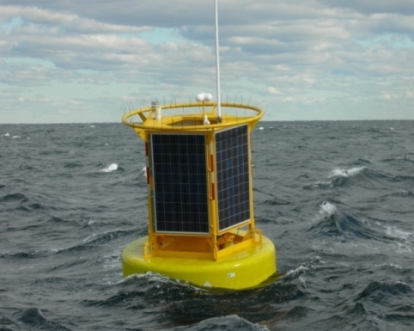
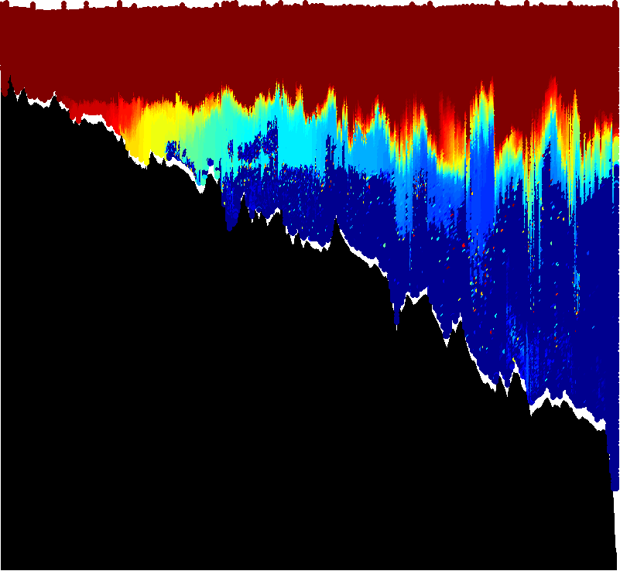
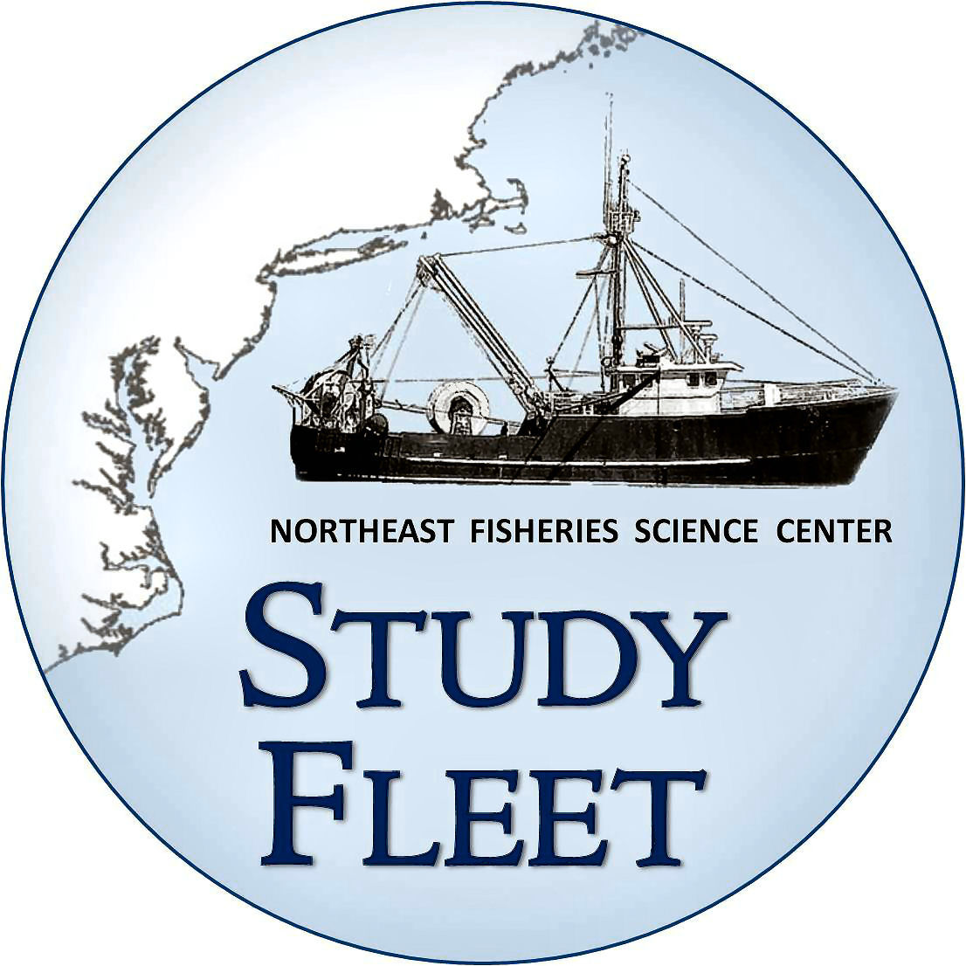
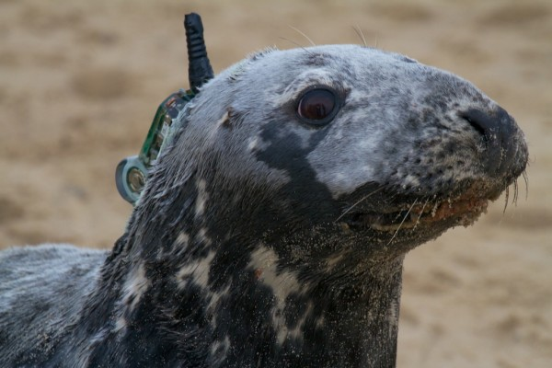
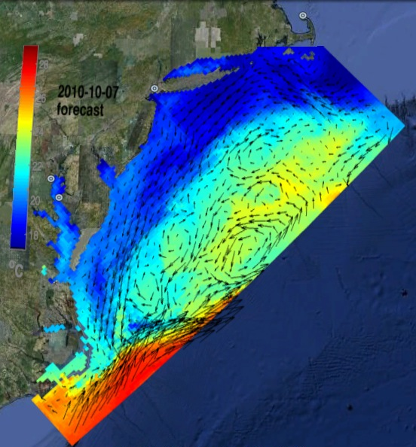
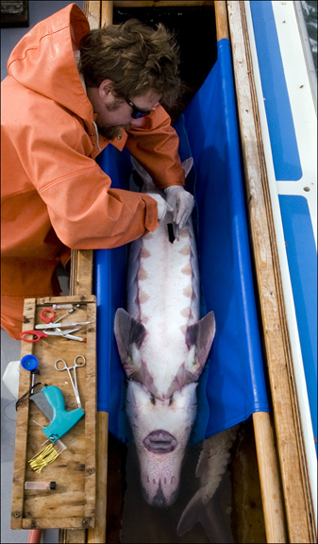
Regional Ocean Observing System:
Regional Ocean Observing System: Networked Ocean World
Satellites
HF radar
Gliders
Buoys
Fishing Vessels
Marine Mammals
Ensemble of Assimilation Models
Fish
Scuba Divers
ROMS

Slide 4
How can we relate a moving fish to the moving ocean observed and predicted by IOOS in a way that is relevant to assessment science and management?
A couple examples…

Slide 5
Some applications of IOOS infrastructure & biophysical models
capturing responses to dynamic ocean environment:
Population & Ecosystem assessment
Observation models
(migration, availability & detectibility to surveys)
---------------------------
Process models
(rates of birth, death, immigration, emigration &
Stock structure)
Tactical management tools
Dynamic spatial management (GRAs)
----------------------------------------
Bicatch reduction tools
Real & near real time ocean information crowdsourcing
What’s the reality of the ocean now, not 3 years ago
‘proactive not reactive’

Slide 6
Some applications of IOOS infrastructure & biophysical models
capturing responses to dynamic ocean environment:
Population & Ecosystem assessment
Observation models
(migration, availability & detectibility to surveys)
---------------------------
Process models
(rates of birth, death, immigration, emigration &
Stock structure)
Tactical management tools
Dynamic spatial management (GRAs)
----------------------------------------
Bicatch reduction tools
Real & near real time ocean information crowdsourcing
What’s the reality of the ocean now, not 3 years ago
‘proactive not reactive’

Slide 7
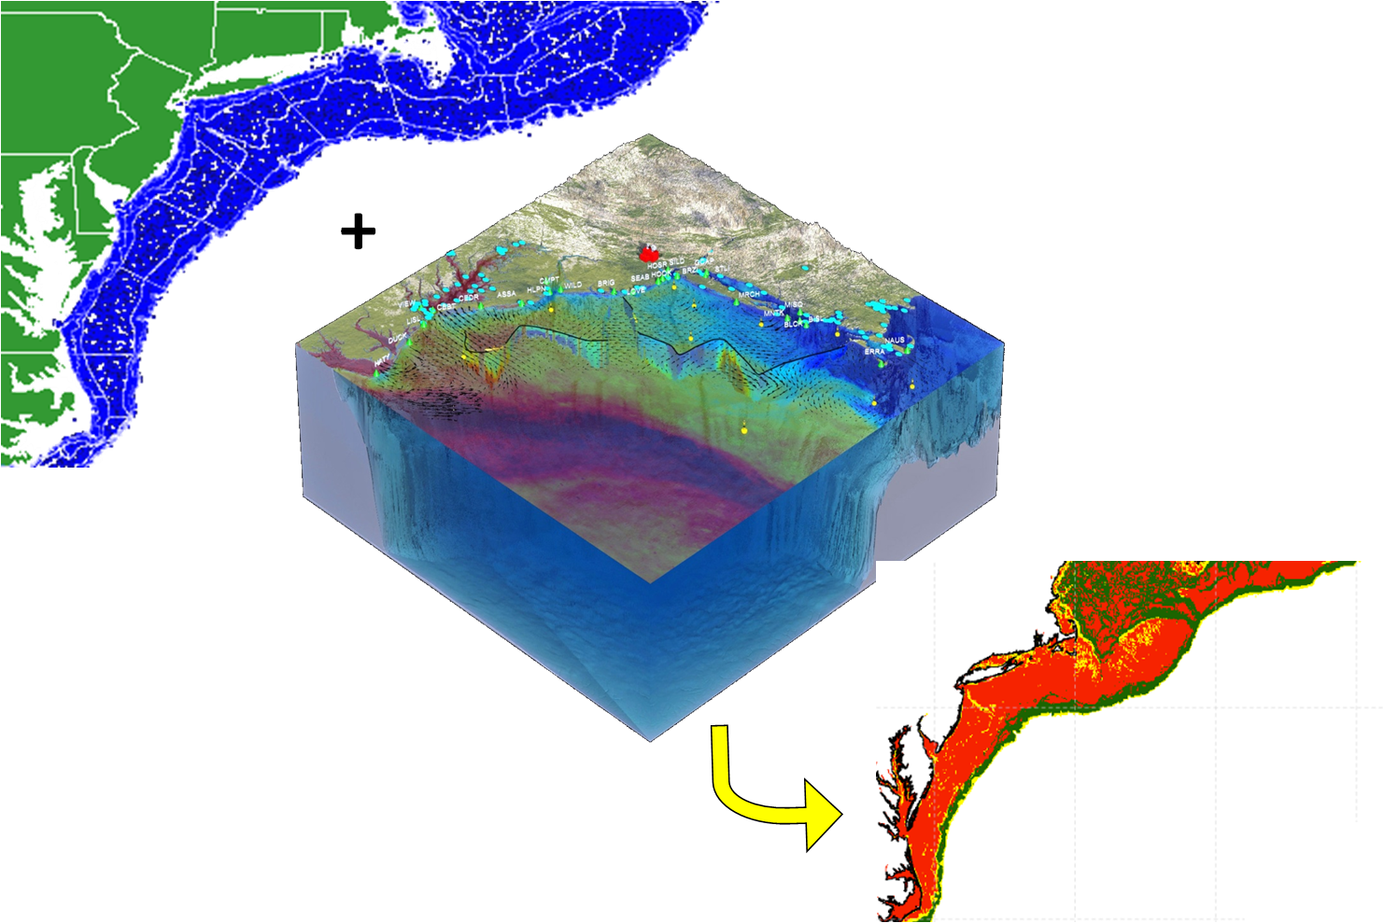
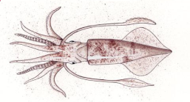
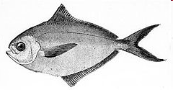
Approach: Regional Habitat Models
NOAA US Fishery Data
Spatial grain = 11km
Ocean
Observations
+
Physical Models
Statistical and Mechanistic
“niche” Models
(e.g. GAM, GLM, MAXENT)
Regional
Habitat
Projection

Slide 8
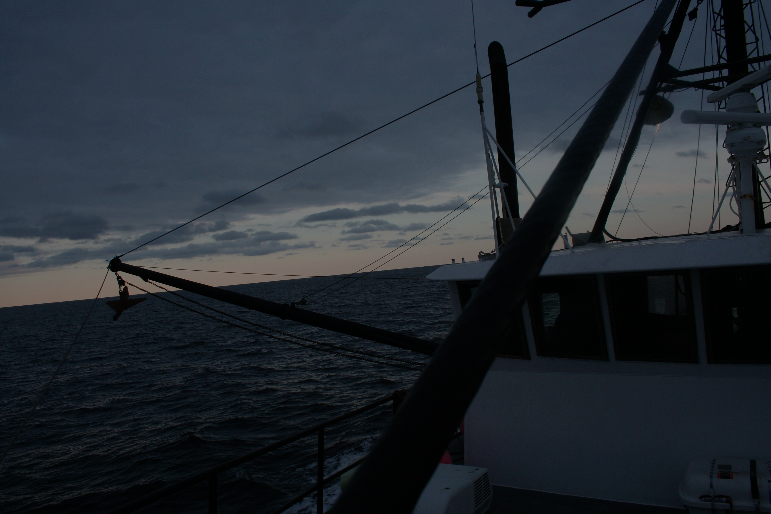
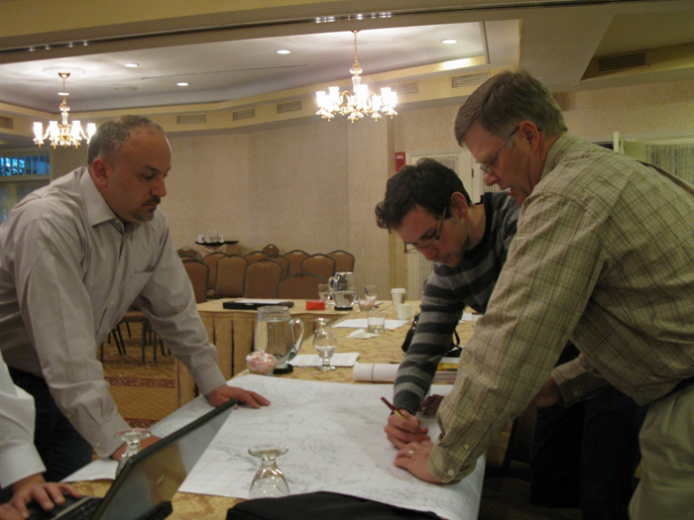
OpenOcean Study Group
Fishery Scientists/Ecologists
John Manderson
(NOAA/NEFSC)
Laura Palamara (Rutgers)
Olaf Jensen (Rutgers)
Tim Miller (NOAA/NEFSC)
Chuck Adams (NOAA/NEFSC)
Howard Townsend (NOAA/NEFSC)
John Quinlan (NOAA/SEFSC)
David Richardson (NOAA/NEFSC)
Physical and Biological Oceanographers
Josh Kohut (Rutgers)
Matt Oliver (U. Delaware)
Andre Schmidt (SMAST)
Nickitas Georgas (Stevens Inst.)
Enrique Curchitser (Rutgers)
Industry/Outreach
Chris Roebuck
Dan & Lars Axelsson
Hank Lackner
Geir Monsen (Seafreeze)
Greg DiDomenico
(Garden State Seafood)
Lunds Fisheries
Eleanor A. Bochenek (Rutgers)
John Hoey (NOAA/NEFSC)
Fisheries Management
Jason Didden (MAFMC)
Rick Seagraves (MAFMC)
Human Dimensions
Steven Gray (U Mass.)

Slide 9
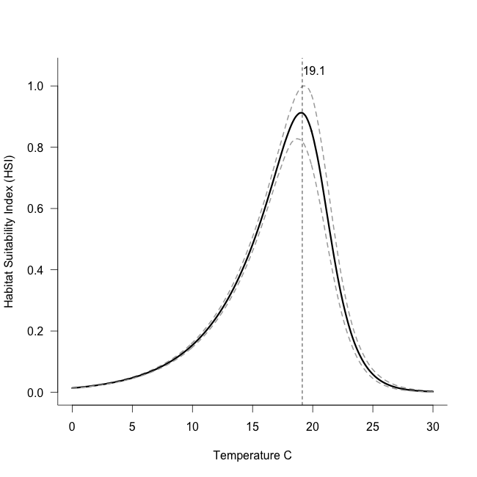
Mechanistic Model v. 3.0
Niche model: nonlinear extension of
Boltzmann-Arrhenius equation
(mechanistic basis in enzyme kinetics)
Water temperature
hindcast from
oceanographic model
1958-2007
Daily Temperature
~7 km Resolution
+
From Enrique Curchitser, Rutgers

Slide 10
Mechanistic Habitat Model Daily: 1958-2007
1989-1992
Index of
thermal
habitat
quality
2002-2004

Slide 11
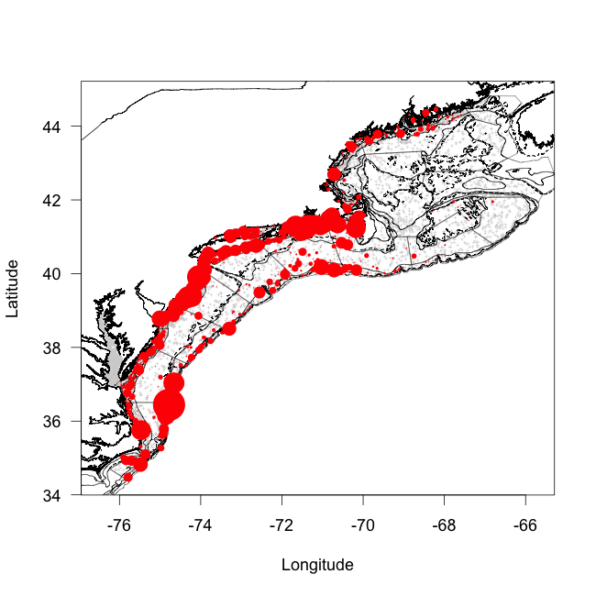
Why focus on availability (ρ)?
Temperature dependent seasonal migrations spring & fall
between under-sampled coastal zone & shelf break habitats
Summer
Winter

Slide 12
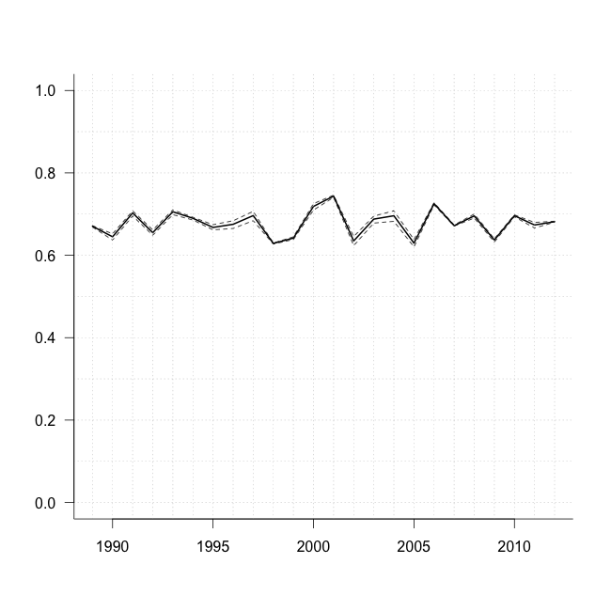
Approach:
Use coupled biophysical model to develop
a habitat based estimate of availability (ρ_{h}) to surveys
Median ρ_{h} = 0.68
(0.62-0.75)
Availability (ρ) to fall NEFSC
survey stations offshore
Estimates changes in availability (ρ) over time.
Thermal habitat based ρ accounts for shifts in species distributions associated with climate impacts on ocean temperatures
Availability (ρ)
Catchability (Q)
Detectability(δ)

Slide 13
From the Mid Atlantic Fishery Management Council (MAFMC) draft 2014 Environmental Assessment for the Butterfish and Longfin Squid fishery specifications:
“The butterfish fishery has mostly been an incidental fishery since 2002.
2014 is the first year of a small directed fishery, with a landings limit of 3,200 mt.
If that limit is caught at 2013 average prices ($1,481 mt), the resulting revenues would be about $4.7 million.
Under the proposed 2015 specifications, the average landings limit for 2015-2017 would be 21,408 mt. This could potentially translate into $31.7 million additional ex-vessel revenues at 2013 prices.”
It is not clear that the fishery will actually land such higher amounts or if the price would remain near $1,481/mt at higher landings levels, so the $31.7 million value is likely an “upper end” possibility.”

Slide 14
Some applications of IOOS infrastructure & biophysical models
capturing responses to dynamic ocean environment:
Population & Ecosystem assessment
Observation models
(migration, availability & detectibility to surveys)
---------------------------
Process models
(rates of birth, death, immigration, emigration &
Stock structure)
Tactical management tools
Dynamic spatial management (GRAs)
----------------------------------------
Bicatch reduction tools
Real & near real time ocean information crowdsourcing
What’s the reality of the ocean now, not 3 years ago
‘proactive not reactive’

Slide 15
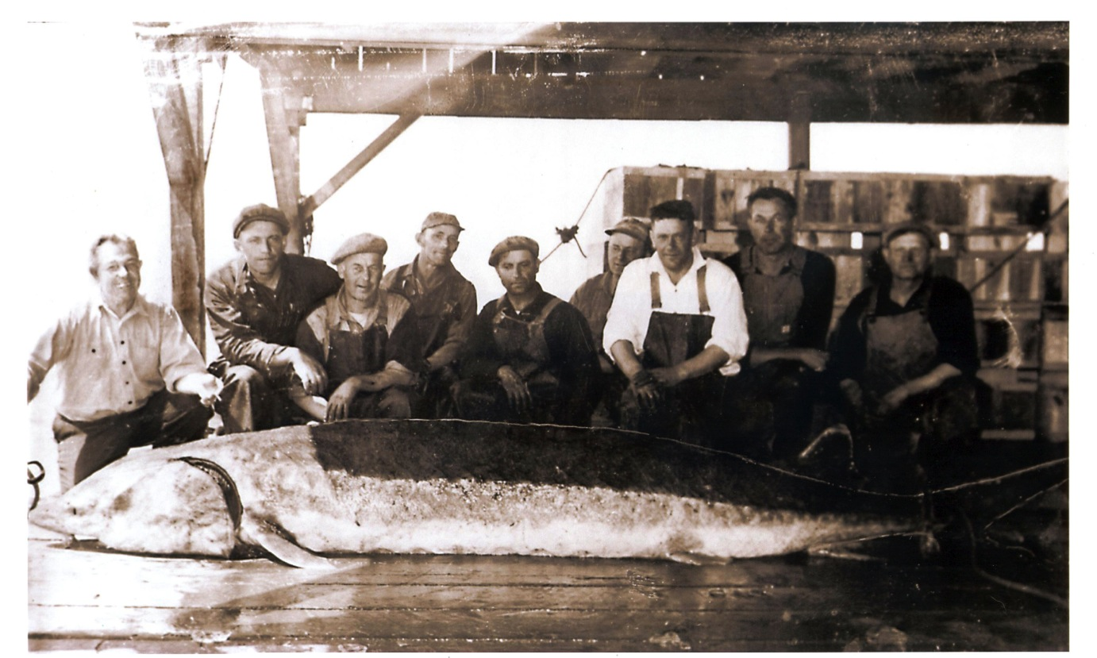
Atlantic Sturgeon
Large range and broad coastal movements
Can Reach 4.5 m, 350 kg, and
60 years of age
1998 US coast wide moratorium
Listed on Feb 6th, 2012
Endangered
(South of the Gulf of Maine)
Threatened
(Gulf of Maine)

Slide 16
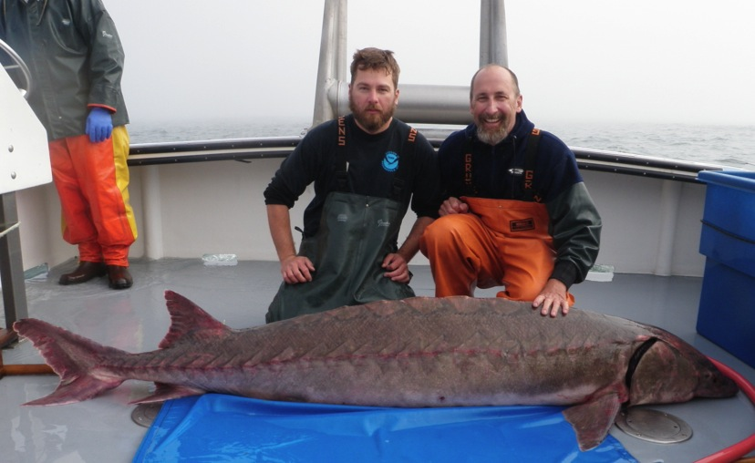
Telemetered Sturgeon
652 Individuals
Delaware
New York

Slide 17
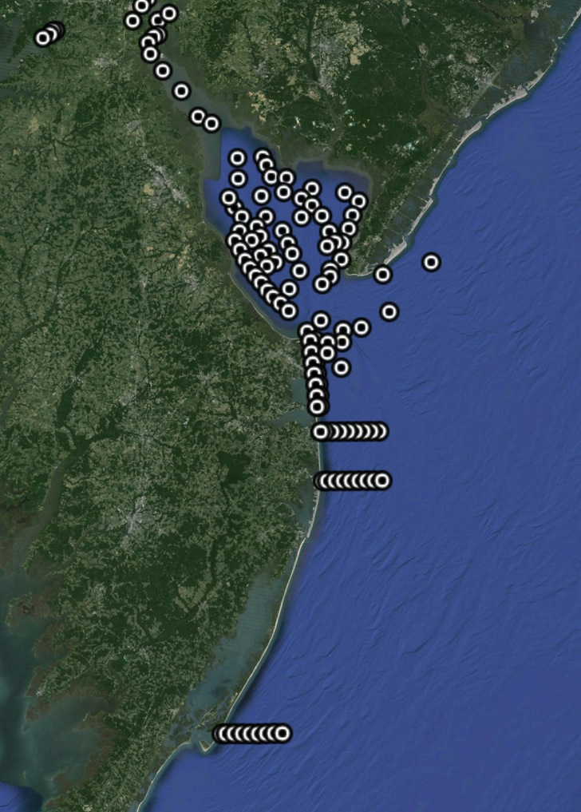
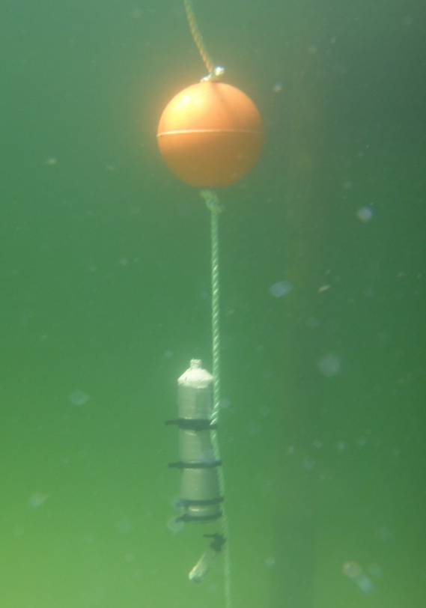
Passive Telemetry
50 km
Notes:
.

Slide 18
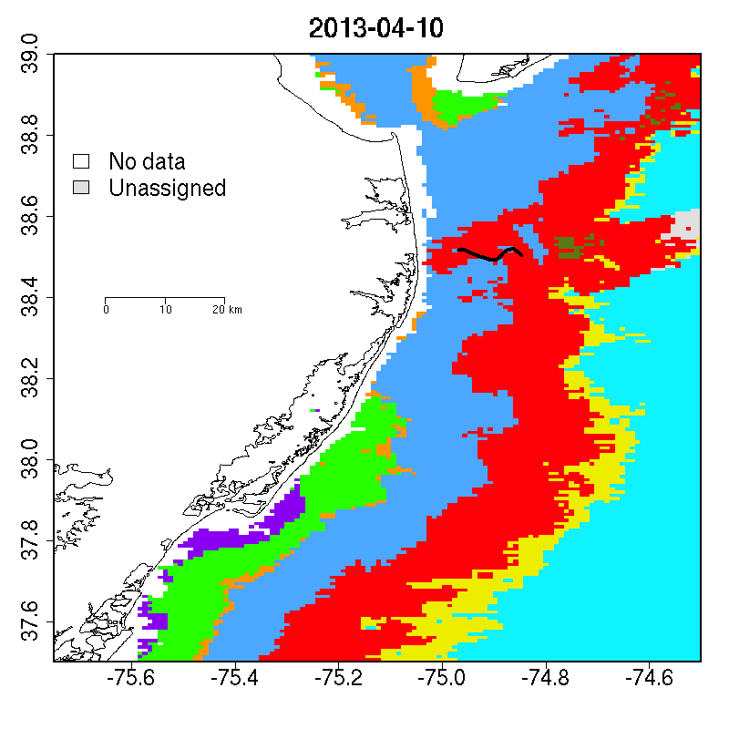
Sturgeon Mission (2013)
79 Days at sea
10 April – 28 June
1,420 km
71,000 Profiles
Salinity
CHL
CDOM
Temperature
Oxygen
62 Sturgeon
187 Detection Hours
No data
Unassigned
Detection

Slide 19
Sturgeon Mission (2013)
79 Days at sea
10 April – 28 June
1,420 km
71,000 Profiles
Salinity
CHL
CDOM
Temperature
Oxygen
62 Sturgeon
187 Detection Hours
No data
Unassigned
Detection

Slide 20
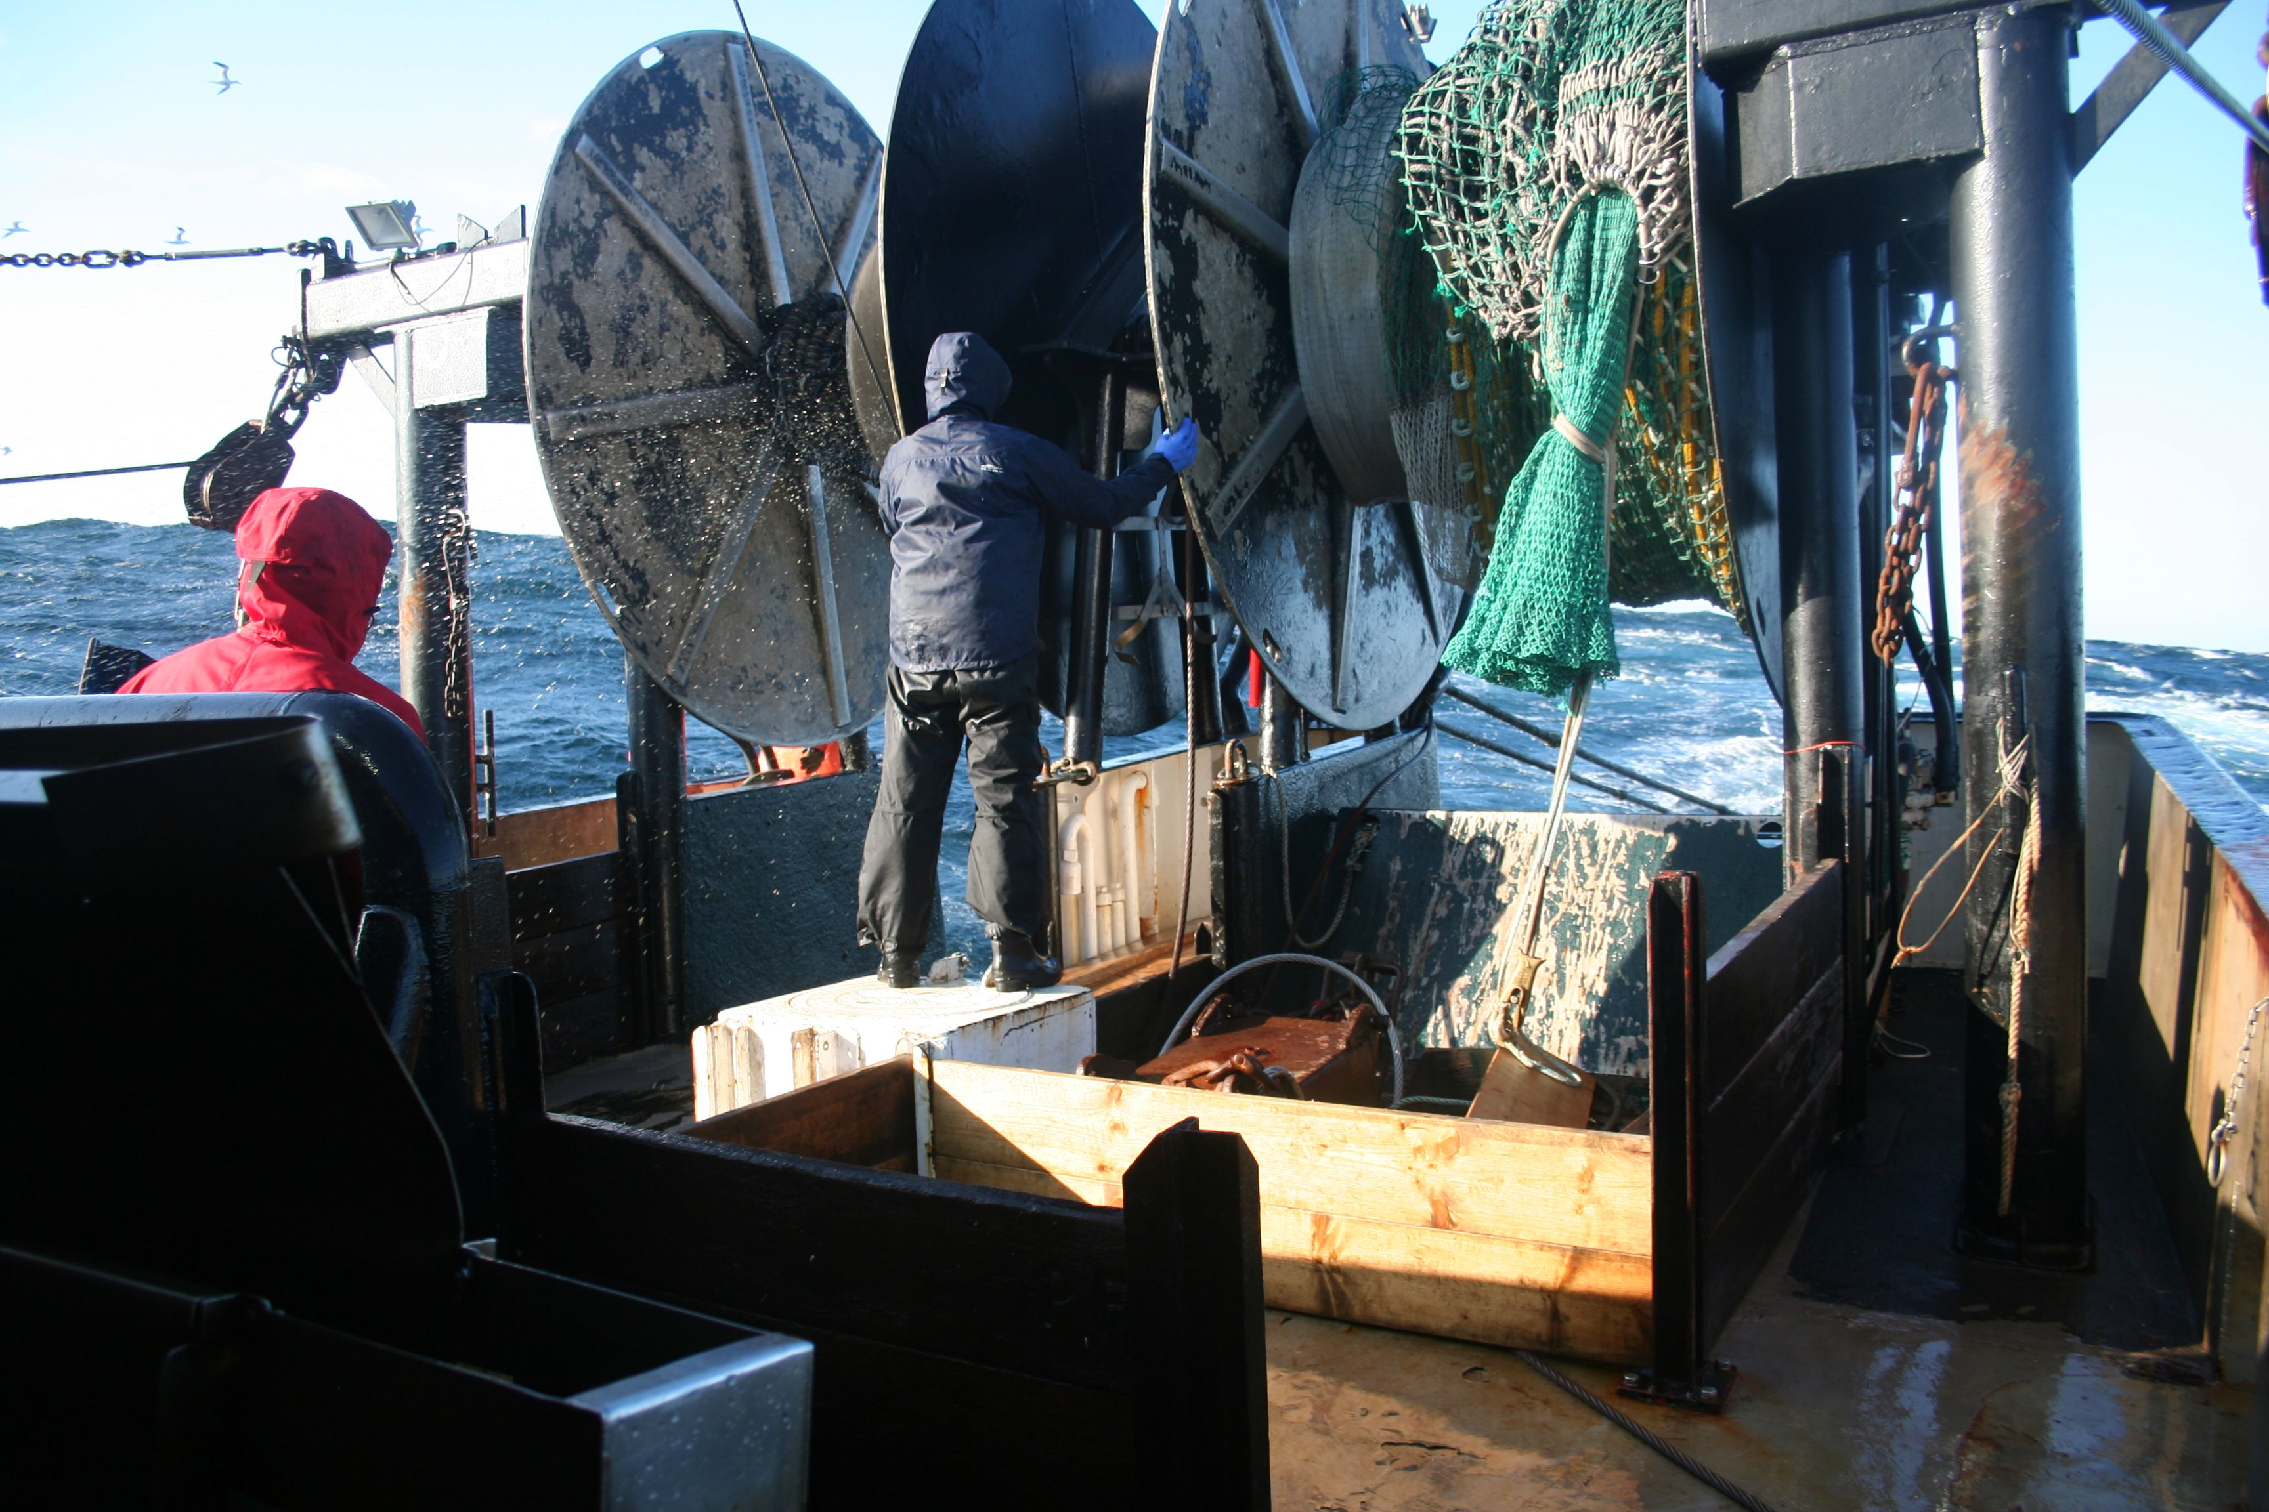
Summary
Ocean observatories capture the dynamics of marine habitats
Habitat models linked to physical models co-developed with scientists, managers, and the industry can support fisheries assessment and management.
These approaches could also support process based studies that develop indices in existing and future single species and ecosystem based assessments.

