Slide 1

Welcome to MARACOOS!
A robust ocean and coastal data partnership advancing a strong economy, health, and wellbeing in the U.S. Mid-Atlantic Region

Slide 2
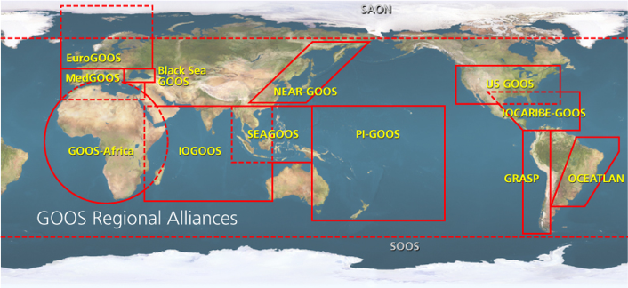

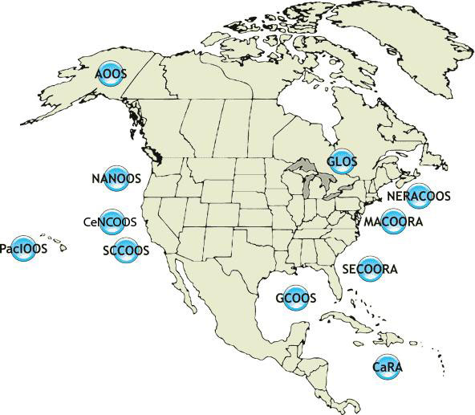






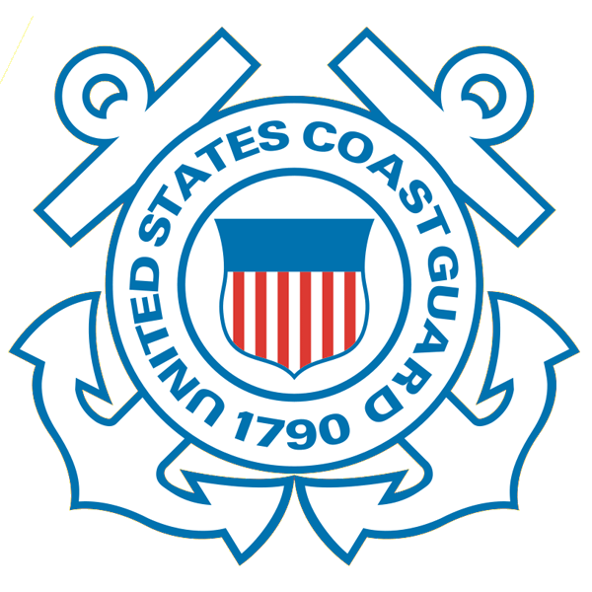









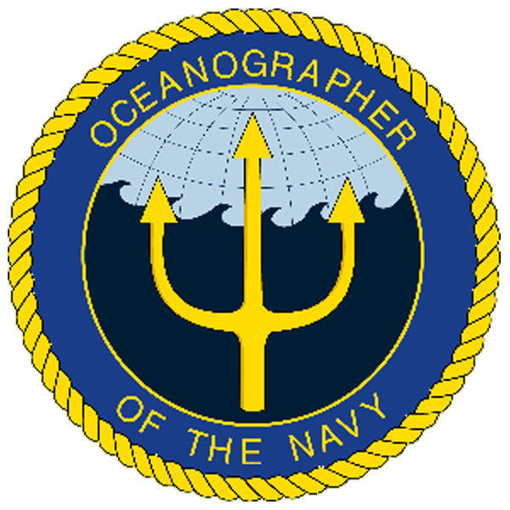
IOOS Relationships
International Component
U.S. National Component
U.S. Regional Component
Global Ocean Observing System
Vessels -
Satellite
Satellite
CODAR
Ships/ Vessels
Glider
REMUS
Data Vis.
MARACOOS
Modeling
Security
Leadership
Education
11 Regional Associations
17 U.S. Federal Agencies

Slide 3
MARACOOS powers regional understanding and prediction
of ocean & coastal dynamics
Collecting, applying, and providing ocean & coastal data for information products that support jobs, the economy, safety, and wellbeing for 78 million people living, working and recreating in the Mid-Atlantic.
Independent 501(c)3 non-profit org.
Federally certified, quality assured, liability backed, broad array of data sets in standard formats with hardened back-up systems
Unique data covering the area from Cape Cod, MA to Cape Hatteras, NC and its five bays and urban estuaries
Easily accessible and customizable
View data → oceansmap.maracoos.org
Download data → maracoos.org/operations

Slide 4
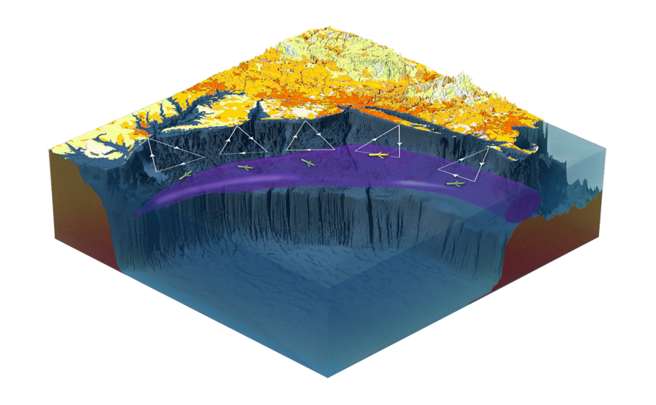
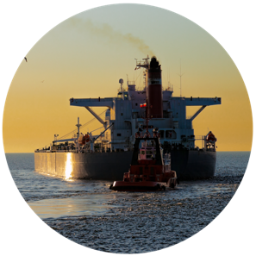
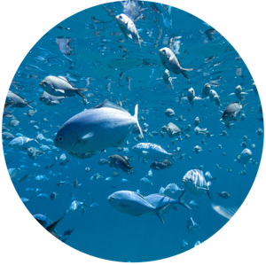
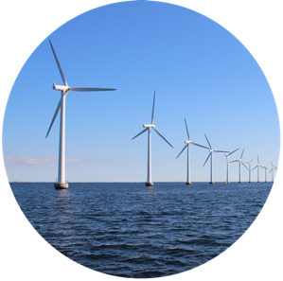

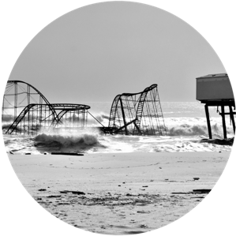
Data with Purpose
Maritime Safety
Fisheries
Energy
Water Quality
Coastal Hazards

Slide 5
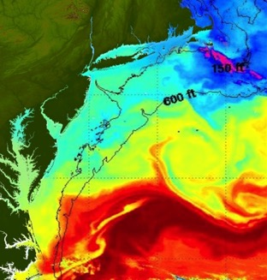
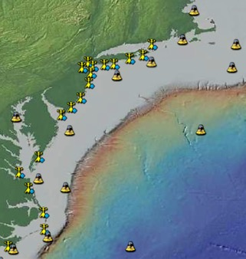
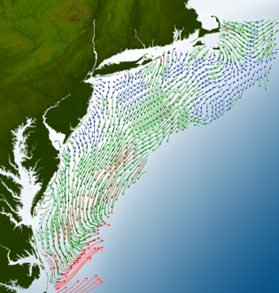
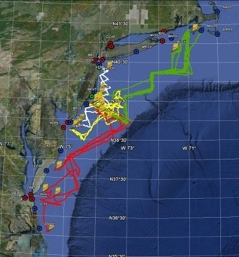
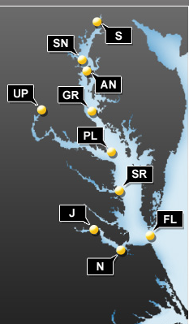
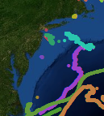
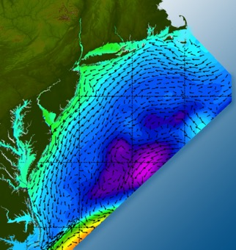
Data with Purpose
Satellites
Weather Stations
HF-Radar
Gliders
Buoys
Ocean Forecast Ensemble
Drifters
View data → oceansmap.maracoos.org
Download data → maracoos.org/operations
Notes:
Collecting, applying, and providing ocean and coastal data for information products that support jobs, the economy, safety, and wellbeing for the 78 million people living, working and recreating in the U.S. Mid-Atlantic region.
Federally certified, quality assured, liability backed, broad array of data sets in standard formats with hardened back-up systems
Unique data covering the area from Cape Cod, MA to Cape Hatteras, NC and its five bays and urban estuaries
Easily accessible and customizable
View data → oceansmap.maracoos.org
Download data → maracoos.org/operations

Slide 6
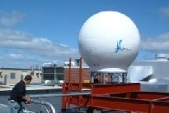
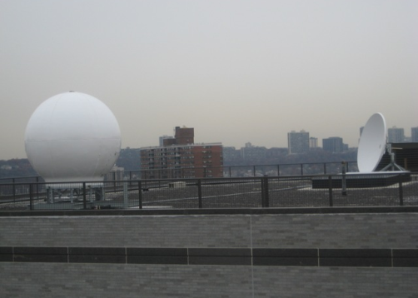
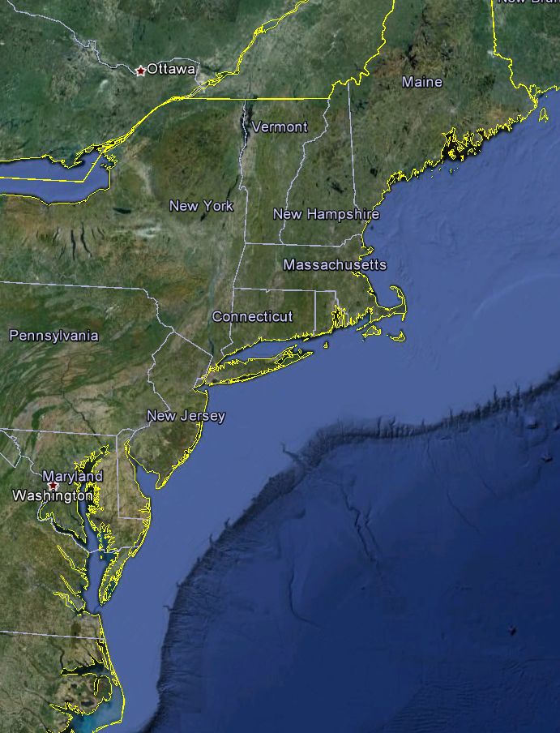
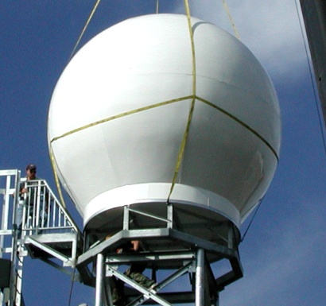
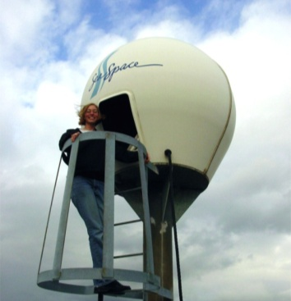
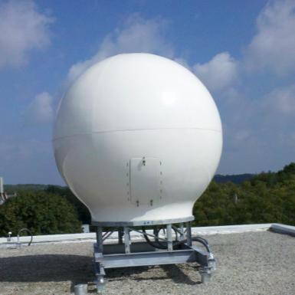
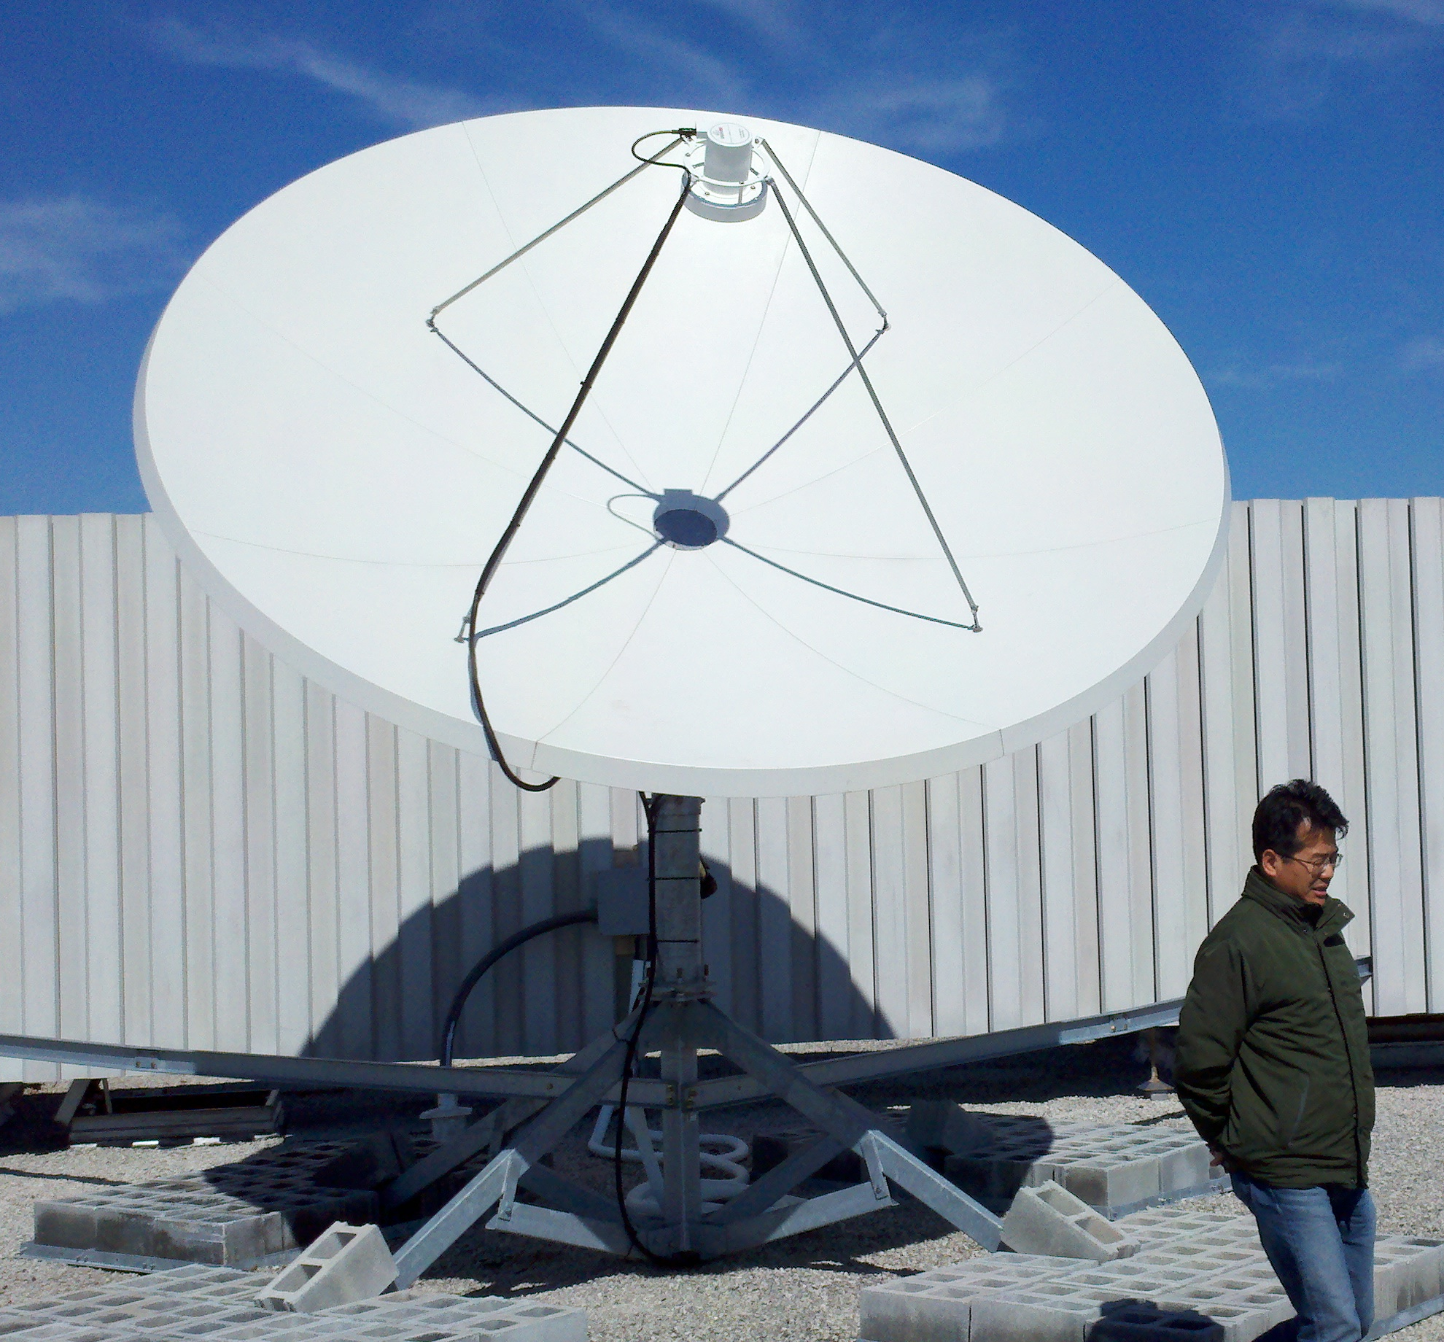
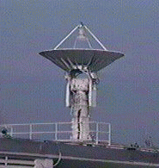

Real-Time Satellite Ground Stations in the Northeast U.S.
Satellites: NOAA Polar Orbiters, NPP, Terra, Aqua, Metop & GOES
U. Maine
City College of N.Y.
Rutgers
Industry
Partner
U. Delaware
Johns Hopkins

Slide 7
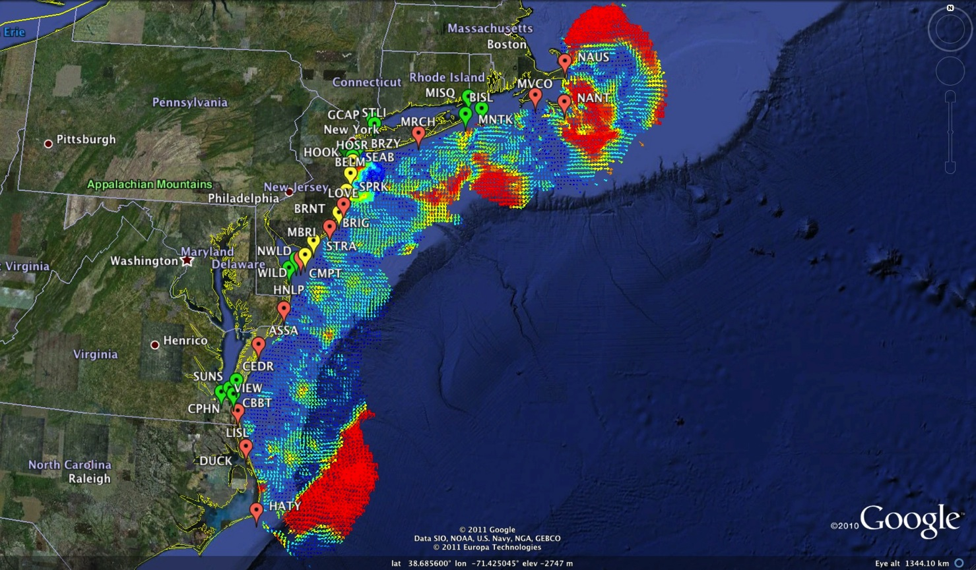
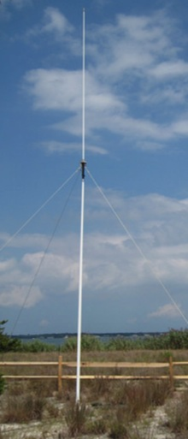
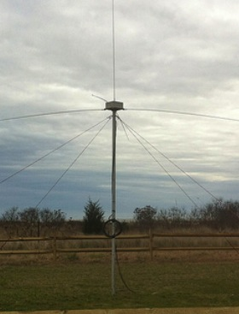
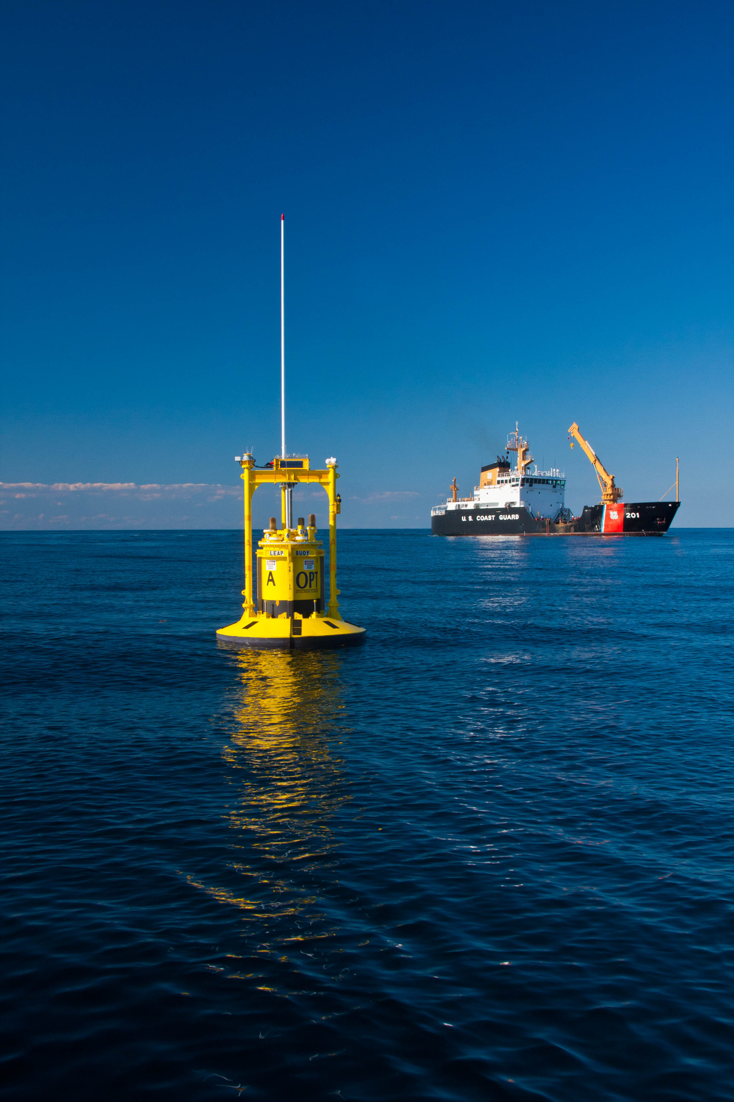
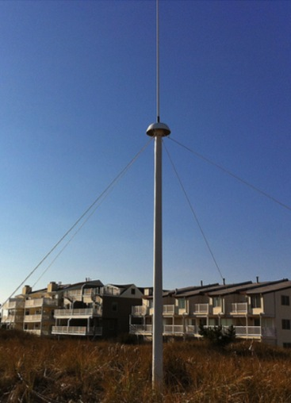

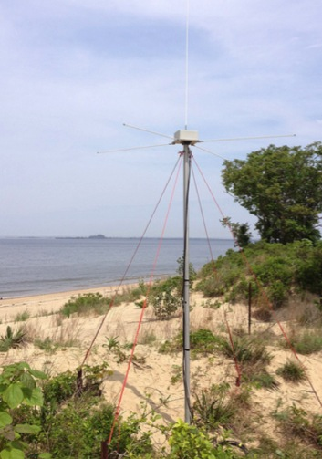



Mid-Atlantic Bight HF Radar Network
1000 km
Cape to Cape
Mid-Atlantic HF Radar Network
16 Long-Range CODARs
8 Medium-Range CODARs
17 Short-Range CODARs
41 Total (Pre-Sandy)
Triple Nested, Multi-static, Multi-use
Industry Partner: CODAR Ocean Sensors

Slide 8
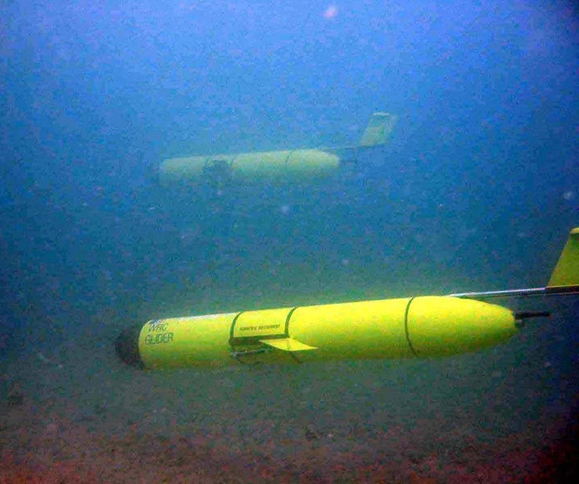
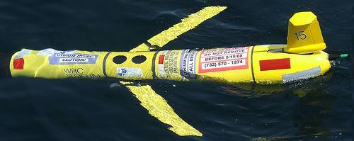
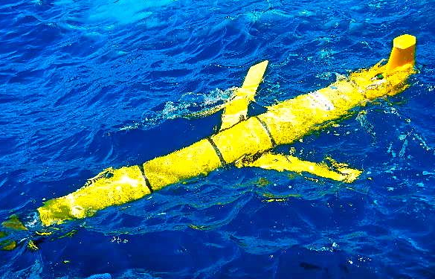
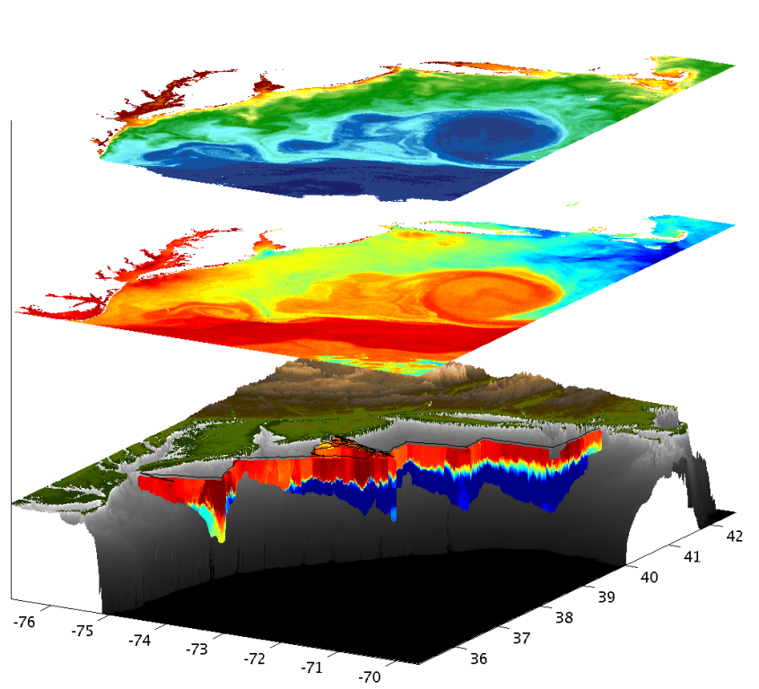
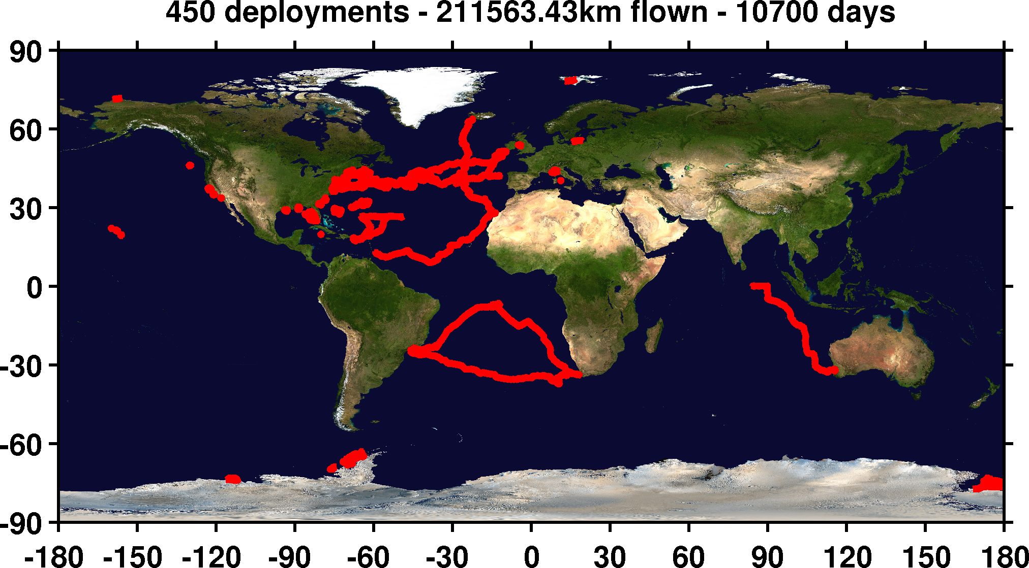

Mid-Atlantic Bight Glider Network
RU01
RU15
RU29
G1
G1-Ruggedized
G2
Satellite Ocean Color
Satellite SST
Subsurface
Glider
Data
Industry Partner

Slide 9
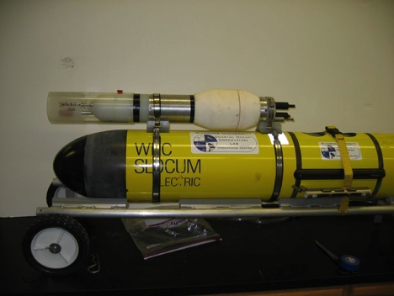
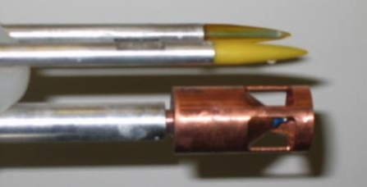
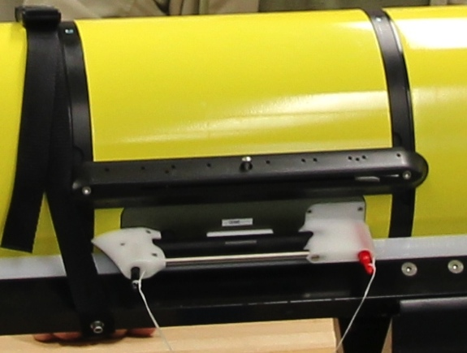
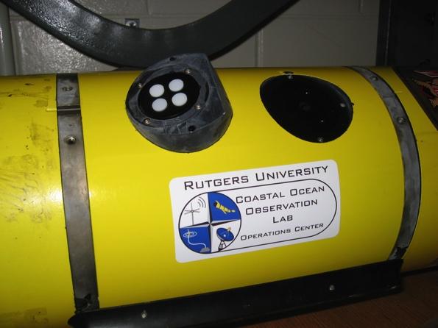
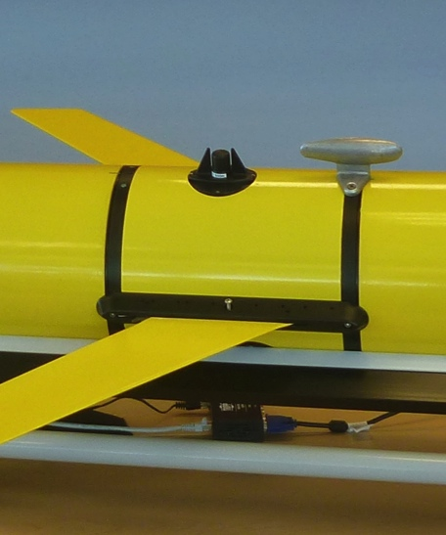
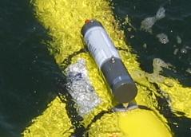
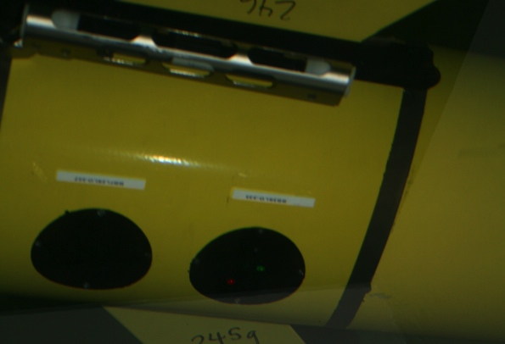
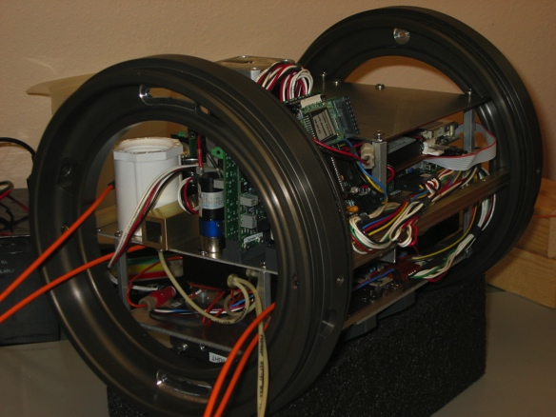
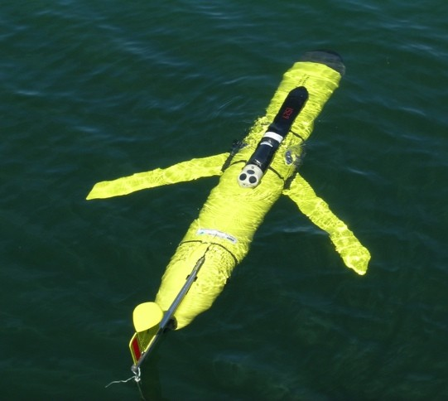
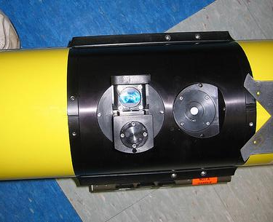
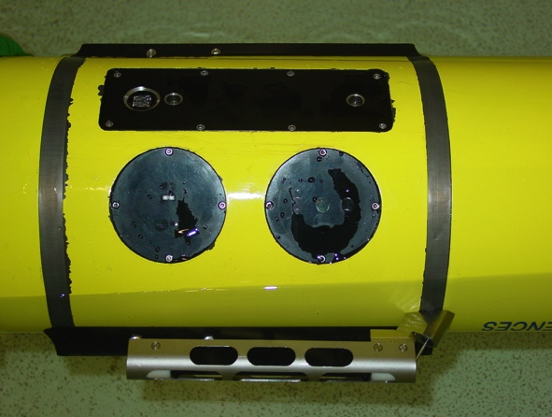

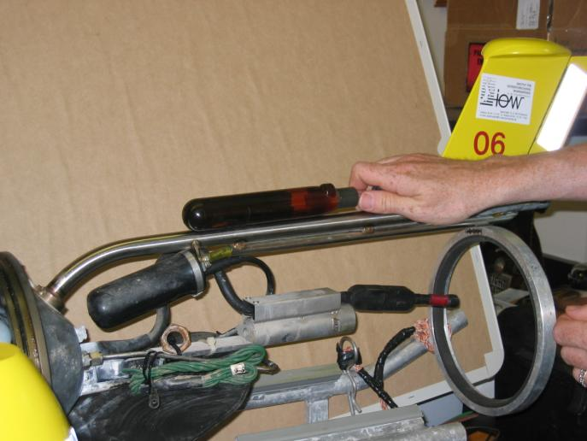
Glider Sensors
Inside Payload Bay or External

Slide 10
Data/Product Development Approach
Need / Requirement
Users
Observations and
Predictions
MARACOOS
& Partners
Products /
Decision Tools
All

Slide 11
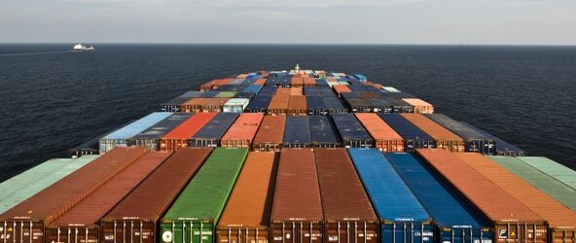
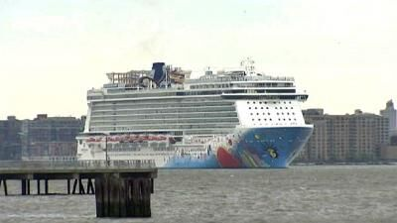
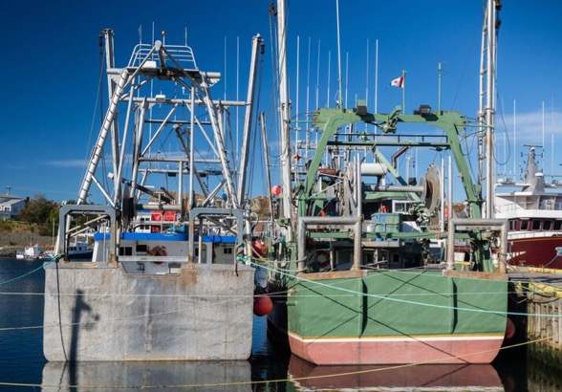
Maritime Commerce and Safety
Notes:
Marine transportation is the primary means of moving goods in and out of the region (and the nation).
Supporting safe transportation includes the
Need to provide surface current information and forecasts for pilots to navigate
A better picture of the ocean (addressing parameters, like upwelling, that are not considered in standard products) and conditions in and around approaches to allow for maximum loads
Need to provide integrated products to support mariners of all types for safer operation
→ This supports 24% of marine commerce moving in and out of the country
→ Supports the passenger cruise industry
Supports fishing safety
In general, this supports the safety of life and property at sea, as well as marine and onshore life and property

Slide 12


Coastal Flooding
Notes:
There are many types of flooding, and we concern ourselves largely with the impacts on coastal and near coastal areas.
The NOAA, the US Geological Survey, along with states and local communities, and many others, concern themselves with water abundance and the dynamic nature of its movement.
Particularly during weather events, people notice the impacts of water on lives and property. But there are also regularly occurring smaller-scale flooding situations that cause damage, that in total, is significant.
There is a need to more data points to enhance and strengthen/validate models
- There is need for coupled modeling across the entire movement of water
- there is a need to support partners who develop products for water related information products, like private sector partners, the National Ocean Service, and the National Weather Service
- this includes things like better wind forecasts, better and consistent surface current information, and data and predictions to support street level inundation/flooding forecasts.
--> this affects life property and the economy, as we see in big events like Superstorm Sandy, but also in smaller episodic events, like the coastal flooding we see in places like Hampton Roads, Virginia.

Slide 13


Search and Rescue
Notes:
Search and Rescue is an important mission of the U.S. Coast Guard.
Narrowing search areas
Providing minimal levels of coverage in time and space (80/80)
Maintaining quality and consistency (improving where possible)
→saving lives and property, and reducing cost to government/taxpayer
Other requirement areas exist also:
Public Health
Food safety and security
Fisheries and Fishing
Pollution Tracking

Slide 14



Optimizing HF Radar for SAR using USCG Surface Drifters
Art Allen
U.S. Coast Guard
Scott Glenn
Rutgers University
Mid-Atlantic Regional Association
Coastal Ocean Observing System

Slide 15



5000 Virtual Drifters – 24 Hours Into Search
HYCOM
CODAR
Notes:
HYCOM, (low Conf) 24 hrs

Slide 16


5000 Virtual Drifters – 48 Hours Into Search
HYCOM
CODAR
Notes:
HYCOM, (low Conf) 24 hrs

Slide 17


5000 Virtual Drifters – 96 Hours Into Search
HYCOM
CODAR
Notes:
HYCOM, (low Conf) 24 hrs

Slide 18


5000 Virtual Drifters – Search Area After 96 Hours
154 km
100 km
232 km
123 km
HYCOM (36,000 km²)
CODAR (12,000 km²)
Notes:
HYCOM (Low Conf) 48 hours

Slide 19





Use of HF Radar Surface Currents for Search And Rescue:
Operational since May 4, 2009
Surface Currents
Data Acquisition
Data Product Generation & Management
Search And Rescue Optimal Planning System (SAROPS)

Slide 20



Hurricane / Storm Intensity
Notes:
Forecasting hurricane and storm direction and strength are the domain of the National Weather Service.
While track errors have decreased considerably over time, decreases in hurricane intensity error have not kept up.
Need to improve intensity forecasts and the models that underpin them
This requires, in part, a better picture of the ocean,
Which requires more data points,
Which requires, among other things, more glider deployments,
Along with better ocean modeling
And better coupling with atmospheric models
To ensure that the new, relevant, data and models are helping drive toward better intensity forecasts.
The Mid-Atlantic alone includes 78 million people across the 600 mile footprint.
Saves lives and property for citizens and communities across the mid-Atlantic footprint, including also government partners such as the U.S. Navy, which has a large presence of high value assets in our region.

Slide 21



78 Million People (1/4 of U.S.)
1000 km Cape to Cape
U..
Middle Atlantic
Regional Association
Coastal
Ocean Observing System
Cape
Cod
Stratified
Coastal Ocean Interactions with
Tropical Cyclones
Sandy
Irene
Barry
Arthur
Scott Glenn, Travis Miles,
Greg Seroka, Robert Forney,
Hugh Roarty, Oscar Schofield, Josh Kohut (Rutgers),
Yi Xu (China) & Fei Yu (China)
Nature Communications (2016)
Hermine
Cape
Hatteras
Notes:
21

Slide 22

Rutgers ROMS 4DVAR uses all available data
from a modern coastal ocean observing system
  more and diverse data is better (T, S, u, sea level)
  bias correction to OBC and MDT is essential
Useful subsurface skill for real-time applications:
  4 days for temperature and salinity;
  1-2 days for velocity
Future directions: variational methods for
observing system design; coupling; ecosystems
correlation
Forward model
Forward model
after bias removal
Data assimilation
analysis/hindcast
depth
2-day forecast
4-day forecast
Bottom temperature
Data used [… real-time SOURCE]
*THREDDS Data Server
72-hour forecast NAM 0Z cycle at 2 am EST [NCEP NOMADS]
RU regional CODAR hourly: 4-hour latency delay [RU TDS*]
RU glider T,S when available (~ 1 hour delay) [RU TDS]
USGS daily average flow available 11:00 EST [USGS waterdata]
AVHRR IR passes 6-8 per day (~ 2 hour delay) [MARACOOS TDS]
REMSS MW-IR blended SST daily average [NASA PO-DAAC]
HYCOM NCODA 7-day forecast updated daily [NRL]
Jason-2, CryoSat, AltiKa along-track altimeter OGDR [RADS.nl]
SOOP XBT/CTD, Argo floats, on GTS [NOAA OSMC ERDDAP]

Slide 23

Advanced Research Version of WRF
Weather Research and Forecasting (WRF) model, Advanced Research core (ARW), Version 3.4.1 (Michalakes et al., 2001)
Horizontal Resolution: 6km
Vertical Resolution: 35 levels, focused near surface
Lateral B.C.: Global Forecast System (GFS) 0.5 degree
Microphysics: WRF Double-Moment 6-class scheme
Planetary Boundary Layer (PBL) scheme: Yonsei University scheme
Longwave radiation: Rapid Radiative Transfer Model (RRTMG)
Shortwave radiation: Dudhia
Bottom B.C. (Sea Surface Temperature, SST): Variant

Slide 24


Hurricane Irene
August 28, 2011
NOAA/NHC Damage:
#7 with >$16 Billion.
Track Accurate;
Intensity Over-predicted.
Avila & Cangialosi, 2012, Tropical Cyclone Report
Hurricane Sandy
October 29, 2012
NOAA/NHC Damage:
#2 with >$68 Billion.
Track Accurate;
Surge Under-predicted.
Georgas et al., 2014, J. of Extr. Even.
Colle et al., 2015, J. Mar. Sci. & Engr.

Slide 25


Motivation: Research to Operations to Research (R2O2R)
Track Error: Decreases in 20-Year Trend Intensity Error: - “Long-term trend is flat”
Track: Improvements attributed to Global Forecast Models & the Super-Ensemble.
Intensity: “…upper-ocean thermal structure can affect the evolution of storm intensity, …Unfortunately, the paucity of subsurface measurements limits our ability to assess the effect of upper-ocean variability on tropical cyclone intensity evolution.”
– Emanuel et al., (2004)
Production Suite Review: December 4, 2012

Slide 26

Hurricane Intensity is modulated by upper ocean heat content
Rapid intensification of Hurricane Katrina over warm ocean water

Slide 27

National Hurricane Center: Intensity Skill in 2012
But
adding the ocean model reduces forecast skill.
WE NEED A BETTER OCEAN!

Slide 28





Hurricane Irene
August 27-28, 2011
Hurricane Irene
0
26
NOAA/NHC:
Damage >$16B ( #7)
Track Accurate
Intensity Over-predicted
depth
temperature
55
14
0
33
depth
salinity
55
29
0
105
depth
% oxygen
Two Gliders Deployed
55
60
8/12
date
9/07

Slide 29





Pre-Irene
Post-Irene
Difference
11C max Cooling
WHAT?
Satellite
SST
WHEN? Glider Temperature
WHY?
HF Radar
Currents
Eye Passage
?

Slide 30

Pre-Irene
Post-Irene
Difference
11C max Cooling
WHAT?
Satellite
SST
WHEN? Glider Temperature
WHY?
HF Radar
Currents
Eye Passage
Eye Passage

Slide 31






Atmospheric Forecast Sensitivity Study
Warm Ocean
Boundary Condition
Cat 1 Hurricane
Cold Ocean
Boundary Condition
Tropical Storm
IMPACT?
>10 knots reduction in peak wind speed

Slide 32

WRF Model Sensitivity Study
Over 130 model runs
Paired to compare sensitivities
Central pressure & max wind
Sensitivity to SST greatest
Seroka, Miles, Xu, Kohut, Schofield & Glenn,
Hurricane Irene Sensitivity to Stratified Coastal Ocean Cooling, Monthly Weather Review, 2016

Slide 33

Historical Hurricanes Crossing the
Middle Atlantic Bight Continental Shelf in Stratified Season

Slide 34

Historical Hurricanes Crossing the MAB in Stratified Season
Observed Ahead-of-Eye-Center Cooling

Slide 35
Hurricane Irene Track August 27-28, 2011
Summary:
Summer Storm
Strong Stratification
Coastal Response
Mixing Cooled Surface
Limited Intensity
Present Models Inadequate
Opportunities for International Collaboration

Slide 36




Historical Typhoons Crossing the Yellow Sea in the Stratified Season
Summer/Winter SST Difference
Ramya Ramadurai, 2009
Bottom Temp
26 Typhoons
tracked across northern East China Sea & Yellow Sea since 1985
Chen et al., CSR, 1992

Slide 37




Typhoon Muifa - Total Cooling Observed by Satellite
SST
Before
Muifa
Track
SST
After
SST
Difference
Up to 7C
From: Sun, Duan, Zhu, Wu, Zhang & Huang, Acta Oceanol. Sin., 2014

Slide 38


Typhoon Muifa:
Ahead-of-Eye-Center Cooling
observed by Coastal Buoy
Muifa
Track
From: Fei Yu, Institute of Oceanology, Chinese Academy of Sciences
Yi Xu, State Key Laboratory of Estuarine & Coastal Research, East China Normal University

Slide 39
MARACOOS Korea Collaboration
2009 - Present

Slide 40



High Frequency Radar Networks

Slide 41








MARACOOS Hosts Korean Visitors
2009, 2012, 2013
2012, 2014

Slide 42






MARACOOS Partners Visit Korea

Slide 43


Korea – U.S.
Joint Program Agreement (JPA)
13 November 2016
IOOS & GOOS Introduction
Regional Ocean Observatories Research:
  Storms: Air Sea Interaction - Scott Glenn
  Storms: Sediment Transport – Travis Miles
  Fisheries – Josh Kohut
  Antarctica – Oscar Schofield

Slide 44





Korea Operational Oceanographic System (KOOS)
Provide monitoring and predicted data to government and to the public to support ocean activity and to solve pending problems such as storm surge, inundation, oil spills, search and rescue, red tide, wave overtopping etc. around the coast of Korea.
Real-time monitoring
Operational Modeling
Data Transmission, Management
Nowcast &
Forecast
Applications
Typhoon
Sediment

Slide 45



KIOST Smart Ocean System (KSOS)
Front screen
클라우드 서버실 및 통제실
융 ∙ 복합실험실
Rear smart glass

Slide 46








Collaboration on Coastal Ocean Observing System
Collaboration on Coastal Ocean Observing System (KIOST-Rutgers)
1. Monitoring of operational Glider, HF-Radar, Satellites(GOCI), Drifters etc.
2. Visualization of real-time monitoring (GOCI) and predicted model data.
CODAR Network
L-Band & X-Band Satellite Receivers
3-D Nowcasts
& Forecasts
Glider Fleet
Notes:
http://www.tacc.utexas.edu/news/press-releases/2012/tacc-releases-new-software
http://www.youtube.com/watch?v=oFQeszkCaPU&feature=relmfu
46

Slide 47





Joint Storm Glider Deployment – Summer 2018
Socheongcho
(2014)
Dokdo
(planing)
37km
Yellow Sea Buoy
(2007)
Gageocho
(2009)
47km
149km
Ieodo
(2003)

Slide 48
Conclusions:
New Ocean Observing Technologies enable New Understanding of Ocean Processes
GOOS provides a structure for Globalization
Korea-U.S. Partnership is a Pathway for Progress

