Slide 1
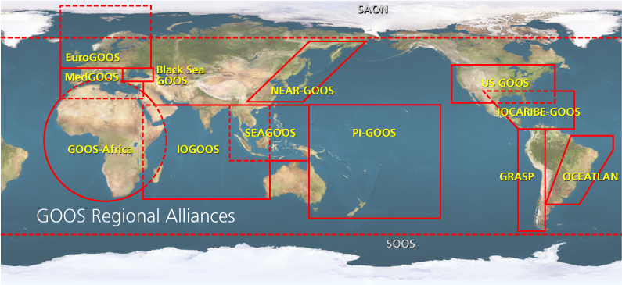

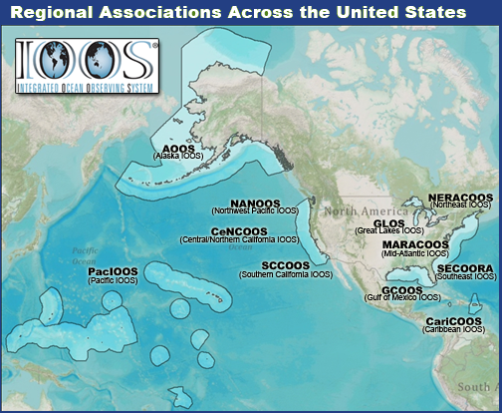


U.S. Integrated Ocean Observing System
IOOS Relationships
International Component
National Component
Regional Component
Global Ocean Observing System
Vessels -
Satellite
Satellite
CODAR
Ships/ Vessels
Glider
REMUS
Data Vis.
Modeling
Security
Leadership
Education
11 Regional Associations
18 U.S. Federal Agencies

Slide 2
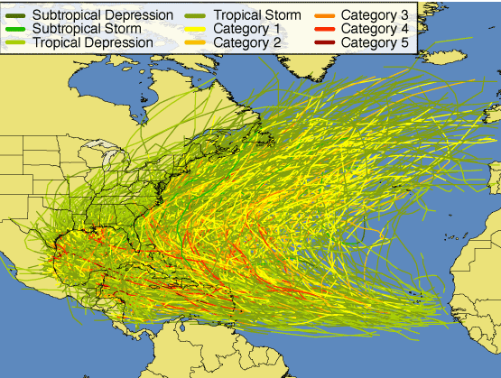
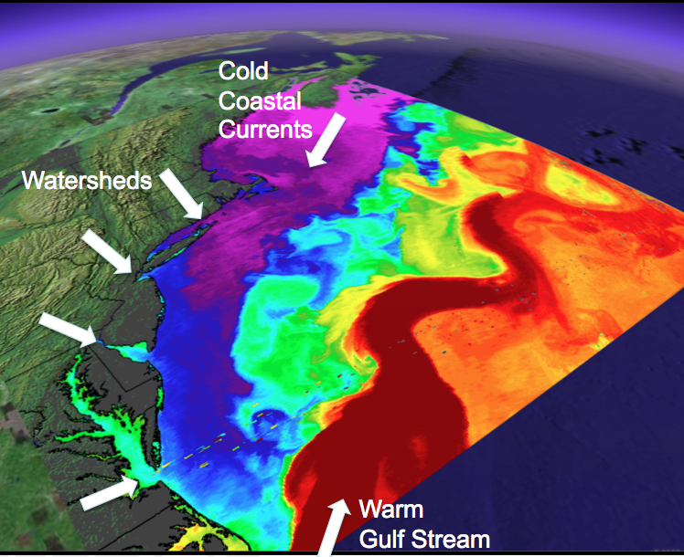
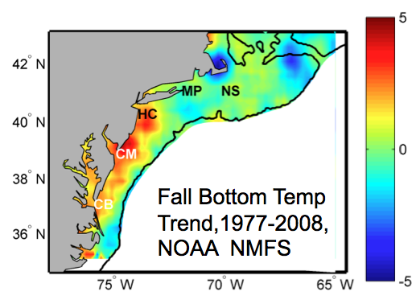
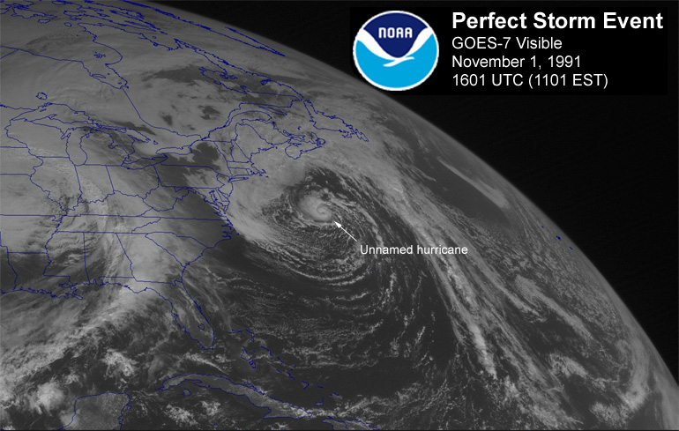
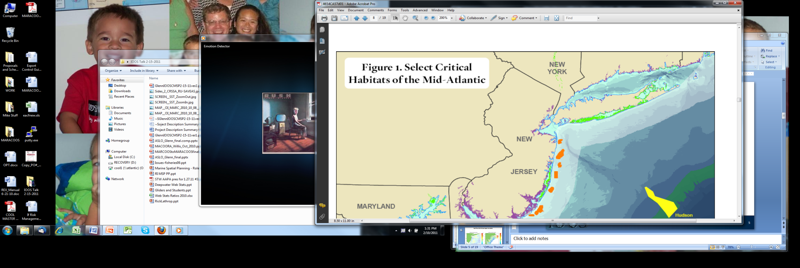
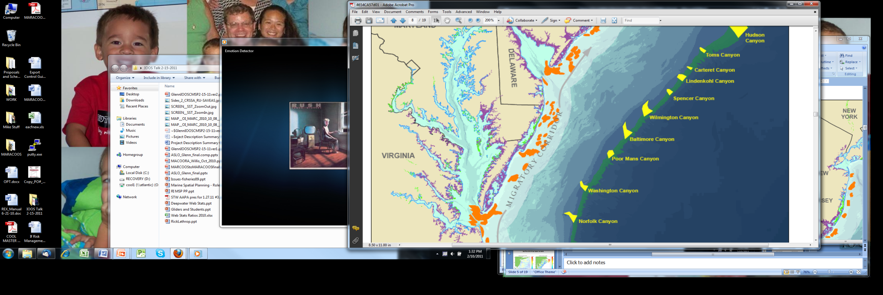
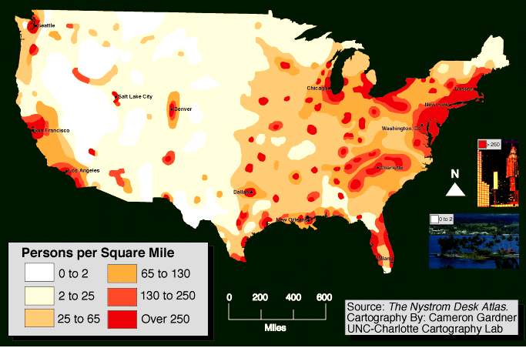
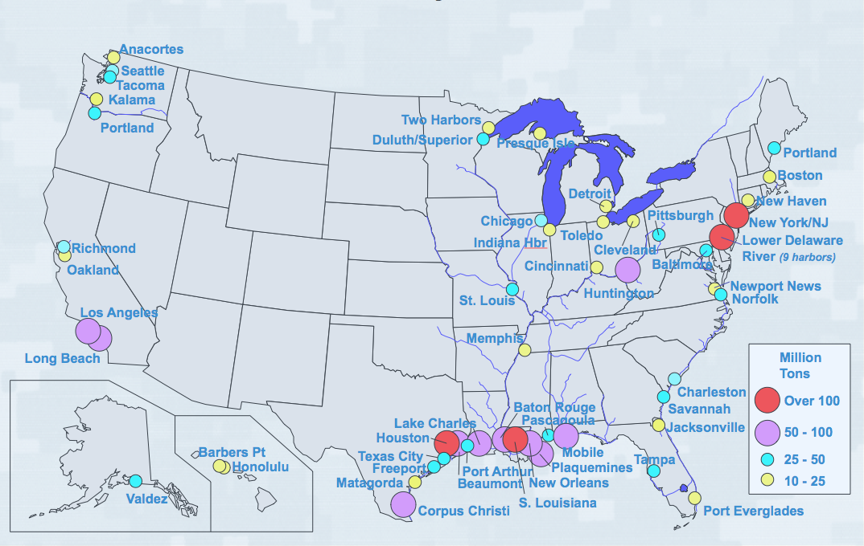
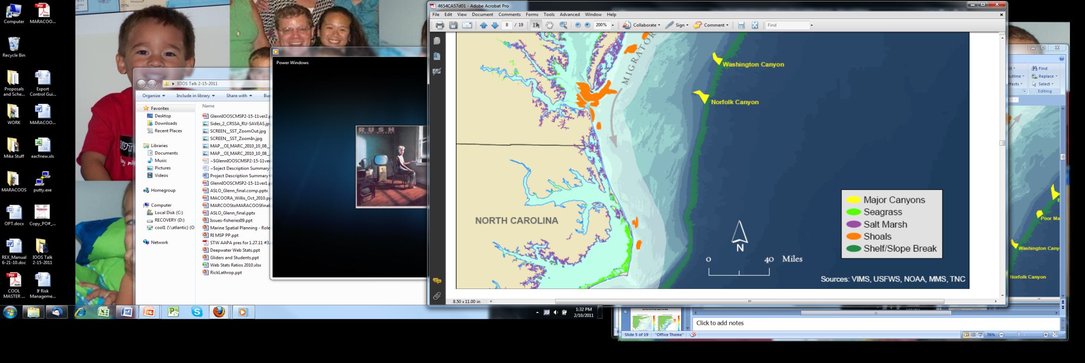
MIDDLE ATLANTIC REGIONAL DRIVERS
Tropical Storms
Climate Change
Ocean Circulation
Critical Habitat
Northeasters
Population
Ports
Notes:
The MAB is a dynamic boundary between cooler arctic waters and warmer tropical waters, with complex seasonal physical dynamics.
Inundation driven by tropical storms and northeasters are year-round threats to the large populations that live on the broad coastal plain.
These dynamics structure shellfish and migratory fish habitats that support both commercial and recreational fisheries.
To further compound these challenges, climate warming is altering fish and shellfish habitats in the MAB, and new rainfall patterns with more frequent extremes are impacting homes, farms and reservoirs.
Developed watersheds and urban estuaries, impacted by a century of industrialization and growing coastal populations, degrade coastal water quality and diminish recreational economies.
This high population density often results in serious pressure and completing demands for marine and coastal resources. These nearshore waters contain tier-one ports, military bases, and important inshore shellfish and finfish grounds.
It is here that economically valuable uses such as recreation, tourism, and fisheries readily conflict with other valuable uses leading to a need for informed coastal and marine spatial planning.

Slide 3
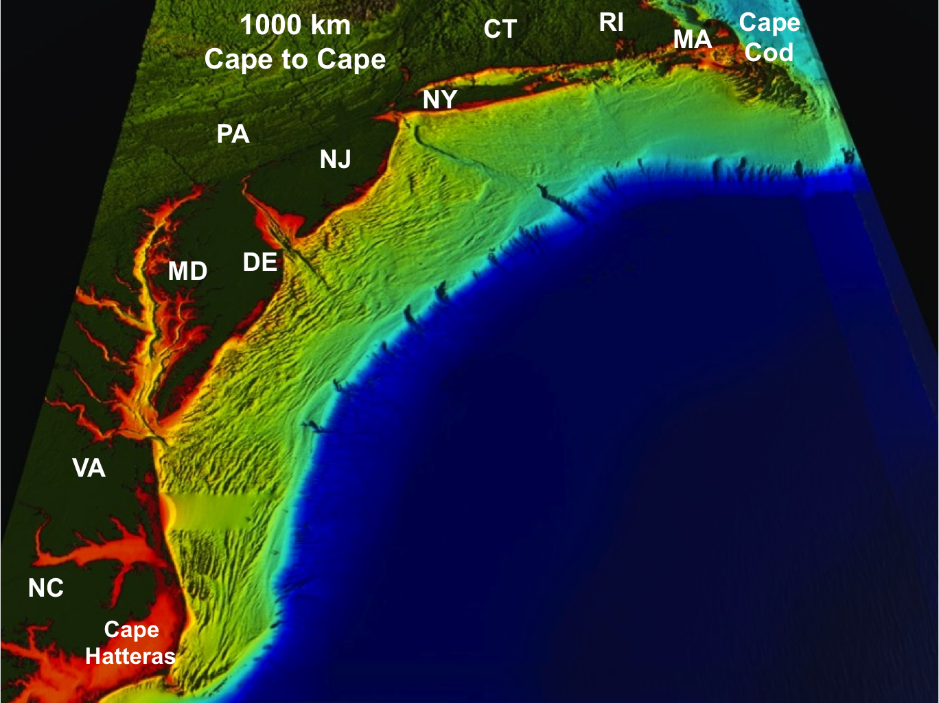
Region of work
MARACOOS Mission:
To seek, discover, share, and apply new knowledge & understanding of our coastal ocean

Slide 4
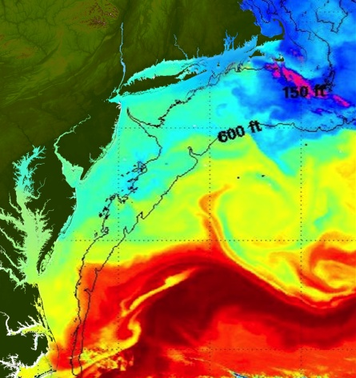
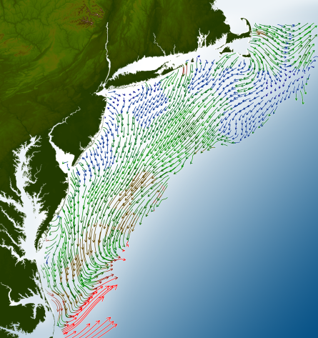
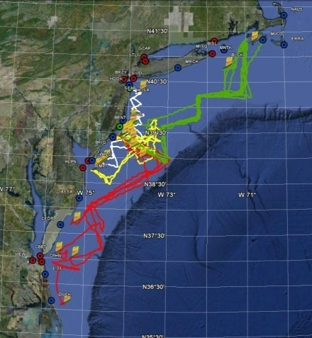
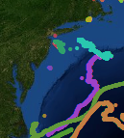
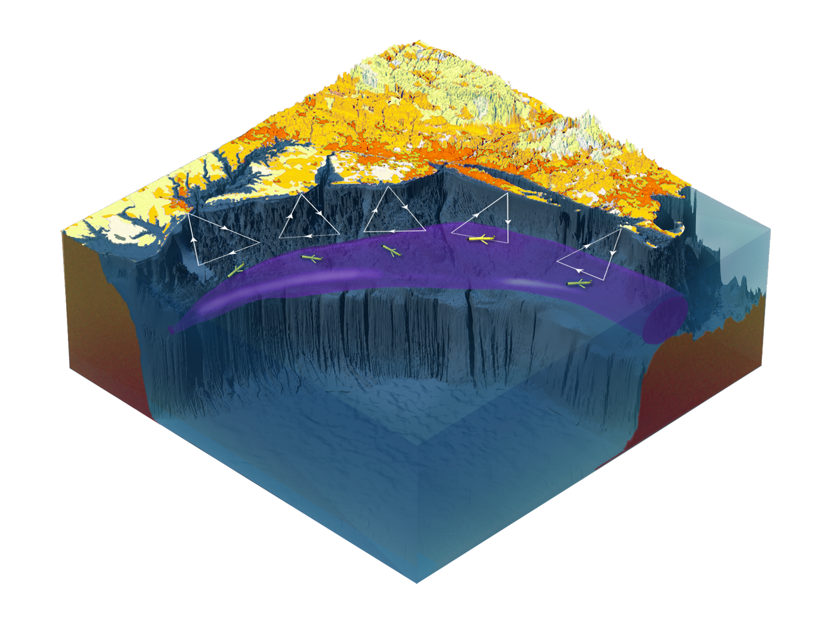



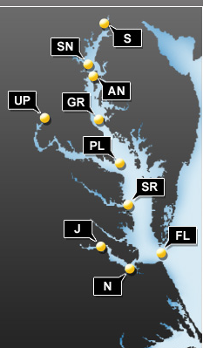
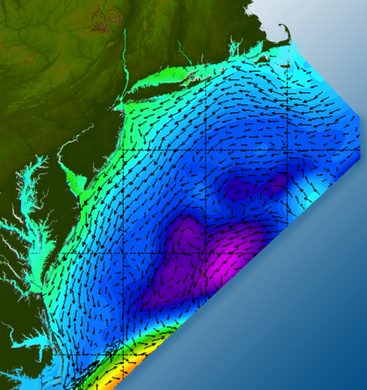
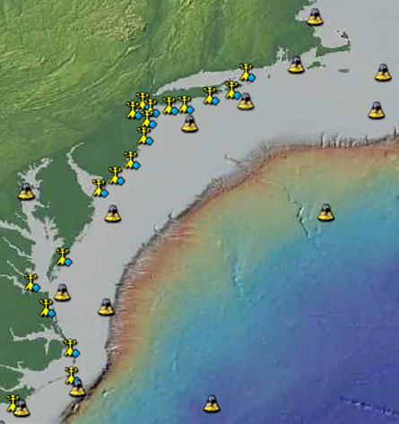
Satellites
Drifters
Gliders
HF-Radar
Population Density
Ocean Forecast Ensemble
Weather Stations
Buoys
Notes:
You saw a version of this slide earlier in Rick Spinrad’s talk; but I wanted to lead off with this, because this is what many folks associate us with: cool technology.
We apply a variety of assets and technologies; some owned by the network itself, and some leveraged.
These help us provide a real-time picture, but also serve to initialize and validate models that underpin a variety of predictions (I don’t use “forecast”)
The choice of technologies is dependent on the regional and local issues being addressed.
The bottom line is that the user needs drive the process.
We take a look at what was needed in terms of information and decision tools, what predictions and models would feed into those products, and what observations and technologies would support the models and predictions.
Of course we have not been able to do everything at once; so we’ve had to prioritize nationally and regionally as to what we will focus on.
We do that through a consultative process with our stakeholders/users as well as with our regional and national network

Slide 5
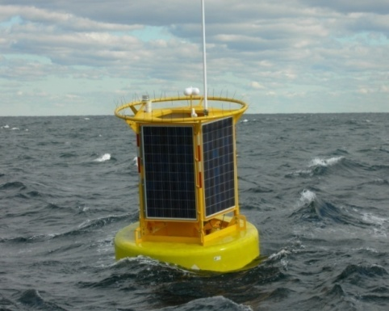
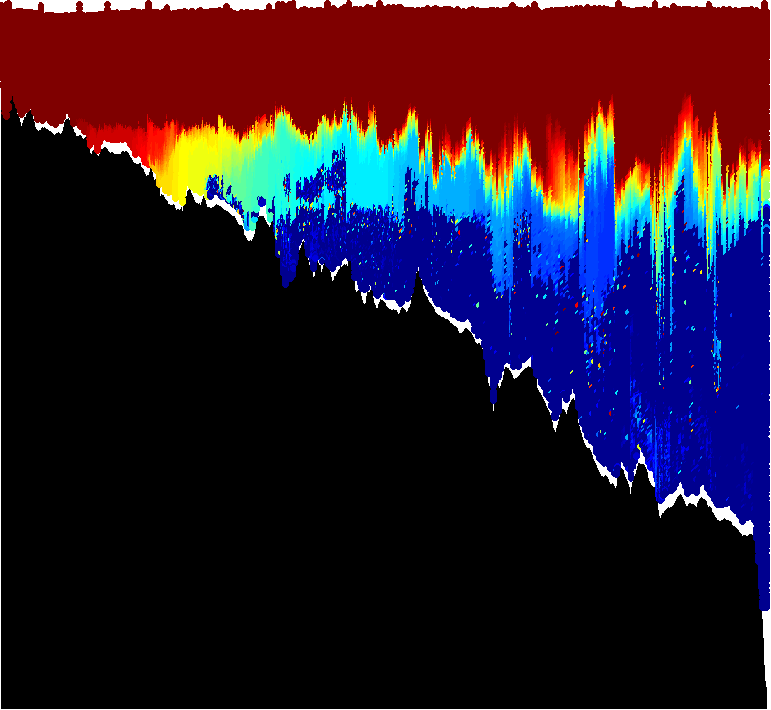
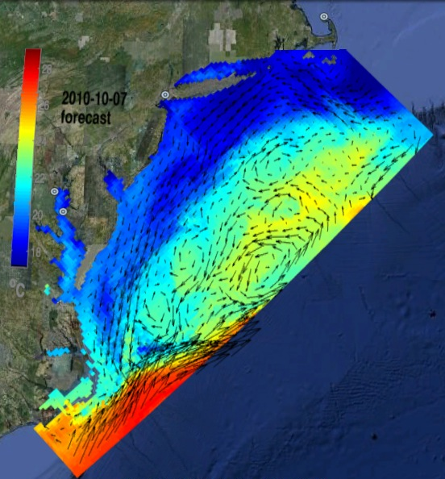
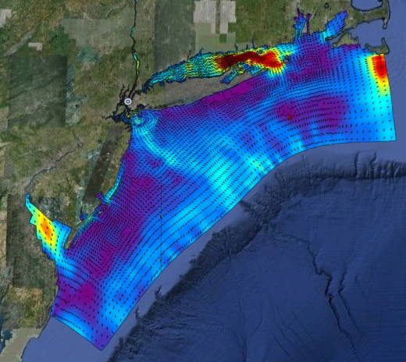
Regional Ocean Observing System
Gliders
Satellites
HF radar
Buoys
Ensemble of Assimilation Models
ROMS
HOPS

Slide 6
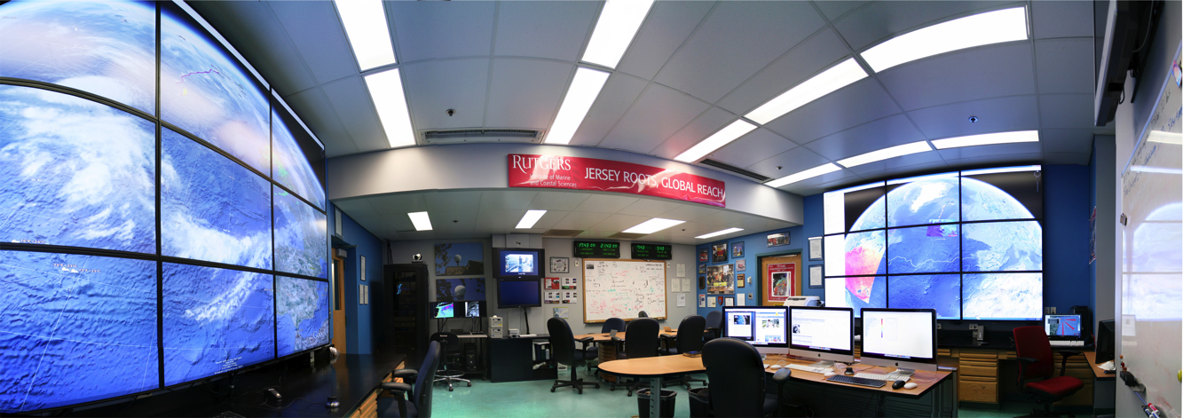
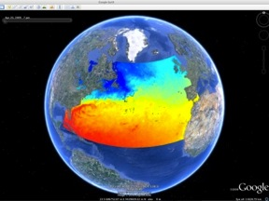
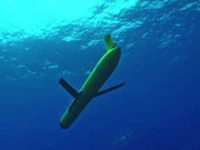
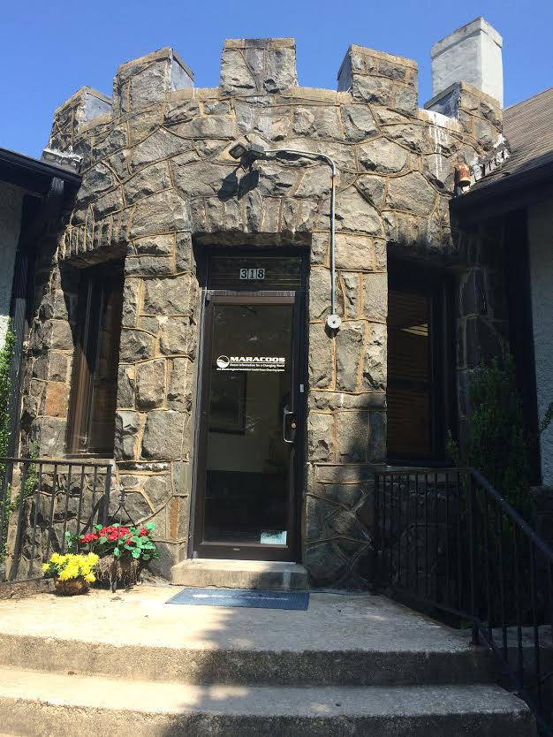
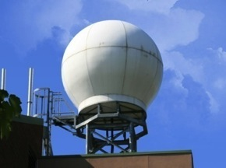
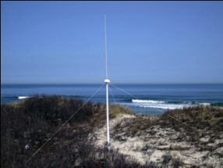
MARACOOS Headquarters and Operations Center
3-D Predictions
Glider Fleet
Satellite Data Acquisition Stations
HF Radar Network

Slide 7
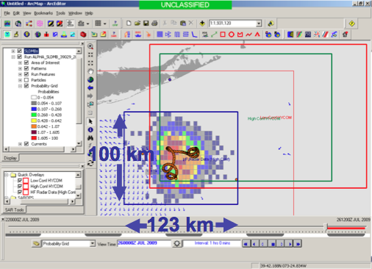
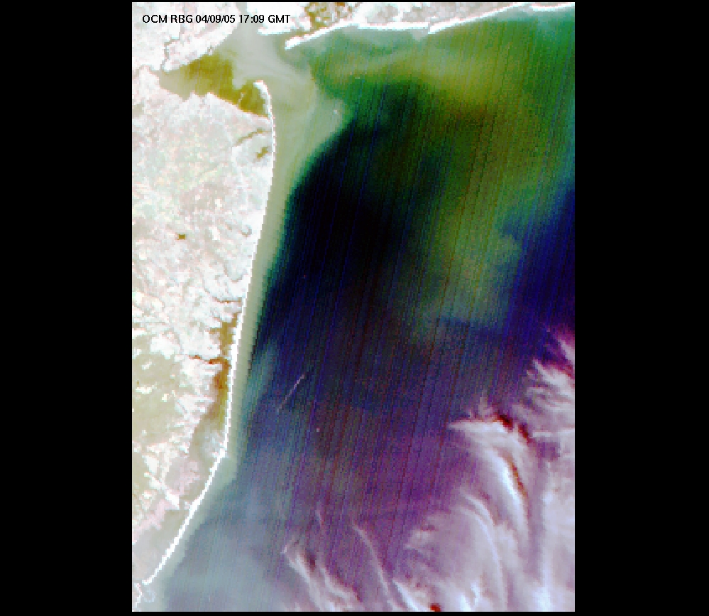
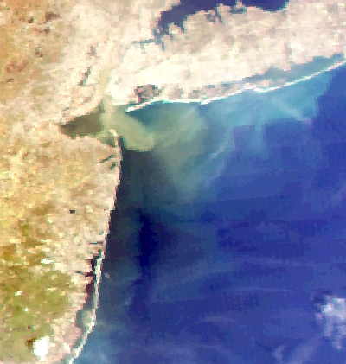
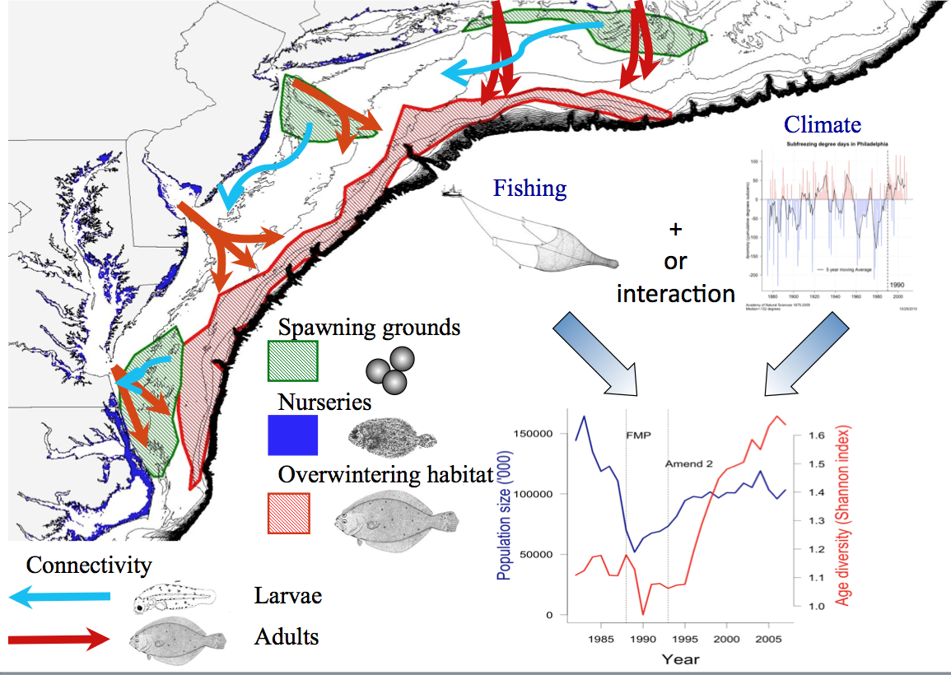
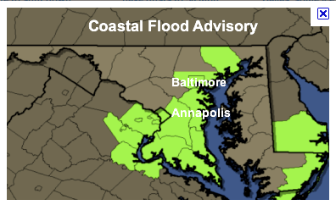
MARACOOS REGIONAL THEMES
1) Maritime Operations – Safety at Sea
3) Water Quality – a) Floatables, b) Hypoxia, c) Nutrients
2) Ecosystem Decision Support - Fisheries
5) Energy – Offshore Wind
4) Coastal Inundation - Flooding
Notes:
Scott

Slide 8
How can we relate a moving fish to the moving ocean observed and predicted by MARACOOS in a way that is relevant to assessment science and management?
A couple examples…

Slide 9
Some applications of IOOS infrastructure & biophysical models
capturing responses to dynamic ocean environment:
Population & Ecosystem assessment
Observation models
(migration, availability & detectibility to surveys)
---------------------------
Process models
(rates of birth, death, immigration, emigration &
Stock structure)
Tactical management tools
Dynamic spatial management (GRAs)
----------------------------------------
Bicatch reduction tools
Real & near real time ocean information crowdsourcing
What’s the reality of the ocean now, not 3 years ago
‘proactive not reactive’

Slide 10
Some applications of IOOS infrastructure & biophysical models
capturing responses to dynamic ocean environment:
Population & Ecosystem assessment
Observation models
(migration, availability & detectibility to surveys)
---------------------------
Process models
(rates of birth, death, immigration, emigration &
Stock structure)
Tactical management tools
Dynamic spatial management (GRAs)
----------------------------------------
Bicatch reduction tools
Real & near real time ocean information crowdsourcing
What’s the reality of the ocean now, not 3 years ago
‘proactive not reactive’

Slide 11
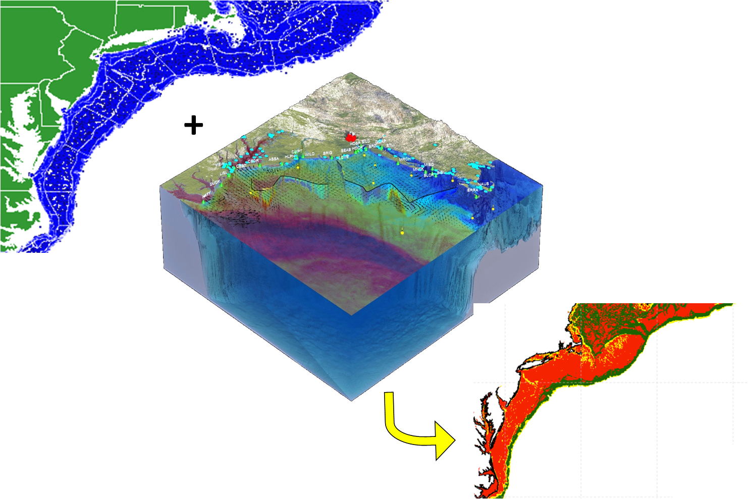
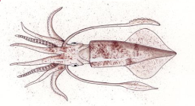
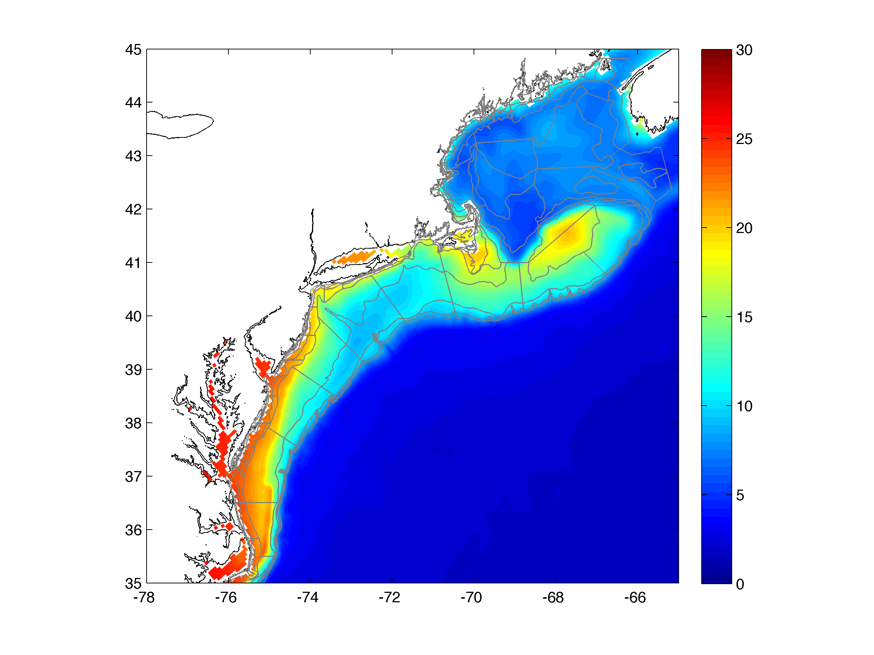
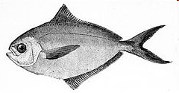
Approach: Regional Habitat Models
NOAA US Fishery Data
Spatial grain = 11km
Ocean
Observations
+
Physical Models
Regional
Habitat
Projection
Statistical and Mechanistic
“niche” Models

Slide 12
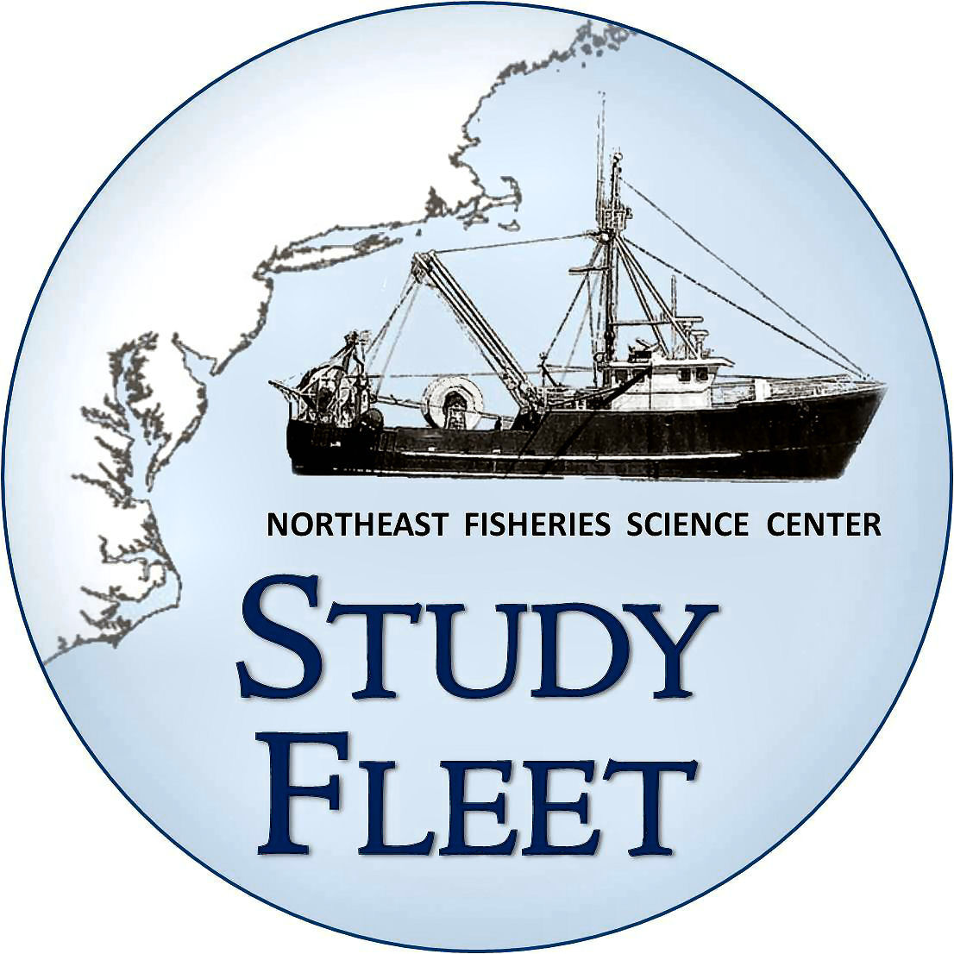
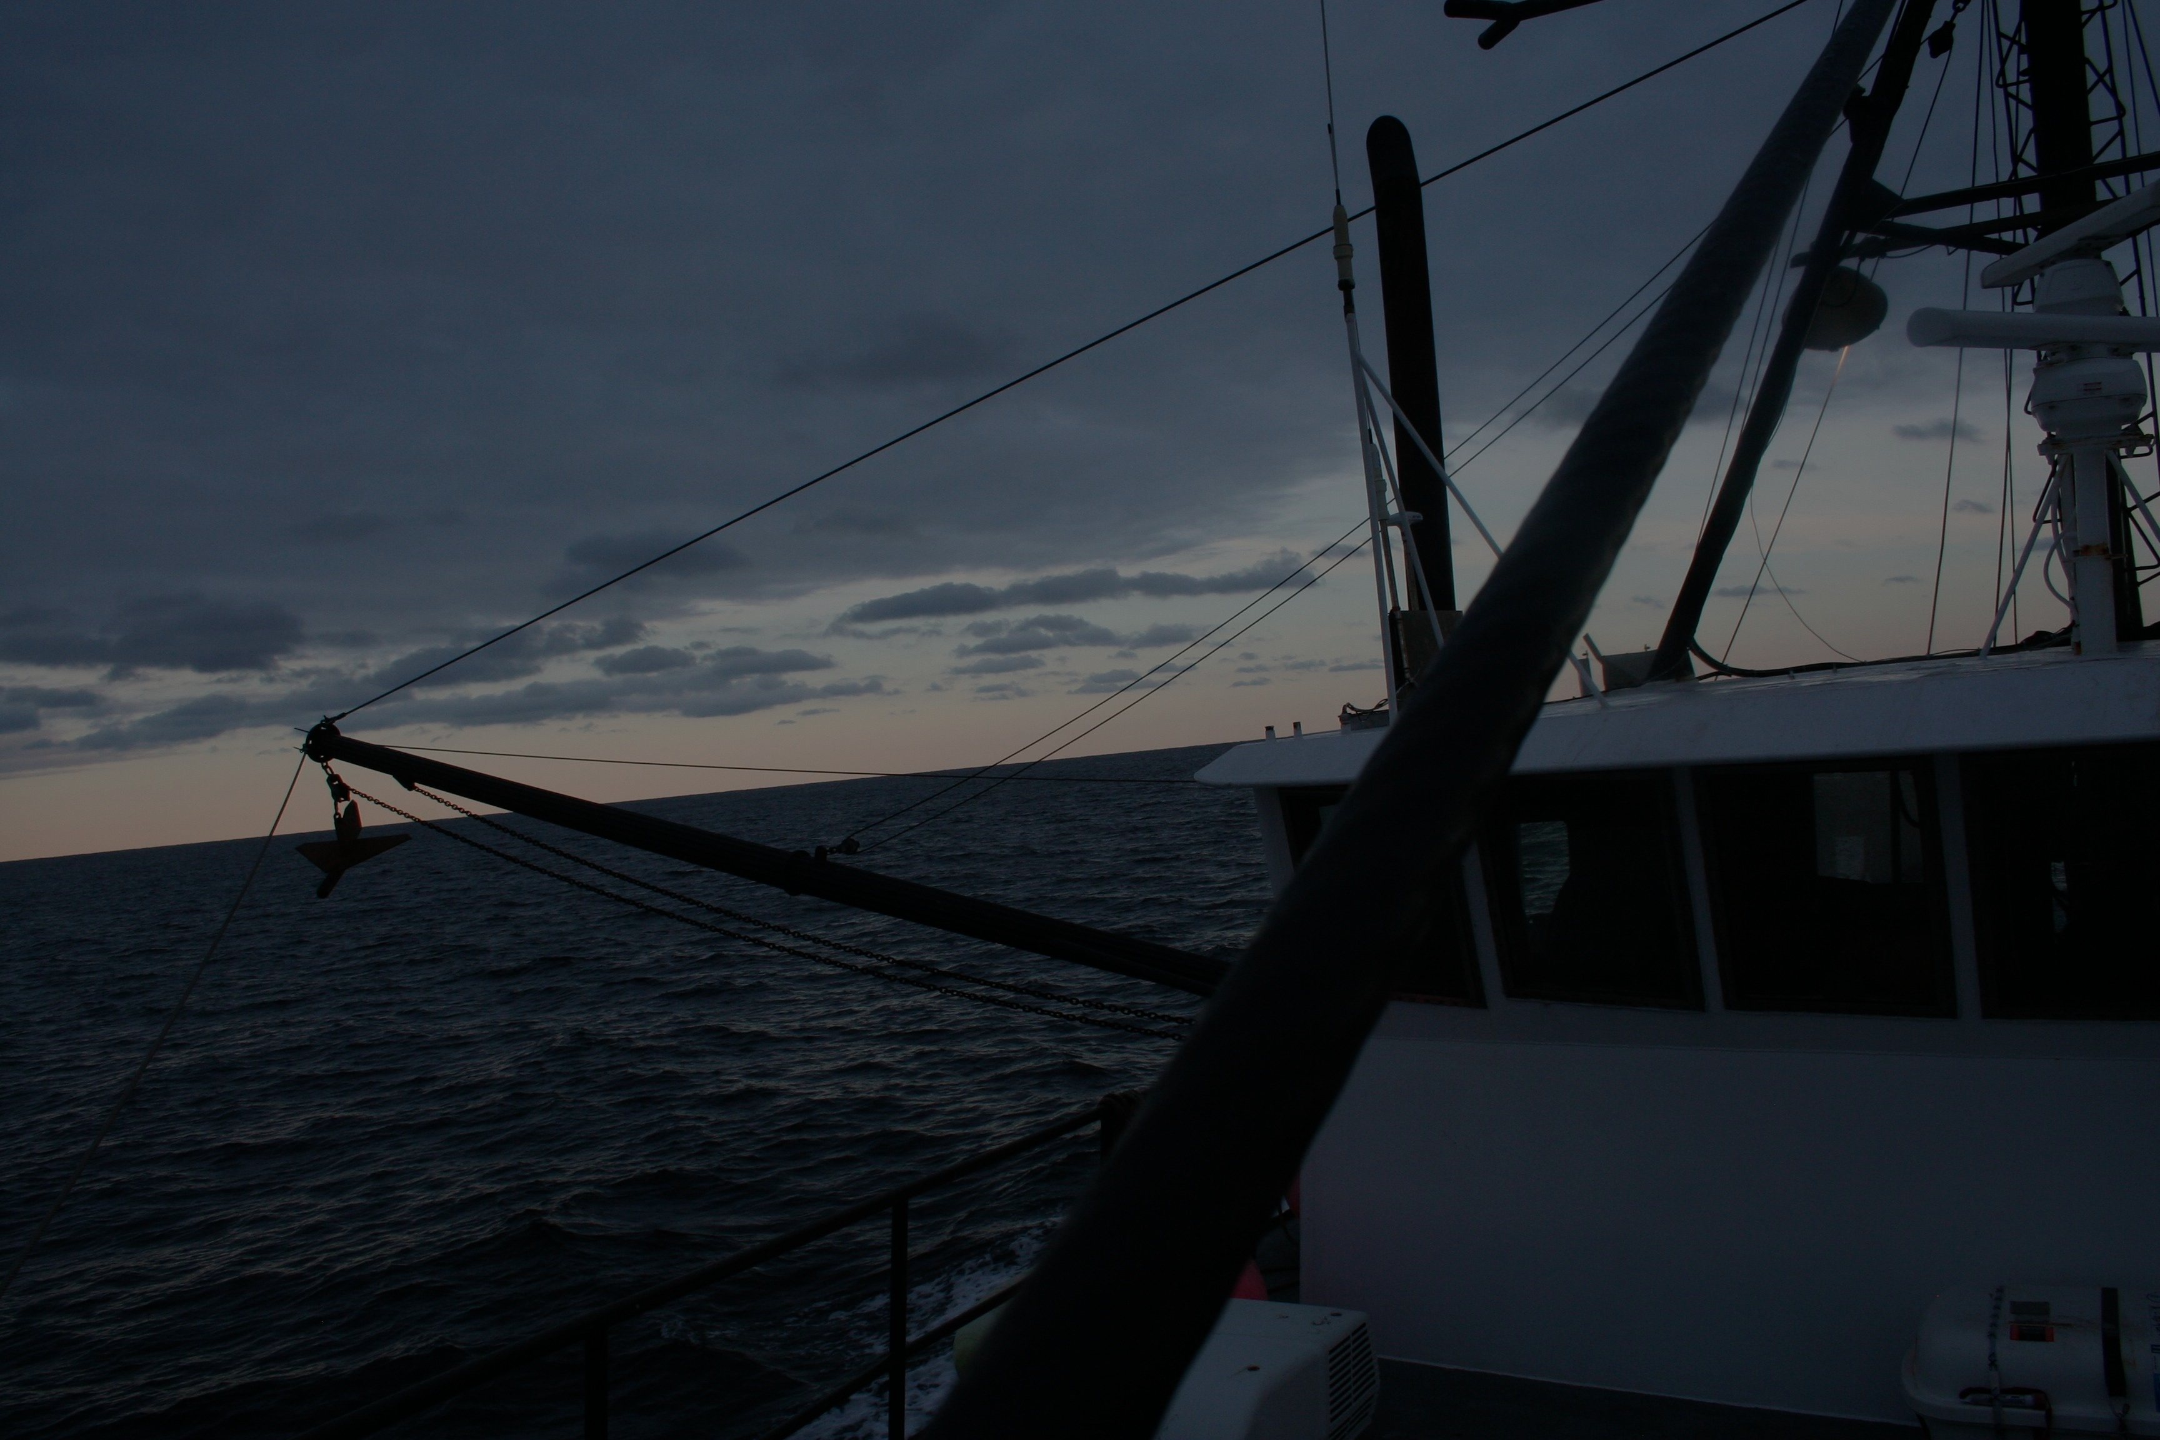
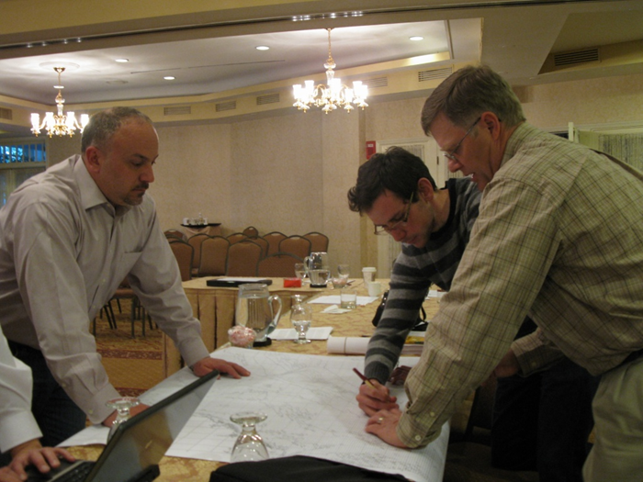
OpenOcean Study Group
Fishery Scientists/Ecologists
John Manderson
(NOAA/NEFSC)
Laura Palamara (Rutgers)
Olaf Jensen (Rutgers)
Tim Miller (NOAA/NEFSC)
Chuck Adams (NOAA/NEFSC)
Howard Townsend (NOAA/NEFSC)
John Quinlan (NOAA/SEFSC)
David Richardson (NOAA/NEFSC)
Physical and Biological Oceanographers
Josh Kohut (Rutgers)
Matt Oliver (U. Delaware)
Andre Schmidt (SMAST)
Nickitas Georgas (Stevens Inst.)
Enrique Curchitser (Rutgers)
Industry/Outreach
Chris Roebuck
Dan & Lars Axelsson
Hank Lackner
Geir Monsen (Seafreeze)
Greg DiDomenico
(Garden State Seafood)
Lunds Fisheries
Eleanor A. Bochenek (Rutgers)
John Hoey (NOAA/NEFSC)
Fisheries Management
Jason Didden (MAFMC)
Rick Seagraves (MAFMC)
Human Dimensions
Steven Gray (U Mass.)

Slide 13
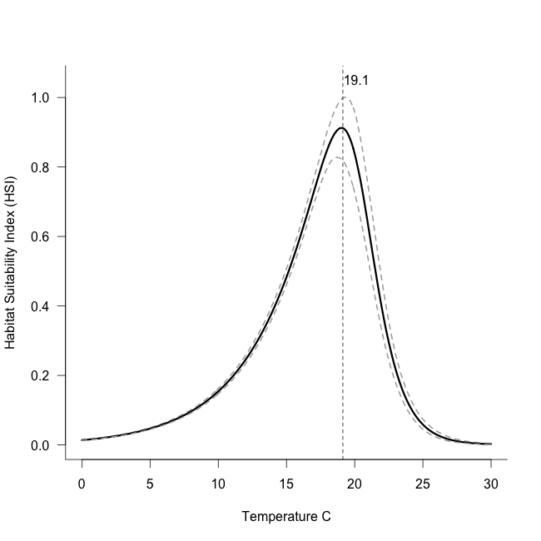
Mechanistic Model v. 3.0
Niche model: nonlinear extension of
Boltzmann-Arrhenius equation
(mechanistic basis in enzyme kinetics)
Water temperature
hindcast from
oceanographic model
1958-2007
Daily Temperature
~7 km Resolution
+
From Enrique Curchitser, Rutgers

Slide 14
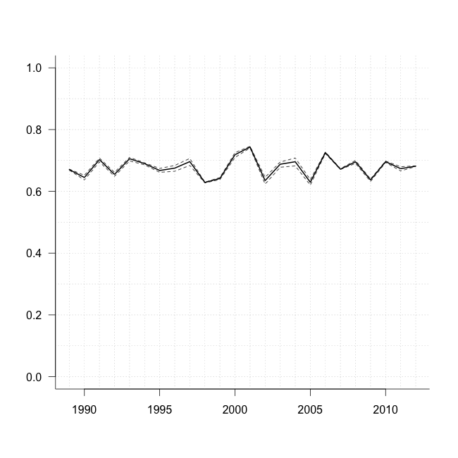
Approach:
Use coupled biophysical model to develop
a habitat based estimate of availability (ρ_{h}) to surveys
Median ρ_{h} = 0.68
(0.62-0.75)
Availability (ρ) to fall NEFSC
survey stations offshore
Estimates changes in availability (ρ) over time.
Thermal habitat based ρ accounts for shifts in species distributions associated with climate impacts on ocean temperatures
Availability (ρ)
Catchability (Q)
Detectability(δ)

Slide 15
Some applications of IOOS infrastructure & biophysical models
capturing responses to dynamic ocean environment:
Population & Ecosystem assessment
Observation models
(migration, availability & detectibility to surveys)
---------------------------
Process models
(rates of birth, death, immigration, emigration &
Stock structure)
Tactical management tools
Dynamic spatial management (GRAs)
----------------------------------------
Bicatch reduction tools
Real & near real time ocean information crowdsourcing
What’s the reality of the ocean now, not 3 years ago
‘proactive not reactive’

Slide 16
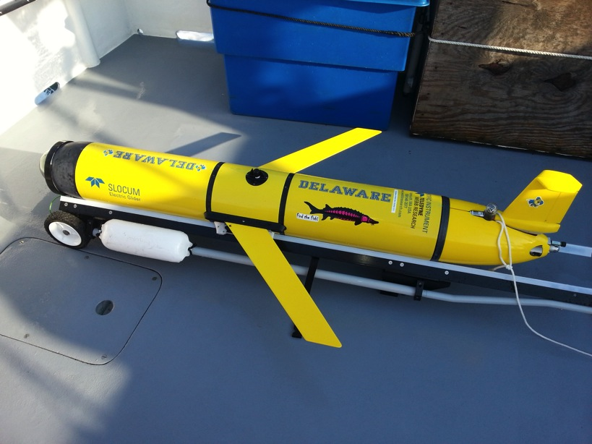
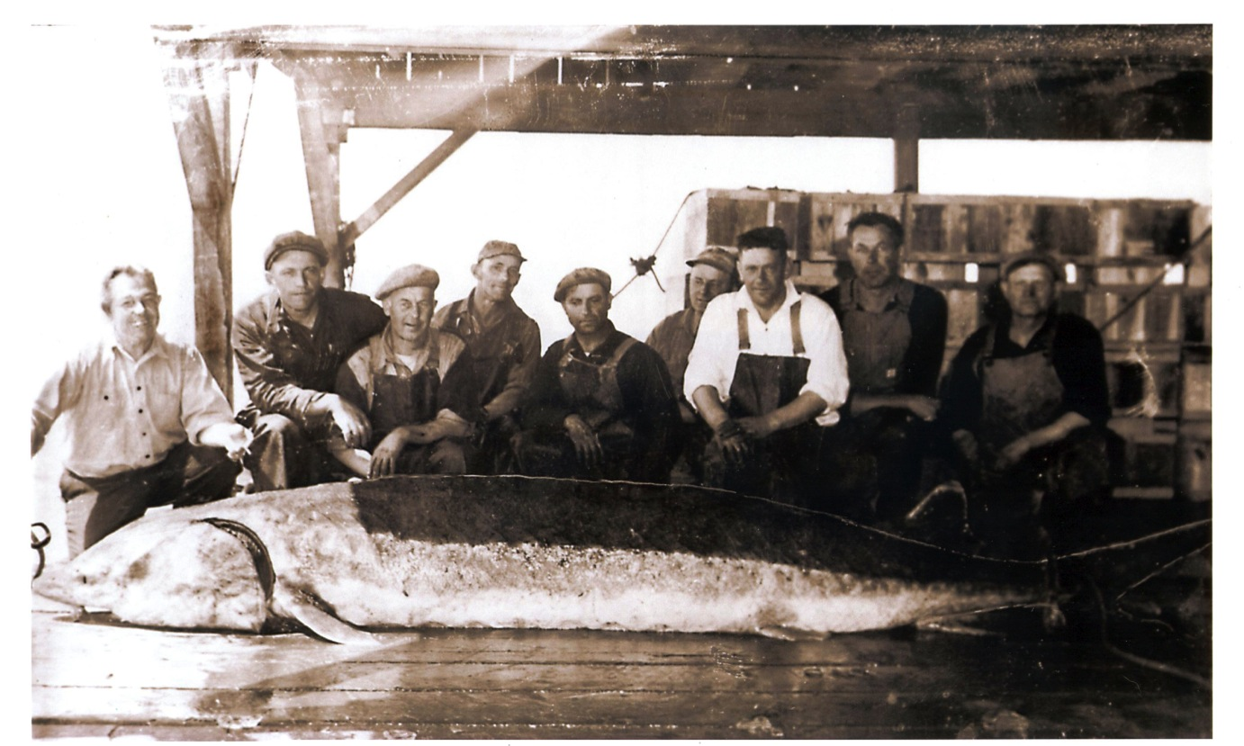
USING SATELLITES AND AUVS IN AN INTEGRATED OCEAN OBSERVATORY TO IDENTIFY ATLANTIC STURGEON HABITAT
Matthew Breece¹, Keith Dunton², Dewayne Fox³, Matthew Oliver¹ 1. University of Delaware, 2. Stony Brook University, 3. Delaware State University

Slide 17
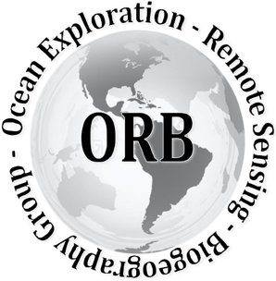






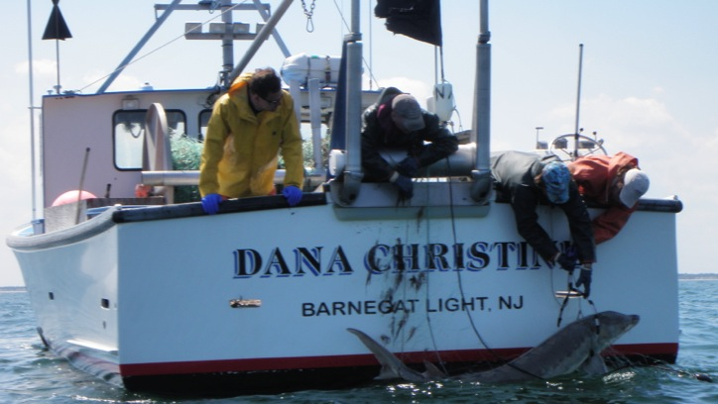



Acknowledgements
Notes:
Also I want to say that this project is just part of a much larger effort of satellites and NASA and even the sections 6 project.

Slide 18
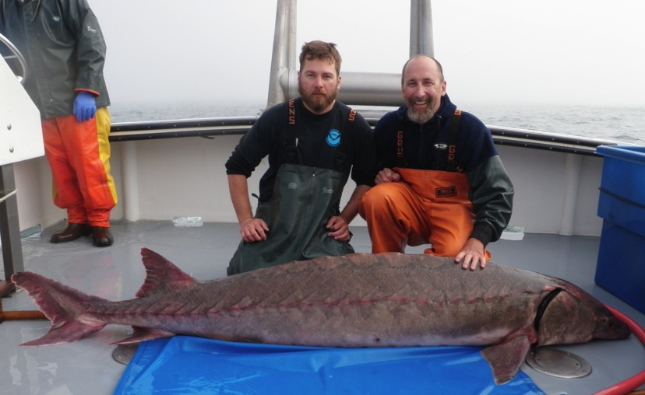
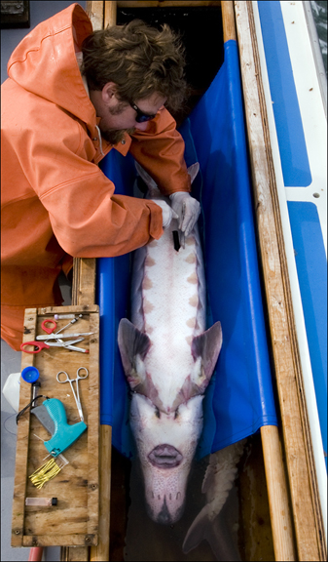

Telemetered Sturgeon
652 Individuals
  Delaware
  New York

Slide 19


Passive Telemetry
50 km
Notes:
.

Slide 20

Receiver Integrated Glider (2011)
Mobile tracking of offshore environments
Reach currently unmonitored areas
Natural addition to ongoing research
Increase understanding of fisheries interactions

Slide 21

Receiver Integrated Glider (2011)
Enables coupling of data sets
  Telemetry data
  Temperature
  Salinity
  Productivity
Moves us beyond fixed arrays

Slide 22


Sturgeon Mission
(2013)
79 Days at sea
  10 April – 28 June
1,420 km
71,000 Profiles
  Salinity
  CHL
  CDOM
  Temperature
  Oxygen
62 Sturgeon
187 Detection Hours
No data
Unassigned
Detection

Slide 23
Sturgeon Mission
(2013)
79 Days at sea
  10 April – 28 June
1,420 km
71,000 Profiles
  Salinity
  CHL
  CDOM
  Temperature
  Oxygen
62 Sturgeon
187 Detection Hours
No data
Unassigned
Detection

Slide 24


Detections by Water Type
4 LIS
23 SUNY
22 DSU
9 VCU/USFWS
2 NCDMF/
NC State
2 SCDNR
Thanks to Collaborators of Atlantic Cooperative Telemetry Network

Slide 25



Relating to Water Column Habitat
Characteristics
Temperature
CDOM
Chlorophyll
= Detections

Slide 26

Summary
Ocean observatories capture the dynamics of marine habitats
Habitat models linked to physical models co-developed with scientists, managers, and the industry can support fisheries assessment and management.
These approaches could also support process based studies that develop indices in existing and future single species and ecosystem based assessments.

