Slide 1
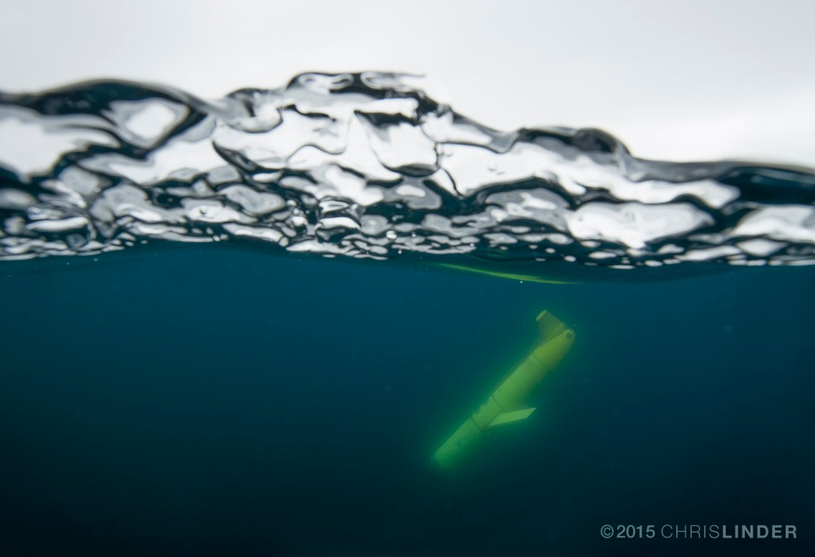
Observing Our Ocean Planet:
The Use of Ocean Gliders
Josh Kohut
Rutgers University,
and MANY MANY MANY Others

Slide 2
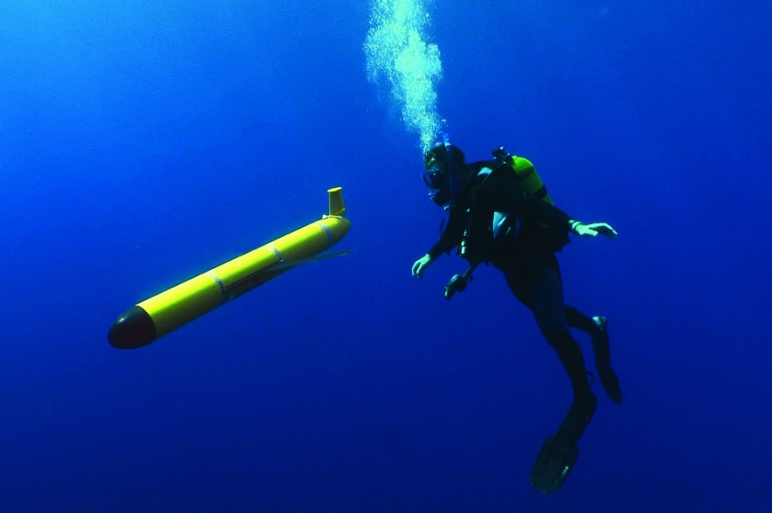
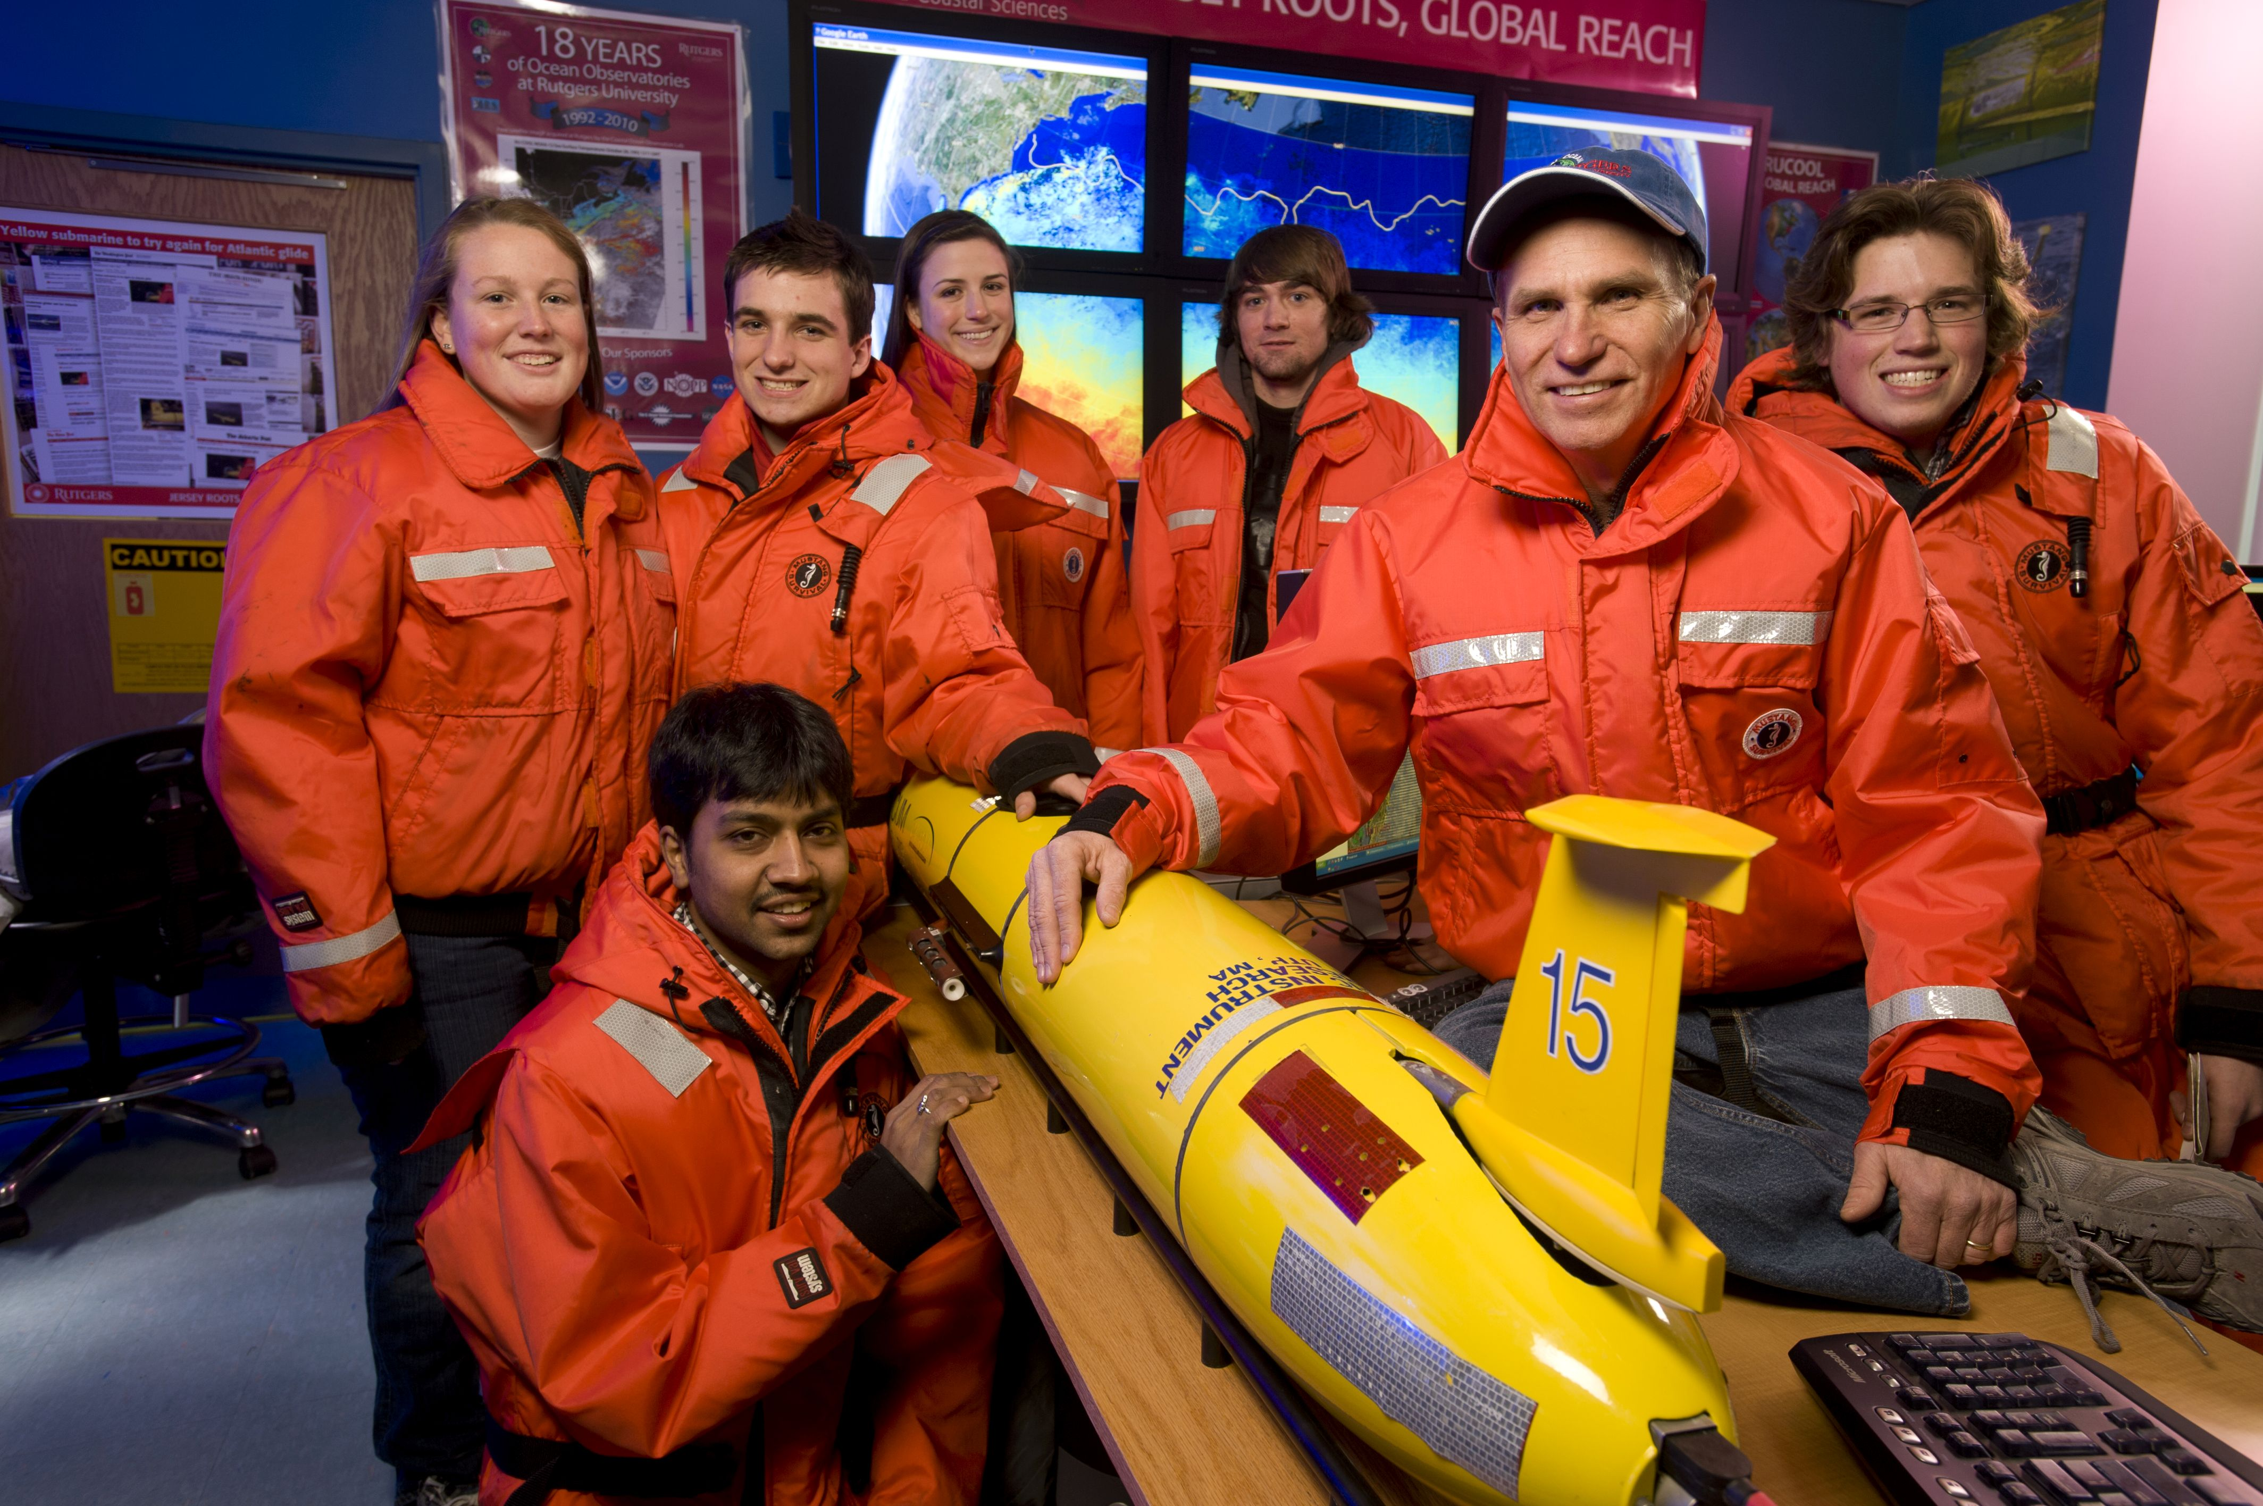
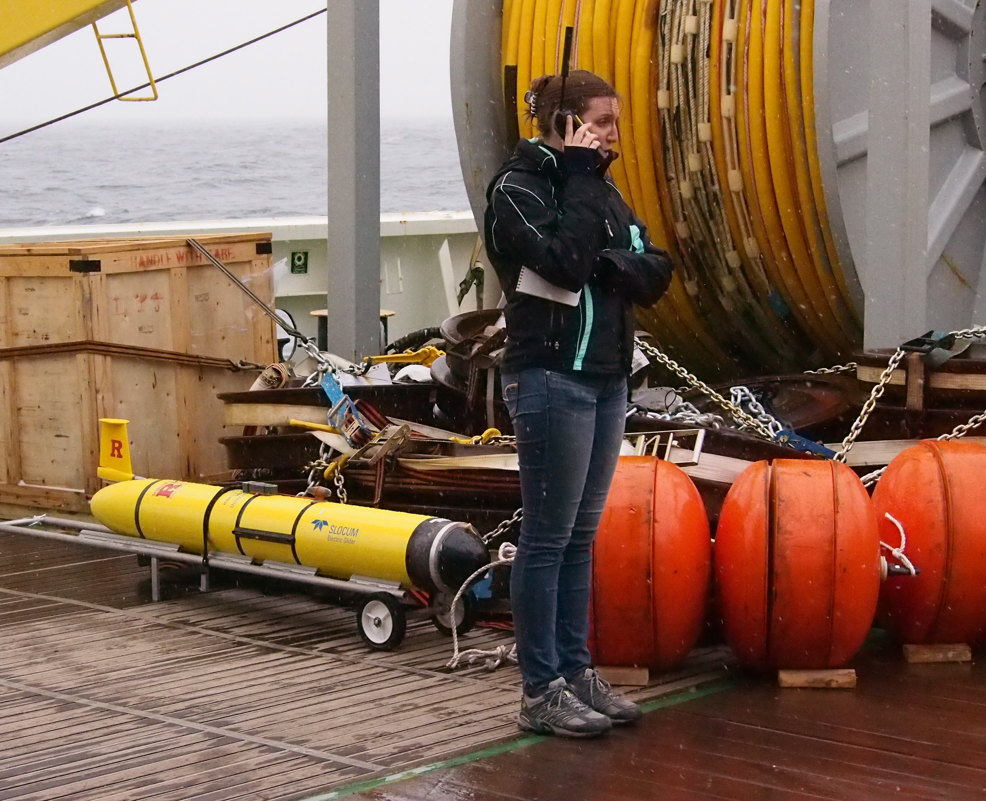
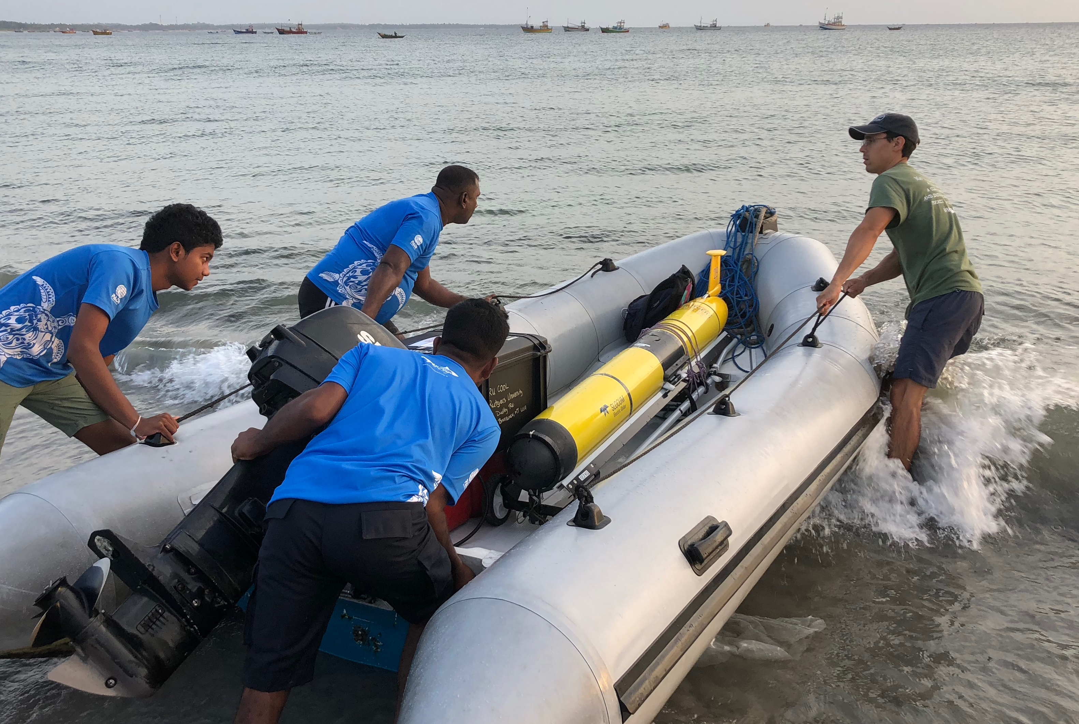
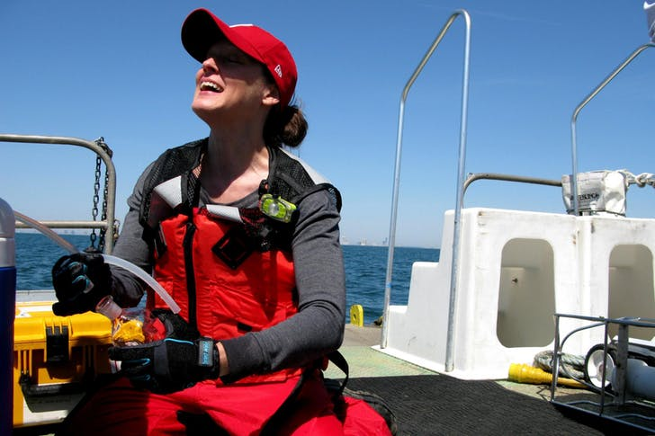
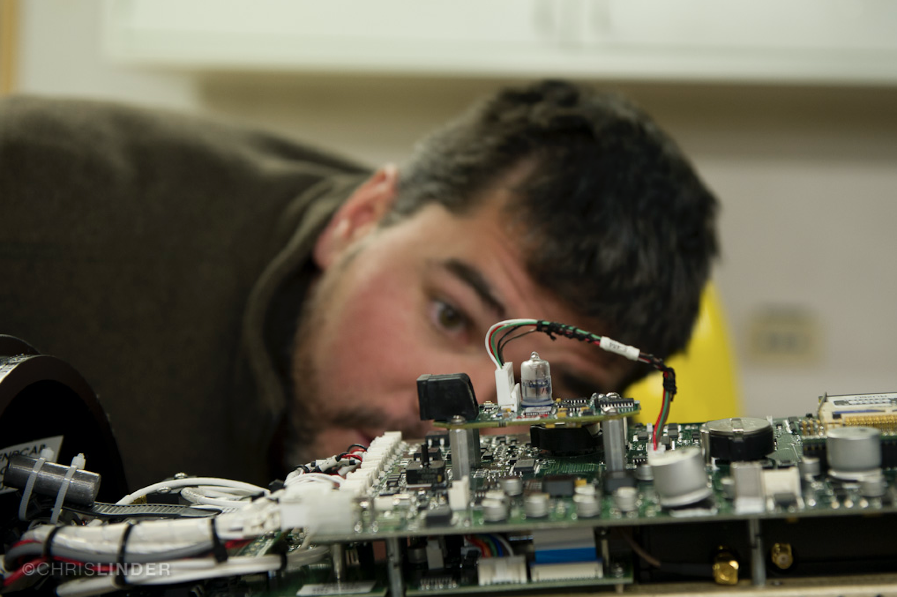
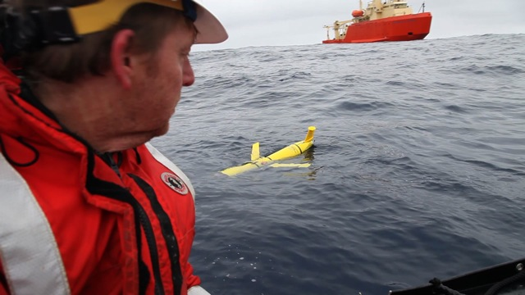
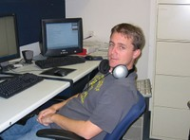
Rutgers Glider Team
and MANY MANY more students and collaborators
Chip Haldeman
Glider
Hardware
& Software
Scott Glenn
Grace Saba
Nicole Waite
Travis Miles
Dave Aragon
Science Data Quality Control,
Post Processing & Sharing
Josh Kohut
John Kerfoot
Project Leads
Oscar Schofield
Laura Nazzaro

Slide 3
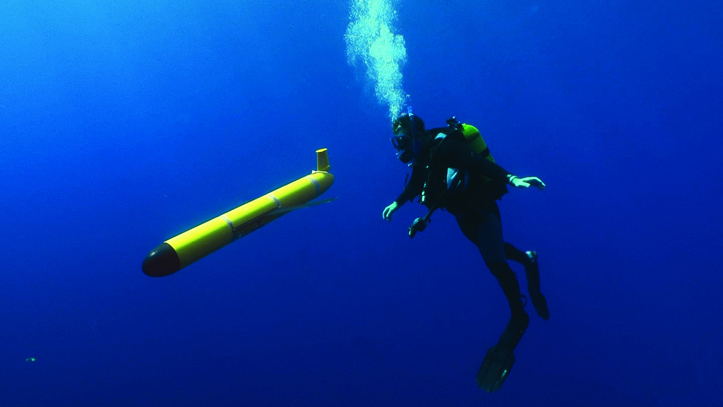
What is an AUV/glider?
Autonomous Underwater Vehicle
Remotely controlled through satellites (Iridium)
Connection available when glider is at the surface
Sampling devices
  CTD (standard)
  Optics : Chlorophyll, Turbidity, CDOM
  Dissolved Oxygen
  Currents
  Suspended Sediment
  Waves
  Echosounder
  Many others…..

Slide 4
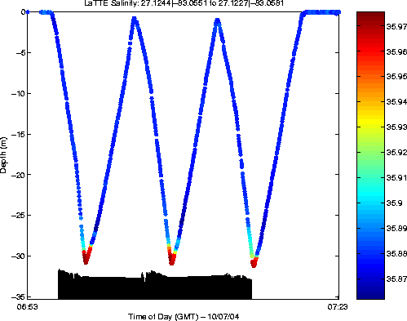
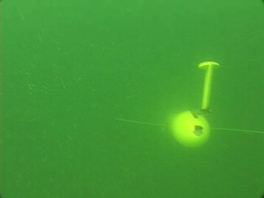
How gliders “fly”
Buoyancy pump in ← the glider pulls in 0.5 L of water
When surfacing to connect glider inflates air bladder
Glider begins to dive downward
Push pump out → glider inflects and begins to climb to the surface

Slide 5

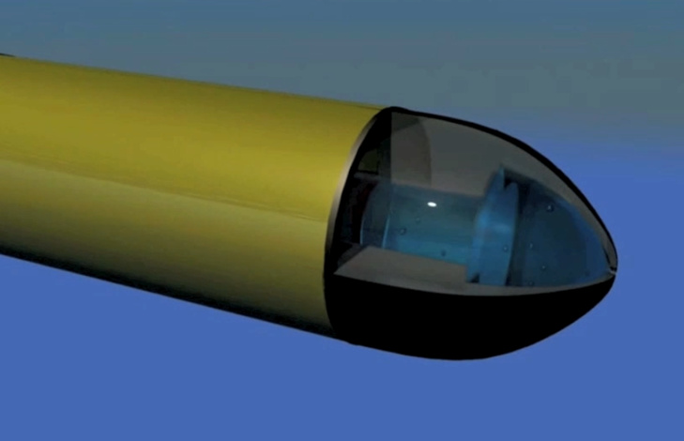
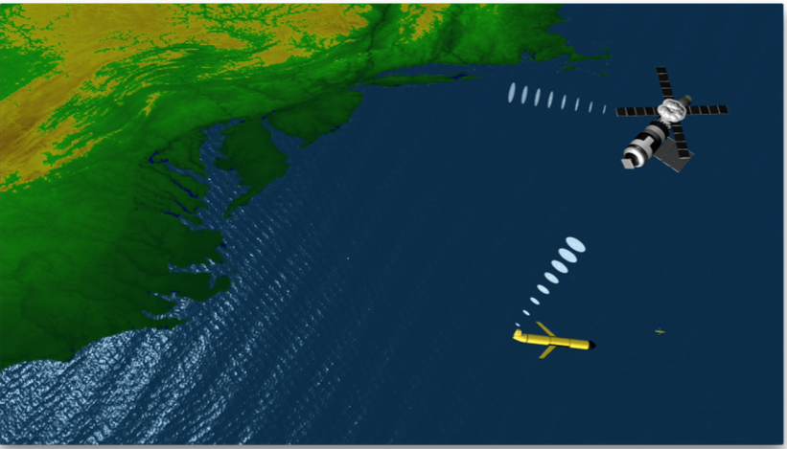
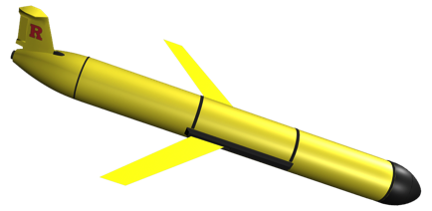
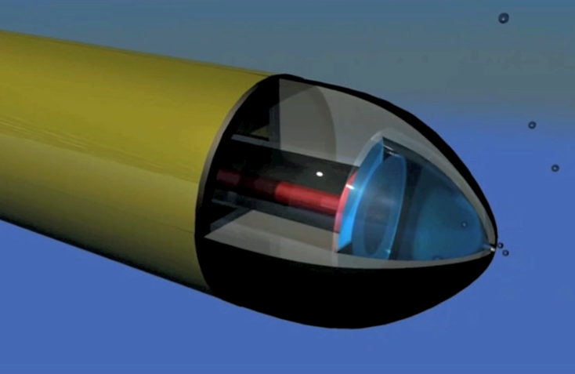
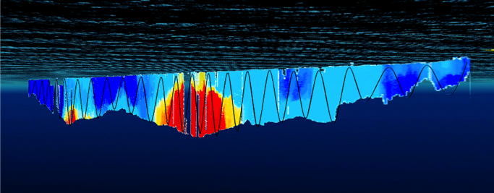
How an underwater Glider works…
At surface,
pump/diaphragm
decreases volume,
Glider descends
4. Glider surfaces,
acquires GPS,
communicates to
shore via satellite
3. Glider flies a saw tooth pattern,
collecting environmental data
along it’s path
2. At depth
pump/diaphragm
increases volume,
Glider ascends

Slide 6
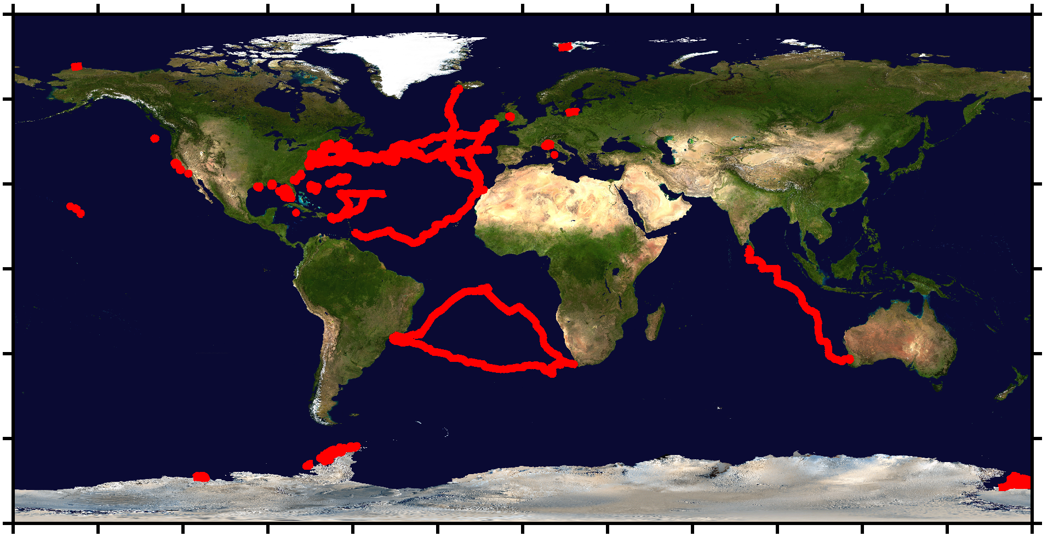
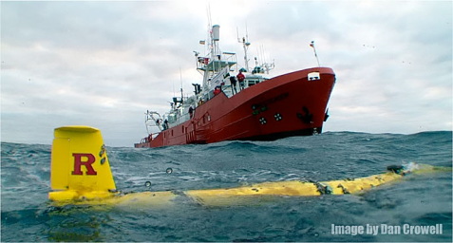
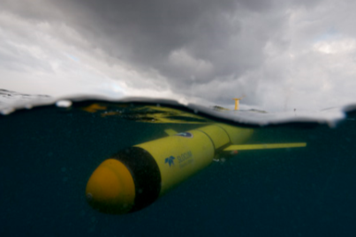
Sustained Subsurface Profile Observations
1 Operations Center, Gliders RU01-RU31

Slide 7
Glider Hardware

Slide 8
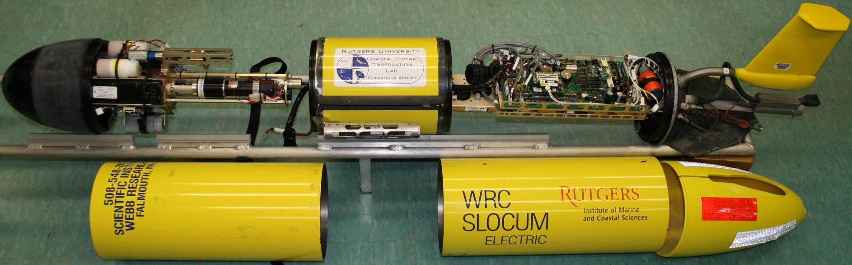
Glider Anatomy
Antenna (Iridium, Freewave, GPS & Argos)
Buoyancy Pump
Science Payload Bay
Control Board
Pitch Motor
Air Bladder
Rudder
Altimeter
CTD
Fore Hull
Aft Hull
Cowling

Slide 9
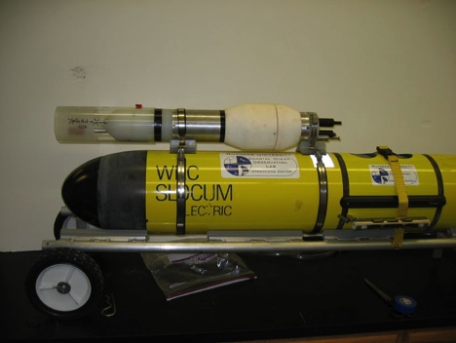
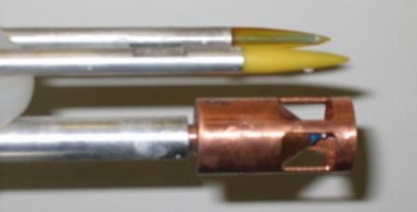
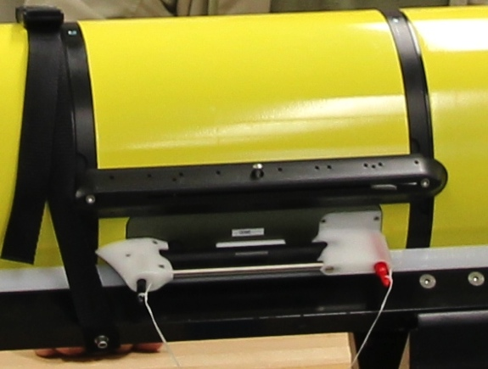
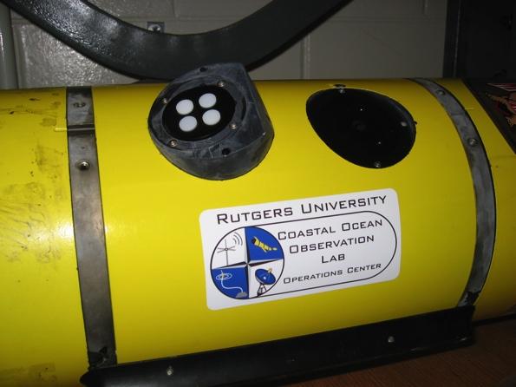
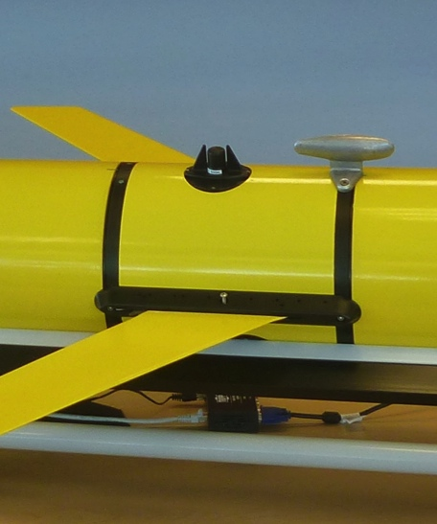
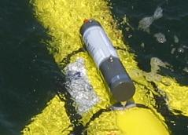
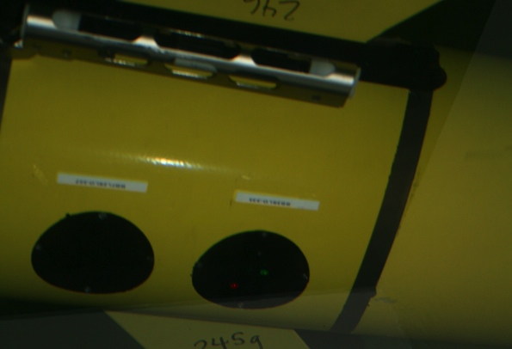
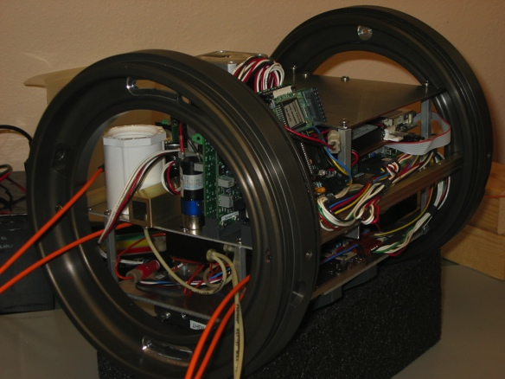
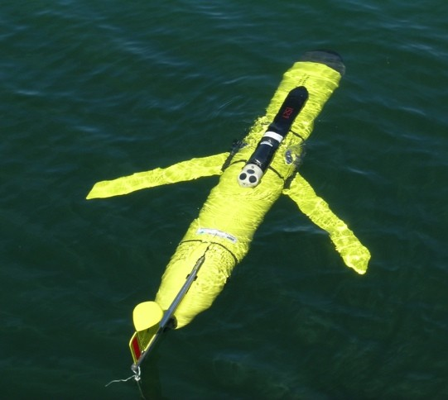
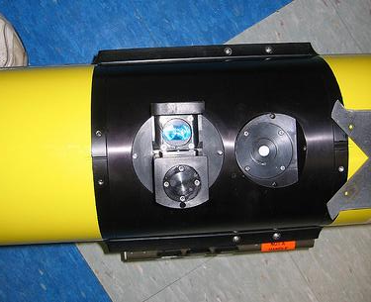
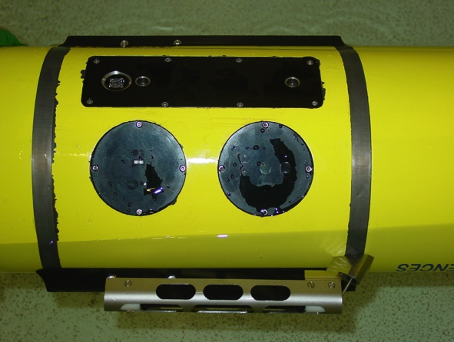

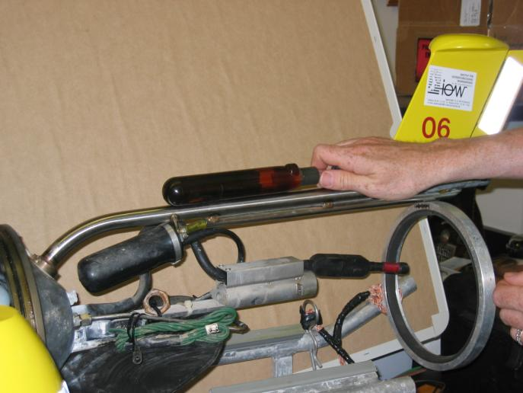
Glider Sensors
Inside Payload Bay or External

Slide 10
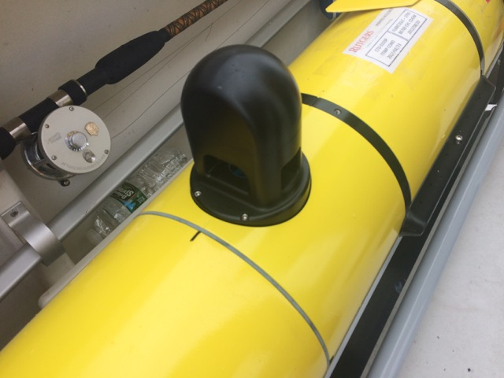


Development & Testing of New Glider Sensors
Suspended Particles - LISST
Jose – September 2017
Suspended Sediment
16 17 18 19 20 21
Days in September 2017

Slide 11
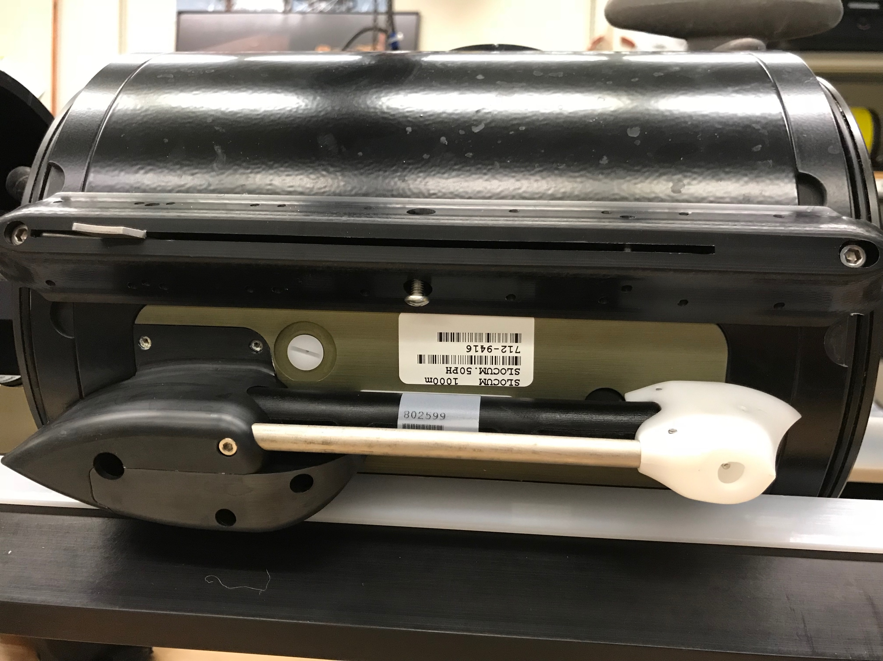

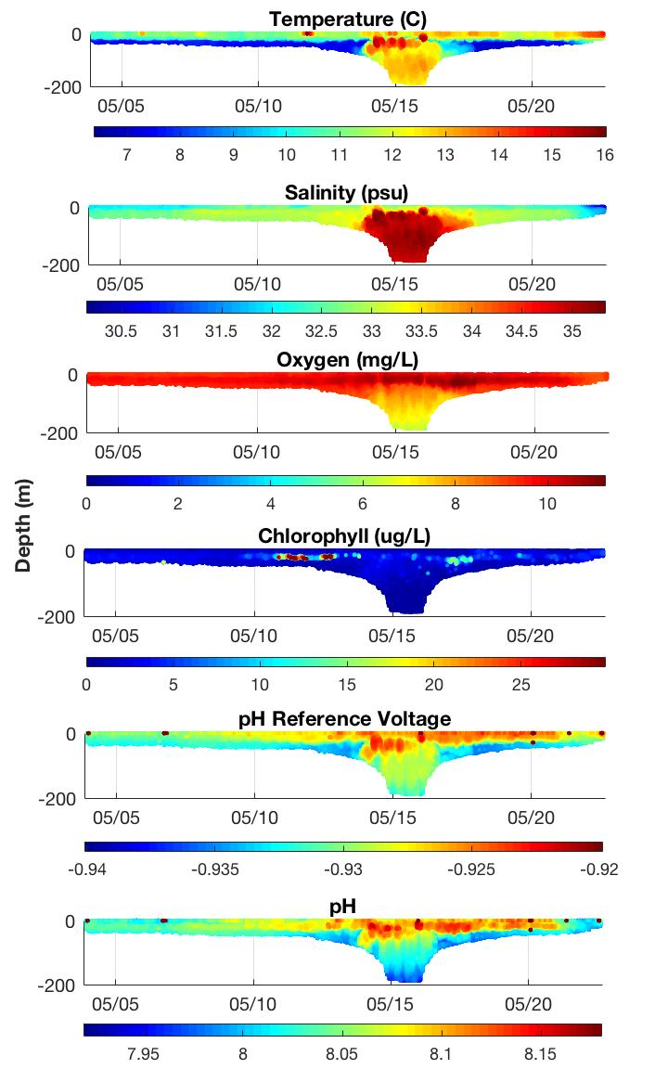

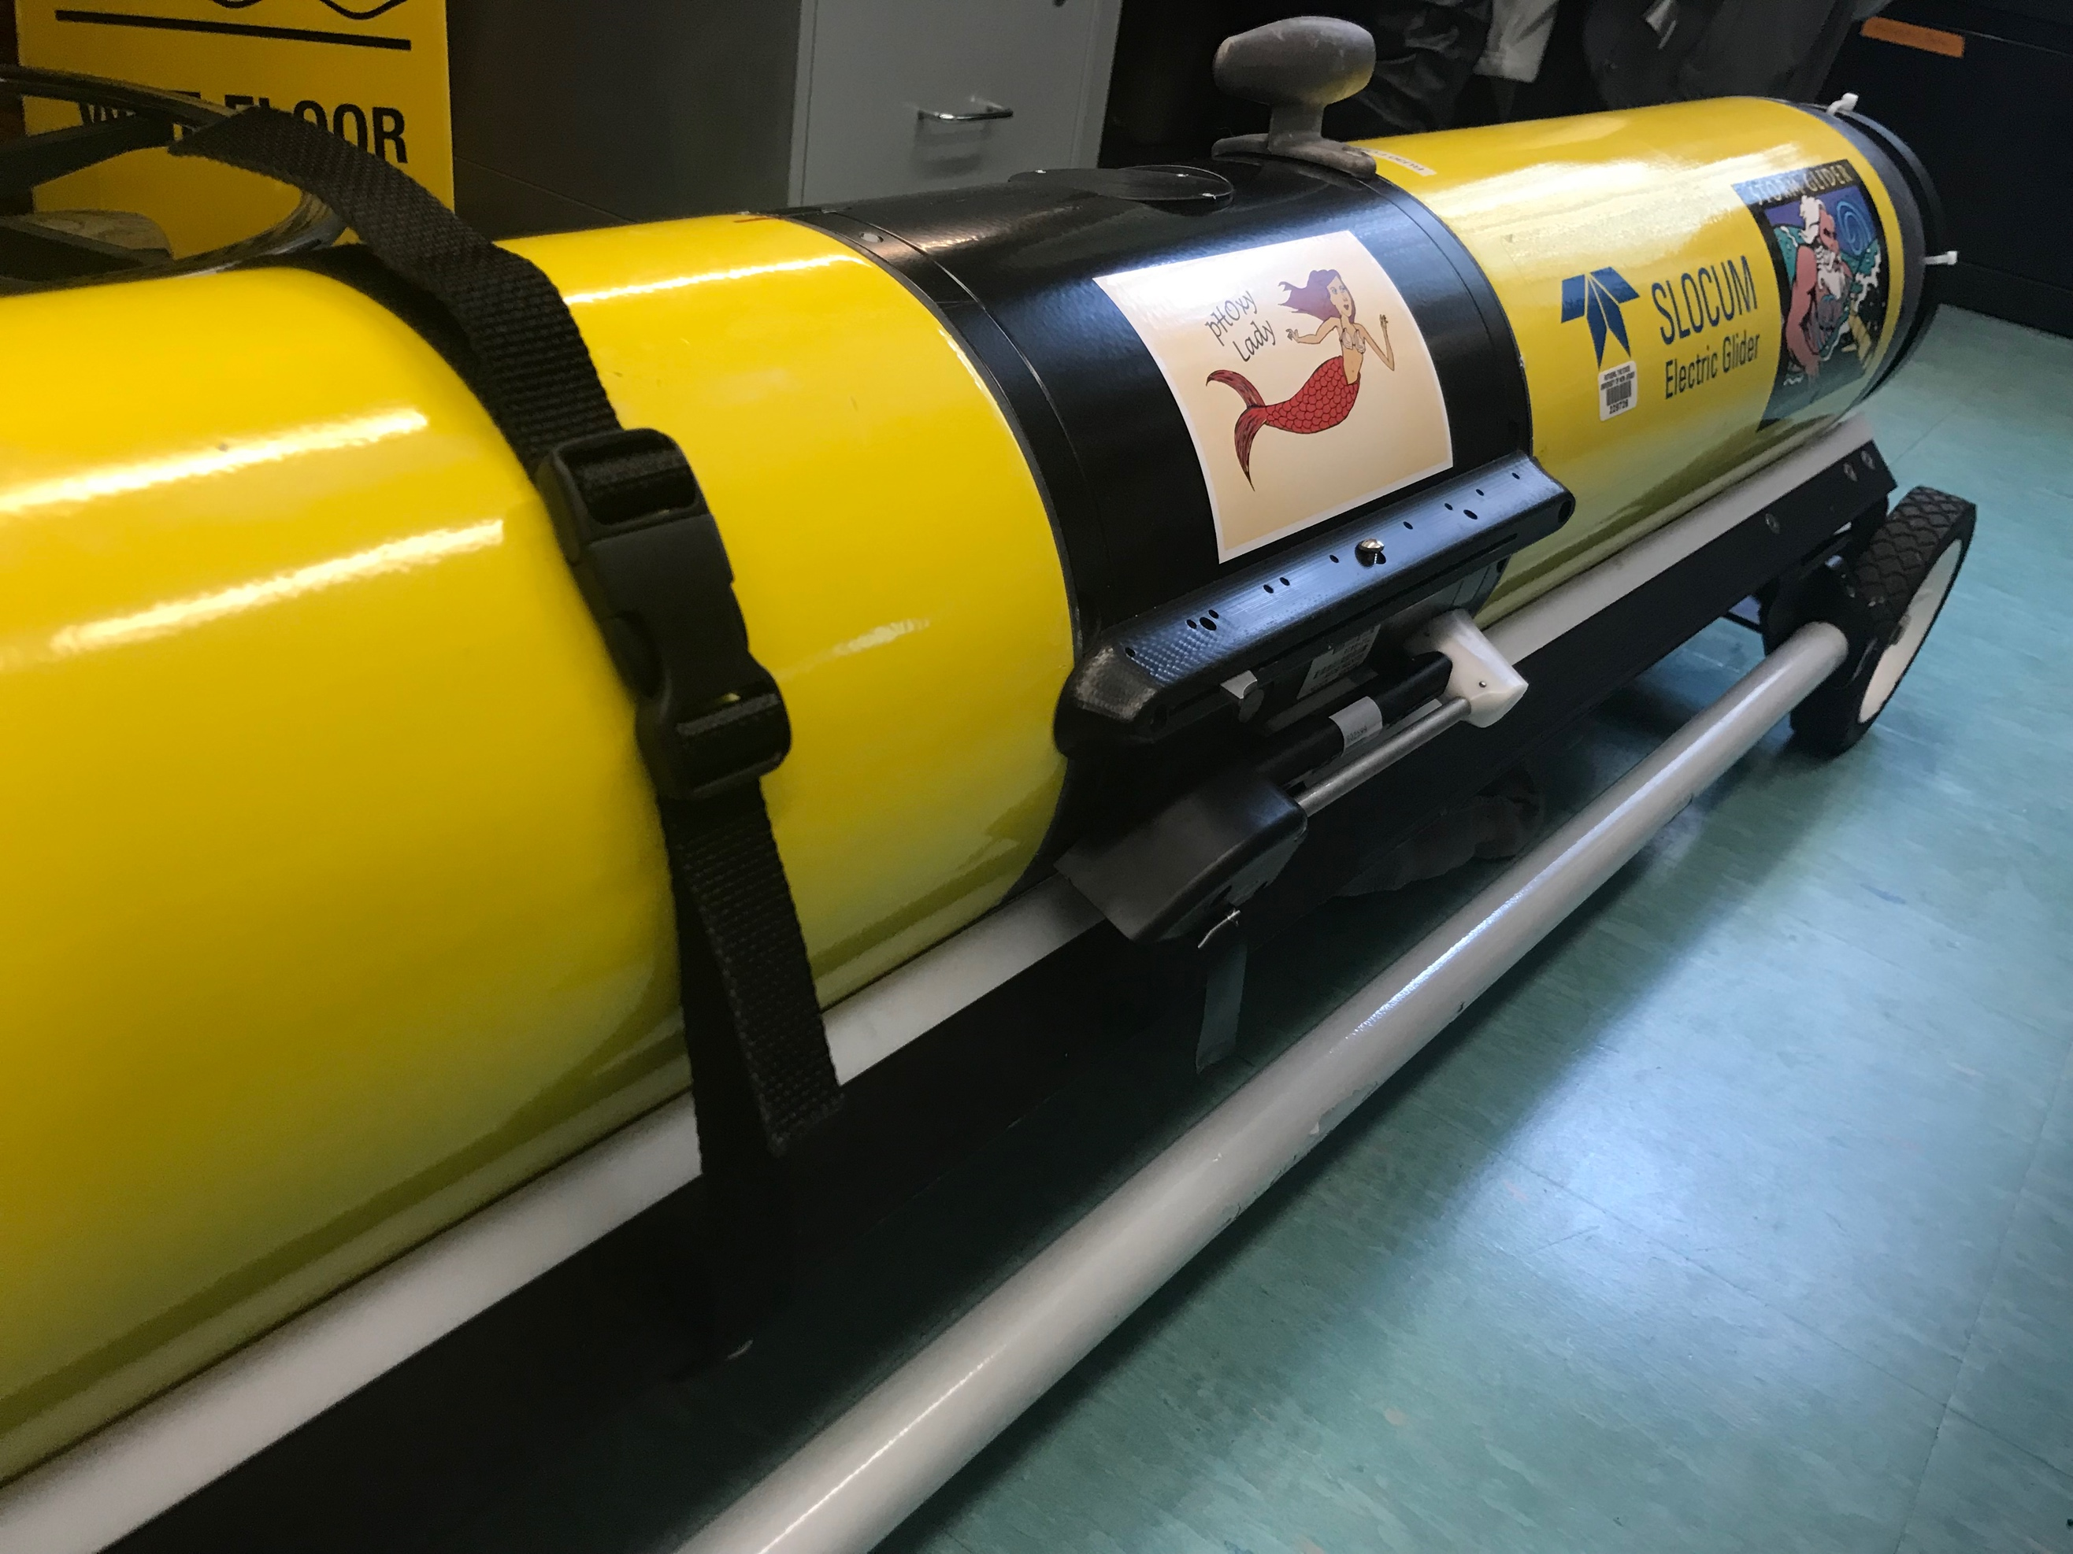
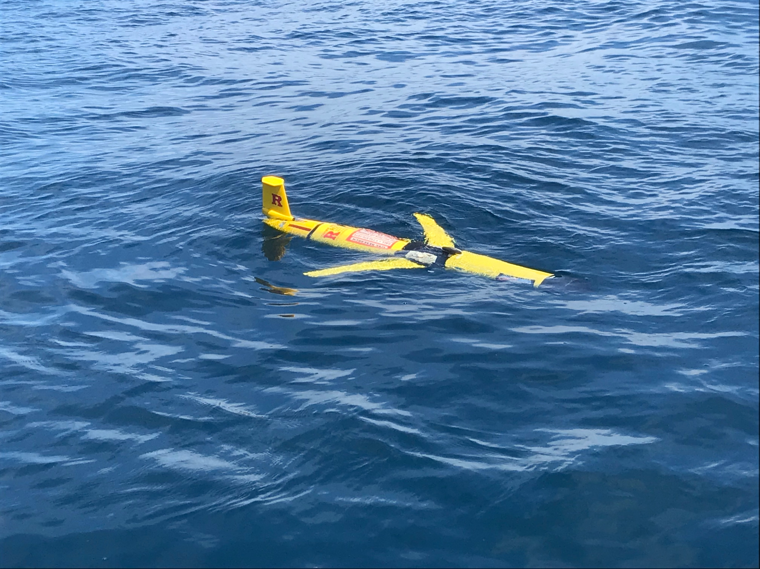
Development & Testing of New Glider Sensors
pH for Ocean Acidification Monitoring
May 2018 – NJ cross-shelf
May 2018 Deployment
NSF OTIC Program (OCE #1634520)

Slide 12
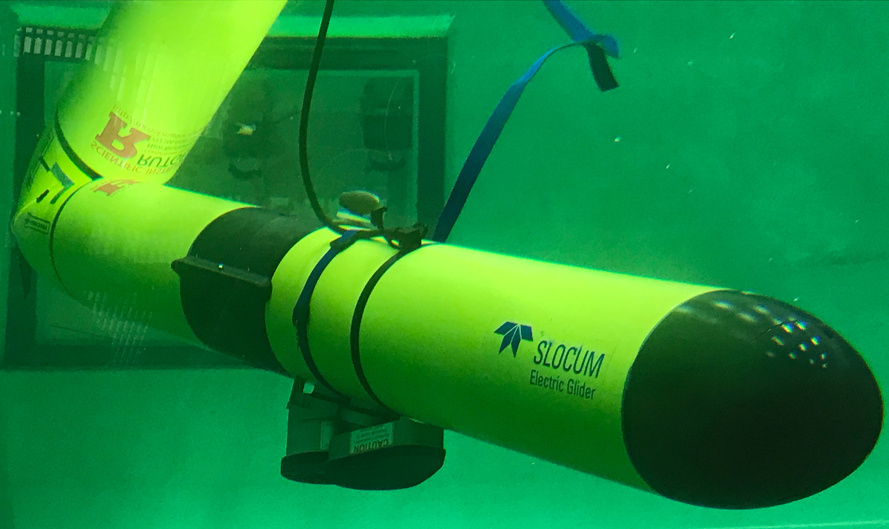

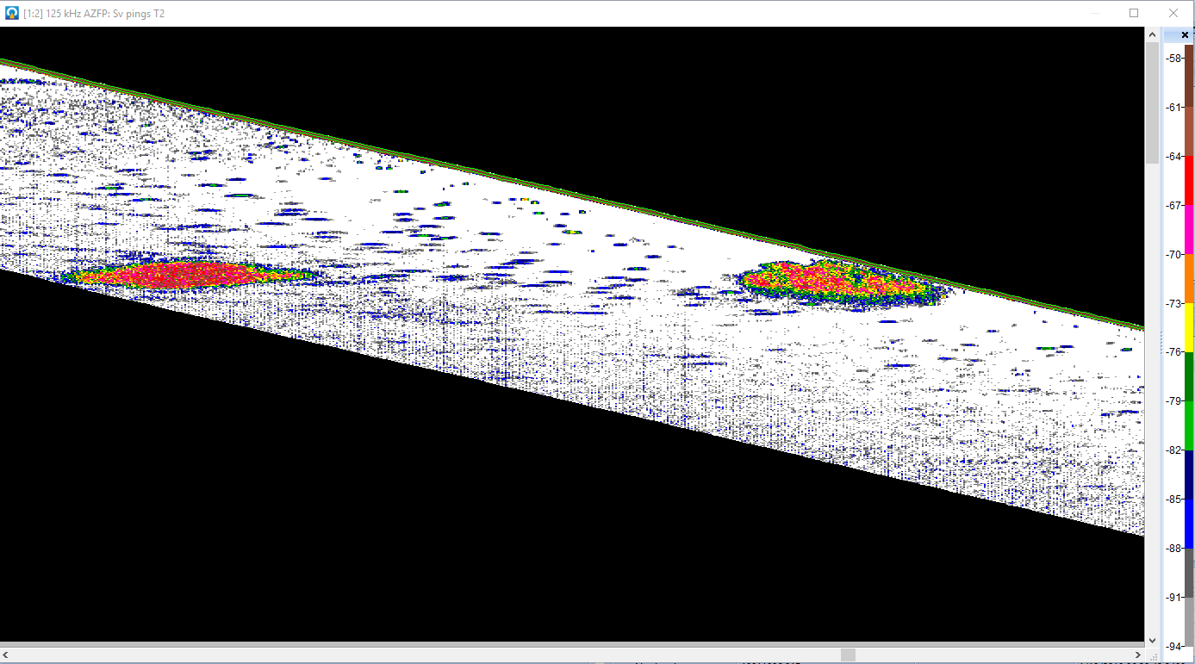
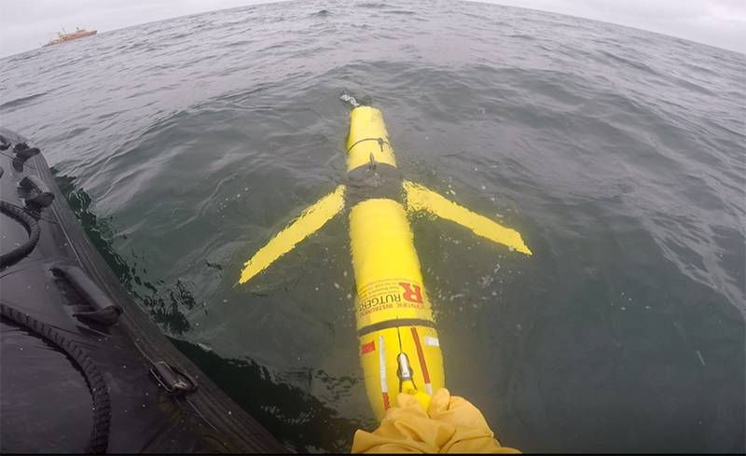
Development & Testing of New Glider Sensors
Acoustic Zooplankton Fish Profiler Echosounder
NSF Polar Programs
(OPP #1743035)
Ability to examine the interactions between multiple trophic levels (phytoplankton, zooplankton and fish) and their relationships to the physical hydrographic driving forces

Slide 13
Piloting

Slide 14
Piloting

Slide 15
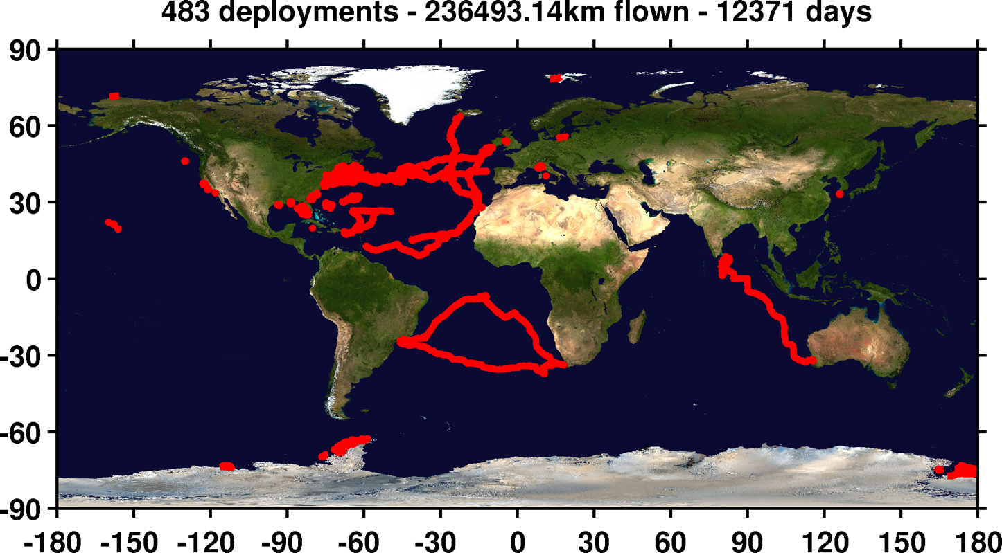


Sustained Subsurface Profile Observations
1 Operations Center, Gliders RU01-RU33

Slide 16
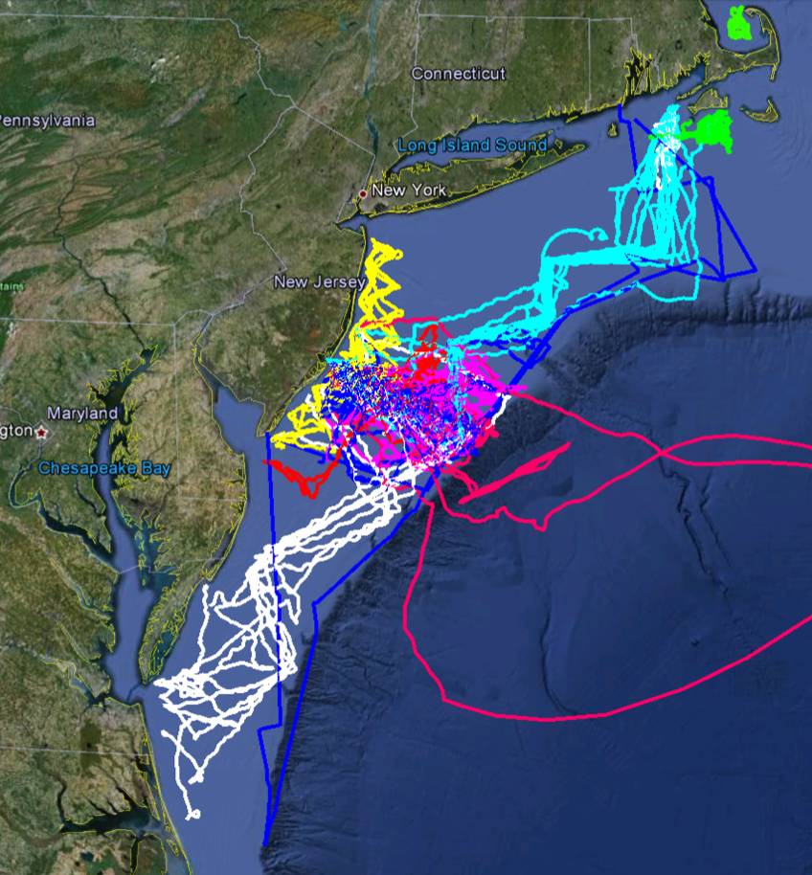
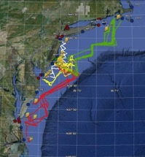
MARACOOS
MURI
Intl. Missions
EPA & NJDEP
Cblast
Endurance
OSSE
SW06
Glider Testbed off the US East Coast
Multiple Projects
Multiple Partners

Slide 17
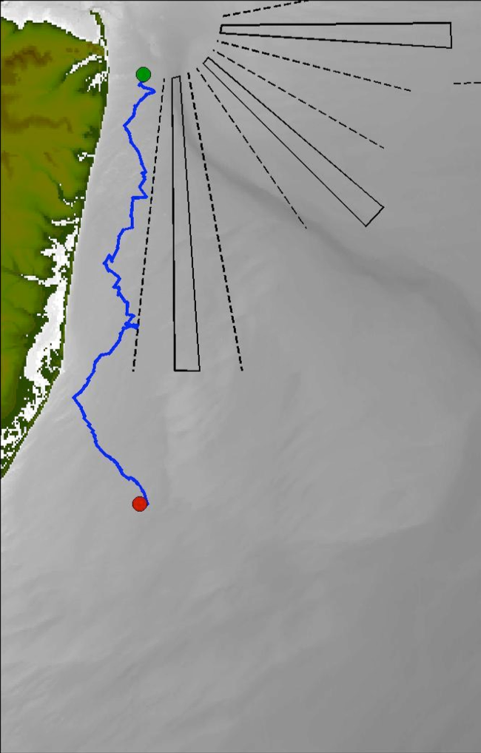


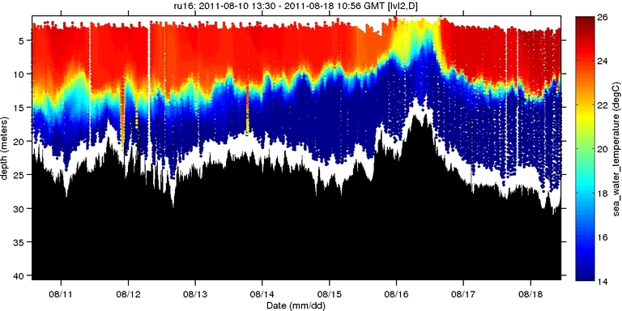
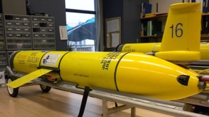
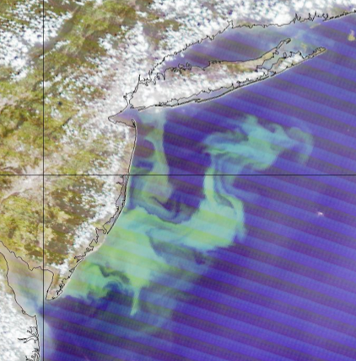
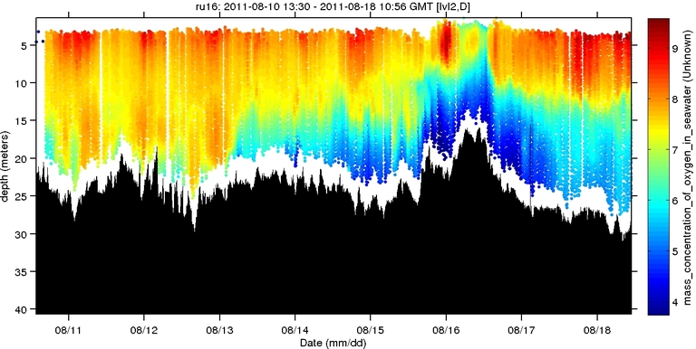
Autonomous Platforms:
Dissolved Oxygen
Shallow Water (5-30m)
Temperature (°C)
Dissolved Oxygen (mg/L)

Slide 18
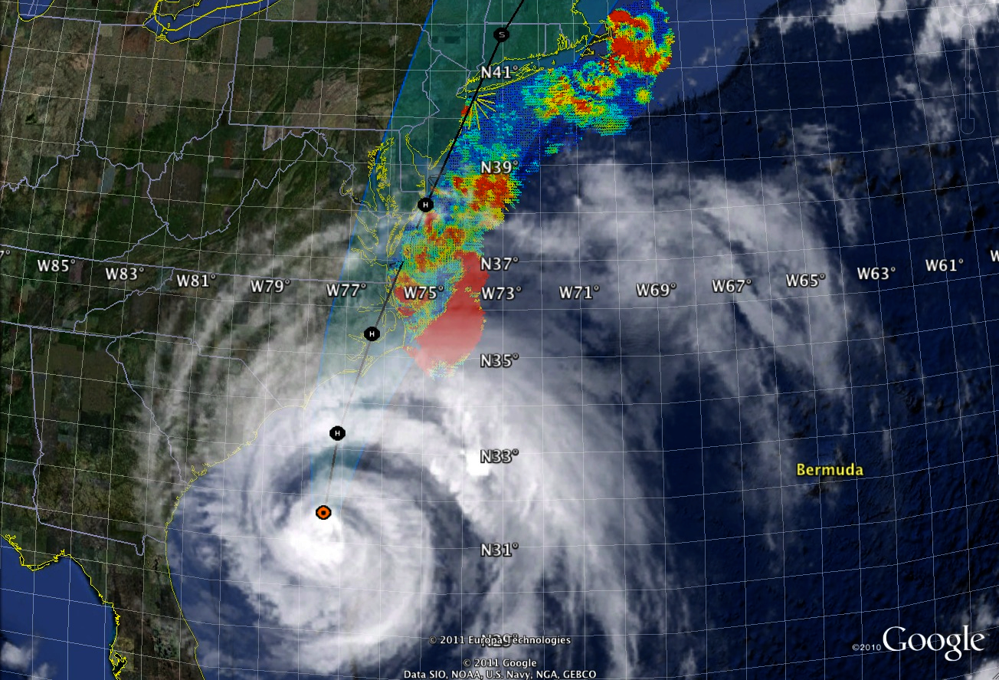




Hurricane Irene August 2011
Two Gliders Deployed

Slide 19




2 Days Before Irene
2 Days After Irene
Difference
11C max cooling
WHAT?
Rutgers
Satellite
Temperature
WHEN? Rutgers Glider Temperature
Eye Passage

Slide 20



Hurricane Intensity depends on the Ocean Forecast
Over 130 model runs
Model sensitivities identify ahead-of-eye cooling as the missing process for rapid de-intensification
Observatory identifies processes responsible for rapid ahead-of-eye cooling.

Slide 21



One year later…
Superstorm Sandy October 2012

Slide 22

Why Study Tropical Cyclones?
NOAA National Centers for Environmental Information (NCEI) U.S. Billion-Dollar Weather and Climate Disasters (2018). /
Notes:
Weather Research and Forecasting Innovation Act: 2017 – Improve forecast intensities
Was supposed to be submitted April 2018 – Was it submitted? Do you have a copy? Do you know what was written?

Slide 23


NOAA Annual Operational Suite Review
Average Track Errors:
Atlantic Basin
Average Intensity Errors:
Atlantic Basin
Factor of 2-4 improvement
20%-30% improvement
Limitations on Hurricane Intensity Improvement
Computing resources and model resolution (Rotunno et al., 2009)
Poor understanding of the atmospheric boundary layer (Nolan et al., 2009; Andreas et al., 2015)
Difficulty in modeling the upper ocean response to storm forcing (Yablonsky and Ginis, 2009).
Cangialosi and Franklin 2017

Slide 24
NOAA Historical Hurricane Tracks: 1851 - previous season
North Atlantic Testbed for the Hurricane Sentinel Glider Lines

Slide 25





Since
1946
Hurricane Sentinels - 2018

Slide 26

2018 Demonstration: Hurricane Sentinel Glider Picket Lines
Atlantic Basin
Multi-institutional 30+ glider fleet
Notes:
This represented over 20 communities varying from fed agencies to universities.

Slide 27




2018 Hurricane Season – 61 Gliders in IOOS Glider DAC
Glider Name
Jun. Aug. Oct. Dec.
Florence
Michael
2945
Glider
Days
123,205
Glider
Profiles

Slide 28

Atlantic Hurricanes 2018
>30 gliders deployed along the Atlantic Coast, Caribbean and Gulf of Mexico in advance of hurricane season
Glider observations assimilated into Navy NCODA for initial conditions of GOFS 3.0 and 3.1
Glider data used by U.S. National Hurricane Center (NHC) in Ocean Heat Content estimates.
Ocean Heat information from NCODA used to help with Florence forecast intensity decision-making.
RTOFS: Real Time ocean forecast system
GOFS: Global Ocean Forecast system
NCODA: Navy Coupled Ocean Data Assimilation

Slide 29
Sustained Subsurface Profile Observations
1 Operations Center, Gliders RU01-RU33

Slide 30




Slide 31








Western Antarctic Peninsula Canyons are
“Biological Hotspots”
Deep undersea canyons link the ACC to coastal “Biological Hotspots”. (Martinson and McKee, 2012).
Upwelling of deep water (UCDW) in these canyons supports local phytoplankton growth (Prézelin et al., 2004).
Predictable and elevated plankton availability (Kavanaugh et al., 2015).
Despite variation in climate (Domack et al., 2001), penguin colonies have persisted in these hotspots for 1,000s of years (Emslie et al., 1998).
PORG

Slide 32









An Integrated Polar Observatory
PORG

Slide 33


West Antarctic Peninsula Glider Deployments
Over 30,000 individual glider profiles in the canyon alone

Slide 34




Glider deployments
in a unique ecosystem

Slide 35






A coordinated fleet of gliders
Anvers Island
Along Canyon
Cross Canyon
Stationary

Slide 36


Teasing out temporal and spatial variability
Temperature Backscatter
Correlation (R)
Time Lag (Hours)

Slide 37

Teasing out temporal and spatial variability
Temperature Backscatter
Correlation (R)
Time Lag (Hours)

Slide 38

Teasing out temporal and spatial variability
Temperature Backscatter
Correlation (R)
Time Lag (Hours)

Slide 39


Slide 40



Penguin Tagging and Tracking
What is special about the ocean
where they feed?
PORG

Slide 41



Masters in Integrated Ocean Observing
Training a workforce – Based on lessons learned:
Residency in an operational ocean observatory – build community through grand challenges
Work together as a team to operate new observing technologies in frontier areas
Curate the data flow from collection to use in forecasts that inform decisions makers
Senior students mentor junior students

Slide 42


Masters in Integrated Ocean Observatories
  Software Bootcamp
    Analysis Tools
    Common File Formats
    QA/QC
  Course Work
    Integrated Ocean Observing I & II (platforms and sensors)
    Ocean Observing Field Lab I & II (field course, prepare, deploy, operate)
    Ocean Cyber-Lab I & II (data analysis, visualization, forecast model operations)
  Capstone Thesis – Leverage the MTS/IEEE Oceans Process
    Thesis Proposal – Submit Abstract
    Thesis Manuscript – Submit Paper
    Thesis Defense – Presentation at Oceans Conference

Slide 43

Summary
  Integrated Approach
  Enabled by New Technologies
  Requires Partnerships
  Supports scientific and societal goals
  We aim to train an experienced and inspired workforce

Slide 44



Data Examples
Maps
Profiles
Transects

Slide 45
Glider Real-Time Data Stream
Glider provides 2 data sources
Phone call log file (Basic information: Location, glider health, status)
Binary science data files (Detailed information: Glider engineering and science data)
ASCII Log Files
[parsed] GPS Location, waypoint, surface sensors
SQL Database → website, Google Earth, etc
Binary Data Files
QARTOD Tested
netCDF → GTS, DAC
netCDF → ERDDAP
Scientists, diagnostics, sharing

Slide 46

https://ioos.noaa.gov/project/qartod/

Slide 47


Slide 48



Glider Data QA/QC
EPA Quality Assurance Project Plan:
Glider Mission Planning
SeaBird CTD
Aanderra Optode 3835
Documents for pre- and
post- deployment glider, CTD and DO QA
QARTOD

Slide 49

Was file received in reasonable amount of time compared to previous file?
Is file formatted correctly?
Did glider surface in reasonable location?
Is data within range the sensor can measure?
Does profile go continuously up or continuously down?
Is data reasonable for given region and season?
Is data point much higher/lower than surrounding points?
Does data increase/decrease too rapidly?
Is there too little (or no) variability in a series of data points (stuck sensor)?

Slide 50


Flags are added as new sensors in glider deployment matlab file (dbd group)
Time
Depth
Temp
Climate Flag
Flat Line
Gross Range
ROC
Spike

Slide 51

Notes:
Highlighted best spike example

Slide 52


Glider Data Assembly Center
Users: Federal, State and local gov’t, public
Goals:
Consolidate all glider data into one location
Make data available to the GTS
Deliver data to the world!
ERDDAP Server
https://gliders.ioos.us/

Slide 53

Map Interface
https://gliders.ioos.us/map/

Slide 54

Data Interface: https://data.ioos.us/gliders/erddap/info/index.html

Slide 55
Graph Interface:

Slide 56

Graph Interface:

Slide 57
Data Access

Slide 58

Data Access

Slide 59

Data Access

Slide 60

Data Access

