Slide 1
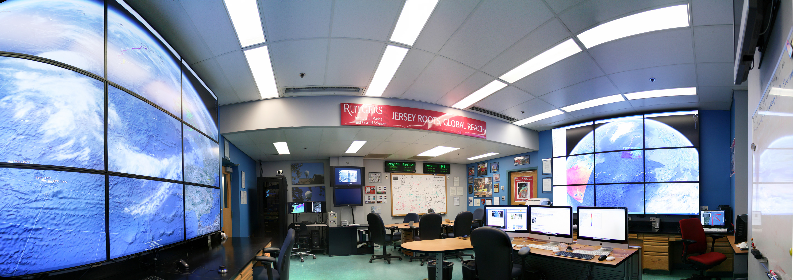
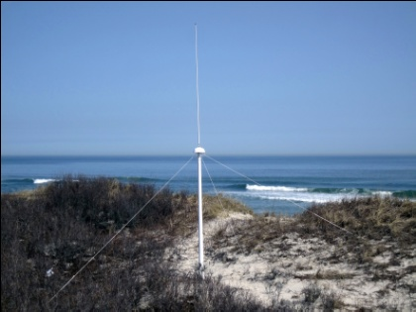
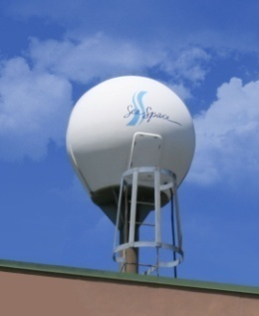
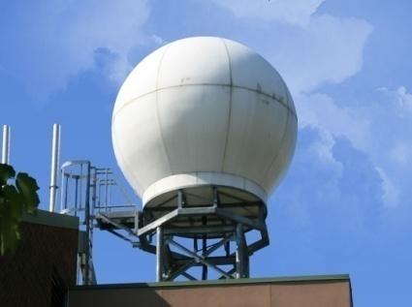
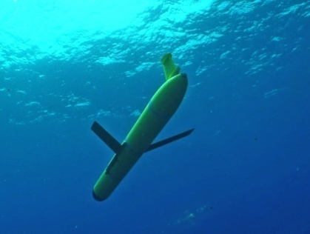
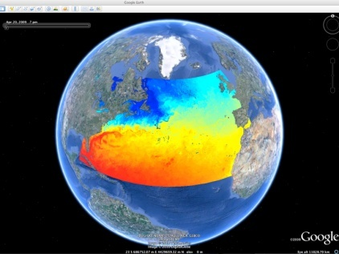
Rutgers University - Coastal Ocean Observation Lab
Vessels -
Satellite
Satellite
CODAR
Ships/ Vessels
Glider
REMUS
Data Vis.
Modeling
Security
Leadership
Education
CODAR Network
L-Band & X-Band Satellite Receivers
Glider Fleet
3-D Nowcasts
& Forecasts

Slide 2
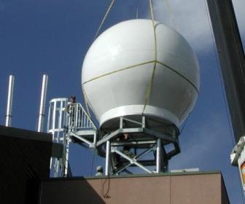
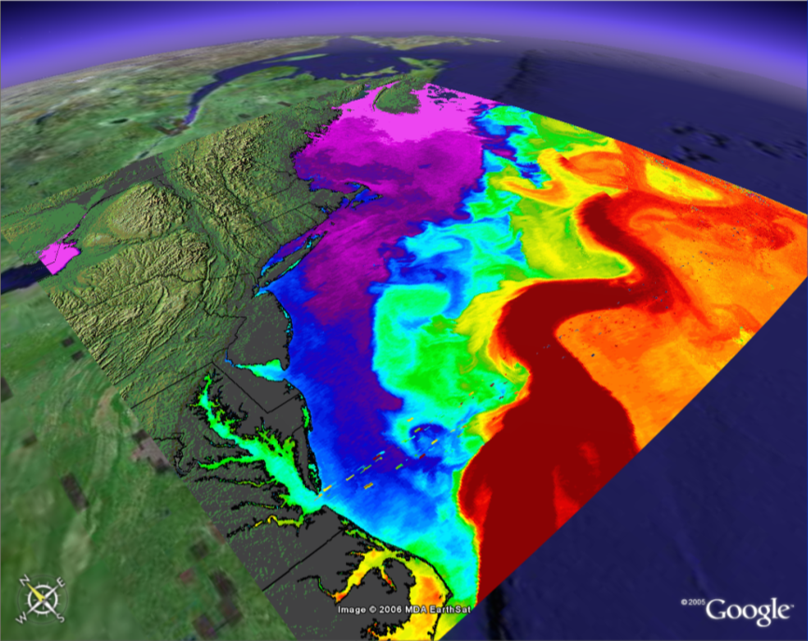
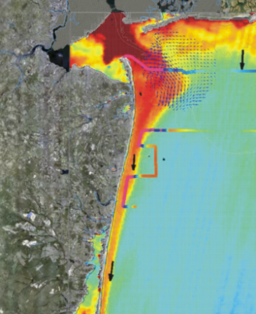
Seeing the Ocean in Color - Satellites
Sea Surface Temperature
Ocean Color
Notes:
2

Slide 3
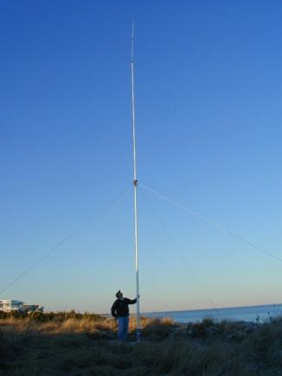
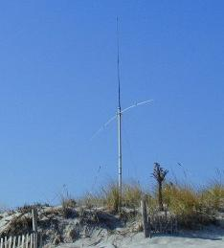
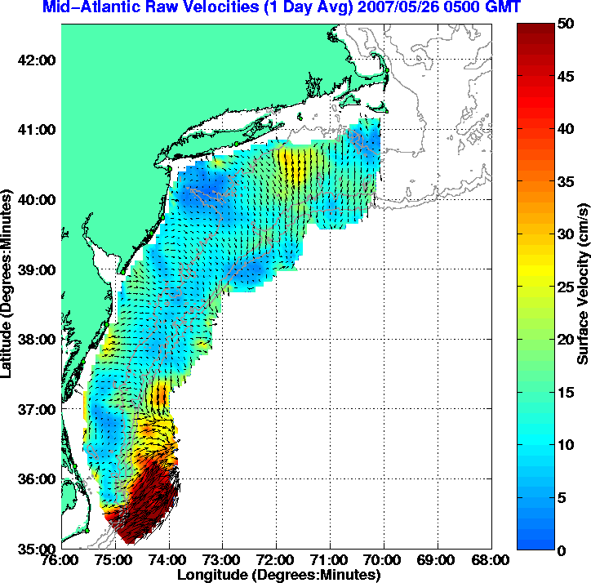
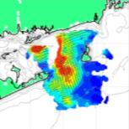
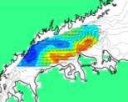
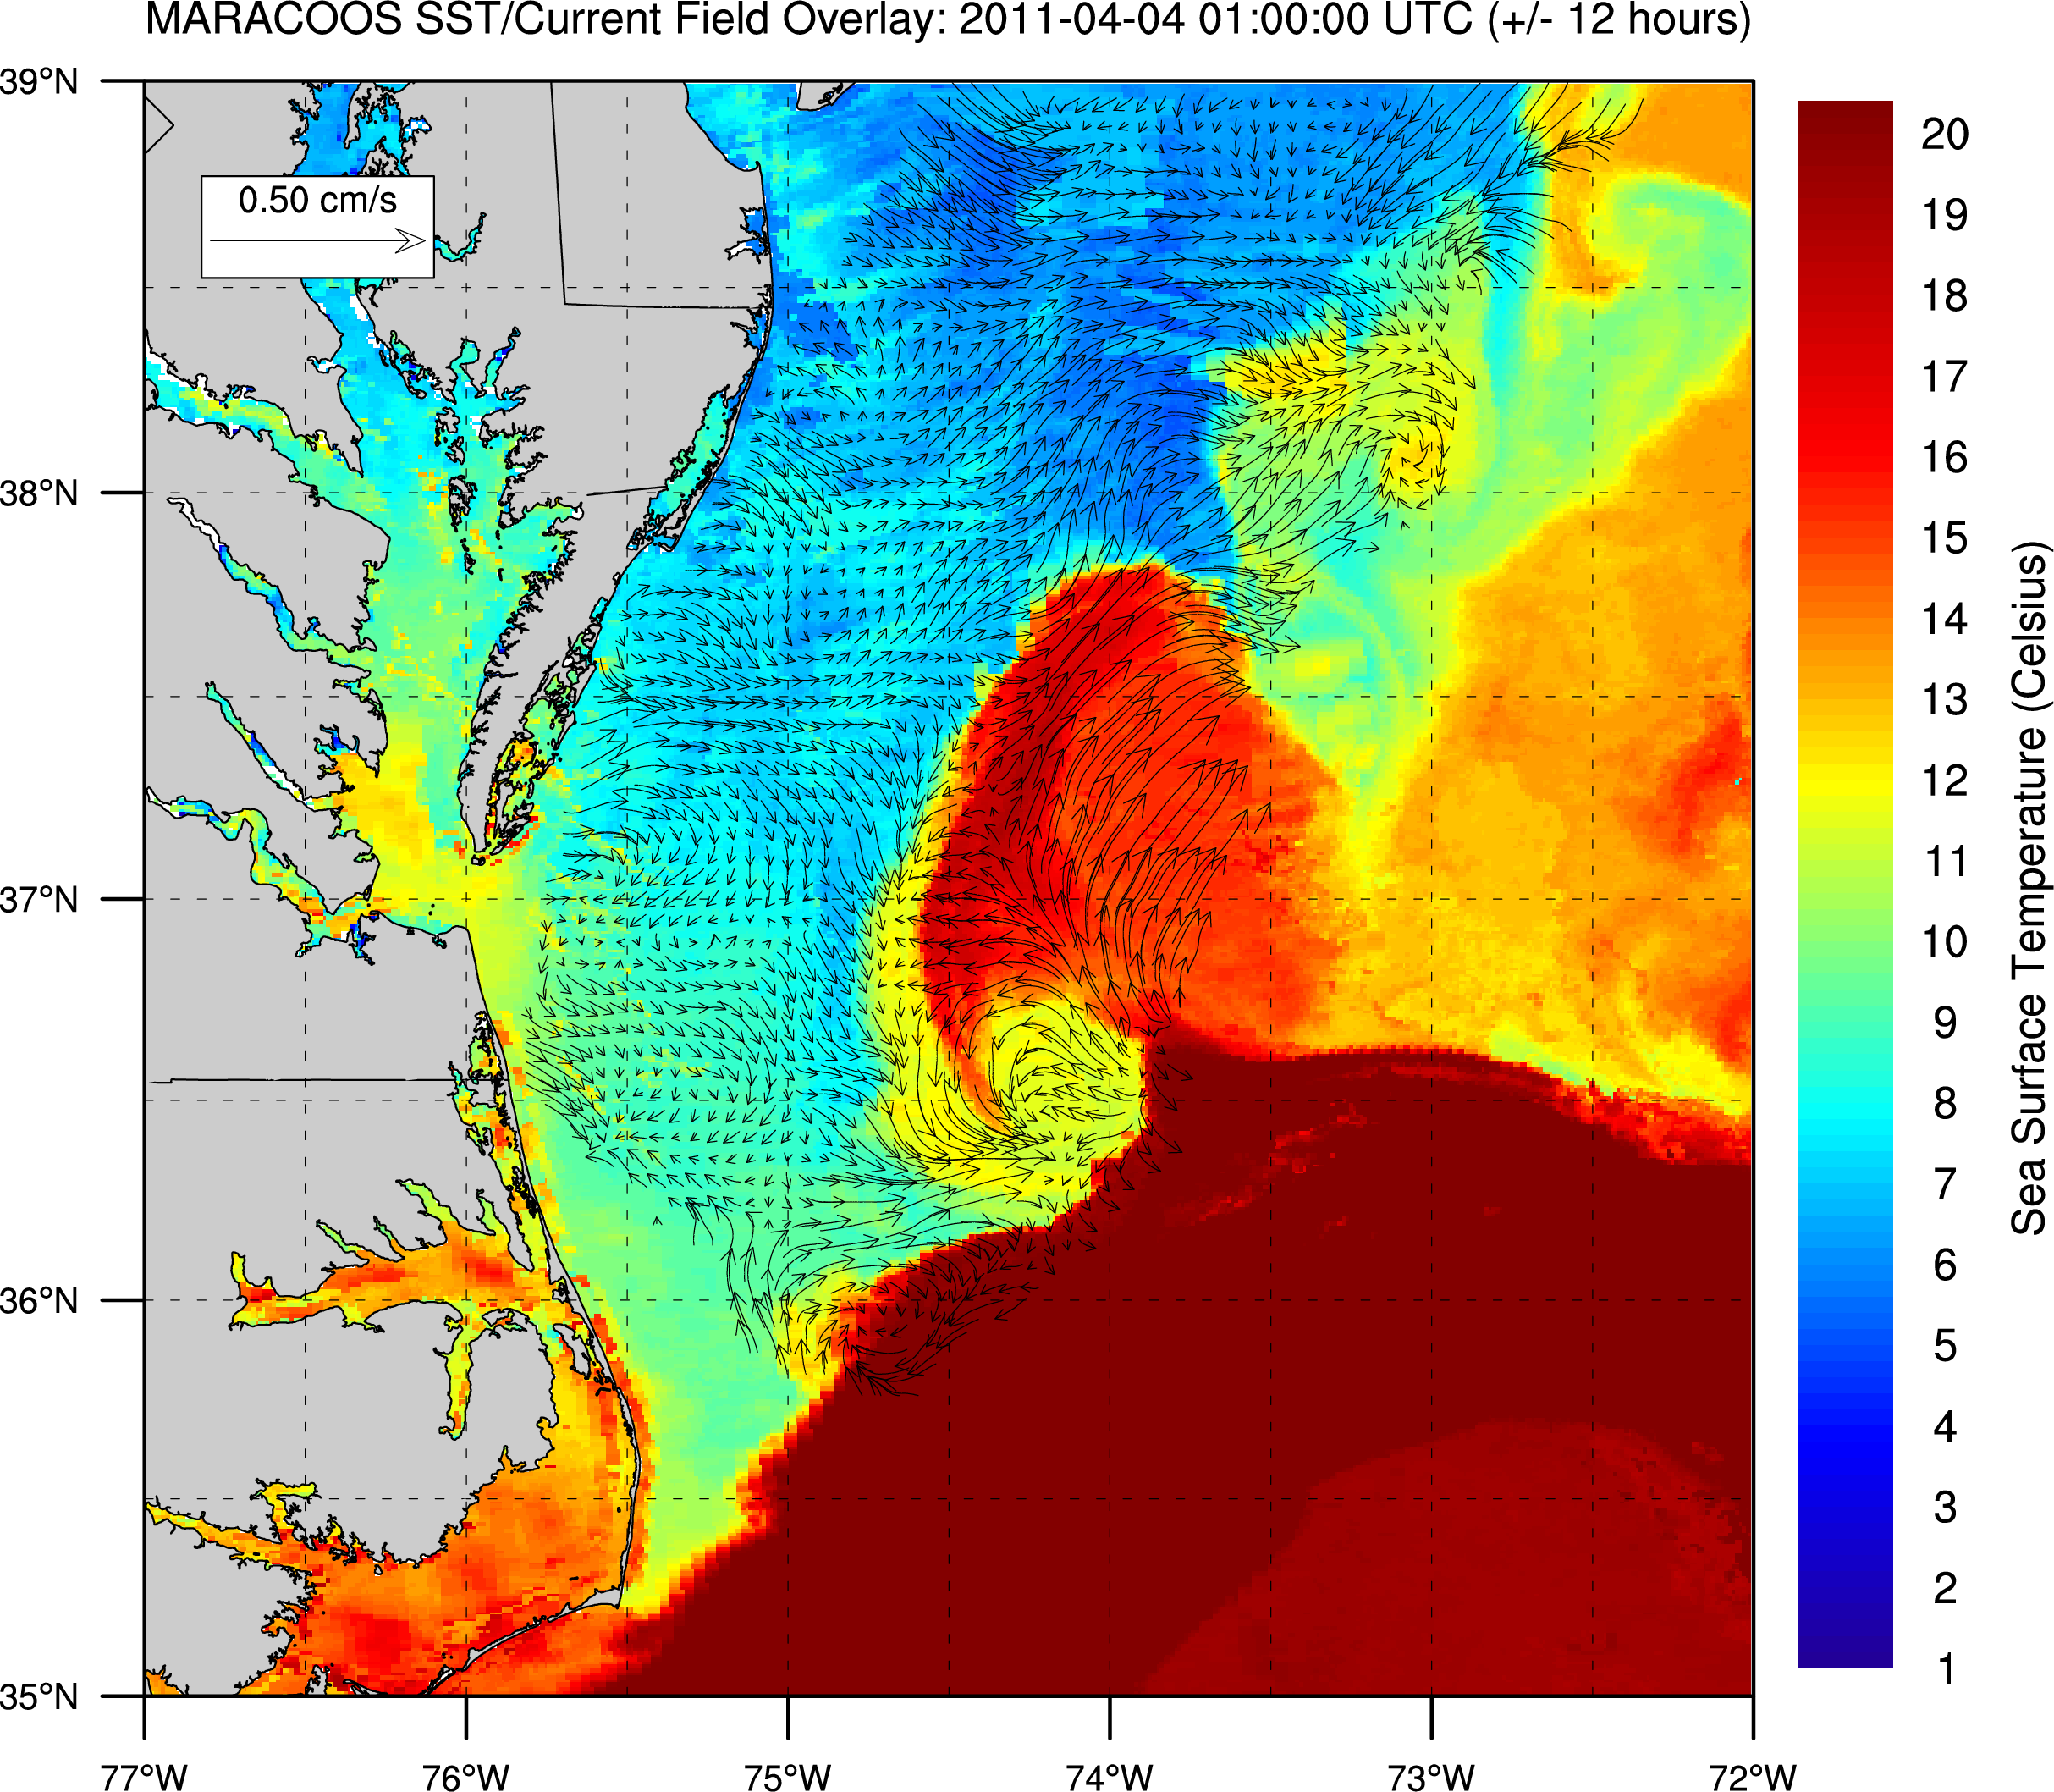
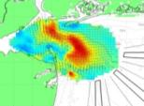
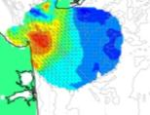
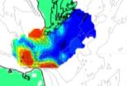
High Frequency Radar – Since 1996
Corporate Partner:
CODAR Ocean Sensors
Nested Grids of Hourly Surface Current Maps ^
Combined CODAR & Satellite Products >
Notes:
3

Slide 4
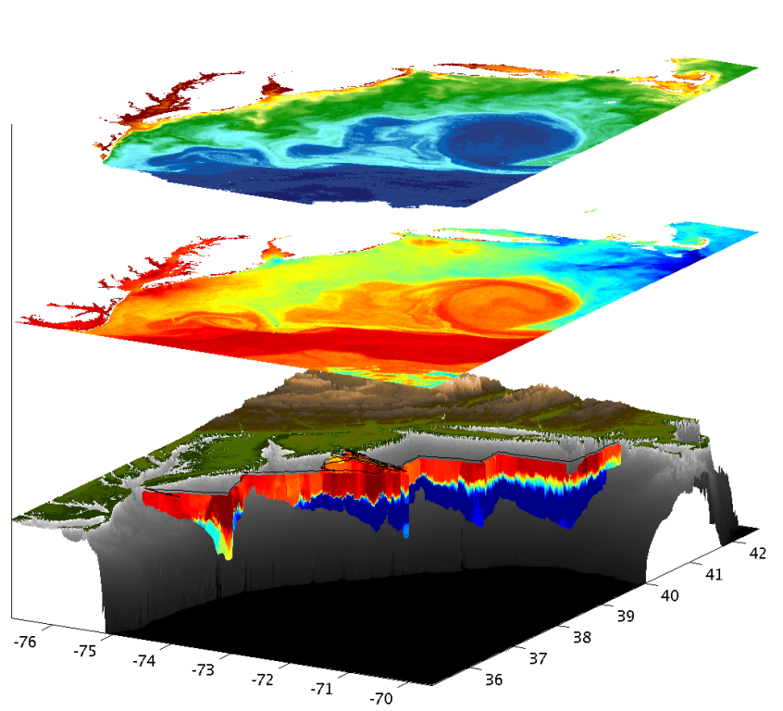
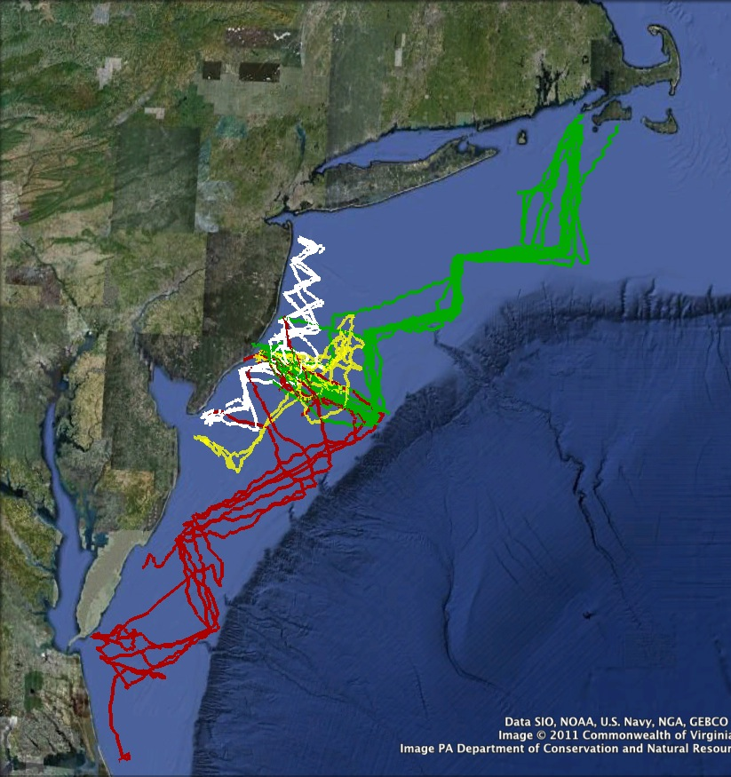
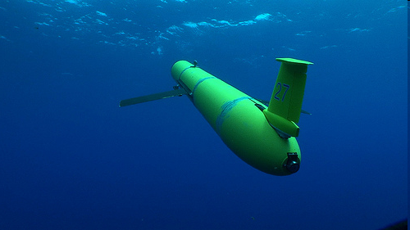
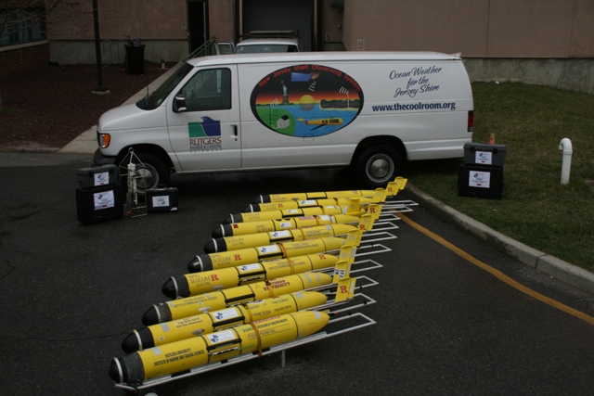
Autonomous Underwater Gliders – Since 1998
Satellite Ocean Color
Corporate Partner: Teledyne Webb Research
Satellite SST
Subsurface
Glider
Data

Slide 5
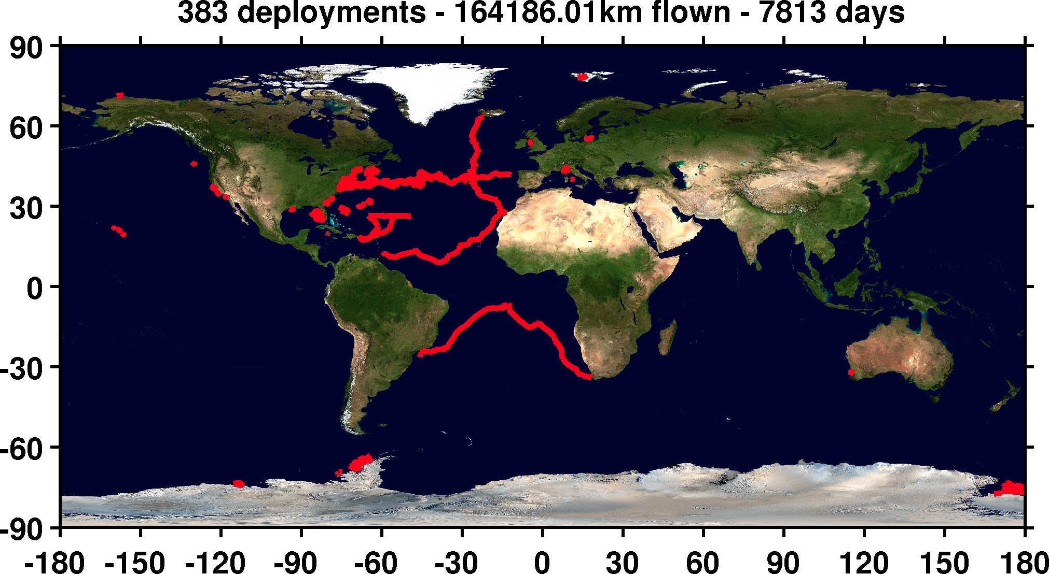
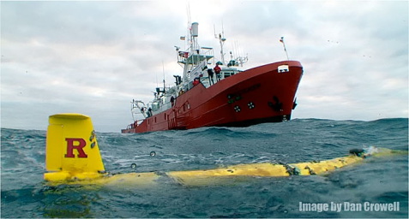
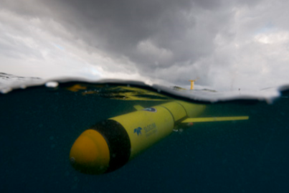
RU-COOL Global Slocum Glider Fleet Deployments
Hurricanes and Nor’easters
Extreme Environments – Antarctica Long Duration Missions

Slide 6
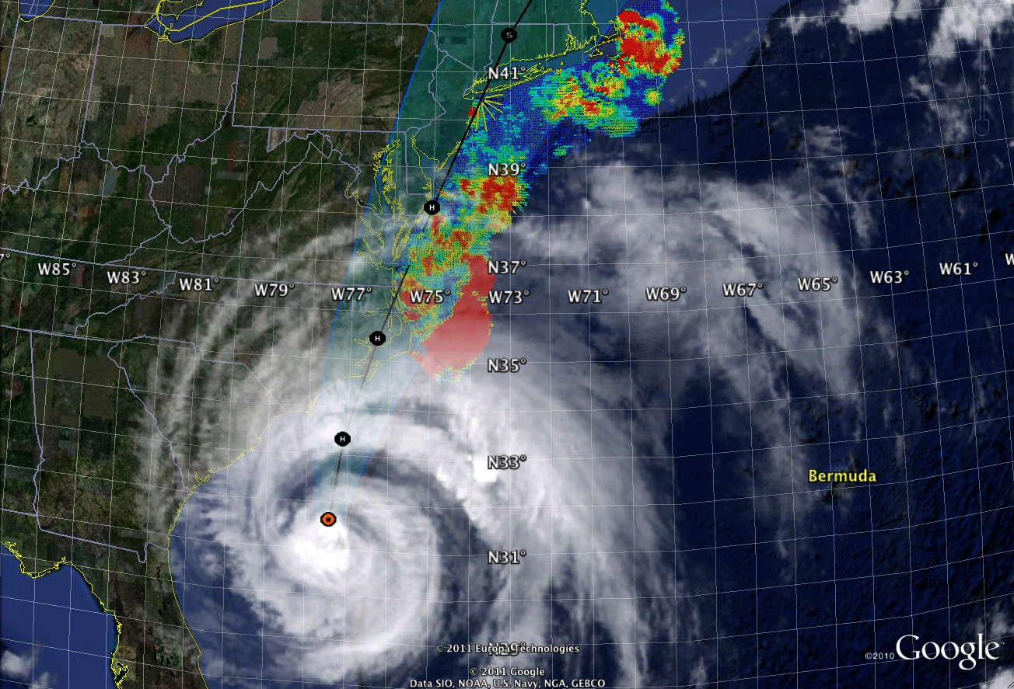
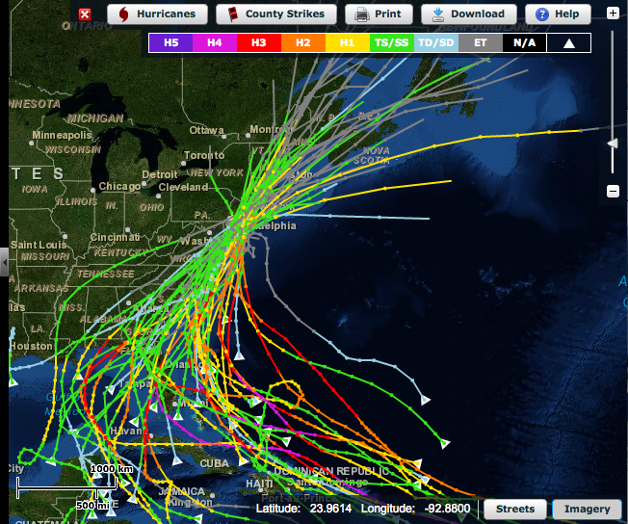
Hurricane Irene: Track (August 2011)
Historical Hurricane Tracks
within 120 km of Atlantic City, NJ

Slide 7
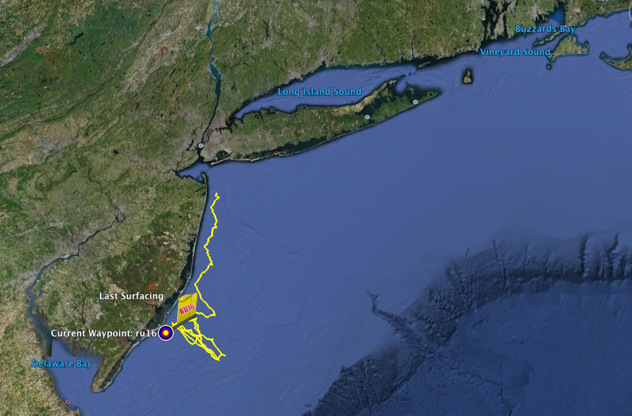
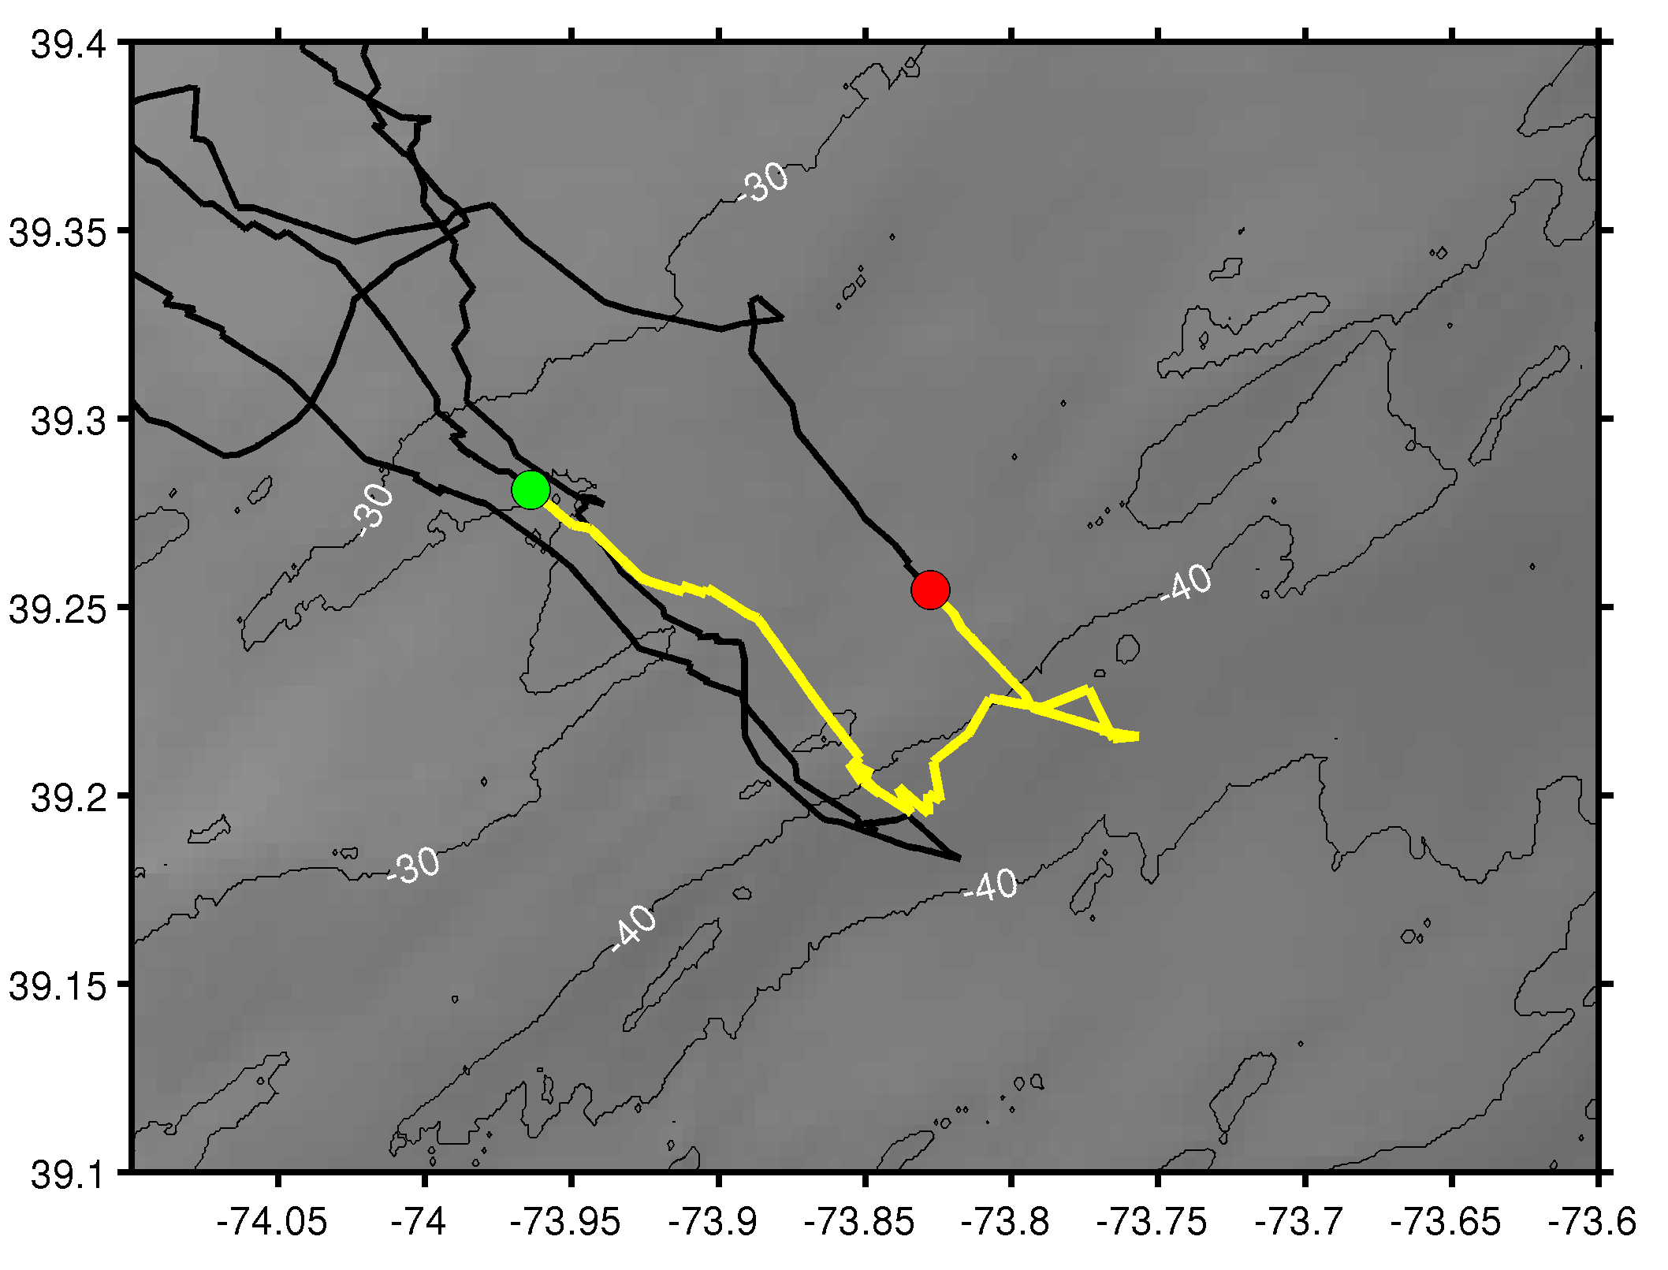
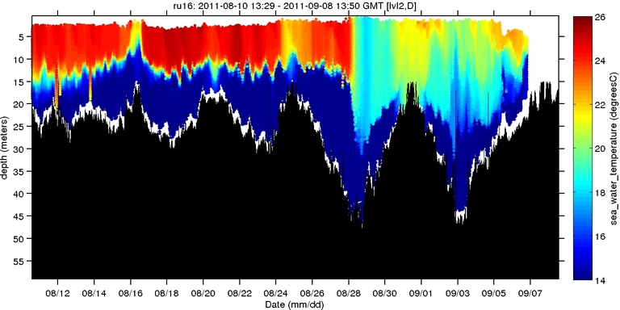
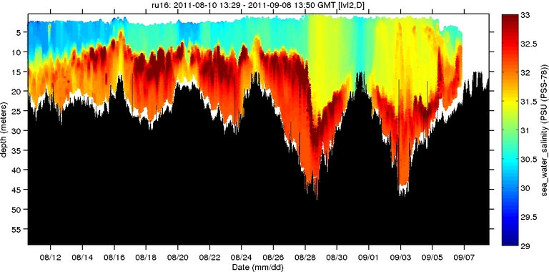
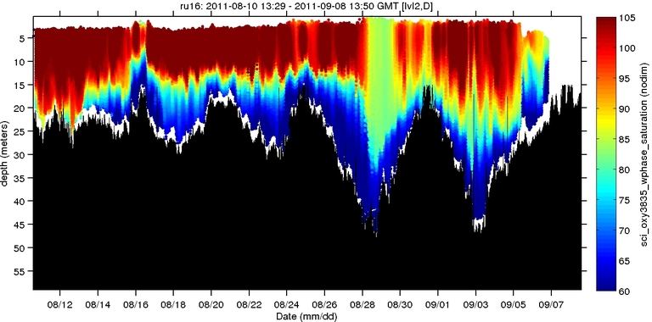
Hurricane Irene: Glider Sampling Through the Storm
Hurricane Irene
0
26
depth
Temperature
RU16
Deployed for EPA.
Map bottom dissolved oxygen.
Provided data on mixing during storm.
55
14
0
33
depth
Salinity
55
29
0
105
depth
% Saturation
(DO)
55
60
Aug 12
date
Sep 07

Slide 8
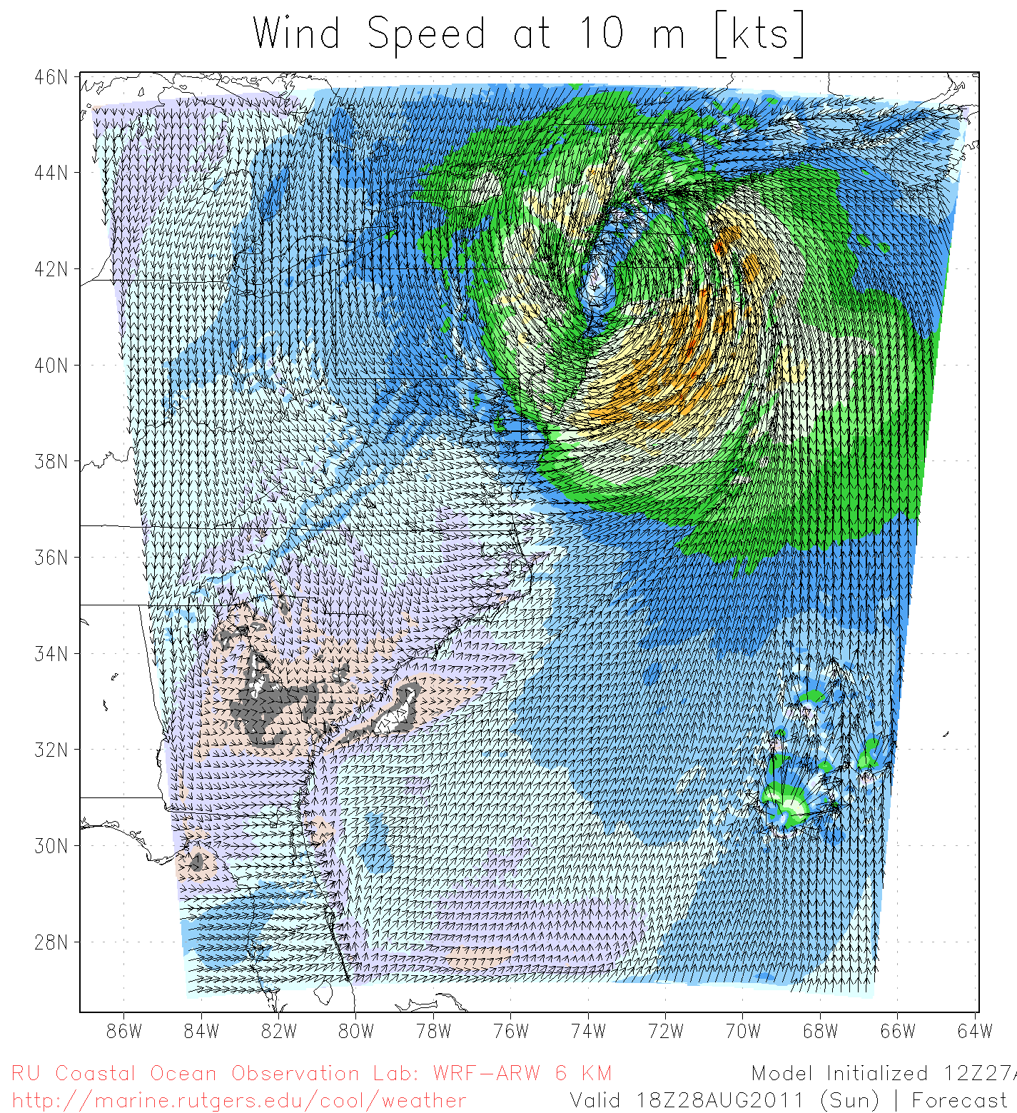
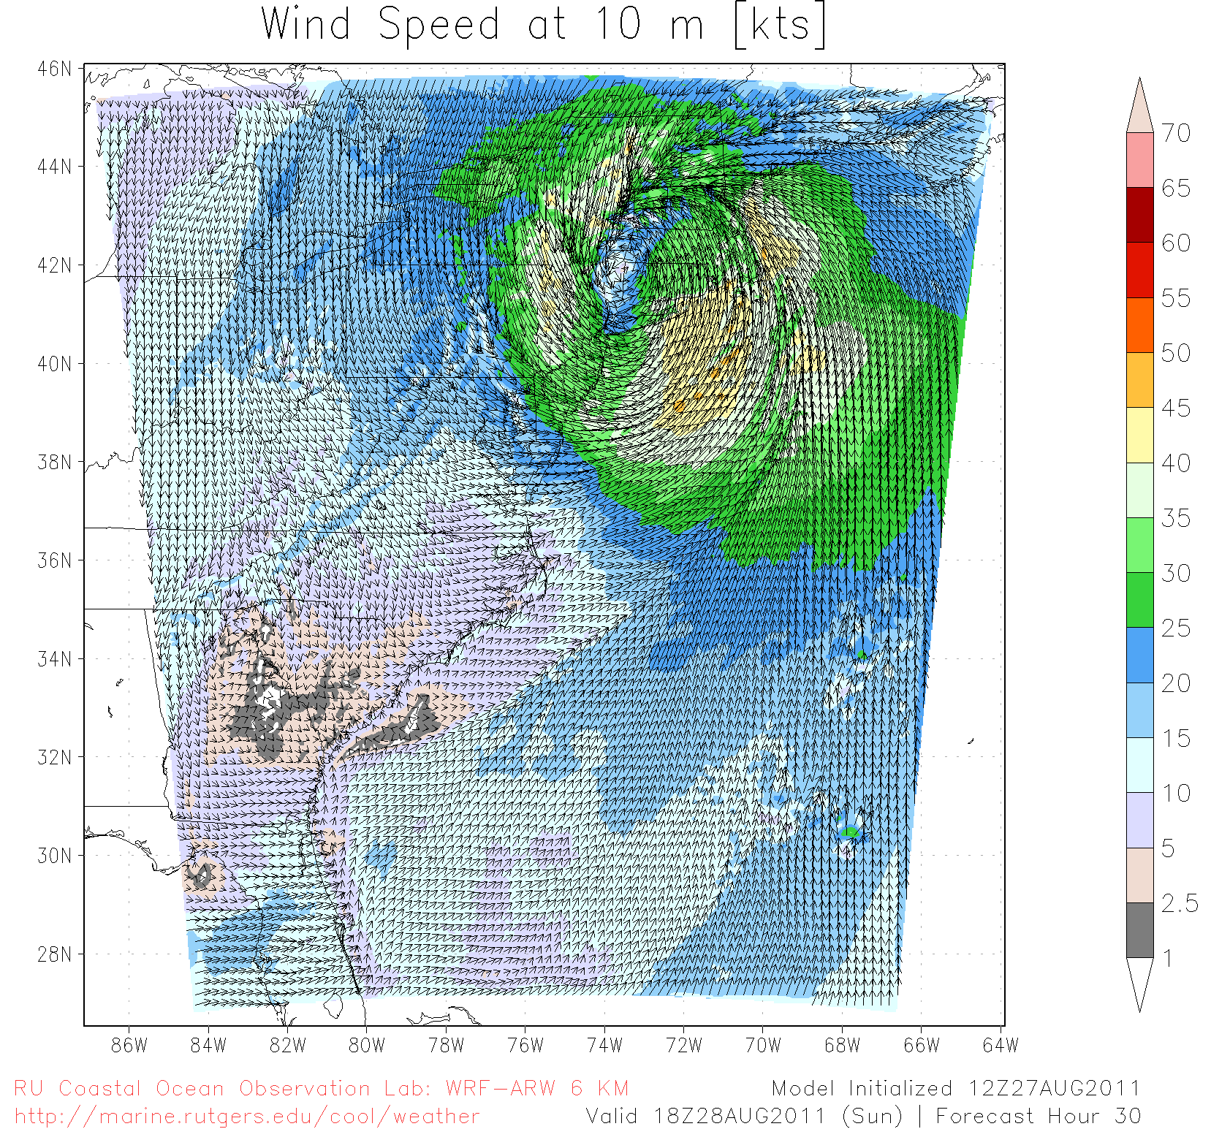
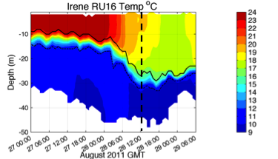
Hurricane Irene SST Sensitivity Hindcast
Global Warm SST
Regional Cold SST
Maximum Wind Speed Skill Score | Official Forecast | Warm SST Hindcast | Warm SST + OML Model Hindcast | Cold SST Hindcast
RMS Error (knots) | 9.43 | 7.13 | 7.09 | 3.61

Slide 9
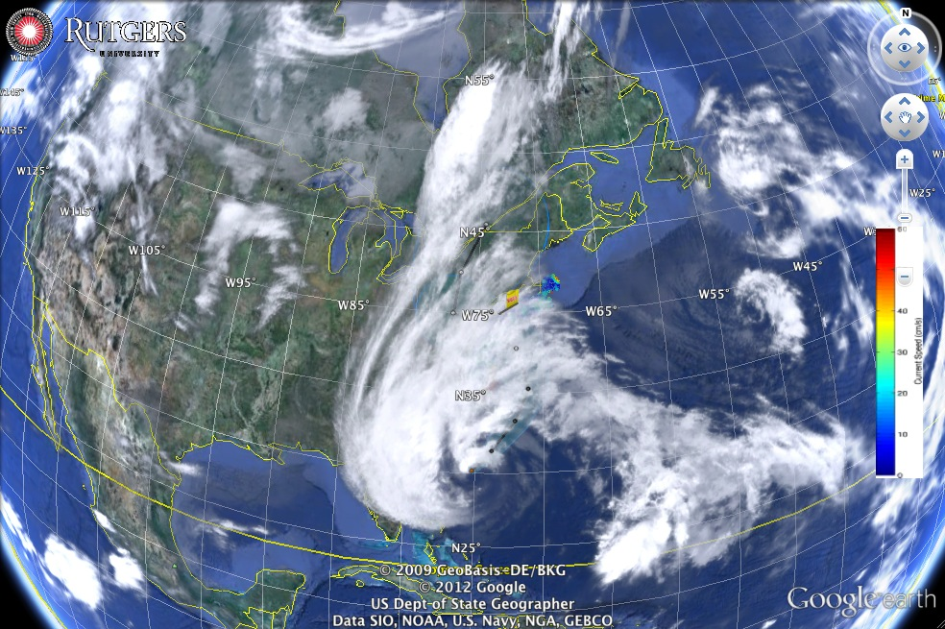
Hurricane Sandy (2012)

Slide 10
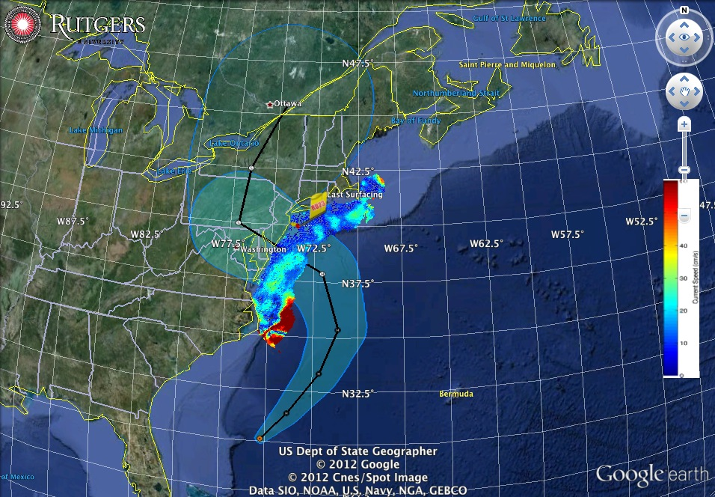
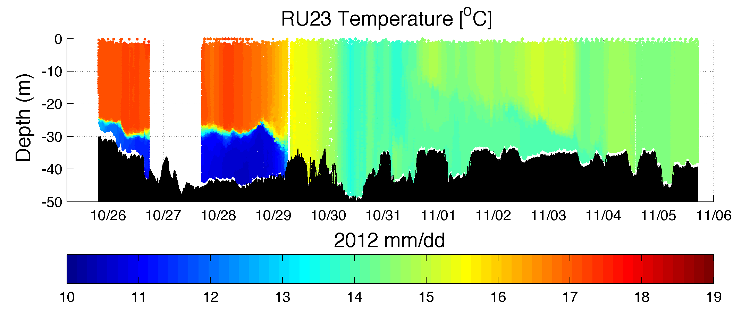
Superstorm Sandy: 2 Days Before Landfall

Slide 11
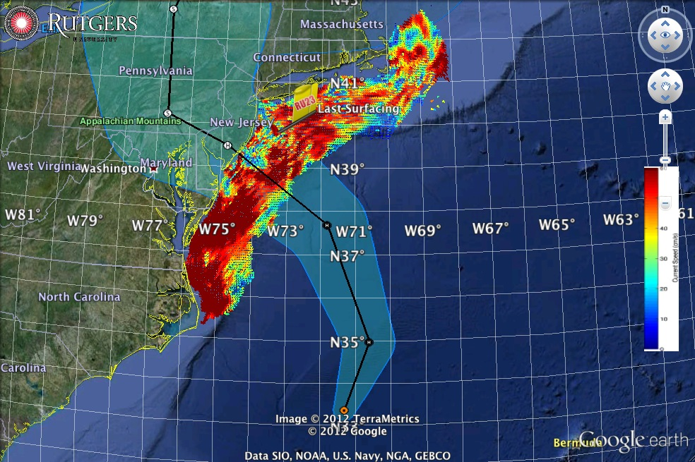
Superstorm Sandy: 1 Day Before Landfall

Slide 12
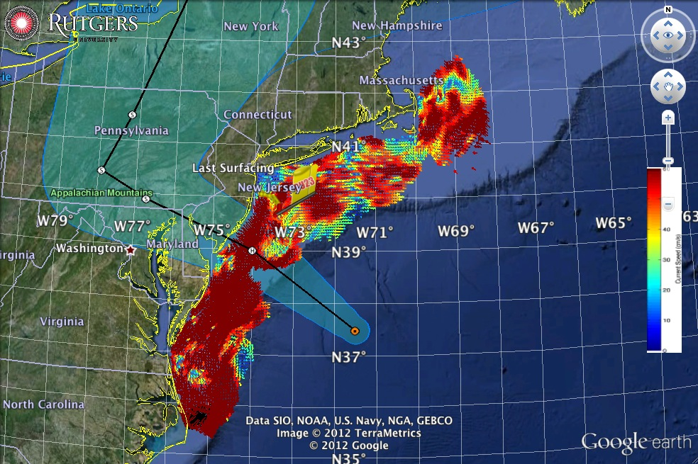
Superstorm Sandy: Morning Before Landfall

Slide 13
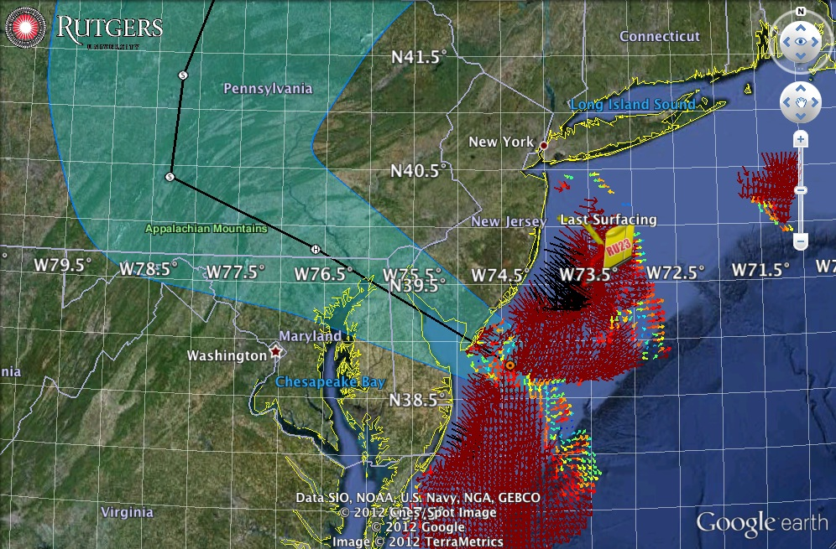
Superstorm Sandy: Landfall (20:00 Local)

Slide 14
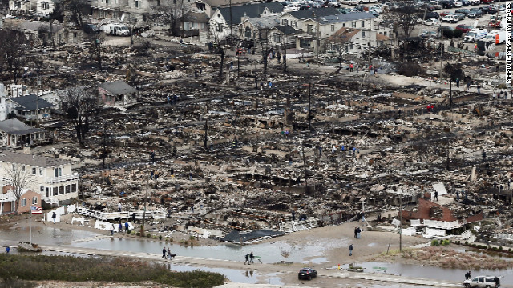
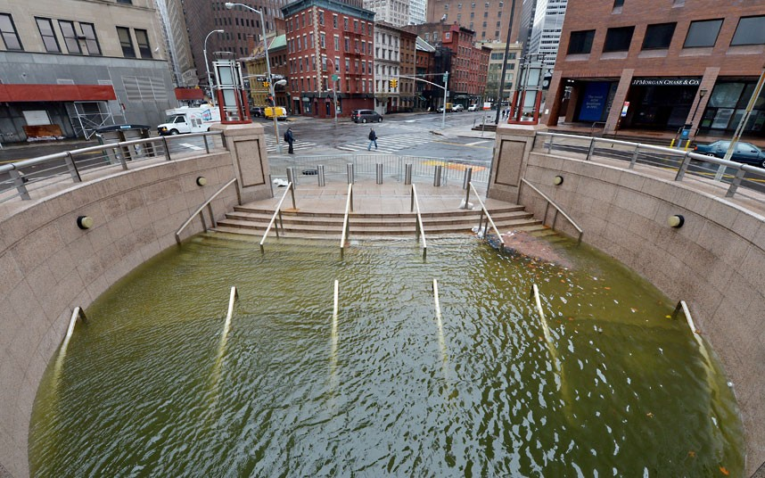
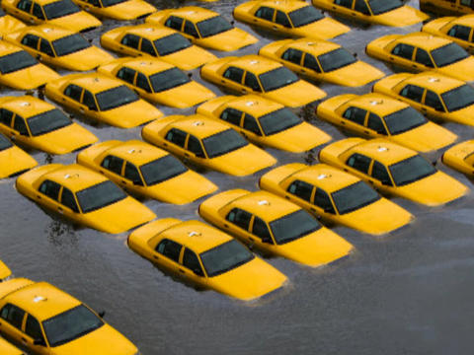
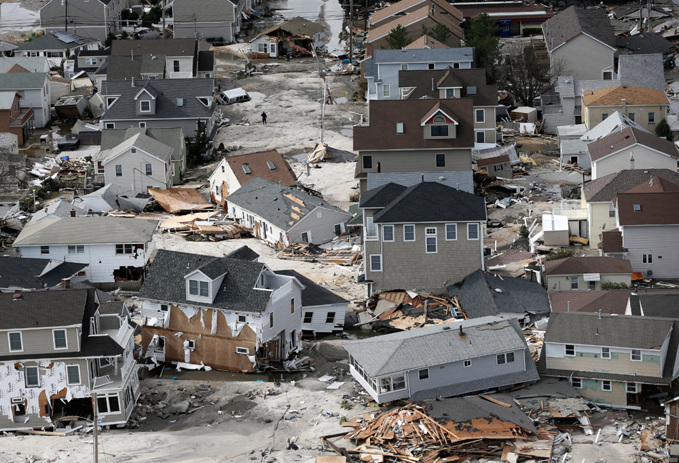

Slide 15
RU-COOL Global Slocum Glider Fleet Deployments
Hurricanes and Nor’easters
Extreme Environments – Antarctica Long Duration Missions

Slide 16
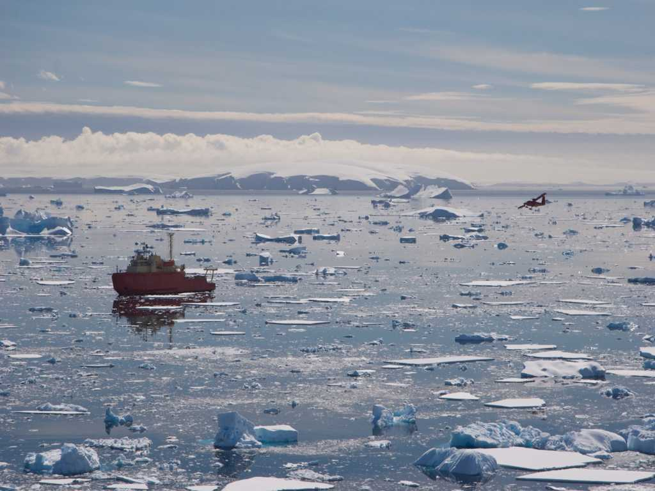
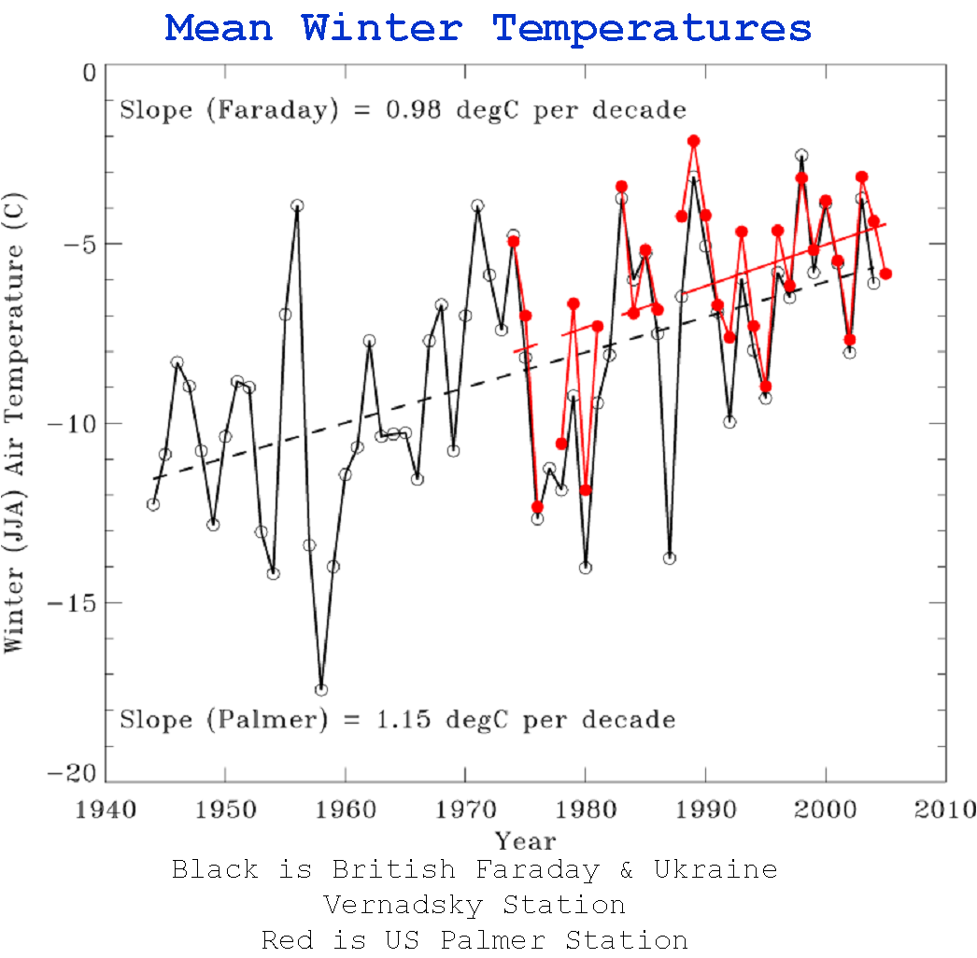
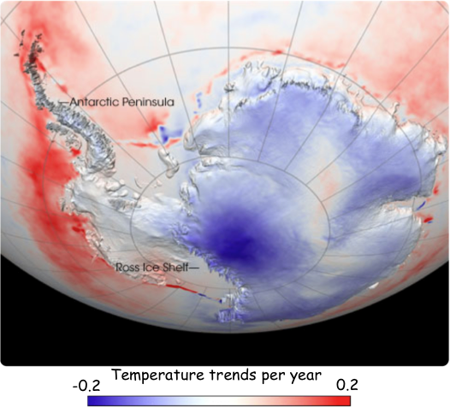
Monitoring our
Changing Planet

Slide 17
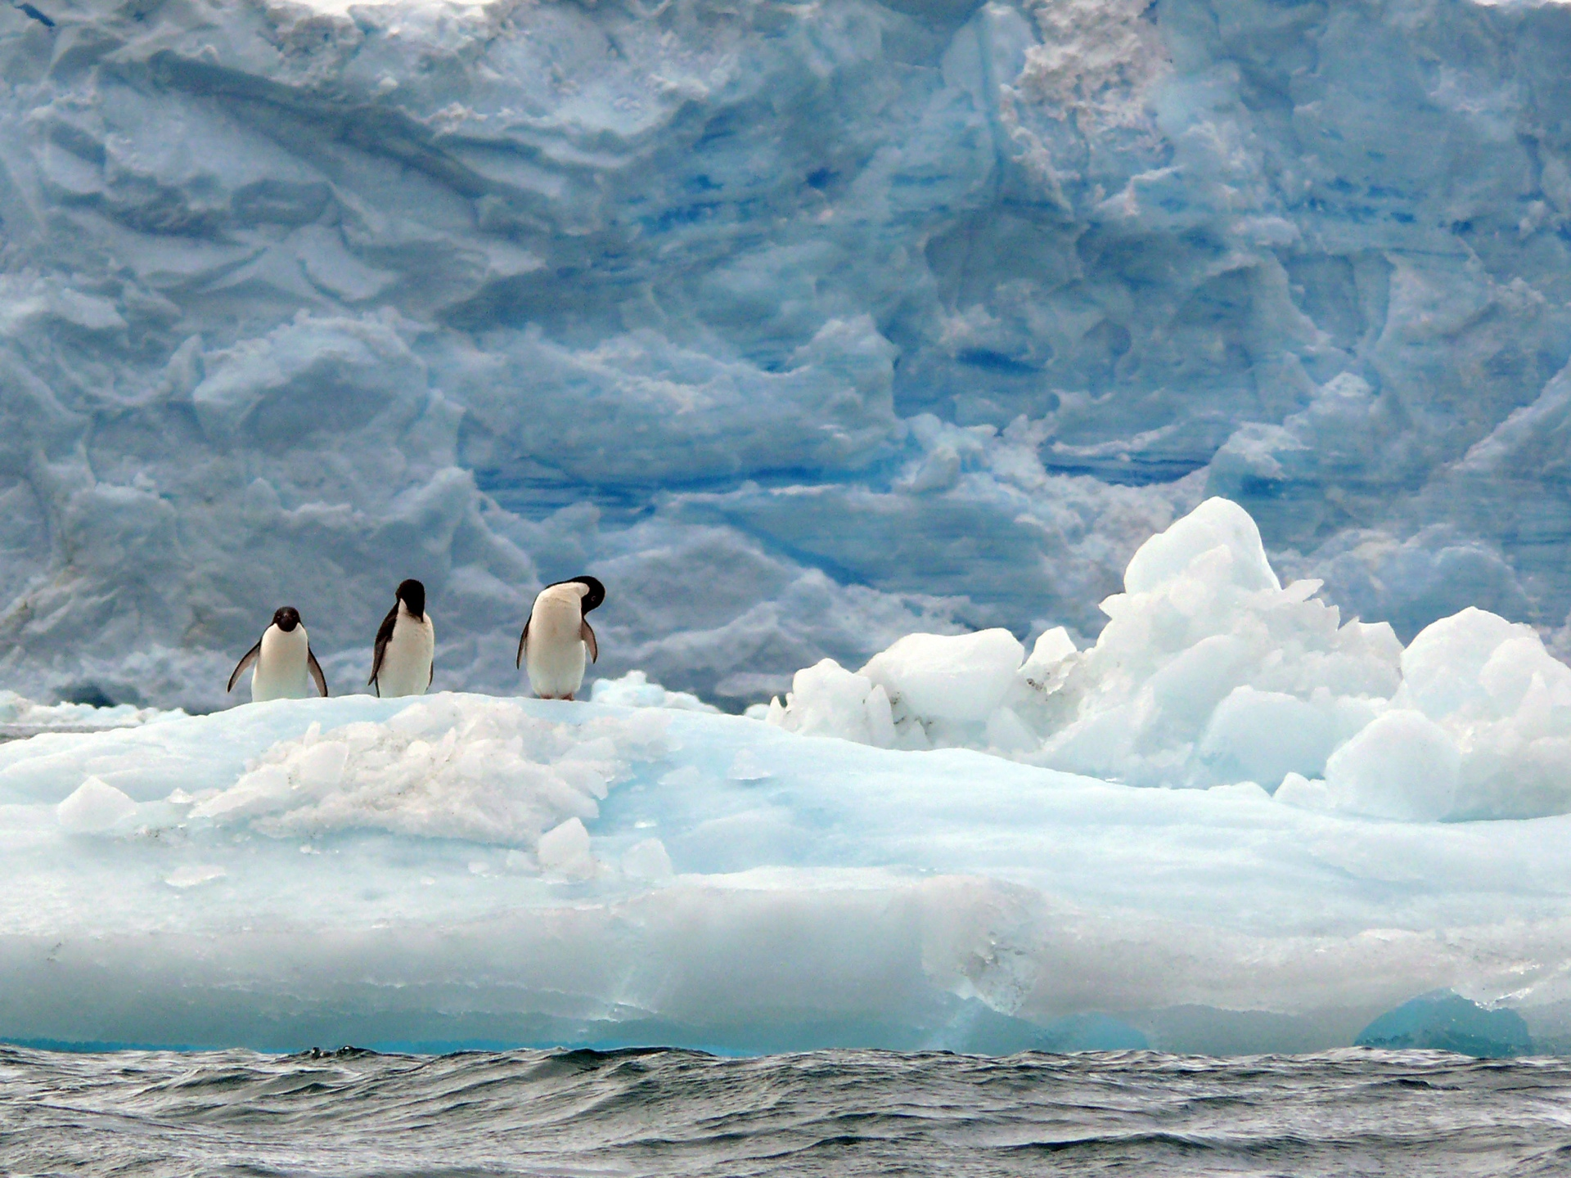
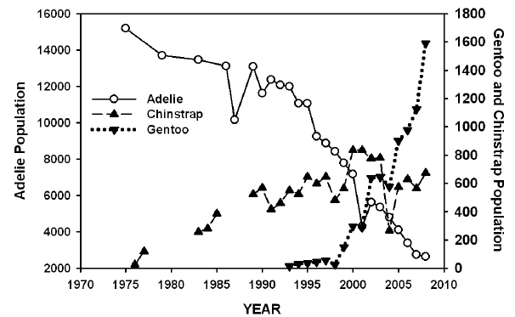

Slide 18

ARSV LM GOULD

Slide 19

Beset in heavy sea ice, Sept-Nov 2001

Slide 20




Glider deployments
in a unique ecosystem

Slide 21





24 Hour Winds (knots)
40
31
22
13
4

Slide 22




Adaptive Sampling of Penguin Habitats
Penguin
Foraging
locations
Kahl et al., 2010

Slide 23




Slide 24
RU-COOL Global Slocum Glider Fleet Deployments
Hurricanes and Nor’easters
Extreme Environments – Antarctica Long Duration Missions

Slide 25






Global Challenger Glider Mission
16 Global-Class Gliders

Slide 26






Companion Course at
Plataforma Oceanica de Canarias
Shared Glider Missions – Iceland to Azores; Azores to Canaries; Canaries to Caribbean
Skype Sessions between classes
Two-way International Exchange programs
Students Learn Science from their teachers
Students Learn Culture from their peers
Glider Silbo >10,000 km flown

Slide 27











Glider RU29: Launched at Cape Town 11 Jan 2013, flown >10,000 km

Slide 28

RTOFS and MERCATOR Comparison to Glider RU29
Ascension Island to Ubatuba, Brazil
Turtle Tracks
Deep Eddy
Cabo Frio Eddy
Full Track Temp Difference
Argo Validation
Mid-Gyre “Turtle Tracks”
Deep Ocean Eddy
Cabo Frio Coastal Eddy

Slide 29


Challenger Mission Totals
GLIDER | START | END | DAYS | KILOMETERS
SILBO LEG 1 | 6/23/2011 | 12/03/2011 | 163.5 | 3,941
SILBO LEG 2 | 3/7/2012 | 5/22/2012 | 76 | 1,706
SILBO LEG 3 | 7/24/2012 | 5/19/2013 | 303 | 4,390
RU 29 LEG 1 | 1/11/2013 | 10/26/2013 | 289 | 5,667
RU29 LEG 2 | 11/10/2013 | 5/18/2014 | 189 | 4,720
TOTAL: |  |  | 1,020.5 | 20,424

Slide 30




Global Challenger Glider Mission
Creating the Next Generation of Ocean Explorers
16 Legs with
16 Global-Class Gliders

Slide 31

Thank You!
http://rucool.marine.rutgers.edu

