Slide 1
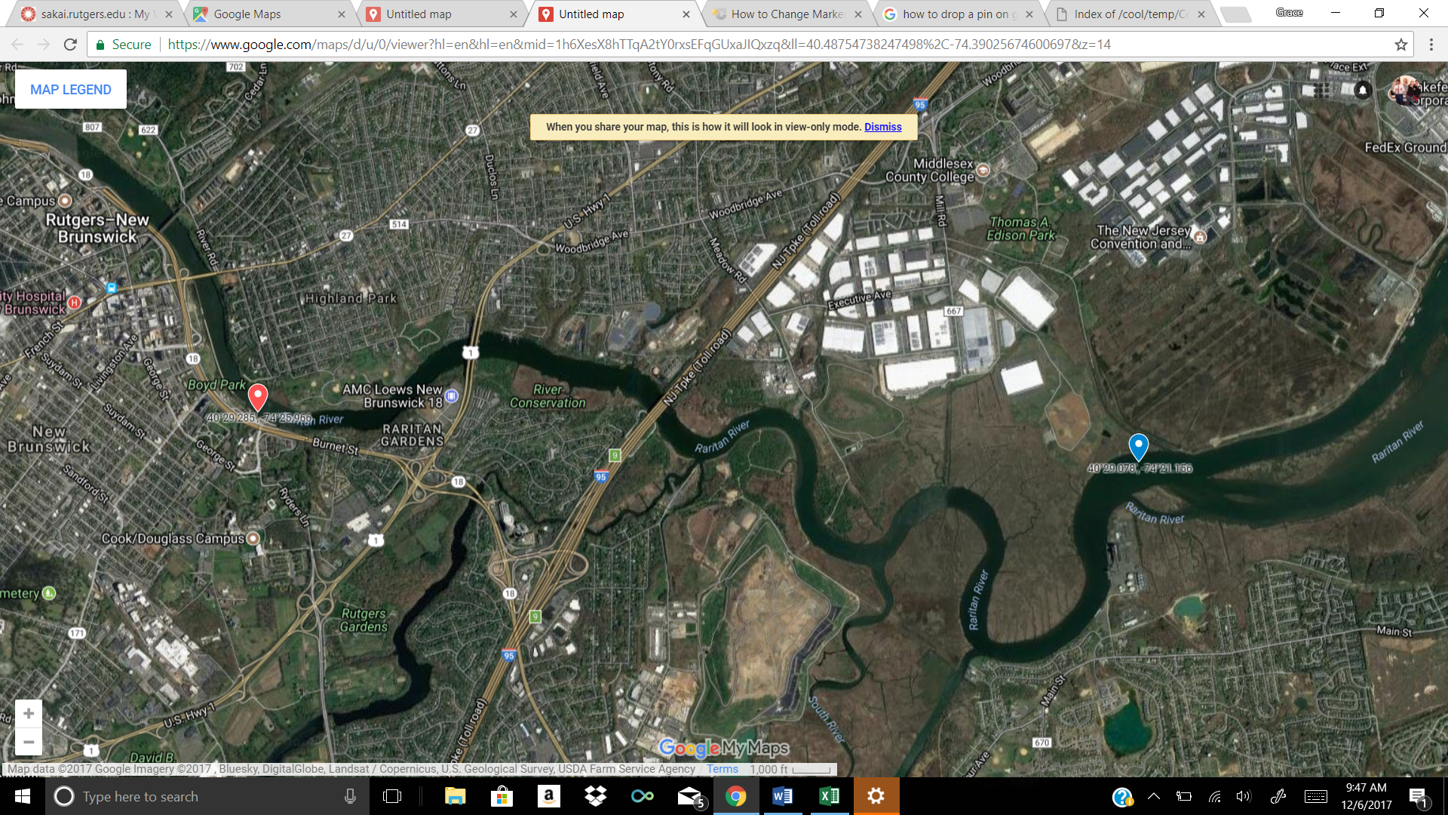
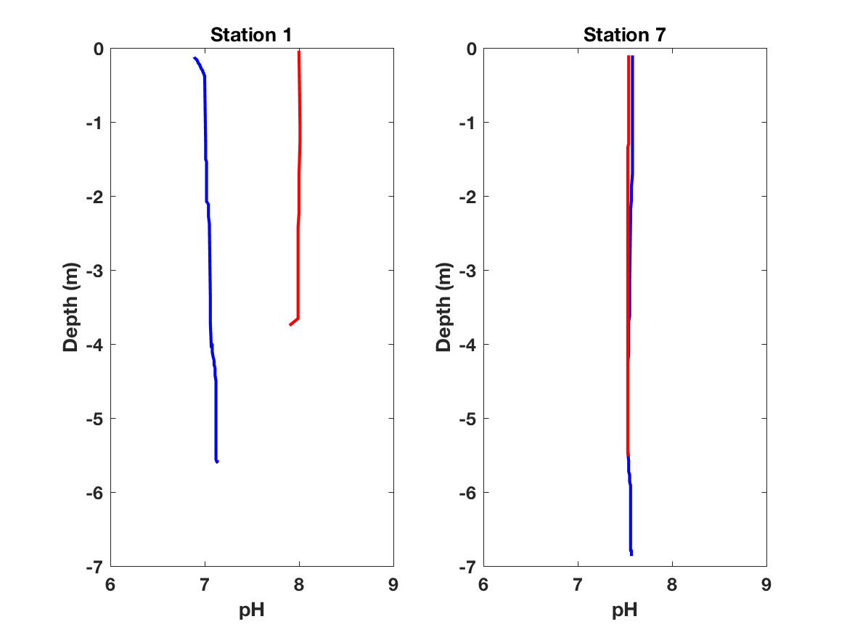
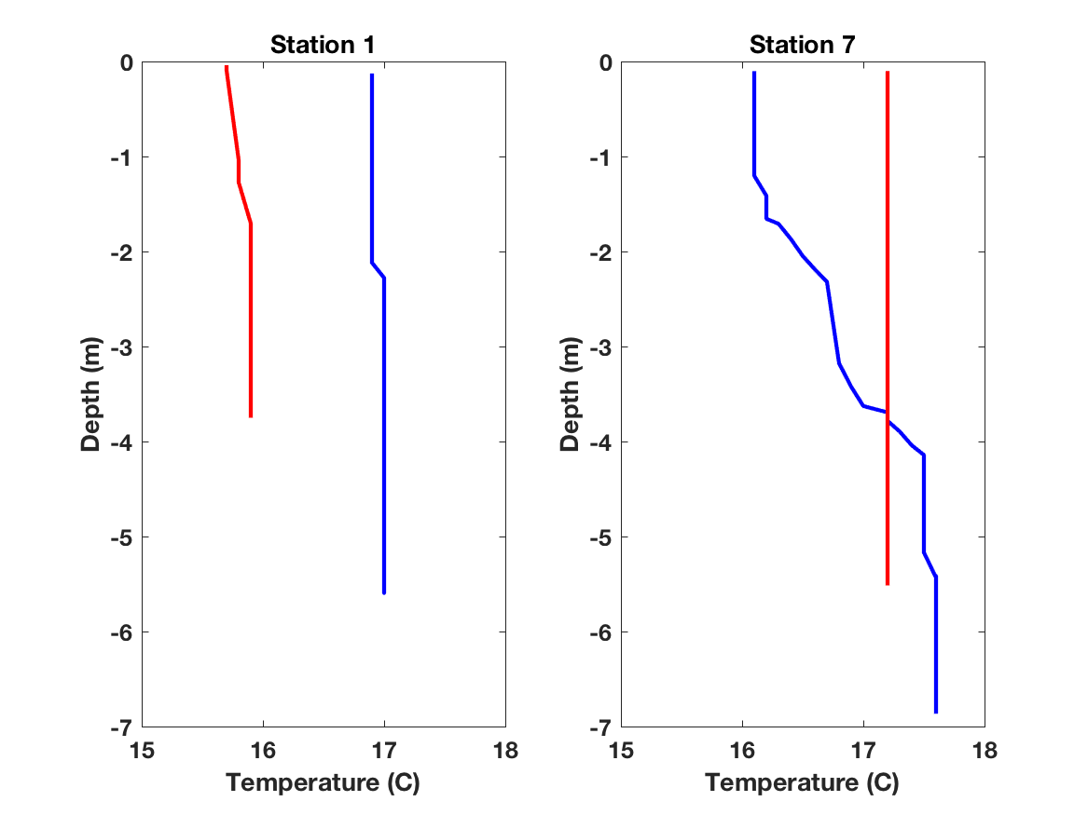
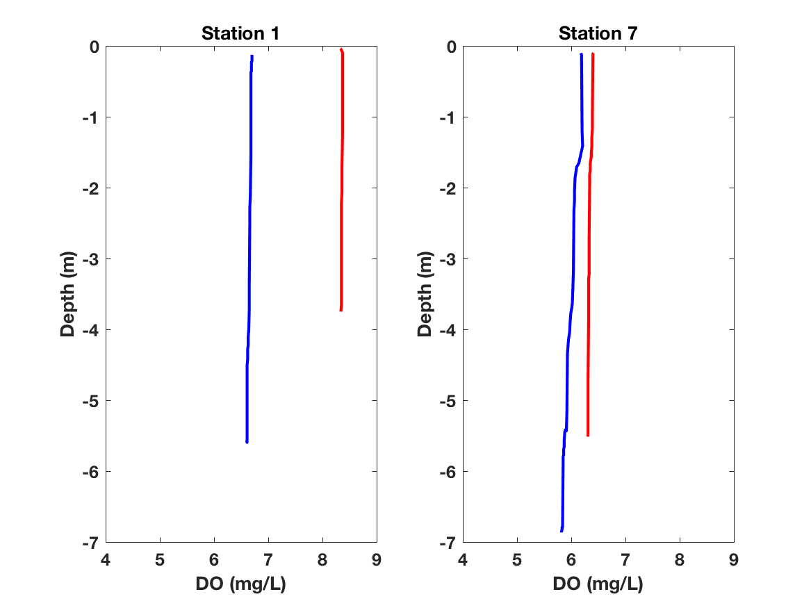
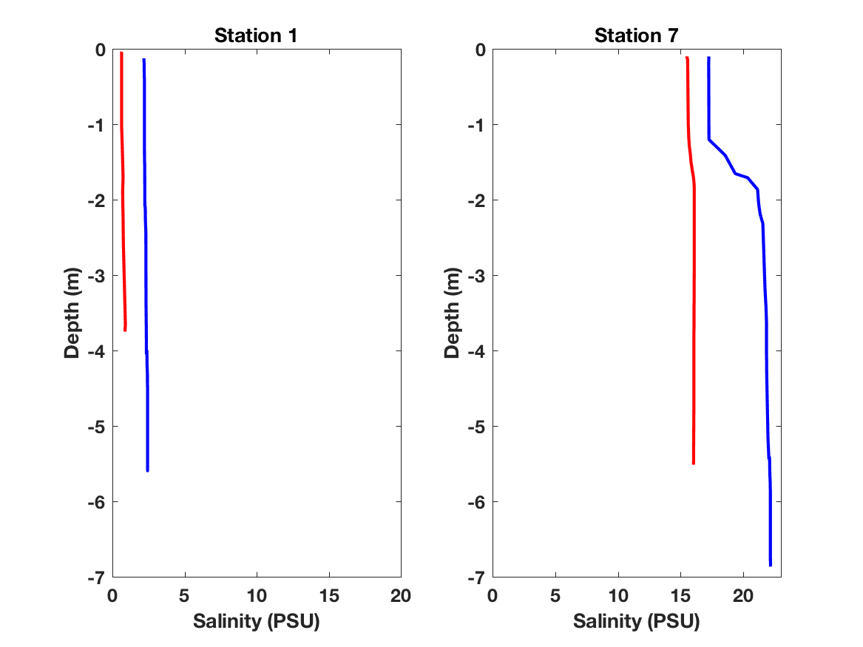
TITLE HERE
2017 Oceanography House Students¹
¹Rutgers University
Raritan River Cruise Objectives
Station Map
pH
2-3 bullets describing profiles
2 bullets describing location of stations relative to campus/river source/ocean
Our two cruises went down the Raritan River, sampling 5 different stations between campus and the river mouth.
At each station, we sampled the physical and chemical properties of the river water
Dissolved Oxygen
Temperature
Region 3
Local Tides
Region 4
2-3 bullets describing profiles
2-3 bullets describing profiles
Cruise 1
Cruise 2
Our sampling day (October 18, 2017) was during the spring tide
Cruise 1 started at high tide and cruise 2 started on the following ebb tide.
Salinity
Conclusions
Raritan River Streamflow
3 to 4 concluding bullets
There was slightly higher discharge compared to the long term mean 4 days before our cruises.
Discharge during the cruise was low and close the long term mean.
2-3 bullets describing profiles

