Slide 1
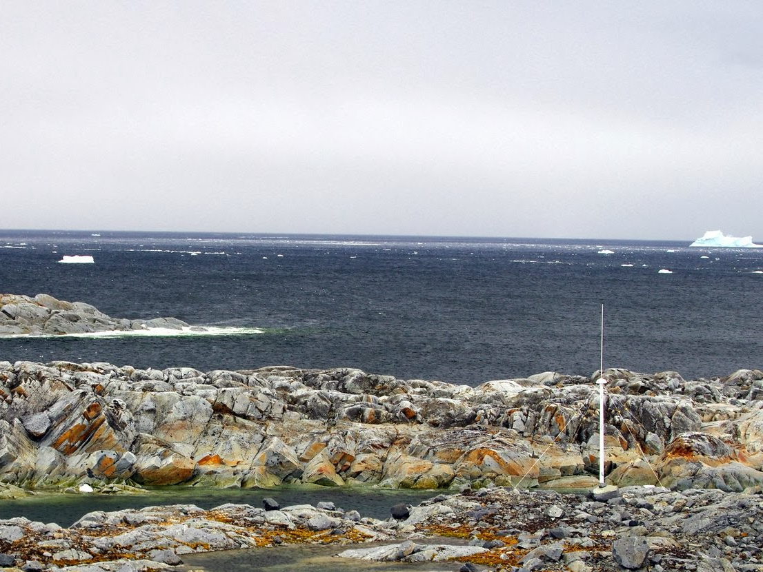


Collaborative research: Impacts of local oceanographic processes on Adélie penguin foraging ecology over Palmer Deep
Rutgers University
Oregon State University
Polar Oceans Research Group
University of Delaware
University of Alaska, Fairbanks
In Collaboration with PAL-LTER (Ducklow et. al.)

Slide 2
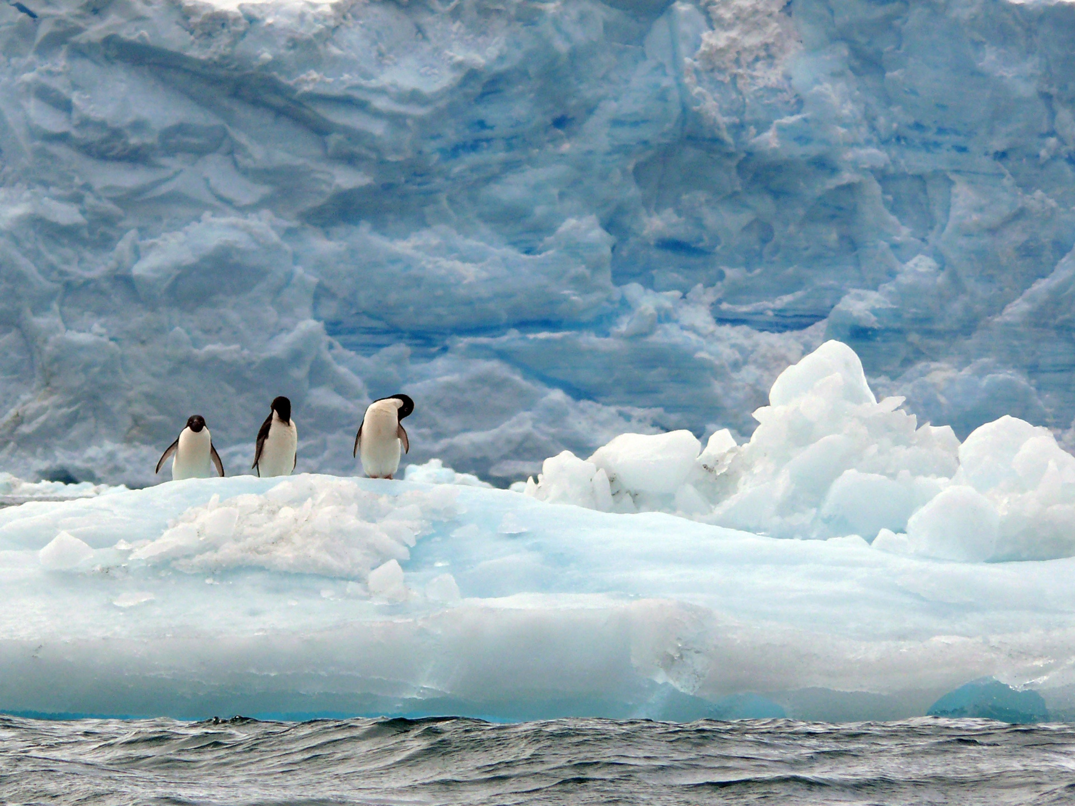
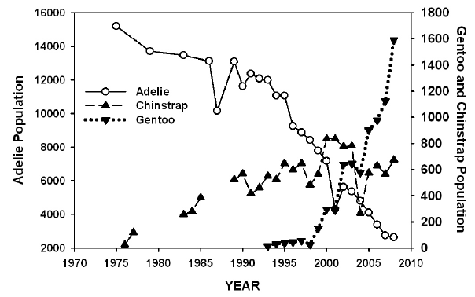


Slide 3
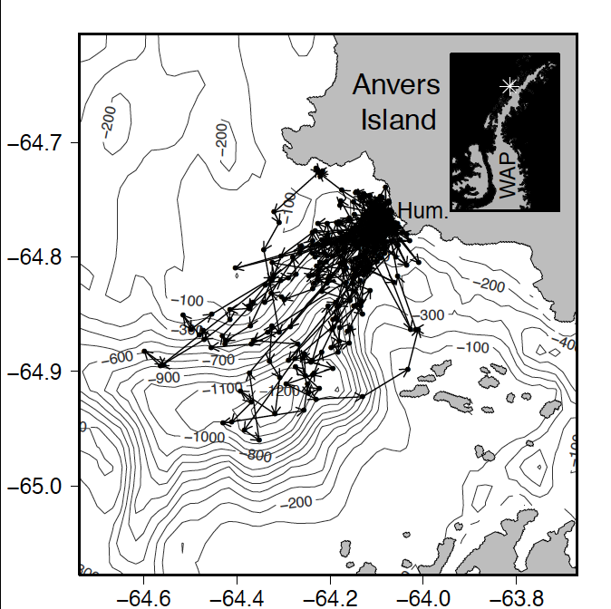
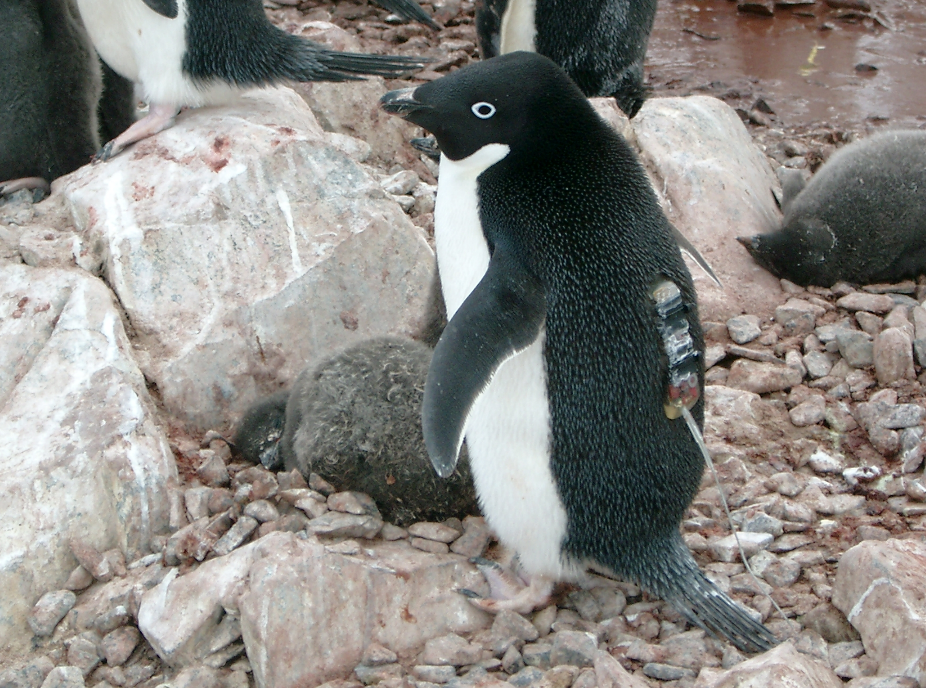
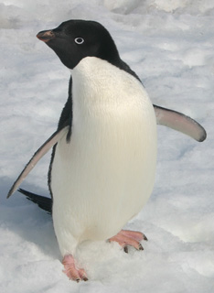
First Field Season Results
Tracking penguins from Humble Island
Where did the Adélie penguins go?

Slide 4
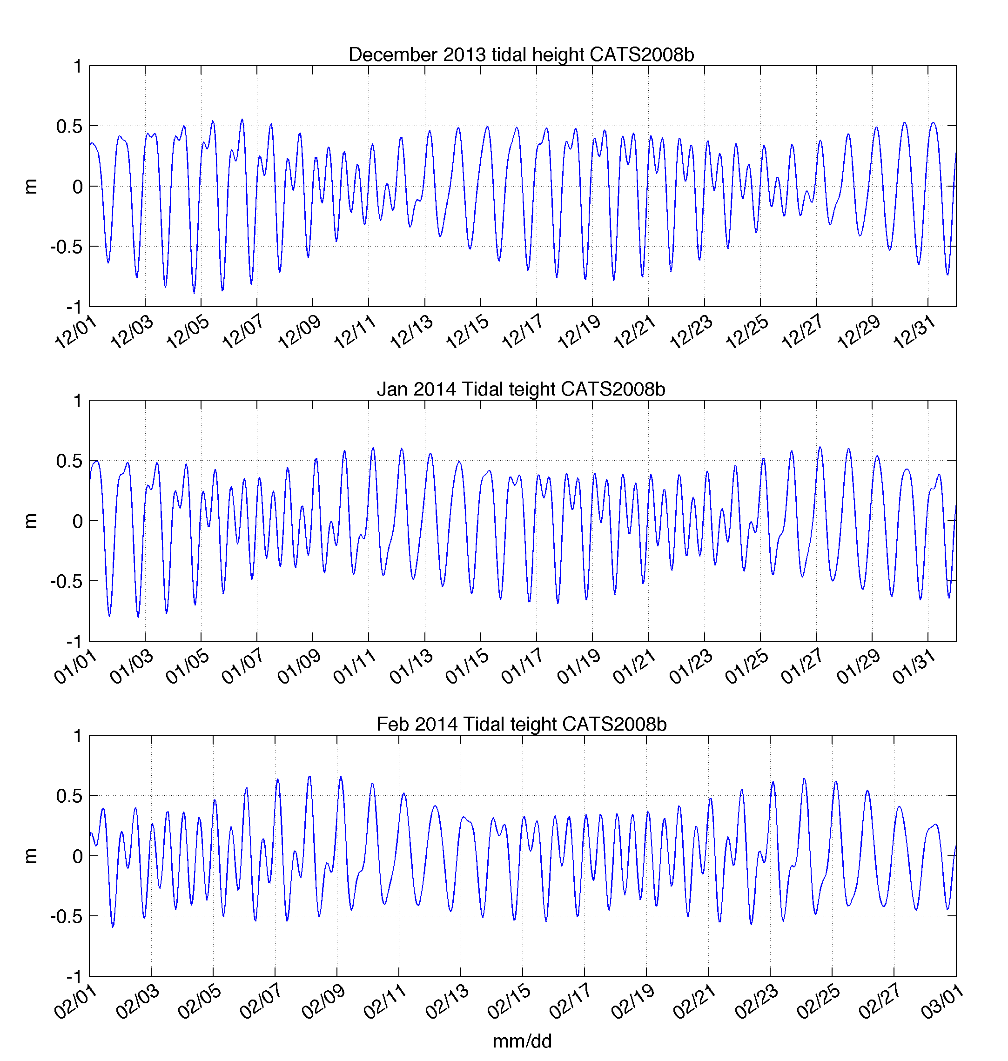
Tidal Dependence on Penguin
Foraging Behavior?
Diurnal
Semi-Diurnal

Slide 5
Science Objectives
From these initial observations we hypothesize that:
H1. Convergence zones in the surface waters within 50 km of the coast shift location between the diurnal and semi-diurnal tidal regime.
H2. These convergence zones concentrate phytoplankton and aggregate schools of krill and subsequently influence the behavior of top predator species between tidal regimes.
To do this we will sample the:
Physics
Primary Producers
Zooplankton
Top Predators
Over semi-diurnal and diurnal tidal regimes.

Slide 6
Technology to be deployed:
Our adaptive Approach
HF Radar (Physics – Surface / Time)
Mooring (Physics – Vertical / Time)
Gliders (Physics and Primary Producers)
Small Boat Surveys (Physics, Primary Producers and Krill)

Slide 7
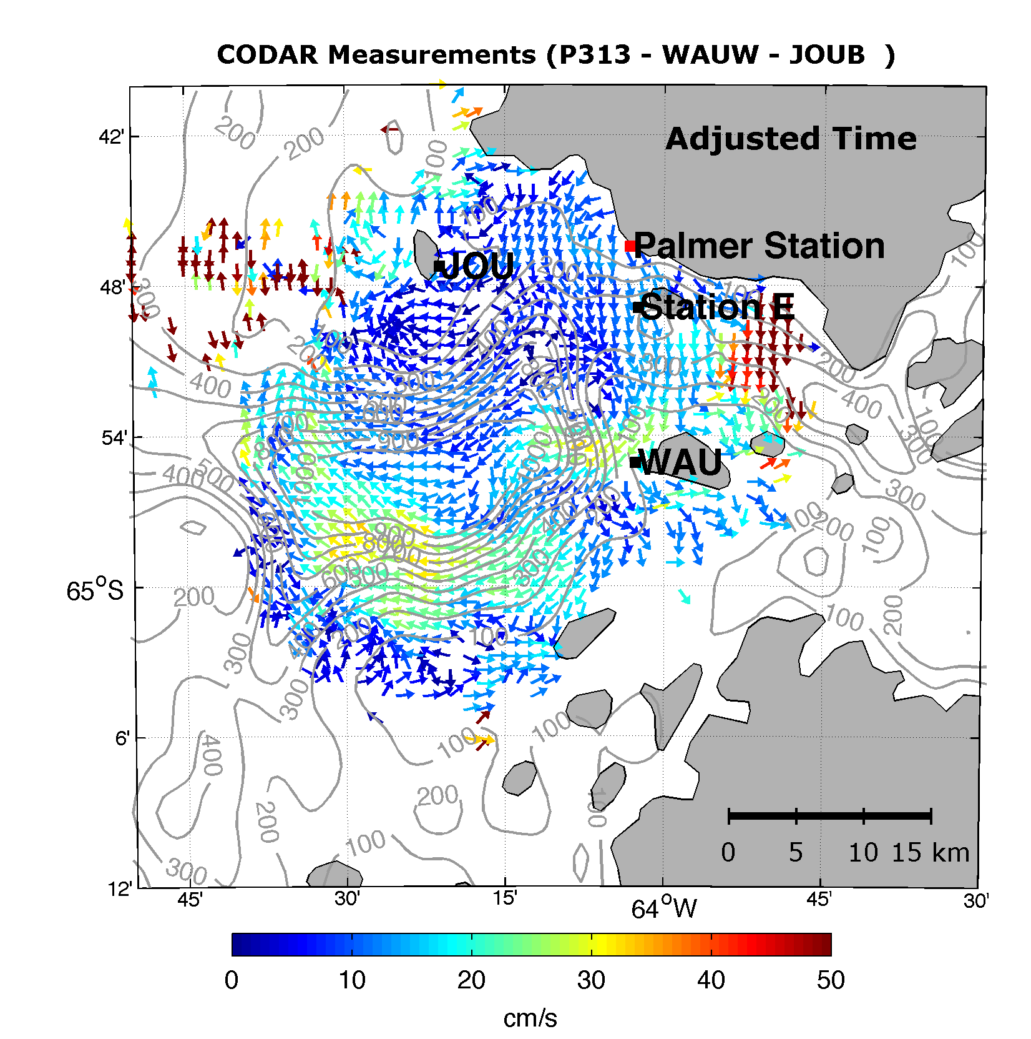
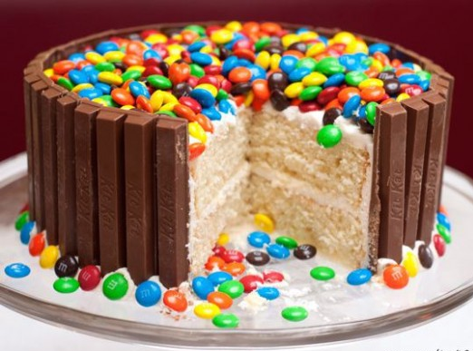
HF Radar
(Physics – Spatial / Time)

Slide 8
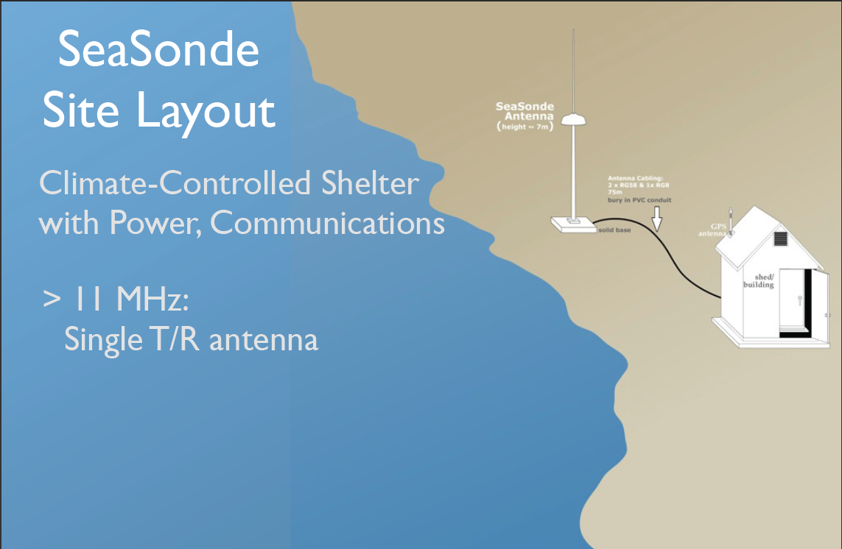

Slide 9
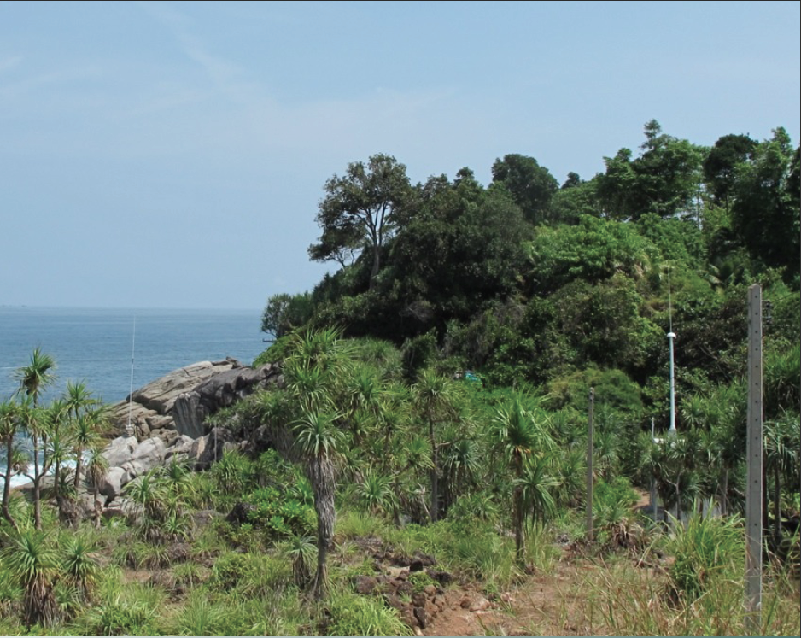
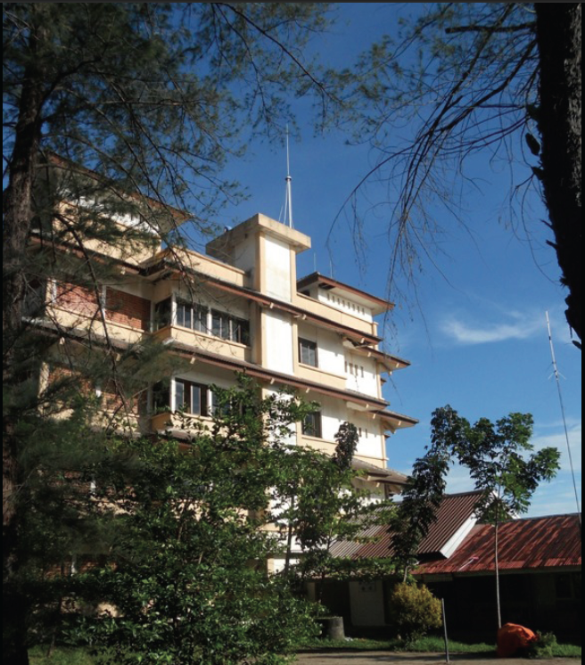
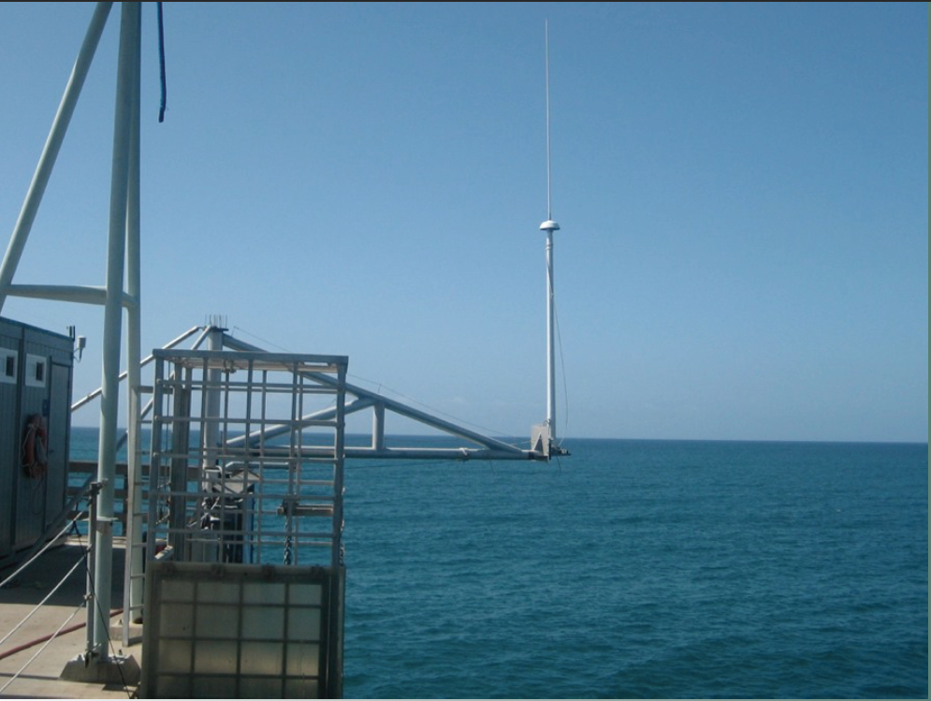

Slide 10
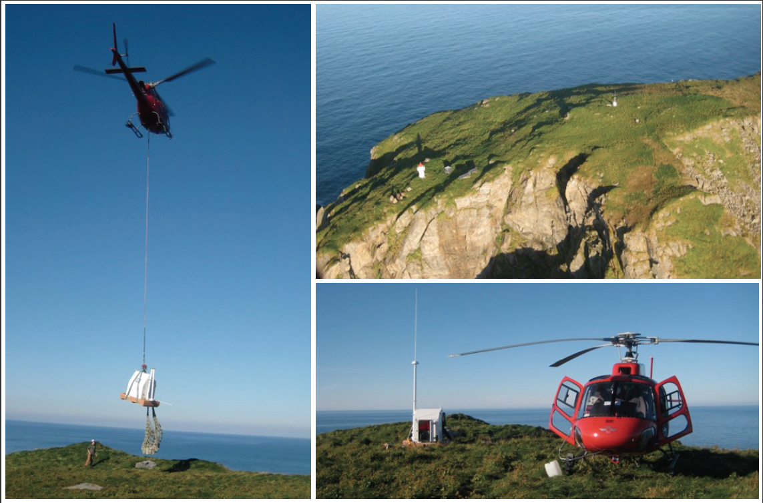

Slide 11
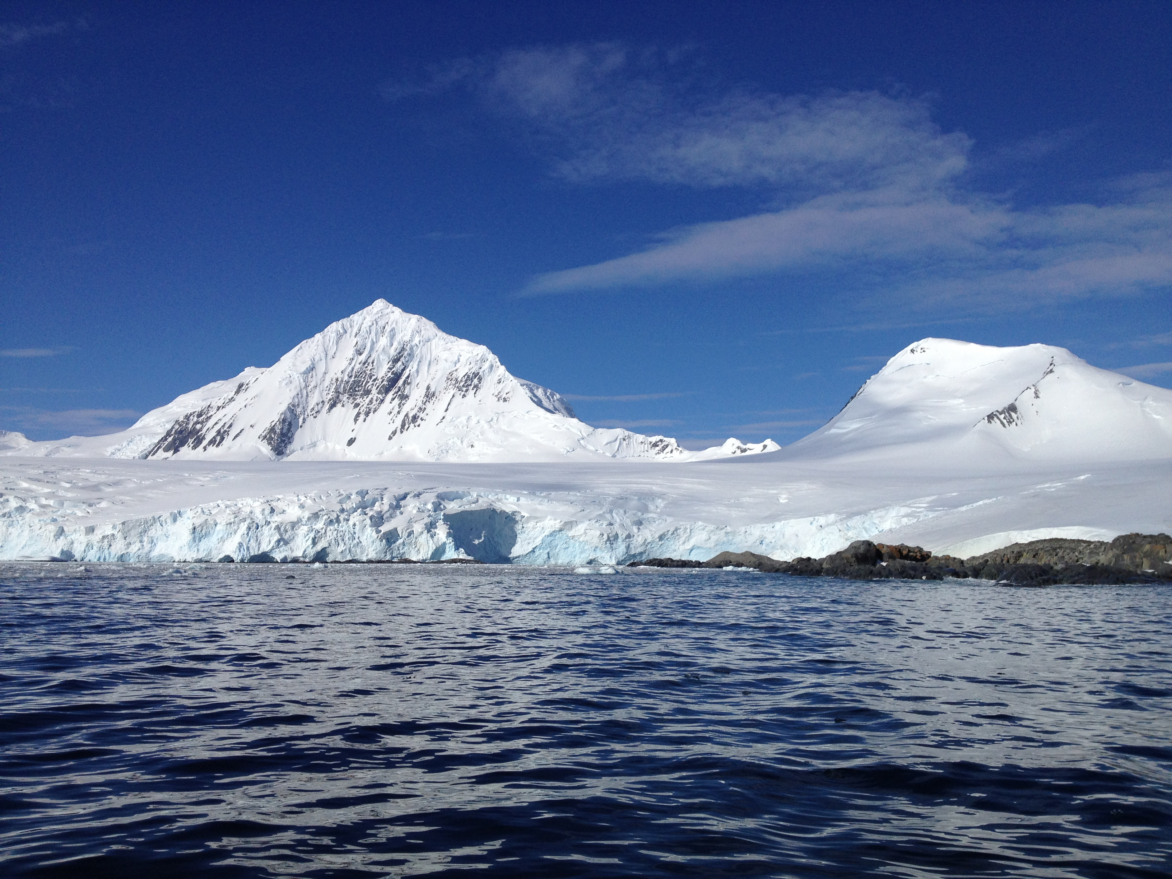

Slide 12
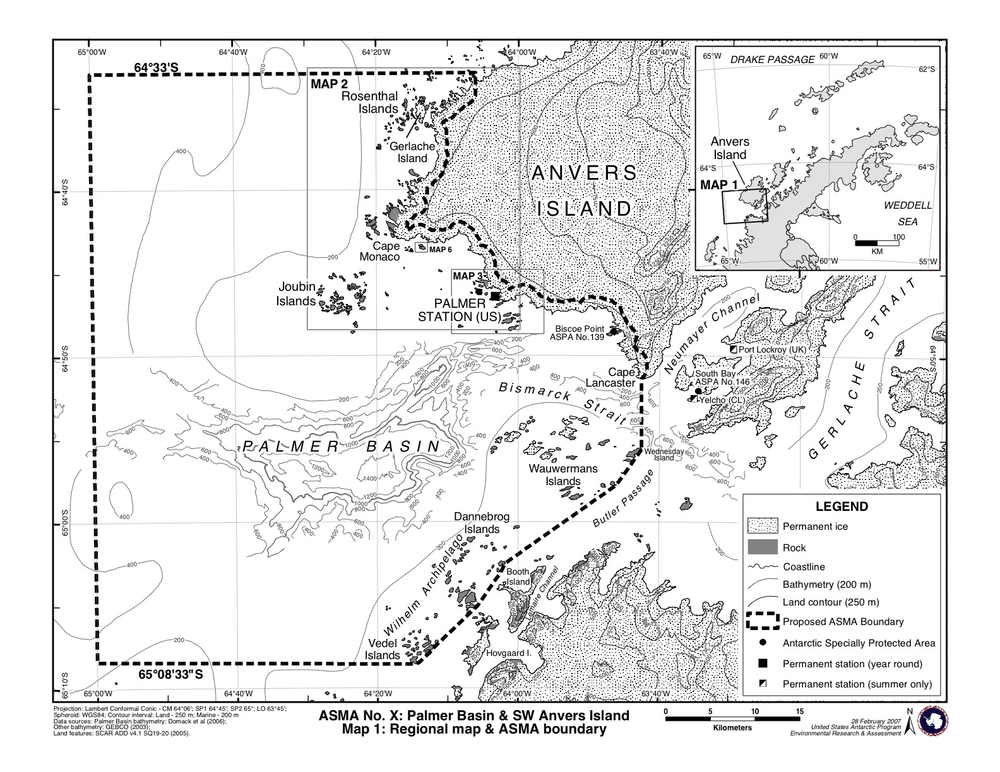
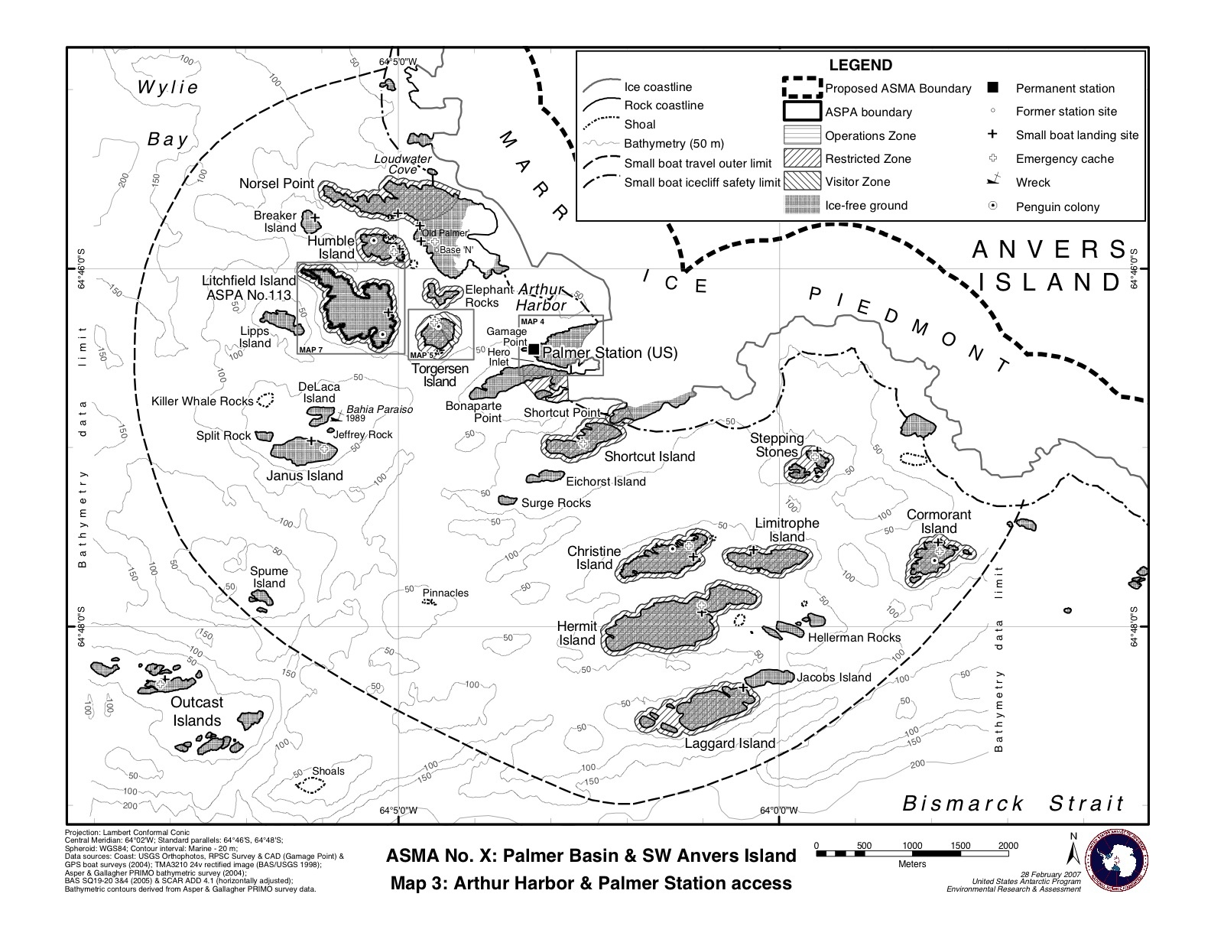

Slide 13
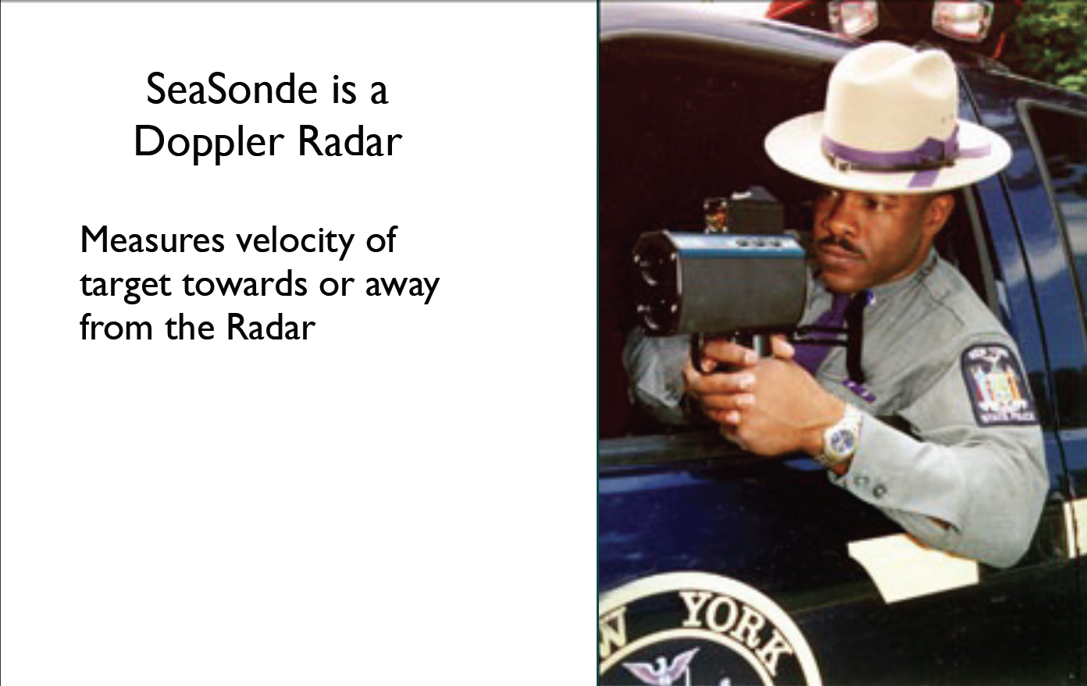
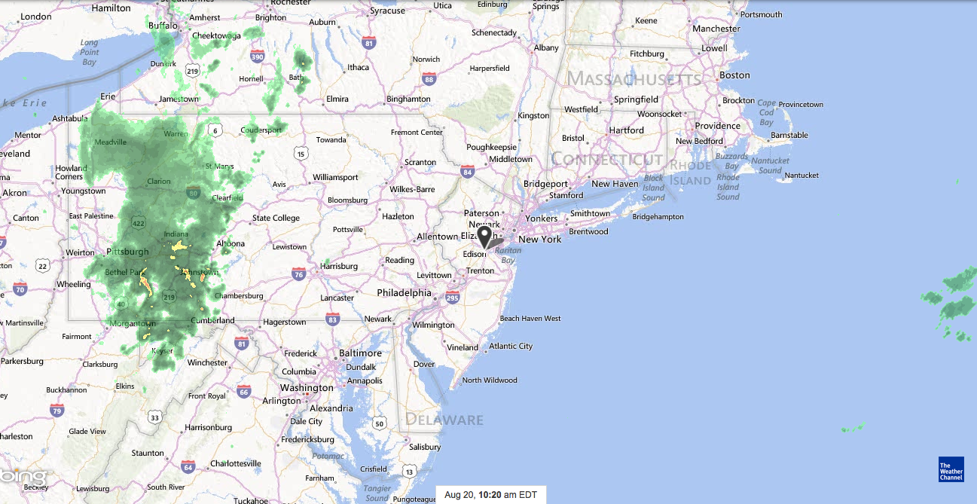

Slide 14
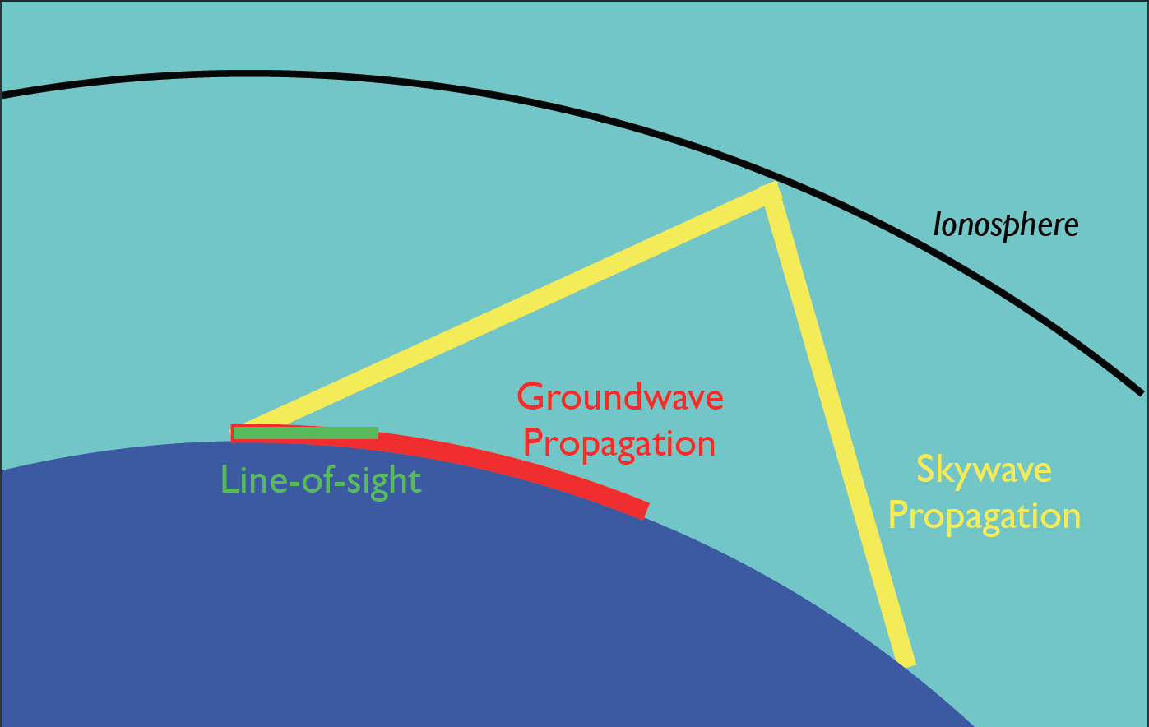
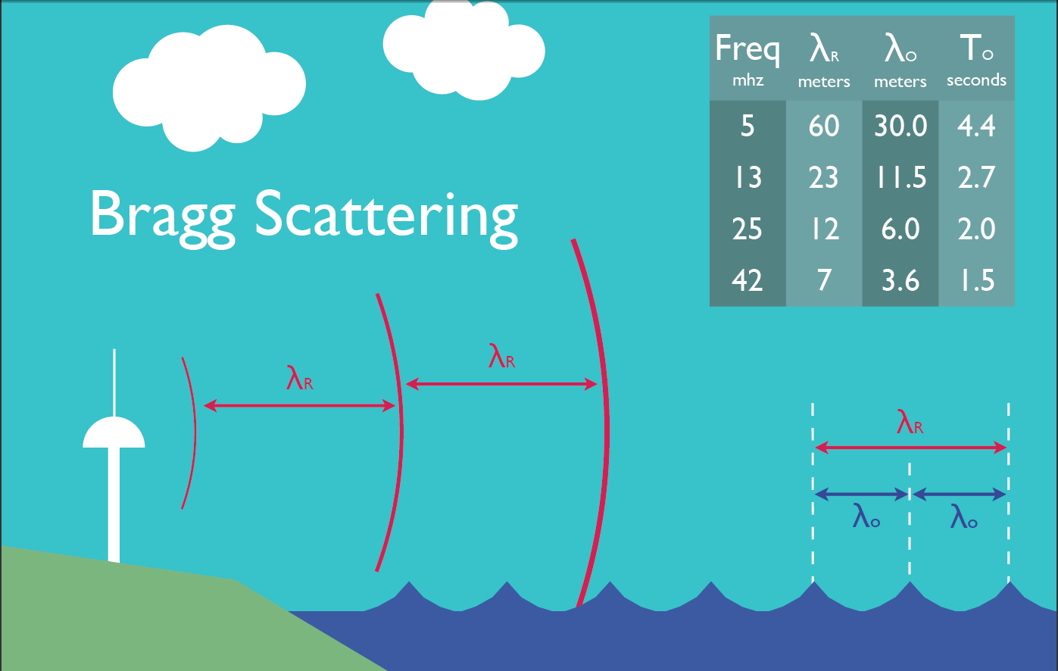

Slide 15
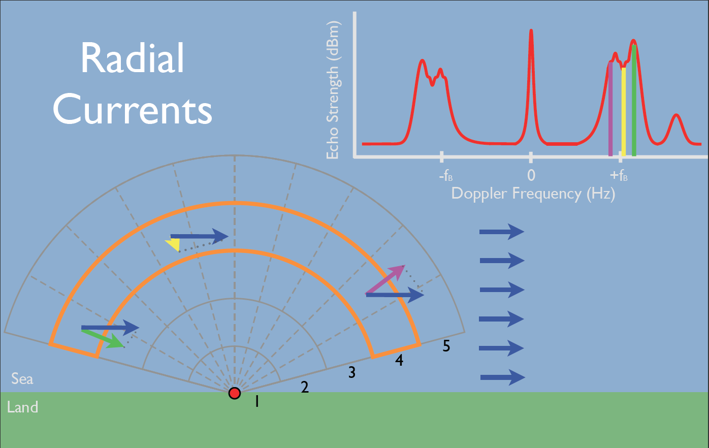

Slide 16
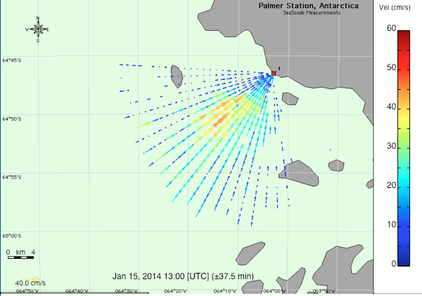
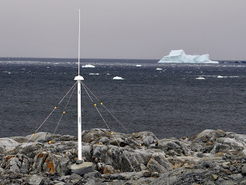

Slide 17
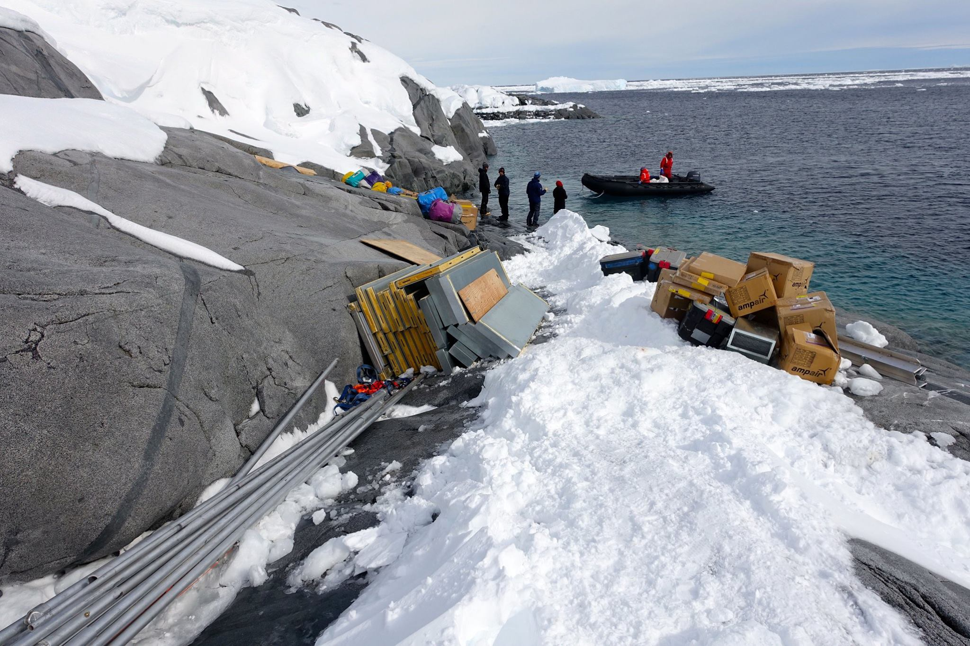
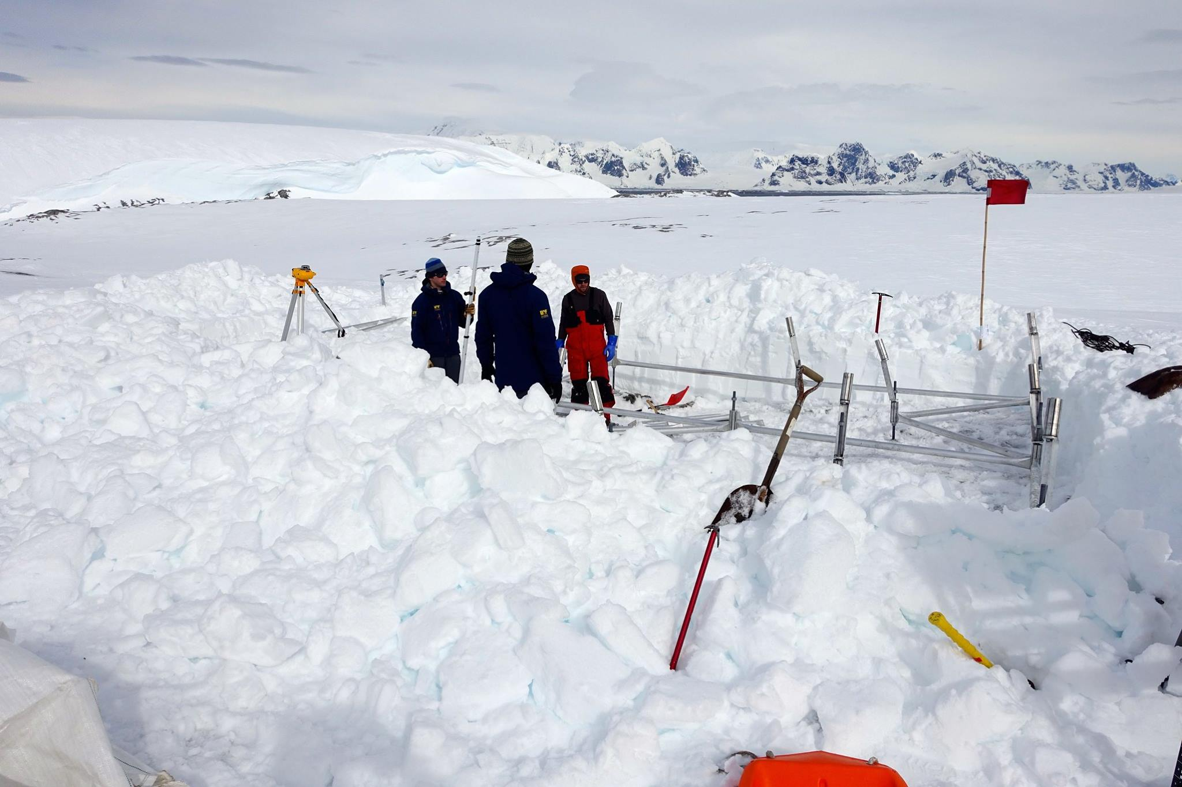
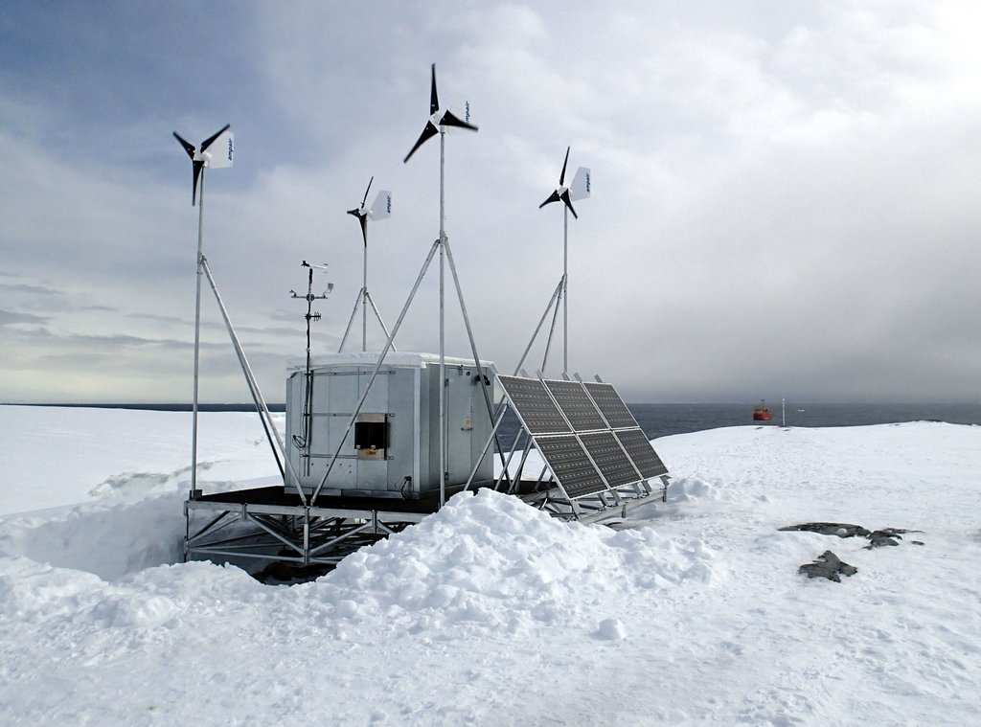
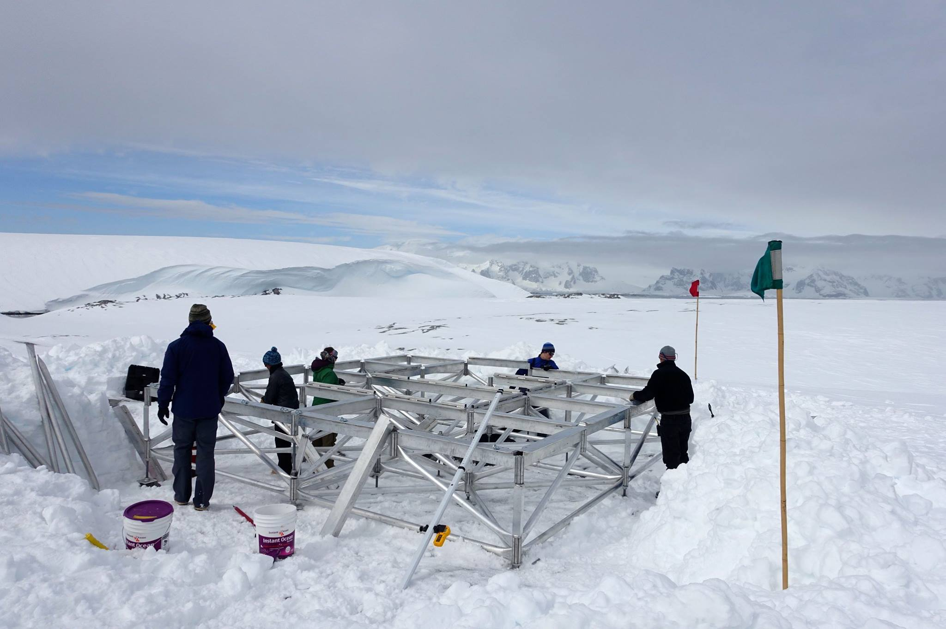

Slide 18
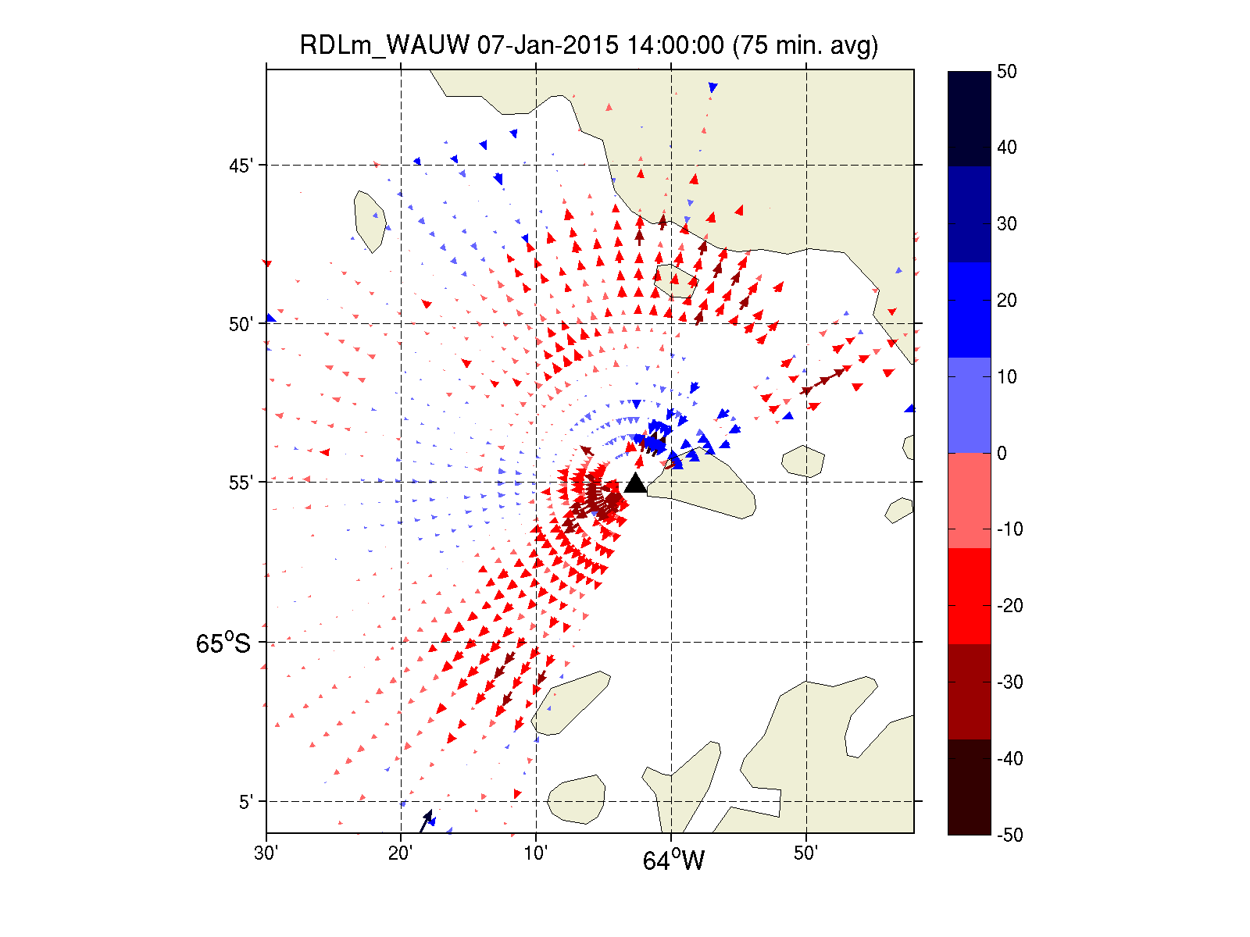
Radials From WAUW

Slide 19
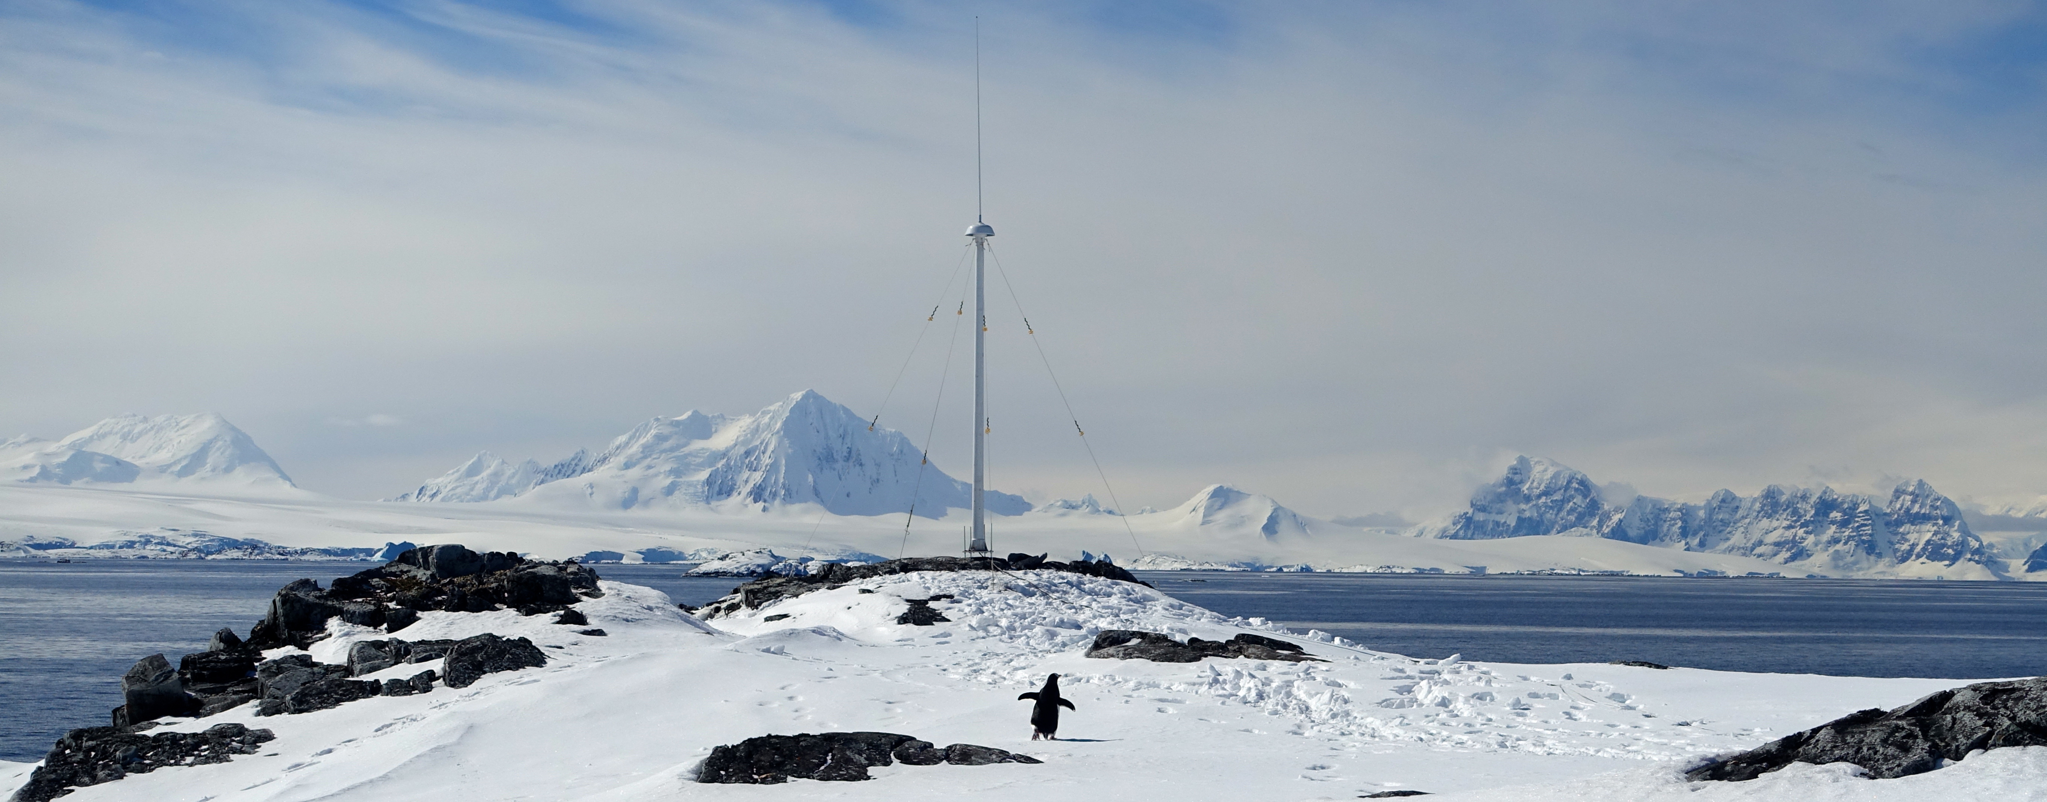
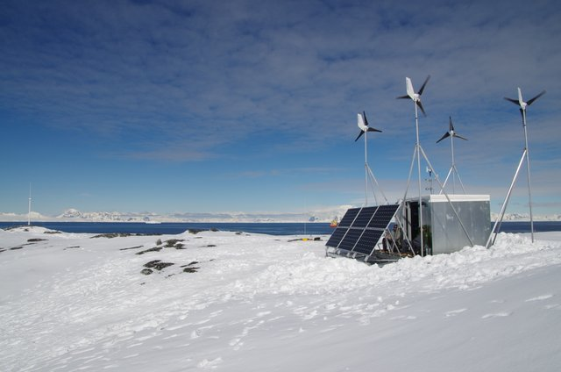
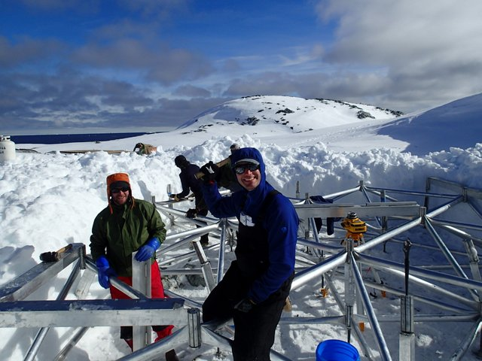

Slide 20
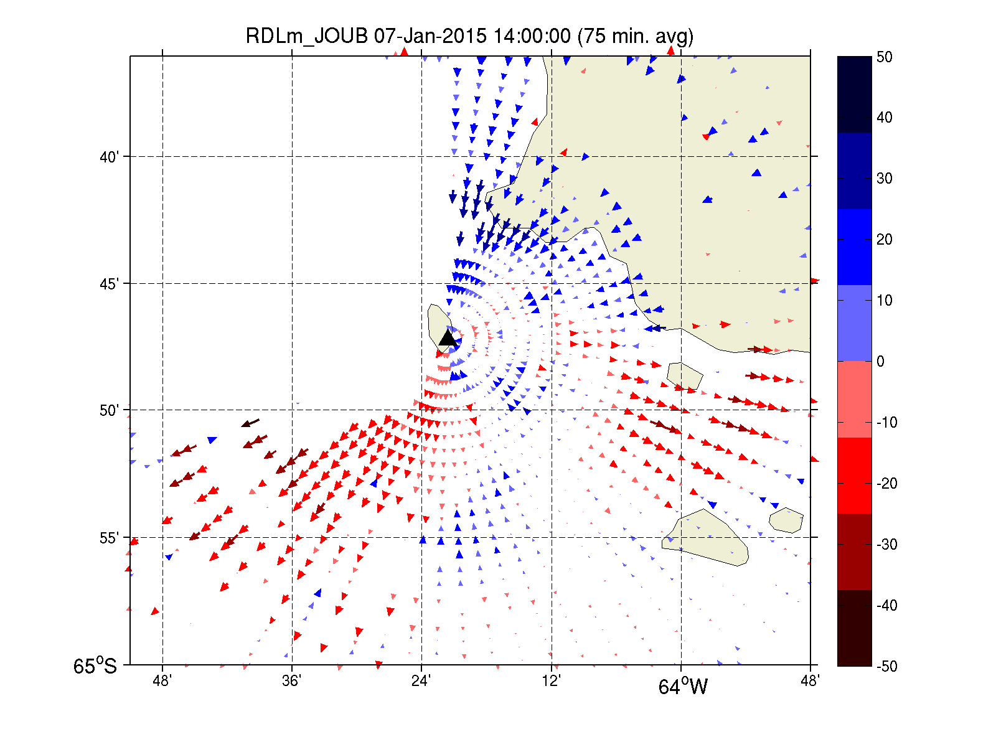
Radials From JOUB

Slide 21
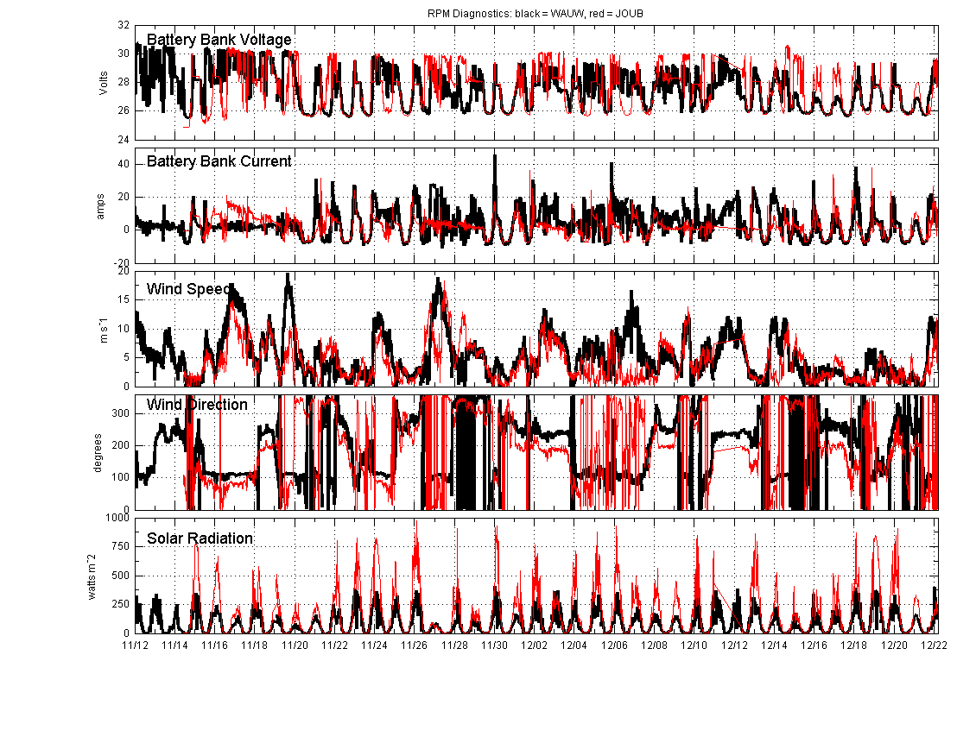

Slide 22
Little
Egg
Harbor
A T L A N T I C O C E A N
CODAR South
Atlantic City

Slide 23
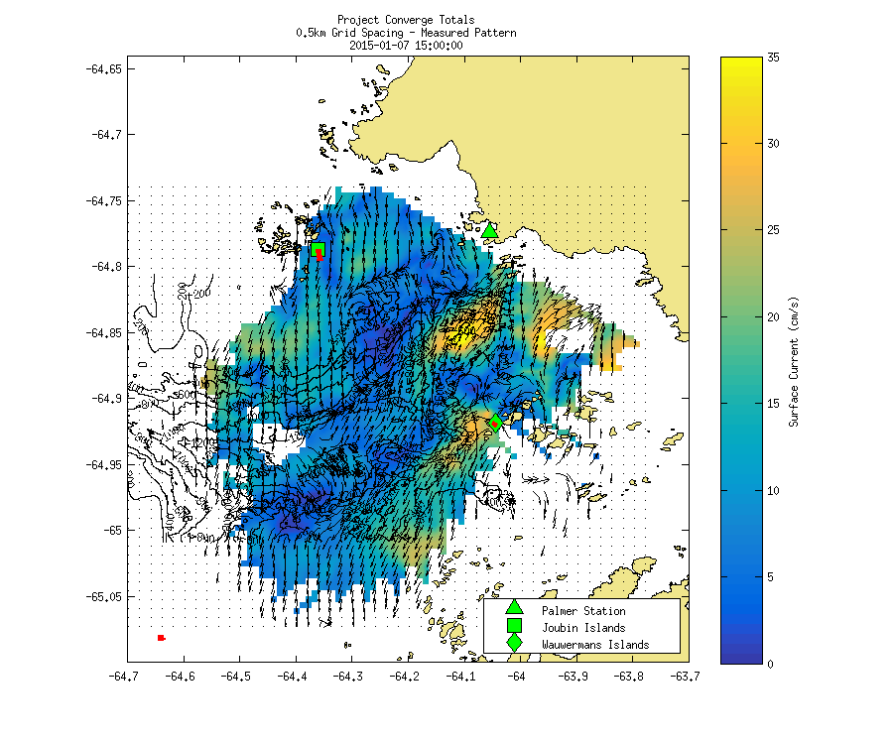

Slide 24
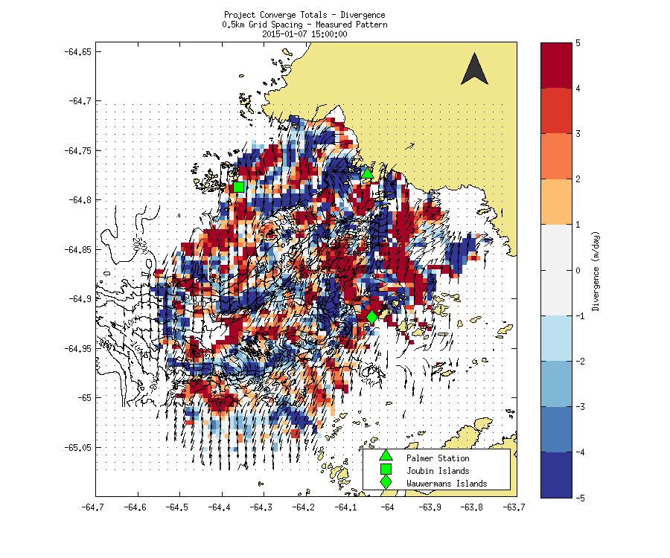

Slide 25
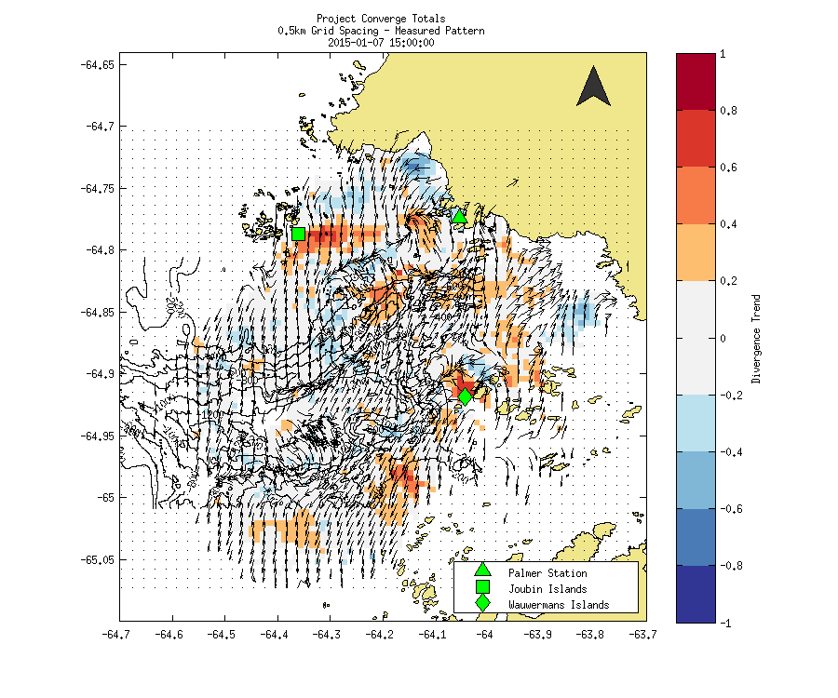

Slide 26
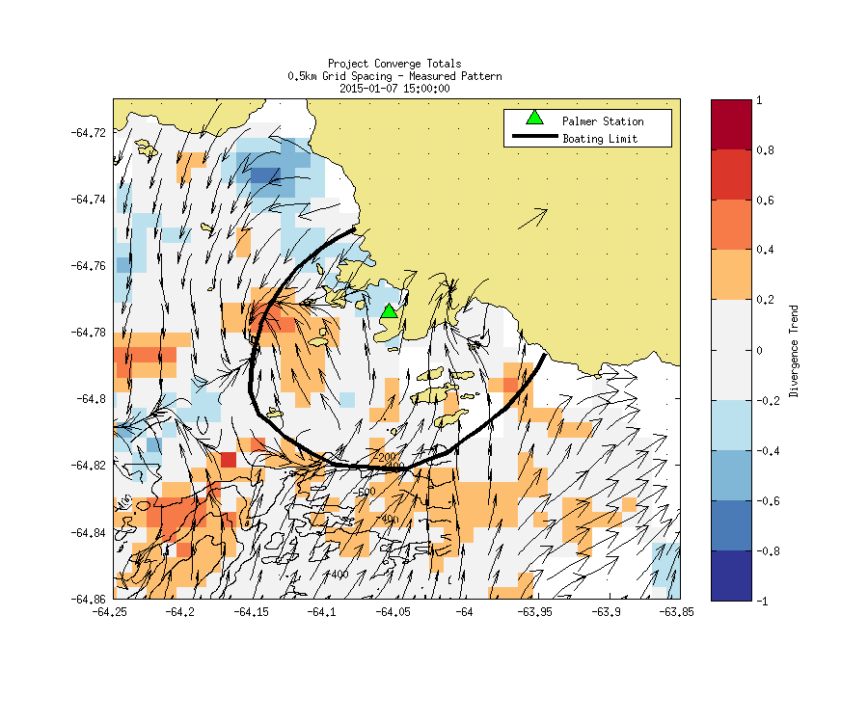
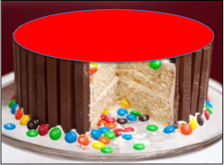

Slide 28
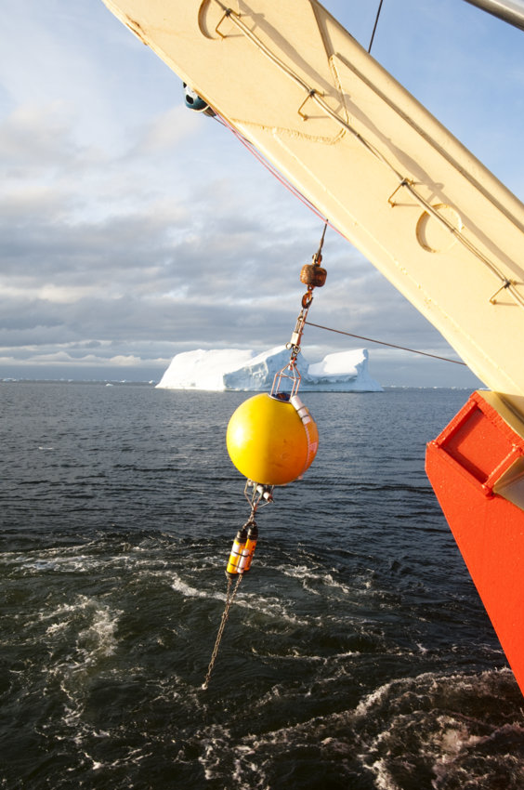
Mooring (Physics – Vertical / Time)
Near Station E
Upward-looking
300 KHz RDI ADCP
Seabird
MicroCAT CTD
RBR Ttide bottom
  pressure recorder
Schedule:
Deployed from Gould on January 5, 2014
Nov/Dec 2014: Service from Gould
Mar 2015: Recover from Gould

Slide 29
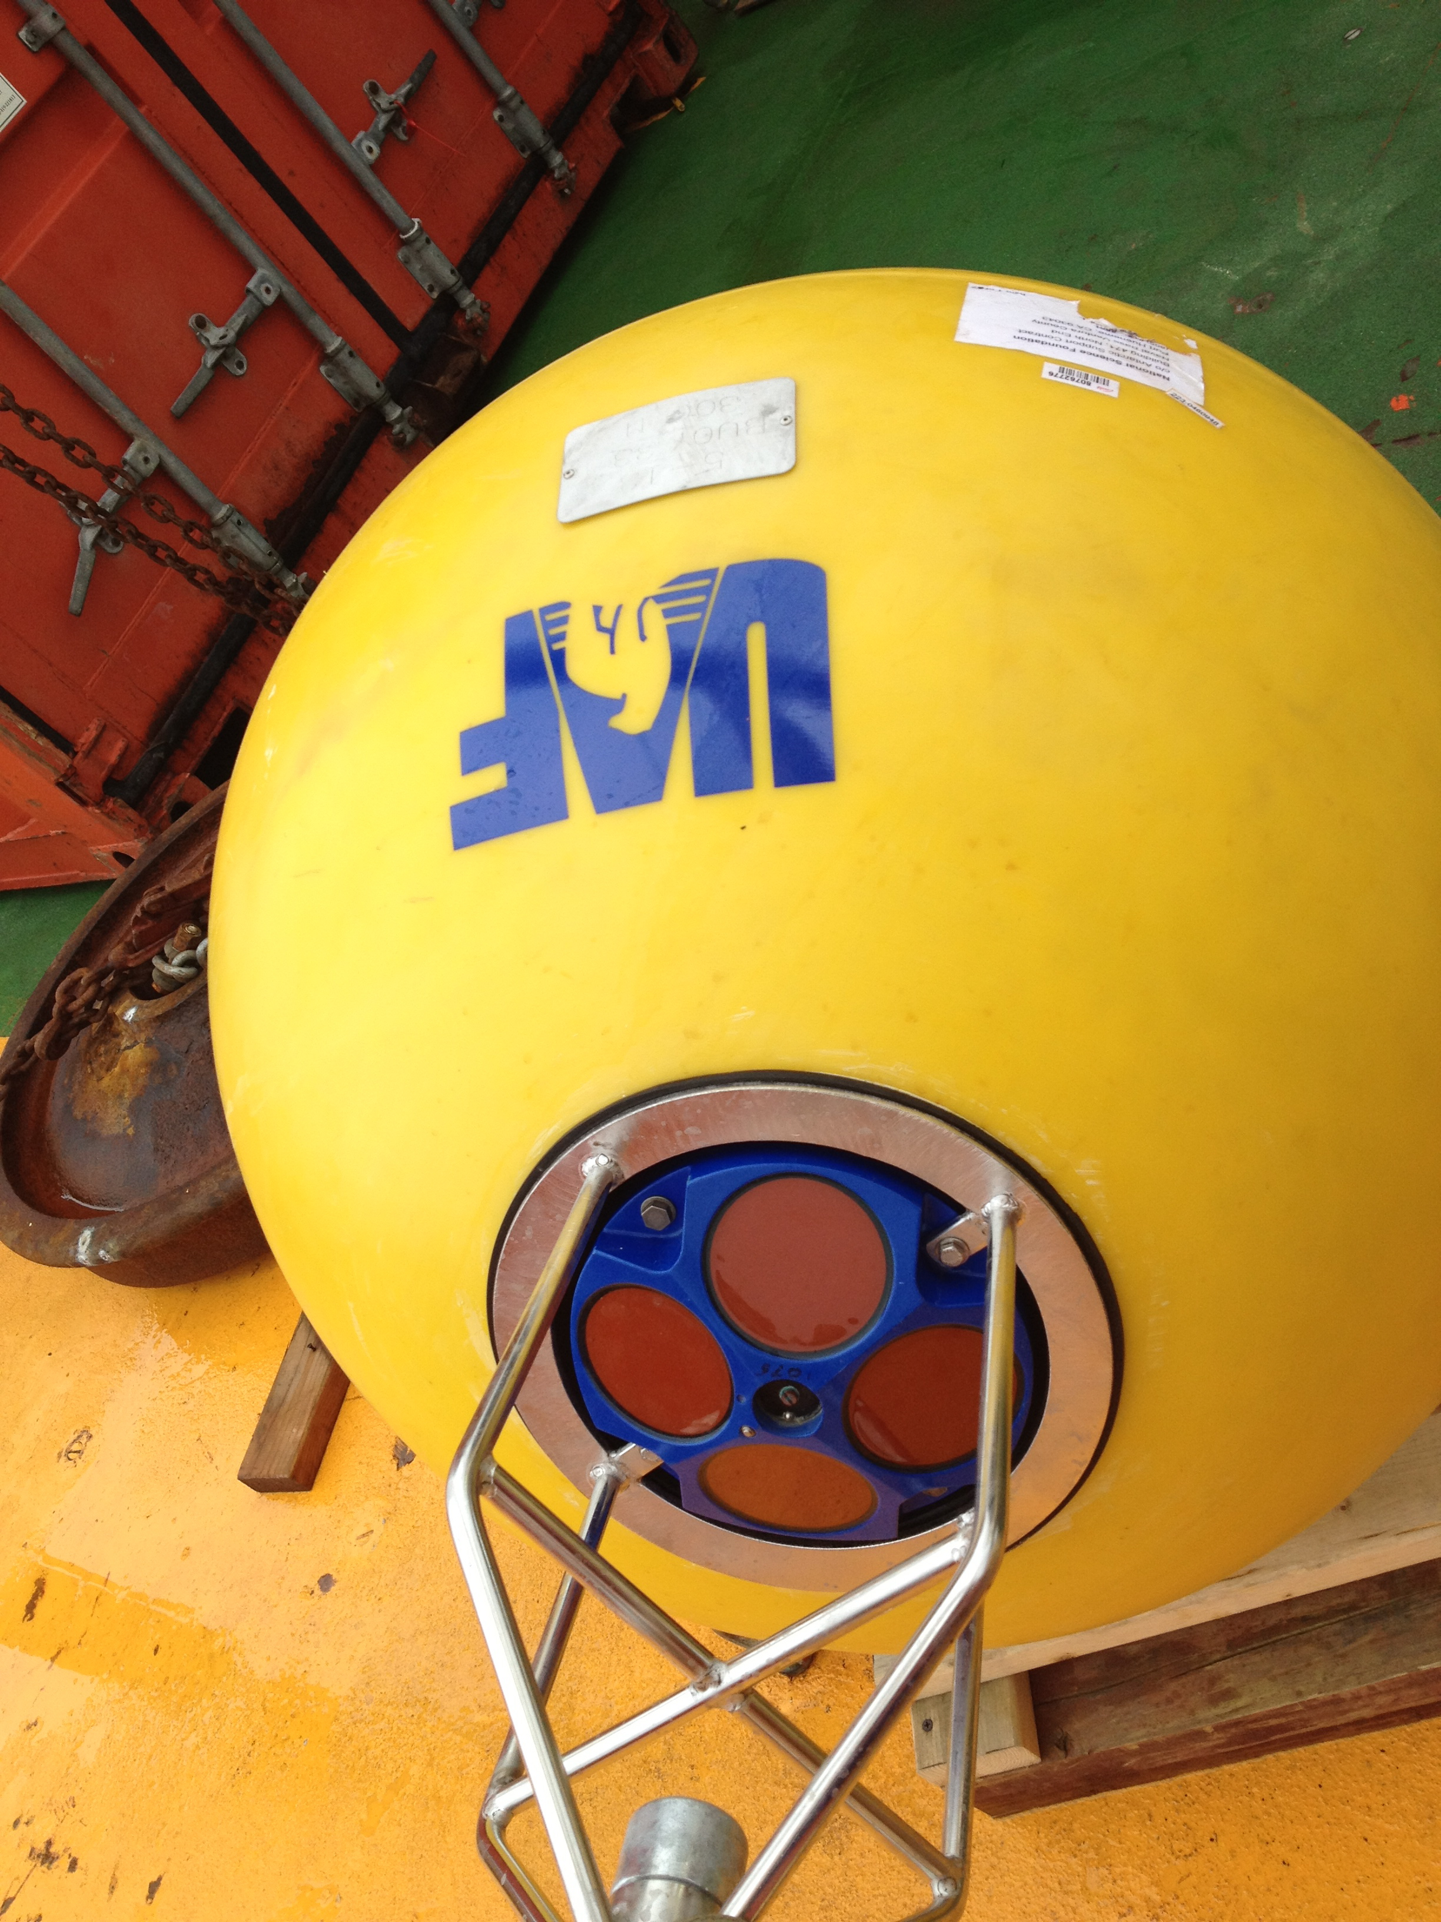
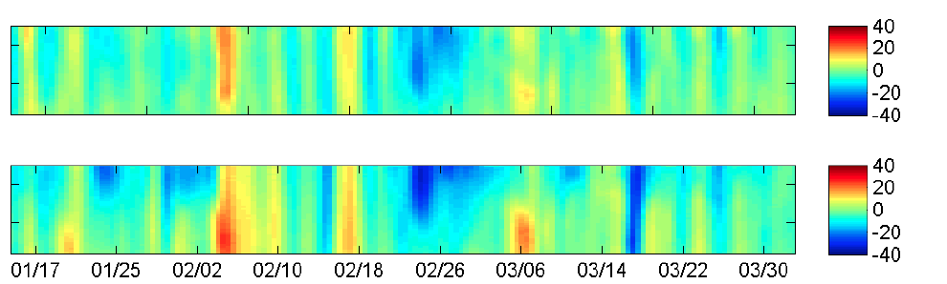
Mooring
Water Velocity
East Component (cm/s)
0
50
0
50
Depth (m)
North Component (cm/s)

Slide 30
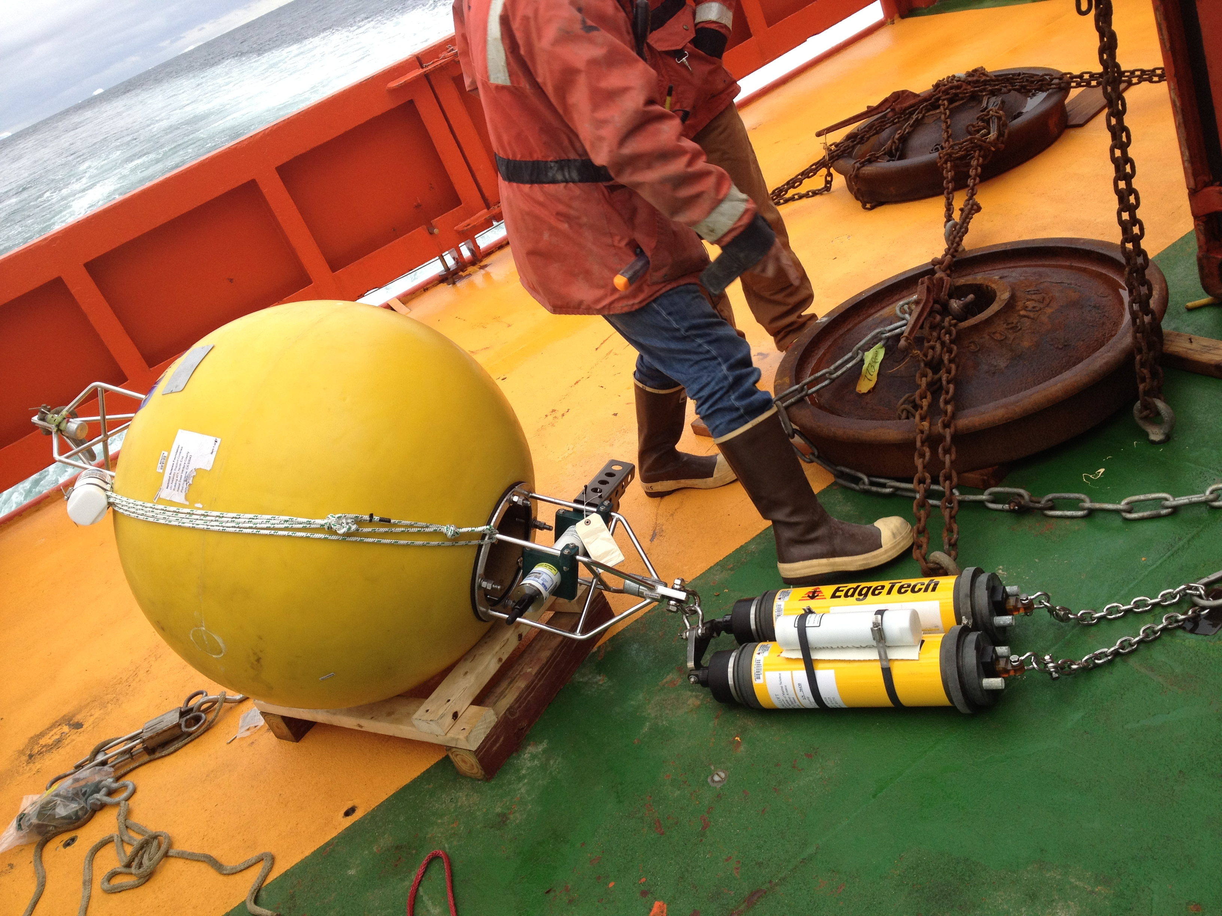
Mooring
Bottom Temperature, Salinity and Pressure

Slide 31
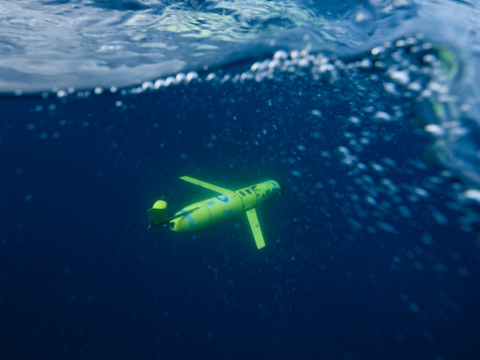
Underwater Robots: Gliders

Slide 32
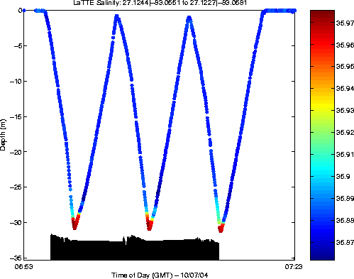
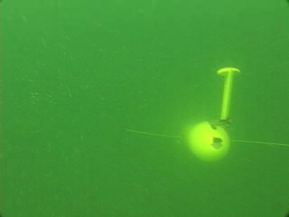
How gliders “fly”
Buoyancy pump in ← the glider pulls in 0.5 L of water
When surfacing to connect glider inflates air bladder
Glider begins to dive downward
Push pump out → glider inflects and begins to climb to the surface

Slide 33
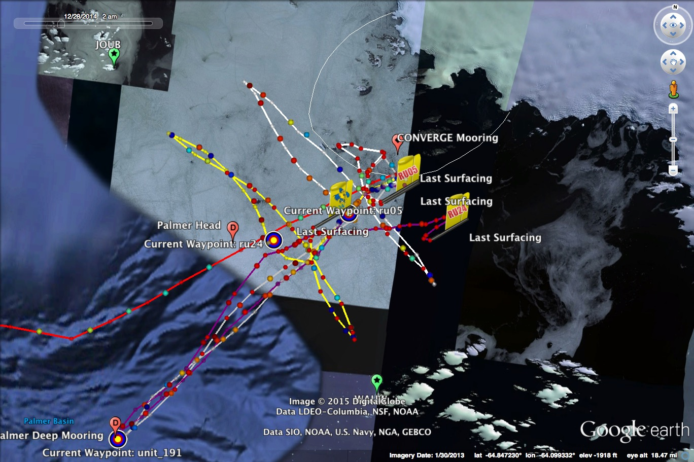

Slide 34
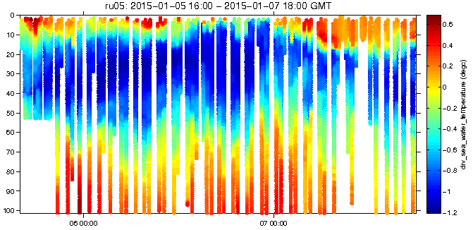
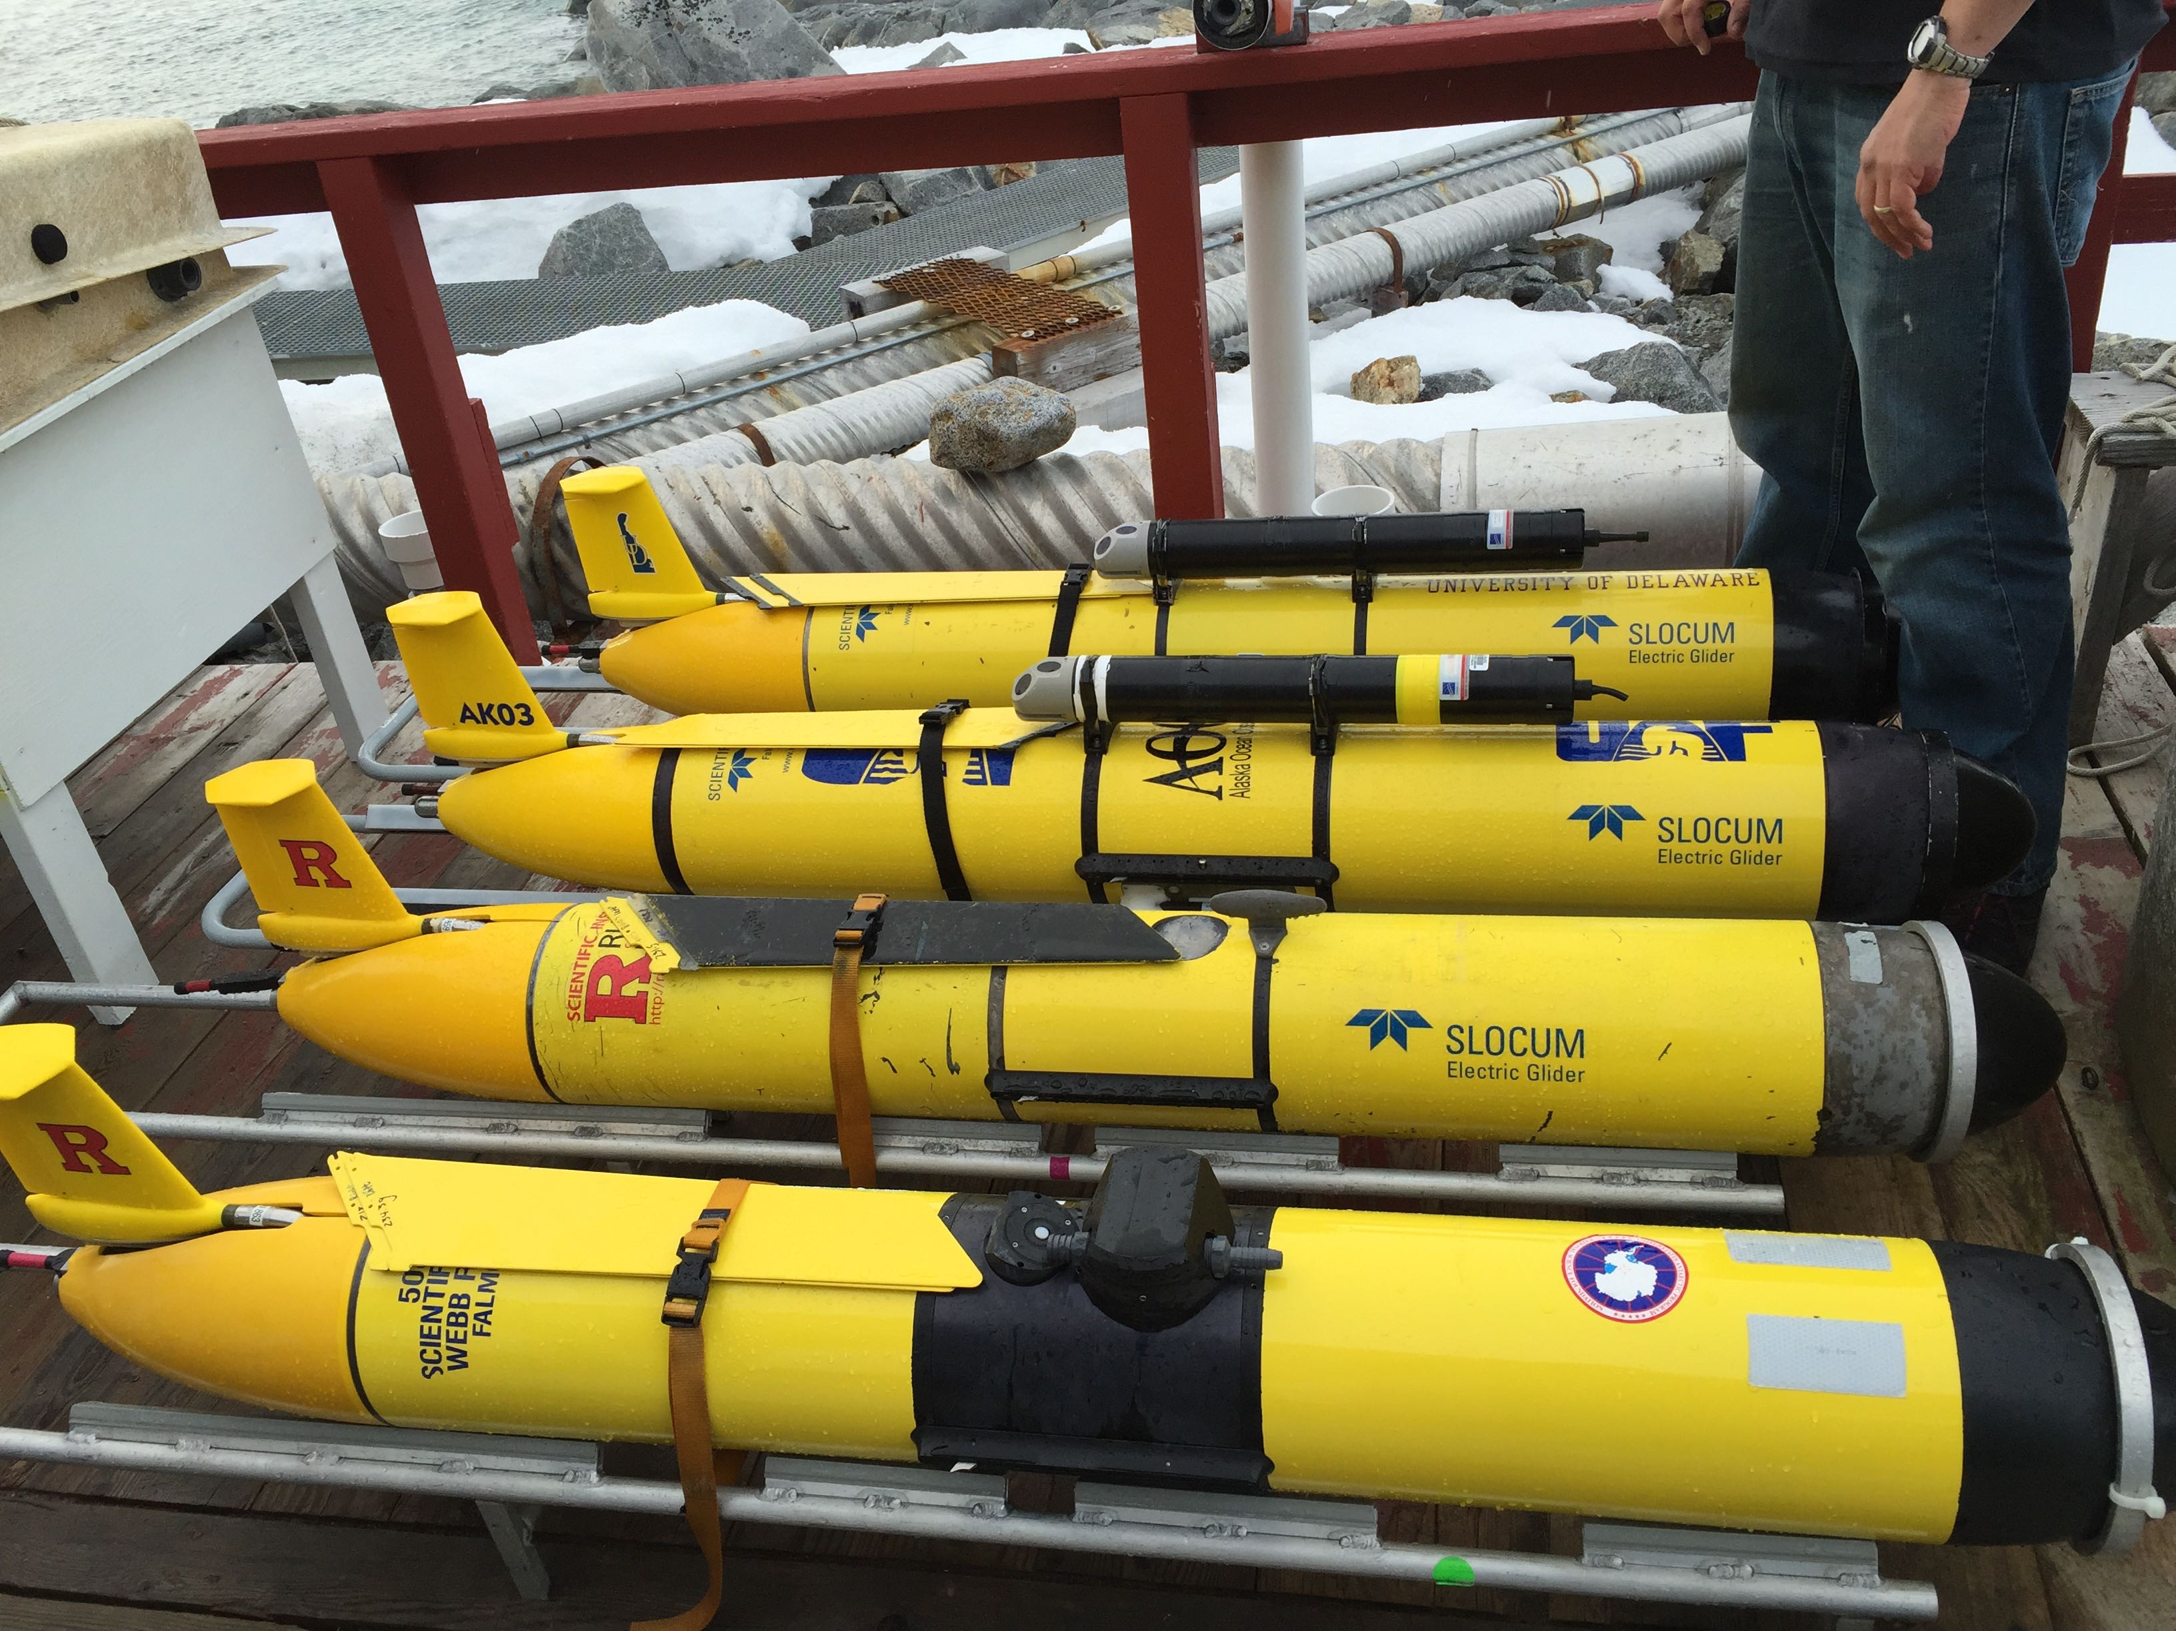
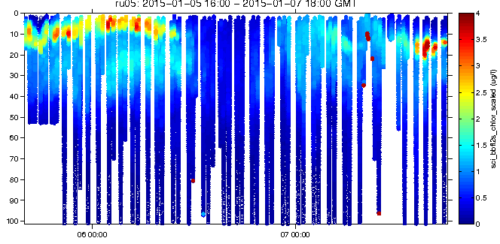
Rutgers
RU05
Temperature
Chlorophyll

Slide 35


University Of Delaware
The Blue Hen
Temperature
Chlorophyll

Slide 36



University Of Alaska
The Noble Sheathbill
Temperature
Chlorophyll

Slide 37


Small Boat Surveys
(Zooplankton - Krill)

Slide 38


Small Boat Surveys
(Temperature, Salinity, Phytoplankton
And Krill)

Slide 39




Small Boat Surveys
(Temperature, Salinity, Phytoplankton
And Krill)

Slide 40



Slide 41



Broader Impacts
VTCs
3000 Participating Students
Liberty Science Center Audiences
Cornell Lab of Ornithology Audiences
Research Blog

Slide 42

http://coseenow.net/converge

Slide 43


http://coseenow.net/converge

Slide 44



