Slide 1
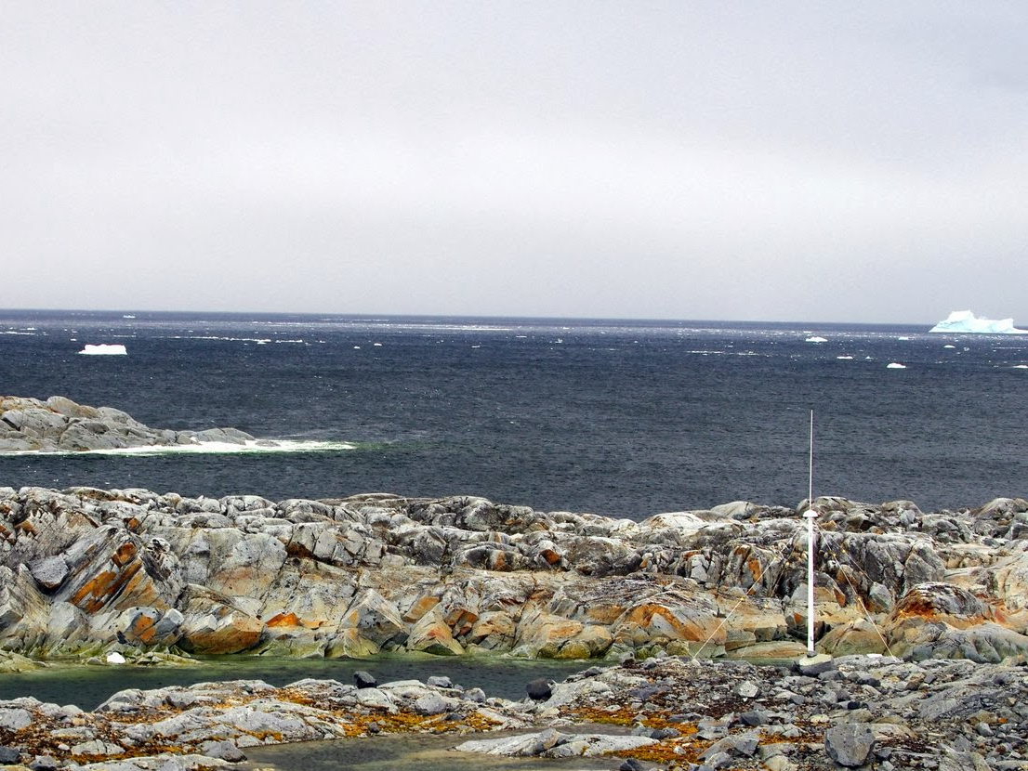


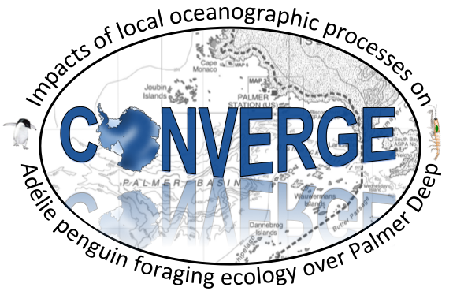
Project CONVERGE:
Impacts of local oceanographic processes on
Adélie penguin foraging ecology
Josh Kohut, Laura Palamara, and Travis Miles
Rutgers University
Kim Bernard
Oregon State University
Bill Fraser and Donna Patterson-Fraser
Polar Oceans Research Group
Matt Oliver and Megan Cimino
University of Delaware
Peter Winsor and Hank Statscewich
University of Alaska, Fairbanks
Erick Fredj
Jerusalem College of Technology
In Collaboration with PAL-LTER

Slide 2
Project CONVERGE:
Impacts of local oceanographic processes on
Adélie penguin foraging ecology
Josh Kohut, Laura Palamara, Travis Miles
Rutgers University
Kim Bernard
Oregon State University
Bill Fraser and Donna Patterson-Fraser
Polar Oceans Research Group
Matt Oliver and Megan Cimino
University of Delaware
Peter Winsor and Hank Statscewich
University of Alaska, Fairbanks
Erick Fredj
Jerusalem College of Technology

Slide 3
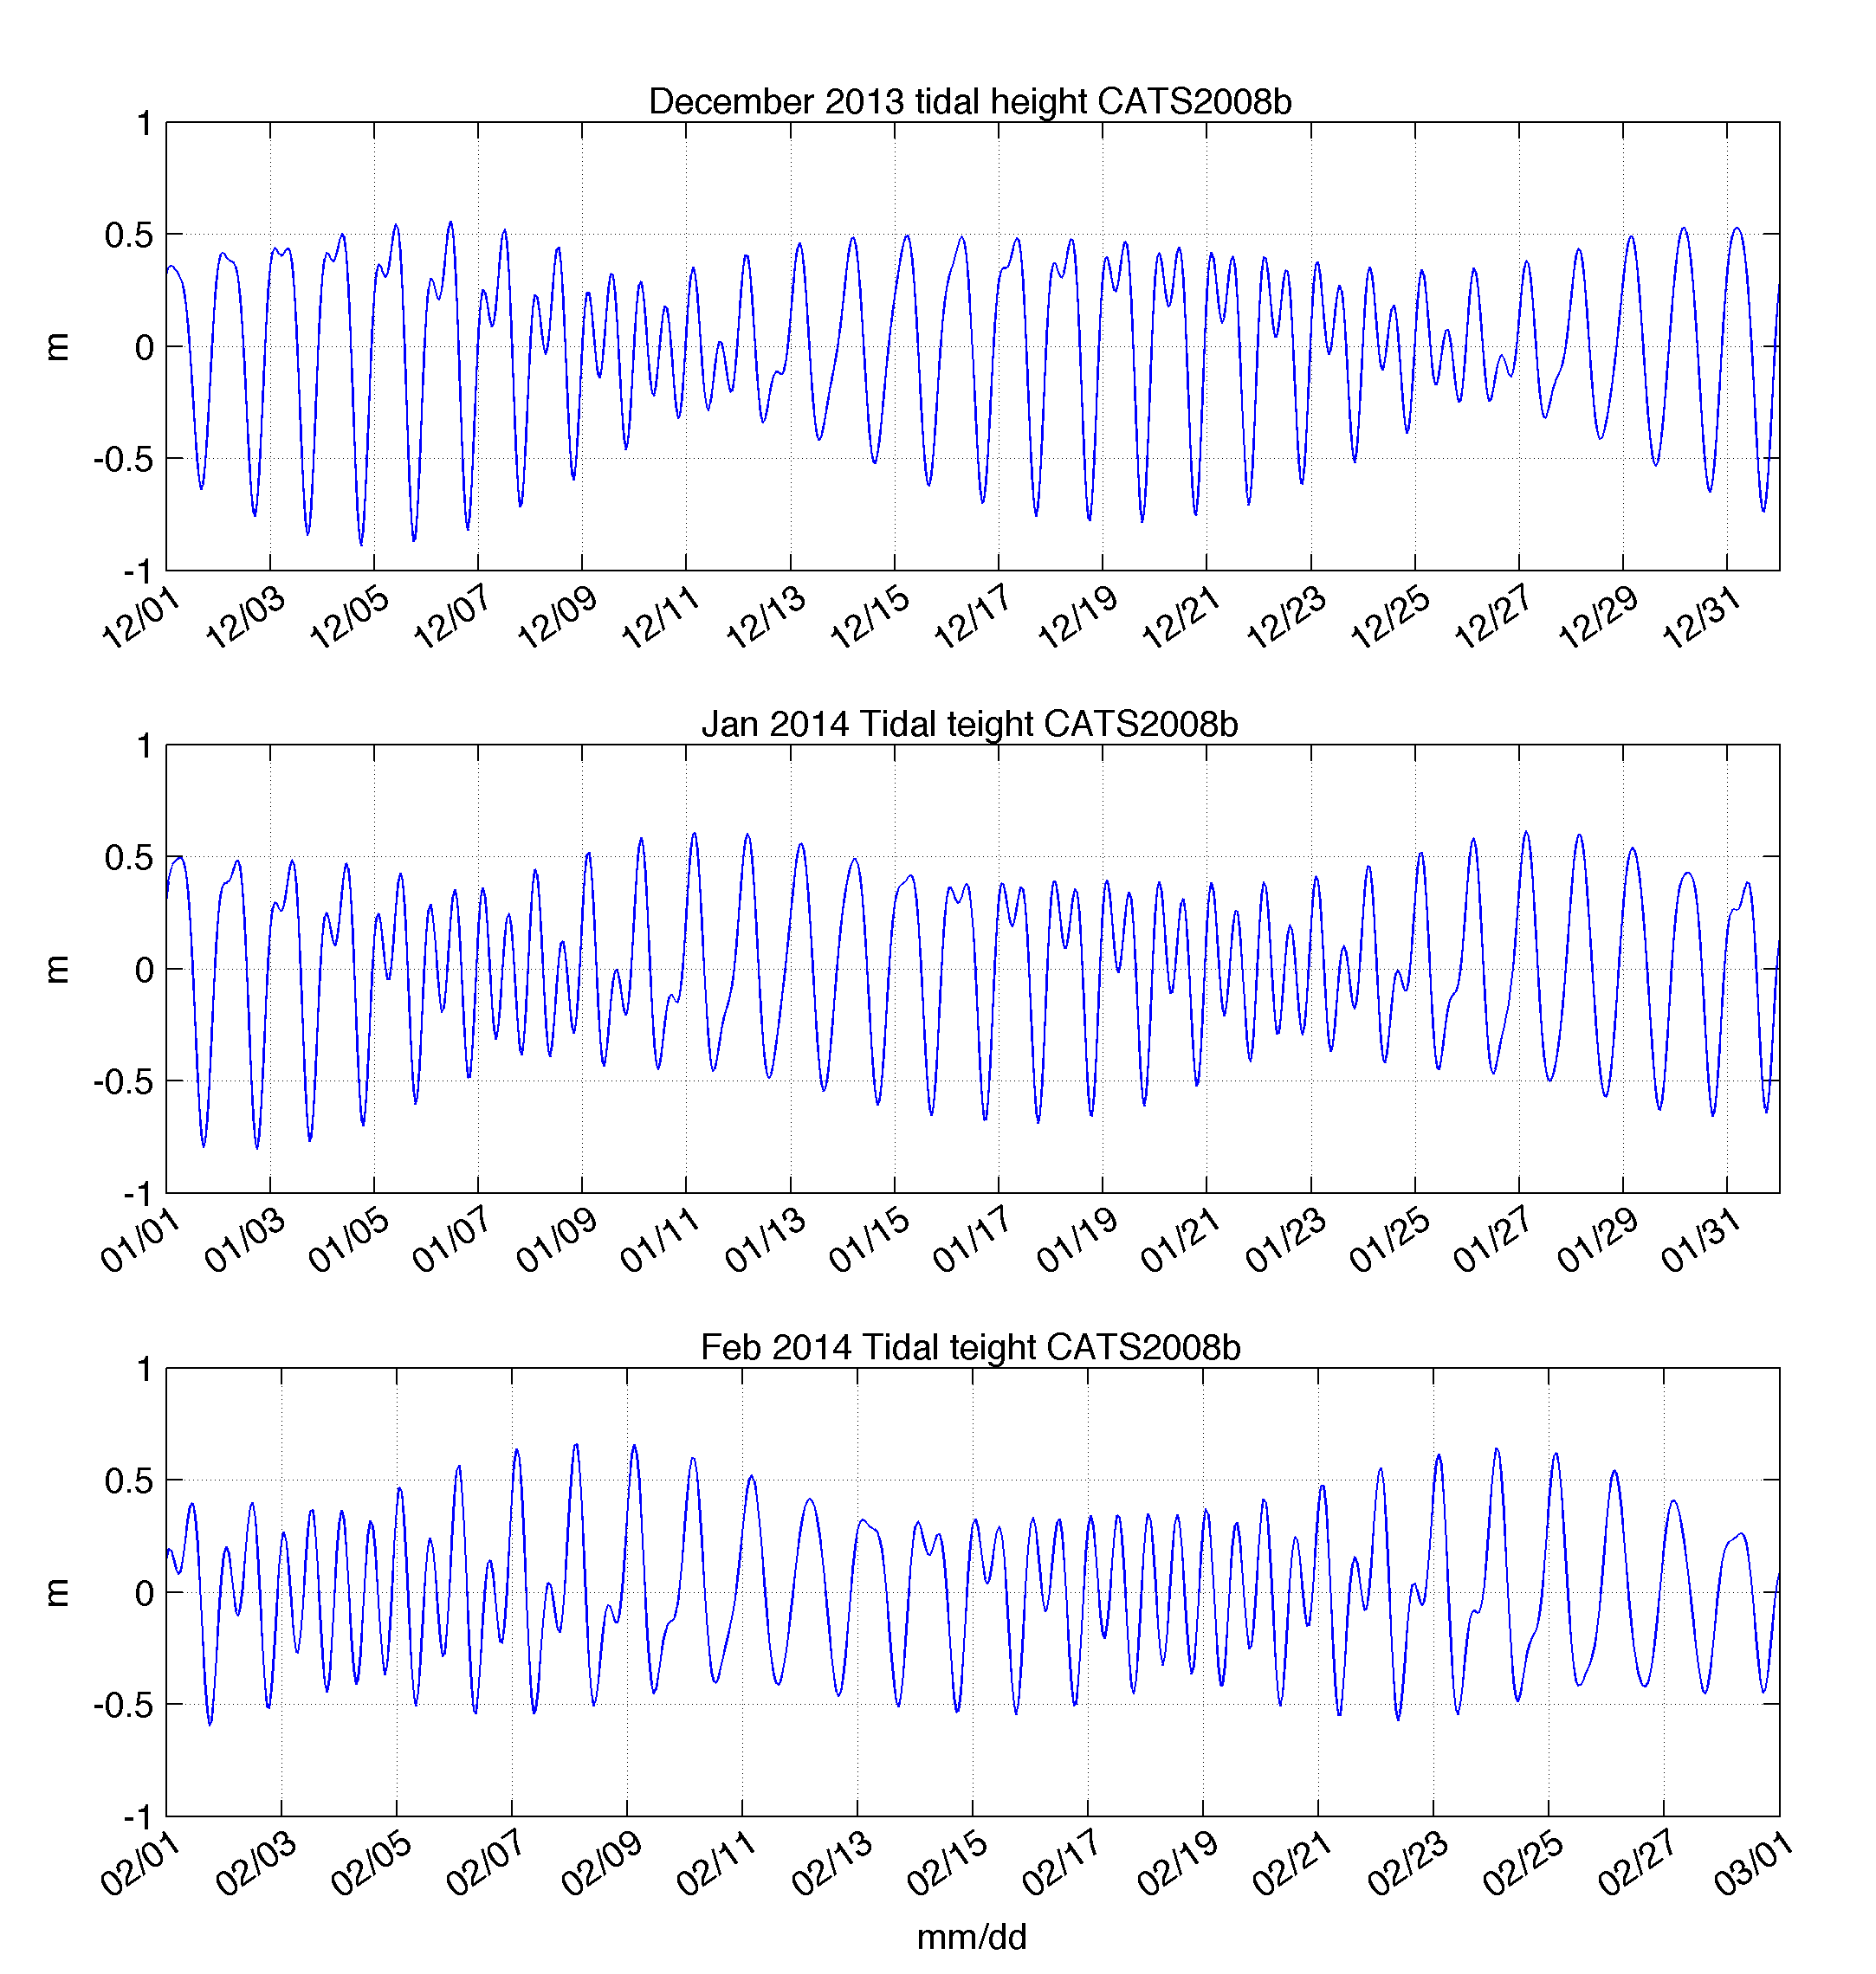
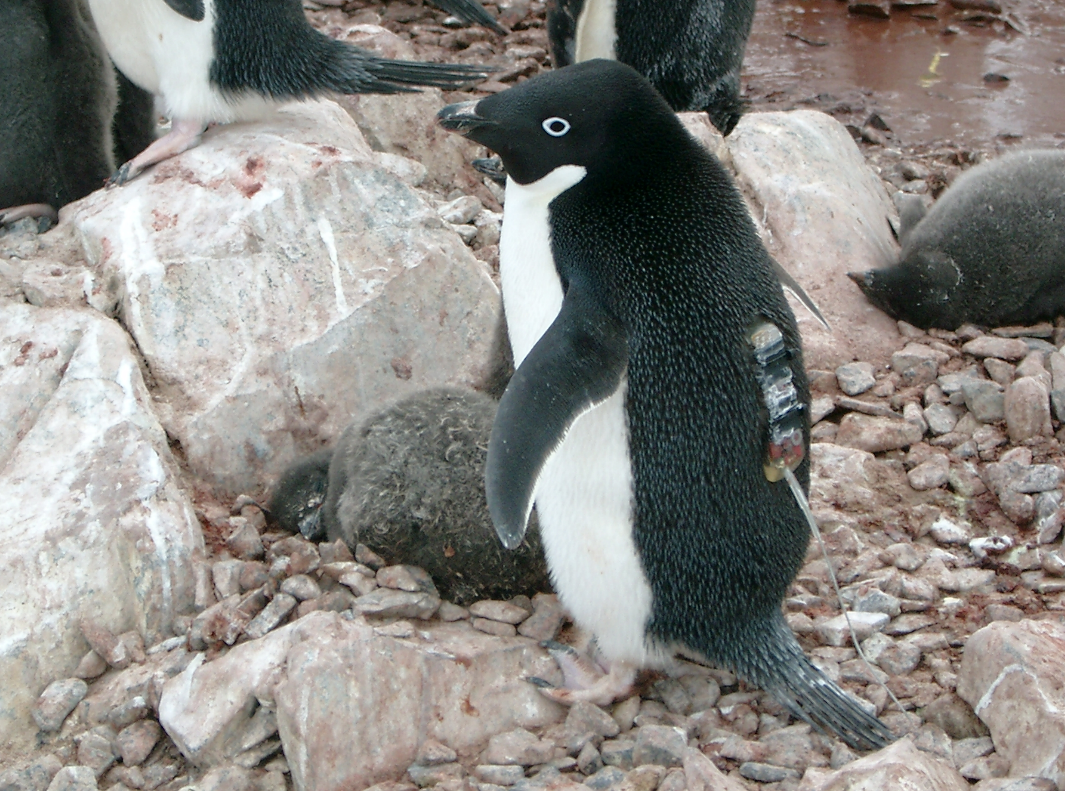
Tidal Dependence on Penguin
Foraging Behavior?
December 2013
Diurnal
January 2014
February 2014
Semi-Diurnal
Oliver et al., 2013

Slide 4
Objectives
H1. Convergence zones in the surface waters within 50 km of the coast shift location between the diurnal and semi-diurnal tidal regime.
H2. These convergence zones concentrate phytoplankton and aggregate schools of krill and subsequently influence the behavior of top predator species between tidal regimes.
To do this we sampled the:
Physics (Statscewich et al., EC44B-1245)
Primary Producers (Oliver et al., HE54C-1600)
Zooplankton (Bernard et al., HE54C-1601)
Top Predators
Over semi-diurnal and diurnal tidal regimes.
Diurnal
Semi-Diurnal

Slide 5
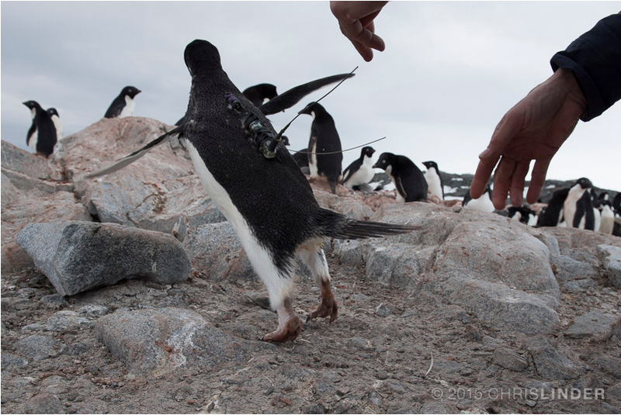
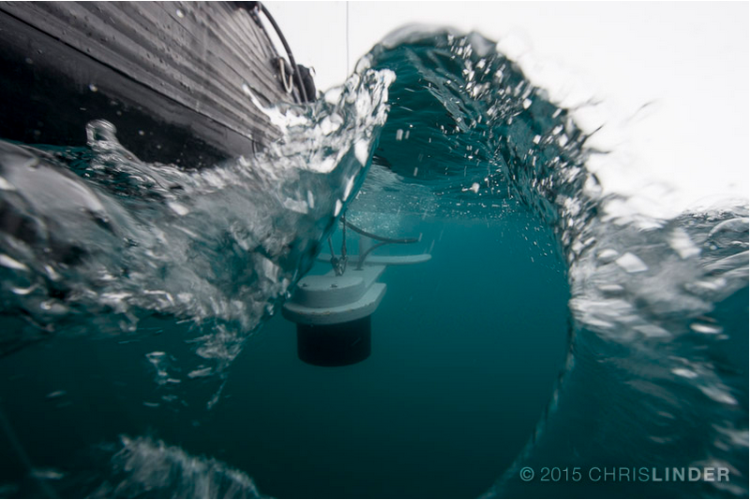
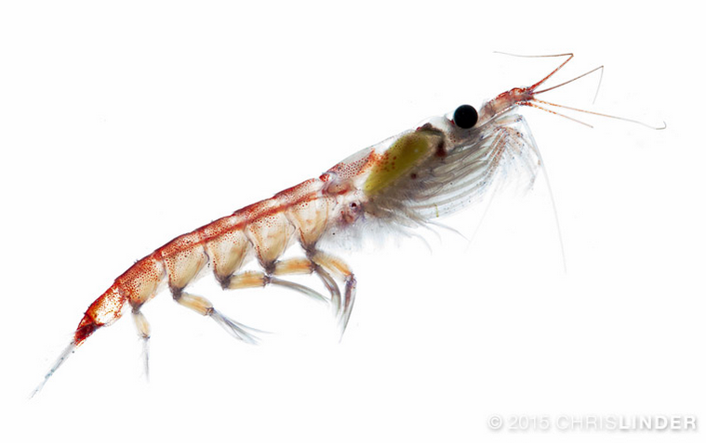
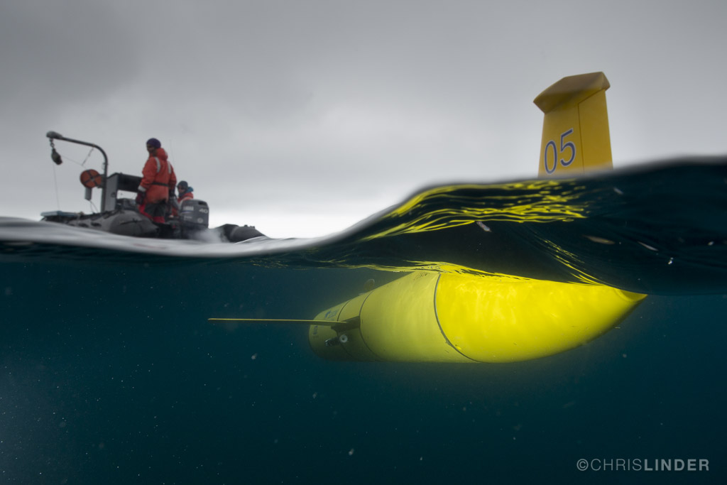
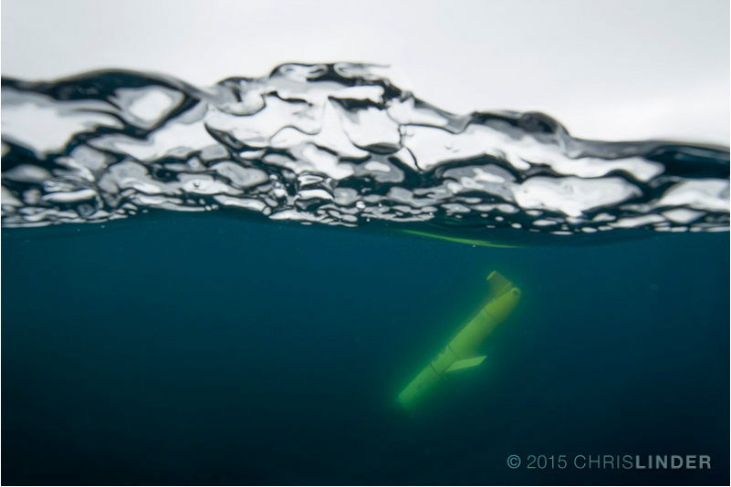
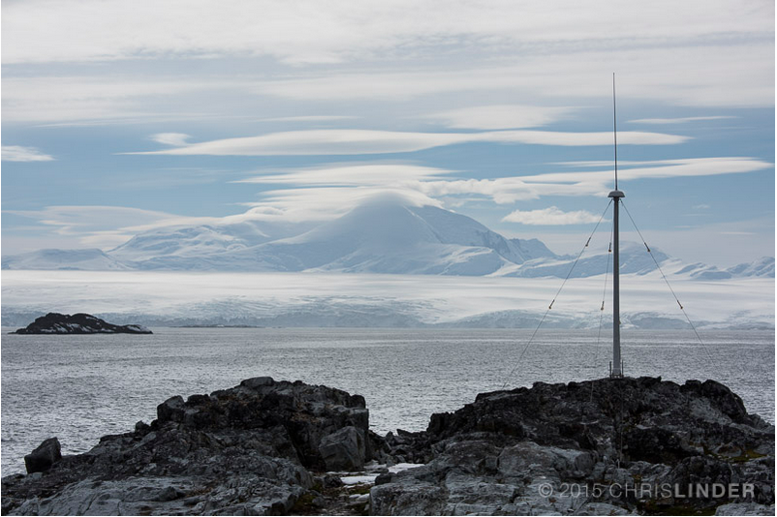
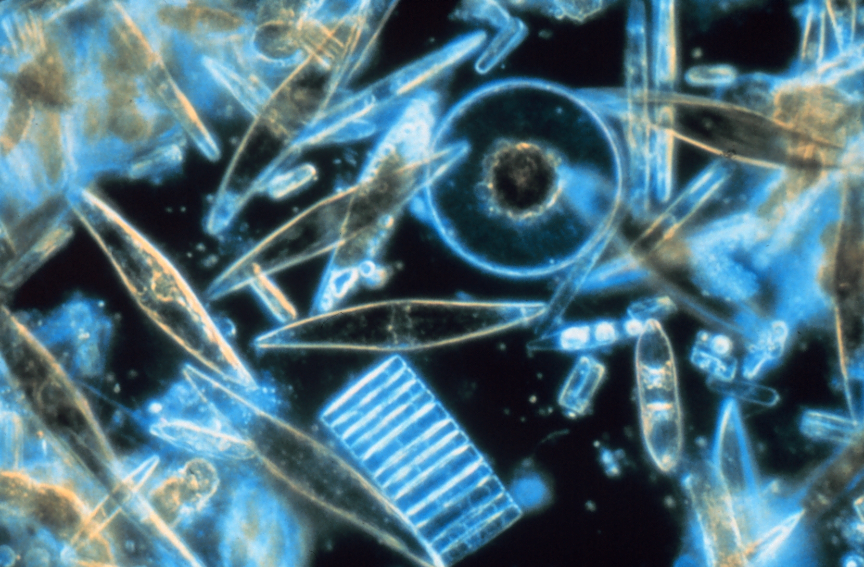
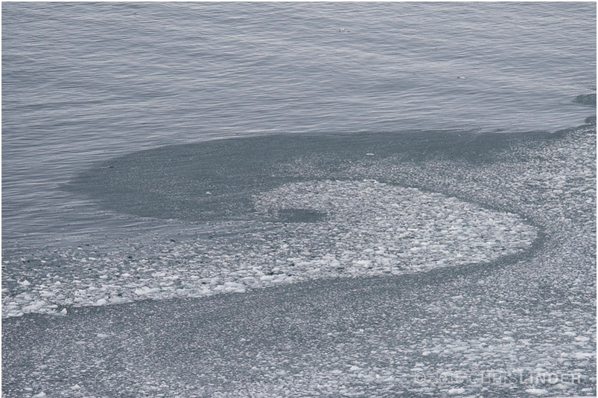
Technology to be deployed:
Our adaptive Approach

Slide 6
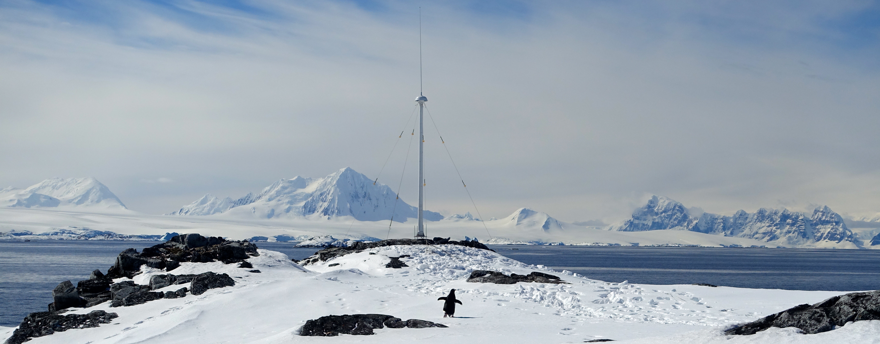
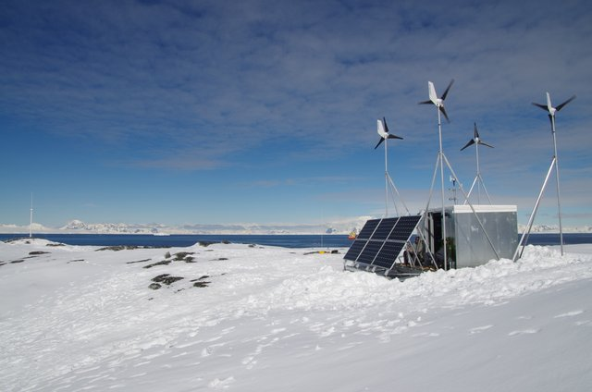
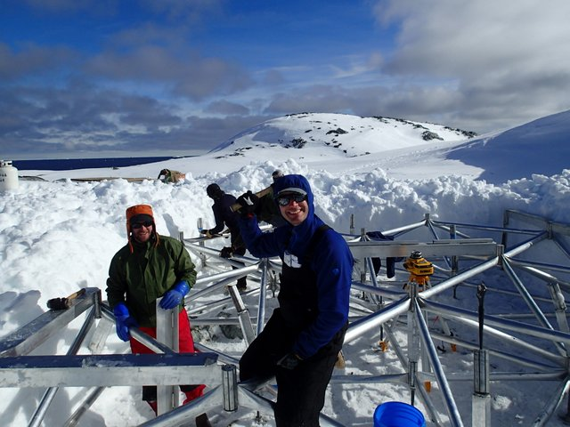

Slide 7
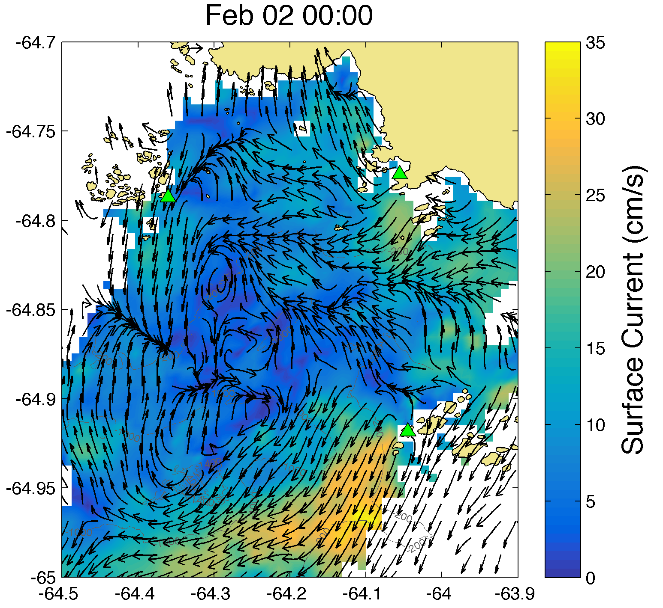
Hourly Surface Current Maps
500 m resolution
For more information
Statscewich et al.
EC44B-1245

Slide 8
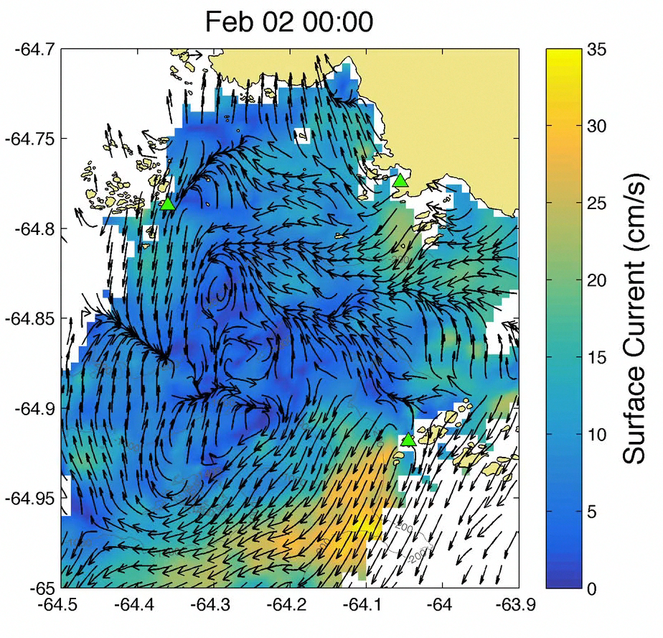
Hourly Surface Current Maps
500 m resolution

Slide 9
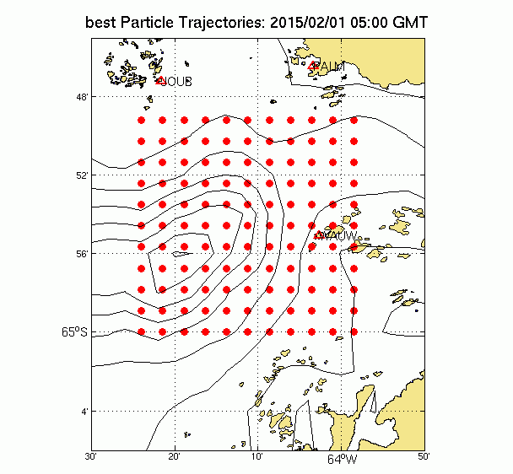

Slide 10
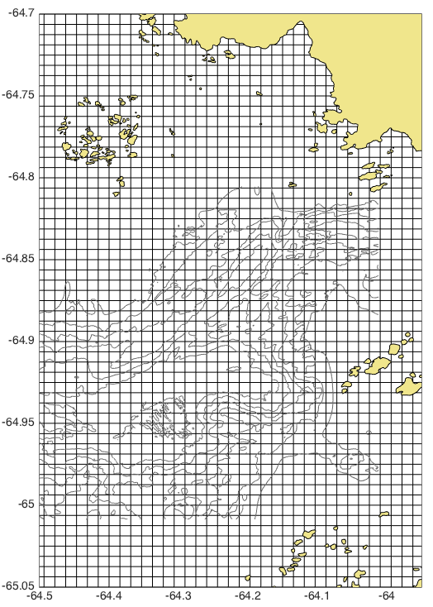
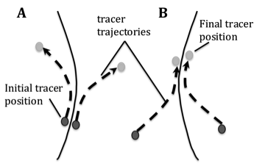
Lagrangian Coherent Structures
800 m
800 m
t₀ = 00:00 hours
t₁ = 12:00 hours

Slide 11
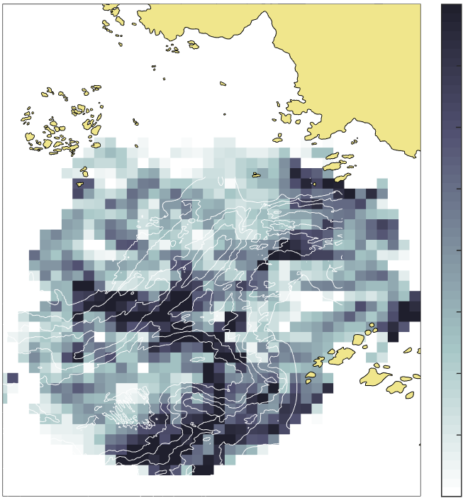
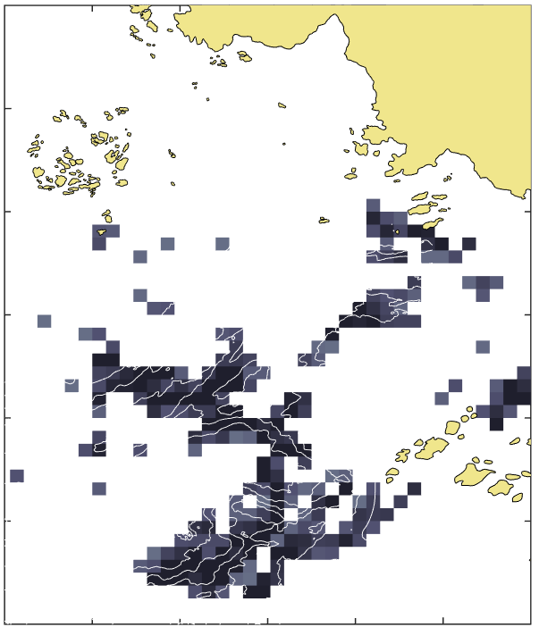
Lagrangian Coherent Structures
4.0
3.5
3.0
2.5
2.0
1.5
1.0
0.5
0
January 27, 2015
Finite Time Lyapunov Exponent (FTLE)
The FTLE field measures maximal linear attraction between initially neighboring particles over a pre-determined finite time interval.
We then calculate daily FTLE fields for January and February 2015.
FTLE (day⁻¹)

Slide 12
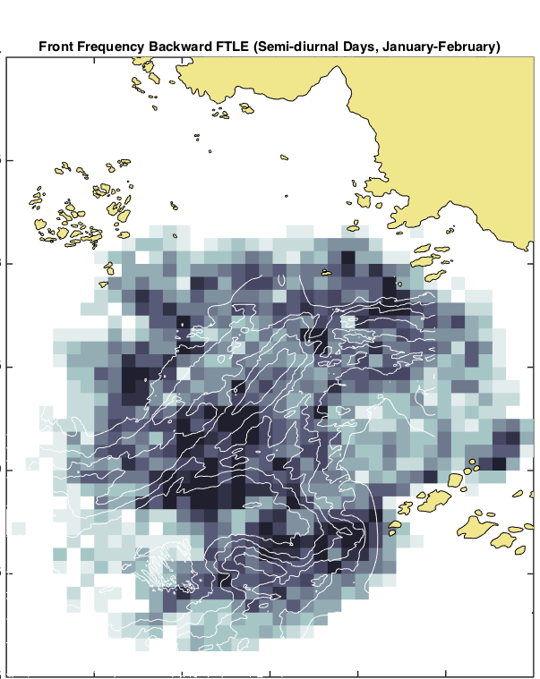
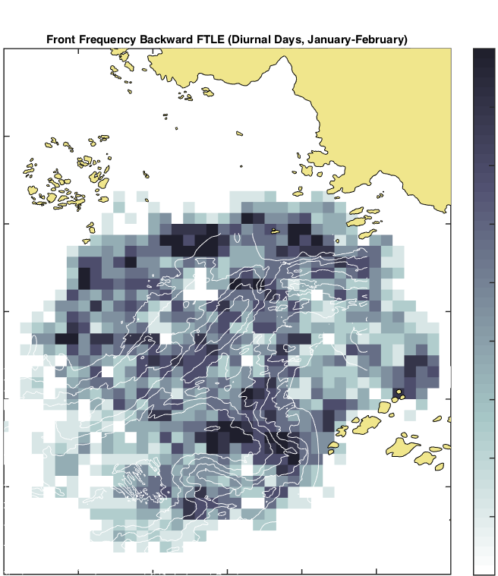
Strong Convergent Fronts
January – February, 2015
Semi-Diurnal
Diurnal
50
45
40
35
30
25
20
15
10
0
Percent Occurrence

Slide 13
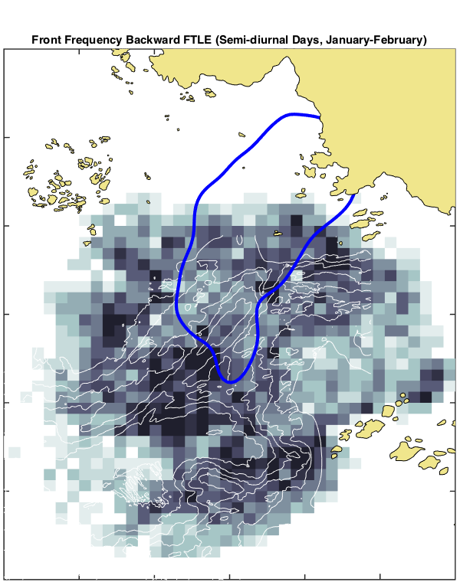

Strong Convergent Fronts
January – February, 2015
Semi-Diurnal
Diurnal
50
45
40
35
30
25
20
15
10
0
Percent Occurrence

Slide 14
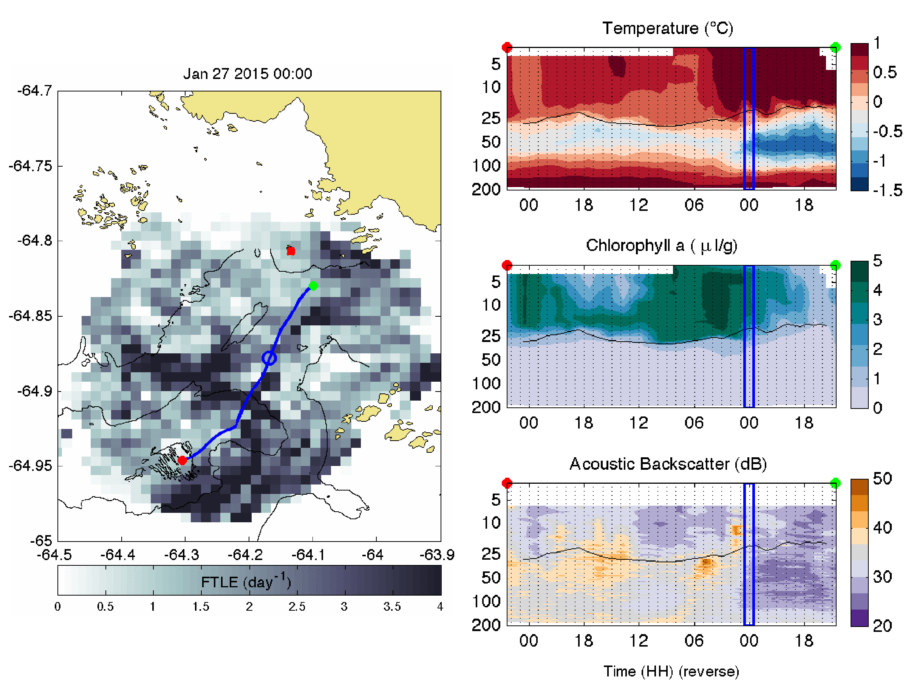
January 27, 2015
Offshore Onshore
00:00 GMT

Slide 15
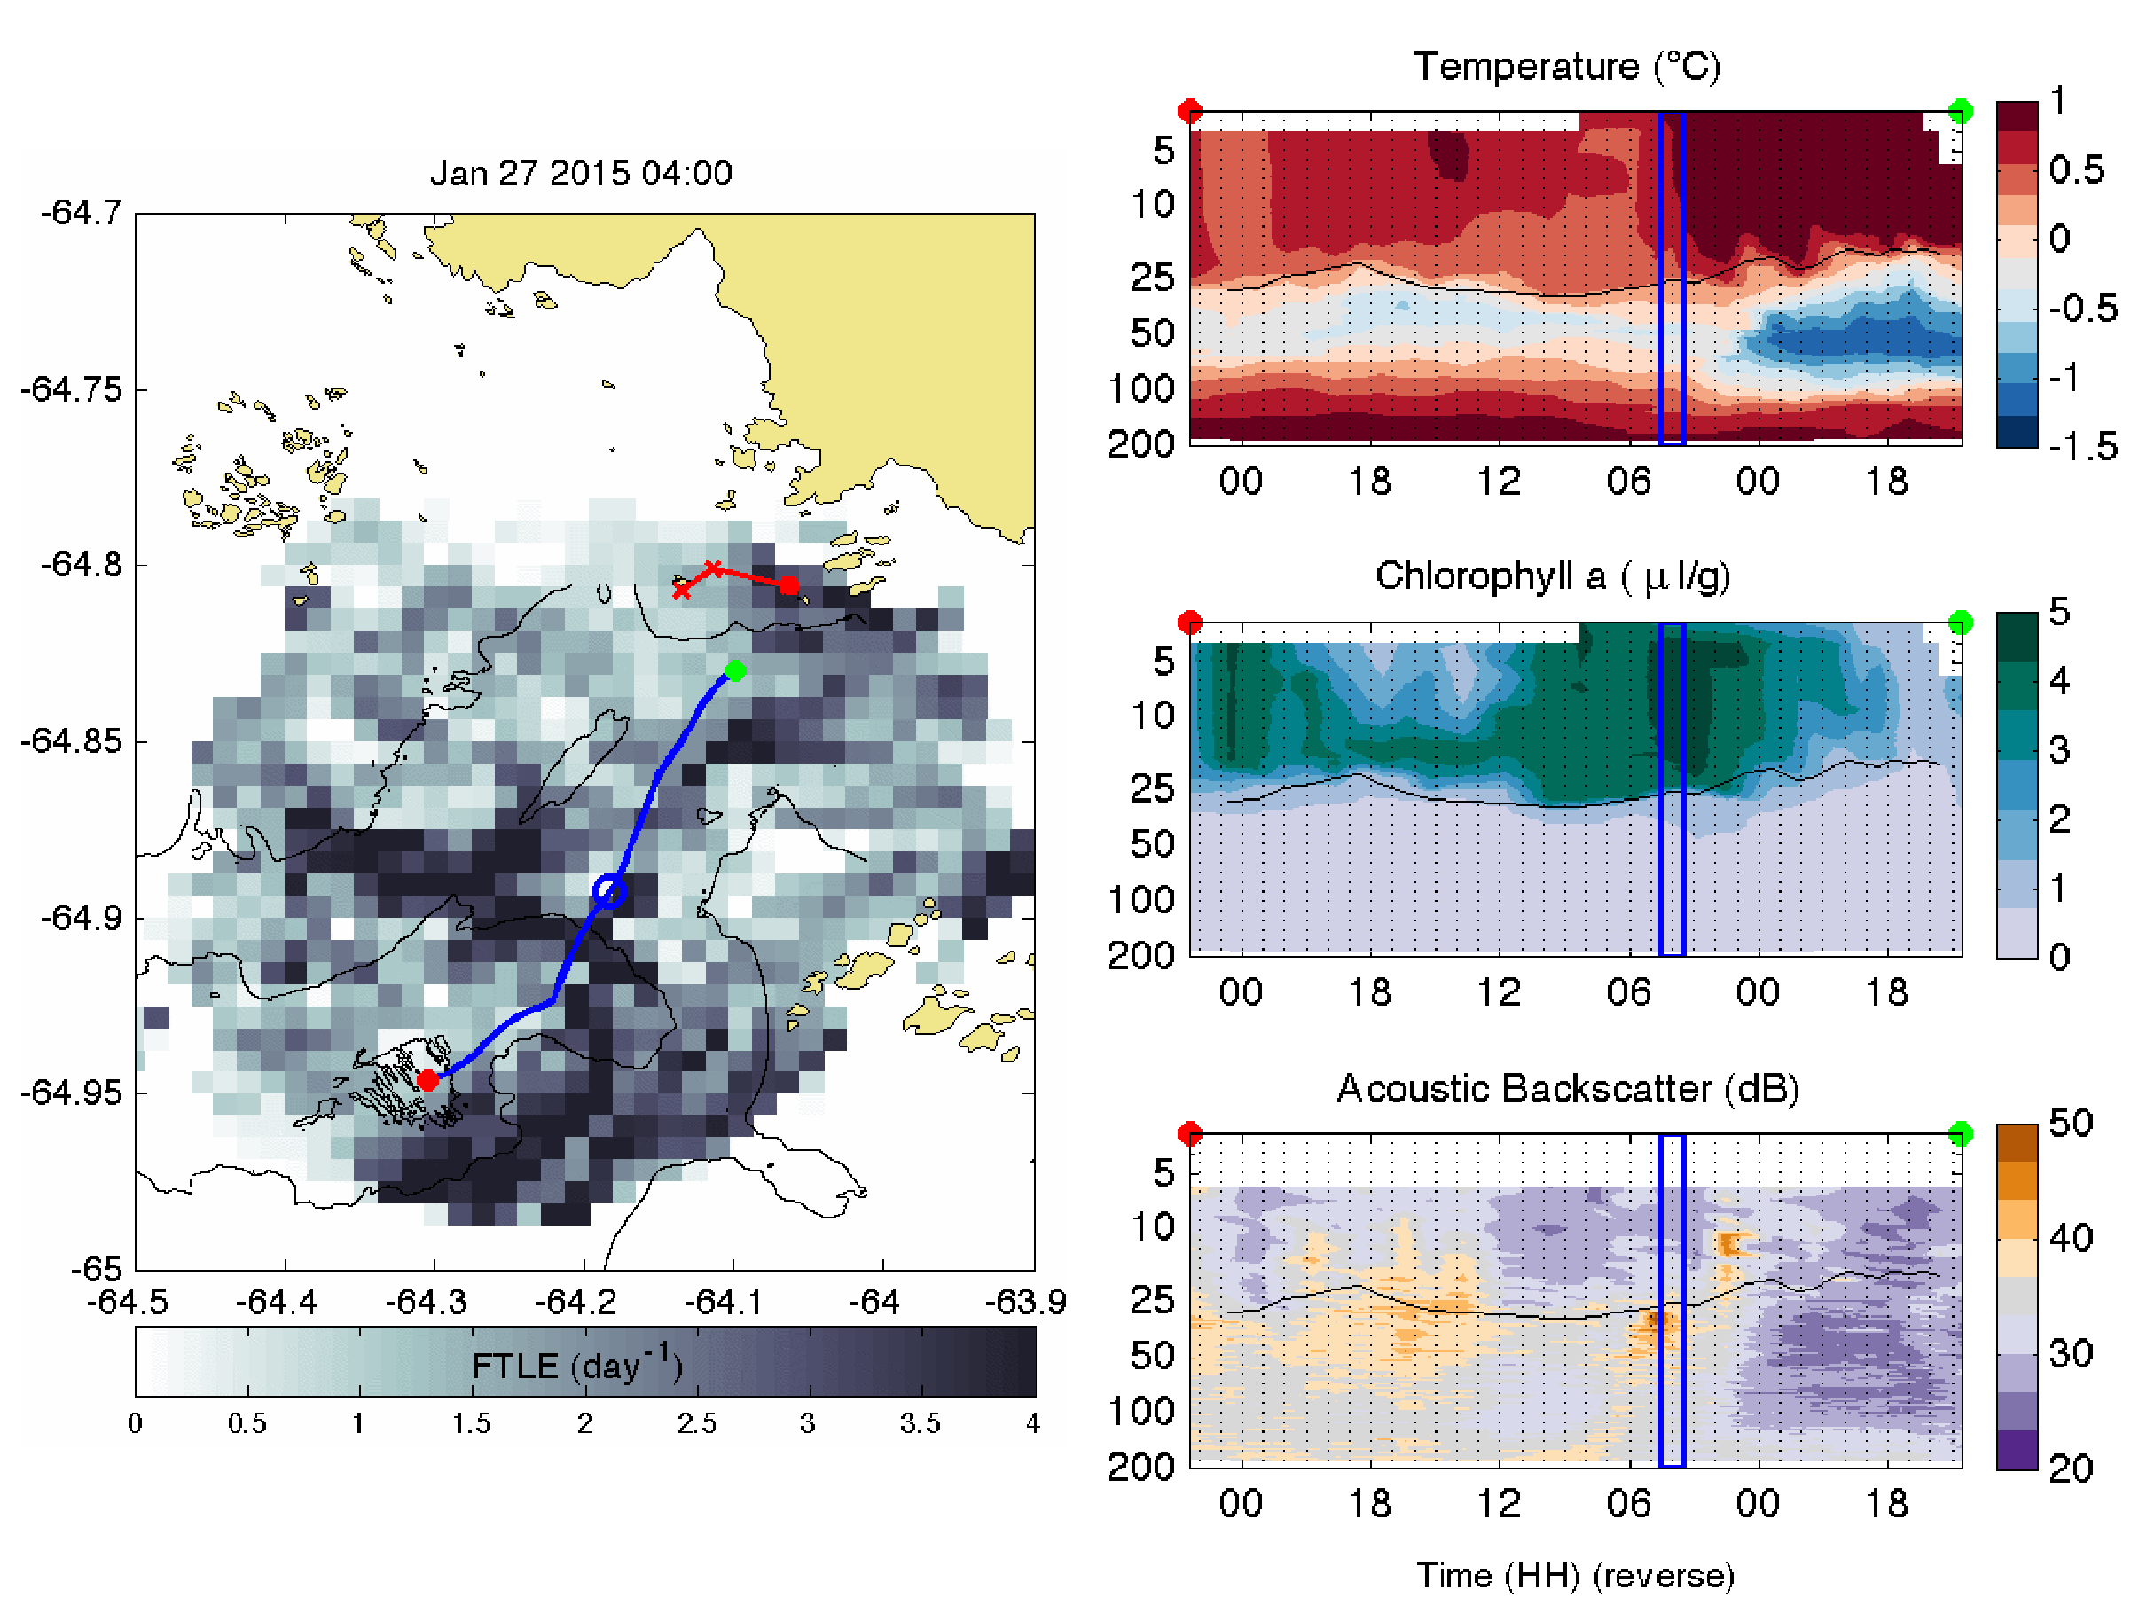
January 27, 2015
Offshore Onshore
Glider - 04:00 GMT
04:00 GMT

Slide 16
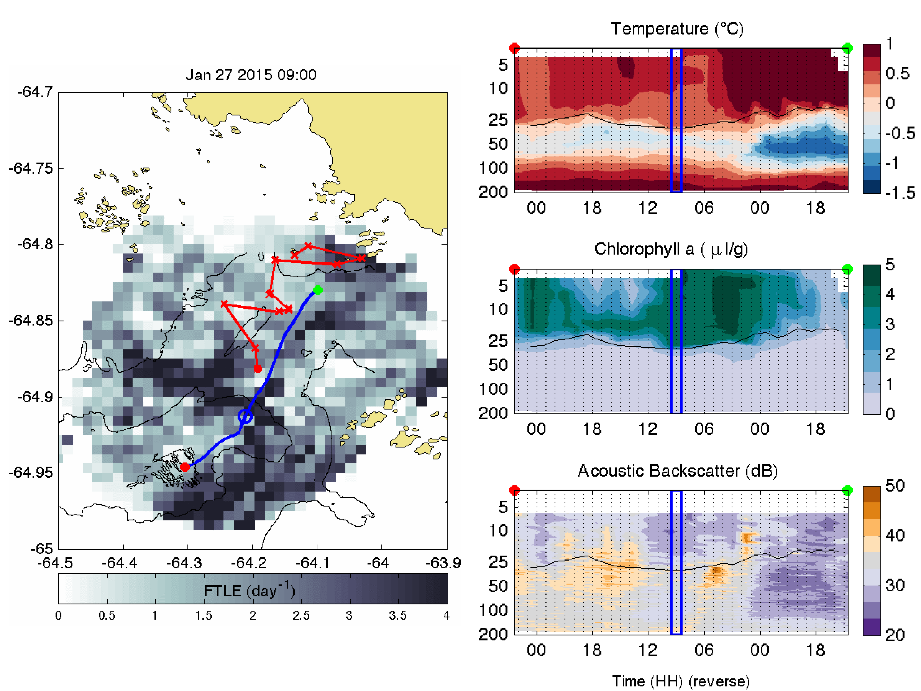
January 27, 2015
Offshore Onshore
Glider - 04:00 GMT
09:00 GMT

Slide 17
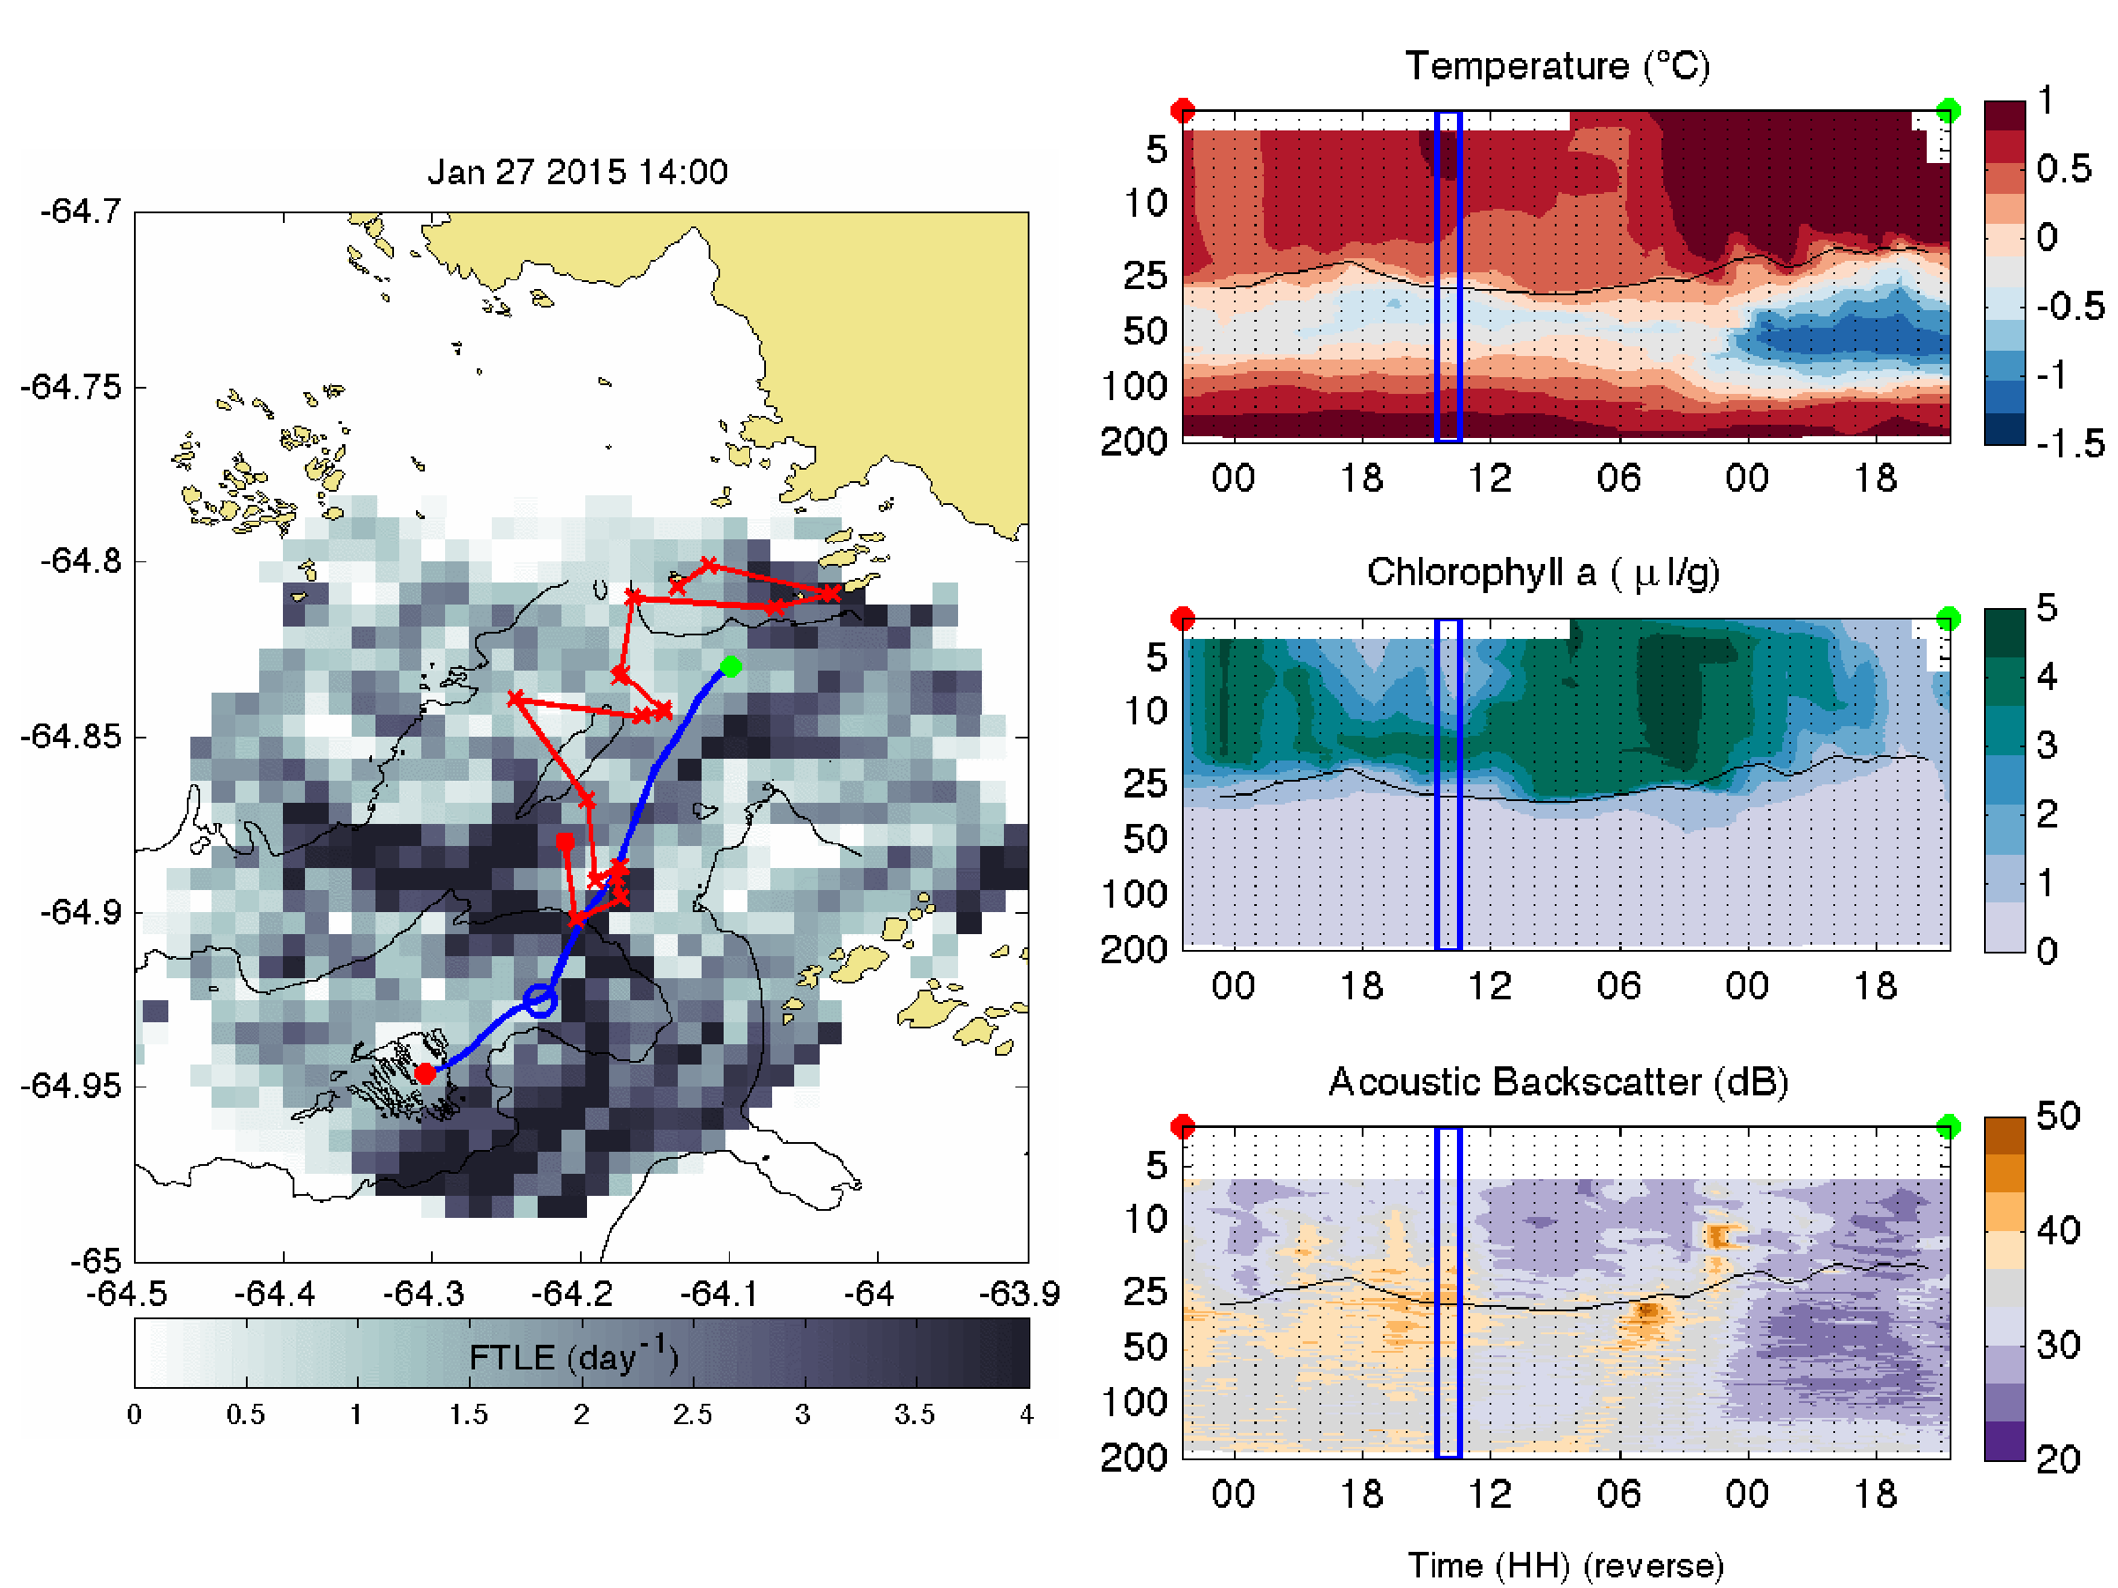
January 27, 2015
Offshore Onshore
Glider - 04:00 GMT
Adelie – 10:00 to 13:00 GMT
14:00 GMT

Slide 18
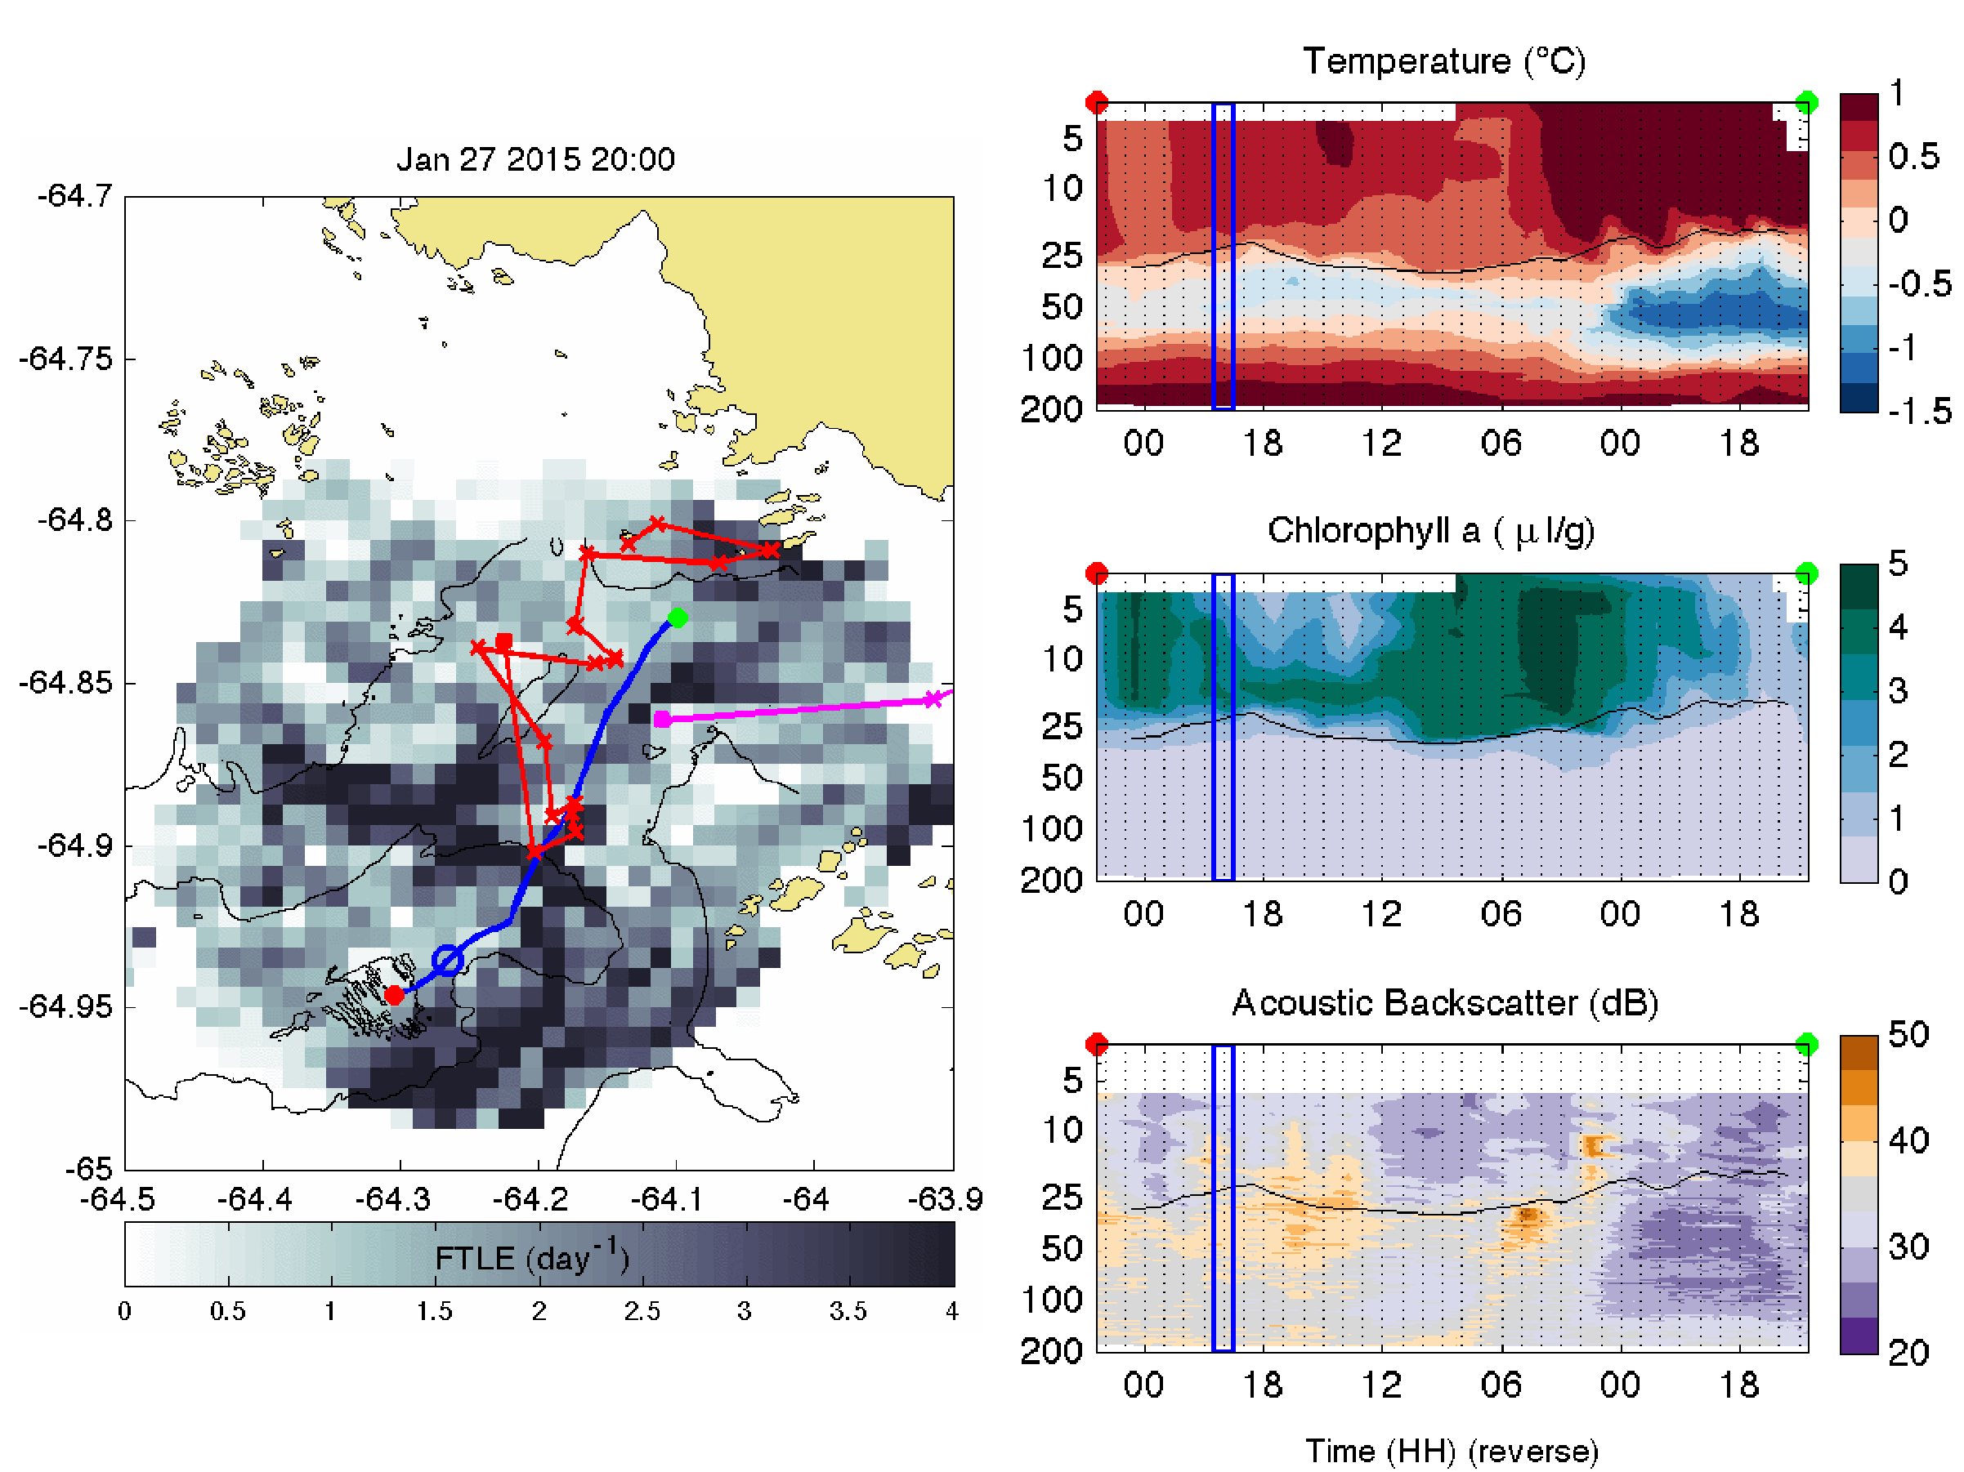
January 27, 2015
Offshore Onshore
Glider - 04:00 GMT
Adelie – 10:00 to 13:00 GMT
20:00 GMT

Slide 19

January 27, 2015
Offshore Onshore
Glider - 04:00 GMT
Adelie – 10:00 to 13:00 GMT
Gentoo – 21:30 to 22:30 GMT
23:00 GMT

Slide 20
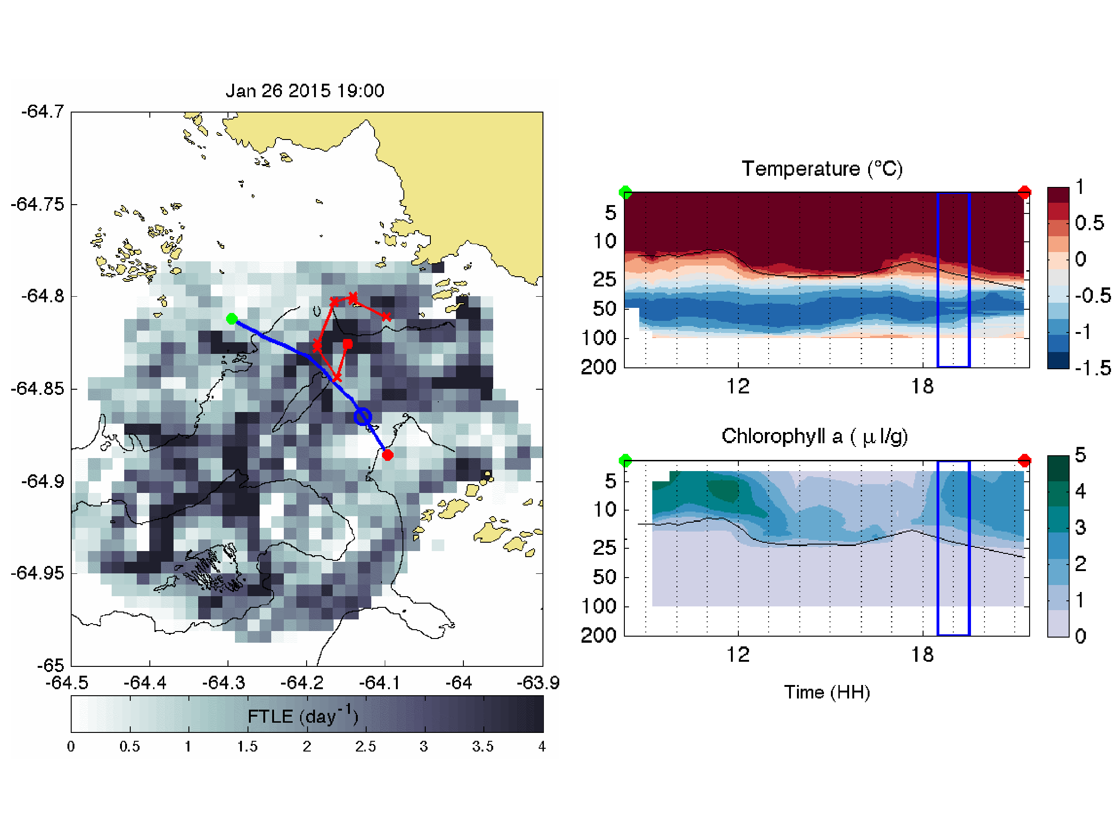
January 26, 2015
West East
19:00 GMT

Slide 21
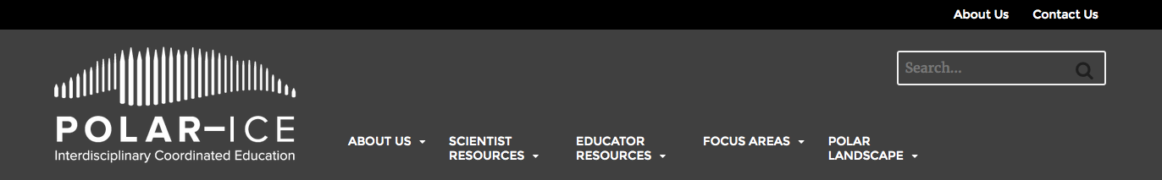
Summary
(H1) Patterns of convergence shifted position between diurnal and semi-diurnal tidal regimes in 2015, consistent with historic penguin foraging behavior.
(H2) There is evidence that these convergent zones identify regions of higher concentrations of food web components.
http://polar-ice.org/
http://coseenow.net/converge/

