Slide 1
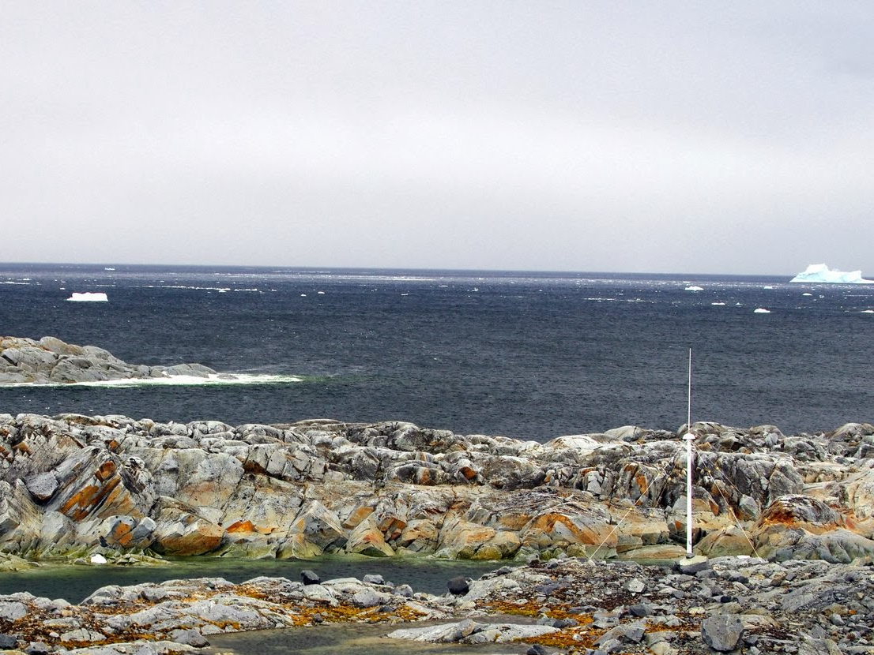
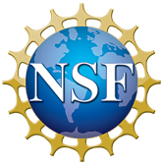
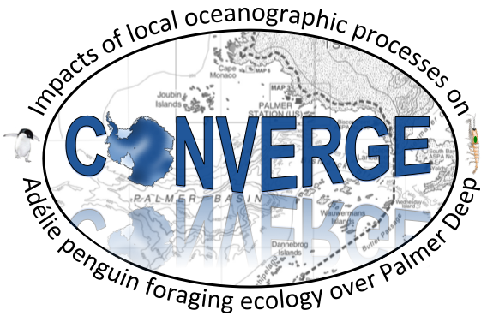
Collaborative research: Impacts of local oceanographic processes on Adélie penguin foraging ecology over Palmer Deep
Rutgers University
Oregon State University
Polar Oceans Research Group
University of Delaware
University of Alaska, Fairbanks
In Collaboration with PAL-LTER (Ducklow et. al.)

Slide 2
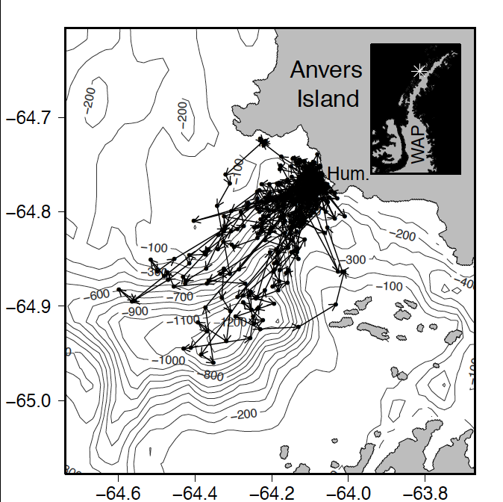
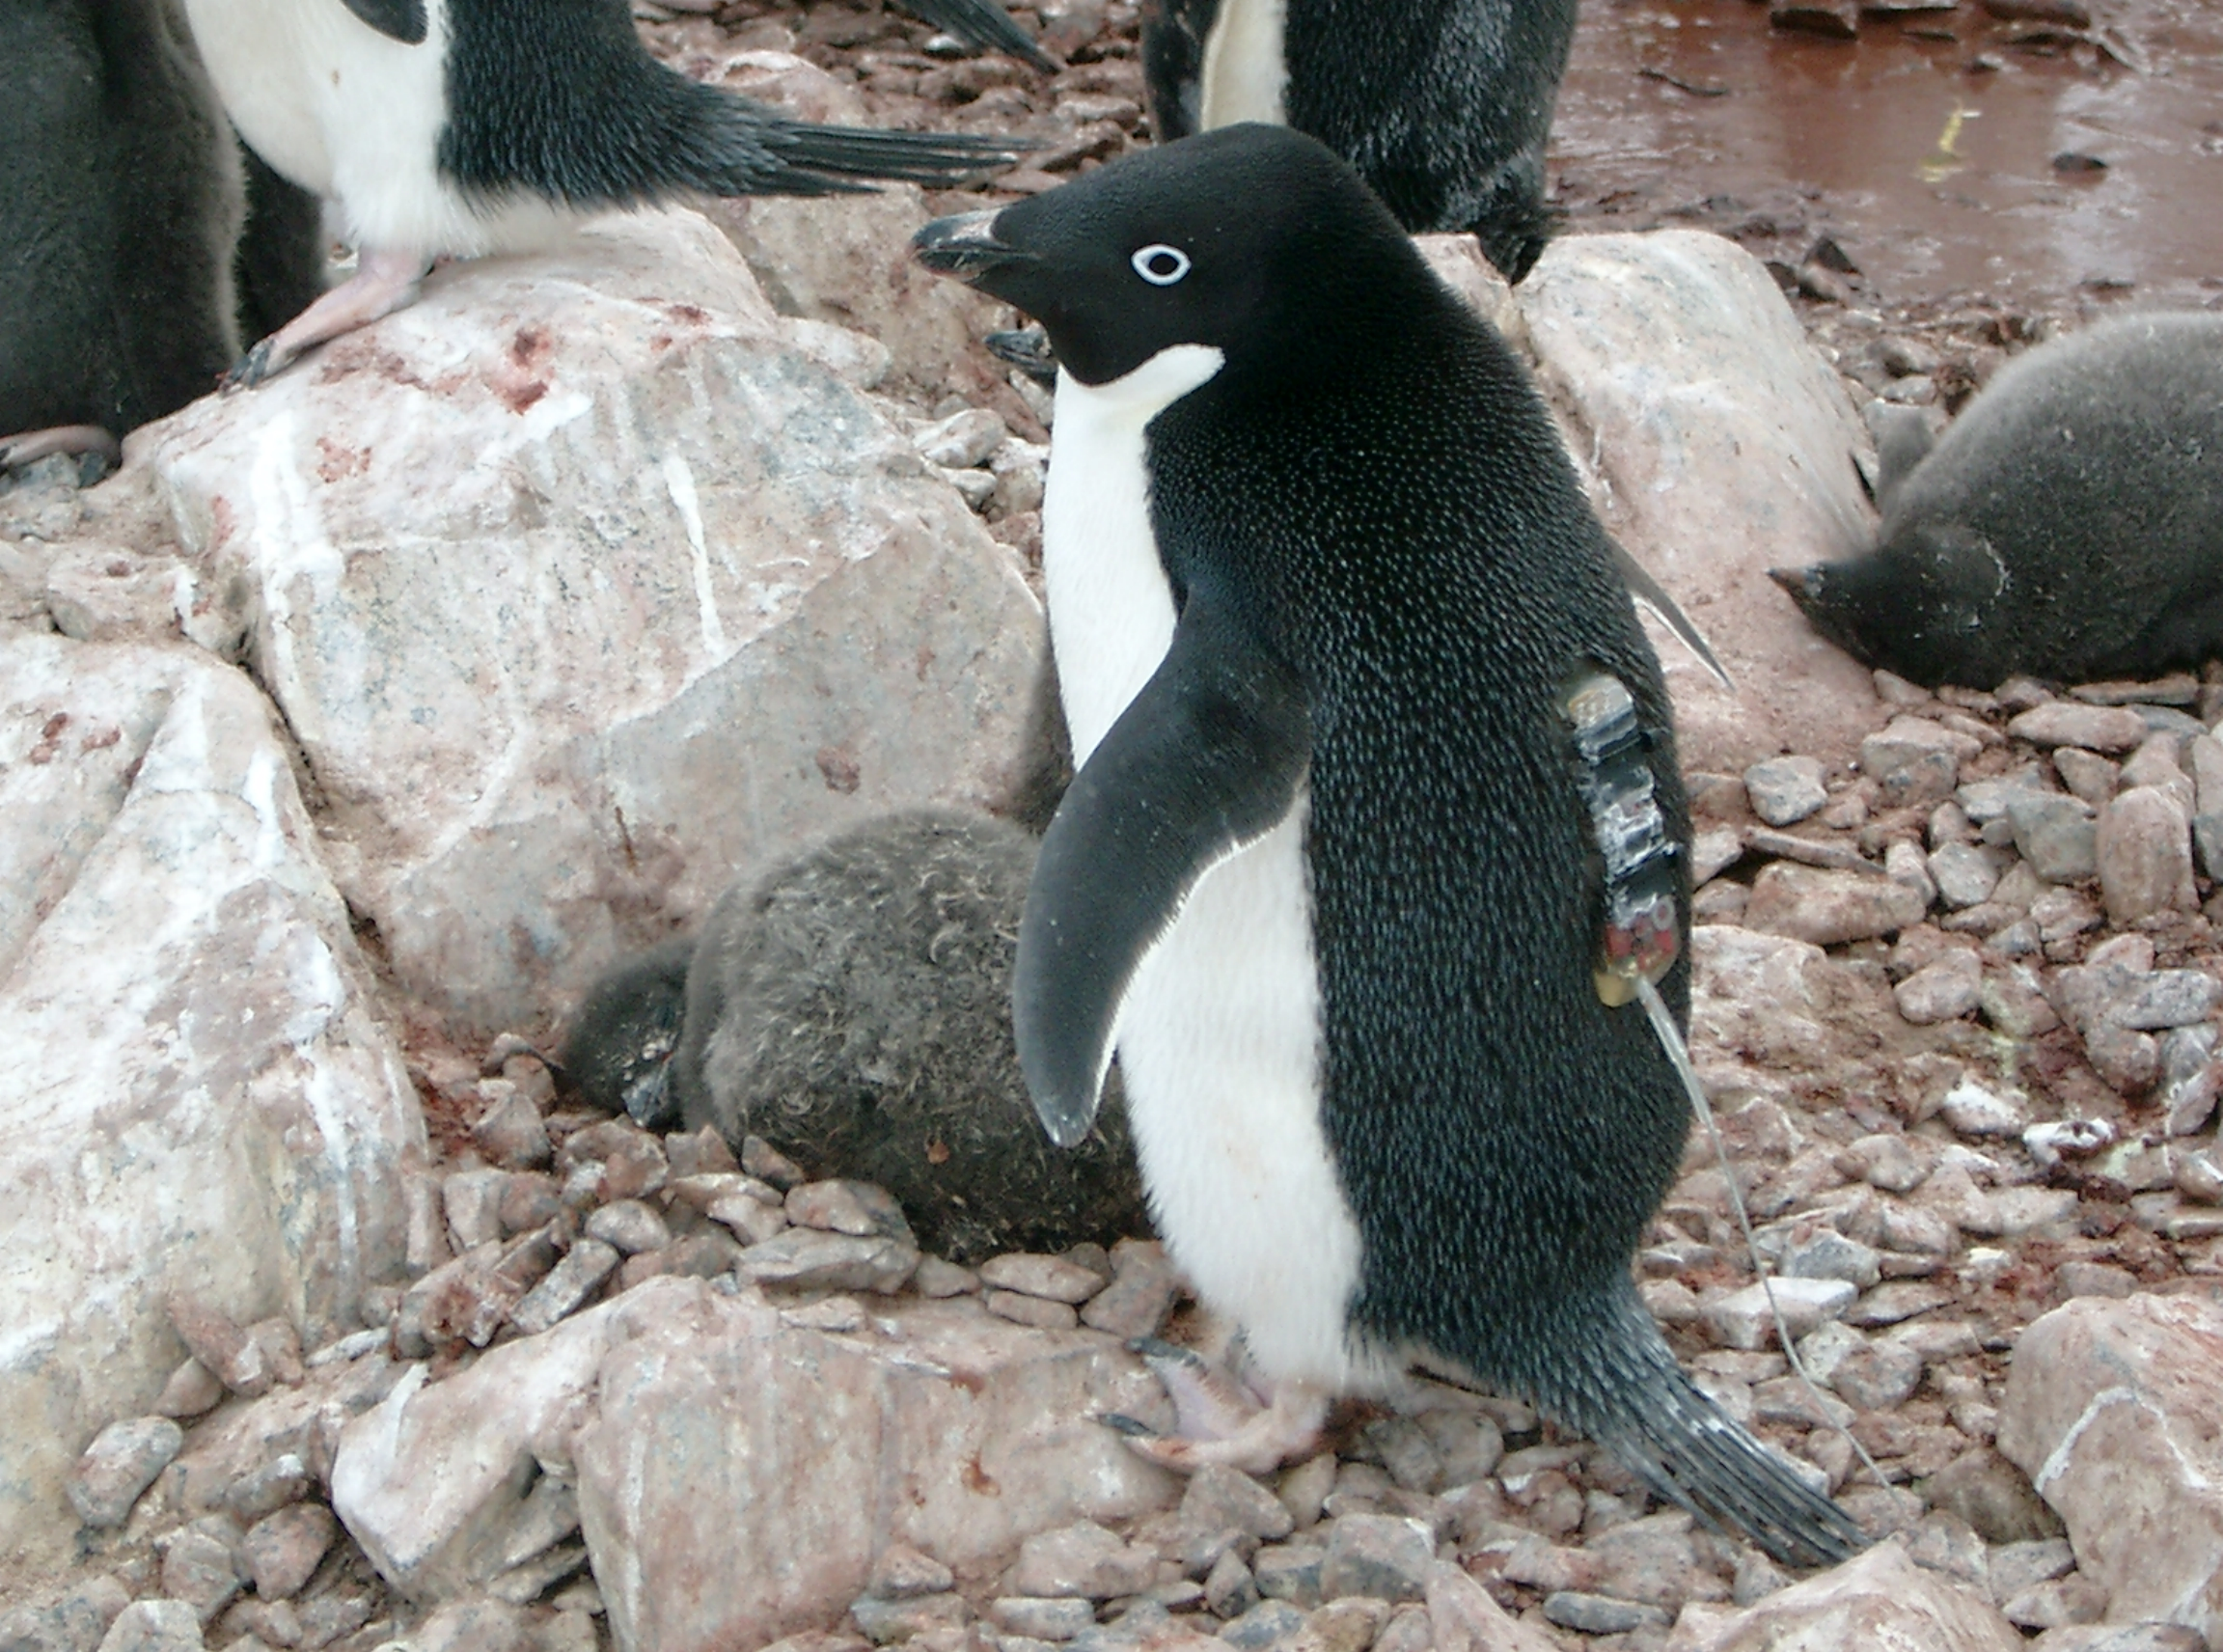
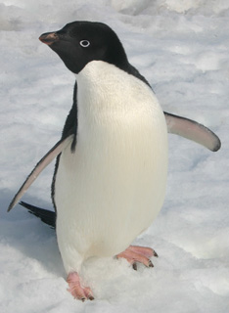
First Field Season Results
Tracking penguins from Humble Island
Where did the Adélie penguins go?

Slide 3
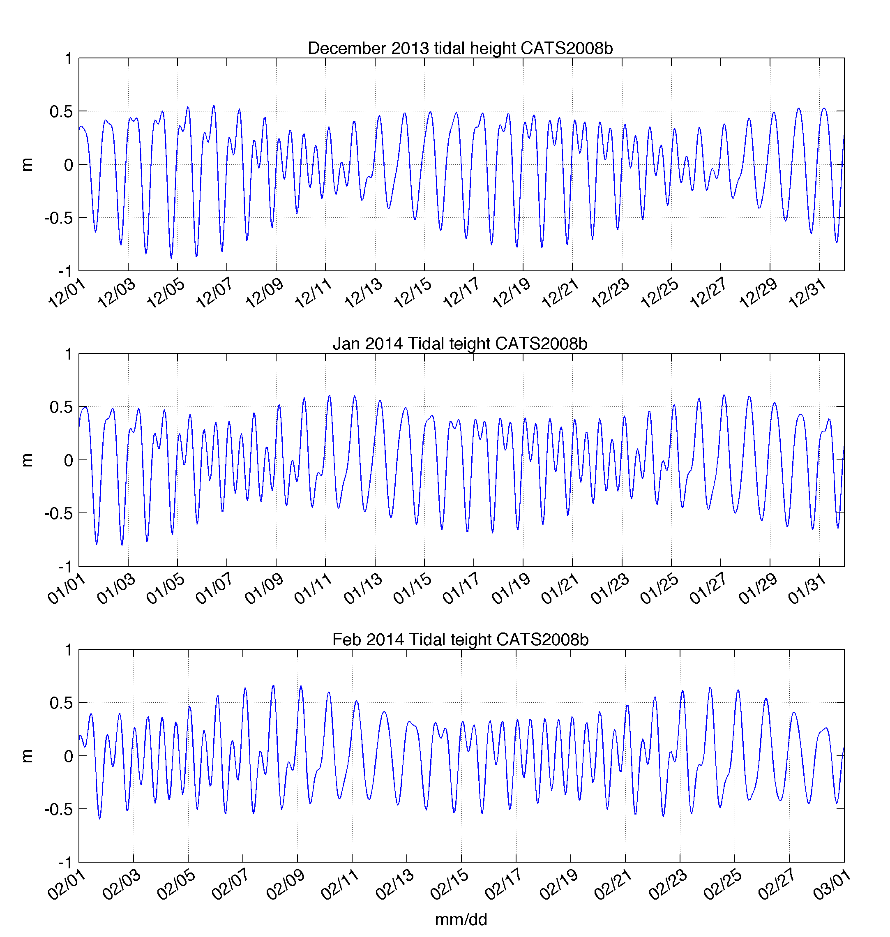
Tidal Dependence on Penguin
Foraging Behavior?
Diurnal
Semi-Diurnal

Slide 4
Science Objectives
From these initial observations we hypothesize that:
H1. Convergence zones in the surface waters within 50 km of the coast shift location between the diurnal and semi-diurnal tidal regime.
H2. These convergence zones concentrate phytoplankton and aggregate schools of krill and subsequently influence the behavior of top predator species between tidal regimes.
To do this we will sample the:
Physics
Primary Producers
Zooplankton
Top Predators
Over semi-diurnal and diurnal tidal regimes.

Slide 5
Technology to be deployed:
Our adaptive Approach
HF Radar (Physics – Surface / Time)
Mooring (Physics – Vertical / Time)
Gliders (Physics and Primary Producers)
Small Boat Surveys (Physics, Primary Producers and Krill)

Slide 6
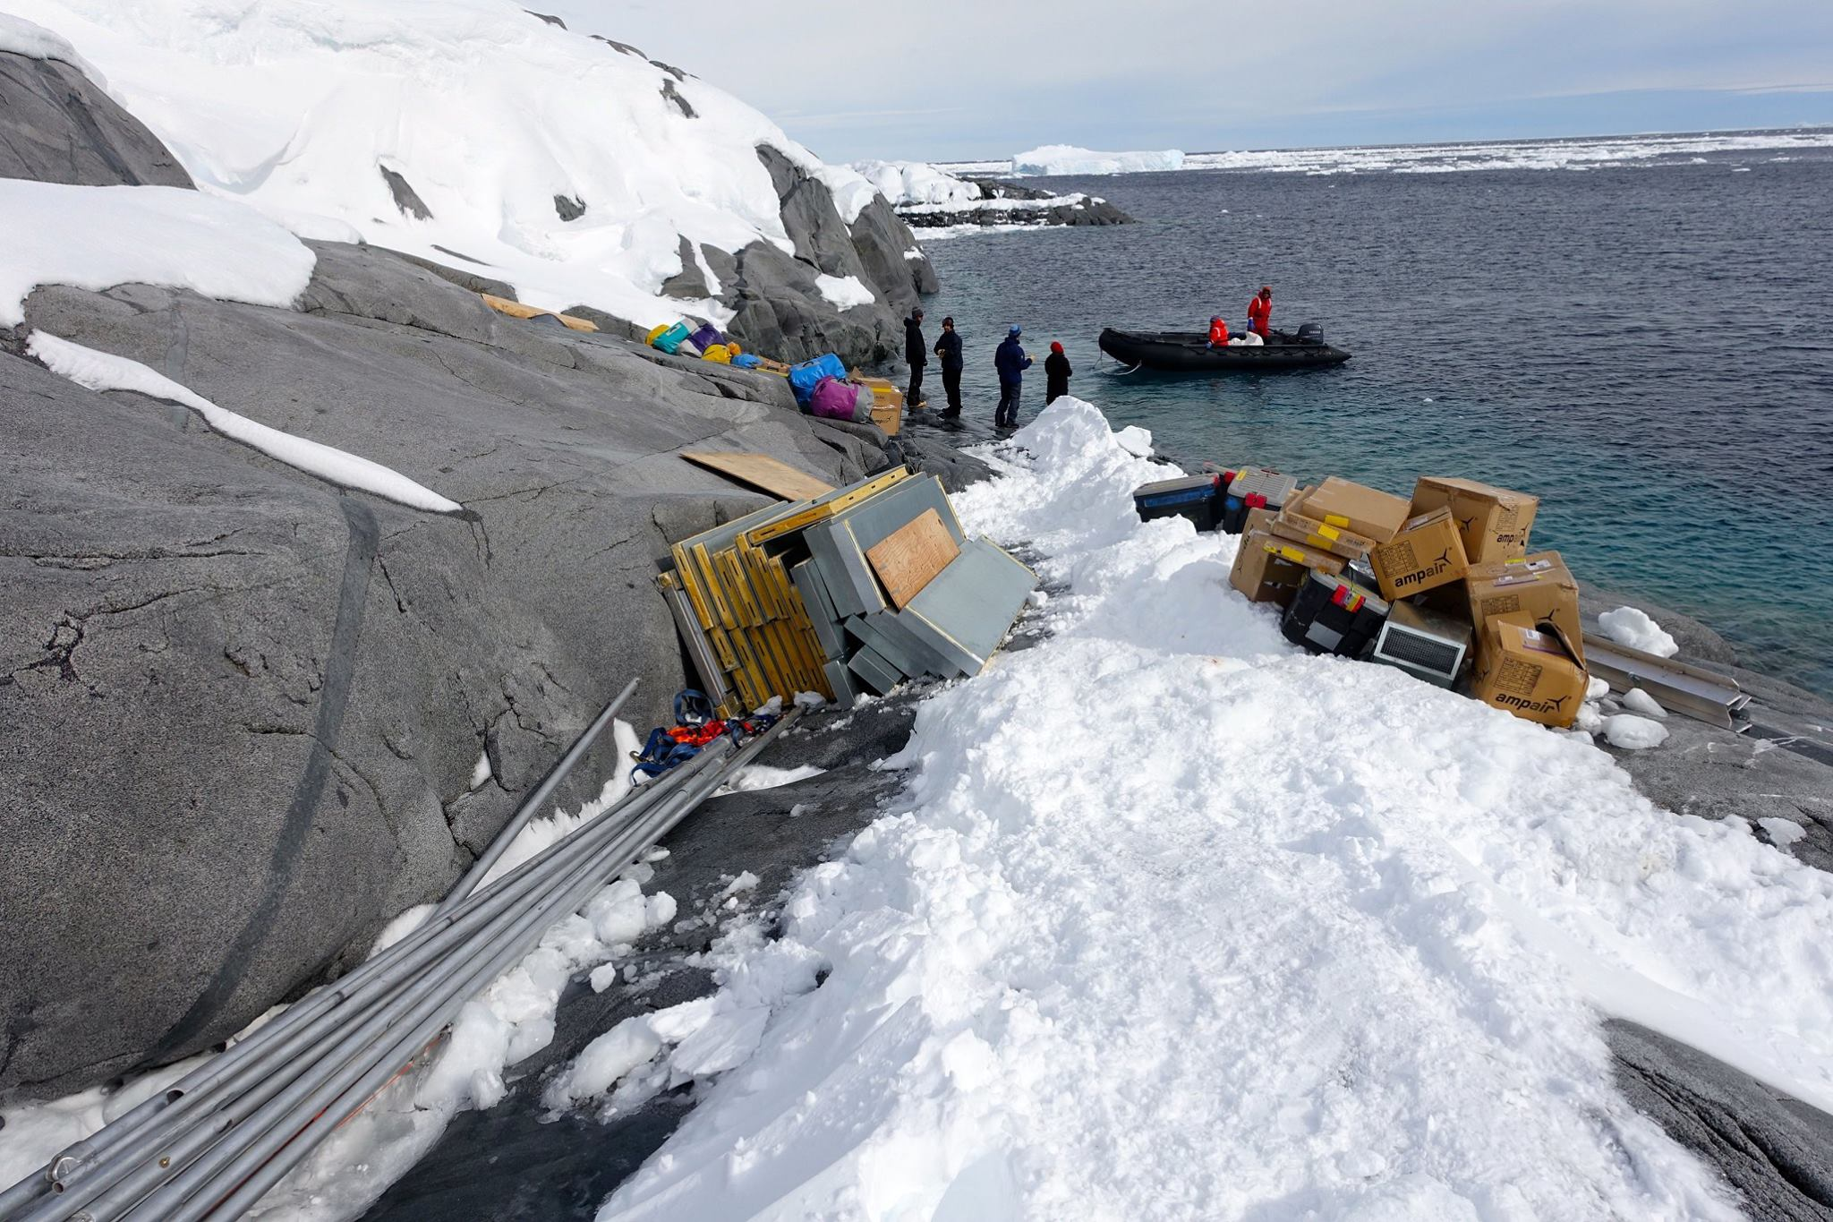
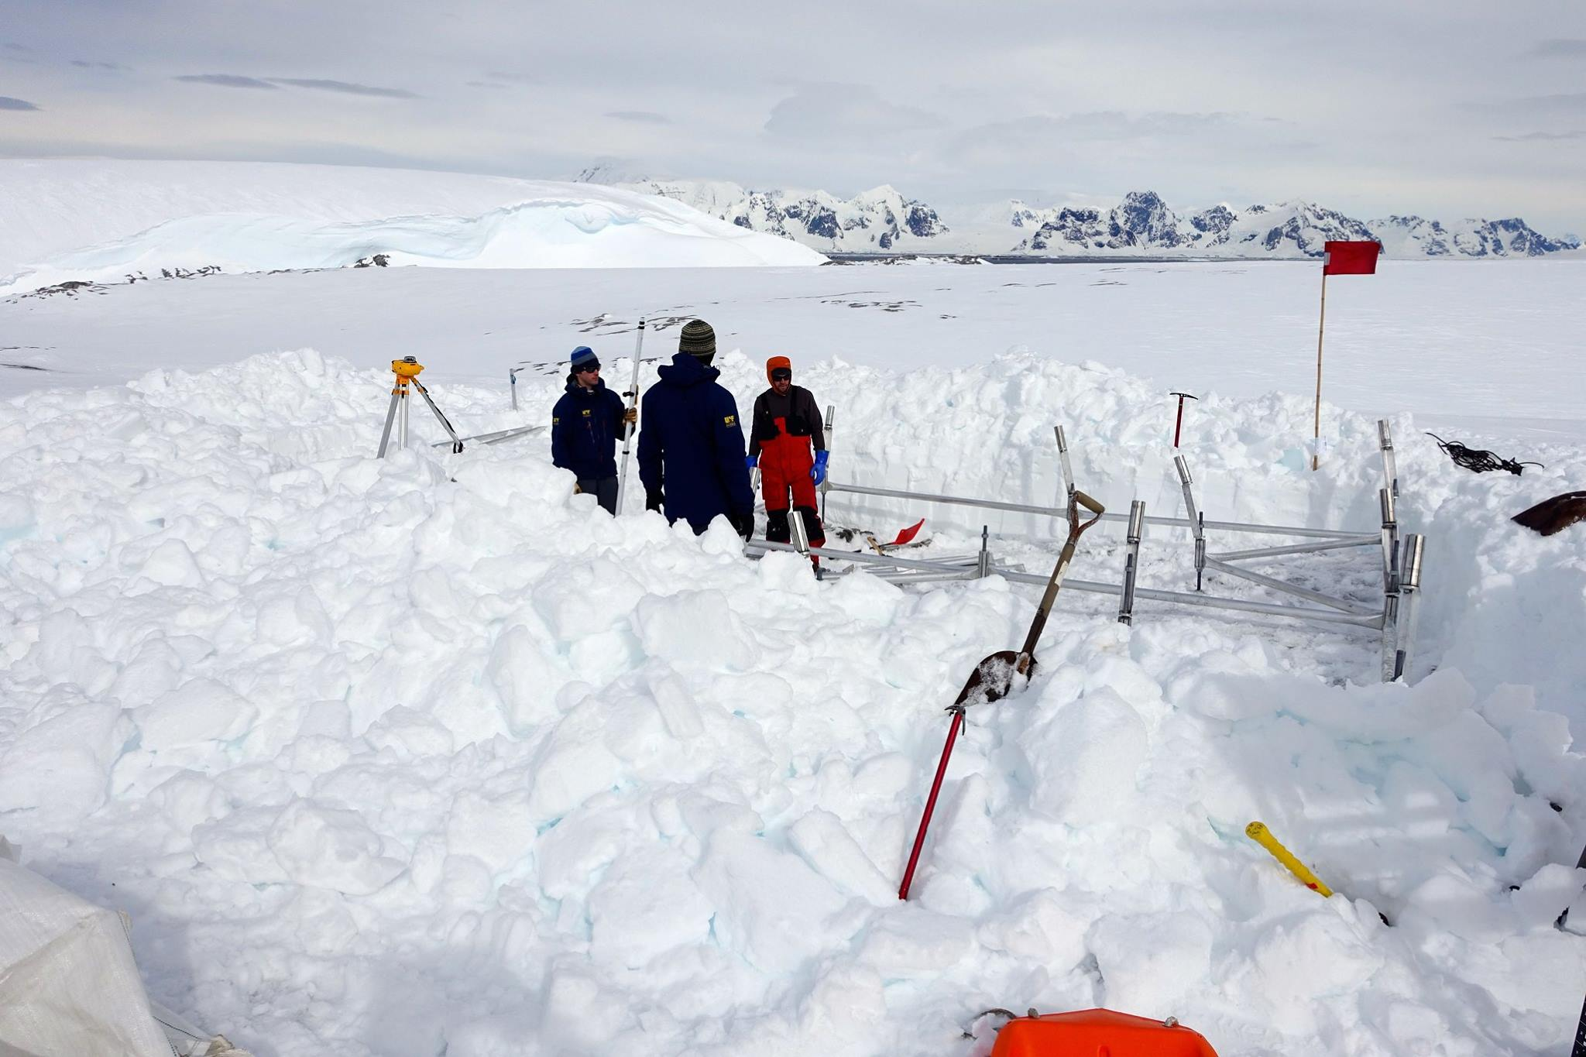
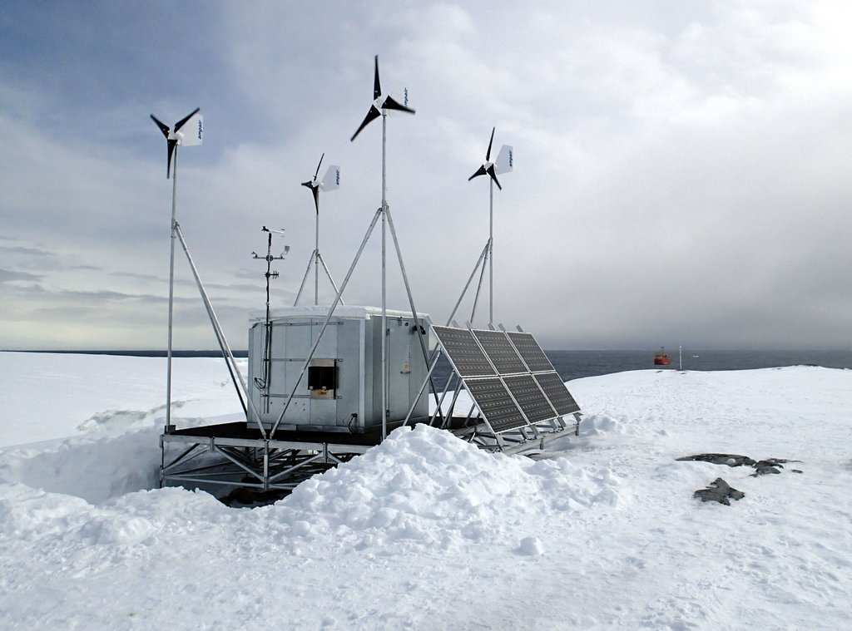
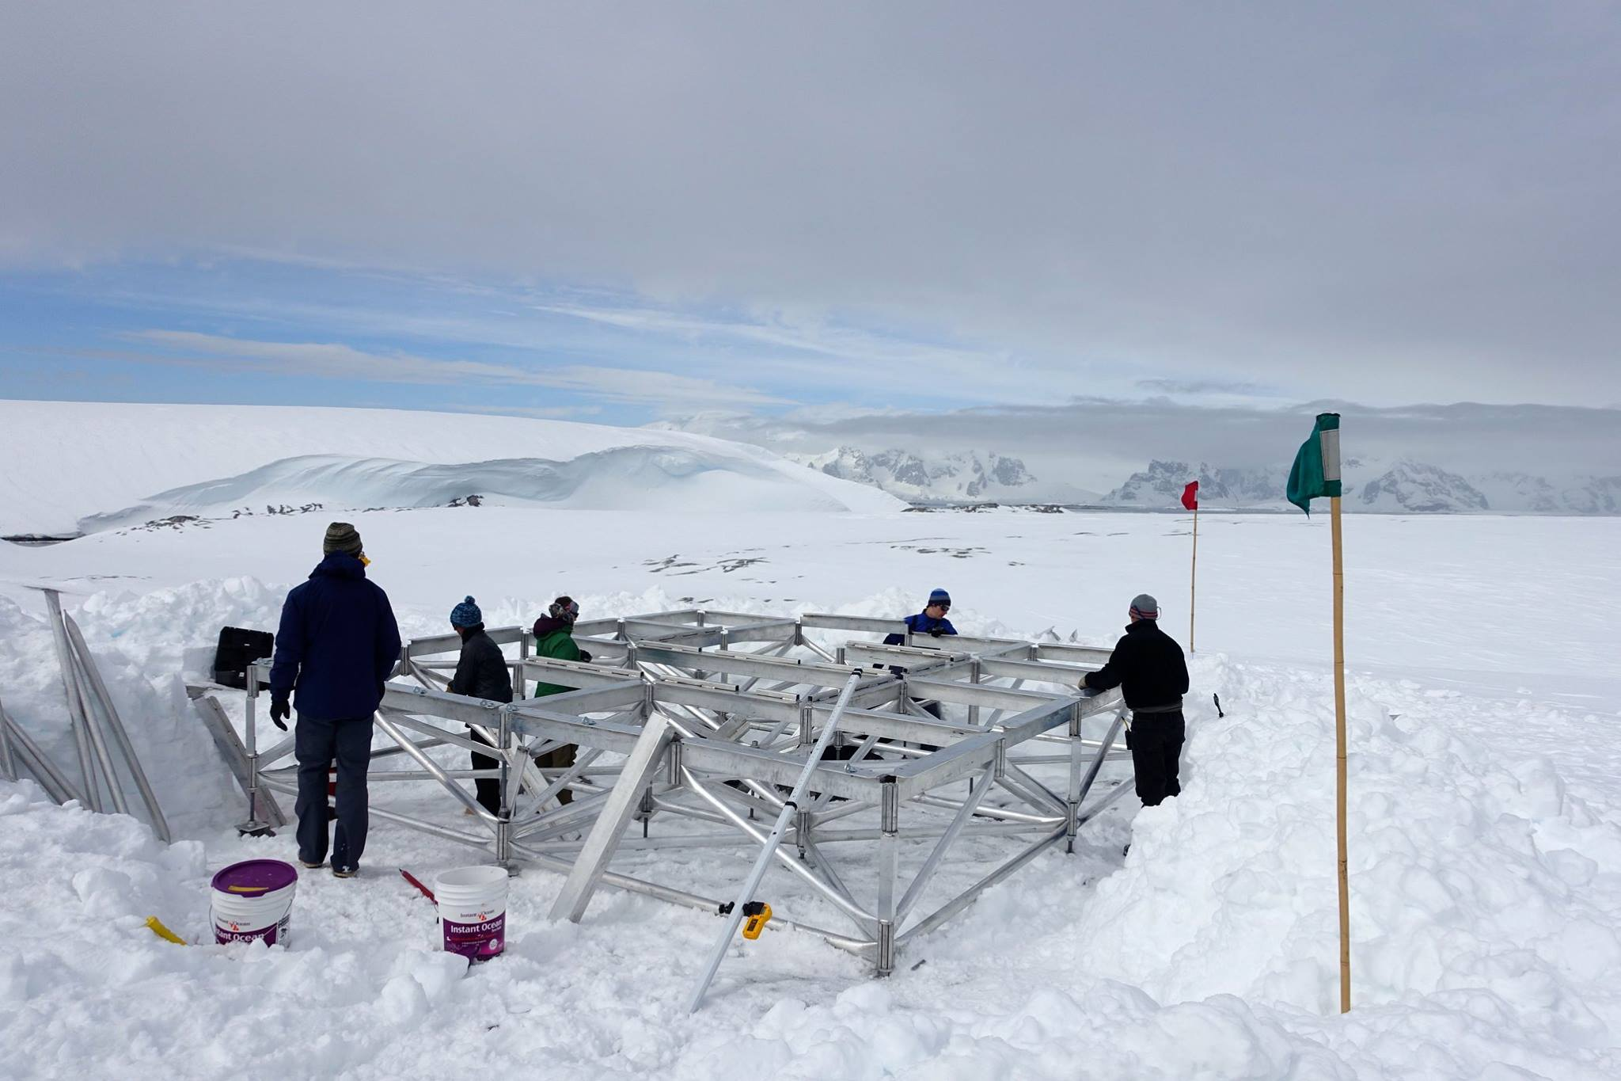

Slide 7
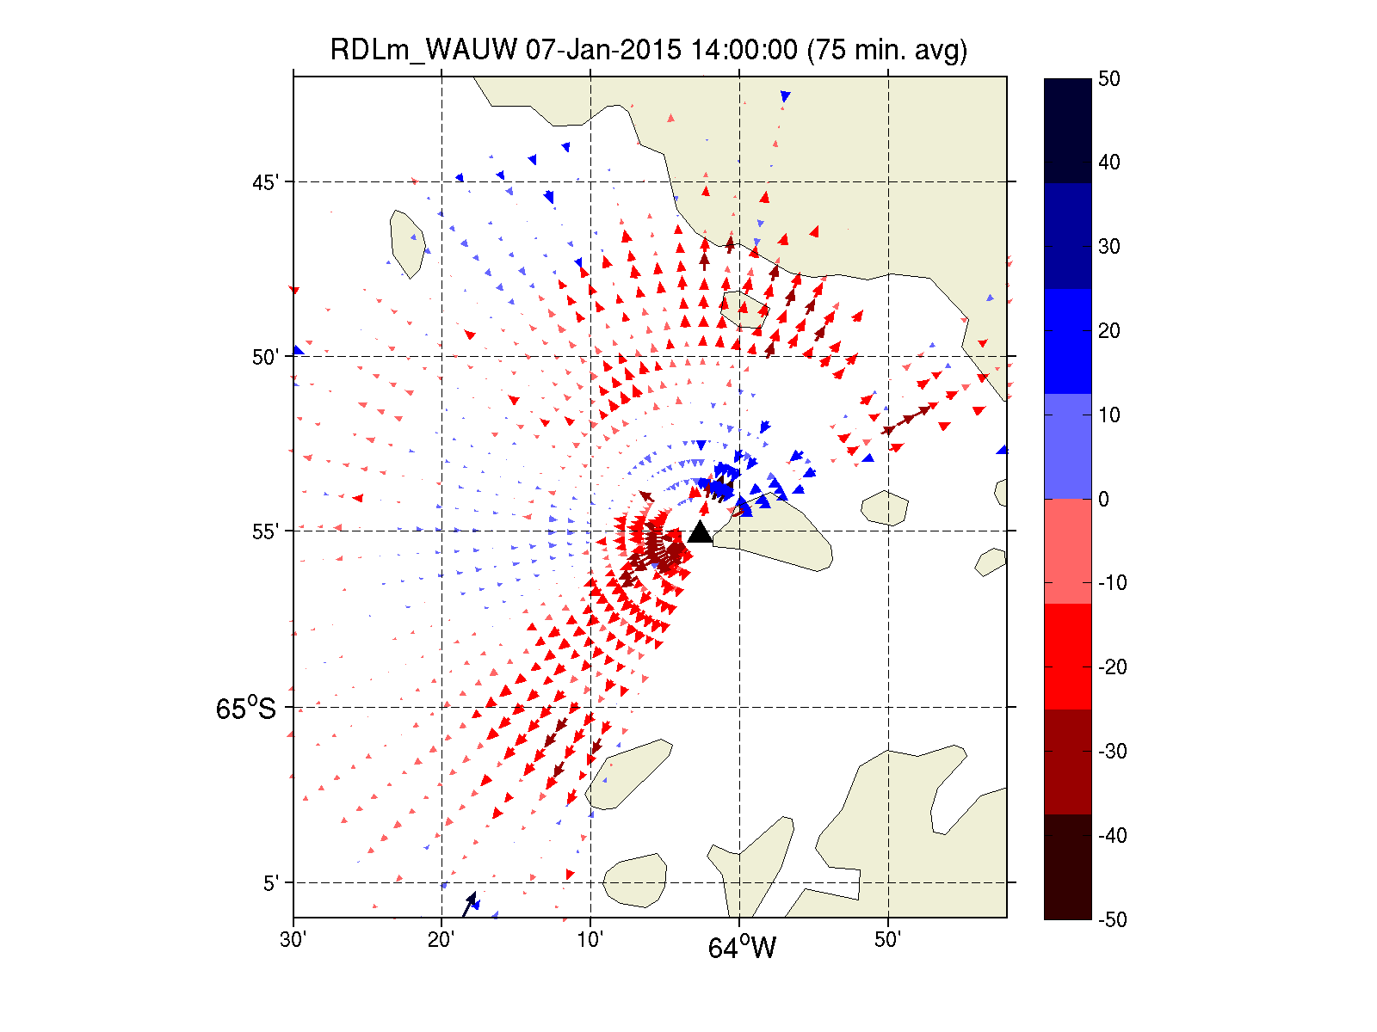
Radials From WAUW

Slide 8
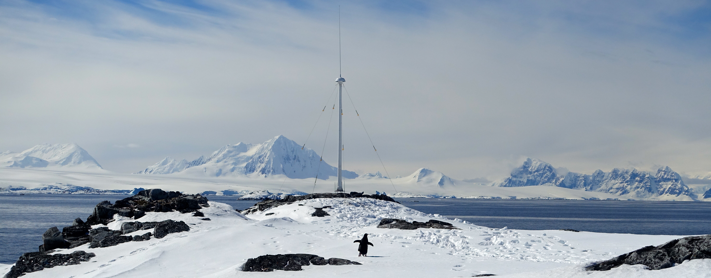
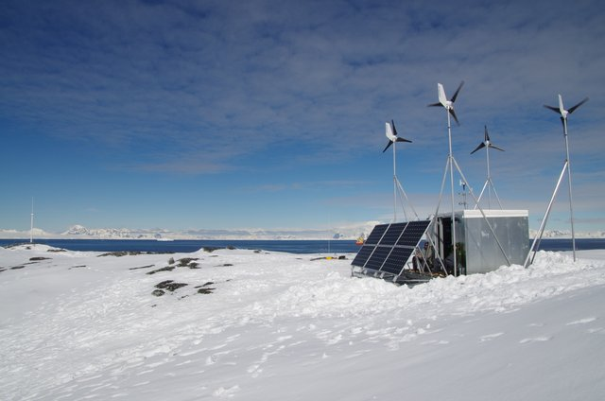
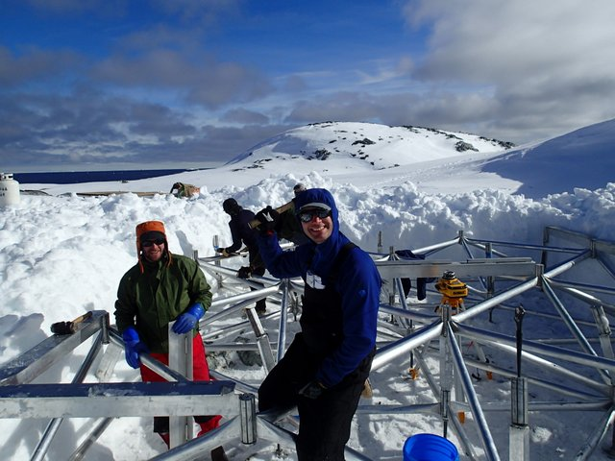

Slide 9
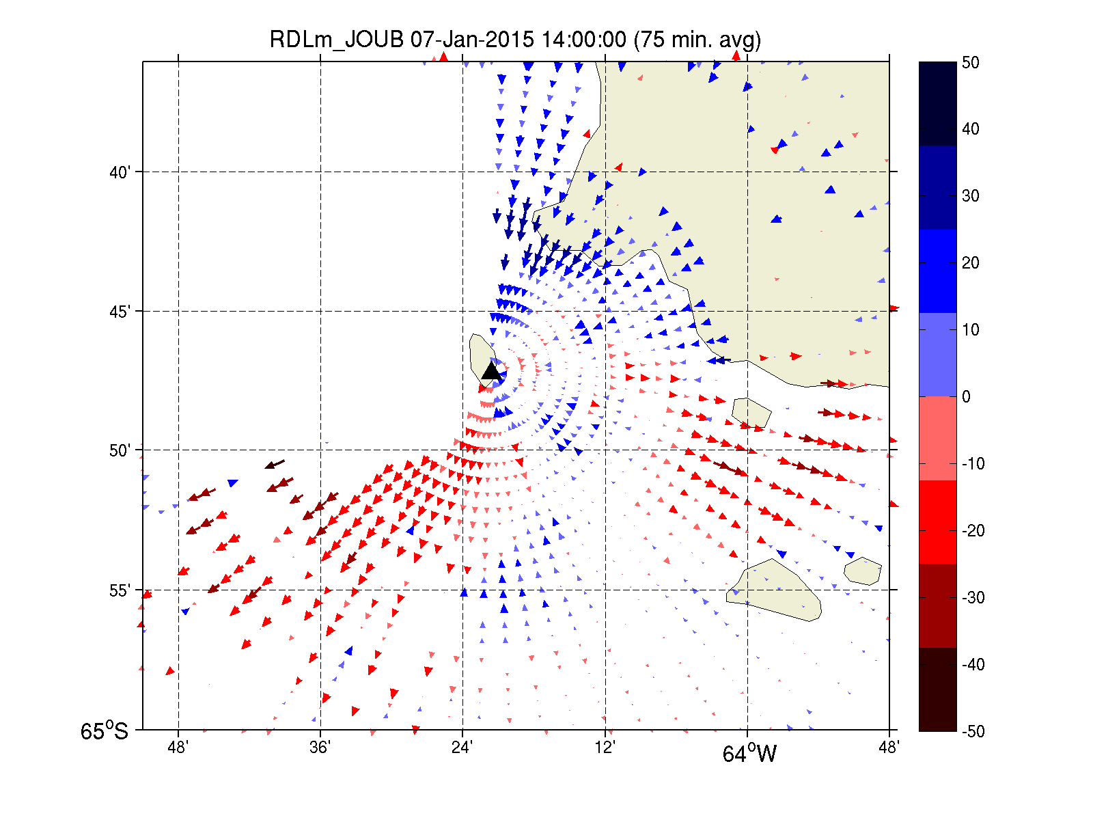
Radials From JOUB

Slide 10
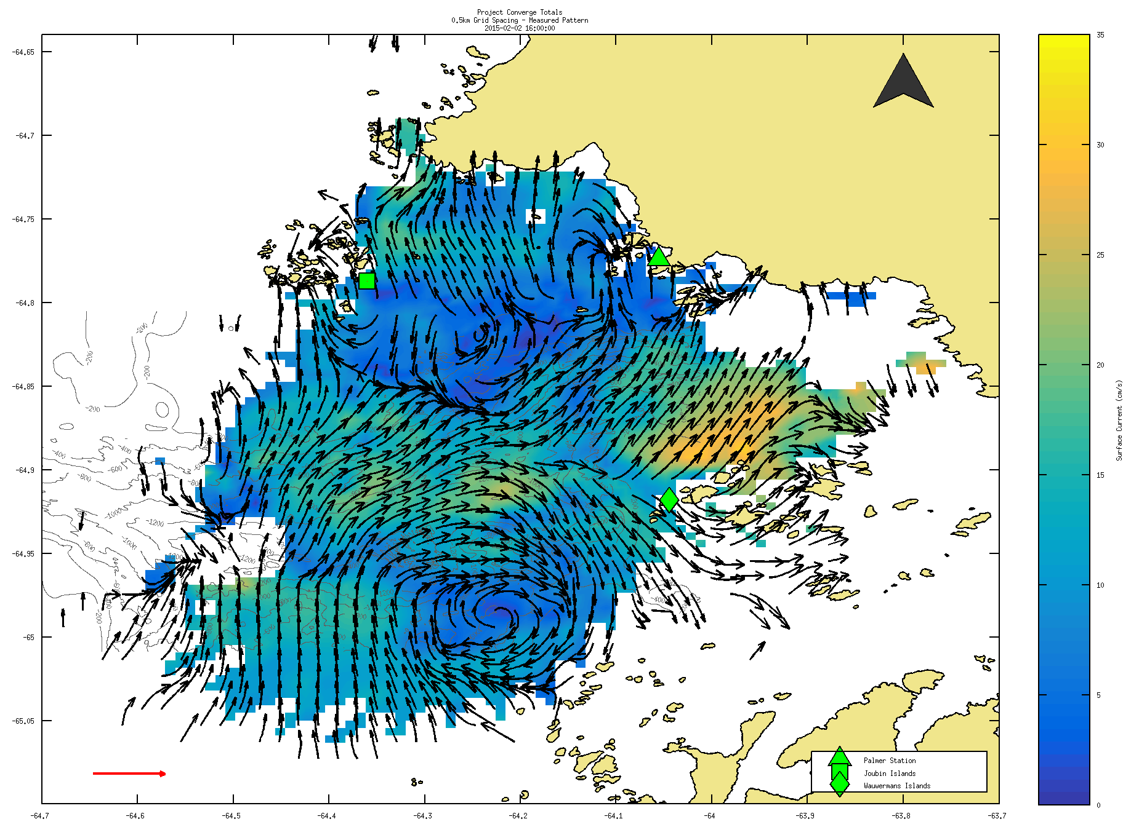

Slide 11
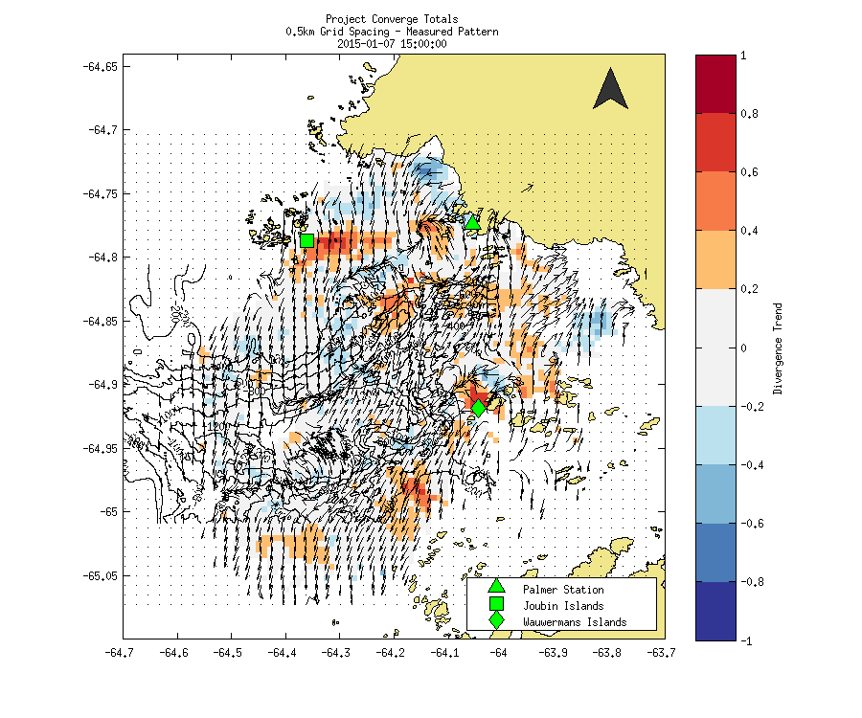

Slide 12
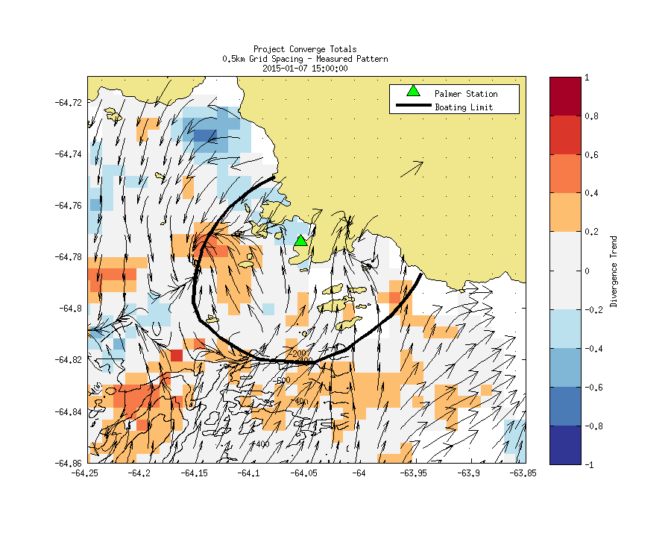

Slide 13
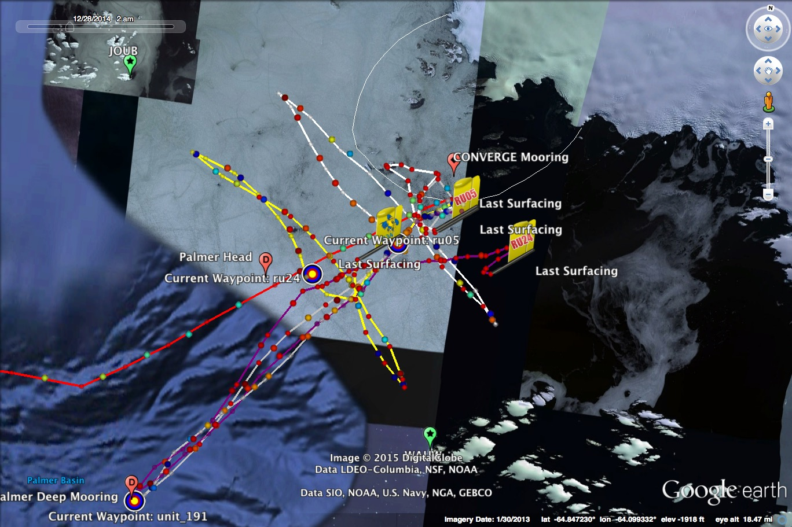

Slide 14
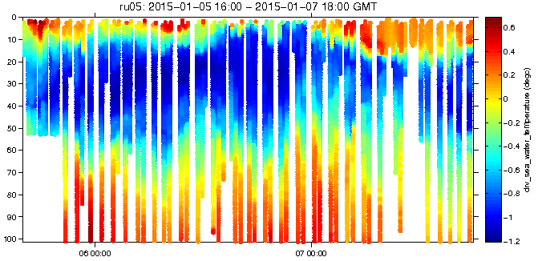
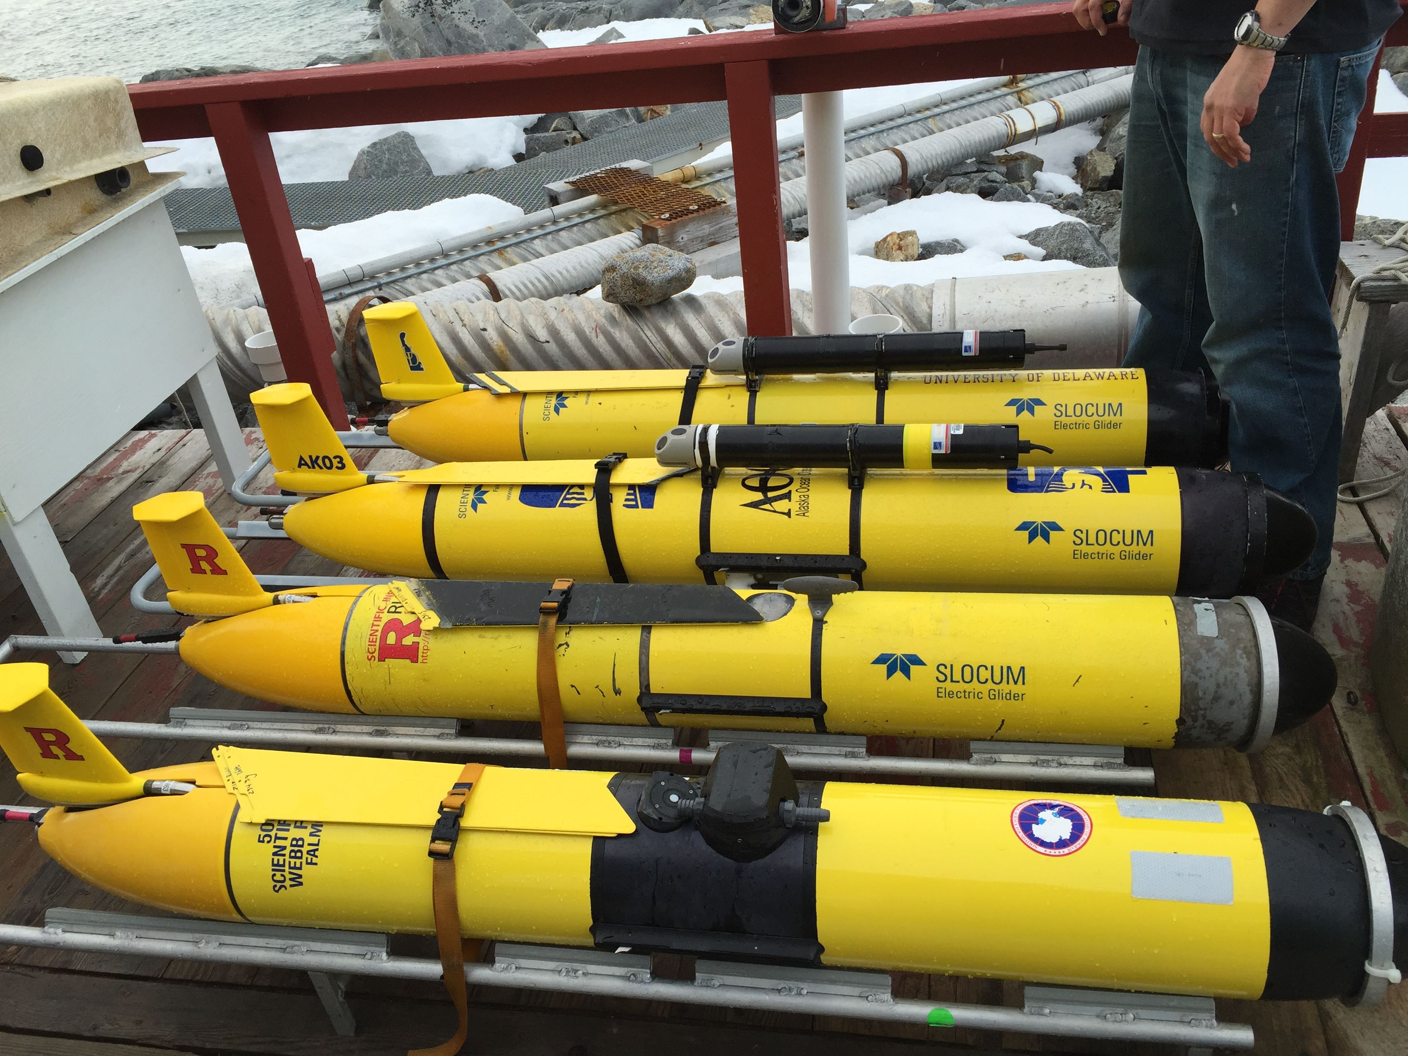
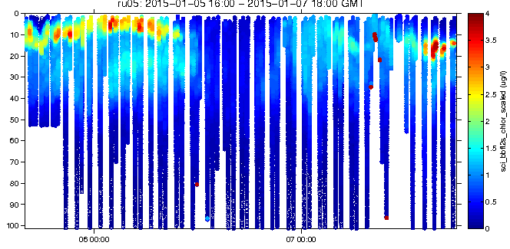
Rutgers
RU05
Temperature
Chlorophyll

Slide 15
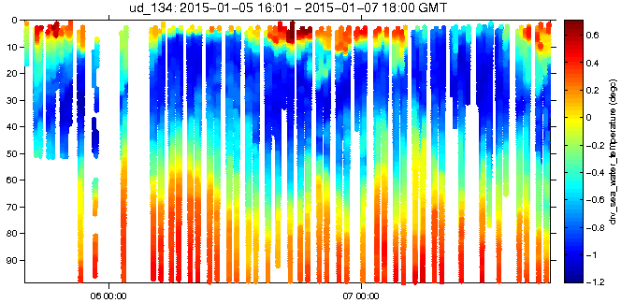
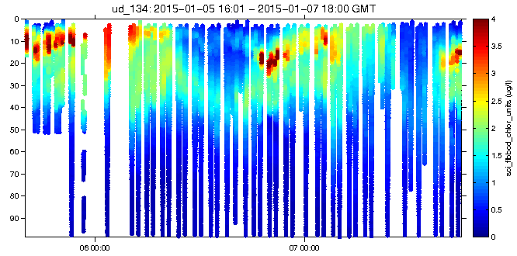
University Of Delaware
The Blue Hen
Temperature
Chlorophyll

Slide 16
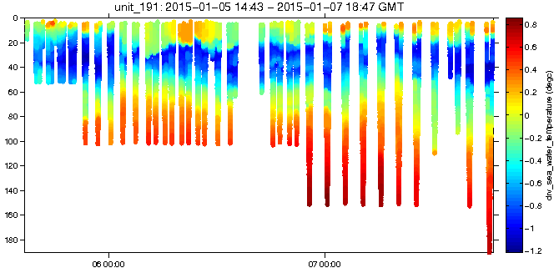
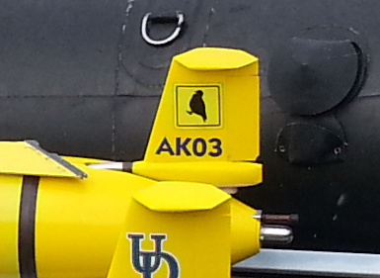
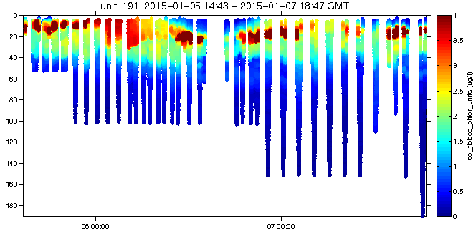
University Of Alaska
The Noble Sheathbill
Temperature
Chlorophyll

Slide 17
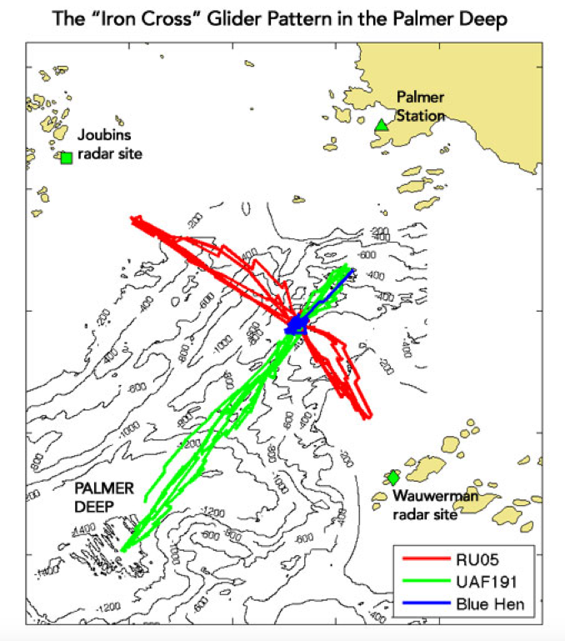
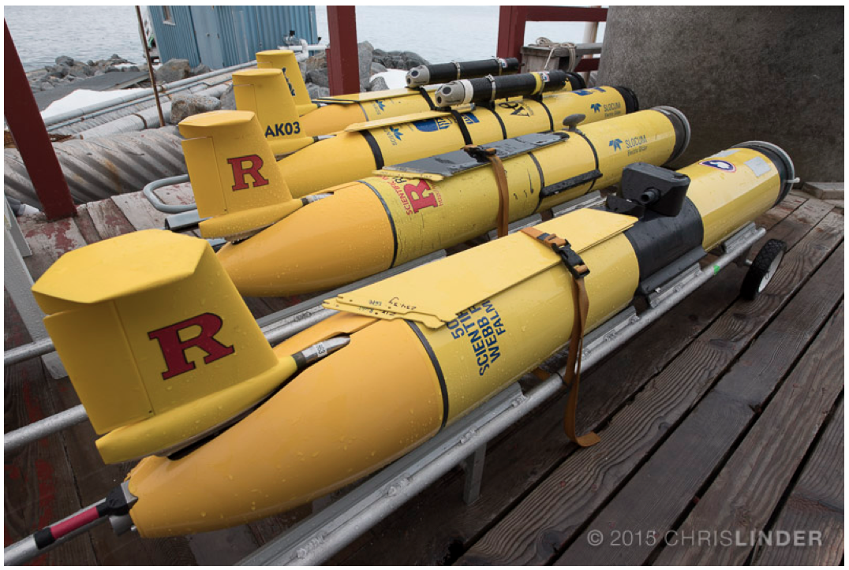

Slide 18
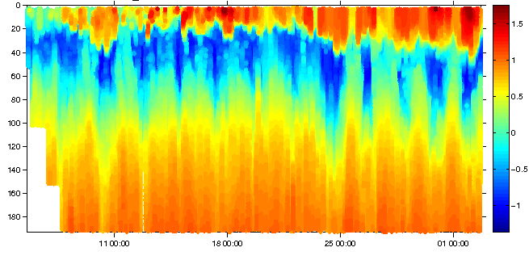
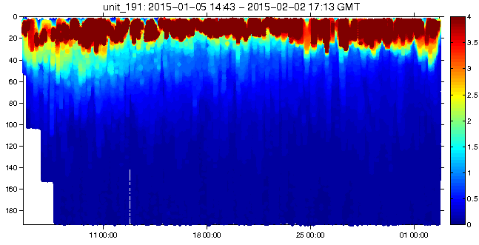
Along Canyon Line
Temperature
Chlorophyll

Slide 19
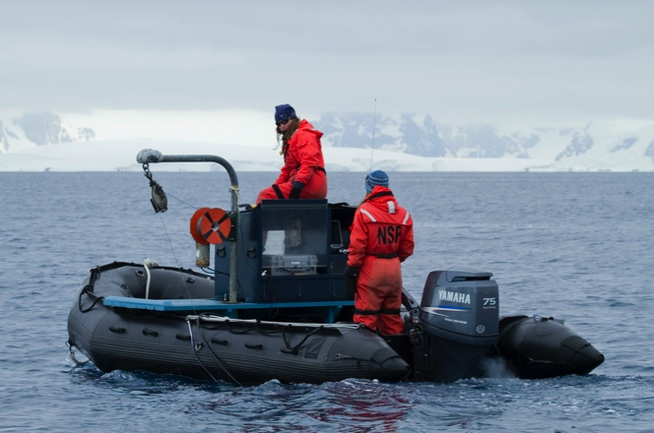
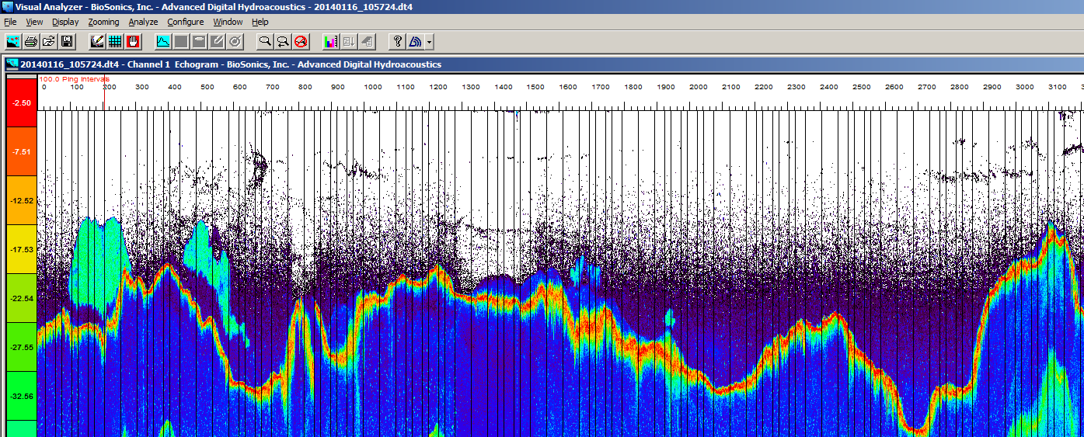
Small Boat Surveys
(Zooplankton - Krill)

Slide 20
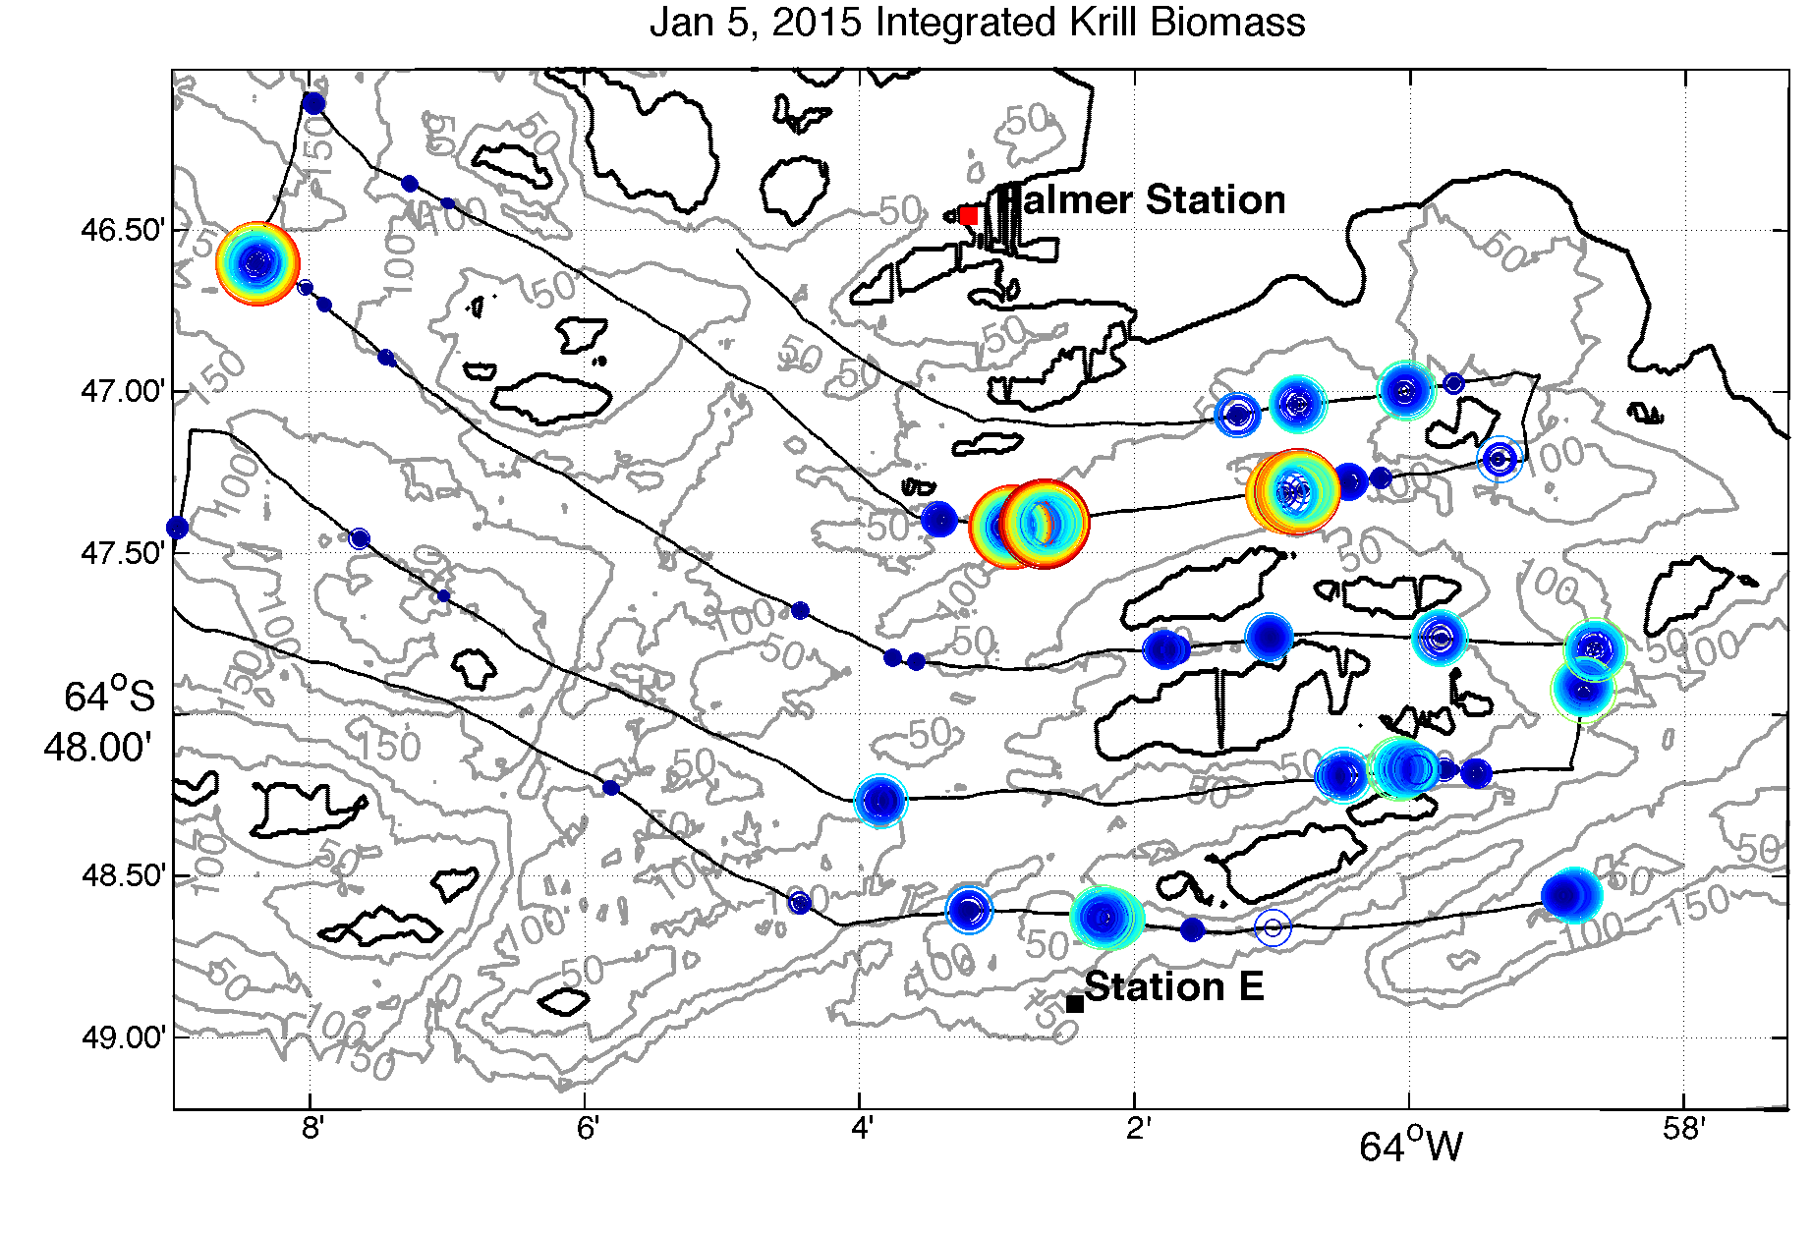
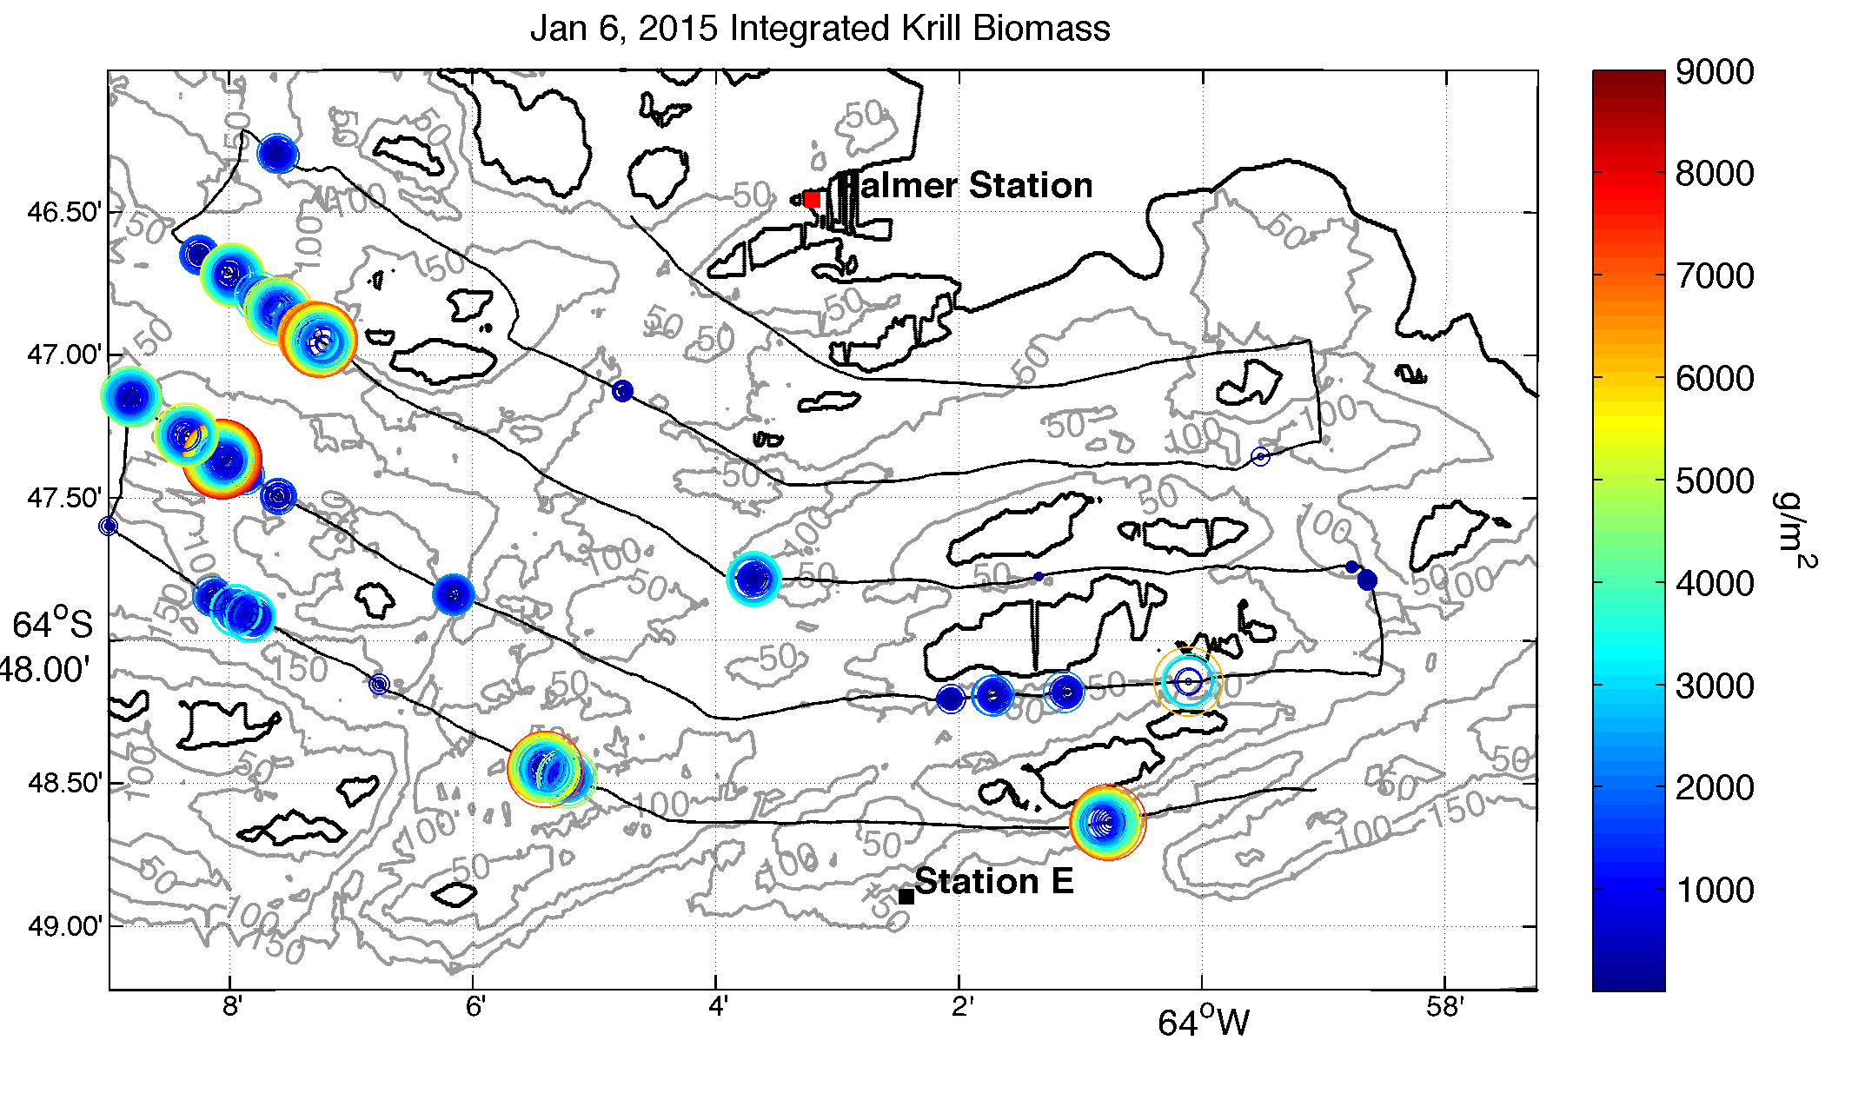
Small Boat Surveys
(Temperature, Salinity, Phytoplankton
And Krill)

Slide 21
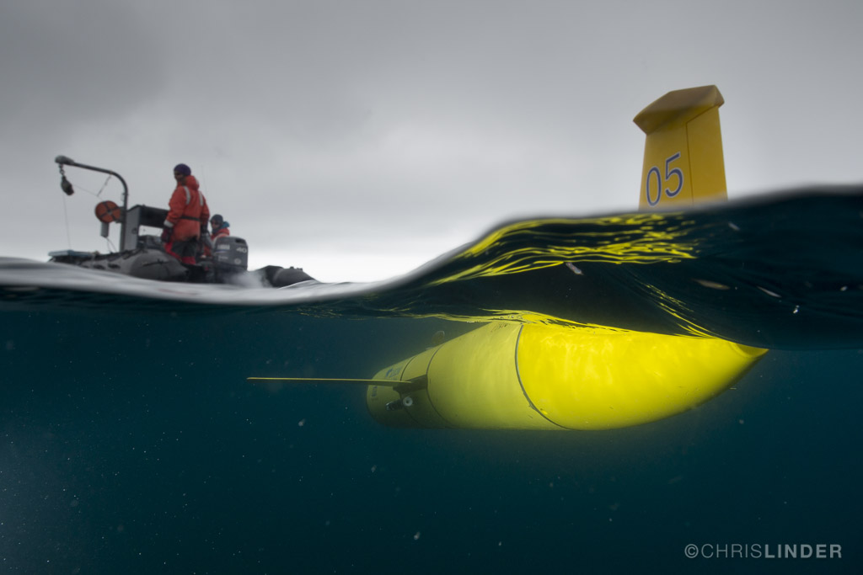
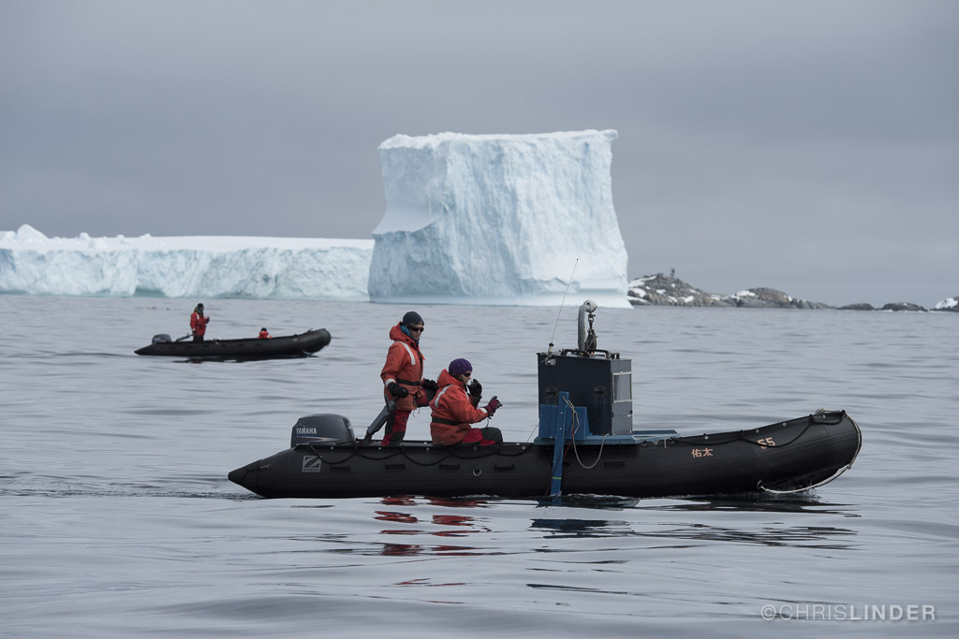
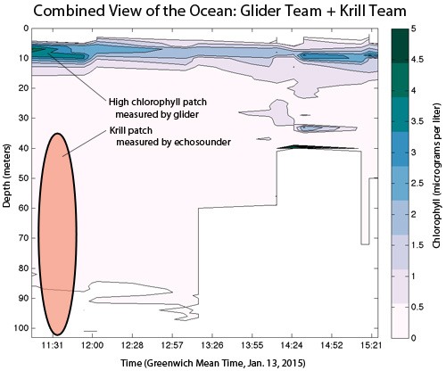

Slide 22
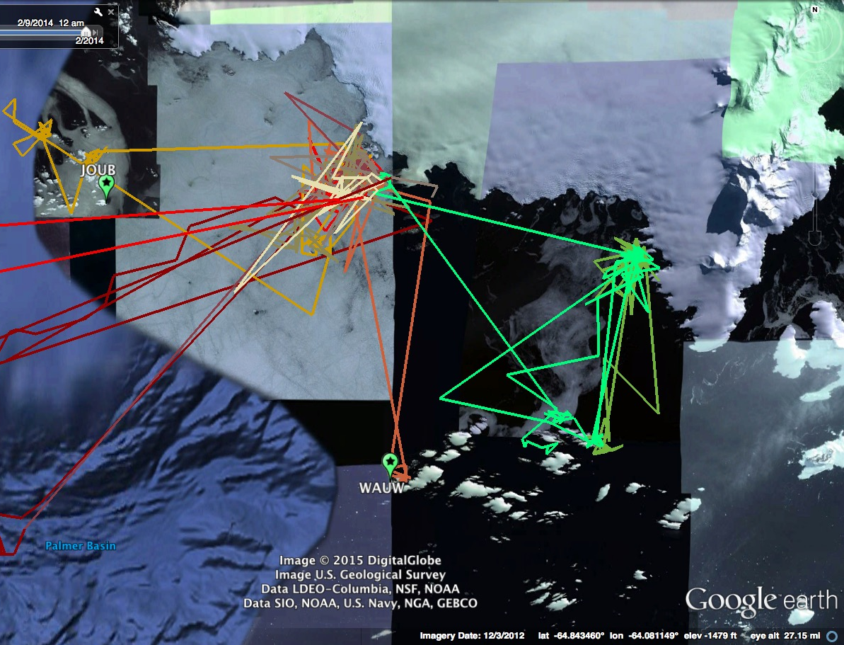

Slide 23
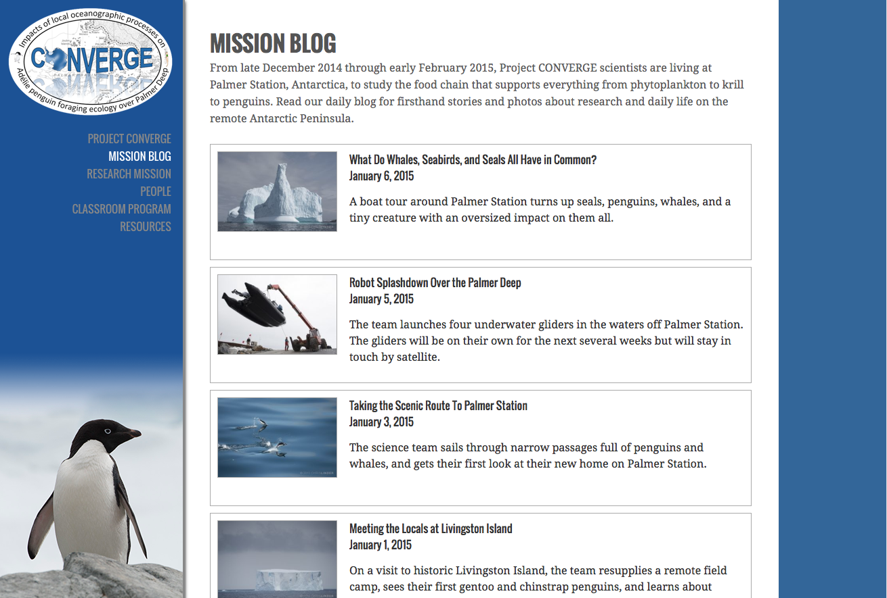
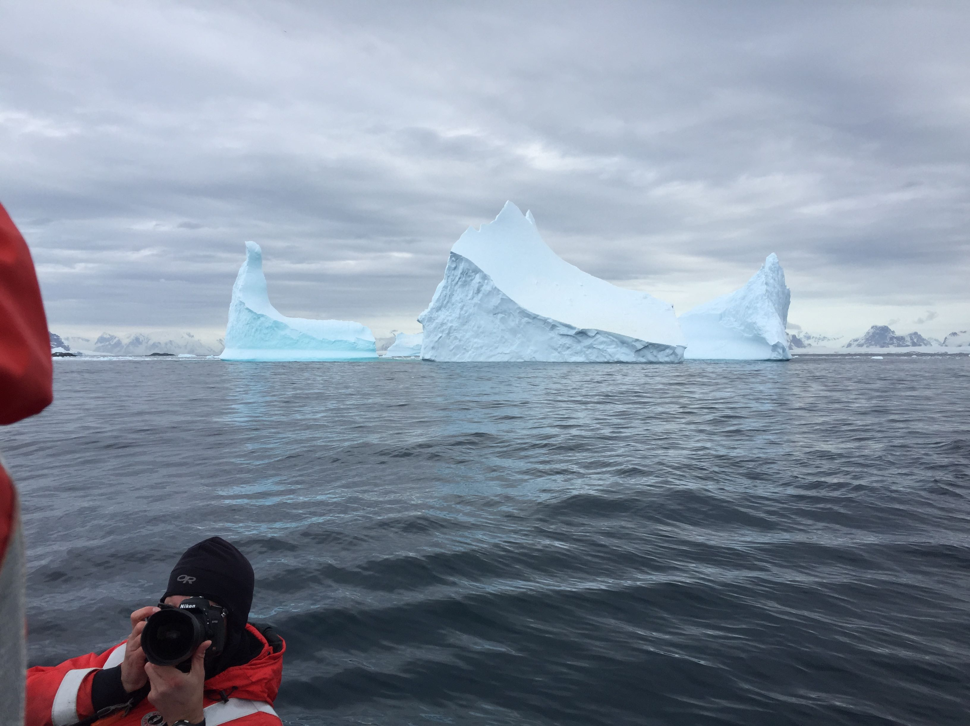
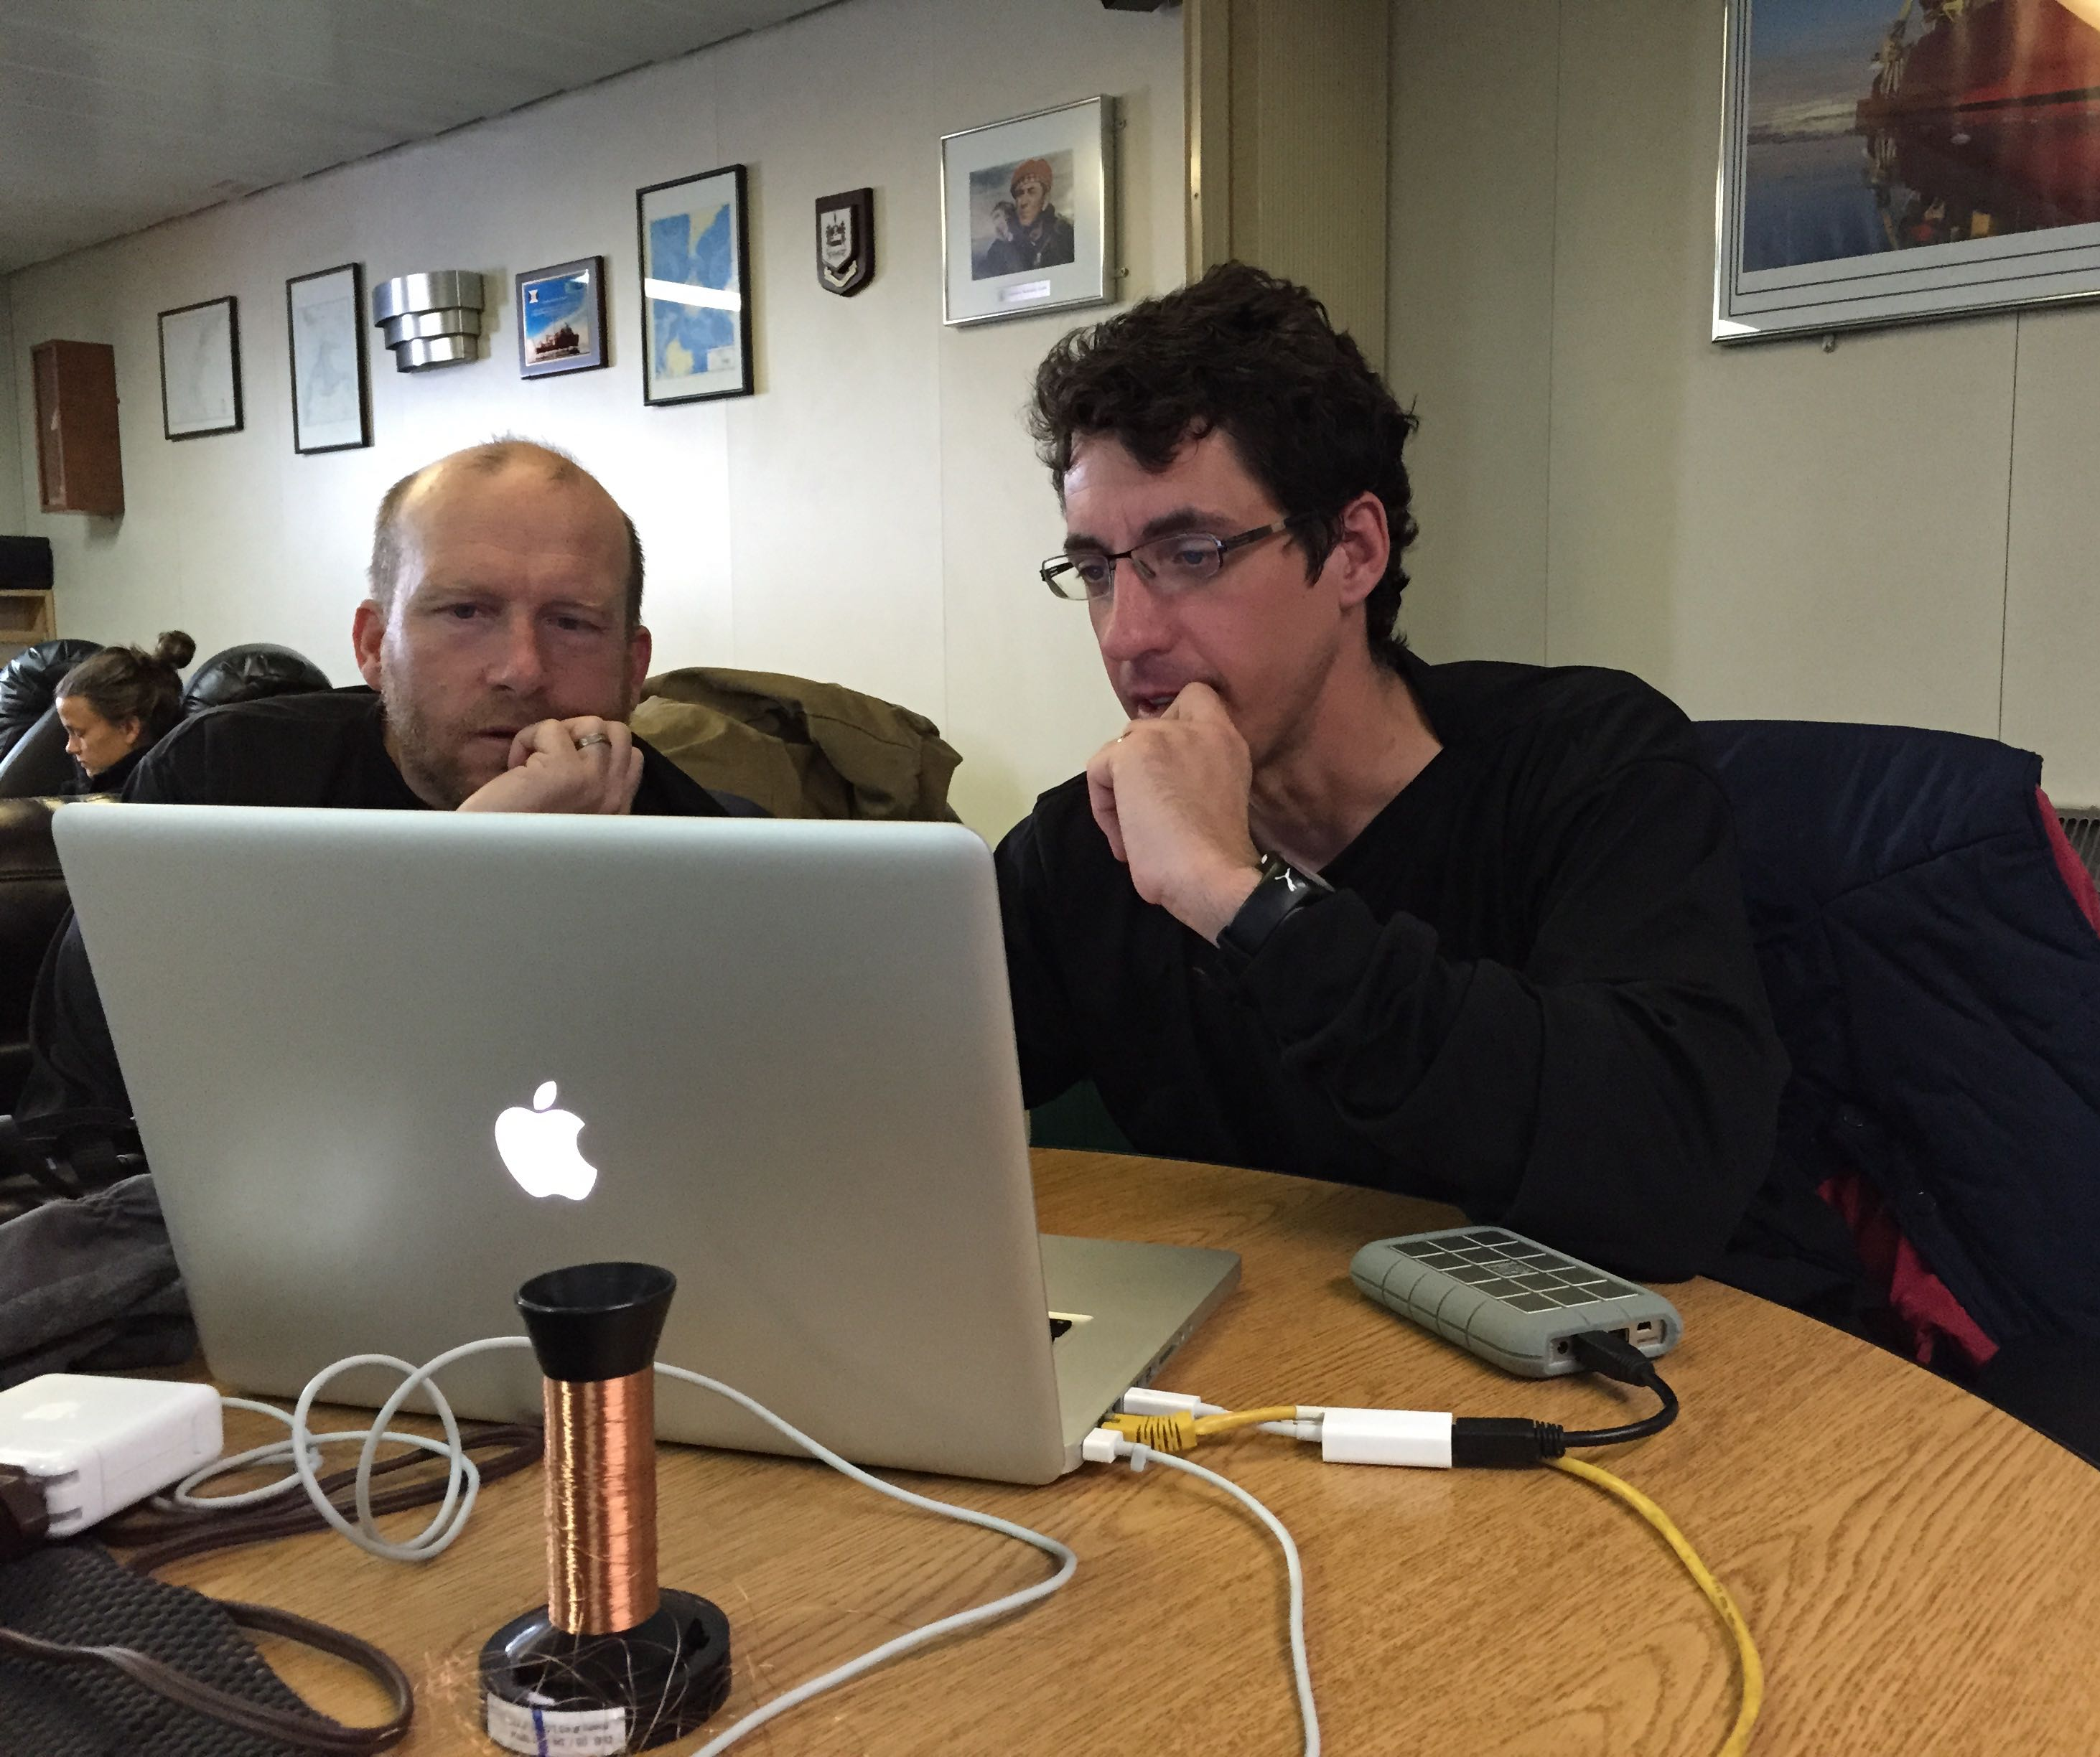
http://coseenow.net/converge

Slide 24
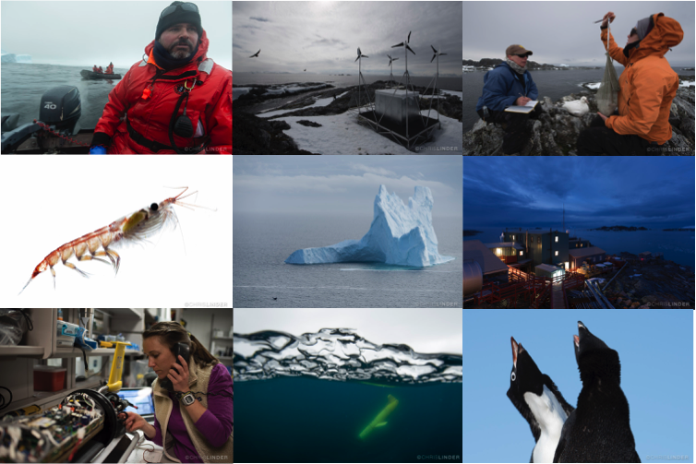
Broader Impacts 12 VTCs Research Blog

Slide 25
