Slide 1
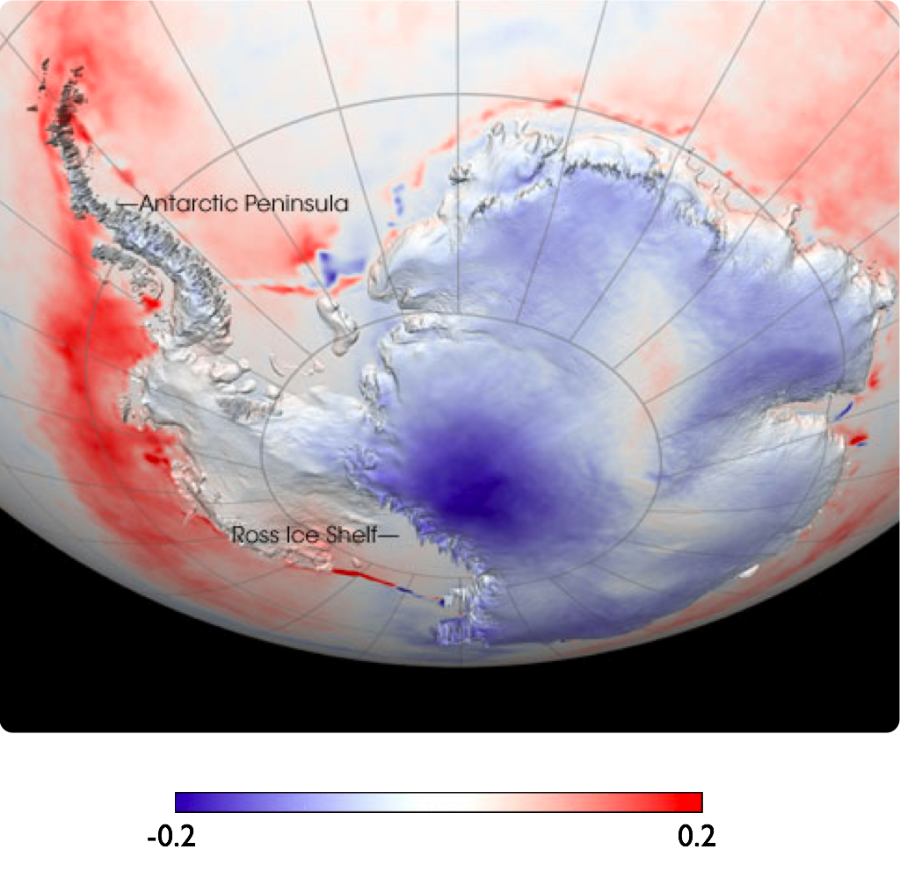
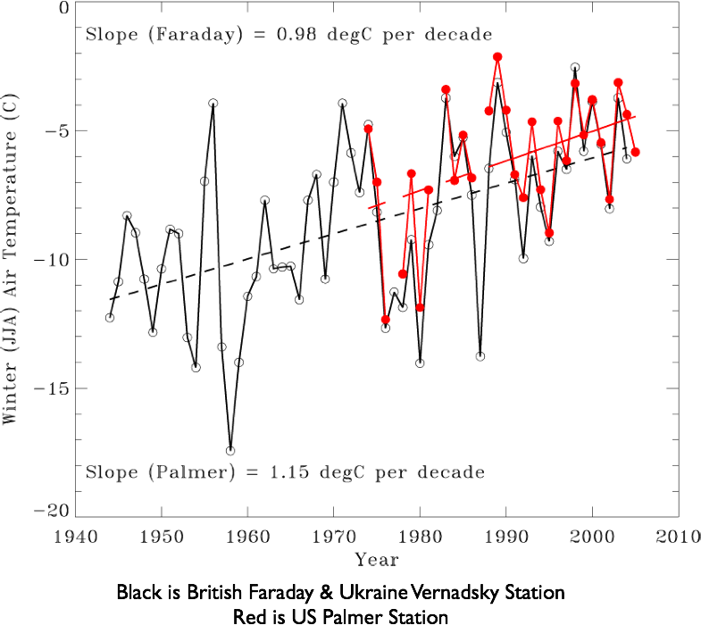
-0.2
Temperature trends per year
0.2

Slide 2
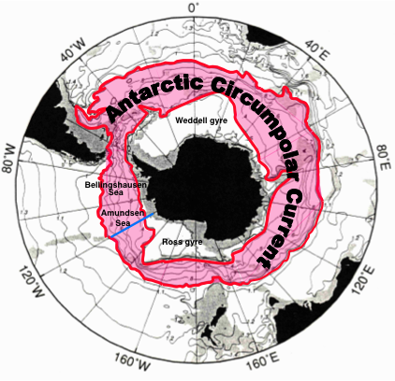

Slide 3
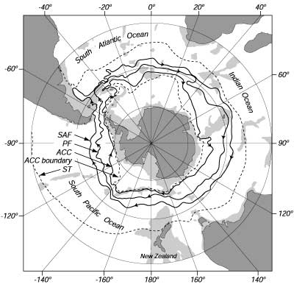

Slide 4
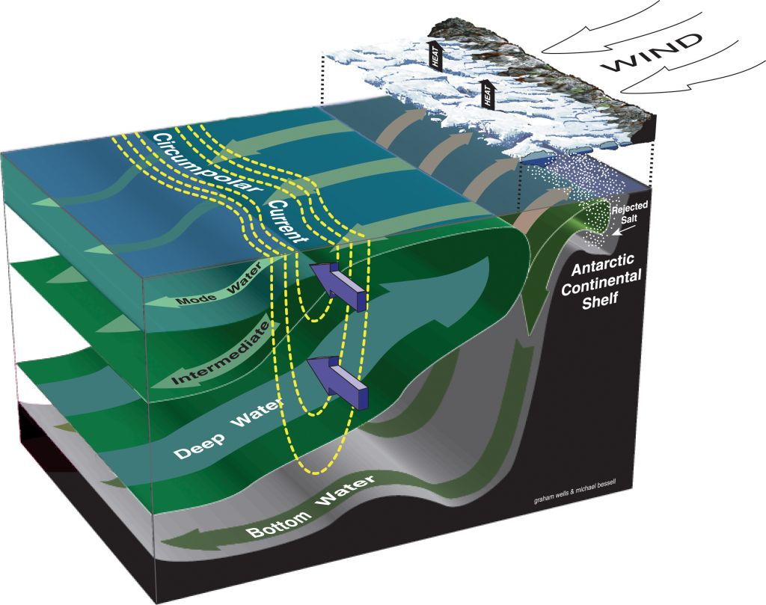

Slide 5
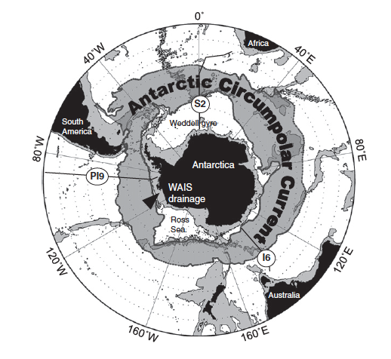
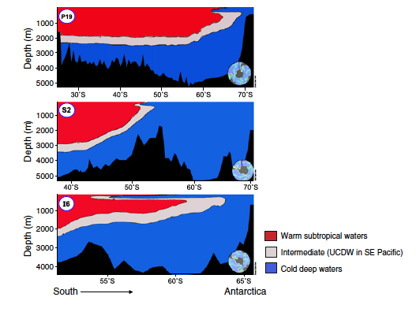

Slide 6
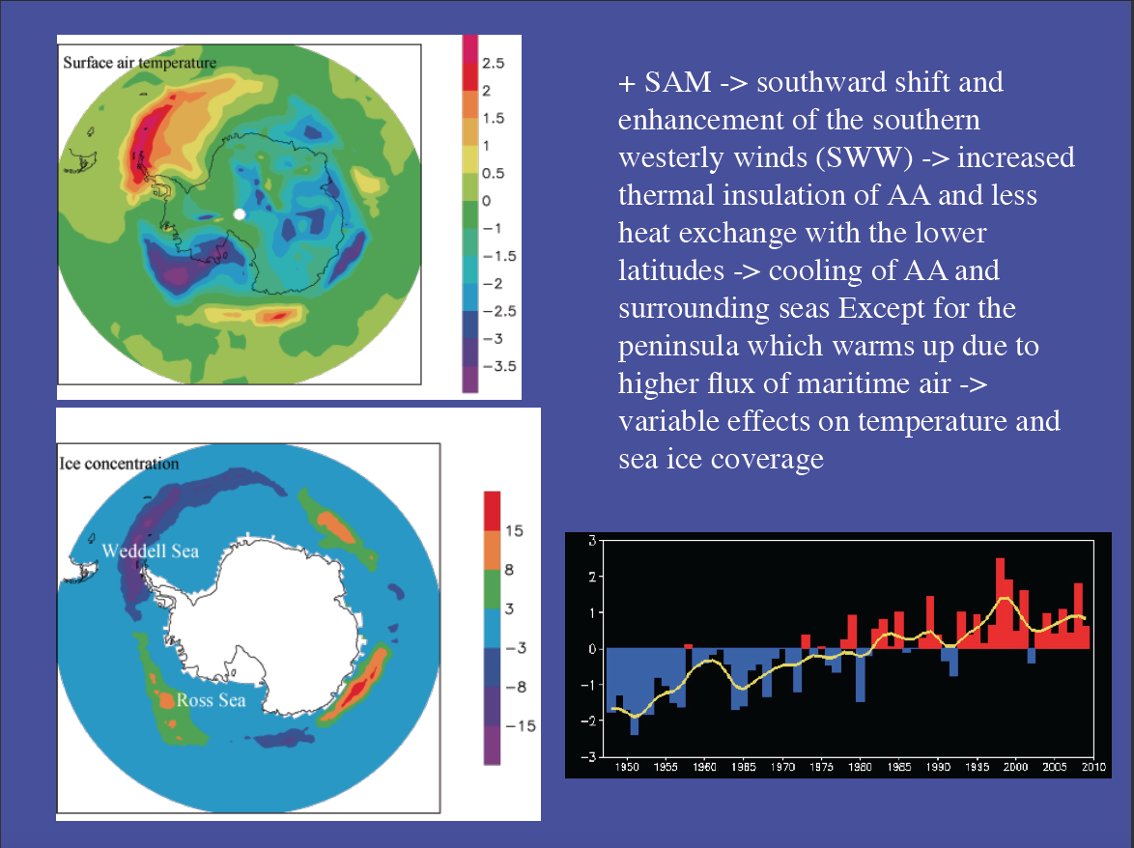

Slide 7
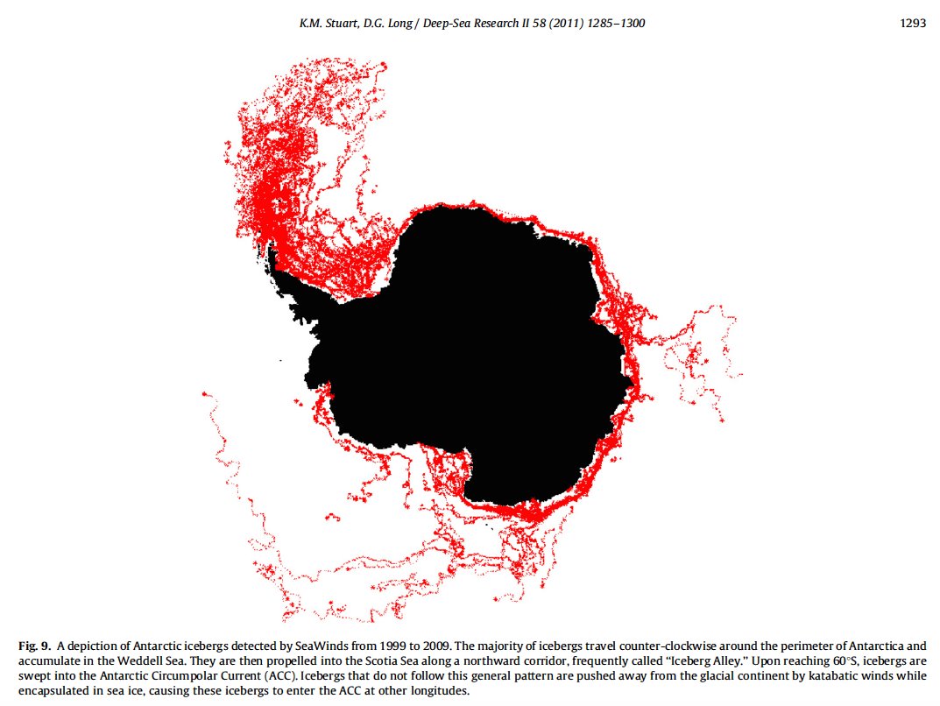

Slide 8
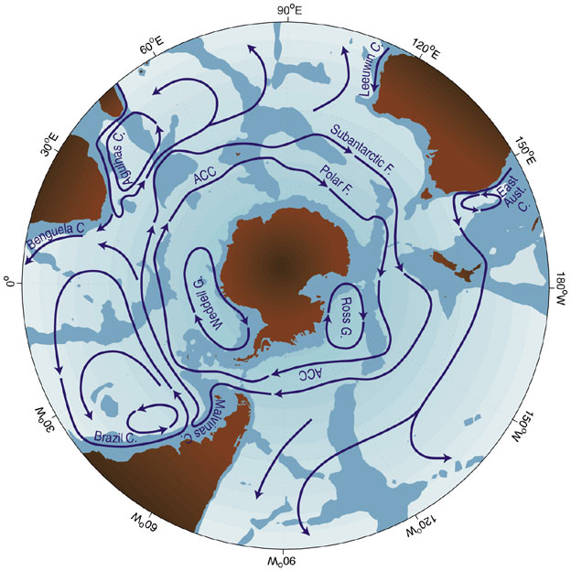

Slide 9
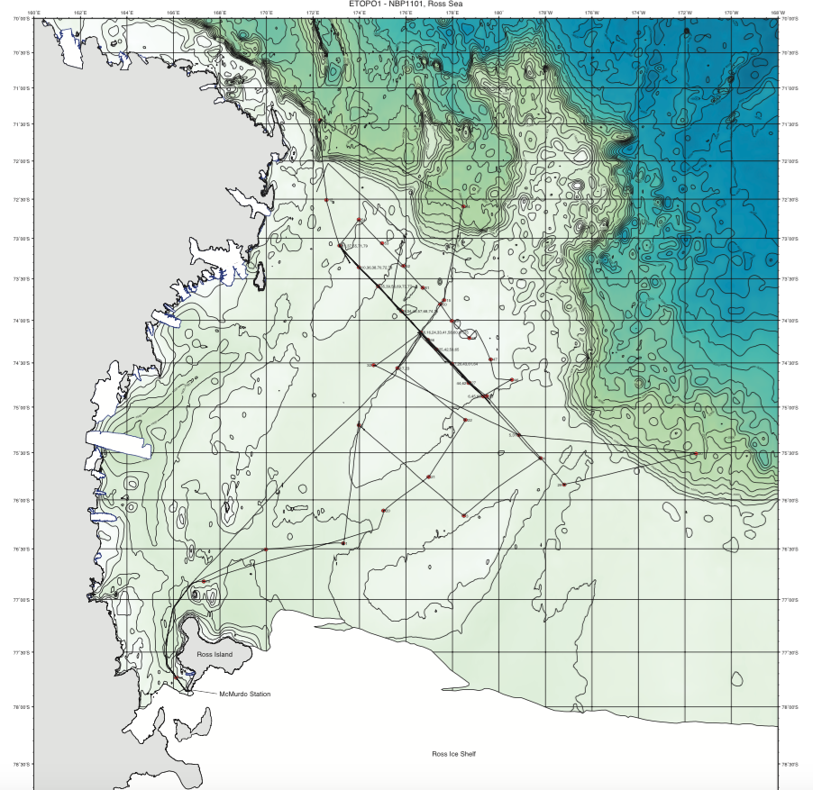

Slide 10
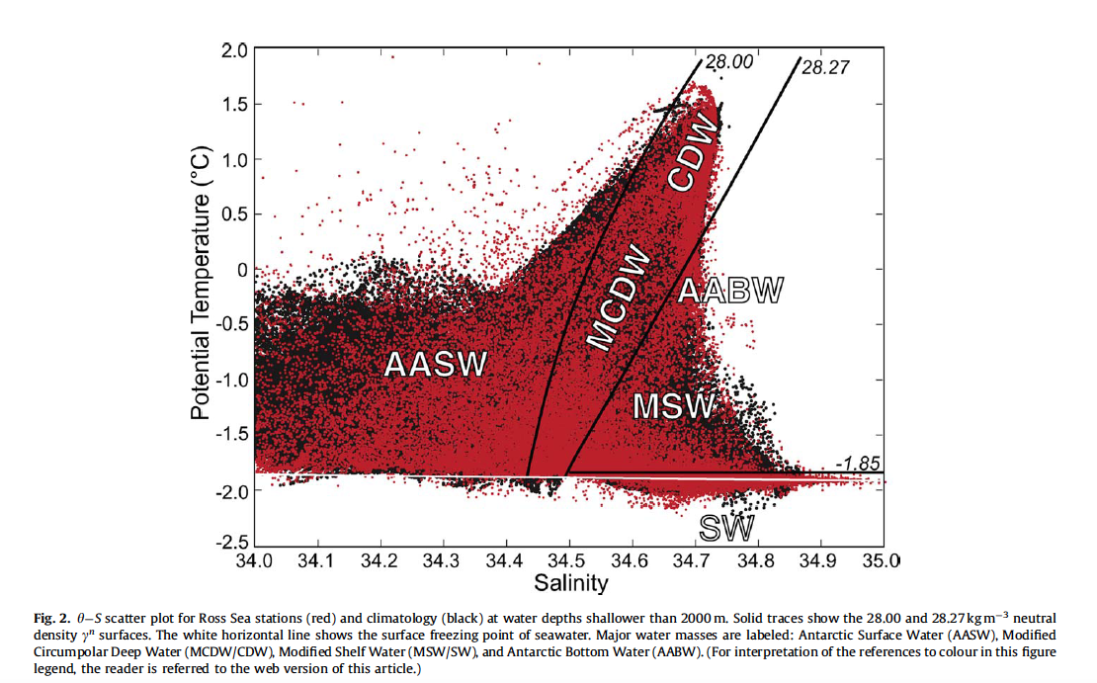

Slide 11
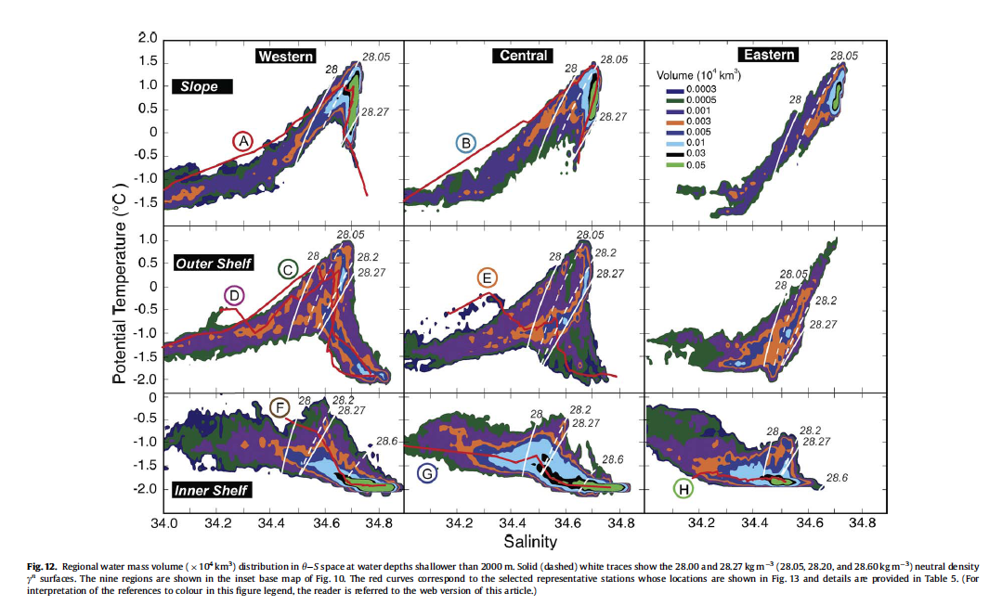

Slide 12
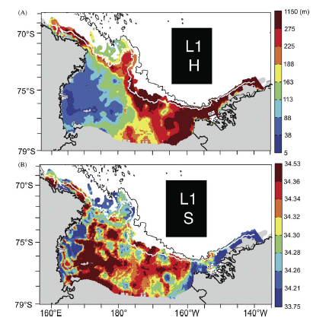

Slide 13
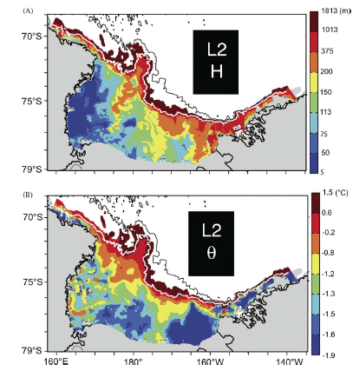

Slide 14
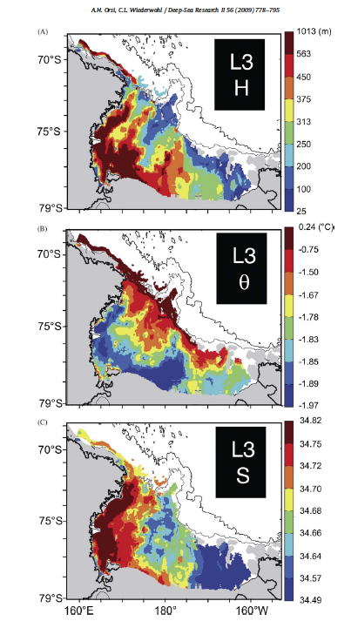

Slide 15
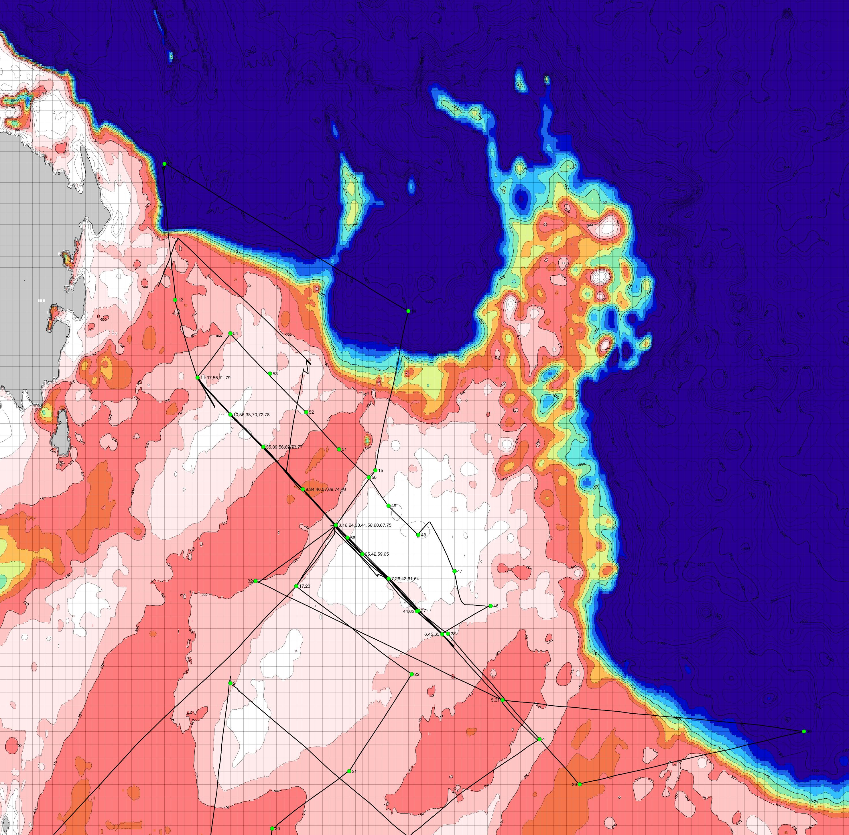
Across-Bank Sections
CTD Stations
8 Sections

Slide 16
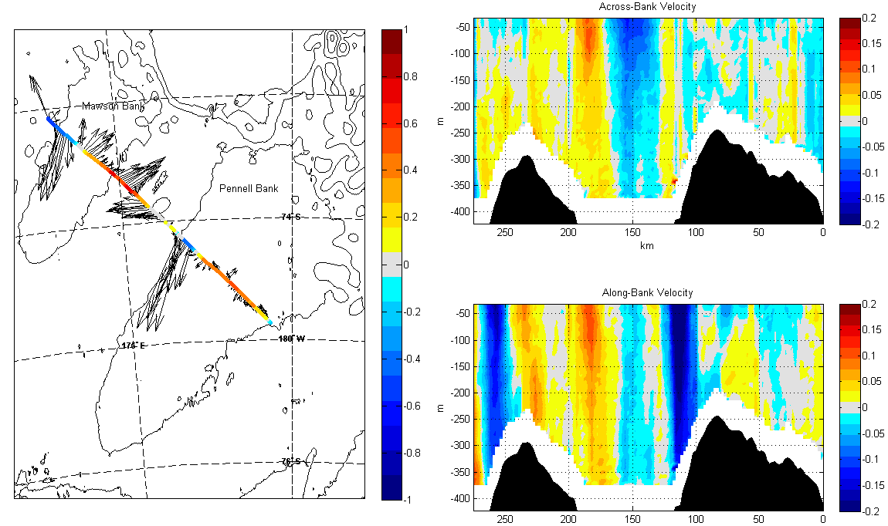
Across-Bank Sections
ADCP Velocity (m/s)
Sediment Characteristics
See Lam et al.: Poster #660 for more details
Clay Silty (ooze) Sandy Poorly Sorted

Slide 17
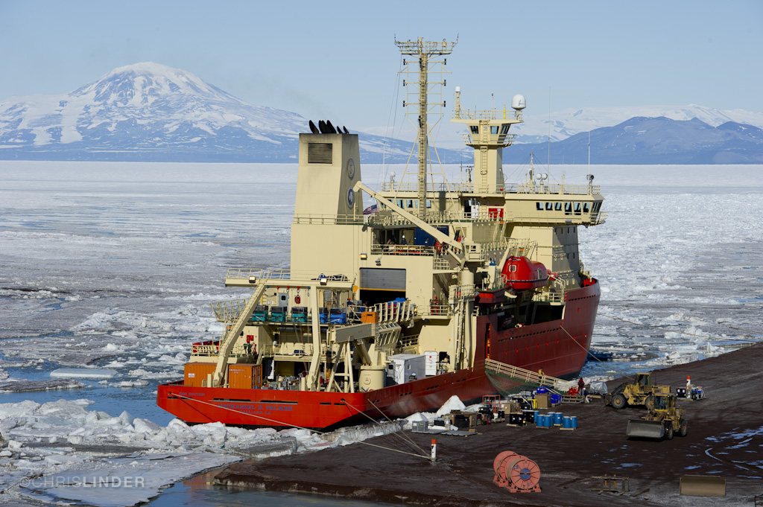
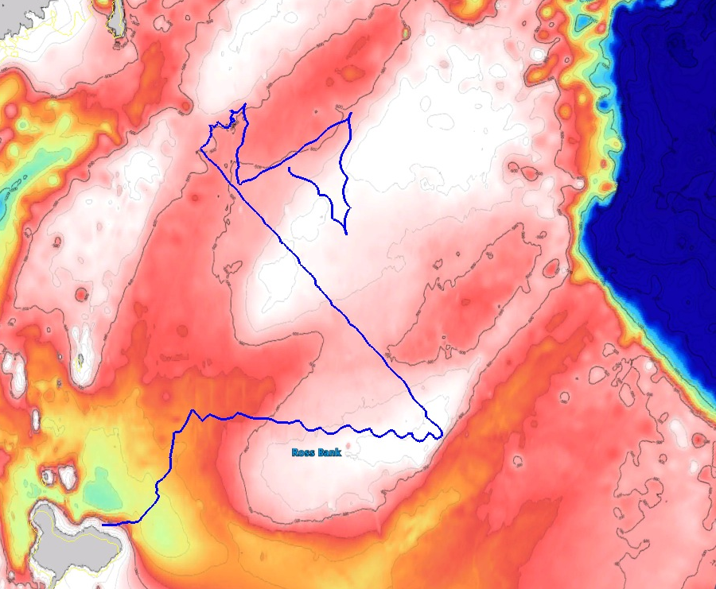
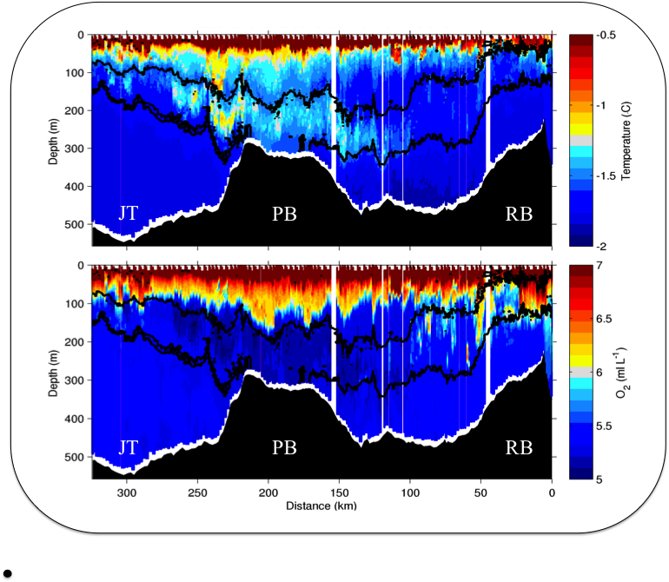
Deep Glider Mapping of Ross Sea Water Masses
Cross bank section identifies peak MCDW

Slide 18
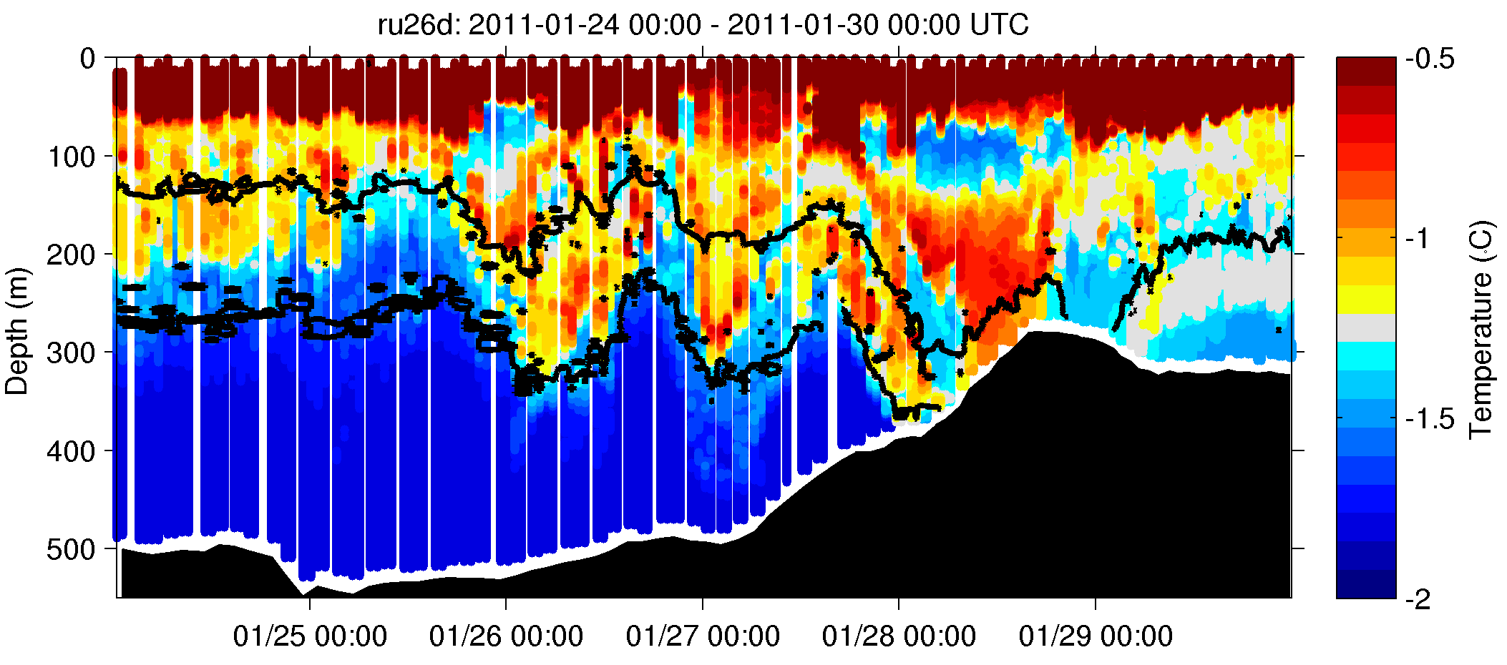
Small Scale Water Mass Variations (Time and Space)
Oregon Tide Model Driver

Slide 19
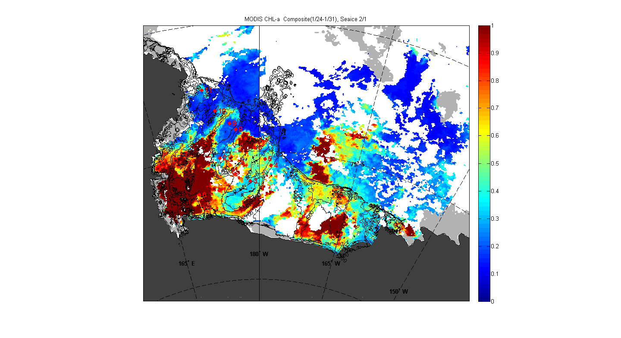
Chlorophyll Concentration
Across the Banks

Slide 20
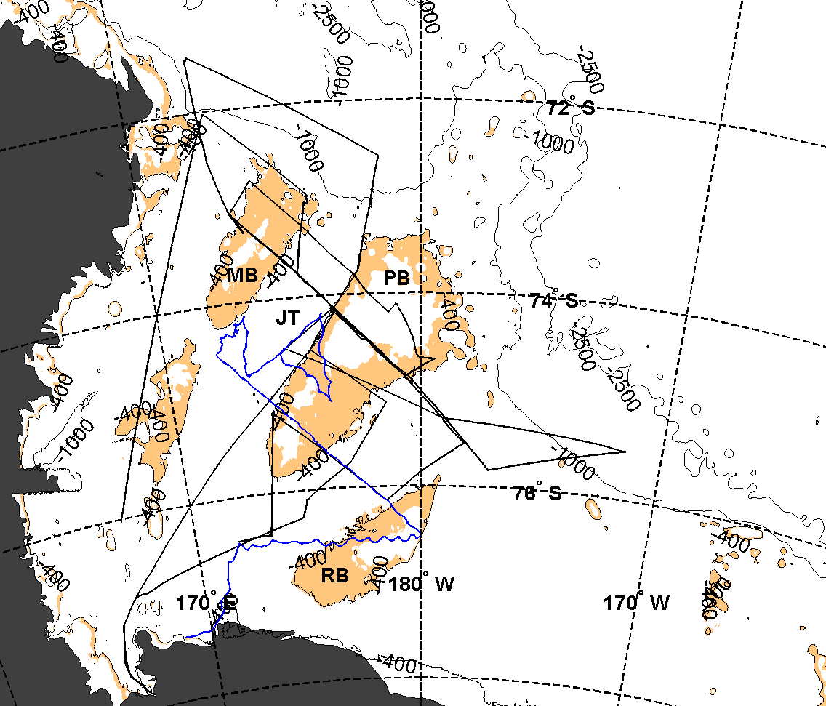
Dynamic Constraint on MCDW
at Mooring Location
(f/H)

Slide 21
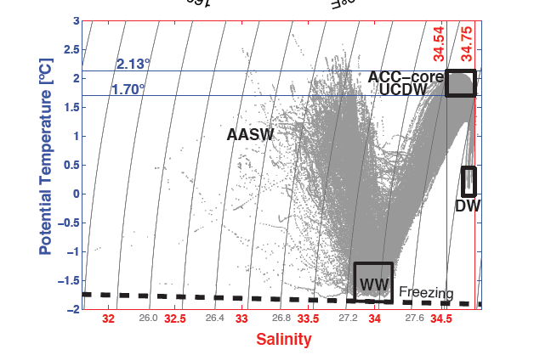

Slide 22
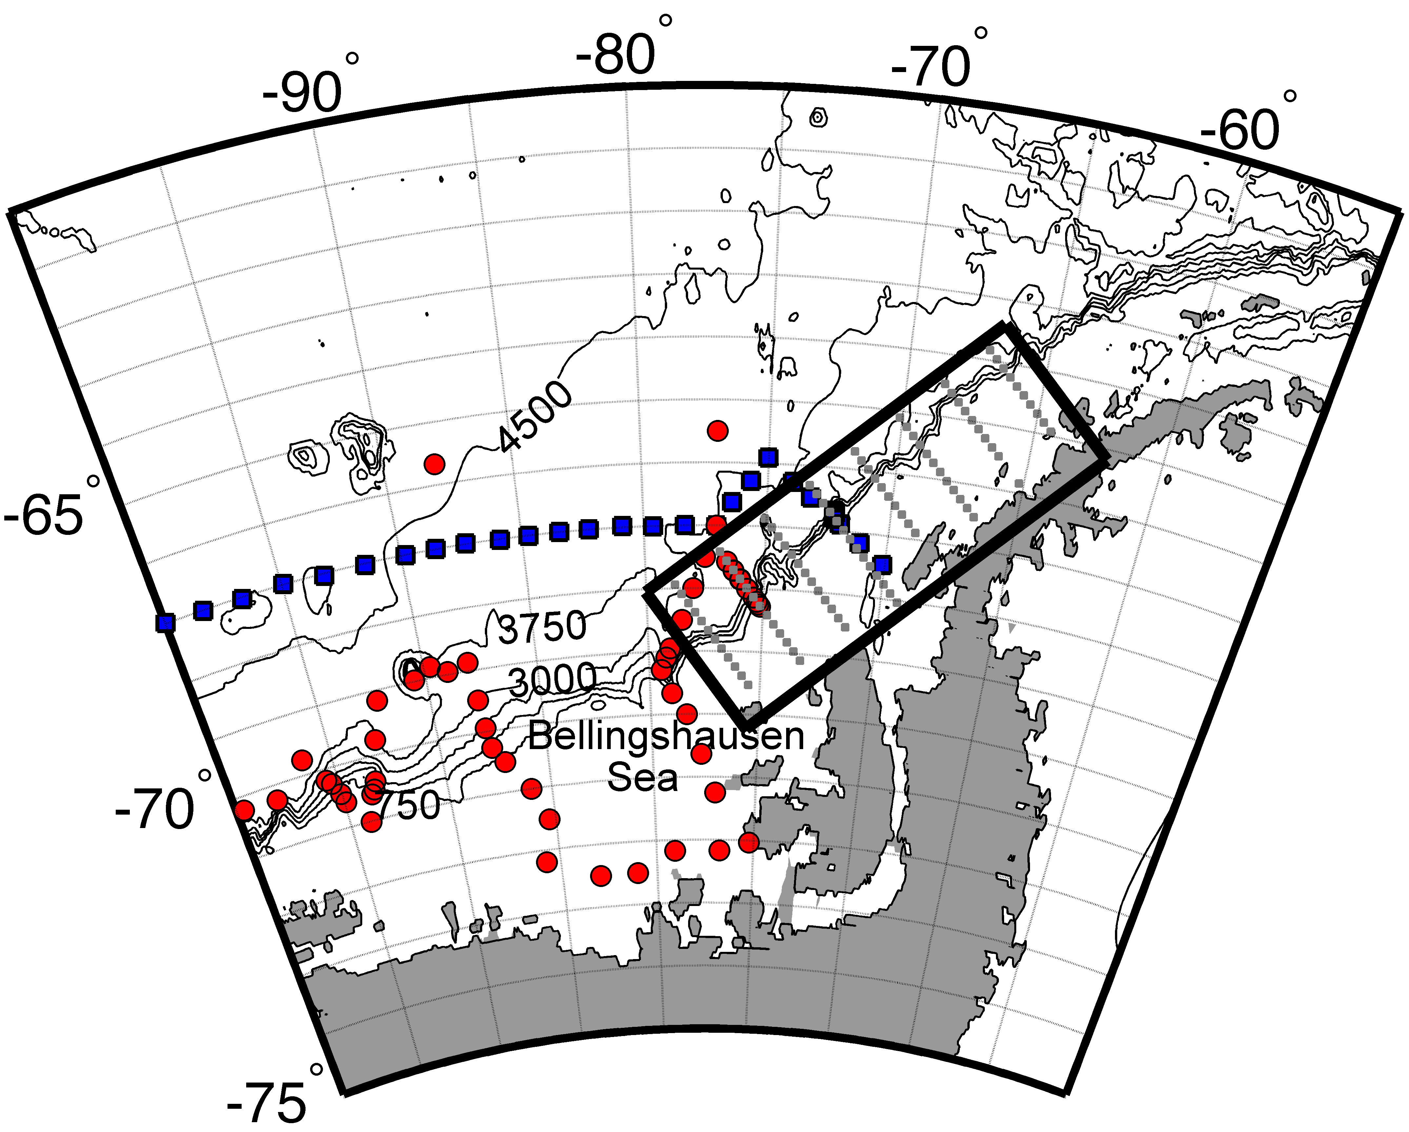
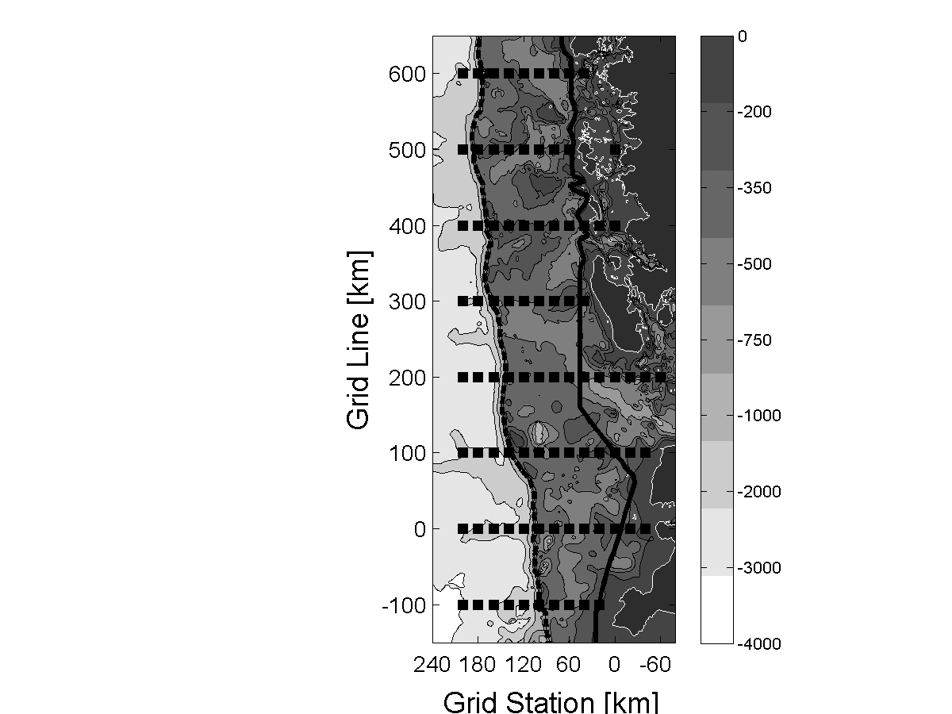
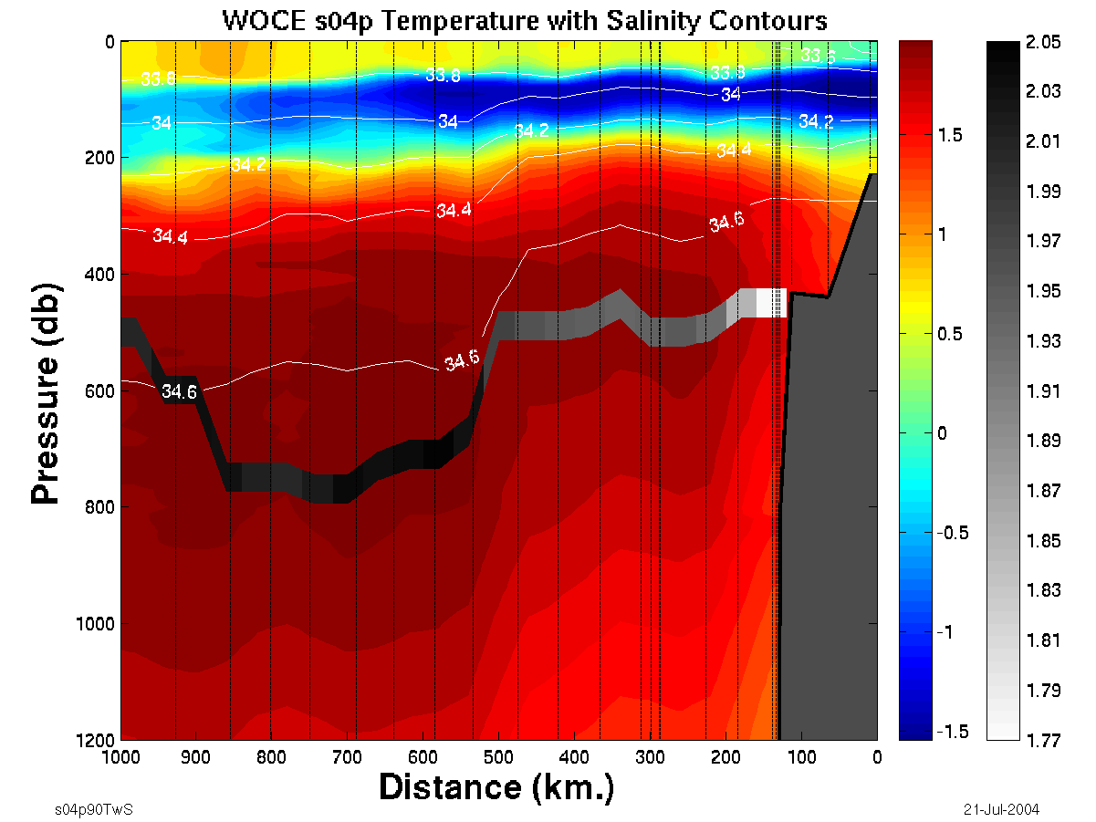
Depth (m)
An
PAL LTER Grid (1992-present)
WOCE S04P: WAP ACC (February 1992)
NBP94-04: Bellingshausen Slope (March 1994)
COAST
R
8
L
8
7
10
Ad
Antarctic Peninsula
Marguerite
Trough
SHELF
Temperature along 200 line
MB
SLOPE
Depth (m)
shelf
T ˚C
Distance Offshore (km)
x
PO moorings (deployment date: 200x)
Notes:
Doug Martinson; Lamont-Doherty Earth Observatory, Columbia University
22
Doug Martinson; Lamont-Doherty Earth Observatory, Columbia University
22
In an effort to help determine the mechanisms by which the warm UCDW is delivered to the continental shelf waters, I have deployed a set of 5 moorings (2 recently lost, but one reconfigured, so we now only have 4, and will only have 3 after this next cruise).
Regardless, there are a number of competing ideas for the mechanisms of delivery:
We know Marguerite trough is a conduit by which nearly pure UCDW makes it way into Marguerite Bay, and one idea is that the UCDW overflows the trough walls during its dynamically driven journey, flooding onto the shelf (like overflowing a bathtub)
People have suggested shelf-wide flooding events by meanders in the ACC
Area is an upwelling region, and dynamic uplift of ACC isopycnals delivers UCDW warm core to shelf floor depth for easy upwelling onto shelf
Eddies or other transient events from slope-shelf break (common form of exchange)
Note that the WOCE S04P line originated along our "200" line and then ran offshore to New Zealand, allowing us an opportunity to relate the shelf waters to the waters of the open ocean (in particular, the core ACC waters).

Slide 23
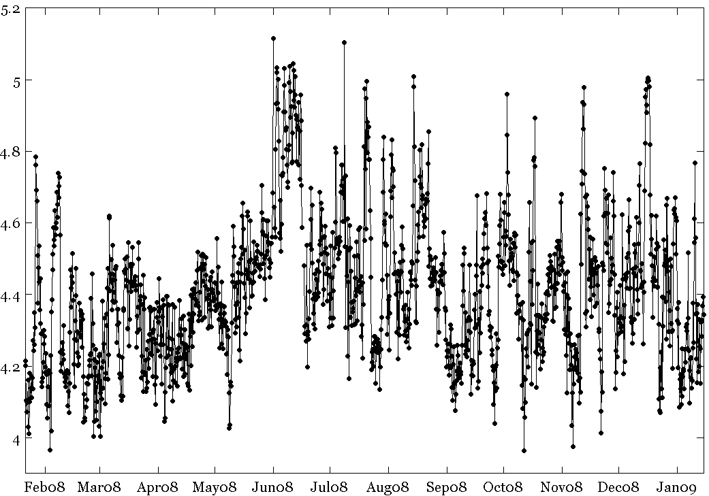
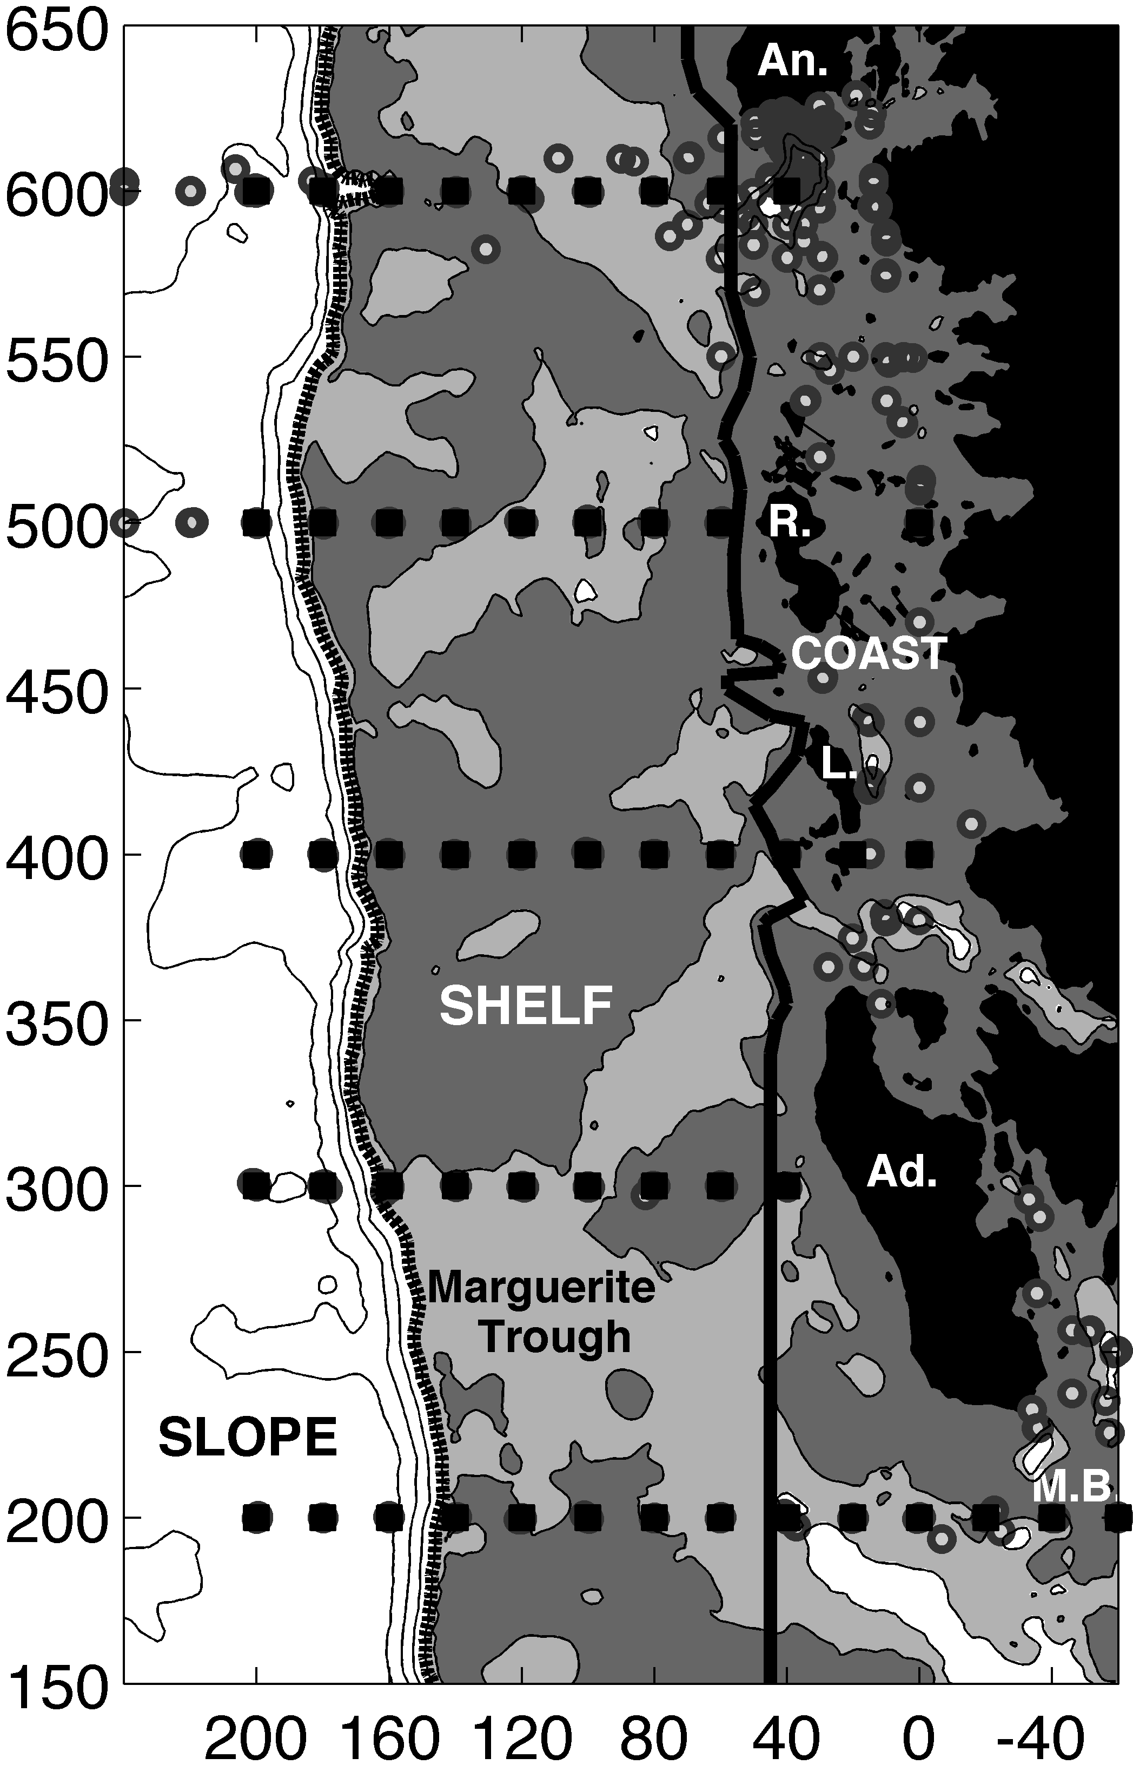
Available ocean heat (Q): 300.100
7
Q (x10⁹ Jm^{–2})
8
8
8
7
8
Notes:
I have actually reported to you from preliminary analyses previously that the first two ideas are not happening from our 2008 mooring data. So here I want to focus on the main unknown one, about eddies, so consider here the time series of the eat content recorded by the 300.100 mooring as shown here.
He signal is quite noisy so we apply a filter (the lowest order mode of an EOF analysis).

Slide 24
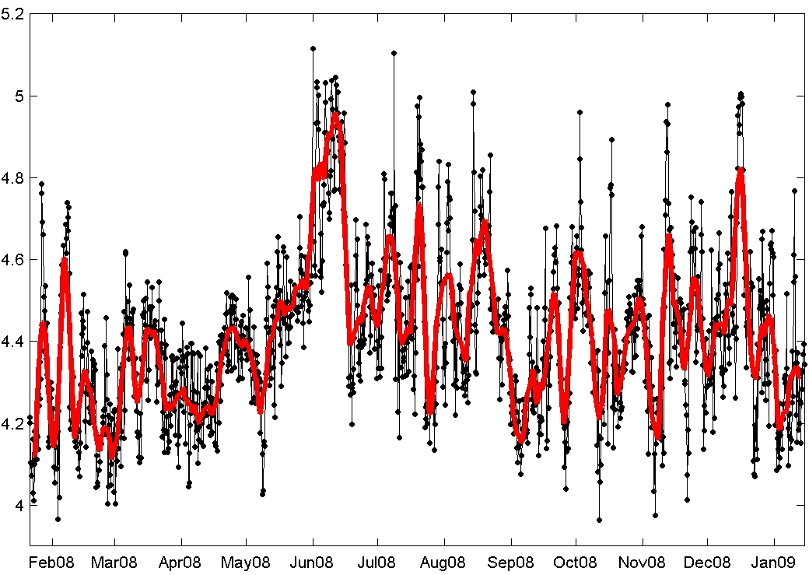
7
Mooring: 300.100 heat content, 2008
Estimate of signal via
Karhunen-Loéve (1st mode): ~56%
7
12
8
10
11
1
2
9
3
4
6
5
Q (x10⁹ Jm^{–2})
Notes:
The EOF analysis (Karhunen-Loeve) is designed to find internally consistent signal within the time series, and the first mode, shown here in red does seem to do a good job of that.
Now, I want to look at the consistency with which the heat increases during the events that show dramatic increase in Q.
I fit a straight line to the slope of one such event, then replicated the slope and found that it fit at least 12 events (nearly every one).
This suggests to me that there is a consistent process driving or influencing each of these warming events.

Slide 25
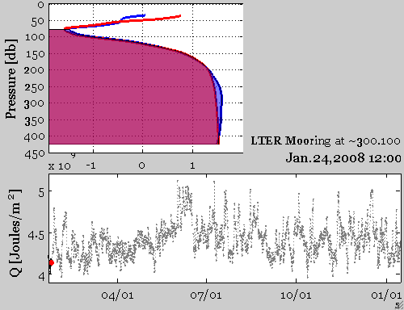
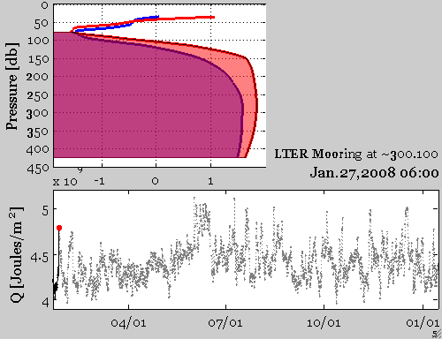

February ”transient" event #1
Notes:
Examination of the water column heat content for each profile during the start, middle and end of the vents shows that the entire water column shifted at the peak of the event and then relaxed to the original water column.
Clearly transient events, and eddies a likely culprit (they are known to develop at slope-shelf breaks).

Slide 26
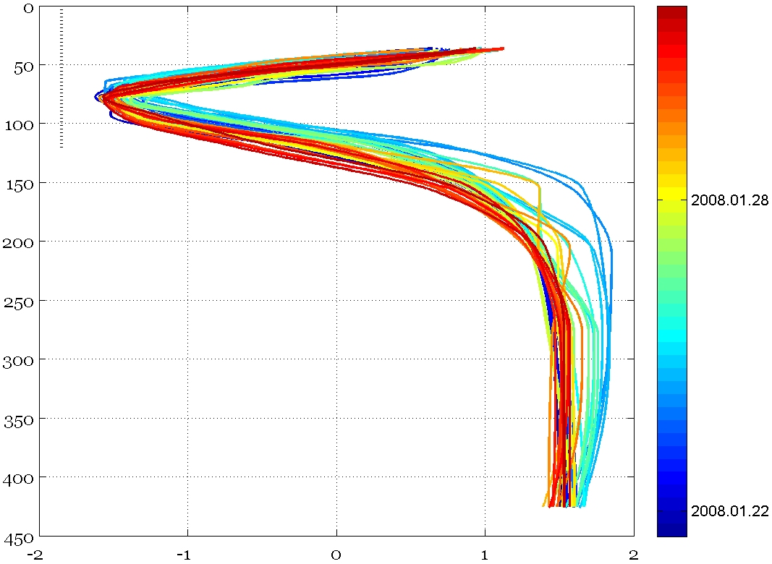
February ”transient" event
Transient
Date
Pressure db
Temperature ˚C
Notes:
Another view showing that the water column changes completely in the peak but relaxes back to the beginning.
Never do we see the warming of the profile begin at the bottom (expected if the warming was from overflowing of the trough), hence my dismissal of the trough overflow hypothesis (though I have to recheck this for every year of data).

Slide 27
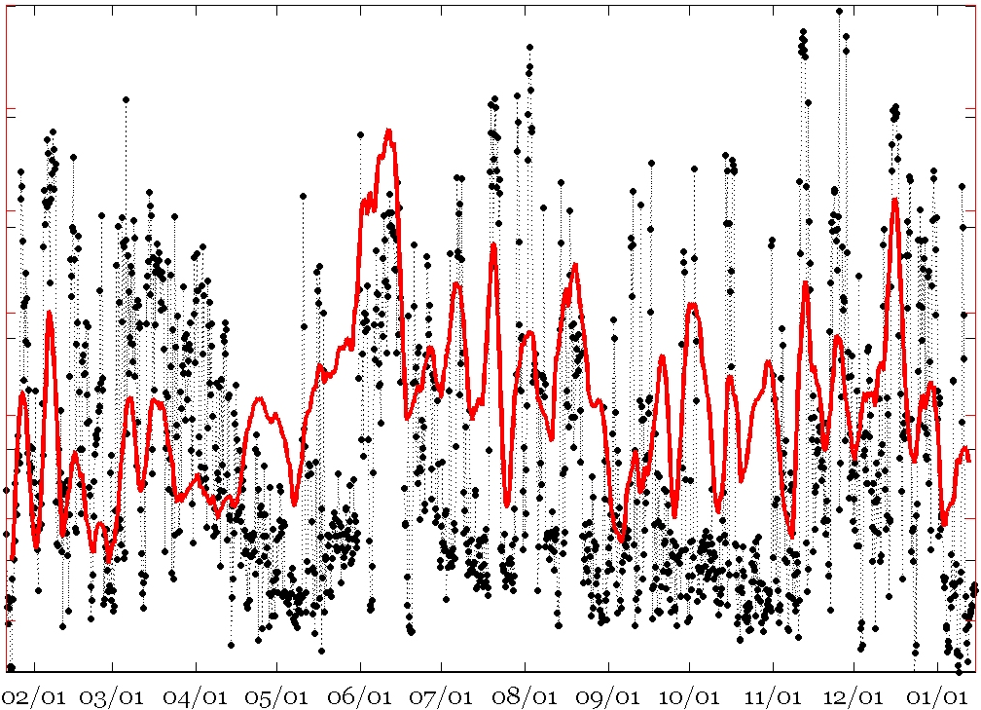
Eddies, based on T_{max} and Q transients (300.100)
5.2
2.0
7
∆
Identified from Q characteristics
and T_{max} values ( ~6.66 day)
5.0
1.9
T (˚C)
4.8
1.8
4.6
1.7
Q (x10⁹ Jm⁻²)
4.4
1.6
4.2
1.5
4.0
1.4
Month/day (2008)
Notes:
Specifically, we see that the change in Q is consistent in a number of transients in mooring Q, likely due to direct passage of the eddies of similar size and drift velocity over the mooring, situated at the trough edge. Clearly this would likely result from topographic steering of the eddies along the trough edge (also consistent with the low modal form of the eddies expected from the 2-layer water column stratification).
So consistent change and transient nature suggests eddies, but even more convincing is the fact that the core of each event is warm water that only exists at the slope where pure UCDW, as delivered by the ACC exists. Nowhere else in the grid is there water this warm.
In fact, from our T-S plots, pure UCDW delivered to the slope break by the ACC is water warmer than 1.7˚ C, and from this several more events enter the category of eddies. In fact the core waters are down right HOT, only possible by moving slugs of pure UCDW onto the shelf.
I am currently working out the estimated eddy heat flux by estimating drift rates (eddies at the slope correlate with those at mid shelf at a 33-day lag), and then assuming that all of the ΔT is dissipated in the region showing the largest fraction of UCDW.

Slide 28
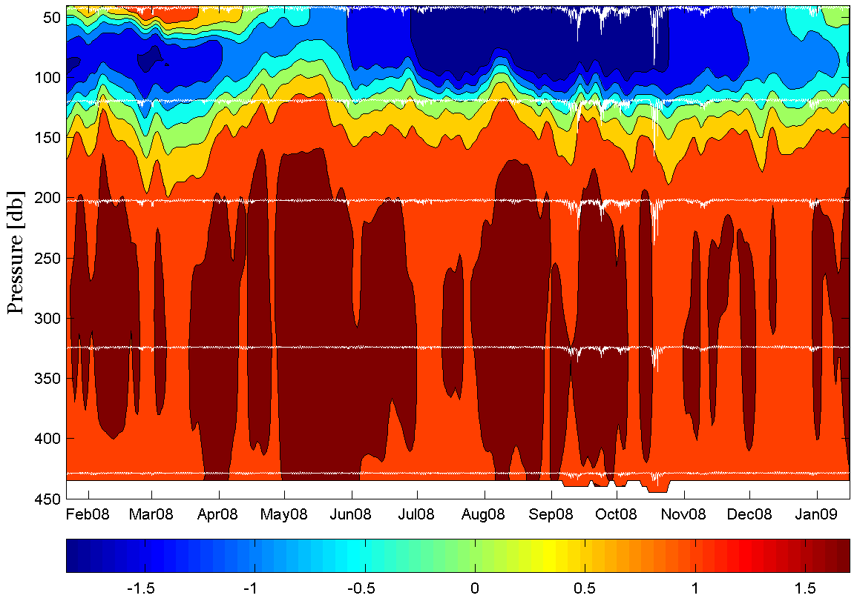
Temperature series (300.160)
T time-series
2
4
3
2
1
5
Notes:
28

Slide 29
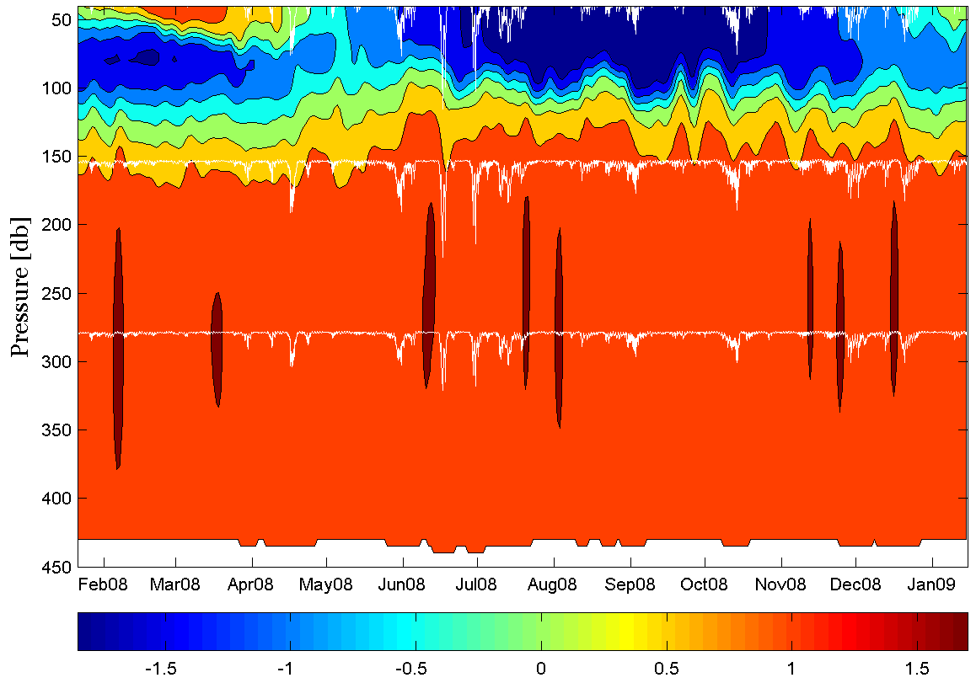
Temperature series (300.100)
1
T time-series
4
3
2
1
5
Notes:
29

Slide 30
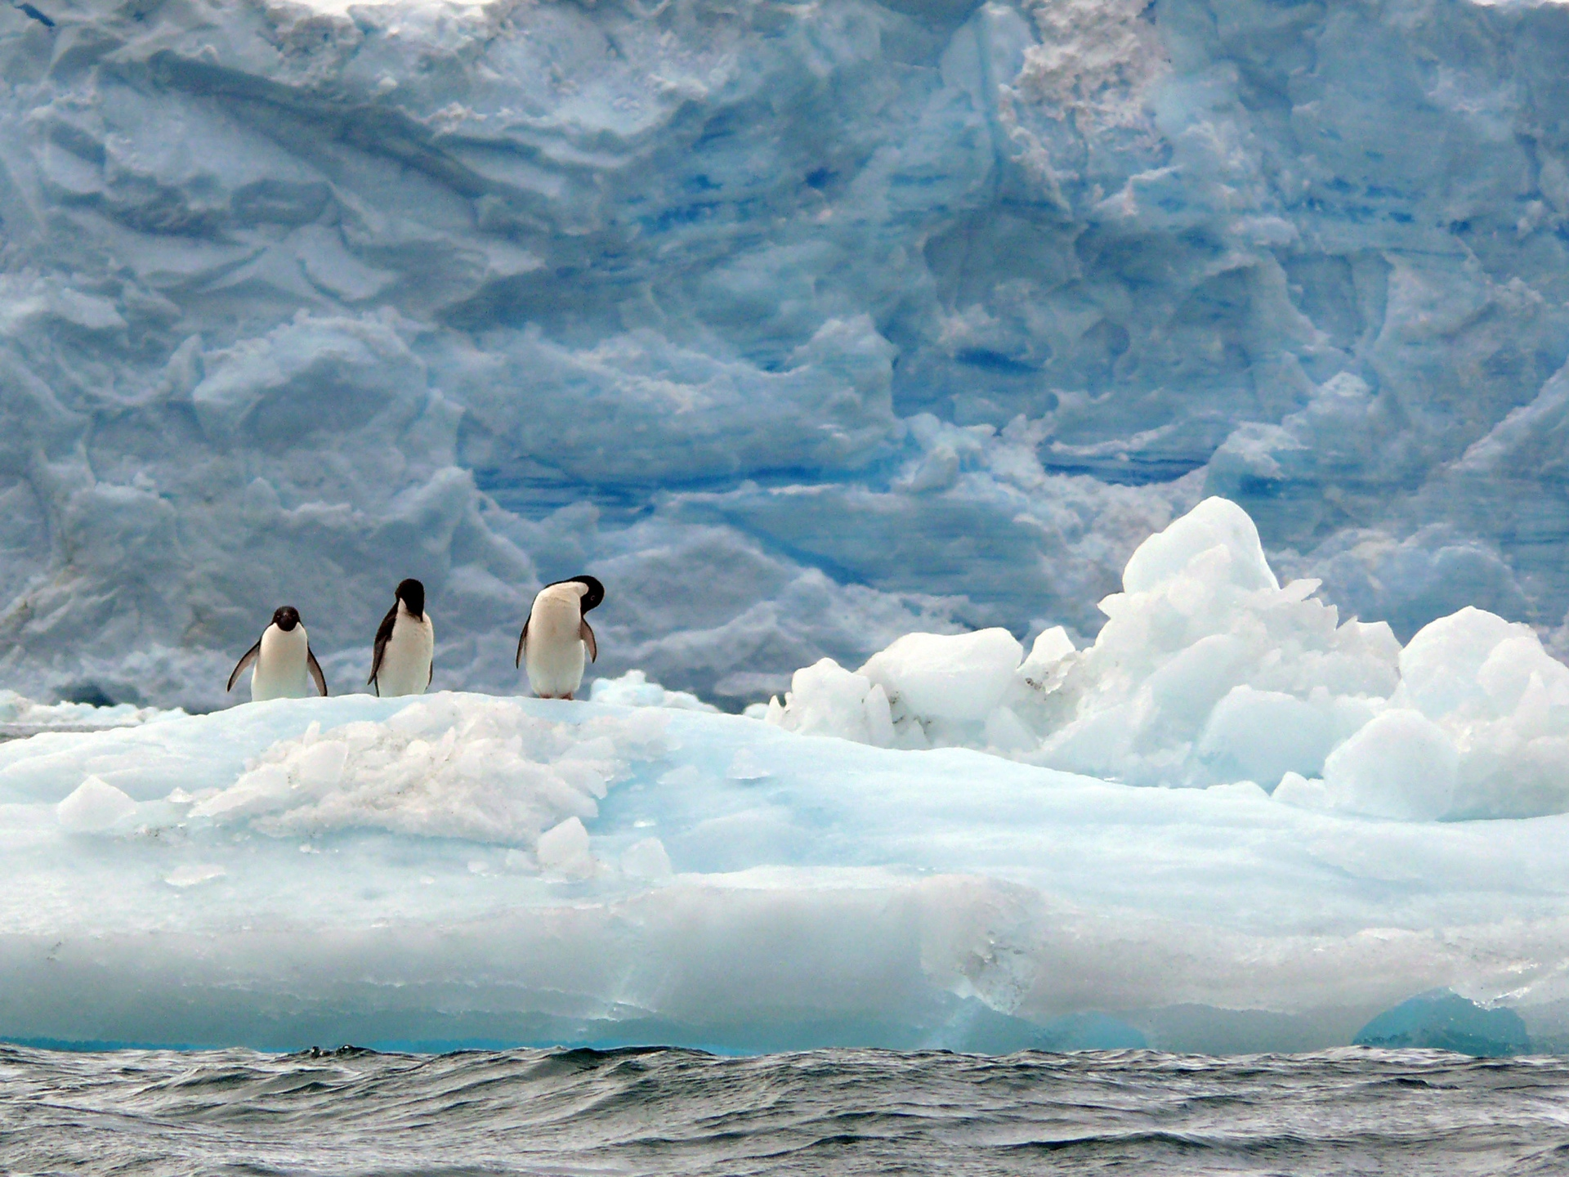
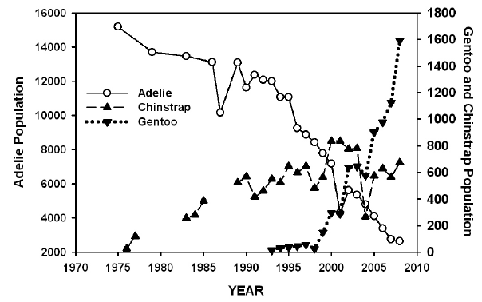


Slide 31
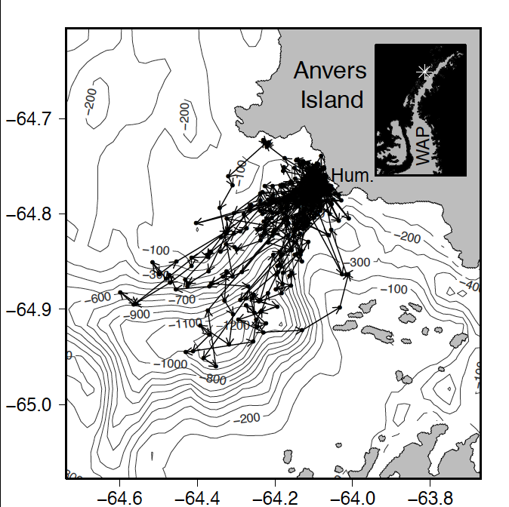
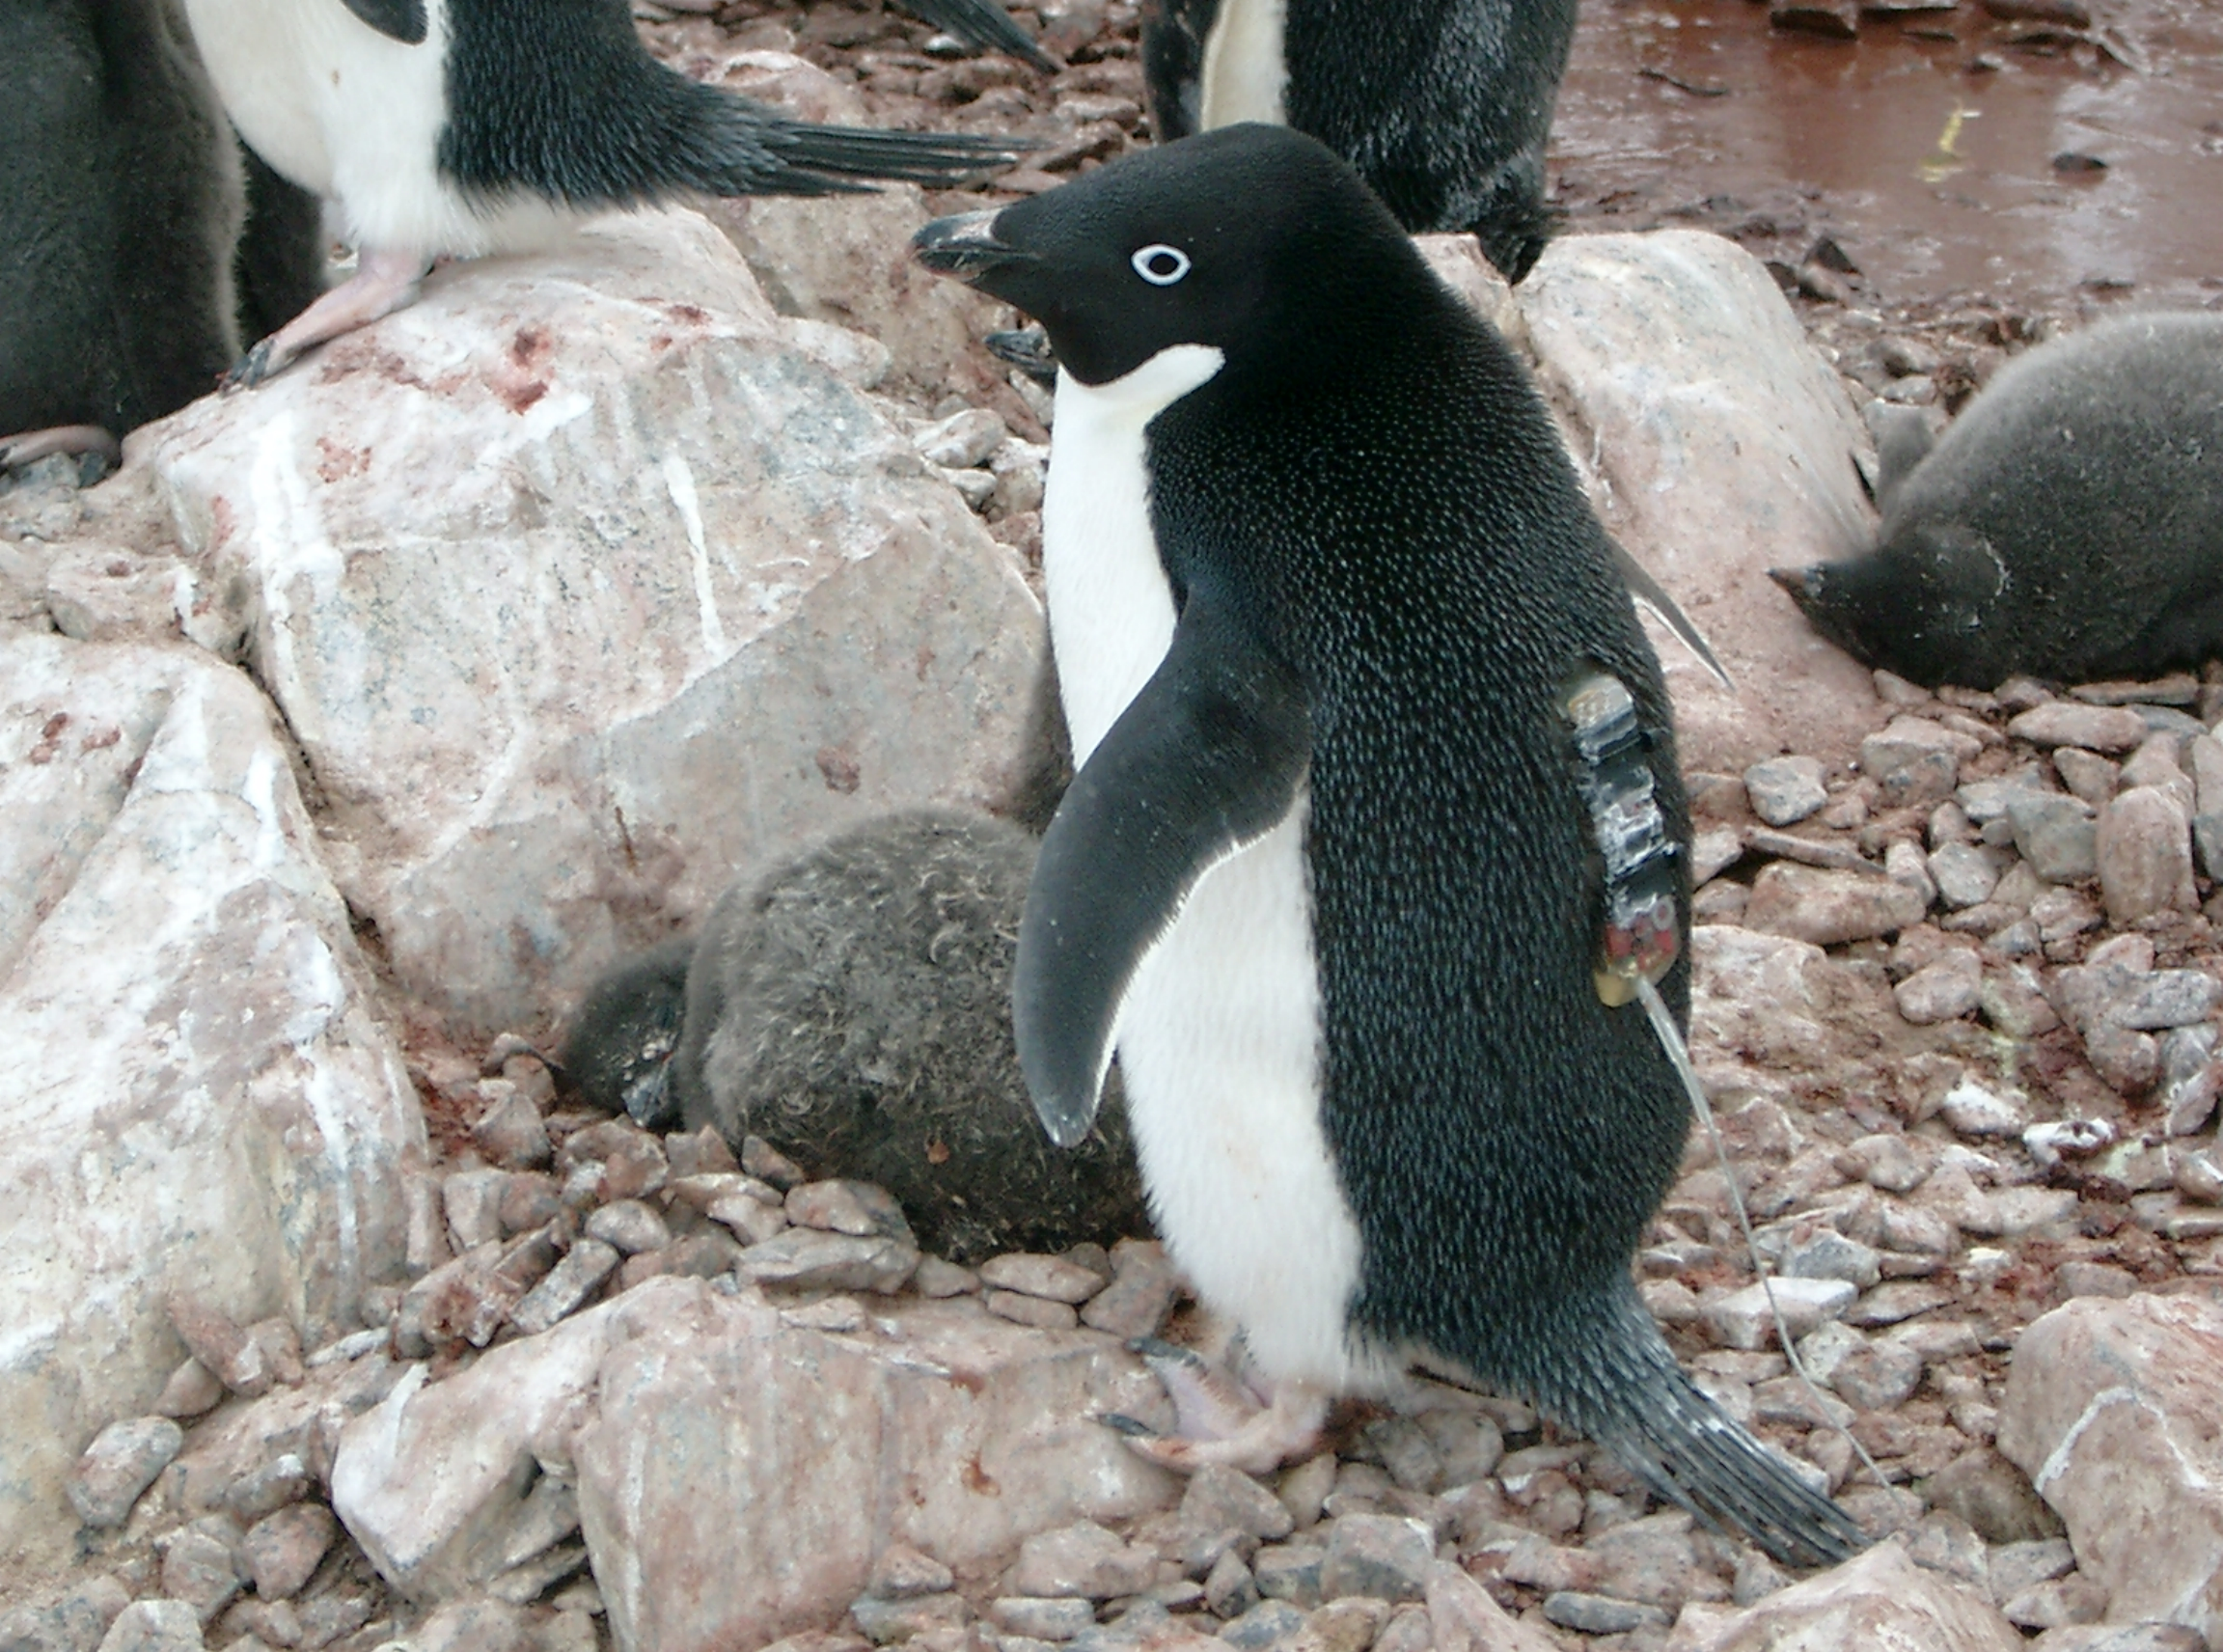
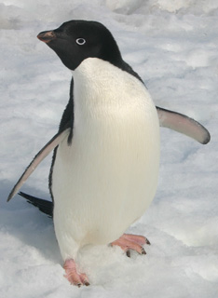
First Field Season Results
Tracking penguins from Humble Island
Where did the Adélie penguins go?

Slide 32
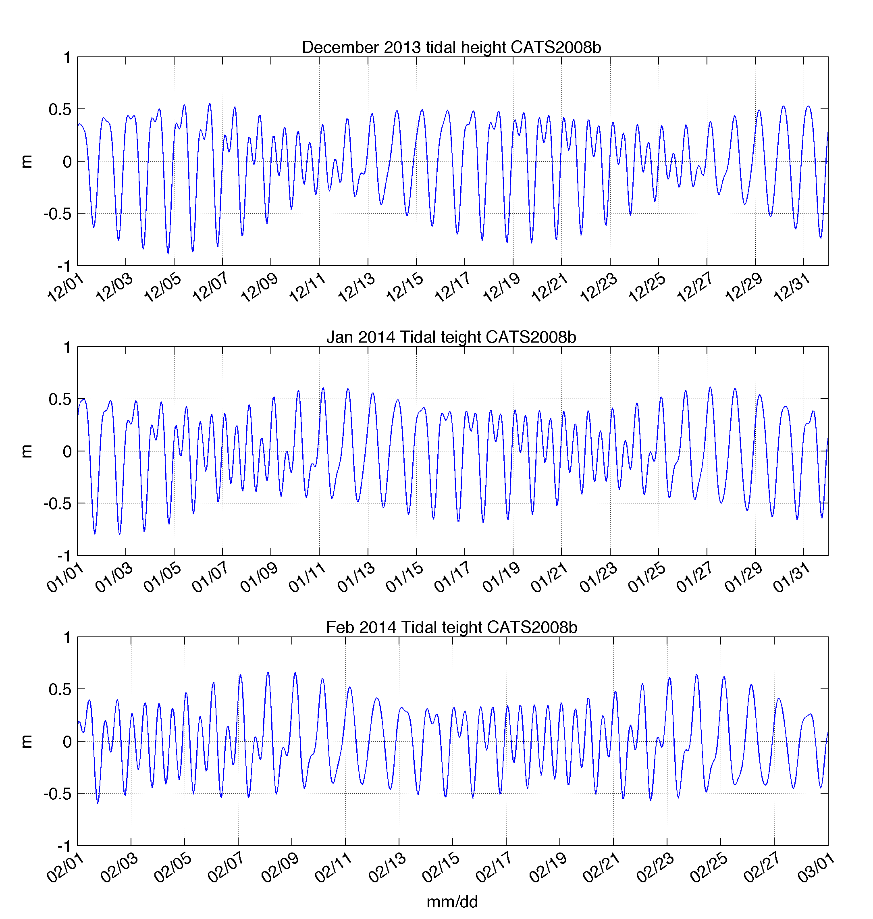
Tidal Dependence on Penguin
Foraging Behavior?
Diurnal
Semi-Diurnal

Slide 33
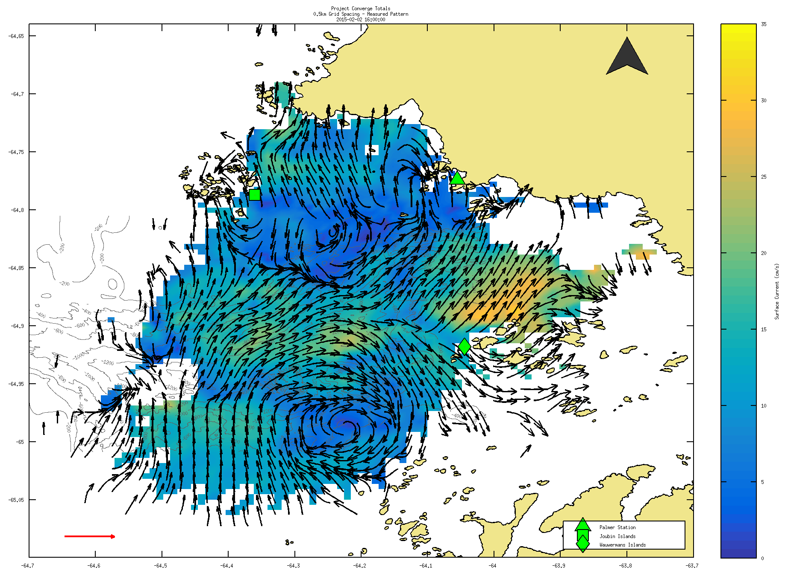

Slide 34
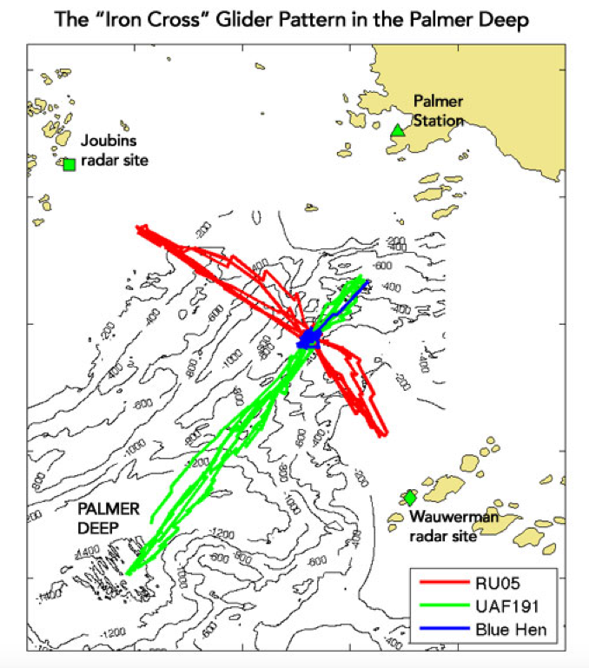
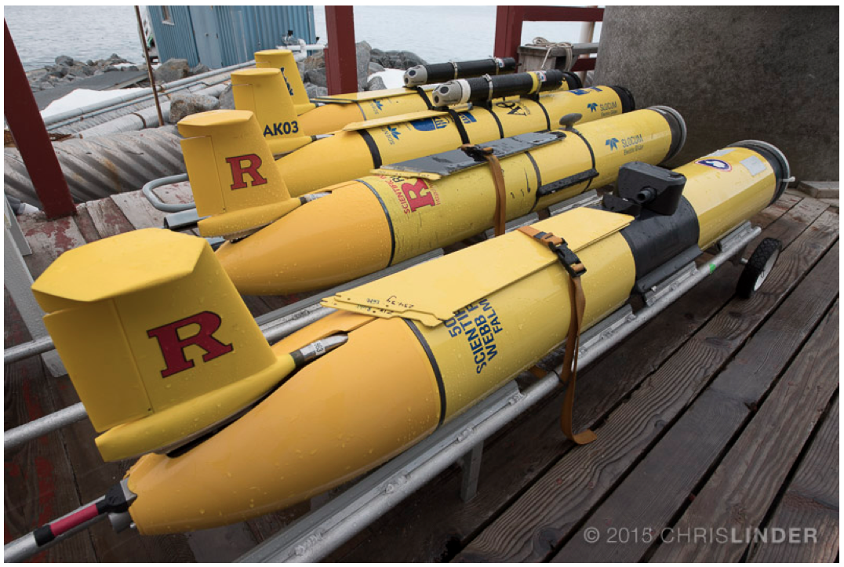

Slide 35
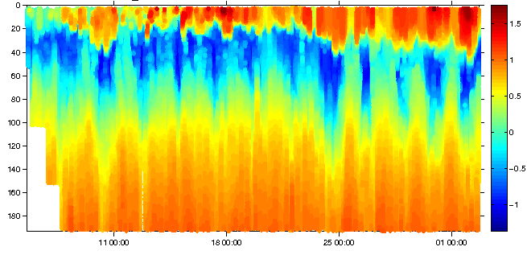
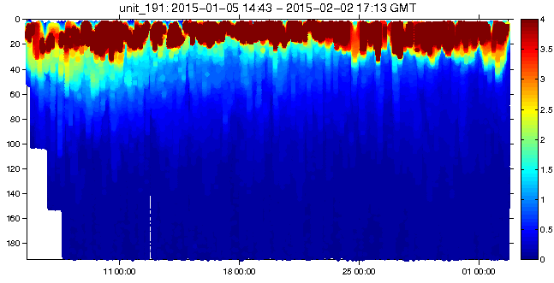
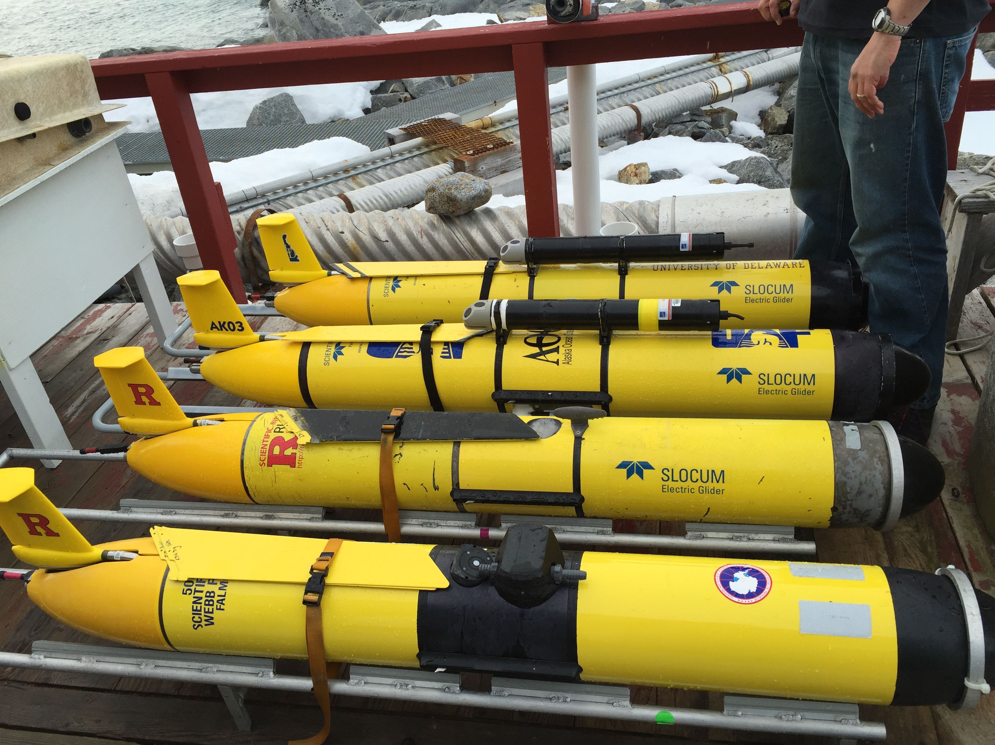
Along Canyon Line
Temperature
Chlorophyll

