Slide 1
Some applications of IOOS infrastructure & biophysical models
capturing responses to dynamic ocean environment:
Population & Ecosystem assessment
Observation models
(migration, availability & detectibility to surveys)
---------------------------
Process models
(rates of birth, death, immigration, emigration &
Stock structure)
Tactical management tools
Dynamic spatial management (GRAs)
----------------------------------------
Bicatch reduction tools
Real & near real time ocean information crowdsourcing
What’s the reality of the ocean now, not 3 years ago
‘proactive not reactive’

Slide 2
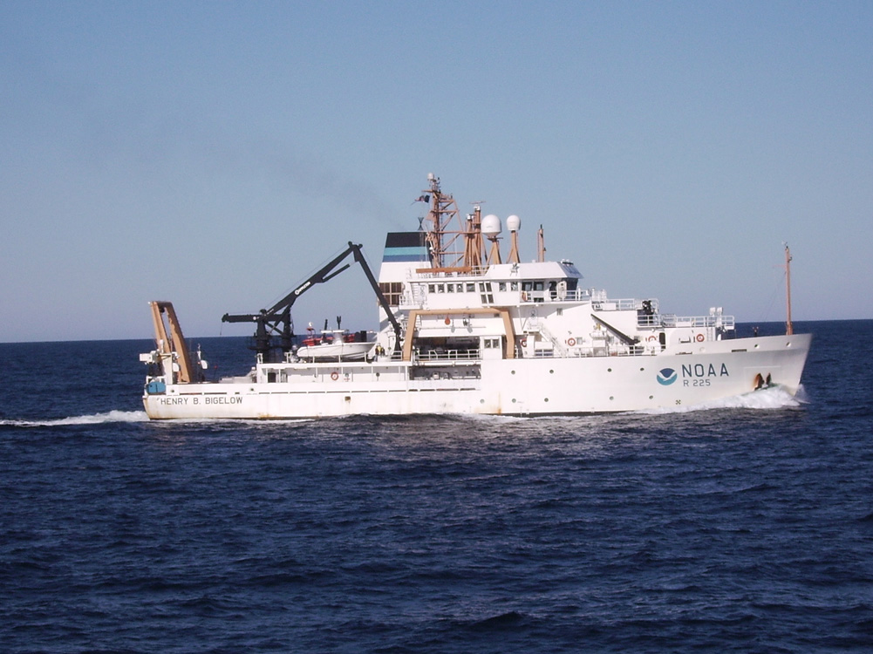
Legal mandate for federal fisheries management Magnuson-Stevens Fishery Conservation & Management Act (1976)
Stock Assessment:
“The use of various statistical and mathematical calculations to make quantitative predictions about the reactions of fish populations to alternative management choices”
- Hilborn and Walters (1992)
Federal Bottom Trawl Survey
45 year Time Series
~600 Stations Annually
Fall and Spring Surveys

Slide 3
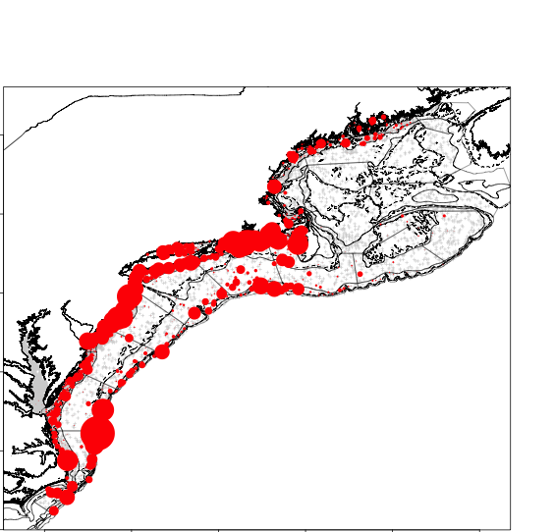
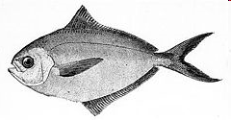
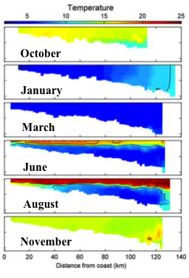
Why focus on dynamic habitat?
Temperature dependent seasonal migrations spring & fall
between under-sampled coastal zone & shelf break habitats
Summer
Winter

Slide 4
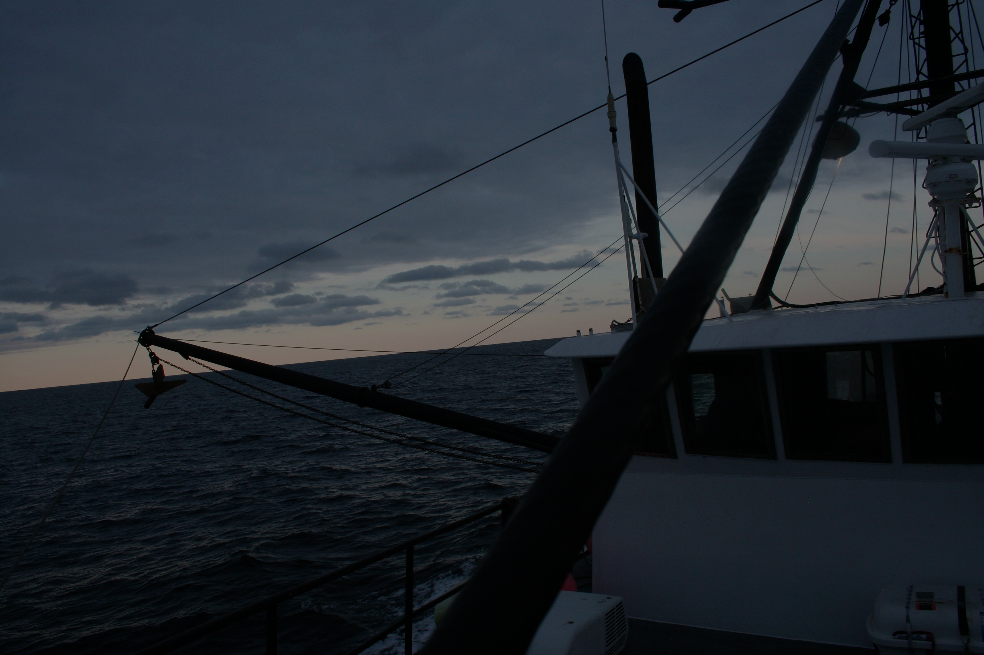
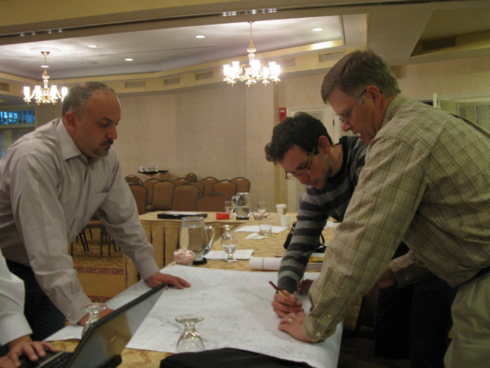
OpenOcean Study Group
Fishery Scientists/Ecologists
John Manderson
(NOAA/NEFSC)
Laura Palamara (Rutgers)
Olaf Jensen (Rutgers)
Tim Miller (NOAA/NEFSC)
Chuck Adams (NOAA/NEFSC)
Howard Townsend (NOAA/NEFSC)
John Quinlan (NOAA/SEFSC)
David Richardson (NOAA/NEFSC)
Physical and Biological Oceanographers
Josh Kohut (Rutgers)
Matt Oliver (U. Delaware)
Andre Schmidt (SMAST)
Nickitas Georgas (Stevens Inst.)
Enrique Curchitser (Rutgers)
Industry/Outreach
Chris Roebuck
Dan & Lars Axelsson
Hank Lackner
Geir Monsen (Seafreeze)
Greg DiDomenico
(Garden State Seafood)
Lunds Fisheries
Eleanor A. Bochenek (Rutgers)
John Hoey (NOAA/NEFSC)
Fisheries Management
Jason Didden (MAFMC)
Rick Seagraves (MAFMC)
Human Dimensions
Steven Gray (U Mass.)
NMFS Northeast Cooperative Research
NMFS Office of Science and Technology

Slide 5
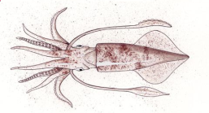
Approach: Regional Habitat Models
NOAA US Fishery Data
Spatial grain = 11km
Ocean
Observations
+
Physical Models
Statistical and Mechanistic
“niche” Models
(e.g. GAM, GLM, MAXENT)
Regional
Habitat
Projection

Slide 6
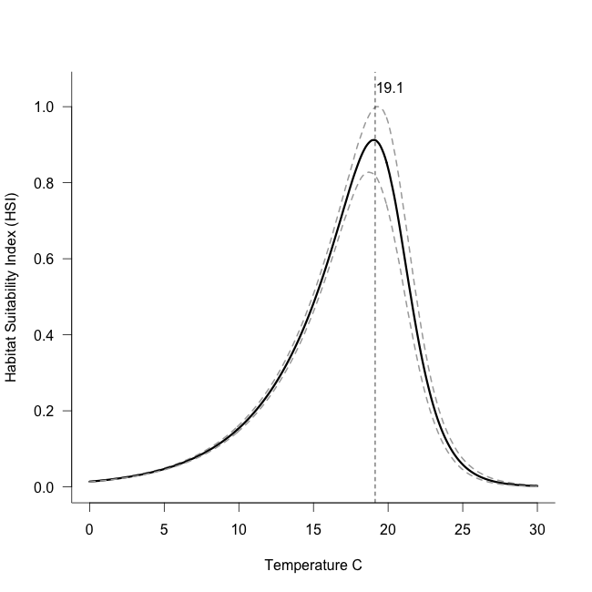
Mechanistic Model v. 3.0
Niche model: nonlinear extension of
Boltzmann-Arrhenius equation
(mechanistic basis in enzyme kinetics)
Water temperature
hindcast from
oceanographic model
1958-2007
Daily Temperature
~7 km Resolution
+
From Enrique Curchitser, Rutgers

Slide 7
Mechanistic Habitat Model Daily: 1958-2007
1989-1992
Index of
thermal
habitat
quality
2002-2004

Slide 8
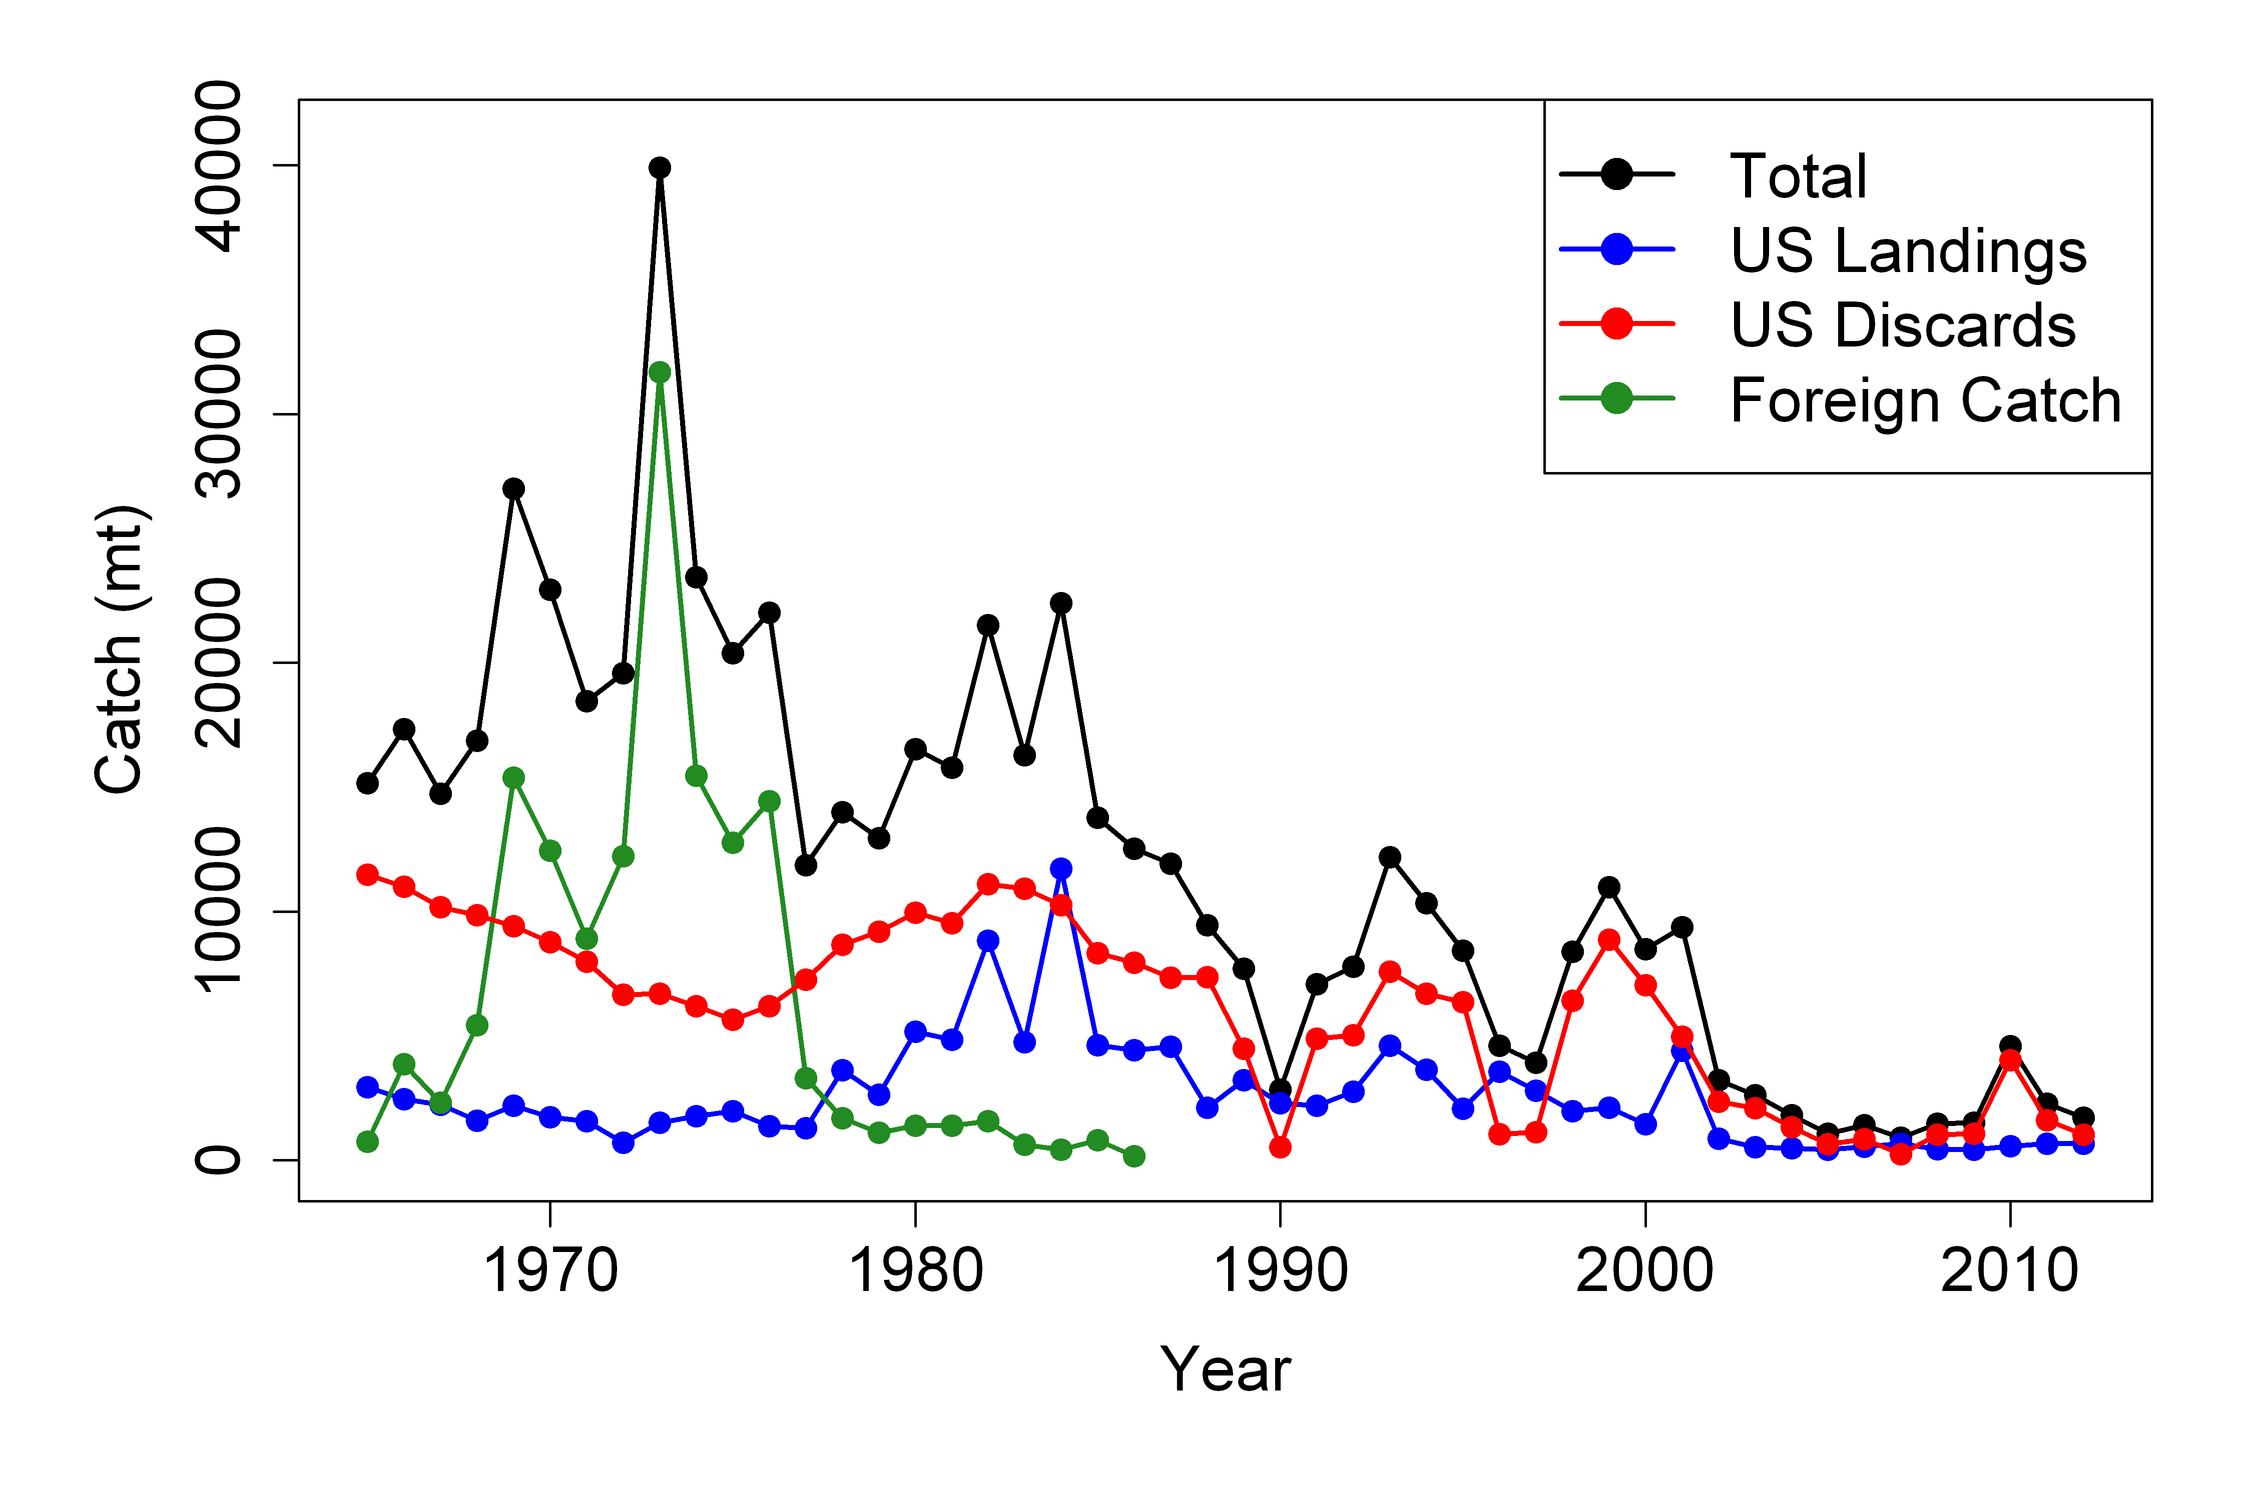
Butterfish commercial landings 1965 - 2012
Why focus on catchability?
Landings low since 2000
Catchability (Q) important in scaling population size.
From Charles Adams
Notes:
Total catch, US landings and discards, and foreign catch of butterfish from 1965-2012.
Corresponds to Tables A1 and A2.

Slide 9
Tor 3. Characterize oceanographic & habitat data pertaining to distribution & availability. If possible, integrate results into assessment
Focus on observation process:
Catchability Q = availability ρ * detectability δ
ρ
Proportion of population in
Survey space-time frame
TOTAL Q
δ
Proportion of fish occupying station caught in net

Slide 10
Approach:
Use coupled biophysical model to develop
a habitat based estimate of availability (ρ_{h}) to surveys
HSI = suitability index (0-1) from habitat model
k_{1...o} = samples in a survey
j = locations
i = times (day)
p = number of samples in strata of sample k

Slide 11
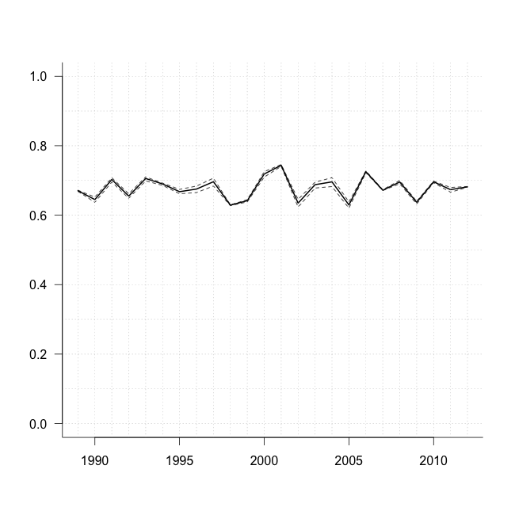
Approach:
Use coupled biophysical model to develop
a habitat based estimate of availability (ρ_{h}) to surveys
Median ρ_{h} = 0.68
(0.62-0.75)
Availability (ρ) to fall NEFSC
survey stations offshore
Estimates changes in availability (ρ) over time.
Thermal habitat based ρ accounts for shifts in species distributions associated with climate impacts on ocean temperatures
Availability (ρ)
Catchability (Q)
Detectability(δ)

Slide 12
From the Mid Atlantic Fishery Management Council (MAFMC) draft 2014 Environmental Assessment for the Butterfish and Longfin Squid fishery specifications:
“The butterfish fishery has mostly been an incidental fishery since 2002.
2014 is the first year of a small directed fishery, with a landings limit of 3,200 mt.
If that limit is caught at 2013 average prices ($1,481 mt), the resulting revenues would be about $4.7 million.
Under the proposed 2015 specifications, the average landings limit for 2015-2017 would be 21,408 mt. This could potentially translate into $31.7 million additional ex-vessel revenues at 2013 prices.”
It is not clear that the fishery will actually land such higher amounts or if the price would remain near $1,481/mt at higher landings levels, so the $31.7 million value is likely an “upper end” possibility.”

Slide 13
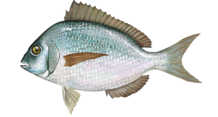
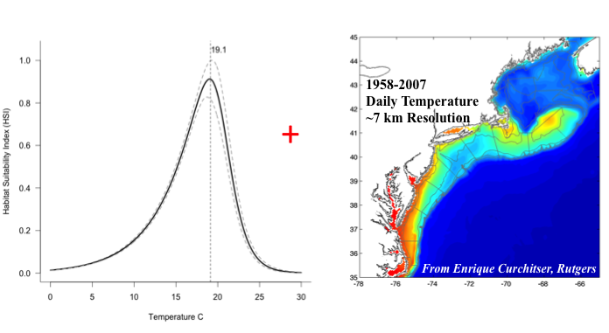
Ecological Decision Support: Opportunities
2015 Bluefish Assessment
2015 Scup Assessment

