Slide 1
Josh Kohut
Center for Ocean Observing Leadership
New Jersey Agriculture Experiment Station
Rutgers, The State University of New Jersey
Doug Zemeckis
Marine Extension Agent for Ocean, Atlantic, and Monmouth Counties
Rutgers Cooperative Extension
New Jersey Agriculture Experiment Station
Notes:
Work for Rutgers, slides, comments, and discussions do not reflect federal, state, or local government positions or plans, or developers
Hope to answer questions to the best of my ability

Slide 2
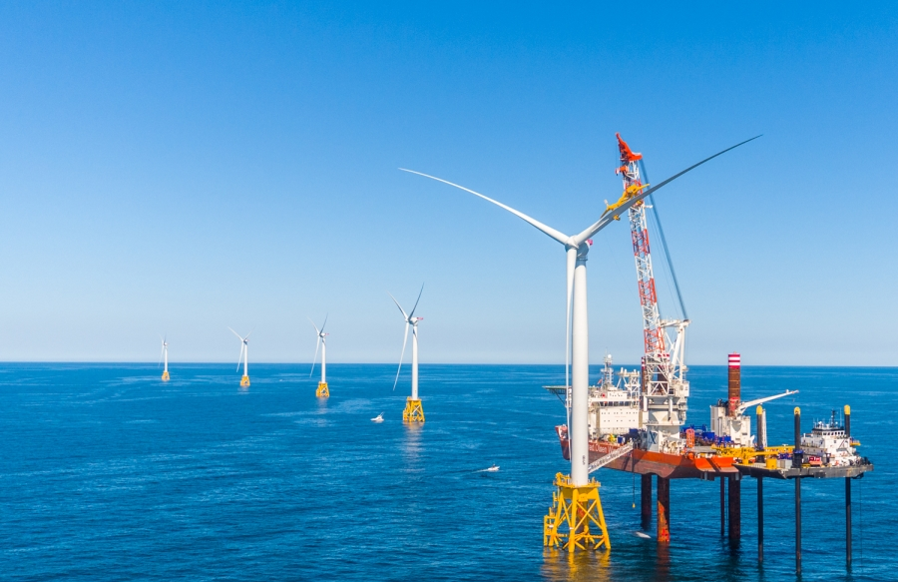
What is Offshore Wind?
Why offshore?
  Close proximity to load demand
  Higher, more constant wind speeds
  Doesn’t occupy land resources
  Much larger turbines than possible onshore
Offshore development is dramatically different than onshore
  Physical and biological characteristics and concerns
  Multiple ocean uses
Dvorak et al. 2012
Notes:
Acoustics impacts on marine wildlife, particularly mammals
Construction, operations, decommissioning all have different concerns

Slide 3
Active Federal Wind Energy Leases
Lease | Year
CVOW Dominion/Ørsted | 2020
Vineyard Wind Avangrid | 2021
South Fork Deepwater | 2022
Ocean Wind Ørsted | 2022
Bay State Wind Ørsted | 2022
US Wind MD | 2022
Revolution Wind Ørsted | 2023
Skipjack/GSOE Ørsted | 2023
Dominion | 2025
US Wind NJ Shell/EDF | 2026
Empire/Boardwalk Equinor | 2027
Kitty Hawk Avangrid | 2027
Source: BOEM
Notes:
CVOW: Coastal Virginia Offshore Wind (demonstration project with Orsted and Dominion)
GSOE: Garden State Offshore Energy
Equinor lease has different names in each state (Boardwalk announced just last week)
Deepwater is wholly owned by Orsted

Slide 4
State Commitments
State | OSW Goal (MW) | Renewable Goal
Massachusetts | 3,200 | 35% by 2030
Rhode Island | 1,000 | 38.5% by 2025
Connecticut | 300 | 48% by 2030
New York | 9,000 | 70% by 2030
New Jersey | 3,500 | 50% by 2030
Maryland | 1,500 | 25% by 2020
Total | 18,500
Source: BOEM
New Jersey Solicitations | Year
1,100 MW | 2018 (now!)
1,200 MW | 2020
1,200 MW | 2022
Notes:
For comparison, Oyster Creek was 636 MW
NJ commitment is about 25% of NJ total electricity use

Slide 5
Initial Draft WEAs

Slide 6
The Federal Offshore Wind Process
NY Bight
Existing NJ Leases
Source: BOEM
6 to 10+ year process from initial call to commissioning
Notes:
SAP = Site Assessment Plan
COP = Construction and Operations Plan

Slide 7
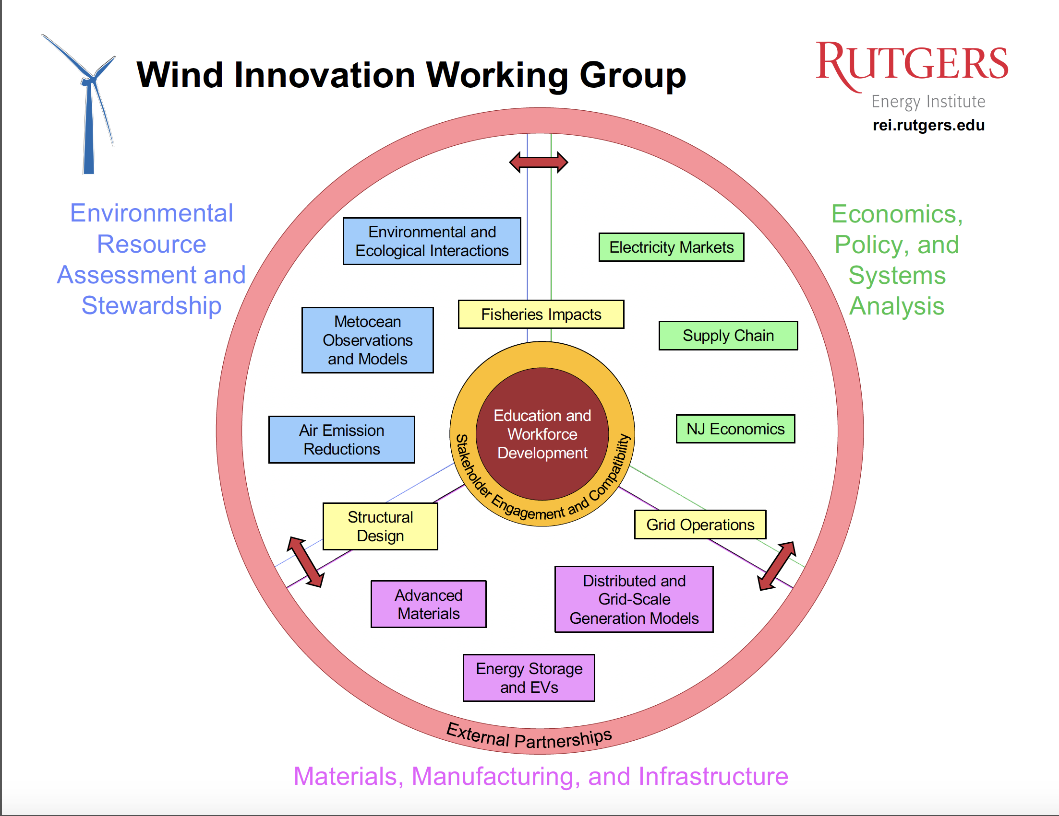

Slide 8
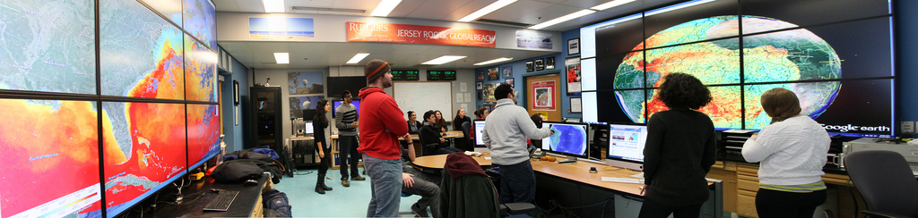
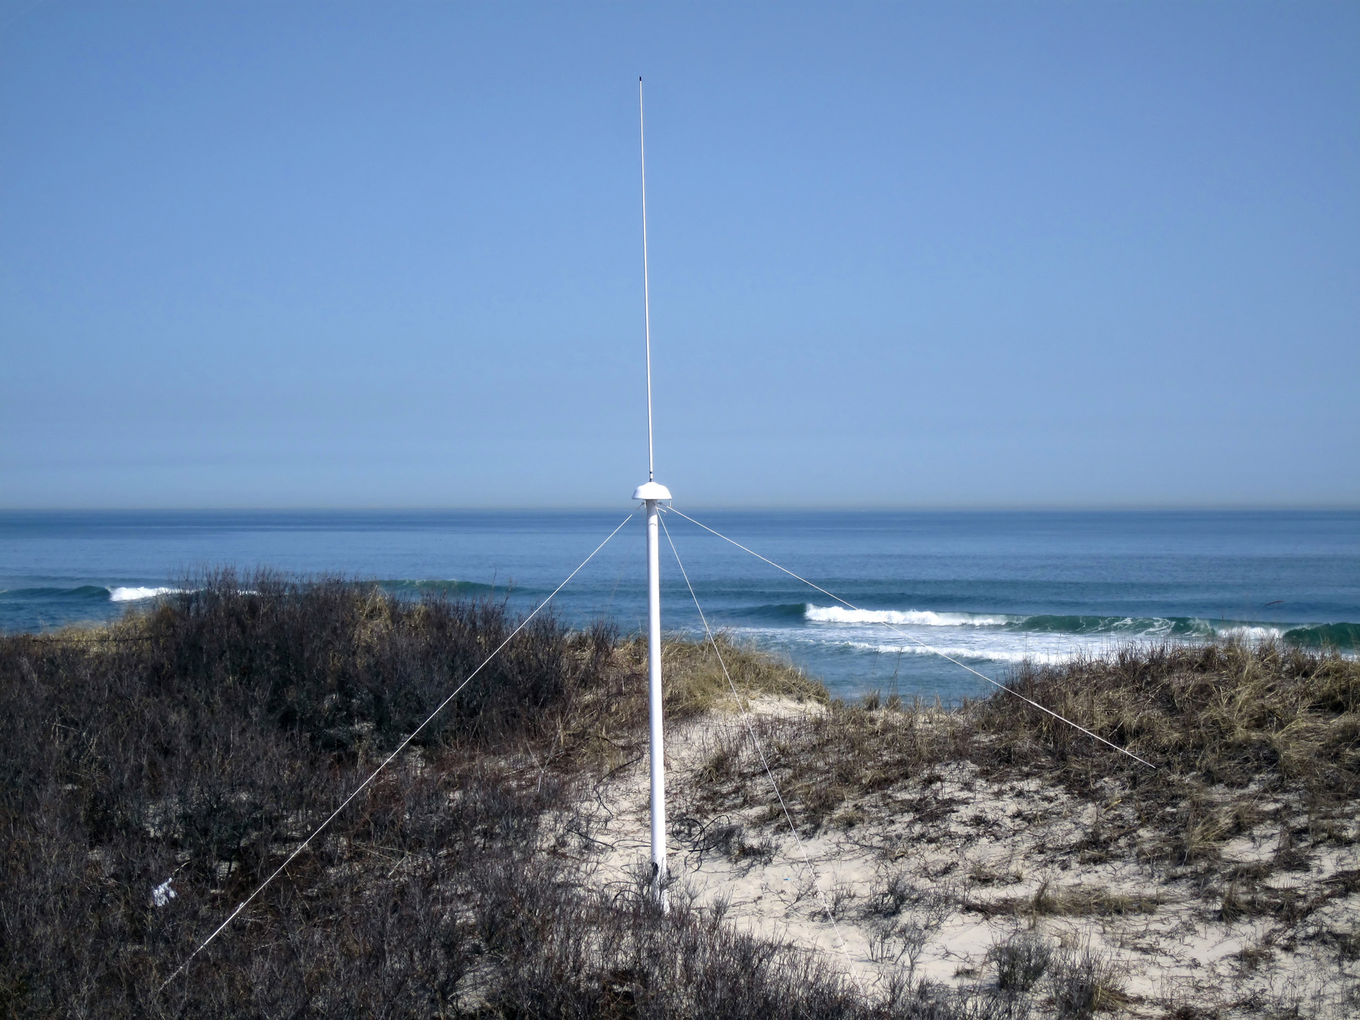
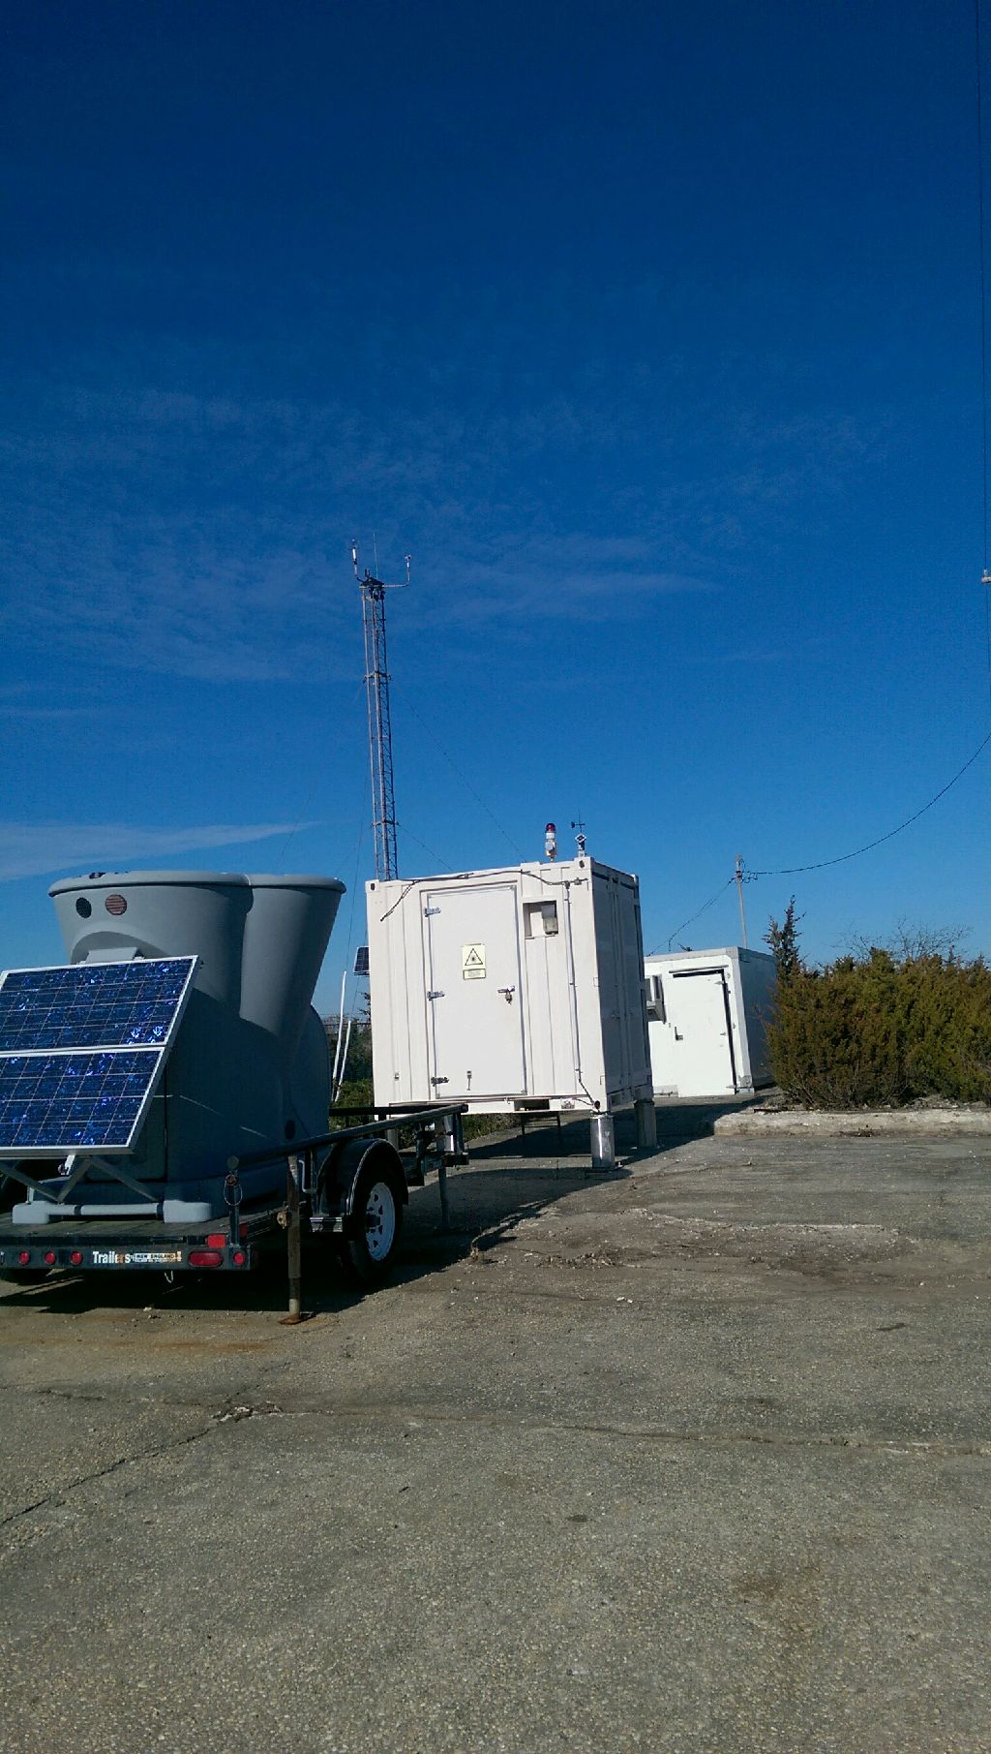
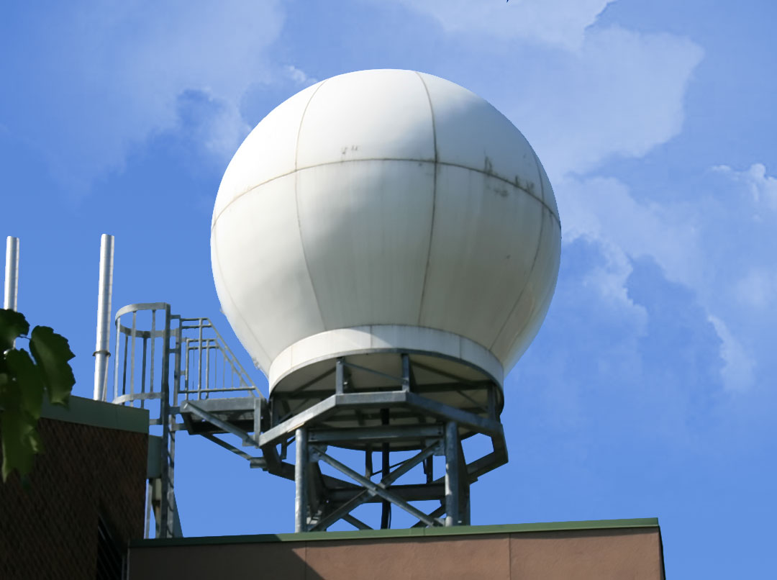
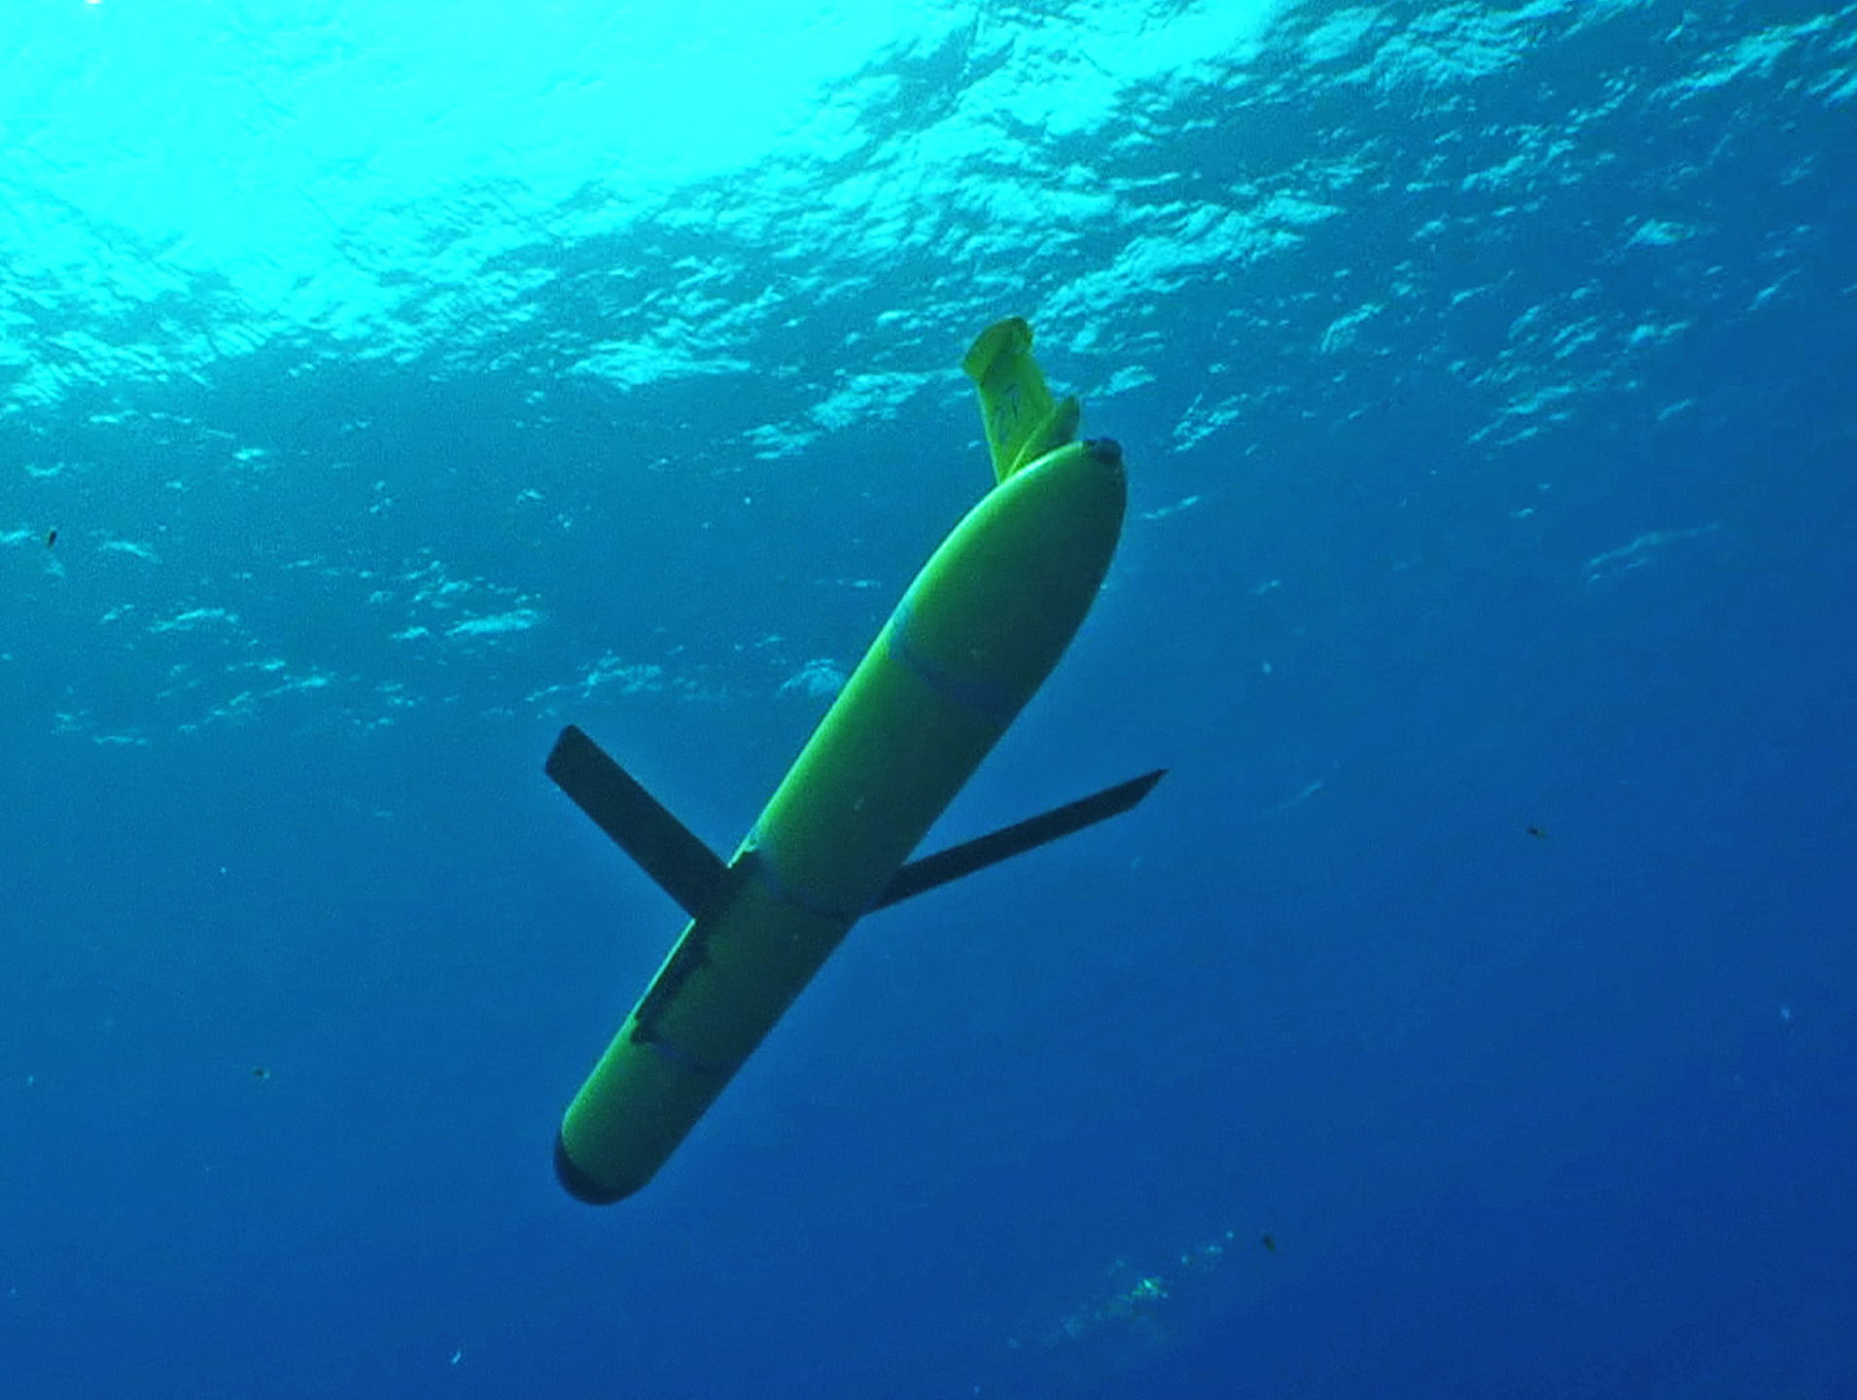
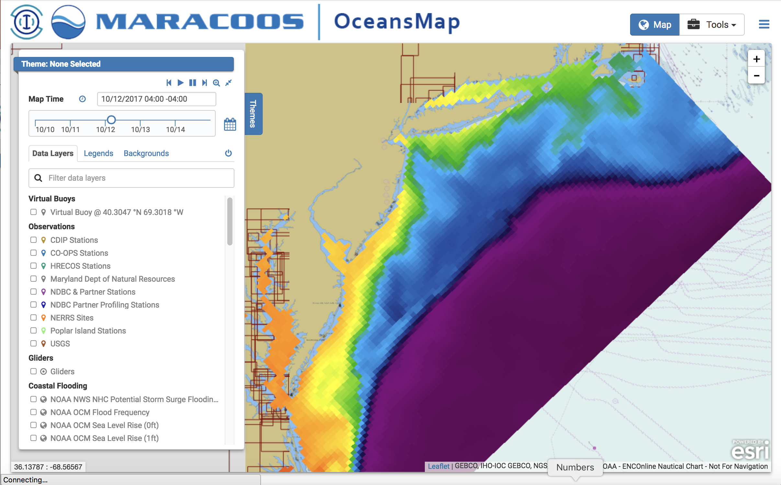
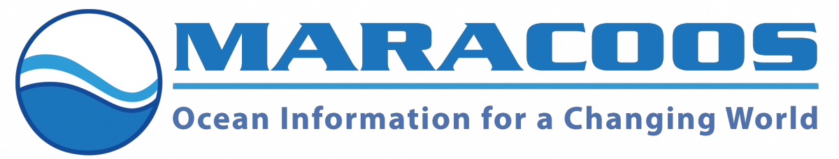
Rutgers University - Center for Ocean Observing Leadership
MARACOOS – A forum to bring forward the best science & technology
Met Station – Tuckerton, NJ
Satellite Receivers
46 Site CODAR Network
468 Glider
Deployments
Met/Ocean
Modeling
Notes:
8
All of this gets combined into our overall operations, research, and educational initiatives in the “COOL Room,” shown here (with a class in the background)
Thanks to many partners

Slide 9
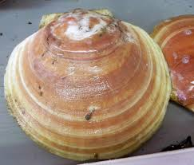
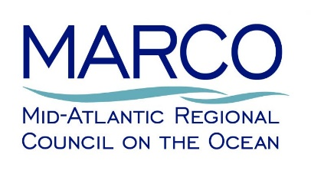
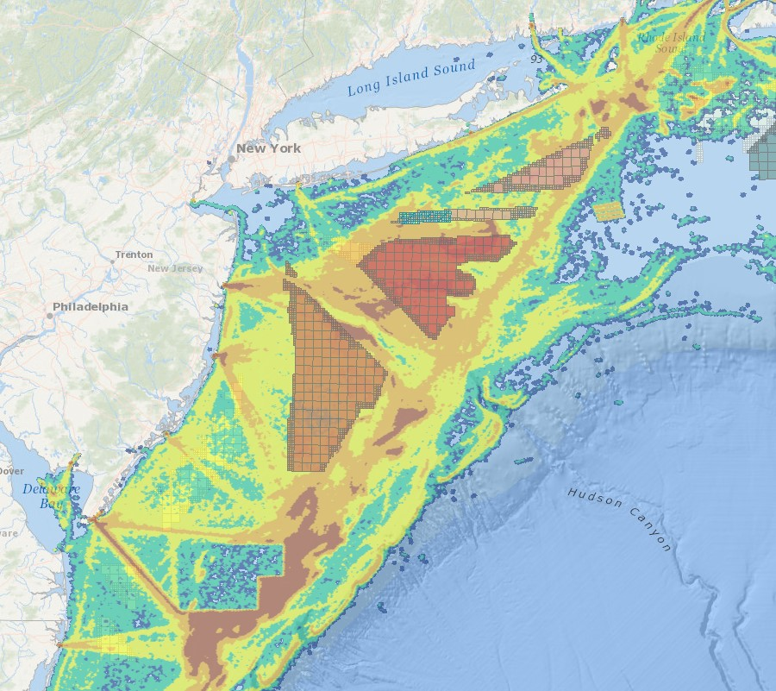
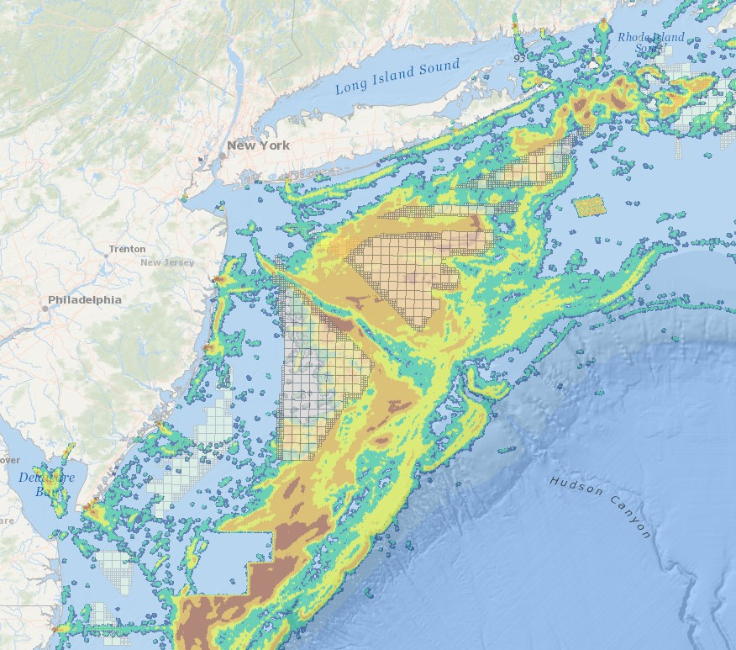
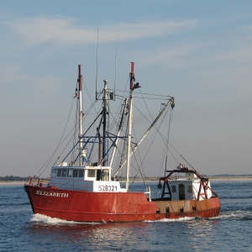
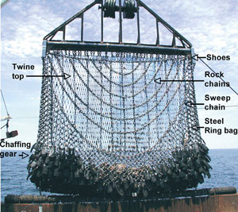
https://portal.midatlanticocean.org/
All Speeds
< 5 knots
Commercial Sea Scallop Fishery – Vessel Monitoring System (VMS) – 2015-2016

Slide 10
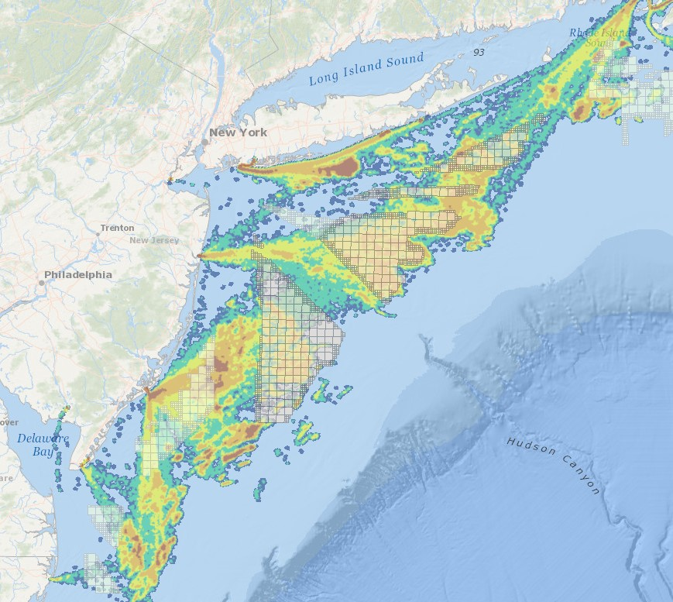
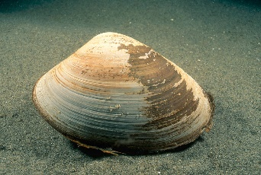
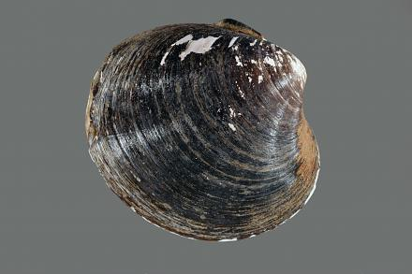
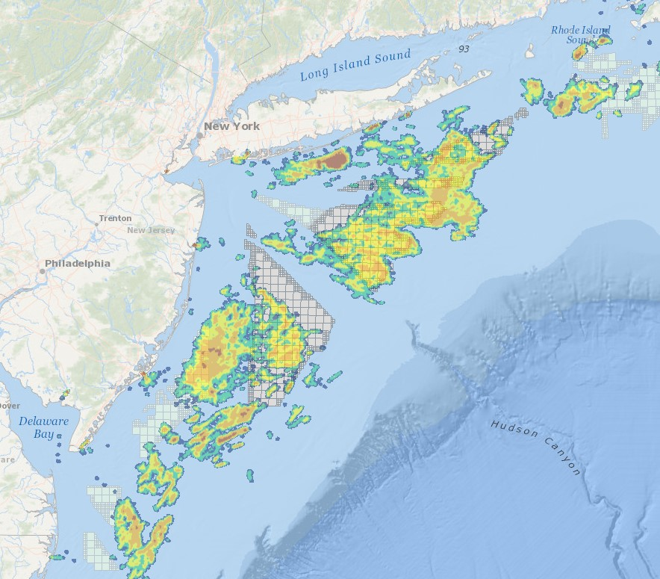
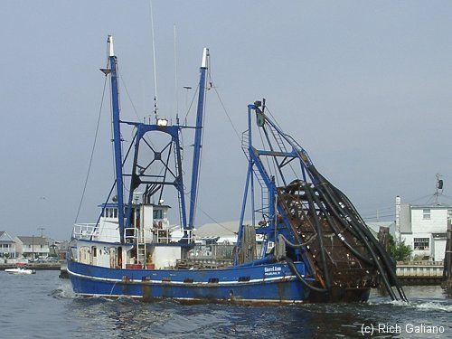
https://portal.midatlanticocean.org/
All Speeds
< 5 knots
Surfclam/Ocean Quahog – Vessel Monitoring System (VMS) – 2015-2016

Slide 11
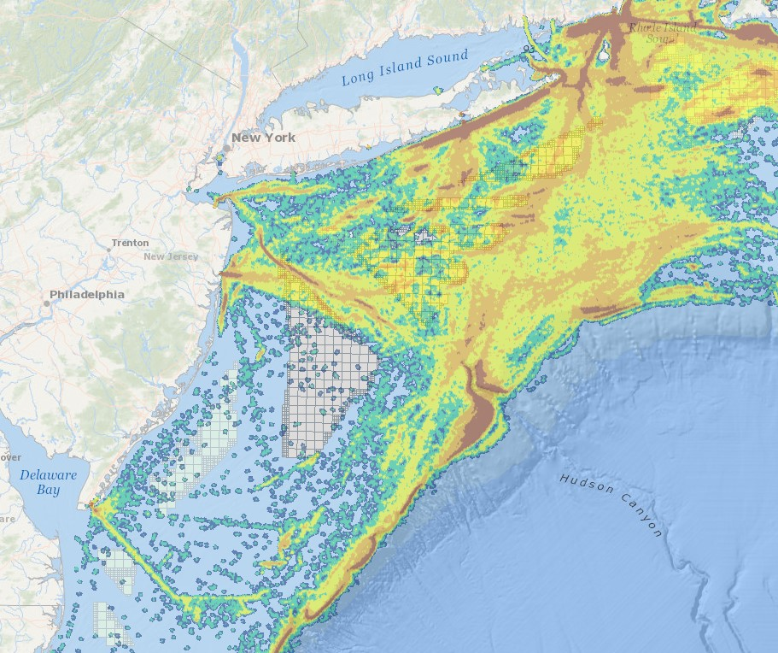
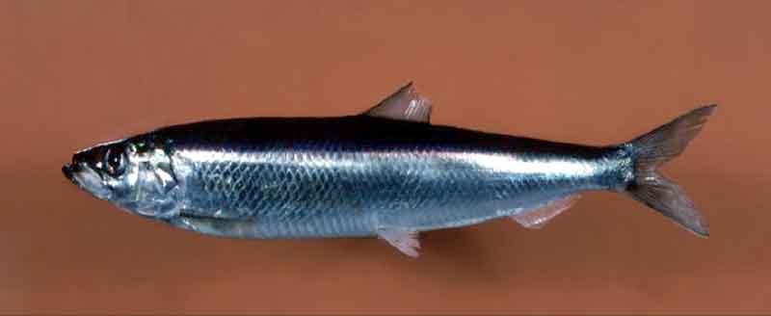
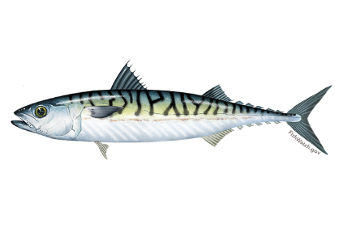
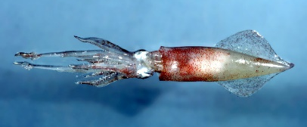
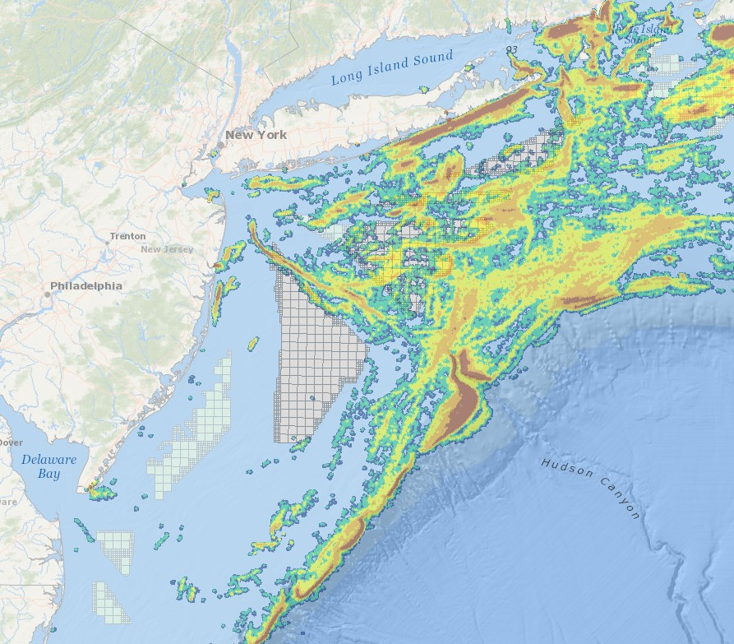
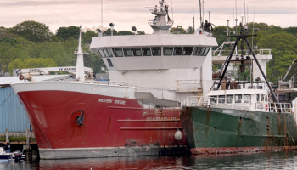
https://portal.midatlanticocean.org/
All Speeds
< 5 knots
Pelagics (Herring/Mackerel/Squid) – Vessel Monitoring System (VMS) – 2015-2016

Slide 12
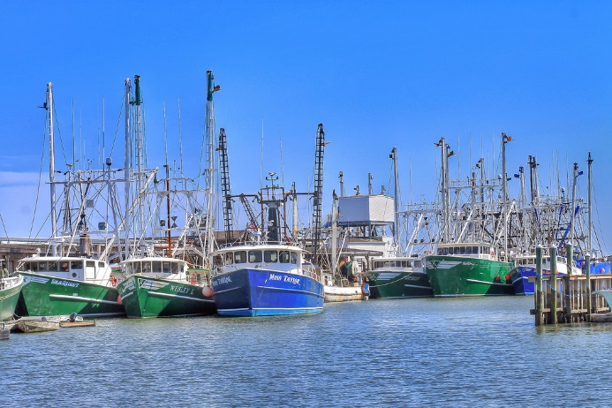
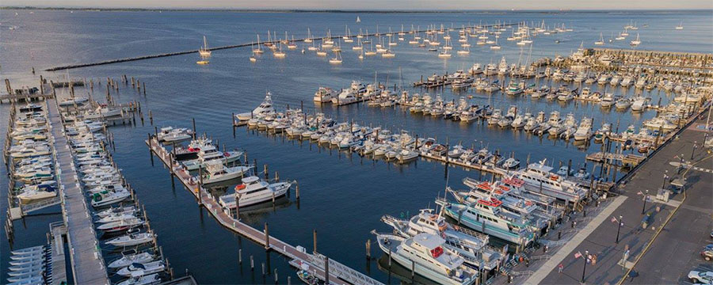
Fishing Industry Concerns and Research Priorities
Access: Before, during, and after construction
  Placement and spacing of turbines and cables
  During fishing activities and while transiting
  Cumulative impacts
Ecosystem Impacts: Influences on physical and biological processes
  Ocean-atmosphere interactions, currents, cold pool dynamics
  Distribution, behavior, reproduction, and survival of marine fishery resources
Navigation and Safety: During fishing activities and while transiting
  Varying weather conditions, different user groups, radar impacts

Slide 13

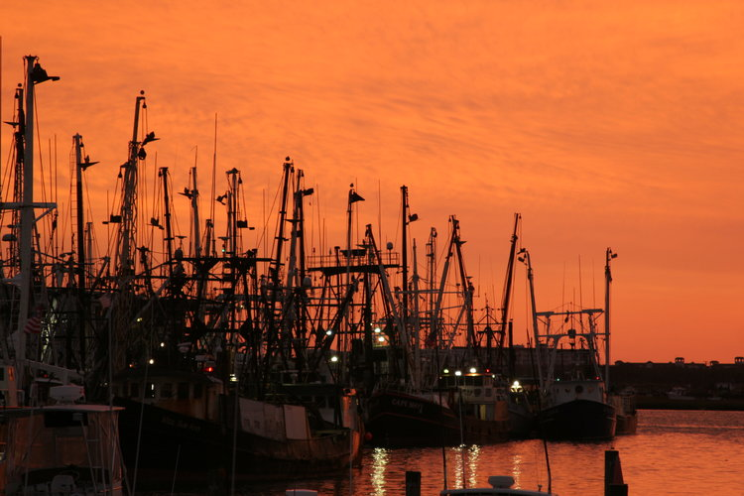
Responsible Offshore Development Alliance (RODA)
Provide a unified voice regarding issues of mutual interest to the commercial fishing industry, related to the siting and operations of new and proposed offshore developments, in order to promote seafood sustainability
Act as a bridge among stakeholders
Coordinate among relevant partners
Support scientific research efforts
  Responsible Offshore Science Alliance (ROSA)
Clearinghouse of scientific information and updates on wind development
https://www.rodafisheries.org/

Slide 15
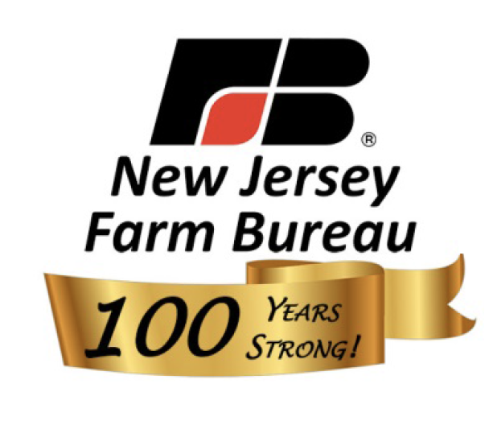
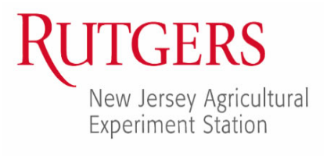
Request For Research
NJAES to partner with stakeholders to address relevant research topics, for example:
The impact of the coastal ocean on terrestrial agriculture in New Jersey.
The impact of proposed offshore wind development on farm production across the New Jersey coastal communities.
Others? We value your input.

Slide 16
Request For Research
Draft research tasks informed by stakeholder input that leverage the relevant resources and expertise of NJAES
Literature review
  Marine boundary layer
  Statewide ag production and economics
  Effects of wind farms on local weather to regional climate
Statistical analysis of NJAES and other public data time series and models
  Local winds, extent of ocean influence across the state, etc.
  Statewide agricultural metrics (ex. heating degree days, crop production)
Empirical studies informed by statistical analyses
  Coastal climate and sea breeze events
  Mechanistic links between onshore transport and crop production
DRAFT

Slide 17
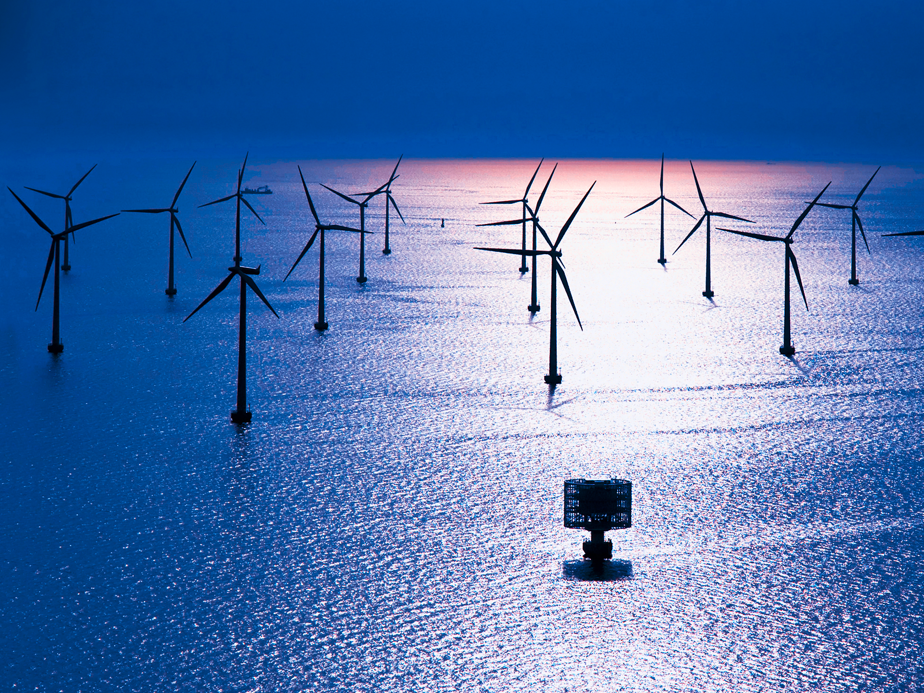
Discussion and Questions
Image: Vattenfall

Slide 20
The New York Bight
Call Area
Wind Energy Area
Lease Area

Slide 21
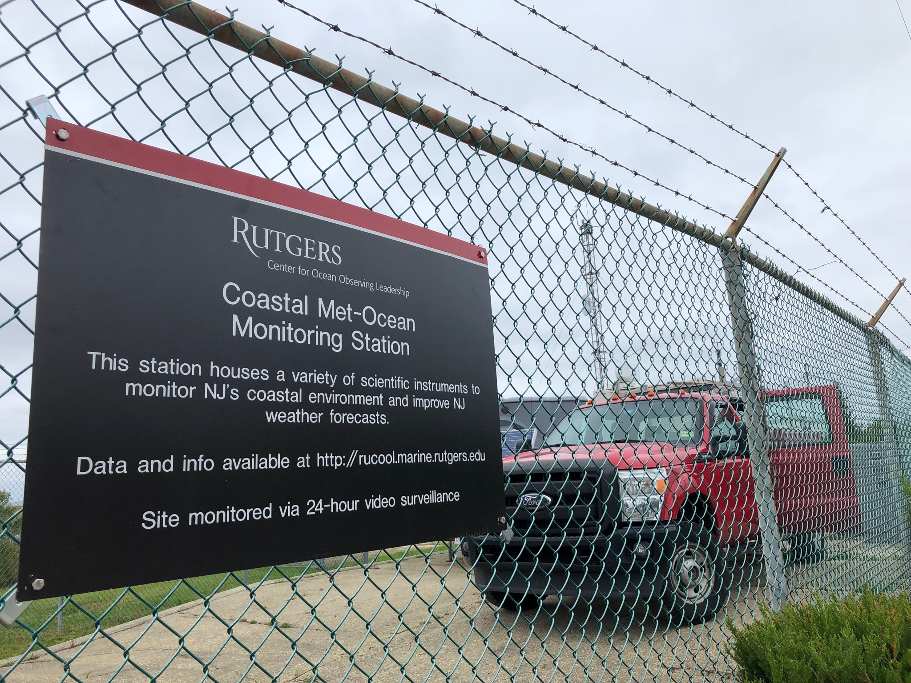
RUCOOL Overview
Founded as the Coastal Ocean Observation Lab in 1992 by Scott Glenn & Oscar Schofield
5 tenure-track faculty (including the founders)
1 extension faculty
3 PhD-level research scientists
7 graduate students
18 FT research and operations staff
Numerous undergraduate students (10+ presently)
Notes:
Scott PO, Oscar BO
Just celebrated our 25th year
Has expanded considerably over that time.
2 PO faculty, 2 BO faculty
Additional collaborative faculty, as well
I actually worked with the group a bit as an undergrad, as well, back in early 2000s! Weather forecasts for local energy company
First glider recovery!

Slide 22
NJ Strategic Plan
Mandated by EO8
Focus on 3 areas
  Supply Chain and Workforce Development
  Energy Pricing and Markets
  Environmental Protection
Stakeholder engagement is key throughout the process
Led by 5 NJ government offices, with 6 member contracting team

Slide 23
State Actions
OWEDA (Offshore Wind Economic Development Act)
  Signed in 2010 by Gov. Christie
  Laid groundwork for OSW in NJ, consistent with NJ Energy Master Plan
  “Net economic benefit test”
  Created the NJ OREC process
Executive Order #8
  Signed in January 2018 by Gov. Murphy
  Sets goal of 3.5 GW by 2030
  Mandates BPU begins rulemaking process to move OREC process forward – first solicitation due December 28
  Mandates development of NJ OSW Strategic Plan (more on this later)
Executive Order #28
  Signed in May 2018 by Gov. Murphy
  NJ renewable energy goals of 21% by 2020, 35% by 2025, and 50% by 2030

Slide 24
Useful Resources
RUCOOL: rucool.marine.rutgers.edu
US BOEM NJ Activities: www.boem.gov/New-Jersey
NJ Offshore Wind Strategic Plan: www.njcleanenergy.com/nj-offshore-wind
US DOE Wind Energy Technologies Office: www.energy.gov/eere/wind

Slide 25
In Summary
Offshore wind is coming to the US, and to NJ
However, much remains in the process to ensure development is done properly
The ocean is a complex place, and all stakeholders can have a say in the process
Researchers at Rutgers as a whole are helping to better inform this process, making sure the best science is used to make the best decisions

Slide 26
Where Does the State Come In?
Large offshore wind lease areas are in federal waters (outside 3 nm from coast)
State and local governments control locations where power is brought ashore
Wind farms do not have a customer without state approvals to sell power into the state (in NJ, this is an Offshore Renewable Energy Certificate, or OREC)
Developers need federal government for leasing and federal permits, and state/local governments to actually bring the power ashore and sell it into the grid

