Slide 1
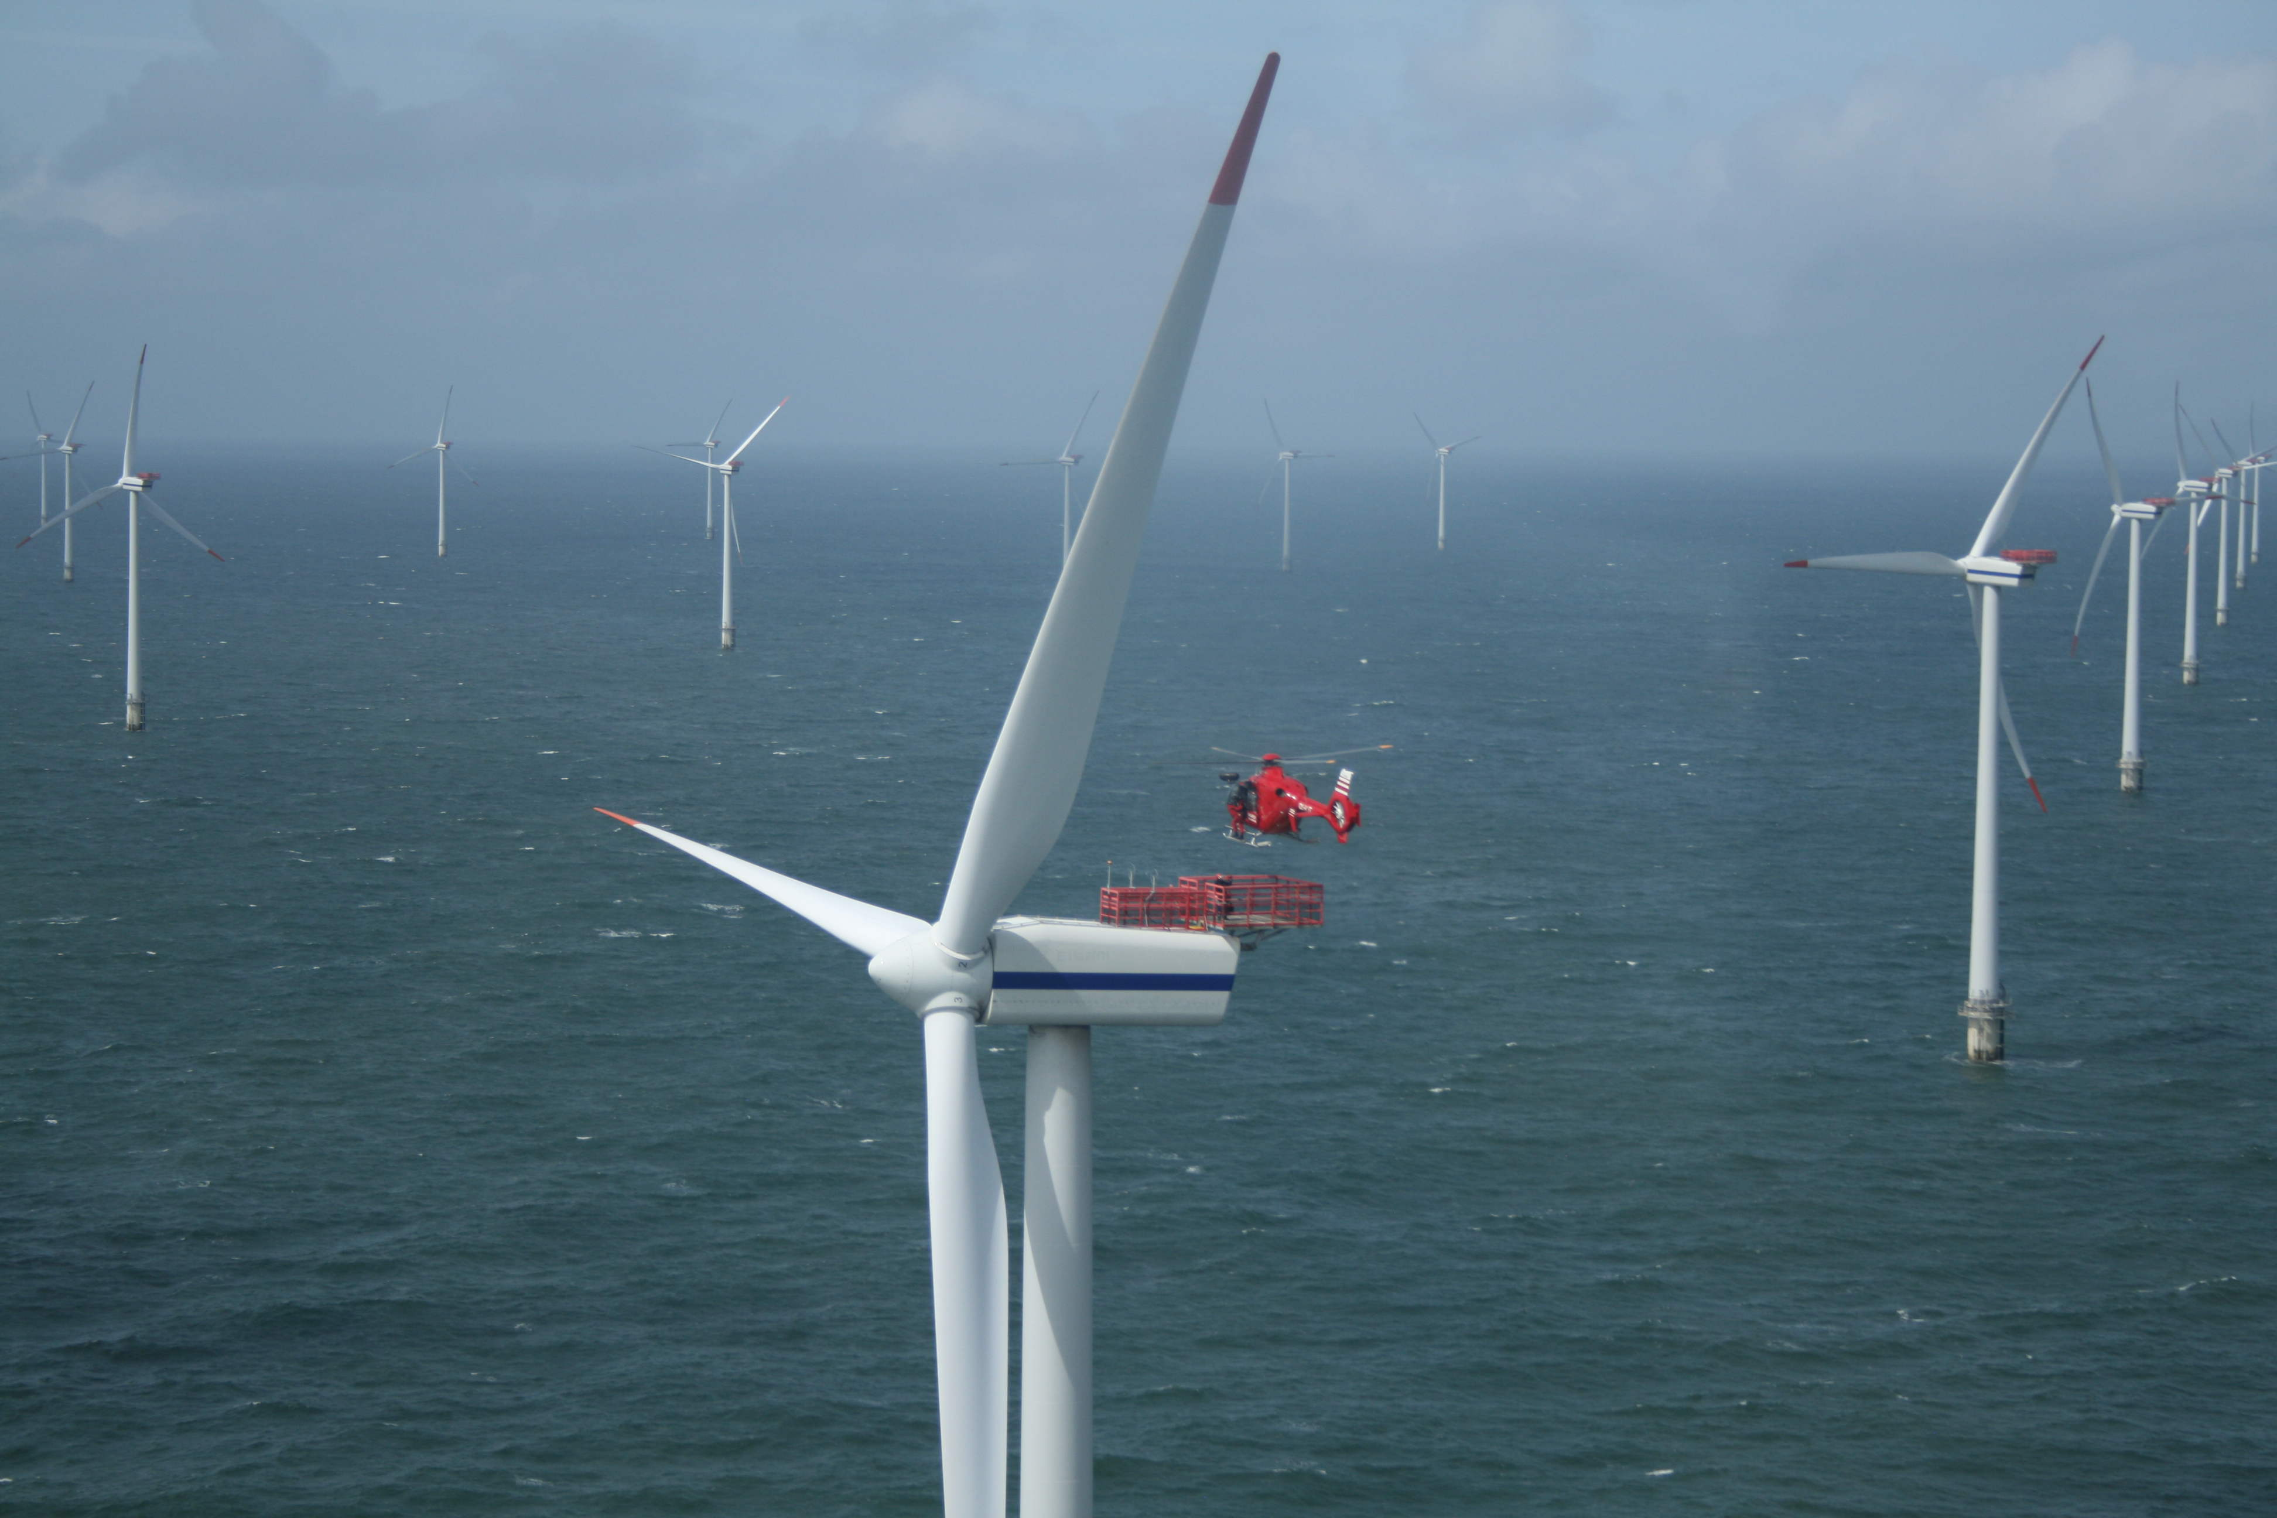






Rutgers University Coastal Ocean Observation Lab (RUCOOL):
Offshore Wind
Greg Seroka
Byrne Seminar:
“Energy Sustainability on Campus”
February 20, 2014

Slide 2
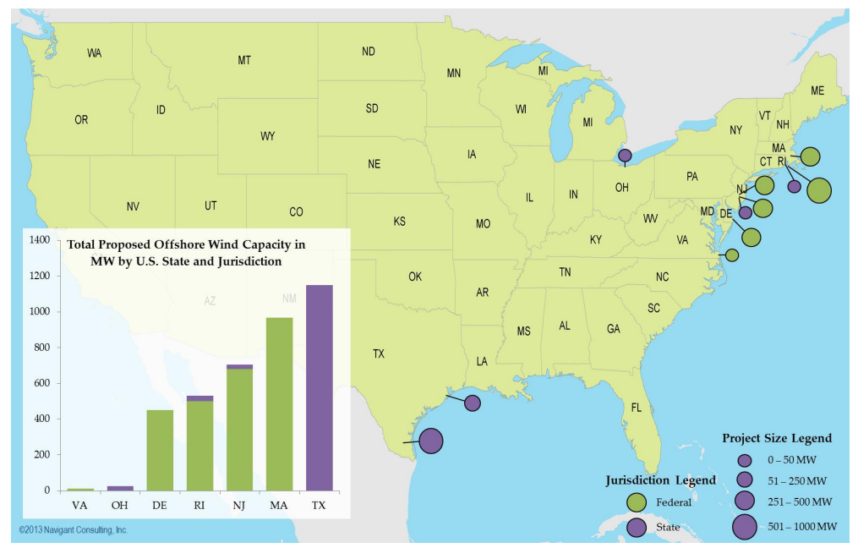
Proposed U.S. Offshore Wind Projects In Advanced Development Stages
Notes:
-Can mention RI, VA lease auctions already performed
-NJ, MA, DE, MD next (NJ farther along than even RI or MA in financing of projects)

Slide 3
U.S. Offshore Wind: Pros
More wind power potential offshore than onshore
Notes:
-closer to population centers- compare to Midwest- less transmission of power needed b/c of less distance
-East coast particularly likely for offshore wind growth due to close proximity to I95 corridor and shallow waters (floating turbines, which are still in research phase, would be needed in deeper West Coast waters)

Slide 4
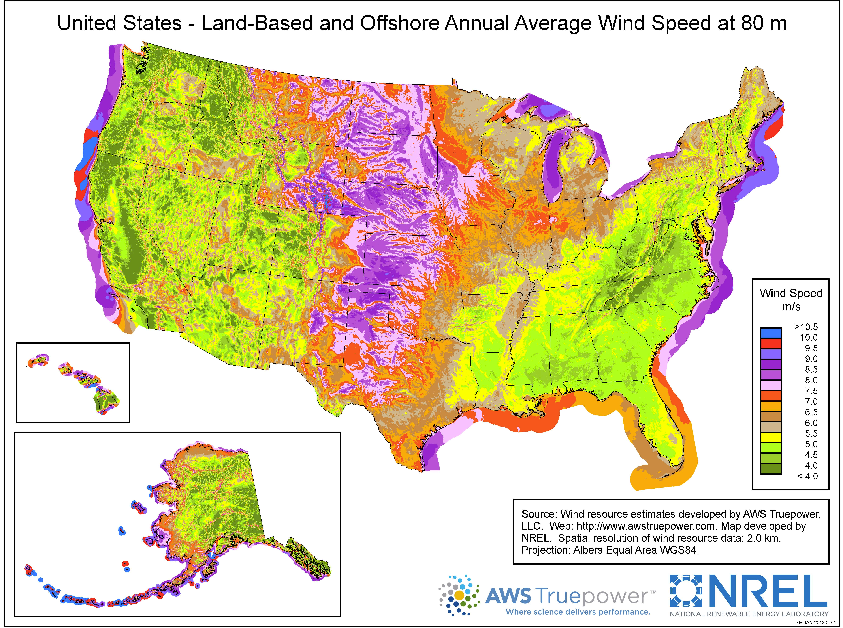
Notes:
-less friction, more wind, more consistent wind

Slide 5
U.S. Offshore Wind: Pros
More wind power potential offshore than onshore
Closer to population centers (coastal cities)
  Less transmission needed
U.S. energy security
Growth esp. along East Coast because:
  Proximity to I95 corridor
  Shallow waters
Notes:
-closer to population centers- compare to Midwest- less transmission of power needed b/c of less distance
-East coast particularly likely for offshore wind growth due to close proximity to I95 corridor and shallow waters (floating turbines, which are still in research phase, would be needed in deeper West Coast waters)

Slide 6
U.S. Offshore Wind: Cons
Cost competitiveness
Lack of infrastructure
  Offshore transmission
  Ports, vessels
Uncertain, lengthy regulatory processes
  e.g. year-by-year extension of Production, Investment Tax Credit (PTC, ITC)
Notes:
-closer to population centers- compare to Midwest- less transmission of power needed b/c of less distance
-East coast particularly likely for offshore wind growth due to close proximity to I95 corridor and shallow waters (floating turbines, which are still in research phase, would be needed in deeper West Coast waters)

Slide 7
Wind Variability
Wind (and solar) are variable renewable energy sources
  2 primary ways to improve cost competitiveness:
    Storage
    Diagnosis, prediction of wind variance
      Backup generation planning (high costs, emissions b/c of power plant “cycling”)
      Construction, maintenance strategies
      Cost-effective integration into & operation in PJM market (power generation forecasting/next-day trading)
Scarce oceanic observations limit #2’s efforts: onshore ($100K) vs. offshore met tower (up to $10 million)
Notes:
Existing DOE and NREL annual average offshore wind resource maps fail to represent variability
Also, by integrating wind estimates with economic modeling, can lower risks of offshore wind development by defining economic cost-benefit analysis under various scenarios

Slide 8
BOEM Call Area

Slide 9
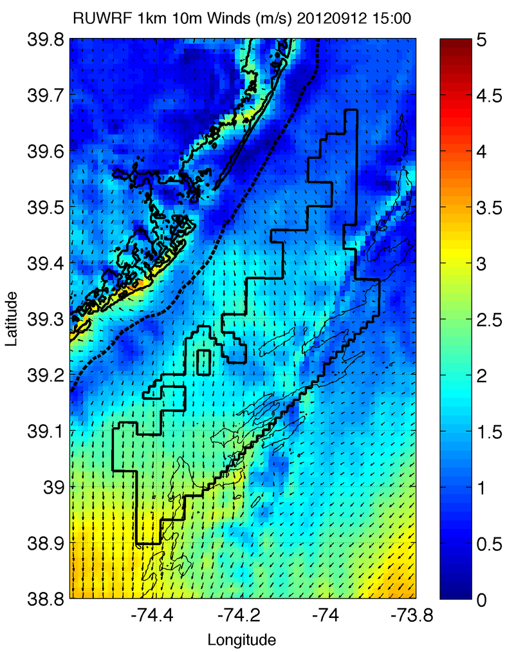
Sea Breeze Variability
To resolve, need both:
Atmosphere and Ocean observations
+
Atmosphere and Ocean modeling

Slide 10
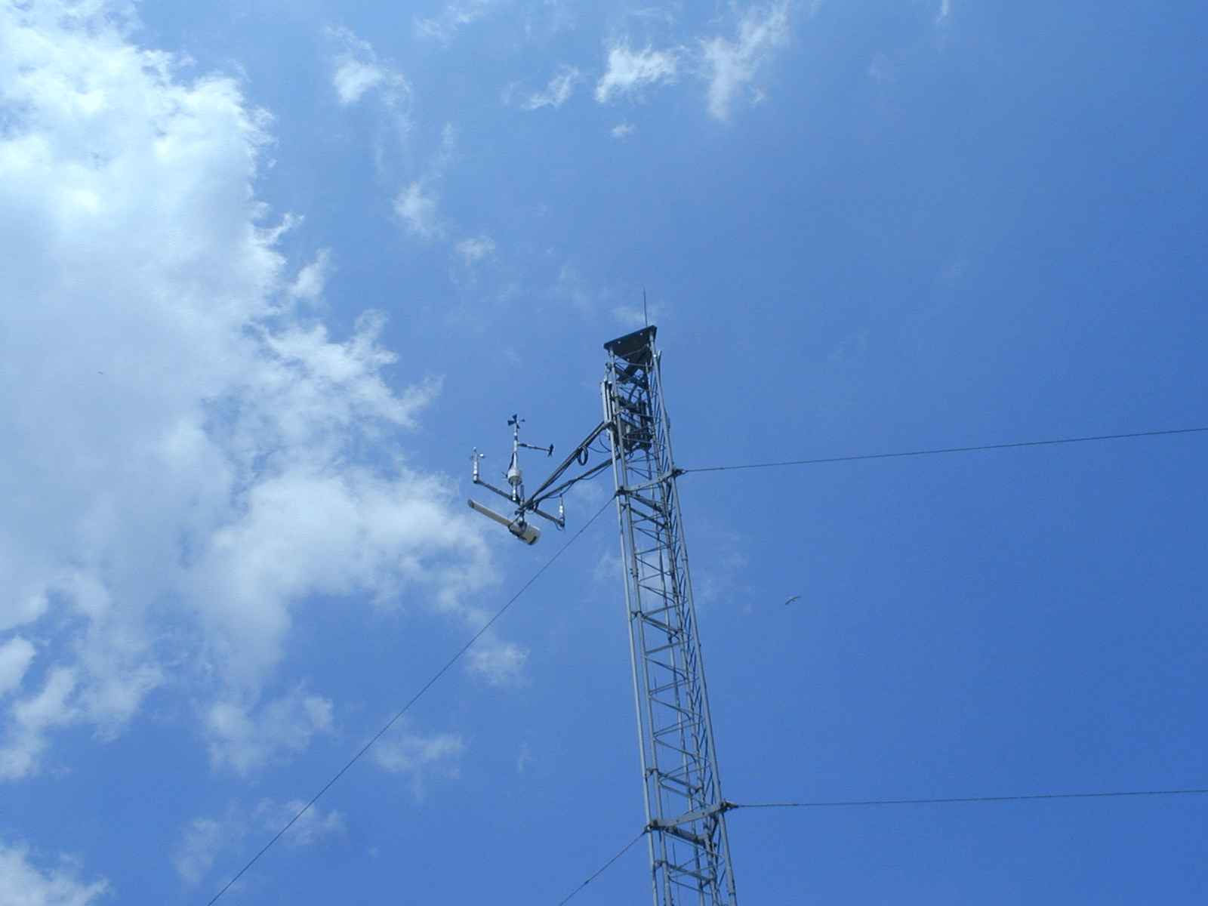
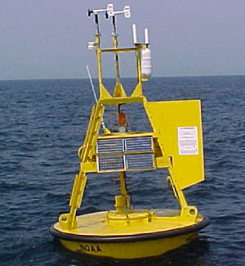
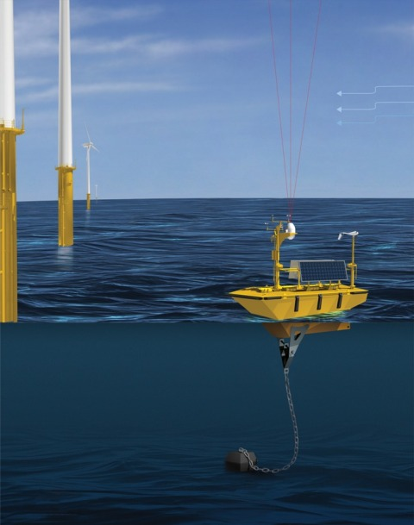
Coastal/Offshore Monitoring
Meteorological Tower
Meteorological Buoy
Coastal/Offshore Scanning LIDAR
Offshore vertical LIDAR
Notes:
-offshore met towers very expensive (multi-million dollar projects!)
-first two cannot provide full spatial, temporal variability in wind
-LIDARs can (esp. scanning LIDAR) but expensive and limited in range
-satellite cannot monitor winds directly, especially at a sufficient resolution
-CODAR cannot monitor winds directly, especially at wind turbine height

Slide 11
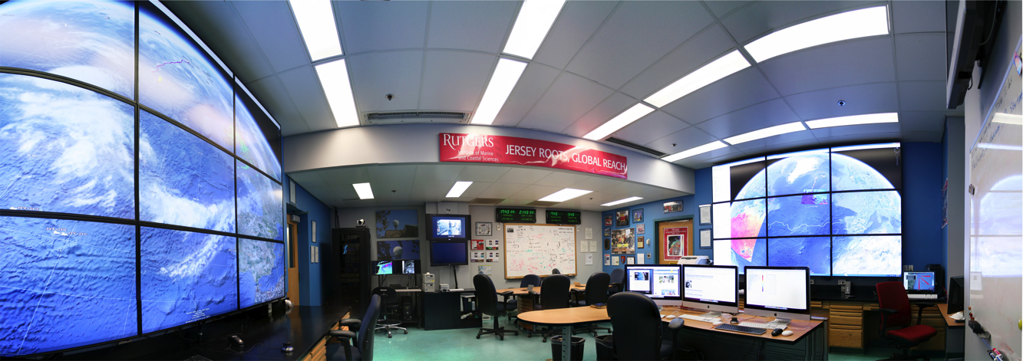
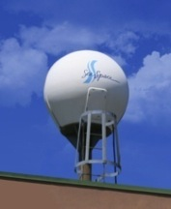
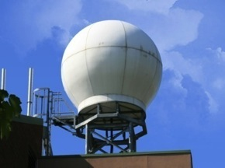
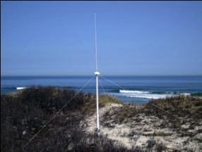
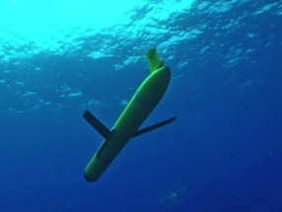
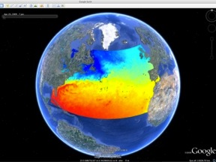
Rutgers University - Coastal Ocean Observation Lab
Operations, Research & Education Center
Vessels -
Satellite
Satellite
CODAR
Ships/ Vessels
Glider
REMUS
Data Vis.
Modeling
Security
Leadership
Education
Satellite Data Acquisition Stations
CODAR Network
Glider Fleet
3-D Forecasts

Slide 12
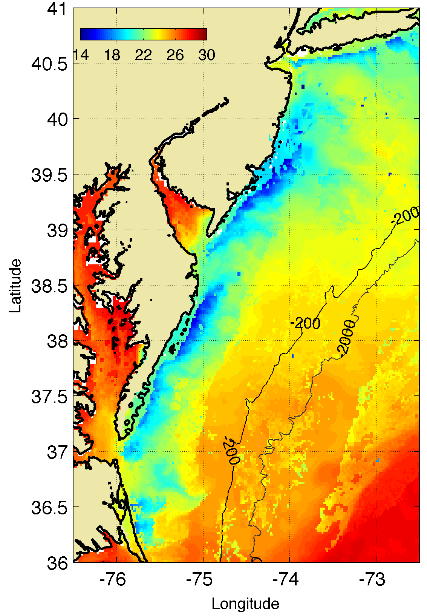
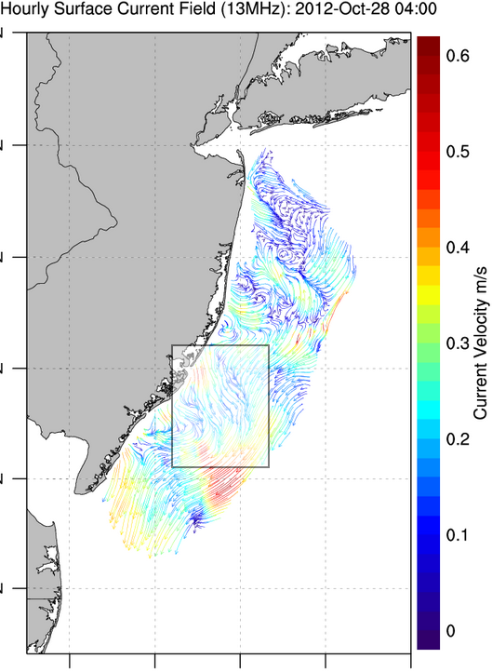
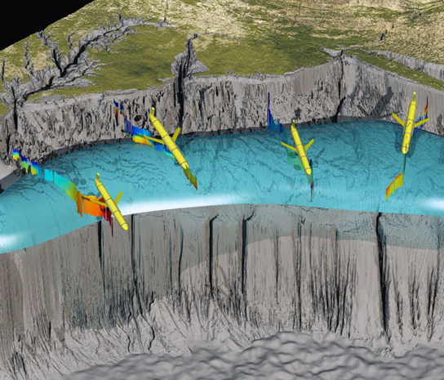
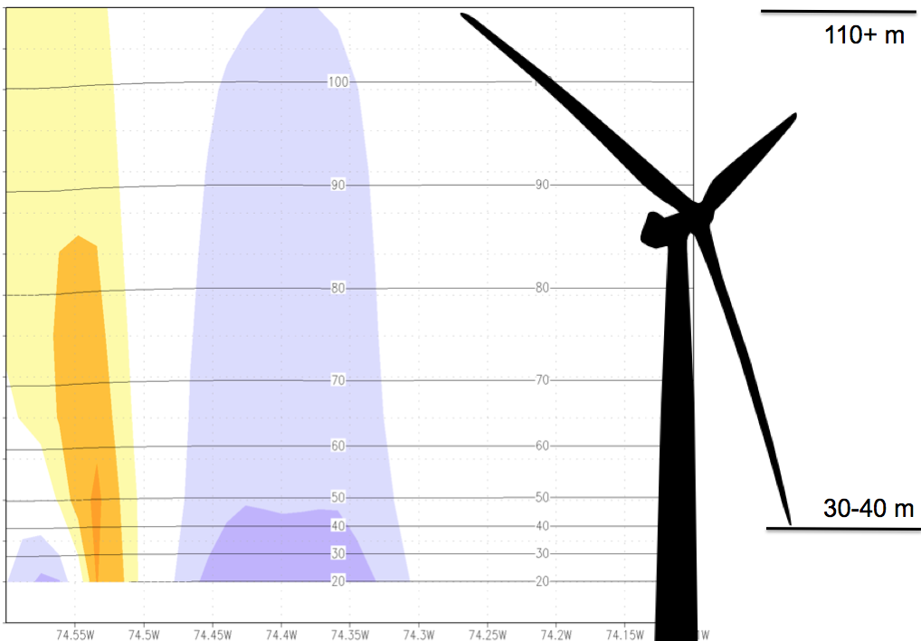
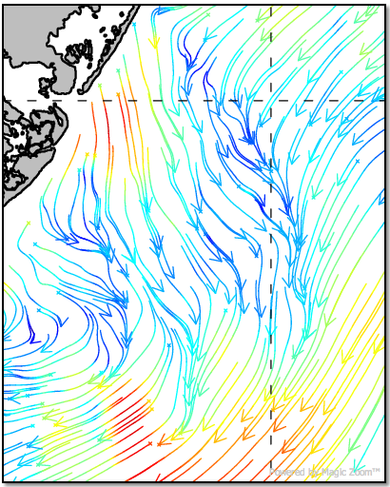
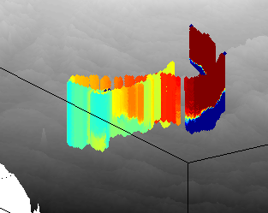
Rutgers University - Coastal Ocean Observation Lab
Operations, Research & Education Center
Vessels -
Satellite
Satellite
CODAR
Ships/ Vessels
Glider
REMUS
Data Vis.
Modeling
Security
Leadership
Education
Satellite Data Acquisition Stations
CODAR Network
Glider Fleet
3-D Forecasts

Slide 13
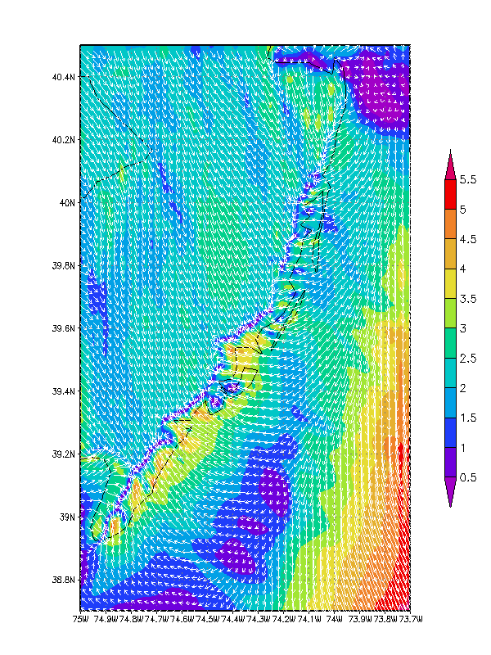
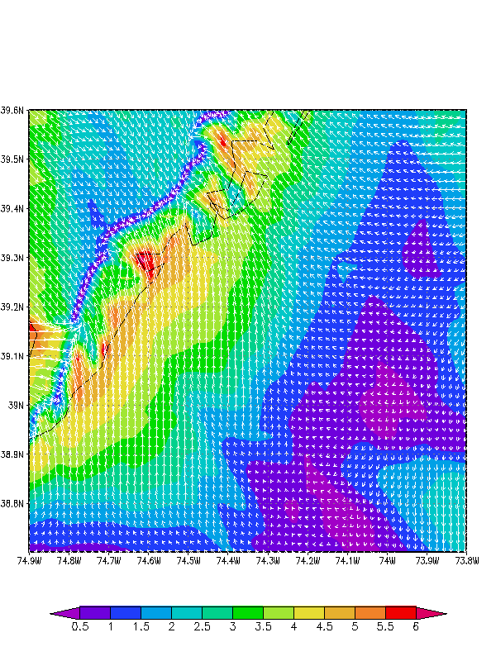
State of New Jersey
New Jersey Board of Public Utilities (NJBPU)
An Advanced Atmosphere/Ocean Assessment Program:
Reducing the Risks Associated with Offshore Wind Energy Development
As Defined by The NJ Energy Master Plan and
The NJ Offshore Wind Energy Economic Development Act
Principal Investigators: Dr. Scott Glenn and Dr. Rich Dunk, CCM
Team Members: Dr. Josh Kohut, Dr. Hugh Roarty, Louis Bowers, Greg Seroka,
John Kerfoot, Laura Palamara, Mike Crowley, Ethan Handel, Colin Evans
New Ocean Data
Hi-Res Weather Model
Spatial Validation Data
Wind Power Statistics
rucool.marine.rutgers.edu/bpu
Notes:
-Demonstrate variability of the offshore wind resource for designated study area by using high resolution nested atmospheric WRF model
-Validate modeling efforts with existing data as well as with developer’s coastal/offshore data (scanning LIDAR, axis LIDAR, three 60m coastal met towers)
-NJ sea breeze has large impact on wind resource during peak energy demand season
-Sea surface temperature is a critical input variable to the atmospheric model for producing accurate wind resource assessments; RUCOOL has developed a unique technique for declouding satellite imagery to ensure that coastal upwelling and storm mixing processes can be resolved
-CODAR is a unique monitoring system for detecting surface currents and the associated spatial wind variability within the study area; wave data and spatial variability of the waves from CODAR can also be used to determine surface roughness features which is an input to the atmospheric model
-This work can be used as a basis for a representative forecasting/predicting program

Slide 14



Current Phase: Rutgers IMCS-CEEEP
Rutgers IMCS monitoring and modeling analyses to support Rutgers CEEEP in the following NJ OSW evaluations:
Economic
Energy
Environmental
Notes:
Lower risks of OSW development by providing baseline economic cost-benefit analysis

Slide 15
Future Possibilities
This work can be used as a basis for a representative forecasting/predicting program
Show economic viability of offshore wind
Most efficient integration into grid
Day ahead bidding of energy by utilities
Construction, operation, maintenance
Notes:
-Provide wind forecasts which can be used to predict variability in wind and optimize integration of electricity into the existing grid

