Slide 1
Contact Information:
Dr. Rich Dunk: dunk@marine.rutgers.edu
Greg Seroka: seroka@marine.rutgers.edu
Dr. Travis Miles: tnmiles@marine.rutgers.edu
Data and Reports Available: http://rucool.marine.rutgers.edu/bpu
Presentation given to RES Americas & DONG
June 6, 2016
Modeling & Evaluation of New Jersey’s Offshore Wind Resource

Slide 2
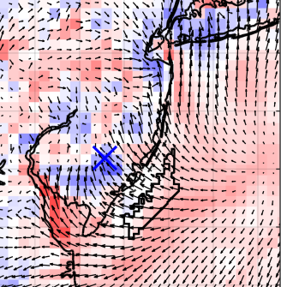
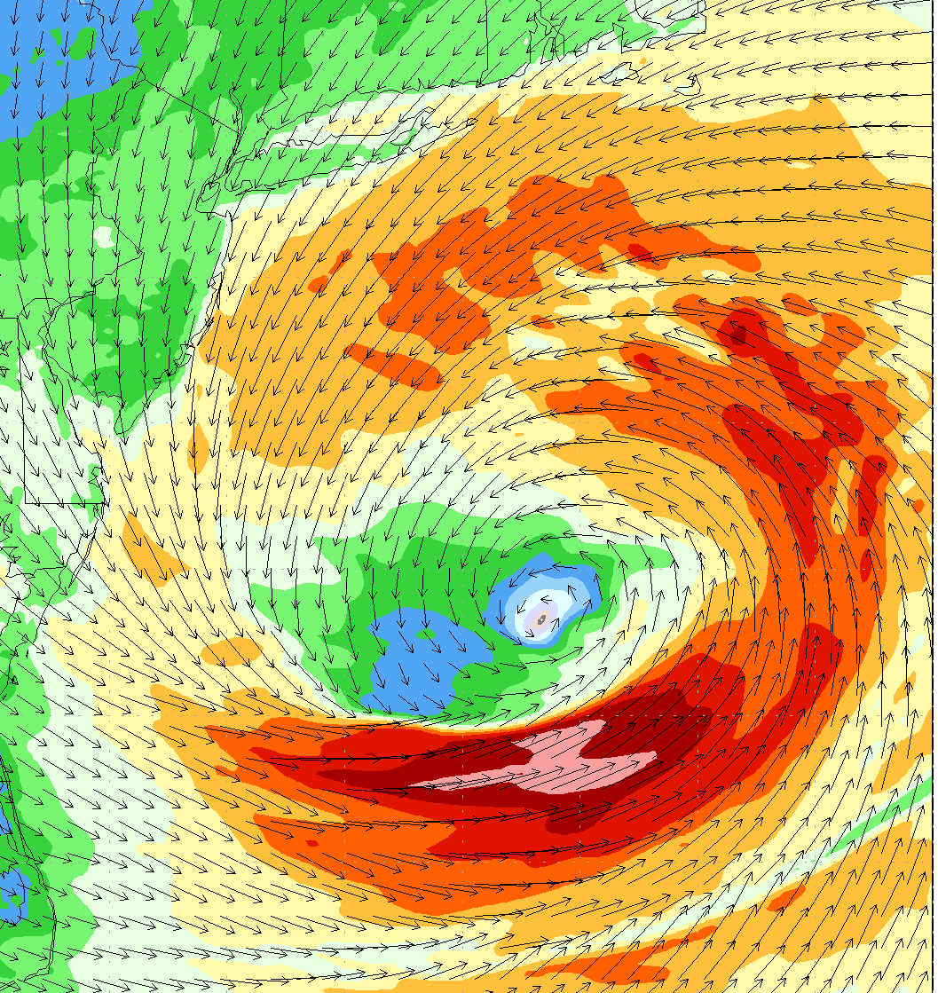
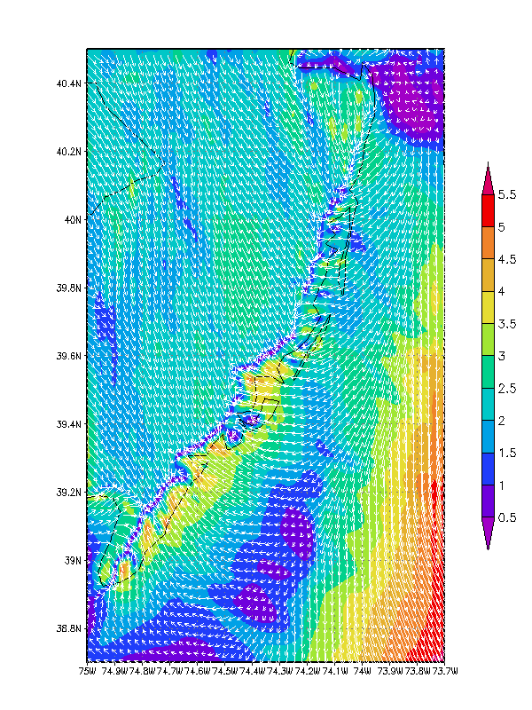
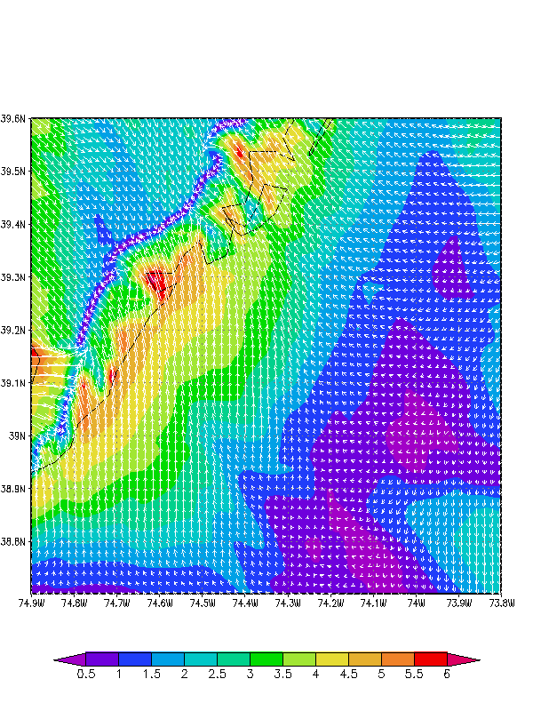

New Jersey Studies of Interest- BOEM
Innovative Sea Breeze Analyses
Ongoing:
Modeling & Evaluation of New Jersey’s
Offshore Wind Resource (Rutgers Univ.)
Atmospheric/oceanic modeling of NJ Offshore Wind Lease Areas
Hourly 3D modeled wind speed 2011-present
Tropical Cyclone Modeling
New Ocean Data
Hi-Res Weather Model
Spatial Validation Data
Wind Power Statistics

Slide 3
New Jersey Studies of Interest- BOEM
Innovative Sea Breeze Analyses
Ongoing:
Modeling & Evaluation of New Jersey’s
Offshore Wind Resource (Rutgers Univ.)
Hourly kWh data, net capacity factor for hypothetical wind farm scenarios
Connections with economic models at RU CEEEP
Tropical Cyclone Modeling
New Ocean Data
Hi-Res Weather Model
Spatial Validation Data
Wind Power Statistics

Slide 4
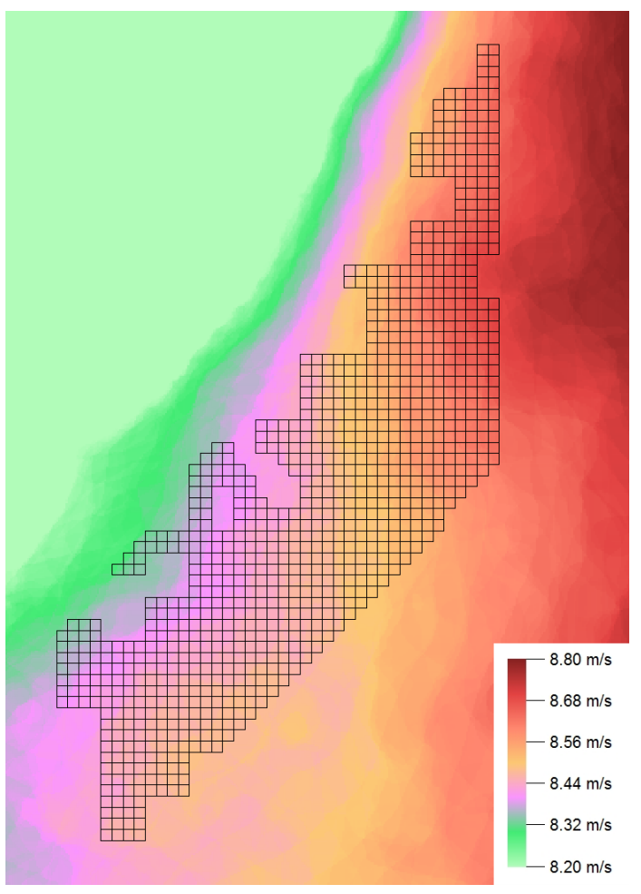
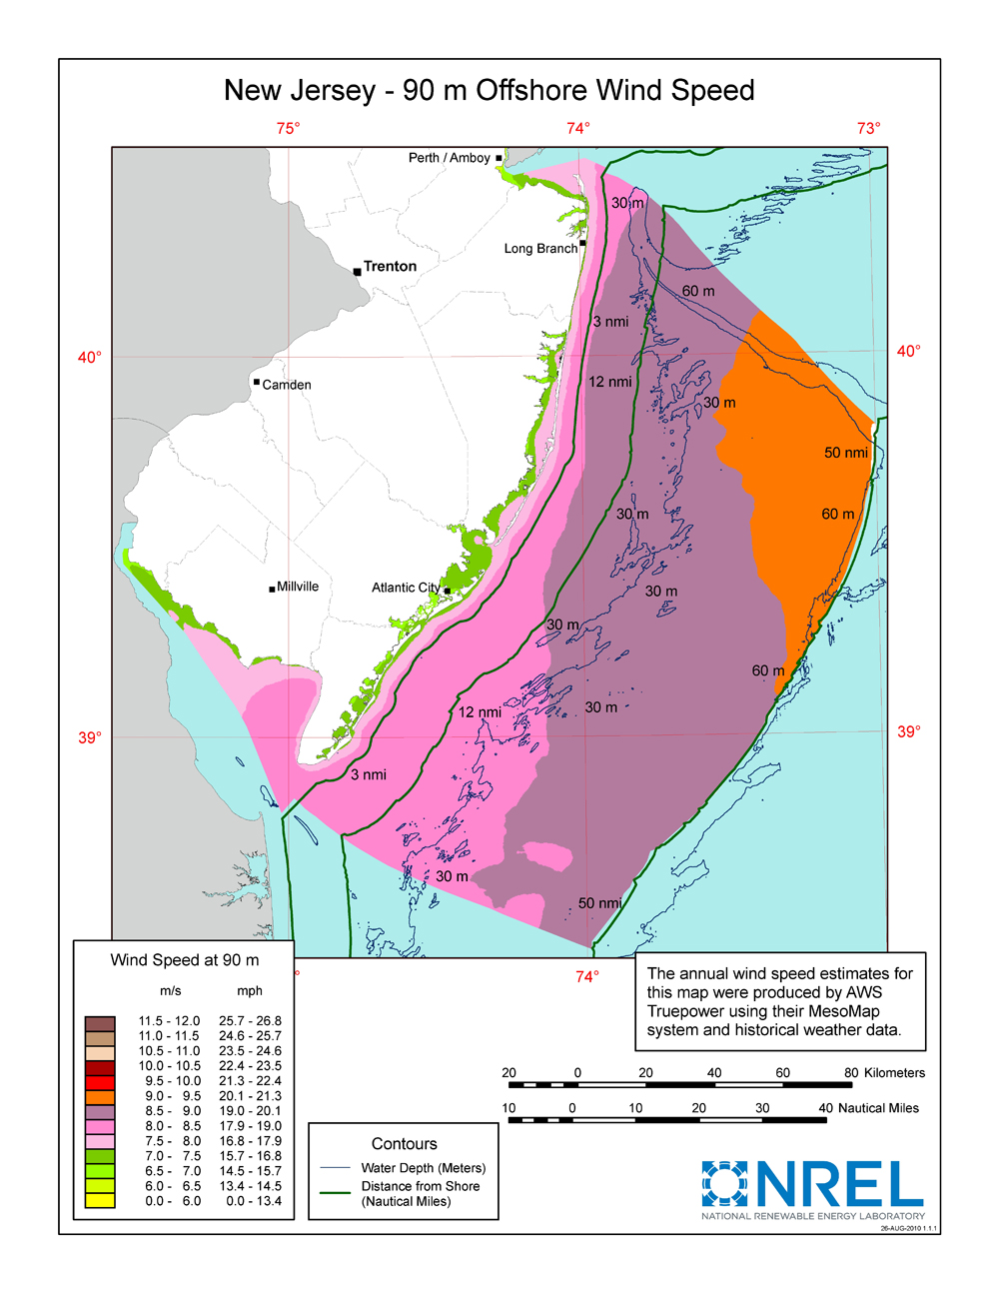


Motivation for OSW Program
Offshore wind (OSW) developers typically use annual average
wind distribution + wind rose for “site suitability” and project planning
Modeling at >=20km grid spacing
Annual Average
NJ WEA Potential Capacity >=3,000 MW

Slide 5
Motivation for OSW Program
NJ BPU OSW Rules require applications to include analysis of project generation during peak electricity demand and on an annual basis over twenty years.
2013-14 PJM Mid-Atl. Daily Max Load
Relative Load
Wind resource variations during peak electricity demand can be caused by sea breeze and intermittent coastal storm events.

Slide 6
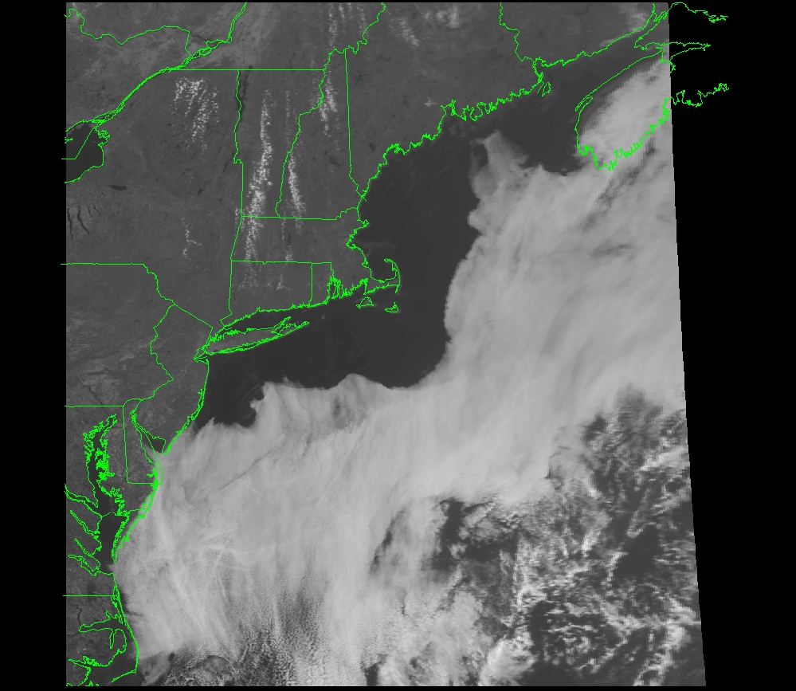
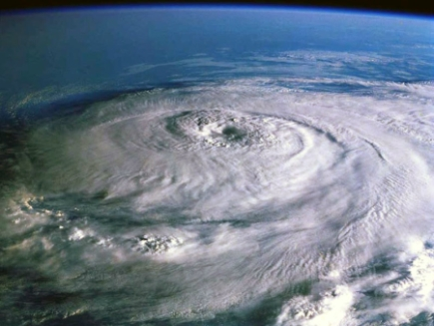
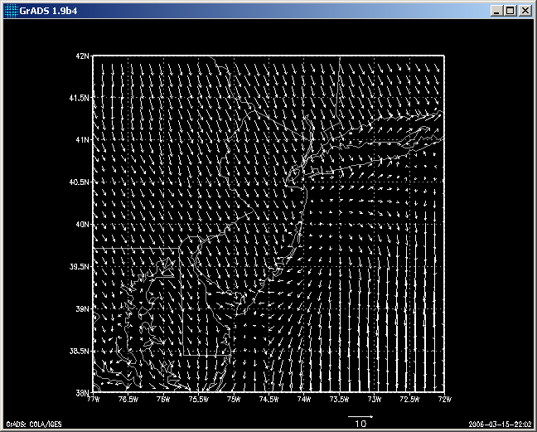
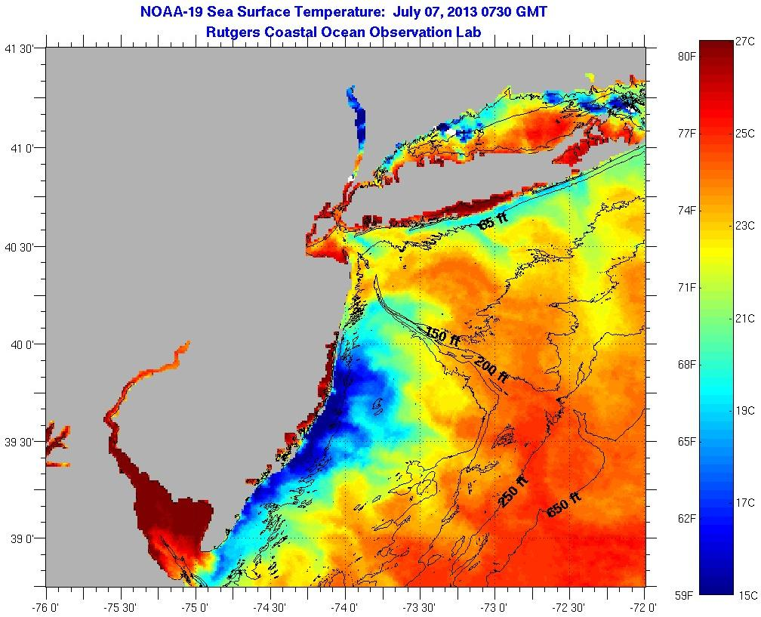
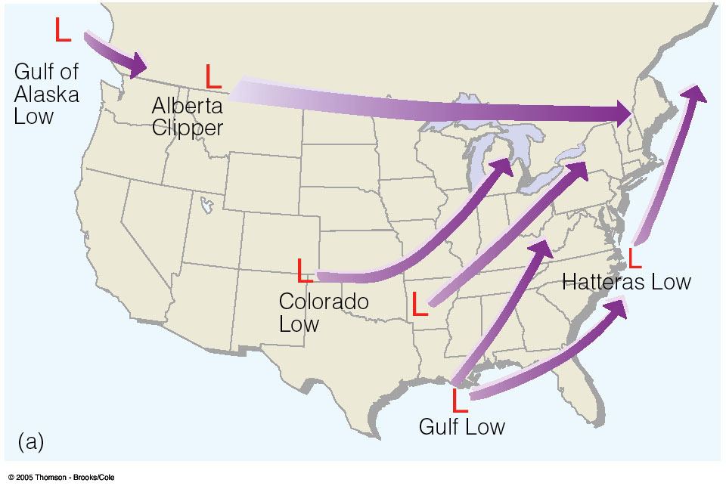
Sources of NJ Wind Variability
Sea Breeze Circulation
Tropical Cyclones
Peak Energy Demand
Peak Energy Demand
Coastal Upwelling
Winter Storms
Secondary Peak Energy Demand
Peak Energy Demand

Slide 7
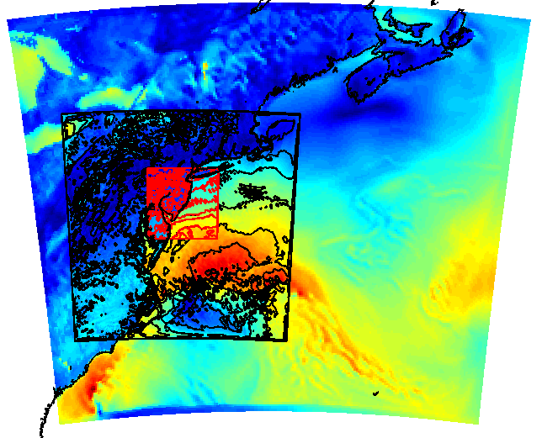
Rutgers University Weather Research & Forecasting
(RU-WRF) Model
Run Continuously 2011 – Present
Triple nested: 9km-3km-1km
  9km: 0, 6, 12, 18Z cycles
  3km: 0, 12Z cycles
  1km: 12Z cycle (Research Mode)
Vertical Levels:
  40-42; more tightly packed near surface
Hourly forecast: out to 5 days (9km),
2 days (3km) and 1 day (1km)
Boundary Conditions:
  9km: 0.25 degree Global Forecast System
  3km: RU-WRF 9km
  1km: RU-WRF 3km
  Satellite SSTs: state-of-the-science declouded coldest pixel composite SST to resolve coastal upwelling and storm mixing
RU-WRF Domains
9km
3km
1km
STANDARD MET VARIABLES SAVED – temperature, pressure, wind speed and direction, wind gusts, solar radiation, humidity, precipitation, etc.
Notes:
High Resolution
Long-time period (5 years)
Sea

Slide 8
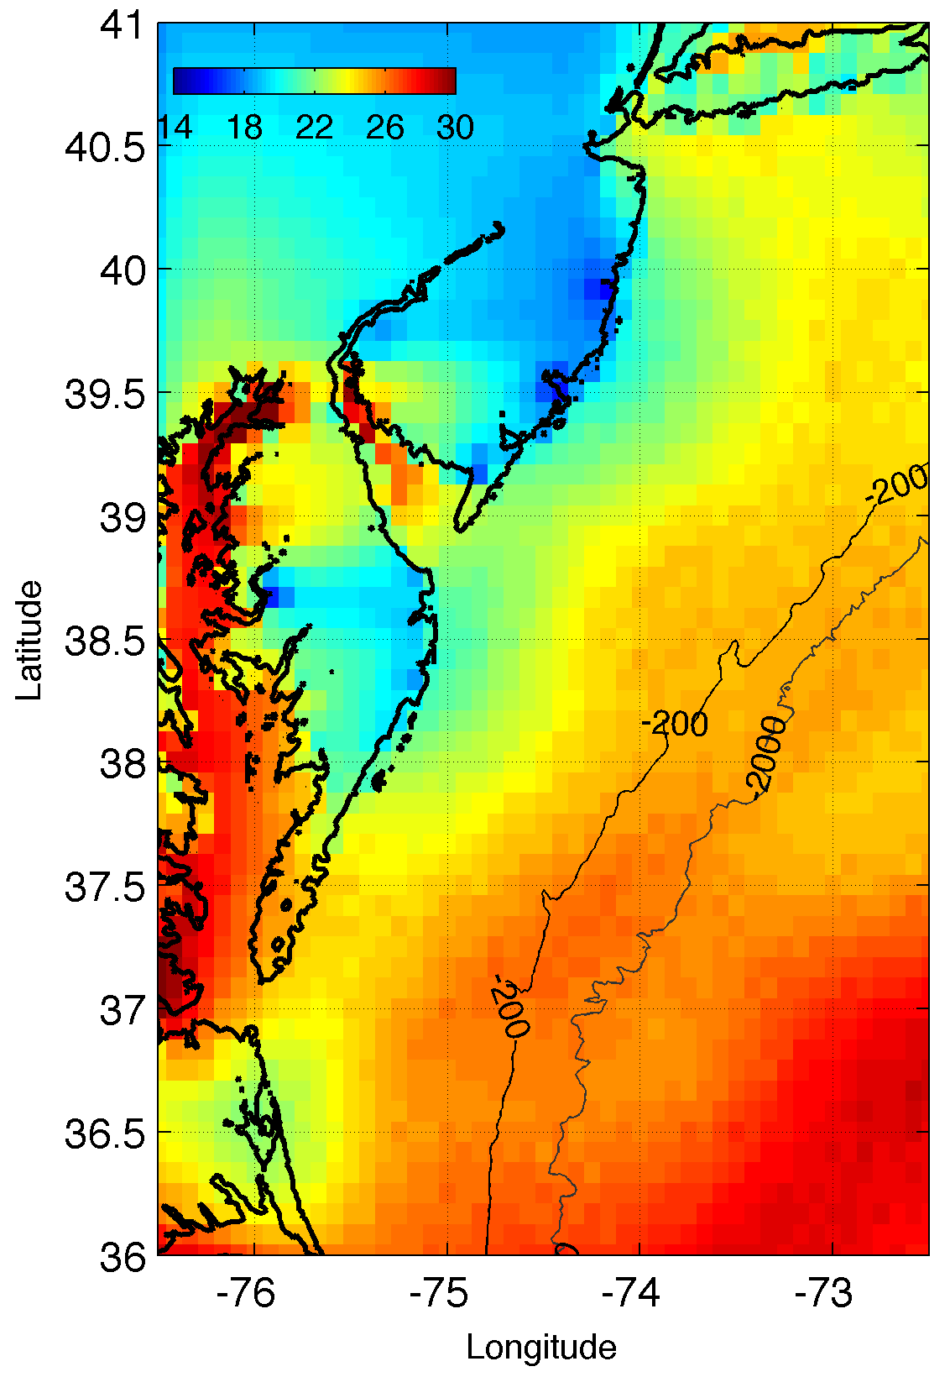
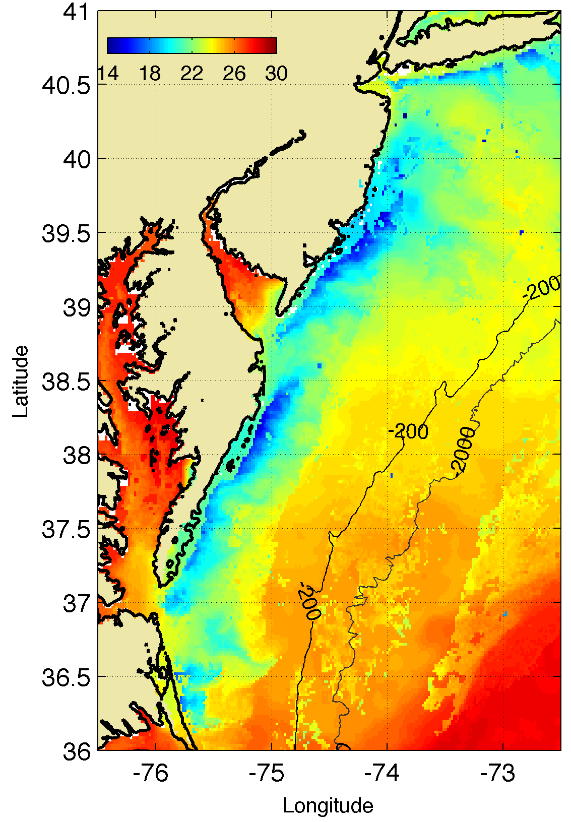
RU-WRF uses coldest pixel SST composite
for bottom boundary conditions
  Web: http://rucool.marine.rutgers.edu/ruwrf-mesoscale-meteorological-model-forecast
Example:
8 July 2013 Upwelling
RTG SST
Coldest Pixel
SST

Slide 9
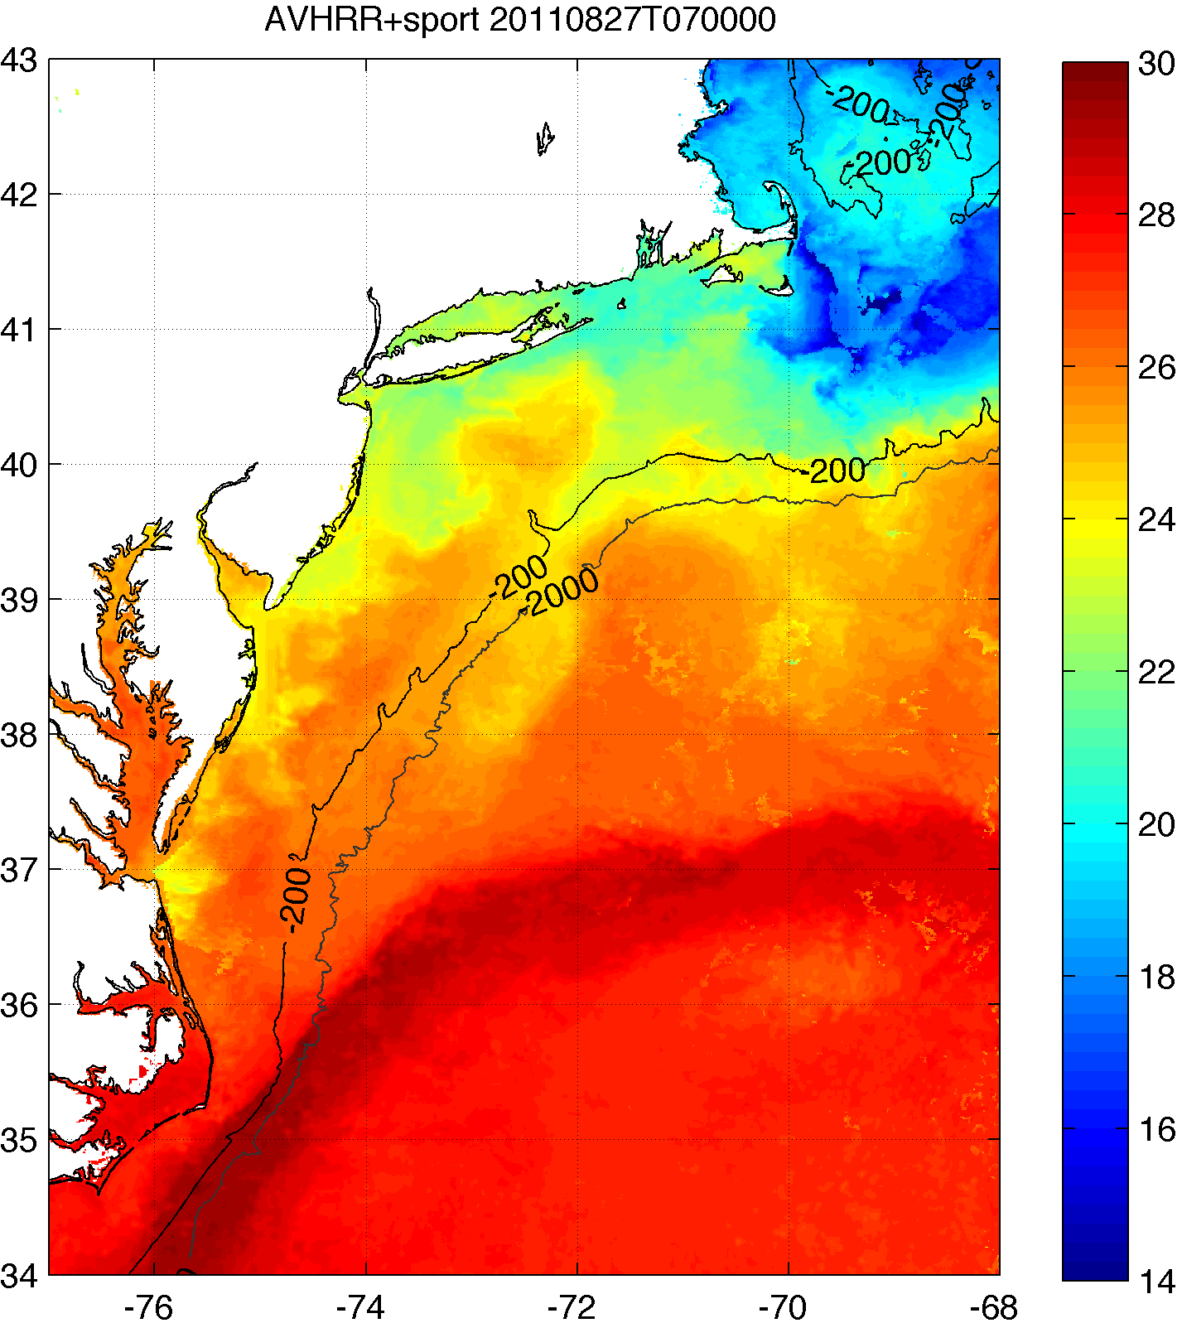
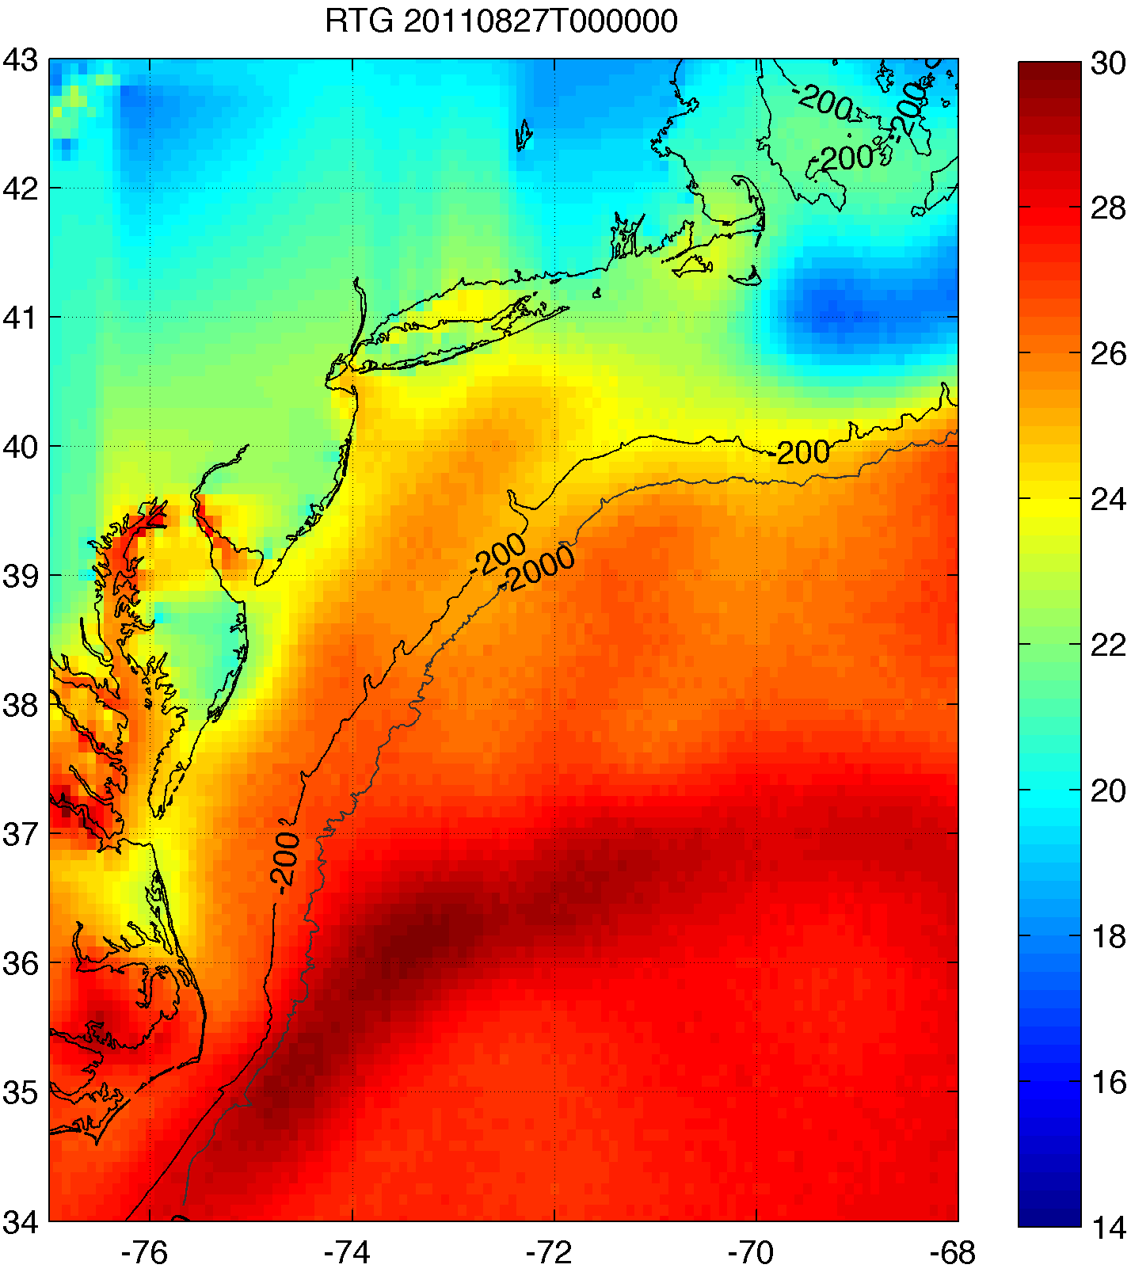
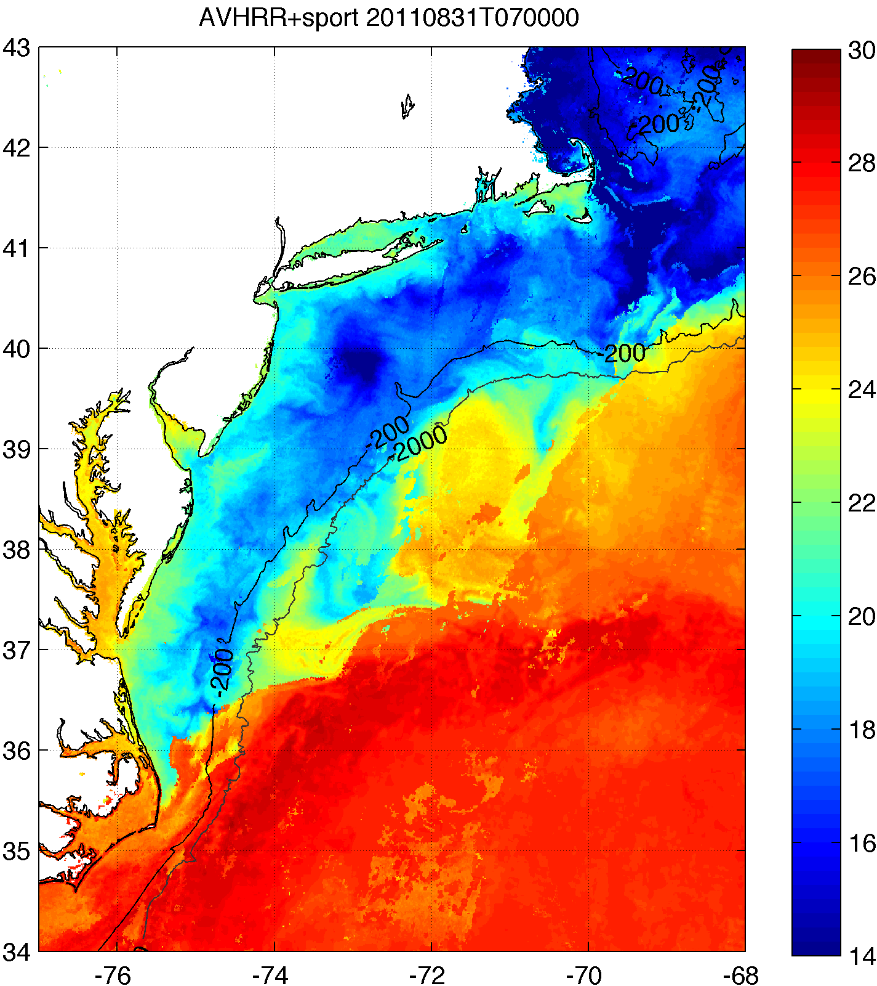
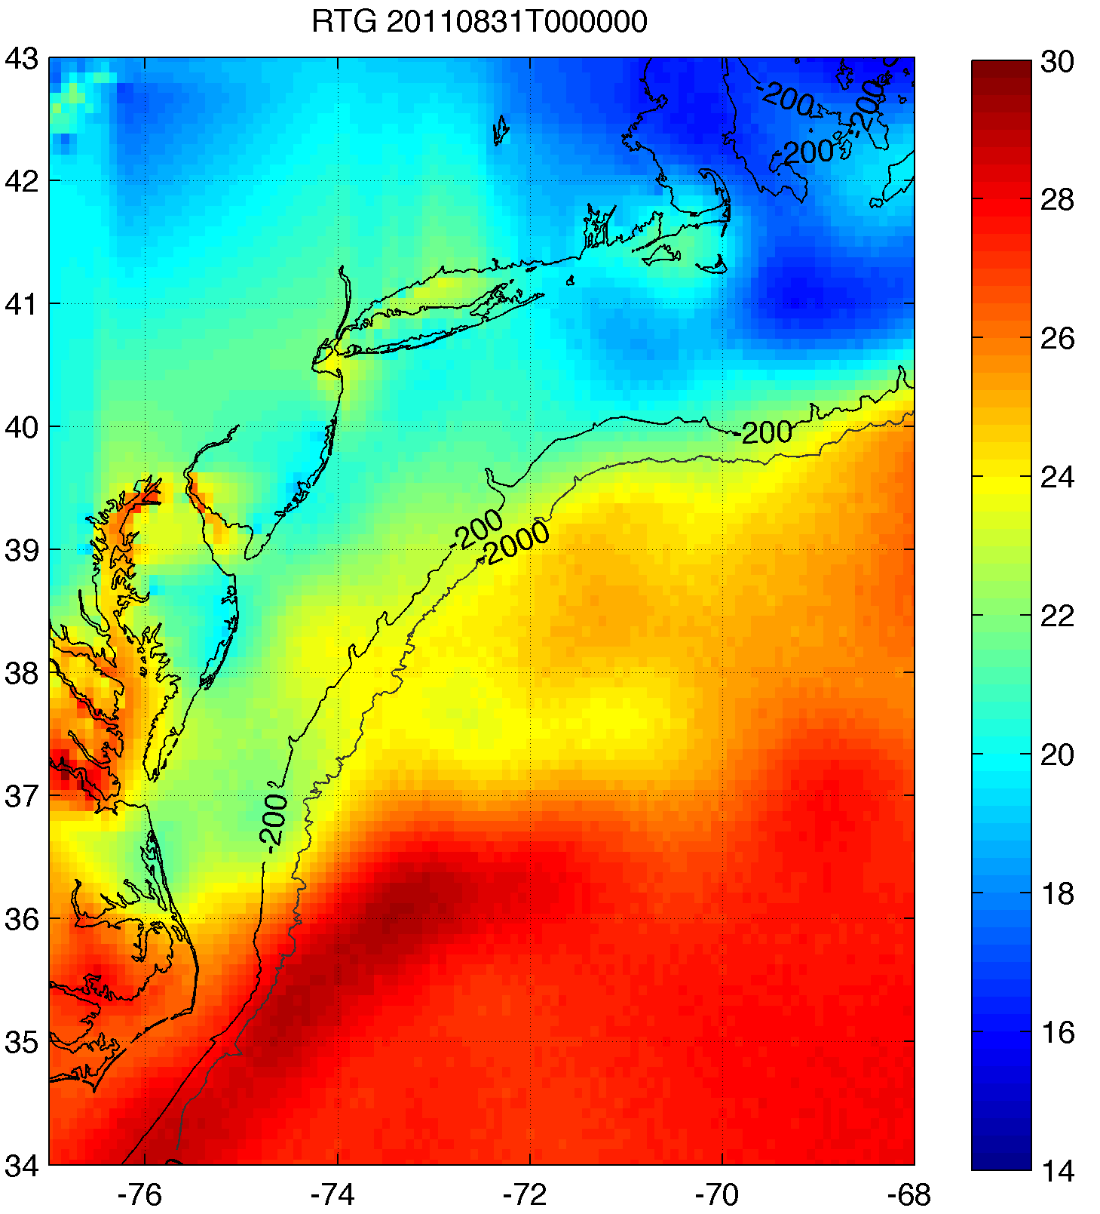
RU-WRF uses coldest pixel SST composite
for bottom boundary conditions
  Web: http://rucool.marine.rutgers.edu/ruwrf-mesoscale-meteorological-model-forecast
Rutgers SST
RTG HR SST
NAM model
BEFORE IRENE
Example:
Hurricane Irene
August 2011
AFTER IRENE

Slide 10
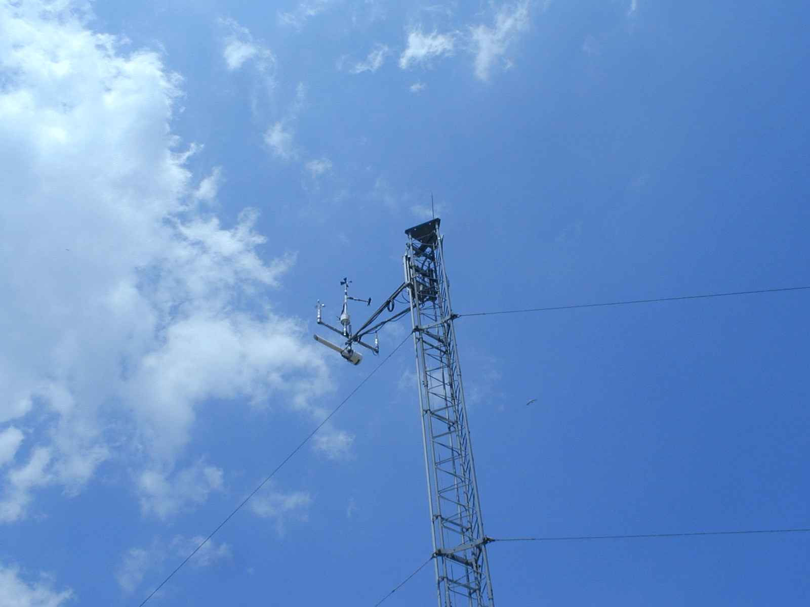
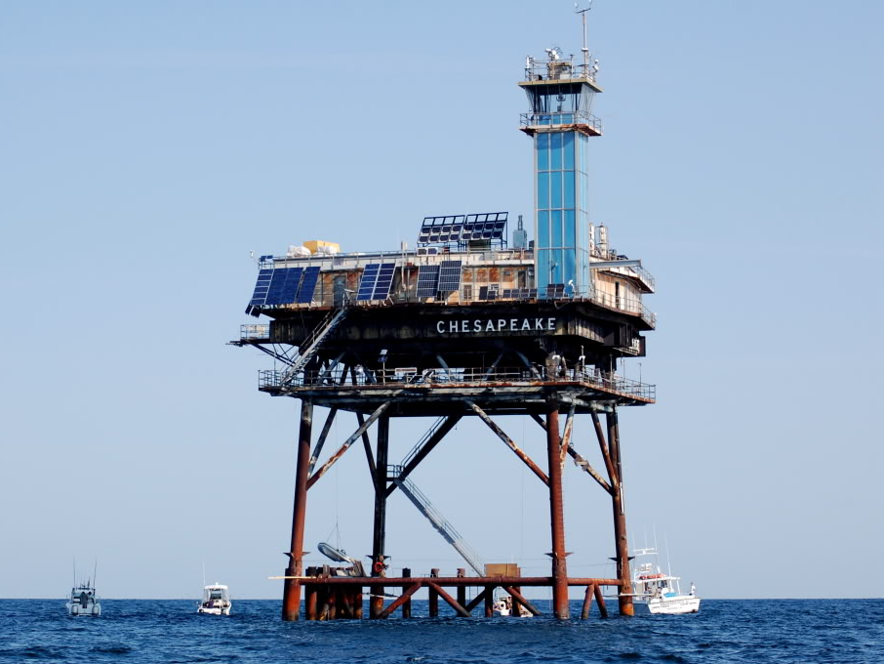
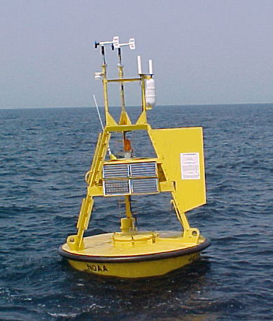
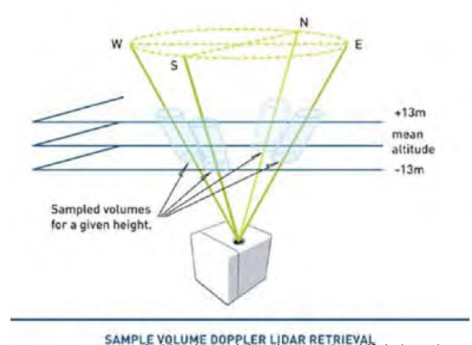
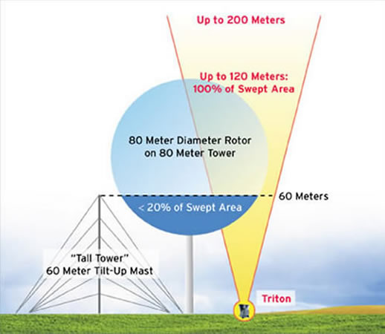
Coastal/Offshore Monitoring
Coastal Met Towers
Offshore Met Monitoring Platform and Met Buoy
Coastal SoDAR and LiDAR Remote Monitoring Systems
Coastal Radar (CODAR)
Notes:
Fishermen: already deployed monitoring buoy, once done go to one 10 nm out
-purchased offshore vertical lidar, measure wind spd, dir, turbulence, deployed in June
-bought scanning lidar, deployed at end of summer
-bought wind tracer near Margate, see 10 nm offshore, in vertical
-2-3 60m met towers along coast, instrumented at 3 levels
Offshore Megawatt (German): no monitoring, rely on our study
Bluewater Wind: claim deploying monitoring sites at end of summer
Garden State Offshore Energy (part PSEG, part Deepwater Wind): vertical lidar on buoy, validate in Rhode Island, target this summer with LIDAR

Slide 11
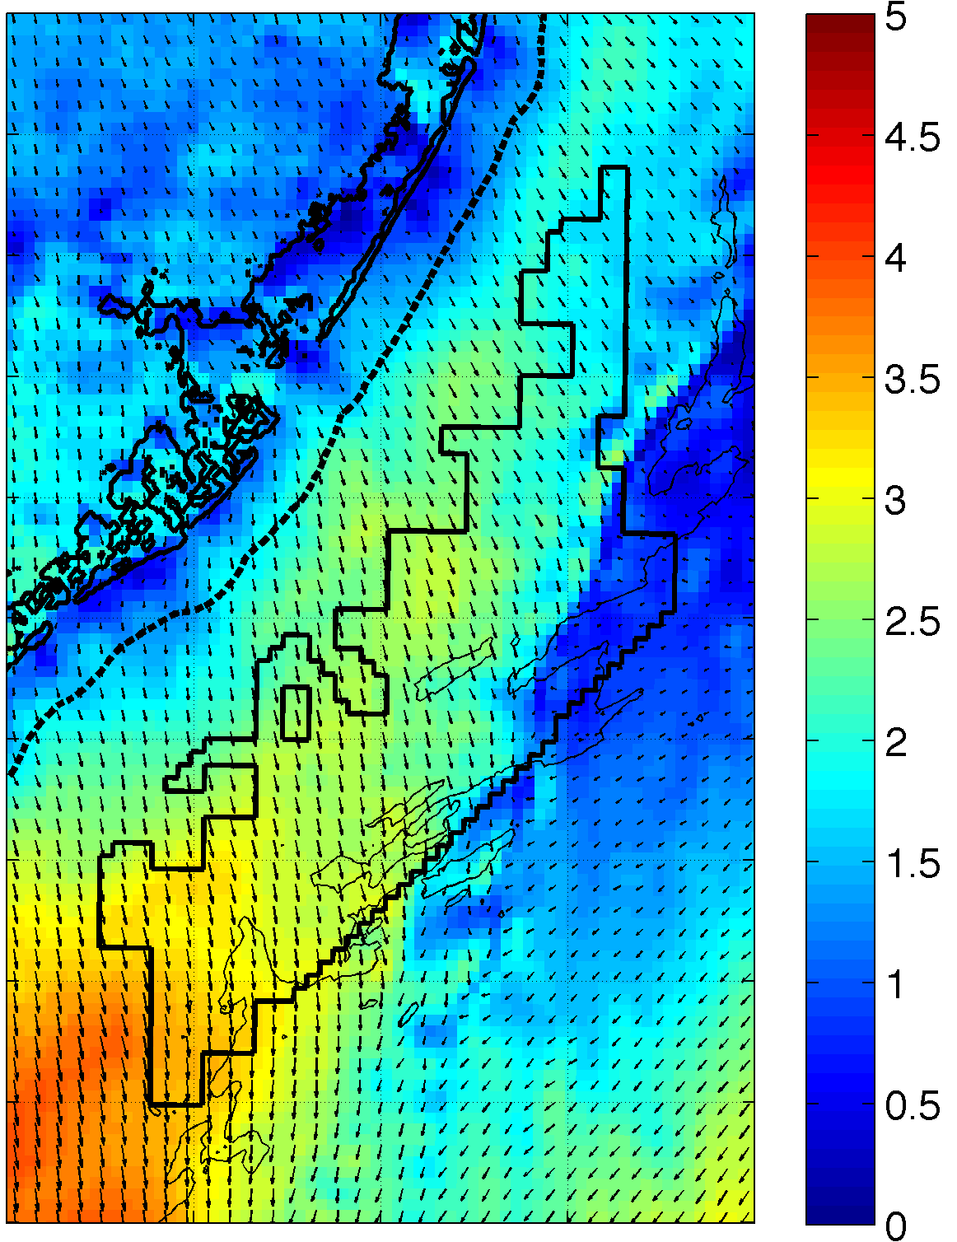
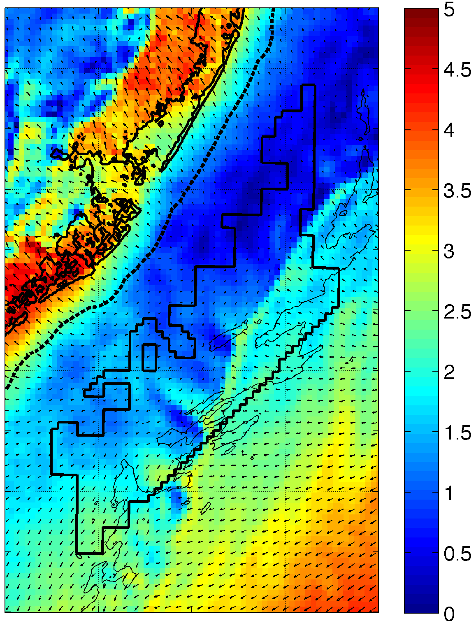
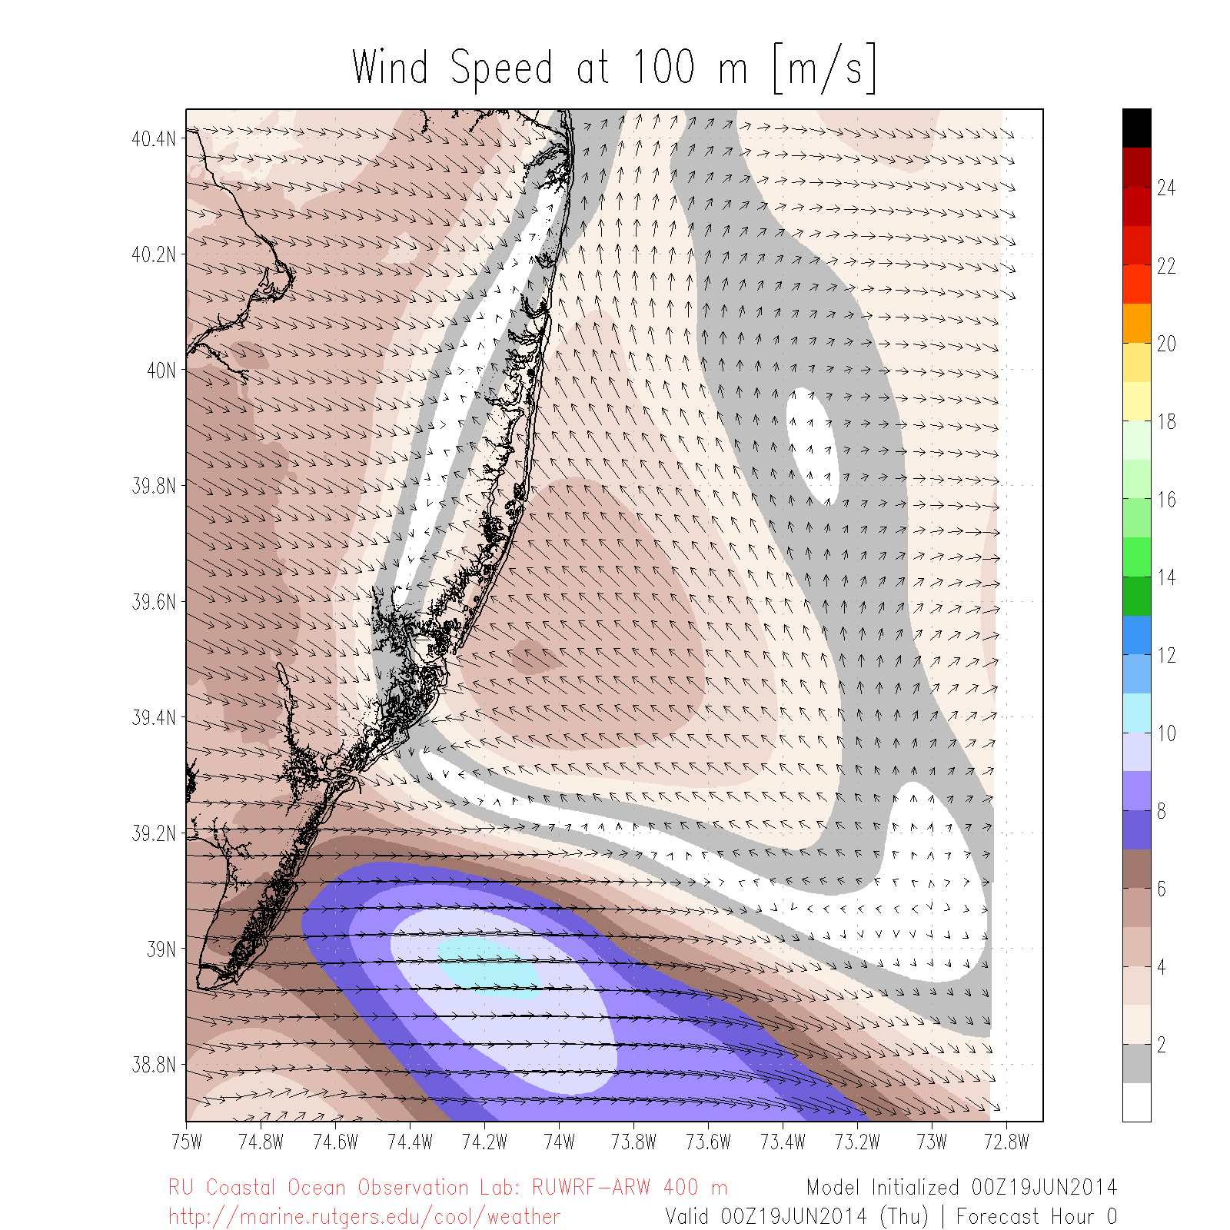
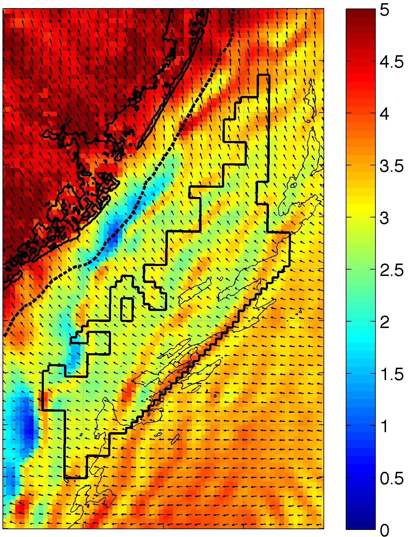
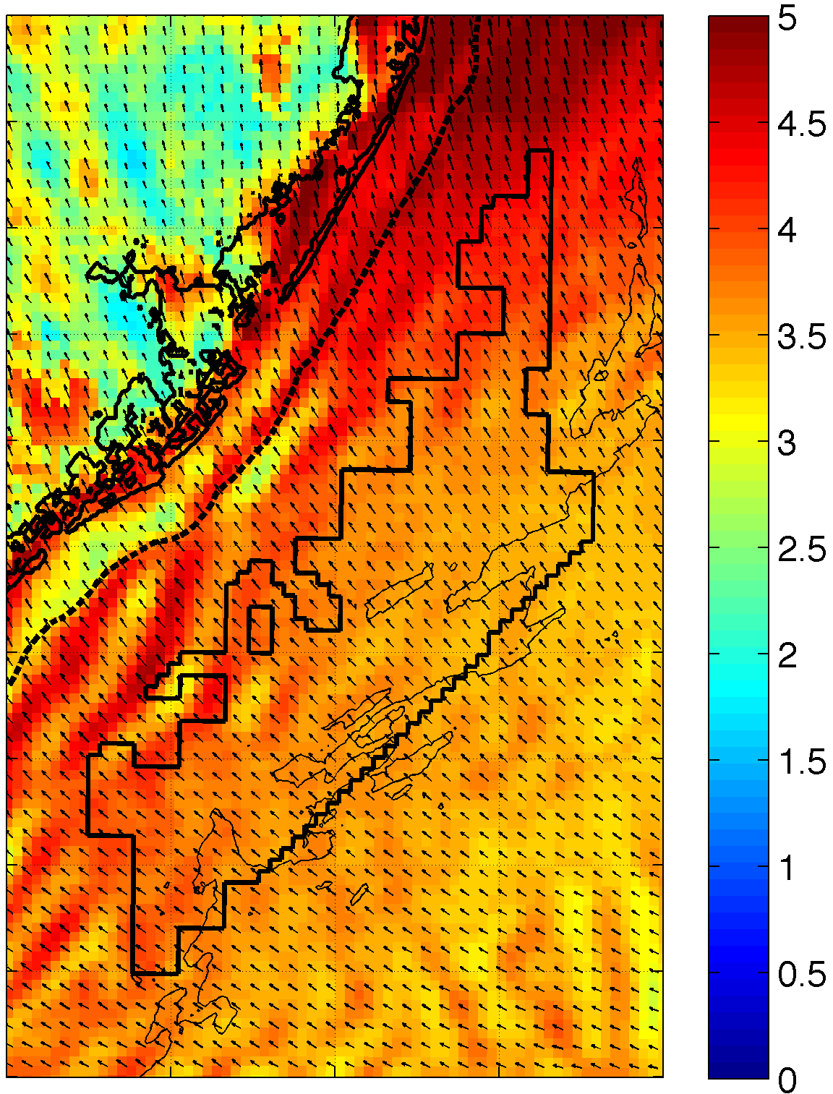
Wind Variability: Sea Breeze
RU-WRF Model Performance
September 12, 2012 10m Winds
June 19, 2014 100m Winds
14:00
17:00
20:00
23:00

Slide 12
Wind Variability: Sea Breeze
RU-WRF Model Performance
Land wind direction
Onshore wind direction
Offshore wind direction
Wind Speed [m/s]
RU-WRF Model 2km Simulation

Slide 13
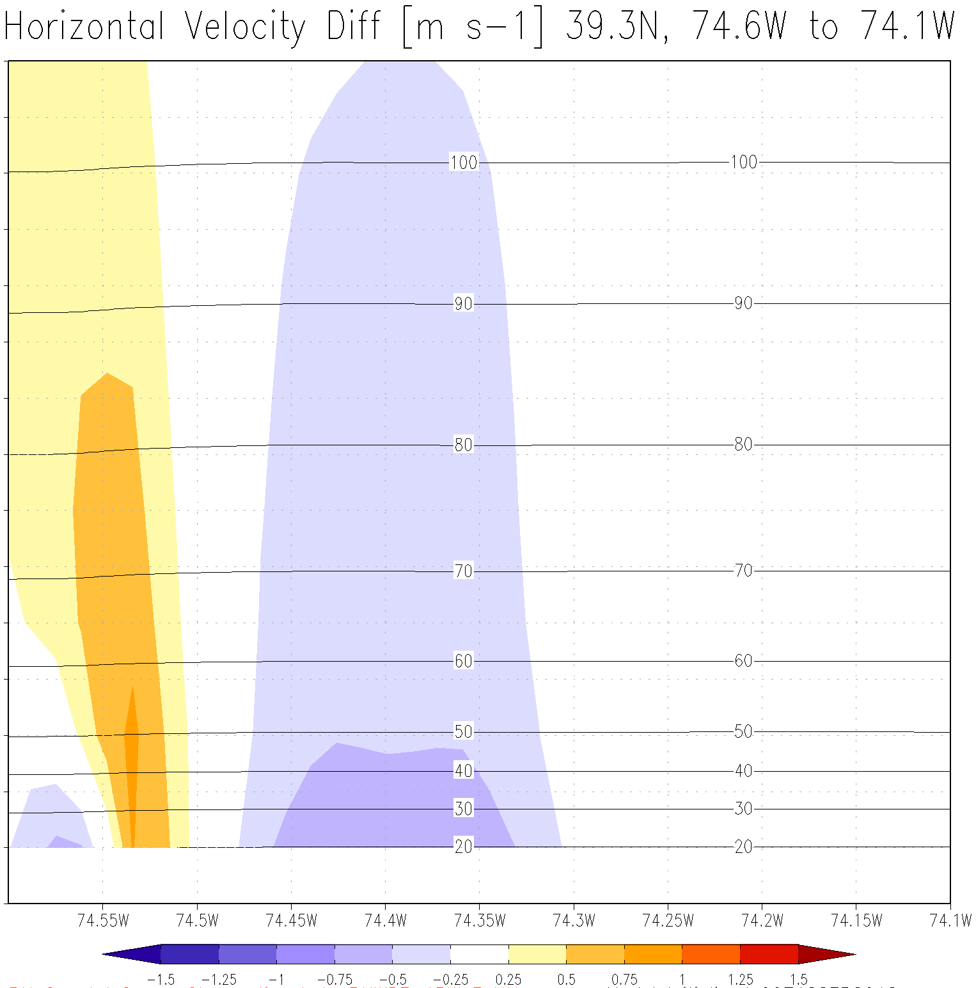

Wind Variability: Coastal Upwelling
RU-WRF Model Performance
110+ m
30-40 m

Slide 14
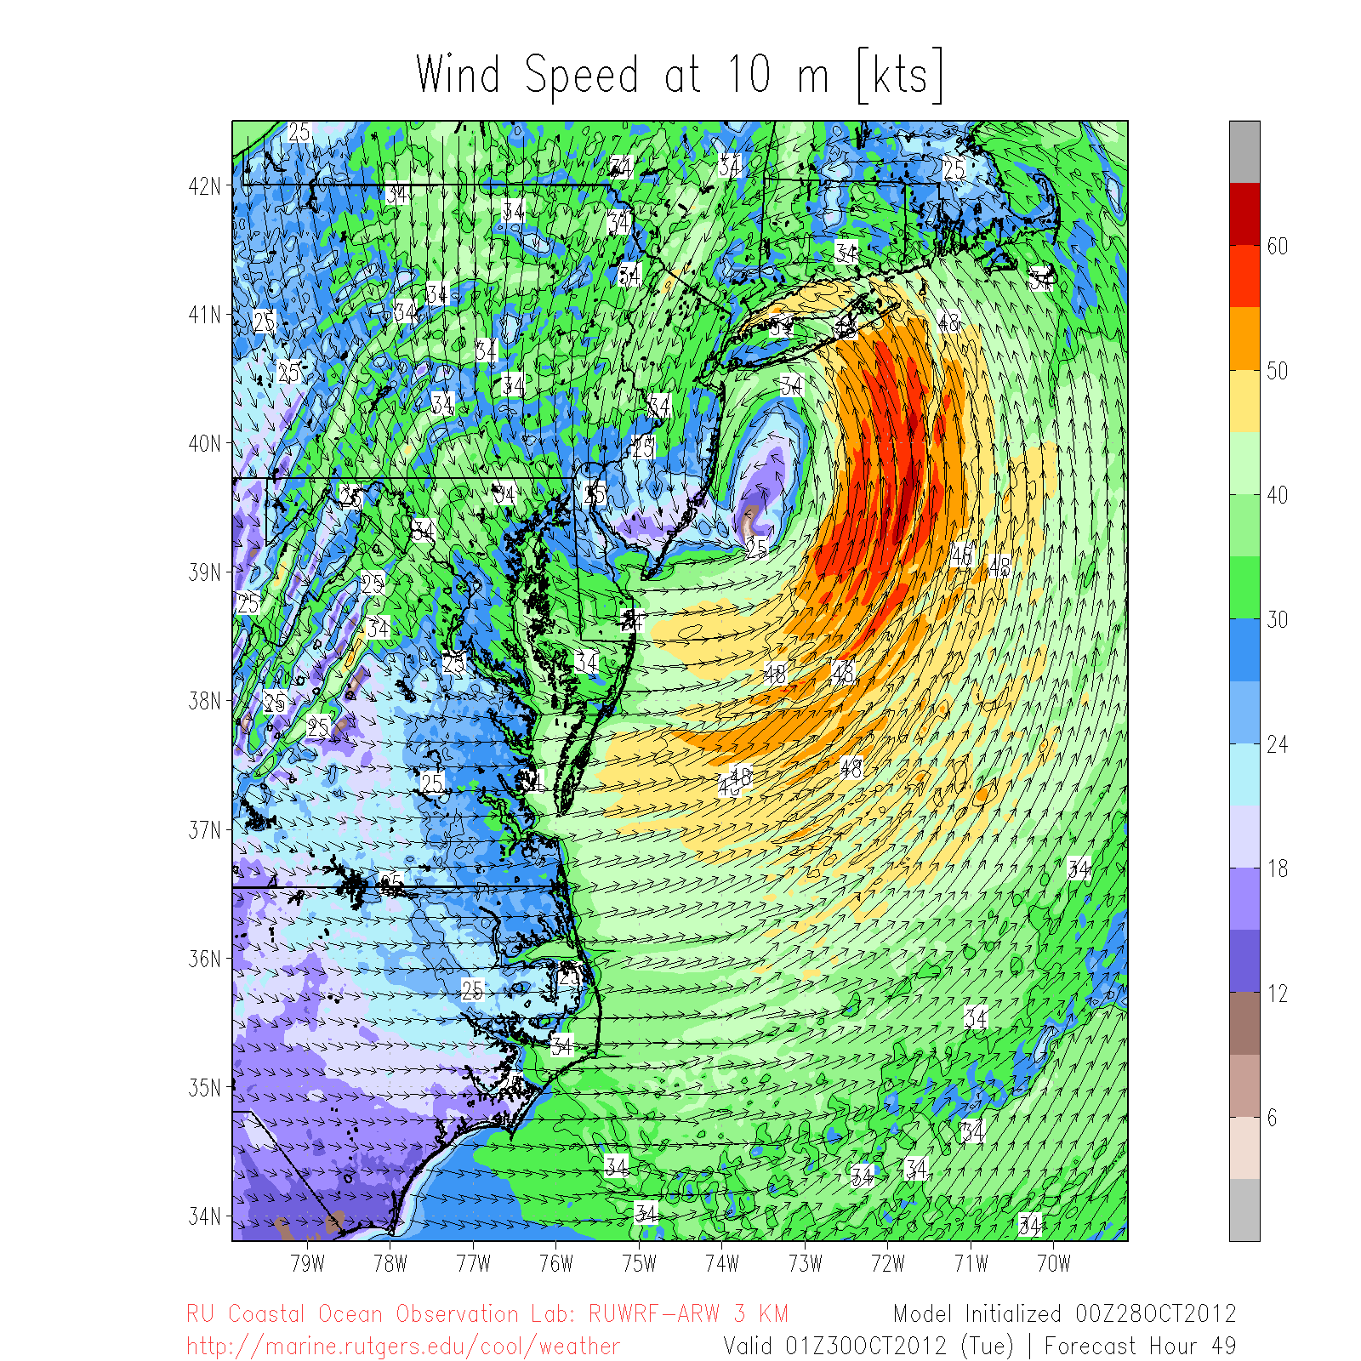
Wind Variability: Tropical Cyclones
RU-WRF Model Performance

Slide 15
Improved OSW Analyses
Space/time variability of wind generation captured by using the high resolution RU-WRF model.
Modeling at <3km grid spacing
Modeling at 20km grid spacing
Annual Average
Hourly winds
Standard
RU-WRF

Slide 16
Existing OSW Resource Products
Virtual Meteorological Tower Data
Wind Resource Maps
Hypothetical Wind Farm Production Data

Slide 17
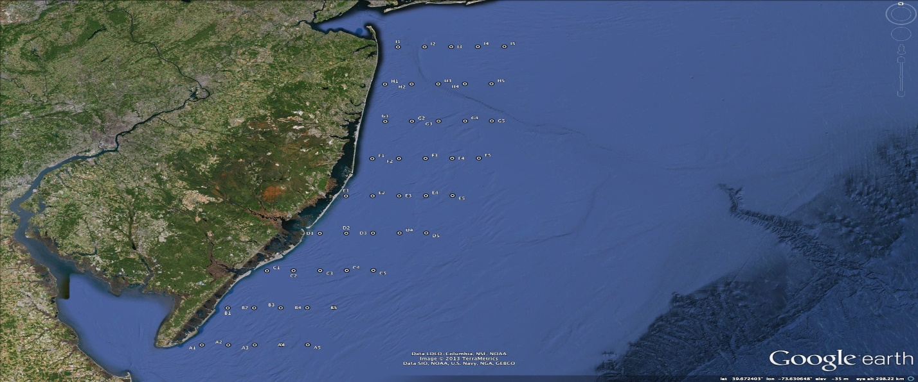
Virtual Meteorological Towers

Slide 18
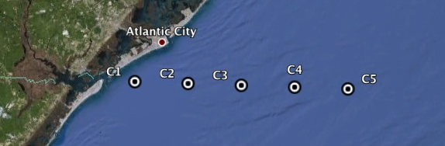
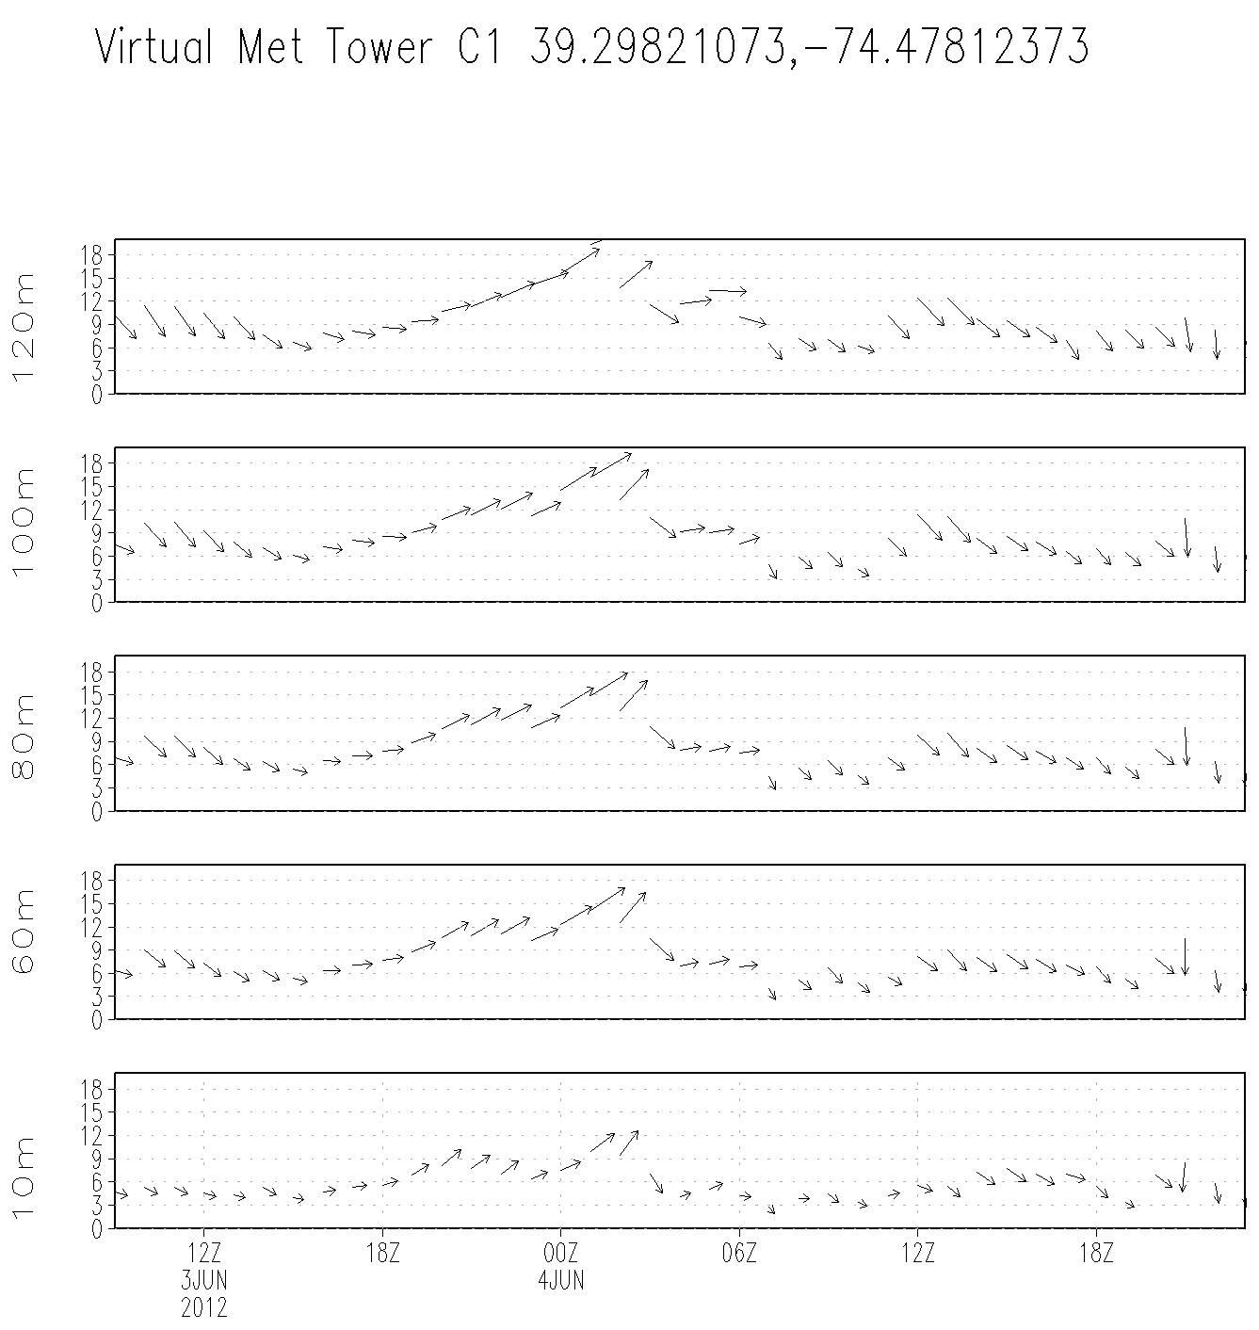
Virtual Met Tower Example
Offshore
120m
100m
80m
Wind Speed
60m
10m
Time→
Notes:
-Peak in wind speed at around 00Z on June 4 is higher offshore than onshore, from surface up to 100m; at 120m, wind speed is comparable offshore to onshore (less frictional drag)

Slide 19
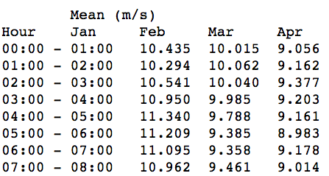
Virtual Met Tower (VMT) Data
Average Monthly and Annual Wind Speeds (m/s) are derived from the mean hourly wind speed for each day of the month @80, 90, 100, 110, 120m for each of the 45 VMTs. Additionally, hourly met data including most standard meteorological parameters are available for every day of the year (8760 hrs) at the selected VMT heights.
…
…

Slide 20
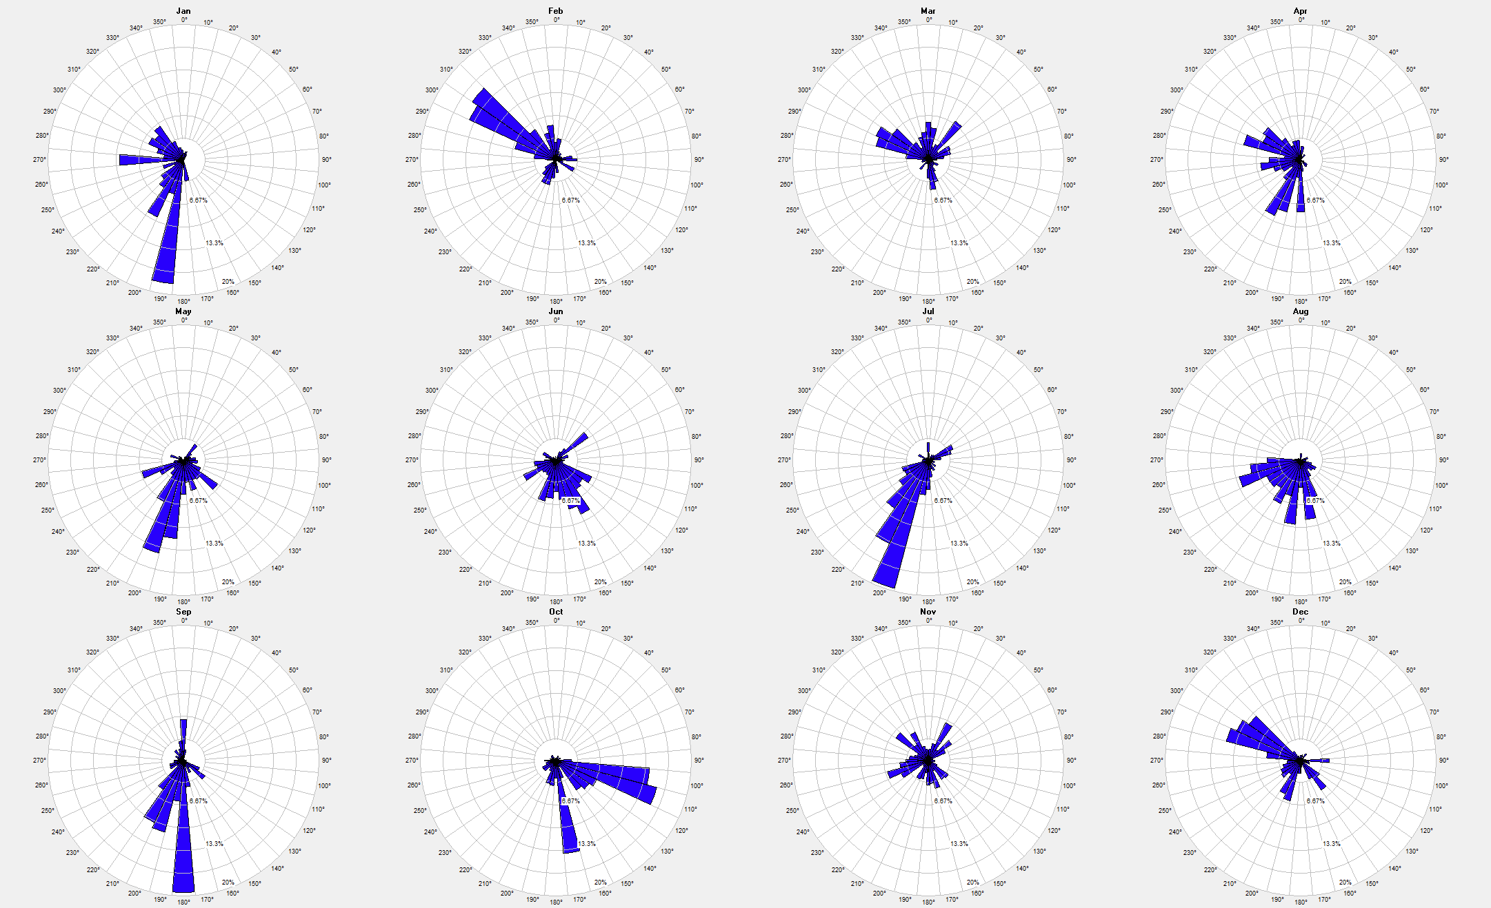
Virtual Met Tower Data
12X24: @80, 90, 100, 110, 120m
8760
Wind Roses: annual, monthly
Jan
Feb…
Dec

Slide 21
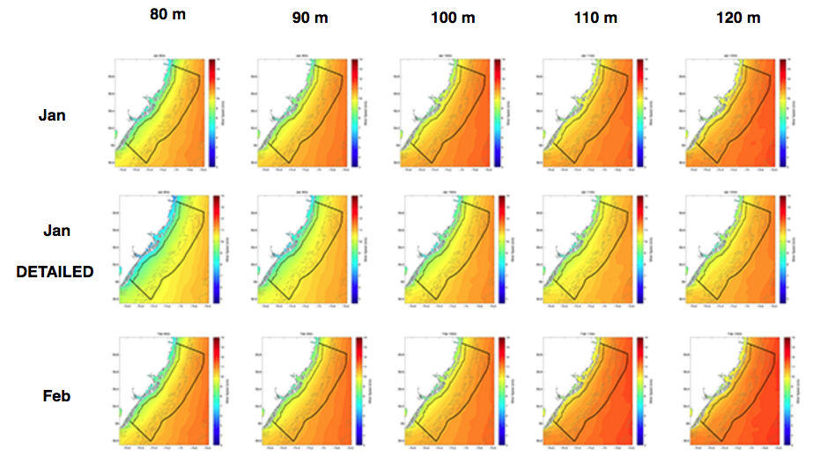
Wind Resource Maps
80, 90, 100, 110, 120m
Annual, Seasonal, Monthly
…

Slide 22
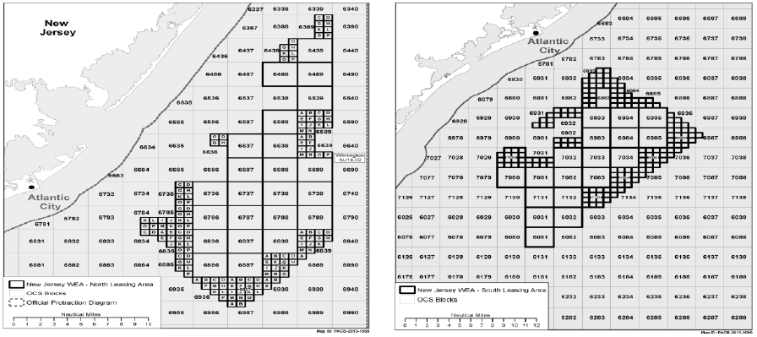
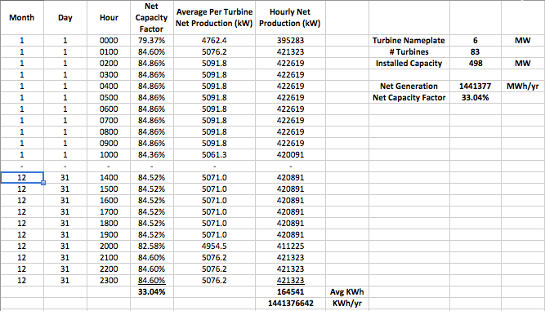
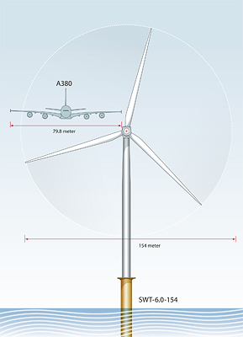
Hypothetical Wind Farm Production Data
Scenarios: 1100, 2000, 3000 MW; 8X10, 10X12, 10X15
Data: Hourly wind speed, kWh, capacity factor aggregated across hypothetical wind farm
North Zone
6 MW WTG
South Zone

Slide 23
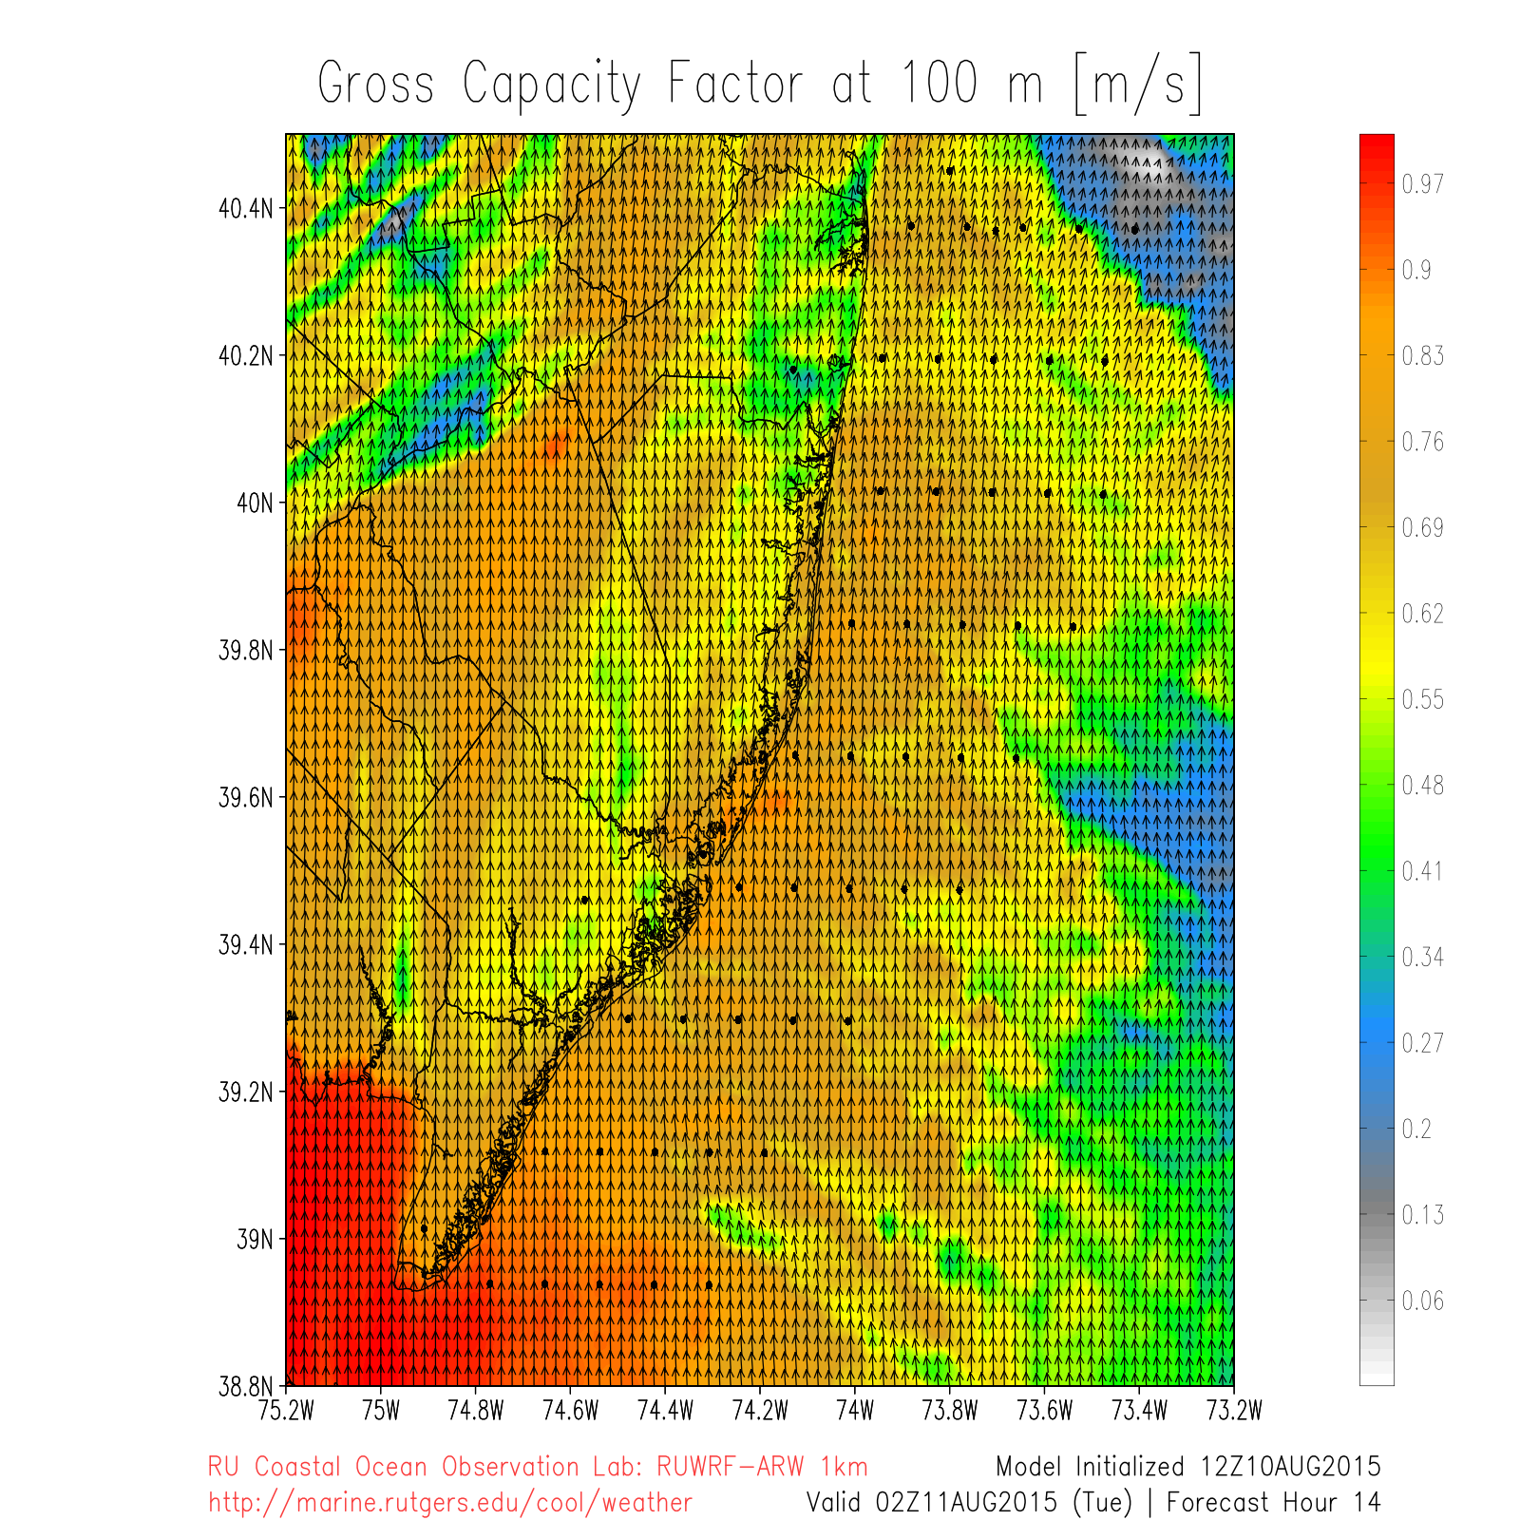
Other OSW Resource Products
Spatial predictions of Gross Capacity Factor
100m Hourly Gross Capacity Factor
during a
sea breeze event

Slide 24

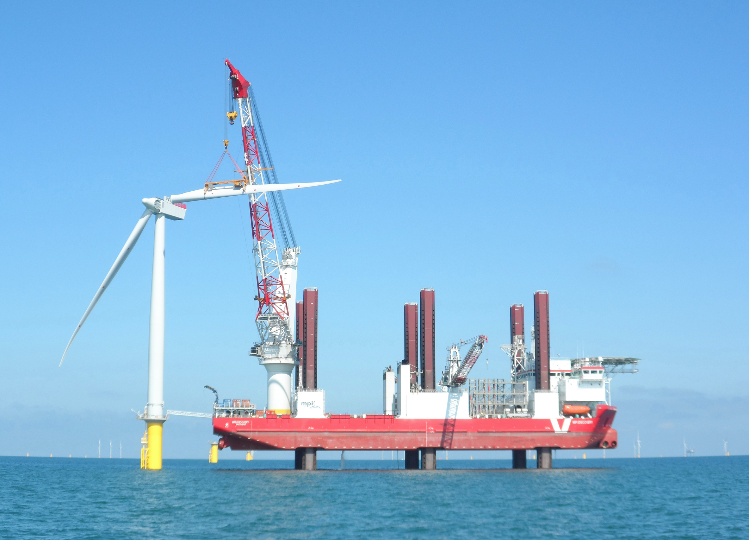
RU-WRF: A Multi-Use Hourly Wind Model
Hourly net production provided to RU CEEEP for economic analyses
Model can also be used for operational forecasting for:
  Severe weather forecasting for construction, O&M
  PJM grid management
  Energy market trading

Slide 25
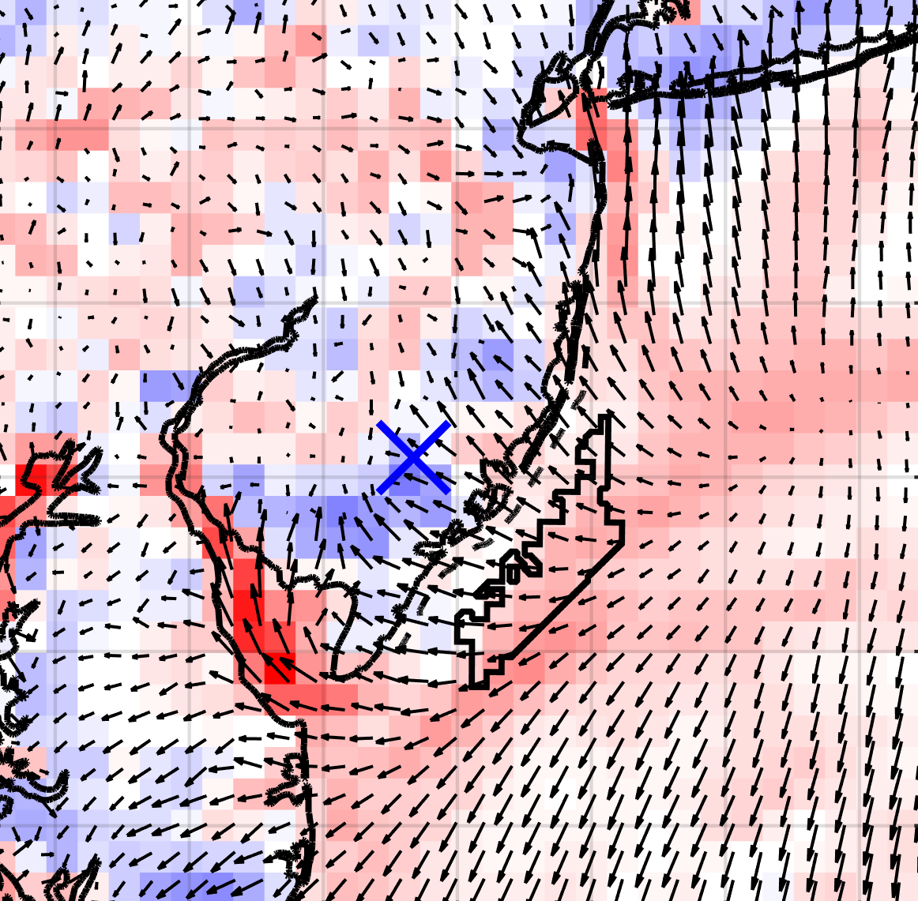
Ongoing/Proposed OSW Studies
Lagrangian Coherent
Structures (LCS) for
offshore sea breeze
clarification→
Sediment transport
and resuspension
Hurricane intensity
LCS for Sea Breeze (red=divergence, blue=convergence)

Slide 26
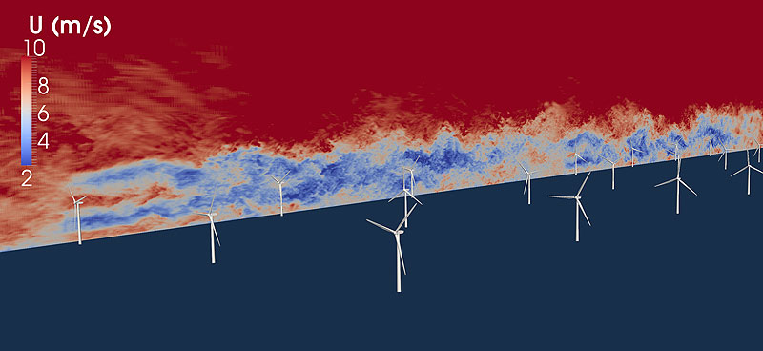
Ongoing/Proposed OSW Studies
Data assimilation
Coupled ocean-atmosphere-wave modeling
Large Eddy Simulation (LES) for coastal/offshore turbulence estimations:
Virtual met tower data used to derive turbulence intensity, wind shear, & atmospheric boundary layer stability at heights representative of OSW WTG dimensions
Hypothetical 1000MW wind farm analysis for the BOEM NJ WEA using “new” generation OSW WTGs with higher efficiencies, power ratings, and hub heights >110m.

Slide 27
Modeling & Evaluation of New Jersey’s Offshore Wind Resource
Contact Information:
Dr. Rich Dunk: dunk@marine.rutgers.edu
Greg Seroka: seroka@marine.rutgers.edu
Dr. Travis Miles: tnmiles@marine.rutgers.edu
Data and Reports Available: http://rucool.marine.rutgers.edu/bpu
Contact Info & Data Link

