Slide 1
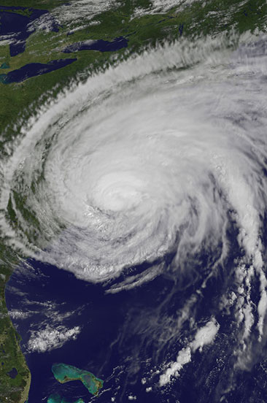
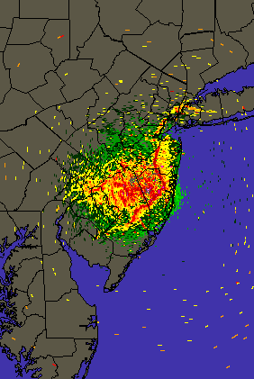






Stratified Coastal Ocean
Interactions with Hurricanes and the Sea Breeze in the U.S. Mid-Atlantic
Dissertation Defense
Greg Seroka
Friday, September 23, 2016
Committee:
Dr. Scott Glenn (advisor)
Dr. Josh Kohut
Dr. John Wilkin
Dr. Rich Dunk (external)

Slide 2
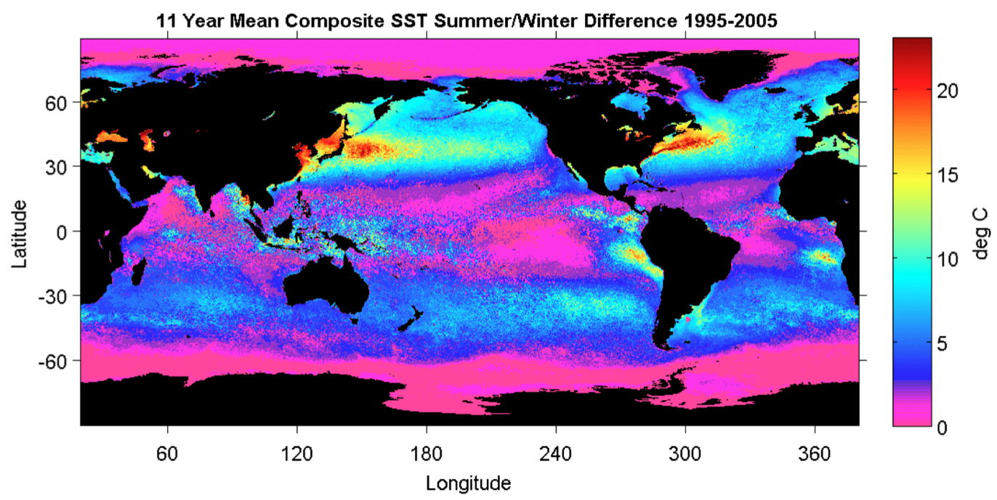
Earth’s northern mid-latitude sea surface temperatures (SSTs) undergo large seasonal cycles.
Summer-Winter SST Difference (1995-2005)
Schofield et al. 1998
Notes:
Earth’s northern mid-latitudes undergo large seasonal cycles, not only in the atmosphere but also in the ocean.
Within the ocean, this seasonal cycle is especially pronounced over the western continental boundaries often characterized by broad continental shelves and proximity to coastal population centers [Schofield et al., 2008].
Figure 1. Global ocean temperature contrast between winter and summer months, which were designated based on the mean seasonal temperatures
measured with the AVHRR satellite. Data were taken between 1995 and 2005. The grey shades on the land masses indicate human
populations (dark grey = high human populations).

Slide 3
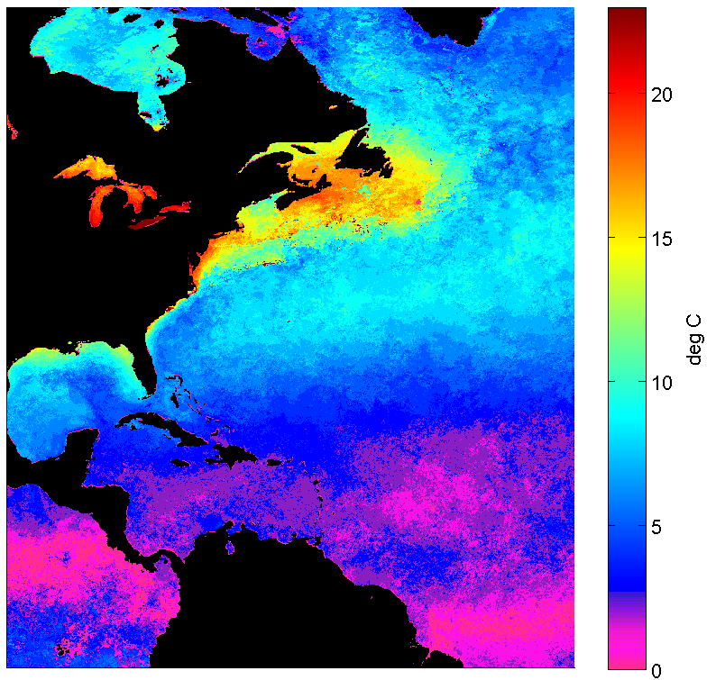
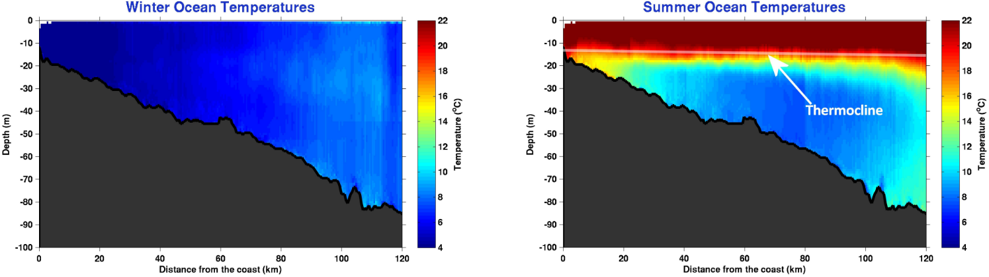
The U.S. Mid-Atlantic summer ocean is one of the most stratified in the world.
Summer-Winter SST Difference
Cold Pool
Winter (1-layer)
Summer (2-layers)
COSEEnow.net
Notes:
-1-slab moving in wind in winter, 2-layer moving in wind in summer- slippery surface layer
-SST seasonality and nearly constant bottom cold water results in 1-layer winter and 2-layer summer
The Mid-Atlantic Bight (MAB) of the eastern U.S. is located on one such broad continental shelf, with a large 20°C seasonal SST cycle.
This seasonality in the surface ocean results in a well-mixed and cold coastal ocean in the winter and a highly-stratified warm surface and cold bottom coastal ocean in the summer [Castelao et al., 2008], due to the presence of the summertime MAB Cold Pool at the bottom of the shelf water [Houghton et al., 1982].

Slide 4
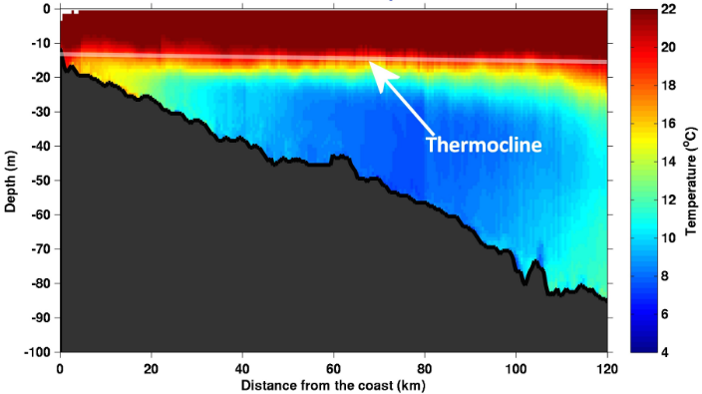
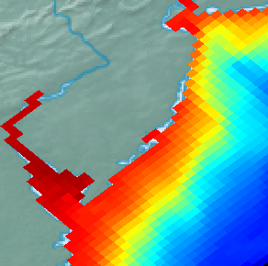
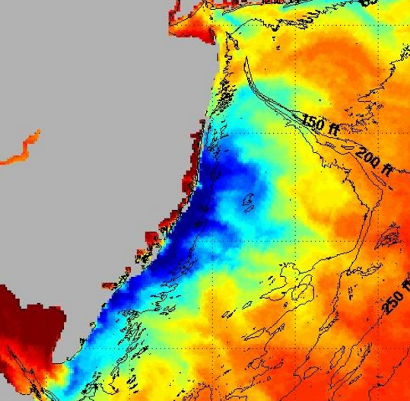
The surface layer is wind-driven, resulting in 2-layer circulations:
Coastal Downwelling
Bottom T
Cold Pool
Coastal Upwelling
SST
Cold Pool
rucool.marine.rutgers.edu
Notes:
-downwelling evident in bottom response
-upwelling evident in surface response
-downwelling for hurricanes- quick response→ shear

Slide 5
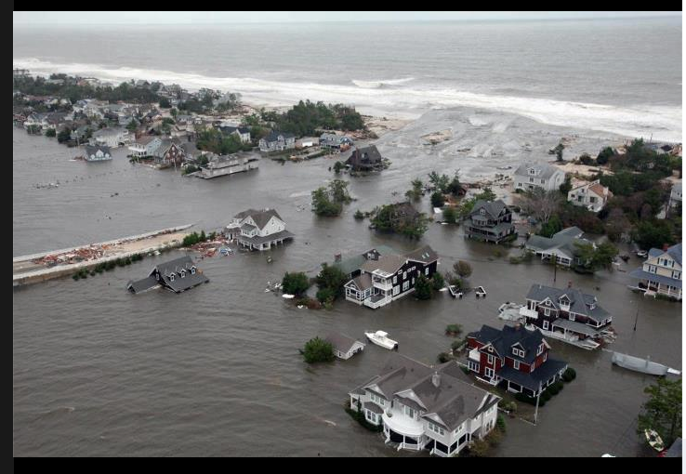

These 2-layer ocean circulations interact with important summer weather processes: tropical cyclones (TCs) and sea breezes.
Tropical Cyclones
Sea Breezes
NJ National Guard
DWWind.com
Incur coastal, inland damages
($ in U.S., lives in Asia)
  Storm surge, wind damage, inland flooding
Occur daily during peak energy demand periods
  Variability→ risk for offshore wind energy development
Notes:
-TCs are called “hurricanes” in the Atlantic basin (focus here)

Slide 6

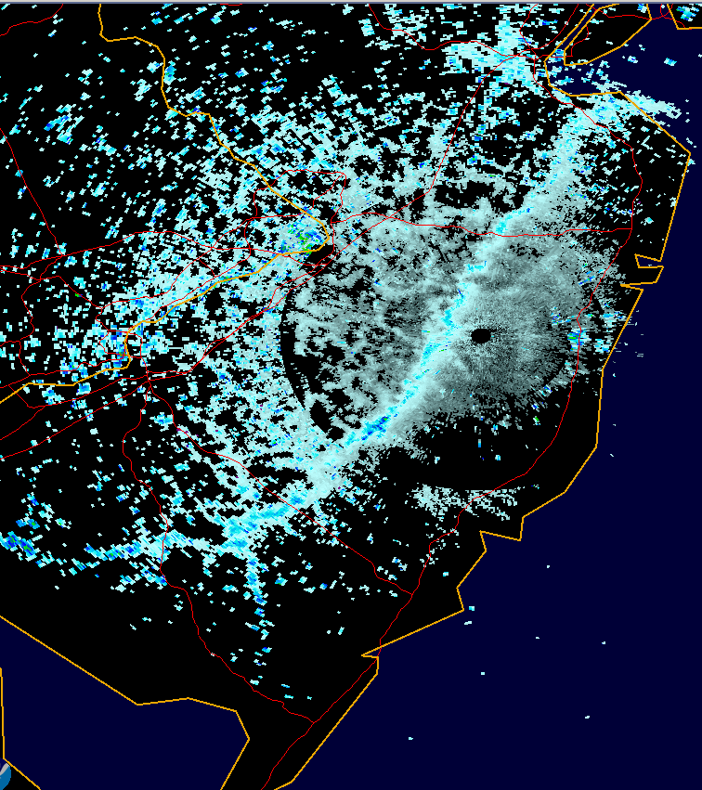
More research about these 2-layer circulations is needed to better predict these processes.
Tropical Cyclones
Sea Breezes
MARACOOS.org
KDIX weather radar
TC intensity forecast improvements lag progress achieved for tracks
(Rogers et al. 2006, Cangialosi & Franklin 2013)
TC research has focused on deep ocean, less to coastal (Marks et al. 1998)
  coastline, shallow bottom influence
  importance to shoreline populations
Inshore sea breeze well-observed + understood, offshore side not (Steele et al. 2014)
Inshore frontal boundary well-marked, offshore spatial scales more difficult to distinguish and define objectively (Finkele 1998)
Notes:
-TCs are called “hurricanes” in the Atlantic basin (focus here)
-Vast majority of TC lifetime is over deep, open ocean

Slide 7
Thesis questions theme around interaction between summer stratified ocean and TCs/sea breezes:
What processes occur in stratified coastal ocean responses to TCs? What is SST response?
  Shear-induced mixing vs. advection? Dominant force balances?
What is impact of SST response (cooling) on TC intensity?
What is spatiotemporal variability in TC coastal processes within each storm?
How can offshore sea breeze be clarified?
What is sensitivity of onshore and offshore sea breeze to synoptic flow and coastal upwelling?
Notes:
Flow chart with questions and matching with projects?

Slide 8
Outline
Red=atmosphere
Blue=ocean
Experimental design
Project 1
  Hurricane Irene Sensitivity to Stratified Coastal Ocean Cooling
  TC coastal atmospheric investigation
Project 2
  Spatiotemporal variability of stratified coastal ocean cooling processes in Hurricane Irene (2011) and Tropical Storm Barry (2007)
  TC coastal oceanic investigation
Project 3
  Offshore Sea Breeze Sensitivity to Coastal Upwelling and Synoptic Flow
  Sea breeze coastal atmospheric investigation
Conclusions

Slide 9
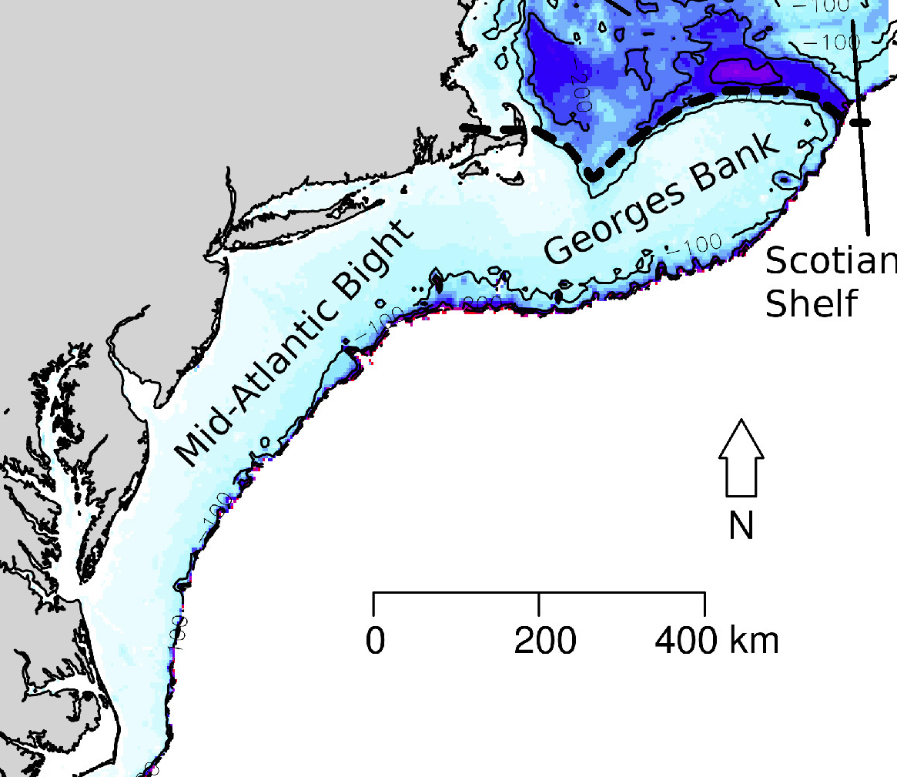
Experimental Design
Mid-Atlantic Bight (MAB) as testing grounds
  Highly stratified summer ocean over wide,
  shallow continental shelf
  TC, sea breeze, & upwelling summer activity
  Offshore wind energy development
  Proximity to population centers
Integration of observations, modeling,
and new techniques
  Observations: underwater gliders, High Frequency (HF) radar, buoys, satellites, weather radar
  Models: Weather Research and Forecasting (WRF, advanced atmosphere), Regional Ocean Modeling System (ROMS, advanced ocean)
  New analysis techniques: Lagrangian Coherent Structures (LCS)
Kleisner et al 2016

Slide 10
Project 1
Hurricane Irene Sensitivity to Stratified Coastal Ocean Cooling

Slide 11
Motivation
Project 1: Hurricane Irene Sensitivity to Stratified Coastal Ocean Cooling
Hurricane Irene (2011) intensity over-predicted (Avila and Cangialosi 2012)
Deep, open ocean: TC cooling 50% front, 50% behind (Price 1981)
Shallow, coastal MAB: 6-11°C, 76-98% total in-storm SST cooling “ahead-of-eye-center” (AOEC)
Stratified coastal ocean processes led to AOEC cooling (Glenn et al. 2016)
Notes:
Front half of Irene’s winds onshore toward MAB coast
Surface ocean currents aligned with onshore winds
Water piled up along MAB coast; pressure gradient force directed offshore
In response, bottom currents offshore
Opposing onshore surface, offshore bottom currents → large shear across thermocline, turbulent entrainment/mixing of bottom cold water to surface
AOEC cooling with onshore winds
-over-prediction: Model guidance and National Hurricane Center (NHC) forecasts
-“consistent high bias”, NC landfall 2 categories below expected
-TC cooling with no eddy features and not including inertial response
-include glider profile in diagram of process?

Slide 12
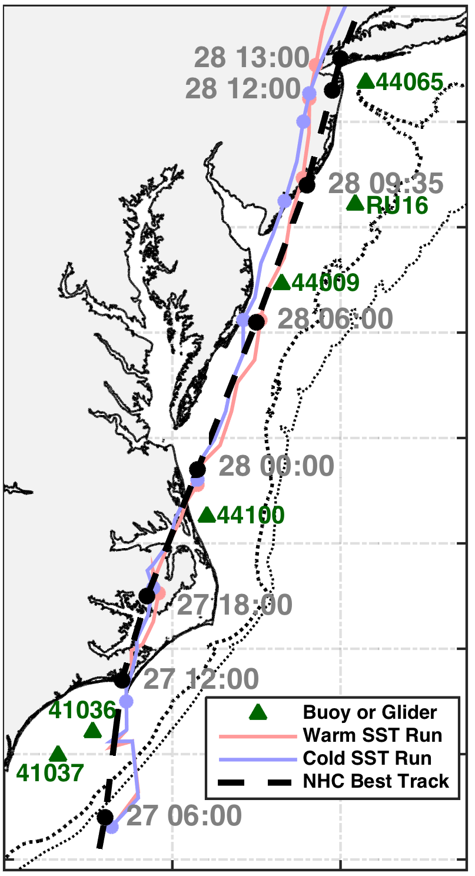
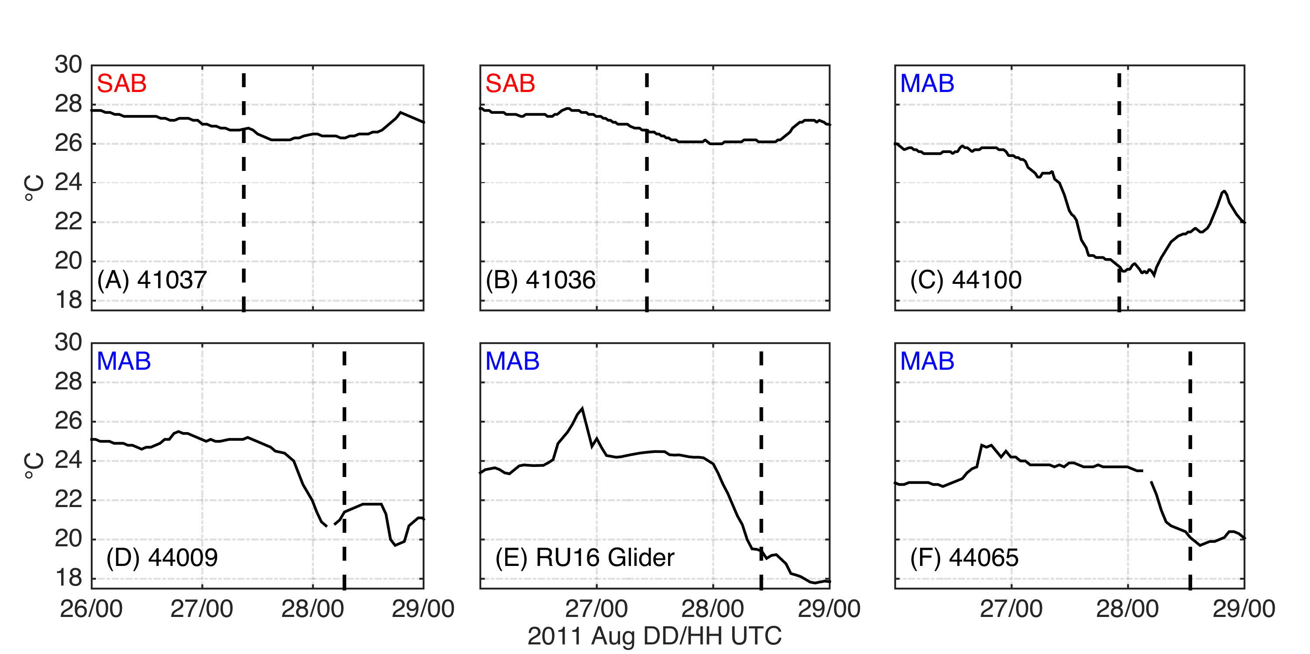
Motivation
Project 1
Ahead-of-eye-center (AOEC) cooling signal in Irene
South
Eye passage
98%
SST
SST
82%
76%
90%
North
Seroka et al. 2016

Slide 13
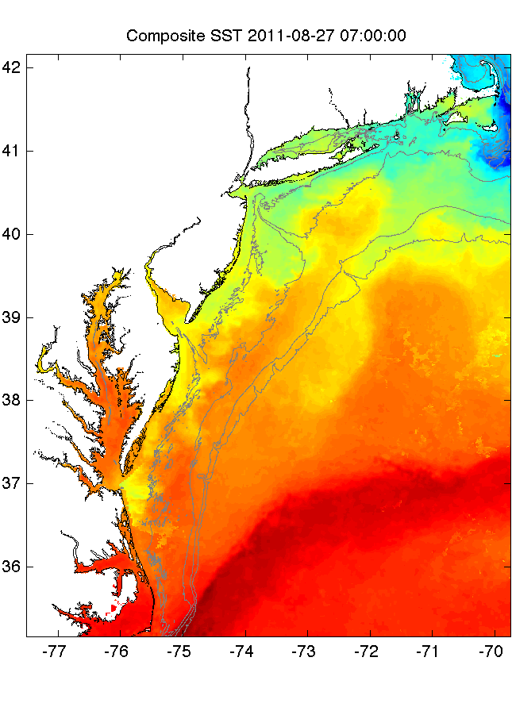
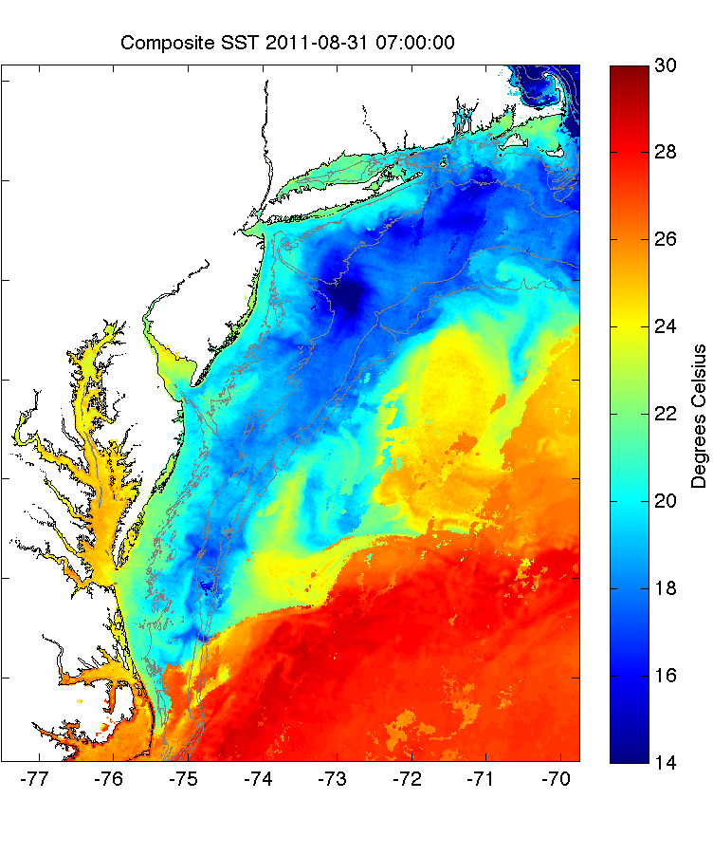
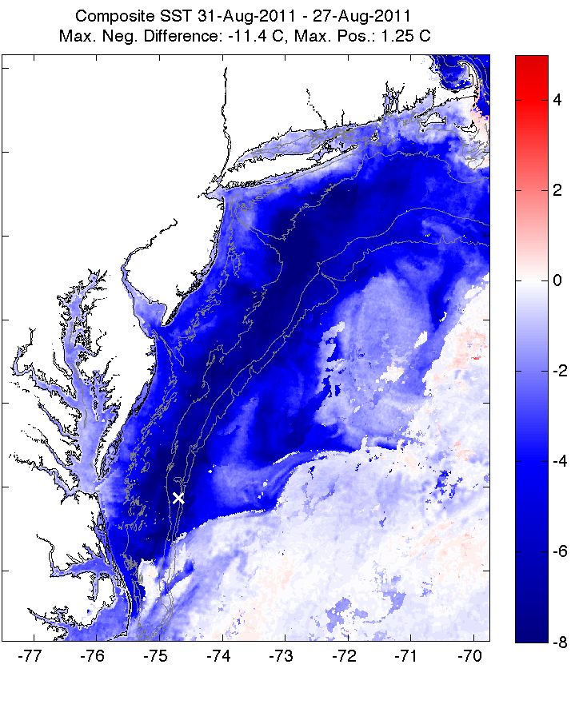
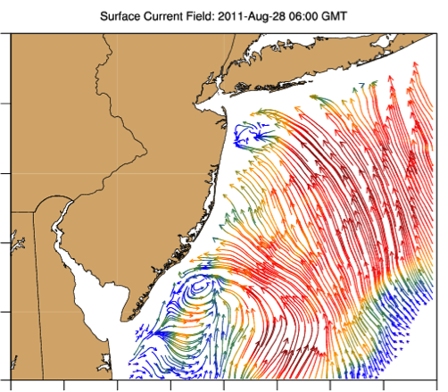
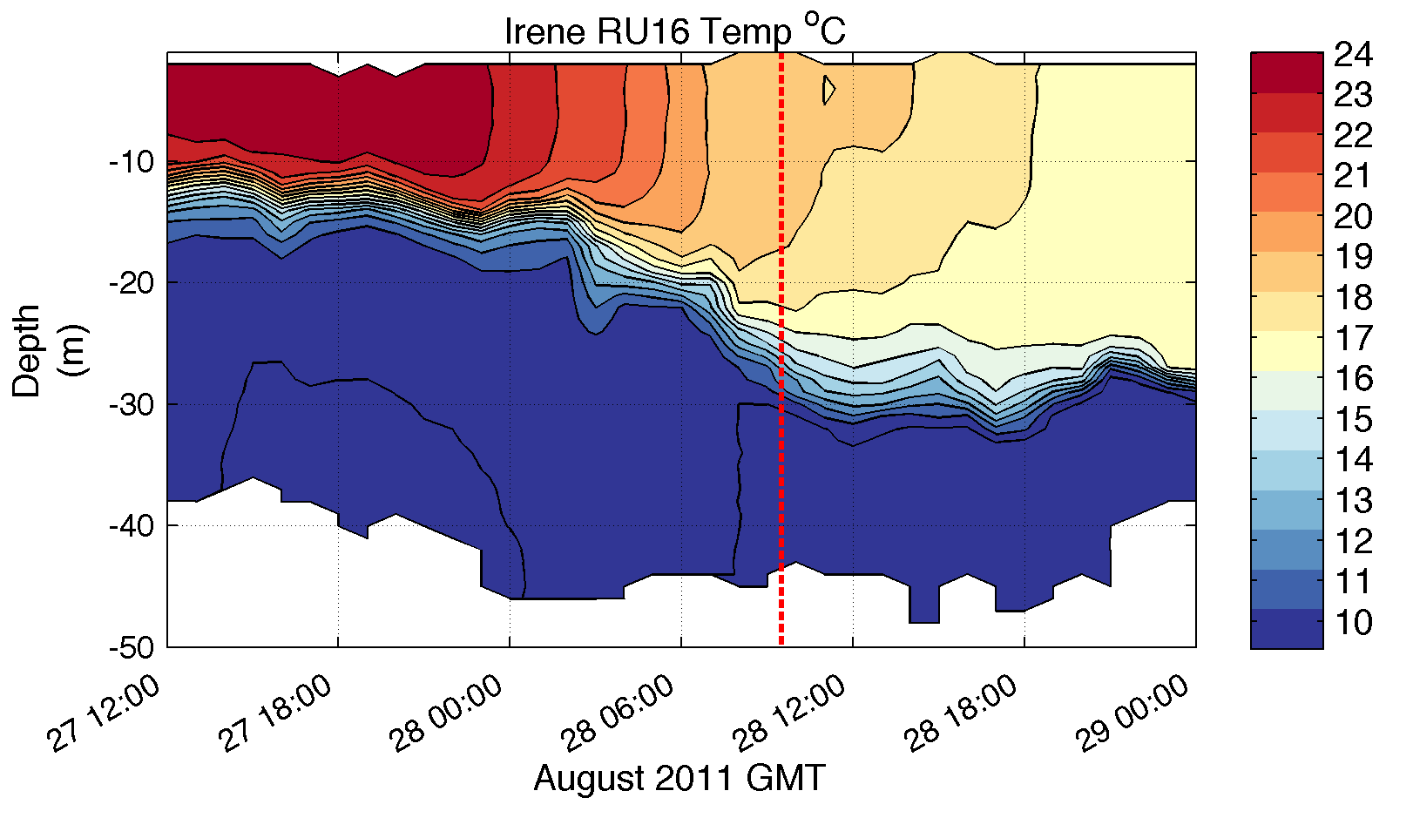
Motivation
Project 1
Pre-Irene
Post-Irene
Difference
11C max Cooling
WHAT?
Satellite
SST
WHEN? Glider Temperature
76%
WHY?
HF Radar
Currents
Downwelling
Eye Passage
Downwelling
Stratified coastal ocean processes led to AOEC cooling (Glenn et al. 2016)
Notes:
Front half of Irene’s winds onshore toward MAB coast
Surface ocean currents aligned with onshore winds
Water piled up along MAB coast; pressure gradient force directed offshore
In response, bottom currents offshore
Opposing onshore surface, offshore bottom currents → large shear across thermocline, turbulent entrainment/mixing of bottom cold water to surface
AOEC cooling with onshore winds

Slide 14
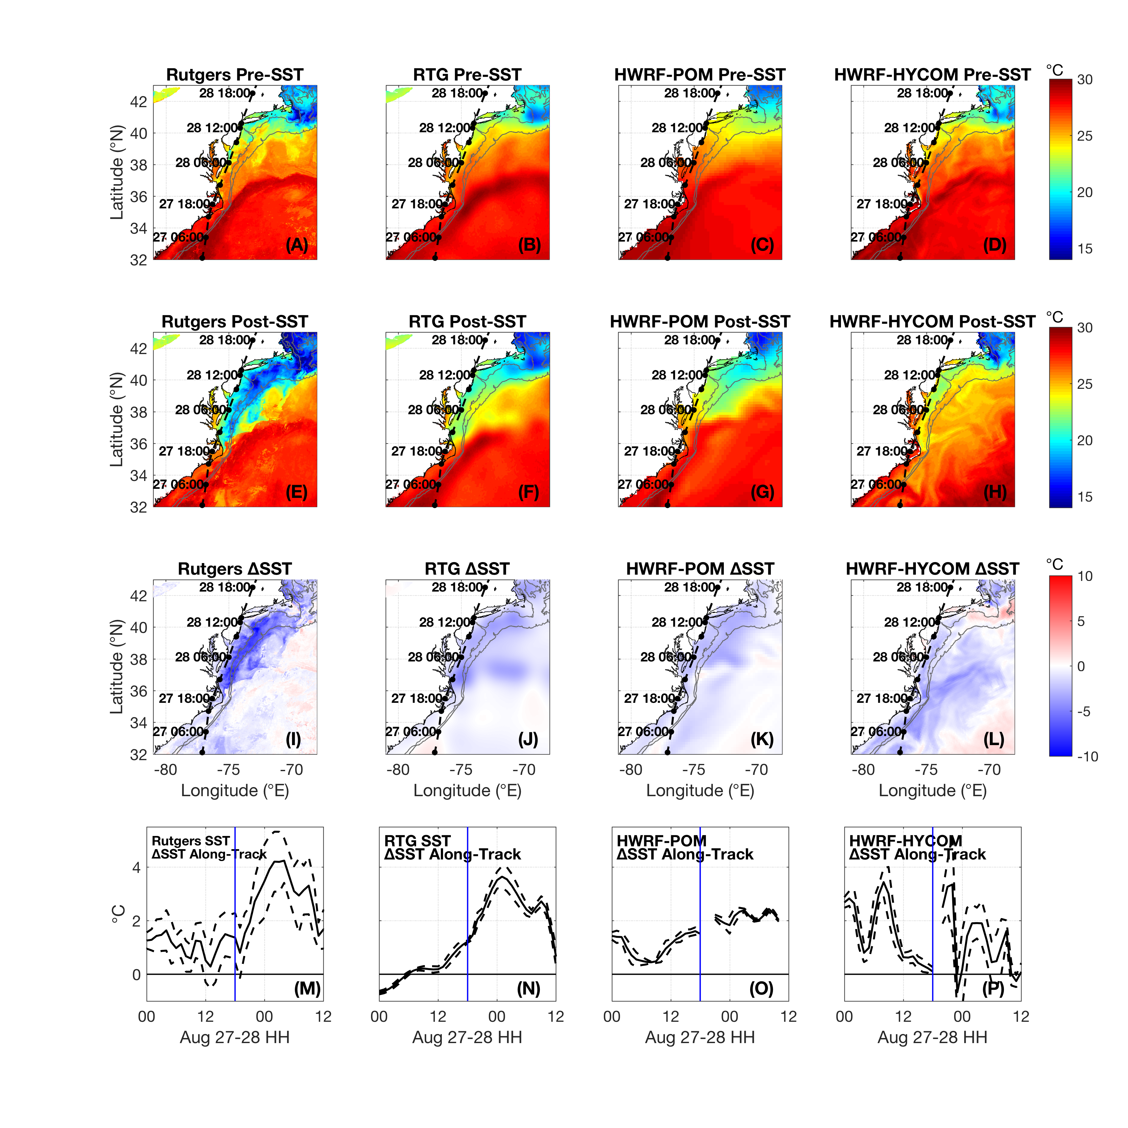
Project 1
Motivation
SST cooling not captured by existing
satellite SST composites, TC forecast models
New SST composite
Existing SST composite
TC forecast models
Seroka et al. 2016
How sensitive was Irene’s intensity to this SST AOEC cooling?
Does the accuracy of modeling improve when including the cooling?
Were track, wind shear, and dry air intrusion—other storm intensity controls—captured by modeling?

Slide 15
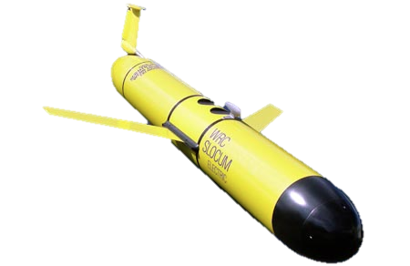
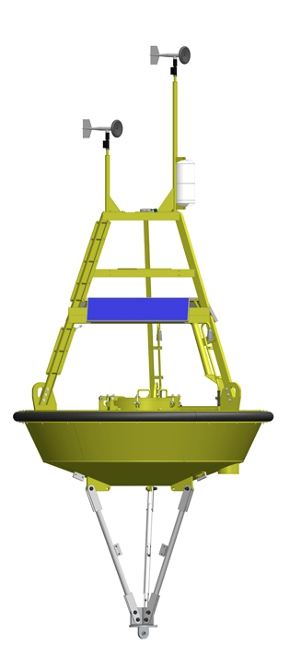


Methods
Project 1
RU16 underwater glider:
40m isobath, right of track
NDBC buoys:
41037, 41036, 44100, 44009, 44065
Satellites:
1km AVHRR 3-day coldest dark pixel SST composite; NASA SPoRT 2km SST for cloudy gaps (Glenn et al. 2016)
Model:
6km WRF-ARW v3.4; I.C., B.C.: GFS 0.5° for correct coastal storm track; 35 vert. levels; init. 06Z 27 Aug 2011
>140 simulations to test sensitivities
Seroka et al. 2016
Notes:
-Make this before figures? Because already showed glider, buoy, satellite SST figs

Slide 16
Results
Project 1
Max Wind
Min Pressure
Seroka et al. 2016
SST:
76-98% AOEC cooling
*Irene intensity most sensitive to SST cooling
over all other WRF parameters tested
Notes:
-sum of the absolute value of the hourly diff between control run minimum SLP (and max sustained 10m winds) and experimental run minimum SLP (and max 10m winds), 23 UTC 27 Aug to end of simulation
-3 largest sensitivities when considering both intensity metrics were due to SST with 3 WRF air-sea flux parameterization options (isftcflx=0,1,2)
-3D PWP no coastline or bathymetry→more in storm SST cooling than observed by RU16

Slide 17
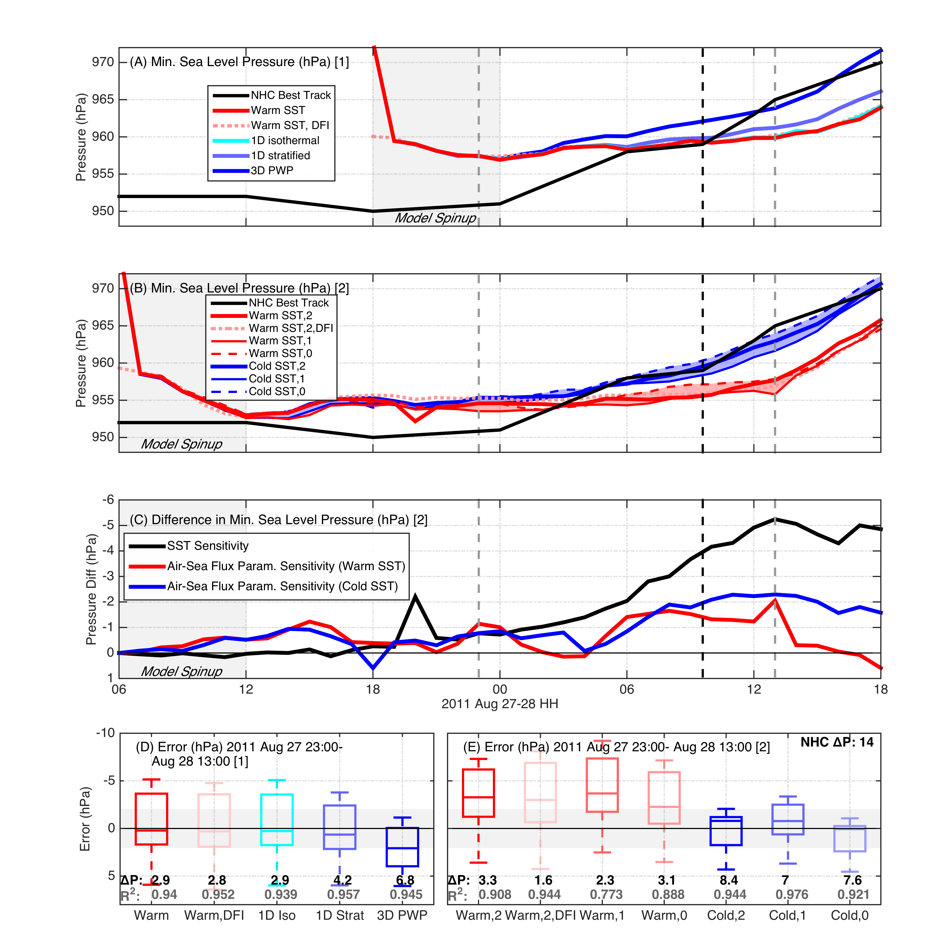
Project 1
Results
Prediction Bias
Including SST cooling in modeling mitigated high bias in intensity predictions
NHC best track uncertainty
Seroka et al. 2016
Notes:
Deintensification rate
OML + coastal, OML + HYCOM

Slide 18
Summary
Project 1
Irene intensity most sensitive to SST AOEC cooling over all other WRF parameters tested
Including SST cooling in modeling mitigated high bias in intensity predictions
SST cooling was key missing contribution in modeling Irene’s rapid decay—not track, wind shear, or dry air intrusion (not shown)

Slide 19
Project 2
  Spatiotemporal variability of stratified coastal ocean cooling processes in Hurricane Irene (2011) and Tropical Storm Barry (2007)

Slide 20
Motivation
Project 2: Spatiotemporal variability of stratified coastal ocean cooling processes in Hurricane Irene (2011) and Tropical Storm Barry (2007)
Baroclinic coastal ocean cooling processes identified in Irene (2011) (Glenn et al. 2016, Nature Comms.)
AOEC signal present in 11 MAB storms since 1985, Typhoon Muifa (2011) in Yellow Sea (Glenn et al. 2016, Nature Comms.)
Cooling had large impact on Irene’s intensity
(Project 1, Seroka et al. 2016, MWR)
Remaining questions:
Did mixing dominate advection, and what was dominant cross-shelf force balance in other 10 MAB storms? Did these lead to the AOEC signal identified? 1
Spatial variability of baroclinic coastal ocean processes, force balances, mixing/advection for Irene? For other 10 MAB storms? 1
What was the impact of the AOEC cooling on other 10 MAB storm intensities? 3 ← Another study…
Notes:
-Cross-shelf and along-shelf variability in cooling processes
-How did shallow water processes compare to deep?

Slide 21
Motivation
Project 2
Full range of storm “personalities” in atmosphere & ocean
  Standard operational model performance metrics (e.g. HWRF) take mean across all storms simulated
Investigate spatiotemporal variability of stratified coastal ocean cooling response over MAB continental shelf for Barry (2007) and Irene (2011)

Slide 22
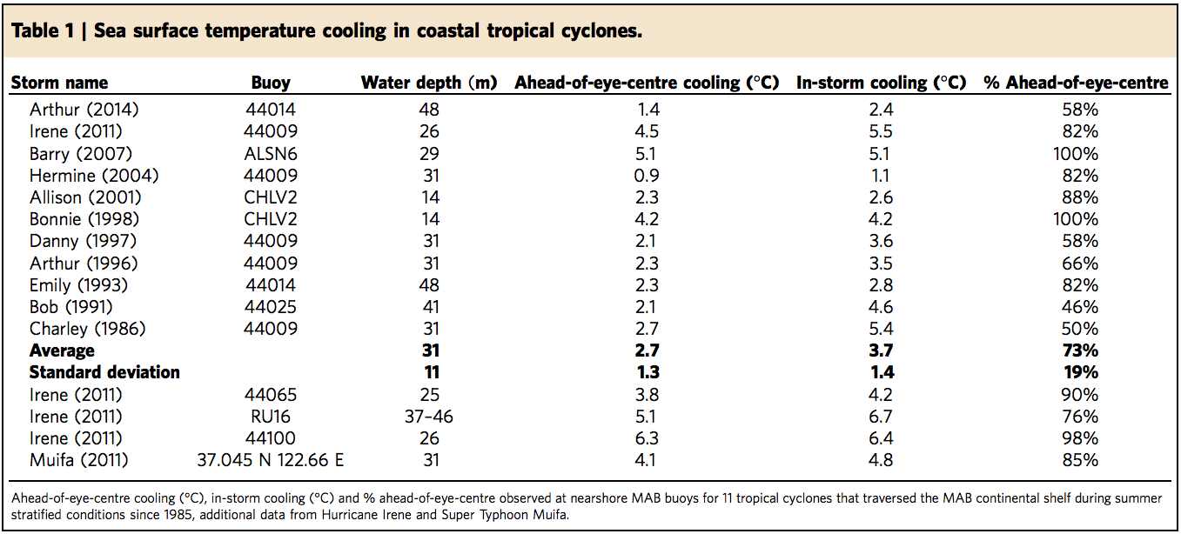
AOEC Cooling Identified in 11 MAB,
1 Yellow Sea storm
Project 2
Glider
Glider
Glenn et al. 2016

Slide 23
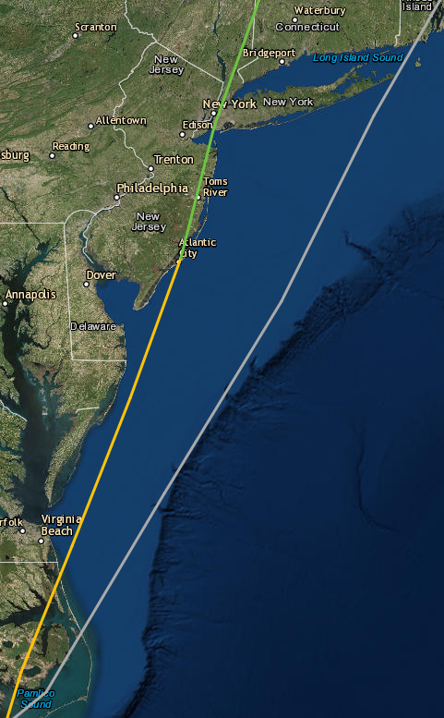
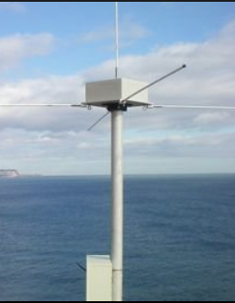
Methods
Project 2
Underwater gliders:
RU16: Irene; RU17: Barry
HF Radar:
Hourly surface ocean currents
Satellites:
AVHRR Multi-channel SST, declouded with empirically-derived MAB summer thresholds
Model:
ROMS ESPreSSO 5km re-runs; 36 vert. levels; 4D-Var ESPreSSO I.C.; NAM 12km atmo. forcing; HYCOM B.C.; USGS rivers; ADCIRC tides (all standard ESPreSSO)
Barry: 12UTC May 29- 12UTC June 8, 2007
Irene: 12UTC Aug 24- 00UTC Sep 3, 2011
17UTC
Jun 4
12UTC
Aug 28
RU17
RU16
Barry (Jun)
Irene
(Aug)
Notes:
-intent not to perform direct inter-storm comparisons
-goal is to better understand conditions in both atm and ocean leading to baroclinic coastal ocean cooling processes, AOEC, and impact on intensity

Slide 24
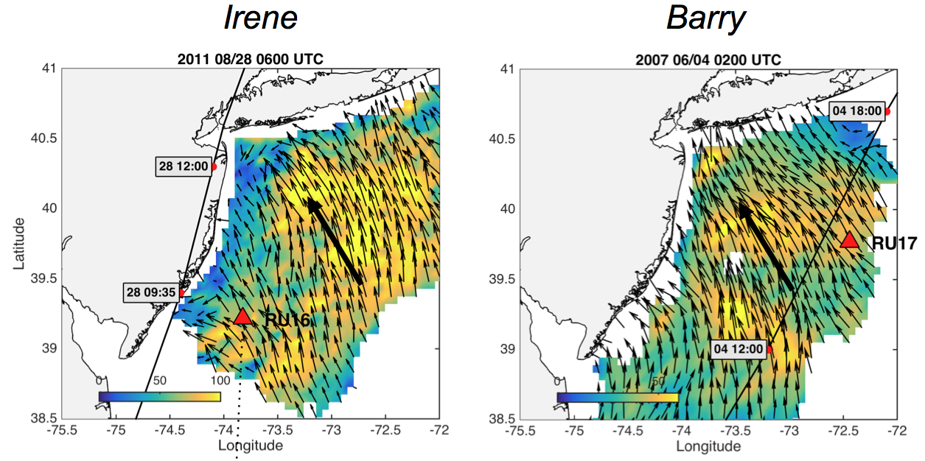
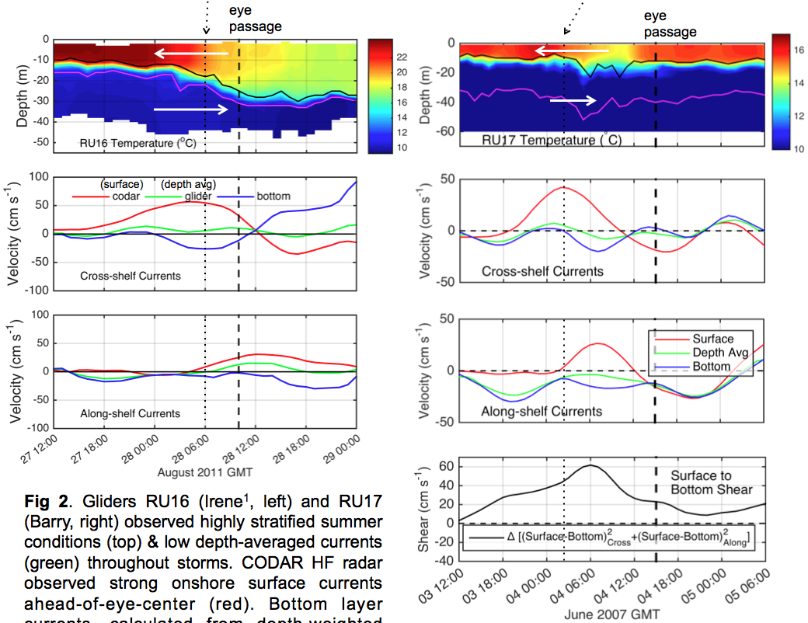
Project 2
Results
Surface to bottom current shear over the MAB shelf peaked AOEC for both storms, and was all cross-shelf for Irene,
Downwelling
Downwelling
and both cross-shelf and along-shelf for Barry.
√
√
Seroka et al. in prep.

Slide 25
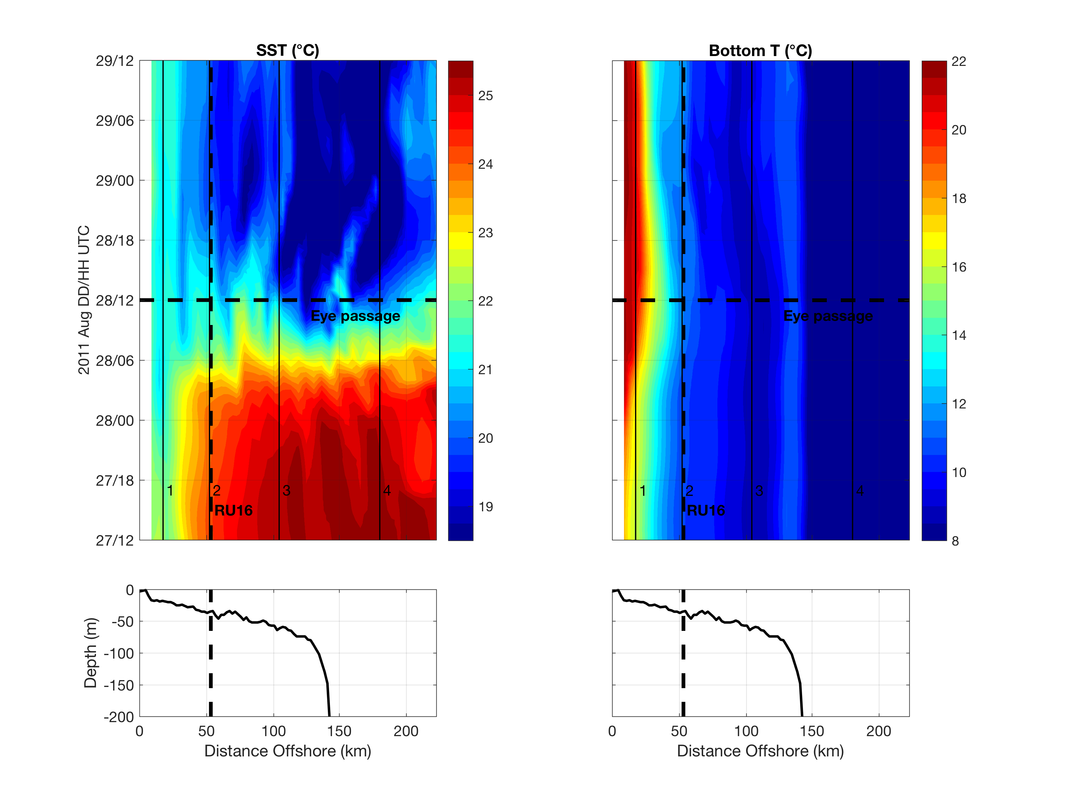
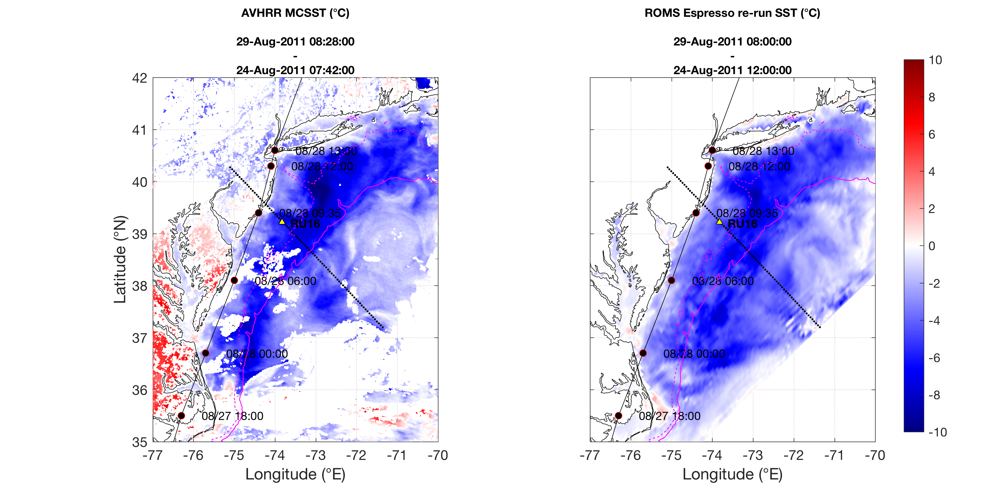
Irene: AOEC SST cooling, downwelling bottom T
Project 2
AOEC SST cooling
Downwelling
Upwelling
Seroka et al. in prep.
Notes:
10

Slide 26
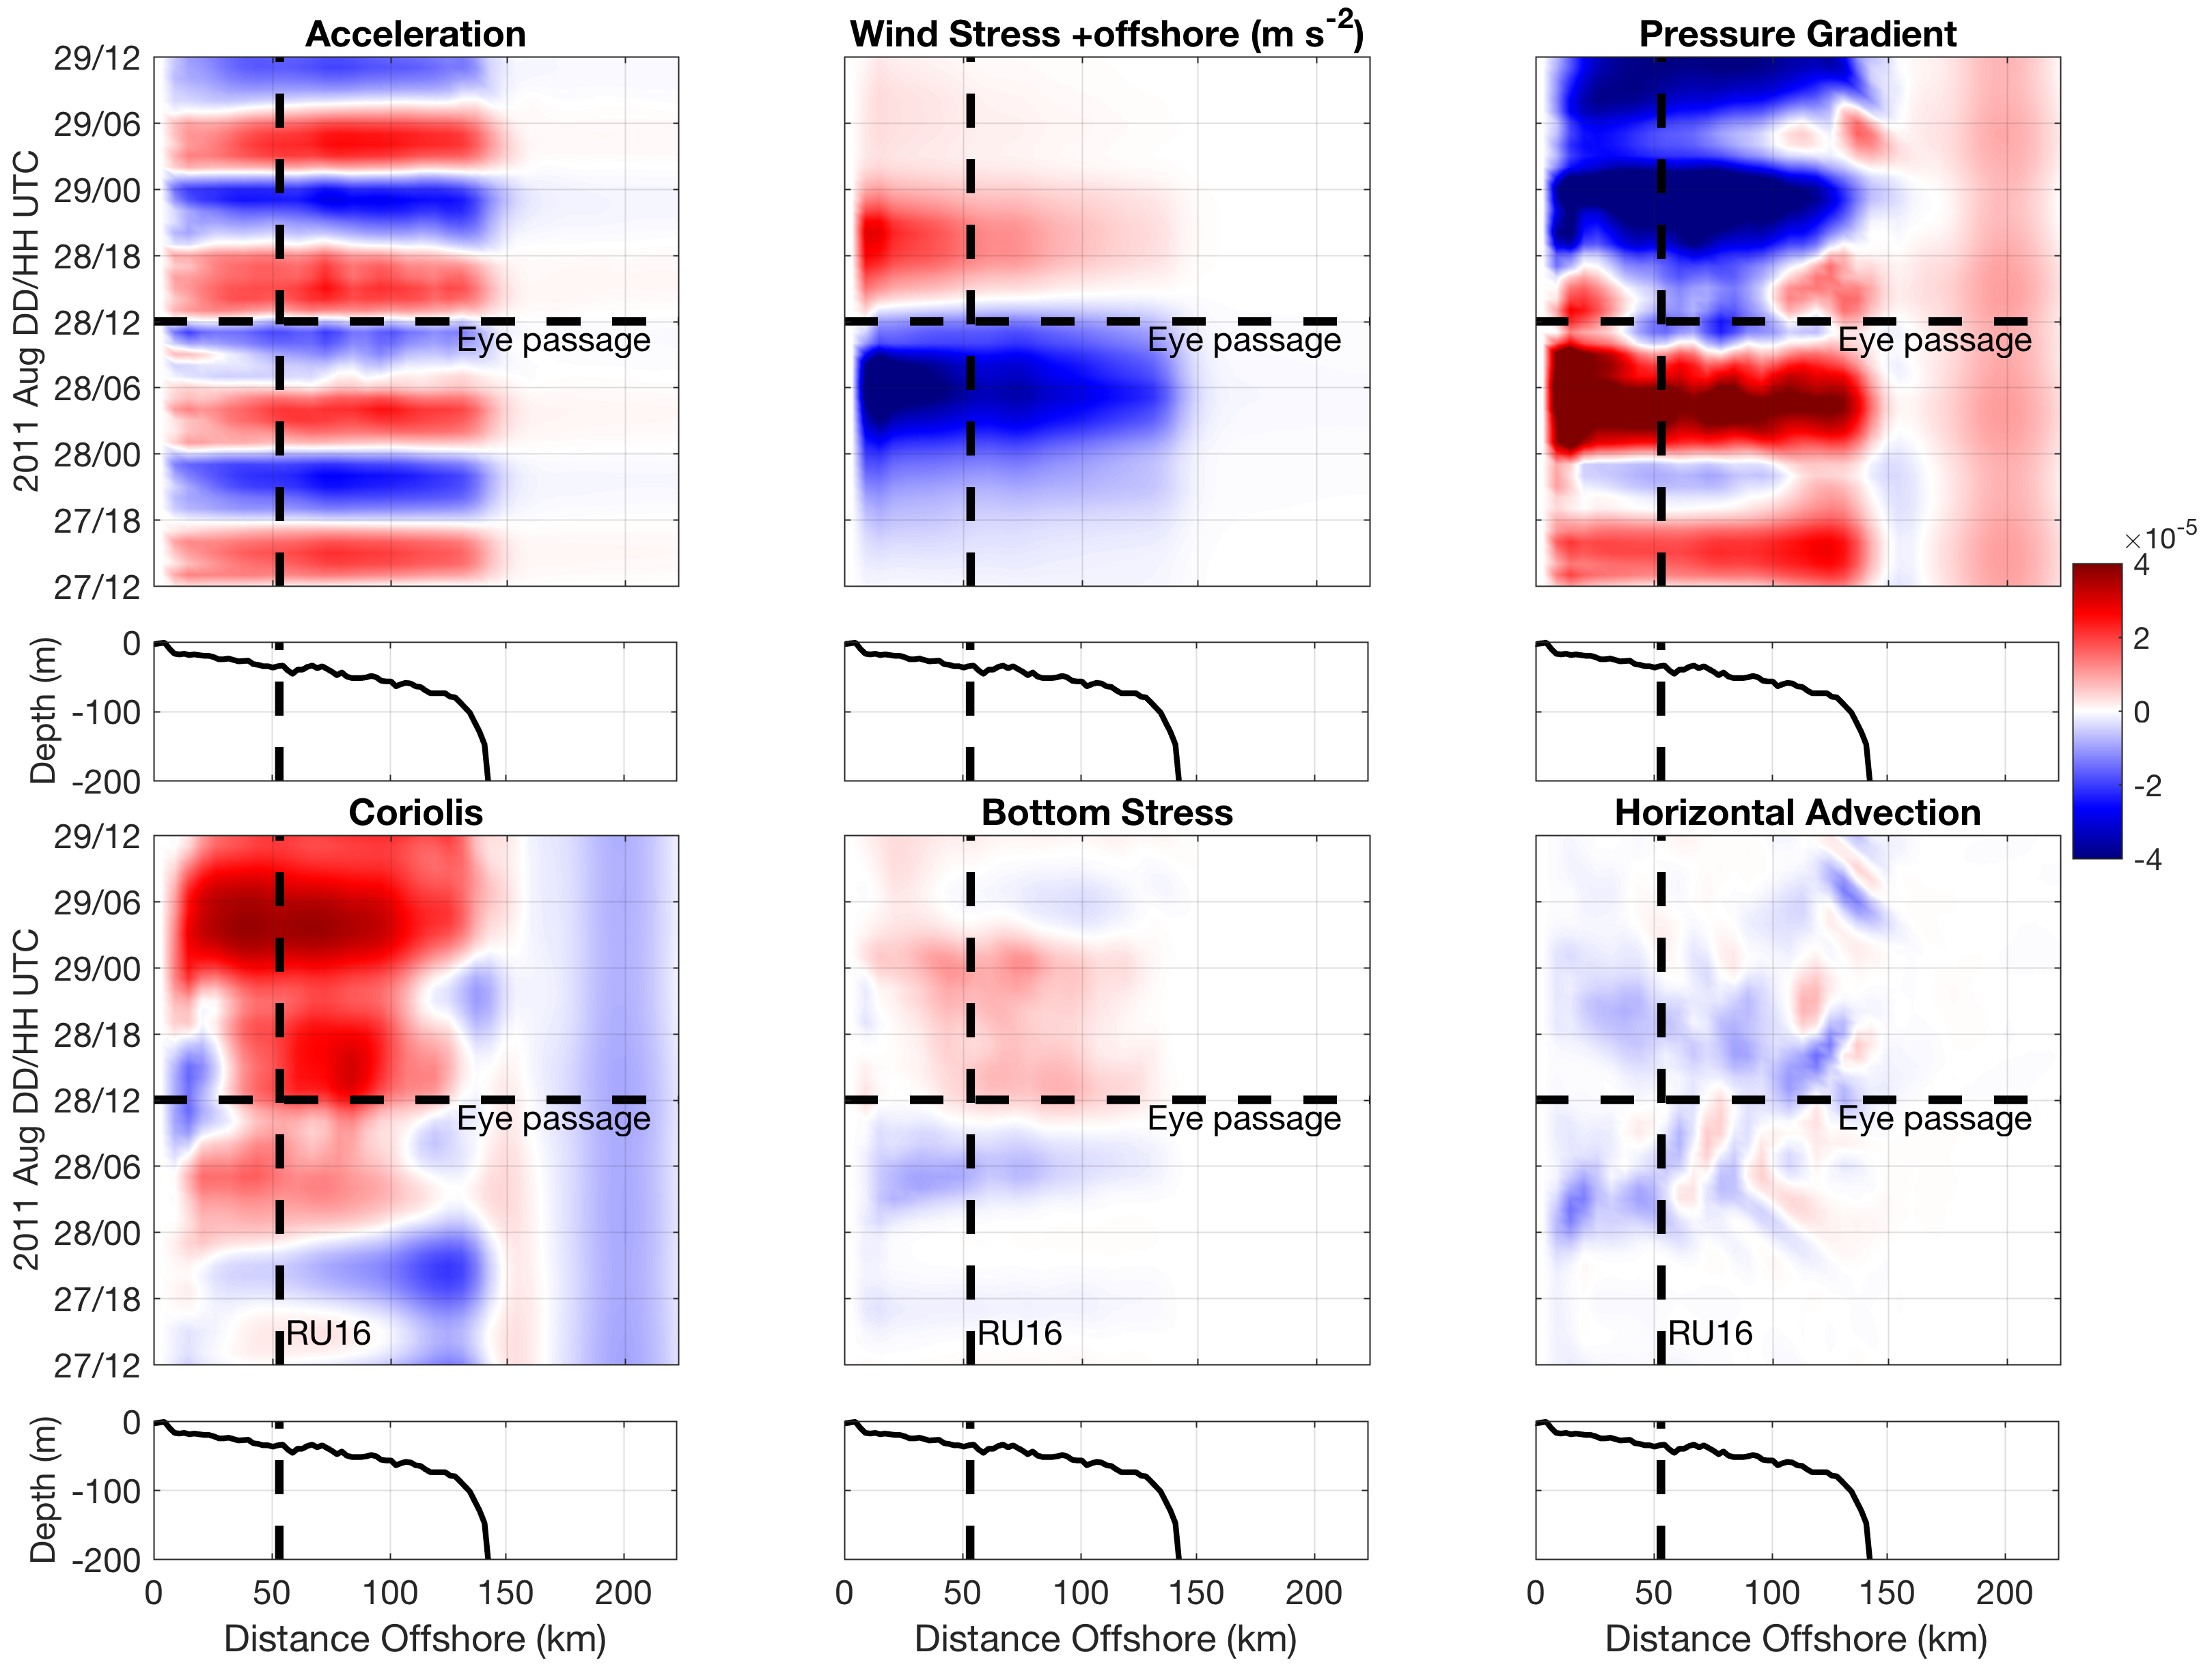
Irene: AOEC onshore wind stress vs. offshore PGF;
Reversed behind eye; PGF across entire shelf
Project 2
+offshore
m s⁻²
-onshore
Seroka et al. in prep.
Notes:
15

Slide 27
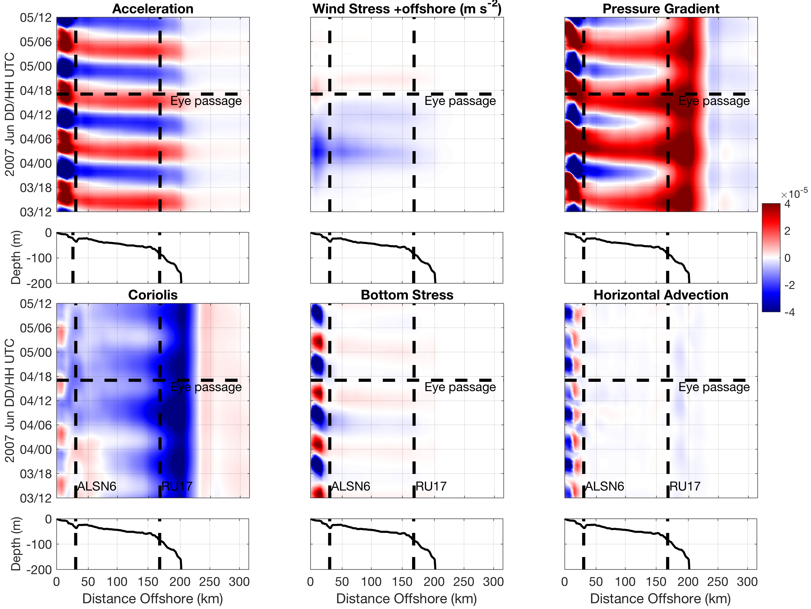
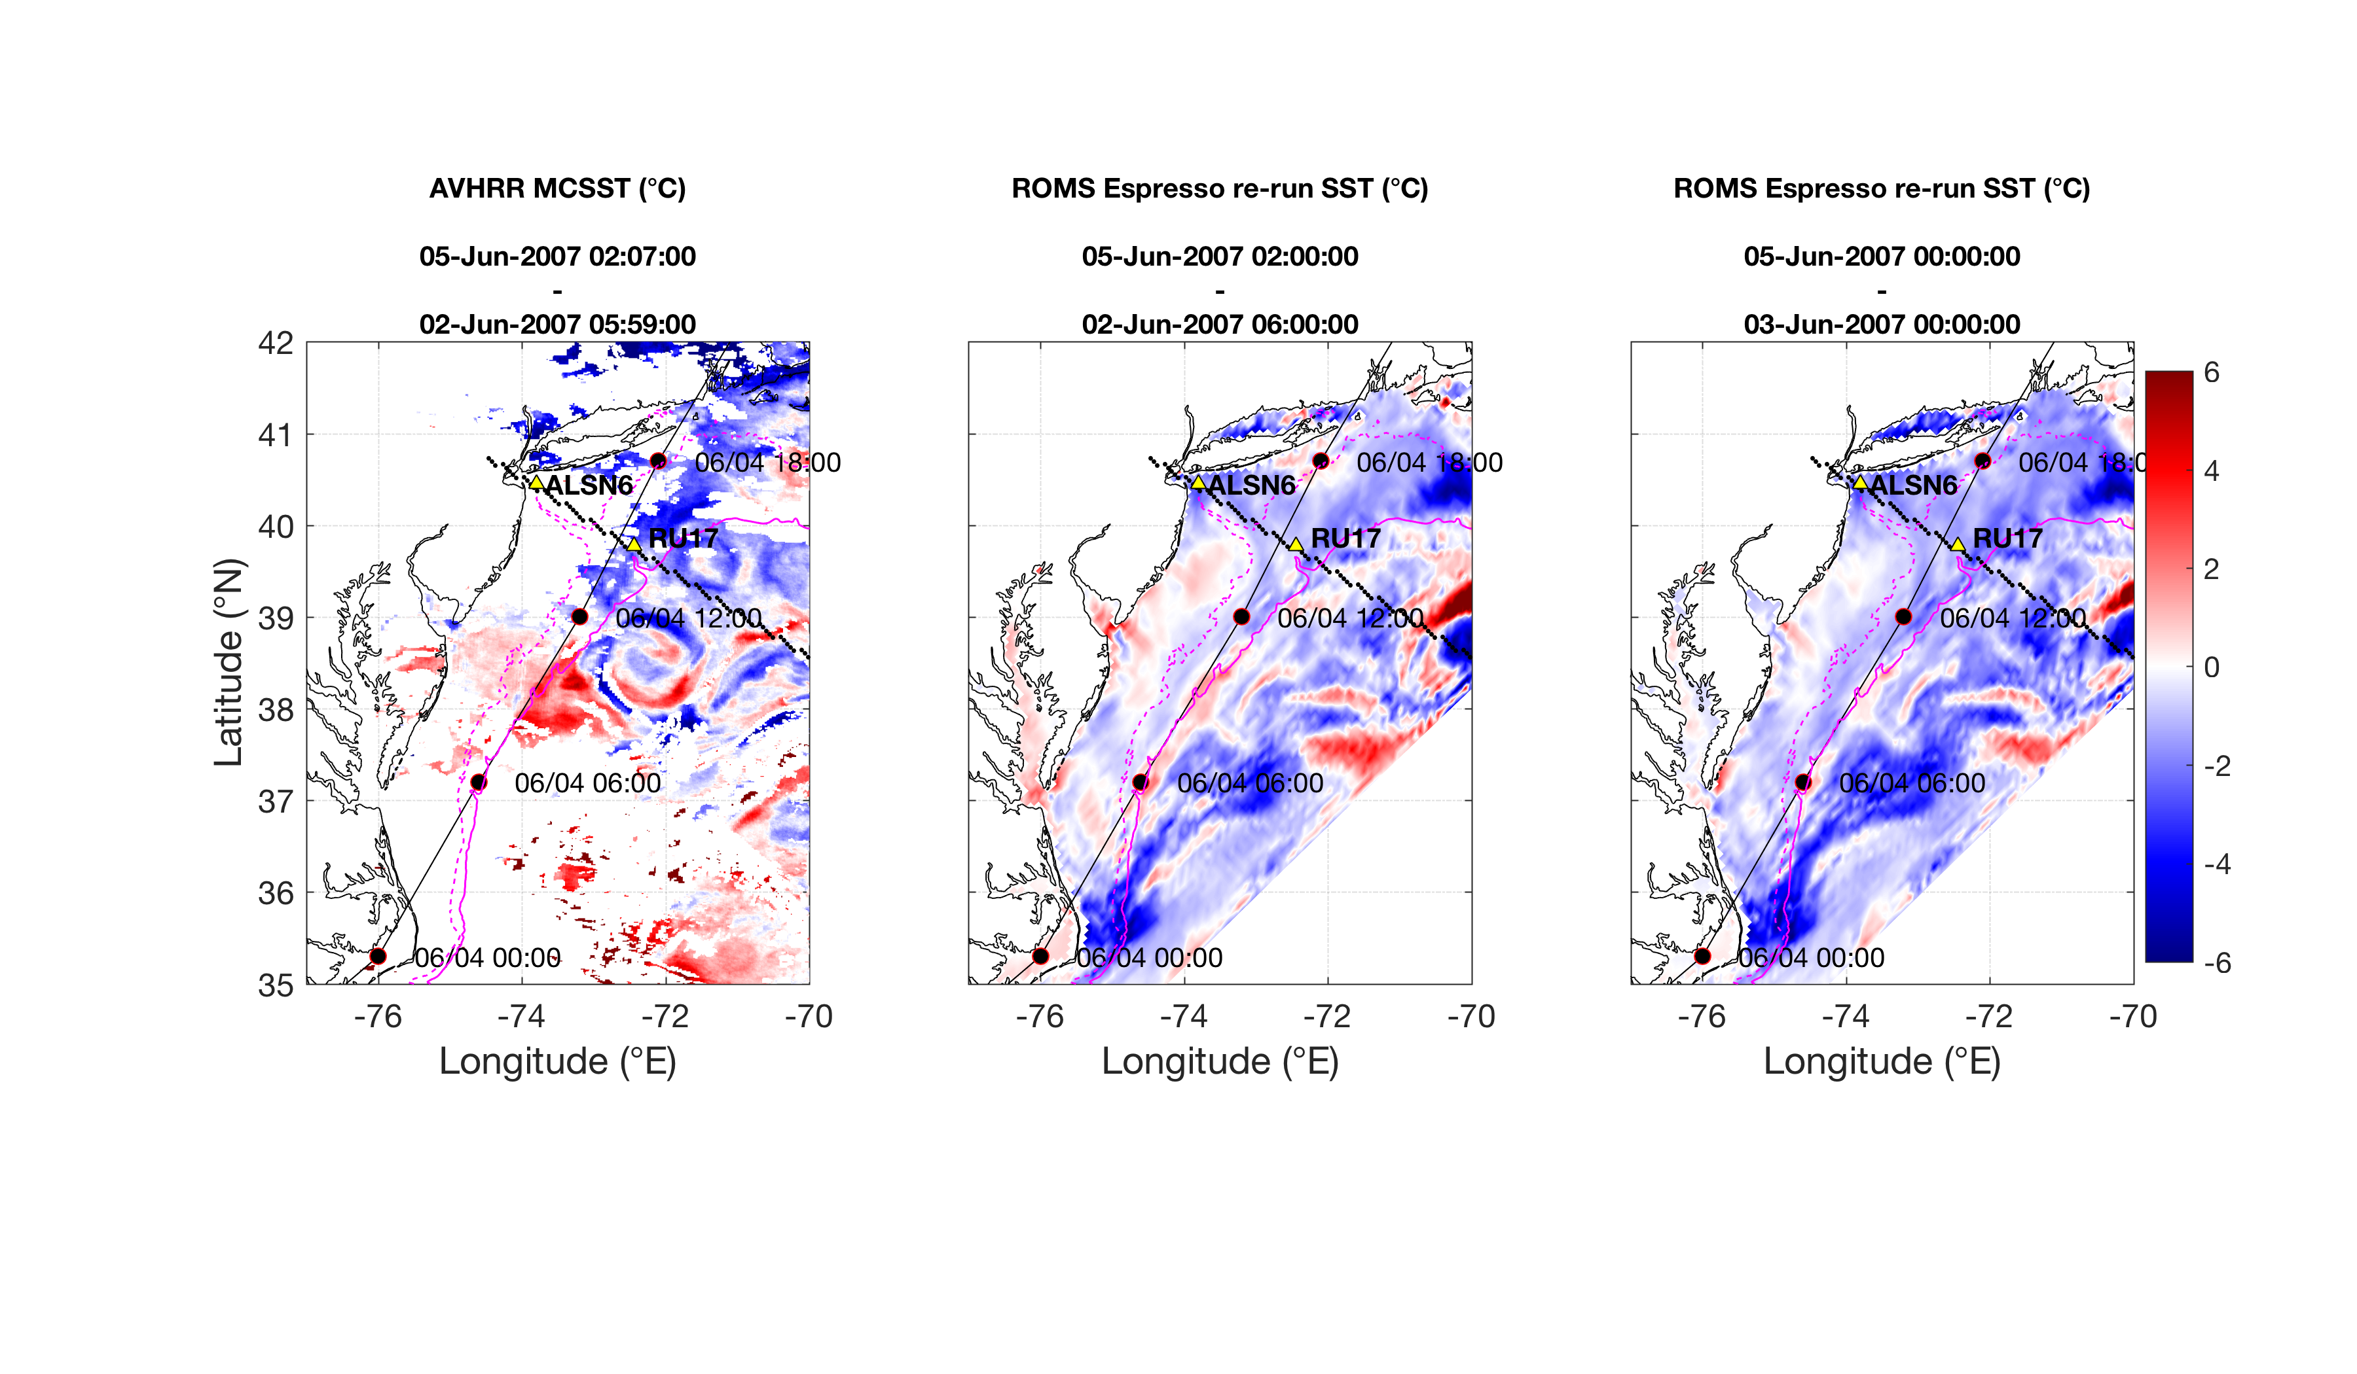
Barry: AOEC onshore wind stress + Coriolis vs. offshore PGF; large tides
Project 2
+offshore
m s⁻²
-onshore
Seroka et al. in prep.
Notes:
22

Slide 28
Summary
Project 2
AOEC SST cooling across entire shelf, bottom T downwelling for both storms (shown for Irene)
Dominant force balances:
  Irene: AOEC onshore wind stress vs. offshore PGF across entire shelf; behind eye reversed, then geostrophic
  Barry: same as Irene, but modulated by tides; along-shelf force balance terms also important (not shown)
Vertical diffusion led to AOEC SST cooling; advection was tidally-modulated alternating warming/cooling (not shown)

Slide 29
Project 3
Offshore Sea Breeze Sensitivity to Coastal Upwelling and Synoptic Flow

Slide 30
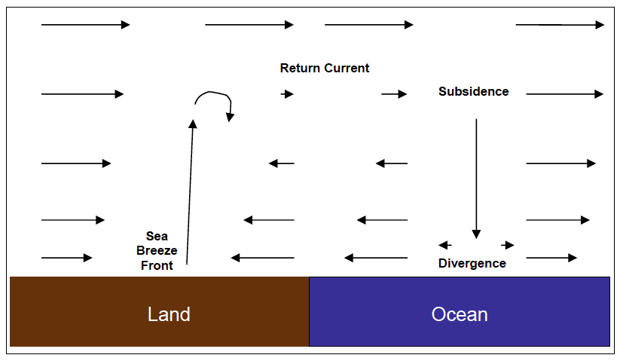
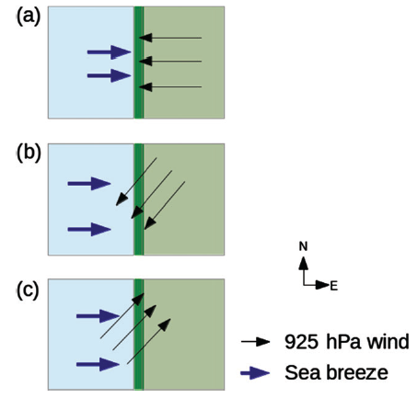
Motivation
Project 3: Offshore Sea Breeze Sensitivity to Coastal Upwelling & Synoptic Flow
Onshore sea breeze observed;
offshore side not (Steele et al. 2014)
Onshore front; offshore more
difficult to distinguish and define
objectively (Finkele 1998)
Previous offshore extent definitions:
  1 m s⁻¹ onshore wind speed in lowest 100m of sea breeze (Arritt 1989)
  Where wind speed uninfluenced by sea breeze (pure sea breezes only)
    Extensive calm region nearby this point not always aligned with largest surface divergence, in contrast to onshore front with largest surface convergence
Need clear, objective definition of offshore extent, for any synoptic, thermal conditions
Warm
Cold
  Pure Sea Breeze

Slide 31
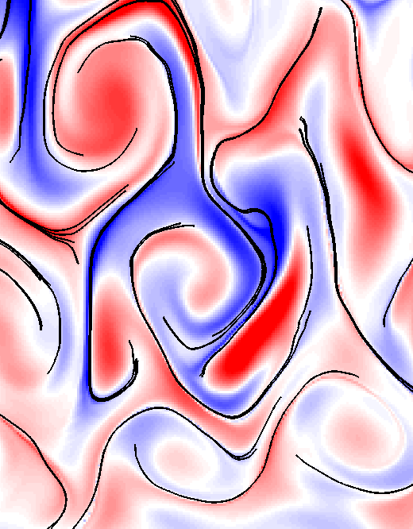
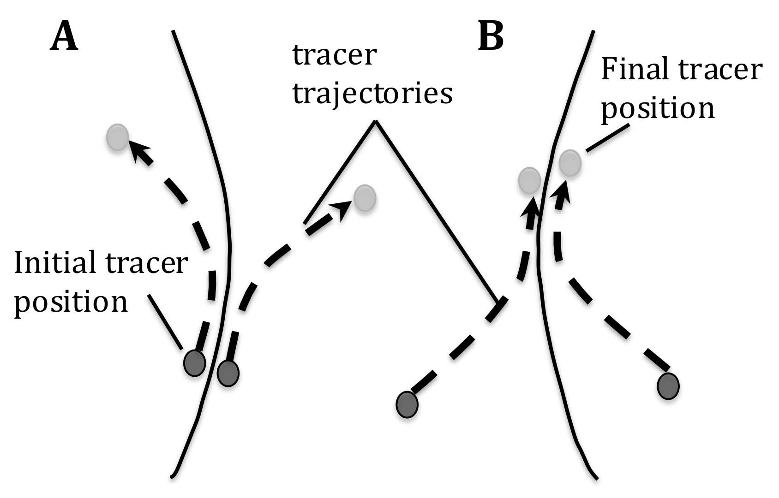

Methods
Project 3
Model: 3km WRF-ARW v3.6.1
Lagrangian Coherent Structures (LCSs):
1. Particles placed on 10km grid in WRF winds
2. Particles forced by 2D winds every 10 min. over 1 hr (forward trajectories) at various heights
-17, 18, 19, 20, 21, 22, 23 UTC-
3. Relative dispersion (RD) calculated
Sea Breeze Cases/Sensitivities:
April 27, 2013: pure, no upwelling
Aug 13, 2012: pure, upwelling
Aug 13: pure, remove upwelling
Aug 13: strong (NJ) vs. weak (MD) synoptic
  Repelling LCS
  Attracting LCS
Demonstration
Upwelling
sensitivity
Synoptic flow
sensitivity
Notes:
Vertical velocities are small compared to horizontal
Satellite: High res in space and time
Previous satellite SST products low in spatial or temporal resolution and are often warmest pixel composites for declouding; cannot resolve coastal upwelling
SST product is IR/near IR (AVHRR); SPoRT is IR/near IR as well
Model: NAM12km for boundary conditions
Cases: largest and longest lasting upwelling in NJ 2012-2014
20140731 case has similar ambient (outside upwelling) water T to 20130707

Slide 32
Project 3
Results
Onshore 100m max blue convergence aligned with inland weather radar sea breeze front
Max red divergence propagates offshore
Seroka et al. in prep.
Notes:
-Blue X for southern cross section, MD cross section?
Answer to vertical velocity:
Only using relative numbers of RD for paper (offshore extent (max); upwelling-non-upwelling)
WRF is consistent with continuity
2D LCS is not- assuming no vertical velocity, which is a valid assumption to make because vertical velocities are very small (100X smaller than horizontal velocities)

Slide 33
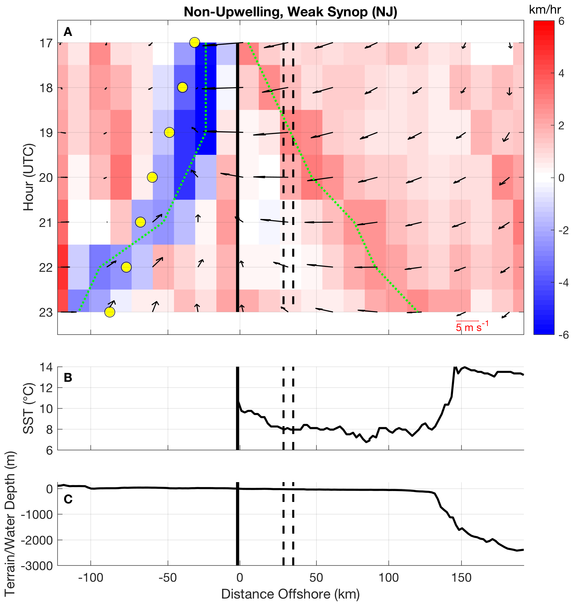
Project 3
Max blue convergence propagates ~100km inland with weather radar front (yellow)
Max red divergence propagates ~125km offshore
Seroka et al. in prep.
Notes:
Uniform SST across the shelf

Slide 34
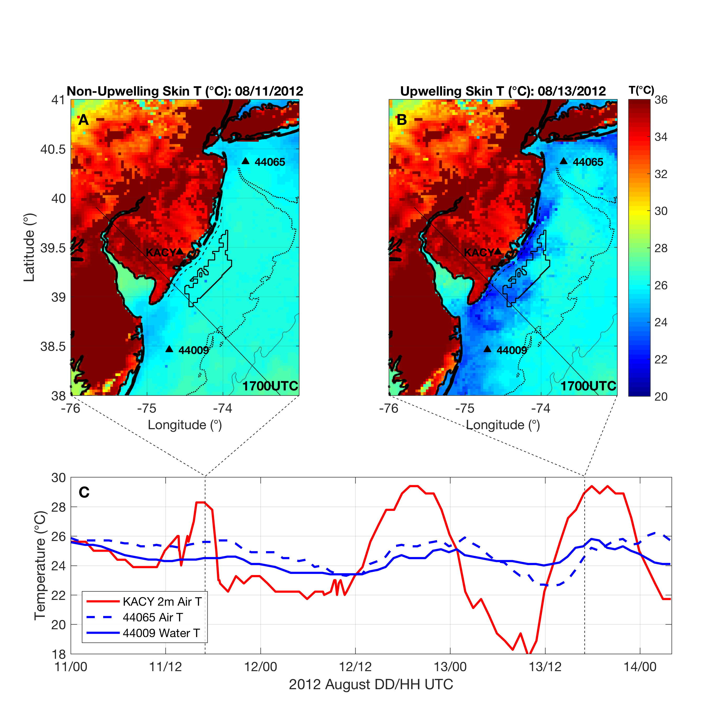
Project 3
Strong synoptic
Weak
synoptic
Upwelling
Seroka et al. in prep.
Seroka et al. in prep.
Notes:
-weather radar first detects NJ Case 1 and 2 sea breezes and MD Case 2 sea breeze at around 1700Z
-weather radar stops detecting all sea breezes around 00Z, which is at end of 1-hr simulation starting at 2300Z

Slide 35
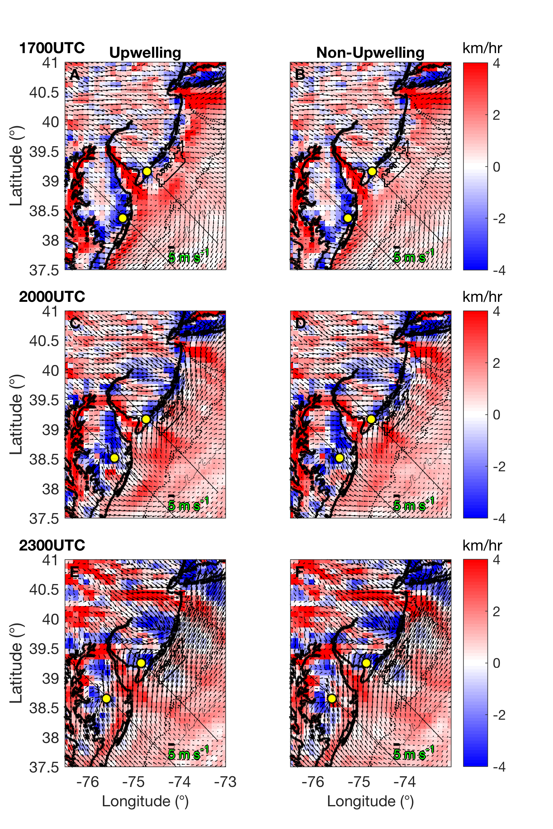
Project 3
Upwelling
Non-Upwelling
Seroka et al. in prep.
NJ stationary- strong synoptic flow
MD propagating- weak synoptic flow
Notes:
-weather radar first detects NJ Case 1 and 2 sea breezes and MD Case 2 sea breeze at around 1700Z
-weather radar stops detecting all sea breezes around 00Z, which is at end of 1-hr simulation starting at 2300Z
-Location of hovmoller cross section and WRF cross section, both plotted, very close
-Location of SST cross section not plotted but close to hovmoller cross section (guess I could have used NCL to get it exactly at WRF cross section, but won’t change conclusions much, if at all)
-The maximum in offshore divergence is insensitive to height, but the maximums are most pronounced at 100m. Wind speed vectors are stronger at 100m as well. This also corresponds to hub height, making this work more broadly applicable.

Slide 36
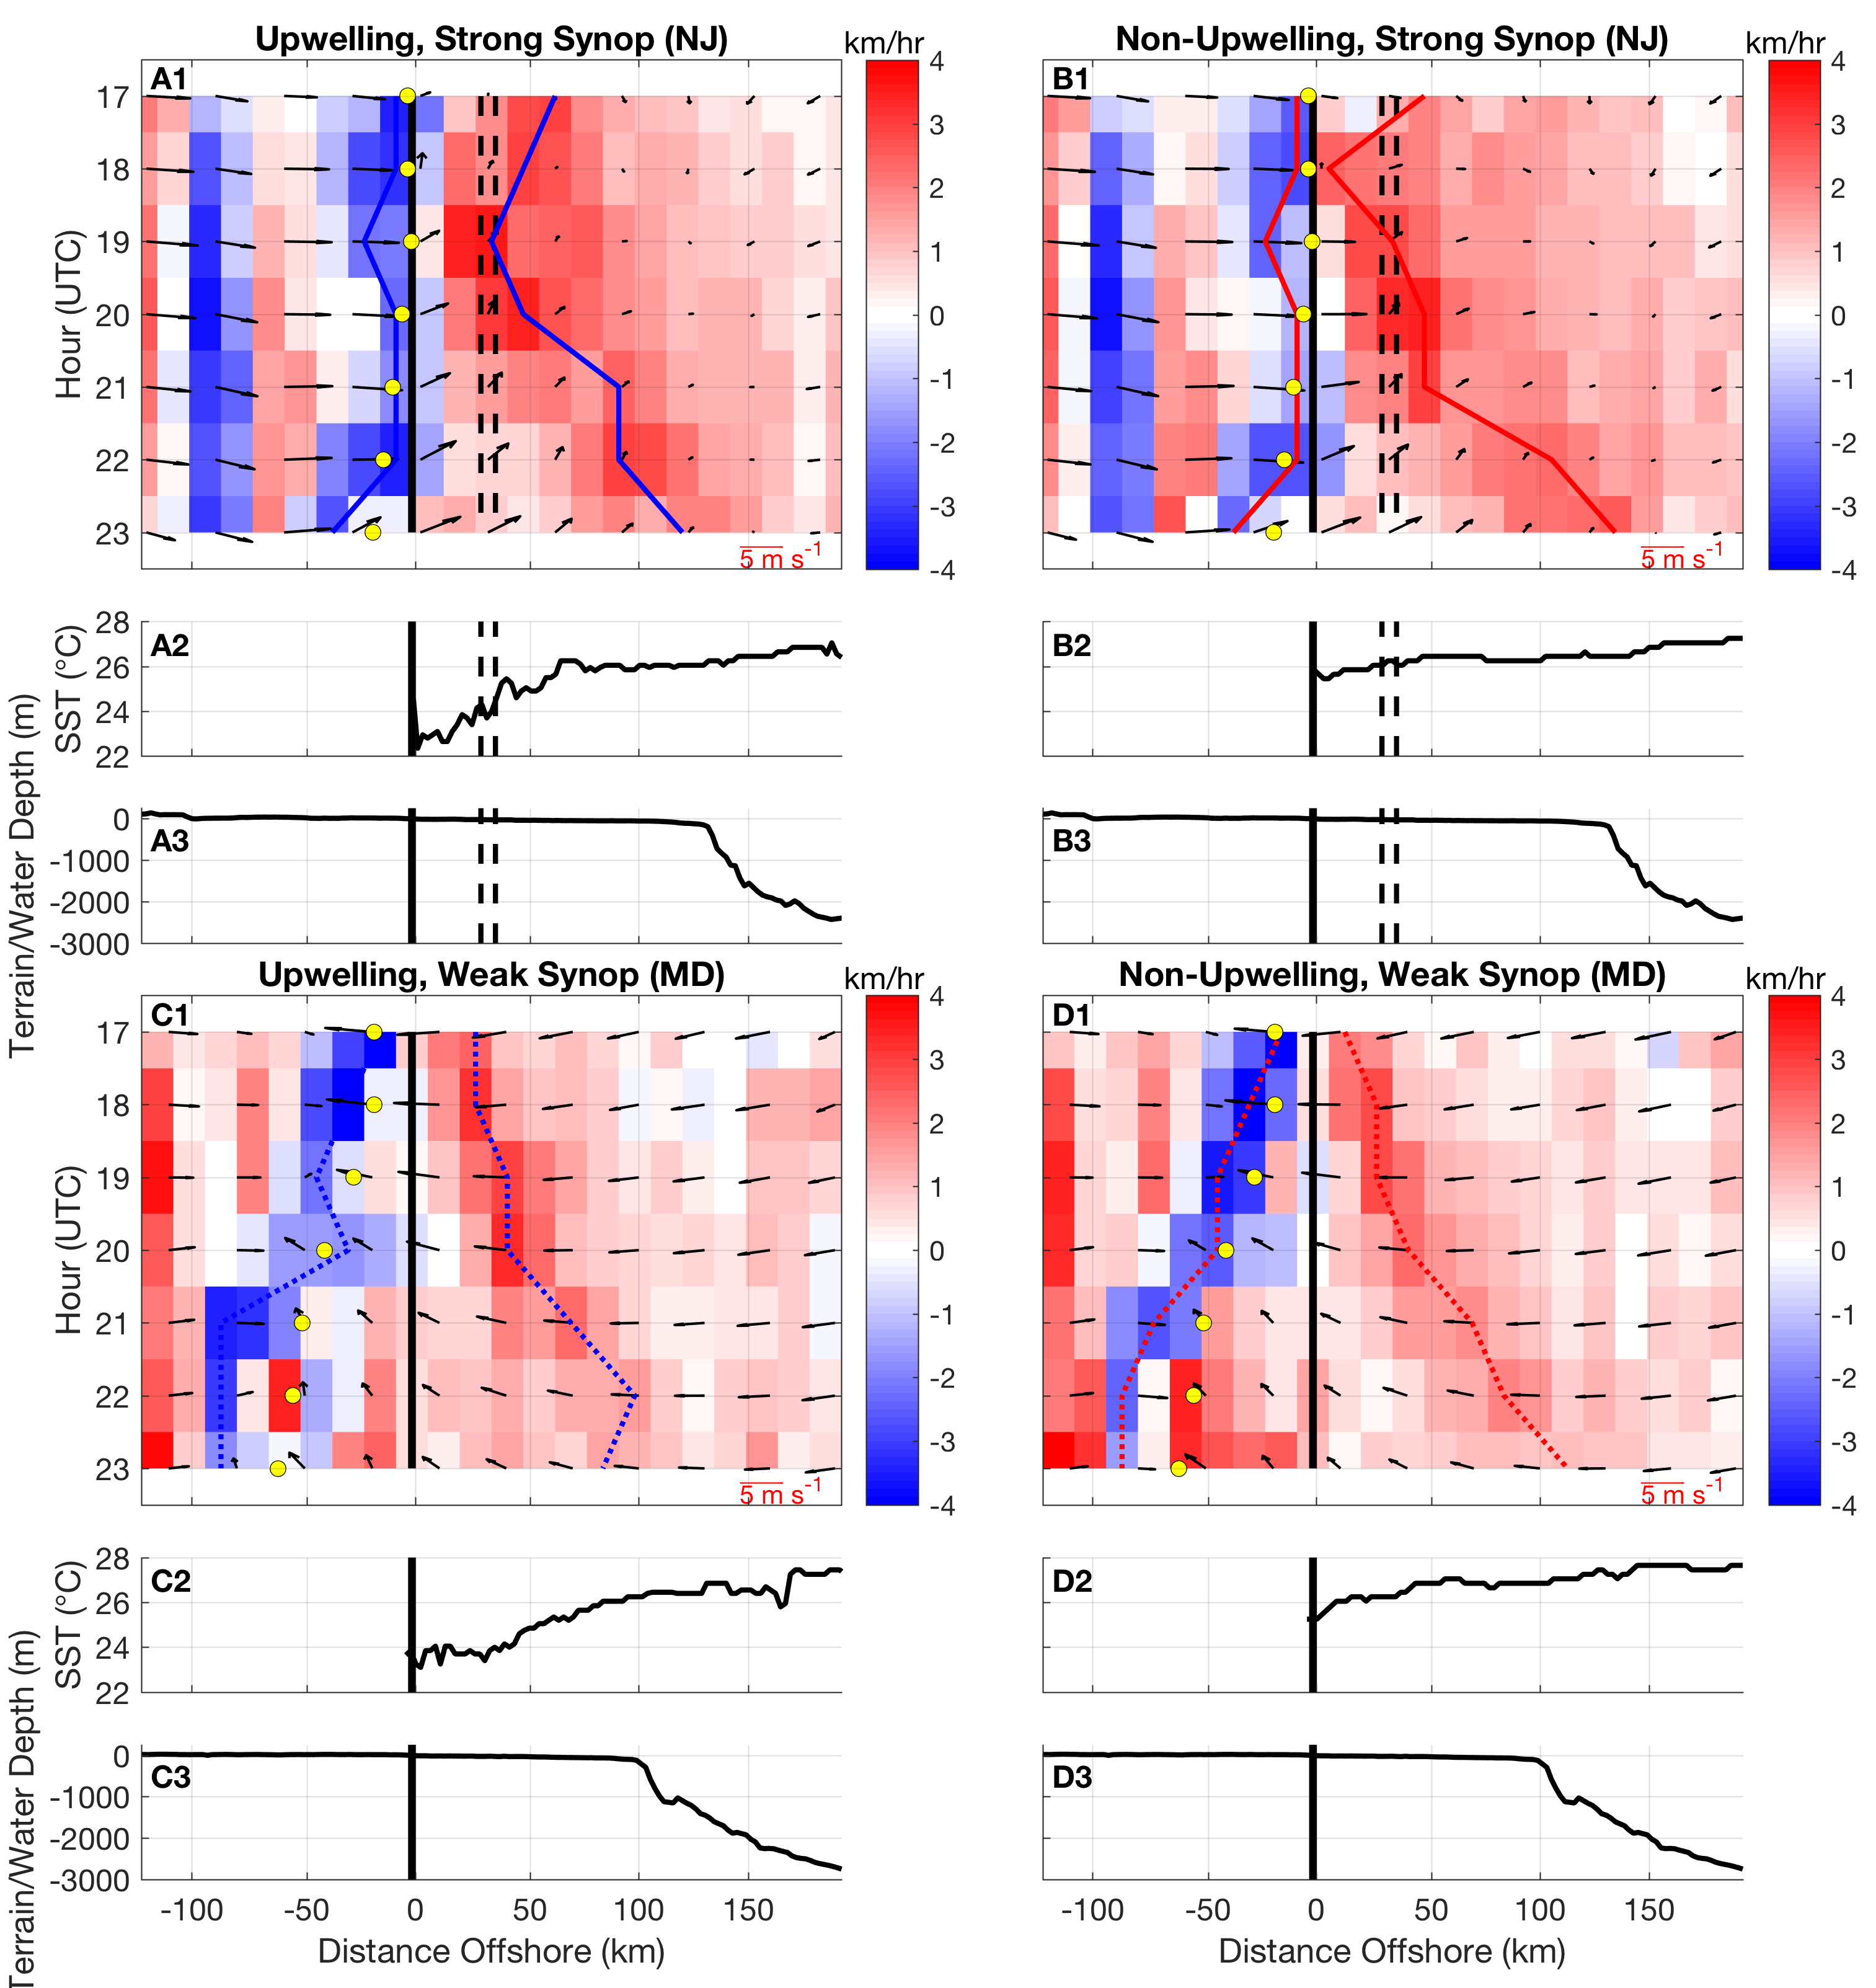
  Upwelling
  Non-Upwelling
Project 3
  NJ
Same Hovmöllers as before…
Let’s composite them…
  MD
  NJ
  MD
Seroka et al. in prep.
Notes:
The vector crosses multiple grid points but the tail is the point it represents.
-This coloring is preserved in the following figures.
-The maximum in offshore divergence is insensitive to height, but the maximums are most pronounced at 50-150m. This also corresponds to hub height, making this work more broadly applicable.

Slide 37
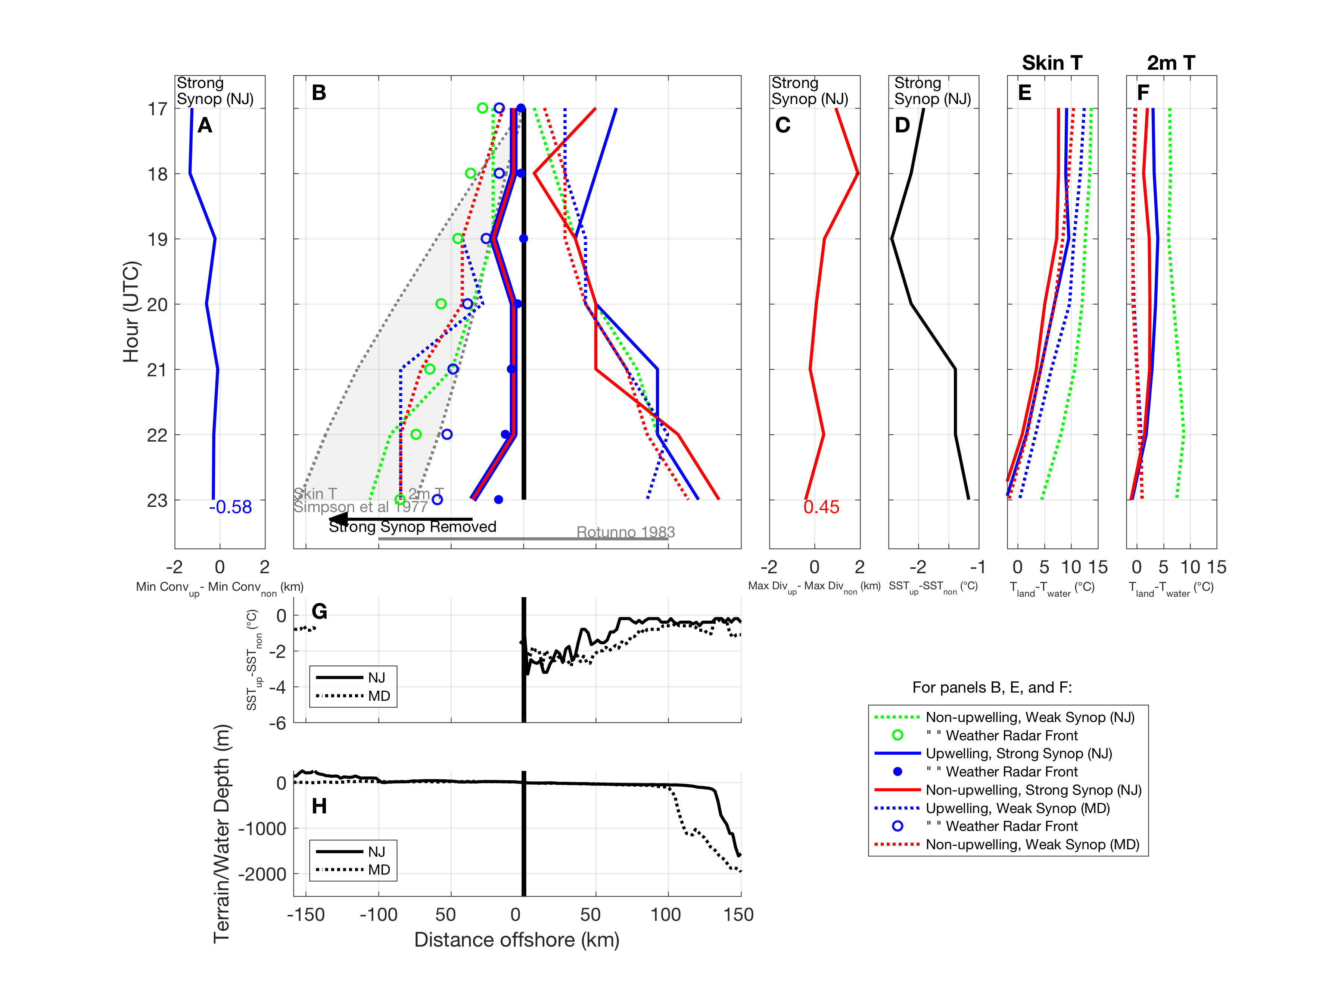
Project 3
Synoptic flow:
Onshore extent sensitive, offshore not (consistent with Finkele 1998)
Upwelling:
Onshore, offshore extent insensitive
(in contrast to Clancy et al 1979, Bowers 2004)
Stronger convergence onshore, stronger divergence offshore with upwelling (not shown here)
Earlier onset; sharper, narrower sea breeze with upwelling (not shown here) (consistent with prior studies)
Seroka et al. in prep.
Notes:
Inland sea breeze extent sensitive to synoptic flow, offshore is not (consistent with Finkele 1998)
Upwelling has no impact on onshore or offshore sea breeze extent, in contrast to Clancy et al. 1979- upwelling sea breeze 2x penetration inland than without upwelling, and in contrast to Bowers 2004- upwelling can force inland sea breeze front several km farther onshore than without upwelling
Roughly same onshore extent as offshore, depending on synoptic conditions. Bowers 2004 found offshore extent roughly 2-3x inland
Upwelling had impact on sea breeze intensity (stronger convergence onshore, stronger divergence offshore with upwelling)
-Case 1 (PHL for NJ) 1.9 m/s weak synoptic flow (925 mb from WRF) along cross section
-Case 2 (PHL for NJ) 4.56 m/s strong synoptic flow (925 mb from WRF) along cross section
-Case 2 (OBX for NJ) 0.609 m/s weak synoptic flow (925 mb from WRF) along cross section
-discussion point: difference in upwelling minus non-upwelling for MD goes to shelf break
-Simpson is based on mean between green dot, blue dot, and red dot, h = 350m
-Rotunno is based on h = 350m, lapse rate is 10K/1000m, latitude = 40N
-starting point assumption for Simpson et al 1977- starts at coast
-ending point assumption for Rotunno
-Simpson: “a similar behaviour [inland rate of propagation] may be expected for all sea-breezes as long as the gradient wind component across the coast is very small”

Slide 38
Summary
Project 3
LCS used to highlight, clarify, objectively define offshore extent of sea breeze (previously ill-defined, not universal)
Used onshore maximum Lagrangian convergence (matched with weather radar front) and offshore maximum Lagrangian divergence as sea breeze boundaries
Sensitivities
  Synoptic flow: inland extent sensitive, offshore not
  Upwelling: a) onshore, offshore extent insensitive; b) stronger convergence onshore, stronger divergence offshore with upwelling; c) earlier onset; sharper, narrower sea breeze with upwelling

Slide 39
Conclusions
AOEC baroclinic coastal ocean cooling key missing contribution in modeling Irene’s rapid decay prior to NJ landfall (Project 1)
Irene’s intensity most sensitive to this cooling than all other WRF parameters tested (1)
Dominant force balance across entire shelf AOEC for Irene (2011), Barry (2007) onshore wind stress vs. offshore PGF (2)
Onshore surface currents opposing offshore bottom currents, enhancing AOEC shear, surface cooling (2)
Vertical diffusion cooled surface layer; advection was tidal (2)
LCS used to demarcate onshore convergent and offshore divergent sea breeze boundaries (3)
Synoptic flow impacted onshore sea breeze extent but not offshore; upwelling did not impact extent but caused earlier onset and more intense sea breeze onshore and offshore (3)

Slide 40
Future Work
Project 1:
  TC coastal ocean modeling improvements (consistent w Halliwell et al 2011):
    e.g. better initialization to resolve sharp thermocline, Cold Pool
Project 2:
  Cause of maximum cooling in Hudson Canyon?
  What stratified coastal processes 9 other MAB storms?
  Intensity impact studies
  Data denial studies for glider assimilation value
Project 3:
  Sea breeze climatology (upwelling, sea breeze types)
  LCS on HF radar surface ocean currents: offshore divergence?
Explore competing factors of baroclinic atmospheric energy strengthening vs. baroclinic coastal ocean cooling weakening processes for cyclones (TC, extratropical), e.g. Sandy
(Galaraneau et al 2013)

Slide 41
Acknowledgements
Advisor: Scott Glenn
Committee: Josh Kohut, John Wilkin, Rich Dunk
Travis Miles, Oscar Schofield
Louis Bowers, Erick Fredj
RU COOL group
Patty Gillen, Steve Levenson
IT: Johnny Lin, Chuck Belmonte, Chris Camastra, Dave Robertson
GPO students
Rest of DMCS
My friends and family, and wife Ilissa
NJ BPU, MARACOOS, NOAA CINAR, NCEP

Slide 42
Thank you!

Slide 43
Extra slides

Slide 44
Motivation
Project 1
Hurricane Irene (2011) intensity over-predicted (Avila and Cangialosi 2012)
Deep, open ocean: TC cooling 50% front, 50% behind (Price 1981)
Shallow, coastal MAB: 6-11°C, 76-98% total in-storm SST cooling “ahead-of-eye-center” (AOEC)
Stratified coastal ocean processes led to AOEC cooling (Glenn et al. 2016)
SST cooling not captured by existing satellite SST composites, TC forecast models (Seroka et al. 2016)
In this project, I investigated:
  Sensitivity of Irene intensity to AOEC cooling
  Accuracy of modeling when including AOEC cooling
  Validation of track, wind shear, dry air intrusion: controls on TC intensity
Notes:
-over-prediction: Model guidance and National Hurricane Center (NHC) forecasts
-“consistent high bias”, NC landfall 2 categories below expected
-TC cooling with no eddy features and not including inertial response

Slide 45
Existing SST composite
TC forecast models
Pre
SST cooling not captured by existing satellite SST composites, TC forecast models
Post
Diff
Diff Along-Track
Seroka et al. 2016

Slide 46
Sensitivity | WRF Namelist Option
A. Model Configuration
1. Horizontal resolution (dx) | 3 km vs. 6 km
2. Vertical resolution (e_vert, eta_levels) | 51 vs. 35 vertical levels
3. Adaptive time step (use_adaptive_time_step) | on vs. off
4. Boundary conditions (update frequency, interval_seconds) | 3 vs. 6 hours
5. Digital Filter Initialization (DFI, dfi_opt) | on (dfi_nfilter=7) vs. off
B. Atmospheric/Model Physics
6. Microphysics (mp_physics) | 6 (WRF Single-Moment 6-class) vs.
 | 16 (WRF Double-Moment 6-class)
7-8. Planetary boundary layer scheme (bl_pbl_physics) | 5 (Mellor-Yamada Nakanishi and Niino Level 2.5) vs. 7 (ACM2) vs.
 | 1 (Yonsei University)
9. Cumulus parameterization (cu_physics) | 1 (Kain-Fritsch, cudt=0, cugd_avedx=1) vs. 0 (off)
10. SST skin (sst_skin) | on vs. off
11-13. Longwave radiation (ra_lw_physics) | 1 (RRTM) vs. 5 (New Goddard) vs.
 | 99 (GFDL) vs. 4 (RRTMG)
14-16. Shortwave radiation (ra_sw_physics) | 1 (Dudhia) vs. 5 (New Goddard) vs.
 | 99 (GFDL) vs. 4 (RRTMG)
17-18. Latent heat flux <0 over water (in module_sf_sfclay) | on vs. off (warm SST)
 | on vs. off (cold SST)
19. Land surface physics (sf_surface_physics) | 1 (5-layer thermal diffusion) vs.
 | 2 (Noah)
C. Advanced Hurricane WRF (AHW) Options
20-21. Air-sea flux parameterizations (isftcflx) | 1 vs. 0 (warm SST)
 | 1 vs. 0 (cold SST)
D. Sea Surface Temperature
22-24. SST | cold vs. warm (isftcflx=2)
 | cold vs. warm (isftcflx=1)
 | cold vs. warm (isftcflx=0)
E. Advanced Hurricane WRF (AHW) Options (12-hour later initialization)
25. Digital Filter Initialization (DFI, dfi_opt) | on (dfi_nfilter=7) vs. off
26-27. 1D Ocean Mixed Layer Model (sf_ocean_physics=1) | on (isothermal warm initial conditions) vs. off
 | on (glider stratified initial conditions) vs. off
28. 3D Ocean Price-Weller-Pinkel Model (sf_ocean_physics=2) | on (glider stratified initial conditions, 400m depth) vs. off

Slide 47
Project 1
Type, AOEC%
Intensity Impact of Deepwater Cooling Processes
3D 56%
Air-sea fluxes tiny, 1D ocean mixing & 3D deepwater gradually larger negative intensity impact
1D mixing 32%
Air-sea flux 8%
Control
Seroka et al. 2016
MAB entrance
Eye passage
MAB exit
Intensity Impact of SST vs. Air-Sea Flux Parameterizations
Cold SST
SST sensitivity greater than
air-sea flux parameterization sensitivity
Warm SST
Prediction Bias
Including SST cooling in modeling mitigated high bias in intensity predictions
NHC uncertainty
Notes:
Deintensification rate
OML + coastal, OML + HYCOM

Slide 48
Results
Project 1
Type, AOEC%
Intensity Impact of Deepwater Cooling Processes
3D 56%
Air-sea fluxes tiny, 1D ocean mixing & 3D deepwater gradually larger negative intensity impact
1D mixing 32%
Air-sea flux 8%
Control
Seroka et al. 2016
MAB entrance
Eye passage
MAB exit
Prediction Bias
Including SST cooling in modeling mitigated high bias in intensity predictions
NHC uncertainty
Notes:
Deintensification rate
OML + coastal, OML + HYCOM

Slide 49
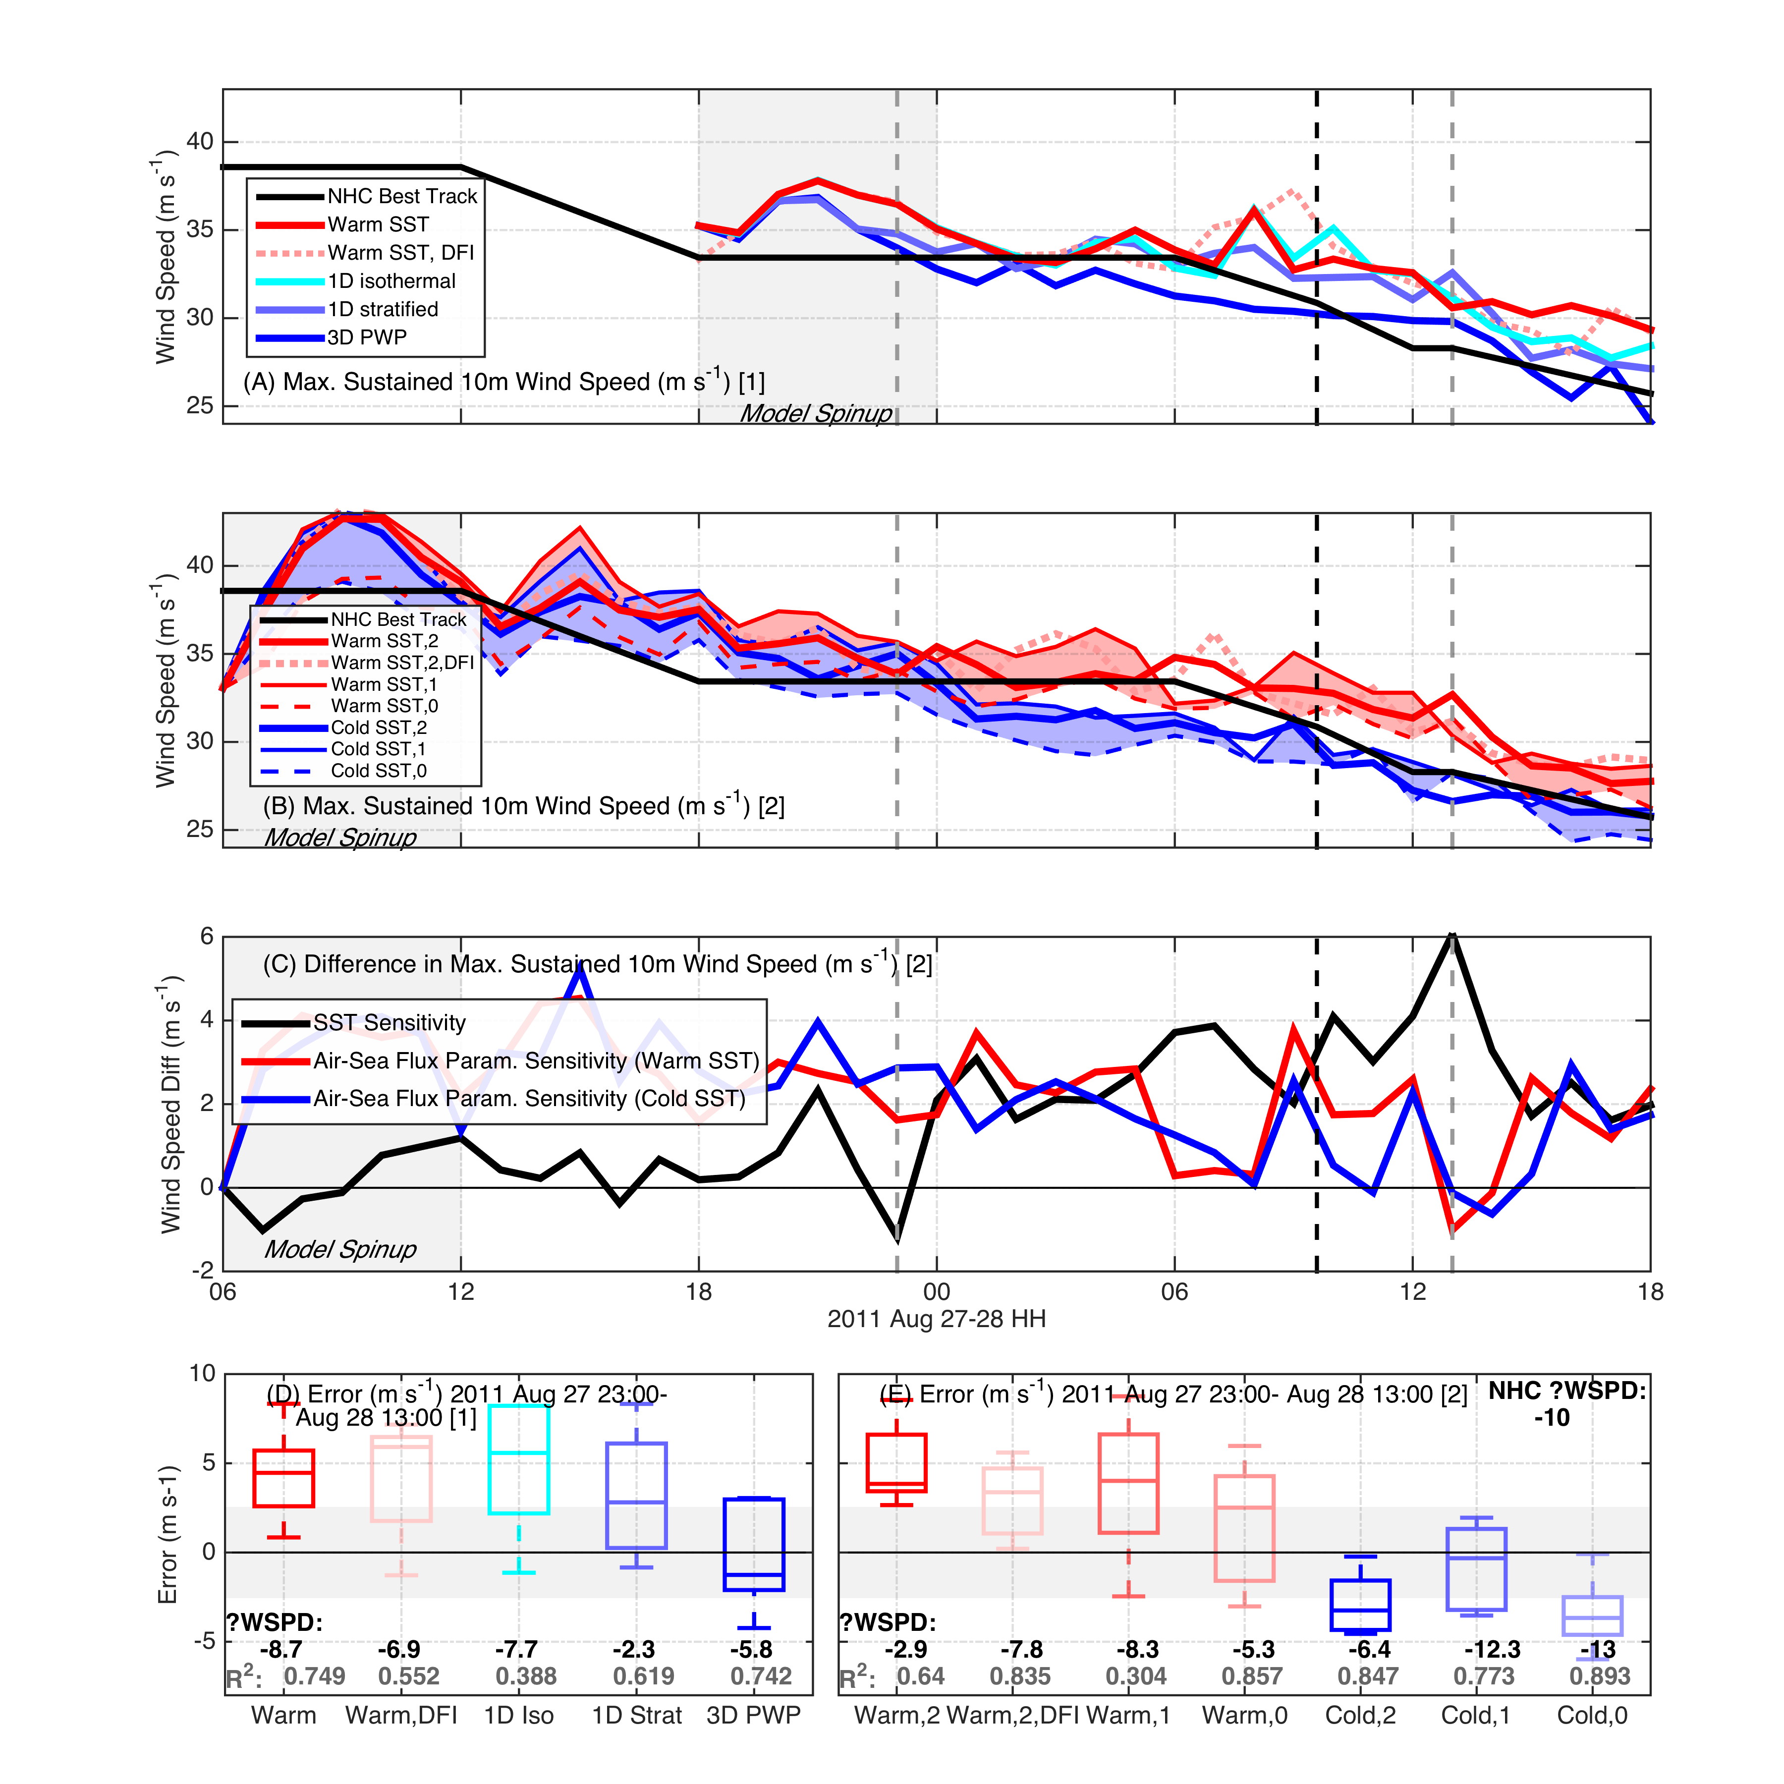

Slide 50
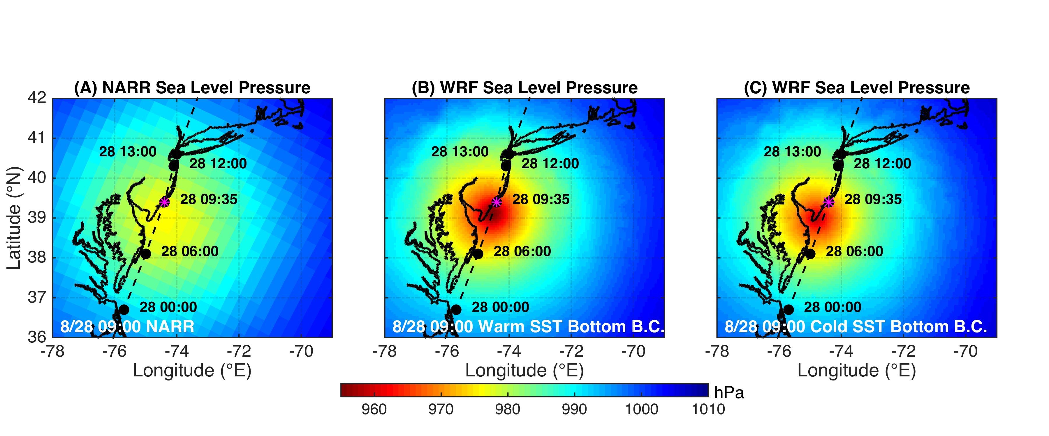

Slide 51
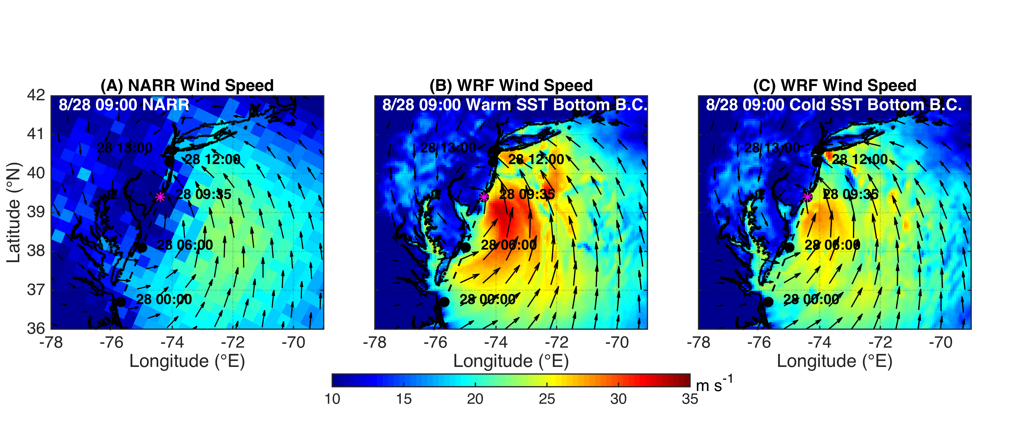
Figure 8
Table 2
Radius of Maximum Wind (nmi)
Time | Bdeck | Warm | Cold
2011082706 | 60 | 58 | 58
2011082712 | 45 | 43 | 43
2011082718 | 45 | 55 | 56
2011082800 | 45 | 39 | 46
2011082806 | 100 | 40 | 40
2011082812 | 100 | 115 | 151
Created table of radii of max winds for warm and cold SST runs and NHC bdeck data- sort of validation that I won’t use as figure but can include in words- radiusmaxwinds.xlsx

Slide 52
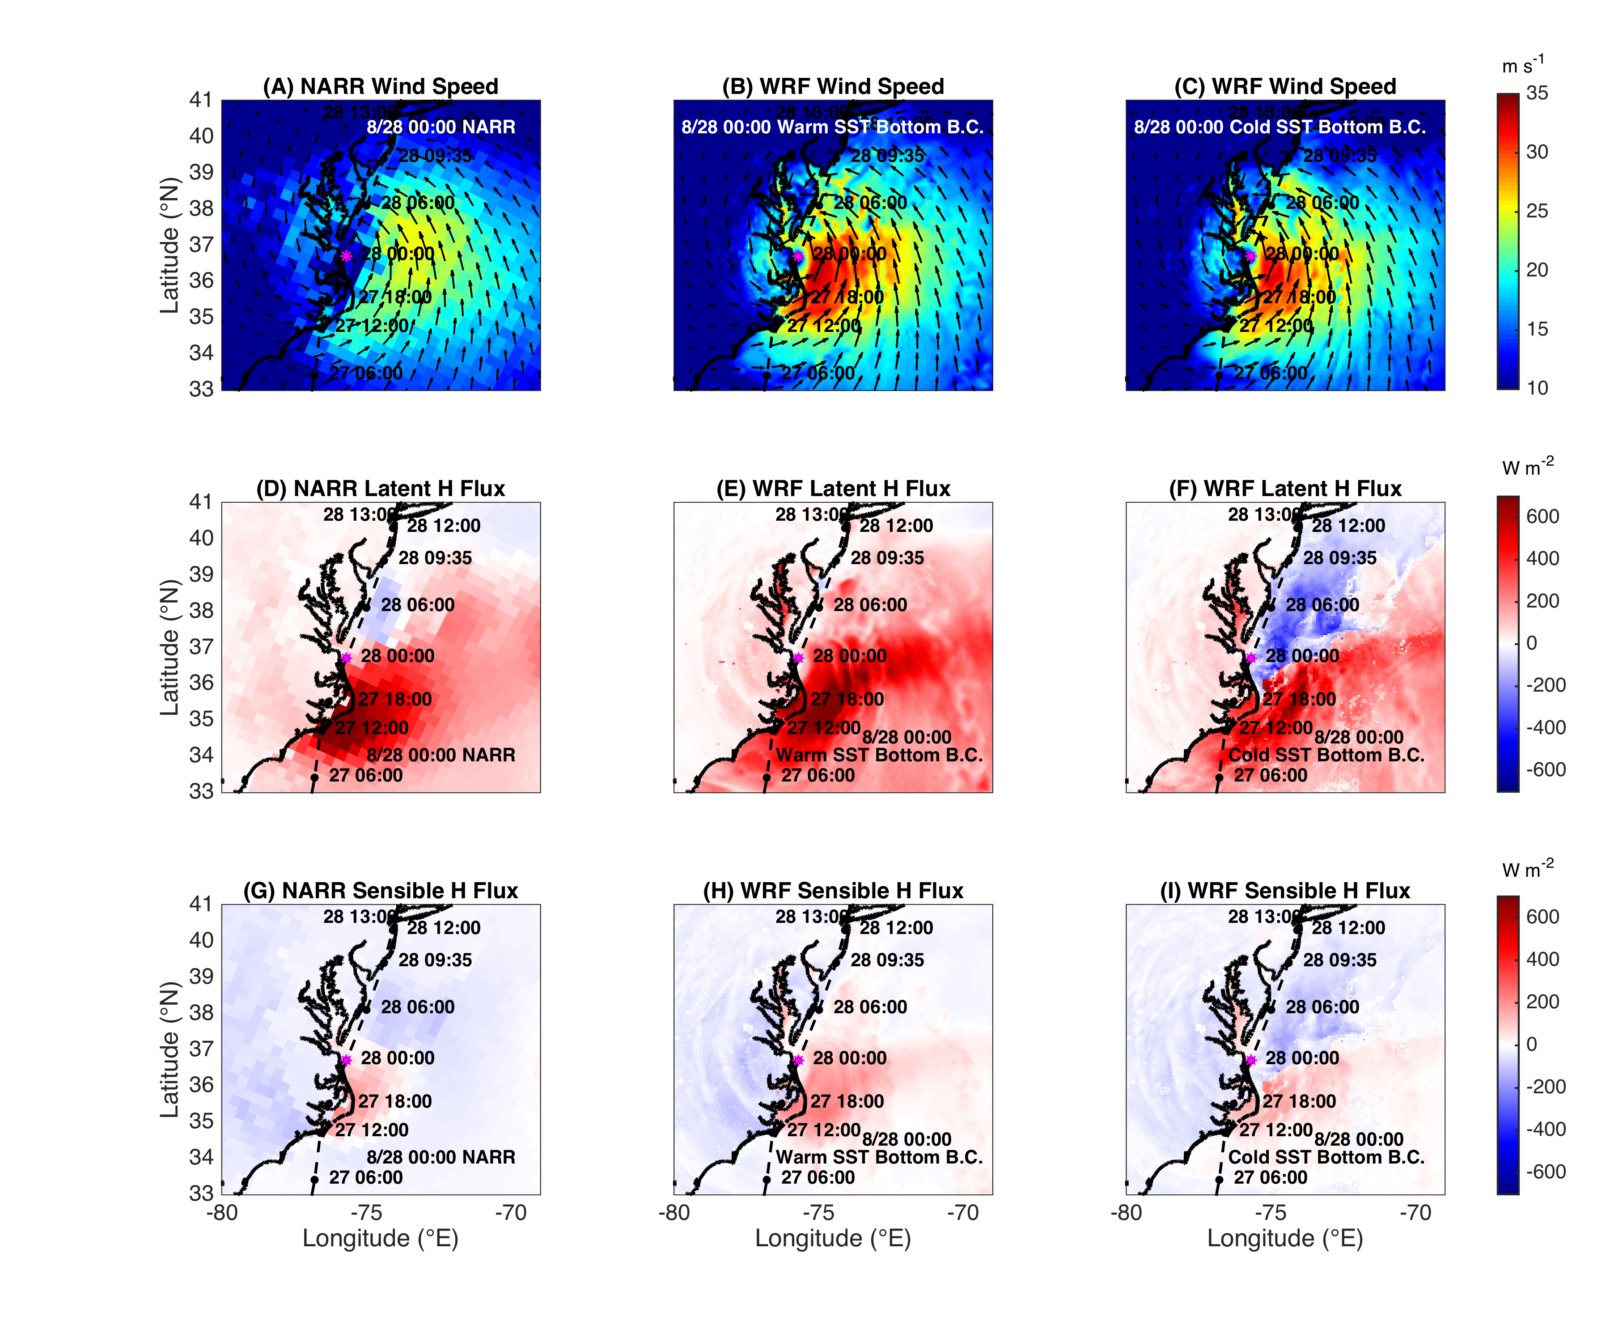
Size, structure insensitive (top row)
NARR fluxes are 3-hr averages

Slide 53
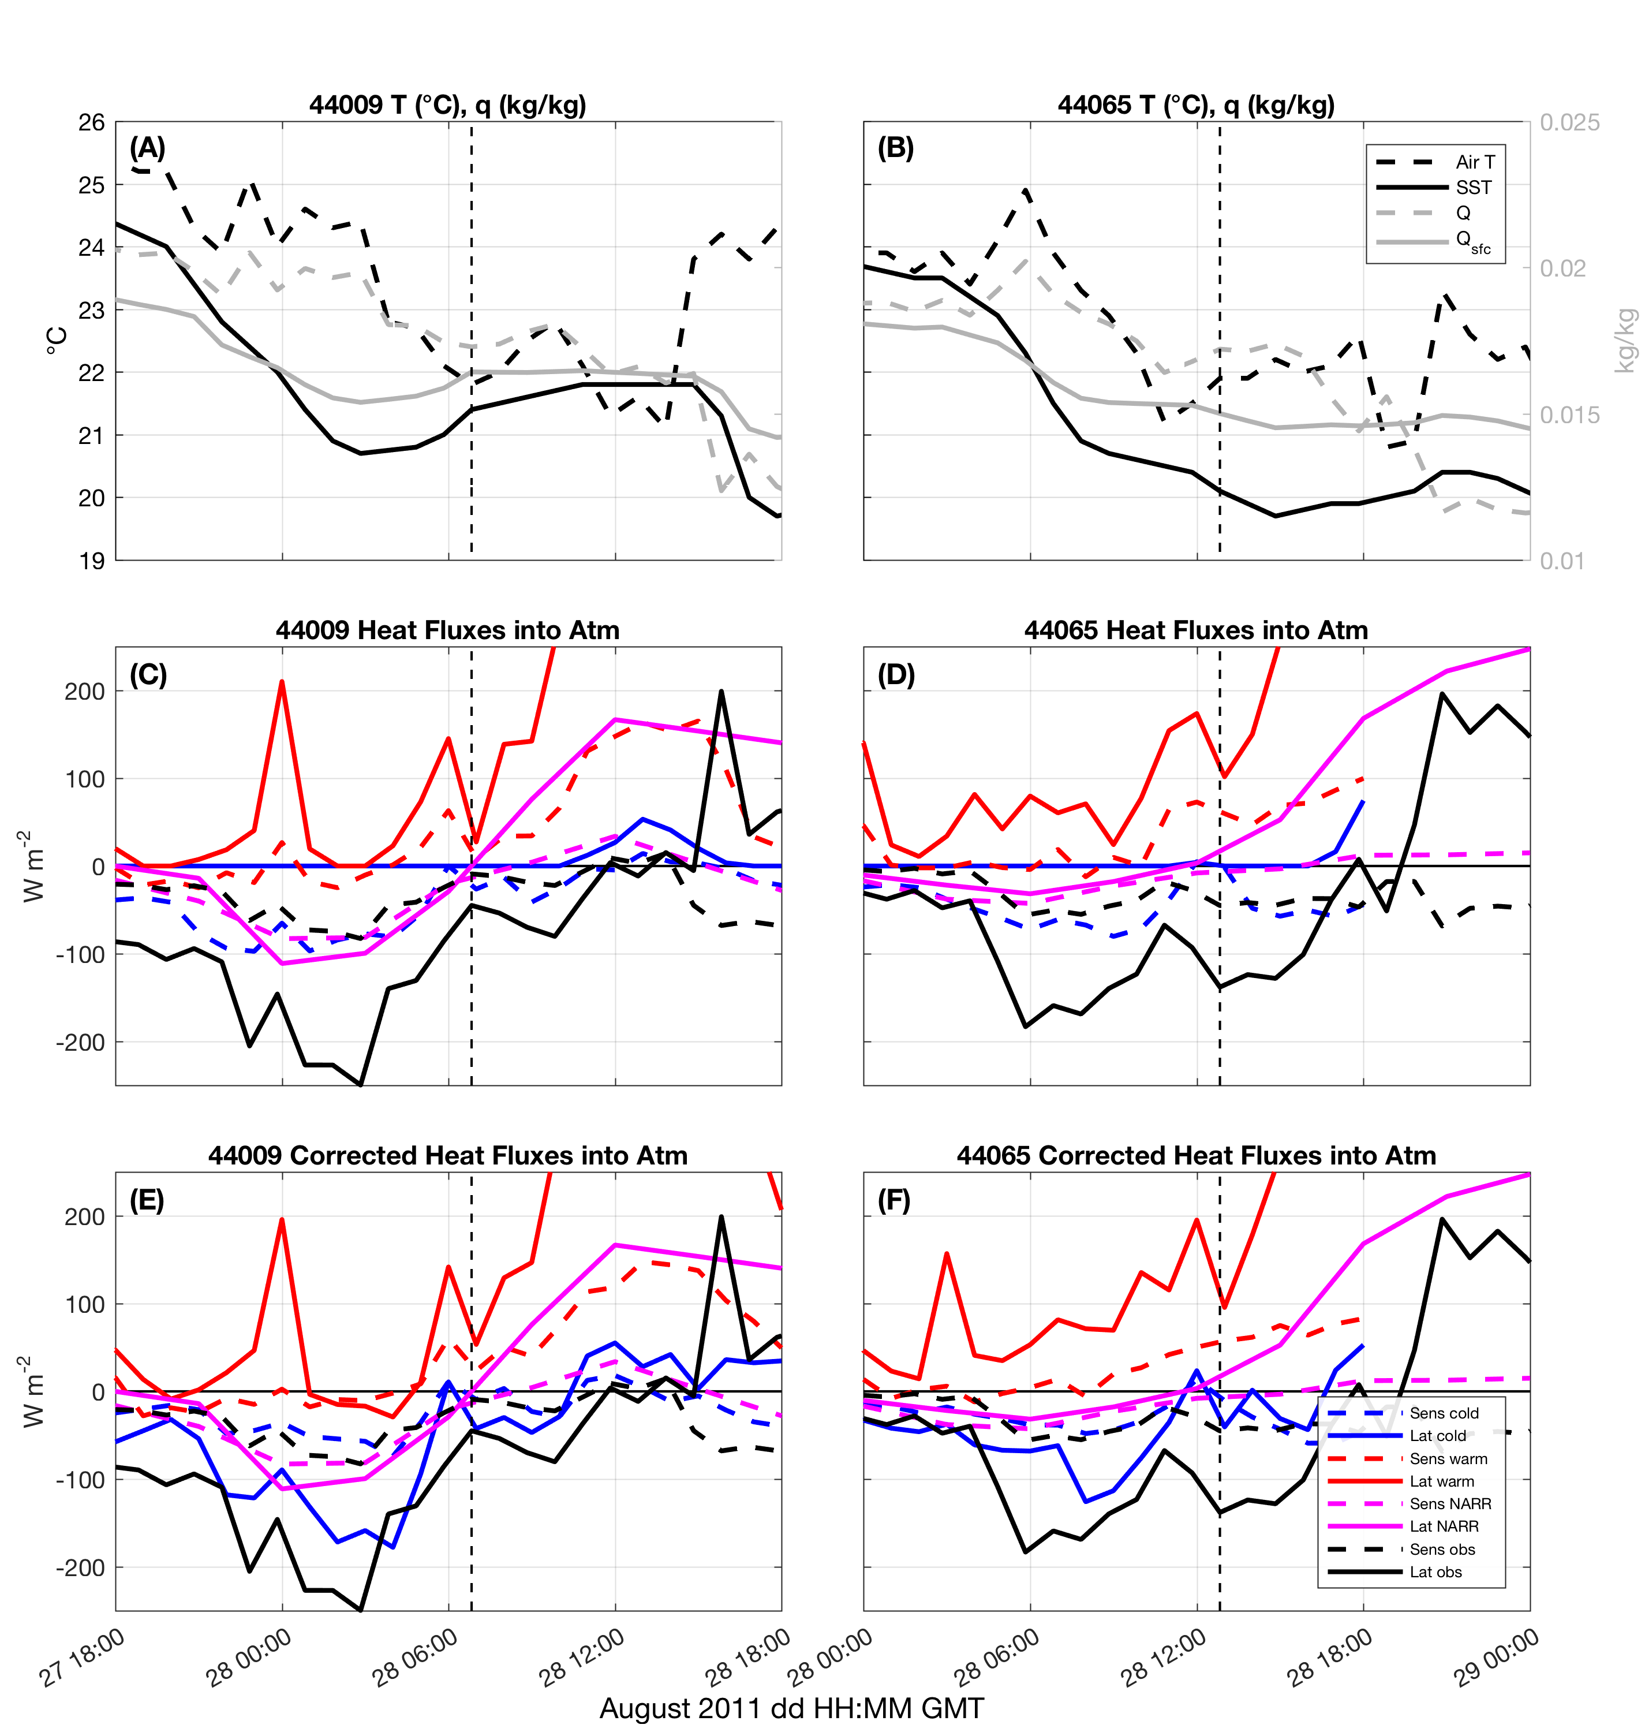

Slide 54
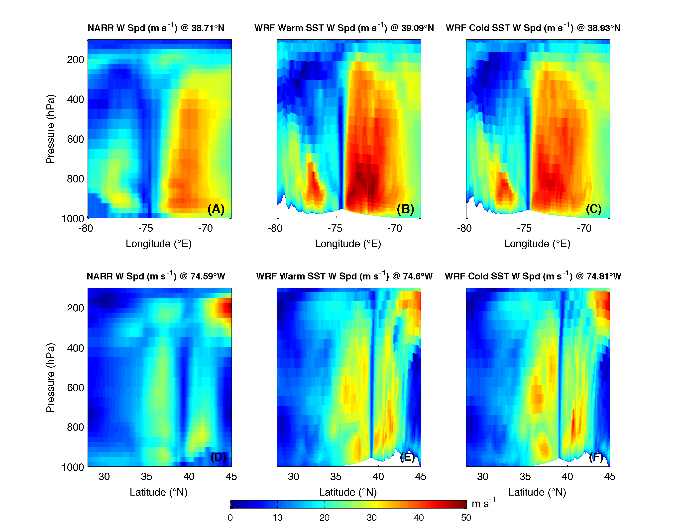
Figure 9
Not used Table
Distance between eyes (km)
Time | NARR- Warm SST | NARR- Cold SST | Warm SST- Cold SST
00UTC 28 Aug | 11 | 7 | 6
03UTC 28 Aug | 18 | 17 | 6
06UTC 28 Aug | 22 | 23 | 18
09UTC 28 Aug | 42 | 31 | 26
12UTC 28 Aug | 39 | 19 | 25

Slide 55
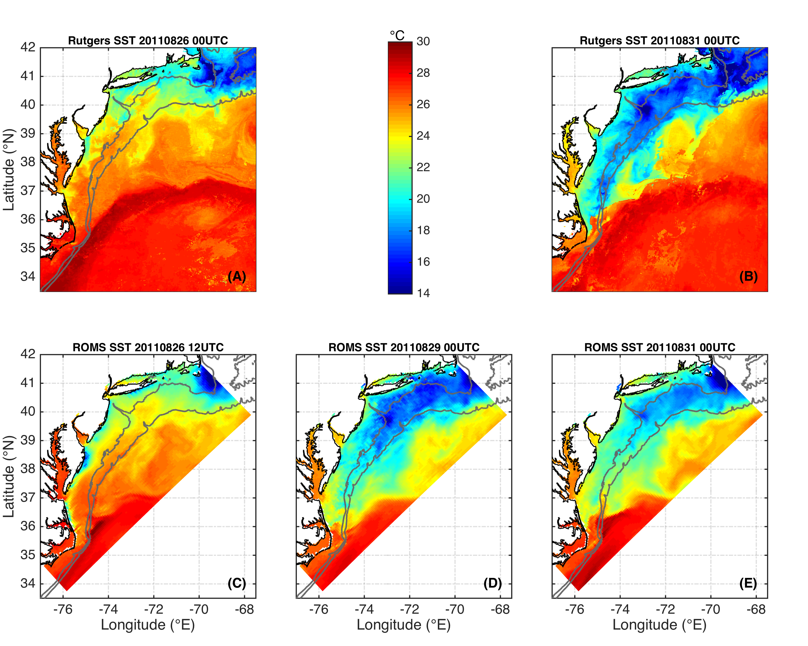
Project 1
SST cooling was key missing contribution in modeling Irene’s rapid decay—not Track
Track
SST cooling
Pre-storm SST
Post-storm SST
NAM, RAP
Seroka et al. 2016
Notes:
Coastal upwelling captured by Rutgers SST 08/26 but not 08/27. ROMS run started 08/26 at 12 UTC
Warm SST simulations used RTG 08/27 to simulate “operational NAM SST”. Figure 3 has 08/26 products plotted to show coastal upwelling

Slide 56
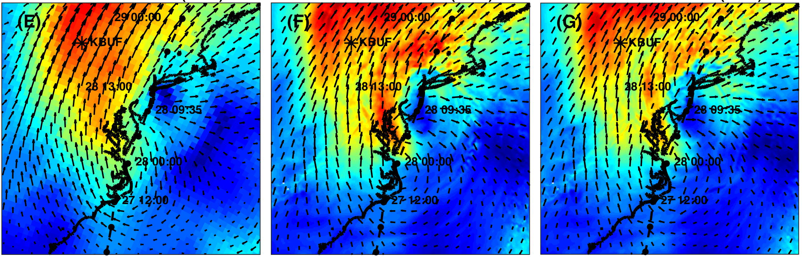
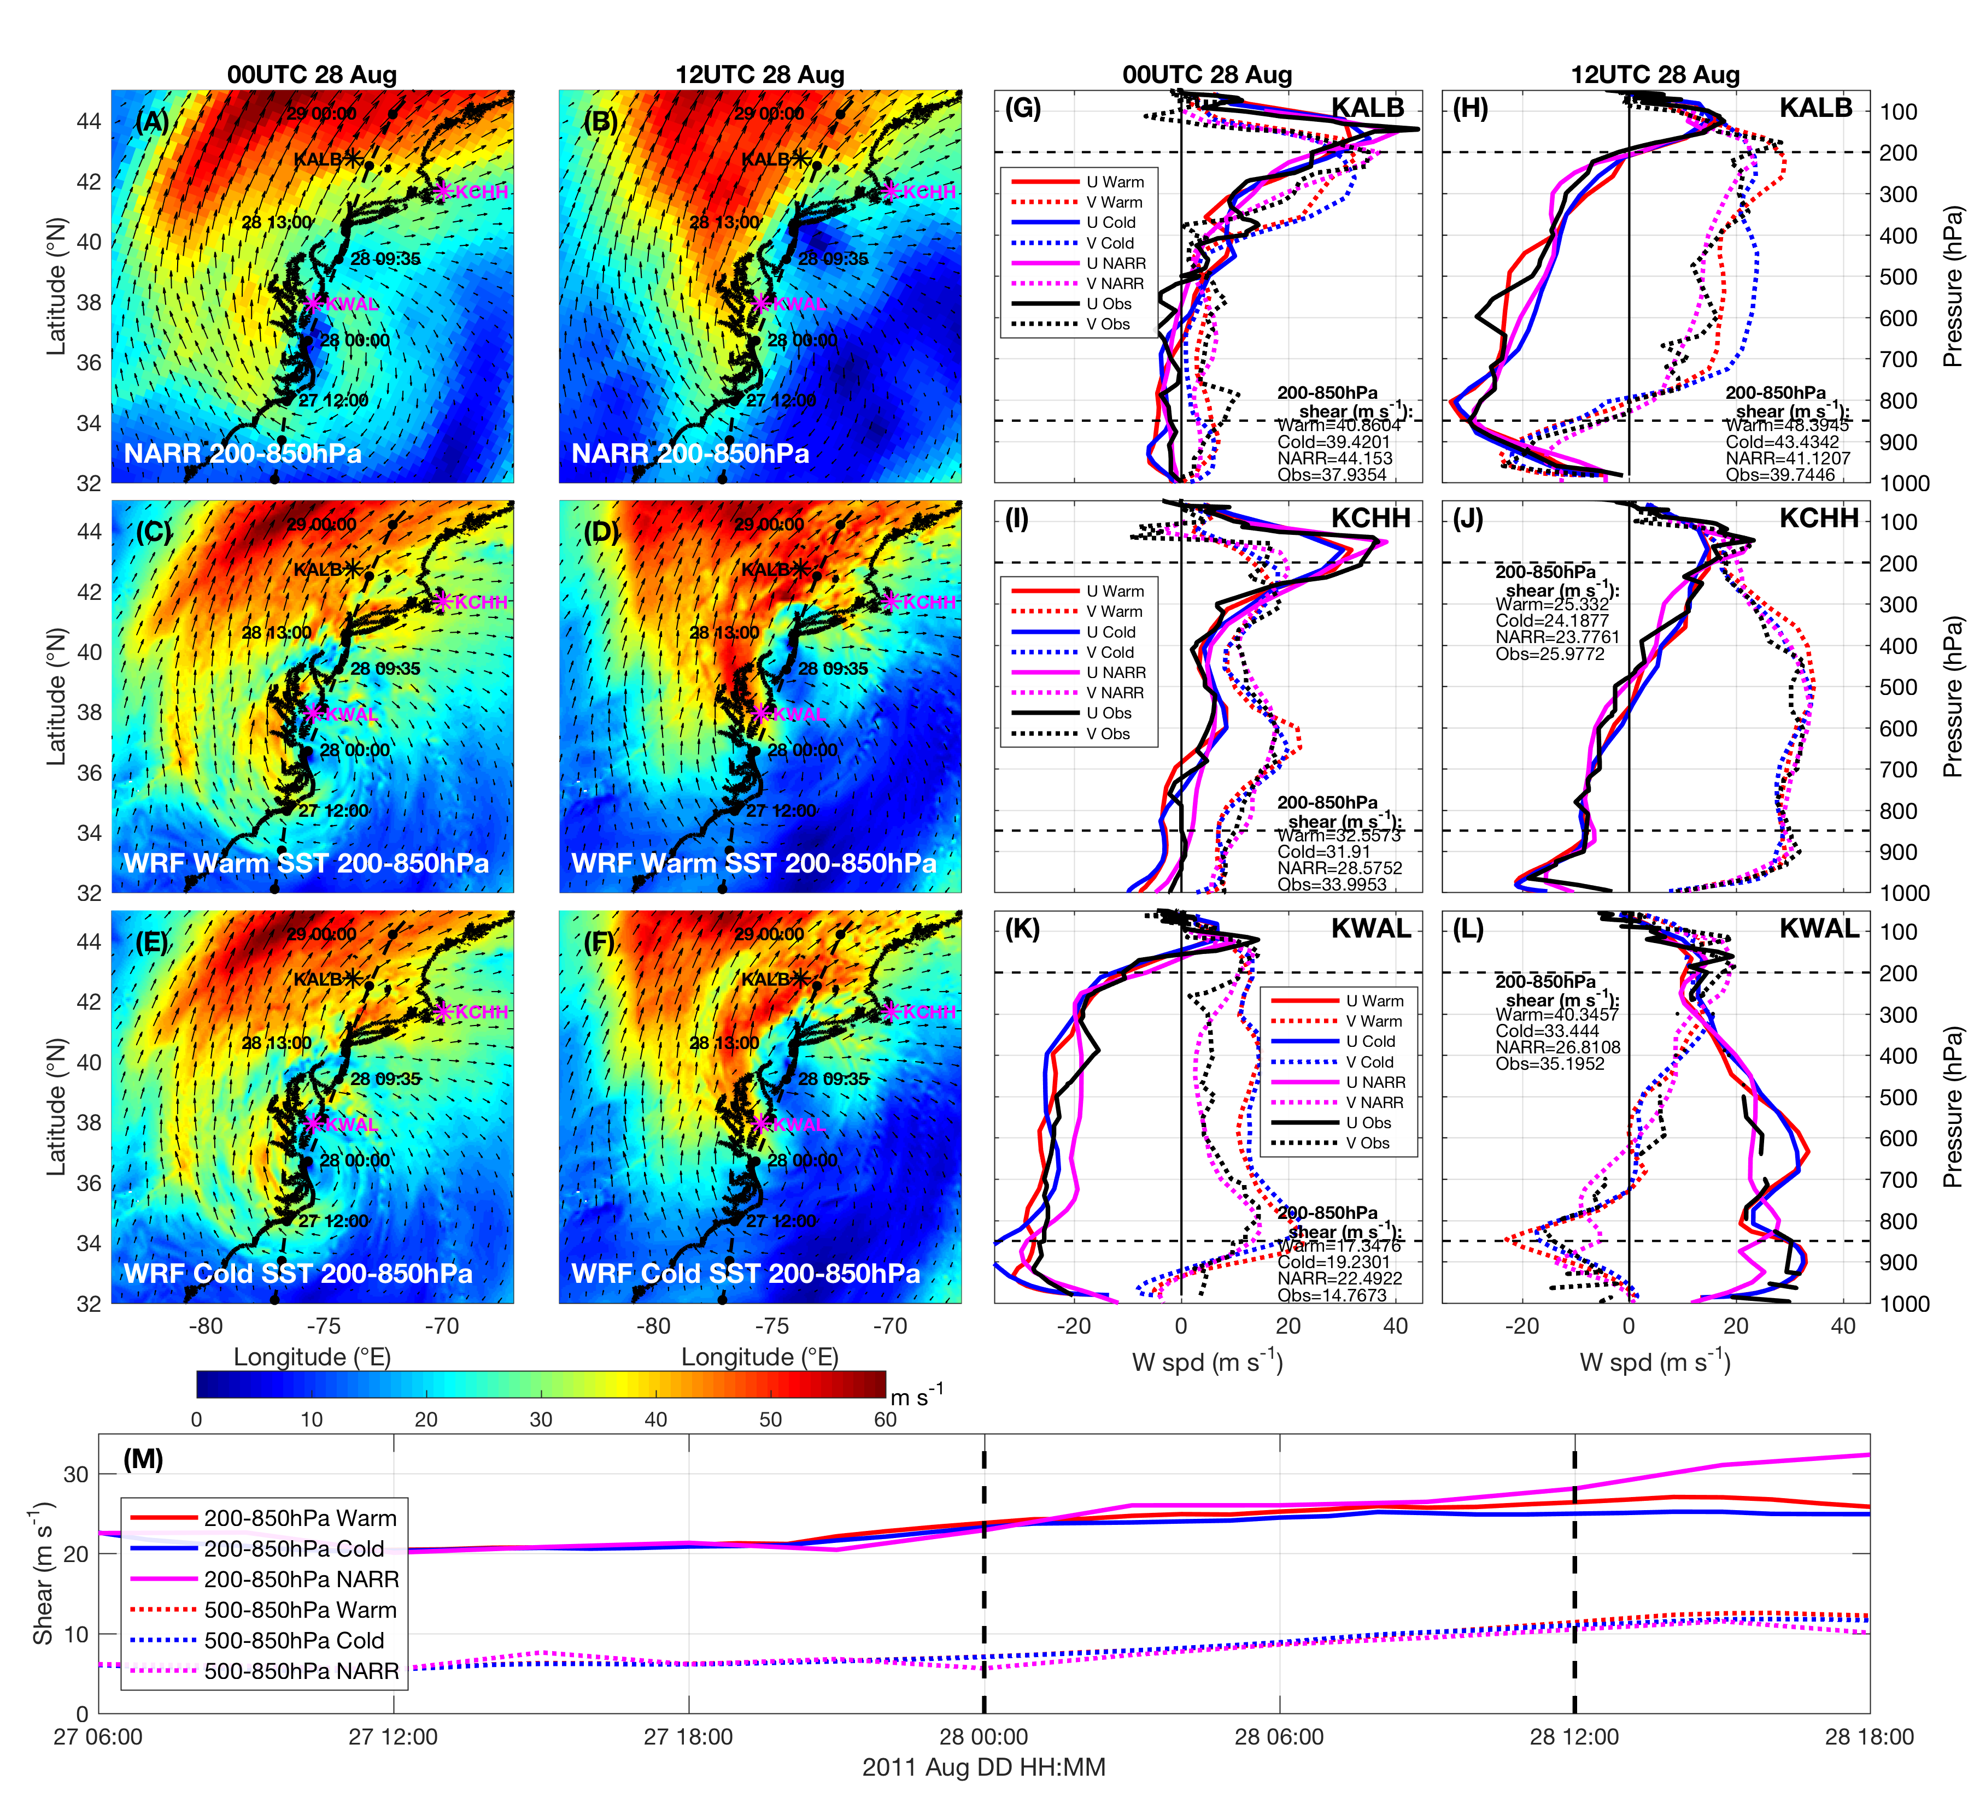
Project 1
SST cooling was key missing contribution in modeling Irene’s rapid decay—not Wind Shear
200-850hPa Wind Shear [m s⁻¹]
NARR
Warm SST
Cold SST
200-800 km Annulus:
200-850, 500-850 hPa Wind Shear [m s⁻¹]
Seroka et al. 2016
Notes:
250mb used because focused on midlatitudes where jet stream is lower in the atmosphere as compared to tropics
On the Calculation of Vertical Shear: An Operational Perspective: “a time lag between the onset of increased vertical shear and decreasing TC intensity has been shown to range from a nearly instantaneous response up to about 36 hours (Frank and Ritchie 2001). Further, some studies have shown that small amounts of vertical shear might actually be conducive in some cases for intensification”
KWAL
KBUF
KOKX
CYWA
KIAD
KMHX
KALB
KPIT

Slide 57

Project 1
SST cooling was key missing contribution in modeling Irene’s rapid decay—not Dry Air Intrusion
RH(%)
Warm SST
Cold SST
GOES 13 Water Vapor
Brightness T (°C)
200mb
700mb
Seroka et al. 2016

Slide 58
Notes:
Coastal upwelling captured by Rutgers SST 08/26 but not 08/27. ROMS run started 08/26 at 12 UTC
Warm SST simulations used RTG 08/27 to simulate “operational NAM SST”. Figure 3 has 08/26 products plotted to show coastal upwelling

Slide 59
Implications
Project 2
Informs sampling strategies for future coastal ocean observatories for TCs
    Target extent of MAB Cold Pool?* very few bottom obs., intensity impact
    Target areas of greatest remaining uncertainty? Near Hudson Canyon?
Improves modeling of full range of stratified coastal ocean TC response
    Target sampling not just for initial conditions (IC) but also for physical responses (forward integration)

Slide 60
Introduction
Project 2: Spatiotemporal variability of stratified coastal ocean cooling processes in Hurricane Irene (2011) and Tropical Storm Barry (2007)
Baroclinic coastal ocean cooling processes identified in Irene (2011) (Glenn et al. 2016)
AOEC signal present in 11 MAB storms since 1985, Typhoon Muifa (2011) in Yellow Sea (Glenn et al. 2016)

Slide 61
Project 2: Introduction
Glenn et al. 2016
Notes:
11 TCs that traversed the MAB continental shelf during summer stratified (Jun-Aug) conditions since 1985

Slide 62
Introduction
Project 2: Introduction
Full range of storm “personalities” in atm. & OCEAN
  Standard operational model performance metrics (e.g. HWRF) take mean across all storms simulated
Investigate spatiotemporal variability of stratified coastal ocean cooling response over MAB continental shelf for Barry & Irene
  Dominant processes? Details?
    Vertical mixing or (horiz or vert) advection?
    Cross-shore and/or along-shore shear across thermocline?
    How far offshore, upshelf/downshelf does PGF=wind stress dominate cross-shore momentum balance? Along-shore?

Slide 63

Irene
Project 2: Results
Notes:
2

Slide 64

Irene
Project 2: Results
SST comparison
Notes:
3

Slide 65
Irene
Project 2: Results
SST cooling
Notes:
4

Slide 66

Irene
Project 2: Results
Glider comparison
Notes:
5

Slide 67

Barry
Project 2: Results
SST comparison
Notes:
6

Slide 68

Barry
Project 2: Results
SST comparison
Notes:
7

Slide 69
Barry
Project 2: Results
SST cooling
Notes:
8

Slide 70

Barry
Project 2: Results
Glider comparison
Notes:
9

Slide 71

Irene: AOEC surface onshore, bottom offshore
Project 2
Notes:
11

Slide 72

Project 2: Results
Notes:
12

Slide 73

Project 2: Results
Notes:
13

Slide 74


Project 2: Results
Notes:
14
-would need to redo bottom layer to get above very bottom ROMS level affected by bottom stress (to see what shear looks like in deep water and compare quantitatively to shallow water)

Slide 75

Barry: AOEC SST cooling, downwelling bottom T
More cross-shelf variability than Irene
Project 2
Notes:
17

Slide 76

Project 2: Results
Notes:
18

Slide 77

Project 2: Results
Notes:
19

Slide 78

Project 2: Results
Notes:
20

Slide 79


Project 2: Results
Notes:
21

Slide 80

Methods
Project 2: Methods
Model:
ROMS ESPreSSO depth-averaged momentum balance terms:
ROMS ESPreSSO temperature rate equation diagnostic terms:
Horizontal diffusion neglected in both
17UTC
Jun 4
12UTC
Aug 28
RU17
RU16
Barry (Jun)
Irene
(Aug)
Total
Horizontal advection
Vertical advection
Vertical diffusion
Horiz. diffusion
Friction
Notes:
-horizontal diffusion neglected

Slide 81

Irene: along-shelf
Project 2: Results
Notes:
16

Slide 82

Barry: AOEC SW-ward wind stress vs. tidal Coriolis + PGF
Project 2
Notes:
23

Slide 83

Irene: Vertical diffusion cooling; tidal advection
@1: sfc cooling stops once bottom cold water gone
Project 2
Notes:
24
-vertical mixing caused by what force balance in deep water? (quiescent deep bottom layer, so no opposing bottom layer for increased shear-driven mixing)

Slide 84

Barry: Vertical diffusion cooling; tidal advection
Project 2
Notes:
25

Slide 85
Motivation
Project 3: Offshore Sea Breeze Sensitivity to Coastal Upwelling & Synoptic Flow
Onshore sea breeze observed;
offshore side not (Steele et al. 2014)
Onshore front; offshore more
difficult to distinguish and define
objectively (Finkele 1998)
Previous offshore extent definitions:
  1 m s⁻¹ onshore wind speed in lowest 100m of sea breeze (Arritt 1989)
  Where wind speed uninfluenced by sea breeze (pure sea breezes only)
    Extensive calm region nearby this point not always aligned with largest surface divergence, in contrast to onshore front with largest surface convergence
Need clear, objective definition of offshore extent, for any synoptic, thermal conditions
Warm
Cold
  Backdoor
  Corkscrew
  Pure
  Synoptic

Slide 86

Methods
Project 3
Model: 3km WRF-ARW v3.6.1; YSU PBL; MM5 Monin-Obukhov surface layer
Lagrangian Coherent Structures (LCSs):
1. Particles placed on 10km grid in WRF winds
2. Particles forced by 2D winds every 10 min. over 1 hr (forward trajectories) at various heights
-17, 18, 19, 20, 21, 22, 23 UTC
3. Relative dispersion (RD) calculated:
Sea Breeze Cases/Sensitivities:
April 27, 2013: pure, no upwelling
Aug 13, 2012: pure, upwelling
Aug 13: pure, remove upwelling
Aug 13: strong (NJ) vs. weak (MD) synoptic
  Repelling LCS
  Attracting LCS
  Backdoor
  Corkscrew
  Pure
  Synoptic
Notes:
Vertical velocities are small compared to horizontal
Satellite: High res in space and time
Previous satellite SST products low in spatial or temporal resolution and are often warmest pixel composites for declouding; cannot resolve coastal upwelling
SST product is IR/near IR (AVHRR); SPoRT is IR/near IR as well
Model: NAM12km for boundary conditions
Cases: largest and longest lasting upwelling in NJ 2012-2014
20140731 case has similar ambient (outside upwelling) water T to 20130707

Slide 87

Fig 1
Notes:
-Talk about synoptic flow in words

Slide 88
Project 3
Results
Onshore 100m max blue convergence aligned with inland weather radar sea breeze front
Seroka et al. in prep.
Notes:
-Blue X for southern cross section, MD cross section?
Answer to vertical velocity:
Only using relative numbers of RD for paper (offshore extent (max); upwelling-non-upwelling)
WRF is consistent with continuity
2D LCS is not- assuming no vertical velocity, which is a valid assumption to make because vertical velocities are very small (100X smaller than horizontal velocities)

Slide 89

Fig 2
Notes:
2 layer ocean, upwelling, 3 nodes- cite several RUCOOL papers- Renato stratification
Cite Eli on spatial extent of offshore sea breeze
Cite Brazil, large enough to affect sea breeze?
Took a 3-year sample to produce 10 case composite, don’t say why
-Sea breeze time of day (afternoon/evening) is also coincident with peak demand time of day (5-7 pm)
Set up Case 1, upwelling sensitivity

Slide 90
Fig 3
Notes:
-Talk about synoptic flow in words
-sentence about fed/state water projects

Slide 91

Fig 4
Notes:
NJ sea breeze and coastal upwelling coincident with peak electricity demand
-Sea breeze time of day (afternoon/evening) is also coincident with peak demand time of day (5-7 pm)
Set up Case 1, upwelling sensitivity

Slide 92
Fig 10
How did we calculate Rotunno and Simpson lines?
Rotunno 1983
From linear theory of motion, horizontal extent of the sea breeze
For f>ω (latitudes>30°): Nh(f² – ω²)^{-1/2}
where f = 2Ωsinϕ Coriolis frequency, ω = 2π day⁻¹ frequency of diurnal heating of land, N = [(g/θ₀)(∂θ/∂z)]^{1/2} the Brunt-Vaisala frequency (stratification), and h = vertical scale of the heating.
N h [ f² – ω² ]^{-1/2}
Nh(f² – ω²)^{-1/2} = [(g/θ₀)(∂θ/∂z)]^{1/2} * 350m * [(2π/64800 s)² – (2π/86400 s)²]^{-1/2}
= [(9.81/300K)(10K/1000m)]^{1/2} * 350m * [(2π/64800 s)² – (2π/86400 s)²]^{-1/2}
=100 km
Notes:
-discussion point: difference in upwelling minus non-upwelling for MD goes to shelf break
-starting point assumption for Simpson et al 1977- starts at coast
-ending point assumption for Rotunno

Slide 93
Project 3: Results
Rotunno 1983
Elliptically-shaped pattern of flow in vertical plane centered on coast, having an aspect ratio (vertical/horizontal scale):
(f² – ω²)^{1/2}N⁻¹ For f>ω (latitudes>30°)
where f = 2Ωsinϕ Coriolis frequency, ω = 2π day⁻¹ frequency of diurnal heating of land, N = [(g/θ₀)(∂θ/∂z)]^{1/2} the Brunt-Vaisala frequency (stratification).
[ f² – ω² ]^{1/2} * N⁻¹
(f² – ω²)^{1/2}N⁻¹ = [(2π/64800 s)² – (2π/86400 s)²]^{1/2} * {[(g/θ₀)(∂θ/∂z)]^{1/2}}⁻¹
= [(2π/64800 s)² – (2π/86400 s)²]^{1/2} * [(9.81/300K)(10K/1000m)]^{-1/2}
= 0.00355 vertical/horizontal scale
Check answer: for our sea breeze circulation
h/Nh(f² – ω²)^{-1/2} = 350m/100,000m = 0.0035✔
Nh(f² – ω²)^{-1/2}
Nh(f² – ω²)^{-1/2}
Aspect ratio
(vertical/horizontal)=
h/Nh(f² – ω²)^{-1/2}=
(f² – ω²)^{1/2}N⁻¹
h: return
flow
h: vertical scale
of heating
land
water
Notes:
-Rotunno 1983: .00685 for aspect ratio of their case
-discussion point: difference in upwelling minus non-upwelling for MD goes to shelf break
-”the atmospheric response is confined to within a distance Nh(f^2-w^2)^-1/2 of the coastline” Rotunno 1983
-symmetrical (linear theory)
-starting point assumption for Simpson et al 1977- starts at coast
-ending point assumption for Rotunno

Slide 94
Fig 10
How did we calculate Rotunno and Simpson lines?
Simpson et al. 1977
The rate of advance of the inland sea breeze front can be expressed as:
u = { [ θ_{L}(t) - θ_{S}(t) ] g h(t,x) / 2θ }^{1/2} →simplified to:
u = { [ T_{Land} - T_{Sea} ] g h / 2T }^{1/2}
where T_{land} is land temperature (K), T_{sea} is sea temperature (K), g is gravity, h is vertical scale of the heating, and T is a reference temperature ~300K.
u = { [ T_{Land} - T_{Sea} ] g h / 2* T }^{1/2}
= { [ T_{Land} - T_{Sea} ] 9.81* 350m / 2*300K }^{1/2}
-T_{land} , T_{sea} based on average temperatures under 3 weak synoptic cases (2 non-upwelling, 1 upwelling)- “unaffected” by synoptic flow
Notes:
-discussion point: difference in upwelling minus non-upwelling for MD goes to shelf break
-starting point assumption for Simpson et al 1977- starts at coast
-ending point assumption for Rotunno

Slide 95

Fig 11

Slide 96

Project 3: Results

Slide 97
Future Work
Project 1:
  TC coastal ocean modeling improvements (consistent w Halliwell et al 2011):
    Better initialization to resolve sharp thermocline
    Better mixing physics to widen and deepen thermocline
    More accurate wind forcing and air-sea flux coefficients
    Fully-coupled, validated ocean-atmosphere-wave model
Project 2:
  Explore causes of cooling variability: pre-existing eddies/structures?
  Along-shelf variability in dominant forces and mixing/advection
  Direct comparison betw. shallow & deep water (don’t use depth-avg forces)
  Cause of maximum cooling in Hudson Canyon?
  Baroclinic coastal processes 9 other MAB storms?
  Intensity impact studies
  Data denial studies for glider assimilation value
Project 3:
  Sea breeze climatology (upwelling, sea breeze types)
  Offshore front in synoptic sea breeze with upwelling?
  Wind shear, turbulence (Large Eddy Simulations?) of each sea breeze type
  LCS on HF radar surface ocean currents: offshore divergence?
Investigate competing factors of baroclinic atmospheric energy strengthening vs. baroclinic coastal ocean cooling weakening processes for TCs, extratropical cyclones, e.g. Sandy (Galaraneau et al 2013)

Slide 98
Post-defense

Slide 99

Rich Dunk’s edits
Major edits in picture to left and locations marked in printed thesis
Other minor edits:
p. 104: changed to “in contrast to”…
p. 114: changed > to <500m
p. 128: added “development” to end of 1st paragraph

Slide 100
Josh Kohut’s edits
Completed all edits throughout thesis except:
Ch. 3: (hurricane pt. 2)
Factual statements instead of questions in intro (for paper)
Garau et al. (2011) thermal-lag induced errors with unpumped CTD corrected first before data analysis→ published this in MWR, is this not true? I use the standard DBD group code. Should we ask Travis?
Figures condensed to multi-panel (for paper)
More descriptive headers (for paper)
Ch. 4: (sea breeze)
LCS description in Methods (for paper)
Change “Further Motivation” to multiple “Background” sections (for paper)
Intro should set up the need for sensitivity study, i.e. sea breeze matters, different ones can occur, does that change offshore wind resource? (for paper)
Description of each case in results (for paper)
Sensitivities should be in discussion, not results (for paper)

Slide 101
Publishing last 2 projects
  Project 2: Spatiotemporal variability of stratified coastal ocean cooling processes in Hurricane Irene (2011) and Tropical Storm Barry (2007)
  JGR-Oceans special section on TC-ocean interaction:
    “Oceanic Responses and Feedbacks to Tropical Cyclones” Special Section
  Deadline Jan 31, 2017
  Need to pare down figs from 25 to 15 or less, can use slides here for most important messages
  Any further analysis needed?
  Schedule calls, evening meetings in person with Scott in MD
  Plan to have draft to co-authors by Thanksgiving/Christmas?
Project 3: Offshore Sea Breeze Sensitivity to Coastal Upwelling & Synoptic Flow
  12 figures and text should be very close for submission
  JGR-Atmospheres?

