Slide 1
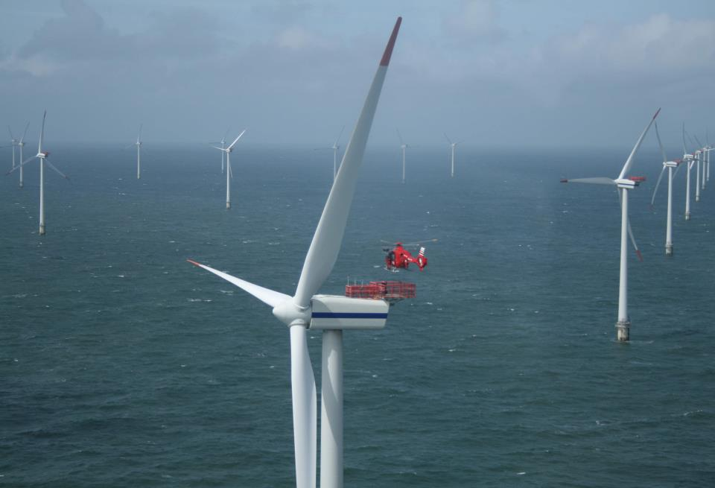
Sea Breeze Tutorial + How the sea breeze and upwelling impact the NJ offshore wind resource
6/30/2015
Greg Seroka, Lou Bowers, Rich Dunk

Slide 2
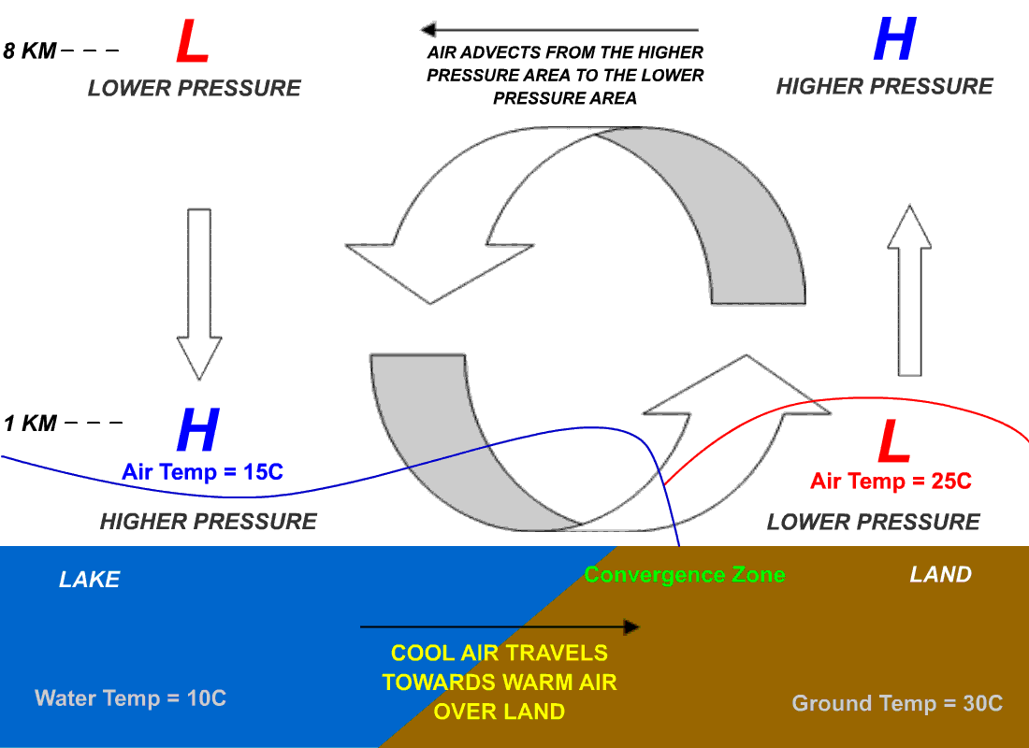
Causes and Circulation
Or Ocean
Notes:
The sea has greater heat capacity than land, so surface of sea warms up more slowly than land’s surface. As temperature of the surface of the land rises, the land heats the air above it by convection. The warm air is less dense so it expands, decreasing the pressure over the land near the coast. The air above the sea has a relatively higher pressure, causing air near the coast to flow towards the lower pressure over land.
If strong offshore wind is present, that is, a wind greater than 8 knots, and opposing the direction of a possible sea breeze, the sea breeze is not likely to develop.

Slide 3
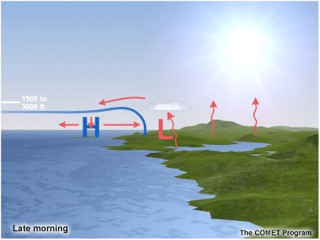
“Diurnal” Circulation
Mid - Late Morning
Sea Breeze begins once T(land)-T(water) > 6-10ºF
Strength of the sea breeze is related to…
the temperature gradient between land and ocean
the synoptic flow
Some cumulus clouds form along the front

Slide 4
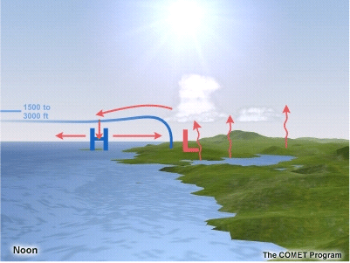
“Diurnal” Circulation
Noon
Pressure over land decreases further
Pressure gradient force increases
Surface wind speeds and depth of sea breeze generally increase as the sea breeze develops
Bay Breezes (DE bay, Raritan Bay) similar setup
Lake & River Breezes: Similar setup but weaker & less penetration inland

Slide 5
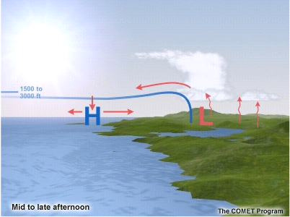
“Diurnal” Circulation
Afternoon
Wind increases as pressure gradient increases
Temperatures can decrease dramatically with passage of sea breeze front
Depending on synoptic scale setup and other modifying factors (to be discussed later), the sea breeze pushes inland
Depending on stability and available moisture, more cumulus form and grow deeper

Slide 6
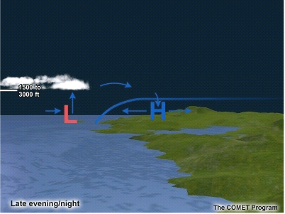
“Diurnal” Circulation
Evening & Night
Circulation gone 1 to 2 hours after sunset
Land cools → Land breeze → Nocturnal convection over water

Slide 7
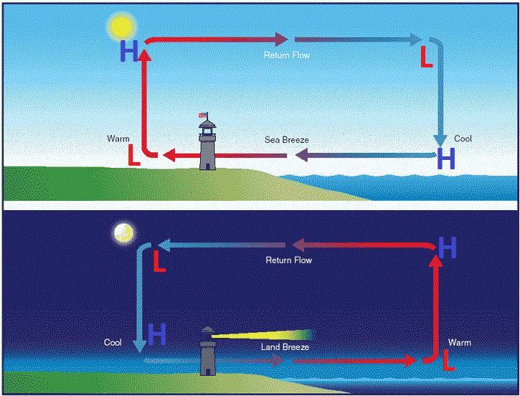
Land Breeze: Reversal at night

Slide 8
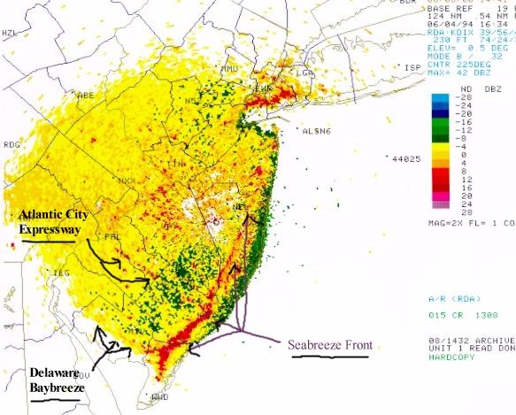
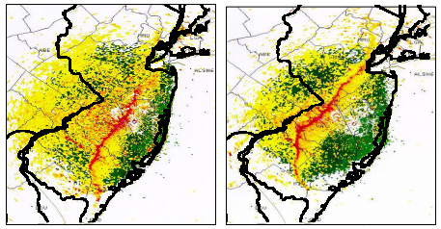
Sea breeze front
Clear-Air Mode Weather Radar

Slide 9
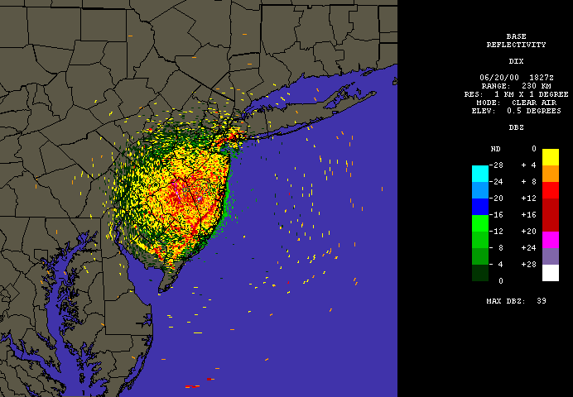
Sea breeze front
Clear-Air Mode Weather Radar

Slide 10
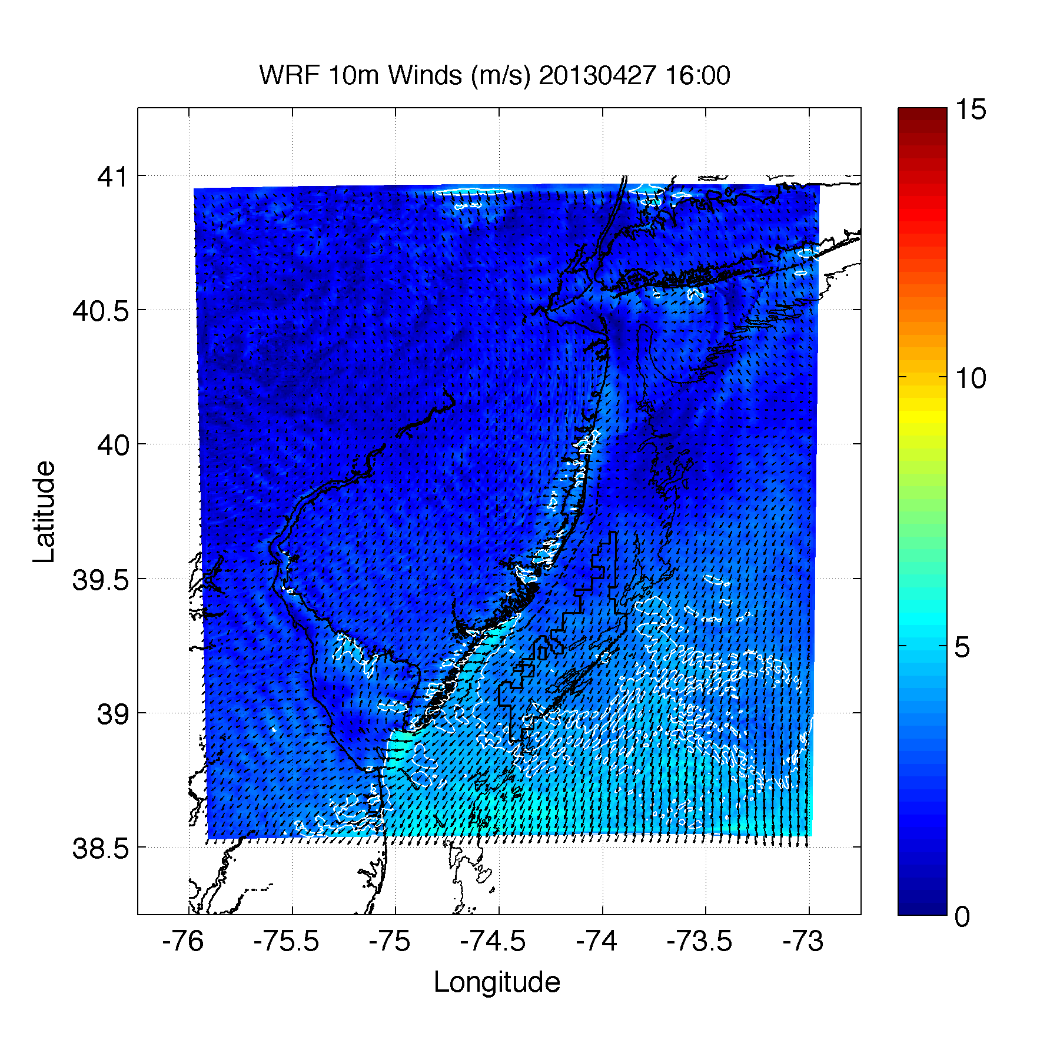

Slide 11
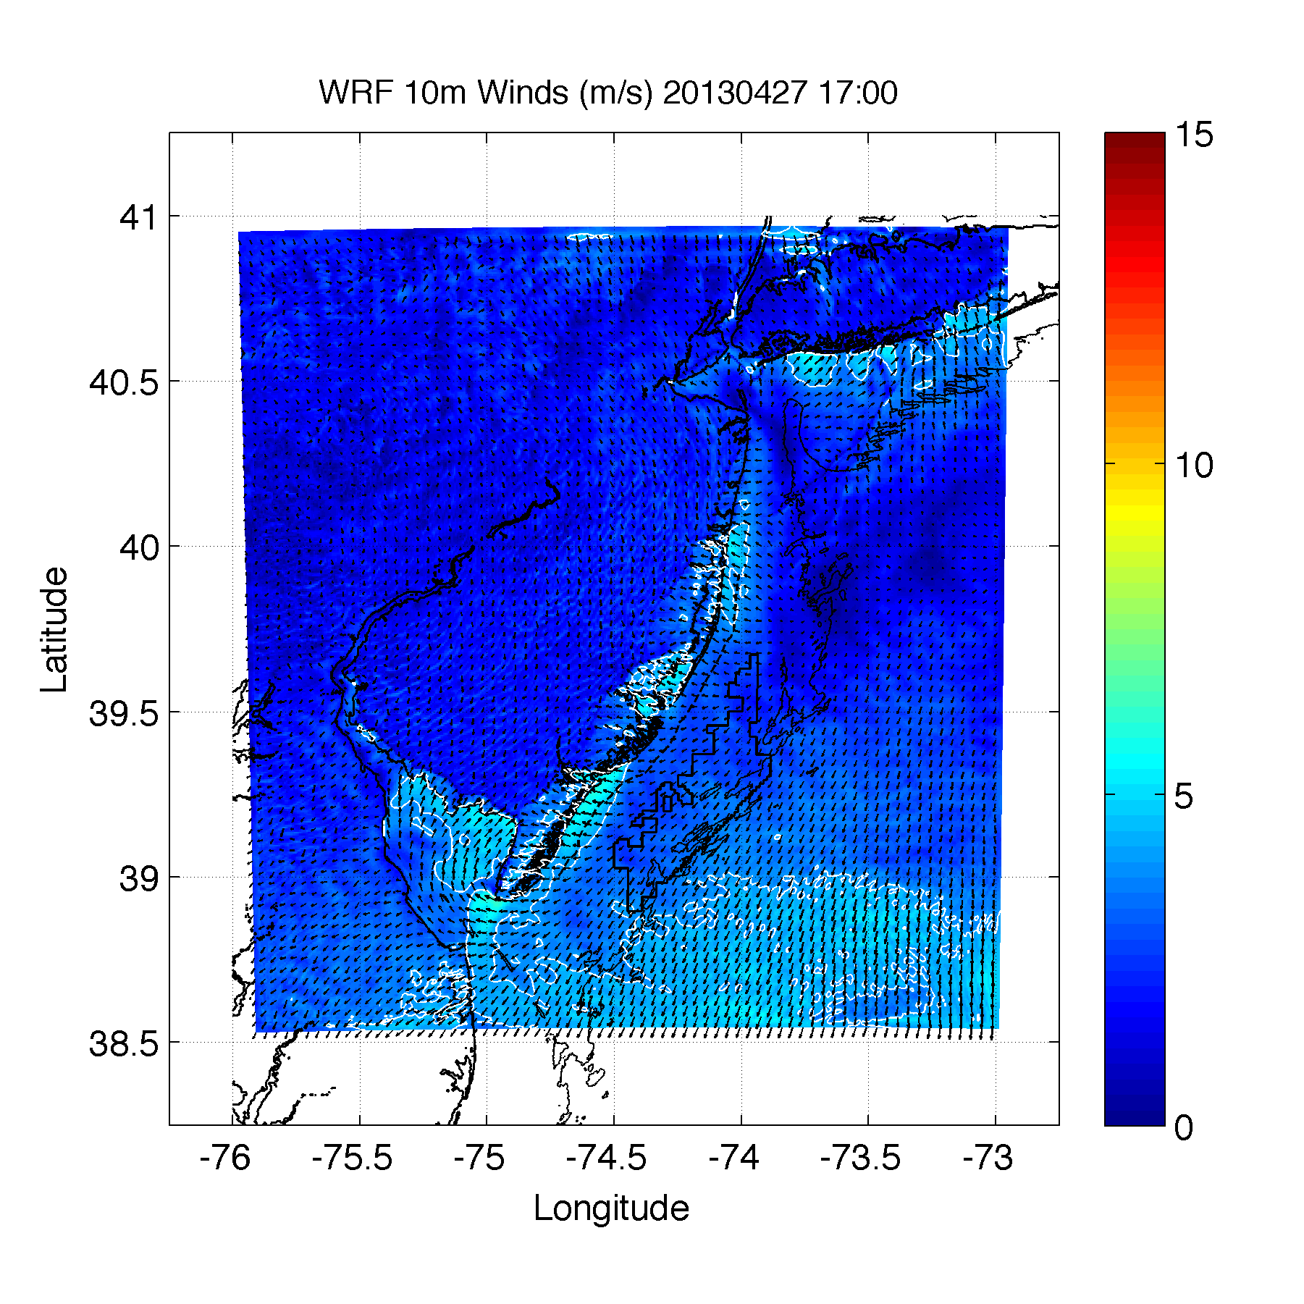

Slide 12
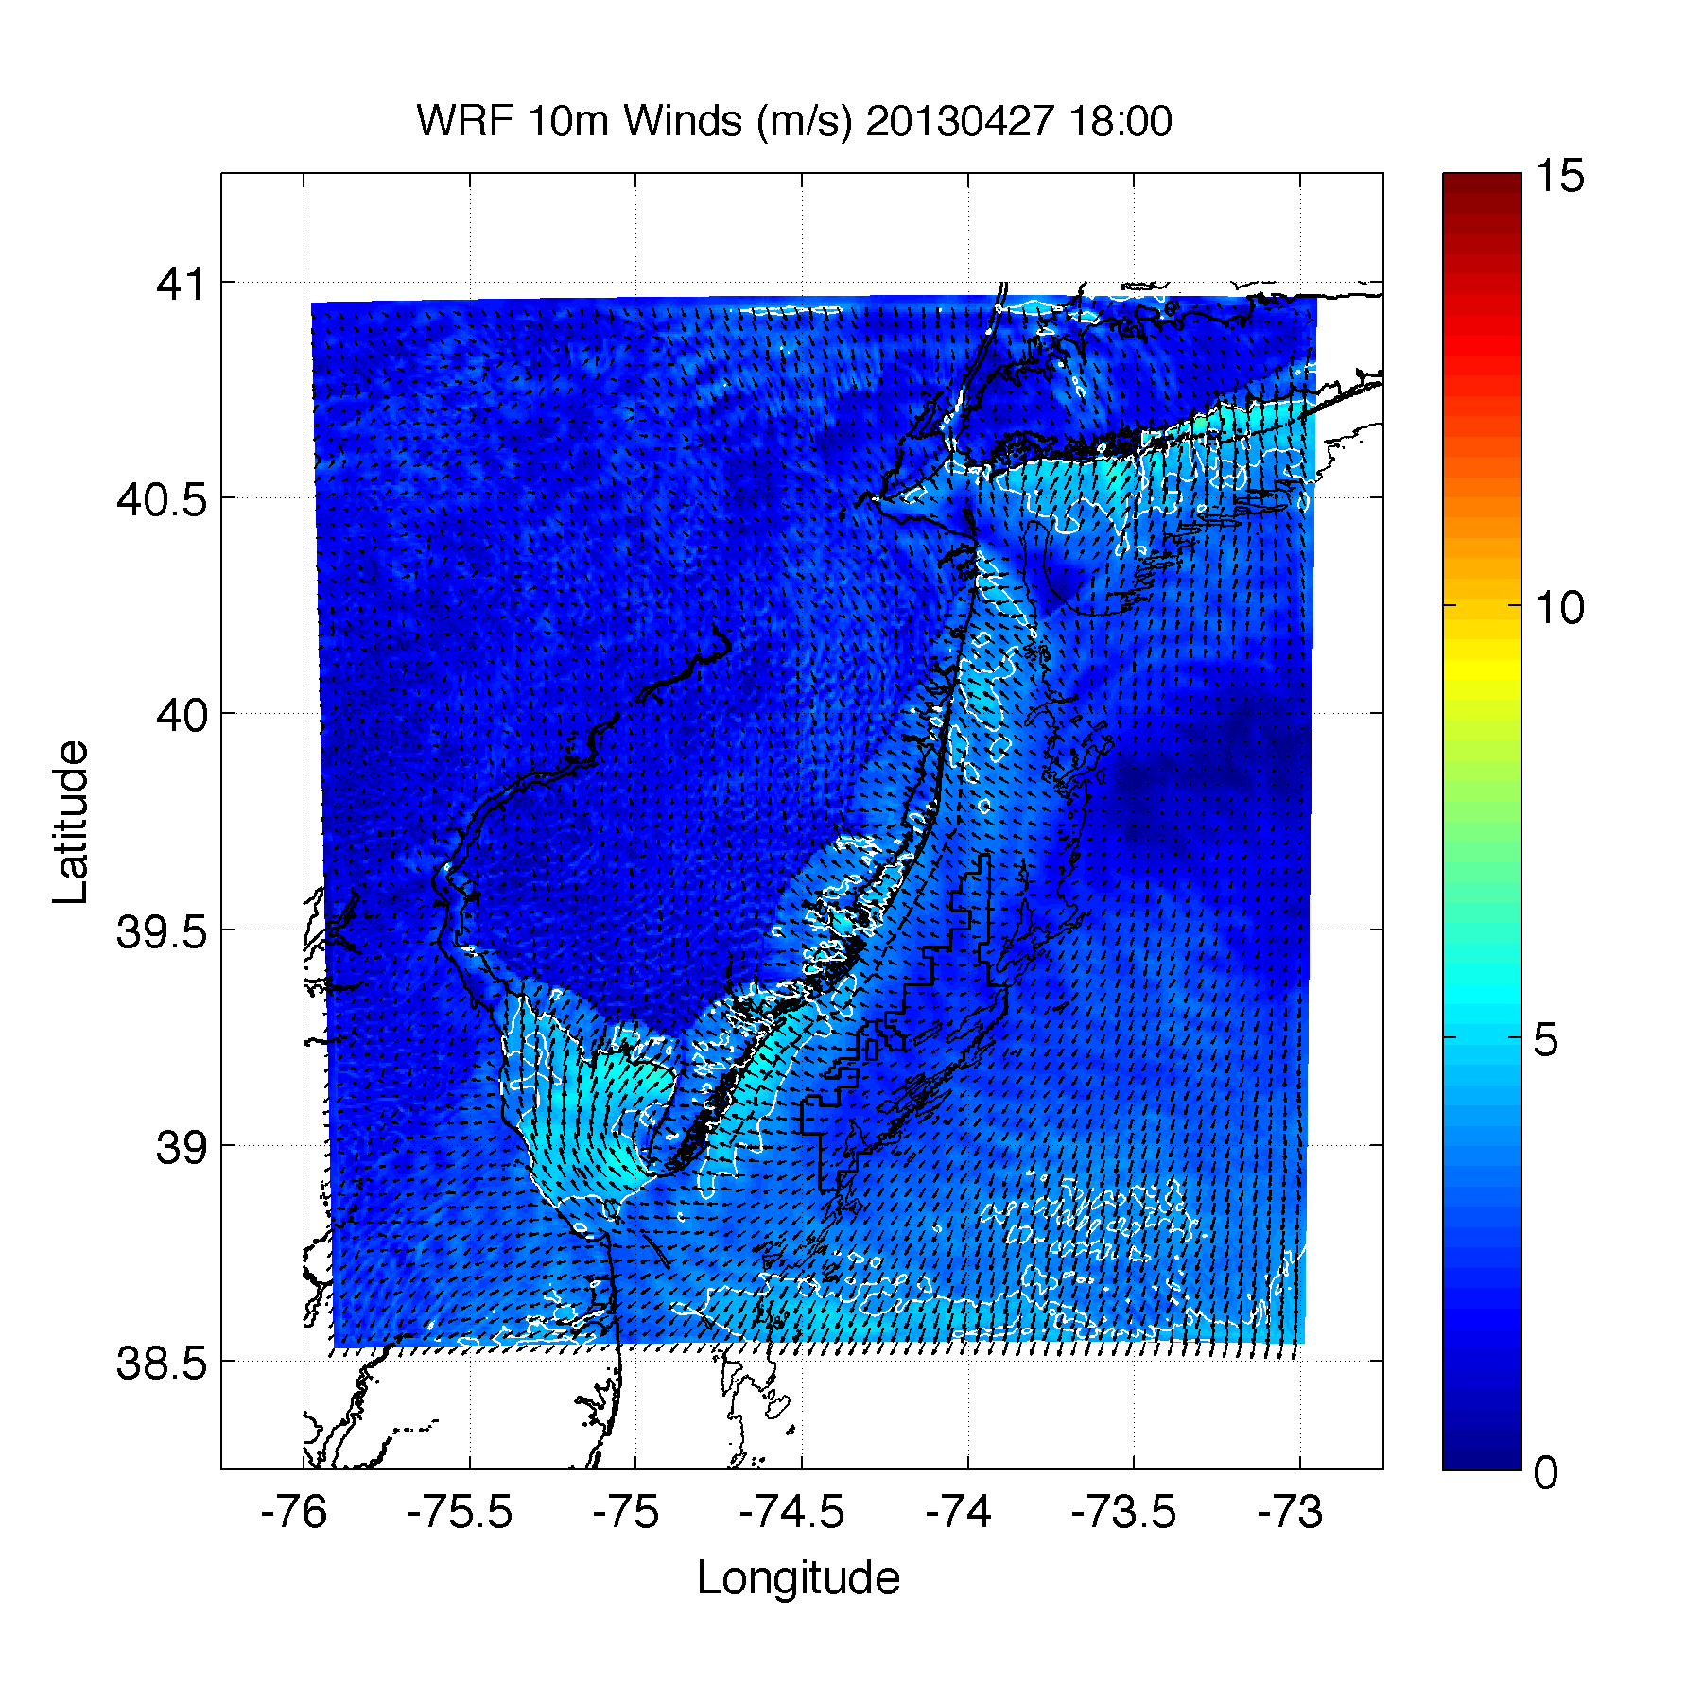

Slide 13
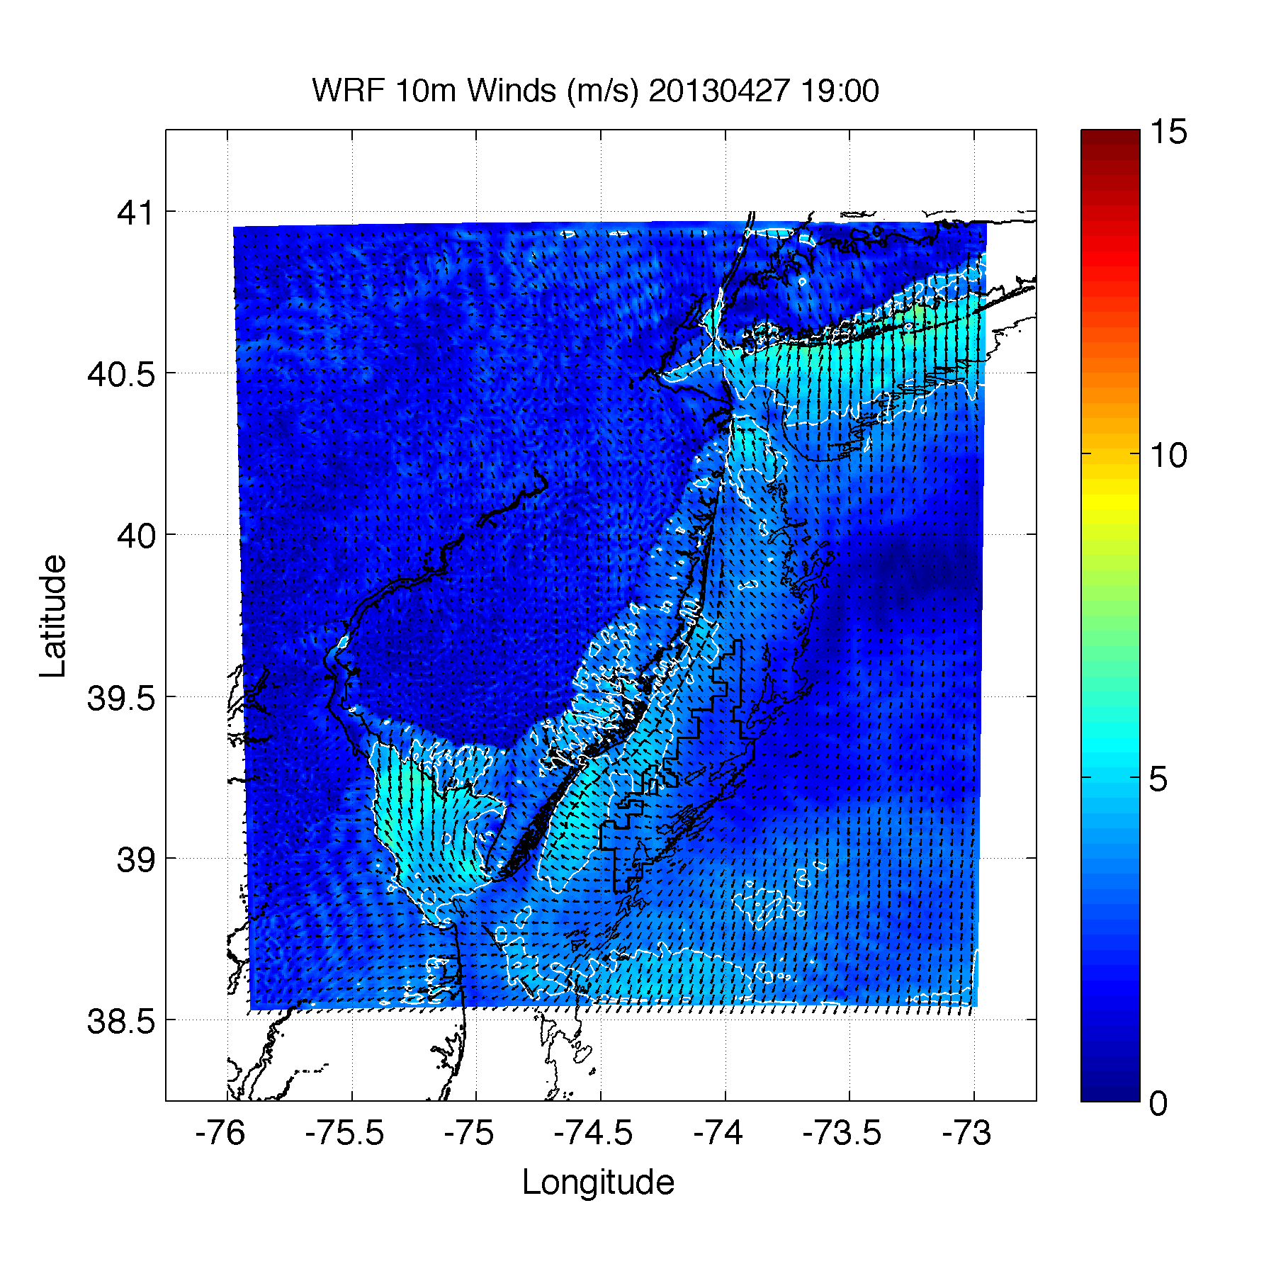

Slide 14
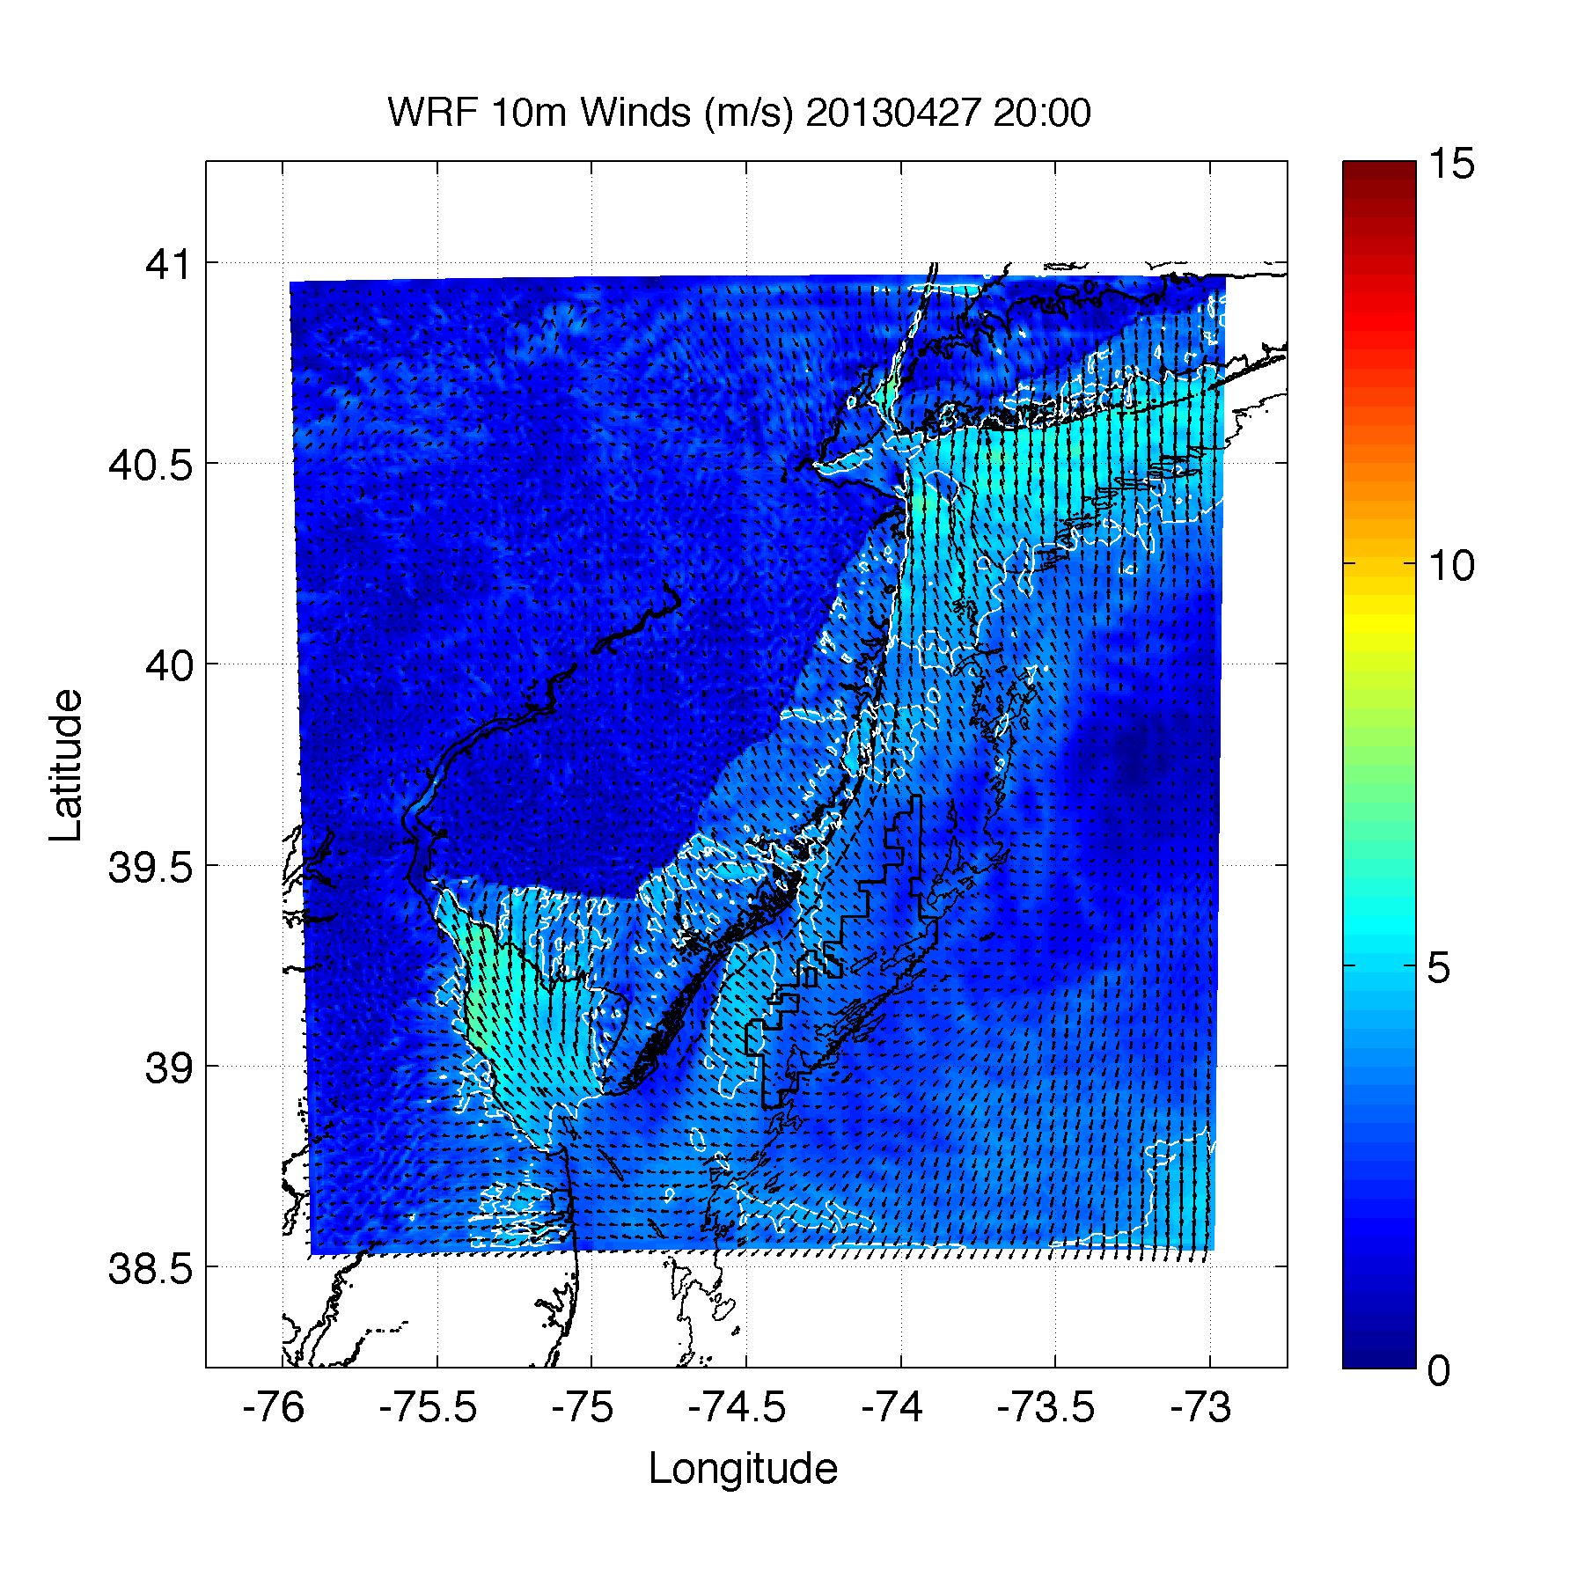

Slide 15
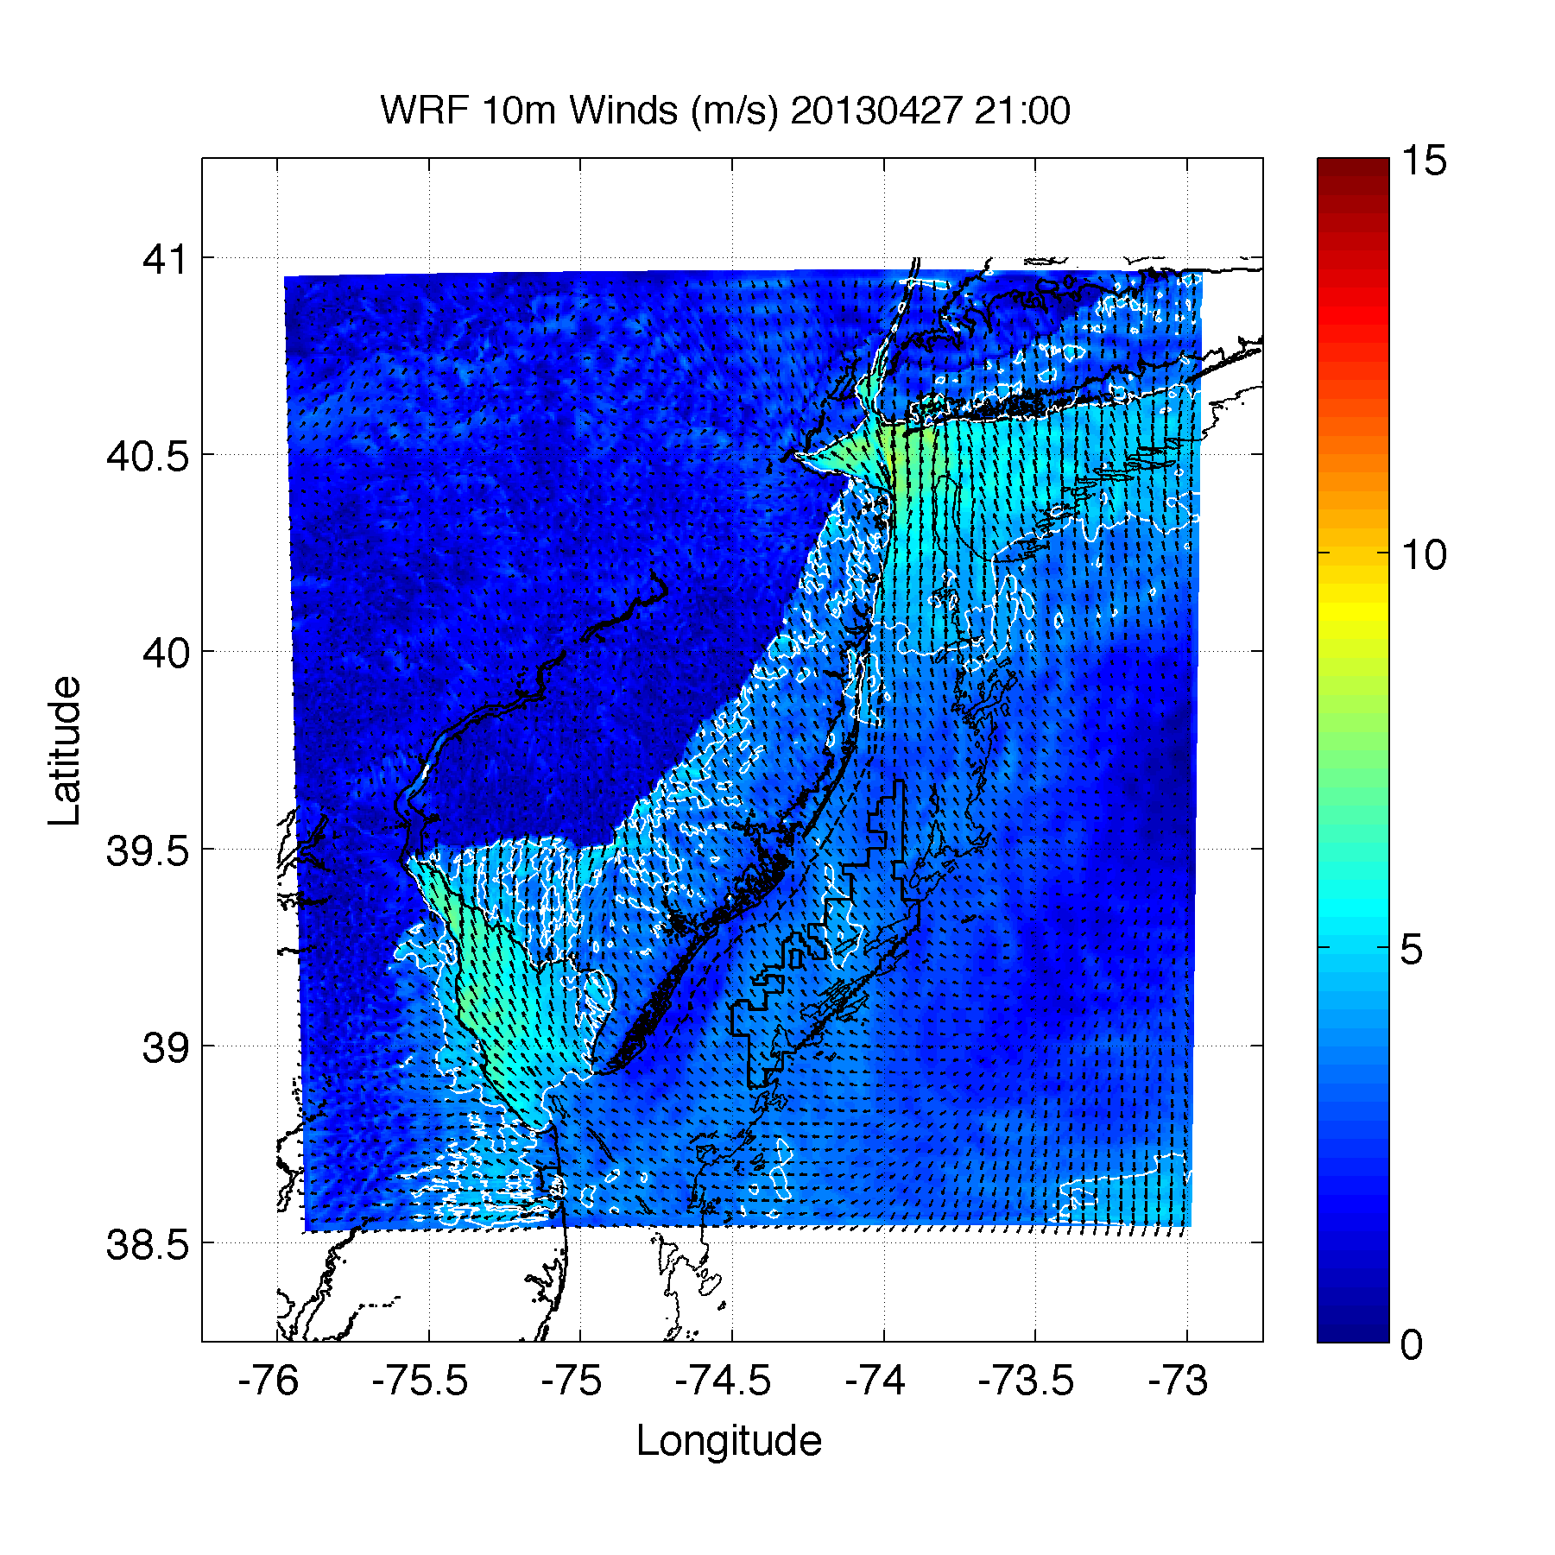

Slide 16
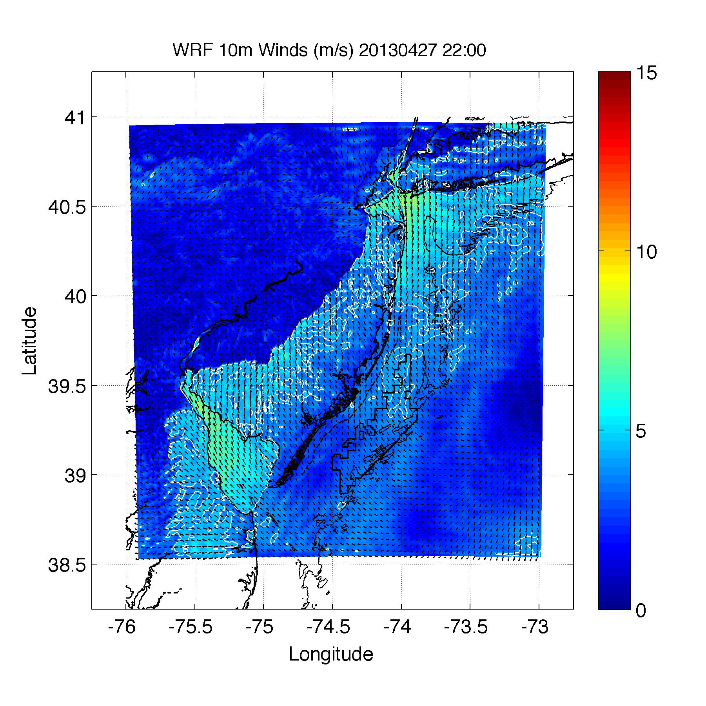

Slide 17
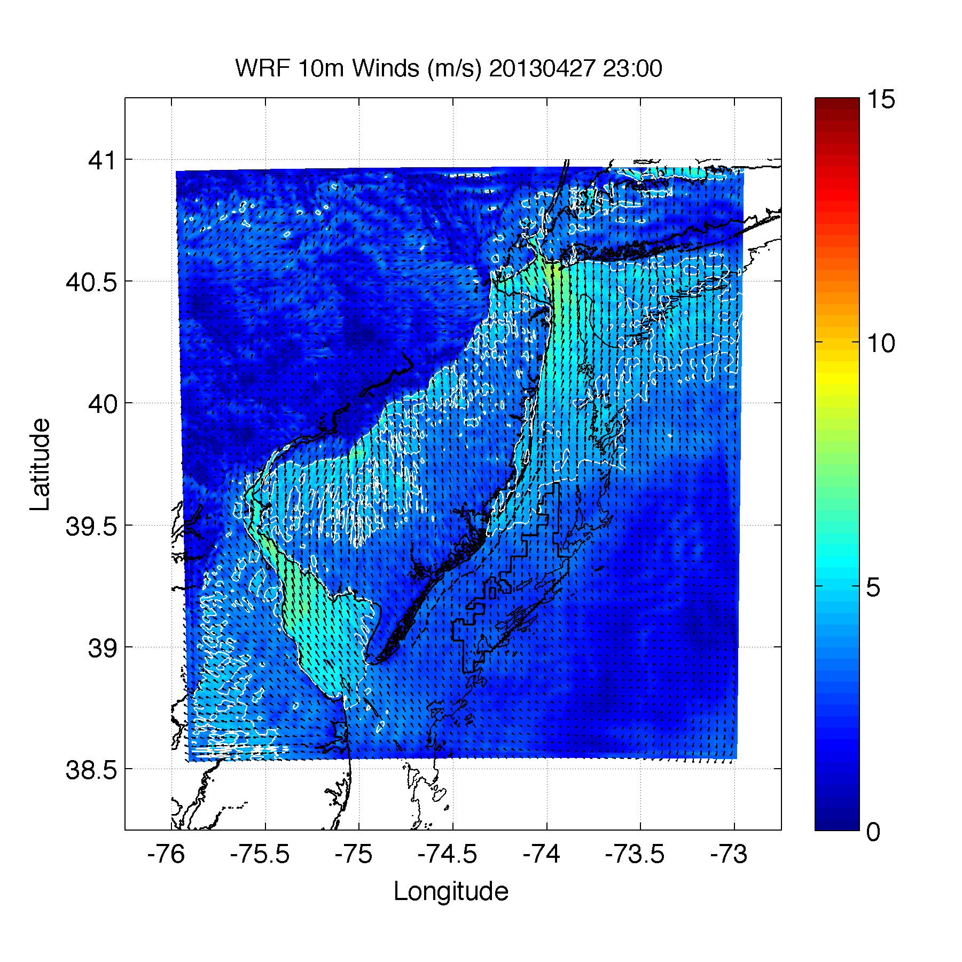

Slide 18
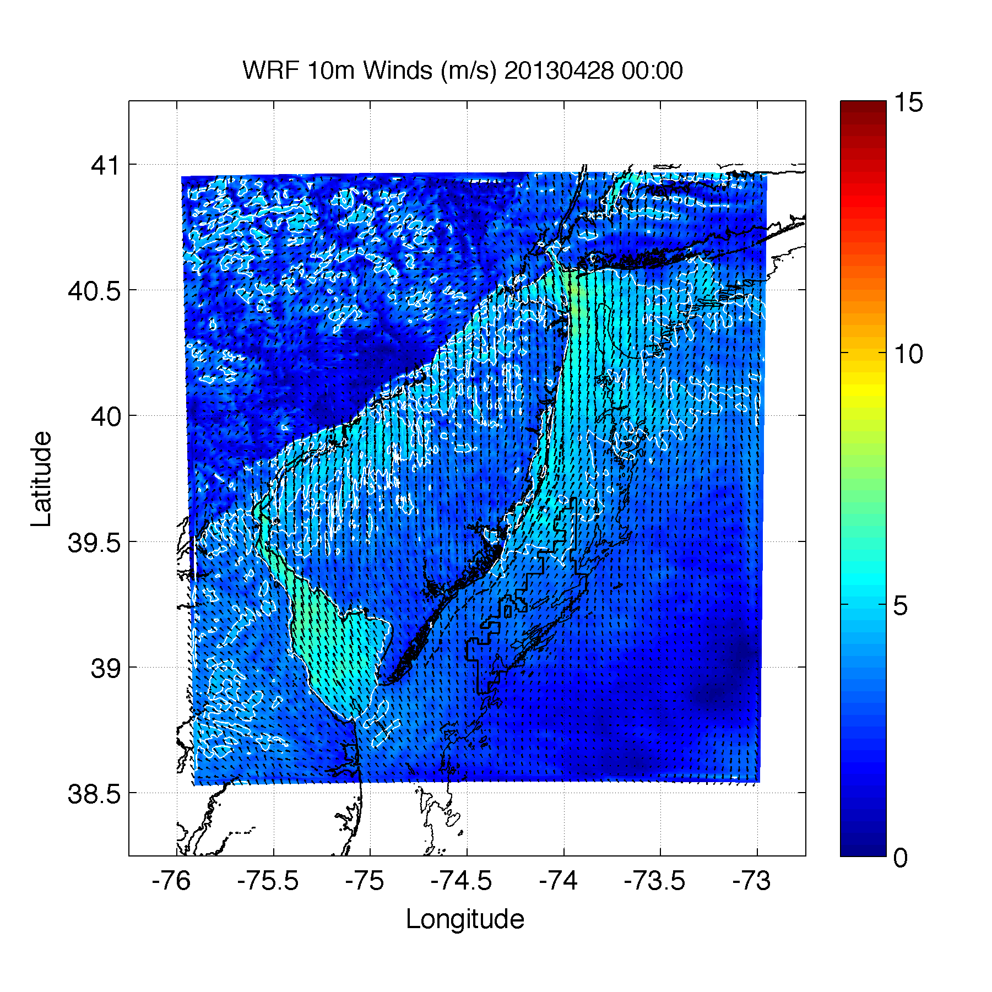

Slide 19
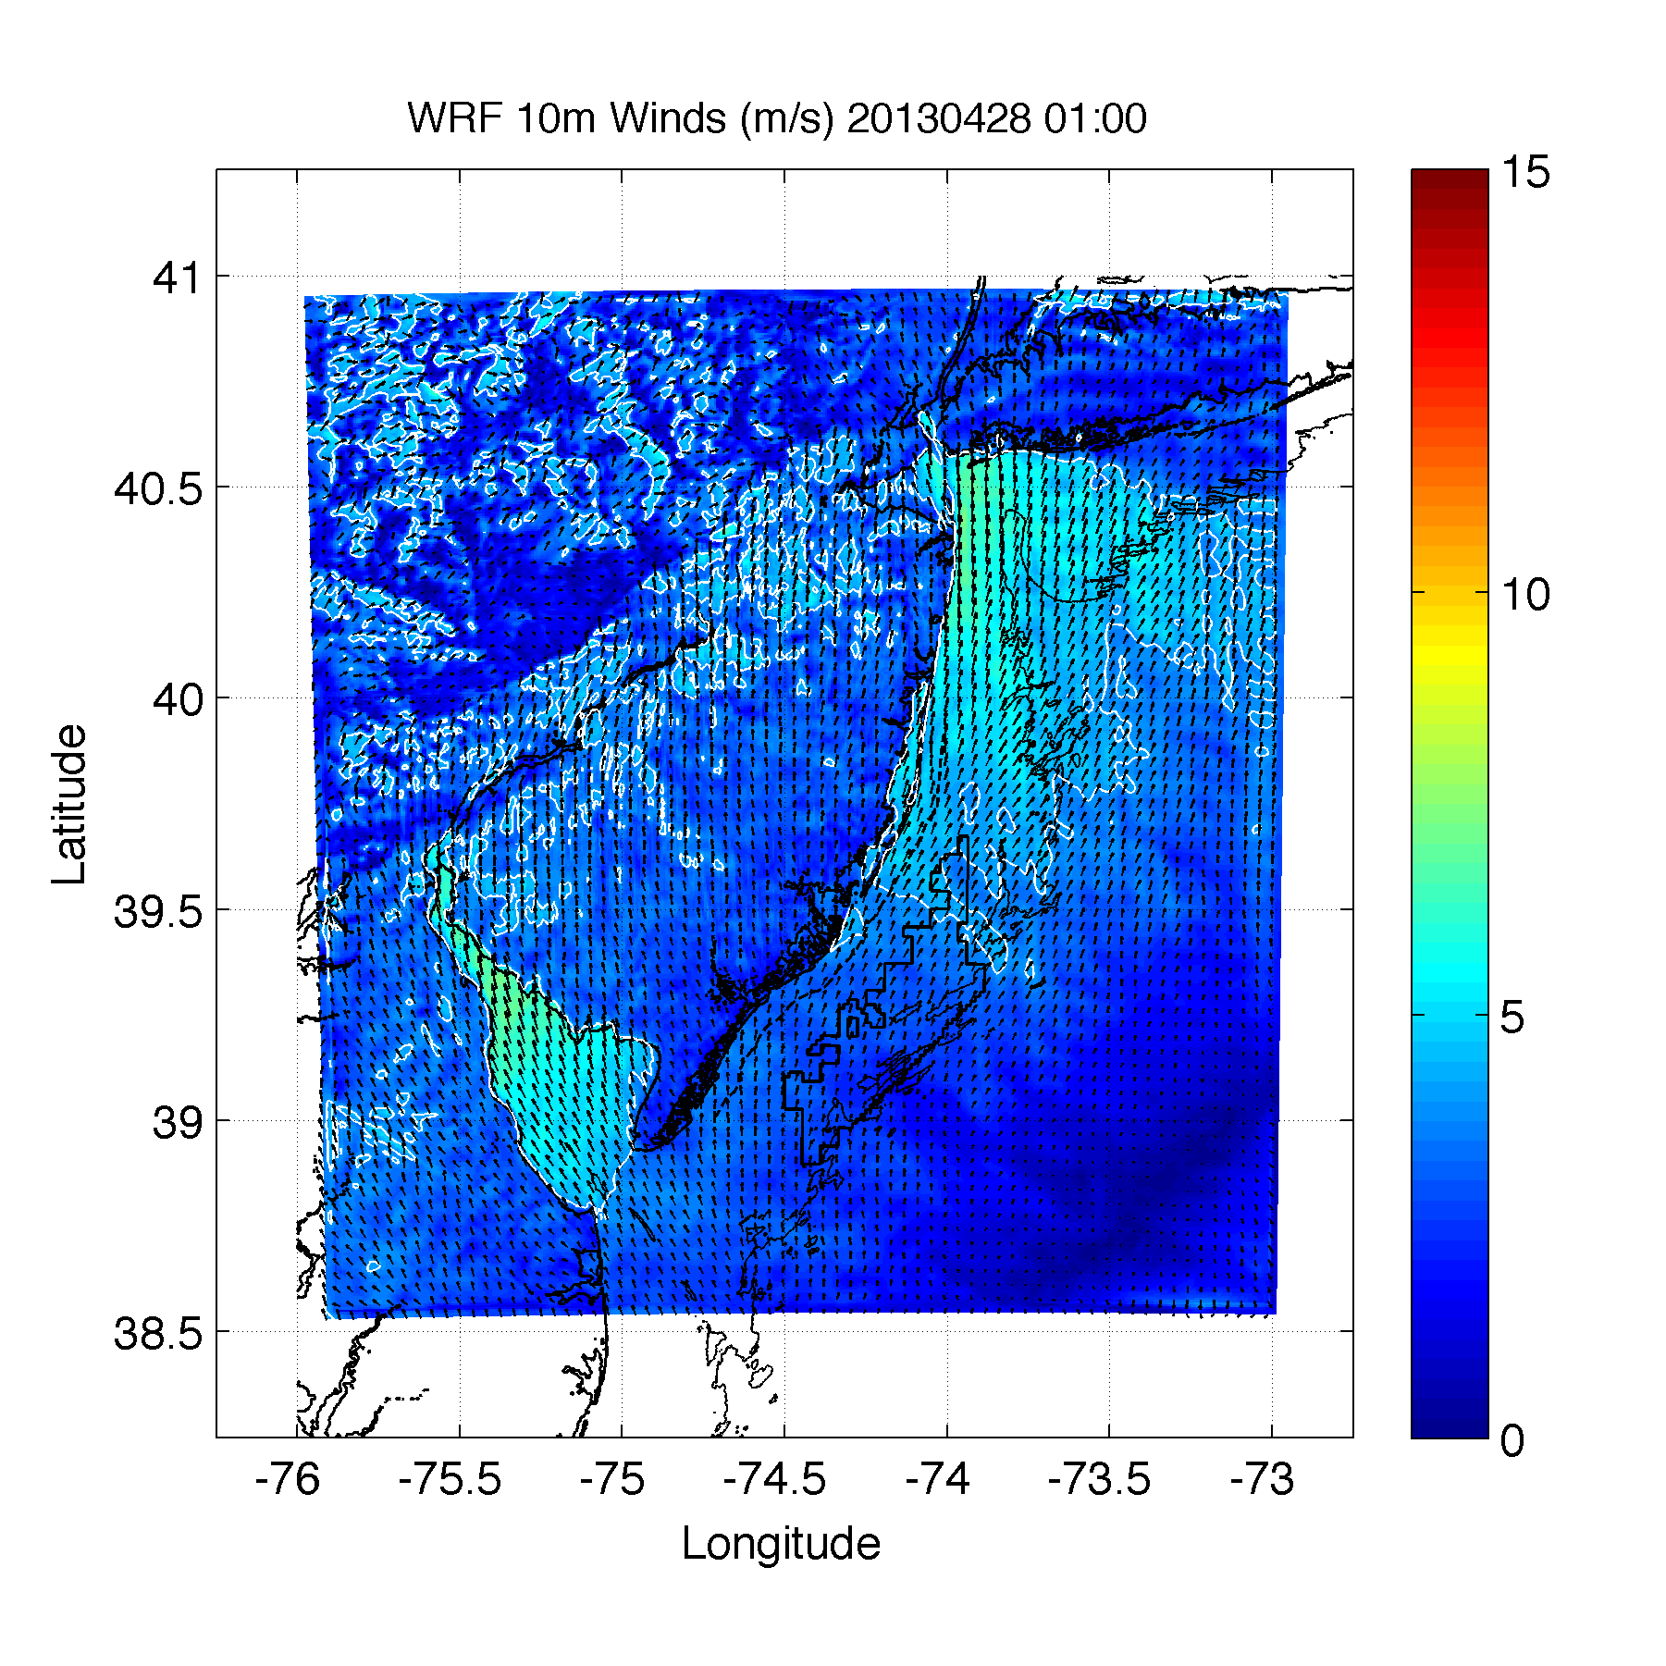

Slide 20
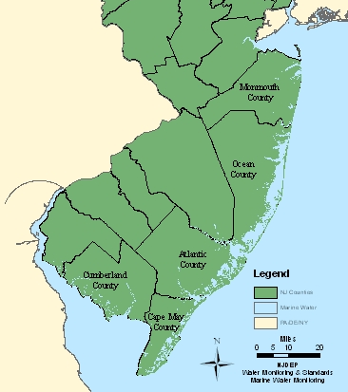
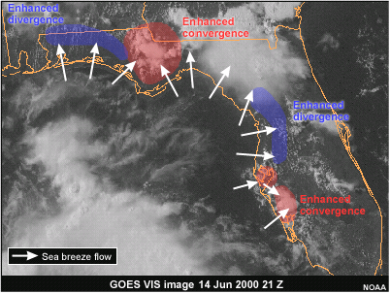
Modifications
Coastline Concavity
Convex coastline focuses convergence and enhances the lift along the sea breeze front
Concave coastline leads to divergence and a reduction in the lift along the sea breeze front
Enhanced convergence
Enhanced divergence

Slide 21
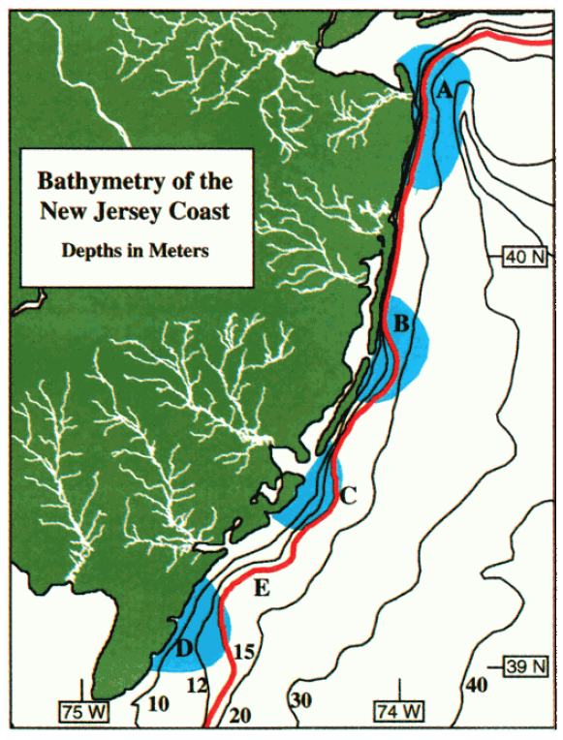
Modifications
Coastal upwelling
Upwelling leads to cooler water coming to the surface
This increases the land-ocean temperature gradient→ promotes and strengthen sea breeze
Can occur in localized areas, creating kinks in the sea breeze

Slide 22
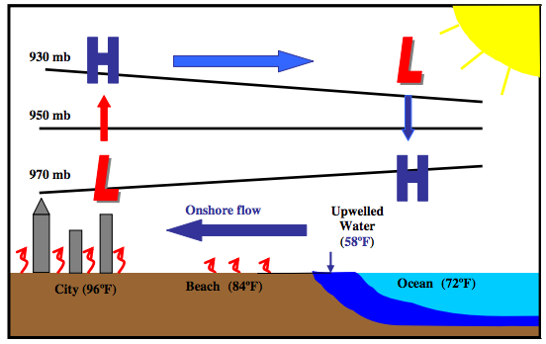
Modifications
Coastal upwelling
Prolonged winds from southwesterly sector off NJ leads to upwelling
Spatial extent of sea breeze may not be as large

Slide 23
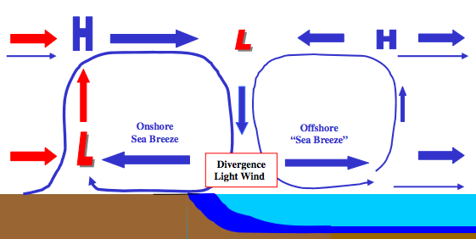
Modifications
Coastal upwelling + Sea breeze Hypothesis
Cold upwelling
Does this occur? With or without upwelling?

Slide 24
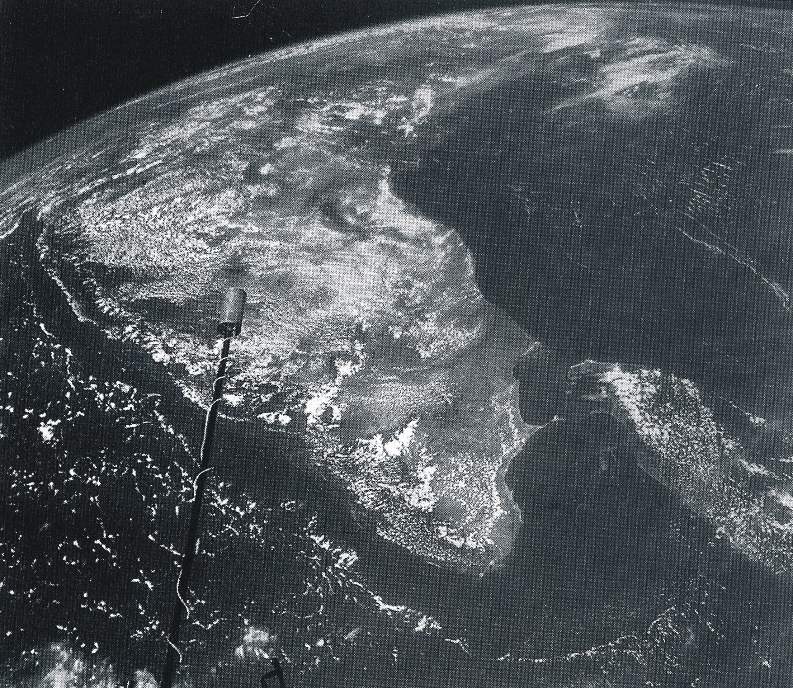
Offshore Extention of the Sea Breeze
Picture of India taken by Gemini XI in 1966
Cloudless area offshore has stable, sinking
air due to the
sea breeze circulation
Offshore extent of the sea breeze is 2-3 times the inland penetration of the sea breeze front
(Simpson, 1994; and many others)

Slide 25
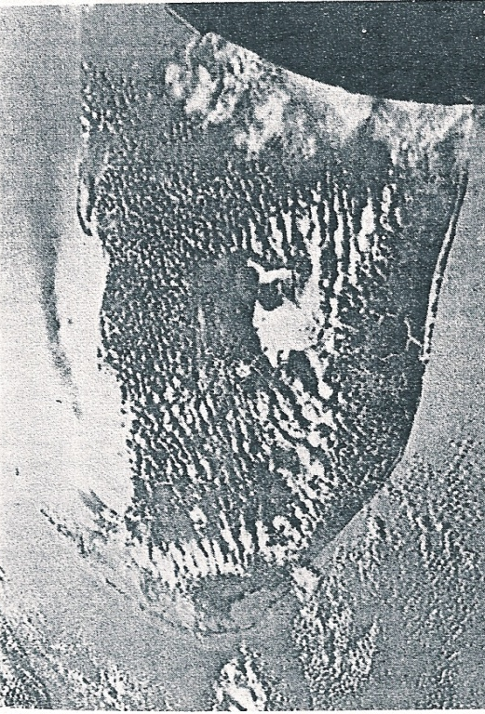
Offshore Extention of the Sea Breeze
Picture of Florida taken by Gemini XII in 1966
Sea breezes are occurring along both the east and west Florida coast
Lack of sunglint off of the calm ocean surface is seen in a dark strip off the west coast as the smooth ocean surface scatters less reflected light
The smooth surface is indicative of calm winds and divergent winds with little wave activity at the offshore edge of the sea breeze
(Fett and Tag, 1984)

Slide 26
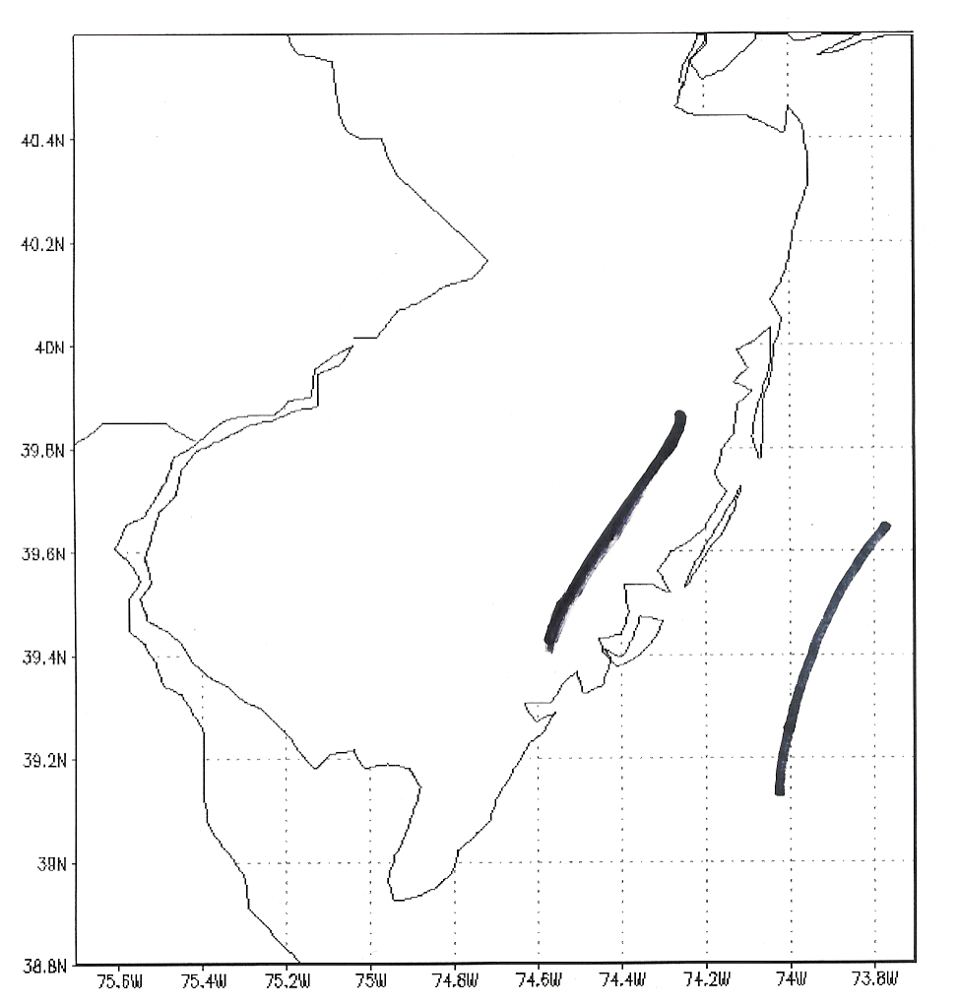
Offshore Extention of the Sea Breeze
Offshore Sea Breeze Front July 26, 2003

Slide 27
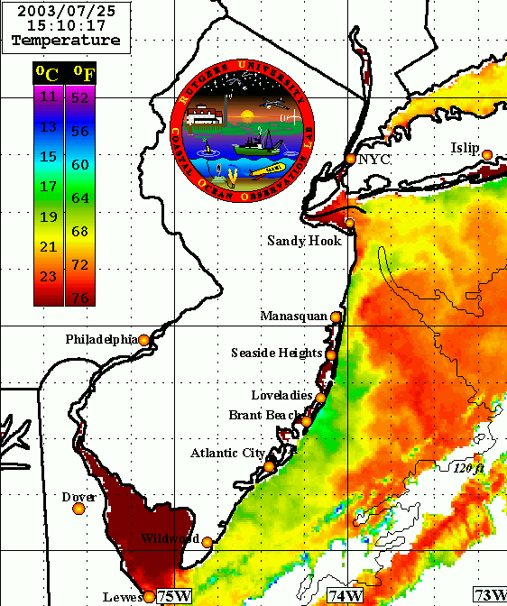
Offshore Extention of the Sea Breeze
Offshore Sea Breeze Front July 26, 2003

Slide 28
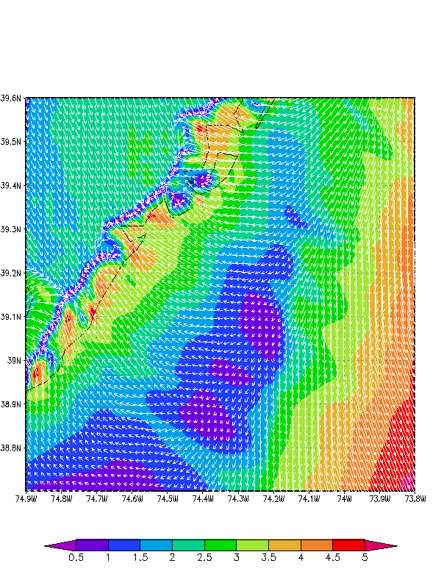
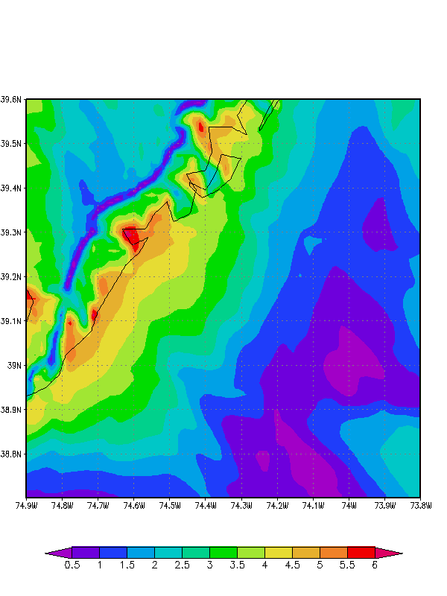
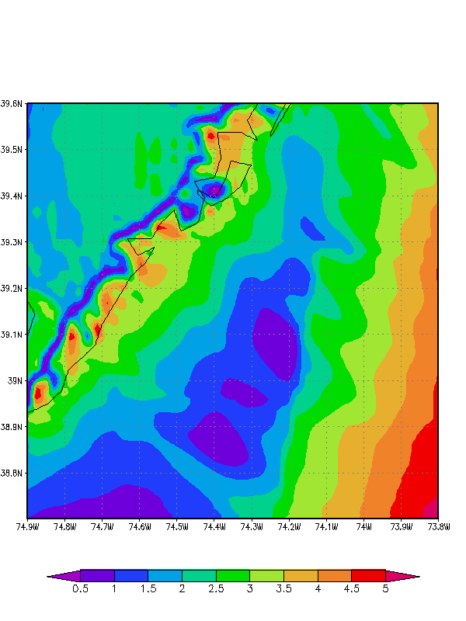
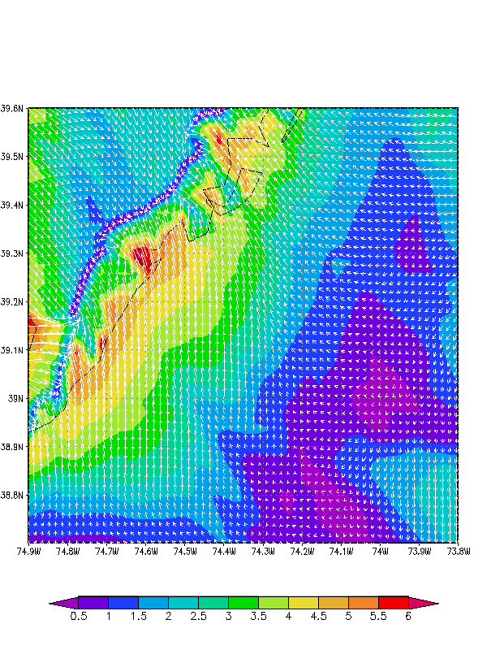
Offshore Extention of the Sea Breeze
Offshore Divergence Zone WRF Case: April 16, 2004 Winds (m/s, shaded)
April 16, 2004 1800 GMT
April 16, 2004 2000 GMT

Slide 29
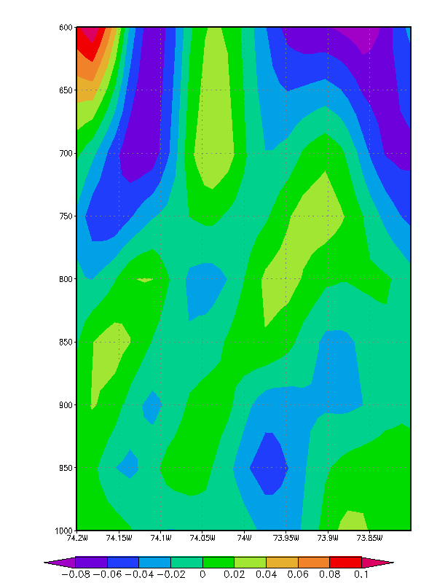
April 16, 2004 2000 GMT
Vertical Velocity (m/s)
mb

Slide 30
Occurrence of sea breeze and upwelling
NJ BPU Offshore Wind Rules state:
“Applications shall account for…the coincidence between time of generation for the project and peak electricity demand.”
NJ sea breeze and coastal upwelling coincident with peak electricity demand
Relative Load
Frequency
Notes:
-Sea breeze time of day (afternoon/evening) is coincident with peak demand time of day (5-7 pm)

Slide 31
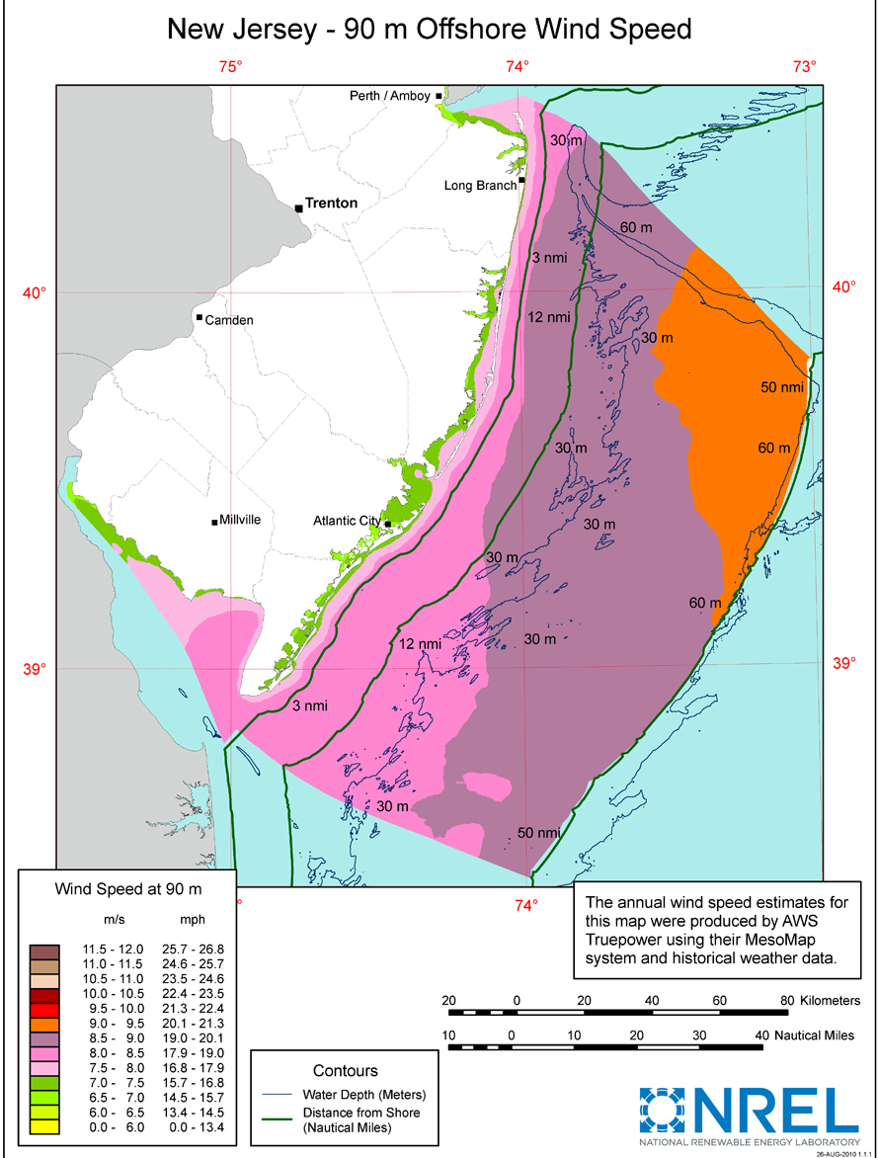
Further motivation, remaining questions
Many existing wind resource maps fail to represent variability
Sea breeze = sig. source of OSW variability, during peak electricity demand
Questions: How does upwelling affect sea breeze, esp. offshore?
What is structure of offshore sea breeze component? How does its shear impact wind resource?
Bowers (2004): NJ onshore sea breeze, upwelling
Steele et al. (2012, 2014) and others: UK offshore sea breeze, no upwelling

Slide 32
Case study: How upwelling alone can impact hub height winds

Slide 33
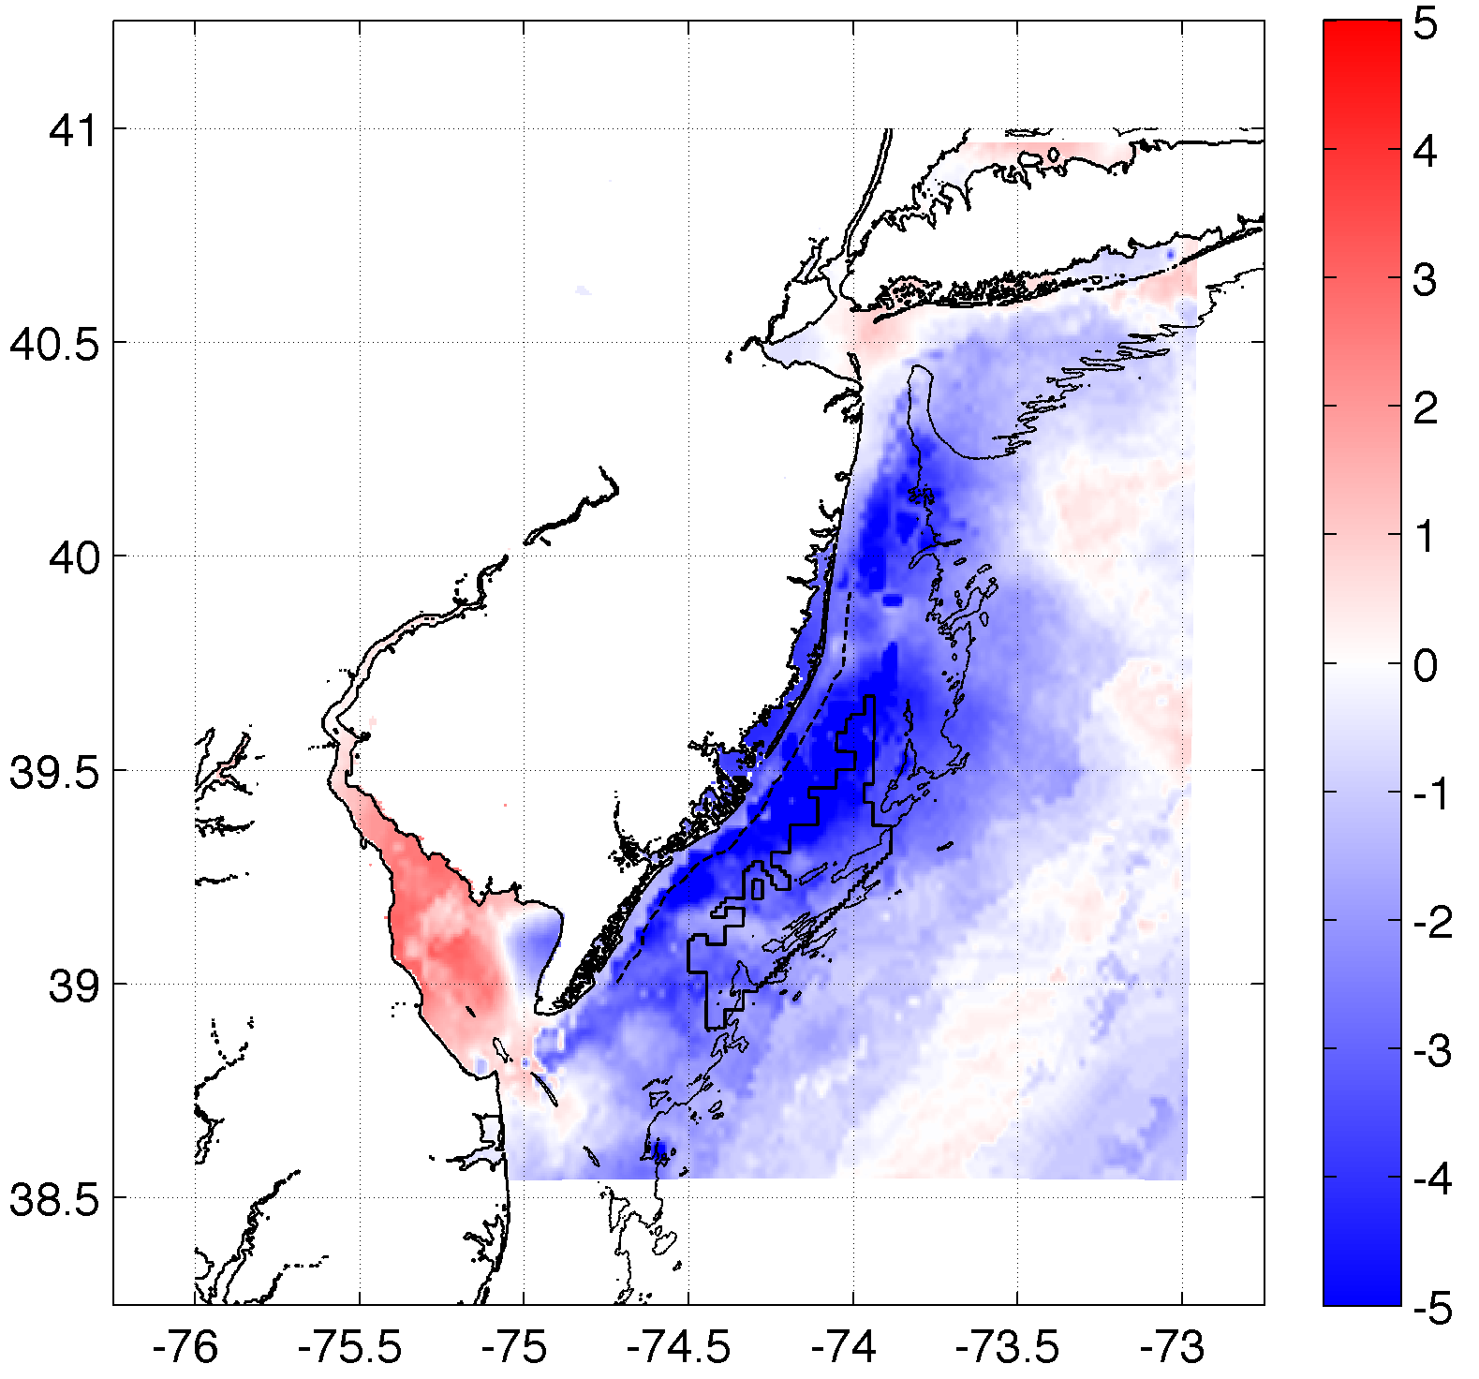
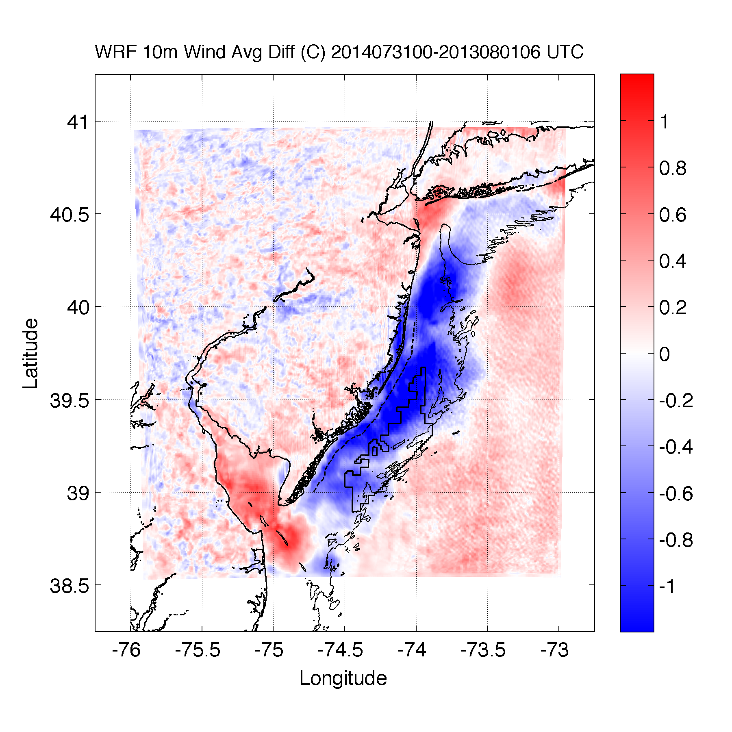
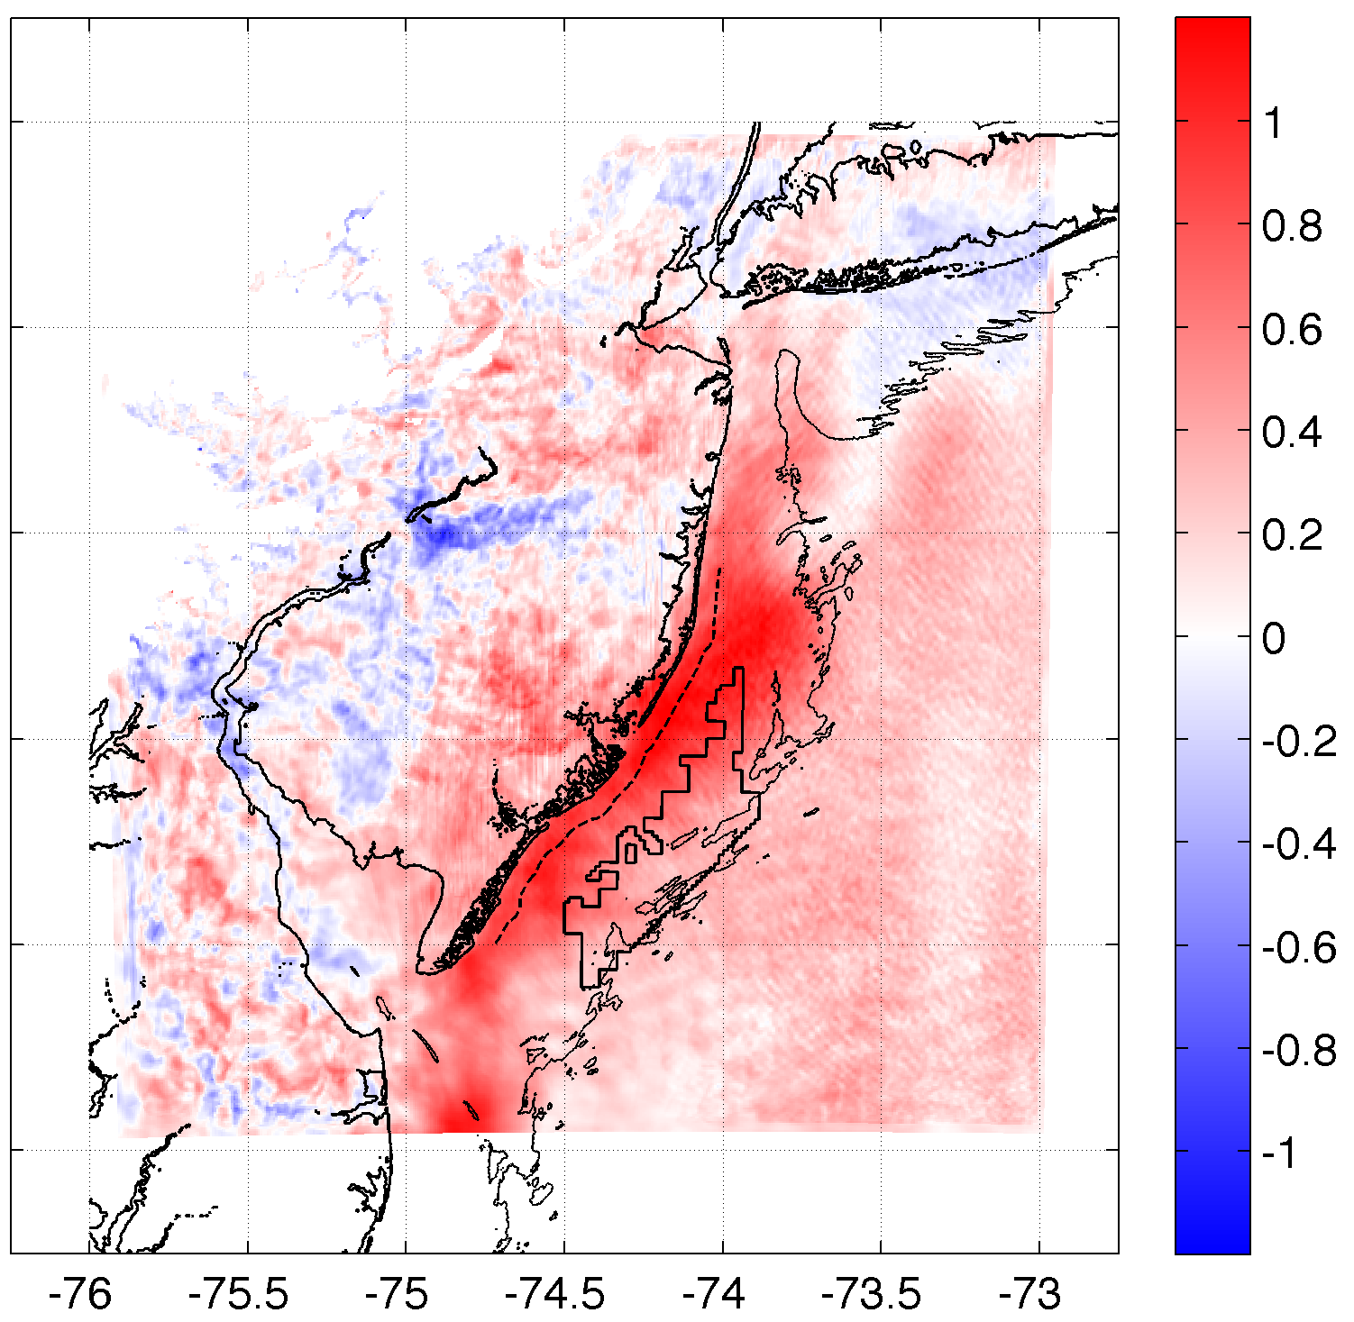
Upwelling produces an inversion, increasing 100m hub height winds
SST Diff.
10m Wind Speed Diff.
100m Wind Speed Diff.
r²=0.61
r²=0.58

Slide 34
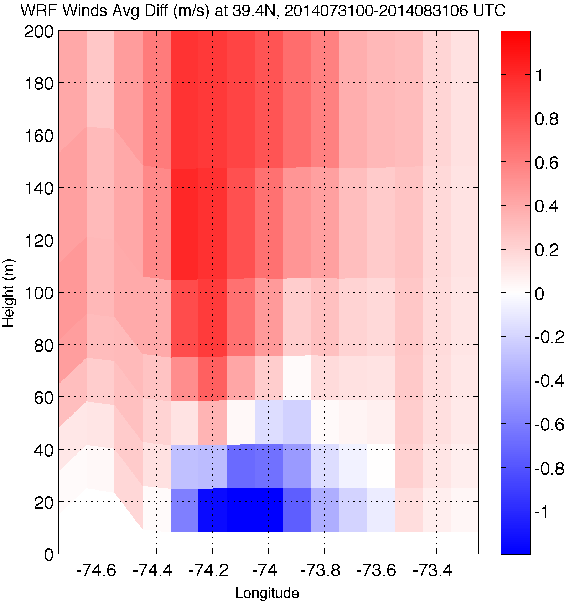
Upwelling produces an inversion, increasing 100m hub height winds
Wind Speed Difference
10m Wind Speed Diff.

Slide 35
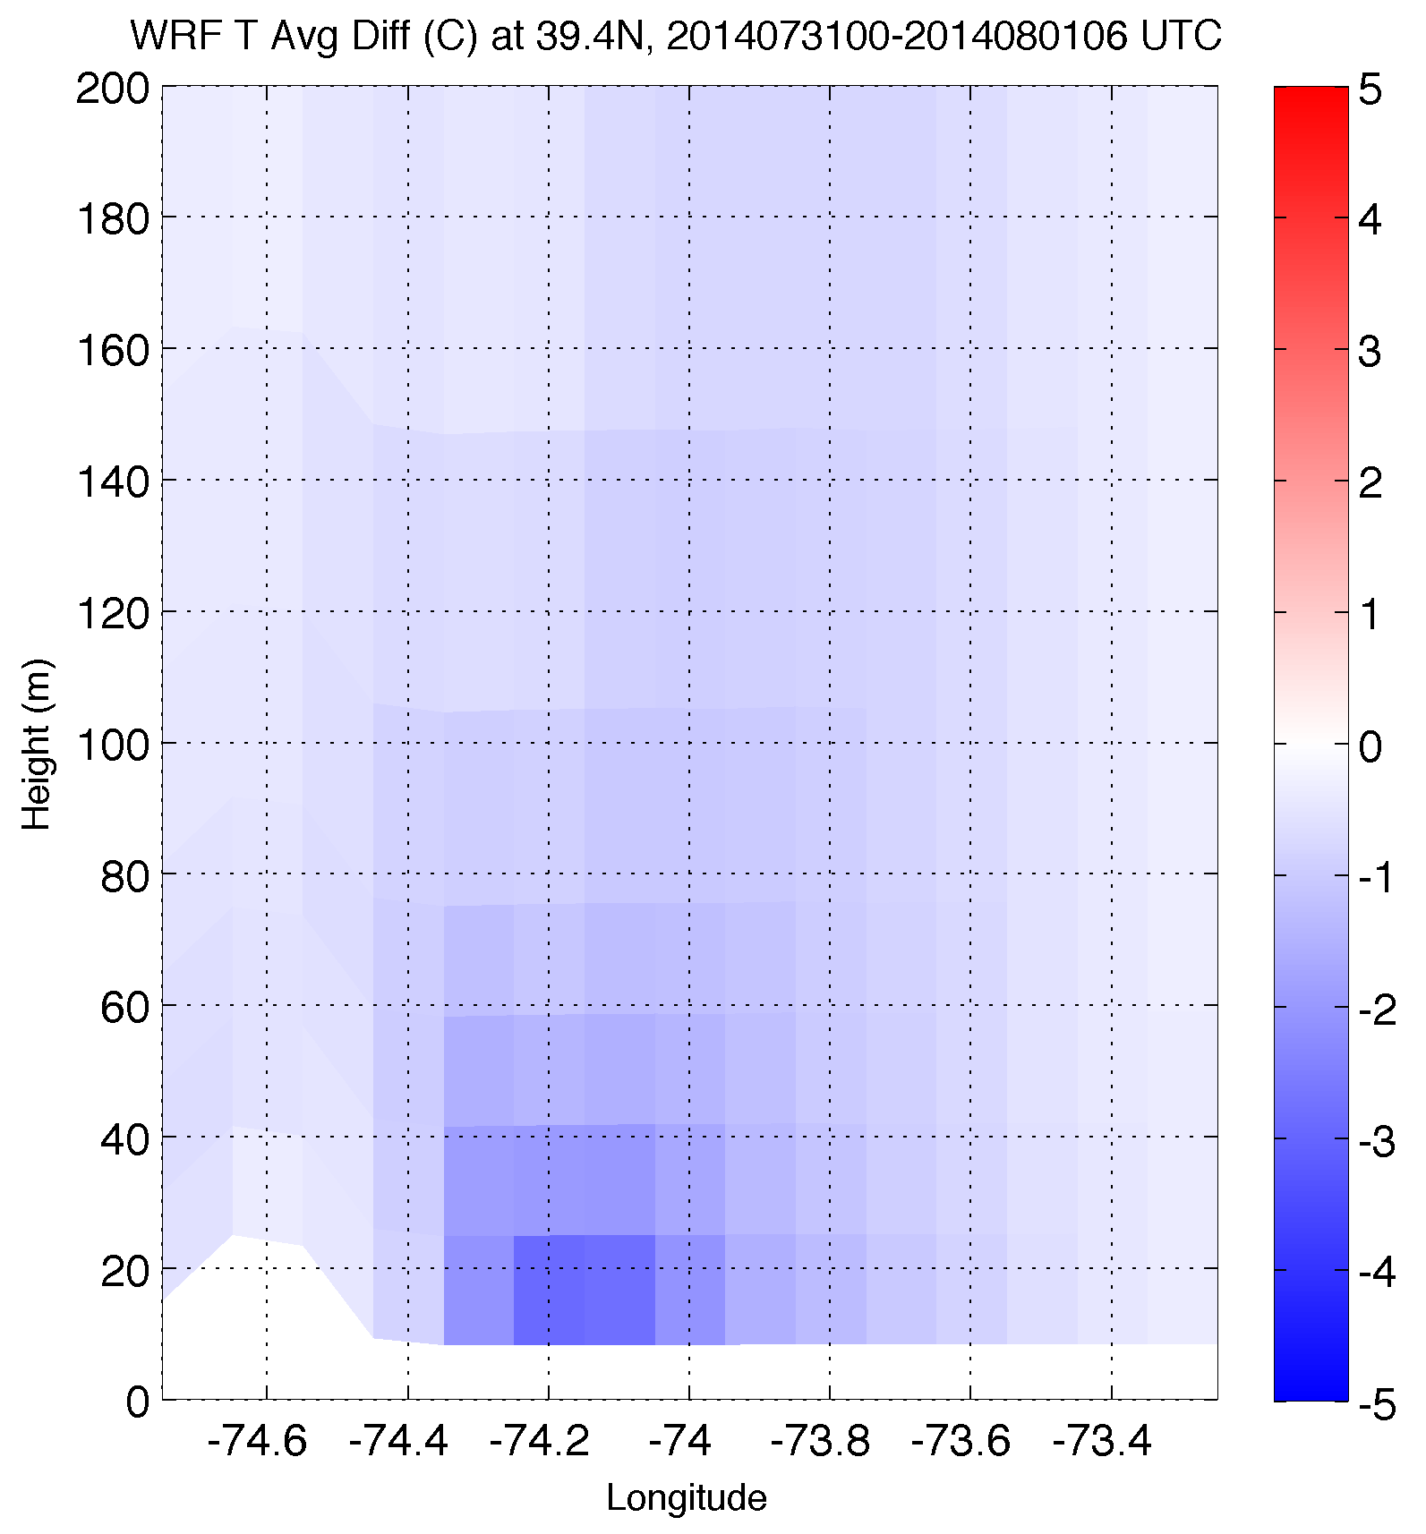
Upwelling produces an inversion, increasing 100m hub height winds
Temperature Difference
10m Wind Speed Diff.

Slide 36
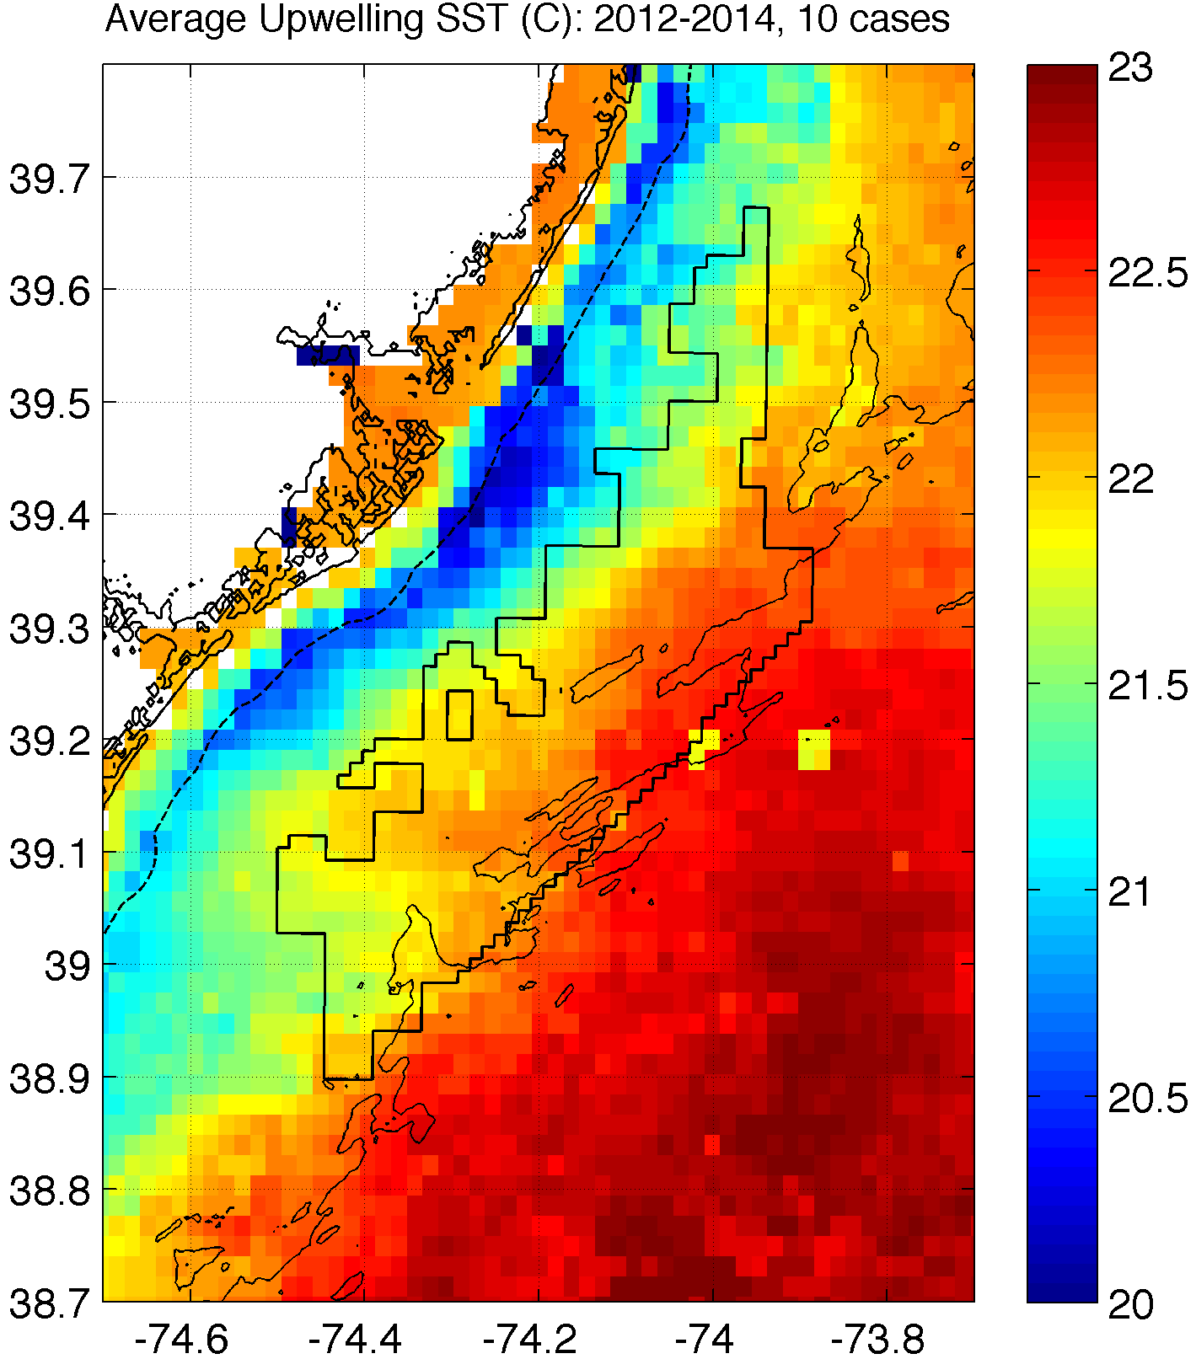
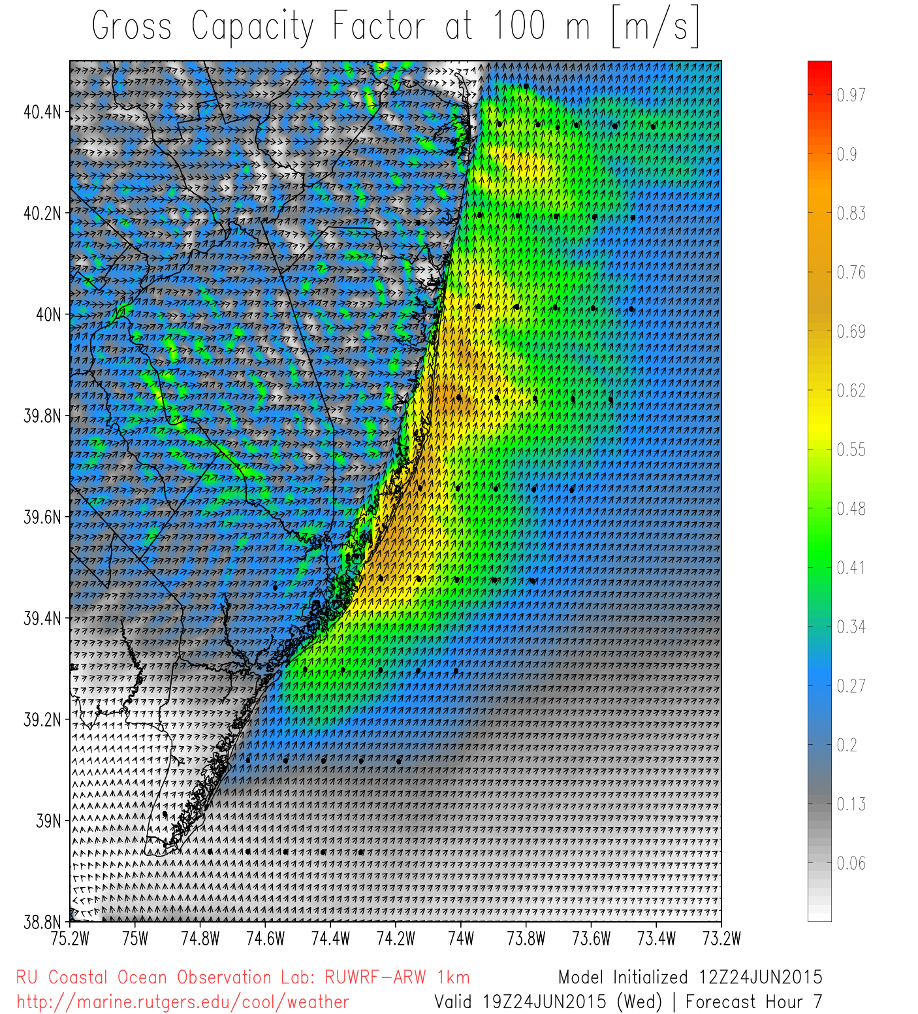
Basic Conclusions and Future Work
Upwelling causes inversion, increasing winds at 100m hub hgt and shear across rotor dimensions
Sea breeze circulation causes significant variability across the NJ WEA
Accurate coupled ocean-atmosphere model needed to diagnose and forecast upwelling and sea breeze interaction

Slide 37
Extra Slides

Slide 38
Materials and Methods
Satellite: state-of-the-science declouding technique designed by Rutgers to determine SST and resolve coastal upwelling
Model: 3km, 600m WRF-ARW 3.6.1; YSU PBL; MM5 Monin-Obukhov surface layer
Advantages (vs. offshore met tower): cost, spatial variability, prediction
Cases:
20140731: sea breeze, no upwelling
2. Artificially add in upwelling (from 20130707)
Coastal upwelling
Notes:
20130427- another case, sea breeze, no upwelling
Satellite: High res in space and time
Previous satellite SST products low in spatial or temporal resolution and are often warmest pixel composites for declouding; cannot resolve coastal upwelling
SST product is IR/near IR (AVHRR); SPoRT is IR/near IR as well
Model: NAM12km for boundary conditions
Cases: largest and longest lasting upwelling in NJ 2012-2014
20140731 case has similar ambient (outside upwelling) water T to 20130707

Slide 39
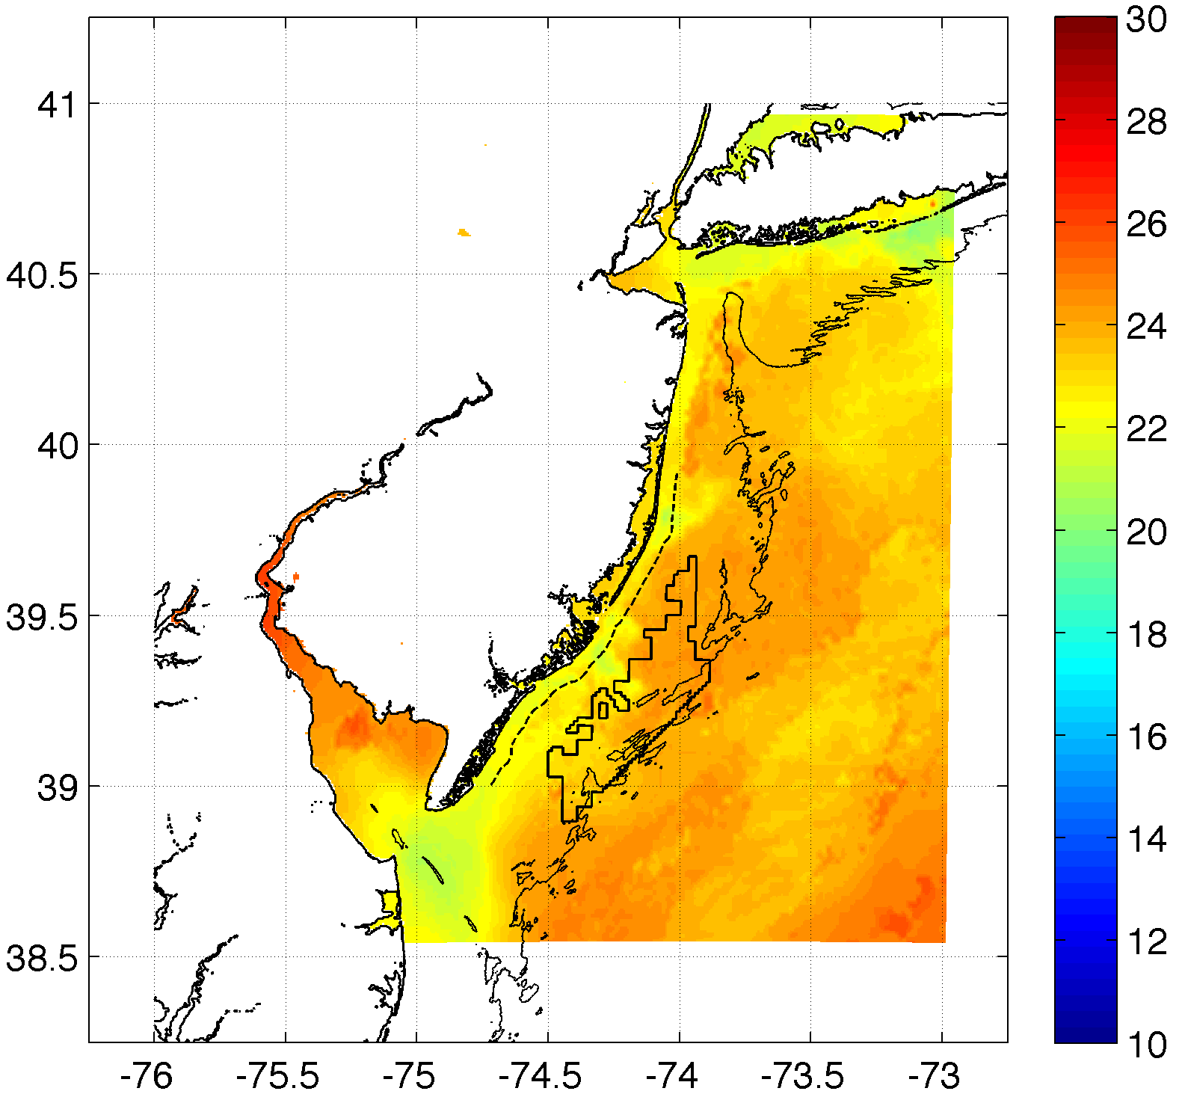
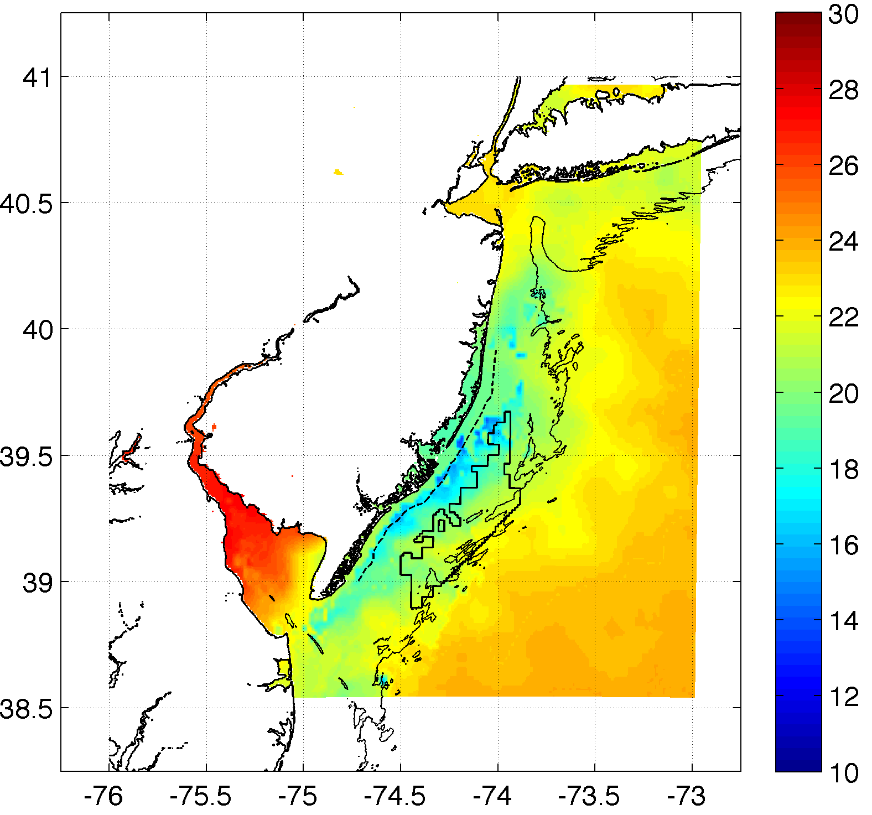
Case 1
Case 2: Add in upwelling

