Slide 1
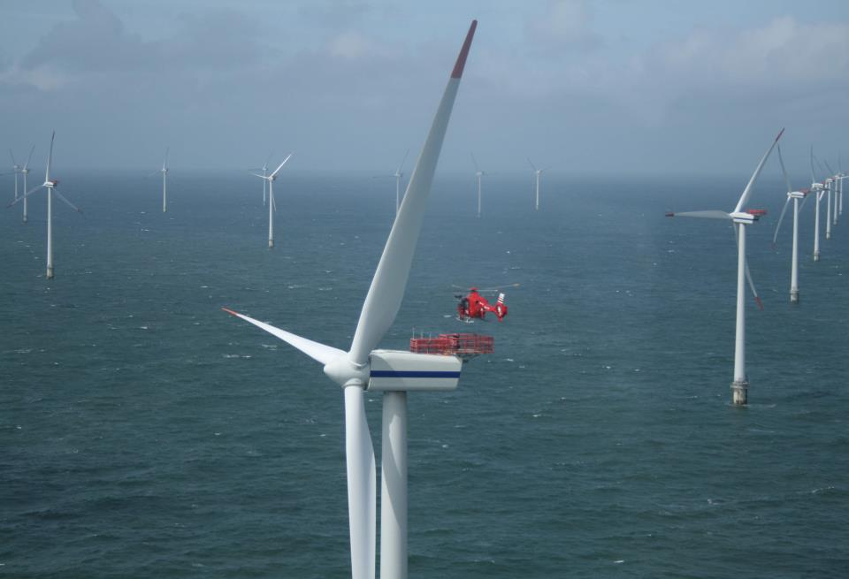







Atmospheric/Oceanic Analyses and Predictions to Support NJ’s Energy Master Plan and Associated Offshore Wind (OSW) Renewable Energy Regulations
Innovative Analytical/Predictive Modeling Applications that will Cost-
Effectively Reduce the “Risks” Associated with Offshore Wind Development Issues Including Wind Resource Variability, Energy Transmission/Distribution Reliability, Environmental/Health Impact, and Educational/Economic Development Incentives
Notes:
Insert turbine picture

Slide 2
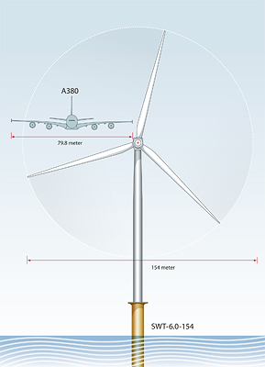
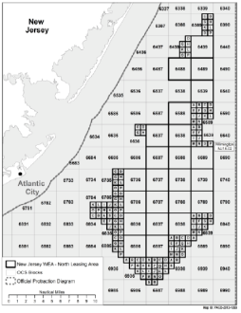
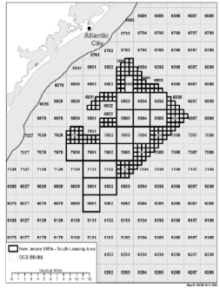
Domain and WTG Size
6 MW WTG
North Zone
South Zone

Slide 3
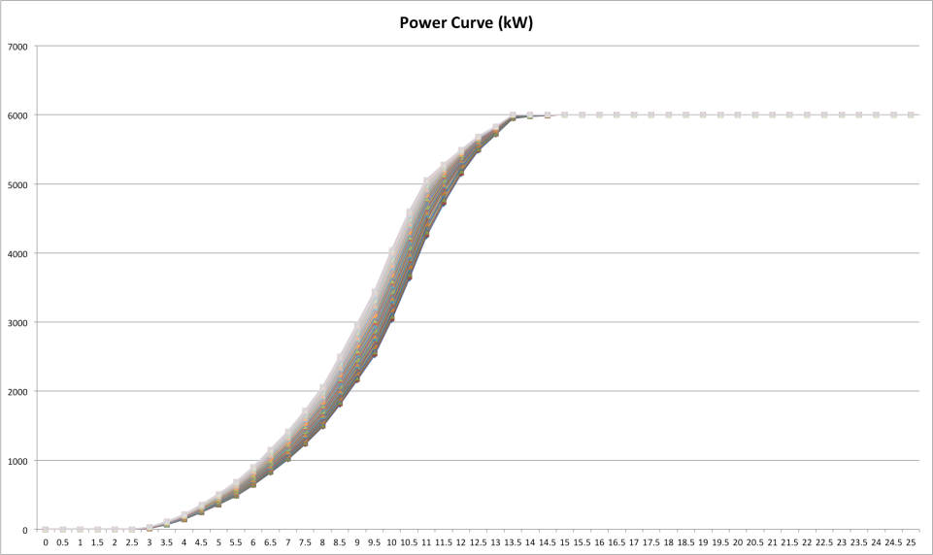
Generic Power Curve – 6 MW WTG

Slide 4
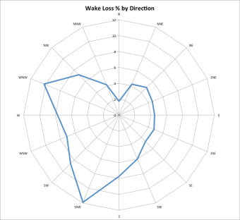
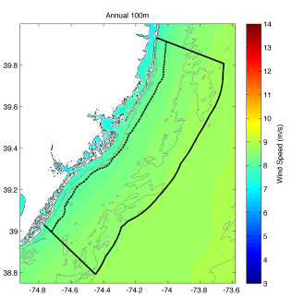
3000 MW
1998 MW
1098 MW

Slide 5

Hypothetical WTG Array Showing 10D X12D Spacing with a “Staggard” C
Hypothetical WTG Array Showing 10D X12D Spacing with a “Staggard” Configuration to Account for Prevailing Winds along with the effects of the Sea breeze Circulation onfiguration to Account for Prevailing Winds along with the effects of the Sea breeze Circulation

Slide 6
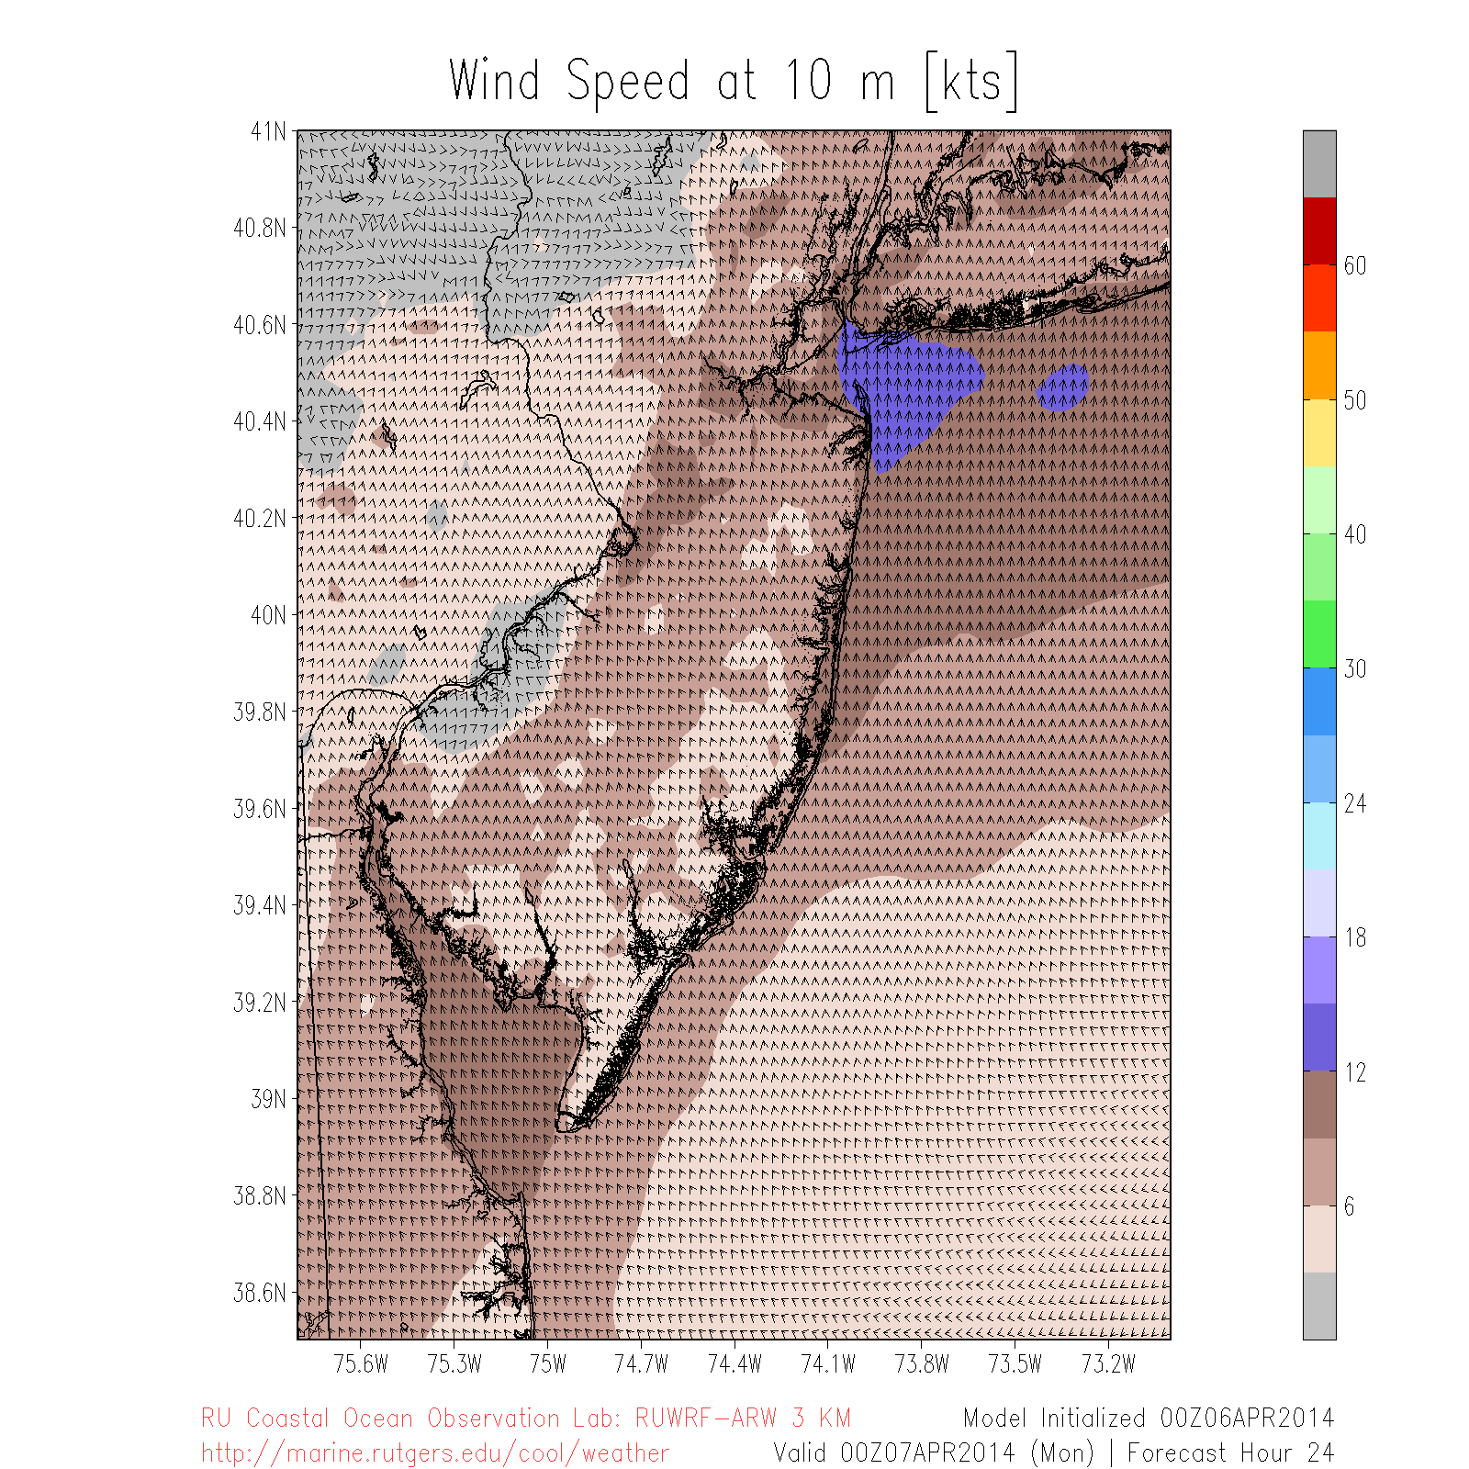
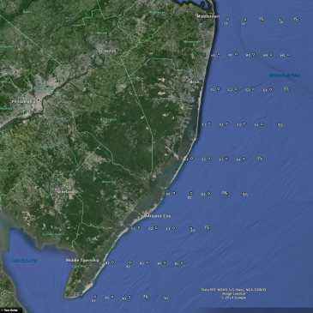
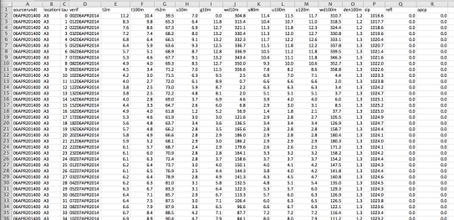

Slide 7
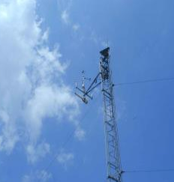
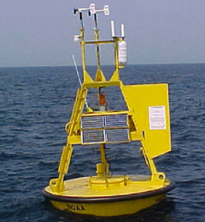
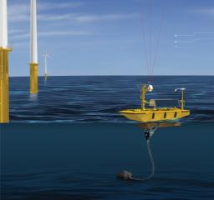
Coastal/Offshore Wind Monitoring
Meteorological Tower
Meteorological Buoy
Offshore vertical LIDAR
Coastal/Offshore Scanning LIDAR
Infrared Satellite
Coastal Radar (CODAR)
Notes:
Fishermen: already deployed monitoring buoy, once done go to one 10 nm out
-purchased offshore vertical lidar, measure wind spd, dir, turbulence, deployed in June
-bought scanning lidar, deployed at end of summer
-bought wind tracer near Margate, see 10 nm offshore, in vertical
-2-3 60m met towers along coast, instrumented at 3 levels
Offshore Megawatt (German): no monitoring, rely on our study
Bluewater Wind: claim deploying monitoring sites at end of summer
Garden State Offshore Energy (part PSEG, part Deepwater Wind): vertical lidar on buoy, validate in Rhode Island, target this summer with LIDAR

Slide 8
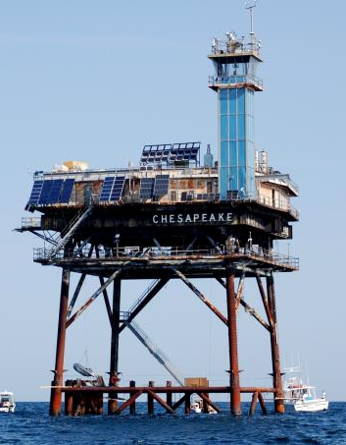
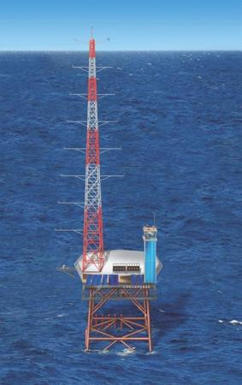
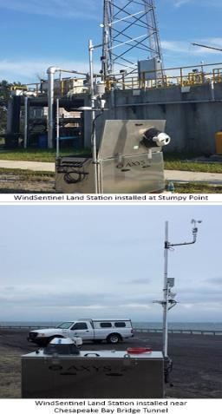
Chesapeake Light Tower
Current
Future

Slide 9
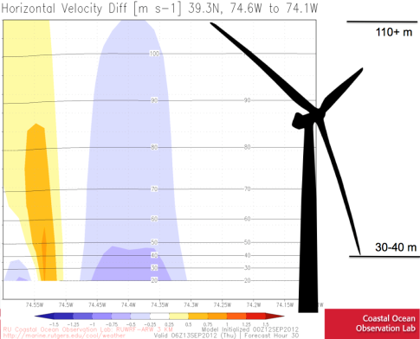
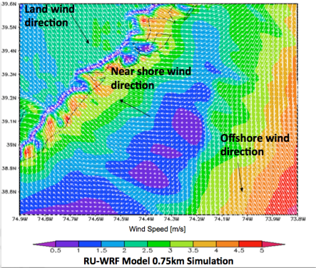
Local Wind Resource Perturbations
Sea breeze and local wind analyses

Slide 10
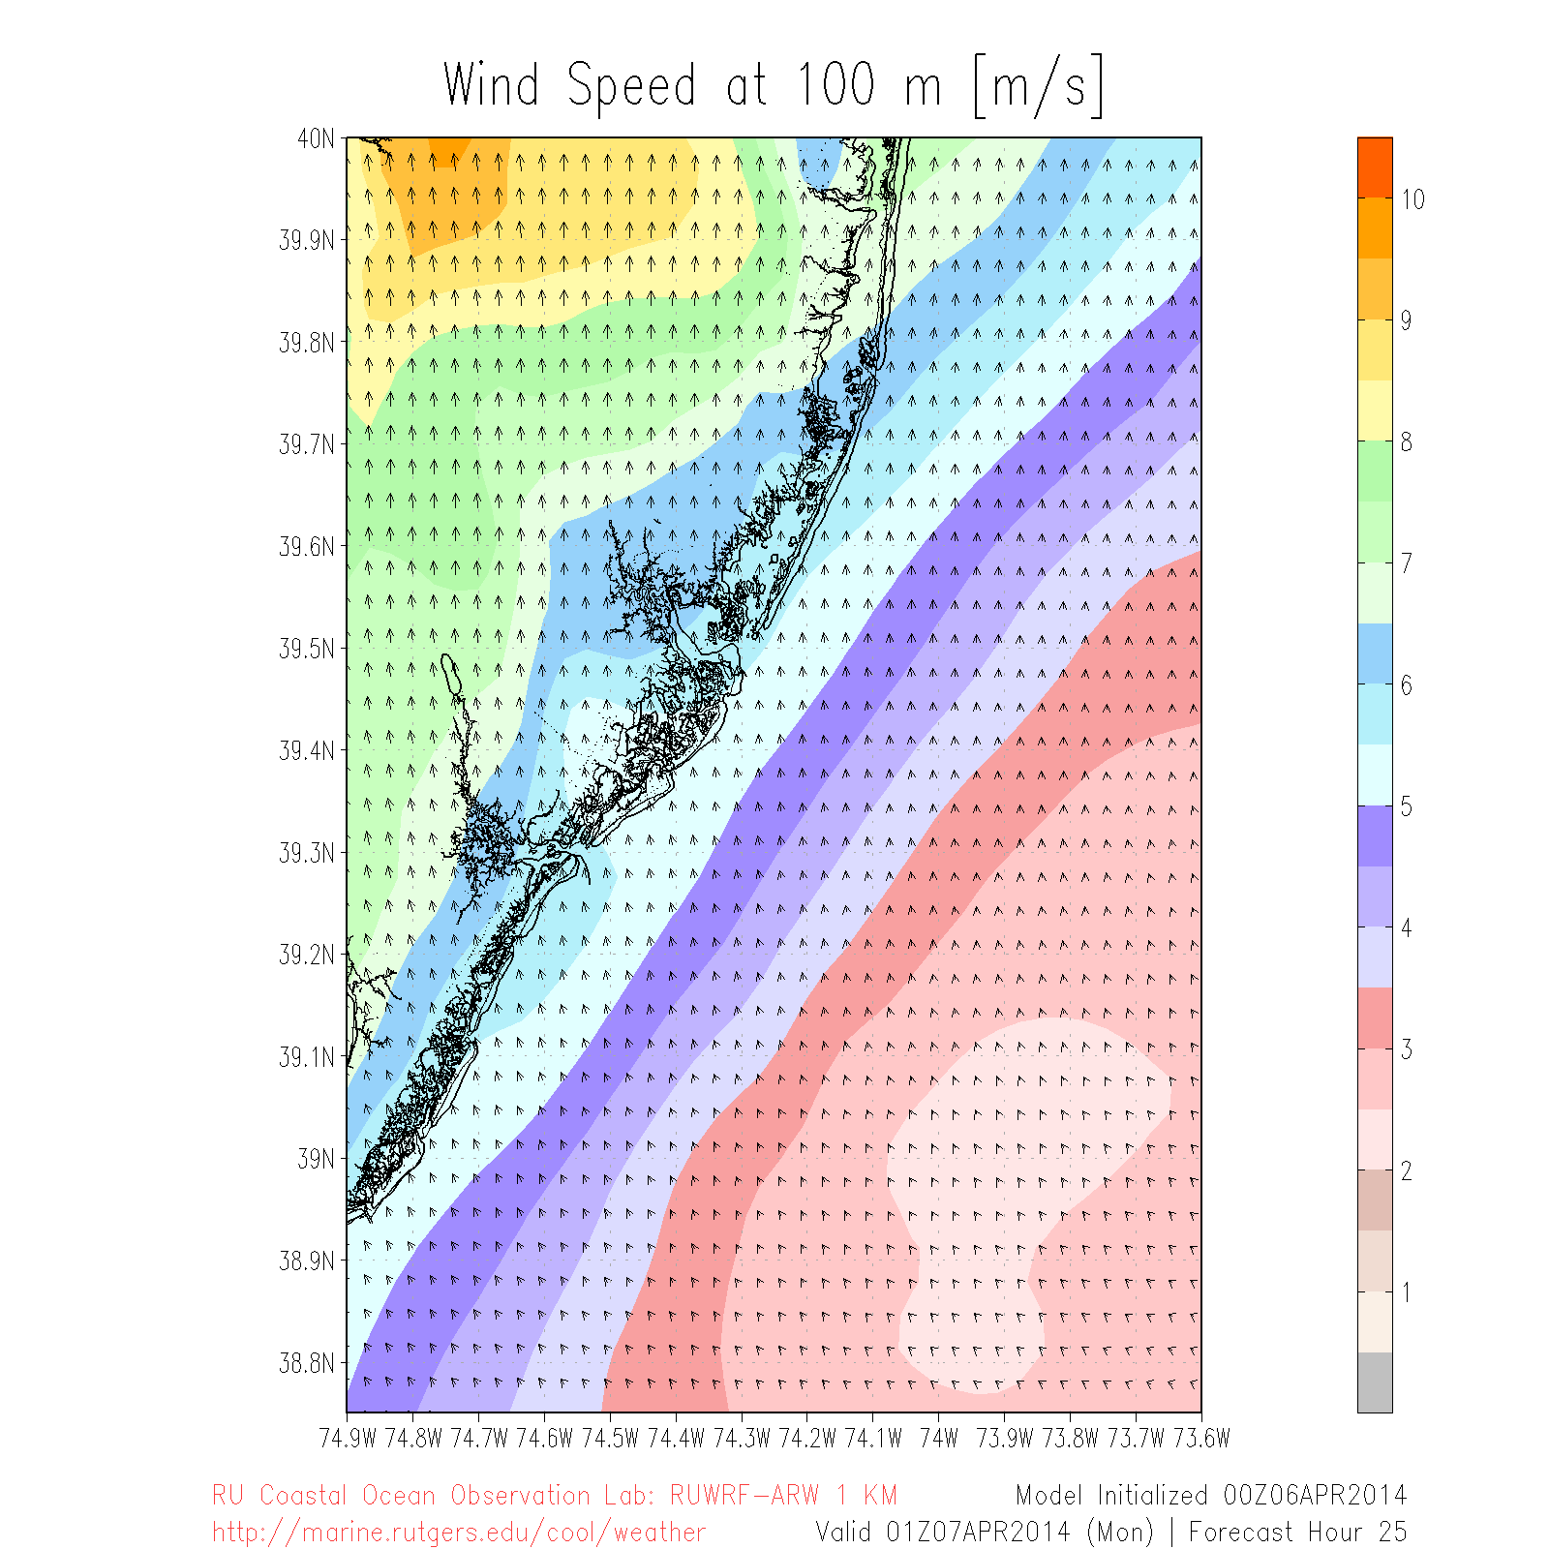
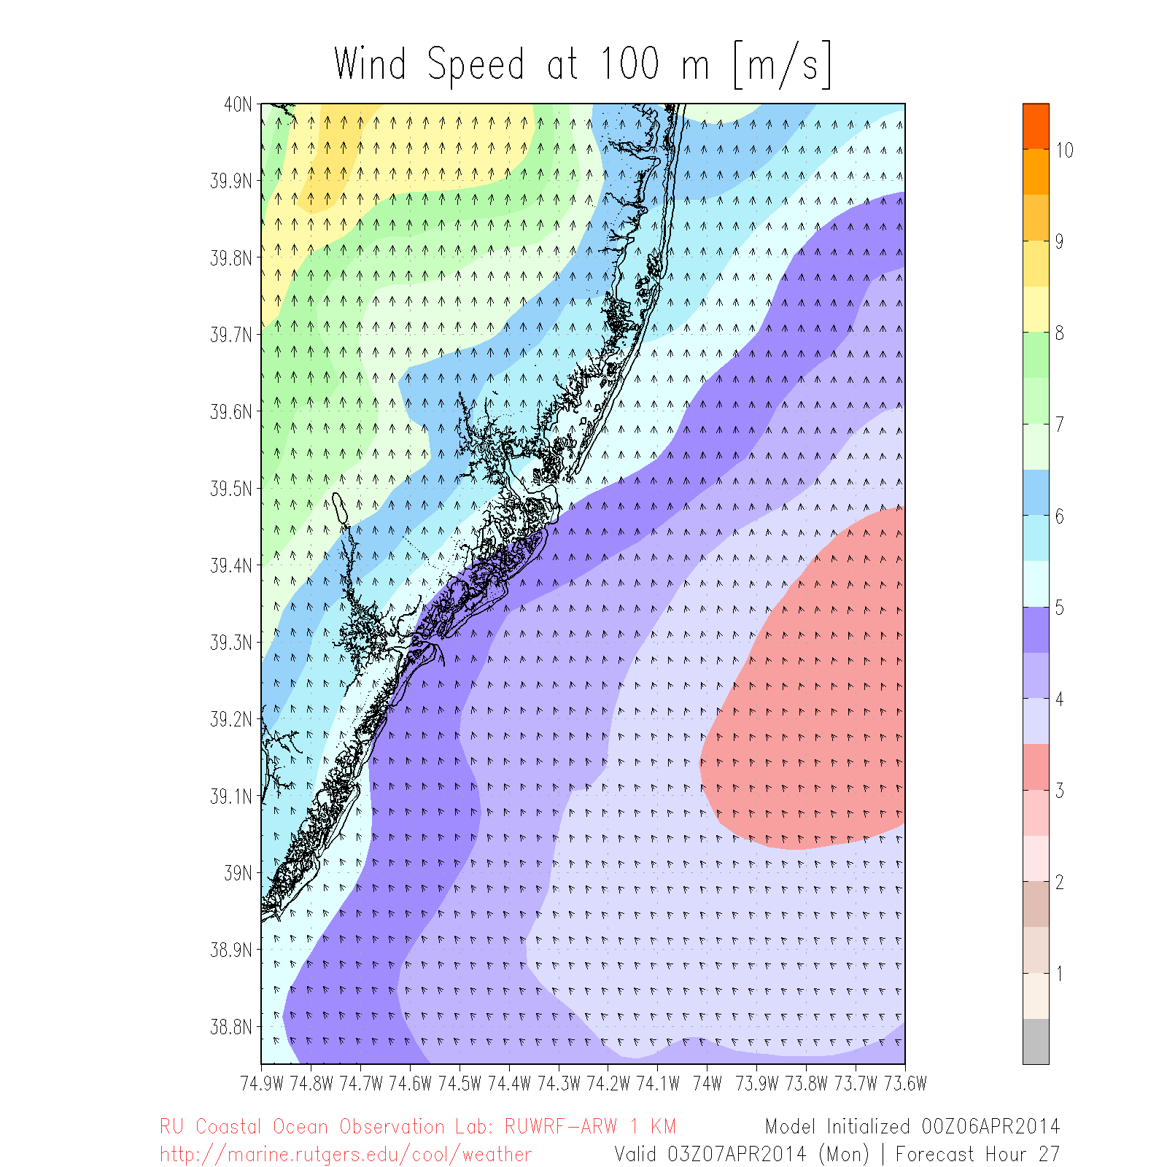

Slide 11
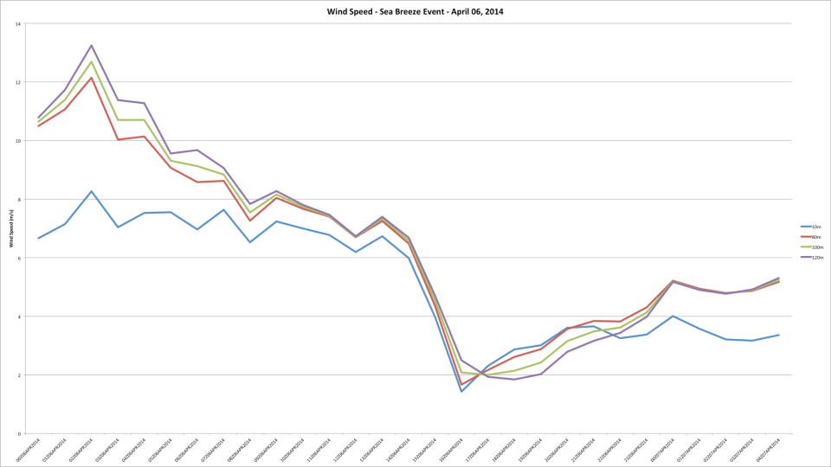

Slide 12
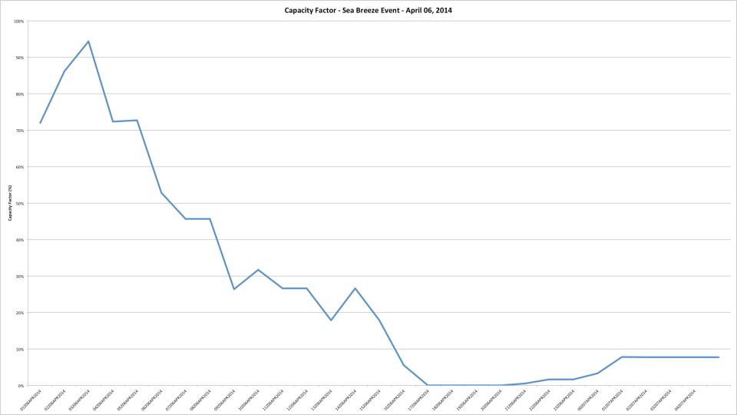

Slide 13
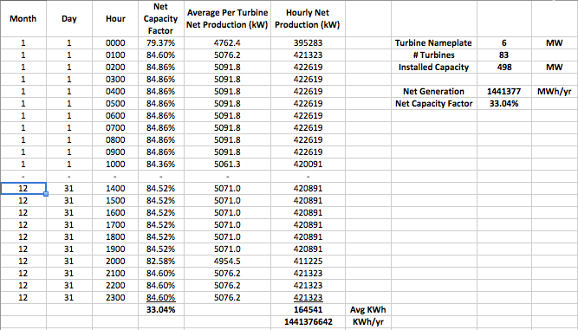
Hourly Wind Energy Production Data Provided to RU CEEEP

Slide 14
Combine Ru IMCS/CEEEP Modeling Programs
Couple/automate data transfer flow
3. PJM
Energy UC &
Dispatch
(Dayzer)
CEEEP
1. Hourly
Wind
Speeds
IMCS
2. Hourly
Wind
Turbine
Energy
Production
(MWh)
IMCS
Other Inputs:
Turbine size, manufacturer and power curve (relationship between wind speed (and other factors?) and power production)
Turbine location and wake effect
Size of wind farm (MW)
Injection point(s) into electricity grid (radial and with AWC)

Slide 15
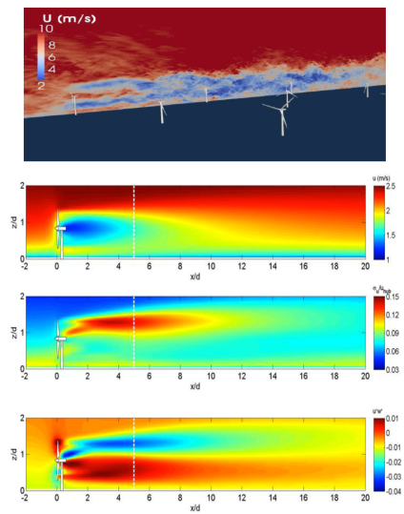
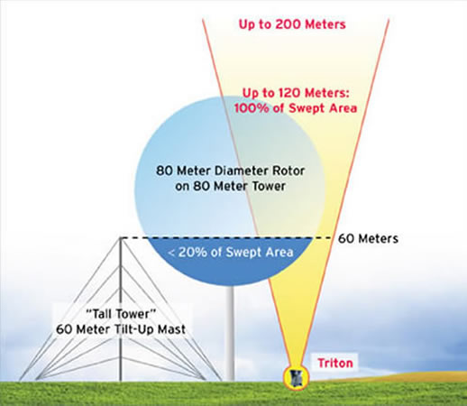
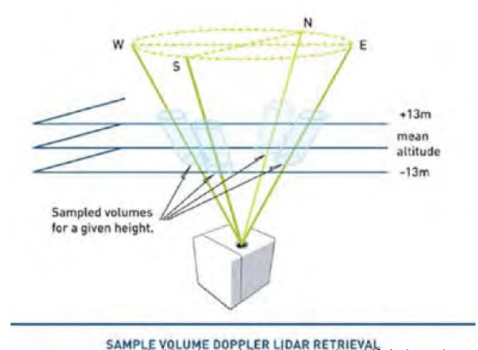
Proposed Modeling/Monitoring Enhancements
Modeling/Monitoring Upgrades
Large-Eddy Simulation (LES)
SODAR
Velocity
Turbulence Intensity
LIDAR
Kinematic Shear Stress

Slide 16
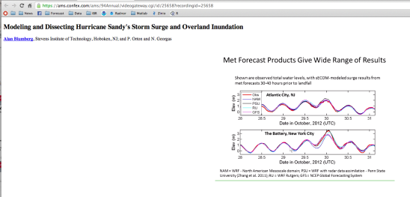
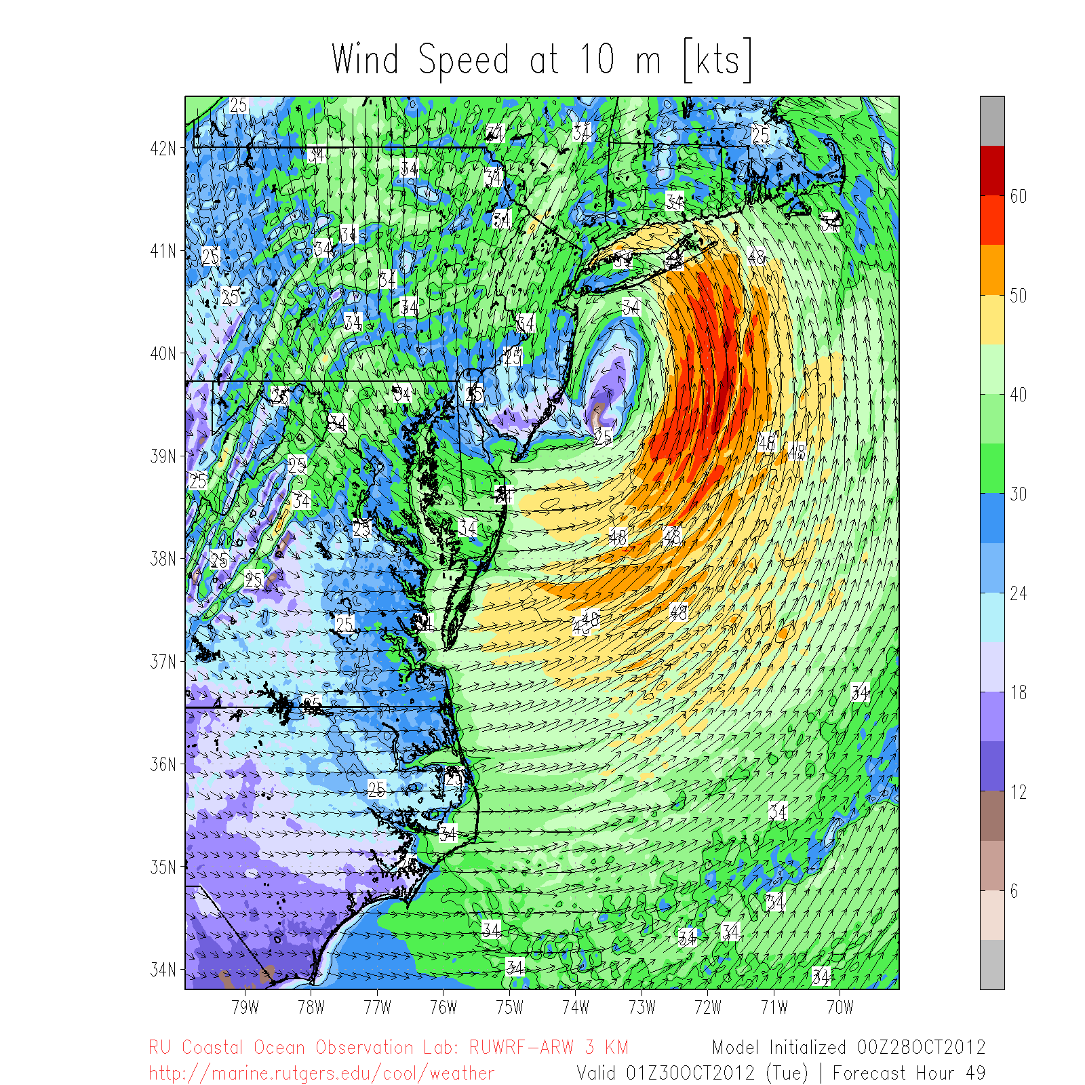
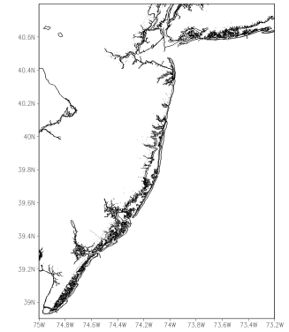
Sandy, Oct 29-30, 2012
80
78
74
70
85
90
53
87
68
79
79
78
60
89
64
88
77
60
73

Slide 17
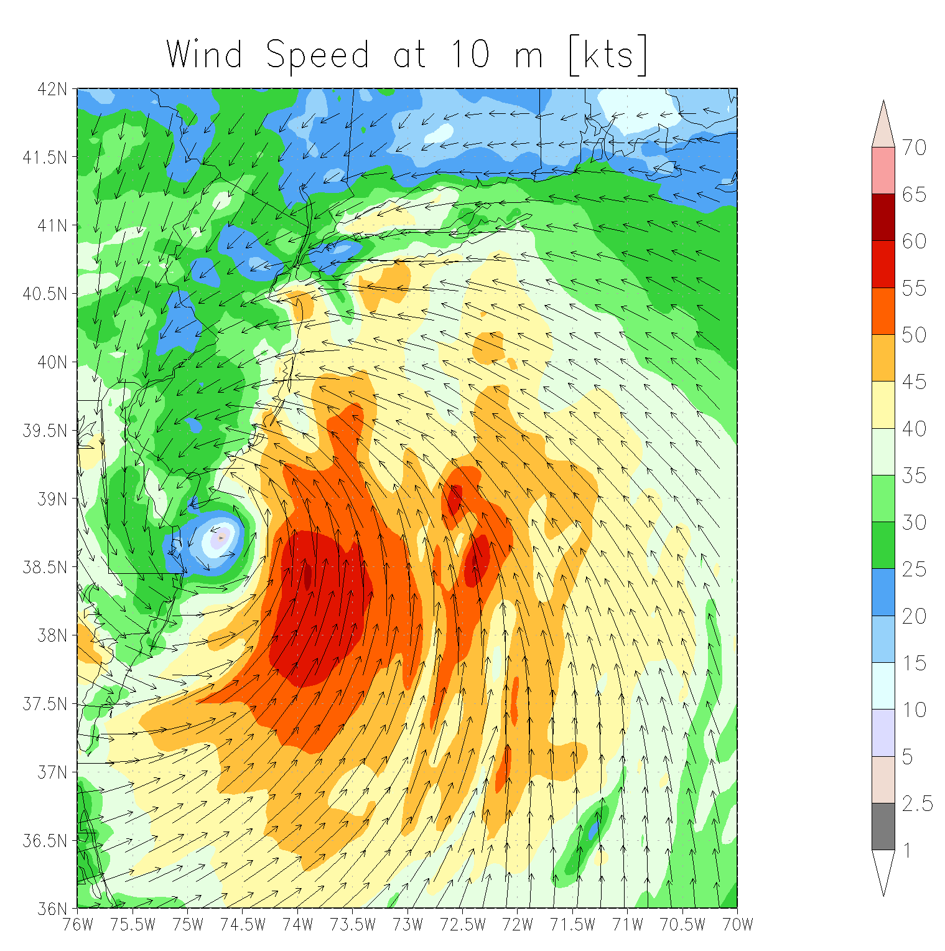
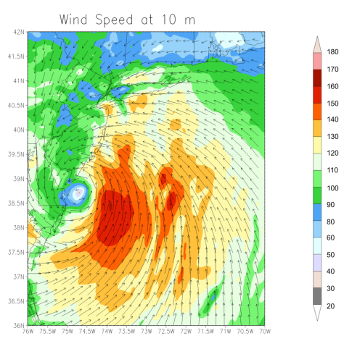
Model Irene with the intensity of the September 1821 Hurricane using RUWRF
Irene Wind Speed at 10m (MPH)
1821 Wind Speed at 10m (MPH)

Slide 18


Reports, Presentations, Meetings, Conference calls
Progress Reports
Website, Presentations, Meetings

