Slide 1
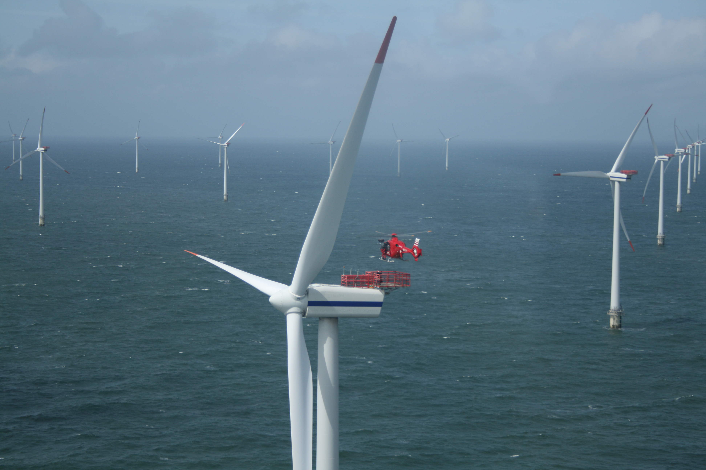







Atmospheric/Oceanic Analyses and Predictions to Support the Wind Energy Development Application Process Defined in NJBPU’s Offshore Wind (OSW) Renewable Energy Rules (N.J.A.C. 14:8-6): Phase III—24 Jun 2014-23 Jun 2015
Innovative Analytical/Predictive Modeling Applications that will Cost-
Effectively Reduce the “Risks” Associated with Offshore Wind Development Issues Including Wind Resource Variability, Energy Transmission/Distribution Reliability, Environmental/Health Impact, and Educational/Economic Development Incentives
Notes:
Insert turbine picture

Slide 2
Outline
Phase I (Completed): Develop monitoring/modeling program for climatology, variability in NJ coastal/offshore wind resource
  Monitoring: Sea surface currents (CODAR), Sea surface temperatures (satellite SSTs), met towers, buoys
  Modeling: RU-WRF atmospheric modeling program (incl. validation)
Phase II (Current): (Hypothetical) offshore wind parks in North/South BOEM NJ WEA zones
  Hourly wind power production for input into RU CEEEP models
  Siemens (and Alstom) Offshore 6MW WTG specs (Total capacity 1100, 2000, 3000 MW)
  Averaged 5-6-7 MW WTG, use info. submitted by 10? OSW developers to BOEM/NJBPU for OSW farm total capacity and location (distance offshore, north/south zone)
Phase III (Proposed): (Actual) proposed offshore wind parks in North/South lease zones (contingent on NJ OREC, BOEM NJ WEA lease auction, NJ OSW application process)
  Task 1: Refinement and upgrade of wind resource modeling (high res LES), monitoring (upgrade satellite SST, SODAR/LIDAR )
  Task 2: Provide hourly annual data to RU CEEEP
  Task 3: Sea breeze and local wind circulation analyses
  Task 4: Automate/couple RU-WRF results to RU CEEEP
  Task 5: Severe weather analyses (climate change)
  Task 6: Progress reports
  Task 7: Presentations, meetings, calls

Slide 3
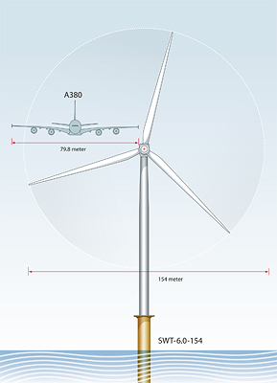
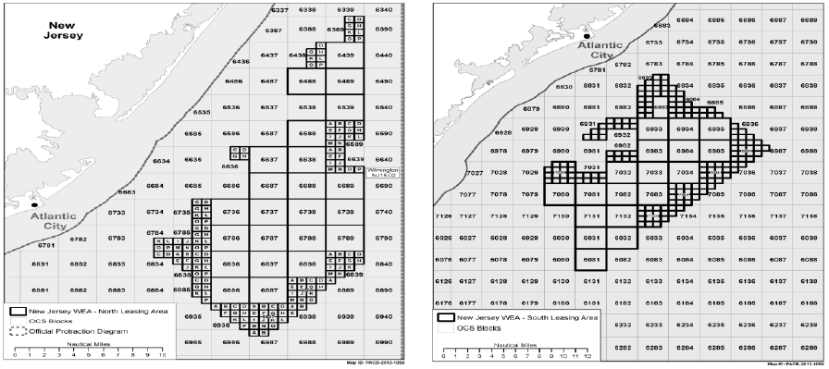
Domain and WTG Size
6 MW WTG
North Zone
South Zone

Slide 4
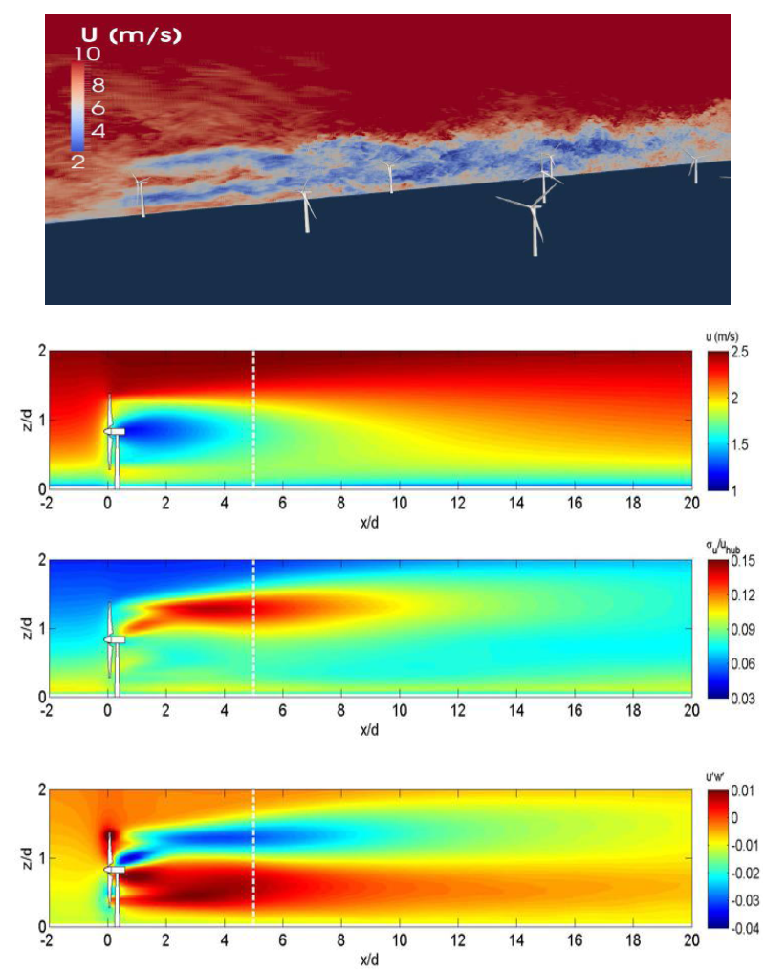
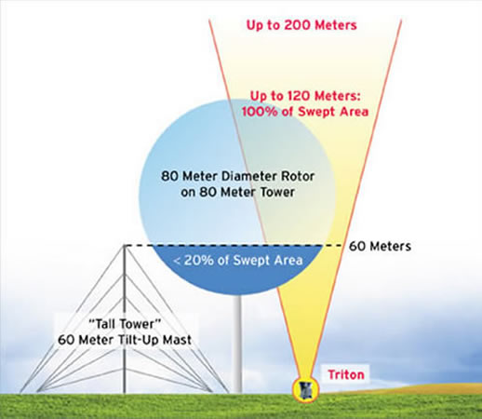
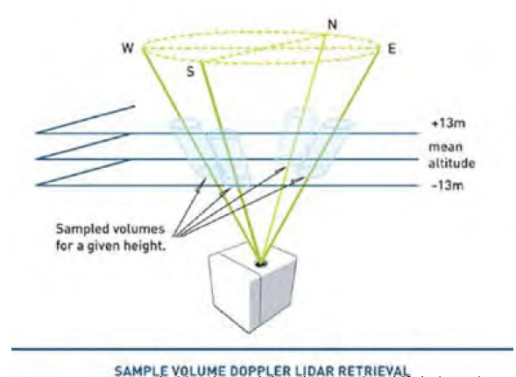
Task 1
Modeling/Monitoring Upgrades
Large-Eddy Simulation (LES)
SODAR
Velocity
Turbulence Intensity
LIDAR
Kinematic Shear Stress

Slide 5
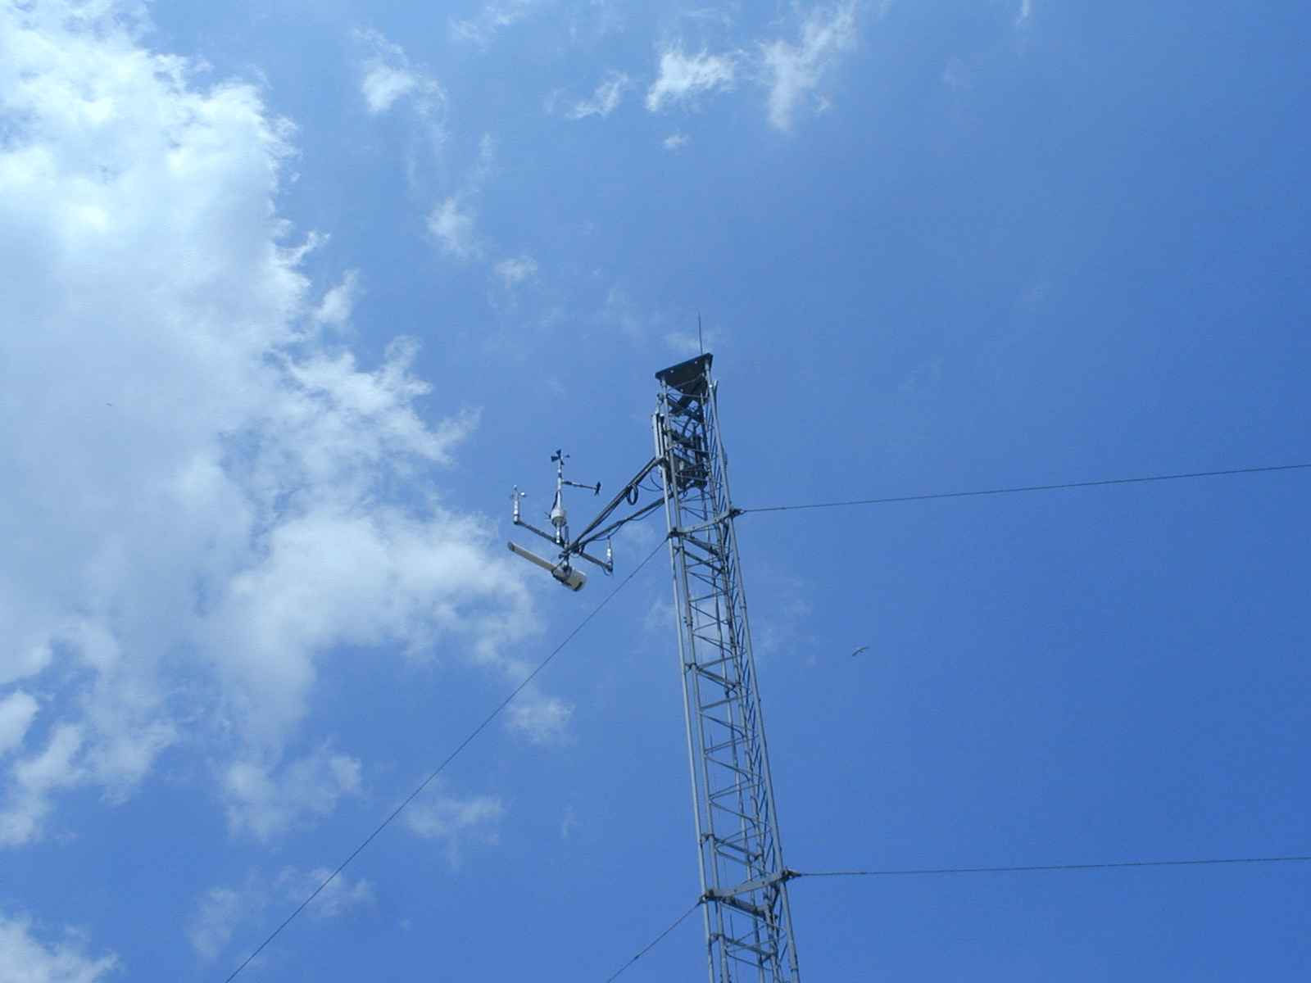
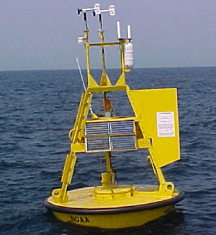
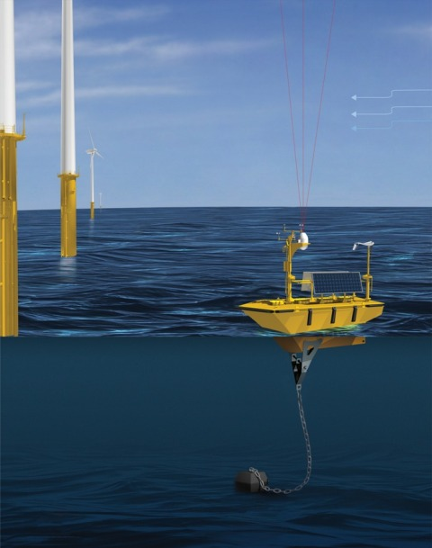
Task 1
Meteorological Tower
Meteorological Buoy
Offshore vertical LIDAR
Coastal/Offshore Scanning LIDAR
Infrared Satellite
Coastal Radar (CODAR)
Notes:
Fishermen: already deployed monitoring buoy, once done go to one 10 nm out
-purchased offshore vertical lidar, measure wind spd, dir, turbulence, deployed in June
-bought scanning lidar, deployed at end of summer
-bought wind tracer near Margate, see 10 nm offshore, in vertical
-2-3 60m met towers along coast, instrumented at 3 levels
Offshore Megawatt (German): no monitoring, rely on our study
Bluewater Wind: claim deploying monitoring sites at end of summer
Garden State Offshore Energy (part PSEG, part Deepwater Wind): vertical lidar on buoy, validate in Rhode Island, target this summer with LIDAR

Slide 6
Task 1
Offshore vertical LIDAR
Coastal/Offshore Scanning LIDAR
Notes:
Fishermen: already deployed monitoring buoy, once done go to one 10 nm out
-purchased offshore vertical lidar, measure wind spd, dir, turbulence, deployed in June
-bought scanning lidar, deployed at end of summer
-bought wind tracer near Margate, see 10 nm offshore, in vertical
-2-3 60m met towers along coast, instrumented at 3 levels
Offshore Megawatt (German): no monitoring, rely on our study
Bluewater Wind: claim deploying monitoring sites at end of summer
Garden State Offshore Energy (part PSEG, part Deepwater Wind): vertical lidar on buoy, validate in Rhode Island, target this summer with LIDAR

Slide 7
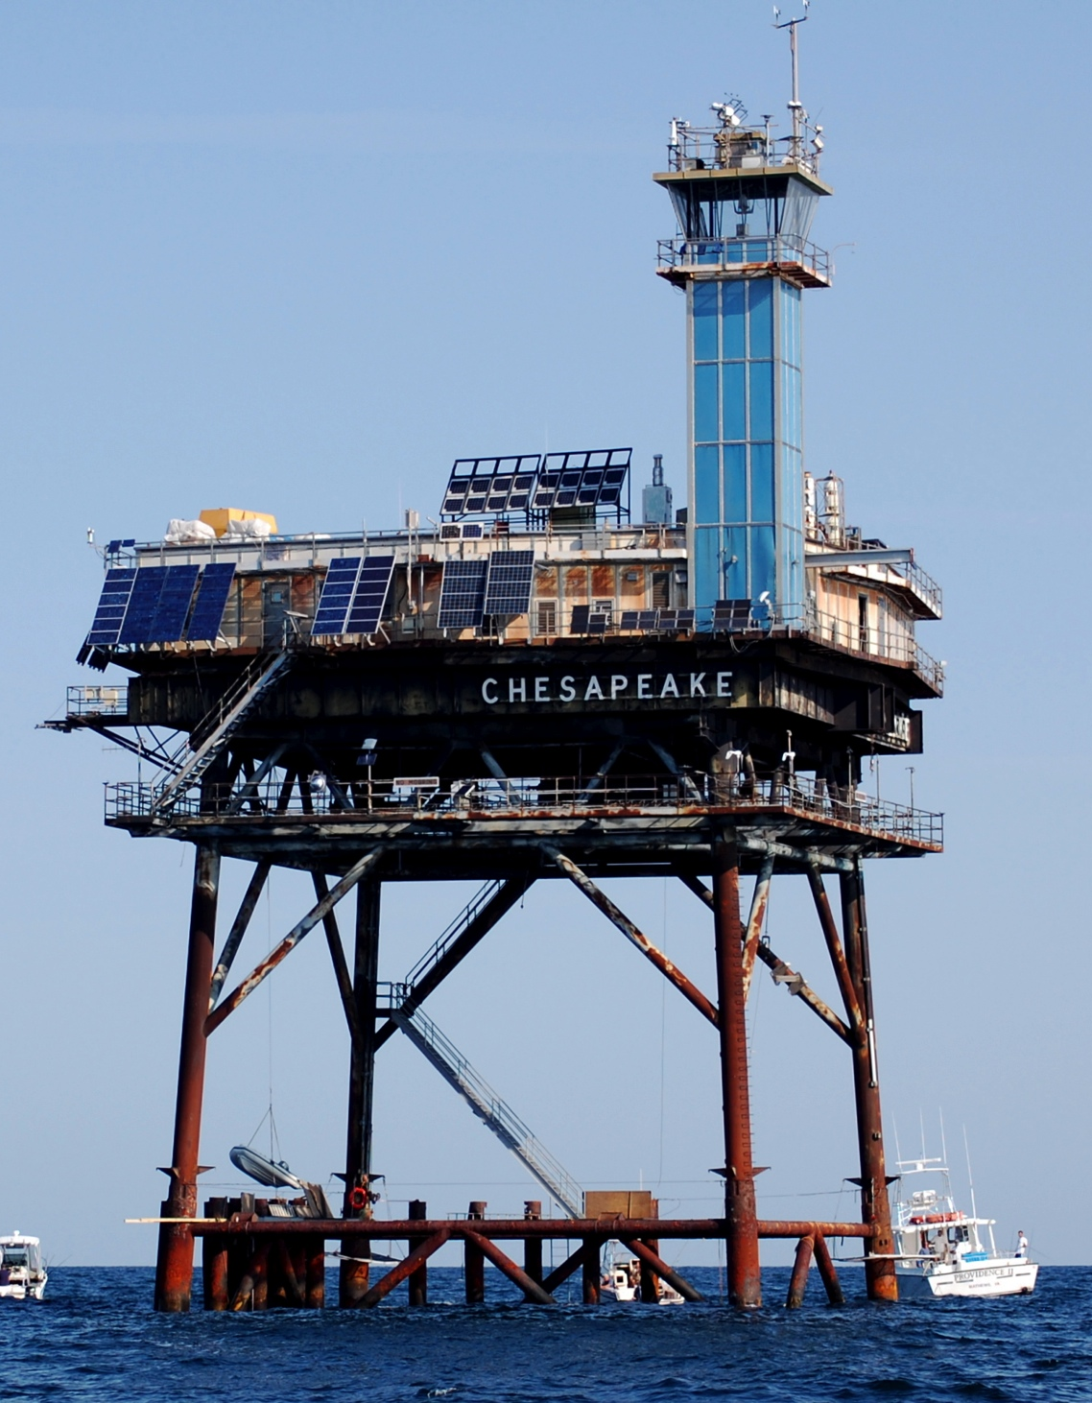
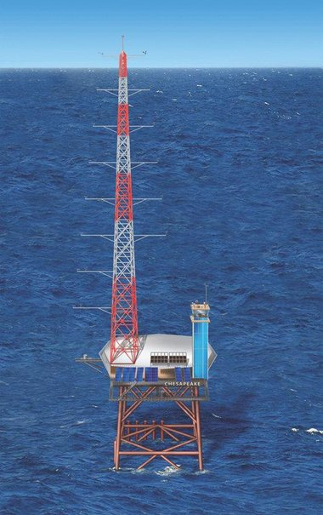
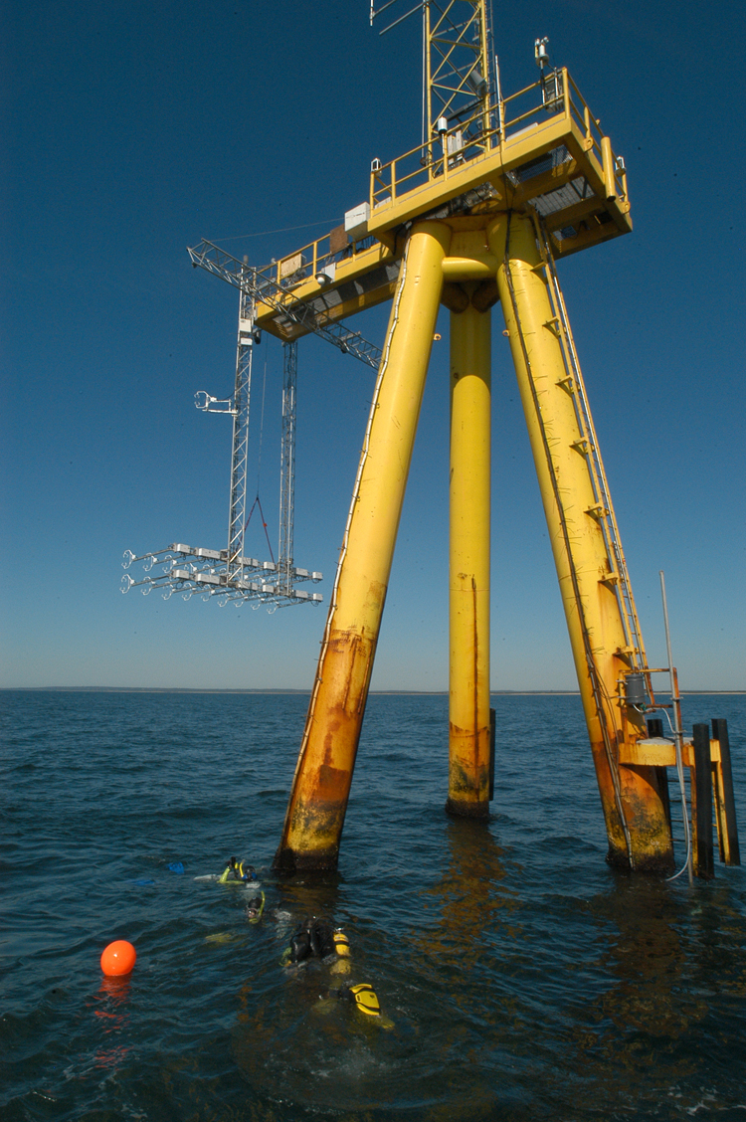
Task 1
Chesapeake Light Tower
Martha’s Vineyard ASIT
Current
Future

Slide 8
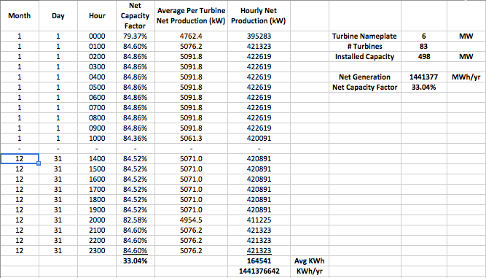
Task 2
Hourly Wind Data to RU CEEEP

Slide 9
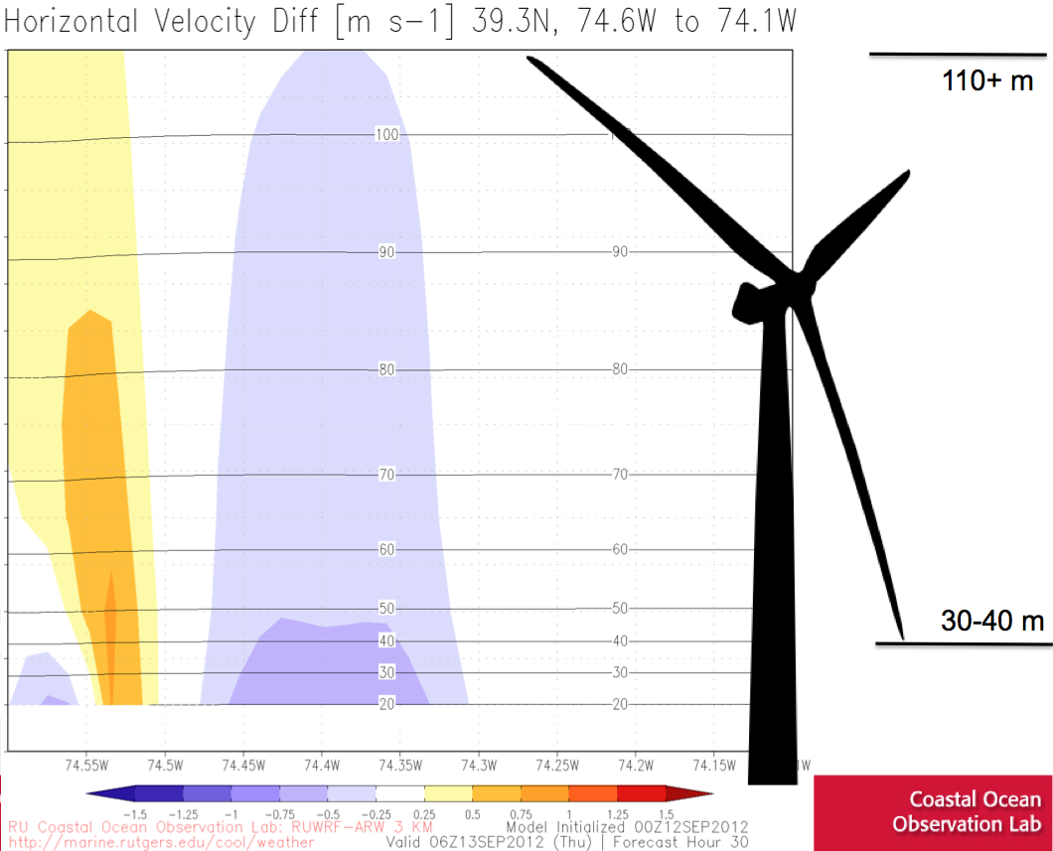
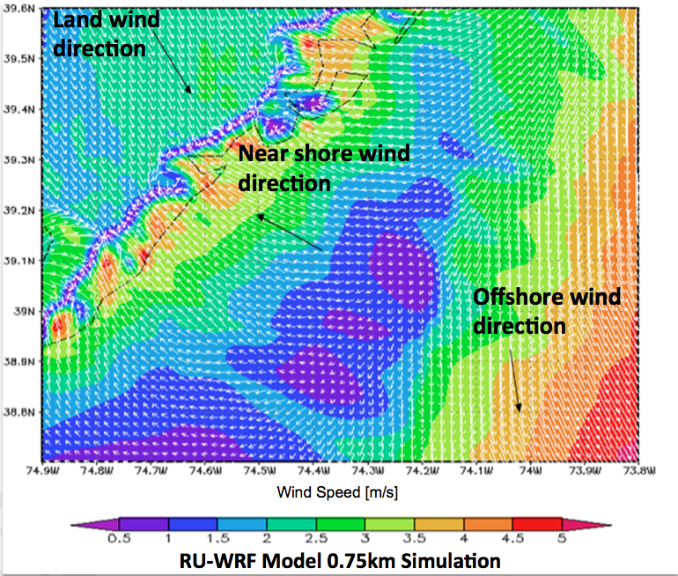
Task 3
Sea breeze and local wind analyses

Slide 10
Task 4
Couple/automate data transfer flow
3. PJM
Energy UC &
Dispatch
(Dayzer)
CEEEP
1. Hourly
Wind
Speeds
IMCS
2. Hourly
Wind
Turbine
Energy
Production
(MWh)
IMCS
Other Inputs:
Turbine size, manufacturer and power curve (relationship between wind speed (and other factors?) and power production)
Turbine location and wake effect
Size of wind farm (MW)
Injection point(s) into electricity grid (radial and with AWC)

Slide 11
Task 5
Scenarios of Possible Severe Weather Events (IMCS)
Engineering-Economic Cost-benefit Analysis of Utility Hardening (CEEEP & Engineering Subcontractor)
Characterization of NJ Macro-economic Impacts (RECON)
Severe Weather Analyses
Hurricane Sandy
“What If” Scenarios
Landfall in August
Landfall at Delmarva Peninsula
  NJ Nuclear plant concerns

Slide 12
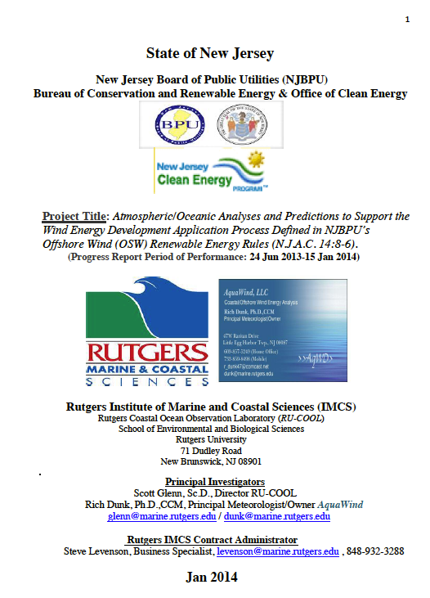
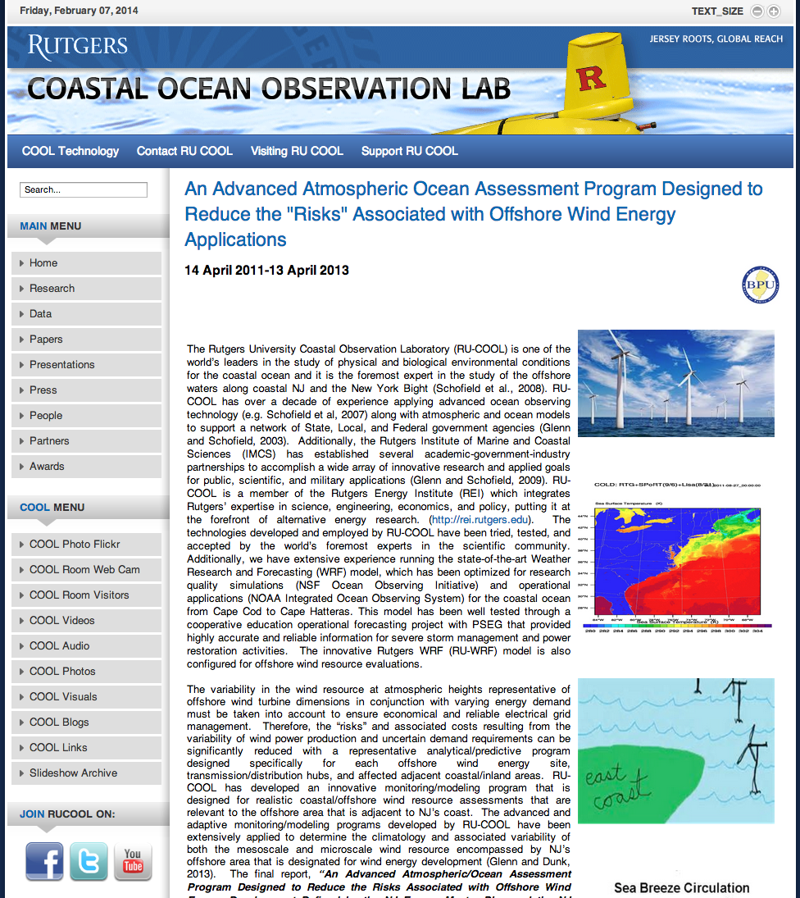
Tasks 6 and 7
Reports, talks, meetings, calls
Progress Reports
Website, Presentations, Meetings

