Slide 1
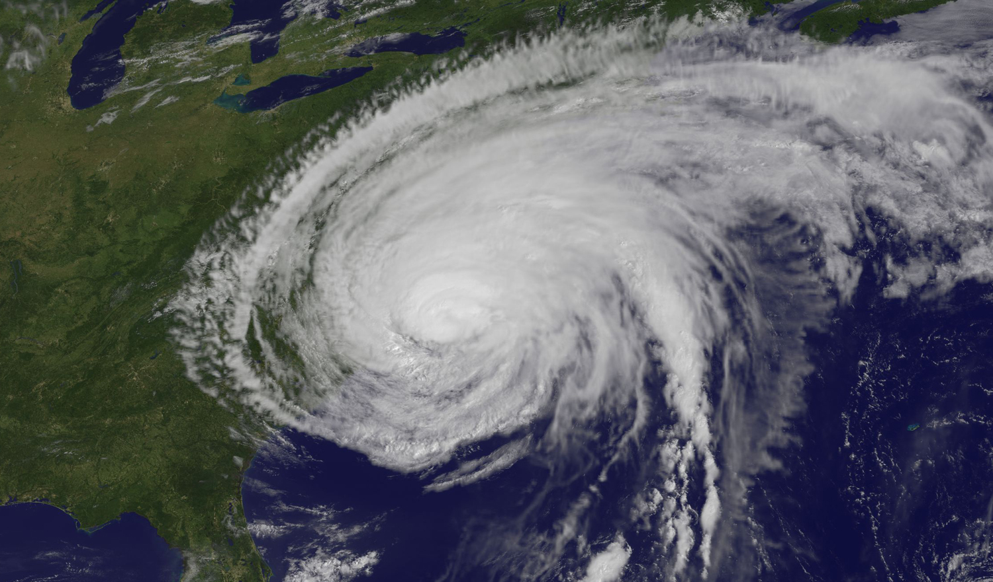
Impact of simple parameterizations of upper ocean heat content on modeled Hurricane Irene (2011) intensity
Greg Seroka, Scott Glenn, Travis Miles, Yi Xu, Oscar Schofield, Josh Kohut
Rutgers University Coastal Ocean Observation Lab
January 30, 2014
HWRF
Image Credit: NASA/NOAA GOES Project

Slide 2
Motivation

Slide 3
Controls on TC Intensity
And setup of Irene experiment (no data assimilation)
Track (incl. land surface characteristics)
Use best boundary conditions for good track (8/27/11 06Z GFS 0.5 degree)
Emanuel et al. (2004)
Notes:
-Track = experimental control

Slide 5
Controls on TC Intensity
And setup of Irene experiment (no data assimilation)
Track (incl. land surface characteristics)
Use best boundary conditions for good track (8/27/11 06Z GFS 0.5 degree)
Vertical Wind Shear
Validate against upper air observations (TBD)
Dry air intrusion
Validate against water vapor satellite imagery (TBD)
Emanuel et al. (2004)

Slide 6
GOES 13 Channel 3

Slide 7
Controls on TC Intensity
And setup of Irene experiment (no data assimilation)
Track (incl. land surface characteristics)
Use best boundary conditions for good track (8/27/11 06Z GFS 0.5 degree)
Vertical Wind Shear
Validate against upper air observations (TBD)
Dry air intrusion
Validate against water vapor satellite imagery (TBD)
Upper-ocean thermal structure (and evolution)
Assumption is—for Irene—models handled #1-3 to some degree (TBD), but not #4 (and Irene was over-forecast)
Emanuel et al. (2004)

Slide 8
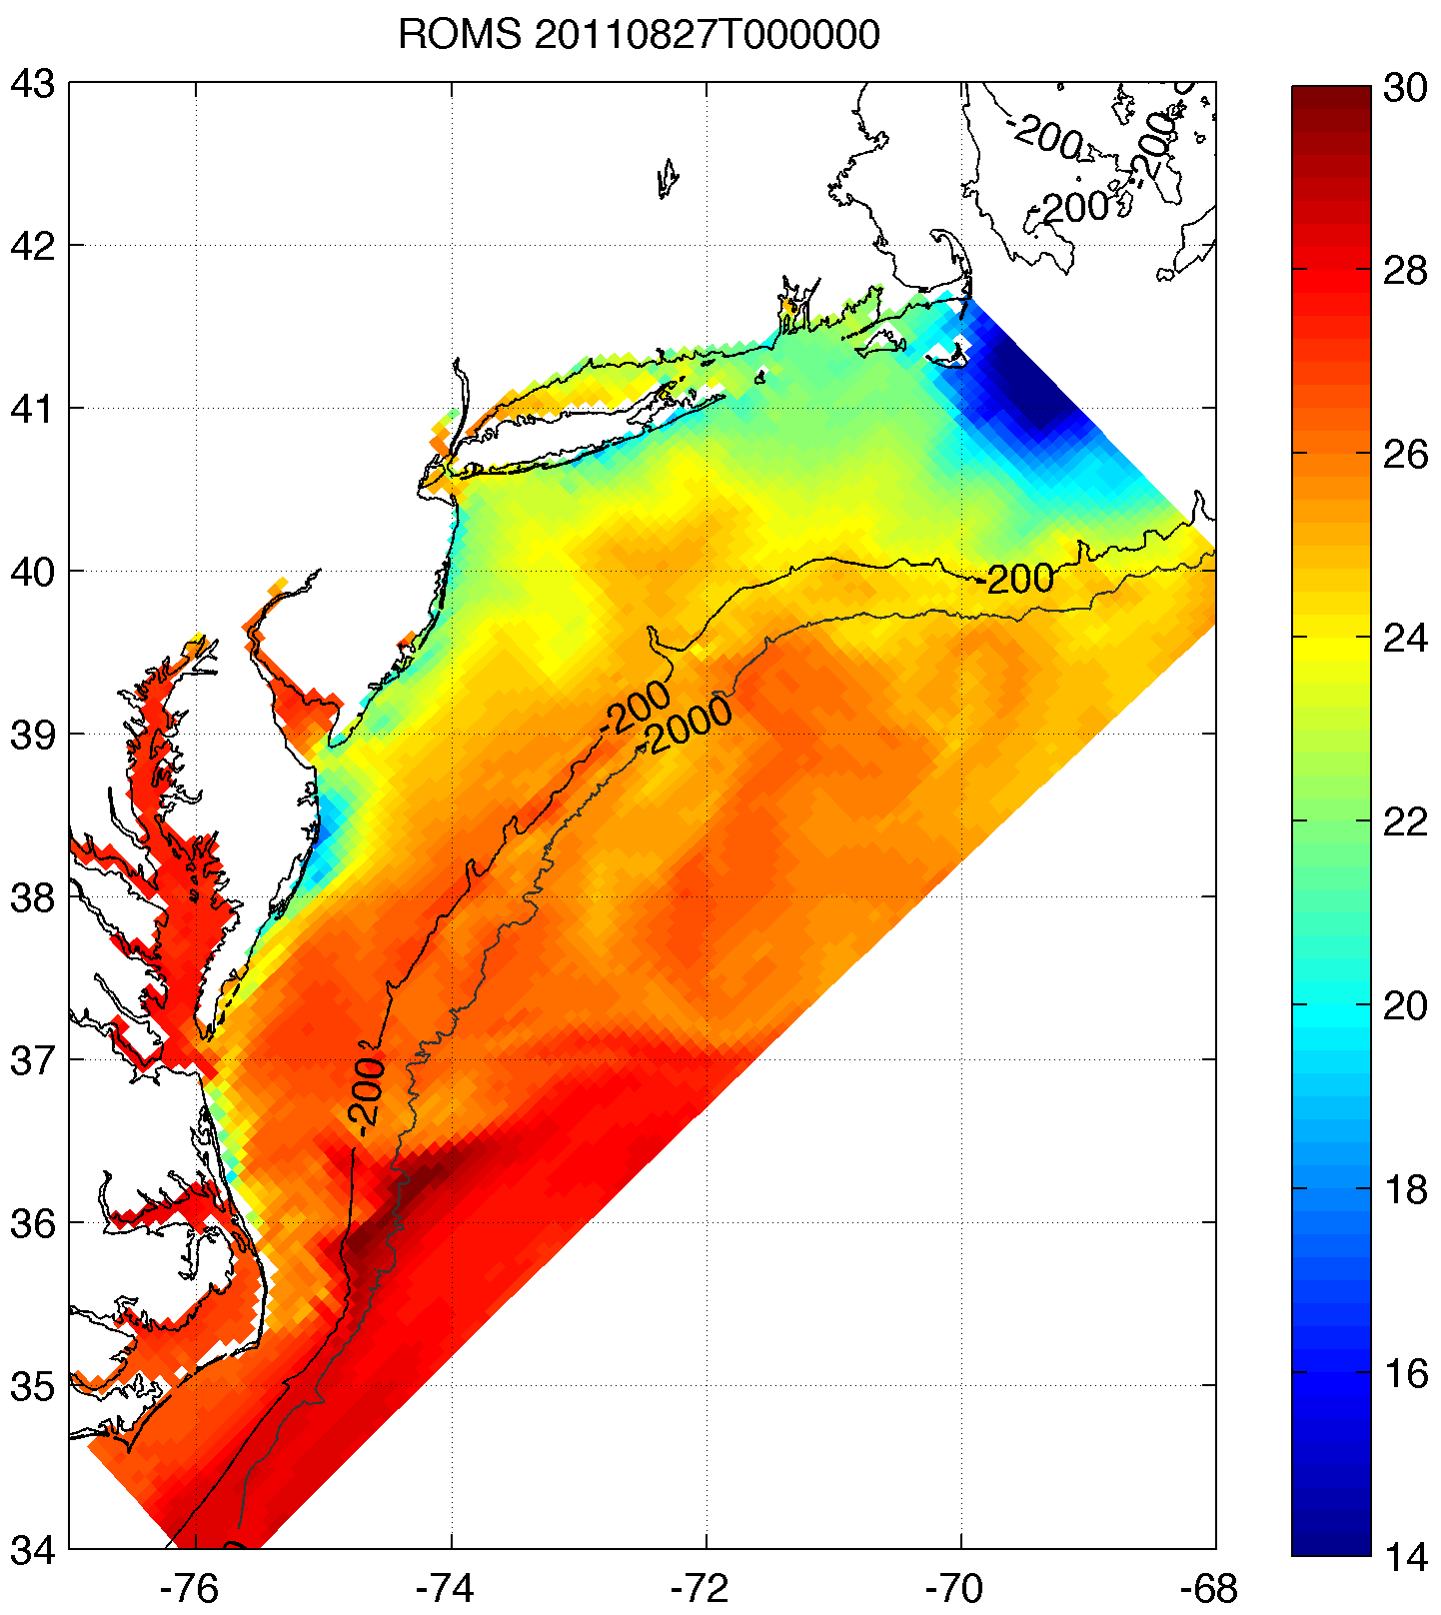
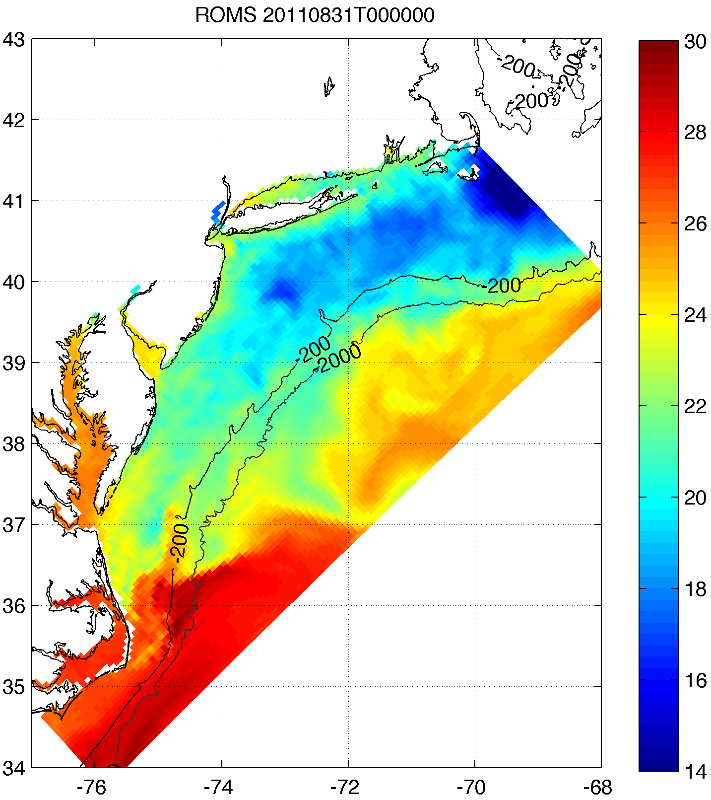
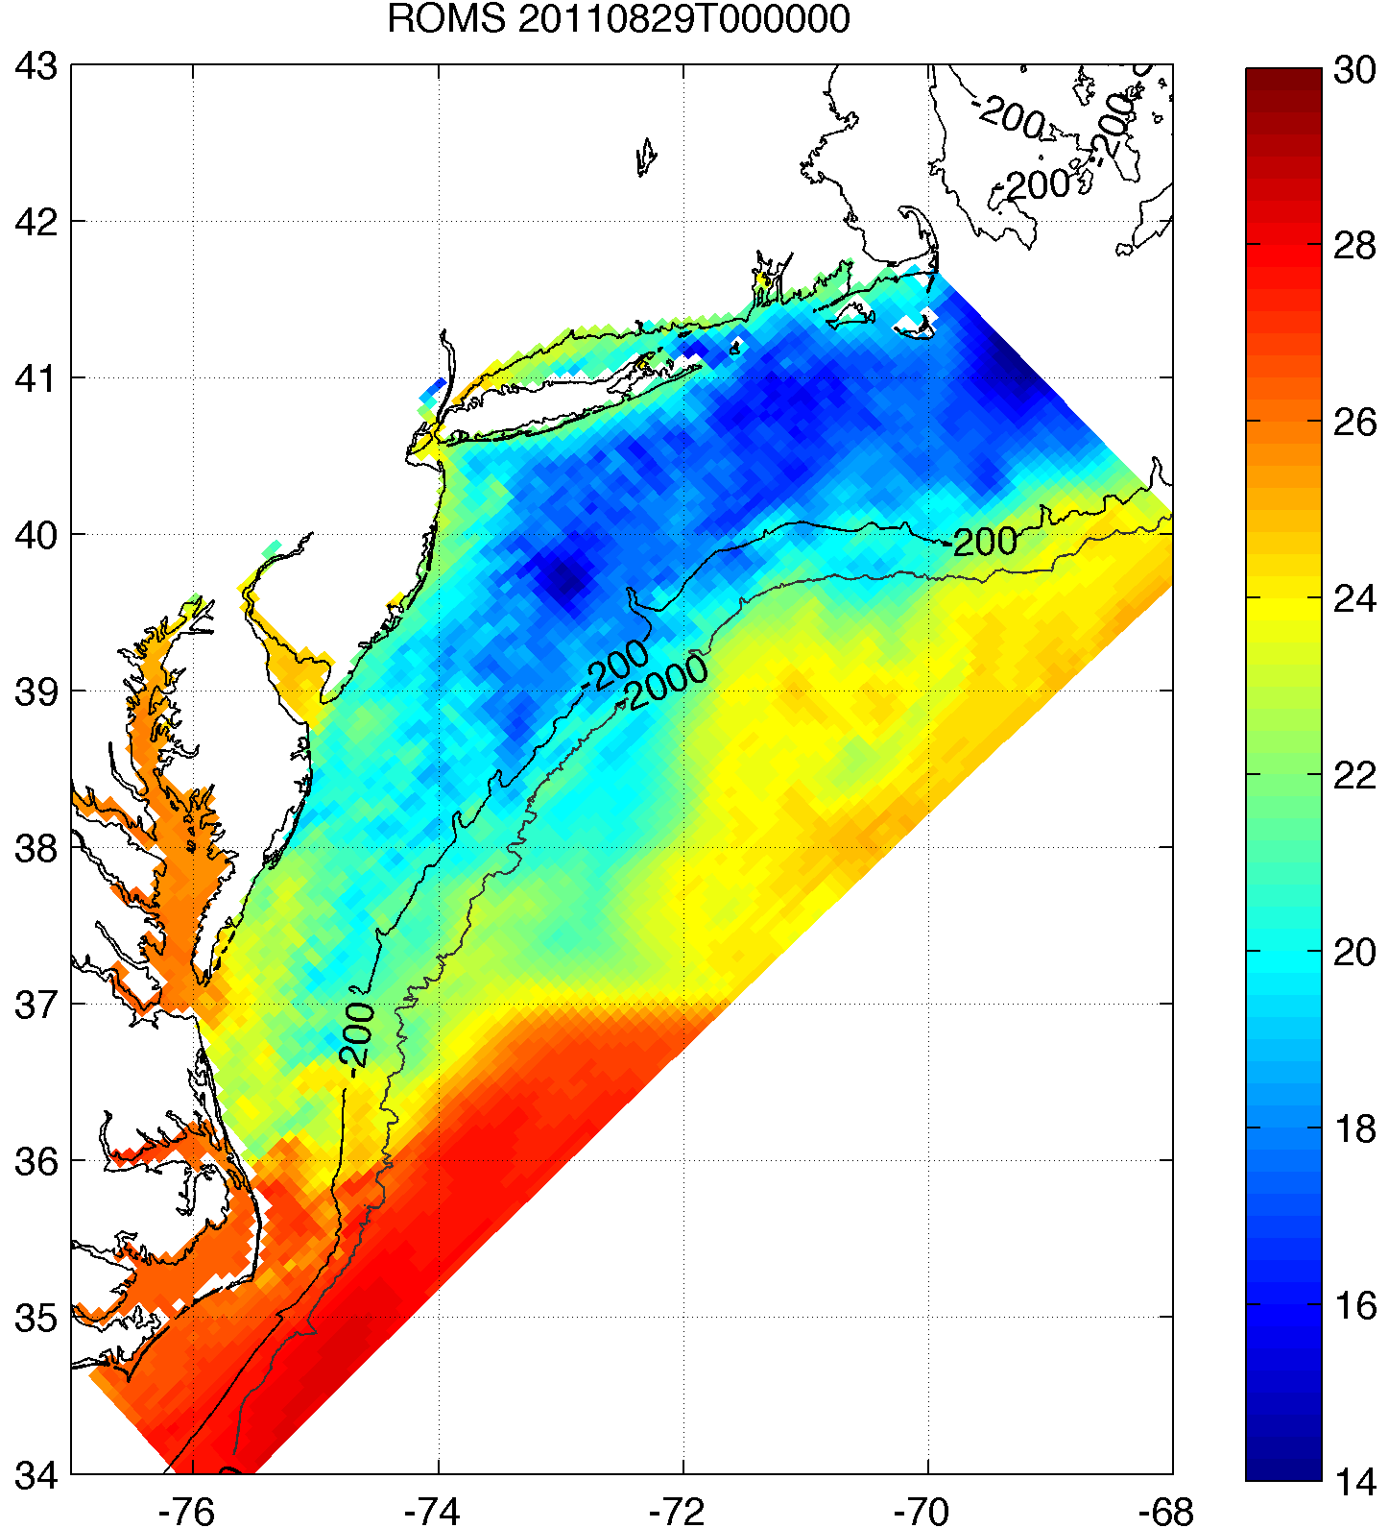
Rutgers
Before
RTG HR (NAM) Before
HWRF-POM
Before
HWRF-HYCOM
Before
ROMS ESPreSSO
Before
Rutgers
After
RTG HR (NAM) After
HWRF-POM
After
HWRF-HYCOM
After
ROMS ESPreSSO
After
Sea Surface Temperature (SST) Comparison
(ROMS ESPreSSO
Right After)
Does not match dates above (clouds did not clear) but shows most cooling
Notes:
-NAM uses fixed warm (RTG) SST
-Even coupled HWRF doesn’t get cooling correct

Slide 9
Rutgers Before
RTG HR (NAM) Before
HWRF-POM
Before
HWRF-HYCOM
Before
ROMS ESPreSSO
Before
Rutgers After
RTG HR (NAM) After
HWRF-POM
After
HWRF-HYCOM
After
ROMS ESPreSSO
After
Sea Surface Temperature (SST) Comparison
(ROMS ESPreSSO
Right After)
Rutgers and RTG on POM grid
Does not match dates above (clouds did not clear) but shows most cooling
Notes:
-NAM uses fixed warm (RTG) SST
-Even coupled HWRF doesn’t get cooling correct

Slide 10
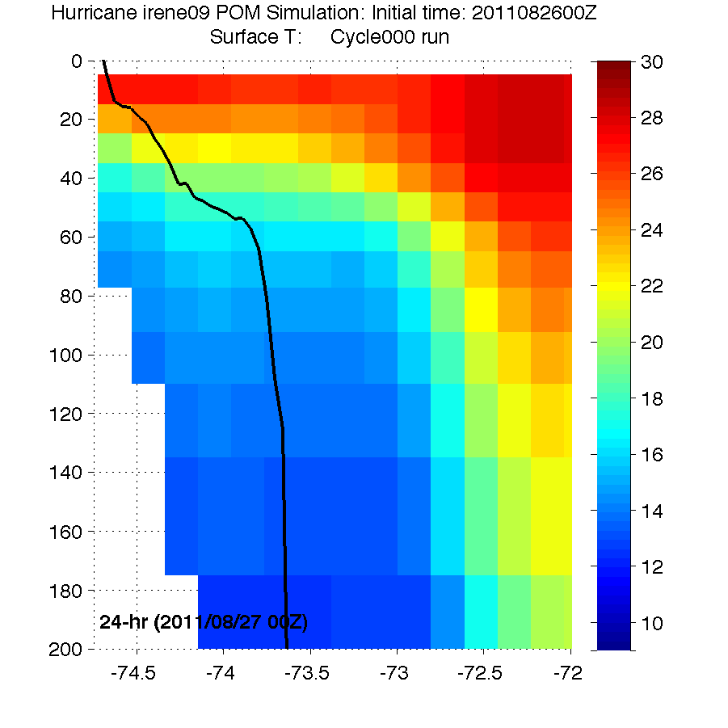
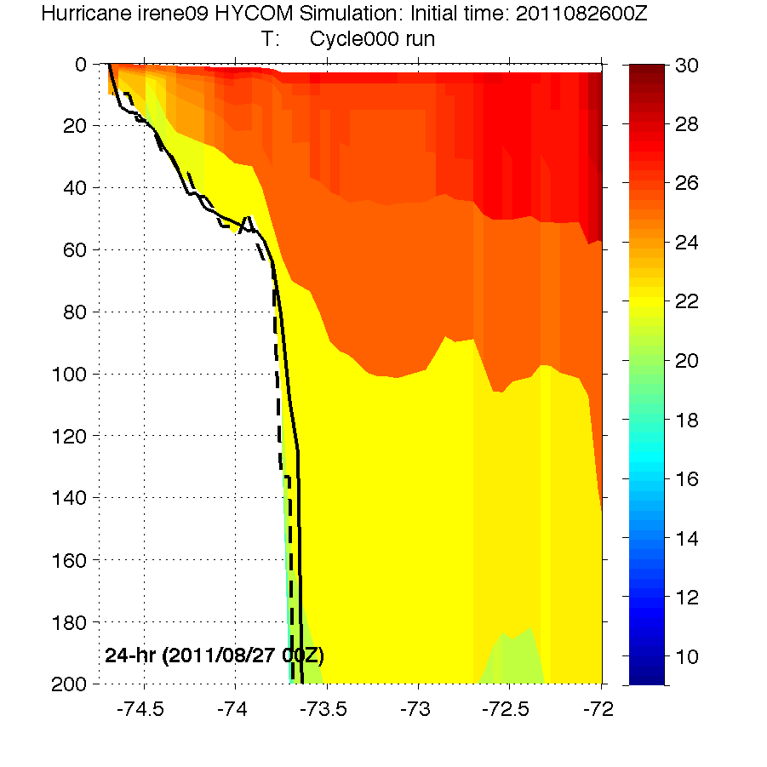
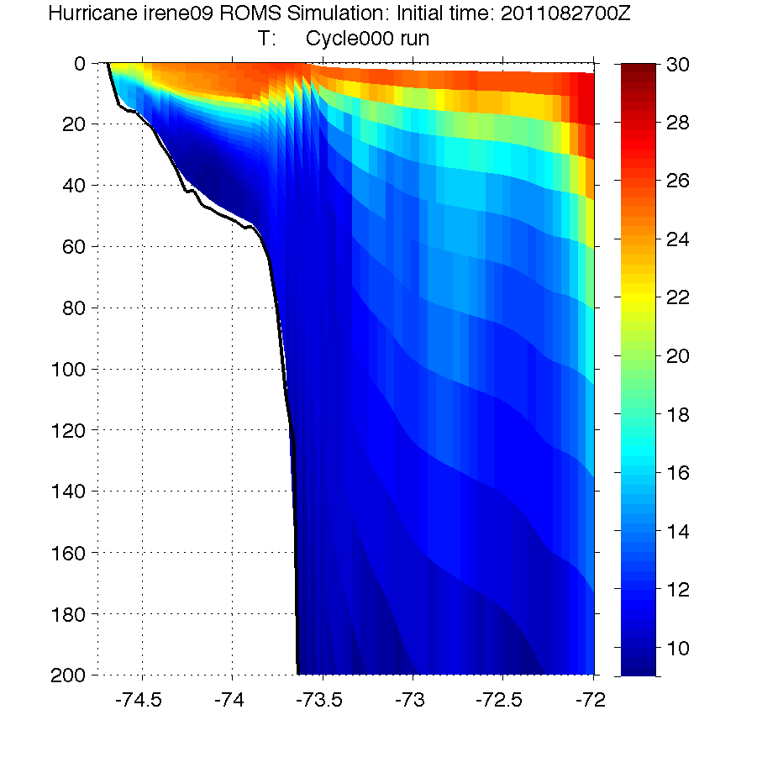
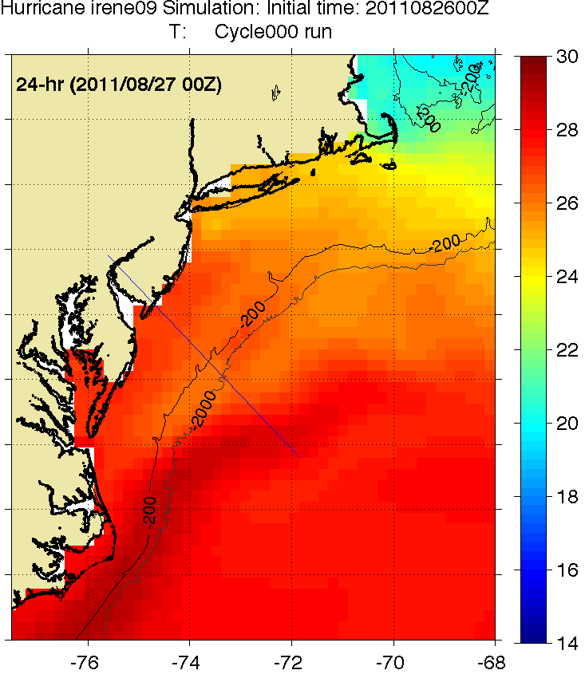
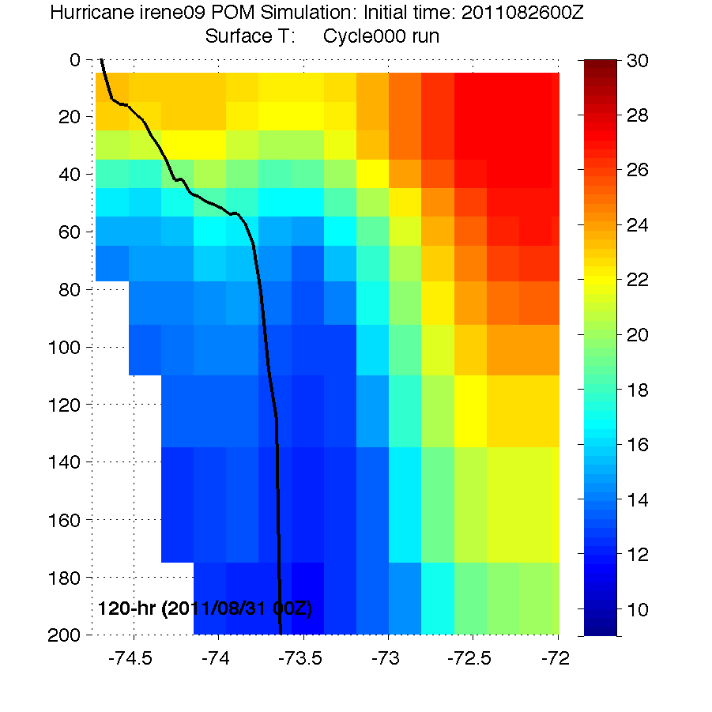
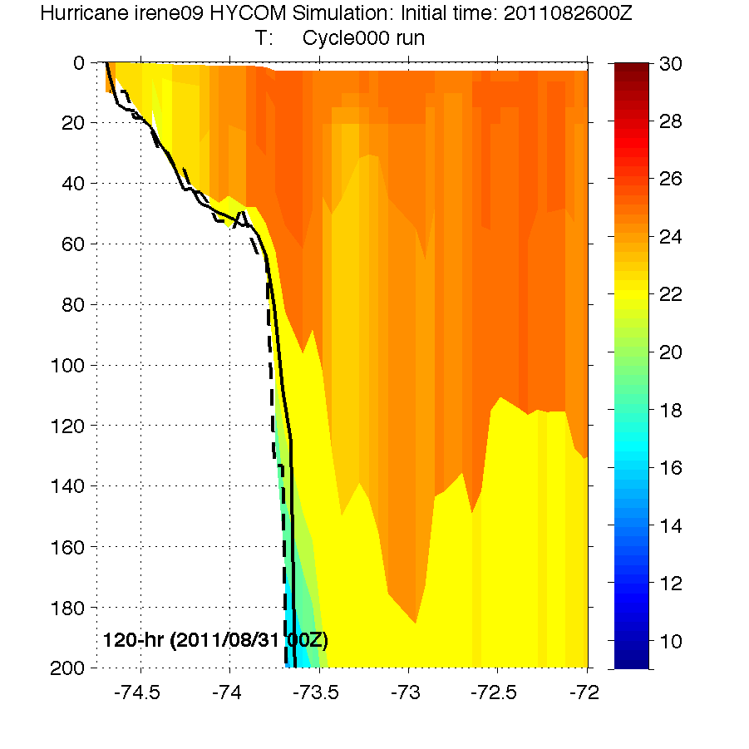
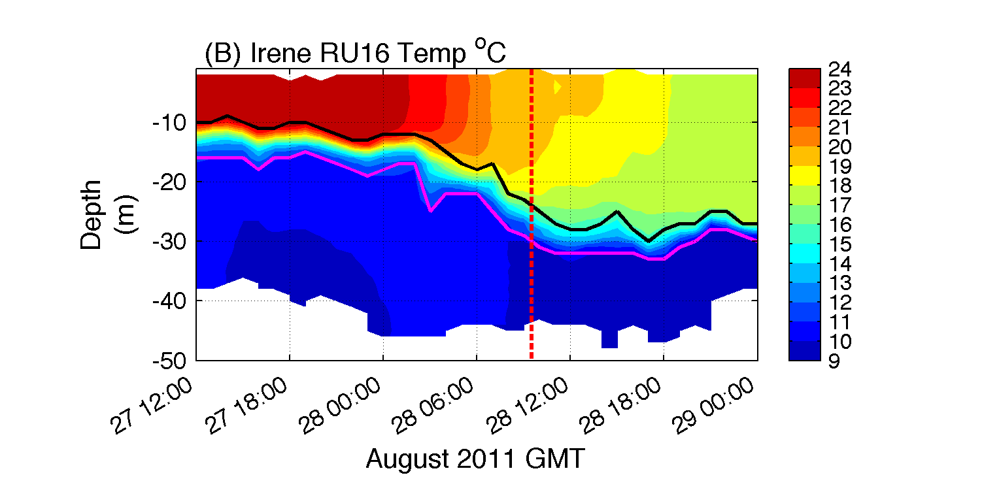
Cross-shelf Transects
HWRF-POM
Before
HWRF-HYCOM
Before
ROMS ESPreSSO
Before
HWRF-POM
After
HWRF-HYCOM
After
Observed bathymetry from NOAA National Geophysical Data Center, U.S. Coastal Relief Model, Retrieved date goes here, http://www.ngdc.noaa.gov/mgg/coastal/crm.html
Notes:
Note that the glider colorbar range is 9 to 24

Slide 11
Observations of Mixing and Surface Cooling

Slide 12
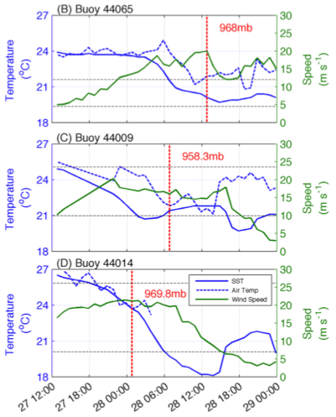
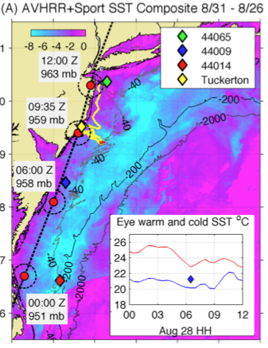
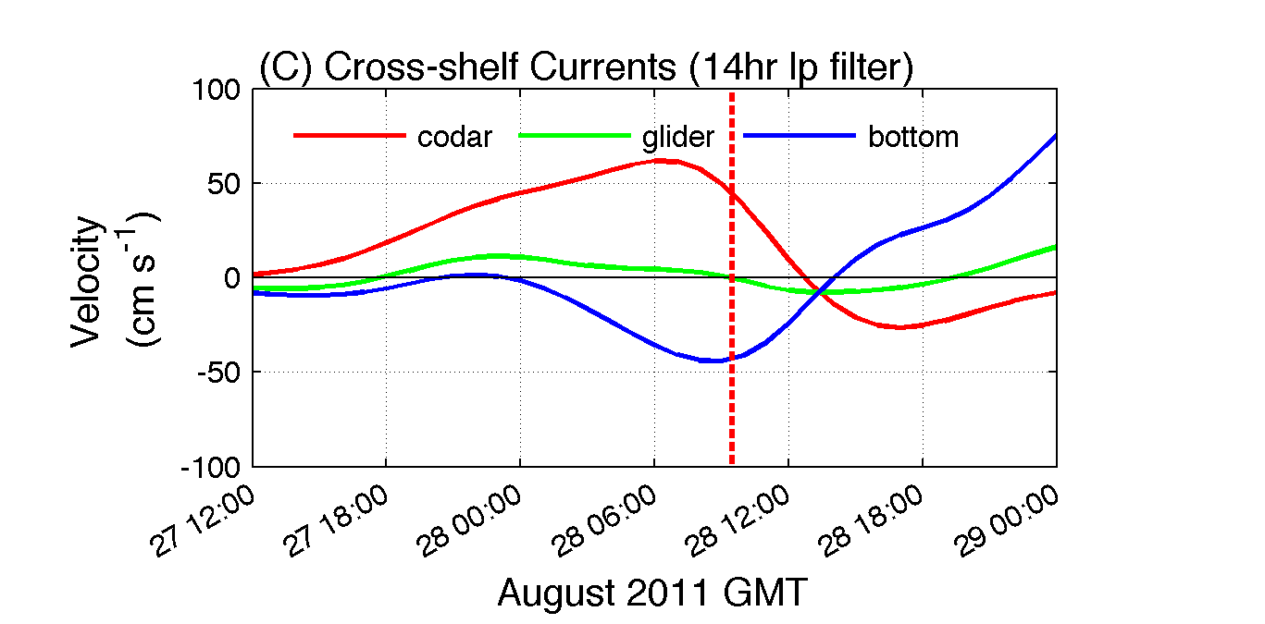
Timing of surface cooling:
ahead of eye passage
At surface
Below surface

Slide 13
Sensitivity Study: Impact of pre-storm SST cooling on intensity

Slide 14
Simple Uncoupled WRF Hindcast Sensitivities: SST Setup
Modify SST input to “simulate” SST cooling:
From fixed warm pre-storm SST (e.g. NAM, GFS) to what?
2 methods to determine optimal timing of SST cooling:
When did models show mixing in southern MAB?
When did “critical mixing” wind speed occur in southern MAB? (Critical mixing w.s. = w.s. observed at buoys and modeled at glider when sea surface cooled). Assumes similar stratification across MAB.
Cooling Time = 8/27 ~10:00 UTC
Model Init. Time = 8/27 06:00 UTC
∴ Used fixed cold post-storm SST
Notes:
-not much mixing occurred in SAB

Slide 15
Explanation of Air-Sea Flux Changes in WRF
τ = -ρu*² = -ρC_{D}U² momentum flux (τ)
H = -ρc_{p}u*θ* = -(ρc_{p})C_{H}UΔθ sensible heat flux (H)
E = -ρL_{ν}u*q* = -(ρL_{ν})C_{Q}UΔq latent heat flux (E)
ρ: density of air
(u*,θ*,q*): friction velocity, surface layer temperature and moisture scales
U: 10m wind speed
c_{p}: specific heat capacity of air, L_{ν}: enthalpy of vaporization
Δ(θ,q): temperature, water vapor difference between z_{ref}=10m and z=sfc In neutrally stable surface layer within TC eyewall (e.g. Powell et al. 2003):
C_{D} = k²/[ln(z_{ref} ⁄ z₀)]² drag coefficient
C_{H} = (C_{D}^{½} ) X [k/ln(z_{ref} ⁄ z_{T})] sensible heat coefficient
C_{Q} = (C_{D}^{½} ) X [k/ln(z_{ref} ⁄ z_{Q})] latent heat coefficient
C_{k} = C_{H} + C_{Q} moist enthalpy coefficient
k: von Kármán constant
z_{ref}: (usually 10m) reference height
Our Changes in SST:
Δθ = θ_{(2 or 10m)} – θ_{sfc} (θ∝T)
Δq = q_{(2 or 10m)} – q_{sfc}
∴Δ(SST)→Δθ_{sfc}→Δθ→ΔH (sensible heat flux)
Δ(SST)→(indirectly)Δq_{sfc}→Δq→ΔE (latent heat flux)
WRF isftcflx | z₀: momentum roughness length | z_{T}: sensible heat roughness length | z_{Q}: latent heat roughness length | Dissipative heating?
0 | z₀ = 0.0185u*²⁄g + 1.59E-5 Charnock (1955) | z₀ | z_{Q} = (z₀⁻¹ + ku*K_{a}⁻¹)⁻¹ Carlson & Boland (1978) | No
1 | See Green & Zhang (2013) for eq. Powell (2003), Donelan (2004) | 10⁻⁴ m | 10⁻⁴ m Large & Pond (1982) | Yes
2 | Same as z₀ for Option 1 Powell (2003), Donelan (2004) | z_{T} = z₀exp[k(7.3Re*^{¼}Pr^{½}-5)] Brutsaert (1975) | z_{Q} = z₀exp[-k(7.3Re*^{¼}Sc^{½}-5)] Brutsaert (1975) | Yes
K_{a}= 2.4E-5 m²s⁻¹ (background molecular viscosity)
Re* = u*Z₀ ⁄ν (Roughness Reynolds number), Pr = 0.71 (Prandtl number), Sc = 0.6 (Schmidt number)
After Green & Zhang (2013)

Slide 16
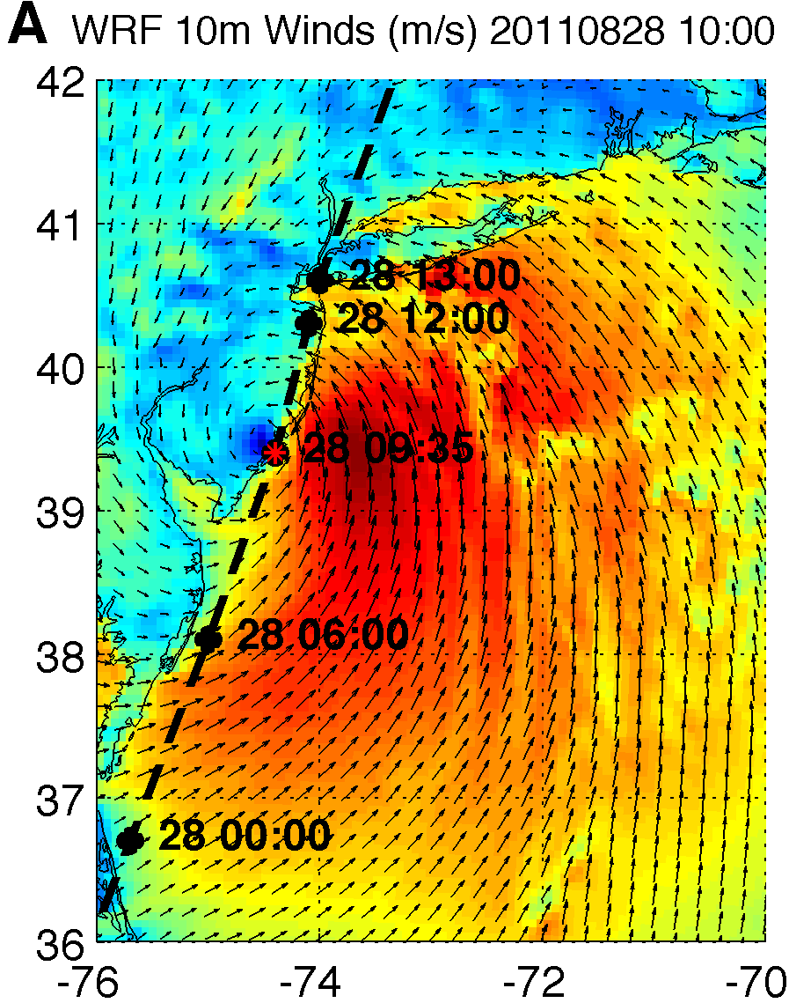
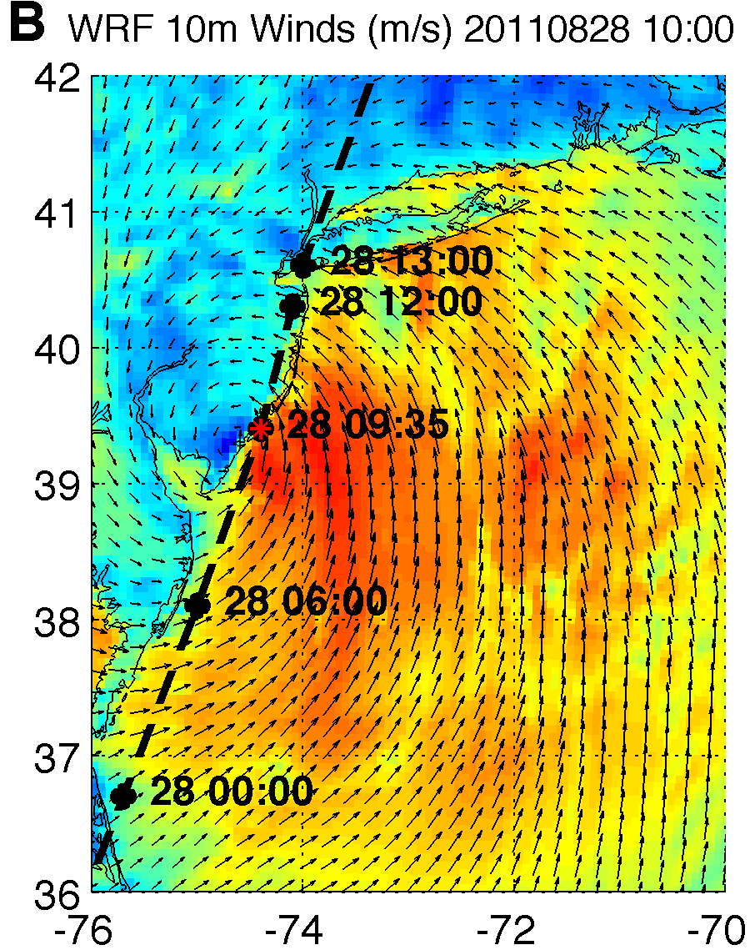
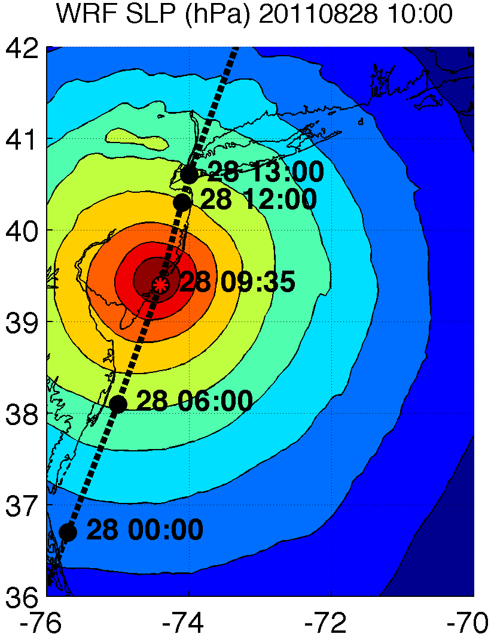
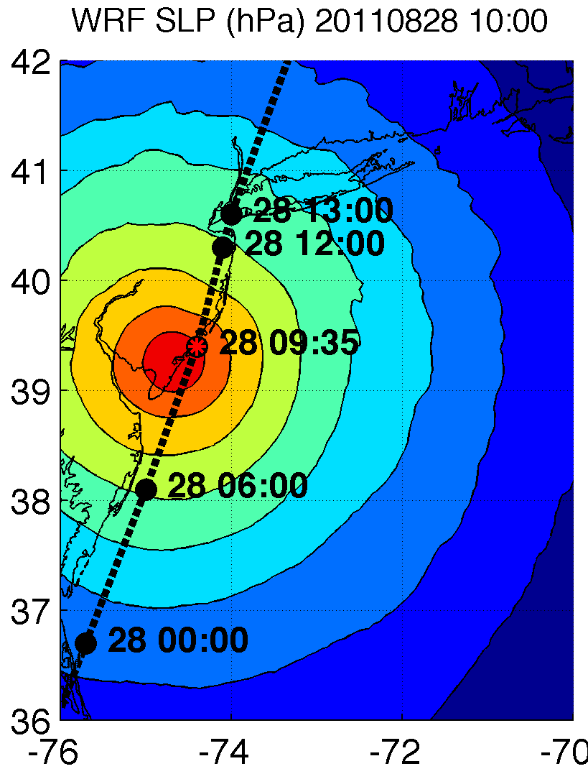
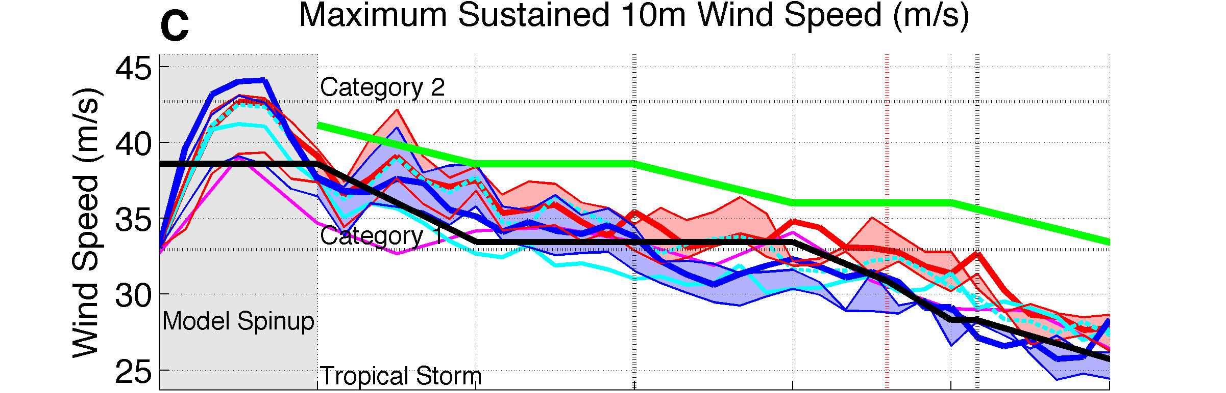
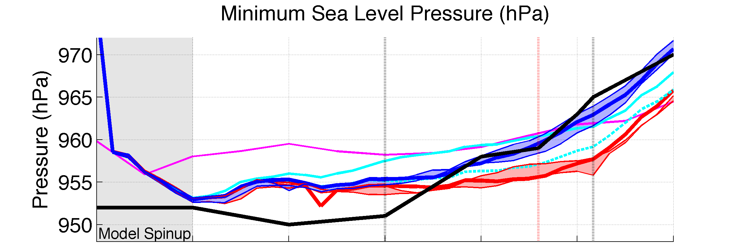
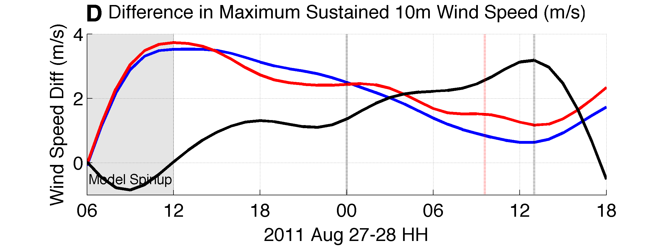
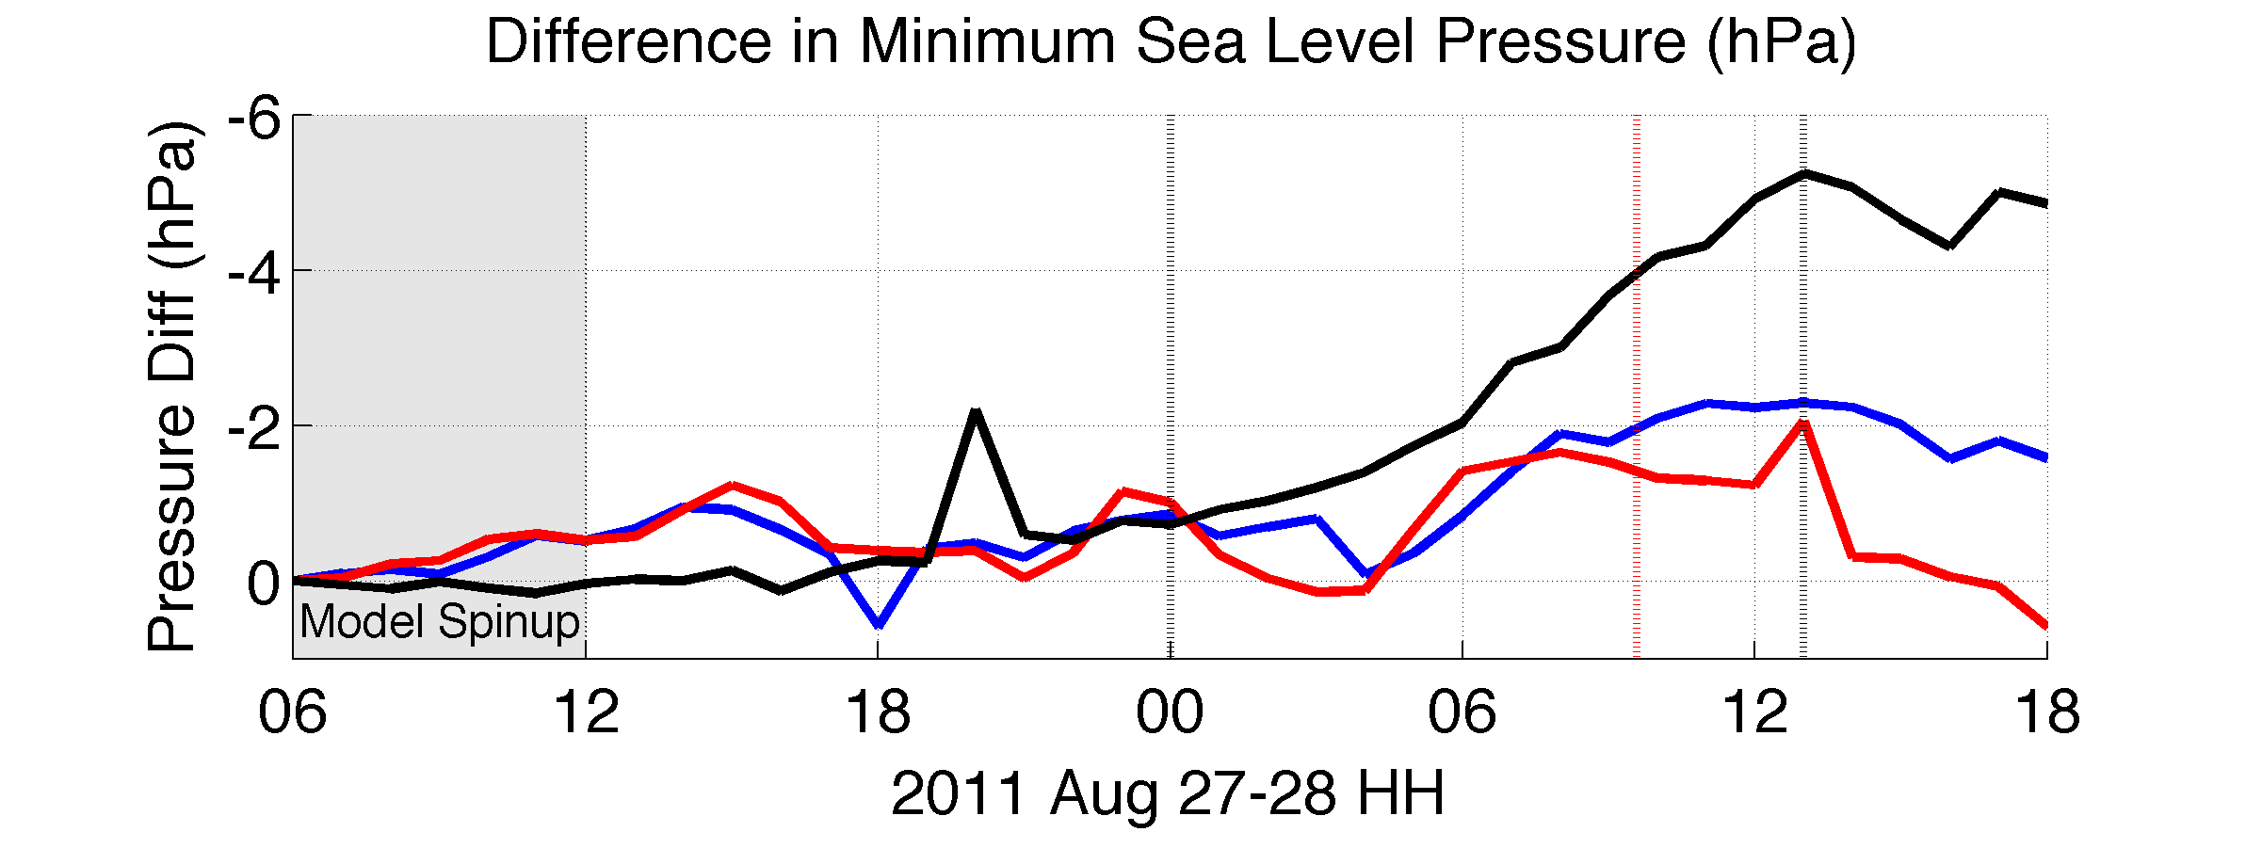
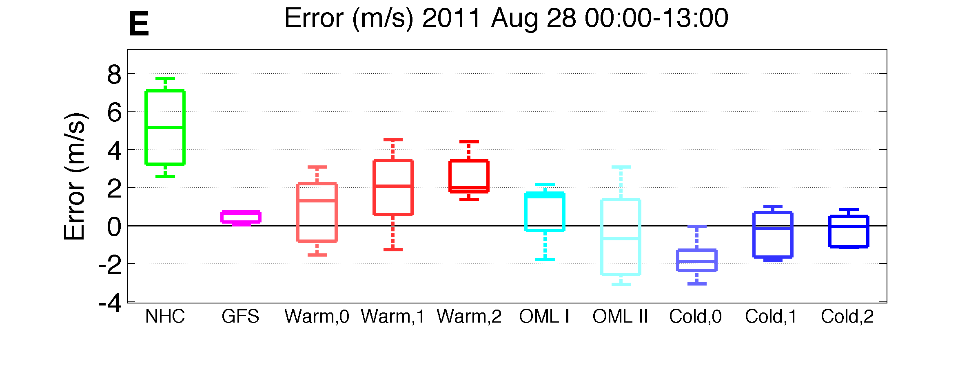
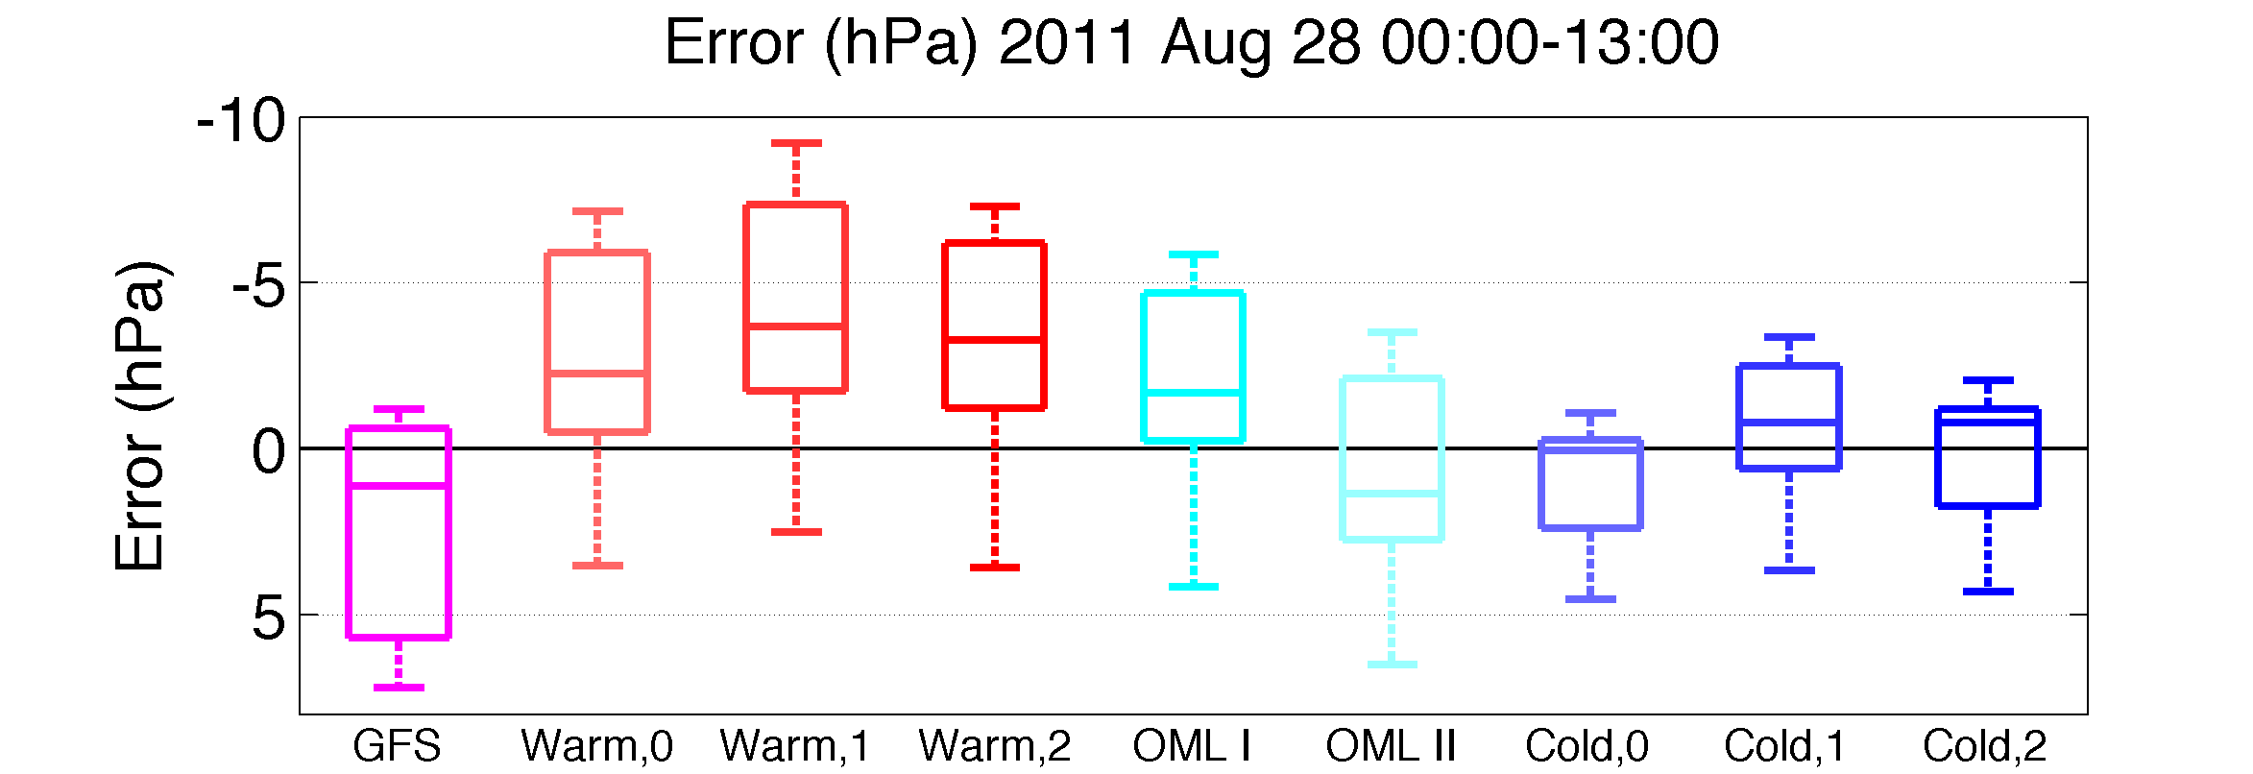
Results:
Notes:
Can provide model setup parameters for WRF runs (namelist) if requested

Slide 17
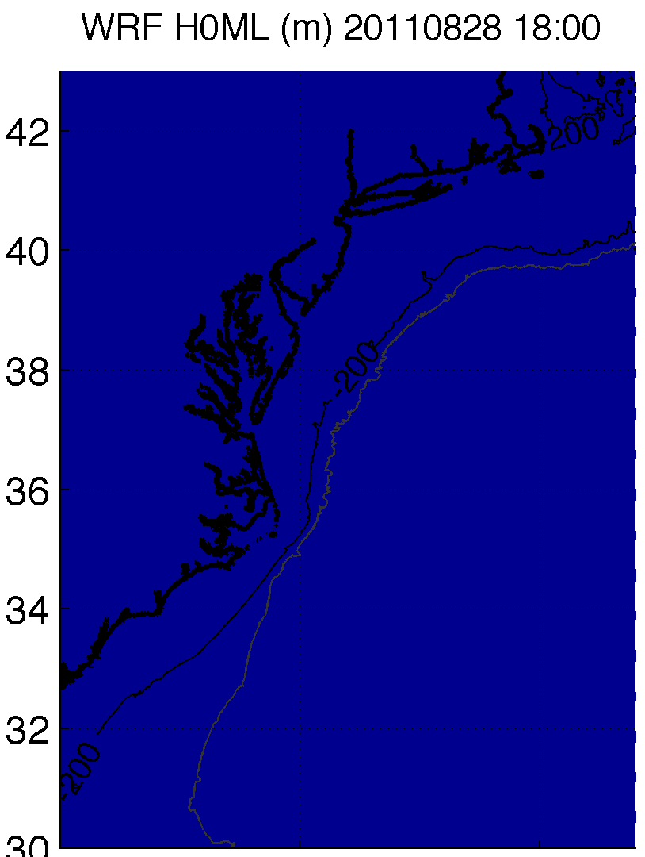
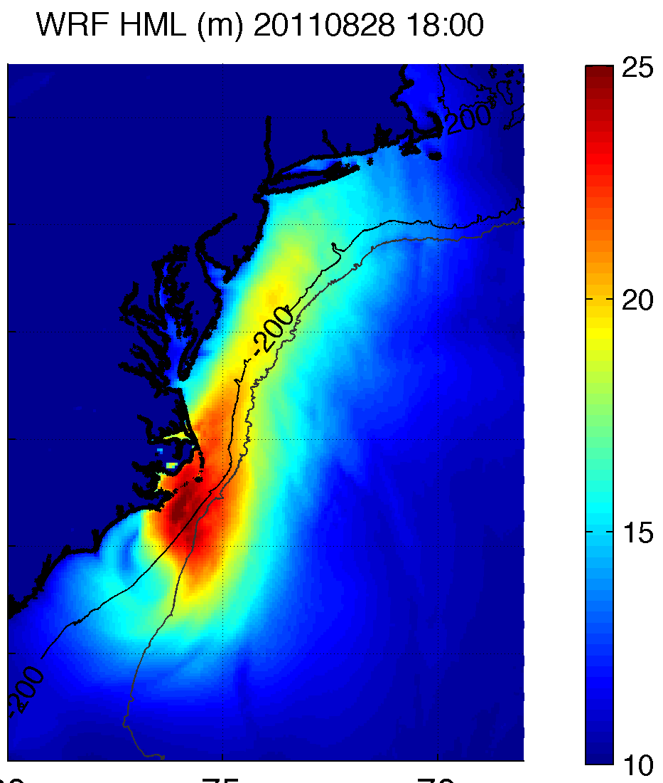
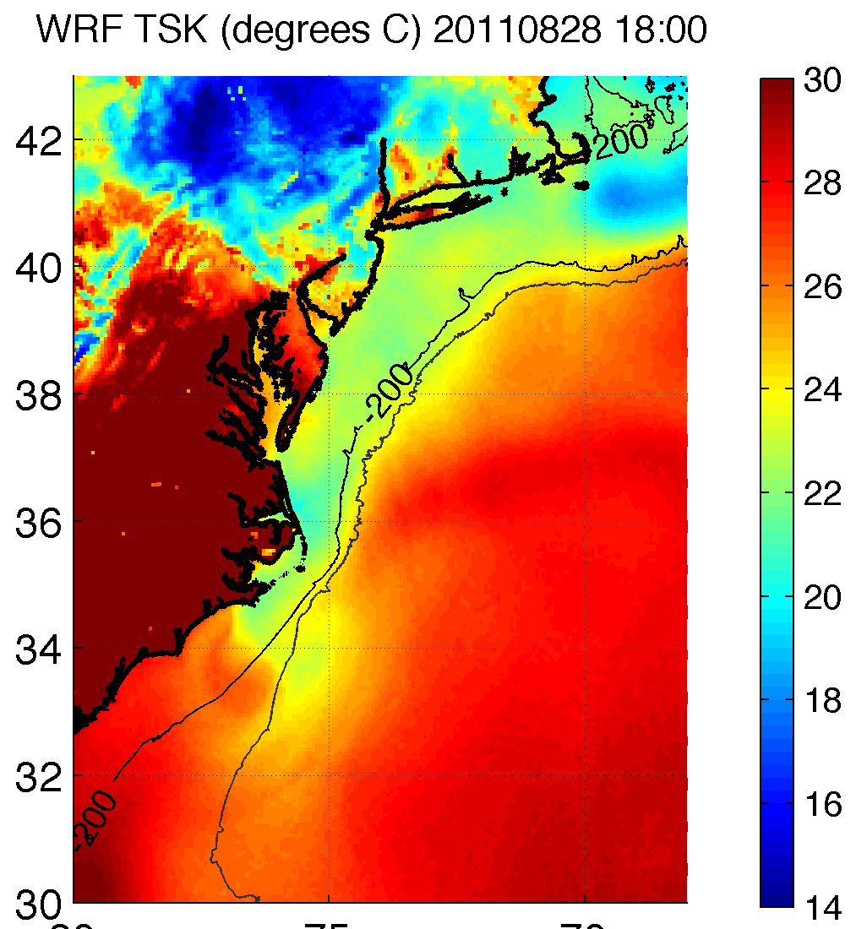
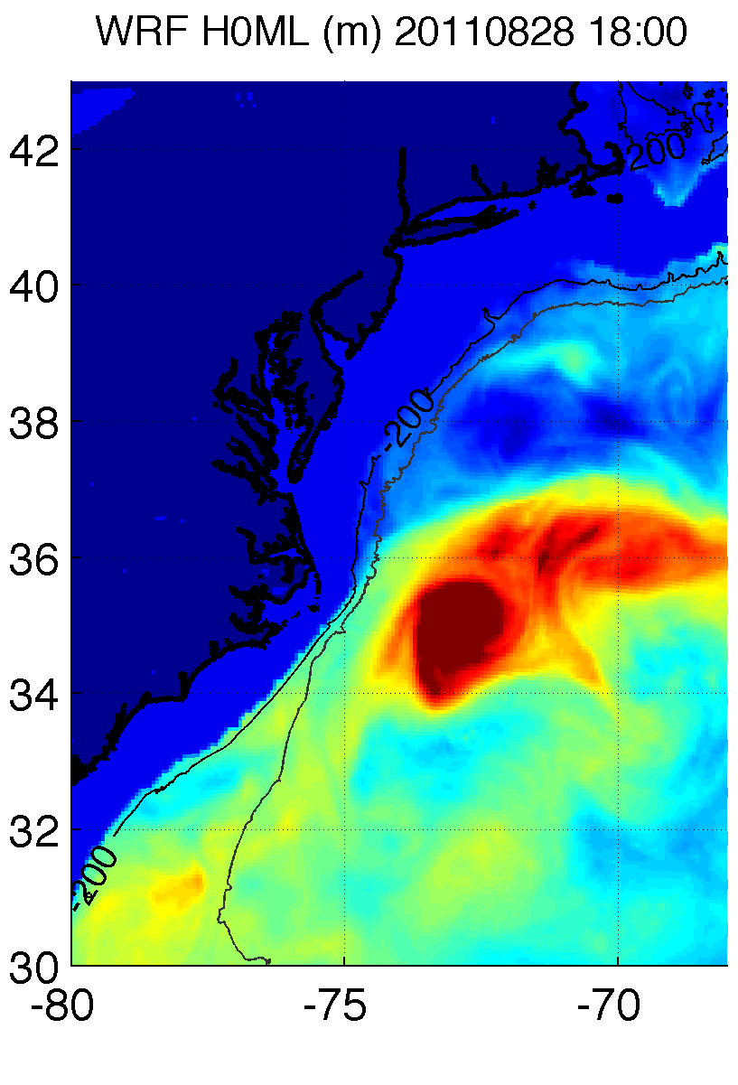
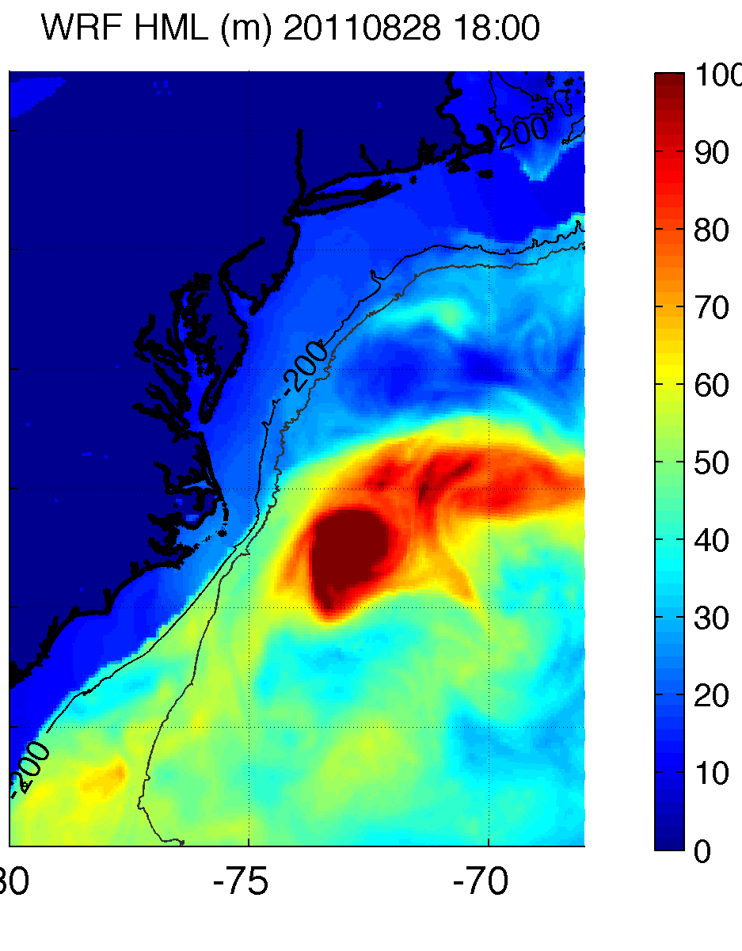
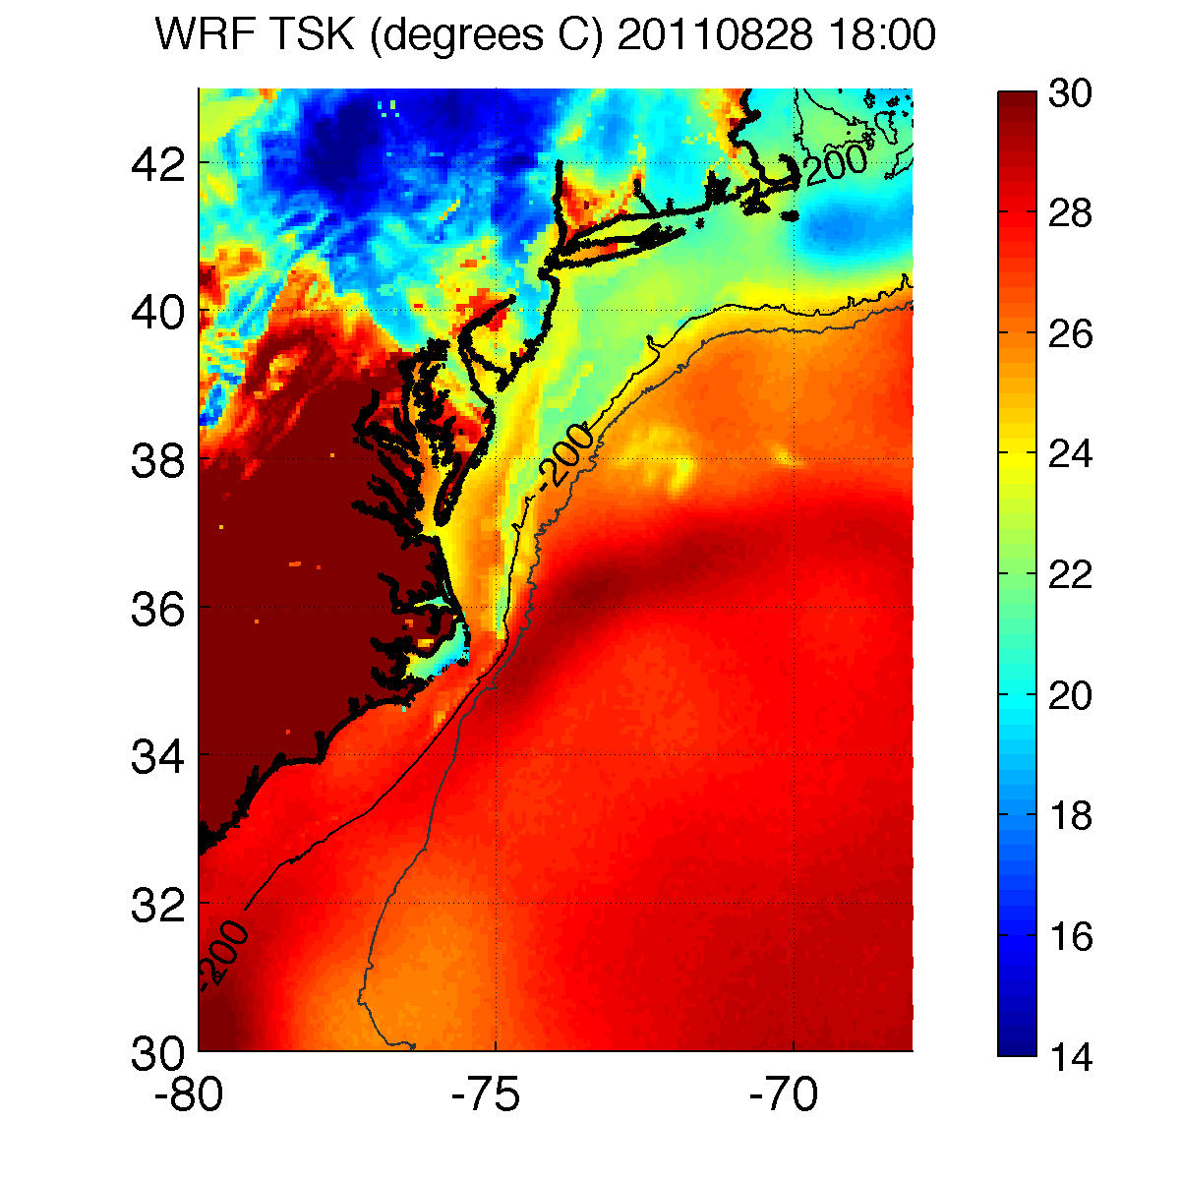
H0ML = 10m
Gamma = 1.6C/m
H0ML from HYCOM
Gamma = 1.6C/m

Slide 18
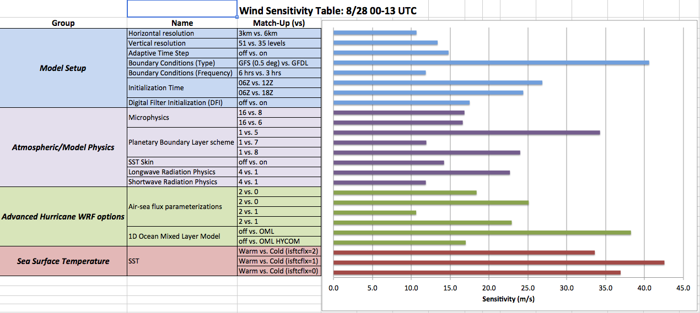
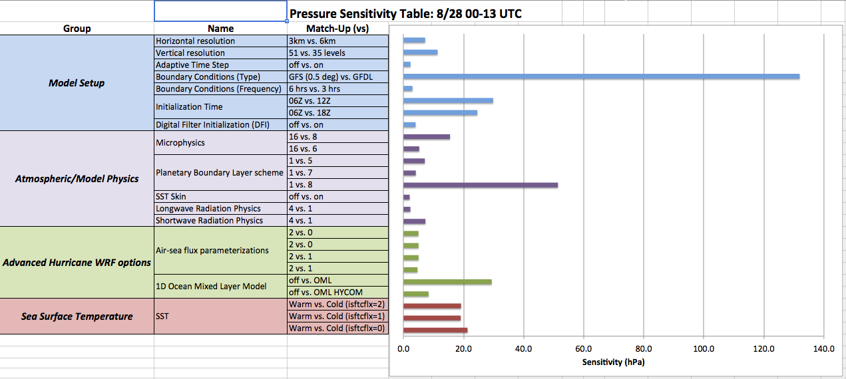
Sensitivity tables:
110 runs
Bad B.C.
Bad forecast of wind
Max wind largest sensitivity to SST
Parameterized Upper Ocean Heat Content
Diff. init. time
Bad B.C.
Bad forecast of pressure
Min SLP large sensitivity to SST

Slide 19
Conclusions
Large majority of SST cooling occurred ahead of Irene’s eye
We determine maximum impact of this cooling on storm intensity (cold post-storm fixed vs. warm pre-storm fixed SST)
Large compared to other parameters (e.g. air/sea flux parameterizations, microphysics)
Some surface cooling occurred during/after eye passage
Actual impact of SST cooling on storm intensity may be slightly lower
A nested high-resolution ocean model (e.g. ROMS) within HYCOM could add significant value to HWRF forecasts in the coastal ocean (hours before landfall)

Slide 20
Thank You

Slide 21
Extra Slides

Slide 22
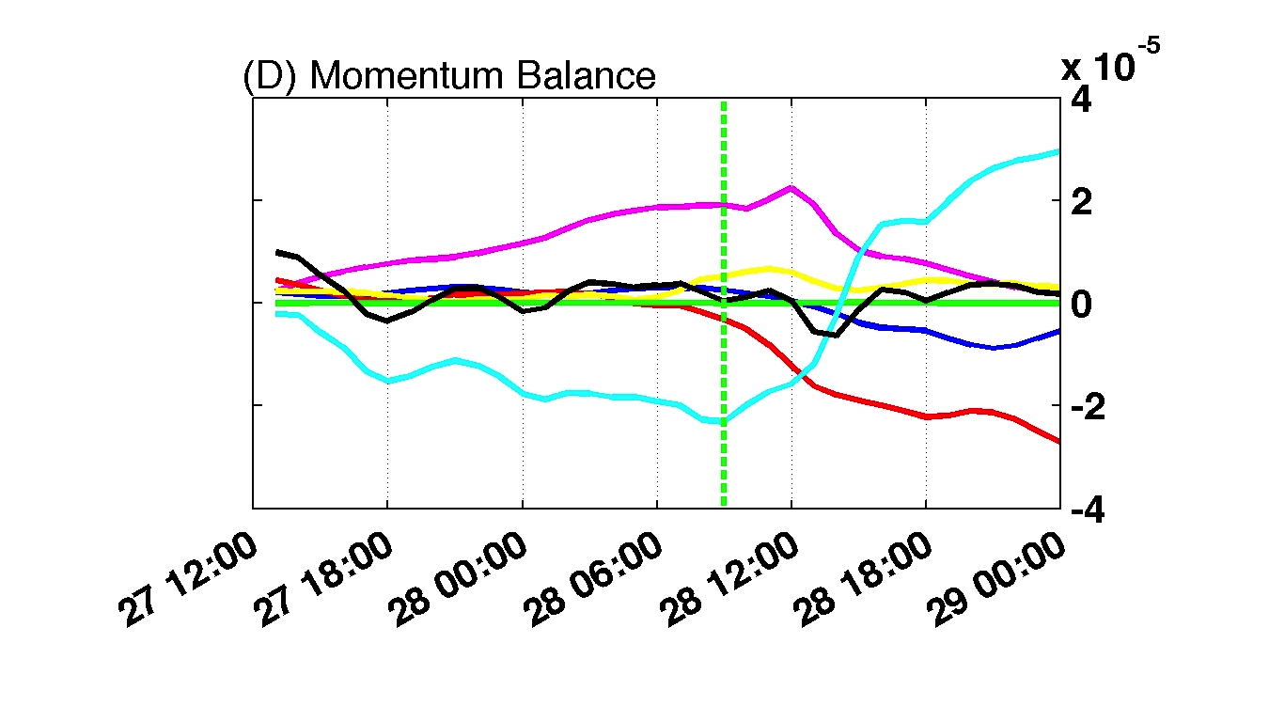
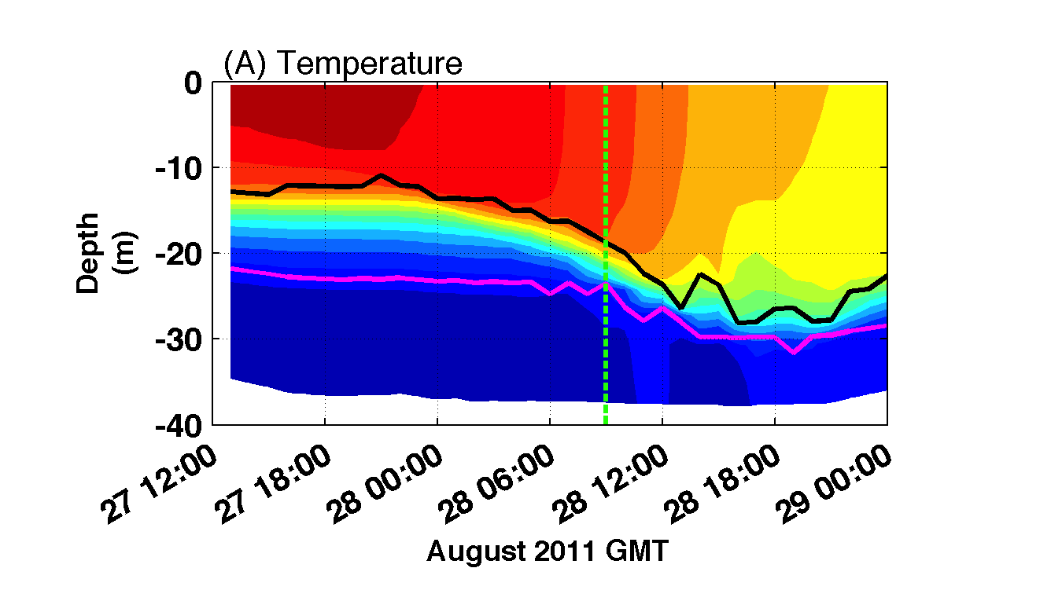
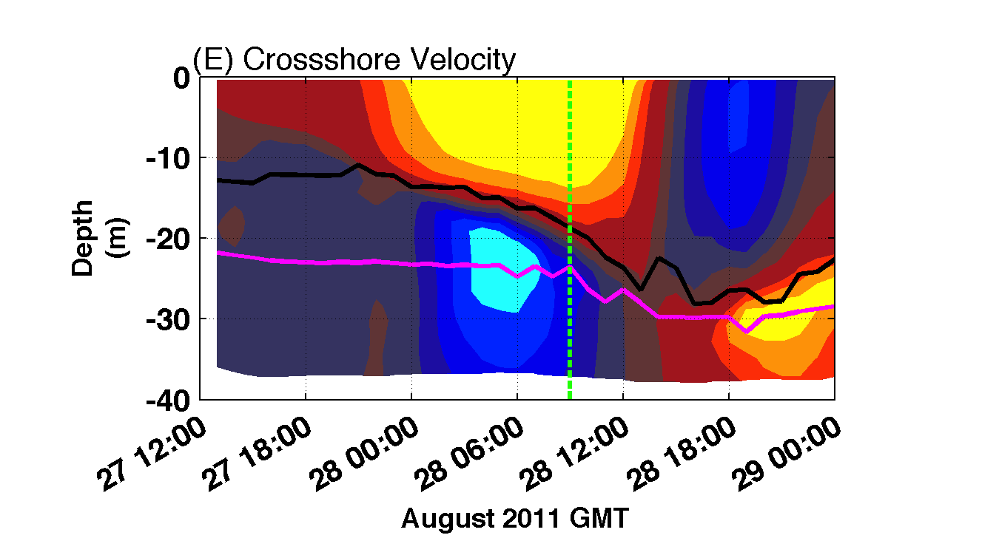
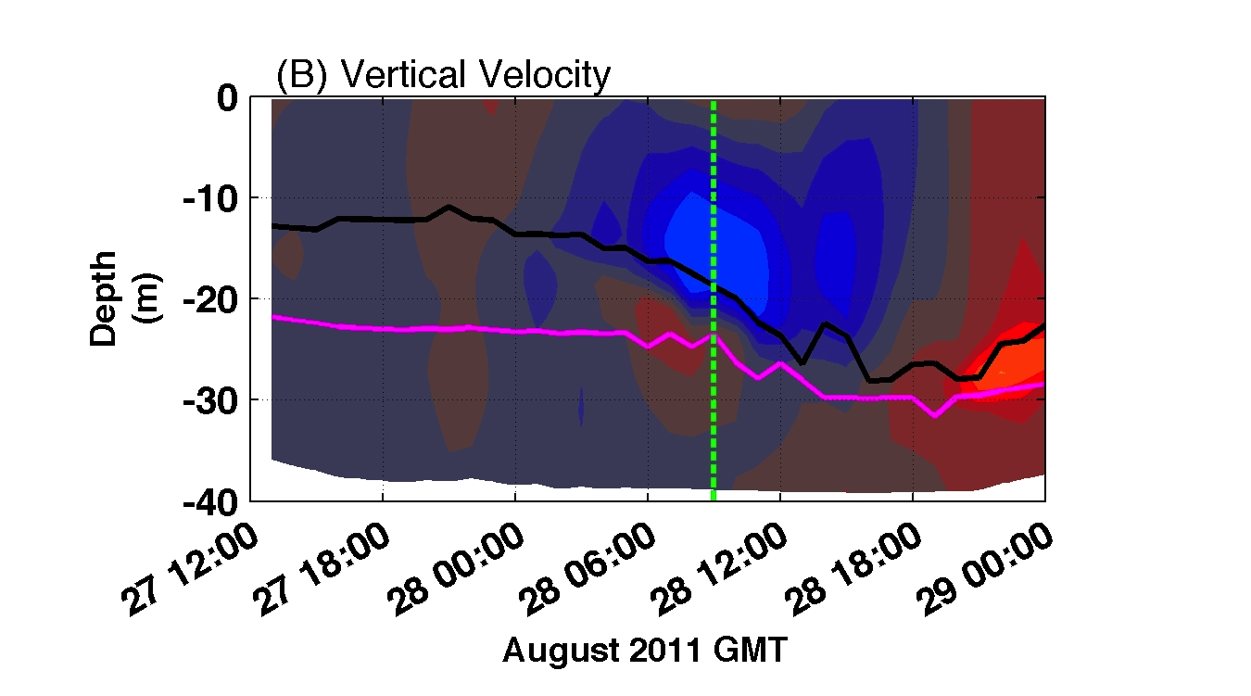
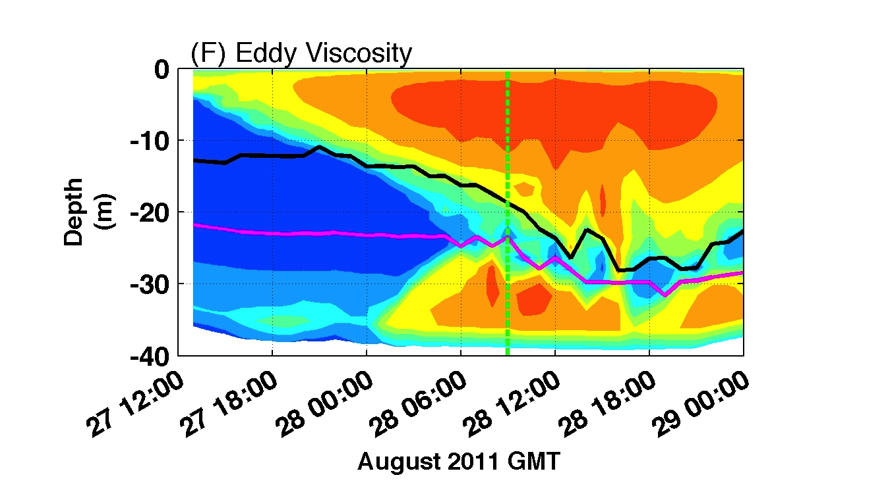
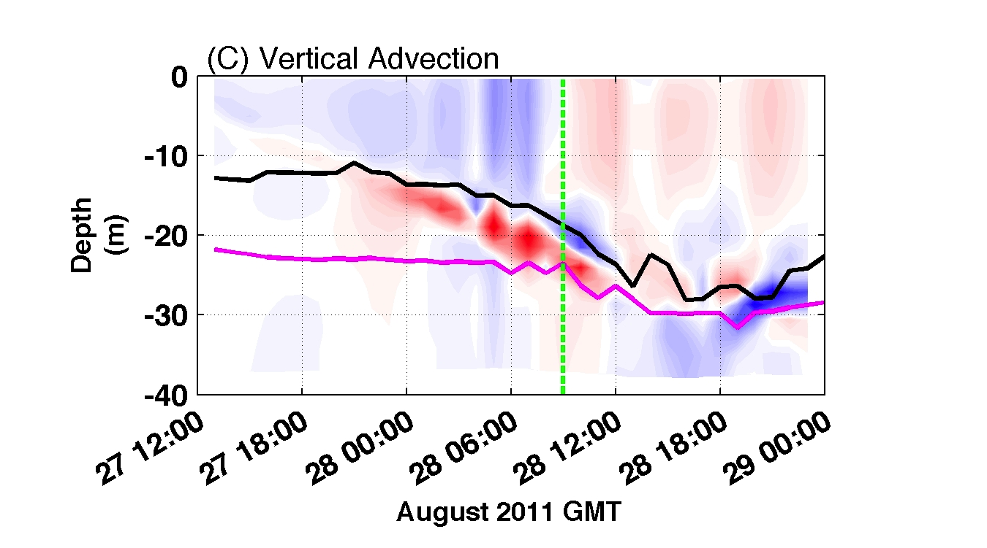
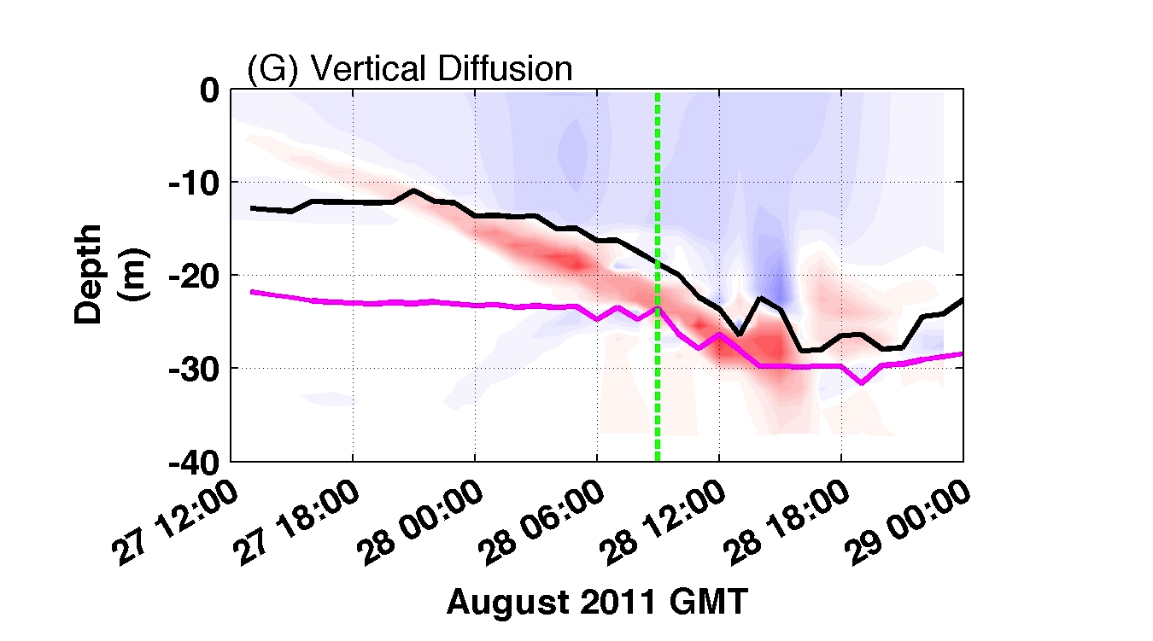
Mechanism for surface cooling: mixing

Slide 23
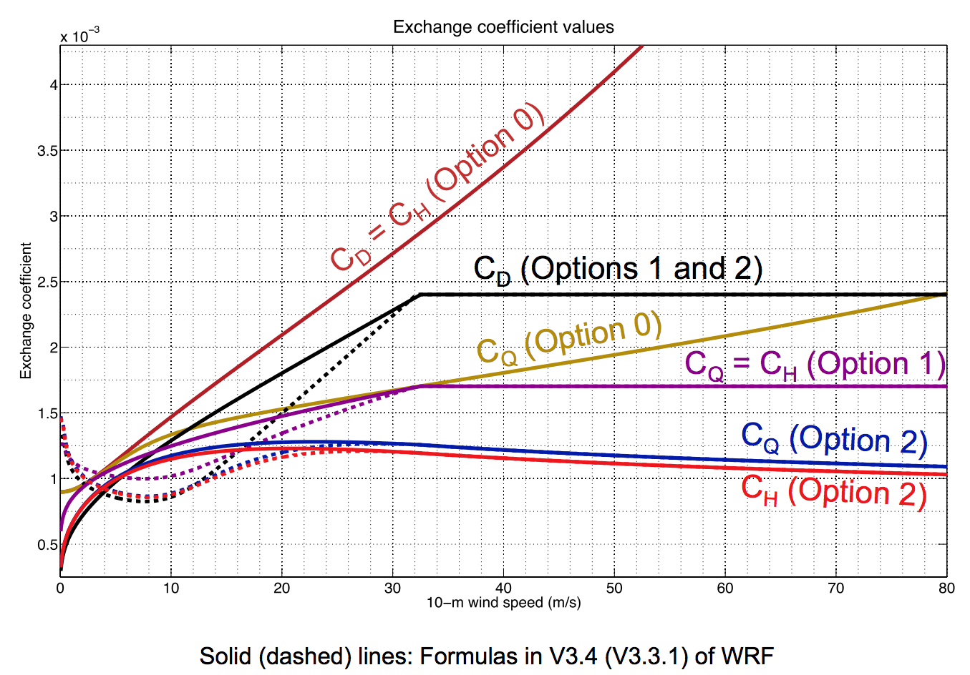
Plot of Resulting Exchange Coefficients
After Zhang et al. (2012) Presentation for HFIP

Slide 24
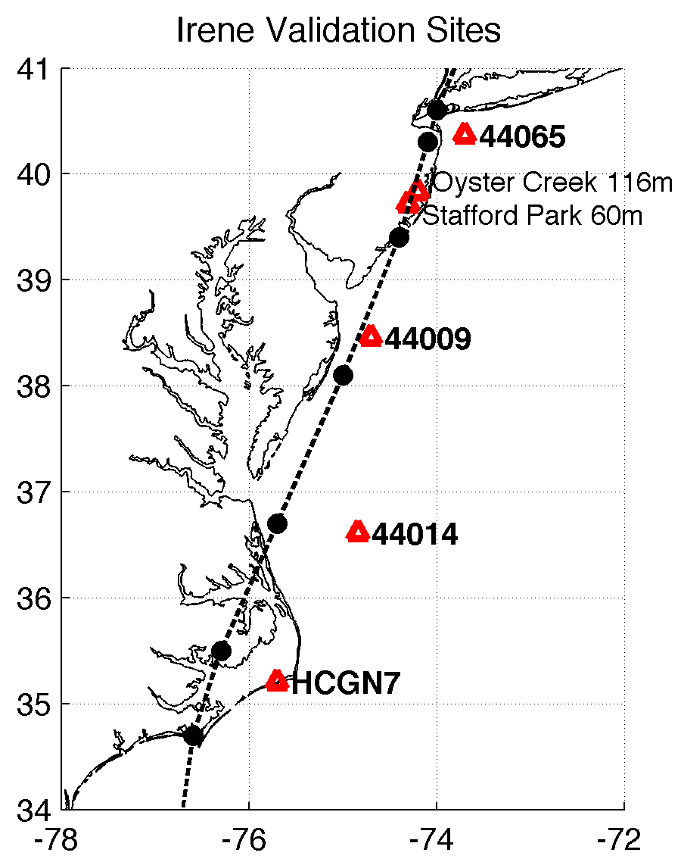
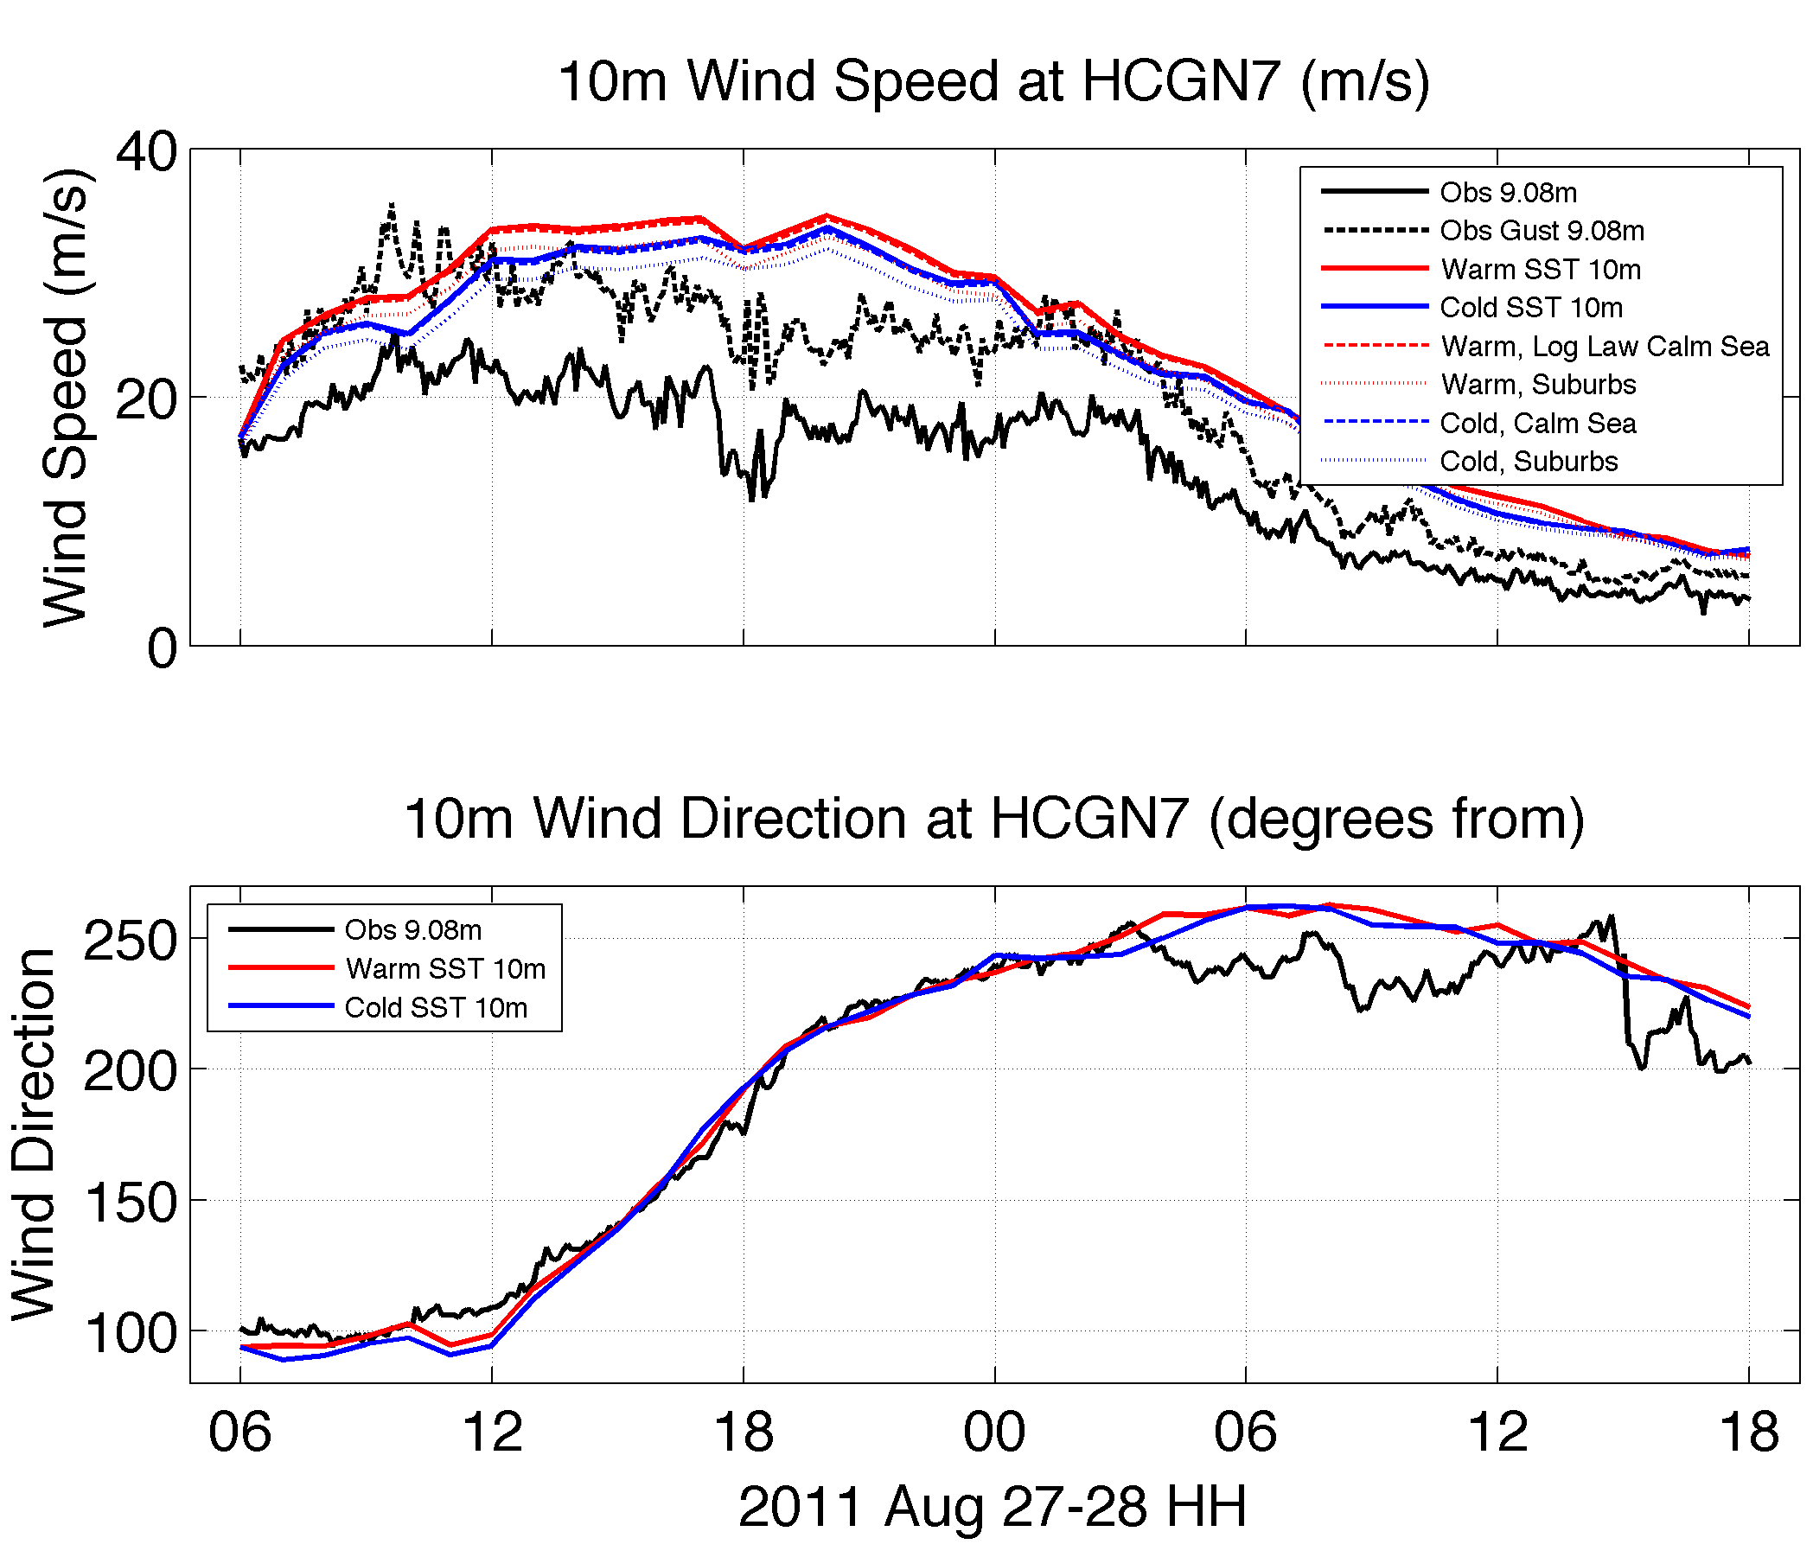
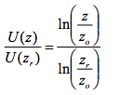
Model Validation
Ray et al. (2006)
Height 9.08m (obs) vs. 10m (WRF) [log law]
Averaging time 2-min (land stations)*, 8-min (buoys) vs. instantaneous (WRF) [obs gusts]
Validate at 44014, 44009, 44065, and tall met towers (for boundary layer shear profile- NHC indicated it as large during Irene)
*OYC: 15-min, Stafford Park: 10- and 60-min

Slide 25
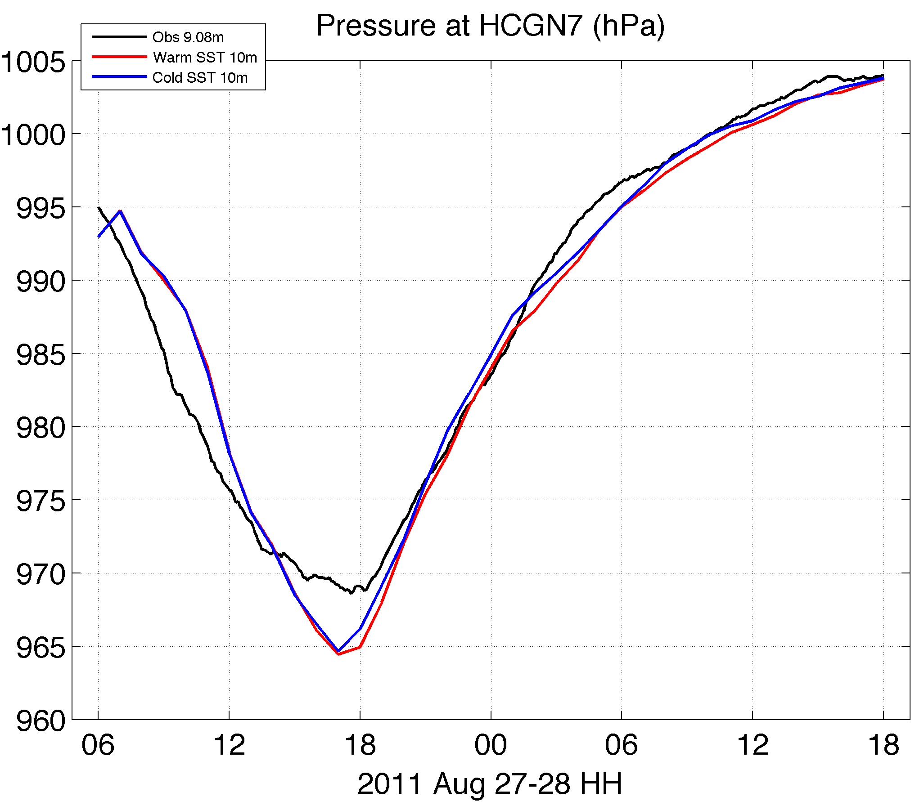
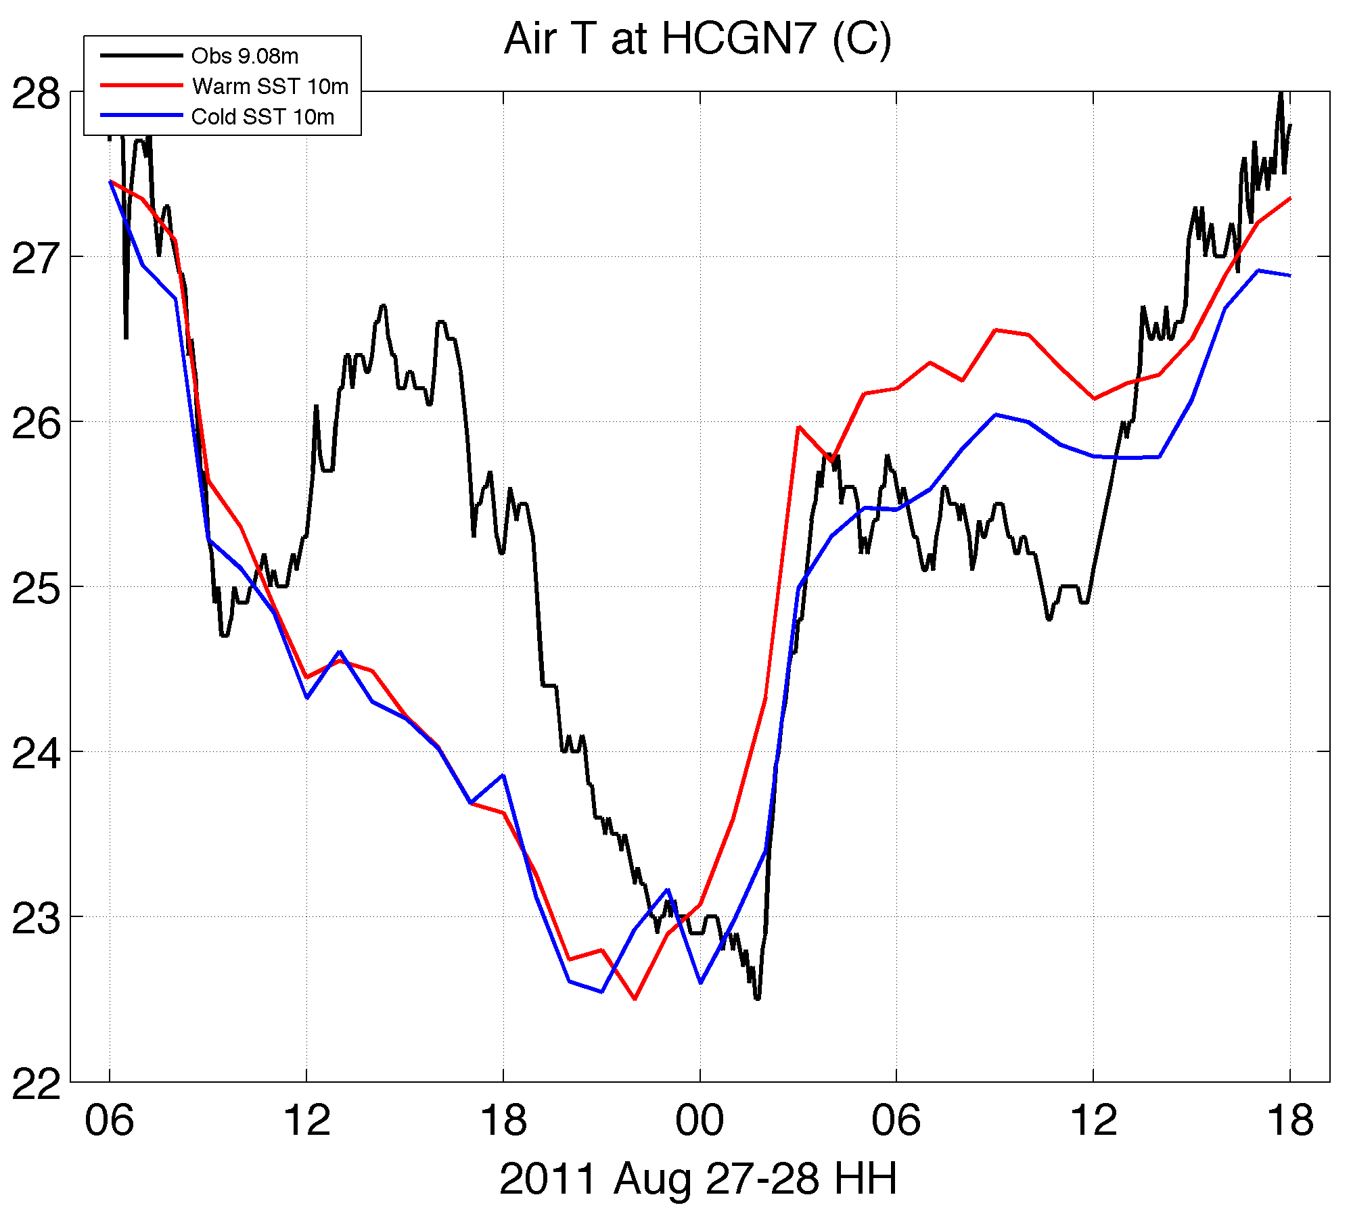
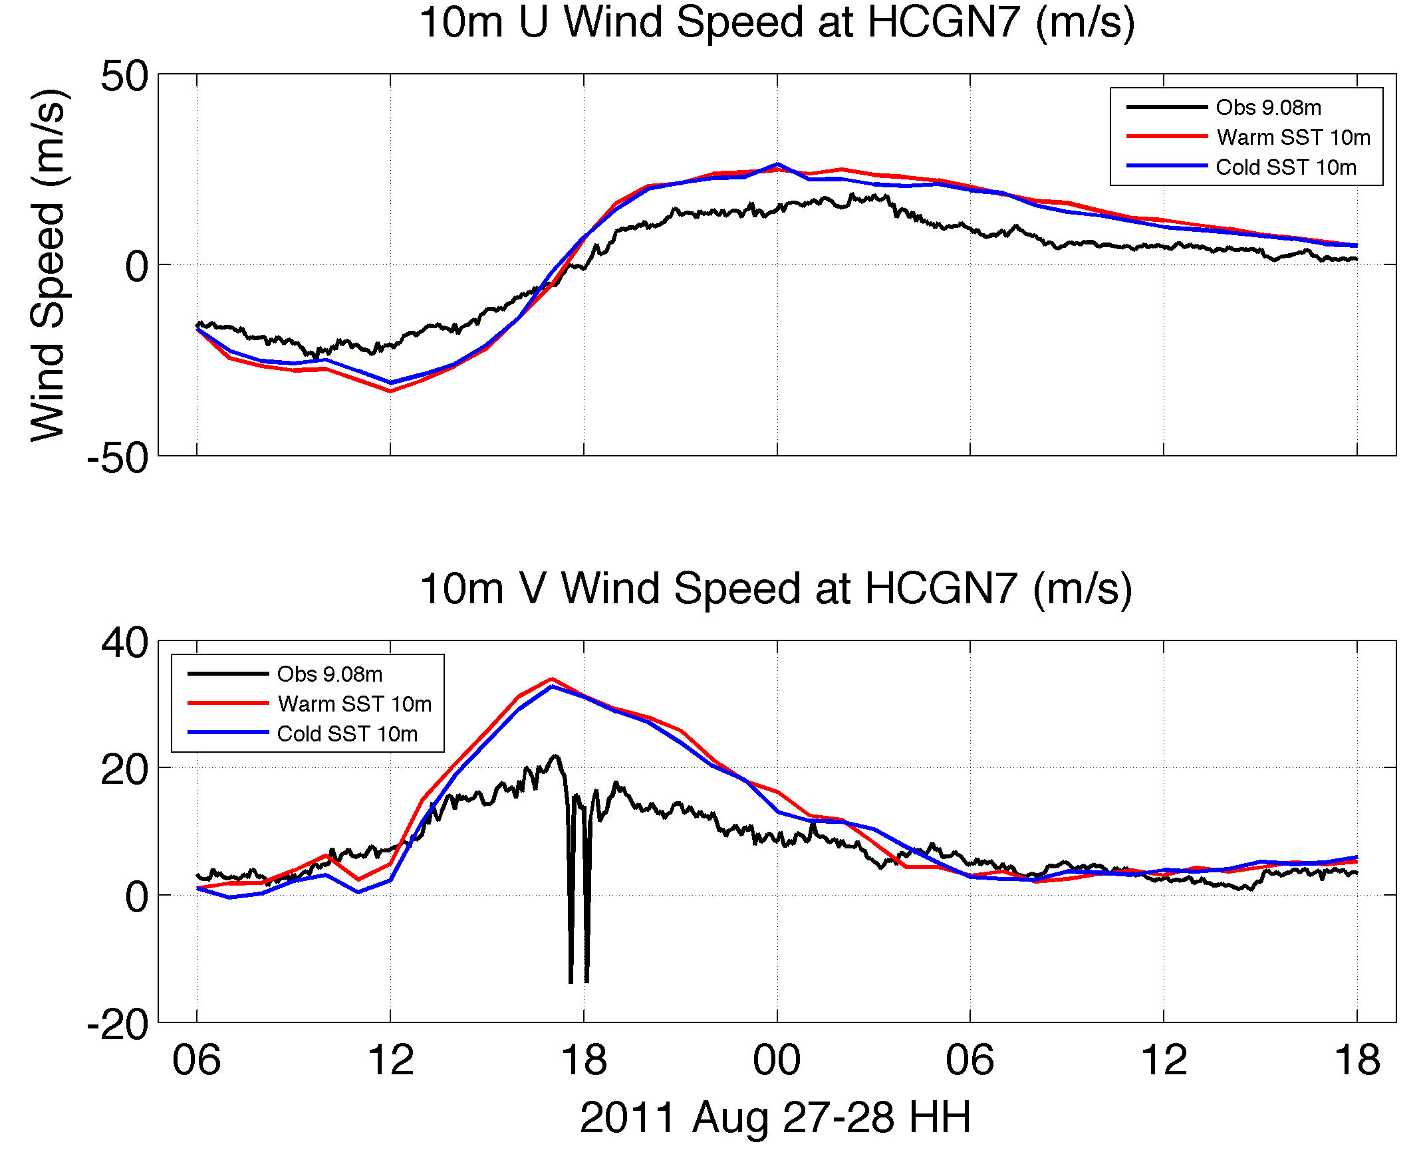
Model Validation

Slide 26
Remaining Work
Finish/complete validation
Other buoys, tall met towers
Wind shear validation
Dry air intrusion validation
Spatial validation of modeled cloud top temperatures (CTT) vs. satellite CTT
Latent and sensible heat fluxes
Quantify diff. (under eye) between warm and cold SST runs
Validate modeled fluxes vs. calculated from buoys (sensible) and satellites (latent)
Force WRF with hourly ROMS ESPreSSO SST – next step in coupled scheme evolution
ROMS ESPreSSO forced with stronger WRF winds mixes too much due to (1) too strong winds? and (2) wide initial tcline
Run WRF V3.5 coupled with 3D Price-Weller-Pinkel ocean model

